Slide 1
Biomedical Informatics II
Data collection principles and Ontology
Lecture in BMS515: Fundamentals of Biomedical Research.
Nov 22, 2019
Room 1225A, JSMBS, University at Buffalo
Werner CEUSTERS, MD
Departments of Biomedical Informatics and Psychiatry,
UB Institute for Healthcare Informatics,
Ontology Research Group, Center of Excellence in Bioinformatics and Life Sciences,
University at Buffalo, NY, USA

Slide 2
Today’s learning outcomes (BMI-II)
Understanding the basic principles of science and research and being able to apply them to discover flaws in published research and prevent flaws in your own (future) research.
Understanding what ontology is and how it relates to science.
Being able to describe the most general ontological distinctions amongst entities and understanding why they matter in science and research.

Slide 3
Where do data come from?
knowledge
information
data
Reality
What is there on the side of the patient

Slide 4
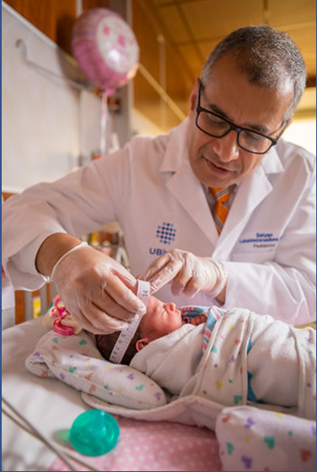
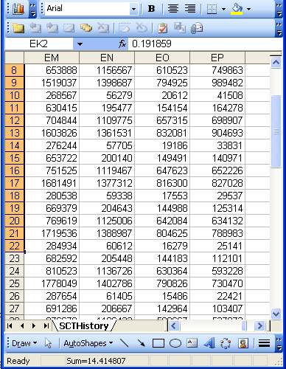
Beings, happenings and descriptions
(research) domain
(research) data
Beings & happenings
Descriptions
https://ubphoto.smugmug.com/Years/2017/17011-Medicine-Satyanarayana-Lakshminrusimha-Newborn-MFS/i-Vj8g6p2

Slide 5
Focus of my programmatic research
How can data/information/ knowledge/… be processed/structured in such a way that:
they are faithful representations of reality, and that
changes introduced in updates reflect faithfully corresponding changes in reality?
What are the requirements for formalisms/systems/… containing data/… satisfying (1a) and (1b) to allow users thereof acquiring a faithful representation of the changes in reality by merely looking at the changes in the data/… ?

Slide 6
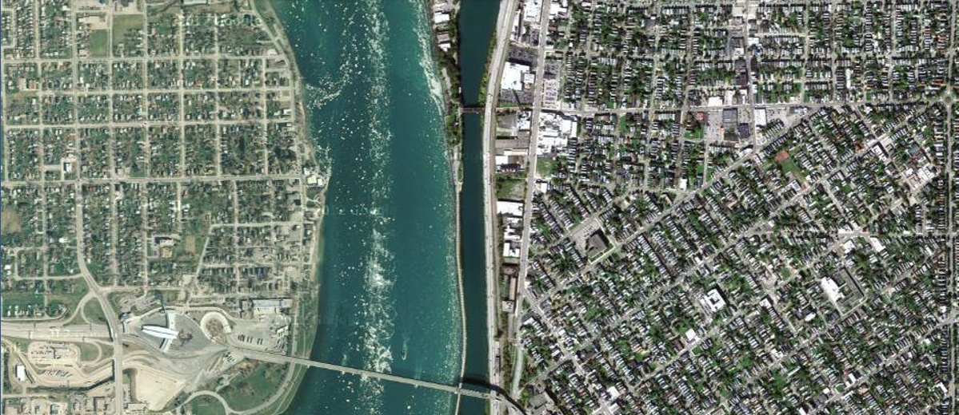
Some particulars north of the Peace Bridge
The Peace Bridge is (now) a kind of bridge
West avenue is (now) a kind of avenue

Slide 7
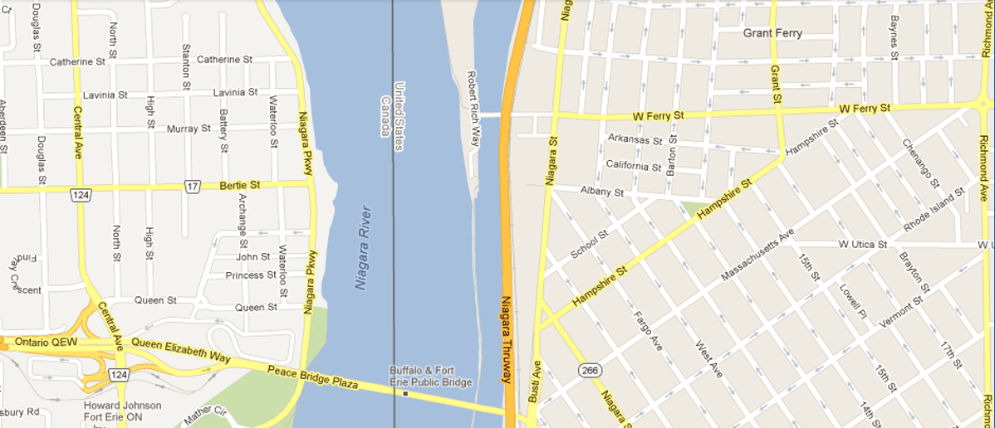
Representation of some of these particulars

Slide 8
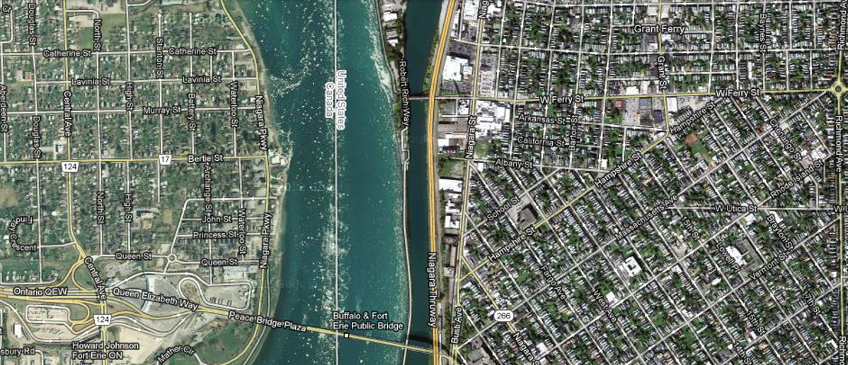
Faithful representation
Perfect correspondence
between representation and what is represented

Slide 9
An ideal dataset
A representation of some pre-existing portion of reality which
  reflects the particulars within its domain – and the relations between them – in such a way that there obtains a systematic correlation between reality and the representation itself,
  is intelligible to a domain expert,
  is formalized in a way that allows it to support automatic information processing.
Smith B, Kusnierczyk W, Schober D, Ceusters W. Towards a Reference Terminology for Ontology Research and Development in the Biomedical Domain. Proceedings of KR-MED 2006, Biomedical Ontology in Action, November 8, 2006, Baltimore MD, USA

Slide 10
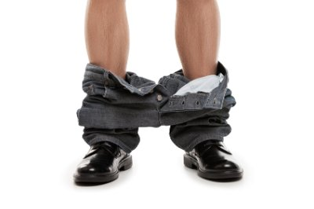
You think?

Slide 11
Reviewers’ comments on my FOIS 2016 papers
‘Although it is not mentioned explicitly, it gives the impression that the authors assume that there is only one reality and that this reality can be faithfully modelled’;
‘The somewhat naive realism that seems to underly the work, namely, that there is an objective reality out there to be observed and recognized’;

Slide 12
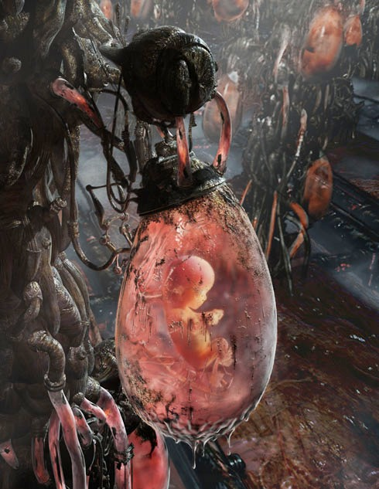
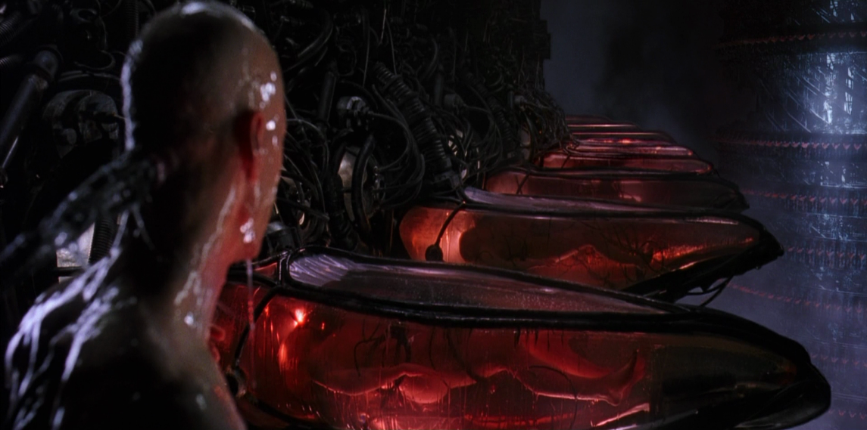
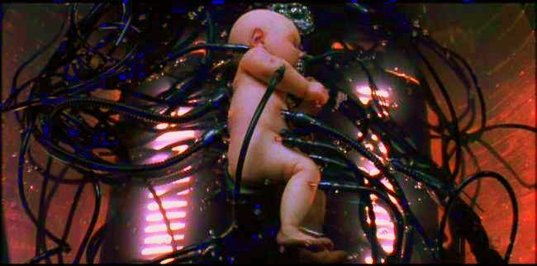
The Matrix

Slide 13
Three relevant disciplines
(research) domain
(research) data
Beings & happenings
Descriptions
https://ubphoto.smugmug.com/Years/2017/17011-Medicine-Satyanarayana-Lakshminrusimha-Newborn-MFS/i-Vj8g6p2

Slide 14
Three relevant disciplines: (1)
Data science:
‘an interdisciplinary field about scientific methods, processes, and systems to extract knowledge or insights from data in various forms, either structured or unstructured, similar to data mining’.
(research) data
https://en.wikipedia.org/wiki/Data_science
Beings & happenings
Descriptions

Slide 15
Three relevant disciplines: (2)
Statistics:
‘a branch of mathematics dealing with the collection, analysis, interpretation, presentation, and organization of data’.
(research) data
https://en.wikipedia.org/wiki/Statistics
Beings & happenings
Descriptions

Slide 16
Three relevant disciplines: (3)
Several branches of philosophy:
Philosophy of science
…
(research) data
Beings & happenings
Descriptions

Slide 17
Philosophy of Science (PhyS) ?
a rigorous academic study that deals specifically with what science is, how it works, and the logic through which we build scientific knowledge.
    http://undsci.berkeley.edu/article/philosophy
a general philosophy of science seeks to describe and understand how science works within a wide range of sciences.
    Malcolm Forster. An Introduction to Philosophy of Science, 2004.
philosophy of science should help us look at claims made within science, and claims made about science, and should help us make informed judgments about how and what we are to think about each case.
    http://www.thegreatcourses.com/professors/jeffrey-l-kasser/

Slide 18
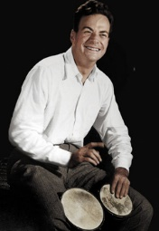
Philosophy of science: use(ful/less)?
‘Philosophy of science is about as useful to scientists as ornithology is to birds’.
    Attributed to Richard Feynman in Donald E. Simanek and John C. Holden, Science Askew: A Light-Hearted Look at the Scientific World (Philadelphia: Institute of Physics Publishing, 2002) , 215.
Feynman photo © Richard Hartt/Caltech archives

Slide 19
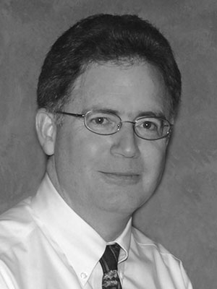
Philosophy of science: use(ful/less)?
‘Philosophy of science is about as useful to scientists as ornithology is to birds’.
    Attributed to Richard Feynman in Donald E. Simanek and John C. Holden, Science Askew: A Light-Hearted Look at the Scientific World (Philadelphia: Institute of Physics Publishing, 2002) , 215.
Feynman photo © Richard Hartt/Caltech archives
‘Science can't be free of philosophy any more than baseball can be free of physics’.
    Jeffrey L. Kasser, Ph.D. http://www.thegreatcourses.com/courses/philosophy-of-science.html#BVRRWidgetID

Slide 20
Some key principles in how to do science
Objective observation: measurement and data (possibly although not necessarily using mathematics as a tool),
Evidence,
Experiment and/or observation as benchmarks for testing hypotheses,
Induction: reasoning to establish general rules or conclusions drawn from facts or examples,
Repetition,
Critical analysis,
Verification and testing: critical exposure to scrutiny, peer review and assessment.
http://sciencecouncil.org/about-us/our-definition-of-science/

Slide 21
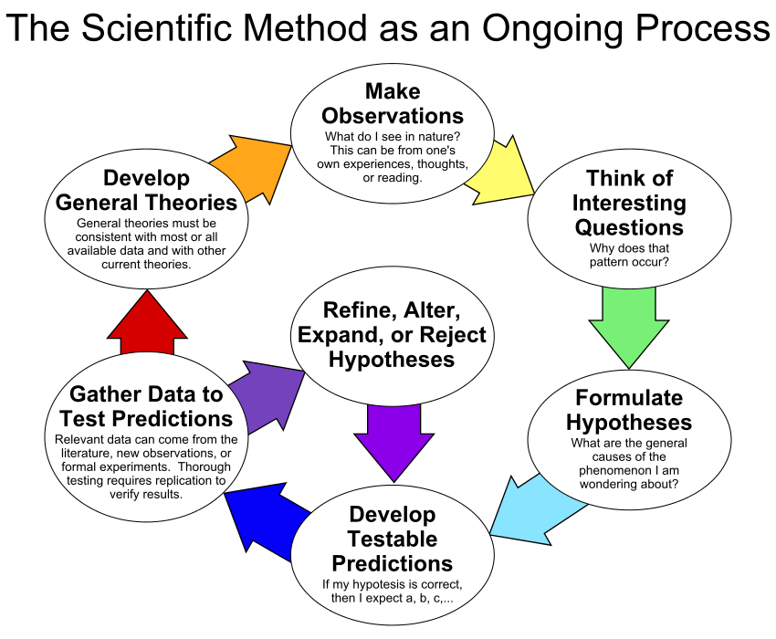
By ArchonMagnus - Own work, CC BY-SA 4.0, https://commons.wikimedia.org/w/index.php?curid=42164616

Slide 22
Scientific Objectivity (1)
Objectivity as Faithfulness to Facts
Objectivity as Absence of Normative Commitments and the Value-Free Ideal

Slide 23
Scientific Objectivity (1)
Objectivity as Faithfulness to Facts
Objectivity as Absence of Normative Commitments and the Value-Free Ideal
Objectivity as Freedom from Personal Biases
  Measurement and Quantification
  Inductive and Statistical Inference

Slide 24
Scientific Objectivity (2)
Science is objective in that, or to the extent that:
its products—theories, laws, experimental results and observations—constitute accurate representations of the external world. The products of science are not tainted by human desires, goals, capabilities or experience.
  product objectivity
the processes and methods that characterize it neither depend on contingent social and ethical values, nor on the individual bias of a scientist
  → process objectivity.
http://plato.stanford.edu/entries/scientific-objectivity

Slide 25
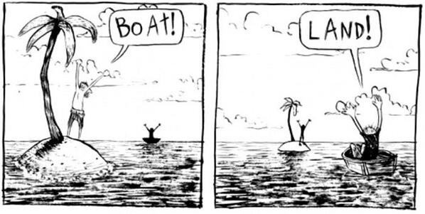
The view from nowhere
There are two kinds of qualities: ones that vary with the perspective one has or takes, and ones that remain constant through/despite changes of perspective. The latter are the objective properties.
http://plato.stanford.edu/entries/scientific-objectivity

Slide 26
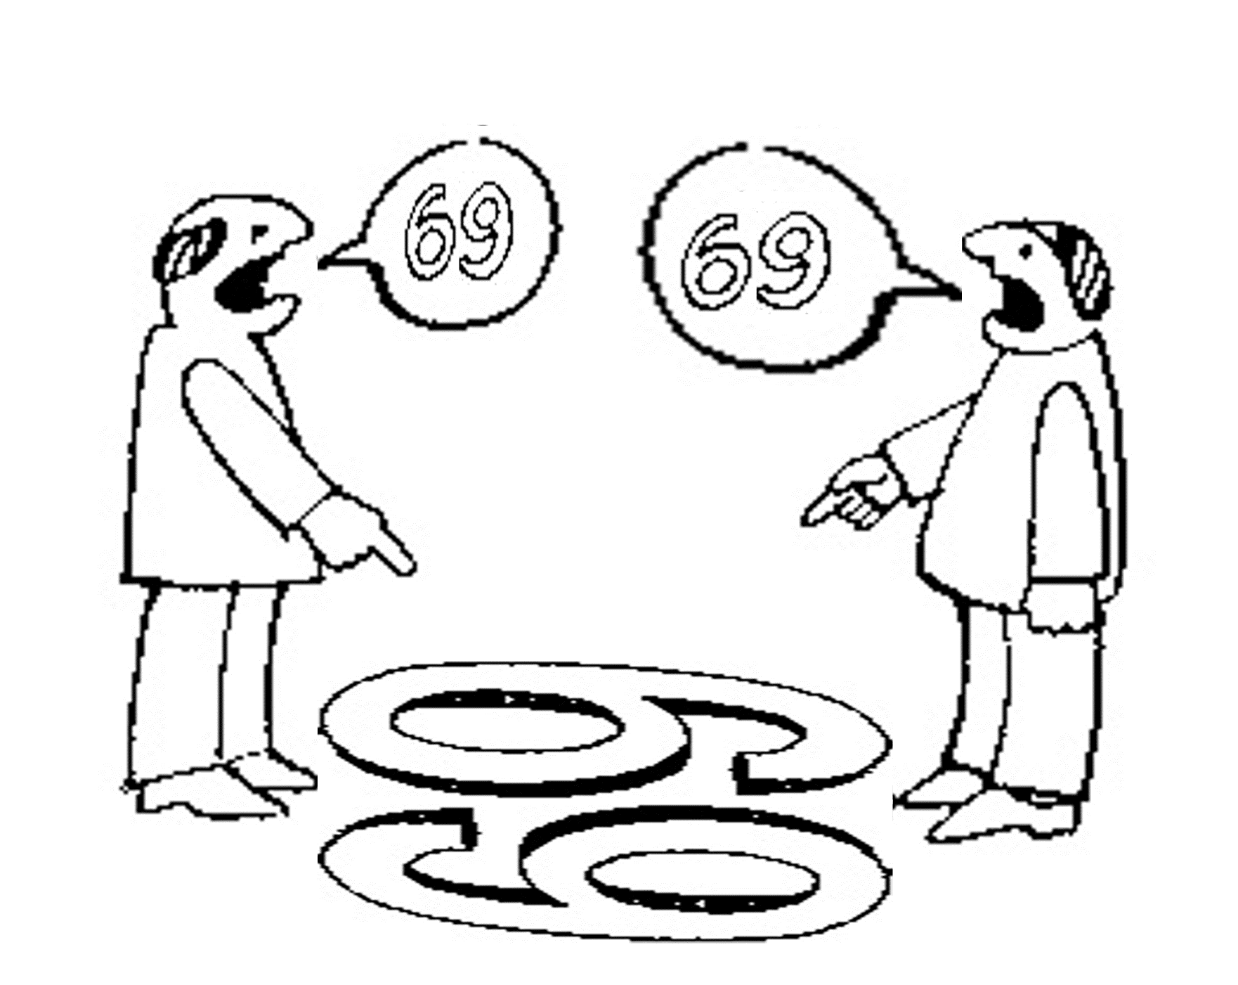
No scientific objectivity here
six
nine

Slide 27
No scientific objectivity here
nine
six

Slide 28
Is there scientific objectivity here?
sixty
nine
sixty
nine

Slide 29
Three disciplines: difference in focus
(research) domain
(research) data
Ontology
Data science
Statistics
Beings & happenings
Descriptions
https://ubphoto.smugmug.com/Years/2017/17011-Medicine-Satyanarayana-Lakshminrusimha-Newborn-MFS/i-Vj8g6p2

Slide 30
The problem of data-focused research
Is it?
Faithful representation: perfect correspondence
between representation and what is represented

Slide 31
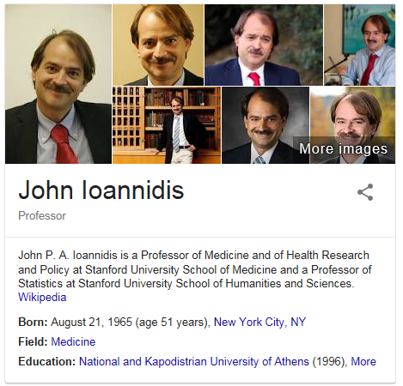
Why is this important?
John P. A. Ioannidis.
Why Most Published Research Findings Are False.
PLOS Medicine 2005;2(8):e124
http://robotics.cs.tamu.edu/RSS2015NegativeResults/pmed.0020124.pdf

Slide 32

AAAS: Machine learning 'causing science crisis'
Pallab Ghosh Science correspondent, BBC News, Washington 16 February 2019
Machine-learning techniques used by thousands of scientists to analyse data are producing results that are misleading and often completely wrong.
A growing amount of scientific research involves using machine learning software to analyse data that has already been collected.
But, according to Dr Allen, the answers they come up with are likely to be inaccurate or wrong because the software is identifying patterns that exist only in that data set and not the real world.
The “reproducibility crisis” in science refers to the alarming number of research results that are not repeated when another group of scientists tries the same experiment. It can mean that the initial results were wrong. One analysis suggested that up to 85% of all biomedical research carried out in the world is wasted effort.
https://www.bbc.com/news/science-environment-47267081

Slide 33
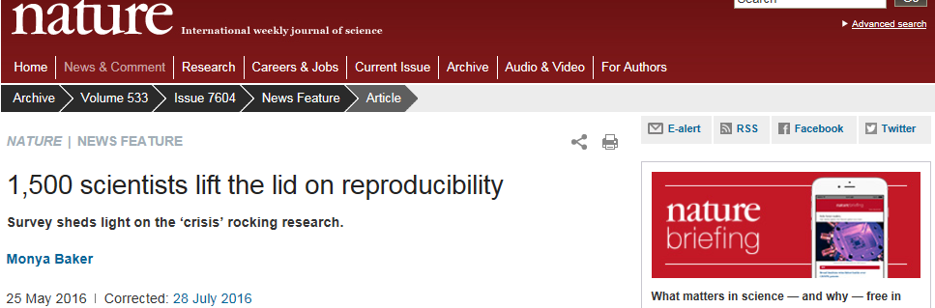
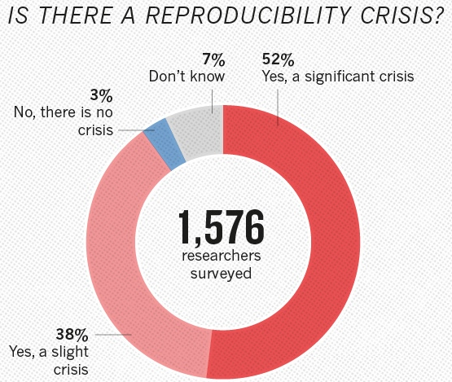


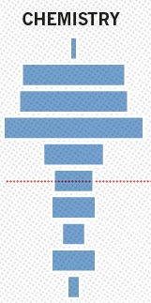
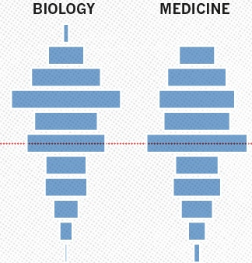


Slide 34
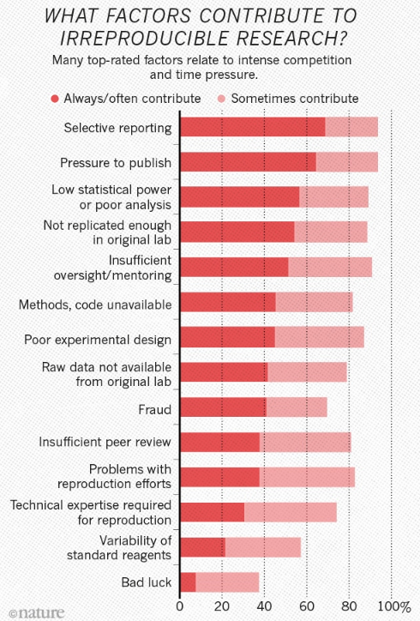
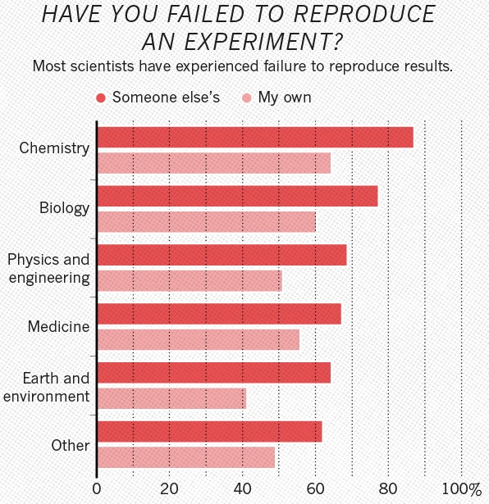

Slide 35

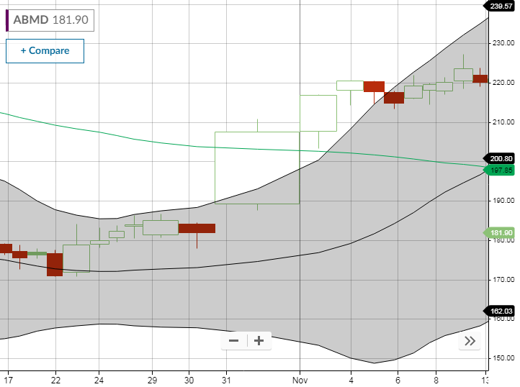
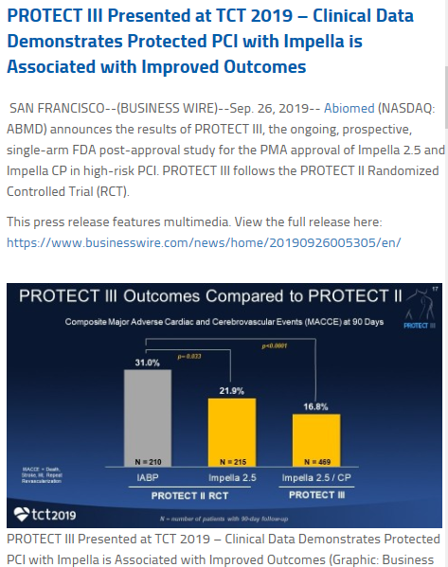

Slide 36
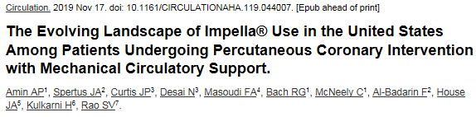
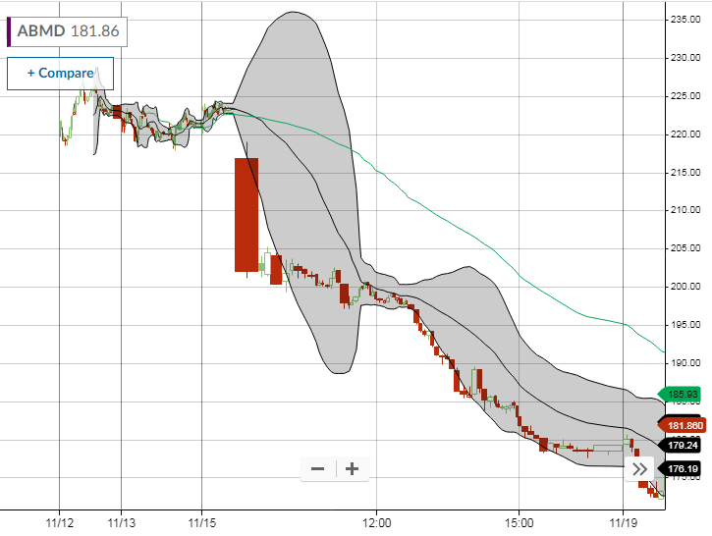
Methods: From the Premier Healthcare Database, we analyzed 48,306 patients undergoing PCI with MCS at 432 hospitals between 1/2004-12/2016.
Conclusions: Impella® use is rapidly increasing among PCI patients treated with MCS, with marked variability in its use and associated outcomes. Although unmeasured confounding cannot be ruled out, when analyzed by time-periods, or at the hospital-level or the patient-level, Impella® use was associated with higher rates of adverse events and costs. More data are needed to define the appropriate role of MCS in patients undergoing PCI.

Slide 37
Three relevant disciplines: (4)
Several branches of philosophy:
Philosophy of science
Ontology
(research) data
Beings & happenings
Descriptions

Slide 38
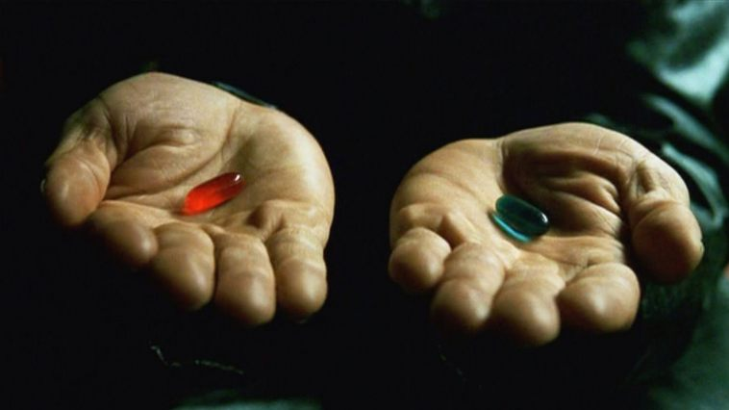
‘Ontology’
Helps scientists to determine and describe what sorts of entities their research is intended to be directed at.

Slide 39
Where do data come from?
knowledge
information
data
Reality
What is there on the side of the patient

Slide 40
Where do data come from?
knowledge
information
data
Questions not often enough asked:
What parts of our data correspond with something out there in reality ?
What parts of reality are not captured by our data, but should because they are relevant ?
Reality
What is there on the side of the patient

Slide 41
Where do data come from?
knowledge
information
data
Questions not often enough asked:
What parts of our data correspond with something out there in reality ?
What parts of reality are not captured by our data, but should because they are relevant ?
Ontology
Reality
What is there on the side of the patient

Slide 42
Four notions of ‘ontology’ as a study
(O1) the study of ontological commitment, i.e. what we or others are committed to,
(O2) the study of what there is,
(O3) the study of the most general features of what there is, and how the things there are relate to each other in the metaphysically most general ways,
(O4) the study of meta-ontology, i.e. saying what task it is that the discipline of ontology should aim to accomplish, if any, how the questions it aims to answer should be understood, and with what methodology they can be answered.
http://plato.stanford.edu/entries/logic-ontology/#DifConOnt

Slide 43
The discipline of ‘Ontology’
Describing reality within a taxonomy of precisely defined entities
Independent Continuant Dependent Continuant
Material Entity Quality
Joint Shape
TMJ Disposition
Function
Chewing function

Slide 44
The discipline of ‘Ontology’
Describing reality within a taxonomy of precisely defined entities
Theoretical ontology → work of ontologists
Independent Continuant Dependent Continuant
Material Entity Quality
Joint Shape
TMJ Disposition
Function
Chewing function
Applied ontology → work of ontologists and domain experts

Slide 45
Without ontologists …
creating terms and definitions quickly runs awry:
  ‘Pain is a sensorial and emotional experience …’
    ‘knee pain’ → emotional experience in your knee?
  ‘13.1.2.4 Painful Trigeminal neuropathy attributed to MS plaque’ comes with the clarification ‘Trigeminal neuropathy induced by MS plaque’;
    The term suggests an opinion on the side of the clinician,
    The description suggests a causal relation on the side of the patient.
Perspectives from outside the domain are more difficult to account for.
  Theoretical ontology → domain independent!

Slide 46
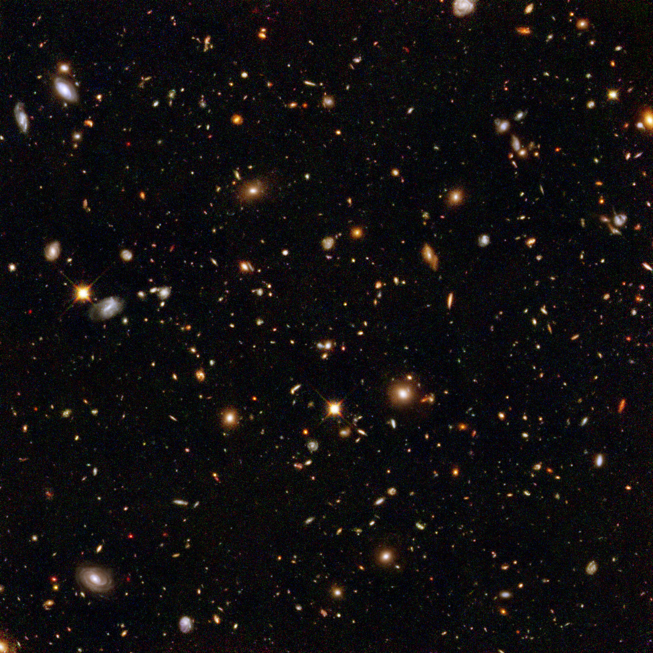

The basis of Ontological Realism (O.R.)
There is an external reality which is ‘objectively’ the way it is;
That reality is accessible to us;
We build in our brains cognitive representations of reality;
We communicate with others about what is there, and what we believe there is there.
Smith B, Kusnierczyk W, Schober D, Ceusters W. Towards a Reference Terminology for Ontology Research and Development in the Biomedical Domain. Proceedings of KR-MED 2006, Biomedical Ontology in Action, November 8, 2006, Baltimore MD, USA

Slide 47
Basic Ontological Distinctions

Slide 48
Basic Formal Ontology: what is out there …
(… we want/need to deal with)?
portions of reality
relations
configurations
?
participation
me participating in my life
universals
entities
?
particulars
continuants
occurrents
me
my life
organism

Slide 49
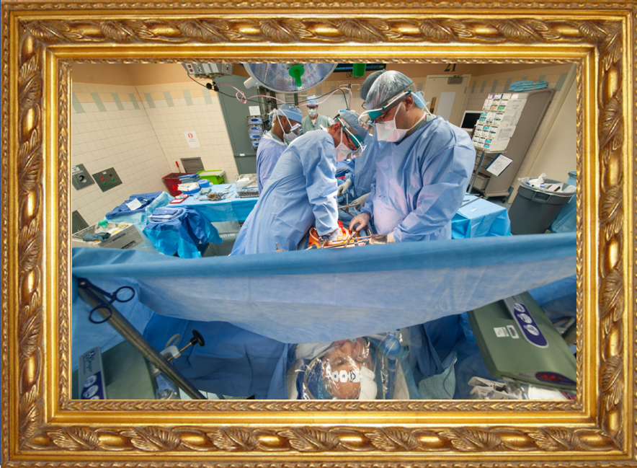
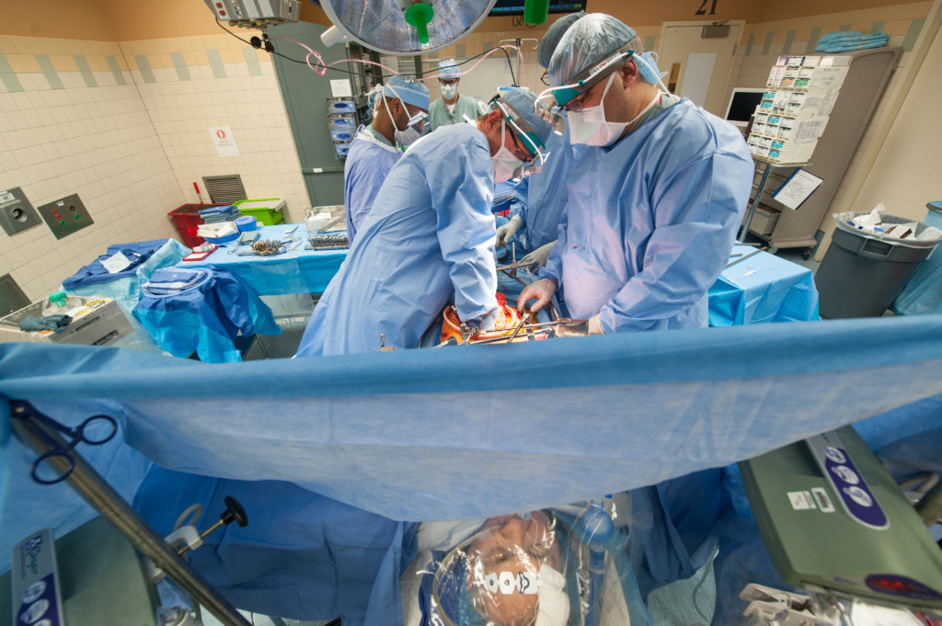
Reality ←→ Representation

Slide 50
Reality ←→ Representation
(research) domain
(research) data
Beings & happenings
Descriptions

Slide 51
OGMS: ‘Findings’ / ‘observations’
On the side of the patient
Bodily features
  Symptoms
  Signs
    Observed through physical examination
    Observed through lab test
Diseases
Representations
Findings
  Anamnestic findings
    Clinical findings
    Laboratory findings
Diagnoses
Scheuermann R, Ceusters W, Smith B. Toward an Ontological Treatment of Disease and Diagnosis. 2009 AMIA Summit on Translational Bioinformatics, San Francisco, California, March 15-17, 2009;: 116-120. Omnipress ISBN:0-9647743-7-2

Slide 52
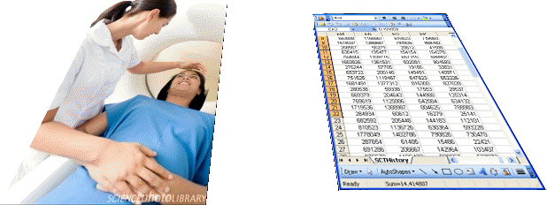
Realism-based Ontology (RBO)
Referents
  are (meta-) physically the way they are,
  relate to each other in an objective way,
  follow ‘laws of nature’.
Window on reality
  restricted by:
  what is physically and technically observable,
  fit between what is measured and what we think is measured,
  fit between established knowledge and ‘laws of nature’.
References
  follow, ideally, the syntactic-semantic conventions of some representation language,
  are restricted by the expressivity of that language,
  reference collections need to come, for correct interpretation, with documentation outside the representation.

Slide 53
Generalization: data generation and use
data
organization
model development
observation &
measurement
further R&D
(instrument and
study optimization)
add
verify
use
Δ = outcome
Generic
beliefs
application

Slide 54
Reality as benchmark for data organization and representation
data
organization
model development
observation &
measurement
further R&D
(instrument and
study optimization)
add
verify
use
Δ = outcome
Generic
beliefs
application

Slide 55
Types ←→ particulars
Types
Particulars
counterparts in reality of (some of)
the general terms used in the formulation of scientific theories
concrete individual entities
(entities that exist in space and time and that exist only once)
Smith B, Ceusters W. Ontological Realism as a Methodology for Coordinated Evolution of Scientific Ontologies. Applied Ontology, 2010;5(3-4):139-188.

Slide 56
Types ←→ particulars
for every universal there is or has been at least one instance
some type
instanceOf …
entities on either site cannot ‘cross’ this boundary
every particular is an instance of at least one universal
some particular

Slide 57

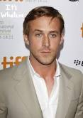
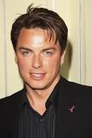
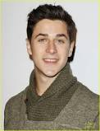
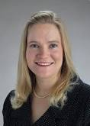
Types ←→ particulars
Human being
instance of at t
particulars

Slide 58
Instances are the objects of classification …
isa
Organism
isa
Vertebrate
isa
Mammal
Human being
instance of at t
particulars

Slide 59
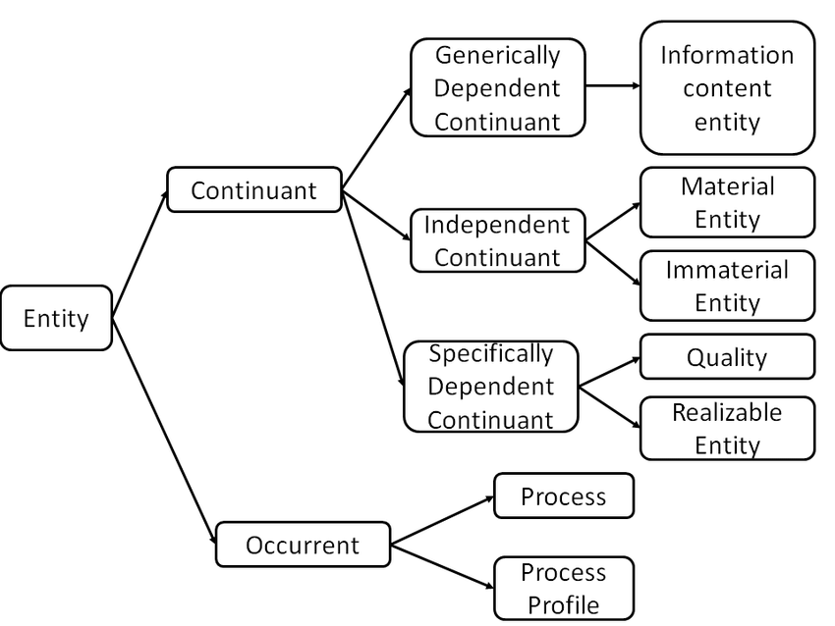
Most generic entities in Basic Formal Ontology

Slide 60
(to be continued)

