Slide 1
Biomedical Informatics I
The discipline of
Biomedical Informatics
Lecture in BMS515: Fundamentals of Biomedical Research.
Nov 20, 2019
Room 1225A, JSMBS, University at Buffalo
Werner CEUSTERS, MD
Departments of Biomedical Informatics and Psychiatry,
UB Institute for Healthcare Informatics,
Ontology Research Group, Center of Excellence in Bioinformatics and Life Sciences,
University at Buffalo, NY, USA

Slide 2
Today’s learning outcomes (BMI I)
Being able to explain what biomedical informatics is, what is part of it, and what it aims to contribute to the advance of biomedical science.

Slide 3
Biomedical Informatics
Definition:
Biomedical informatics (BMI) is
the interdisciplinary field
that studies and pursues the effective uses of biomedical data, information, and knowledge
for scientific inquiry, problem solving, and decision making,
driven by efforts to improve human health.
CA Kulikowski, EH Shortliffe, LM Currie, PL Elkin, LE Hunter, TR Johnson, IJ Kalet, LA Lenert, MA Musen, JG Ozbolt, JW Smith, PZ Tarczy-Hornoch, JWilliamson; AMIA Board white paper: definition of biomedical informatics and specification of core competencies for graduate education in the discipline, Journal of the American Medical Informatics Association, Volume 19, Issue 6, 1 November 2012, Pages 931–938, https://doi.org/10.1136/amiajnl-2012-001053

Slide 4
Biomedical Informatics
Definition:
Biomedical informatics (BMI) is
the interdisciplinary field
that studies and pursues the effective uses of biomedical data, information, and knowledge
for scientific inquiry, problem solving, and decision making,
driven by efforts to improve human health.
CA Kulikowski, EH Shortliffe, LM Currie, PL Elkin, LE Hunter, TR Johnson, IJ Kalet, LA Lenert, MA Musen, JG Ozbolt, JW Smith, PZ Tarczy-Hornoch, JWilliamson; AMIA Board white paper: definition of biomedical informatics and specification of core competencies for graduate education in the discipline, Journal of the American Medical Informatics Association, Volume 19, Issue 6, 1 November 2012, Pages 931–938, https://doi.org/10.1136/amiajnl-2012-001053

Slide 5
Interdisciplinary Nature of Biomedical Informatics: the main stream view
Computer Science (hardware)
Computer Science (software)
Cognitive Science
& Decision Making
Bioengineering
Biomedical
Informatics
Management
Sciences
Epidemiology
And Statistics
Basic Biomedical
Sciences
Clinical
Sciences

Slide 6
Interdisciplinary Nature of Biomedical Informatics:
UB Department of BMI’s view
Computer Science (hardware)
Informatics
Human factors
ergonomics
Computer Science (software)
Cognitive Science
& Decision Making
Bioengineering
Biomedical
Informatics
Management
Sciences
Epidemiology
And Statistics
Philosophy
Basic Biomedical
Sciences
Clinical
Sciences
Philosophy
Of Science
(Biomedical)
Ontology

Slide 7
Biomedical Informatics in Perspective
Basic
Research
Biomedical Informatics Methods, Techniques, and Theories
Sociotechnical and Human Centered
Design
Imaging
Informatics
Clinical
Informatics
Public Health Informatics
Bioinformatics
Applied
Research
and
Practice

Slide 8
Biomedical Informatics in Perspective
Basic
Research
Biomedical Informatics Methods, Techniques, and Theories
Sociotechnical and Human Centered
Design
Imaging
Informatics
Clinical
Informatics
Public Health Informatics
Bioinformatics
Applied
Research
and
Practice
Molecular and
Cellular
Processes
Tissues and
Organs
Individuals
(Patients)
Populations
And Society
Healthcare
workforce

Slide 9
Subdiscipline: Bio-informatics
Basic
Research
Biomedical Informatics Methods, Techniques, and Theories
Sociotechnical and Human Centered
Design
Biomedical Informatics ≠
Bioinformatics
Imaging
Informatics
Clinical
Informatics
Public Health Informatics
Bioinformatics
Applied
Research
and
Practice
Molecular and
Cellular
Processes
Tissues and
Organs
Individuals
(Patients)
Populations
And Society
Healthcare
workforce

Slide 10
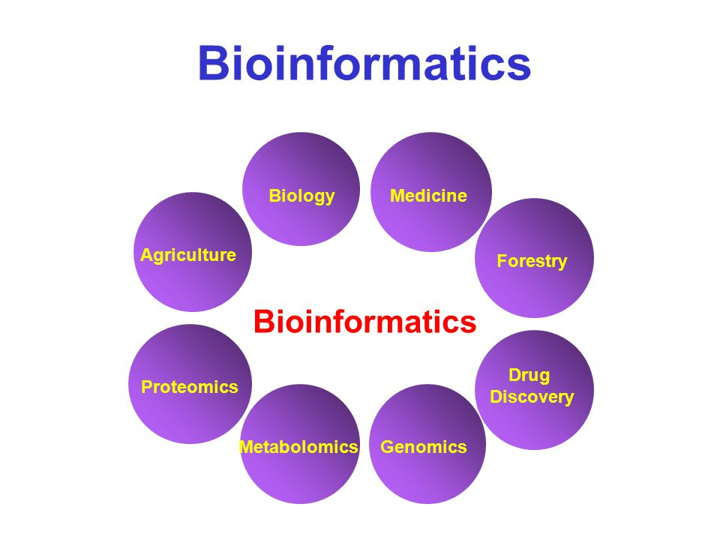
A Bioinformatics Pep Talk David Wishart University of Alberta. http://slideplayer.com/slide/4545718/

Slide 11
Combinations: Health Informatics
Basic
Research
Biomedical Informatics Methods, Techniques, and Theories
Sociotechnical and Human Centered
Design
Imaging
Informatics
Clinical
Informatics
Public Health Informatics
Bioinformatics
Applied
Research
and
Practice
Molecular and
Cellular
Processes
Tissues and
Organs
Individuals
(Patients)
Populations
And Society
Healthcare
workforce

Slide 12
Combinations: Pharmacogenomics
Basic
Research
Biomedical Informatics Methods, Techniques, and Theories
Sociotechnical and Human Centered
Design
Imaging
Informatics
Clinical
Informatics
Public Health Informatics
Bioinformatics
Applied
Research
and
Practice
Molecular and
Cellular
Processes
Tissues and
Organs
Individuals
(Patients)
Populations
And Society
Healthcare
workforce

Slide 13
Combinations: Consumer health
Basic
Research
Biomedical Informatics Methods, Techniques, and Theories
Sociotechnical and Human Centered
Design
Imaging
Informatics
Clinical
Informatics
Public Health Informatics
Bioinformatics
Applied
Research
and
Practice
Molecular and
Cellular
Processes
Tissues and
Organs
Individuals
(Patients)
Populations
And Society
Healthcare
workforce

Slide 14
Combinations: Biomolecular imaging
Basic
Research
Biomedical Informatics Methods, Techniques, and Theories
Sociotechnical and Human Centered
Design
Imaging
Informatics
Clinical
Informatics
Public Health Informatics
Bioinformatics
Applied
Research
and
Practice
Molecular and
Cellular
Processes
Tissues and
Organs
Individuals
(Patients)
Populations
And Society
Healthcare
workforce

Slide 15
Combinations: Translational Informatics
Basic
Research
Biomedical Informatics Methods, Techniques, and Theories
Sociotechnical and Human Centered
Design
Imaging
Informatics
Clinical
Informatics
Public Health Informatics
Bioinformatics
Applied
Research
and
Practice
Molecular and
Cellular
Processes
Tissues and
Organs
Individuals
(Patients)
Populations
And Society
Healthcare
workforce

Slide 16
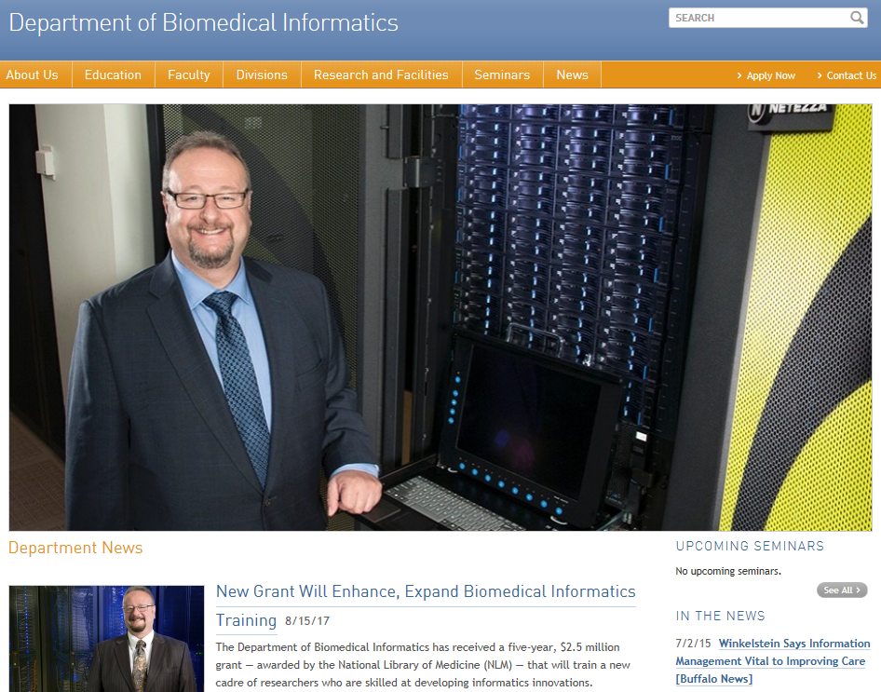

Slide 17
UB BMI Divisions
Basic
Research
Biomedical Informatics Methods, Techniques, and Theories
Sociotechnical and Human Centered
Design
Imaging
Informatics
Clinical
Informatics
Public Health Informatics
Bioinformatics
Applied
Research
and
Practice
Molecular and
Cellular
Processes
Tissues and
Organs
Individuals
(Patients)
Populations
And Society
Healthcare
workforce
Biomedical Ontology

Slide 18
UB BMI Divisions
Basic
Research
Biomedical Informatics Methods, Techniques, and Theories
Sociotechnical and Human Centered
Design
Clinical
Informatics
Public Health Informatics
Bioinformatics
Applied
Research
and
Practice
Molecular and
Cellular
Processes
Individuals
(Patients)
Populations
And Society
Healthcare
workforce
Biomedical Ontology

Slide 19
Biomedical Informatics
Definition:
Biomedical informatics (BMI) is
the interdisciplinary field
that studies and pursues the effective uses of biomedical data, information, and knowledge
for scientific inquiry, problem solving, and decision making,
driven by efforts to improve human health.
CA Kulikowski, EH Shortliffe, LM Currie, PL Elkin, LE Hunter, TR Johnson, IJ Kalet, LA Lenert, MA Musen, JG Ozbolt, JW Smith, PZ Tarczy-Hornoch, JWilliamson; AMIA Board white paper: definition of biomedical informatics and specification of core competencies for graduate education in the discipline, Journal of the American Medical Informatics Association, Volume 19, Issue 6, 1 November 2012, Pages 931–938, https://doi.org/10.1136/amiajnl-2012-001053

Slide 20
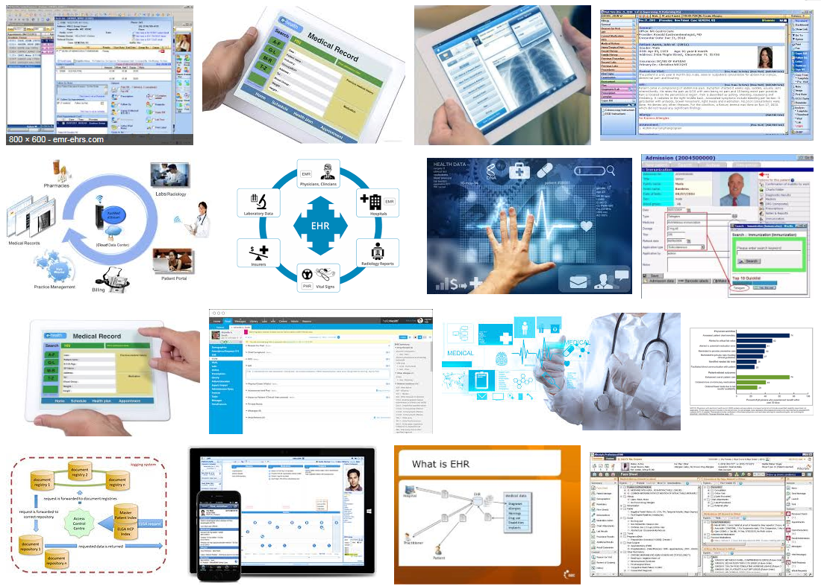
Electronic health records

Slide 21
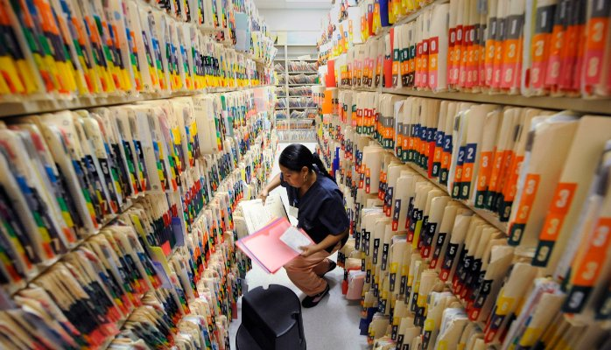
What it tried to solve first

Slide 22
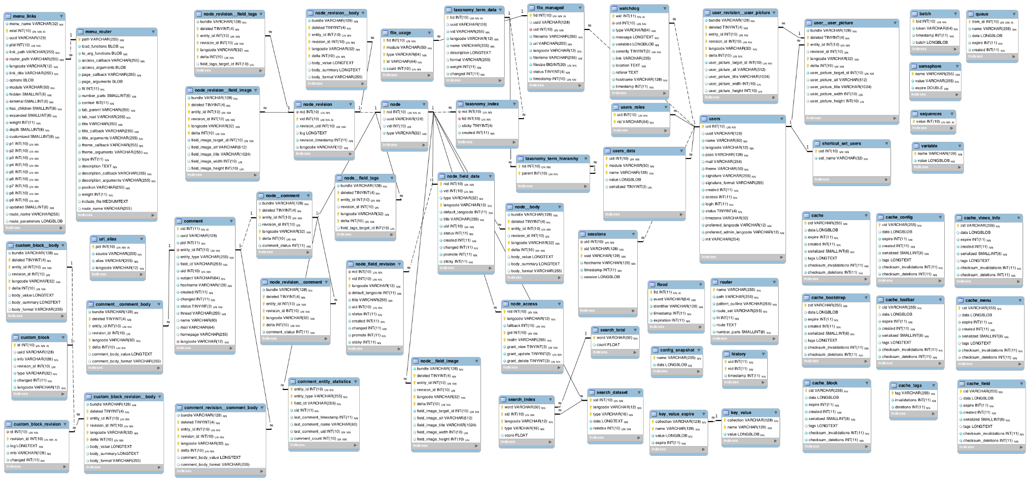

Slide 23
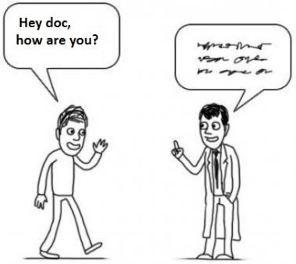
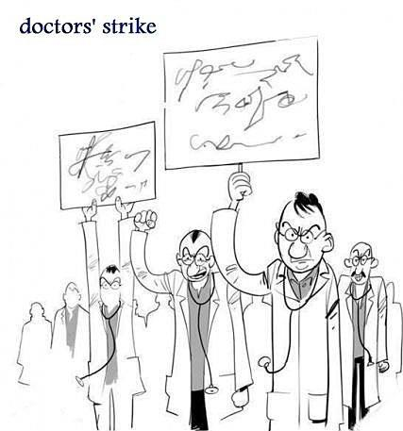
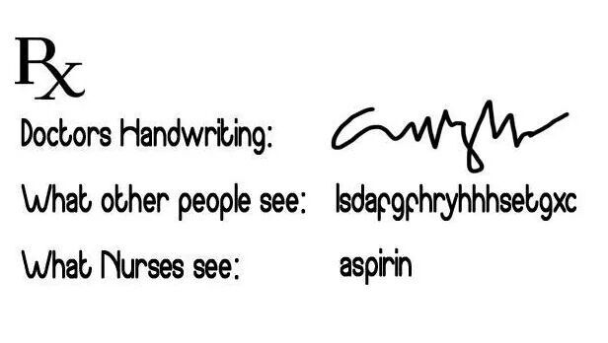
What it solved next
http://topyaps.com/doctors-handwriting

Slide 24
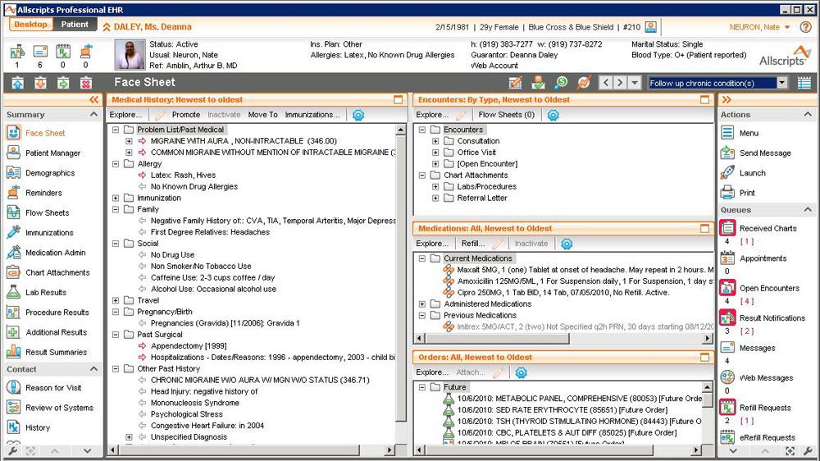

Slide 25
Attention to functionality (US)
← Billing
← Practice management
← Lab results
← ePrescribing
← Regulations
← Clinical

Slide 26
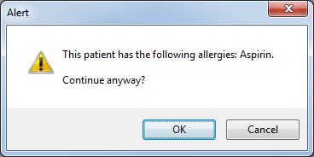

Slide 27
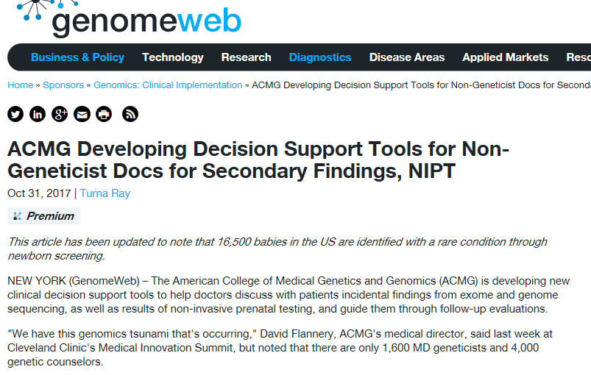
https://www.genomeweb.com/molecular-diagnostics/
acmg-developing-decision-support-tools-non-geneticist-docs-secondary-findings

Slide 28
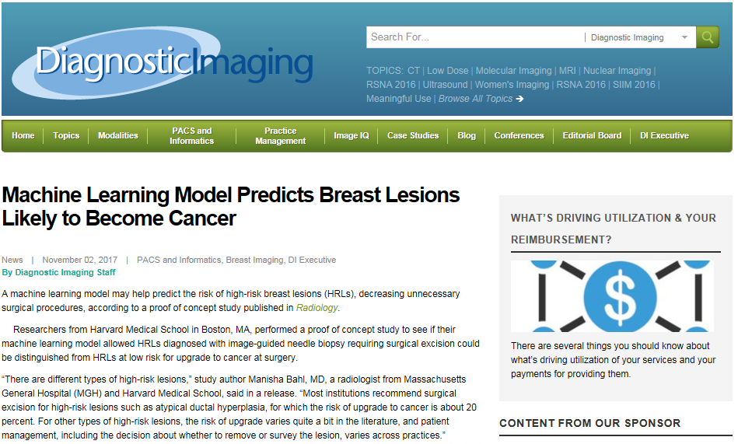

Slide 29
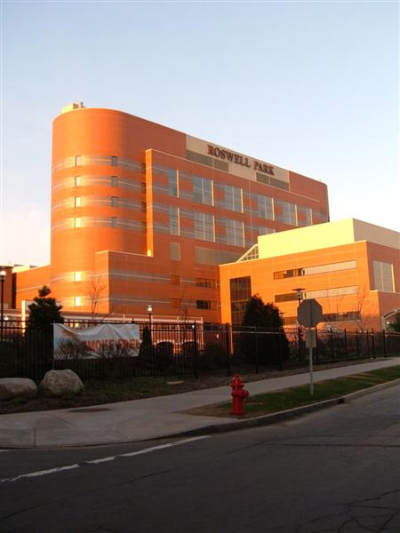

Semantic interoperability
Everything collected wherever, whenever and about whomever which is relevant to a medical problem in whomever, whenever and wherever, should be accessible without loss of relevant detail.

Slide 30
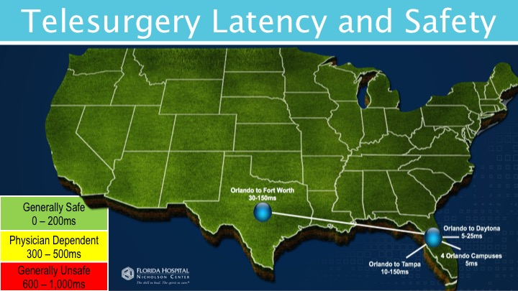
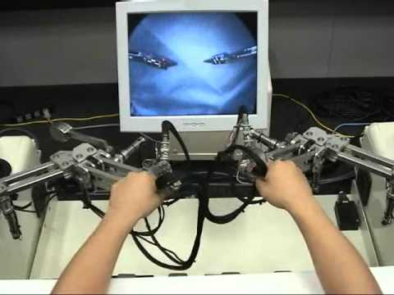
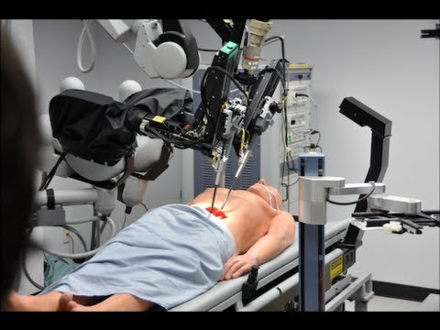

Slide 31
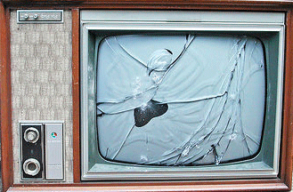

A possible end-goal for biomedical informatics
http://www.youtube.com/watch?v=-vT1Jm0jKmM

Slide 32
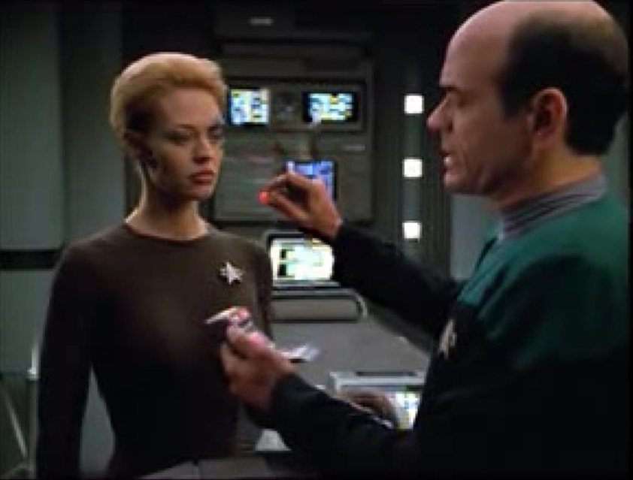
Why should we be surprised ?
A human being with function enhancing electronic implants
A ‘doctor’ who is in fact some sort of computer program capable of making medical diagnoses
A tiny scanner capable of detecting bodily anomalies
Flawless communication between a human and a computer

Slide 33
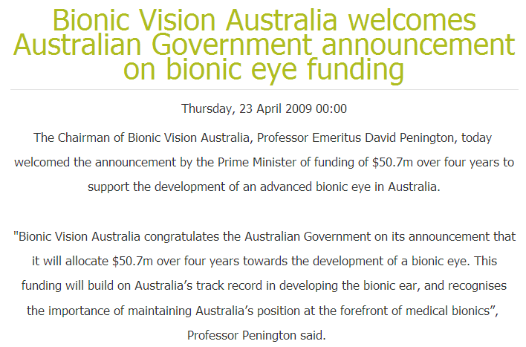
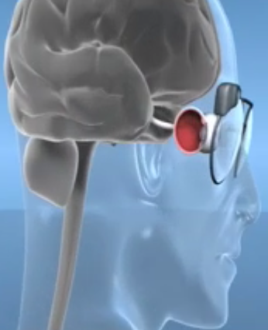
Or not ? … towards a bionic eye
http://bionicvision.org.au/

Slide 34
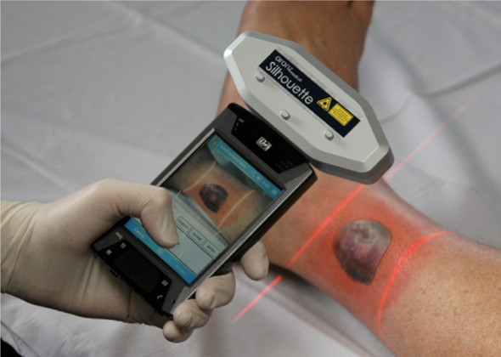
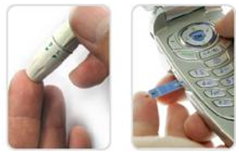
Or not ? … mobile diagnostics
SilhouetteMobile™
scans and stores information about a wound's width and depth, which helps nurses track healing over time as new tissue fills in the injury
GlucoPack™
reads and transmits glucose readings

Slide 35

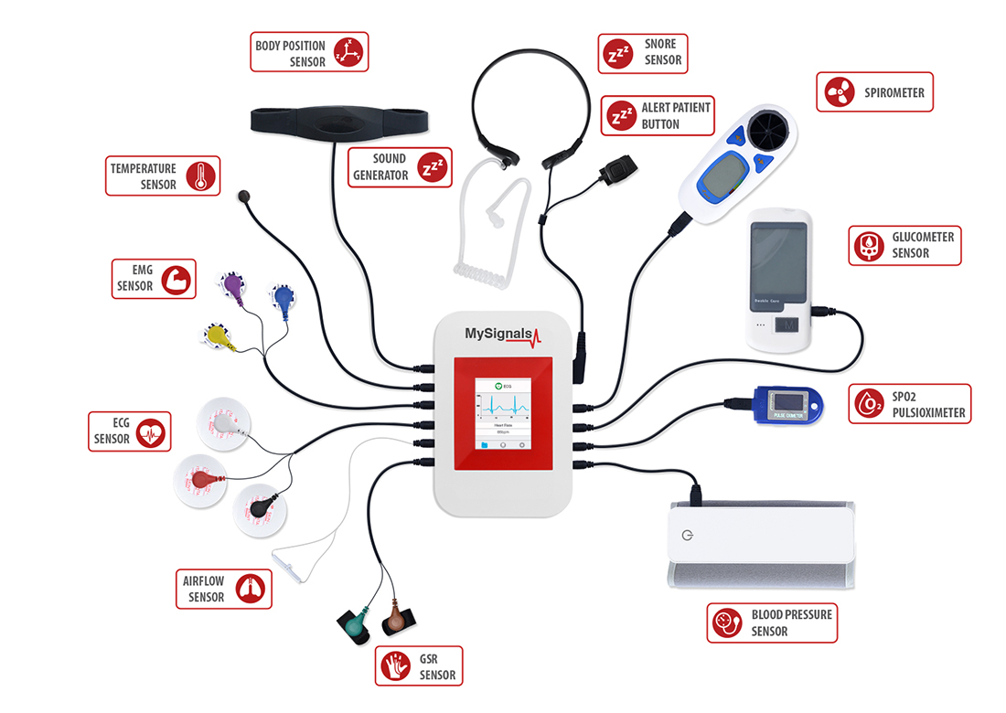
Internet of Things

Slide 36
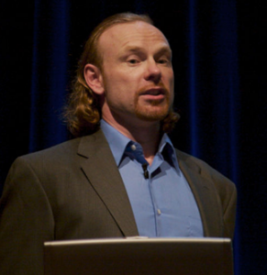
Or not ? … Transhumanism
"Philosophies of life that seek the continuation and acceleration of the evolution of intelligent life beyond its currently human form and human limitations by means of science and technology, guided by life-promoting principles and values."
Max More

Slide 37
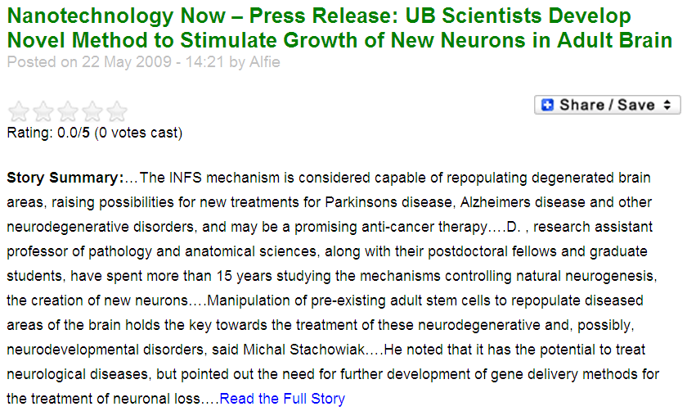
Beyond natural evolution …

Slide 38
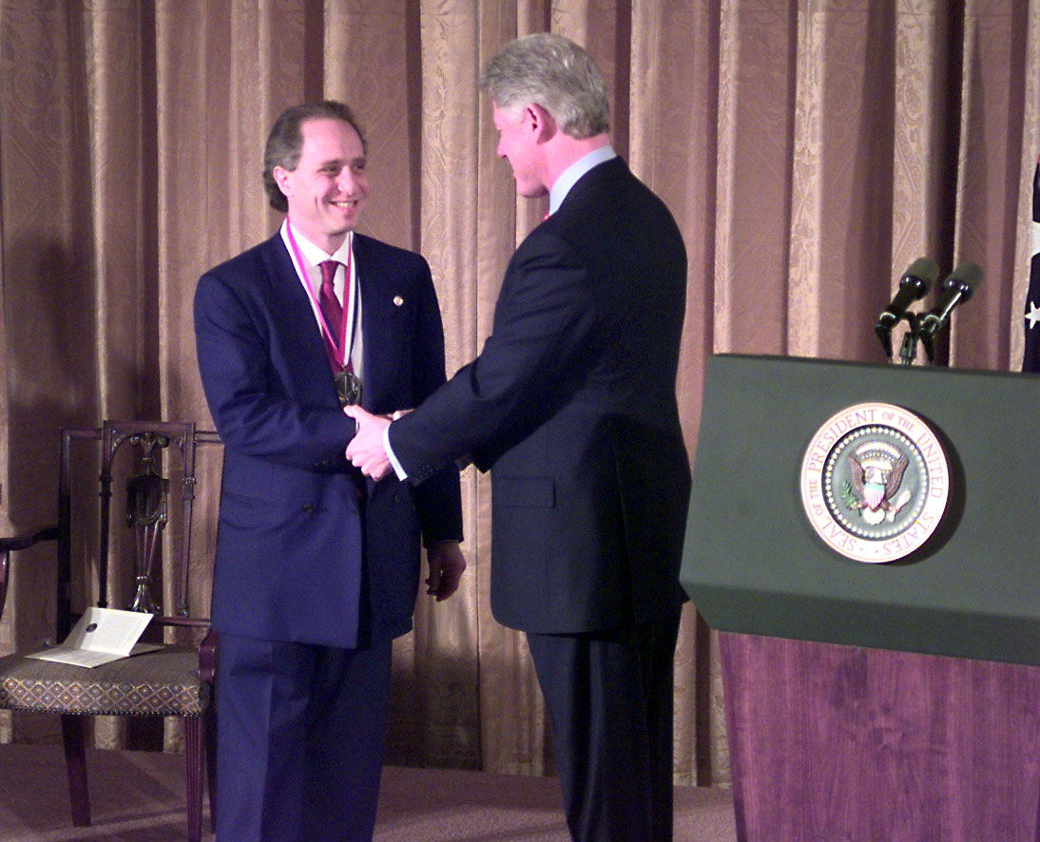

to … mind uploading ?
Ray Kurzweil receives National Medal of Technology (1999).

Slide 39
Biomedical Informatics
Definition:
Biomedical informatics (BMI) is
the interdisciplinary field
that studies and pursues the effective uses of biomedical data, information, and knowledge
for scientific inquiry, problem solving, and decision making,
driven by efforts to improve human health.
CA Kulikowski, EH Shortliffe, LM Currie, PL Elkin, LE Hunter, TR Johnson, IJ Kalet, LA Lenert, MA Musen, JG Ozbolt, JW Smith, PZ Tarczy-Hornoch, JWilliamson; AMIA Board white paper: definition of biomedical informatics and specification of core competencies for graduate education in the discipline, Journal of the American Medical Informatics Association, Volume 19, Issue 6, 1 November 2012, Pages 931–938, https://doi.org/10.1136/amiajnl-2012-001053

Slide 40
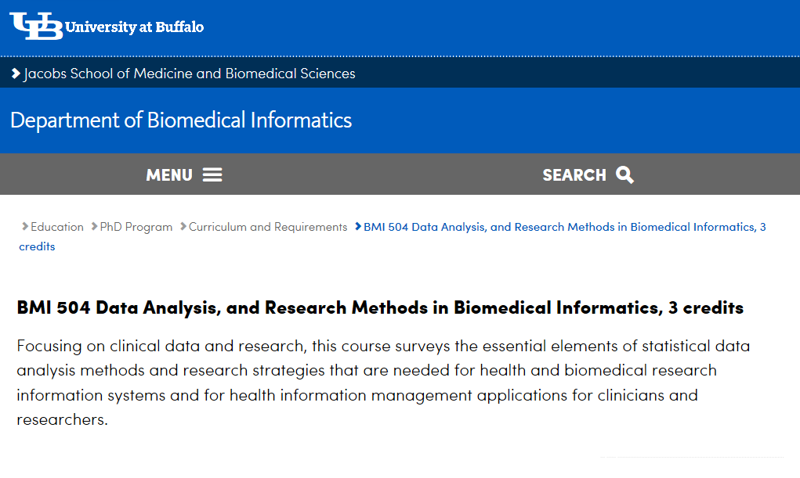

Slide 41
BMI 504 Course overview
C1 | Fundamentals of science & research | C8 | Descriptive and elementary statistics
C2 | Types of bias | C9 | Statistical analysis
C3 | Overview of research designs | C10 | Clinical trial design
C4 | Planning research projects | C11 | Integration of qualitative and quantitative methods
C5 | Data collection in qualitative research | C12 | Quality of research proposals
C6 | Elements of epidemiology | C13 | Ethics, plagiarism, informed consent
C7 | Data analysis of quantitative and qualitative variables | C14 | Oral presentation of research proposals

Slide 42
Current mainstream informatics thinking
knowledge
information
data

Slide 43
Current mainstream informatics thinking
?
knowledge
information
data

Slide 44
Current mainstream informatics thinking
wisdom
knowledge
information
data

Slide 45
Where do data come from?
knowledge
information
data
Reality
What is there on the side of the patient

Slide 46
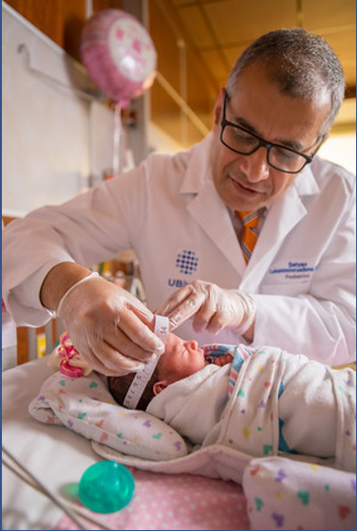
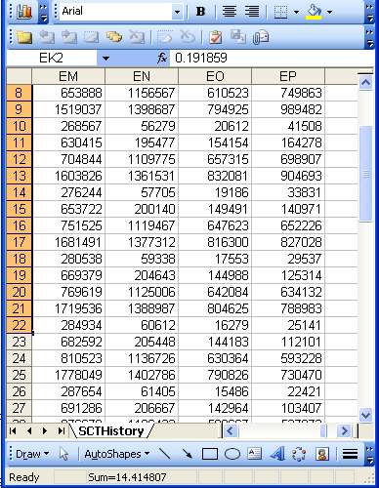
Beings, happenings and descriptions
(research) domain
(research) data
Beings & happenings
Descriptions
https://ubphoto.smugmug.com/Years/2017/17011-Medicine-Satyanarayana-Lakshminrusimha-Newborn-MFS/i-Vj8g6p2

