Slide 1
Biomedical Informatics Lecture in BMS199: New Frontiers in Biomedical Sciences: everyday medicine Nov 13, 2018 125 Kapoor Hall, University at Buffalo
Werner CEUSTERS, MD
Departments of Biomedical Informatics and Psychiatry,
UB Institute for Healthcare Informatics,
Ontology Research Group, Center of Excellence in Bioinformatics and Life Sciences,
University at Buffalo, NY, USA

Slide 2
I’m in biomedical informatics
Nov 13, 2017: https://3.bp.blogspot.com/_FuYHZ06Yub8/S7OgCrNfIBI/AAAAAAAACsc/a0547FtS47s/s1600/confused-face2.jpg

Slide 3
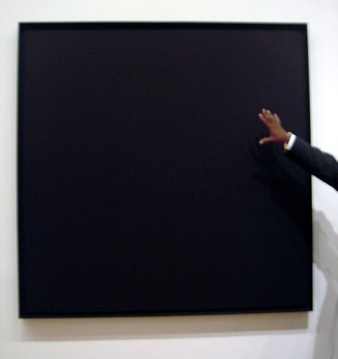
Art ?
Nov 13, 2017: https://3.bp.blogspot.com/_FuYHZ06Yub8/S7OgCrNfIBI/AAAAAAAACsc/a0547FtS47s/s1600/confused-face2.jpg
http://painting.about.com/od/famouspainters/ig/famous-paintings/Ad-Reinhardt-.htm

Slide 4
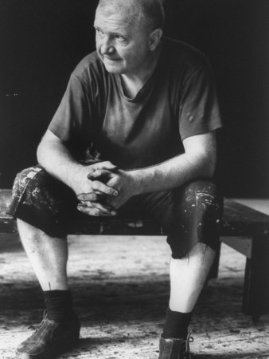
Art? Depends on who the creator is.
http://ludwig-mies-vanderrohe.blogspot.com/2011/07/ad-reinhardt-abstract-expressionist.html
Adolph ‘Ad’ Frederick Reinhardt
✳ Buffalo, NY 12/24/1913
† Manhattan, NY 8/30/1967
http://painting.about.com/od/famouspainters/ig/famous-paintings/Ad-Reinhardt-.htm

Slide 5
For sale
Ad Reinhardt, Buffalo/New York 1913 – 1967 New York
IRIS MYSTIQUE
1957. Oil on canvas in artist's frame.
96,5 x 45 cm (without frame), 102 x 51 cm (framed) (38 x 17 ¾ in. (without frame), 40 ⅛ x 20 ⅛ in. (framed)) Inscribed on the reverse : Ad Reinhardt Portrait d‘Iris Clert 1957 Oil Collection Ahrenberg Chexbres. On the stretcher a label of the Pace Gallery, New York.
Relined..
EUR 250.000 – 350.000 / US $ 324,000 – 453,000
We would like to thank Anna Reinhardt, New York, for kindly providing additional information
Provenance: Theodor Ahrenberg, Chexbres (Acquired in 1961 from the Galerie Iris Clert, Paris) / Pace Gallery, New York (1997) / Private collection, Berlin
Exhibitions: Les 41 presentent: Iris Clert. Paris, Galerie Iris Clert, 1961 (no. cat.) / Kompass New York. Frankfurt, Kunstverein, 1968, cat. no. 50, ill. / Der Sammler Theodor Ahrenberg und das Atelier in Chexbres. 15 Jahre mit Kunst and Künstlern 1960 - 1975. Düsseldorf, Kunsthalle, 1977, Kat-no. 289, full-page ill., o.S
Literature and Illustration: Exh. cat. Norman Lewis. Black Paintings 1944-1977. New York, Studio Museum of Harlem, 1998, ill. p. 17 pl. 9 (not exhibited)
http://www.arcadja.com/auctions/en/reinhardt_ad/artist/24077/

Slide 6
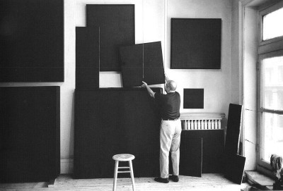
A ‘rich’ collection
http://thesingleroad.blogspot.com/2011_02_01_archive.html
http://minimalissimo.com/2012/10/black-paintings/

Slide 7
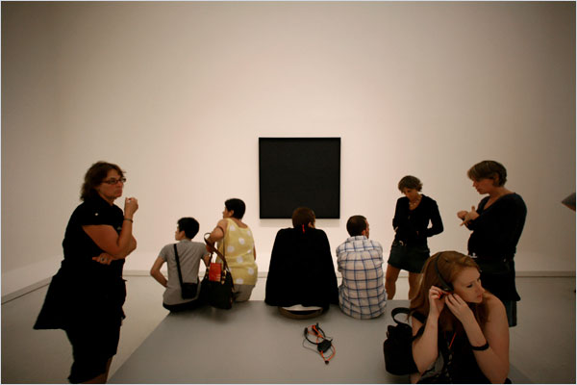
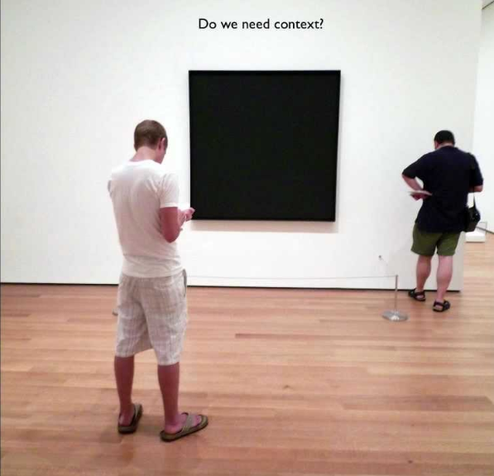
Nevertheless, people don’t seem to be impressed
http://www.nytimes.com/slideshow/2008/08/01/arts/0801-BLACK_index.html?_r=0
http://www.artbabble.org/video/smarthistory/ad-reinhardt-abstract-painting-1963

Slide 8
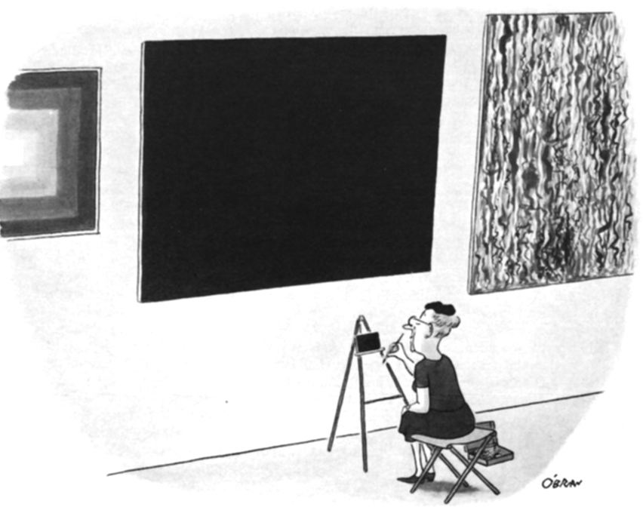
Except this one
William O’Brian, August 19, 1967
http://www.newyorker.com/online/blogs/culture/2013/12/slide-show-ad-reinhardts-cartoons-make-an-appearance-at-at-david-zwirner.html#slide_ss_0=1

Slide 9
Art is what you can get away with
http://www.azquotes.com/quote/356243

Slide 10
Art is what you can get away with
Biomedical informatics is not something you can get easily away with.
- Werner Ceusters -

Slide 11
Biomedical Informatics
Definition:
Biomedical informatics (BMI) is
the interdisciplinary field
that studies and pursues the effective uses of biomedical data, information, and knowledge
for scientific inquiry, problem solving, and decision making,
driven by efforts to improve human health.
CA Kulikowski, EH Shortliffe, LM Currie, PL Elkin, LE Hunter, TR Johnson, IJ Kalet, LA Lenert, MA Musen, JG Ozbolt, JW Smith, PZ Tarczy-Hornoch, JWilliamson; AMIA Board white paper: definition of biomedical informatics and specification of core competencies for graduate education in the discipline, Journal of the American Medical Informatics Association, Volume 19, Issue 6, 1 November 2012, Pages 931–938, https://doi.org/10.1136/amiajnl-2012-001053

Slide 12
Biomedical Informatics
Definition:
Biomedical informatics (BMI) is
the interdisciplinary field
that studies and pursues the effective uses of biomedical data, information, and knowledge
for scientific inquiry, problem solving, and decision making,
driven by efforts to improve human health.
CA Kulikowski, EH Shortliffe, LM Currie, PL Elkin, LE Hunter, TR Johnson, IJ Kalet, LA Lenert, MA Musen, JG Ozbolt, JW Smith, PZ Tarczy-Hornoch, JWilliamson; AMIA Board white paper: definition of biomedical informatics and specification of core competencies for graduate education in the discipline, Journal of the American Medical Informatics Association, Volume 19, Issue 6, 1 November 2012, Pages 931–938, https://doi.org/10.1136/amiajnl-2012-001053

Slide 13
Interdisciplinary Nature of Biomedical Informatics: the main stream view
Computer Science (hardware)
Computer Science (software)
Cognitive Science
& Decision Making
Bioengineering
Biomedical
Informatics
Management
Sciences
Epidemiology
And Statistics
Basic Biomedical
Sciences
Clinical
Sciences

Slide 14
Interdisciplinary Nature of Biomedical Informatics: UB Department of BMI’s view
Computer Science (hardware)
Informatics
Human factors
ergonomics
Computer Science (software)
Cognitive Science
& Decision Making
Bioengineering
Biomedical
Informatics
Management
Sciences
Epidemiology
And Statistics
Philosophy
Basic Biomedical
Sciences
Clinical
Sciences
Philosophy
Of Science
(Biomedical)
Ontology

Slide 15
Biomedical Informatics in Perspective
Basic
Research
Biomedical Informatics Methods, Techniques, and Theories
Sociotechnical and Human Centered
Design
Imaging
Informatics
Clinical
Informatics
Public Health Informatics
Bioinformatics
Applied
Research
and
Practice

Slide 16
Biomedical Informatics in Perspective
Basic
Research
Biomedical Informatics Methods, Techniques, and Theories
Sociotechnical and Human Centered
Design
Imaging
Informatics
Clinical
Informatics
Public Health Informatics
Bioinformatics
Applied
Research
and
Practice
Molecular and
Cellular
Processes
Tissues and
Organs
Individuals
(Patients)
Populations
And Society
Healthcare
workforce

Slide 17
Subdiscipline: Bio-informatics
Basic
Research
Biomedical Informatics Methods, Techniques, and Theories
Sociotechnical and Human Centered
Design
Biomedical Informatics ≠
Bioinformatics
Imaging
Informatics
Clinical
Informatics
Public Health Informatics
Bioinformatics
Applied
Research
and
Practice
Molecular and
Cellular
Processes
Tissues and
Organs
Individuals
(Patients)
Populations
And Society
Healthcare
workforce

Slide 18
A Bioinformatics Pep Talk David Wishart University of Alberta. http://slideplayer.com/slide/4545718/

Slide 19
Combinations: Health Informatics
Basic
Research
Biomedical Informatics Methods, Techniques, and Theories
Sociotechnical and Human Centered
Design
Imaging
Informatics
Clinical
Informatics
Public Health Informatics
Bioinformatics
Applied
Research
and
Practice
Molecular and
Cellular
Processes
Tissues and
Organs
Individuals
(Patients)
Populations
And Society
Healthcare
workforce

Slide 20
Combinations: Pharmacogenomics
Basic
Research
Biomedical Informatics Methods, Techniques, and Theories
Sociotechnical and Human Centered
Design
Imaging
Informatics
Clinical
Informatics
Public Health Informatics
Bioinformatics
Applied
Research
and
Practice
Molecular and
Cellular
Processes
Tissues and
Organs
Individuals
(Patients)
Populations
And Society
Healthcare
workforce

Slide 21
Combinations: Consumer health
Basic
Research
Biomedical Informatics Methods, Techniques, and Theories
Sociotechnical and Human Centered
Design
Imaging
Informatics
Clinical
Informatics
Public Health Informatics
Bioinformatics
Applied
Research
and
Practice
Molecular and
Cellular
Processes
Tissues and
Organs
Individuals
(Patients)
Populations
And Society
Healthcare
workforce

Slide 22
Combinations: Biomolecular imaging
Basic
Research
Biomedical Informatics Methods, Techniques, and Theories
Sociotechnical and Human Centered
Design
Imaging
Informatics
Clinical
Informatics
Public Health Informatics
Bioinformatics
Applied
Research
and
Practice
Molecular and
Cellular
Processes
Tissues and
Organs
Individuals
(Patients)
Populations
And Society
Healthcare
workforce

Slide 23
Combinations: Translational Informatics
Basic
Research
Biomedical Informatics Methods, Techniques, and Theories
Sociotechnical and Human Centered
Design
Imaging
Informatics
Clinical
Informatics
Public Health Informatics
Bioinformatics
Applied
Research
and
Practice
Molecular and
Cellular
Processes
Tissues and
Organs
Individuals
(Patients)
Populations
And Society
Healthcare
workforce

Slide 24
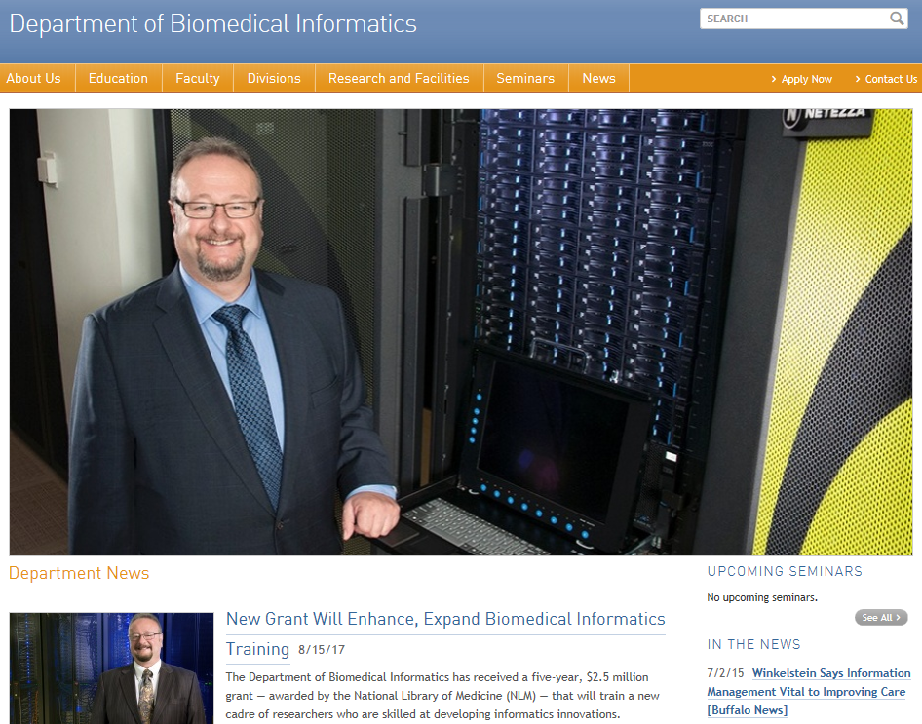

Slide 25
UB BMI Divisions
Basic
Research
Biomedical Informatics Methods, Techniques, and Theories
Sociotechnical and Human Centered
Design
Imaging
Informatics
Clinical
Informatics
Public Health Informatics
Bioinformatics
Applied
Research
and
Practice
Molecular and
Cellular
Processes
Tissues and
Organs
Individuals
(Patients)
Populations
And Society
Healthcare
workforce
Biomedical Ontology

Slide 26
UB BMI Divisions
Basic
Research
Biomedical Informatics Methods, Techniques, and Theories
Sociotechnical and Human Centered
Design
Clinical
Informatics
Public Health Informatics
Bioinformatics
Applied
Research
and
Practice
Molecular and
Cellular
Processes
Individuals
(Patients)
Populations
And Society
Healthcare
workforce
Biomedical Ontology

Slide 27
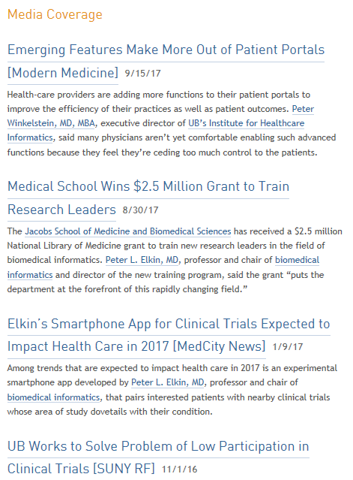

Slide 28
Biomedical Informatics
Definition:
Biomedical informatics (BMI) is
the interdisciplinary field
that studies and pursues the effective uses of biomedical data, information, and knowledge
for scientific inquiry, problem solving, and decision making,
driven by efforts to improve human health.
CA Kulikowski, EH Shortliffe, LM Currie, PL Elkin, LE Hunter, TR Johnson, IJ Kalet, LA Lenert, MA Musen, JG Ozbolt, JW Smith, PZ Tarczy-Hornoch, JWilliamson; AMIA Board white paper: definition of biomedical informatics and specification of core competencies for graduate education in the discipline, Journal of the American Medical Informatics Association, Volume 19, Issue 6, 1 November 2012, Pages 931–938, https://doi.org/10.1136/amiajnl-2012-001053

Slide 29
Current mainstream informatics thinking
knowledge
information
data

Slide 30
Current mainstream informatics thinking
?
knowledge
information
data

Slide 31
Current mainstream informatics thinking
wisdom
knowledge
information
data

Slide 32
Where do data come from?
knowledge
information
data
Reality
What is there on the side of the patient

Slide 33
Generalization: data generation and use
data
organization
model development
observation &
measurement
further R&D
(instrument and
study optimization)
add
verify
use
Δ = outcome
Generic
beliefs
application

Slide 34
Where do data come from?
knowledge
information
data
Questions not often enough asked:
What parts of our data correspond with something out there in reality ?
What parts of reality are not captured by our data, but should because they are relevant ?
Reality
What is there on the side of the patient

Slide 35
Where do data come from?
knowledge
information
data
Questions not often enough asked:
What parts of our data correspond with something out there in reality ?
What parts of reality are not captured by our data, but should because they are relevant ?
Ontology
Reality
What is there on the side of the patient

Slide 36
Generalization: data generation and use
data
organization
model development
observation &
measurement
further R&D
(instrument and
study optimization)
add
verify
use
Δ = outcome
Generic
beliefs
application

Slide 37
Reality as benchmark for data organization and representation
data
organization
model development
observation &
measurement
further R&D
(instrument and
study optimization)
add
verify
use
Δ = outcome
Generic
beliefs
application

Slide 38
Biomedical Informatics
Definition:
Biomedical informatics (BMI) is
the interdisciplinary field
that studies and pursues the effective uses of biomedical data, information, and knowledge
for scientific inquiry, problem solving, and decision making,
driven by efforts to improve human health.
CA Kulikowski, EH Shortliffe, LM Currie, PL Elkin, LE Hunter, TR Johnson, IJ Kalet, LA Lenert, MA Musen, JG Ozbolt, JW Smith, PZ Tarczy-Hornoch, JWilliamson; AMIA Board white paper: definition of biomedical informatics and specification of core competencies for graduate education in the discipline, Journal of the American Medical Informatics Association, Volume 19, Issue 6, 1 November 2012, Pages 931–938, https://doi.org/10.1136/amiajnl-2012-001053

Slide 39
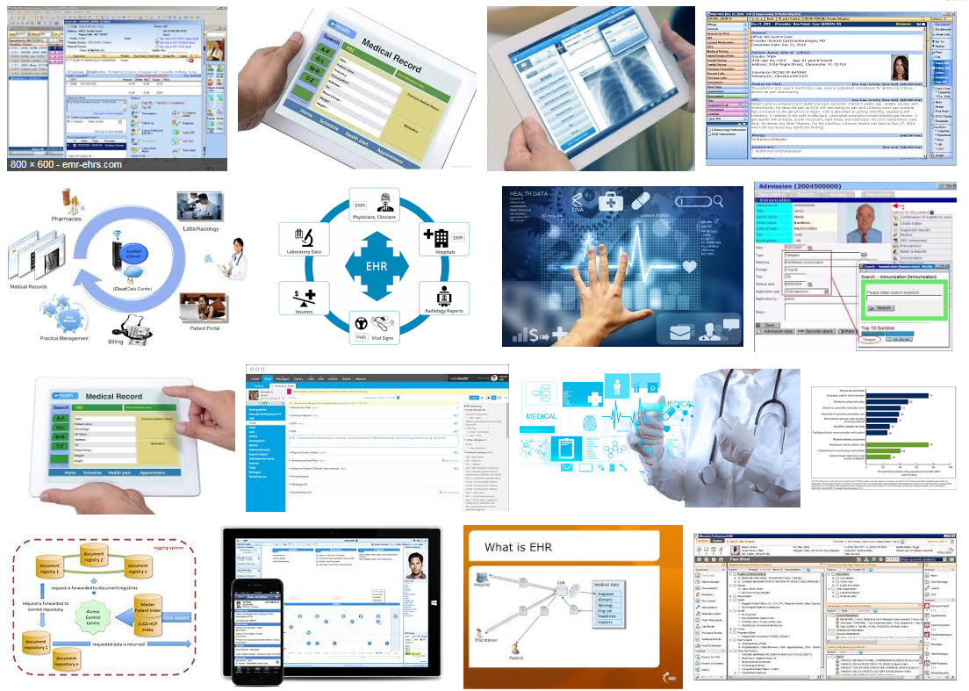
Electronic health records

Slide 40
What it tried to solve first

Slide 42
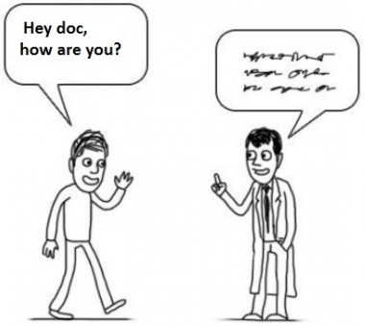
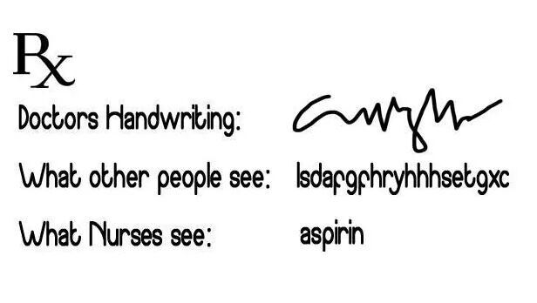
What it solved next
http://topyaps.com/doctors-handwriting

Slide 43
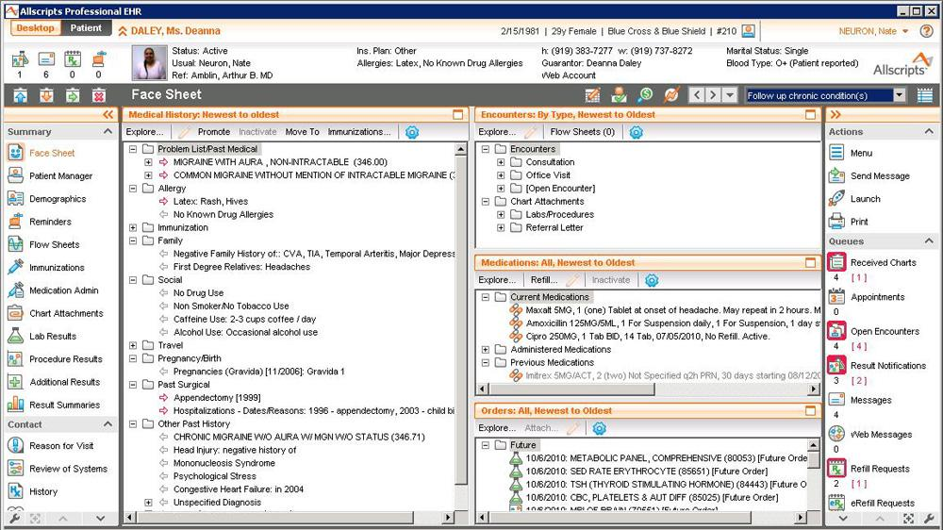

Slide 44
Attention to functionality (US)
← Billing
← Practice management
← Lab results
← ePrescribing
← Regulations
← Clinical

Slide 45
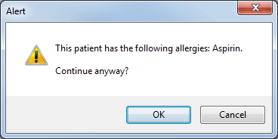

Slide 46
Clinical Decision Support

Slide 47
https://www.genomeweb.com/molecular-diagnostics/
acmg-developing-decision-support-tools-non-geneticist-docs-secondary-findings

Slide 49
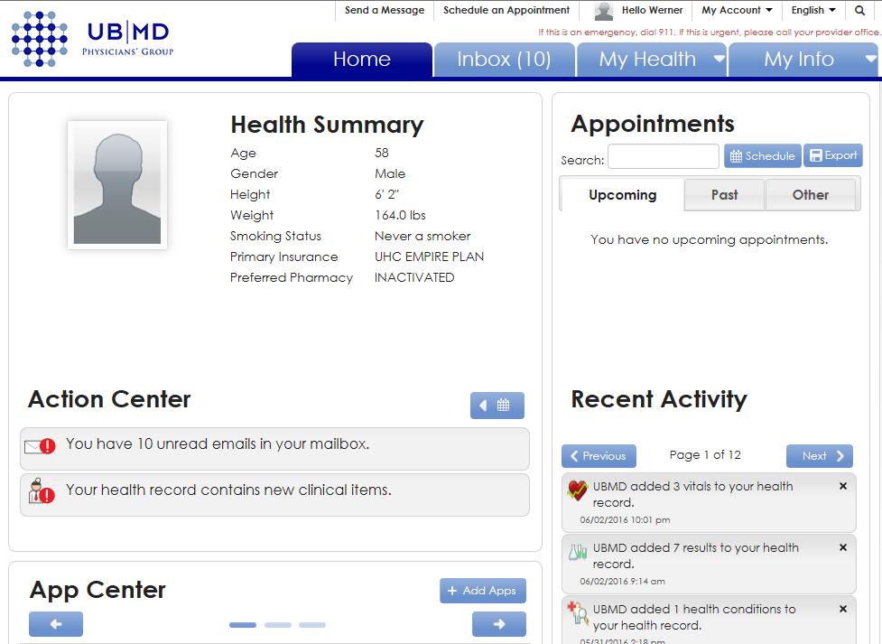
Patient Portals

Slide 50
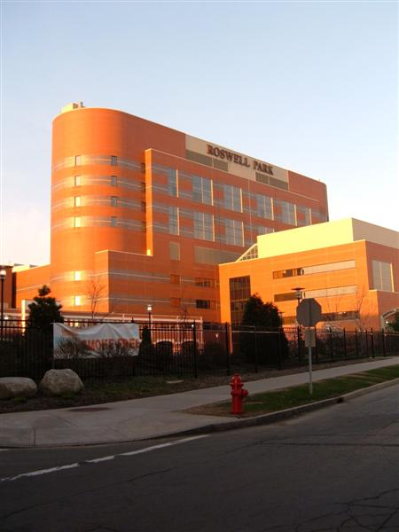
Semantic interoperability
Everything collected wherever, whenever and about whomever which is relevant to a medical problem in whomever, whenever and wherever, should be accessible without loss of relevant detail.

Slide 51
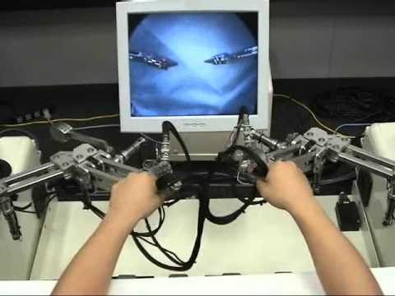

Slide 52
Careers in Biomedical Informatics
Positions Employers
Chief Medical Information Officers
Chief Medical Officers (CMOs)
Chief Information Officers (CIOs)
Directors of Medical Informatics
Chief Nursing Information Officers
Project managers
Implementation specialists
Project designers
Researchers
Programmers
Clinical systems analysts
Health information technology (HIT) educators and trainers
HIT consultants
Template writers
Nursing informatics specialists
Account representatives
Hospitals and health systems
Community health centers
Physician practices and clinics
Health care agencies within federal and state government
Health information technology system vendors
eHealth companies
Health insurance companies
Pharmaceutical companies
Academic institutions
Consulting services

Slide 53
HIMMS Conferences
http://www.orlandosentinel.com/health/os-pictures-himss-healthcare-information-technology-conference-140224,0,1443512.photogallery

Slide 54
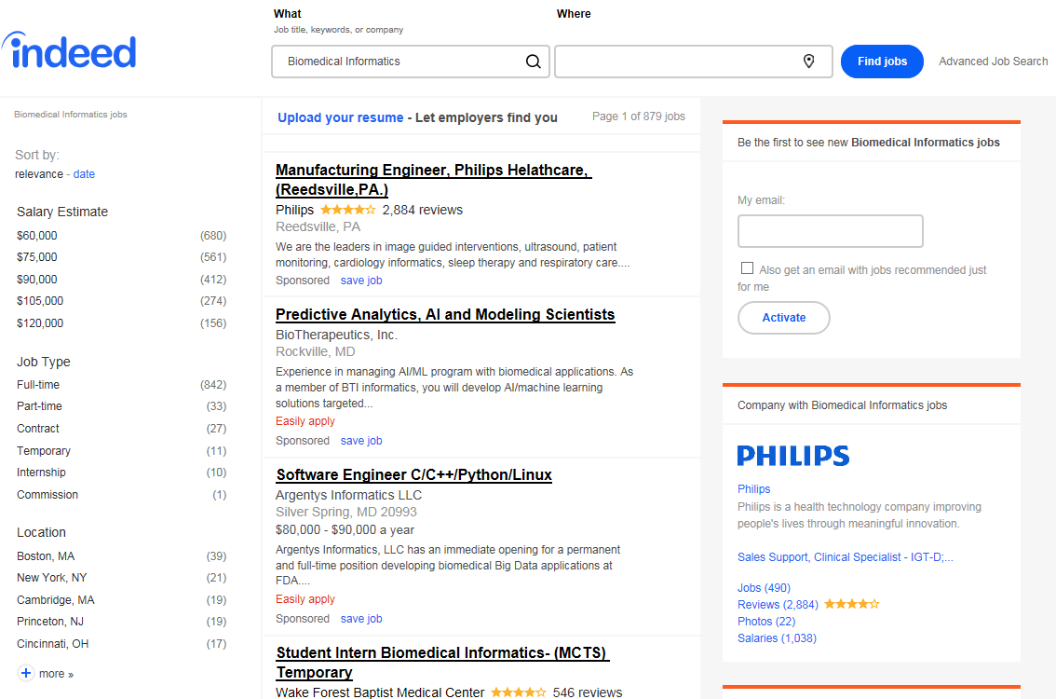
Nov 2, 2018

Slide 55
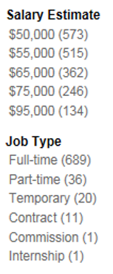
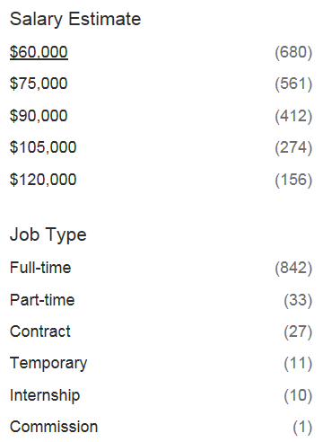
Positions & salaries going up dramatically !
Nov 2017
Nov 2018
https://www.indeed.com/q-Biomedical-Informatics-jobs.html

Slide 56
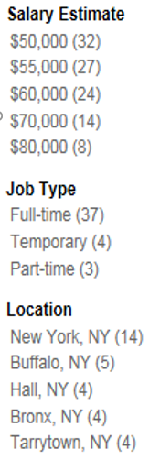
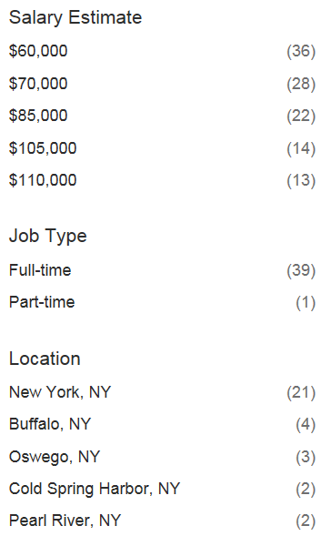
Open BMI positions New York State
Nov 2017
Nov 2018
https://www.indeed.com/q-Biomedical-Informatics-jobs.html

Slide 57
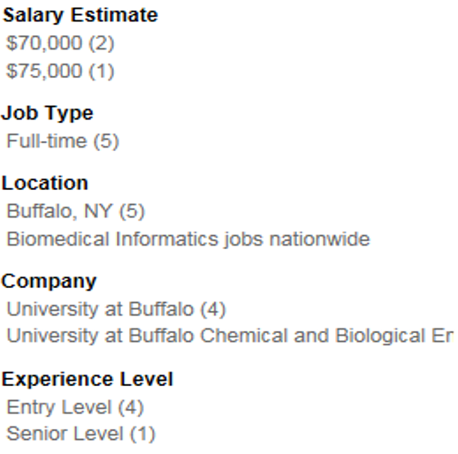
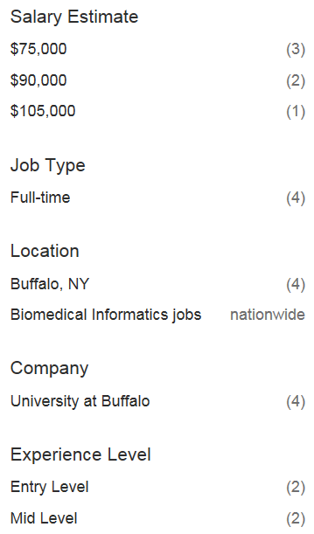
Open BMI positions in Buffalo
Nov 2017
Nov 2018
Nov 2017
Nov 2018
https://www.indeed.com/q-Biomedical-Informatics-jobs.html

Slide 58
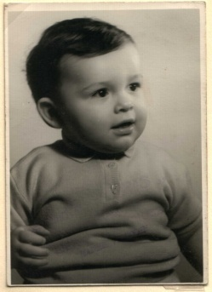
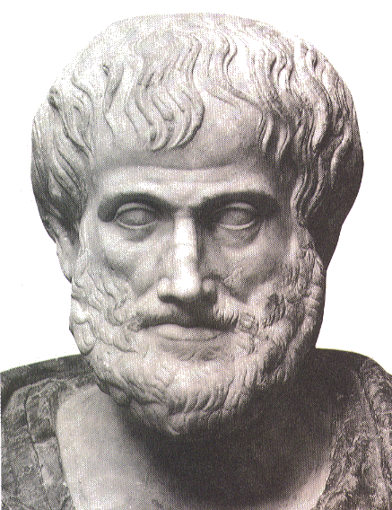
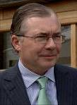
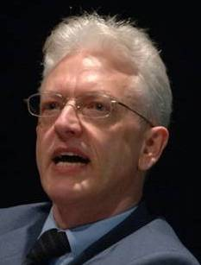
Short personal history
2014
2012
1977
1959 -
2006
1989
2004
1992
2002
1995
1998
1993

Slide 59
A trajectory of mixes and mingles …
Informatics
Knowledge Representation
Linguistics
Computational Linguistics
Ontology
Philosophy
Medical Natural
Language Understanding
Realism-Based
Ontology
Electronic
Health Records
Translational
Research
Referent
Tracking
Medicine
Pharmacogenomics
Performing
Arts
Defense &
Intelligence
Biology
Pharmacology

Slide 62
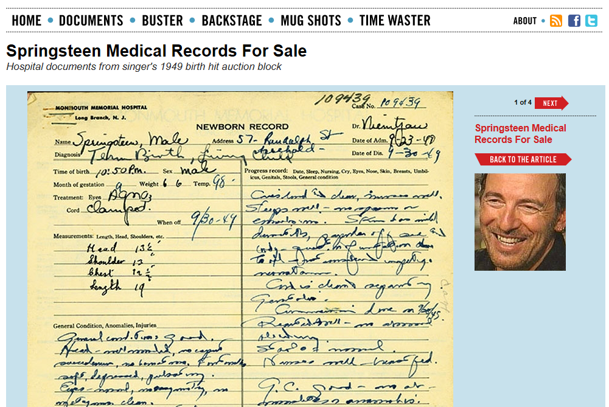
http://www.thesmokinggun.com/file/springsteen-medical-records-sale

Slide 63
Necessary involvements
Academia
Government
Industry
Citizens

Slide 64
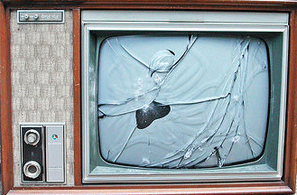
A possible end-goal for biomedical informatics
http://www.youtube.com/watch?v=-vT1Jm0jKmM

Slide 65
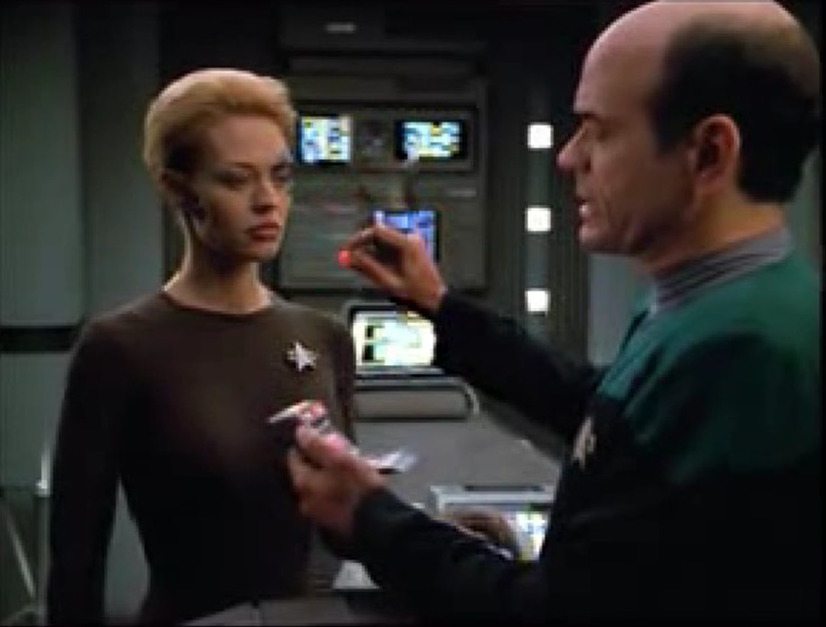
Why should we be surprised ?
A human being with function enhancing electronic implants
A ‘doctor’ who is in fact some sort of computer program capable of making medical diagnoses
A tiny scanner capable of detecting bodily anomalies
Flawless communication between a human and a computer

Slide 66
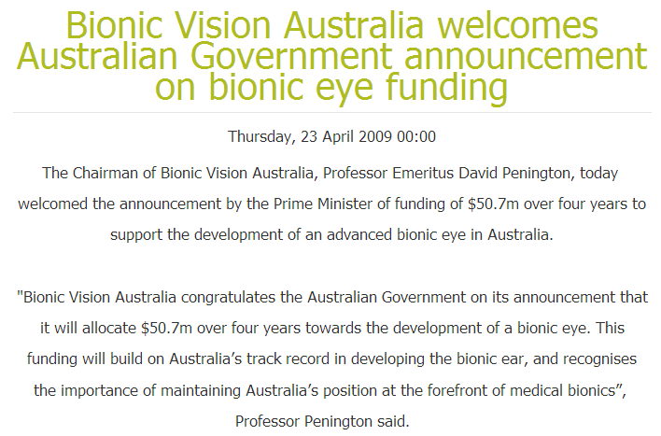
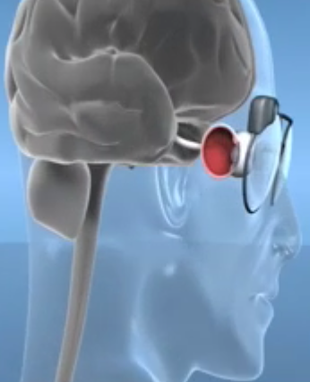
Or not ? … towards a bionic eye
http://bionicvision.org.au/

Slide 67
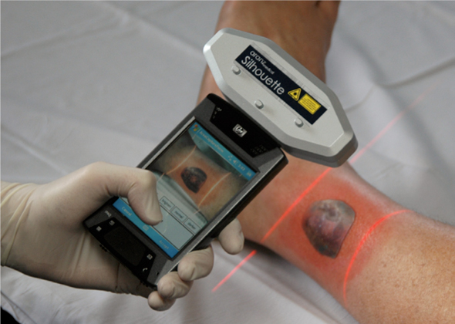
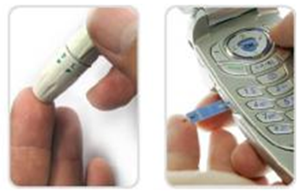
Or not ? … mobile diagnostics
SilhouetteMobile™
scans and stores information about a wound's width and depth, which helps nurses track healing over time as new tissue fills in the injury
GlucoPack™
reads and transmits glucose readings

Slide 68
Internet of Things

Slide 69
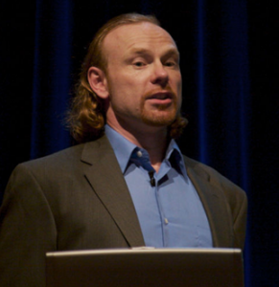
Or not ? … Transhumanism
"Philosophies of life that seek the continuation and acceleration of the evolution of intelligent life beyond its currently human form and human limitations by means of science and technology, guided by life-promoting principles and values."
Max More

Slide 70
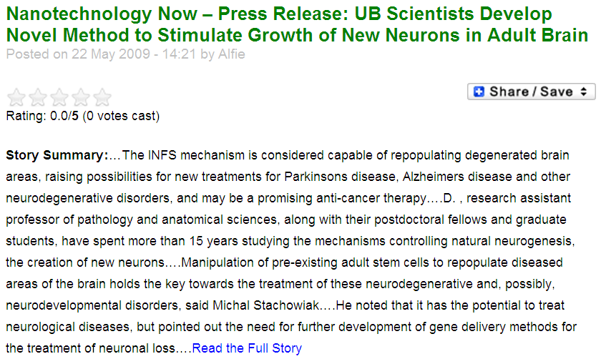
Beyond natural evolution …

Slide 71
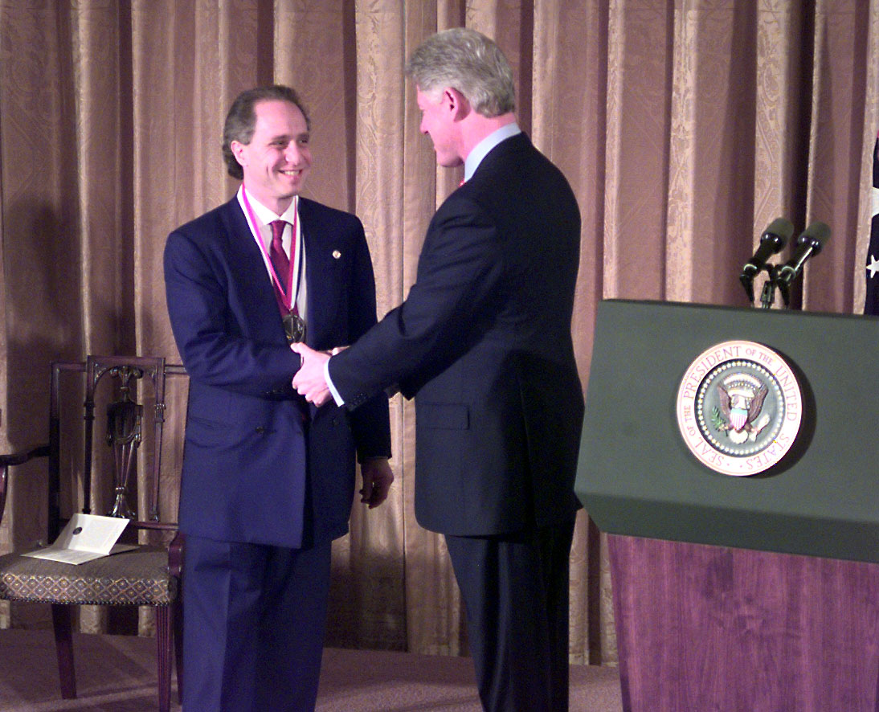
to … mind uploading ?
Ray Kurzweil receives National Medal of Technology (1999).

