Slide 1
Research Methods for
Biomedical Informatics
July 21, 2021
UB Summer Informatics Data Science Bootcamp
Department of Biomedical Informatics, University at Buffalo
July 12 – August 26, 2021
Werner CEUSTERS, MD
Division Chief Biomedical Ontology,
Department of Biomedical Informatics
University at Buffalo, NY, USA

Slide 2
BMI504 - Course overview
C1. Introduction To Research And Research Proposals
C2. Fundamentals Of Science And Research
C3. Parameters For Research Designs
C4. Planning Of Research Projects
C5. Types Of Bias
C6. Qualitative Research Methods: Theory And Data Collection Methods
C7. Mixed Methods: Integration Of Quantitative And Qualitative Methods
C8. Introduction To Data Analysis Of Quantitative And Qualitative Variables
C9. Elements Of Epidemiology
C10. Descriptive And Elementary Statistics
C11. Statistical Analysis
C12. Clinical Trial Design
C13. Fundamentals Of Research: Quality Of Research Proposals
C14. Presentation Of Final Research Proposals
C15. Final Exam.

Slide 3
Today: essence of these topics
C1. Introduction To Research And Research Proposals
C2. Fundamentals Of Science And Research
C3. Parameters For Research Designs
C4. Planning Of Research Projects
C5. Types Of Bias
C6. Qualitative Research Methods: Theory And Data Collection Methods
C7. Mixed Methods: Integration Of Quantitative And Qualitative Methods
C8. Introduction To Data Analysis Of Quantitative And Qualitative Variables
C9. Elements Of Epidemiology
C10. Descriptive And Elementary Statistics
C11. Statistical Analysis
C12. Clinical Trial Design
C13. Fundamentals Of Research: Quality Of Research Proposals
C14. Presentation Of Final Research Proposals
C15. Final Exam.

Slide 4
Definition of ‘Biomedical Informatics’
Biomedical informatics (BMI) is
the interdisciplinary field
that studies and pursues the effective uses of biomedical data, information, and knowledge
for scientific inquiry, problem solving, and decision making,
driven by efforts to improve human health.
CA Kulikowski, EH Shortliffe, LM Currie, PL Elkin, LE Hunter, TR Johnson, IJ Kalet, LA Lenert, MA Musen, JG Ozbolt, JW Smith, PZ Tarczy-Hornoch, JWilliamson; AMIA Board white paper: definition of biomedical informatics and specification of core competencies for graduate education in the discipline, Journal of the American Medical Informatics Association, Volume 19, Issue 6, 1 November 2012, Pages 931–938, https://doi.org/10.1136/amiajnl-2012-001053

Slide 5
Definition of ‘research’
careful or diligent search;
studious inquiry or examination; especially:
investigation or experimentation
aimed at
- the discovery and interpretation of facts,
- revision of accepted theories or laws in the light of new facts,
- or practical application of such new or revised theories or laws;
the collecting of information about a particular subject.
http://www.merriam-webster.com/dictionary/research

Slide 6

The scientific endeavor in general
data
organization
model development
observation &
measurement
further R&D
(instrument and
study optimization)
add
verify
use
Δ = outcome
Generic
beliefs
application

Slide 7
The scientific endeavor of BMI
Biomedical informatics (BMI) is
the interdisciplinary field
that studies and pursues the effective uses of biomedical data, information, and knowledge
for scientific inquiry, problem solving, and decision making,
driven by efforts to improve human health.
goal

Slide 8
The scientific endeavor of BMI
Biomedical informatics (BMI) is
the interdisciplinary field
that studies and pursues the effective uses of biomedical data, information, and knowledge
for scientific inquiry, problem solving, and decision making,
driven by efforts to improve human health.
objectives

Slide 9
The scientific endeavor of BMI
Biomedical informatics (BMI) is
the interdisciplinary field
that studies and pursues the effective uses of biomedical data, information, and knowledge
for scientific inquiry, problem solving, and decision making,
driven by efforts to improve human health.
core activities

Slide 10
The scientific endeavor of BMI
Biomedical informatics (BMI) is
the interdisciplinary field
that studies and pursues the effective uses of biomedical data, information, and knowledge
for scientific inquiry, problem solving, and decision making,
driven by efforts to improve human health.

Slide 11
Some key principles in how to do science
Objective observation: measure and acquire data (possibly although not necessarily using mathematics as a tool),
Experiment and/or observation as benchmarks for testing hypotheses,
Repetition,
Critical analysis,
Generating evidence,
Induction: reasoning to establish general rules or conclusions drawn from facts or examples,
Verification and testing: critical exposure to scrutiny, peer review and assessment.
http://sciencecouncil.org/about-us/our-definition-of-science/

Slide 12
The most popular way for doing science:
‘The Scientific Method’
principles and procedures for the systematic pursuit of knowledge involving:
  the recognition and formulation of a problem,
  the collection of data through observation and experiment, and
  the formulation and testing of hypotheses.
http://www.merriam-webster.com/dictionary/scientific%20method

Slide 13
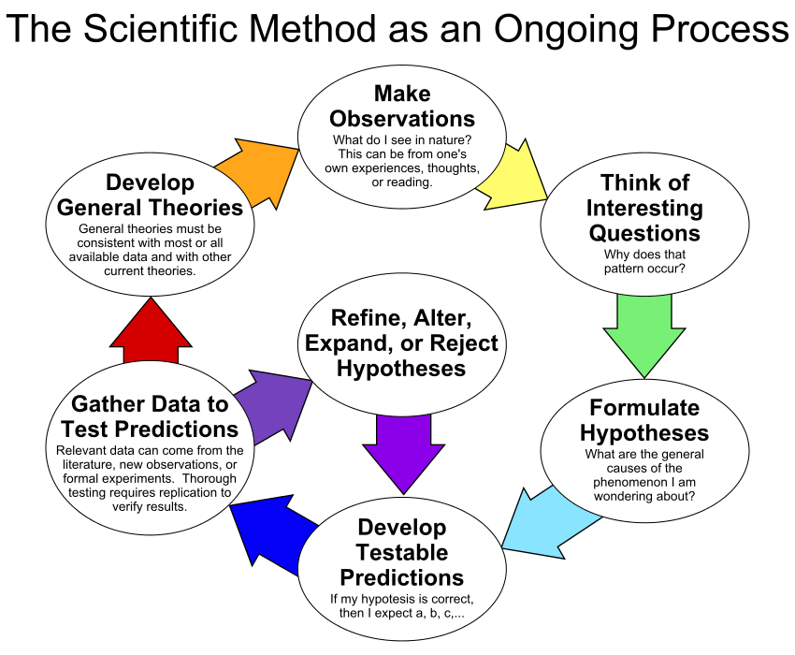
?
By ArchonMagnus - Own work, CC BY-SA 4.0, https://commons.wikimedia.org/w/index.php?curid=42164616

Slide 14
Avoiding and identifying pseudoscience
Belief in authority: It is contended that some have a special ability to determine what is true or false. Others must accept their judgments.
Unrepeatable experiments: Reliance is put on experiments that cannot be repeated by others with the same outcome.
Handpicked examples: are used although they are not representative of the general category that the investigation refers to.
Unwillingness to test: A theory is not tested although it can be.
Disregard of refuting information: Observations or experiments that conflict with a theory are neglected.
Built-in subterfuge: The testing of a theory is so arranged that the theory can only be confirmed, never disconfirmed, by the outcome.
Explanations are abandoned without replacement. Tenable explanations are given up without being replaced, so that the new theory leaves much more unexplained than the previous one.
Hansson, Sven Ove, "Science and Pseudo-Science", The Stanford Encyclopedia of Philosophy (Spring 2015 Edition), Edward N. Zalta (ed.). https://plato.stanford.edu/archives/spr2015/entries/pseudo-science/.
List of fallacious arguments: http://www.don-lindsay-archive.org/skeptic/arguments.html

Slide 15
Fifteen common mistakes encountered in clinical research. Failure to …
}
carefully examine the literature for similar, prior research,
critically assess the prior literature,
have a detailed, written and vetted protocol,
perform sample size analysis before the study begins,
specify the inclusion and exclusion criteria for your subjects,
implement adequate bias control measures,
write and stick to a detailed time line,
vigorously recruit and retain subjects,
specify the exact statistical assumptions made in the analysis,
examine for normality of the data,
determine and report the error of your measurement methods,
report missing data, dropped subjects and use of an intention to treat analysis,
perform and report power calculations,
point out the weaknesses of your own study,
understand and use correct scientific language.
design
}
execution
}
analysis
}
reporting
Journal of Prosthodontic Research 55 (2011) 1–6.
https://www.sciencedirect.com/science/article/pii/S188319581000112X?via%3Dihub

Slide 16
What Are The Most Common Stupid Mistakes In Bioinformatics?
off-by-one errors
regex errors
parsing a complex alignment/file format incorrectly (e.g. BLAST or GenBank, probably the original rationale for developing BioPerl)
failing to account for strand
failing to revcomp sequences
failing to account for the last element in a file (because of a improper loop condition or no EOL character on last line)
failing to account for OS dependent line breaks
using the wrong assembly/annotation/release
using the wrong genome coordinate system
using the wrong file (multiple versions, version skew)
failing to account for nested/intercalated annotation features (e.g. genes)
assuming all jobs have completed on a cluster
deleting files
not randomizing your data properly
improper use of statistical tests
not documenting methods fully (to check and correct all of the above)
https://www.biostars.org/p/7126/

Slide 17
Selecting a topic
What should be researched in BMI?

Slide 18
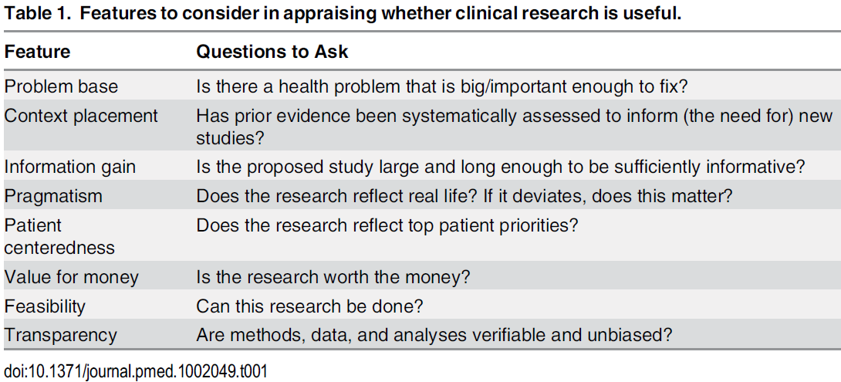
Usefulness features per Ioannidis
Ioannidis JPA (2016) Why Most Clinical Research Is Not Useful.
PLoS Med 13(6): e1002049.
https://doi.org/10.1371/journal.pmed.1002049

Slide 19
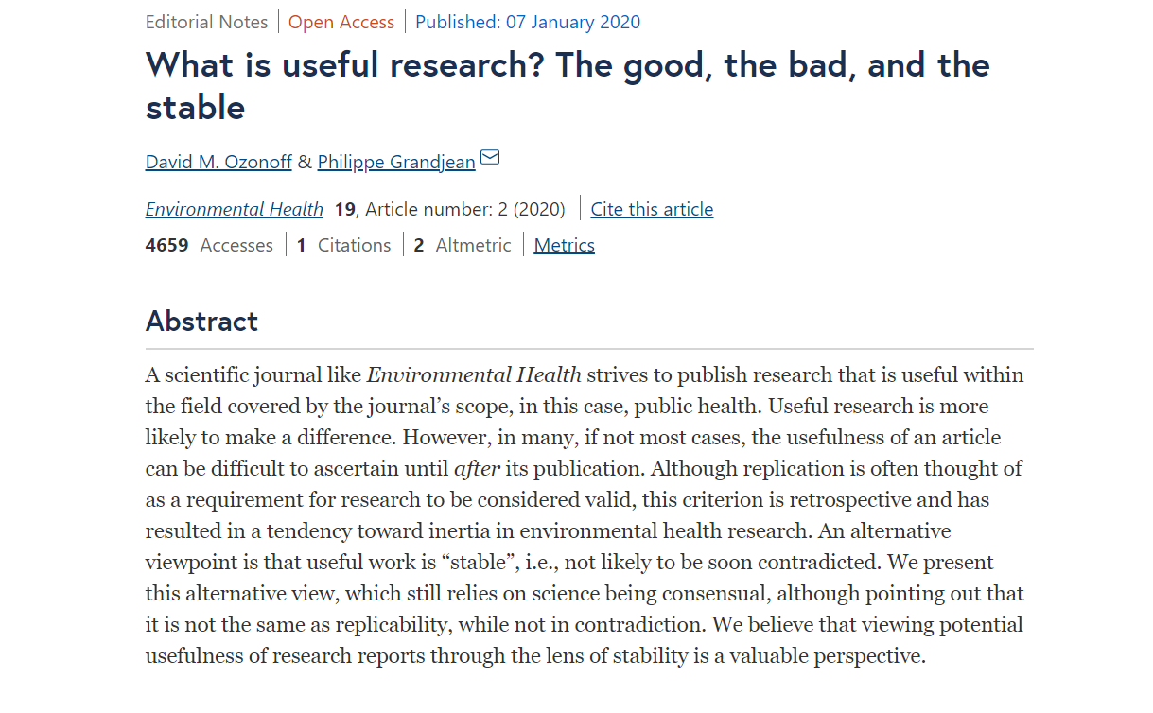
https://ehjournal.biomedcentral.com/articles/10.1186/s12940-019-0556-5

Slide 20
Research topics of ‘utter importance’ (2002)
Conception, structuring and testing of:
  comprehensive electronic patient records suitable for direct patient care and secondary use;
  information system architectures that support co-operative patient-centered cross-institutional care;
  system architectures for ‘knowledge centers’ offering specialized medical knowledge world-wide;
  methods for medical data mining aimed at clinical and epidemiological research, as well as health reporting;
  Comprehensive practically useful and mobile ICT tools for patient care.
Reinhold Haux, Elske Ammenwerth, Werner Herzog, Petra Knaup, Health care in the information society. A prognosis for the year 2013,
International Journal of Medical Informatics, Volume 66, Issues 1–3, 2002, Pages 3-21, ISSN 1386-5056,
https://doi.org/10.1016/S1386-5056(02)00030-8

Slide 21
Some questions asked to a panel (2017)
What are highly original and relevant research fields for BMI which are not adequately addressed by current medical informatics research?
Which methodological or technical approaches are insufficiently used in trying to solve highly original and relevant research questions in our field?
Do we know about or can we guess at reasons for the above?
What could be consequences of change for research strategies?
What could be consequences of change on the knowledge and skills that have to be included in educational programs and courses in BMI?
Haux R, Kulikowski CA, Bakken S, et al. Research Strategies for Biomedical and Health Informatics. Some Thought-provoking and Critical Proposals to Encourage Scientific Debate on the Nature of Good Research in Medical Informatics.
Methods Inf Med. 2017;56(S 01):e1-e10. Published 2017 Jan 25. doi:10.3414/ME16-01-0125
https://www.ncbi.nlm.nih.gov/pmc/articles/PMC5388922/?tool=pmcentrez

Slide 22
Some remarkable opinions
‘discovery and intervention research in BMHI often lack a solid theoretical foundation’,
‘BMHI needs development and testing of middle range theories as strategy for knowledge building and advancing the field as a scientific discipline’,
‘there is a large difference in sense of values between scientists and engineers’,
‘we have to think about the principles of setting up a research question’,
‘we should ask more questions to scrutinize our assumptions’,
‘more research on hypothesis generation and problem solving’,
‘research should always rest on “methodologies that capture the processes integral to applications, the users and the world in which the users function”’
Haux R, Kulikowski CA, Bakken S, et al. Research Strategies for Biomedical and Health Informatics. Some Thought-provoking and Critical Proposals to Encourage Scientific Debate on the Nature of Good Research in Medical Informatics.
Methods Inf Med. 2017;56(S 01):e1-e10. Published 2017 Jan 25. doi:10.3414/ME16-01-0125
https://www.ncbi.nlm.nih.gov/pmc/articles/PMC5388922/?tool=pmcentrez

Slide 23
Some suggested causes
‘education programs emphasize the engineering rather than scientific aspects of the discipline’,
‘failure to define our discipline and its sub-disciplines and their core theory’,
‘reluctance of reporting non-positive results, though there are many learnable failures’,
‘the field tends to accept the technologies of vendors with minimal questioning or change in current practices’,
‘the research is focused mainly on the applications either to develop them or to evaluate them, hence missing the main goal which is that research is required to verify the theory or to develop new theory’,
‘we incline to do as we were taught or told, that we rather run with the pack and may over time become ‘comfortably numb’’.
Haux R, Kulikowski CA, Bakken S, et al. Research Strategies for Biomedical and Health Informatics. Some Thought-provoking and Critical Proposals to Encourage Scientific Debate on the Nature of Good Research in Medical Informatics.
Methods Inf Med. 2017;56(S 01):e1-e10. Published 2017 Jan 25. doi:10.3414/ME16-01-0125
https://www.ncbi.nlm.nih.gov/pmc/articles/PMC5388922/?tool=pmcentrez

Slide 24

‘I did it their way’ (song for students)
https://www.youtube.com/watch?v=ifOBvExZOXI

Slide 25

Why the majority is always wrong
https://www.youtube.com/watch?v=VNGFep6rncY

Slide 26
Selecting a topic
What should be researched in BMI?
Am I able to make a good choice?

Slide 27
Scientific Objectivity (1)
Objectivity as Faithfulness to Facts
Objectivity as Absence of Normative Commitments and the Value-Free Ideal
Objectivity as Freedom from Personal Biases
  Measurement and Quantification
  Inductive and Statistical Inference

Slide 28
Scientific Objectivity (2)
Science is objective in that, or to the extent that:
its products—theories, laws, experimental results and observations—constitute accurate representations of the external world. The products of science are not tainted by human desires, goals, capabilities or experience.
  product objectivity
the processes and methods that characterize it neither depend on contingent social and ethical values, nor on the individual bias of a scientist
  → process objectivity.
http://plato.stanford.edu/entries/scientific-objectivity

Slide 29
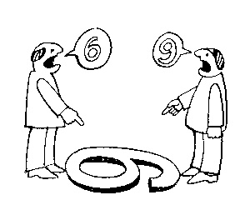
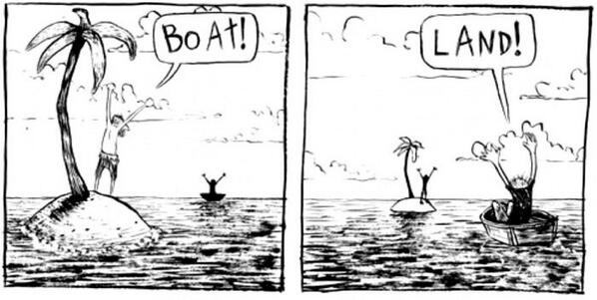
The view from nowhere
There are two kinds of qualities:
ones that vary with the perspective one has or takes, and,
ones that remain constant through changes of perspective. The latter are the objective properties.
http://plato.stanford.edu/entries/scientific-objectivity

Slide 30
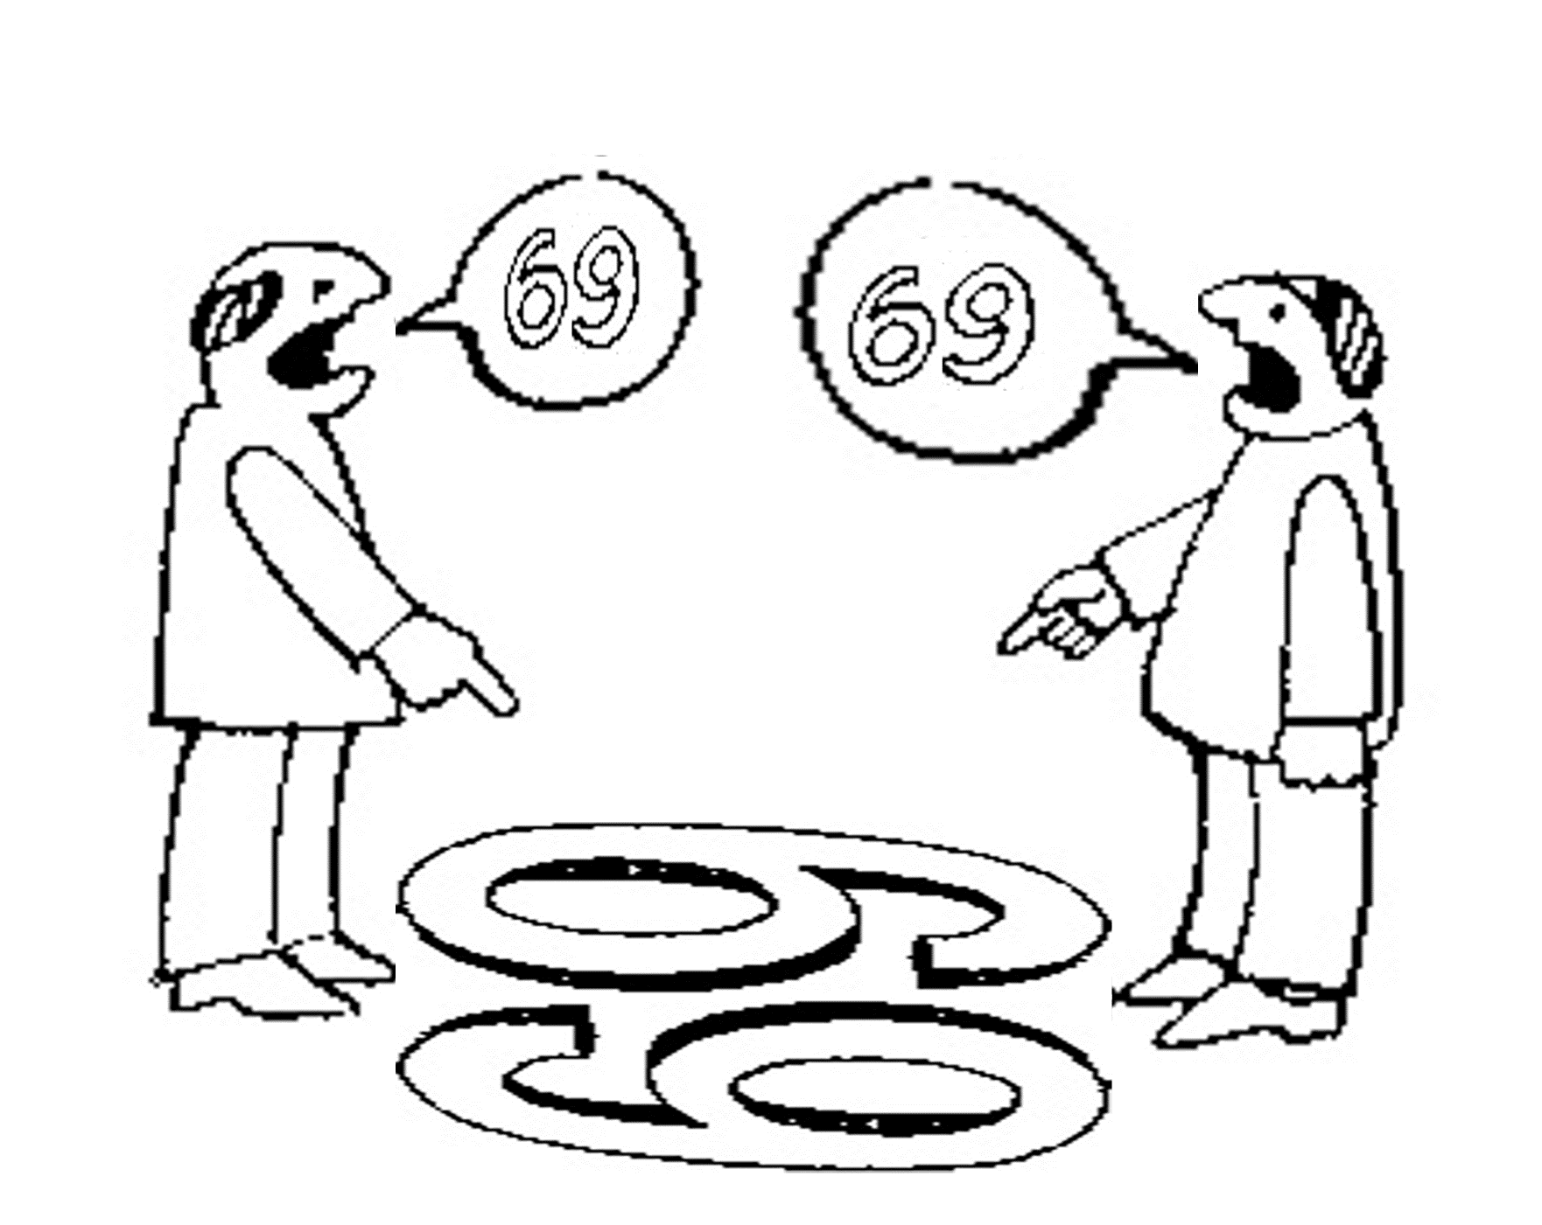
To sharpen your critical thinking: is there scientific objectivity here?
sixty
nine
sixty
nine

Slide 31
Impact of value(s) on science
the choice of a scientific research problem;
the gathering of evidence in relation to the problem;
the acceptance of a scientific hypothesis or theory as an adequate answer to the problem on the basis of the evidence;
the proliferation and application of scientific research results.
(Weber 1917 [1988]).
http://plato.stanford.edu/entries/scientific-objectivity

Slide 32
Value types
Scientific values:
  Accuracy, simplicity, …
Epistemic (or cognitive) values:
  predictive accuracy, scope, unification, explanatory power, coherence with other accepted theories, …
Contextual (non-cognitive) values:
  moral, personal, social, political and cultural values such as pleasure, justice and equality, conservation of the natural environment, diversity, …
http://plato.stanford.edu/entries/scientific-objectivity

Slide 33
Three theses
Value-Free Ideal (VFI):
    Scientists should strive to minimize the influence of contextual values on scientific reasoning, e.g., in gathering evidence and assessing/accepting scientific theories.
    scientific objectivity is characterized by absence of contextual values and by exclusive commitment to epistemic values in scientific reasoning.
Value-Neutrality Thesis (VNT):
    Scientists can—at least in principle—gather evidence and assess/accept theories without making contextual value judgments.
Value-Laden Thesis (VLT):
    Scientists cannot gather evidence and assess/accept theories without making contextual value judgments.
http://plato.stanford.edu/entries/scientific-objectivity

Slide 34
What type of study?

Slide 35
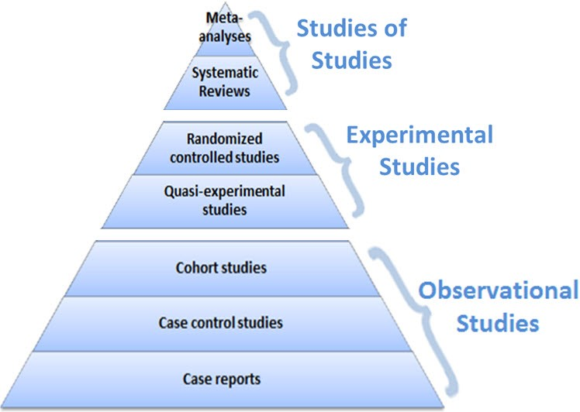
Study type and level of evidence
Evidence
level
https://guides.library.vcu.edu/humphrey/journal-club

Slide 36
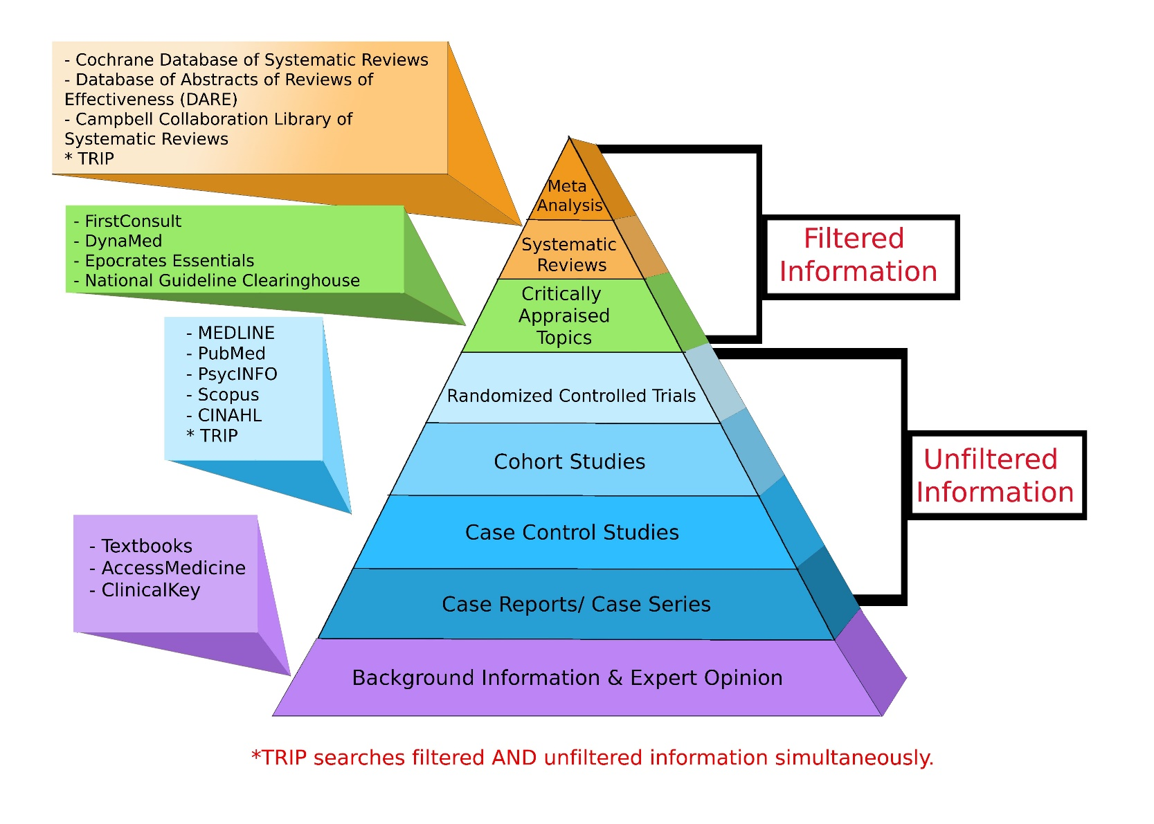
Where to search
http://libguides.gwumc.edu/ebm/studytypes

Slide 37
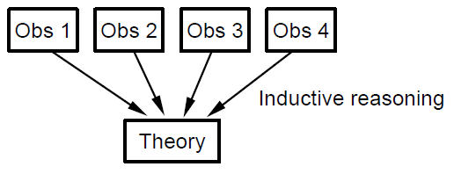
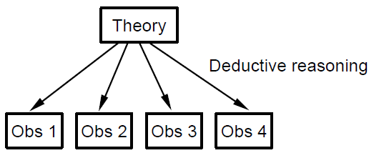
Theory building versus testing
Theory building
Theory testing

Slide 38
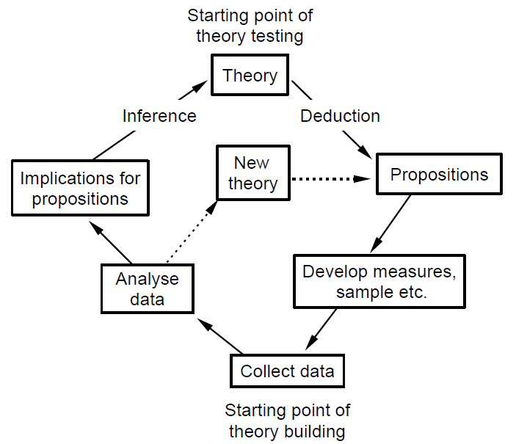
Logic of scientific research
https://www.nyu.edu/classes/bkg/methods/005847ch1.pdf

Slide 39
Time perspective of what is studied
Past
Present
Future

Slide 40
BMI = multidisciplinary, yet …
‘Too often, research on information and communication technologies in the health sector appears to miss either the health problem or the information technology problem.’
‘If the research does not capture the processes integral to both the world of health science and the world of information science, valuable efforts are expended developing applications that do not address the intended problem.’
Gray K, Sockolow P.
Conceptual Models in Health Informatics Research: A Literature Review and Suggestions for Development. JMIR Med Inform. 2016 Feb 24;4(1):e7. doi: 10.2196/medinform.5021.
PMID: 26912288; PMCID: PMC4785238.
https://www.ncbi.nlm.nih.gov/pmc/articles/PMC4785238/

Slide 41

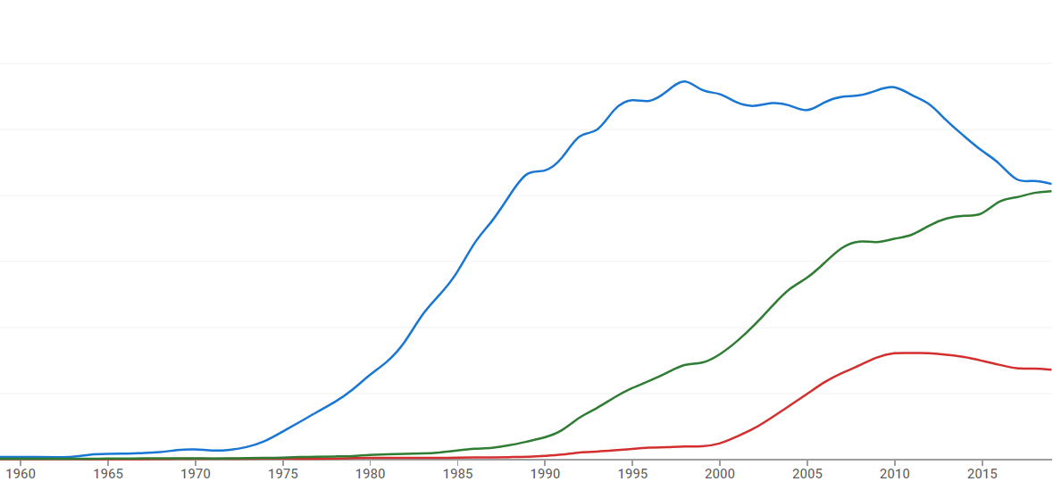
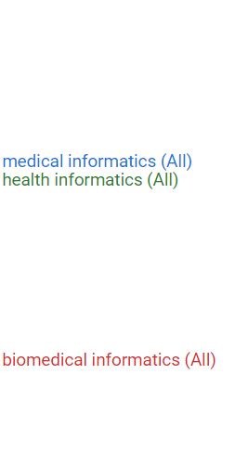
Mentions in Google Books
https://books.google.com/ngrams/graph?content=medical+informatics%2Cbiomedical+informatics%2Chealth+informatics&year_start=1950&year_end=2019&corpus=26&smoothing=3&case_insensitive=true

Slide 42
7-step methodology for developing conceptual models in health informatics research
acknowledging the limitations of health science and information science conceptual models;
giving a rationale for one’s choice of integrative conceptual model;
explicating a conceptual model verbally and graphically;
seeking feedback about the conceptual model from stakeholders in both the health science and information science domains;
aligning a conceptual model with an appropriate research design;
adapting a conceptual model in response to new knowledge over time; and
disseminating conceptual models in scholarly and scientific forums.
Gray K, Sockolow P.
Conceptual Models in Health Informatics Research: A Literature Review and Suggestions for Development. JMIR Med Inform. 2016 Feb 24;4(1):e7. doi: 10.2196/medinform.5021.
PMID: 26912288; PMCID: PMC4785238.
https://www.ncbi.nlm.nih.gov/pmc/articles/PMC4785238/

Slide 43
7-step methodology for developing conceptual models in health informatics research
acknowledging the limitations of health science and information science conceptual models;
giving a rationale for one’s choice of integrative conceptual model;
explicating a conceptual model verbally and graphically;
seeking feedback about the conceptual model from stakeholders in both the health science and information science domains;
aligning a conceptual model with an appropriate research design;
adapting a conceptual model in response to new knowledge over time; and
disseminating conceptual models in scholarly and scientific forums.
Gray K, Sockolow P.
Conceptual Models in Health Informatics Research: A Literature Review and Suggestions for Development. JMIR Med Inform. 2016 Feb 24;4(1):e7. doi: 10.2196/medinform.5021.
PMID: 26912288; PMCID: PMC4785238.
https://www.ncbi.nlm.nih.gov/pmc/articles/PMC4785238/

Slide 44
Goal of Research Design
to ensure that the data obtained enable the researcher to effectively address the research problem logically and as unambiguously as possible.

Slide 45
Distinct research purpose → distinct design
to describe and understand some phenomenon in its natural context
  → Descriptive Study
to look for an association among variables by studying the situation without managing any intervention
  → Observational or Epidemiological Study
to determine the effect of a specified intervention (e.g., protocol, method, or treatment) managed by the investigator
  → Experimental Trial
to validate a test, tool or diagnostic method
  → Diagnostic, Validity or Reliability Study
Adapted from: Research Design Algorithm developed by the American Dietetic Association, 2010
https://www.andeal.org/vault/2440/web/files/Research_Design_Algorithm.pdf

Slide 46
Research Design: what and what parts
The plans and procedures for research that span the steps from broad assumptions to detailed methods of data collection, analysis, and interpretation.
Decision to select a design must be informed by:
  research problem, esp. its nature,
  worldviews: the philosophical assumptions the researcher brings to the study;
  methodology: procedures of inquiry (quantitative / qualitative / mixed)
  research methods: how to conduct data collection, analysis, and interpretation.
Adapted from: Creswell, Research Design, Los Angeles, 2014
https://www.amazon.com/Research-Design-Qualitative-Quantitative-Approaches/dp/1452226105

Slide 47
Design versus methodology
Research design | Research methodology
Focuses on the end-product: What kind of study is being planned and what kind of results are aimed at. E.g. Historical - comparative study, interpretive approach OR exploratory study, inductive and deductive etc. | Focuses on the research process and the kind of tools and procedures to be used. E.g. Document analysis, survey methods, analysis of existing (secondary) data/statistics etc.)
Point of departure (driven by) = Research problem or question. | Point of departure (driven by) = Specific tasks (data collection or sampling) at hand.
Focuses on the logic of research: What evidence is required to address the question adequately? | Focuses on the individual (not linear) steps in the research process and the most ‘objective’ (unbiased) procedures to be employed.
Dr Brian van Wyk. Research design and methods; Part I.
https://www.uwc.ac.za/Students/Postgraduate/Documents/Research_and_Design_I.pdf

Slide 48
Design types by research method
Quantitative | Qualitative | Mixed Methods
Experimental designs Nonexperimental designs, such as surveys | Narrative research Phenomenology Grounded theory Ethnographies Case study | Convergent Explanatory sequential Exploratory sequential Transformative, embedded, or multiphase
Adapted from: Creswell, Research Design, Los Angeles, 2014, p12
https://www.amazon.com/Research-Design-Qualitative-Quantitative-Approaches/dp/1452226105

Slide 49
Experiment
Non-experimental design:
  compare people who signed up for a program vs. people who did not sign up for any program.
  people who sign up may be different from those who don’t sign up.
Experimental design:
  Researcher randomly assigns people with alcoholism to treatment or no treatment
  Determination of cause and effect variable.

Slide 50
Quantitative, qualitative and mixed methods
Quantitative methods | Qualitative methods | Mixed methods
Predetermined methods | Emerging methods | Both predetermined and emerging methods
Instrument based questions | Open-ended questions | Both open- and closed-ended questions
Observational data, performance data, attitude data, and census data | Interview data, observation data, document data, and audiovisual data | Multiple forms of data drawing on all possibilities
Statistical analysis | Text and image analysis | Statistical and text analysis
Statistical interpretation | Themes, patterns interpretation | Integration of multiple interpretations

Slide 51
Qualitative research
Goals:
  exploring and understanding the meaning individuals or groups ascribe to a social or human problem;
  rendering the complexity of a situation.
Process of research:
  focus on emerging questions and procedures,
  data typically collected in the participant’s setting,
  data analysis inductively building from particulars to general themes,
  the researcher makes interpretations of the meaning of the data.
  flexible structure of research report.
Creswell, Research Design, Los Angeles, 2014, p12
https://www.amazon.com/Research-Design-Qualitative-Quantitative-Approaches/dp/1452226105

Slide 52
Characteristics of qualitative research
Purpose | Understanding - Seeks to understand people’s interpretations.
Reality | Dynamic [in an odd sense] – ‘Reality changes with changes in people’s perceptions’.
Viewpoint | Insider - Reality is what people perceive it to be.
Values | Value bound - Values will have an impact and should be understood and taken into account when conducting and reporting research.
Focus | Holistic - A total or complete picture is sought.
Orientation | Discovery - Theories and hypotheses are evolved from data as collected.
Data | Subjective - Data are perceptions of the people in the environment.
Instrumentation | Human - The human person is the primary collection instrument.
Conditions | Naturalistic - Investigations are conducted under natural conditions.
Results | Valid [if done lege artis] - The focus is on design and procedures to gain "real," "rich," and "deep" data.
http://www.okstate.edu/ag/agedcm4h/academic/aged5980a/5980/newpage21.htm ‘[…]’: my comments

Slide 53
Different types of qualitative study design
Ethnography:
  Portrait of people-study of the story and culture of a group usually to develop cultural awareness and sensitivity;
Phenomenology:
  Study of individual’s lived experiences of events-e.g. the experience of AIDS care;
Grounded Theory:
  Going beyond adding to the existing body of knowledge-developing a new theory about a phenomenon-theory grounded on data;
Participatory action research:
  Individuals & groups researching their own personal beings, socio-cultural settings and experiences;
Case study:
  In-depth investigation of a single or small number of units at a point (over a period) in time.
Joan LaFrance. Fundamentals of Qualitative Research. AIHEC NARCH Meeting DinѐCollege. June 25, 2015
http://www.aihec.org/our-stories/docs/BehavioralHealth/2015/11_FundamentalsOfQualitativeResearch-DrLaFrance.pdf

Slide 54
Types of Data Collection in QLRM
}
Questionnaire
Interviews ‘surveys’
Focus groups
Observation
(Data) extraction
Secondary data sources
Ethnography
MC. Harrell & MA. Bradley. Data Collection Methods: Semi-Structured Interviews and Focus Groups. RAND Corporation 2009. http://www.rand.org/pubs/technical_reports/TR718.html

Slide 55
Questionnaire, Interview, or Focus Group?
Characteristics of research | Q | I | FG
Depth of information required |  | + | +
Need to resolve (seemingly) conflicting information |  | + | +
Relative importance attached by sources to issue | + | +
Generalizability of findings | + | +
Timeliness of results |  | + | +
Sensitivity of the issue researched | + | +

Slide 56
Questionnaire, Interview, or Focus Group?
Characteristics of research | Q | I | FG
Depth of information required |  | + | +
Need to resolve (seemingly) conflicting information |  | + | +
Relative importance attached by sources to issue | + | +
Generalizability of findings | + | +
Timeliness of results |  | + | +
Sensitivity of the issue researched | + | +
When in doubt which one to select, go for: ….
interviews

Slide 57
Steps for questionnaire-based surveys
Write out the primary and secondary aims of the study.
Identify the data elements to be collected relating to these aims.
Review the current literature to identify already validated questionnaires that use these or similar data elements.
Compose a draft of the questionnaire.
Solicit some advice on the draft and adjust accordingly.
Test it out in a small sample and adjust again.
Finalize and roll out.

Slide 58
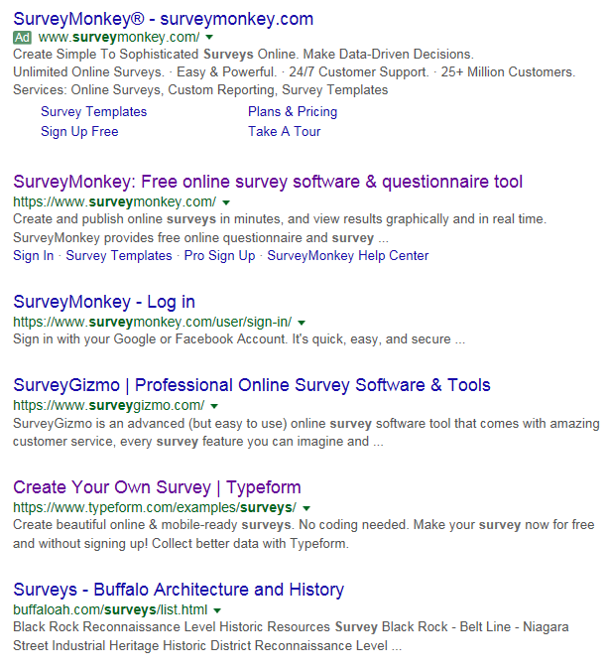
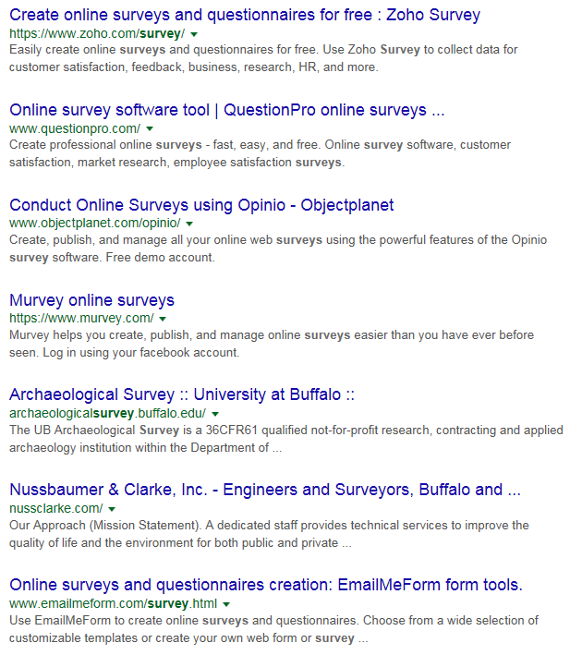
Web surveys, anything more popular?

Slide 59
Pros and cons of questionnaires
Advantages:
good for gathering descriptive data,
can cover a wide range of topics,
are relatively inexpensive to use,
may provide anonymity,
can be analyzed using a variety of existing software.
Disadvantages:
Self-report may lead to biased reporting;
Data may provide a general picture but lack depth;
May not provide adequate information on context.
NSF. The 2002 User Friendly Handbook for Project Evaluation. Section III - An Overview of Quantitative and Qualitative Data Collection Methods. https://www.nsf.gov/pubs/2002/nsf02057/nsf02057_4.pdf

Slide 60
Questions (generally) to be avoided
Double-barreled:
    two questions in one;
Leading:
    Suggest answers in a certain direction;
Use of double negatives;
Use unfamiliar jargon or technical terms;
Vague questions;
Use of emotional language;
Questions beyond the respondent’s capability to answer.
MC. Harrell & MA. Bradley. Data Collection Methods: Semi-Structured Interviews and Focus Groups. RAND Corporation 2009. http://www.rand.org/pubs/technical_reports/TR718.htm l

Slide 61
Some types of open-ended questions
Hypothetical:
    If you get the chance to be a Covid-19 scientist, do you think you can discover a vaccine for the virus?
Provocative:
    I have heard people saying most evaluations are subjective-what do you think?
Ideal:
    In your opinion, what would be the best solution for making EHR systems more useful for secondary data analysis?
Interpretative:
    What do you mean by a ‘user-friendly EHR system’ ?
Adapted from: MC. Harrell & MA. Bradley. Data Collection Methods: Semi-Structured Interviews and Focus Groups. RAND Corporation 2009. http://www.rand.org/pubs/technical_reports/TR718.html

Slide 62
Data extraction
Select text to examine;
Identify themes;
Build codebook;
Tag text for themes;
Search for subthemes;
Search for patterns among themes:
    Examine distribution of themes across types of people/cases;
    Examine relationships among themes (potential hypotheses).
MC. Harrell & MA. Bradley. Data Collection Methods: Semi-Structured Interviews and Focus Groups. RAND Corporation 2009. http://www.rand.org/pubs/technical_reports/TR718.html

Slide 63
Data extraction: code assignment
Aboutness:
  Characteristics of respondents,
  Topics researched.
Form:
  Meaningless,
  Taxonomic.
Organization:
  Categorical,
  Broader – narrower,
  Subsumption.
‘Coding tree’

Slide 64
Rating scale requirements
It should be easy to interpret the meaning of each scale point.
The meaning of scale points should be interpreted identically by all respondents.
The scale should give enough points to differentiate respondents from one another as much as validly possible.
Responses to the survey rating scale should be reliable, meaning that if we give the same question again, each respondent should provide the same answer.
The scale’s points should map as closely as possible to the underlying idea (construct) of the scale.
https://www.qualtrics.com/blog/three-tips-for-effectively-using-scale-point-questions/

Slide 65

Number of scale points
For constructs that range from positive to negative (bi-polar constructs): use a 1-7 point scale that includes a middle or neutral point.
For constructs that range from zero to positive (unipolar constructs): use a 1-5 point scale.
https://www.qualtrics.com/blog/three-tips-for-effectively-using-scale-point-questions/

Slide 66
Quantitative research
Goals:
  testing objective theories deductively by examining the relationship among variables;
  being able to generalize and replicate the findings.
Process of research:
  measuring variables, typically on instruments, so that numbered data can be analyzed using statistical procedures;
  building in protections against bias;
  controlling for alternative explanations.
  the final written report has a set structure consisting of introduction, literature and theory, methods, results, and discussion.
Creswell, Research Design, Los Angeles, 2014
https://www.amazon.com/Research-Design-Qualitative-Quantitative-Approaches/dp/1452226105

Slide 67
Mixed methods research
Goal:
  Obtain a deeper and more complete understanding of a research problem than either approach alone.
Process of research:
  collecting both quantitative and qualitative data,
  integrating the two forms of data, and
  using distinct designs that may involve different philosophical assumptions and theoretical frameworks.
Creswell, Research Design, Los Angeles, 2014
https://www.amazon.com/Research-Design-Qualitative-Quantitative-Approaches/dp/1452226105

Slide 68
Various mixed method designs
Convergence: using both types to answer the same question, through comparison of results to see if they reach the same conclusion (triangulation) or by converting a data set from one type into another.
Complementarity: using each method to answer a related question or series of questions for purposes of evaluation or elaboration.
Expansion: using one type to answer questions raised by the other type.
Development: using one type to answer questions that will enable use of the other method to answer other questions.
Sampling: using one type to define or identify the participant sample for collection and analysis of data representing the other type.
Palinkas et. al. Mixed Method Designs in Implementation Research.
Adm Policy Ment Health (2011) 38:44–53 https://pubmed.ncbi.nlm.nih.gov/20967495/

Slide 69
Comparison of research processes
Quantitative Methods | Mixed Methods | Qualitative Methods
Pre-determined methods Instrument based questions Performance data, attitude data, observational data, and census data Statistical analysis Statistical interpretation | Both predetermined and emerging Both open- and closed-ended questions Multiple forms of data drawing on all possibilities Statistical and text analysis Across databases interpretation | Emerging methods Open-ended questions Interview data, observation data, document data, and audiovisual data Text and image analysis Themes, patterns interpretation
Creswell JW. Research design : qualitative, quantitative, and mixed methods approaches— 4th ed. Sage Publications, 2014, p17.

Slide 70
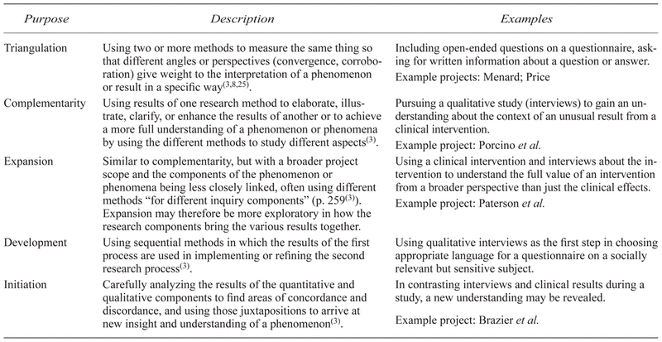
Some purposes of mixed methods
Greene JC, Caracelli VJ, Graham WF. Toward a conceptual framework for mixed-method evaluation designs. Educ Eval Policy Anal 1989; 11(3): 255–274.

Slide 71
Working with the data sets
Merge
  Merge or converge the two datasets by actually bringing them together (e.g., convergence—triangulation to validate one dataset using another type of dataset)
Connect
  Have one dataset build upon another data set (e.g., complementarity—elaboration, transformation, expansion, initiation or sampling)
Embed
  Conduct one study within another so that one type of data provides a supportive role to the other dataset (e.g., complementarity—evaluation)
Palinkas et. al. Mixed Method Designs in Implementation Research.
Adm Policy Ment Health (2011) 38:44–53 https://pubmed.ncbi.nlm.nih.gov/20967495/

Slide 72
Convergent parallel mixed methods (1)
Key assumption:
Both qualitative and quantitative data provide different types of information—often detailed views of participants qualitatively and scores on instruments quantitatively—and together they yield results that should be the same.
Creswell, Research Design, Los Angeles, 2014
https://www.amazon.com/Research-Design-Qualitative-Quantitative-Approaches/dp/1452226105

Slide 73
Sequential designs
Explanatory sequential mixed methods
Exploratory sequential mixed methods
Creswell, Research Design, Los Angeles, 2014
https://www.amazon.com/Research-Design-Qualitative-Quantitative-Approaches/dp/1452226105

Slide 74
Concurrent design
Creswell, Research Design, Los Angeles, 2014
https://www.amazon.com/Research-Design-Qualitative-Quantitative-Approaches/dp/1452226105

Slide 75
Research process plan

Slide 76
Steps in research data analysis
Specify the question you are asking.
Put the question in the form of a null hypothesis and alternative hypothesis.
Determine which variables are relevant to the question.
Determine what kind of variable each one is.
Put the question in the form of a statistical null hypothesis and alternative hypothesis.
Design an experiment that controls or randomizes the confounding variables.
Based on the number of variables, the kinds of variables, the expected fit to the parametric assumptions, and the hypothesis to be tested, choose the best statistical test to use.
If possible, do a power analysis to determine a good sample size for the experiment.
Do the experiment.
Examine the data to see if it meets the assumptions of the statistical test you chose. If it doesn't, choose a more appropriate test.
Apply the statistical test you chose, and interpret the results.
Communicate your results effectively, usually with a graph or table.
John H. McDonald. The Handbook of Biological Statistics ©. 2014. http://www.biostathandbook.com/

Slide 77
Steps in research data analysis
Specify the question you are asking.
Put the question in the form of a null hypothesis and alternative hypothesis.
Determine which variables are relevant to the question.
Determine what kind of variable each one is.
Put the question in the form of a statistical null hypothesis and alternative hypothesis.
Design an experiment that controls or randomizes the confounding variables.
Based on the number of variables, the kinds of variables, the expected fit to the parametric assumptions, and the hypothesis to be tested, choose the best statistical test to use.
If possible, do a power analysis to determine a good sample size for the experiment.
Do the experiment.
Examine the data to see if it meets the assumptions of the statistical test you chose. If it doesn't, choose a more appropriate test.
Apply the statistical test you chose, and interpret the results.
Communicate your results effectively, usually with a graph or table.
John H. McDonald. The Handbook of Biological Statistics ©. 2014. http://www.biostathandbook.com/

Slide 78
Framing the research question: PICO(TT)
P | Patient Population of patients Problem | What is the best way to briefly describe this patient population or situation? E.g. pregnant women over 40 with preeclampsia, adolescent boys 13-15, etc.
I | Intervention (therapy or test) | What is the intervention? E.g. a drug, a questionnaire, a test, a procedure, etc.
C | Comparison | Is there an alternative intervention to compare to? E.g. placebo, current standard of care, another therapy, etc.
O | Outcome | Include specific patient-oriented outcomes E.g. morbidity, quality of life, etc.
T | Time for completion | Used to identify the time/duration for your data collection or for assessing your outcome. I.e. how long before you are to see that the intervention is having a positive impact OR the time in which the intervention will be delivered
T | Type of study | What is the ideal study design to answer this question? What type of study design do you realistically anticipate finding? E.g. randomized-controlled trial, systematic reviews, etc.
https://www.fda.gov/media/109448/download

Slide 79
Evidence Based Medicine question types
Intervention/Therapy
Etiology
Diagnosis
Prognosis/Prediction
Meaning
https://www.aaacn.org/sites/default/files/documents/misc-docs/1e_PICOT_Questions_template.pdf

Slide 80
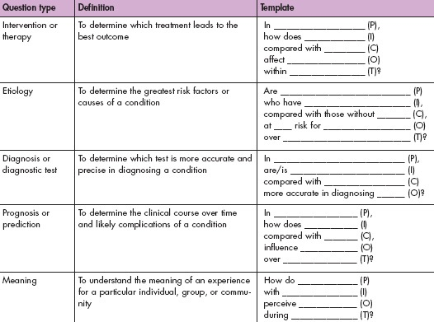
https://www.aaacn.org/sites/default/files/documents/misc-docs/1e_PICOT_Questions_template.pdf

Slide 81
Steps in research data analysis
Specify the question you are asking.
Put the question in the form of a null hypothesis and alternative hypothesis.
Determine which variables are relevant to the question.
Determine what kind of variable each one is.
Put the question in the form of a statistical null hypothesis and alternative hypothesis.
Design an experiment that controls or randomizes the confounding variables.
Based on the number of variables, the kinds of variables, the expected fit to the parametric assumptions, and the hypothesis to be tested, choose the best statistical test to use.
If possible, do a power analysis to determine a good sample size for the experiment.
Do the experiment.
Examine the data to see if it meets the assumptions of the statistical test you chose. If it doesn't, choose a more appropriate test.
Apply the statistical test you chose, and interpret the results.
Communicate your results effectively, usually with a graph or table.
John H. McDonald. The Handbook of Biological Statistics ©. 2014. http://www.biostathandbook.com/

Slide 82
Steps in research data analysis
Specify the question you are asking.
Put the question in the form of a null hypothesis and alternative hypothesis.
Determine which variables are relevant to the question.
Determine what kind of variable each one is.
Put the question in the form of a statistical null hypothesis and alternative hypothesis.
Design an experiment that controls or randomizes the confounding variables.
Based on the number of variables, the kinds of variables, the expected fit to the parametric assumptions, and the hypothesis to be tested, choose the best statistical test to use.
If possible, do a power analysis to determine a good sample size for the experiment.
Do the experiment.
Examine the data to see if it meets the assumptions of the statistical test you chose. If it doesn't, choose a more appropriate test.
Apply the statistical test you chose, and interpret the results.
Communicate your results effectively, usually with a graph or table.
John H. McDonald. The Handbook of Biological Statistics ©. 2014. http://www.biostathandbook.com/

Slide 83
Kinds of variables
Can be classified along several axes, but most importantly:
  Dependent versus independent,
  Level of measurement,
  Discrete or continuous.
All variables need to be extremely precisely defined and described!!!

Slide 84
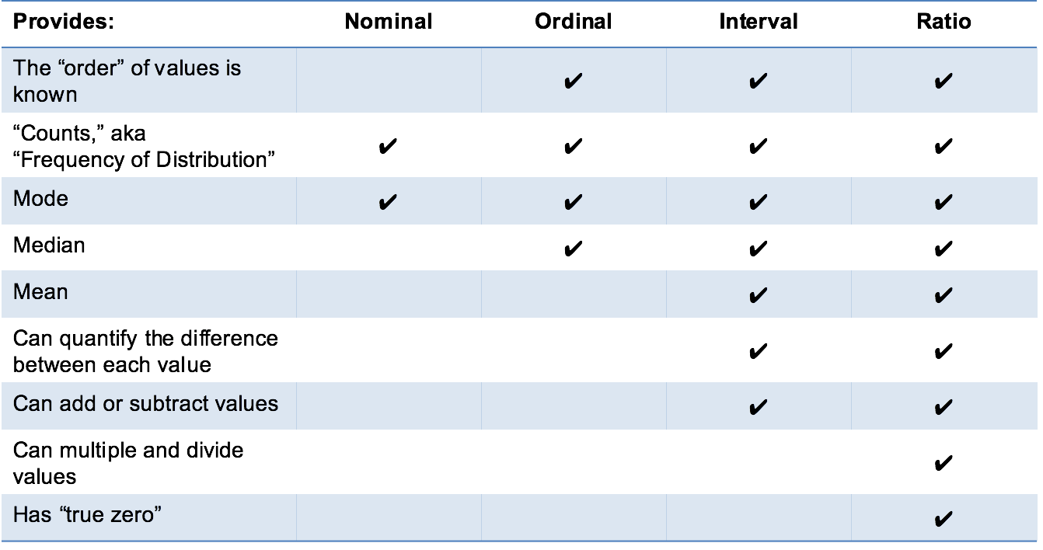
Levels of measurement
http://www.mymarketresearchmethods.com/types-of-data-nominal-ordinal-interval-ratio/

Slide 85
Clarify variables in terms of what and how.
Meaningful label:
  Short term that functions as a name to identify the perspective in communications about the research.
Theoretical definition:
  Description that specifies what sort of PoR the defining researcher carved out through the perspective.
Operational definition:
  Description intended to allow other researchers
    (a) to observe (in case of concepts) the intended PoRs from the very same perspective objectively or,
    (b) to build (in case of constructs) the perspective in exactly the same way as intended.
Adapted from: James H. Watt and Sjef van den Berg. Research Methods For Communication Science. 2002
http://www.cios.org/readbook/rmcs/rmcs.htm

Slide 86
Requirements for operational definitions
Must contain instructions as precisely as possible for observations/calculations to be done repeatably and objectively;
Must specify:
  how observations are to be done, and calculations or logical combinations to be performed,
  units of measurements,
  level of measurement:
    categorical , … ?
Correspondence between theoretical and operational definition establishes the validity of the measurements.
Adapted from: James H. Watt and Sjef van den Berg. Research Methods For Communication Science. 2002
http://www.cios.org/readbook/rmcs/rmcs.htm

Slide 87

Relationship with reality
Referents
Window on reality
References
  Portions of Reality ‘in focus’
  unit of analysis
  Perspective
  Label
  Definitions:
  Variable
  Values
  Face validity
  Theoretical
  definition
  Operational
  definition
  Measurement validity
Adapted from: James H. Watt and Sjef van den Berg. Research Methods For Communication Science. 2002
http://www.cios.org/readbook/rmcs/rmcs.htm

Slide 88
Example
Variable: SPPC
Label: Satisfaction with Primary Physician Communication
Operational definition 1 (nominal level of measurement)
    Response to the question: Do you feel that most of the time your communication with your primary physician is satisfactory?
    (a) YES or (b) NO
Operational definition 2 (ordinal level of measurement)
    Response to the question: Do you feel that most of the time your communication with your primary physician is:
    (a) very satisfactory (d) somewhat unsatisfactory
    (b) somewhat satisfactory (e) very unsatisfactory
    (c) neither
exhibits variation in
values
Adapted from: James H. Watt and Sjef van den Berg. Research Methods For Communication Science. 2002
http://www.cios.org/readbook/rmcs/rmcs.htm

Slide 89
Steps in research data analysis
Specify the question you are asking.
Put the question in the form of a null hypothesis and alternative hypothesis.
Determine which variables are relevant to the question.
Determine what kind of variable each one is.
Put the question in the form of a statistical null hypothesis and alternative hypothesis.
Design an experiment that controls or randomizes the confounding variables.
Based on the number of variables, the kinds of variables, the expected fit to the parametric assumptions, and the hypothesis to be tested, choose the best statistical test to use.
If possible, do a power analysis to determine a good sample size for the experiment.
Do the experiment.
Examine the data to see if it meets the assumptions of the statistical test you chose. If it doesn't, choose a more appropriate test.
Apply the statistical test you chose, and interpret the results.
Communicate your results effectively, usually with a graph or table.
John H. McDonald. The Handbook of Biological Statistics ©. 2014. http://www.biostathandbook.com/

Slide 90
Statistical hypothesis
A statistical hypothesis is an assumption about a ‘population parameter’, i.e. a measurable characteristic of a population, such as a mean or a standard deviation.
This assumption may or may not be true.
Hypothesis testing refers to the formal procedures used by statisticians to accept or reject statistical hypotheses.
The best way to determine whether a statistical hypothesis is true would be to examine the entire population. Since that is often impractical, researchers typically examine a random sample from the population. If sample data are not consistent with the statistical hypothesis, the hypothesis is rejected.
http://stattrek.com/hypothesis-test/hypothesis-testing.aspx

Slide 91
Data and Reality
Referents
Window on reality
References
?
?
?
  ‘Average heart rate’

Slide 92
‘Scientific Laws’: a matter of relationships
Referents
Window on reality
References
  Portions of Reality
  ‘in focus’
  Perspective
  Variable
  Values
  How are these
  related?
  ‘Physical
  Exercise’
  ‘Heart rate’
  Working out
  Heart rate
  Relationship in reality (‘a priori relationship’)
  Relationships between variables

Slide 93
Relationships between variables
No relationship:
  ‘person length’ ‘body temperature’
Covariance relationship:
    a change in one variable is associated with a change in another variable (in whatever way)
    ‘person length’ ‘person mass’
Causal relationship:
    a change in one variable brings about a change in another variable (in whatever way)
    ‘physical exercise’ ‘heart rate’
    cause / independent variable effect / dependent variable
+
+

Slide 94
Requirements for causal relationships
Spatiotemporal contiguity:
    variables must be observed within units of analysis.
Covariance:
    the values of two variables must shift together in some systematic way.
Temporal ordering:
    a change in the cause variable must happen before the related change in the effect variable.
Necessary connection:
    A statement – the ‘theoretical linkage’ or ‘theoretical rationale’ - providing the justification for the posited causation within the theory.
Adapted from: James H. Watt and Sjef van den Berg. Research Methods For Communication Science. 2002
http://www.cios.org/readbook/rmcs/rmcs.htm

Slide 95
Observed relationships and reality
Referents
Window on reality
References
Physical exercise
‘Physical
exercise’
+
Heart
efficiency
+
+
-
Heart rate
under effort
+
Heart rate
at rest
‘Heart rate’

Slide 96
Observed relationships and reality
Referents
Window on reality
References
Physical exercise
‘Physical
exercise’
+
Heart
efficiency
theory
+
+
-
Heart rate
under effort
+
Heart rate
at rest
‘Heart rate’

Slide 97
‘Theoretical definition’ and
‘Theoretical linkage’
The ‘theoretical definition’:
  is a … description that specifies what sort of PoR the defining researcher carved out through the perspective.
  explains the nature of a PoR observed through a perspective.
The ‘theoretical linkage’:
  provides the justification for the posited causation within the theory;
  explains, as the product of a rational process, the nature of a relationship between two concepts/ constructs.

Slide 98
Observed relationships and reality
Referents
Window on reality
References
Physical exercise
Theoretical definition
‘Physical
exercise’
+
Heart
efficiency
Theoretical linkage
+
+
-
Operational linkage
Heart rate
under effort
+
Heart rate
at rest
‘Heart rate’

Slide 99
Without specifying the theoretical linkage, there is no value in p-values!
Referents
Window on reality
References
Physical exercise
Theoretical definition
‘Physical
exercise’
+
Heart
efficiency
Theoretical linkage
+
+
-
Operational linkage
Heart rate
under effort
+
Heart rate
at rest
‘Heart rate’

Slide 100
Steps in research data analysis
Specify the question you are asking.
Put the question in the form of a null hypothesis and alternative hypothesis.
Determine which variables are relevant to the question.
Determine what kind of variable each one is.
Put the question in the form of a statistical null hypothesis and alternative hypothesis.
Design an experiment that controls or randomizes the confounding variables.
Based on the number of variables, the kinds of variables, the expected fit to the parametric assumptions, and the hypothesis to be tested, choose the best statistical test to use.
If possible, do a power analysis to determine a good sample size for the experiment.
Do the experiment.
Examine the data to see if it meets the assumptions of the statistical test you chose. If it doesn't, choose a more appropriate test.
Apply the statistical test you chose, and interpret the results.
Communicate your results effectively, usually with a graph or table.
John H. McDonald. The Handbook of Biological Statistics ©. 2014. http://www.biostathandbook.com/

Slide 101
Some Data Quality Dimensions
Dimension | # cited | Dimension | # cited | Dimension | # cited
Accuracy | 25 | Format | 4 | Comparability | 2
Reliability | 22 | Interpretability | 4 | Conciseness | 2
Timeliness | 19 | Content | 3 | Freedom from bias | 2
Relevance | 16 | Efficiency | 3 | Informativeness | 2
Completeness | 15 | Importance | 3 | Level of detail | 2
Currency | 9 | Sufficiency | 3 | Quantitativeness | 2
Consistency | 8 | Usability | 3 | Scope | 2
Flexibility | 5 | Usefulness | 3 | Understandability | 2
Precision | 5 | Clarity | 2
Wang, R.Y., Storey, V.C., and Firth, C.P.
A framework for analysis of data quality research.
IEEE Trans. on Knowl. Data Eng. 7, 4 (1995), pp. 623–640.
https://web.mit.edu/tdqm/www/tdqmpub/SURVEYIEEEKDEAug95.pdf

Slide 102
Precision and accuracy of representations
Precision
  The degree to which distinct representations (references) about the same portion of reality (the referent) are similar when derived under similar circumstances.
Accuracy
  The degree to which a representation actually represents what it was intended to represent.
  How close is a representation to the truth?

Slide 103
Validity and reliability of representational methods/procedures
Validity
  The extent to which a method or procedure allows or is able to derive representations of what is intended to be represented.
Reliability
  The degree to which a method or procedure allows or is able to derive similar representations under similar circumstances.

Slide 104
Validity
Internal validity
  The method produces an accurate representation for the portion of reality under scrutiny.
External validity
  The method produces for all similar portions of reality representations which with respect to these portions of reality are accurate to the same degree.
  → generalizability

Slide 105
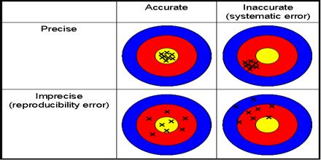
Error
Error: the difference between the representation and the referent

Slide 106
Error types
Random error:
  An error of a sort we can’t predict (even if we tried with all means possible)
  Only caused by chance.
→ contributes to reduction in precision
Systematic error:
  An error due to any cause other than sampling variability.
  → contributes to reduction in accuracy

Slide 107
‘Bias’
Most accurate, general determination:
Error introduced by lack of internal validity of a method which therefor produces inaccurate representations

Slide 108
Mainstream classification of bias types
Selection bias:
  distortion that results from the method by which referents are selected into the study population,
Information bias (also called misclassification bias):
  distortion that results from
    inaccuracies in the representation of referent characteristics,
    incorrect classification therefrom,
Confounding bias:
  distortion in the interpretation of representations due to failure to take into account the effect of non-represented portions of reality other than the represented referent(s).
Adapted from: Kleinbaum DG, Kupper LL, Morgenstern H. Epidemiologic research. Belmont, CA: Lifetime Learning Publications, 1982.
https://www.amazon.com/Epidemiologic-Research-Principles-Quantitative-Methods/dp/047128985X

Slide 109
Potential effects of biased methods
Need to be accounted for when distinctions in references are used as estimates for distinctions in referents assumed to exist because of some factor:
  Positive bias:
    The real distinction has a smaller magnitude than the estimated one.
  Negative bias:
    The real distinction is smaller than …
  Bias ‘away from the null’:
    The estimated distinction is further away from ‘no distinction’ than the real distinction is away from it.
  Bias ‘towards the null’:
    The estimated distinction is closer to ‘no distinction’ than …
VJ. Schoenbach J. Schildkraut, W. Rosamond, Sources of error, 2001. http://www.epidemiolog.net/

Slide 110
Fight bias through management plans
Study management plan:
  is a document that explains the procedures or extras steps to be taken to minimize the risk of bias.
  The procedures or protections put into place to reduce the risk of bias are often called “controls.”
  Management plans are typically tailored to the specific study and/or sponsor and the researcher’s financial interests.
J. Moore, C. McGoff, MA. Conflicts of Interest in Human Subjects. Research. https://about.citiprogram.org/en/homepage/ .

Slide 111
For example: Randomization
Goal: minimizing treatment selection bias;
    assignment to treated group not based on prognostic factors;
    prevents confounding of the treatment effects with other prognostic variables.
Strategies:
  Simple: flip a coin for each subject.
  Constrained: subjects pick token (T or nT) from a bag.
  Adaptive, several schemas, e.g.:
    pick token from bag to determine group, put it back, add one token from opposite category, or,
    pick from bag, give selected treatment, if treatment successful add two tokens of same treatment to bag, otherwise, one of each.
  Stratified: create treatment groups that are balanced with respect to confounding (prognostic) variables.

Slide 112
Avoiding bias in surveys
Respondent bias occurs when a participant is unable or unwilling to provide accurate or honest answers to a survey.
Inability to provide correct answers because of unfamiliarity, respondent fatigue, faulty recall, question format, and question context.
Opt out choice in the question design - do not know, not sure etc,
Proper screening questions should be used to select the respondents who will be able to answer the question correctly.

Slide 113
Risks for bias in interviews
Bias A:
  the effects of the researcher on the interviewees;
    e.g. researcher poses a threat to the interviewees.
Bias B:
  the effects of the interviewees on the researcher;
    e.g. researcher ‘becomes native’, part of the interviewees.
AJ. Onwuegbuzie et.al. Innovative Data Collection Strategies in Qualitative Research. The Qualitative Report 2010;15(3):696-726.
http://www.nova.edu/ssss/QR/QR15-3/onwuegbuzie.pdf

Slide 114
Some methods for dealing with bias after the facts
Typical for ‘opt-in’ surveys where responses come not from pre-determined cohorts of respondents.
    Population: 50 % males, 40% > 50 years
    Respondents: 30 % males, 10% > 50 years
Introduction of ‘weighting’ factors.
  Raking: an iterative computational process which is repeated until the weighted distribution of all of the weighting variables matches their specified targets.
  Matching: start with a representative sample and match each case with a very similar case. Discard any un-matched responses.
  Propensity weighting: weighting each case by the inverse of its estimated probability of selection.
Method(s) to be used must be reported in the proposal.
https://www.pewresearch.org/methods/2018/01/26/how-different-weighting-methods-work/

Slide 115
Bias in biomedical informatics

Slide 116
Does Health IT improves outcome?
Science Daily, August 31, 2011
Federal Investment in Electronic Health Records Likely to Reap Returns in Quality of Care, Study Finds
A study . . . involving more than 27,000 adults with diabetes found that those in physician practices using EHRs were significantly more likely to have health care and outcomes that align with accepted standards than those where physicians rely on patient records.
(Excerpted from www.sciencedaily.com/releases/2011/08/110831115930.htm .)

Slide 117
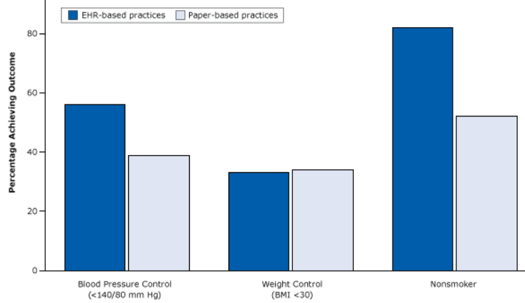
The ‘evidence’ …
https://www.cdc.gov/pcd/issues/2015/15_0187.htm

Slide 118
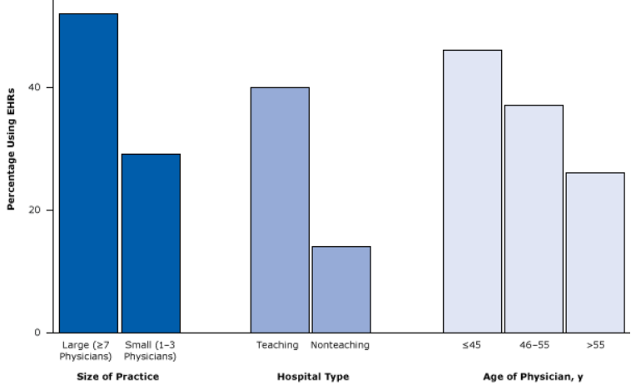
The bias
https://www.cdc.gov/pcd/issues/2015/15_0187.htm

Slide 119
Missing data in EHRs
EHRs are notorious for incompleteness of information
Completeness can be defined in various ways and patient records classified according to their degree of completeness.
  Weiskopf NG, Hripcsak G, Swaminathan S, Weng C. Defining and measuring completeness of electronic health records for secondary use. Journal of Biomedical Informatics. 2013 Oct;46(5):830-836.
Would there be bias in doing secondary data analysis when filtering for complete records?
→ Yes !!! It tends to select sicker patients.
Rusanov, A., Weiskopf, N.G., Wang, S. et al. Hidden in plain sight: bias towards sick patients when sampling patients with sufficient electronic health record data for research. BMC Med Inform Decis Mak 14, 51 (2014)
https://bmcmedinformdecismak.biomedcentral.com/articles/10.1186/1472-6947-14-51

Slide 120
Sources of bias in EHR-based studies
Health care system bias, emanating from: Reimbursement system, pay for performance parameters
‎Role of general practitioner in the health care system; gatekeeping/nongatekeeping
‎Professional clinical guidelines
‎Ease of access by patients to their records
‎Data sharing between health care providers
‎Practice workload
‎Variations between electronic health record (EHR) system functionalities and lay-out
‎Coding systems and thesauruses
‎Knowledge and education regarding the use of EHR systems
‎Data extraction tools
‎Data processing—redatabasing
‎Research dataset preparation
‎Research methodologies
Verheij RA, Curcin V, Delaney BC, McGilchrist MM
Possible Sources of Bias in Primary Care Electronic Health Record Data Use and Reuse
J Med Internet Res 2018;20(5):e185
https://pubmed.ncbi.nlm.nih.gov/29844010/

Slide 121
Bias at warp speed: how AI may contribute to the disparities gap in the time of COVID-19
‘Furthermore, a systematic review study of COVID-19 prediction models uncovered that serious shortcomings, particularly in regard to potential biases, are alarmingly widespread. The PROBAST (Prediction model Risk Of Bias ASsessment Tool) study tool rated all 66 screened models at “high” or “unclear” risk of bias. The most frequent problems encountered were:
unrepresentative data samples,
high likelihood of model overfitting, and
imprecise reporting of study populations and intended model use.’
Eliane Röösli, Brian Rice, Tina Hernandez-Boussard
Journal of the American Medical Informatics Association, Volume 28, Issue 1, January 2021, Pages 190–192,
https://doi.org/10.1093/jamia/ocaa210

Slide 122
Gene annotation bias impedes biomedical research
‘our results provide an evidence of a strong research bias in literature that focuses on well-annotated genes instead of those with the most significant disease relationship in terms of both expression and genetic variation.’
this experimental paradigm has led to a gene-centric disease research bias where hypotheses are confounded by the streetlight effect of looking for “answers where the light is better rather than where the truth is more likely to lie”’
‘the list of unannotated genes is simply ignored because pathway analysis tools cannot map them to any GO terms. Hence, the self-perpetuating cycle of inequality continues.’
Haynes, W.A., Tomczak, A. & Khatri, P. Gene annotation bias impedes biomedical research. Sci Rep 8, 1362 (2018). https://doi.org/10.1038/s41598-018-19333-x

Slide 123
Biases in electronic health record data due to processes within the healthcare system: retrospective observational study
https://www.bmj.com/content/361/bmj.k1479
Objective: evaluate the impact of healthcare processes on the predictive value of EHR data.
Design: Retrospective observational study on 669 452 patients treated at the two hospitals over one year between 2005 and 2006.
Main outcome measures: the relative predictive accuracy of each laboratory test for three year survival, using the time of the day, day of the week, and ordering frequency of the test, compared to the value of the test result.
Results: the presence of a lab test order, regardless of any other info about the test result, is associated (P<0.001) with the odds of survival in 233 of 272 (86%) tests. When lab tests were ordered was more accurate than the test results in predicting survival in 118 of 174 tests (68%).
Conclusions: healthcare processes must be accounted for in analysis of observational health data. Without careful consideration to context, EHR data are unsuitable for many research questions.

Slide 124
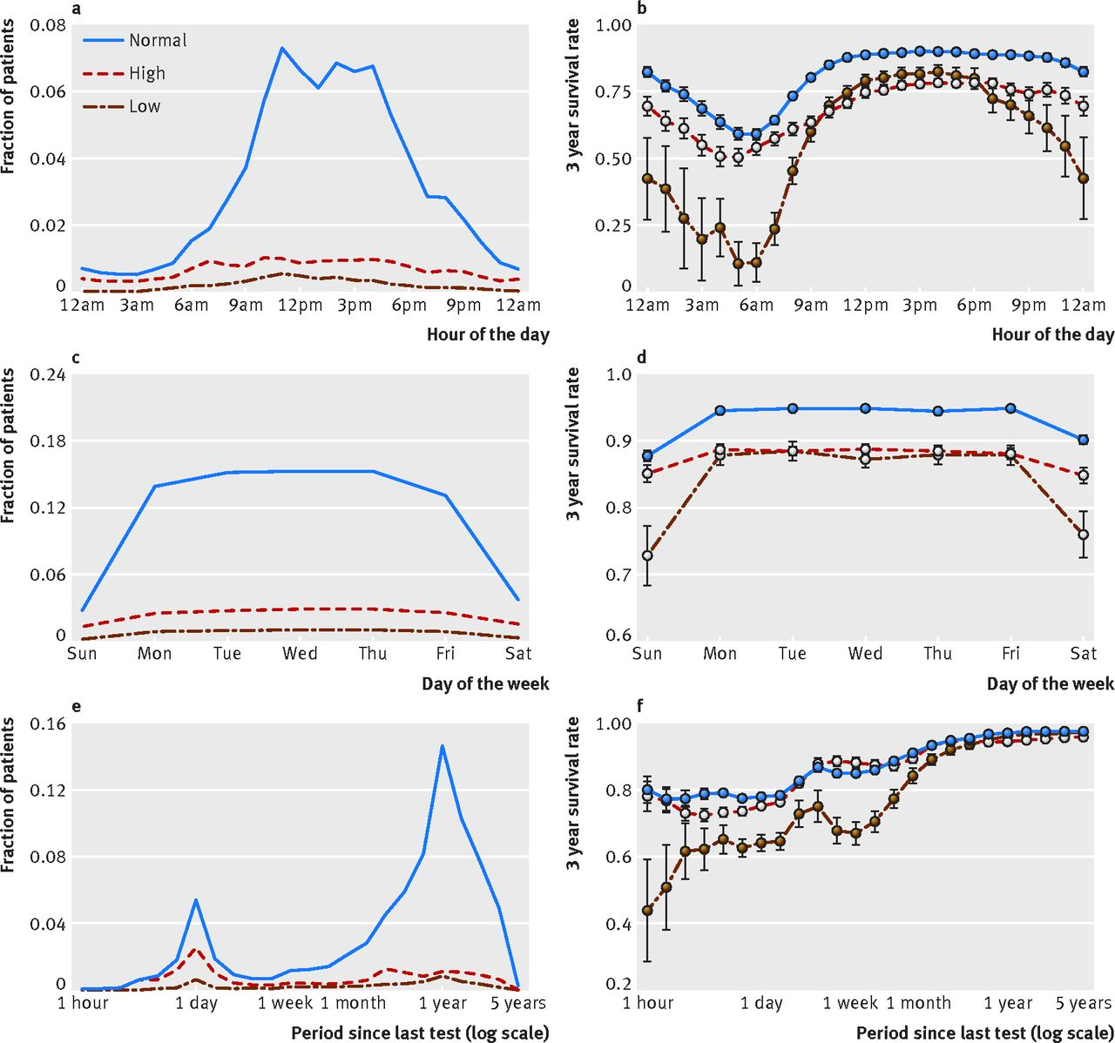
https://www.bmj.com/content/bmj/361/bmj.k1479/F3.large.jpg

Slide 125
Steps in research data analysis
Specify the question you are asking.
Put the question in the form of a null hypothesis and alternative hypothesis.
Determine which variables are relevant to the question.
Determine what kind of variable each one is.
Put the question in the form of a statistical null hypothesis and alternative hypothesis.
Design an experiment that controls or randomizes the confounding variables.
Based on the number of variables, the kinds of variables, the expected fit to the parametric assumptions, and the hypothesis to be tested, choose the best statistical test to use.
If possible, do a power analysis to determine a good sample size for the experiment.
Do the experiment.
Examine the data to see if it meets the assumptions of the statistical test you chose. If it doesn't, choose a more appropriate test.
Apply the statistical test you chose, and interpret the results.
Communicate your results effectively, usually with a graph or table.
John H. McDonald. The Handbook of Biological Statistics ©. 2014. http://www.biostathandbook.com/

Slide 126
Quality criteria for research
Worthy topic
Rich rigor
Sincerity
Credibility
Resonance
Significant contribution
Ethical
Meaningful coherence
Sarah J. Tracy. Qualitative Quality: Eight “Big-Tent”
Criteria for Excellent Qualitative Research. Qualitative Inquiry 2010;16(10):837–851.
https://journals.sagepub.com/doi/10.1177/1077800410383121

Slide 127
Table of Baseline Data
Table describing the characteristics of the intervention and control groups before the trial begins
Variables
  Demographics (age, gender, race, ethnicity, etc.)
  Lab Values
  Diagnoses
  Severity of illness scores (any risk factors for the primary outcome)
  Abnormal cut offs for values
  Combined values as needed for composite measures
  Comparison of the intervention and control groups

Slide 128
Good Reporting of A Mixed Methods Study (GRAMMS)
Describe:
  the justification for using a mixed methods approach to the research question;
  the design in terms of the purpose, priority, and sequence of methods;
  each method in terms of sampling, data collection and analysis;
  where integration has occurred, how it has occurred, and who has participated in it;
  any limitation of one method associated with the presence of the other method; and
  any insights gained from mixing or integrating methods.
O’Cathain, A., Murphy, E., & Nicholl, J. (2008). The quality of mixed methods studies in health services research. Journal of Health Services Research Policy, 13(2), 92-98.
https://pubmed.ncbi.nlm.nih.gov/18416914/

