Slide 1
Principles of
Realism-Based Biomedical Ontology
July 14, 2021
UB Summer Informatics Data Science Bootcamp
Department of Biomedical Informatics, University at Buffalo
July 12 – August 26, 2021
Werner CEUSTERS, MD
Division Chief Biomedical Ontology,
Department of Biomedical Informatics
University at Buffalo, NY, USA

Slide 2
Today’s topics
‘Ontology’ and its place in ‘knowledge representation’.
Realism-based ontology:
  general principles:
    What to represent → ‘ontology’: philosophical discipline,
      Basic principles to classify what exists
    How to represent → ‘ontology’: formal representation,
  Basic Formal Ontology,
    Fundamental entities,
    Most common mistakes.
    Application in OGMS: Ontology for General Medical Science.

Slide 3
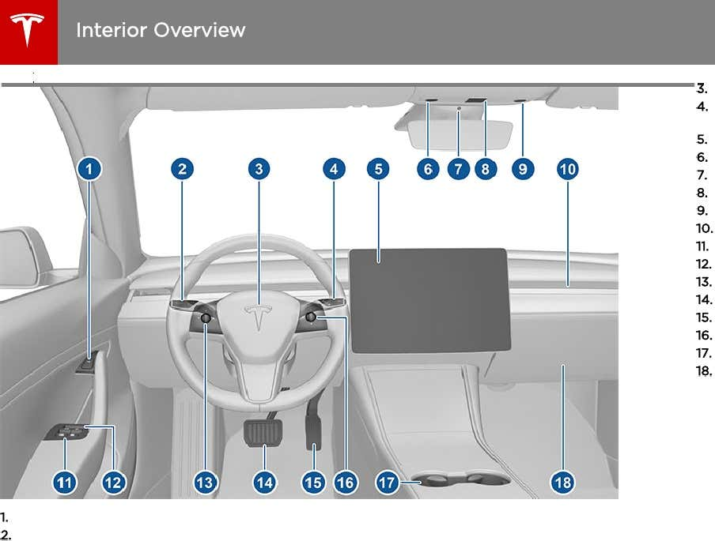

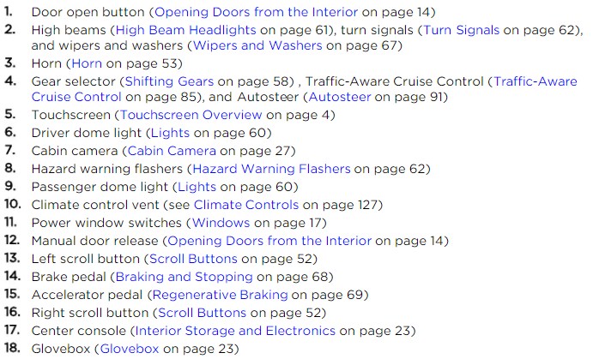
Owner’s manual

Slide 4
Student Learning Objectives
Explain the basic distinctions between:
  ‘Ontology’ versus ontologies versus ‘ontologies’,
  Concept-based versus realism-based ontologies,
  Portions of reality versus representations thereof,
  Particulars versus universals (and defined classes),
  Continuants versus occurrents,
  Relational entities versus formal relations,
Understand how these distinctions are used in BFO and OGMS.
Identify in existing ontologies fundamental mistakes against these distinctions and the principles behind them.
Long term goals:
  Better understand OBI and IAO.
  Be able to apply the principles to your own ontology designs.

Slide 5
Recitation on July 28, 2021
Non-exclusive options:
  Discuss specific road blocks in your ontology work
    Send me not later than July 25 your issues in PowerPoint (one issue per slide) to wceusters@gmail.com
  Have a quiz
  Lab exercise on issues with existing ontologies:
    Snomed CT
    99.3% of BioPortal ontologies
  Lab exercise on ontology design from scientific paper
  …

Slide 6
‘Ontology’ versus ontologies versus
‘ontologies’

Slide 7
Most cited definition
An ontology is an explicit specification of a conceptualization.
…
T. R. Gruber. A Translation Approach to Portable Ontologies.
Knowledge Acquisition, 5(2):199–220, 1993.
http://tomgruber.org/writing/ontolingua-kaj-1993.pdf

Slide 8
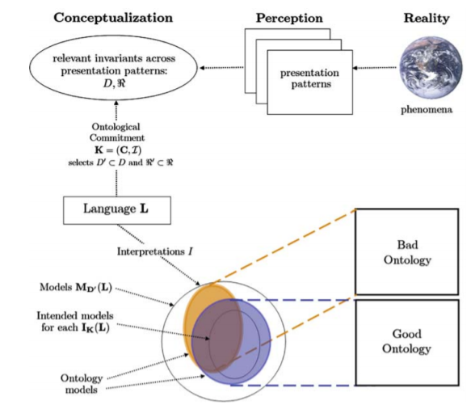
Ontology and conceptualization
Fig. 2. The relationships between phenomena occurring in reality, their perception (at different times), their abstracted conceptualization, the language used to talk about such conceptualization, its intended models, and an ontology.
What Is an Ontology?
Nicola Guarino, Daniel Oberle, and Steffen Staab
S. Staab and R. Studer (eds.), Handbook on Ontologies, International Handbooks 1
on Information Systems, DOI 10.1007/978-3-540-92673-3,
Springer-Verlag Berlin Heidelberg 2009
http://citeseerx.ist.psu.edu/viewdoc/download?doi=10.1.1.175.2138&rep=rep1&type=pdf

Slide 9
Computer science approach to ontology the representation language(s) is/(are) hidden in tools and applications
Ontology
Authoring Tools
create
Domain
Ontologies
Reasoners
Semantic
Applications
use

Slide 10
Computer science approach to ontology
Ontology
Authoring Tools
the logic in reasoners:
guarantees consistent reasoning,
does not guarantee the faithfulness of the representation.
create
Domain
Ontologies
Reasoners
Semantic
Applications
use

Slide 11
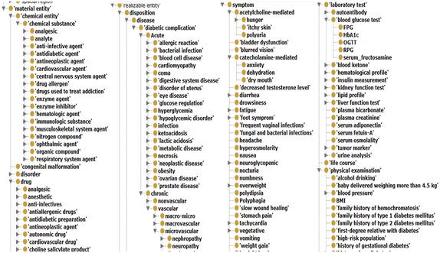
Abusing Protégé, BFO and OGMS
No reference provided due to vicarious embarrassment

Slide 12
Stated goals and purposes of ontologies
Investigating a domain,
Representing a domain,
Enhancing collaboration,
Supporting data-related processing
  annotating, searching, indexing, merging, comparing, …,
Supporting ontology-related process
  comparing, merging, (re-)using, aligning, emulating, …,
Providing reasoning facilities for specific applications.
Towards modelling the intended purpose of ontologies: A case study in geography.
R Denaux, AG Cohn, V Dimitrova, G Hart
Proceedings of the Terra Cognita Workshop in conjunction with the 8th International Semantic Web Conference, CEUR-WS. Org. 2009. http://ceur-ws.org/Vol-518/terra09_submission_9.pdf

Slide 13
Stated goals and purposes of ontologies
Investigating a domain,
Representing a domain,
Enhancing collaboration,
Supporting data-related processing
  annotating, searching, indexing, merging, comparing, …,
Supporting ontology-related process
  comparing, merging, (re-)using, aligning, emulating, …,
Providing reasoning facilities for specific applications.
for people
for machines
Towards modelling the intended purpose of ontologies: A case study in geography.
R Denaux, AG Cohn, V Dimitrova, G Hart
Proceedings of the Terra Cognita Workshop in conjunction with the 8th International Semantic Web Conference, CEUR-WS. Org. 2009. http://ceur-ws.org/Vol-518/terra09_submission_9.pdf

Slide 14
Ontologies and ‘ontologies’
‘ontologies’
Direct
usefulness
for
people
Terminological
systems
Knowledge representation
systems
Realism-based
Ontologies
Direct usefulness for computers
Inspired by: Rector, A.. “Clinical terminology: why is it so hard?” Methods of information in medicine 38 4-5 (1999): 239-52 .

Slide 15
Early goals of Biomedical Ontology in
Healthcare Information Technology (HIT)
supporting the creation and use of adequate biomedical terminology.
supporting the creation of adequate coding and classification systems.
→ Terminological systems

Slide 16
Additional goals of Biomedical Ontology in
Healthcare Information Technology (HIT)
solving the semantic interoperability problem for heterogeneous biomedical information systems.
improving biomedical decision support applications.
Knowledge representation
systems

Slide 17
Additional Goals of Realism-based Biomedical Ontology in HIT
supporting the identification of what sorts of biomedical entities exist, how they relate to each other and how they are best represented.

Slide 18
Most cited definition
An ontology is an explicit specification of a conceptualization.
The term is borrowed from philosophy, where an ontology is a systematic account of Existence. For knowledge-based systems, what “exists” is exactly that which can be represented.
T. R. Gruber. A Translation Approach to Portable Ontologies.
Knowledge Acquisition, 5(2):199–220, 1993.
http://tomgruber.org/writing/ontolingua-kaj-1993.pdf

Slide 19
‘Ontology’ in philosophy
Ontology (no plural) is the study of what entities exist and how they relate to each other;
by some philosophers taken to be synonymous with ‘metaphysics’ while others draw distinctions in many distinct ways (the distinctions being irrelevant for this talk), but almost agreeing on the following classification:
  metaphysics → studies ‘how is the world?’
    general metaphysics → studies general principles and ‘laws’ about the world
      ontology → studies what type of entities exist in the world
    special metaphysics → focuses on specific principles and entities
distinct from ‘epistemology’ which is the study of how we can come to know about what exists.
distinct from ‘terminology’ which is the study of what terms mean and how to name things.

Slide 20
Concept-based versus
Realism-based
Ontology

Slide 21
Commitment to generic entities
Nominalism:
  there are no generic entities in reality: there is no personhood, there are only individual persons.
Conceptualism: ← mainstream approach
  generalizations are in our ‘minds’. Personhood is a concept construed in our ‘mind’ that allows us to reason about persons without any particular person in mind.
Realism: ← my approach
  generic entities do exist and are called ‘universals’. Each particular person is an instance of the universal we call ‘person’.

Slide 22
Conceptualism versus Ontological Realism
concept
term
referent
Conceptualism

Slide 23
Conceptualism versus Ontological Realism
First order reality
concept
universal
term
referent
representational
unit
particular
Conceptualism
Ontological Realism

Slide 24
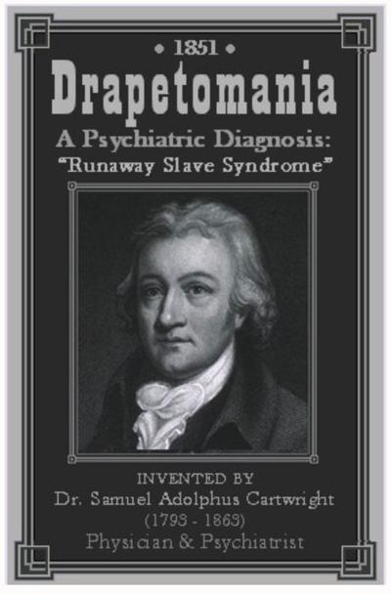
Conceptualism versus Ontological Realism
concept
term
referent
Conceptualism
https://www.phillytrib.com/commentary/drapetomania-compliant-blacks-sane-resisting-blacks-insane/article_0087a2d0-1acb-5364-870c-1205212e0a13.html

Slide 25
Ontological Realism offers three ways of relating, without assigning beliefs (concepts) a central status
drapetomania
slave
running away
mental disorder
propensity
How terms are related
How beliefs are / can
be related
How referents (in
reality) are related

Slide 26
drapetomania
slave
running away
mental disorder
propensity
How terms are
related
How beliefs are / can
be related
How referents
(in reality)
are related
Knowledge representation
systems
Terminological
systems
Realism-based
Ontologies

Slide 27
What do we really want to represent ?
Representation of
?
Concepts
or
Reality
?
Figure modified from: What Is an Ontology? Nicola Guarino, Daniel Oberle, and Steffen Staab
S. Staab and R. Studer (eds.), Handbook on Ontologies, International Handbooks 1 on Information Systems, DOI 10.1007/978-3-540-92673-3, Springer-Verlag Berlin Heidelberg 2009
http://citeseerx.ist.psu.edu/viewdoc/download?doi=10.1.1.175.2138&rep=rep1&type=pdf

Slide 28

Philosophical approach to ontology
Ontological Realism: uses ontology as philosophical discipline to build ontologies as faithful representations of reality.
Smith B, Ceusters W. Ontological Realism as a Methodology for Coordinated Evolution of Scientific Ontologies. Applied Ontology, 2010;5(3-4):139-188.
https://www.ncbi.nlm.nih.gov/pmc/articles/PMC3104413/

Slide 29
Further readings on the issue
Incoherencies and inconsistencies in how ‘concept’ is defined and in how concepts are used for representation:
Essential distinctions between concept-based and realism-based representations and how they might co-exist:
Differing views on what computational ontologies should be, how to be designed, and what determines their quality:
Barry Smith, Beyond Concepts, or: Ontology as Reality Representation. Achille Varzi and Laure Vieu (eds.), Formal Ontology and Information Systems. Proceedings of the Third International Conference (FOIS 2004), Amsterdam: IOS Press, 2004, 73–84. http://ontology.buffalo.edu/bfo/BeyondConcepts.pdf
Gunnar O. Klein and Barry Smith. Concept Systems and Ontologies: Recommendations for Basic Terminology. Trans Jpn Soc Artif Intell. 2010 Jan 1; 25(3): 433–441. https://www.ncbi.nlm.nih.gov/pmc/articles/PMC3034144/
M Brochhausen 1, A Burgun, W Ceusters, A Hasman, T Y Leong, M Musen, J L Oliveira, M Peleg, A Rector, S Schulz.
Discussion of "biomedical ontologies: toward scientific debate". Methods Inf Med. 2011;50(3):217-36..
https://ink.library.smu.edu.sg/cgi/viewcontent.cgi?article=4011&context=sis_research

Slide 30
Portions of reality versus representations thereof

Slide 31


Reality ←→ Representation

Slide 32
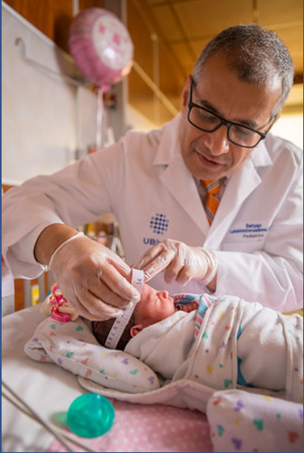
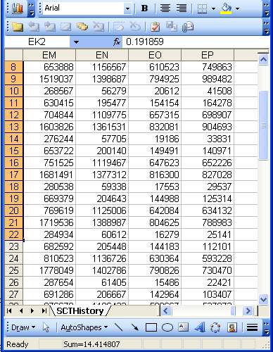
Reality ←→ Representation
(research) domain
(research) data
Beings & happenings
Descriptions

Slide 33

Realism-based Ontology (RBO)
Referents
  are (meta-) physically the way they are,
  relate to each other in an objective way,
  follow ‘laws of nature’.
Window on reality
  restricted by:
  what is physically and technically observable,
  fit between what is measured and what we think is measured,
  fit between established knowledge and ‘laws of nature’.
References
  follow, ideally, the syntactic-semantic conventions of some representation language,
  are restricted by the expressivity of that language,
  reference collections need to come, for correct interpretation, with documentation outside the representation.

Slide 34
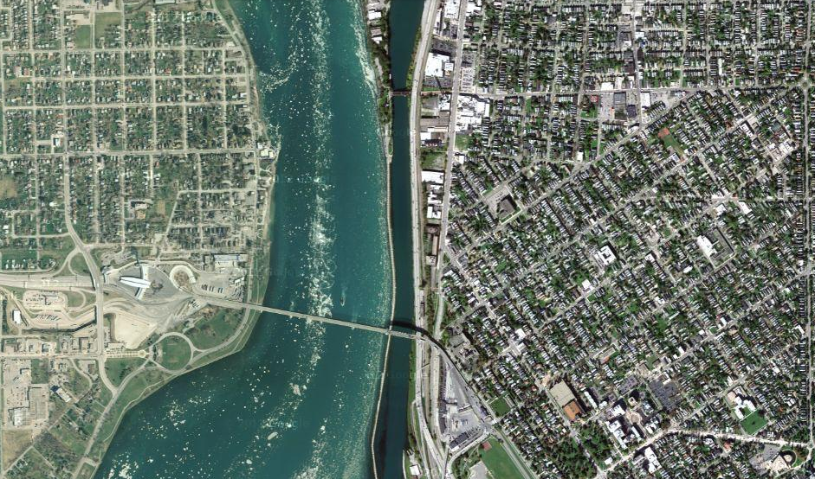
Satellite view

Slide 35
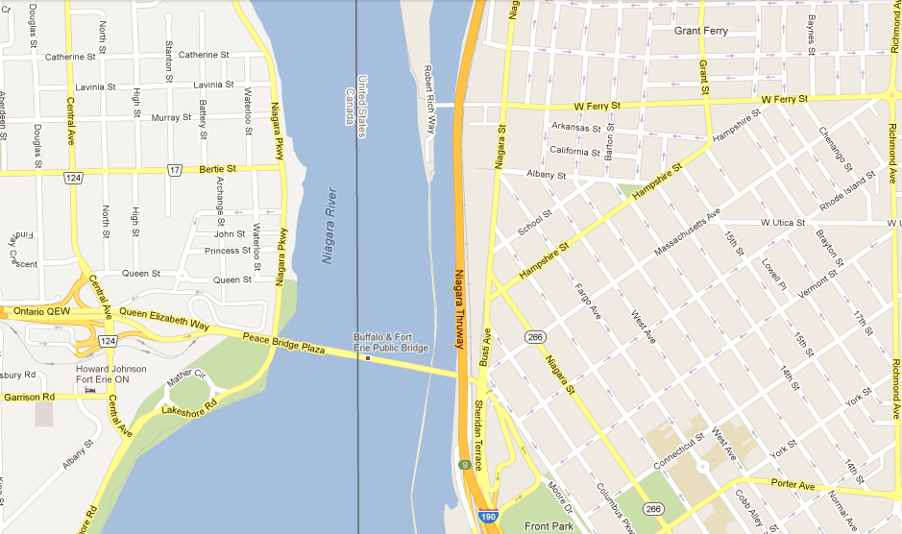
Map

Slide 36
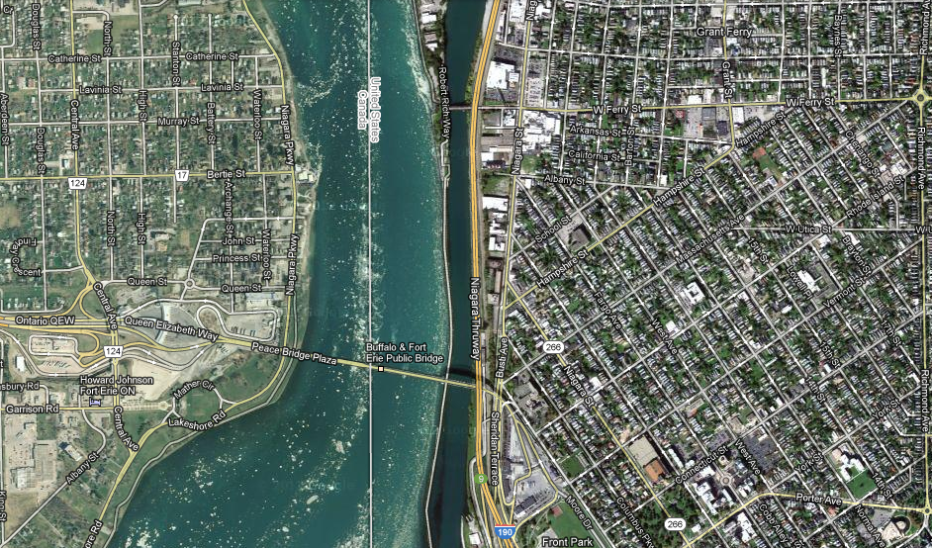
Map overlay

Slide 37
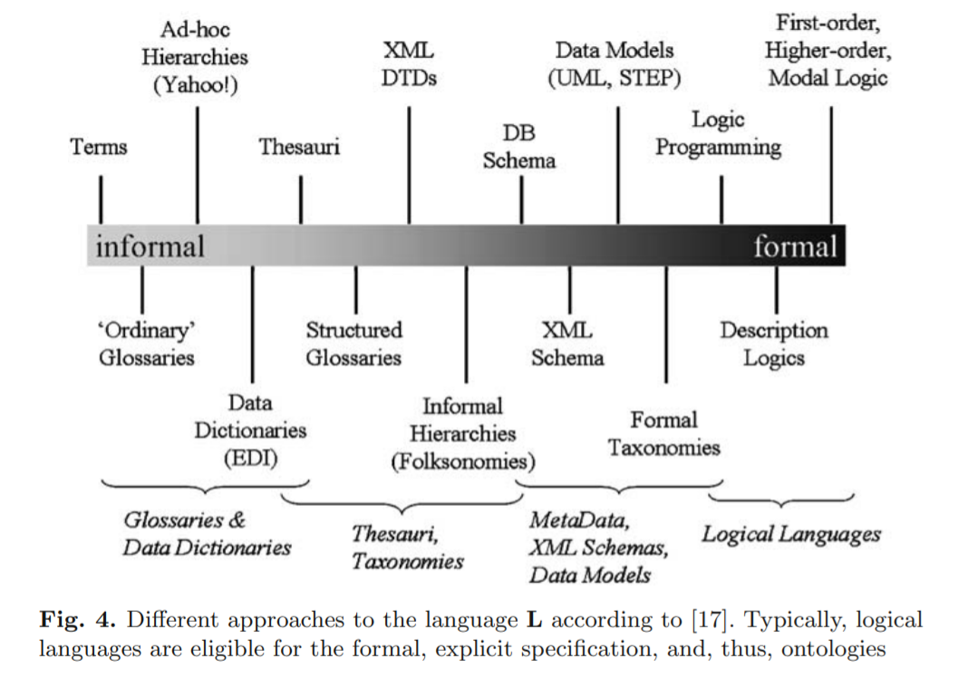
Representation Languages
What Is an Ontology? Nicola Guarino, Daniel Oberle, and Steffen Staab
http://citeseerx.ist.psu.edu/viewdoc/download?doi=10.1.1.175.2138&rep=rep1&type=pdf

Slide 38
‘On beyond Gruber: “Ontologies” in today’s bio-medical information systems and the limits of OWL’
The differences in the semantics of OWL, Frames, and ICD are often misunderstood.
Statements can be invariants, generalizations, associations, or comments.
Only invariants can be represented directly in OWL and description logics.
Frames are better suited for generalizations; SKOS for associations.
ICD aggregations can be linked to OWL by queries but not represented directly.
Rector, A.; Schulz, S.; Rodrigues, J.M.; Chute, C.G.; Solbrig, H. On beyond Gruber: “Ontologies” in today’s biomedical information systems and the limits of OWL. J. Biomed. Inform. X 2019, 2, 100002
https://www.sciencedirect.com/science/article/pii/S2590177X19300010# .

Slide 39
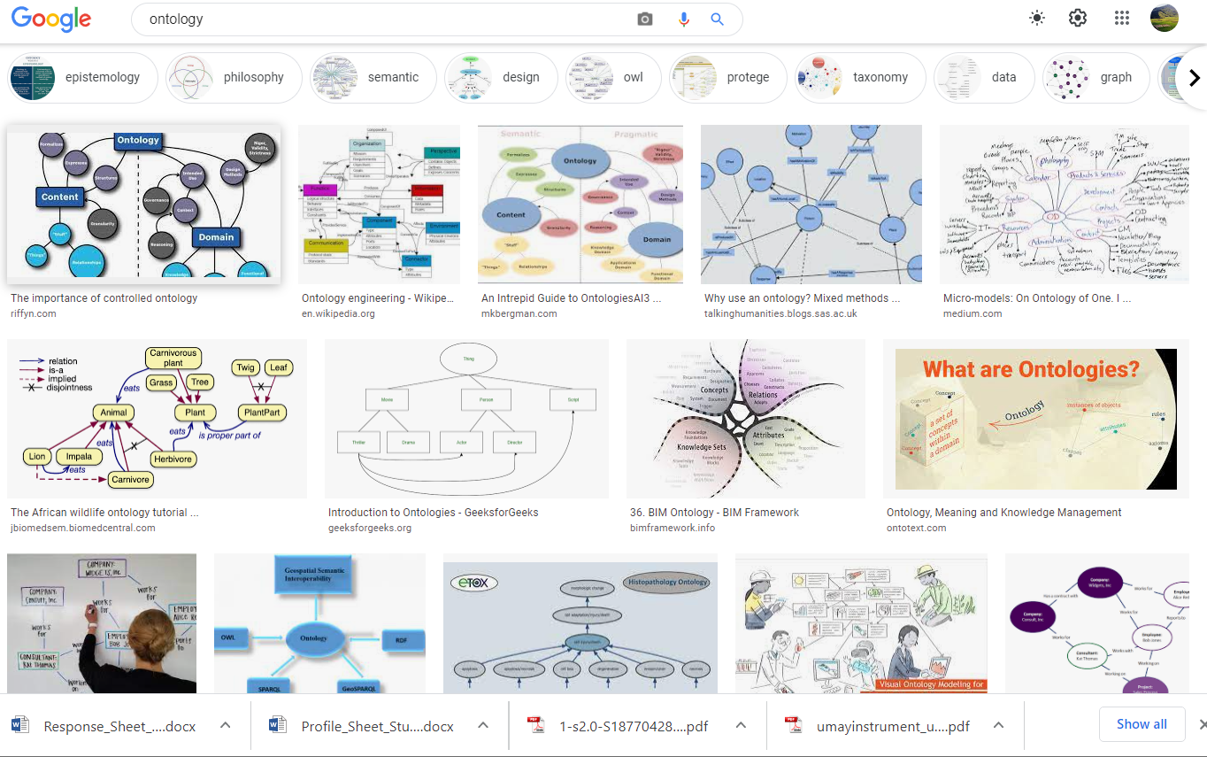
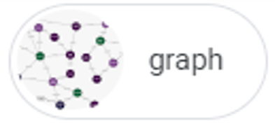
Google Image’s view on ‘ontology’ (July 7. 2021)

Slide 40
Some sets
.
A
.
.
.
.
B
.
.
D
E
.
G
H
I

Slide 41
Simple graph: tree view on those sets
A
…
B
D
E
G
H
I

Slide 42
Taxonomic tree
A
…
B
All nodes represent groups (X, Y, …) the members of which have something (S_{x}, S_{y}) similar in some way.
All edges represent the same relation r which expresses some classificatory principle which is such that if X r Y holds, then the members of X have similarities S_{x} and S_{y}.
D
E
G
H
I

Slide 43
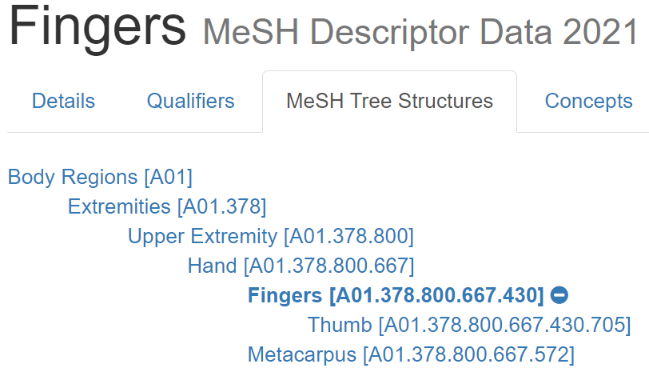
A tree, but not a taxonomic tree
July 12, 2021: https://meshb.nlm.nih.gov/record/ui?ui=D005385

Slide 44
Taxonomic Directed Acyclic Graph (DAG)
A
…
B
All nodes represent groups (X, Y, …) the members of which have something (S_{x}, S_{y}) similar in some way.
All edges represent the same relation r which expresses some classificatory principle which is such that if X r Y holds, then the members of X have similarities S_{x} and S_{y}.
D
E
G
H
I

Slide 45
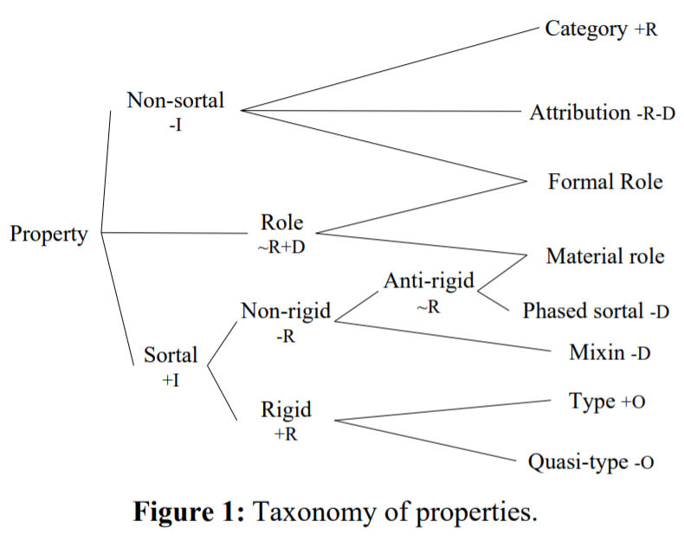
Eliminating ‘multiple inheritance’
→ OntoClean
Guarino, Nicola, and Chris Welty. 2000. A Formal Ontology of Properties. In, Dieng, R., and Corby, O., eds, Proceedings of EKAW-2000: The 12th International Conference on Knowledge Engineering and Knowledge Management. Berlin:Springer LNCS Vol. 1937/2000. Pp. 97–112. October, 2000.
http://citeseer.ist.psu.edu/viewdoc/download;jsessionid=F44932DA1E2DB5DAB49EC0D773370943?doi=10.1.1.28.7392&rep=rep1&type=pdf

Slide 46
Set view on a DAG
.
A
.
.
.
.
B
.
.
D
.
.
E
G
H
I

Slide 47
Taxonomic tree with non-taxonomic relations
A
B
C
D
E
F
G
H
I
J
K
L

Slide 48
Why is the ‘set’-perspective so important?
→ subClassOf in OWL ←
3.2.1 rdfs:subClassOf
AXIOM SCHEMA: class description rdfs:subClassOf class description
The rdfs:subClassOf construct is defined as part of RDF Schema. Its meaning in OWL is exactly the same:
  if the class description C1 is defined as a subclass of class description C2,
  then the set of individuals in the class extension of C1 should be a subset of the set of individuals in the class extension of C2.
An example:
    <owl:Class rdf:ID="Opera">
      <rdfs:subClassOf rdf:resource="#MusicalWork" />
    </owl:Class>
https://www.w3.org/TR/owl-ref/#subClassOf-def

Slide 49
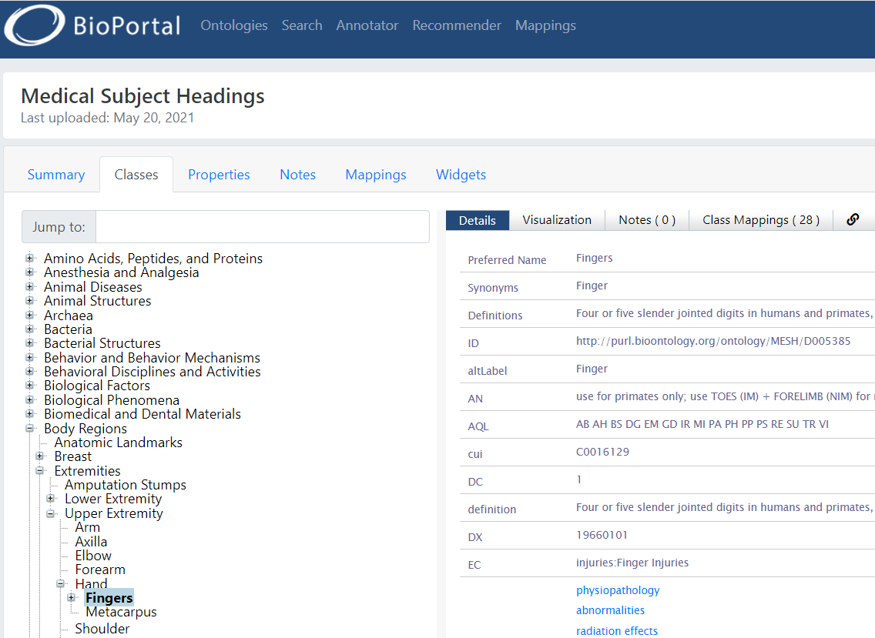
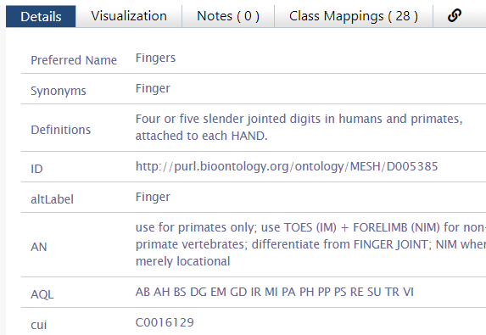

broader-than
Wrong!!!
https://bioportal.bioontology.org/ontologies/MESH?p=classes&conceptid=http%3A%2F%2Fpurl.bioontology.org%2Fontology%2FMESH%2FD005385

Slide 50
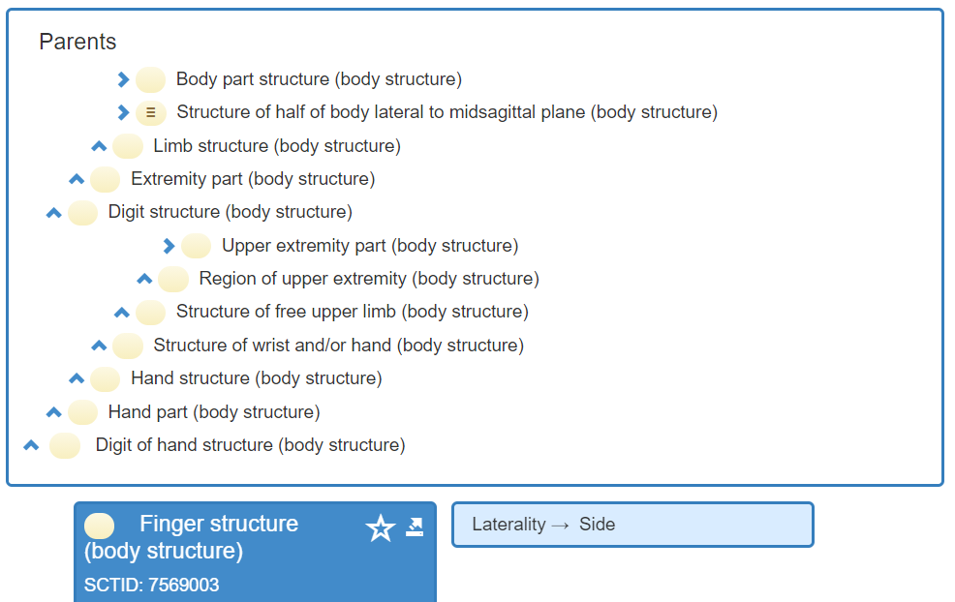
‘Finger’ in SNOMED CT
…
Snomed approach based on:
Schulz S, Romacker M, Hahn U. Part-whole reasoning in medical ontologies revisited--introducing SEP triplets into classification-based description logics. Proc AMIA Symp. 1998:830-4. PMID: 9929335; PMCID: PMC2232338.
https://pubmed.ncbi.nlm.nih.gov/9929335/
https://browser.ihtsdotools.org/?perspective=full&conceptId1=7569003&edition=MAIN/2021-01-31&release=&languages=en

Slide 51
particulars versus types
(universals and defined classes)

Slide 52
‘Type’
Names for something generic in main-stream ontology
  ‘concept’
  ‘kind’
  ‘category’
  ‘class’
  ‘prototype’
  …
In realism-based ontology:
  ‘Type’:
    ‘Universal’: human being
    ‘Defined class’: human being in Buffalo
  ‘Class’: all human beings

Slide 53
Realism-based terminology
Particular (individual):
  individual entity that exist(ed) in space and time, that exist(ed) only once and carries identity.
Type:
  counterpart in reality of some non-empty general term used in the formulation of some scientific theory.
Universal: type which has particulars as instances (= is instantiated by particulars).
Class: extension (=maximal collection) of a non-empty general term.
Defined class: collection of particulars defined by selection or combination of terms denoting particulars or types.
Smith B, Ceusters W. Ontological Realism as a Methodology for Coordinated Evolution of Scientific Ontologies. Applied Ontology, 2010;5(3-4):139-188.
https://www.ncbi.nlm.nih.gov/pmc/articles/PMC3104413/

Slide 54
Types versus particulars
for every universal there is or has been at least one instance
some type
instanceOf …
entities on either site cannot ‘cross’ this boundary
every particular is an instance of at least one universal
some particular

Slide 55




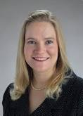
Types versus particulars
Human being
instance of at t
particulars

Slide 56
Types versus particulars
Reality versus representation !
Photograph
instance of at t
particulars

Slide 57
Instances are the objects of classification …
isa
Organism
isa
Vertebrate
isa
Mammal
Human being
instance of at t
particulars

Slide 58
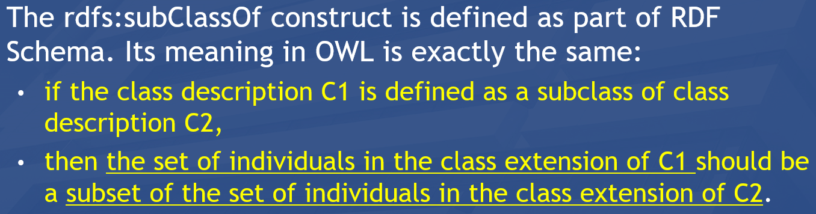
Instances are the objects of classification …
isa
Organism
isa
Vertebrate
isa
Mammal
Human being
instance of at t
particulars

Slide 59
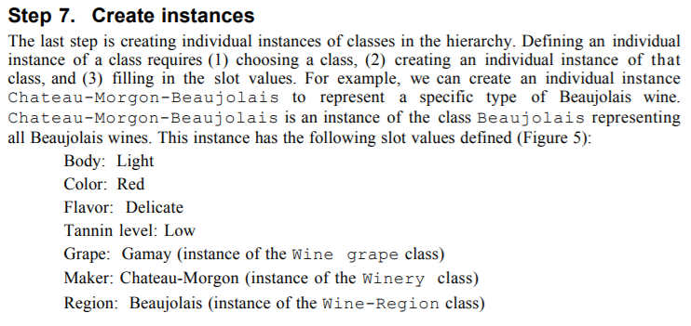
Whether something is a particular or a type is NOT a matter of choice, but a matter of reality!!!
Wrong!!!
https://protege.stanford.edu/publications/ontology_development/ontology101.pdf, p11

Slide 60
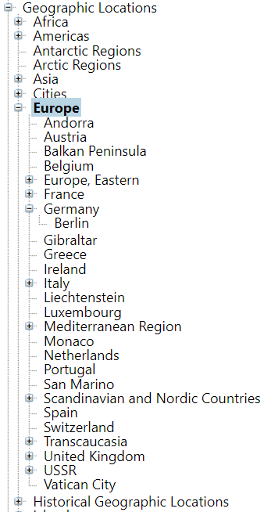
Several mistakes per
RBO rules !!!
Particulars are represented as types;
    Lame excuse: ‘we mean that this type has only one instance’.
Particulars have other particulars as instances;
    The lame excuse breaks down: a class with one instance cannot have a subclass.
subClassOf overload.

Slide 61
Importance of the particular/universal distinction (1)
Ignoring the distinction may lead to assertions in which
  Different interpretations are possible depending on which terms intend particulars and which universals,

Slide 62
Importance of being clear
The International Classification of Headache Disorders has
‘Persistent idiopathic facial pain (PIFP)’
  = ‘persistent facial pain with varying presentations …’
  Imagine three patients:
  all three have continuously facial pain,
  the first one has always pain which presents itself in the same way,
  the second one has also always pain which presents itself in the same way, but in a different way than in the first patient,
  the third one’s pain presents itself sometimes like in the first patient, sometimes like in the second patient, and sometimes different from those.
  Which patients satisfy the definition for PIFP ?

Slide 63
Do you see the ambiguity ?
‘Persistent idiopathic facial pain (PIFP)’
  = ‘persistent facial pain with varying presentations …’
persistent
facial pain
presentation
type1
presentation
type2
presentation
type3
types
t₂
t₃
t₁
t₁
t₁
t₂
t₂
t₃
t₁
t₃
parti-
culars
t₁
t₂
t₂
t₁
t₃
t₂
t₃
t₃
my pain
her pain
his pain

Slide 64
Make it clear whether assertions are about particulars or types
‘Persistent idiopathic facial pain (PIFP)’
  = ‘persistent facial pain with varying presentations …’
  if the description is about types, then the three particular pains fall under PIFP.
  if the description is about (arbitrary) particulars, then only her pain falls under PIFP.

Slide 65
Importance of the particular/universal distinction (2)
Ignoring the distinction may lead to assertions in which
  Different interpretations are possible depending on which terms intend particulars and which universals,
  the authors run together forms of speech governed by different logical rules.

Slide 66
How to analyze these assertions?
Examples:
  ‘Stating that (sleep) bruxism is a behavior in no way precludes the possibility (at some to-be-specified and validated cut point) of it being more than a behavior, either a risk factor or disorder’.
  ‘Bruxism is a continuously distributed behavior’
        Raphael KG, Santiago V, Lobbezoo F. Bruxism is a continuously distributed behaviour, but disorder decisions are dichotomous (Response to letter by Manfredini, De Laat, Winocur, & Ahlberg (2016)). J Oral Rehabil. 2016 Oct;43(10):802-3. https://www.ncbi.nlm.nih.gov/pmc/articles/PMC5538380/

Slide 67
  ‘ … bruxism is a behavior …’
This is a statement about universals:
Bruxism
isa
Behavior
Ceusters W, Smith B. On Defining Bruxism.
Medical Informatics Europe (MIE2018), Goteborg, Sweden, April 24-26, 2018.
Stud Health Technol Inform. 2018;247:551-555.
https://ebooks.iospress.nl/publication/48852

Slide 68
  ‘ … bruxism is a behavior …’
This is a statement about universals:
here is an instance
Bruxism
isa
Behavior
Instance of
John’s repetitive jaw muscle activity of last night

Slide 69
  ‘ … bruxism is a behavior …’
This is a statement about universals:
here is an instance
Bruxism
isa
Behavior
Instance of
Instance of
John’s repetitive jaw muscle activity of last night

Slide 70
  ‘ … bruxism is a behavior …’
  ‘Bruxism is a continuously distributed behavior’
Are these statements about universals ?
continuously distributed behavior
isa
Bruxism
isa
Behavior
???
Instance of
Instance of
John’s repetitive jaw muscle activity of last night

Slide 71
  ‘ … bruxism is a behavior …’
  ‘Bruxism is a continuously distributed behavior’
Are these statements about universals ?
continuously distributed behavior
isa
Bruxism
isa
Behavior
???
Instance of
Instance of ???
Instance of
John’s repetitive jaw muscle activity of last night

Slide 72
  ‘ … bruxism is a behavior …’
  ‘Bruxism is a continuously distributed behavior’
Are these statements about universals ?
continuously distributed behavior
isa
Bruxism
isa
Behavior
???
Instance of
Instance of ???
Instance of
What is ‘in’ all particulars that are instances of bruxism
John’s repetitive jaw muscle activity of last night

Slide 73
  ‘ … bruxism is a behavior …’
  ‘Bruxism is a continuously distributed behavior’
Are these statements about universals ?
continuously distributed behavior
isa
Bruxism
isa
Behavior
???
Instance of
Instance of ???
Instance of
Is ‘in’ no particular at all!!!
Is rather a ‘type of universal’, a
construct outside the particular/universal realm.
John’s repetitive jaw muscle activity of last night

Slide 74
The Basic Formal Ontology
(BFO)

Slide 75
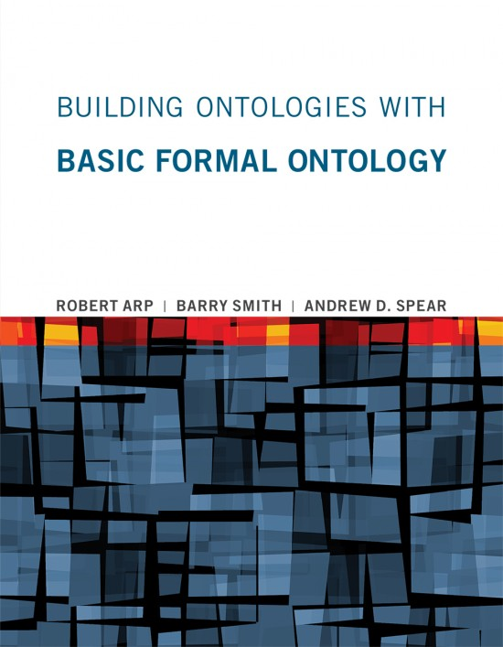
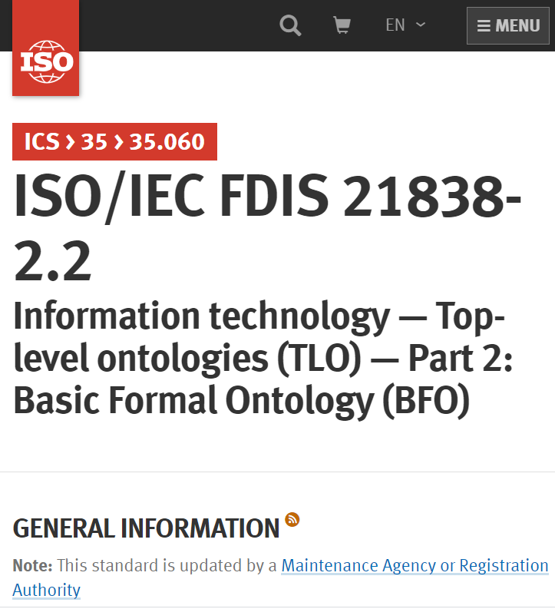
BFO’s major references
https://mitpress.mit.edu/books/building-ontologies-basic-formal-ontology
https://github.com/BFO-ontology/BFO-2020

Slide 76
BFO top
Entity
Elucidation:
An entity is anything that exists or has existed (or will exist).

Slide 77
Continuants versus
Occurrents

Slide 78
BFO top
Entity
Continuant
Occurrent
me my life
my intelligence my reasoning
my heart function the functioning of my heart
my instructor role my teaching
… …

Slide 79
Continuants ←→ Occurrents
 | Continuant | Occurrent
Entities that at any time they exist,
exist
in total
Entities that at any time they exist,
exist only
partially
Smith B, Ceusters W. Ontological Realism as a Methodology for Coordinated Evolution of Scientific Ontologies. Applied Ontology, 2010;5(3-4):139-188.

Slide 80
An ontological square
 | Continuant | Occurrent
Types | Tooth | Teeth grinding
Particulars | My left maxillary first molar | My teeth grinding

Slide 81
An ontological square
 | Continuant | Occurrent
Types | Tooth | Teeth grinding
Particulars | My left maxillary first molar | My teeth grinding
Instance
of at t
Instance
of

Slide 82




Continuants preserve identity while changing
human
being
me
me
t
Instance-of
in 1960
child
Instance-of
since 1980
adult
living
creature
animal
caterpillar
butterfly

Slide 83
The importance of temporal indexing
benign
tumor
malignant
tumor
stomach
instanceOf at t₂
instanceOf at t₁
instanceOf at t₂
instanceOf at t₁
partOf at t₁
this-4
this-1’s stomach
partOf at t₂

Slide 84
The importance of temporal indexing
benign
tumor
malignant
tumor
stomach
instanceOf at t₂
instanceOf at t₁
instanceOf at t₂
instanceOf at t₁
this-4
partOf at t₁
this-1’s stomach
this-5
partOf at t₂

Slide 85
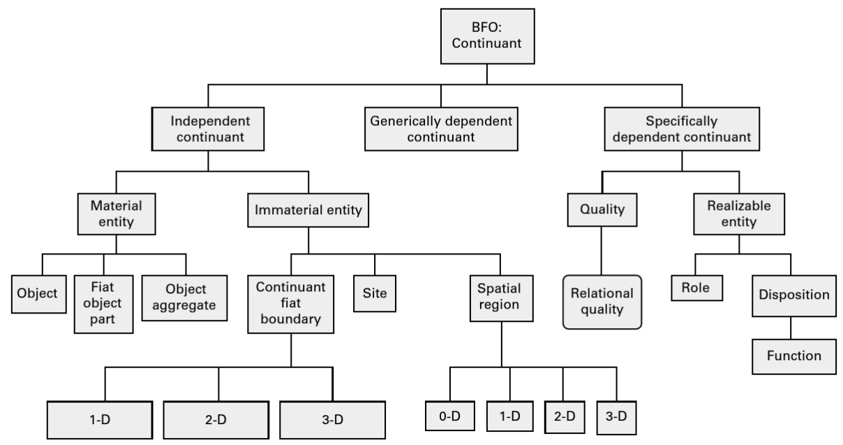
Continuants in BFO

Slide 86
Three major continuant types in BFO
Continuant
Independent
Continuant
IC
Specifically
dependent
continuant
Generically
dependent
continuant
SDC
GDC

Slide 87
Specifically Dependent Continuant
Specifically Dependent Continuant
Quality
Realizable
Entity
Relational
Quality
Disposition
Role
Function
Arp, R., B. Smith, and A.D. Spear,
Building ontologies with basic formal ontology. 2015,
The MIT Press,: Cambridge, Massachusetts. p. 1 online resource (245 p).

Slide 88
Specifically Dependent Continuant
Specifically Dependent Continuant
Quality
Realizable
Entity
Elucidation: a quality is a specifically dependent continuant that, in contrast to roles and dispositions, does not require any further process in order to be realized.
Elucidation: b is a realizable entity means: b is a specifically dependent continuant that inheres in some independent continuant which is not a spatial region and is of a type some instances of which are realized in processes of a correlated type.
  ISO/IEC PRF 21838-2:2020(E)

Slide 89
Realizables and realizations
Continuant
Occurrent
Realizable entity
Process
Fragility of a glass
Skill of a craftsman
Role of a student
Function of a heart
Breaking
Constructing
Studying
Beating

Slide 90
Occurrent
Occurrent
Process
Temporal Region
unfolds itself in time
Process
Boundary
Spatiotemporal
Region
start or end of process

Slide 91
Relational entities versus formal relations

Slide 92
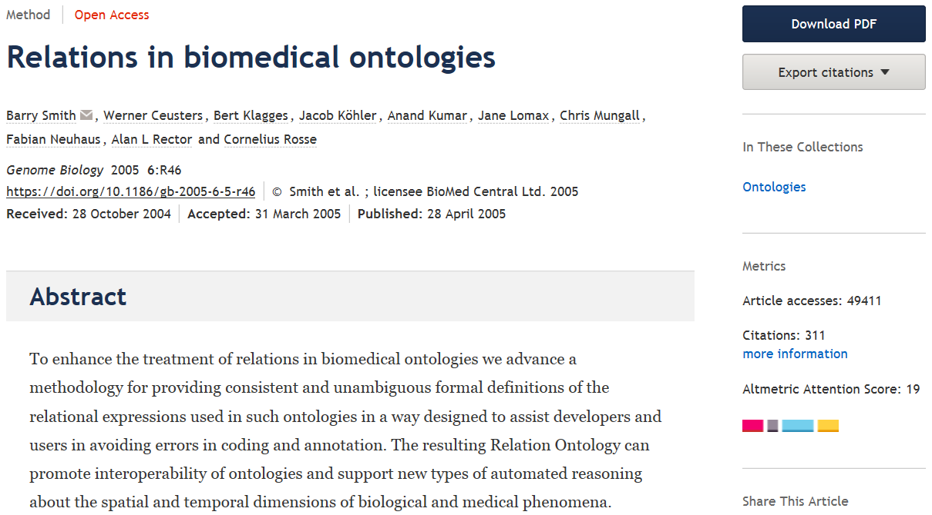
https://genomebiology.biomedcentral.com/articles/10.1186/gb-2005-6-5-r46

Slide 93
Essentials
Distinguishing what is denoted by ‘relation’ in technical sense (‘formal relations’) from what is denoted by ‘relation’ in non-formal language (‘material relations’);
Differences between type-level formal relations, particular-level formal relations and particular-type-level formal relations;
Arity and other properties of formal relations and differences thereof between particular-type formal relations and their corresponding type-level formal relations;
Elucidation versus definition of formal relations;
‘Basic’ formal relations versus ‘shortcut’ formal relations;
Axiomatic characterization of formal relations.

Slide 94
‘Relations’
(mainstream view)
Relations:
  ‘entities that glue together other entities’
  Formal relations:
    ‘hold between two or more entities directly, without any further intervening individual’.
  Material relations:
    ‘have material structure on their own’.
        = are entities
    Guizzardi & Wagner. What’s in a Relationship: An Ontological Analysis. In: Qing Li, Stefano Spaccapietra, Eric Yu, Antoni Olivé (Eds.), Conceptual Modeling - ER 2008. Lecture Notes in Computer Science, Vol. 5231, 83-97, 2008 https://doi.org/10.1007/978-3-540-87877-3_8↗

Slide 95
Material relation
‘John is friends with Mary’
isAbout at t
J&M’s
friendship
John
Mary

Slide 96
Material relation
‘John is friends with Mary’
isAbout at t
J&M’s
friendship
John
Mary
instanceOf at t
BFO:Object
BFO:Relational Quality

Slide 97
Material relation
‘John is friends with Mary’
isAbout at t
inheresIn at t
J&M’s
friendship
inheresIn at t
John
Mary
instanceOf at t
BFO:Object
BFO:Relational Quality

Slide 98
Material relation
‘John is friends with Mary’
isAbout at t
inheresIn at t
J&M’s
friendship
inheresIn at t
John
Mary
instanceOf at t
BFO:Object
BFO:Relational Quality

Slide 99
Material relations
‘have material structure on their own’
Are entities in their own right.
Relate other entities to each other by means of formal relations.
Examples: what might by some be denoted by:
  ‘patient’,
  ‘treatment’,
  ‘driver’.
Examples in BFO:
  relational qualities
      Have independent continuants as their bearers.
  relational processes: kissing, buying, …

Slide 100
Formal relations
‘John is friends with Mary’
isAbout at t
inheresIn at t
J&M’s
friendship
inheresIn at t
John
Mary
instanceOf at t
BFO:Object
BFO:Relational Quality

Slide 101
Formal relations
‘hold between two or more entities directly, without any further intervening individual’
Basic formal relations:
  existential dependence, inherence, subtype-of, part-of, subset-of, instantiation, …
Domain formal relations:
  ‘relations that exhibit similar characteristics, i.e., those relations of comparison such as is taller than, is older than, knows more Greek than’.
    Guizzardi & Wagner. What’s in a Relationship: An Ontological Analysis. In: Qing Li, Stefano Spaccapietra, Eric Yu, Antoni Olivé (Eds.), Conceptual Modeling - ER 2008. Lecture Notes in Computer Science, Vol. 5231, 83-97, 2008 https://doi.org/10.1007/978-3-540-87877-3_8↗

Slide 102
Arity of a relation
Binary:
  My youth partOf my life
1 2
Ternary:
  My hand partOf me now
1 2 3
Quaternary:
  My left middle finger between my left index finger
    1 2
  and my left ring finger now
  3 4
…

Slide 103
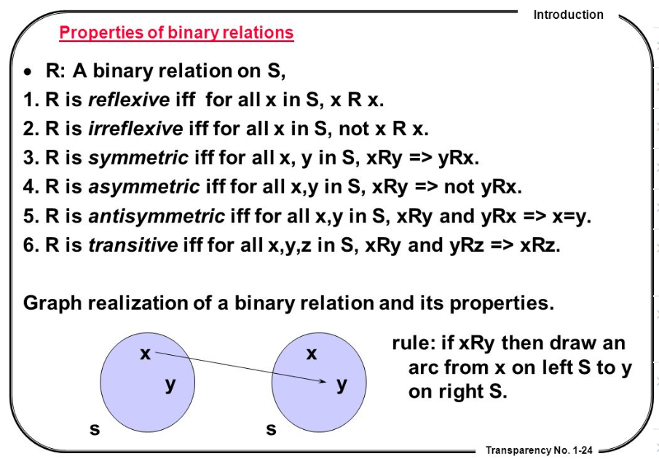
Properties of binary relations
http://en.ndncdc.org/page/symmetric-binary-relation-on-set/

Slide 104
Relations in Ontological Realism
Instance-level relations
  Your heart (instance-level) continuant_part_of your body at t
  Your heart beating (instance-level) has_participant your heart at t
Instance-type relations
  John’s heart instantiates human heart at t.
  John’s heart beating instantiates human heart beating.
Type-level relations
  human heart continuant_part­_of human body
  human heart beating process has_occurrent_part beat profile

Slide 105
Features of relations on the level of instances may not hold on the level of universals
nucleus adjacent_to cytoplasm
  Not: cytoplasm adjacent_to nucleus
    Red blood cells don’t have a nucleus
seminal vesicle adjacent_to urinary bladder
  Not: urinary bladder adjacent_to seminal vesicle
    Women don’t have seminal vesicles
Adjacency as a relation between universals is not symmetric while it is symmetric at particular level.

Slide 106
Type-level relations presuppose the underlying instance-level relations
A part_of B =def(roughly). All instances of A are instance-level-parts-of some instance of B
  e.g. human heart part_of human
A has_participant B =def(roughly). All instances of A have some instance of B as instance-level participant
  e.g. cell binding has_participant cell

Slide 107
the all-some form
A continuant_part_of B =def.
  for all instances a and times t,
  If a is an instance of the universal A at t,
  then there is some instance b of the universal B
  such that
  a is an instance-level part_of b at t
Domain: Continuant
Range: Continuant

Slide 108
Remember forever !!!
Formal relations expressed in the BFO are all type-type relations.
    IC isa Continuant
    SDC specifically depends on IC
domain
range

Slide 109
Remember !!!
Formal relations expressed in the BFO are all type-type relations.
    IC isa Continuant
    SDC specifically depends on IC
BFO’s type-type relations don’t express anything about types, but only what is the case for all particulars in the domain position of the relation.
BFO’s type-type relations are defined / elucidated on the basis of instance-level relations.

Slide 110
Elucidation versus definition
x is_about y means:
  x refers to or is cognitively directed towards y. Domain: representations; Range: portions of reality. Axiom: if x is_about y then y exists (veridicality).
‘A means B’:
    If A is the case, you can conclude that B holds.
    If B is the case, you cannot conclude anything re A.
x is_a_representation_of y =def.
  x is a representa­tion & x is_about y (where y is a portion of reality). Note that not all representations are about something.
‘A =def. B’ :
    If A is the case, you can conclude that B holds.
    If B is the case, you can conclude that A holds.
    If one doesn’t hold, the other one doesn’t hold.

Slide 111
Formal BFO definition for is_a
The is_a relation is the subtype or subuniversal relation between universals or types.
  C is_a C1 =def.:
    C and C1 are continuant universals, and
    for all c, t, if c instance_of C at t then c instance_of C1 at t
  P is_a P1 =def.:
    P and P1 are occurrent universals, and
    for all p, if p instance_of P then p instance_of P1

Slide 112
Compare with RDFS / OWL
Ff the class description C1 is defined as a subclass of class description C2, then the set of individuals in the class extension of C1 should be a subset of the set of individuals in the class extension of C2.
Differences with BFO:
  subClass is primitive, being a subset is a consequence
  You just have to declare it → how do you want the domain to be, not how the domain is!
  No time indexing.

Slide 113
Avoid at all cost!!!
X hasY Y
Disease hasSymptom Symptom
Object hasTemperature Temperature
…
(unless you define such relations as explicitly as ‘shortcut’ relations)

Slide 114
Basics of the
Ontology for General Medical Science
Scheuermann R, Ceusters W, Smith B. Toward an Ontological Treatment of Disease and Diagnosis., San Francisco, California, March 15-17, 2009;: 116-120. Omnipress ISBN:0-9647743-7-2
http://www.referent-tracking.com/RTU/files/AMIA-0075-T2009/1.0/AMIA-0075-T2009.pdf

Slide 115
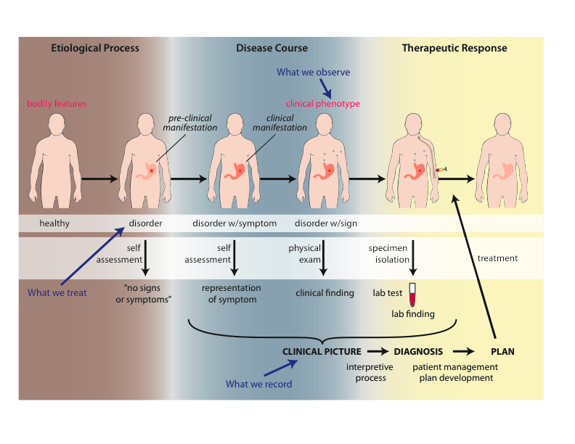
Big Picture of OGMS

Slide 116
Approach
a disease is a disposition rooted in a physical disorder in the organism and realized in pathological processes.
produces
bears
realized_in
etiological process
disorder
disposition
pathological process
produces
diagnosis
interpretive process
signs & symptoms
abnormal bodily features
produces
participates_in
recognized_as
Notes:
font was too small, color inside green boxes was hardly readable

Slide 117
Key OGMS definitions
DISORDER | A causally relatively isolated combination of physical components that is (a) clinically abnormal and (b) maximal, in the sense that it is not a part of some larger such combination.
DISEASE
DISEASE COURSE
DIAGNOSIS
Scheuermann R, Ceusters W, Smith B. Toward an Ontological Treatment of Disease and Diagnosis. 2009 AMIA Summit on Translational Bioinformatics, San Francisco, California, March 15-17, 2009;: 116-120. Omnipress ISBN:0-9647743-7-2

Slide 118
Clinically abnormal
something is clinically abnormal if:
  is not part of the life plan for an organism of the relevant type (unlike aging or pregnancy),
  is causally linked to an elevated risk either of pain or other feelings of illness, or of death or dysfunction, and
  is such that the elevated risk exceeds a certain threshold level.

Slide 119
Key OGMS definitions
DISORDER | A causally relatively isolated combination of physical components that is (a) clinically abnormal and (b) maximal, in the sense that it is not a part of some larger such combination.
DISEASE | A DISPOSITION (i) to undergo PATHOLOGICAL PROCESSes that (ii) exists in an ORGANISM because of one or more DISORDERs in that ORGANISM.
DISEASE COURSE
DIAGNOSIS
Scheuermann R, Ceusters W, Smith B. Toward an Ontological Treatment of Disease and Diagnosis. 2009 AMIA Summit on Translational Bioinformatics, San Francisco, California, March 15-17, 2009;: 116-120. Omnipress ISBN:0-9647743-7-2

Slide 120
Disposition
Subtype of Realizable Entity:
  if it ceases to exist, then its bearer and/or its immediate surrounding environment is physically changed;
  its realization occurs when its bearer is in some special physical circumstances;
  its realization is what it is in virtue of the bearer’s physical make-up.

Slide 121
Role (Externally-Grounded Realizable Entity)
role =def. a realizable entity
  which exists because the bearer is in some special physical, social, or institutional set of circumstances in which the bearer does not have to be, and
  is not such that, if it ceases to exist, then the physical make-up of the bearer is thereby changed.

Slide 122
Pathological process
Pathological Process =def. – A bodily process that is a manifestation of a disorder and is clinically abnormal.

Slide 123
Disease particulars can instantiate distinct universals at distinct times
coronary heart disease
disease associated with early lesions and small fibrous plaques
disease associated with asymptomatic (‘silent’) infarction
disease associated with surface disruption of plaque
unstable angina
stable angina
instantiates at t₂
instantiates at t₃
instantiates at t₄
instantiates at t₅
instantiates at t₁
John’s coronary heart disease
time

Slide 124
Key OGMS definitions
DISORDER | A causally relatively isolated combination of physical components that is (a) clinically abnormal and (b) maximal, in the sense that it is not a part of some larger such combination.
DISEASE | A DISPOSITION (i) to undergo PATHOLOGICAL PROCESSes that (ii) exists in an ORGANISM because of one or more DISORDERs in that ORGANISM.
DISEASE COURSE | The totality of all PROCESSes through which a given DISEASE instance is realized.
DIAGNOSIS
Scheuermann R, Ceusters W, Smith B. Toward an Ontological Treatment of Disease and Diagnosis. 2009 AMIA Summit on Translational Bioinformatics, San Francisco, California, March 15-17, 2009;: 116-120. Omnipress ISBN:0-9647743-7-2

Slide 125
Key OGMS definitions
DISORDER | A causally relatively isolated combination of physical components that is (a) clinically abnormal and (b) maximal, in the sense that it is not a part of some larger such combination.
DISEASE | A DISPOSITION (i) to undergo PATHOLOGICAL PROCESSes that (ii) exists in an ORGANISM because of one or more DISORDERs in that ORGANISM.
DISEASE COURSE | The totality of all PROCESSes through which a given DISEASE instance is realized.
DIAGNOSIS | A conclusion of an interpretive PROCESS that has as input a CLINICAL PICTURE of a given patient and as output an assertion (diagnostic statement) to the effect that the patient has a DISEASE of such and such a type.
Scheuermann R, Ceusters W, Smith B. Toward an Ontological Treatment of Disease and Diagnosis. 2009 AMIA Summit on Translational Bioinformatics, San Francisco, California, March 15-17, 2009;: 116-120. Omnipress ISBN:0-9647743-7-2

Slide 126
Clinical picture
Clinical Picture =def. – A representation of a clinical phenotype that is inferred from the combination of laboratory, image and clinical findings about a given patient.
Representations are information content entities (IAO)
Smith B, Ceusters W. Aboutness: Towards Foundations for the Information Artifact Ontology. International Conference on Biomedical Ontologies, ICBO 2015, Lisbon, Portugal, July 27-30, 2015;47-51. http://www.referent-tracking.com/RTU/files/ICBO2015Proceedings-Smith-Ceusters/1.0/ICBO2015Proceedings-Smith-Ceusters.pdf

Slide 127
Generically Dependent Continuants
Generically
Dependent
Continuant
if one bearer ceases to exist, then the entity can survive, because there are other bearers
(copyability)
the pdf file on my laptop
the DNA (sequence) in this chromosome
A diagnosis
Information
Content
Entity
Gene
Sequence

Slide 128
No conflation of diagnosis, disease, and disorder
produces
bears
realized_in
etiological process
disorder
disease
pathological process
produces
diagnosis
interpretive process
signs & symptoms
abnormal bodily features
produces
participates_in
recognized_as
Notes:
font was too small, color inside green boxes was hardly readable

Slide 129
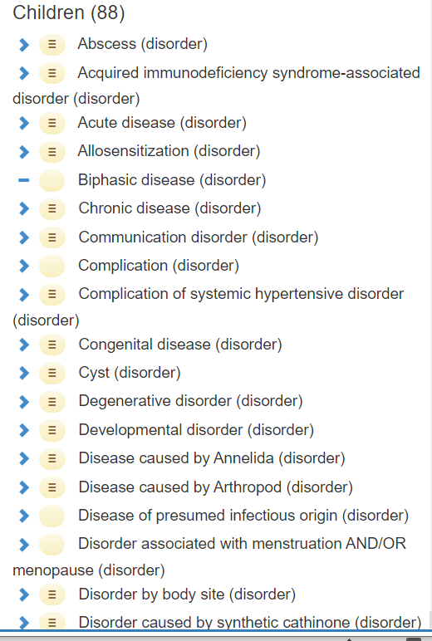
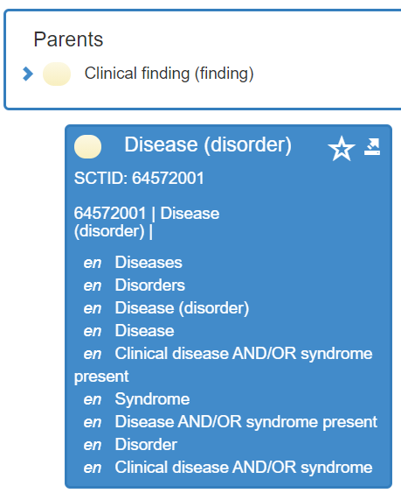
‘Disease’ in Snomed CT

Slide 130
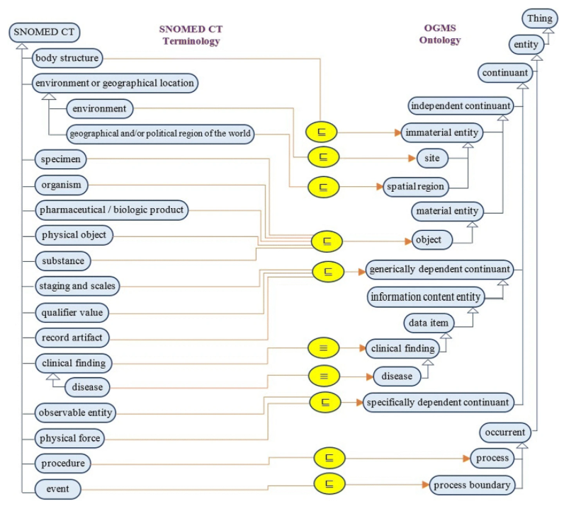
No!!!
El-Sappagh, S., Franda, F., Ali, F. et al. SNOMED CT standard ontology based on the ontology for general medical science. BMC Med Inform Decis Mak 18, 76 (2018).
https://doi.org/10.1186/s12911-018-0651-5

Slide 131
Bad ‘disease ontologies’
Despite being listed in the OBO-Foundry: http://www.obofoundry.org/ontology/doid.html
Mondo Disease Ontology: collection of several other ‘ontologies’:
  https://mondo.monarchinitiative.org/
  https://www.ebi.ac.uk/ols/ontologies/mondo
The Semantic Science Ontology: incoherent foundation
https://bioportal.bioontology.org/ontologies/SIO?p=classes&conceptid=http%3A%2F%2Fsemanticscience.org%2Fresource%2FSIO_010299

