Slide 1
BMI714 – Spring 2022
Principles of Referent Tracking in Biomedical Informatics
(class number 19404)
Class 8 – March 29, 2022
Problem list management in EHRs: basics and problems
Werner CEUSTERS^{1,2}
¹ Department of Biomedical Informatics, University at Buffalo, USA
² Department of Psychiatry, University at Buffalo, USA

Slide 2
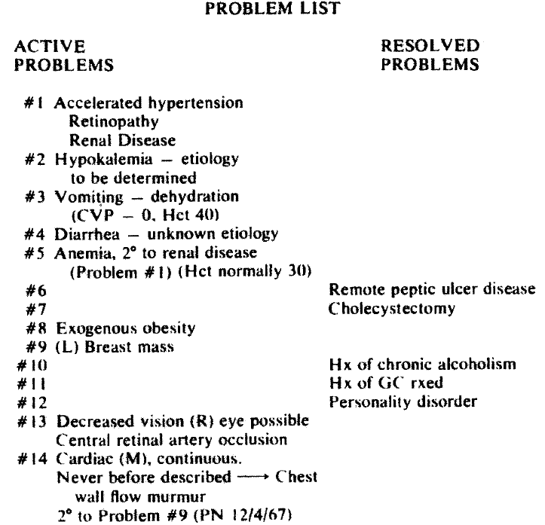

L. Weed.
Medical records that guide and teach.
New England Journal of Medicine 278 (1968), 593-600.

Slide 3
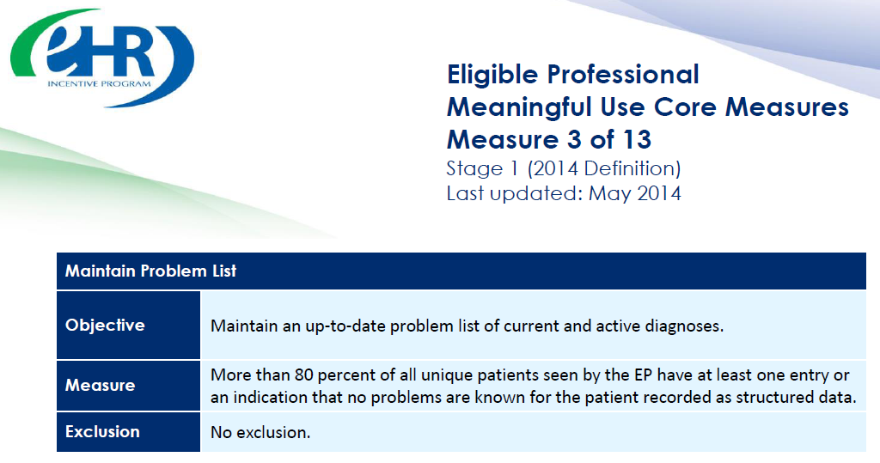

https://www.cms.gov/Regulations-and-Guidance/Legislation/EHRIncentivePrograms/downloads/3_Maintain_Problem_ListEP.pdf

Slide 4
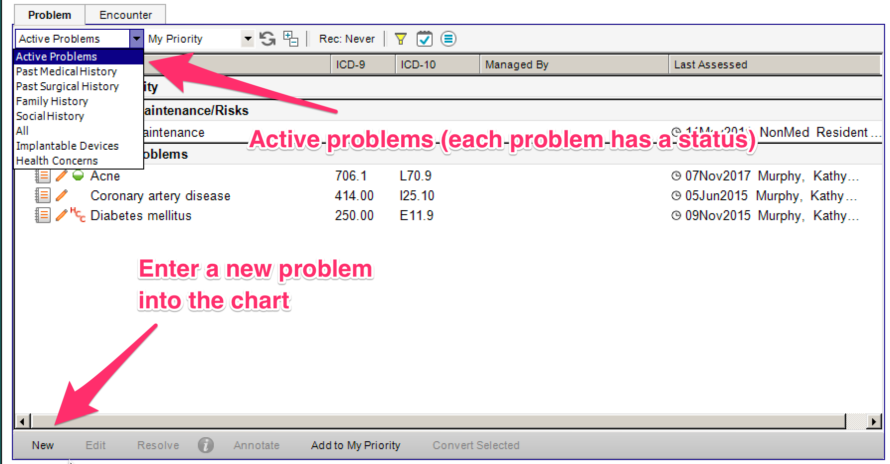

Slide 5
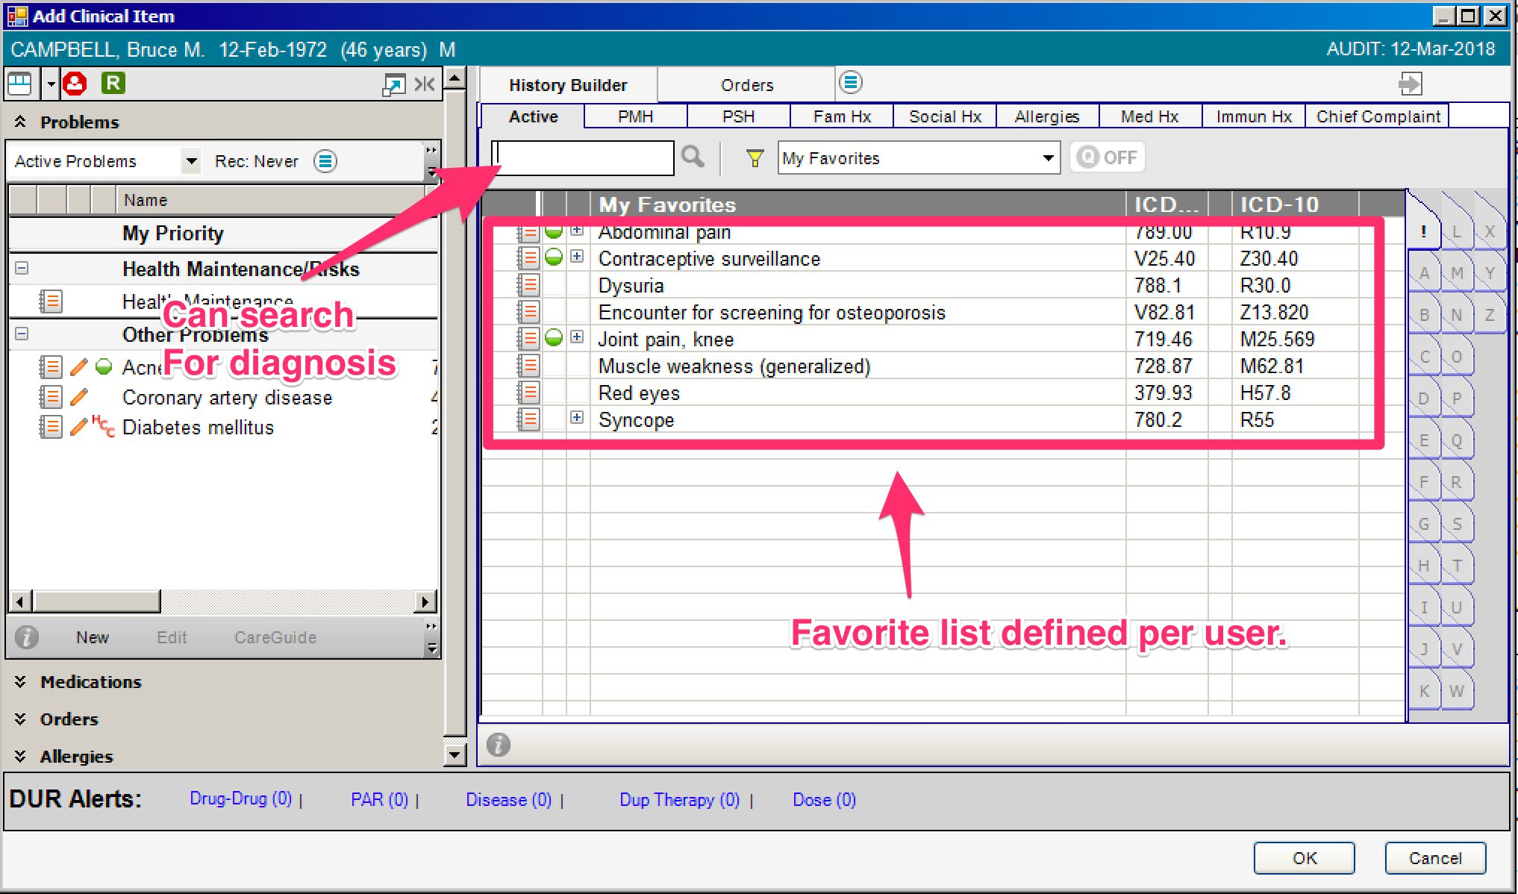

Slide 6
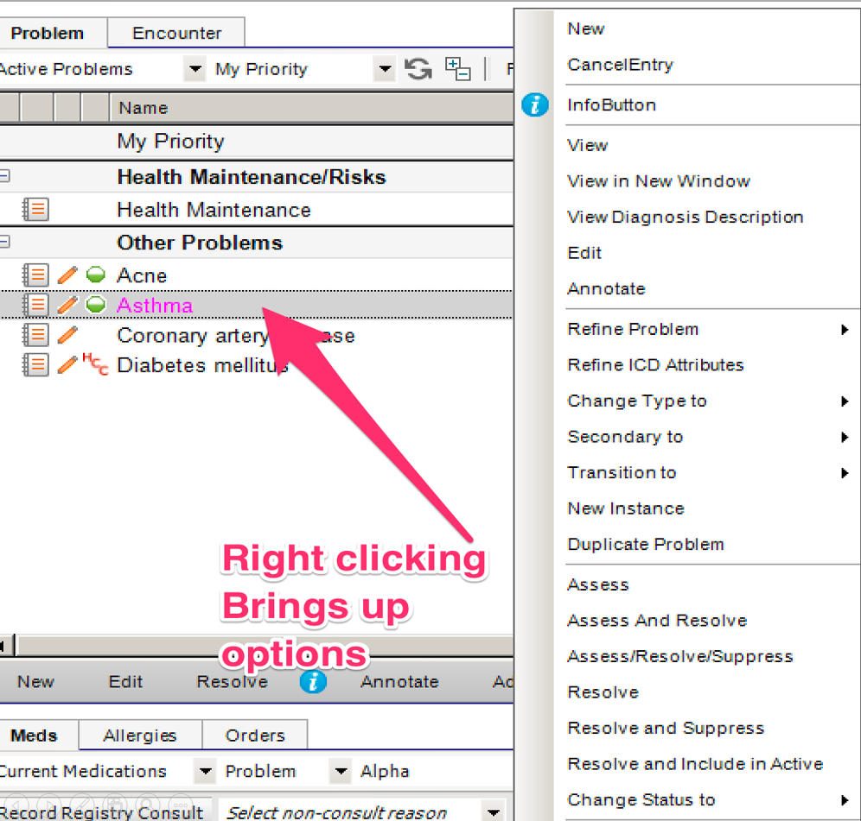



Slide 7
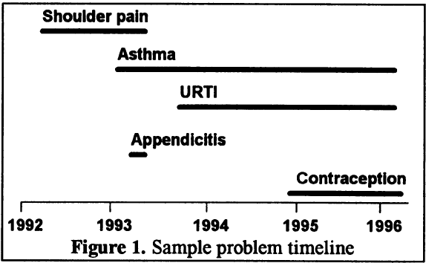
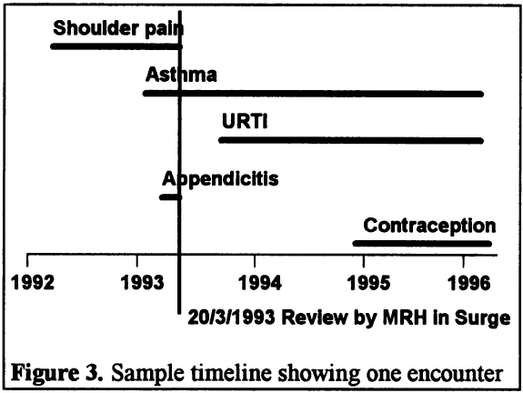
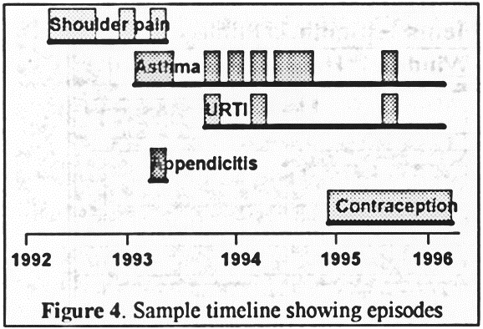
Problems
Encounters
Episodes
Salmon P, Rappaport A, Bainbridge M, Hayes G, Williams J. Taking the problem oriented medical record forward. Proc AMIA Annu Fall Symp. 1996:463-7.

Slide 8
The problematic ‘Problem’
‘A Problem has a single name which can change over time.
A Problem may have no underlying condition in the medical sense.
A Problem may or may not appear to be a "problem" to the patient.
The status of the Problem doesn't necessarily imply that the underlying condition, if any, has the same status.
Problems are headings that a Problem list can made from.
A Problem is by nature a grouper of other statements.’
‘We defined a “Problem” or “Cancer Disease” as something that required a plan for “diagnosis” and/or “management”’

Slide 9
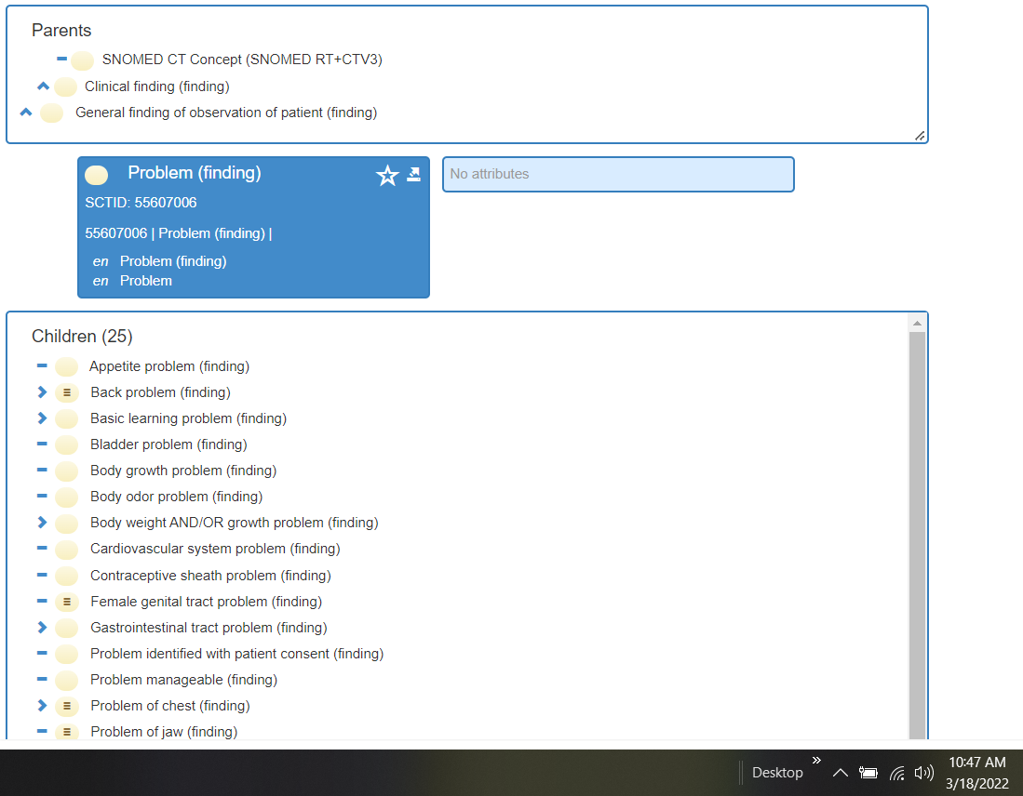
‘Problem’
(in SNOMED CT)

Slide 10
Problem as ontological entity?
Larry Weed did not define ‘problem’ but gave many examples of what ‘counts’ as problems.
If there would be the universal ‘problem’, what sensible questions should be asked:
  Are there particulars that at time t only instantiate ‘problem’ (and its subsumers) and no other universal?
  Can particulars which at time t1 do not instantiate ‘problem’ become instances of ‘problem’ at t2?
    If so, would this be possible without any other change having occurred in such particular?

Slide 11
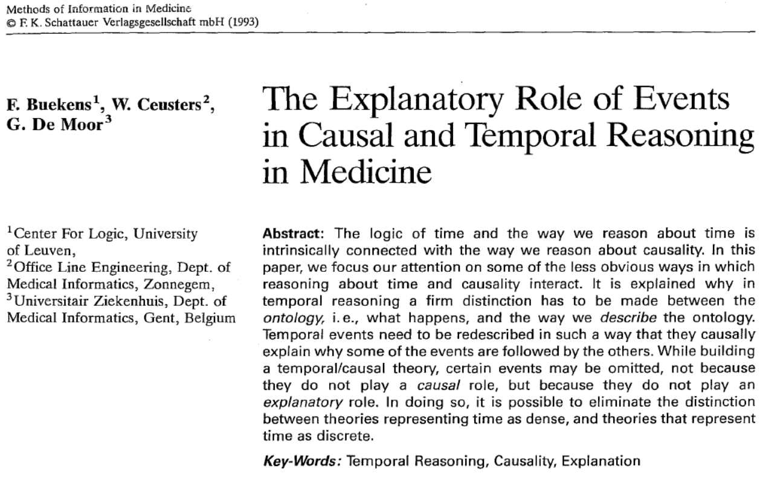

Slide 12
Problem as ontological entity?
‘A Problem has a single name which can change over time.
A Problem may have no underlying condition in the medical sense
A Problem may or may not appear to be a "problem" to the patient.
The status of the Problem doesn't necessarily imply that the underlying condition, if any, has the same status,-
Problems are headings that a Problem list can made from.
A Problem is by nature a grouper of other statements.’
‘We defined a “Problem” or “Cancer Disease” as something that required a plan for “diagnosis” and/or “management”’

Slide 13
‘Problem’ as representation
In general (an attempt open to scrutiny):
  To assert that x is a problem is to assert that x, or something in which x participates, has the disposition to interfere, or interferes, with a process that because of x is anticipated to have, or already has, an undesired outcome with respect to some plan or expected development/progression/evolution.
  There are no problems in reality, only problem ascriptions.

Slide 14
‘Problem’ in the context of an EMR
EMR Problem = (tentative elucidation)
  a representation R about at least a patient Y or his environment,
  created by a clinician D
  with the goal to make the intended audience of R aware
  that there exist some continuant C that participates – or has the disposition to participate – in a process P that interferes with an occurrent part of the history H of Y,
  such that H is anticipated by D to exhibit, or already exhibits, an undesirable outcome with respect to Y’s health.
‘at least’ → R is usually about something more precise than Y, but if so, then not always directly about C or P, but something that stands in one or other relation to C or P.

Slide 15
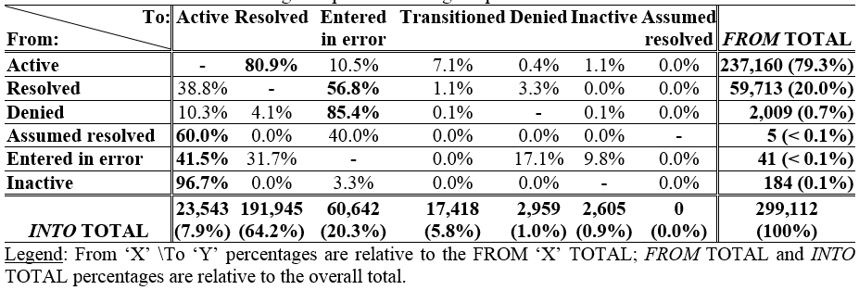
Problem status changes
Ceusters W, Blaisure J. Caveats for the use of the active problem list as ground truth for decision support. EFMI Special Topic Conference on Decision Support Systems and Education (EFMI STC-2018), Zagreb, Kroatia, Oct 14-16, 2018. Stud Health Technol Inform. 2018;255:10-14. (paper, response to reviewers, slides)

Slide 16
Active / Resolved
 |  |  |  | EHR update event
PtID | PrID | Problem | 0 | 1 | 2 | 3 | 4 | 5 | 6 | 7 | 8 | 9 | 10 | 11 | 12 | 13 | 14 | 15
B1 | 1 | Cerumen Impaction In Both Ears | N | D |  | D | D | D | D | R | A
 | 2 | Impacted cerumen of right ear |  |  |  |  |  |  |  |  |  | N
B2 | 1 | Cerumen Impaction | N | D | R | A | R | A | R | A | D | D
C1 | 1 | Acute Sinusitis | N | D | D | R | A | R | A | D | R | A
C2 | 1 | Acute Sinusitis | N | D | D | D | D | D | R | A | D | D | R | A | R | A | D
Legend: ‘PtID’: patient identifier; ‘PrID’: problem header identifier; ‘N’: Problem header added and marked active; ‘D’: problem documentation added; ‘A’: problem header marked active; ‘R’: problem resolved; Arrow: problem ‘transitioned’ into the problem pointed at by the arrow. Solid background: problem ‘active’.

Slide 17
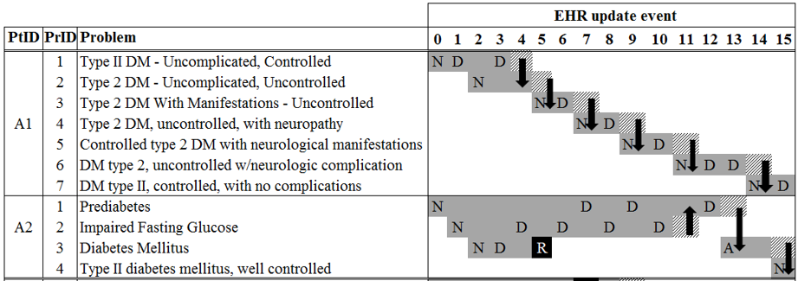
Transitions in two diabetes patients
Ceusters W, Blaisure J. Caveats for the use of the active problem list as ground truth for decision support. EFMI Special Topic Conference on Decision Support Systems and Education (EFMI STC-2018), Zagreb, Kroatia, Oct 14-16, 2018. Stud Health Technol Inform. 2018;255:10-14. (paper, response to reviewers, slides)

Slide 18
Future work: towards an OGMS-based
Referent Tracking Interpretation

Slide 19
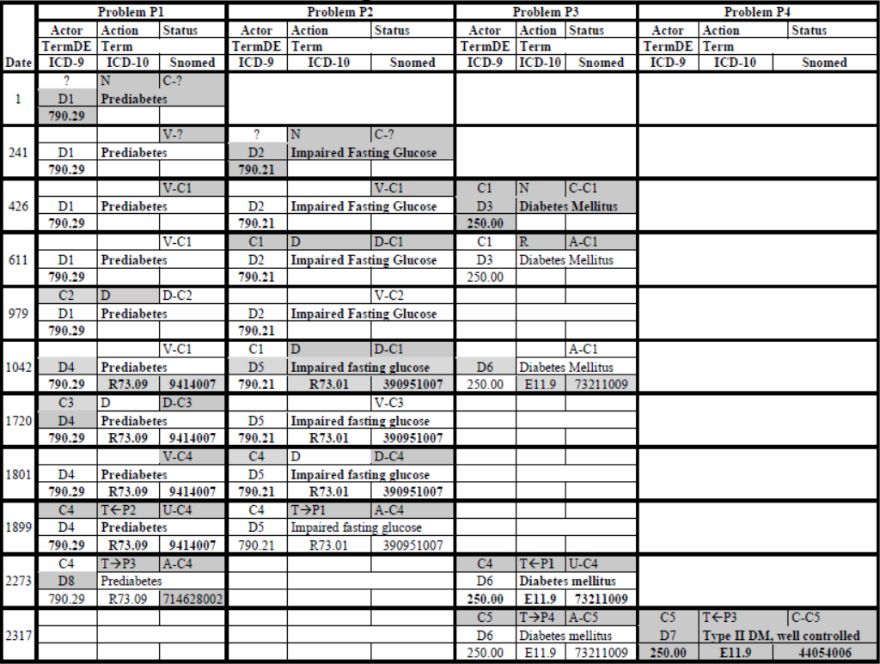

Slide 20
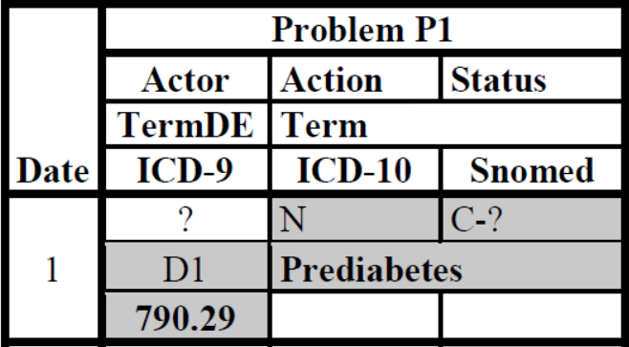
Actions on the problem list
‘N’: new problem instance asserted by actor,
‘D’: medical record updated with information relevant to the problem,
‘R’: actor declared the problem to be resolved,
‘T→Pn’: actor declared ‘transitioning’ of the problem into problem Pn,
‘T←Pn’: actor declared problem Pn to be ‘transitioned’ into the problem under scrutiny,
‘E’: actor declared problem to have been entered in error.
Ceusters W. The place of Referent Tracking in Biomedical Informatics.
In Elkin, Peter (ed.) Terminology, Ontology and Their Implementations. Springer Nature. (Forthcoming, preprint).

Slide 21
Status of a problem on the problem list
‘C’: ‘created’ de novo or transitioned from another one,
‘D’: ‘documented’, resulting from an action of type ‘D’,
‘A’: ‘archived’, either as the result of an action of type ‘R’, or when the problem is declared to have transitioned into another one.
‘U’: ‘updated’, occurs after another problem was transitioned in the one with the ‘U’ status,
‘V’: ‘visible’ to the user while manipulating another problem on the problem list.
Ceusters W. The place of Referent Tracking in Biomedical Informatics.
In Elkin, Peter (ed.) Terminology, Ontology and Their Implementations. Springer Nature. (Forthcoming, preprint).

Slide 22
Terminology associated with a problem
TermDE: identifier for a row in the EMR’s dictionary
Term: term in the dictionary
ICD-9: ICD-9-CM code
ICD-10: ICD-10-CM code
Snomed: Snomed CT code
How dictionary updates relate to the user is for this EMR not documented.
Ceusters W. The place of Referent Tracking in Biomedical Informatics.
In Elkin, Peter (ed.) Terminology, Ontology and Their Implementations. Springer Nature. (Forthcoming, preprint).

Slide 23
RT-based problem list management principles
Assumptions:
  User- and system actions on EMR data are co-managed by means of a Referent Tracking System (RTS).
  Actors on the problem list are assigned RUIs prior to be able to manipulate the problem list.
  Actor entries are assumed to be faithful unless the RTS’ logic identifies inconsistencies.
  The RTS uses realism-based principles for tracking the problem list and the entities the problem ascriptions are or might be about.
  The RTS’ ontologies are sufficiently populated to apply the principles on the basis of pre-implemented logic.

Slide 24
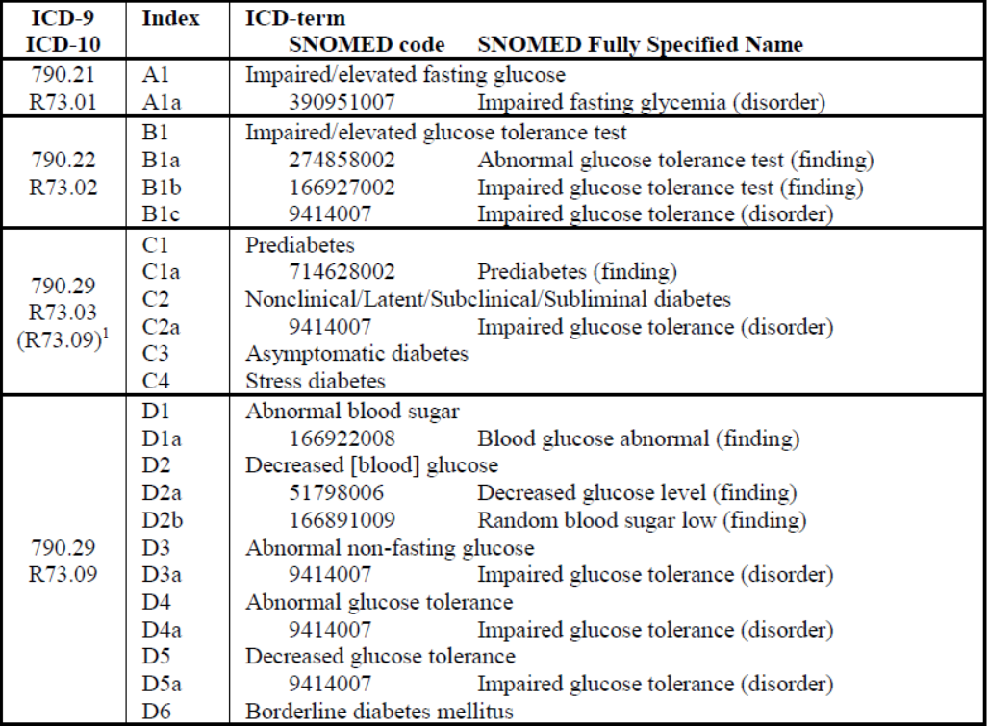

Slide 25
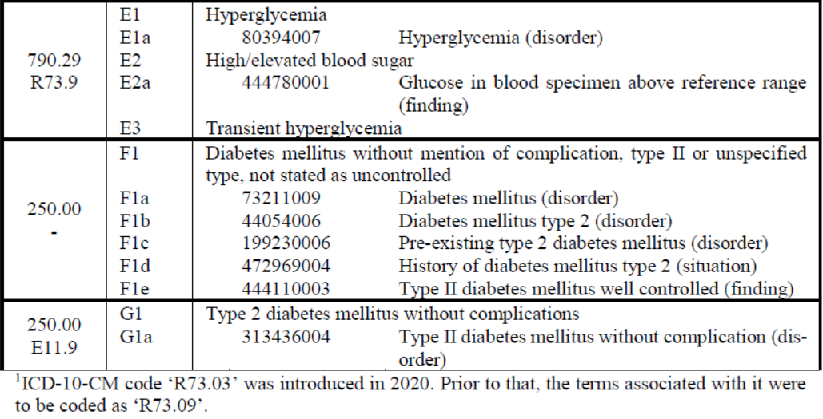
Ceusters W. The place of Referent Tracking in Biomedical Informatics.
In Elkin, Peter (ed.) Terminology, Ontology and Their Implementations. Springer Nature. (Forthcoming, preprint).

Slide 26
Case study
Discuss the following slide, using previous slides as guides, with respect to:
  What happened?
  What should have happened?
  How could an appropriately implemented RTS with adequate ontologies and business logic have interacted?
Use this as inspiration for A3, due April 4.
  describe relative analogue scenarios under which the portion of reality described by the variables you selected for assignment A1 (or any modification thereof after reassessment thereof) may change over time, and how that might impact the database when maintained by authors or compiled from sources with distinct perspectives on the domain. They must indicate the business-rules identified in A2 that are impacted under the scenarios and describe any necessary modifications that are required.

Slide 28
Referent Tracking Tuple Types
Tuple-type | Abstract syntax
A | A#< RUI_{a}, RUI_{p}, ‘A’/‘R’,‘+SU’/‘-SU’, t>
D | D#< RUI_{d}, RUI_{T}, t, ‘I’/E, R, S >
F | F#< RUI_{d}, t_{a}, RUI_{a}, RUI_{T}, C >
NtoI | NtoI#< ‘+’/‘-’, nt_{j}, n_{i}, RUI_{p}, rT, t_{r}, RUI_{c}>
NtoN | NtoN#< ‘+’/‘-’, r, P, rT/‘-’, t_{r}/‘-’>
NtoR | NtoR#< ‘+’/‘-’, inst, RUI_{n}, RUI_{r}, rT/‘-’, t_{r}/‘-’>
NtoC | NtoC#< ‘+’/‘-’, r, RUI_{cs}, RUI_{p}, code, rT, t_{r}>
NtoR(-) | NtoR(-)#< r, RUI_{p}, RUI_{r}, rT/‘-’, t_{r}/‘-’>
Ceusters W. The place of Referent Tracking in Biomedical Informatics. In Elkin, Peter (ed.) Terminology, Ontology and Their Implementations. Springer Nature. (Forthcoming, preprint).

Slide 29
‘Denotation’-tuple (LDC2e) semantics
A-tuple | A#< RUI_{a}, RUI_{p}, ‘A’/‘R’,‘+SU’/‘-SU’, t>
RUI_{a} assigned (‘A’) or reserved (‘R’) at temporal instant t ‘RUIp’ to/for a uniquely identifiable PoR either as singularly (‘+SU’) or potentially non-singularly (‘-SU’) unique identifier.
NtoI-tuple | NtoI#< ‘+’/‘-’, nt_{j}, n_{i}, RUI_{p}, rT, t_{r}, RUI_{c}>
It is (‘+’) or not (‘-’) the case that the temporal region at which RUI_{c} considers n_{i} to be an identifying descriptor of the descriptor type nt_{j} for PoR RUI_{p} relates in manner rT to temporal region t_{r}.
Ceusters W. The place of Referent Tracking in Biomedical Informatics. In Elkin, Peter (ed.) Terminology, Ontology and Their Implementations. Springer Nature. (Forthcoming, preprint).

Slide 30
‘Domain’-tuple (LDC1) semantics
NtoN-tuple | NtoN#< ‘+’/‘-’, r, P, rT/‘-’, t_{r}/‘-’>
It is (‘+’) or not (‘-’) the case that relation r obtains between the non-repeatable PoRs referred to in the ordered set of RUIs P (wrt. temporal region t_{r} in manner rT)
NtoR-tuple | NtoR#< ‘+’/‘-’, inst, RUI_{n}, RUI_{r}, rT/‘-’, t_{r}/‘-’>
It is (‘+’) or not (‘-’) the case that the instantiation relation inst obtains between the non-repeatable PoR RUI_{n} and the repeatable PoR RUI_{r} (wrt. temporal region t_{r} in manner rT).
NtoC-tuple | NtoC#< ‘+’/‘-’, r, RUI_{cs}, RUI_{p}, code, rT, t_{r}>
It is (‘+’) or not (‘-’) the case that the temporal region at which concept code code from concept system RUI_{cs} is an accurate code for the non-repeatable PoR RUI_{p} in a way expressed by r, relates in manner rT to temporal region t_{r}.
NtoR(-) -tuple | NtoR(-)#< r, RUI_{p}, RUI_{r}, rT/‘-’, t_{r}/‘-’>
It is the case that the relation r does not obtain between the non-repeatable PoR RUI_{p} and any of the non-repeatable PoRs in which repeatable PoR RUI_{r} is repeated (wrt. temporal region t_{r} in manner rT).
Ceusters W. The place of Referent Tracking in Biomedical Informatics. In Elkin, Peter (ed.) Terminology, Ontology and Their Implementations. Springer Nature. (Forthcoming, preprint).

Slide 31
‘Meta’-tuple (LDC2i) semantics
D-tuple | D#< RUI_{d}, RUI_{T}, t, ‘I’/E, R, S >
RUI_{d} registered at temporal instant t tuple RUI_{T,} i.e. a tuple other than D# itself, either as an insertion (‘I’) in the RTS for reason R, or as the correction of an error of type E in which case S is a list of RUIs denoting the tuples, if any at all, that replace RUI_{T}.
F-tuple | F#< RUI_{d}, t_{a}, RUI_{a}, RUI_{T}, C >
RUI_{d} asserts at temporal instant t_{a} that his confidence in the faithfulness of tuple RUI_{T} as authored by RUI_{a} is of level C.
Ceusters W. The place of Referent Tracking in Biomedical Informatics. In Elkin, Peter (ed.) Terminology, Ontology and Their Implementations. Springer Nature. (Forthcoming, preprint).

