Slide 1
BMI714 – Spring 2022
Principles of Referent Tracking in Biomedical Informatics
(class number 19404)
Class 6 – March 8, 2022
Implementing data structures for
Referent Tracking tuples (1)
Werner CEUSTERS^{1,2}
¹ Department of Biomedical Informatics, University at Buffalo, USA
² Department of Psychiatry, University at Buffalo, USA

Slide 2
Referent Tracking Tuple Types
Tuple-type | Abstract syntax
A | A#< RUI_{a}, RUI_{p}, ‘A’/‘R’,‘+SU’/‘-SU’, t>
D | D#< RUI_{d}, RUI_{T}, t, ‘I’/E, R, S >
F | F#< RUI_{d}, t_{a}, RUI_{a}, RUI_{T}, C >
NtoI | NtoI#< ‘+’/‘-’, nt_{j}, n_{i}, RUI_{p}, rT, t_{r}, RUI_{c}>
NtoN | NtoN#< ‘+’/‘-’, r, P, rT/‘-’, t_{r}/‘-’>
NtoR | NtoR#< ‘+’/‘-’, inst, RUI_{n}, RUI_{r}, rT/‘-’, t_{r}/‘-’>
NtoC | NtoC#< ‘+’/‘-’, r, RUI_{cs}, RUI_{p}, code, rT, t_{r}>
NtoR(-) | NtoR(-)#< r, RUI_{p}, RUI_{r}, rT/‘-’, t_{r}/‘-’>
Ceusters W. The place of Referent Tracking in Biomedical Informatics. In Elkin, Peter (ed.) Terminology, Ontology and Their Implementations. Springer Nature. (Forthcoming, preprint).

Slide 3
Bad programmers worry about the code. Good programmers worry about data structures and their relationships.
Linus Torvalds
Fold knowledge into data, so program logic can be stupid and robust.
Eric Raymond

Slide 4
Basic data structure requirements
Optimized for the tasks an application has to perform.
Optimized for the algorithms that together perform a specific task.
Trade-offs:
  Write / read (search) / space
  Dynamics of the data pool
  Relationships between data-elements
  Design complexity
Excellent overview:
John Bullinaria. Lecture Notes for Data Structures and Algorithms. https://www.cs.bham.ac.uk/~jxb/DSA/dsa.pdf

Slide 5
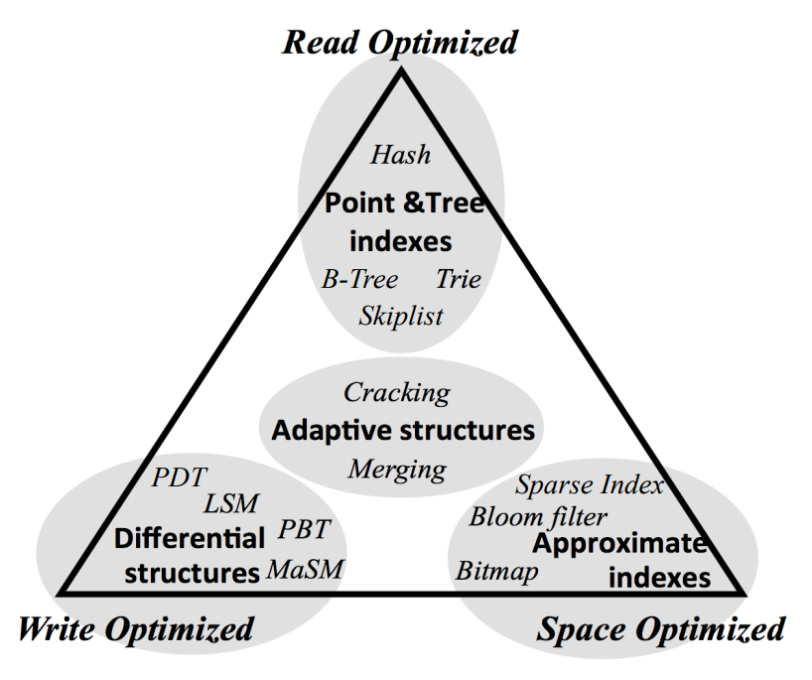
Data structure engineering trade-offs
S. Idreos, et al., “The Periodic Table of Data Structures”
Bulletin of the IEEE Computer Society Technical Committee on Data Engineering, vol. 41, no. 3, pp. 64-75, 2018.
Paper: https://stratos.seas.harvard.edu/publications/periodic-table-data-structures
Lecture: https://www.youtube.com/watch?v=wzvoveScKao

Slide 6
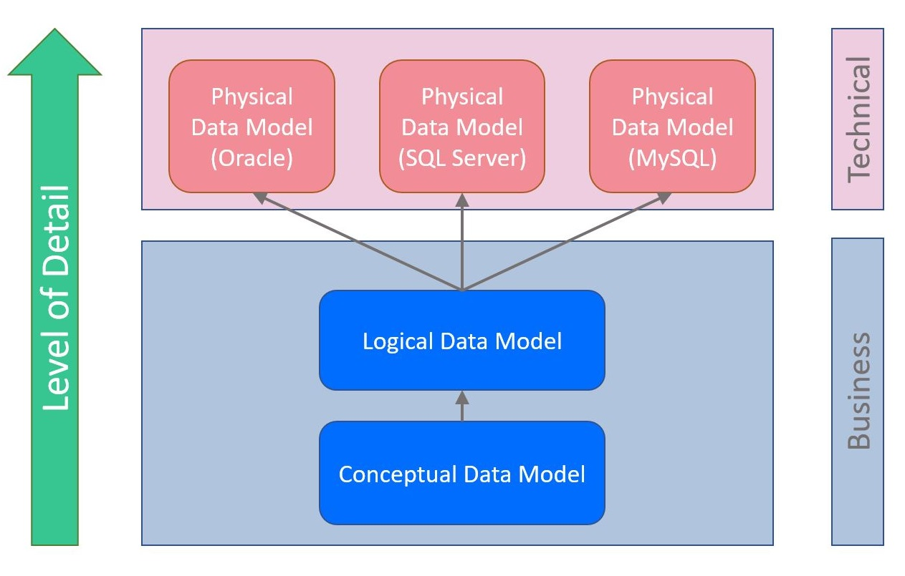
RDBMS technology
https://vertabelo.com/blog/conceptual-logical-physical-data-model/

Slide 7
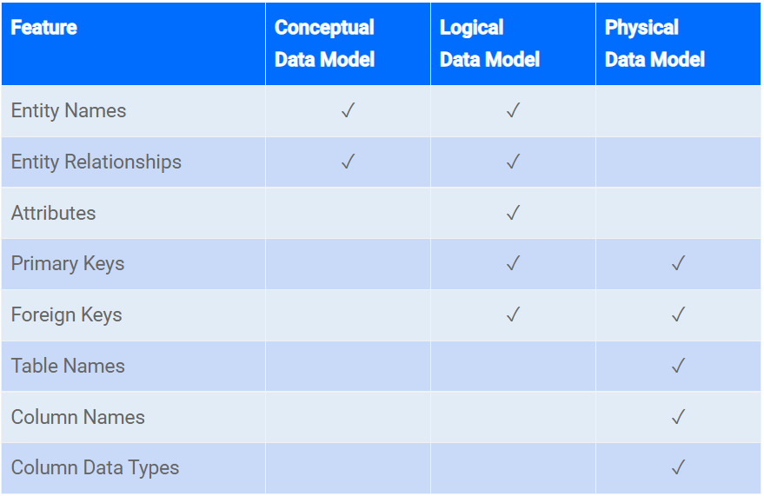
When working with RDBMS
https://vertabelo.com/blog/conceptual-logical-physical-data-model/

Slide 8
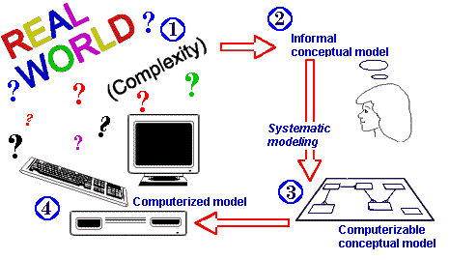
Data structure design priorities for realism-based ontology approaches (1)
It must be possible to generate from the logical data structure (LDS) logical data components (LDC) that mimic mereologically the ontology of the portion of reality (PoR) the component is about.
‘Conceptual’
‘Ontological’
Follow the principles of ontological realism
http://www.cems.uwe.ac.uk/~kg-doyle/tdrewry/lds.htm

Slide 9
Data structure design priorities for realism-based ontology approaches (2)
It must be possible to generate from the logical data structure (LDS) logical data components (LDC) that mimic mereologically the ontology of the portion of reality (PoR) the component is about.
  Essentially distinct logical data component (LDC) types:
  LDC1: represent a PoR which is not about anything;
  LDC2: represent representations
    LDC2e: represent representations outside the LDS;
    LDC2i: represent representations inside the LDS.

Slide 10
The mereology of realism-based LDCs
It being the case that
John has diabetes
An entry in the EMR
stating that John has diabetes
It being the case that Dr. Smith says that John has diabetes
An entry in the EMR stating that the entry in the EMR stating that John has diabetes, is wrong
An entry in the EMR stating that Dr. Smith told John that he has diabetes
An entry in the RTS stating that Dr. Smith told John that he has diabetes

Slide 11
The mereology of realism-based LDCs
An entry in the RTS stating that the entry in the RTS stating that Dr. Smith told John that he has diabetes, is wrong
#1
#1
PoRs can be referenced multiple times in complex LDCs.
  e.g. above: #1 denotes John.

Slide 12
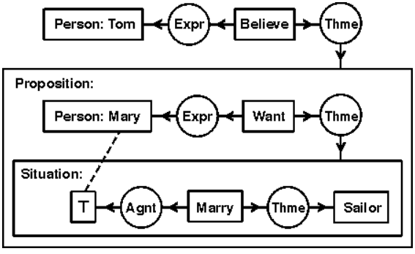
Close, but not exactly like this …
Tom believes that Mary wants to marry a sailor
In KIF:
(exists ((?x1 person) (?x2 believe))
(and (expr ?x2 ?x1)
(thme ?x2
(exists ((?x3 person) (?x4 want) (?x8 situation))
(and (name ?x3 'Mary) (expr ?x4 ?x3) (thme ?x4 ?x8)
(dscr ?x8 (exists ((?x5 marry) (?x6 sailor))
(and (Agnt ?x5 ?x3) (Thme ?x5 ?x6)))))))))
http://www.jfsowa.com/cg/cgexampw.htm

Slide 13
Related RT tuples are like SOLOR’s ANFs
‘The ANF Reference Model is a logical information model describing the format of a normalized clinical statement that may have originated from an information system data store, a standard-based message (e.g. HL7 Version 2), a standard-document (e.g. HL7 CDA), a standard-based resource (e.g. HL7 FHIR), or an instance of a CIMI model (e.g. FHIR-based profile, openEHR archetype).’
‘The ANF Reference Model describes the normal form proposed by ANF. Along with the editorial rules the ANF Reference Model describes how to reduce data redundancy to support analysis of aggregated clinical statements.’
‘A clinical statement expressed in the ANF Reference Model is in Analysis Normal Form if and only if it conforms to all the Editorial Rules defined by this specification.’
http://solor.io/wp-content/uploads/2020/01/ANF-Ballot-Jan-2020.pdf

Slide 14
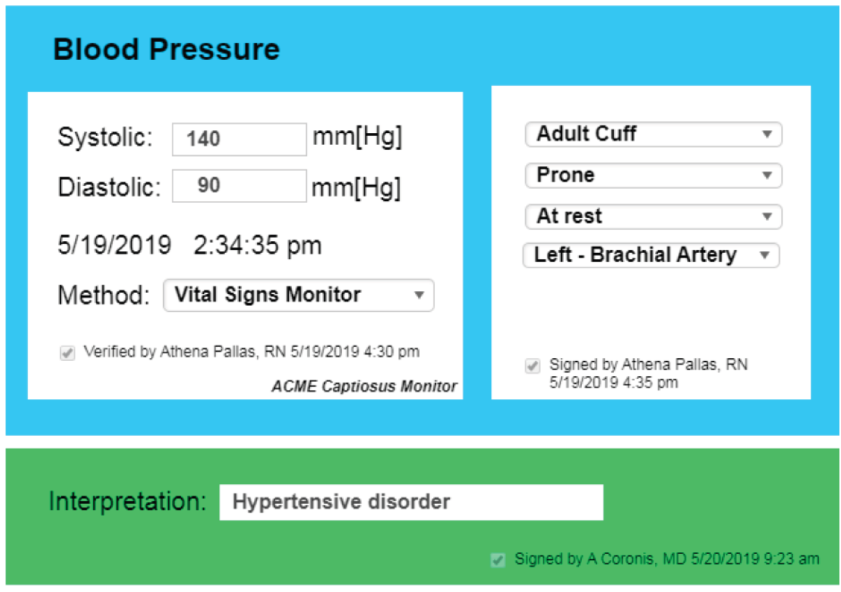
Example EMR user interface
http://solor.io/wp-content/uploads/2020/01/ANF-Ballot-Jan-2020.pdf

Slide 15
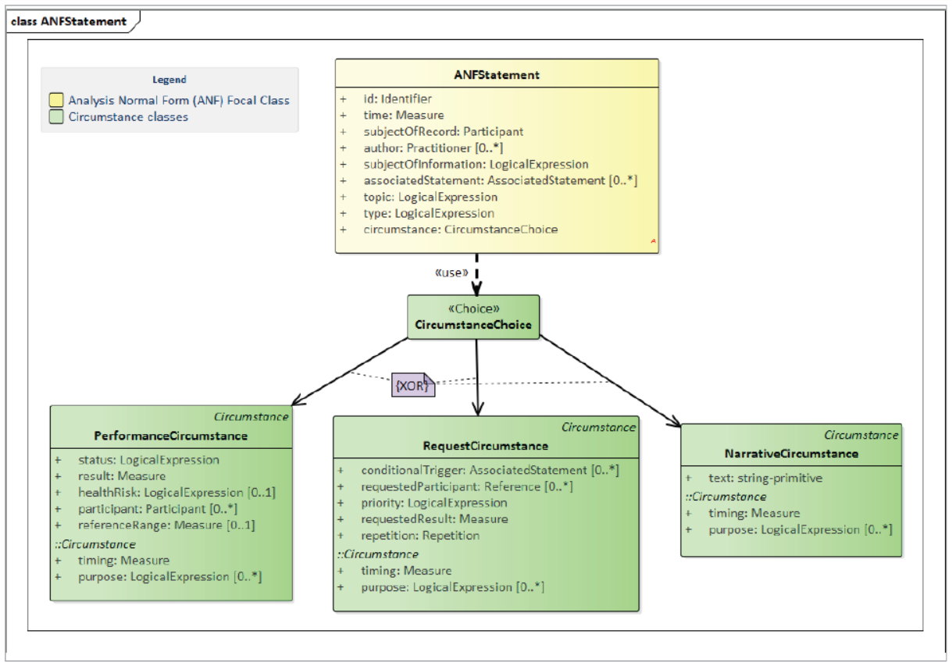
ANF model in UML
http://solor.io/wp-content/uploads/2020/01/ANF-Ballot-Jan-2020.pdf

Slide 16
Data structure design priorities for realism-based ontology approaches (3)
Realism-based LDCs correspond to ‘views’ in traditional database systems.
The data structures to implement the RT-tuples in a Referent Tracking System (RTS) correspond to the conceptual data model in traditional database design.
RT tuples should be given a model-theoretic semantics too.

Slide 17
‘Denotation’-tuple (LDC2e) semantics
A-tuple | A#< RUI_{a}, RUI_{p}, ‘A’/‘R’,‘+SU’/‘-SU’, t>
RUI_{a} assigned (‘A’) or reserved (‘R’) at temporal instant t ‘RUIp’ to/for a uniquely identifiable PoR either as singularly (‘+SU’) or potentially non-singularly (‘-SU’) unique identifier.
NtoI-tuple | NtoI#< ‘+’/‘-’, nt_{j}, n_{i}, RUI_{p}, rT, t_{r}, RUI_{c}>
It is (‘+’) or not (‘-’) the case that the temporal region at which RUI_{c} considers n_{i} to be an identifying descriptor of the descriptor type nt_{j} for PoR RUI_{p} relates in manner rT to temporal region t_{r}.
Ceusters W. The place of Referent Tracking in Biomedical Informatics. In Elkin, Peter (ed.) Terminology, Ontology and Their Implementations. Springer Nature. (Forthcoming, preprint).

Slide 18
‘Domain’-tuple (LDC1) semantics
NtoN-tuple | NtoN#< ‘+’/‘-’, r, P, rT/‘-’, t_{r}/‘-’>
It is (‘+’) or not (‘-’) the case that relation r obtains between the non-repeatable PoRs referred to in the ordered set of RUIs P (wrt. temporal region t_{r} in manner rT)
NtoR-tuple | NtoR#< ‘+’/‘-’, inst, RUI_{n}, RUI_{r}, rT/‘-’, t_{r}/‘-’>
It is (‘+’) or not (‘-’) the case that the instantiation relation inst obtains between the non-repeatable PoR RUI_{n} and the repeatable PoR RUI_{r} (wrt. temporal region t_{r} in manner rT).
NtoC-tuple | NtoC#< ‘+’/‘-’, r, RUI_{cs}, RUI_{p}, code, rT, t_{r}>
It is (‘+’) or not (‘-’) the case that the temporal region at which concept code code from concept system RUI_{cs} is an accurate code for the non-repeatable PoR RUI_{p} in a way expressed by r, relates in manner rT to temporal region t_{r}.
NtoR(-) -tuple | NtoR(-)#< r, RUI_{p}, RUI_{r}, rT/‘-’, t_{r}/‘-’>
It is the case that the relation r does not obtain between the non-repeatable PoR RUI_{p} and any of the non-repeatable PoRs in which repeatable PoR RUI_{r} is repeated (wrt. temporal region t_{r} in manner rT).
Ceusters W. The place of Referent Tracking in Biomedical Informatics. In Elkin, Peter (ed.) Terminology, Ontology and Their Implementations. Springer Nature. (Forthcoming, preprint).

Slide 19
‘Meta’-tuple (LDC2i) semantics
D-tuple | D#< RUI_{d}, RUI_{T}, t, ‘I’/E, R, S >
RUI_{d} registered at temporal instant t tuple RUI_{T,} i.e. a tuple other than D# itself, either as an insertion (‘I’) in the RTS for reason R, or as the correction of an error of type E in which case S is a list of RUIs denoting the tuples, if any at all, that replace RUI_{T}.
F-tuple | F#< RUI_{d}, t_{a}, RUI_{a}, RUI_{T}, C >
RUI_{d} asserts at temporal instant t_{a} that his confidence in the faithfulness of tuple RUI_{T} as authored by RUI_{a} is of level C.
Ceusters W. The place of Referent Tracking in Biomedical Informatics. In Elkin, Peter (ed.) Terminology, Ontology and Their Implementations. Springer Nature. (Forthcoming, preprint).

Slide 20
E.g.: what do A-tuples line up with?
A-tuple | A#< RUI_{a}, RUI_{p}, ‘A’/‘R’,‘+SU’/‘-SU’, t>
RUI_{a} assigned (‘A’) or reserved (‘R’) at temporal instant t ‘RUIp’ to/for a uniquely identifiable PoR either as singularly (‘+SU’) or potentially non-singularly (‘-SU’) unique identifier.
Model-theoretic semantics

Slide 21
What a persisted A-tuple lines up with
A-tuple | A#< RUI_{a}, RUI_{p}, ‘A’/‘R’,‘+SU’/‘-SU’, t>
RUI_{a} assigned (‘A’) or reserved (‘R’) at temporal instant t ‘RUIp’ to/for a uniquely identifiable PoR either as singularly (‘+SU’) or potentially non-singularly (‘-SU’) unique identifier.
The values of RUI_{p}, RUI_{a} and t are constants in the logical language and are interpreted as individuals in the domain of discourse (DoD).
The DoD includes entities that (possibly) correspond to objects in reality in addition to entities that don’t:
  The objects denoted by the values of RUI_{a} and t exist or there would not have been the A-tuple,
  The value of RUI_{p} does not have an object as referent when the value of RUI_{p} is reserved, or when it is assigned and the object denoted by the value of RUI_{a} is wrong about it.
There might be more than one constant in the logical language that maps to one entity in the DoD when the A-tuple’s 4th argument = ‘-SU’.

Slide 22
E.g.: what do NtoI⁺-tuples line up with?
NtoI-tuple | NtoI#< ‘+’/‘-’, nt_{j}, n_{i}, RUI_{p}, rT, t_{r}, RUI_{c}>
It is (‘+’) or not (‘-’) the case that the temporal region at which RUI_{c} considers n_{i} to be an identifying descriptor of the descriptor type nt_{j} for PoR RUI_{p} relates in manner rT to temporal region t_{r}.
Model-theoretic semantics

Slide 23
What a persisted NtoI⁺-tuple lines up with
NtoI-tuple | NtoI#< ‘+’/‘-’, nt_{j}, n_{i}, RUI_{p}, rT, t_{r}, RUI_{c}>
It is (‘+’) or not (‘-’) the case that the temporal region at which RUI_{c} considers n_{i} to be an identifying descriptor of the descriptor type nt_{j} for PoR RUI_{p} relates in manner rT to temporal region t_{r}.
The values of RUI_{p}, RUI_{c} and t_{r} are constants in the logical language and are interpreted as individuals in the domain of discourse (DoD).
The values of nt_{j} and n_{i} are terms in the object language.

Slide 24
Essential questions for your projects relevant for choosing a data structure (1)
Is my database evolving or is it immutable?
  When evolving:
    Do I need to track changes?
    Do deletions reflect corresponding changes in reality or the correction of mistakes?
    Do additions impact the interpretation of data already present?
    Do additions reflect changes in reality or changes in knowledge about reality?
    How big can it grow?
  If immutable:
    Do the data provide a historical perspective or a snapshot?

Slide 25
Essential questions for your projects relevant for choosing a data structure (2)
Do I need or wish to link your data to other databases?
To what extent do data elements in your database identify unique objects in reality?
  Explicitly?
  Implicitly?
    Uniqueness derivable from available ontology?
What searches / procedures do you want to run over the RT-compatible transformation of your source database(s)?
To what extent are choices re data structures dependent on what your development environment is good or bad at?

Slide 26
Essential questions for your projects relevant for choosing a data structure (3)
Whenever possible:
  Stay as closely as possible to the BFO2020-principles about:
    What should figure as outdiscourse terms in CL
    Arity of the arguments in sentences with outdiscourse terms
      Thus not: (lung #1)
      But: (instance-of #1 lung t..)
  Distinguish between LCDs, either explicitly in the data structures, or inferable by algorithms.
    The pair ‘#1 is an occurrent’ and ‘#1 is not an occurrent’ is inconsistent.
    The pair ‘#2 says #1 is an occurrent’ and ‘#3 says #1 is not an occurrent’ is not inconsistent.

Slide 27
Guided exercise

Slide 28
Assignment A2
Students must define in their representation or programming language of choice data structures and business rules that are capable of representing and managing in a way compatible with a BFO-perspective on reality relationships between entities pertaining to the choice of variables made in A1 (or corrections thereof) and in line with the tuple-types defined in Referent Tracking.
If OWL or any description logic format is selected, students need to address appropriately the problem of dealing with non-binary relationships and time specifications (see f.i. https://johnbeverley.com/blogic/2018/6/13/binary-relations-in-owl-generic-and-specific ). When Excel is used, elements of temporal databases might come in handy (e.g. https://www.sciencedirect.com/topics/computer-science/bitemporal-data , R4).
• Due date: March 22, 2021, noon

Slide 29
A2 assessment
Assessment criteria | Weight
Coverage of all RT tuple types | 20%
Completeness, correctness and clarity of the documentation of the business rules that check for consistency once the data structures are used to populate the referent tracking system | 70%
Adequate coverage of time | 10%

Slide 30
Decisions, decisions, …
The programming language / environment and associated tools you will use. Argumentation.
  If Prolog: https://www.metalevel.at/prolog/data
What you want the implementation to achieve with the selected variables.
Data structure choice.
Business rules.

