Slide 1
BMI714 – Spring 2022
Principles of Referent Tracking in Biomedical Informatics
(class number 19404)
Class 3 – Feb 15, 2022
Approaches related to Referent Tracking: Semantic Web, Linked Data, Knowledge Graphs
Werner CEUSTERS^{1,2}
¹ Department of Biomedical Informatics, University at Buffalo, USA
² Department of Psychiatry, University at Buffalo, USA

Slide 2
Questions about the reading?

Slide 3
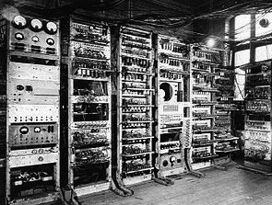
In the beginning there was …
1949: The Manchester Mark I: First Digital Computer
https://www.britannica.com/technology/Manchester-Mark-I

Slide 4
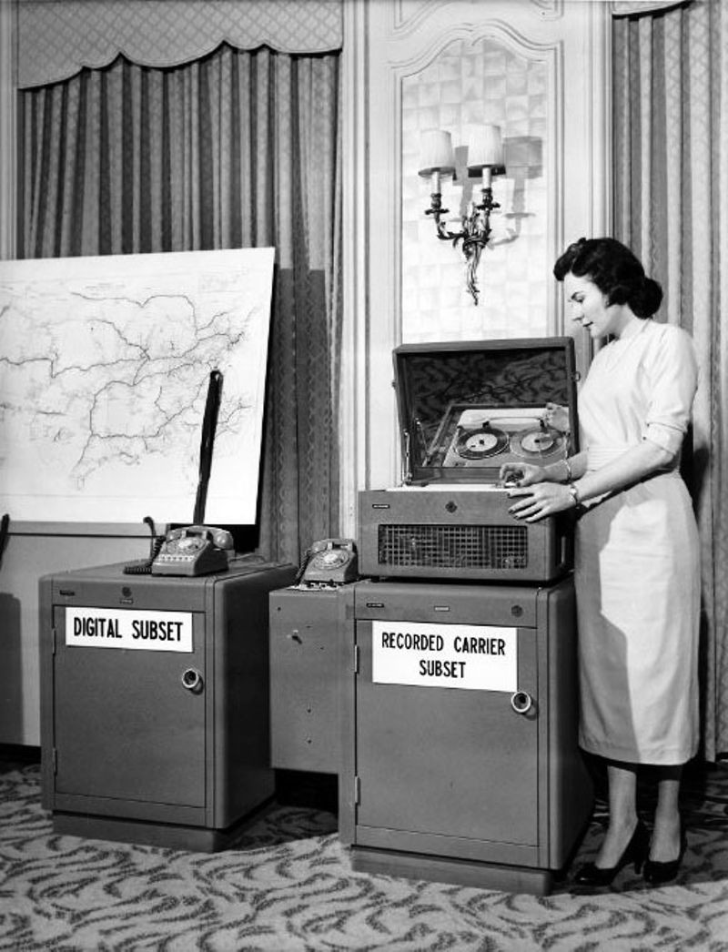
1958
First modem
(AT&T)
Asynchronous data links
https://www.computerhistory.org/timeline/networking-the-web/

Slide 5
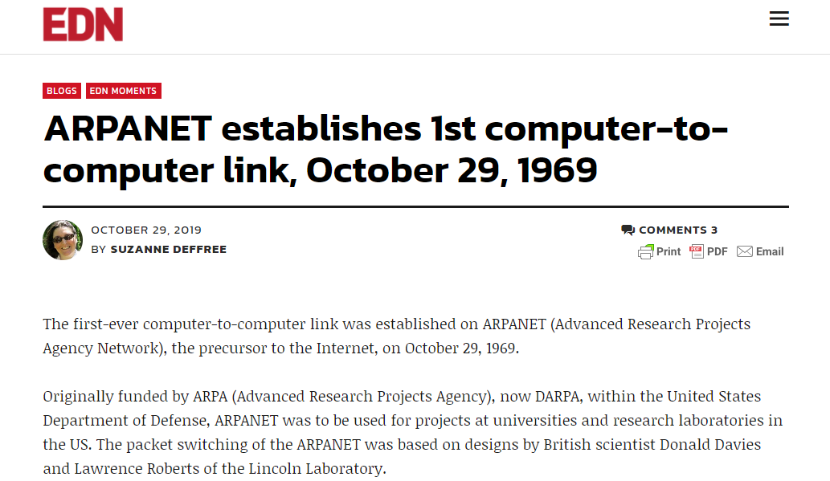
ARPANET
https://www.edn.com/arpanet-establishes-1st-computer-to-computer-link-october-29-1969/

Slide 6
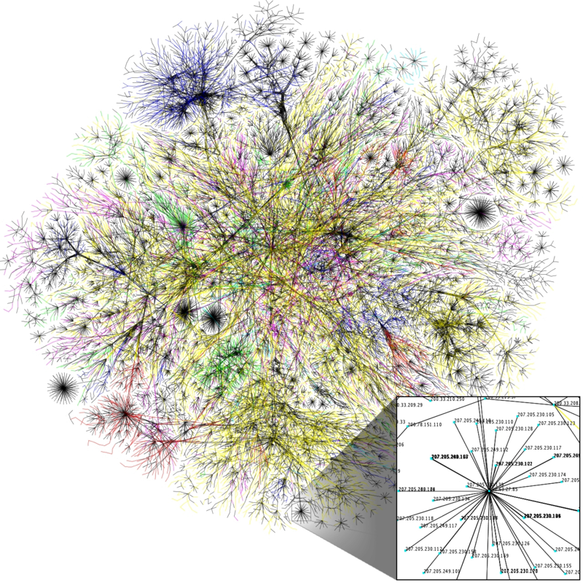
Emergence of other computer networks and merging into ‘The Internet’ (1980)
NPL network
Merit Network
CYCLADES
X.25 and public data networks
UUCP and Usenet
…
https://commons.wikimedia.org/wiki/File:Internet_map_1024_-_transparent,_inverted.png

Slide 7
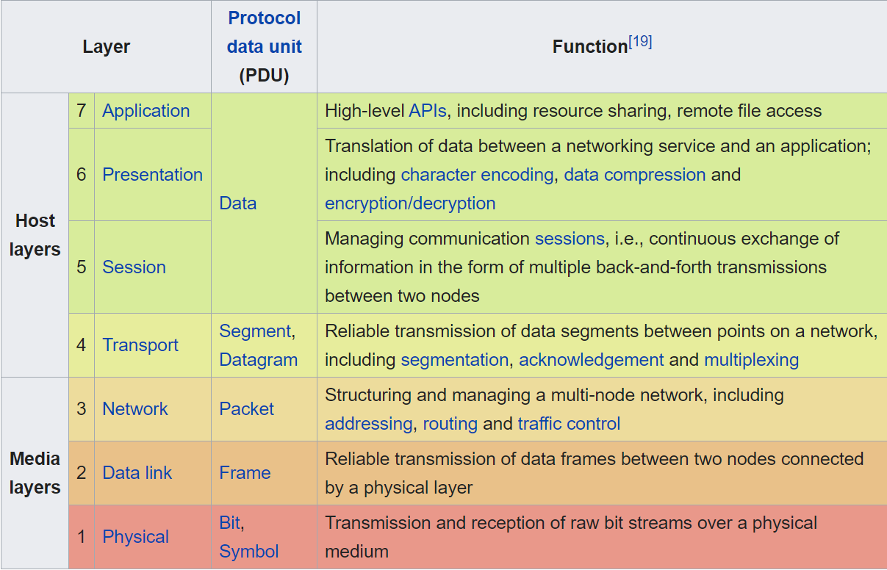
Open Systems Interconnection model
(OSI model – ISO 1980)

Slide 8
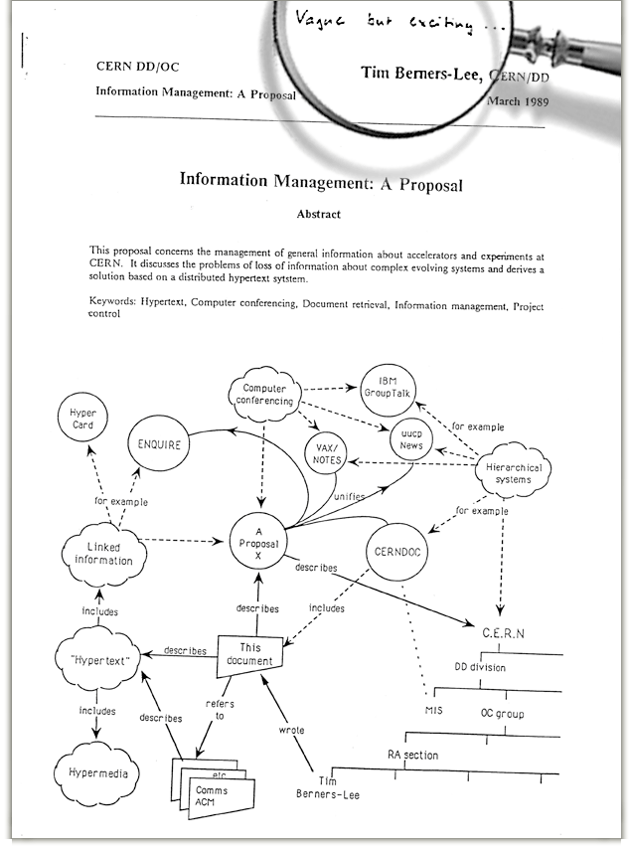
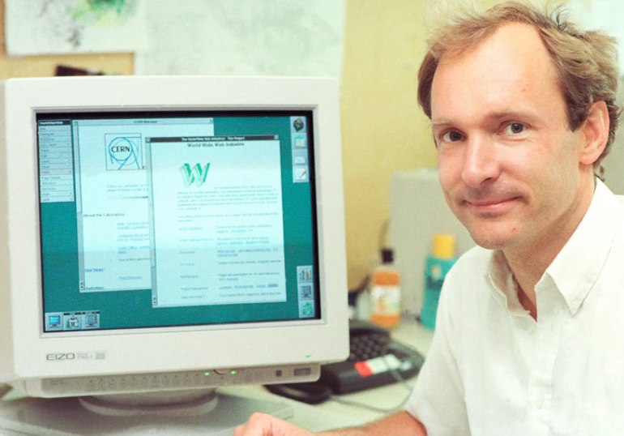
1989: the vision of the
World Wide Web
This proposal concerns the management of general information about accelerators and experiments at CERN. It discusses the problems of loss of information about complex evolving systems and derives a solution based on a distributed hypertext system.
https://www.w3.org/History/1989/proposal.html#:~:text=Information%20Management%3A%20A%20Proposal&text=This%20proposal%20concerns%20the%20management,on%20a%20distributed%20hypertext%20system.

Slide 9
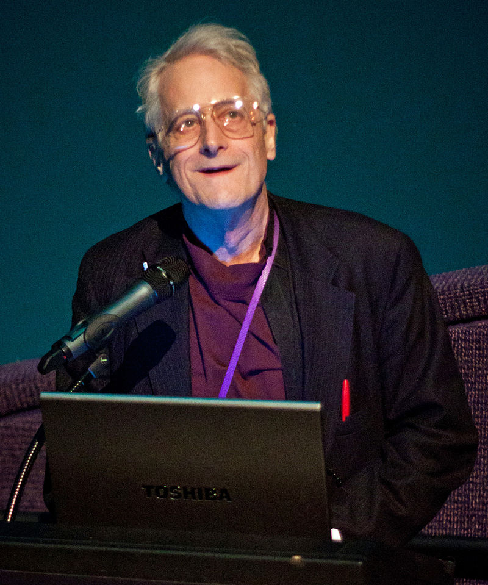
1963: ‘Hypertext’
The terms 'hypertext' and 'hypermedia’ were coined by Ted Nelson as part of a model he developed for creating and using linked content (first published reference 1965)
Later formalized in ‘document description languages’
https://en.wikipedia.org/wiki/Hypertext#cite_note-7
By Dgies - Own work, CC BY-SA 3.0, https://commons.wikimedia.org/w/index.php?curid=13691666

Slide 10
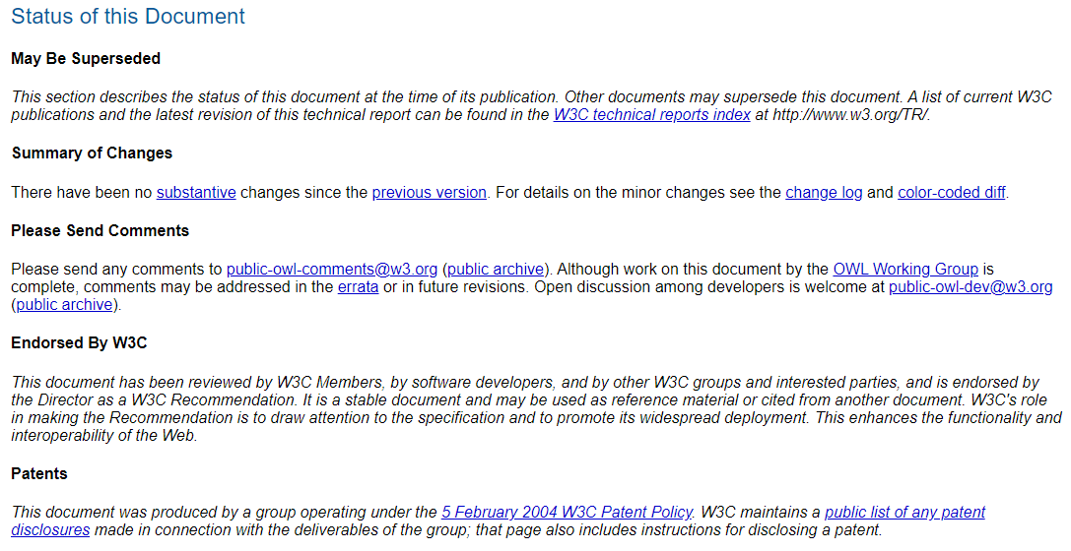
Hypertext document

Slide 11
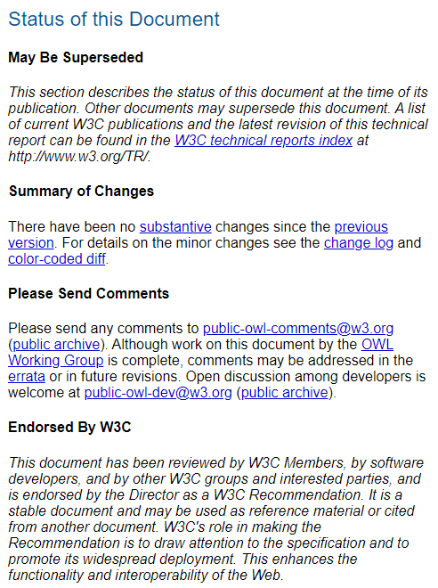
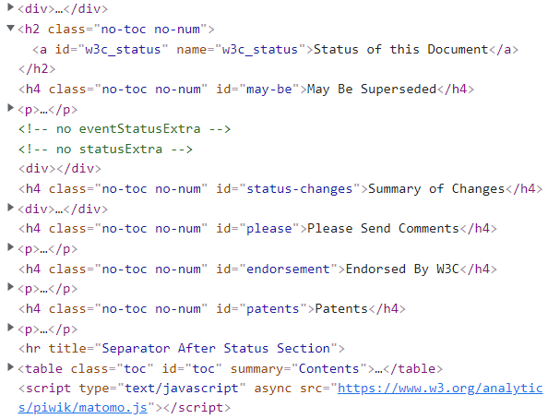
HTML source

Slide 12
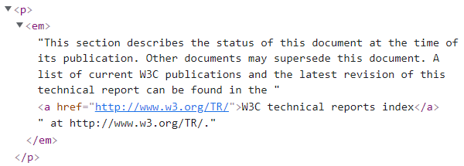
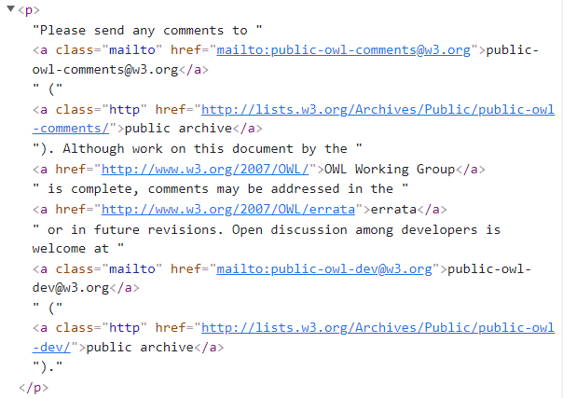
HTML source

Slide 13
Families of document description languages
SGML: Standardized General Markup Language
  ISO 8879:1986 → prior to WWW vision!
  Abstract syntax for documents + DTD (Document Type Definition)
Concrete syntaxes based on SGML and developed for WWW
  XML: eXtended Markup Language
    A meta-language to define markup-languages
    Tags are free to choose and a browser decides what to do with it.
  HTML: HyperText Markup Language:
    Fixed set of tags which browsers render in agreed upon ways.
https://www.w3.org/People/Raggett/Drafts/xml.html

Slide 14
XML example
<?xml version="1.0" encoding="UTF-8" standalone="no"?>
<!DOCTYPE people_list SYSTEM "example.dtd">
<people_list>
<person>
<name>Fred Bloggs</name>
<birthdate>2008-11-27</birthdate>
<gender>Male</gender>
</person>
</people_list>
<!ELEMENT people_list (person)*>
<!ELEMENT person (name, birthdate?, gender?, socialsecuritynumber?)>
<!ELEMENT name (#PCDATA)>
<!ELEMENT birthdate (#PCDATA)>
<!ELEMENT gender (#PCDATA)>
<!ELEMENT socialsecuritynumber (#PCDATA)>
https://en.wikipedia.org/wiki/Document_type_definition

Slide 15
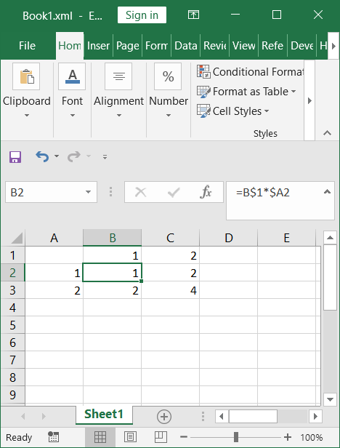
XML rendering of a spreadsheet

Slide 16
XML format
(1)
<?xml version="1.0"?>
<?mso-application progid="Excel.Sheet"?>
<Workbook xmlns="urn:schemas-microsoft-com:office:spreadsheet"
xmlns:o="urn:schemas-microsoft-com:office:office"
xmlns:x="urn:schemas-microsoft-com:office:excel"
xmlns:ss="urn:schemas-microsoft-com:office:spreadsheet"
xmlns:html="http://www.w3.org/TR/REC-html40">
<DocumentProperties xmlns="urn:schemas-microsoft-com:office:office">
<Author>Ceusters</Author>
<LastAuthor>Ceusters</LastAuthor>
<Created>2022-02-11T21:14:48Z</Created>
<LastSaved>2022-02-11T21:17:59Z</LastSaved>
<Company>University at Buffalo</Company>
<Version>16.00</Version>
</DocumentProperties>
<OfficeDocumentSettings xmlns="urn:schemas-microsoft-com:office:office">
<AllowPNG/>
</OfficeDocumentSettings>
<ExcelWorkbook xmlns="urn:schemas-microsoft-com:office:excel">
<WindowHeight>8256</WindowHeight>
<WindowWidth>23040</WindowWidth>
<WindowTopX>32767</WindowTopX>
<WindowTopY>32767</WindowTopY>
<ProtectStructure>False</ProtectStructure>
<ProtectWindows>False</ProtectWindows>
</ExcelWorkbook>

Slide 17
XML format (2)
<Worksheet ss:Name="Sheet1">
<Table ss:ExpandedColumnCount="3" ss:ExpandedRowCount="3" x:FullColumns="1"
x:FullRows="1" ss:DefaultRowHeight="14.4">
<Row>
<Cell ss:Index="2"><Data ss:Type="Number">1</Data></Cell>
<Cell><Data ss:Type="Number">2</Data></Cell>
</Row>
<Row>
<Cell><Data ss:Type="Number">1</Data></Cell>
<Cell ss:Formula="=R1C*RC1"><Data ss:Type="Number">1</Data></Cell>
<Cell ss:Formula="=R1C*RC1"><Data ss:Type="Number">2</Data></Cell>
</Row>
<Row>
<Cell><Data ss:Type="Number">2</Data></Cell>
<Cell ss:Formula="=R1C*RC1"><Data ss:Type="Number">2</Data></Cell>
<Cell ss:Formula="=R1C*RC1"><Data ss:Type="Number">4</Data></Cell>
</Row>
</Table>
…
</Worksheet>
</Workbook>

Slide 18
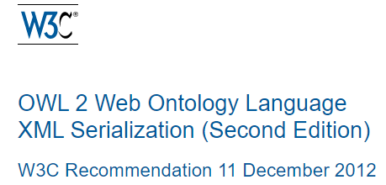
XML serialization of an OWL2 ontology
<?xml version="1.0" encoding="UTF-8"?>
<Ontology xmlns:xsi="http://www.w3.org/2001/XMLSchema-instance"
xsi:schemaLocation="http://www.w3.org/2002/07/owl# http://www.w3.org/2009/09/owl2-xml.xsd"
xmlns="http://www.w3.org/2002/07/owl#"
xml:base="http://example.com/myOntology"
ontologyIRI="http://example.com/myOntology">
<Prefix name="myOnt" IRI="http://example.com/myOntology#"/>
<Import>http://example.com/someOtherOntology</Import>
<Declaration> <Class IRI="#Animal"/> </Declaration>
<Declaration> <Class abbreviatedIRI="myOnt:Tabloid"/> </Declaration>
<Declaration> <ObjectProperty IRI="#eats"/> </Declaration>
<Declaration> <ObjectProperty IRI="#reads"/> </Declaration>
<SubClassOf>
<Class abbreviatedIRI="myOnt:Animal"/>
<ObjectAllValuesFrom>
<ObjectProperty IRI="#reads"/>
<Class IRI="#Tabloid"/>
</ObjectAllValuesFrom>
</SubClassOf>
</Ontology>
https://www.w3.org/TR/owl2-xml-serialization/

Slide 19
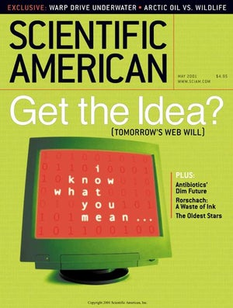
2001: ‘The semantic web’ vision
‘Most of the Web's content today [2001] is designed for humans to read, not for computer programs to manipulate meaningfully’.
‘The Semantic Web will enable machines to COMPREHEND se-mantic documents and data, not human speech and writings’.
‘Properly designed, the Semantic Web can assist the evolution of human knowledge as a whole’.
Berners-Lee, T., Hendler, J., and Lassila, O. The Semantic Web. Scientific American 284, 5 (May 2001), 34–43.

Slide 20
RDF: Resource Description Framework
Collection of six documents:
  Primer, Concepts, Syntax, Semantics,
  Vocabulary, Test Cases.
Characteristics:
  a language for representing information about resources in the WWW, in particular metadata about Web resources, such as the title, author, modification date, …
  … when this information needs to be processed by applications, rather than being only displayed to people,
  … based on the idea of identifying things using Web identifiers (called Uniform Resource Identifiers, or URIs), and describing resources in terms of simple properties and property values.
https://www.w3.org/TR/rdf-primer/

Slide 21
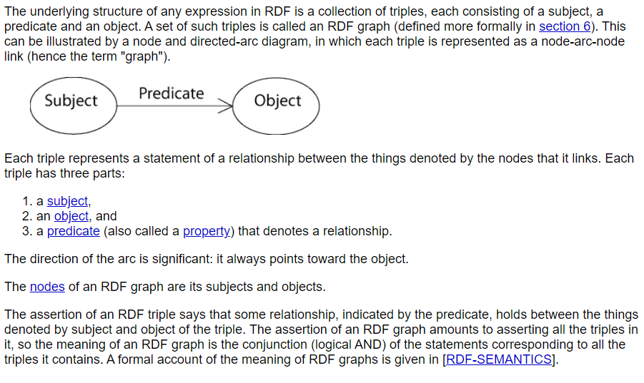
RDF graph: data model
https://www.w3.org/TR/rdf-concepts/#section-Concepts

Slide 22
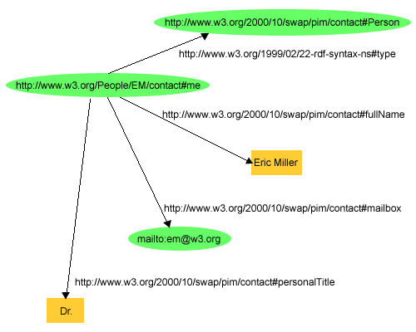
RDF example
<?xml version="1.0"?>
<rdf:RDF xmlns:rdf="http://www.w3.org/1999/02/22-rdf-syntax-ns#"
xmlns:contact="http://www.w3.org/2000/10/swap/pim/contact#">
<contact:Person rdf:about="http://www.w3.org/People/EM/contact#me">
<contact:fullName>Eric Miller</contact:fullName>
<contact:mailbox rdf:resource="mailto:em@w3.org"/>
<contact:personalTitle>Dr.</contact:personalTitle>
</contact:Person>
</rdf:RDF>
https://www.w3.org/TR/rdf-primer/

Slide 23
Address Data Table
StaffID | City | Street | State | ZIP
85740 | Bedford | 1501 Grant Ave | Massachusetts | 01730
How to put in RDF?

Slide 24
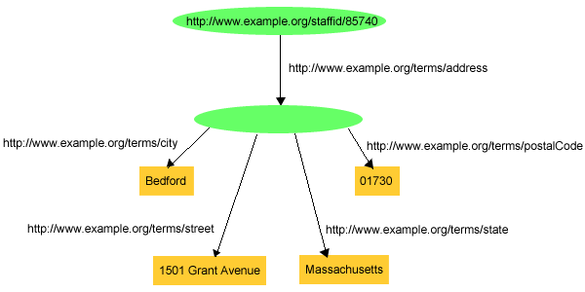
RDF Graph Data Model
RDF Graph:
  a collection of triples, each consisting of a subject, a predicate and an object, as a conjunction (logical-AND) of simple binary relationships.
  RDF does not provide means to express negation (NOT) or disjunction (OR).
https://www.w3.org/TR/rdf-concepts/

Slide 25
RDF(S) Vocabulary - classes
Class name | comment
rdfs:Resource | The class resource, everything.
rdfs:Literal | The class of literal values, e.g. textual strings and integers.
rdf:langString | The class of language-tagged string literal values.
rdf:HTML | The class of HTML literal values.
rdf:XMLLiteral | The class of XML literal values.
rdfs:Class | The class of classes.
rdf:Property | The class of RDF properties.
rdfs:Datatype | The class of RDF datatypes.
rdf:Statement | The class of RDF statements.
rdf:Bag | The class of unordered containers.
rdf:Seq | The class of ordered containers.
rdf:Alt | The class of containers of alternatives.
rdfs:Container | The class of RDF containers.
rdfs:ContainerMembershipProperty | The class of container membership properties, rdf:_1, rdf:_2, ..., all of which are sub-properties of 'member'.
rdf:List | The class of RDF Lists.
https://www.w3.org/TR/rdf-schema/#ch_summary

Slide 26
RDF(S) Vocabulary - properties
Property name | comment | domain | range
rdf:type | The subject is an instance of a class. | rdfs:Resource | rdfs:Class
rdfs:subClassOf | The subject is a subclass of a class. | rdfs:Class | rdfs:Class
rdfs:subPropertyOf | The subject is a subproperty of a property. | rdf:Property | rdf:Property
rdfs:domain | A domain of the subject property. | rdf:Property | rdfs:Class
rdfs:range | A range of the subject property. | rdf:Property | rdfs:Class
rdfs:label | A human-readable name for the subject. | rdfs:Resource | rdfs:Literal
rdfs:comment | A description of the subject resource. | rdfs:Resource | rdfs:Literal
rdfs:member | A member of the subject resource. | rdfs:Resource | rdfs:Resource
rdf:first | The first item in the subject RDF list. | rdf:List | rdfs:Resource
rdf:rest | The rest of the subject RDF list after the first item. | rdf:List | rdf:List
rdfs:seeAlso | Further information about the subject resource. | rdfs:Resource | rdfs:Resource
rdfs:isDefinedBy | The definition of the subject resource. | rdfs:Resource | rdfs:Resource
rdf:value | Idiomatic property used for structured values. | rdfs:Resource | rdfs:Resource
rdf:subject | The subject of the subject RDF statement. | rdf:Statement | rdfs:Resource
rdf:predicate | The predicate of the subject RDF statement. | rdf:Statement | rdfs:Resource
rdf:object | The object of the subject RDF statement. | rdf:Statement | rdfs:Resource
https://www.w3.org/TR/rdf-schema/#ch_summary

Slide 27
RDF(S) - semantics
Extremely weak model-theoretic semantics, usually ignored.
RDF is intended for use as a base notation for a variety of extended notations such as OWL2, SPARQL and RIF, whose expressions can be encoded as RDF graphs which use a particular vocabulary with a specially defined meaning.
Particular IRI vocabularies may be given meanings by other specifications or conventions. When such extra meanings are assumed, a given RDF graph may support more extensive entailments than are sanctioned by the basic RDF semantics.
https://www.w3.org/TR/rdf11-mt/

Slide 28
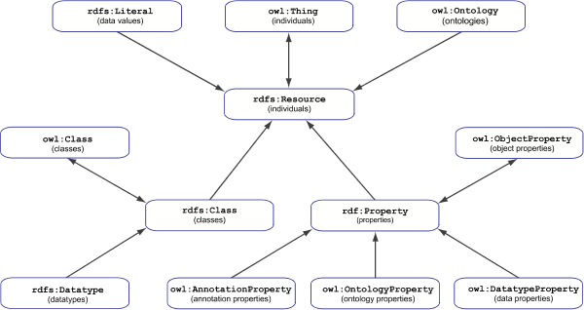
RDF(S) – OWL2
https://www.w3.org/TR/owl2-rdf-based-semantics/

Slide 29
RDFS - RIF
‘This specification describes RIF-Core (the Core dialect of the Rule Interchange Format). From a theoretical perspective, RIF-Core corresponds to the language of definite Horn rules without function symbols (often called 'Datalog') with a standard first-order semantics. RIF-Core thus is a subset of RIF-BLD [RIF-BLD]. At the same time, RIF-Core is a language of production rules where conclusions are interpreted as assert actions. RIF-Core thus also is a subset of RIF-PRD [RIF-PRD]. Moreover, RIF-Core is based on built-in functions and predicates over selected XML Schema datatypes, as specified in RIF-DTB 1.0 [RIF-DTB]. The common subset of RIF-BLD and RIF-PRD is specified based on RIF-DTB 1.0.’
https://www.w3.org/TR/2013/REC-rif-core-20130205/

Slide 30
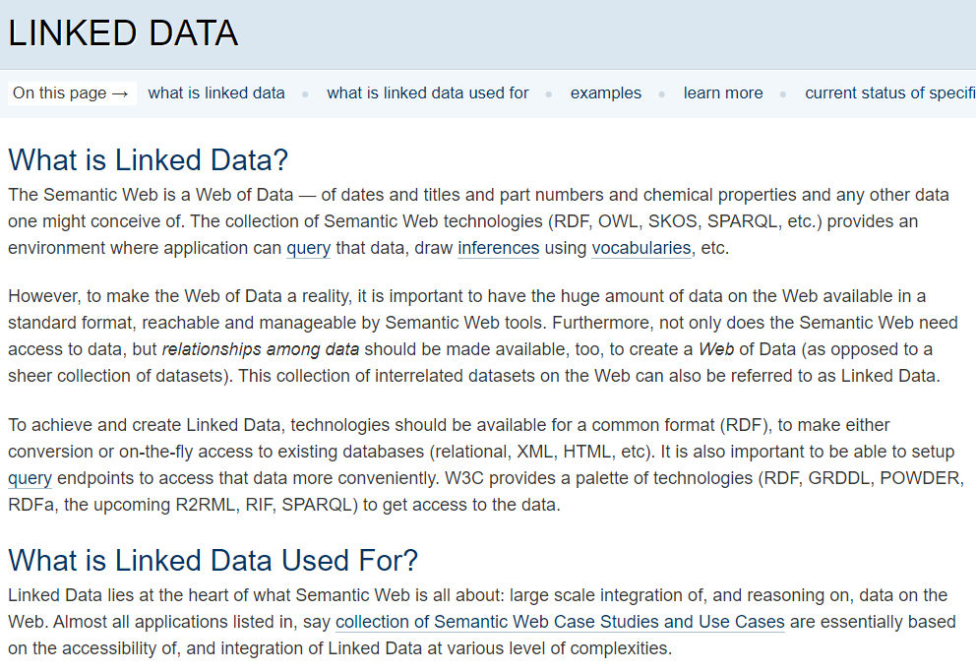


https://www.w3.org/standards/semanticweb/data

Slide 31
‘Knowledge graph’
The latest buzz word.
Made popular through graph databases, another buzz word, hyped and marketed by IT-companies.
  2012: Google ‘Knowledge Graph’
Nothing more than a database system that accepts RDF-tuples.
Only interesting researcher working on KG’s: Lars Vogt.
  E.g.: ‘FAIR data representation in times of eScience: a comparison of instance-based and class-based semantic representations of empirical data using phenotype descriptions as example’.
  https://jbiomedsem.biomedcentral.com/articles/10.1186/s13326-021-00254-0
  As RT, plea for separating assertions and what they are about, including the possibility to make assertions about assertions.

