Slide 1
BMI714 – Spring 2022 Principles of Referent Tracking in Biomedical Informatics (class number 19404) Class 2 – Feb 8, 2022 Elements of Logic useful for Referent Tracking
Werner CEUSTERS^{1,2}
¹ Department of Biomedical Informatics, University at Buffalo, USA
² Department of Psychiatry, University at Buffalo, USA

Slide 2
What is ‘a logic’
A formal or informal language together with a deductive system and/or a model-theoretic semantics.
The language has components that correspond to a part of a natural language like English or Greek.
The deductive system is to capture, codify, or simply record arguments that are valid for the given language.
The semantics is to capture, codify, or record the meanings, or truth-conditions for at least part of the language.
Shapiro, Stewart and Teresa Kouri Kissel, "Classical Logic",
The Stanford Encyclopedia of Philosophy (Spring 2021 Edition), Edward N. Zalta (ed.).
https://plato.stanford.edu/archives/spr2021/entries/logic-classical/

Slide 3
‘Formal language’
= (possibly infinite) set of sentences (variously called words or formulas) built from a fixed set of letters or symbols.
alphabet: the inventory from which the letters of a formal language are taken and over which the language is defined.
well-formed formulæ (wff): the strings of symbols that are syntactically allowed in a formal language.
The syntax can be defined without reference to interpretation. For example, we can determine that (P or Q) is a well-formed formula even without knowing whether it is true or false.
https://en.wikipedia.org/wiki/Interpretation_(logic)

Slide 4
Alphabet of First Order Logic (FOL)
Logical connectives (⇒, ∧, ∨, and ⇐⇒ ), negation (¬), and parentheses.
Constants symbols: strings that will be interpreted as representing individuals.
Variable symbols: used as “place holders” for quantifying over individuals.
Predicate symbols each with zero or a finite number of arguments, used to denote properties of individuals and relationships among them.
Function symbols each with a number of input arguments mapping the specified number of input individuals to other individuals.
Universal and existential quantifier symbols to quantify over individuals.
Adapted from: Alan Fern. CS532, Winter 2010 Lecture Notes: First-Order Logic: Syntax and Semantics. January 8, 2010. https://web.engr.oregonstate.edu/~afern/classes/cs532/notes/fo-ss.pdf

Slide 5
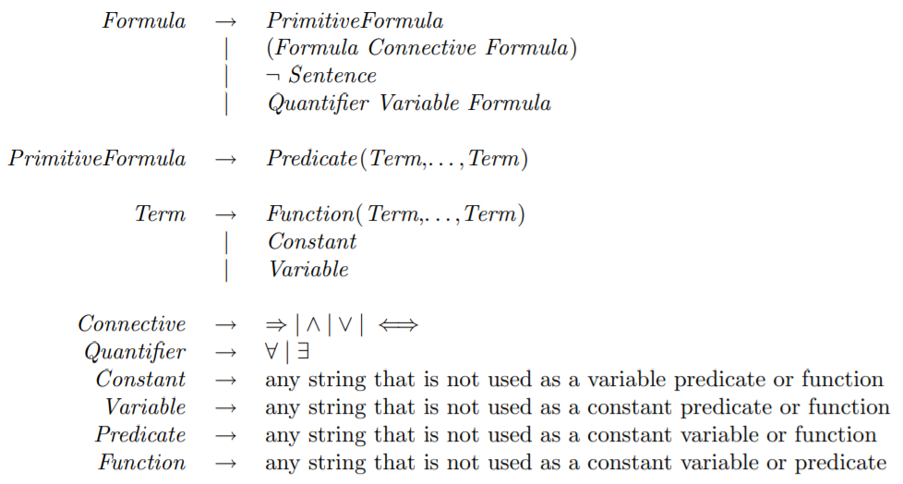
(a specific) Syntax of FOL
used to construct
alphabet
Adapted from: Alan Fern. CS532, Winter 2010 Lecture Notes: First-Order Logic: Syntax and Semantics. January 8, 2010. https://web.engr.oregonstate.edu/~afern/classes/cs532/notes/fo-ss.pdf

Slide 6
FOL terms and formulae
Terms: used to ‘index’ / ‘reference’ / ‘name’ individuals in the ‘domain of discourse’.
Formulas: used to state properties and to be interpreted as true or false based on FOL’s semantics.
primitive formulas (= atoms): predicate symbols applied to the appropriate number of terms,
ground formulas: formulas without variables,
ground atoms: atoms without variables,
closed formulas: formulas in which all variables are associated with quantifiers.
Adapted from: Alan Fern. CS532, Winter 2010 Lecture Notes: First-Order Logic: Syntax and Semantics. January 8, 2010. https://web.engr.oregonstate.edu/~afern/classes/cs532/notes/fo-ss.pdf

Slide 7
FOL semantics (simplified)
Definition of the ‘models’ of FOL which all consist of:
a non-empty ‘domain’ D of individuals
an interpretation function I which assigns a meaning or interpretation to each of the available constant, function, and predicate symbols:
If c is a constant symbol, then I(c) is an individual in D.
If f is a function symbol of arity n, then I(f) is a total function from D^{n} to D, thus one that maps n individuals to the domain D.
If p is a predicate symbol of arity n > 0, then I(p) is a subset of D^{n}; if I(p) is not empty, then p is true for its arguments.
If p is a predicate symbol of arity 0, i.e. a simple proposition, then I(p) is equal to either true or false.
In a similar, but more complex way, interpretations for terms and formulae are defined.
Adapted from: Alan Fern. CS532, Winter 2010 Lecture Notes: First-Order Logic: Syntax and Semantics. January 8, 2010. https://web.engr.oregonstate.edu/~afern/classes/cs532/notes/fo-ss.pdf

Slide 8
For BFO and Referent Tracking
The domain must be a portion of reality!
Ontology rather than fantology (from ‘fantasy’).

Slide 9
Description Logics
Works the same way.
An excellent introduction in the syntax and semantics of the various description logics is in:
Sebastian Rudolph
Foundations of Description Logics
Karlsruhe Institute of Technology Germany
May 2011
https://www.aifb.kit.edu/images/1/19/DL-Intro.pdf

Slide 10
Important characteristics of logics
Satisfiability:
a formula is satisfiable if it is true under some assignment of values to its variables.
a theory, i.e. a set of formulae, is satisfiable if at least one interpretation makes every formula in the theory true.
Validity:
a formula is valid if every assignment of values to its variables makes the formula true.
a theory is valid if every formula in it is true in every interpretation.
Decidability:
a logic is decidable if there is an effective method for determining whether arbitrary formulas are theorems, i.e. logically valid formulas of the logic.
https://en.wikipedia.org/wiki/Satisfiability
https://en.wikipedia.org/wiki/Decidability_(logic)

Slide 11
Decidability of FOL and DLs
First-order logic is not decidable when equality is used and at least one other predicate with two or more arguments.
Descriptions logics are designed so they are decidable, at the cost of what you can express.

Slide 12
Common Logic (CL)
CL is a family of first-order logics which share a common abstract syntax and model theory, and an XML framework for encoding and transmitting them, or their content, on an open network.
CL syntax is very relaxed in the expressions it allows, in some ways going beyond classical FOL.
ISO standard: https://standards.iso.org/ittf/PubliclyAvailableStandards/c066249_ISO_IEC_24707_2018.zip
The semantics is NOT exactly the same as in FOL, but differences are for this course not relevant.
https://www.w3.org/2004/12/rules-ws/slides/pathayes.pdf

Slide 13
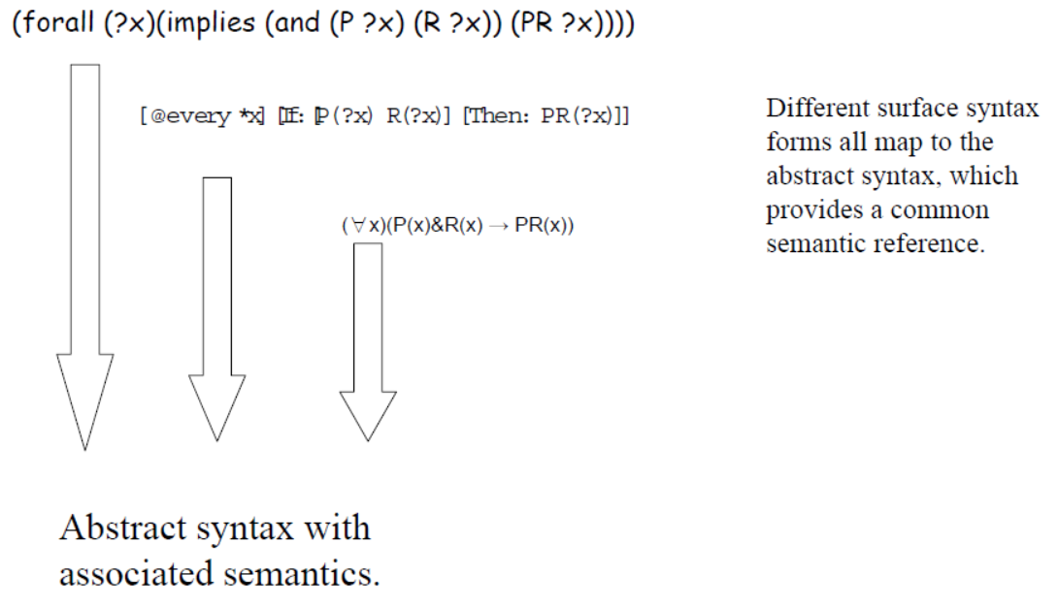
CL dialects
https://www.w3.org/2004/12/rules-ws/slides/pathayes.pdf

Slide 14
Common Logic Interchange Format (CLIF)
John is going to Boston by bus
(exists (x y)
(and (Go x) (Person John) (City Boston)
(Bus y) (Agent x John)
(Destination x Boston) (Instrument x y)))
CLIF is the format used for the BFO2020 axiomatization.
https://standards.iso.org/ittf/PubliclyAvailableStandards/c066249_ISO_IEC_24707_2018.zip

Slide 15
(for this course) Relevant CLIF constructs
The BFO2020-style syntax for making FOL assertions.
The ‘envelope’.

Slide 16
BFO2020-style CLIF constructs for FOL (1)
Predicate: (predicate_name {arguments})
where ‘{arguments}’ is a list of terms and/or variables.
(universal site)
(instance-of werner human-being yesterday)
(inheres-in this-color that-ball)
Quantified construct: (quantifier ({vars}) <construct>)
where ‘{vars}’ is a list of variables.
(exists (t) (instance-of werner human-being t))
(forall (x y) (instance-of x entity y))
Negation: (not <construct>)
(not (= object history))
(not (exists (t) (instance-of werner quality t)))

Slide 17
BFO2020-style CLIF constructs for FOL (2)
Construct-list: (and/or {constructs})
(and (instance-of werner human-being yesterday)
(instance-of werner human-being today))
(or (inheres-in this-color this-ball)
(inheres-in this-color that-ball))
Implication: (if/iff <construct> <construct>)
(iff (occurrent-part-of a b)
(has-occurrent-part b a))
(if (exists (t) (instance-of a occurrent t))
(occurrent-part-of a a))

Slide 18
BFO2020-style CLIF constructs for FOL (3)
Considerable nesting of constructs possible!
(forall (p)
(if (exists (tp)
(instance-of p process tp))
(exists (pb tb tp)
(and (occupies-temporal-region p tp)
(occurrent-part-of pb p)
(occupies-temporal-region pb tb)
(instance-of pb process-boundary tb)
(exists (ltp ftp)
(and (has-first-instant tp ftp)
(has-last-instant tp ltp)
(or (= tb ftp) (= tb ltp))))))))

Slide 19
Some CLIF BFO2020-style conventions
All variables must have an explicit quantifier.
A list of constructs MUST use one of ‘and’ and ‘or’, but lists of 1 are allowed although not needed.

Slide 20
Correct?
(forall a b t
(if (continuant-part-of a b t)
(has-continuant-part b a t)))
(forall (a b)
(if (continuant-part-of a b t)
(has-continuant-part b a t)))

Slide 21
Correct?
(and
(inheres-in this-color this-ball)
(inheres-in this-color that-ball) )

Slide 22
The BFO2020-CLIF-style ‘envelope’
(cl:comment ‘<whatever text>’
(cl:text
(cl:ttl <whatever text>
(cl:outdiscourse {a list of all predicate_names used in THIS file} )
(cl:comment "<whatever text>"
<FOL-construct> )
(cl:comment "<whatever text>"
<FOL-construct> )
…
)))

Slide 23
Correct?
(cl:comment ‘A one axiom document’
(cl:text
(cl:ttl too short for a title
(cl:outdiscourse instance-of occurrent-part-of spatially-projects-onto)
(cl:comment “this is the one axiom"
(forall (b c)
(if (and (exists (t) (instance-of b spatiotemporal-region t))
(exists (t) (instance-of c spatiotemporal-region t)))
(iff (temporal-part-of b c)
(exists (tb tc)
and (temporally-projects-onto b tb)
(temporally-projects-onto c tc)
(and (occurrent-part-of tb tc)
(forall (tp)
(if (and (occurrent-part-of tp tb)
(exists (s) (spatially-projects-onto b s tp)))
(exists (s) (and (spatially-projects-onto b s tp)
(spatially-projects-onto c s tp)))))))))))
)))

Slide 24
FOL to CNF (and other) conversions
Algorithm: Putting Axioms into Clausal Form
Eliminate the implications.
Move the negations down to the atomic formulas.
Eliminate the existential quantifiers.
Rename the variables, if necessary.
Move the universal quantifiers to the left.
Move the disjunctions down to the literals.
Eliminate the conjunctions.
Rename the variables, if necessary.
Eliminate the universal quantifiers.
https://www.cs.cornell.edu/courses/cs4700/2011fa/lectures/16_FirstOrderLogic.pdf
https://www.cs.miami.edu/home/geoff/Courses/COMP6210-10M/Content/FOFToCNF.shtml#:~:text=Clause%20Normal%20Form%20(CNF)%20is,%7C%2C%20e.g.%2C%20C%7C.

Slide 25
Too make life easier
A prototype in Prolog under development by yours truly:
BFO2020style-CLIFparser.pl
init.txt
envelope.clx
NOT completely fool-proof but processes the entire BFO2020 axiomatization correctly, and found mistakes in the Nov 12, 2021 version available here (and not corrected thus far):
https://github.com/BFO-ontology/BFO-2020/tree/21838-2/21838-2/common-logic
For extra credit: find them and correct 2 of them !!!

Slide 26
Assignment A1
See syllabus!

Slide 27
Exercises

