Slide 1
BMI714 – Spring 2022
Principles of Referent Tracking in Biomedical Informatics
(class number 19404)
Class 1 – Feb 1, 2022
Course introduction
Werner CEUSTERS^{1,2}
¹ Department of Biomedical Informatics, University at Buffalo, USA
² Department of Psychiatry, University at Buffalo, USA

Slide 2
Class overview
Who’s who?
Introduction to Referent Tracking
An exercise in detecting ambiguities
Course overview and expectations
I take questions at any time.

Slide 3
What is ‘referent tracking’?
In general:
  ‘referent’ (defined class): an entity denoted by some reference in a representation;
  ‘reference’ (defined class): a representation that denotes some entity;
  ‘referent tracking’: keeping track of how entities stand in relation to each other by keeping track of how their references are used in representations.

Slide 4
Issues in referent tracking in general
Given a representation:
  What parts of a representation are veridical?
  What parts of a veridical representation are representational units?
  Which representational units in a representation are references?
  What entities are denoted by specific references?

Slide 5
RT issues in language
Various forms with non-standard definitions:
  Reference resolution
  Co-reference resolution
  Anaphora resolution
Examples:
  ‘I bought two fish, removed their scales, and ate them’.
  ‘Jane was in the library. When Suzy came in, she laughed.’
  ‘He visited us Monday’.
  ‘Margaret saw the diamond sparkling in the sun and adored it’s beauty’.

Slide 6
RT issues in EHRs: the ‘problem list’
PtID
Date
ObsCode
Narrative
5572
04/07/1990
26442006
closed fracture of shaft of femur
5572
04/07/1990
81134009
Fracture, closed, spiral
5572
12/07/1990
26442006
closed fracture of shaft of femur
5572
12/07/1990
9001224
Accident in public building (supermarket)
5572
04/07/1990
79001
Essential hypertension
0939
24/12/1991
255174002
benign polyp of biliary tract
2309
21/03/1992
26442006
closed fracture of shaft of femur
2309
21/03/1992
9001224
Accident in public building (supermarket)
47804
03/04/1993
58298795
Other lesion on other specified region
5572
17/05/1993
79001
Essential hypertension
298
22/08/1993
2909872
Closed fracture of radial head
298
22/08/1993
9001224
Accident in public building (supermarket)
5572
01/04/1997
26442006
closed fracture of shaft of femur
5572
01/04/1997
79001
Essential hypertension
0939
20/12/1998
255087006
malignant polyp of biliary tract

Slide 7
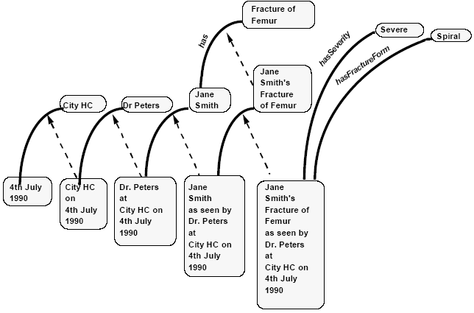
Having just any representation formalism will not do.
Categories: “represent concepts and are analogous to classes in other formalisms”
Individuals: “concrete instances of categories which persist in space and time”
Occurrences: “are specific occurrences of individuals and must be situated in space and time. The most important
group of occurrences are observations — i.e. agents’ observations of individuals.”
Rector AL, Nowlan WA, Kay S, Goble CA, Howkins TJ.
A framework for modelling the electronic medical record.
Methods Inf Med. 1993 Apr;32(2):109-19.

Slide 8
Main problem areas for this EHR:
Statements refer only very implicitly to the concrete entities about which they give information.
Idiosyncracies of concept-based terminologies
  tell us only that some instance of the class the codes refer to, is refered to in the statement, but not what instance precisely.
  Are usually confused about classes and individuals.
    “Country” and “Belgium”.
Mixing up the act of observation and the thing observed.
Mixing up statements and the entities these statements refer to.

Slide 9
We can do better, can’t we?
Categories: “represent concepts and are analogous to classes in other formalisms”
Individuals: “concrete instances of categories which persist in space and time”
Occurrences: “are specific occurrences of individuals and must be situated in space and time. The most important
group of occurrences are observations — i.e. agents’ observations of individuals.”
Rector AL, Nowlan WA, Kay S, Goble CA, Howkins TJ.
A framework for modelling the electronic medical record.
Methods Inf Med. 1993 Apr;32(2):109-19.

Slide 10
An appropriate ontological analysis
Universals
continuants
EHR system
City HC’s EHR system
HC
City HC
Freezer section
The freezer section of Jane’s favourite supermarket
Jane Smith
Person
Dr. Peters
Dr. Longley
Femur
Jane’s left femur
Jane’s left femur
Fracture
Jane’s left femur fracture
Image
Jane’s fracture’s image
t
occurrents
Jane’s falling
Jane’s fracture as seen by Dr. Peters
Jane’s fracture as seen by Dr. Longley
Instances of
Jane’s fracture
Jane’s femur breaking
Dr. Peter’s examination of Jane’s fracture
Dr. Peter’s ordering of an X-ray
Shooting the pictures of Jane’s leg
Jane’s fracture’s healing
Dr. Peter’s diagnosis making
Dr. Longley’s examination of Jane’ s fracture
Freezer section dismantled
Jane dies

Slide 11
Ontological recategorisation
Fracture
Of Femur
Severe
Spiral
Jane
Smith’s
Fracture
Of Femur
Jane
Smith’s
Fracture
Of Femur’s
severity
Jane
Smith’s
Fracture
Of Femur’s
shape
Jane
Smith
CityHC
Dr. Peters
City HC
exists on
4th July
1990
Dr. Peters
located at
City HC on
4th July
1990
Jane Smith’s
consultation
with
Dr. Peters at
City HC on
4th July
1990
Dr. Peters’
assessment of
Jane Smith’s
fracture of
femur
at
City HC on
4th July
1990

Slide 12
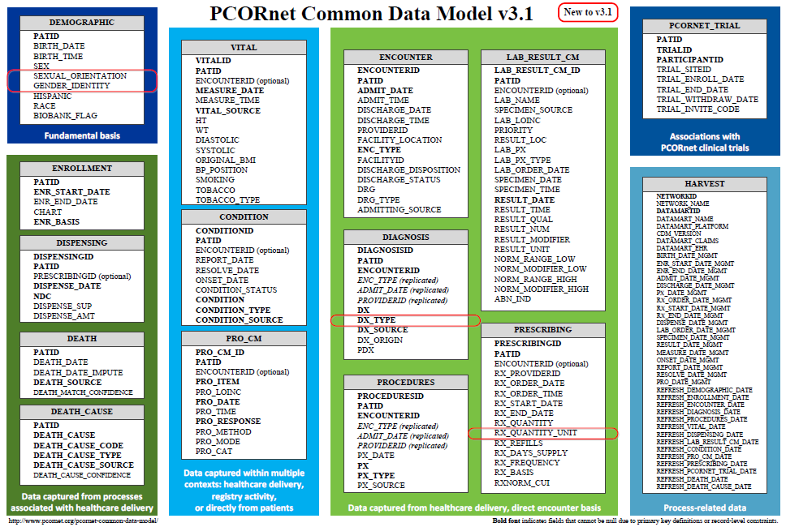
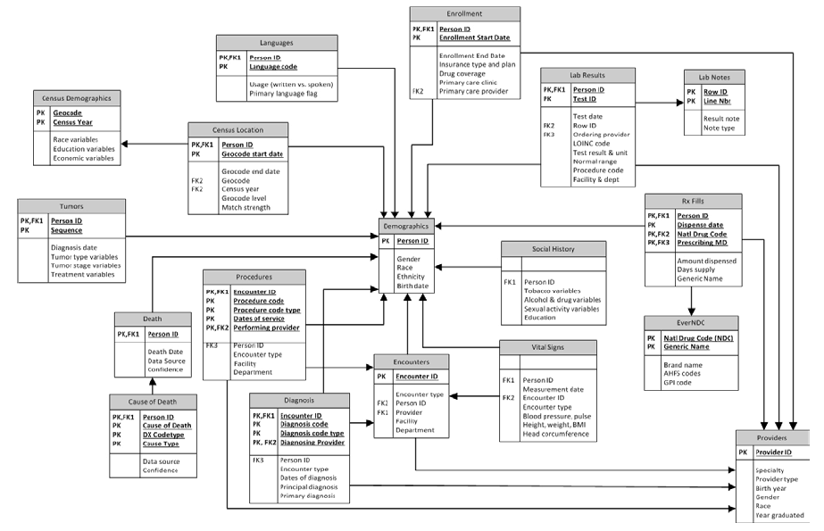
Common Data Models for Secondary Use
The Observational Medical Outcomes Partnership (OMOP)
Health Care Systems Research Network (HCSRN)
The National Patient-Centered Clinical Research Network (PCORNet)

Slide 13
Three sorts of count errors in OMOP
Respectively due to:
  cardinality and attribute restrictions,
  inconsistent normalization,
  confusing data with what it is about.
Give examples of each sort NOT from OMOP similar (whether real or hypothetical).
Ceusters W, Blaisure J. A Realism-Based View on Counts in OMOP’s Common Data Model.
14th International Conference on Wearable, micro & Nano Technologies (pHealth 2017), Eindhoven, The Netherlands, May 14-16, 2017.
Studies in Health Technology and Informatics 2017;237:55-62.

Slide 14
PERSON table
Allows for each unique patient only
  one location,
  one gender,
  one primary care provider, and
  one care site.
Although:
  ‘patients over time can have distinct locations, genders’;
  ‘it is the responsibility of the data holder to select the one value to use in the CDM’.
What criteria to use?
What with the multiple observation periods?

Slide 15
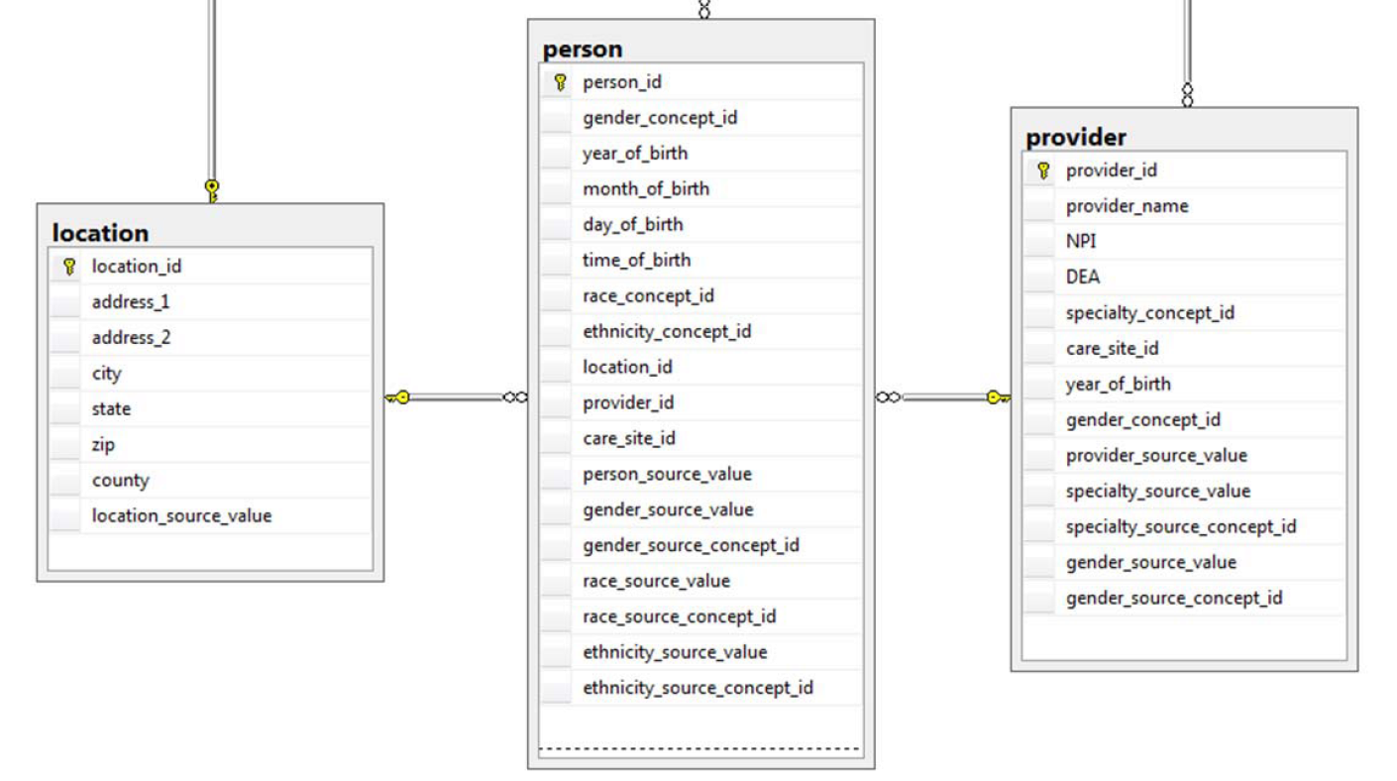
Person versus Provider

Slide 16
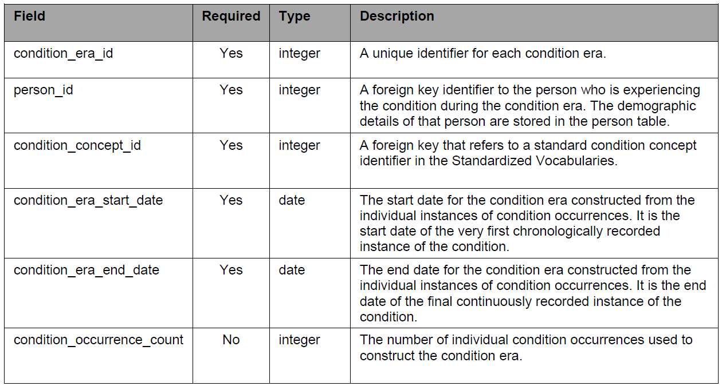
Condition-occurrences versus eras

Slide 17
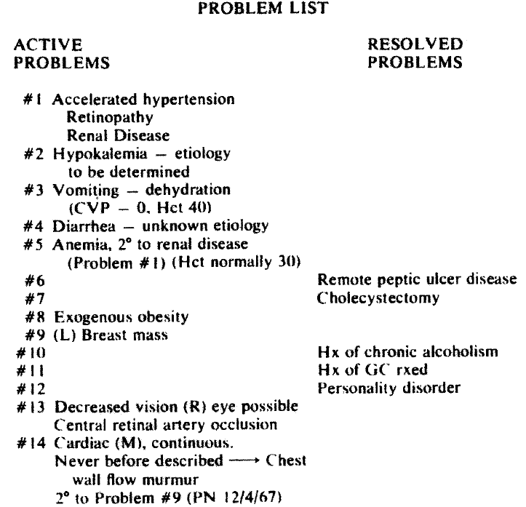

L. Weed.
Medical records that guide and teach.
New England Journal of Medicine 278 (1968), 593-600.

Slide 18
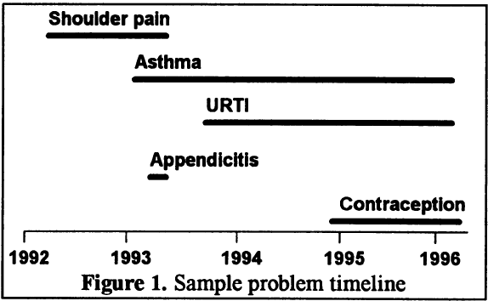
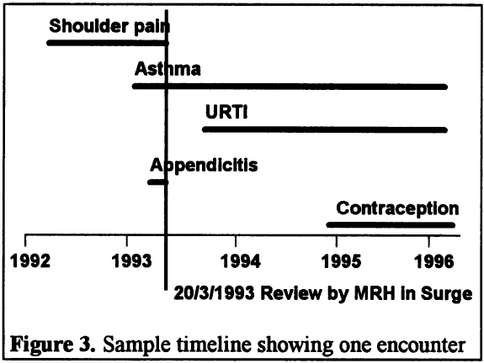
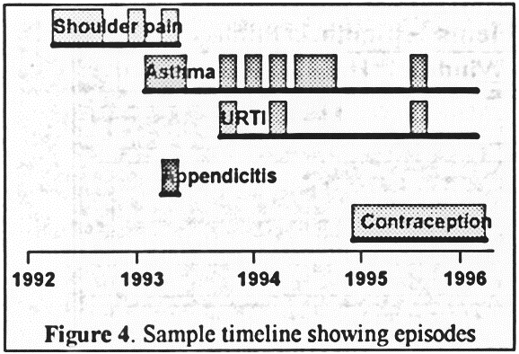
Problems
Encounters
Episodes
Salmon P, Rappaport A, Bainbridge M, Hayes G, Williams J. Taking the problem oriented medical record forward. Proc AMIA Annu Fall Symp. 1996:463-7.

Slide 19
Conventions
Condition Era records will be derived from the CONDITION_OCCURRENCE table using a standardized algorithm.
Each Condition Era corresponds to one or many CONDITION_OCCURRENCE records that form a continuous interval and contain the same drug condition-occurrence.
The condition_concept_id field contains Concepts that are identical to those of the CONDITION_OCCURRENCE table records that make up the Condition Era.
The Condition Era Start Date is the start date of the first Condition Occurrence.
The Condition Era End Date is the end date of the last Condition Occurrence.

Slide 20
An erroneous example
Why?
‘a Condition Era representing ICD-9 code 410.01
  (Acute Myocardial Infarction (AMI) of anterolateral wall, initial episode)
  would be aggregated to a Condition Era representing ICD-9 code 410.41
  (AMI inferior wall, initial episode)
  occurring within 30 days
  as both of these ICD-9 codes annotate to the same Condition Concept, Acute Myocardial Infarction, within the MedDRA hierarchy’.
Reisinger SJ, Ryan PB, O'Hara DJ, Powell GE, Painter JL, Pattishall EN, et al. Development and evaluation of a common data model enabling active drug safety surveillance using disparate healthcare databases.
J Am Med Inform Assoc. 2010 Nov-Dec;17(6):652-62, p656

Slide 21
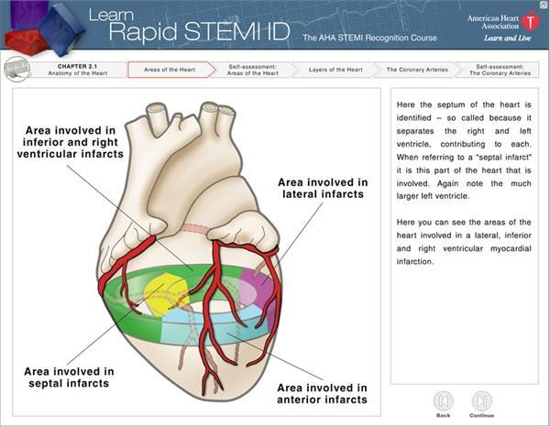
http://myheart.net/articles/stemi/

Slide 22
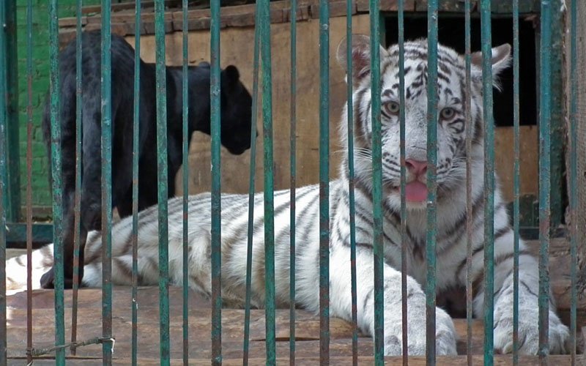
feline
isa
isa
panther
tiger
Instance-of
Instance-of
Only one feline in this cage?

Slide 23


Ultimate goal of Referent Tracking
A digital copy of the world

Slide 24
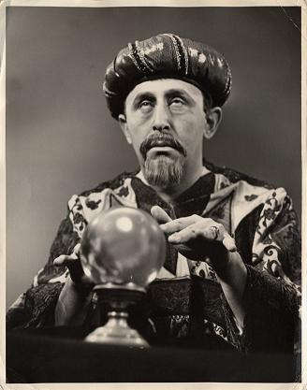

In fact … the ultimate crystal ball

Slide 25


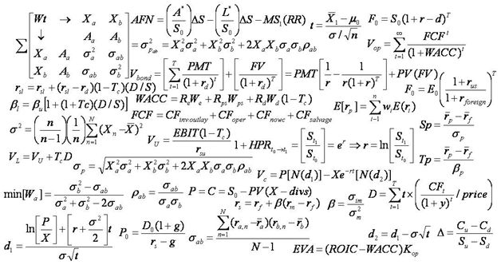
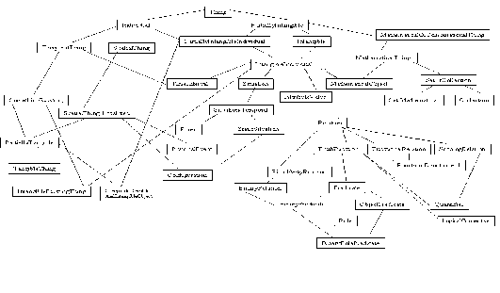
Two major representational components
formulae representing ‘laws of nature’
symbols denoting what these ‘laws’ govern

Slide 26
Representations mimicking reality
→ The Time Lords’ Matrix on the planet Gallifrey (Dr. Who, 1976)

Slide 27


Major problem: the ‘binding’ wall
How to do it right ?
gives you a cartoon of the world

Slide 28
Requirements for this digital copy
R1: A faithful representation of reality
R2 … of everything that is digitally registered,
        what is generic → scientific theories
        what is specific → what individual entities exist and how they relate ontologically rather than statistically
R3: … throughout reality’s entire history,
R4 … which is computable in order to …
        … allow queries over the world’s past and present,
        … make predictions,
        … fill in gaps,
        … identify mistakes,
        … understand ‘the why’ about realities
        ...

Slide 29
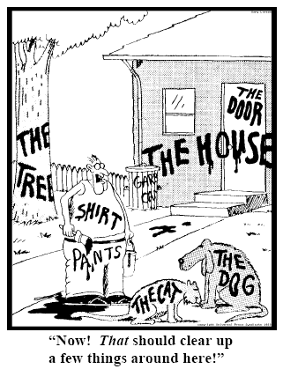
Essence of Referent Tracking
explicit reference to the individual entities
relevant to the accurate description of some
portion of reality, ...
Ceusters W, Smith B. Strategies for Referent Tracking in Electronic Health Records. J Biomed Inform. 2006 Jun;39(3):362-78.

Slide 30
Essence of Referent Tracking
explicit reference to the individual entities
relevant to the accurate description of some
portion of reality, ...
Ceusters W, Smith B. Strategies for Referent Tracking in Electronic Health Records. J Biomed Inform. 2006 Jun;39(3):362-78.

Slide 31
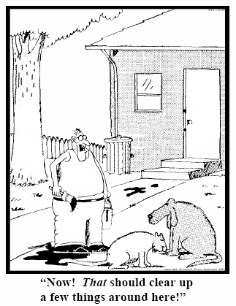
RT method: IUI assignment
  Introduce an Instance Unique Identifier (IUI) for each relevant particular (individual) entity
78
235
5678
321
322
666
427
Ceusters W, Smith B. Strategies for Referent Tracking in Electronic Health Records. J Biomed Inform. 2006 Jun;39(3):362-78.

Slide 32
Portions of reality
entities (= particulars, = instances),
  e.g.: me, my life;
relations,
  e.g.: the 3-place parthood relation between me, my nose, and the temporal region at which it holds,
types,
  universals, e.g. Nose,
  defined classes, e.g. Crooked Nose,
configurations,
  e.g. my nose now being part of me.

Slide 33
Identifiers and pseudo-identifiers
Representation | Reality
ID-a
ID-b | Entity-1
ID-c | Entity-2
ID-d | Entity-3
ID-e | Entity-4
ID-f | Entity-5

Slide 34
Identifiers and pseudo-identifiers
Representation | Reality
ID-a
ID-b | Entity-1
ID-c | Entity-2
ID-d | Entity-3
ID-e | Entity-4
ID-f | Entity-5
Pseudo-identifiers:
  ID-a: denotes nothing
  ID-b: denotes ambiguously
Singularly unique identifier: ID-c
Non-singularly unique identifiers: ID-f, ID-d, ID-e

Slide 35
IUI
There is for any particular only one identifier within all systems in which the entity is represented
Globally and Singularly Unique Identifier for a Particular
there is for any particular only one identifier within a given representation system

Slide 36
Importance:
L1.
Reality
Generic
Specific
L3. Accessible representation
INFORMATION CONTENT ENTITY
‘WC has migraine’
L2. Beliefs (cognitive representation)
DIAGNOSIS
my doctor’s
diagnosis
L1⁻¹.
L1 which is not about anything
LAPTOP
HUMAN BEING
my doctor’s computer
my doctor
DISEASE
me
my migraine
MIGRAINE
HEADACHE
my headache
Ontology
Referent Tracking
Underrepresented majority in information systems!

Slide 37
Problem list in an EHR
PtID
Date
IUI
ObsCode
Narrative
5572
04/07/1990
#1
26442006
closed fracture of shaft of femur
5572
04/07/1990
#1
81134009
Fracture, closed, spiral
5572
12/07/1990
#1
26442006
closed fracture of shaft of femur
5572
12/07/1990
#2
9001224
Accident in public building #11(supermarket)
instanceOf
hasParticipant
#2
Accident in supermarket
creates
t2
at
at
Closed spiral fracture
t1
#1
instanceOf
Closed femur shaft fracture
at
partOf
at
t3
#5572

Slide 38
Examples of Referent Tracking assertions
  #1 participantOf #2 at t1
  #2 instanceOf DiagnosticProcess
  #1 participantOf #3 at t2
  #3 instanceOf Life
  #1 participantOf #4 at t3
  #4 instanceOf SurgicalProcedure
  #4 precededBy #2
  #4 partOf #3
  t3 partOf t2
Note: all RT tuples in this presentation follow the BFO 2.0 conventions, NOT BFO2020!

Slide 39
Key mechanism: IUI assignment
= an act carried out by the first ‘cognitive agent’ feeling the need to acknowledge the existence of a particular it has information about by labelling it with a universally unique singular identifier.
‘cognitive agent’:
  A person;
  An organisation;
  A device or software agent, e.g.
    Bank note printer,
    Image analysis software.

Slide 40
‘#n’: (globally) singularly unique identifiers
  #1 participantOf #2 at t1
  #2 instanceOf DiagnosticProcess
  #1 participantOf #3 at t2
  #3 instanceOf Life
  #1 participantOf #4 at t3
  #4 instanceOf SurgicalProcedure
  #4 precededBy #2
  #4 part of #3
  t3 partOf t2

Slide 41
‘tn’: (globally) unique identifiers
  #1 participantOf #2 at t1
  #2 instanceOf DiagnosticProcess
  #1 participantOf #3 at t2
  #3 instanceOf Life
  #1 participantOf #4 at t3
  #4 instanceOf SurgicalProcedure
  #4 precededBy #2
  #4 part of #3
  t3 partOf t2

Slide 42
Identifier assignment
You can only assign an identifier to something existing.
However, besides the existence of the entity, what or how it is precisely does not need to be known.

Slide 43
Identifier assignment
You can only assign an identifier to something existing.
However, besides the existence of the entity, what or how it is precisely does not need to be known.
  #1 participantOf #3 at t2
  #3 instanceOf Life

Slide 44
Identifier assignment
You can only assign an identifier to something existing.
However, besides the existence of the entity, what or how it is precisely does not need to be known.
  #1 participantOf #3 at t2
  #3 instanceOf Life
  t2 can be used as ID for the temporal region during which #1 participates in his life even if nothing is known (yet) about the length of t2.

Slide 45
Do t1 and t2 denote distinct temporal regions?
  #1 participantOf #2 at t1
  #2 instanceOf Life
  #3 participantOf #4 at t2
  #4 instanceOf Life
  #5 instanceOf MonoZygoticTwinBrotherHood
  #5 inheresIn #1 at t1
  #5 inheresIn #3 at t2

Slide 46
Do t1 and t2 denote distinct temporal regions?
  #1 participantOf #2 at t1
  #2 instanceOf Life
  #3 participantOf #4 at t2
  #4 instanceOf Life
  #5 instanceOf MonoZygoticTwinBrotherHood
  #5 inheresIn #1 at t1
  #5 inheresIn #3 at t2
  We will be able to tell when at least one of the twins dies:
    If only one: no.
    If both at the same time: yes.

Slide 47
Capacities for reasoners
  #1 participantOf #2 at t1
  #2 instanceOf DiagnosticProcess
  #1 participantOf #3 at t2
  #3 instanceOf Life
  #1 participantOf #4 at t3
  #4 instanceOf SurgicalProcedure
  #4 precededBy #2
  #4 partOf #3
  t3 partOf t2

Slide 48
Careful though !
  #1 participantOf #2 at t1
  #2 instanceOf DiagnosticProcess
  #1 participantOf #3 at t2
  #3 instanceOf Life
  #1 participantOf #4 at t3
  #4 instanceOf SurgicalProcedure
  #4 precededBy #2
  #4 partOf #3
  t3 partOf t2
  How does t1 relates to #2 ?

Slide 49
Careful though !
  #1 participantOf #2 at t1
  #2 instanceOf DiagnosticProcess
  #1 participantOf #3 at t2
  #3 instanceOf Life
  #1 participantOf #4 at t3
  #4 instanceOf SurgicalProcedure
  #4 precededBy #2
  #4 partOf #3
  t3 partOf t2
  How does t2 relates to #3 ?

Slide 50
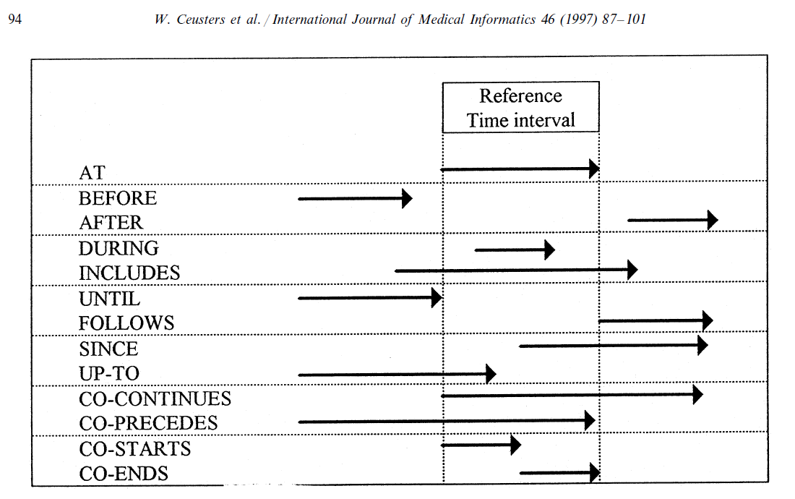
Representation of relation with time intervals

Slide 51
Essentials of Referent Tracking
Deciding what particulars should receive a universally unique identifier (IUI);
Finding out whether or not a particular has already been assigned a IUI (each particular should receive maximally one IUI);
Generating an IUI;
Using IUIs in information systems, i.e. issues concerning the syntax and semantics of statements containing IUIs;
Determining the truth values of statements in which IUIs are used;
Correcting errors in the assignment of IUIs and in other assertions in tuples..

Slide 52
Referent Tracking System Components
Referent Tracking Software:
    Manipulation of assertions about particulars.
Referent Tracking Datastore:
    IUI repository:
    A collection of:
      A-tuples, each one representing the assignment of a globally unique singular identifier to some particular.
      N-tuples, each one providing a name for a particular
    Referent Tracking Database:
    A collection of assertions in the form of tuples of various sorts about the particulars denoted through A-tuples in the IUI repository.
Manzoor S, Ceusters W, Rudnicki R. Implementation of a Referent Tracking System. International Journal of Healthcare Information Systems and Informatics 2007;2(4):41-58.

Slide 53
Referent Tracking System Environment

Slide 54
Main RT principles
Requirements for an assertion to be useful: clarity in …
  (1) what precisely is attributed – i.e. what features, characteristics, properties, etc. are ascribed to some entity relevant to the patient’s health – and
  (2) about what it is attributed – i.e. to which entity the features, characteristics, properties, etc. are ascribed.
Terminology:
  ‘Predicate’: the part of a descriptive statement that ascribes features to some entity, i.e. the referent;
  ‘Predication’: the process of ascribing characteristics to something.
  ‘Ascription’: a descriptive statement resulting from a predication.

Slide 55
Main RT principles: RTP1
A predicate shall be made about one or more referents if and only if:
  these referents are uniquely identified in the RTS (RTP1.1) and
  the author of the predicate holds at least two beliefs:
    (1) that the referents are real, were real or very likely will become real (RTP1.2) and
    (2) that what is predicated about these referents – within the specified time-frame when time-indexing is required – is either true, or more likely true than false.
    (3) In the latter case, the strength of the belief in the correctness of the predicate needs to be expressed as well (RTP1.3). This holds for positive ascriptions as well as negative ascriptions, i.e. ascriptions positing that something is not the case.
Ceusters W. The place of Referent Tracking in Biomedical Informatics.
In Elkin, Peter (ed.) Terminology, Ontology and Their Implementations. Springer Nature. (Forthcoming, preprint).

Slide 56
Main RT principles: RTP2
The Referent Tracking System (RTS) must keep track of
  the provenance of assertions, thus by whom and when predicates were asserted, confirmed, contradicted, corrected or rejected in the EMR (RTP2.1) and
  by whom and when such changes were registered in the RTS (RTP2.2).
Ceusters W. The place of Referent Tracking in Biomedical Informatics.
In Elkin, Peter (ed.) Terminology, Ontology and Their Implementations. Springer Nature. (Forthcoming, preprint).

Slide 57
Main RT principles: RTP3
RTP3.1: the RTS must use the ascriptions to construct a representation of reality from the perspective of one or more clearly specified ontologies which are sufficiently expressive and comprehensive to accommodate all types of ascriptions in the EMR.
RTP3.2: this representation must be updated whenever the pool of ascriptions in the EMR is updated.
RTP3.3: ascriptions which when taken together do not allow a representation to be constructed which is free from contradictions and inconsistencies need to be identified and appropriate reconciliation procedures invoked (RTP3.4).
Ceusters W. The place of Referent Tracking in Biomedical Informatics.
In Elkin, Peter (ed.) Terminology, Ontology and Their Implementations. Springer Nature. (Forthcoming, preprint).

Slide 58
2. A little exercise to sharpen your brain

Slide 59
Ambiguity in ICD-11’s ‘Content model’
A classification unit in ICD is called an “ICD entity”. In other words, any distinct classification rubric is called an Entity. (The term “Entity” is used interchangeably – in the same meaning -- with the term “ICD Concept”.
An ICD entity may be:
  A category
  A block
  A chapter
A category (which is the most common reference to an ICD class) may be a disease, disorder or syndrome; sign, symptom or other health problem such as injuries, or a combination of the above.
World Health Organization. ICD-11 Content Model Reference Guide. 11th Revision. January 2011.
http://www.who.int/classifications/icd/revision/Content_Model_Reference_Guide.January_2011.pdf

Slide 60
Data Idiosyncrasies for Use of EHR Data
Diagnostic uncertainty: why are the following assertions true?
A diagnosis may be recorded when there is only a suspicion of disease.
Some overlapping clinical conditions are difficult to distinguish reliably.
Patients may only partially fit diagnostic criteria.
Patients in whom diagnostic testing is done but come out negative are still more likely to have disease.
Question: if you can’t change anything to the EHR system, what guidelines would you give users to prevent these idiosyncrasies?
Hersh WR Weiner MG Embi PJ et al.. Caveats for the use of operational electronic health record data in comparative effectiveness research. Med Care 2013; 51 (8 Suppl 3):S30–7.

Slide 61
Data Idiosyncrasies for Use of EHR Data
Diagnostic timing: why are the following assertions true?
Repeated diagnosis codes over time may represent a new event or a follow-up to an earlier event.
First diagnosis in a database is not necessarily an incident case of disease.
Chronic diseases may vary in severity over time.
Question: what features must an EHR system have to make it possible that users can enter diagnoses so that these idiosyncrasies wouldn’t occur. Explain in detail and very specifically.
Hersh WR Weiner MG Embi PJ et al.. Caveats for the use of operational electronic health record data in comparative effectiveness research. Med Care 2013; 51 (8 Suppl 3):S30–7.

Slide 62
What ambiguity do you see?
HL7 definitions drawn from RIM, HL7 Glossary, or Data Types (DT) documents:
Act (RIM): A record of something that is being done, has been done, can be done, or is intended or requested to be done.
Act.id (RIM): A unique identifier for the Act.
Procedure (RIM): An Act whose immediate and primary outcome (post-condition) is the alteration of the physical condition of the subject.
Ceusters W, Smith B.
What do Identifiers in HL7 Identify? An Essay in the Ontology of Identity.
In: Okada M and Smith B (eds.) Interdisciplinary Ontology; Proceedings of the Second Interdisciplinary Ontology Meeting (InterOntology 2009), Tokyo, Japan, February 28 - March 1, 2009;:77-86.

Slide 63
3. Course overview

Slide 64
Coursework
Each student develops a ‘skeleton’ of a referent tracking system (RTS) for a data collection to their research.
The functions of this RTS will be:
  to represent in a uniform and ontologically principled way:
    certain variables (or data types) within these data collections,
    the portions of reality they are (intended to be) about and
    the possible relationships between 1 and 2;
  to track possible changes in the data collections and the resulting changes in the RTS itself,
  to track quality changes in the data collections and the RTS,
  to support automatic decision support or advanced analytics within the covered research domain.

Slide 65
‘Skeleton’ of an RTS
Either:
  a requirements specification for such a system followed by a description of data structures and algorithms for essential functions,
  an appropriately documented prototype implementation in the programming language of the student’s choice demonstrating the relevant functionalities of a referent tracking system for application in their domain, limited but all-encompassing to what is focused on in this course.
Details: see syllabus BMI714-Spring2022-syllabus.pdf

