Slide 1
BMI708 – Spring 2021 Advanced Topics in Biomedical Ontology (class number 24641) Class 4 – Sept 21, 2021 Comparing BFO’s, SNOMED CT’s and ICD’s basic ontological assumptions.
Werner CEUSTERS^{1,2}
¹ Department of Biomedical Informatics, University at Buffalo, USA
² Department of Psychiatry, University at Buffalo, USA

Slide 2
Issues with last week’s topics?

Slide 3
Is there an issue with this program?
Example Prolog program: father.pl
fatherOf(X,Y) :- parentOf(X,Y),male(X).
father(X) :- fatherOf(X,_).
grandfatherOf(X,Y) :- fatherOf(X,Z), parentOf(Z,Y).
parentOf(john,_).
parentOf(bert, john).
male(bert).
Example queries:
?-father(_). ‘Does there exist a father?’
?-father(X). ‘Who is a father?’
?-parentOf(bert,X). ‘Of who is Bert a parent?’
?-grandfatherOf(X,_). ‘Who is a grandfather of somebody?’
?-grandfatherOf(_,_). ‘Is there somebody who has a grandfather?’
?-grandfatherOf(X,Y). ‘Who is grandfather of who?’
?-parentOf(X,john),male(X). ‘Who is a male parent of john?’

Slide 4
Verifying through ‘competency questions’
?- father(_).
true.
?- father(X).
X = bert.
?- parentOf(bert,X).
X = john.
?- grandfatherOf(X,Y).
X = bert.
?- grandfatherOf(X,_).
X = bert.
?- grandfatherOf(_,_).
true.
?- parentOf(X,john),male(X).
X = bert.
Example Prolog program:
fatherOf(X,Y) :- parentOf(X,Y),male(X).
father(X) :- fatherOf(X,_).
grandfatherOf(X,Y) :- fatherOf(X,Z), parentOf(Z,Y).
parentOf(john,_).
parentOf(bert, john).
male(bert).

Slide 5
What if …?
?- grandfatherOf(X,werner).
X = bert.
?- parentOf(X,irshad).
X = john .
?- parentOf(X,Irshad).
X = john ;
X = bert,
Irshad = john.
Example Prolog program:
fatherOf(X,Y) :- parentOf(X,Y),male(X).
father(X) :- fatherOf(X,_).
grandfatherOf(X,Y) :- fatherOf(X,Z), parentOf(Z,Y).
parentOf(john,_).
parentOf(bert, john).
male(bert).

Slide 6
What if …?
?- grandfatherOf(X,werner).
X = bert.
?- parentOf(X,irshad).
X = john .
?- parentOf(X,Irshad).
X = john ;
X = bert,
Irshad = john.
Example Prolog program:
fatherOf(X,Y) :- parentOf(X,Y),male(X).
father(X) :- fatherOf(X,_).
grandfatherOf(X,Y) :- fatherOf(X,Z), parentOf(Z,Y).
parentOf(john,_).
parentOf(bert, john).
male(bert).
Irshad is capitalized, thus a variable, and one with existential quantification because in a query.
parentOf(john,_) has a universally quantified anonymous variable because it is in the head of the clause, thus any value would make the clause true.

Slide 7
Issues with any of the required readings?
https://pubmed.ncbi.nlm.nih.gov/25160346/
https://www.researchgate.net/publication/220438613_Consolidating_SNOMED_CT's_ontological_commitment
https://www.nature.com/articles/npre.2009.3465.1

Slide 8
BFO’s basic assumptions

Slide 9
BFO’s basic existence assumptions
At any time, there is always something that exists.
Whatever exists, instantiates a universal.
Every universal is instantiated at least once.
if m is a material entity, then there is some one-dimensional temporal region during which m exists.
Relata of instance-of are particular, universal, temporal-region.
Particulars exist at some time.
A particular exists at any temporal-part of the time that it exists.
A particular instantiates a universal u at any temporal-part of the time that it instantiates u.
Relata of exists-at are particulars.
Reformulated from: existence-instantiation.cl

Slide 10
BFO’s basic existence assumptions
Need there be such assumptions?
Do they need to expressed in BFO’s axiomatization?
Do they need to be expressed in CL in this way?
Can all BFO’s CL clauses be translated in logical Prolog clauses?
Should all BFO’s CL clauses that can be translated in logical Prolog clauses be translated?
ISO/IEC 21838‑2:2021(E) Information technology — Top-level ontologies (TLO) — Part 2: Basic Formal Ontology (BFO)

Slide 11
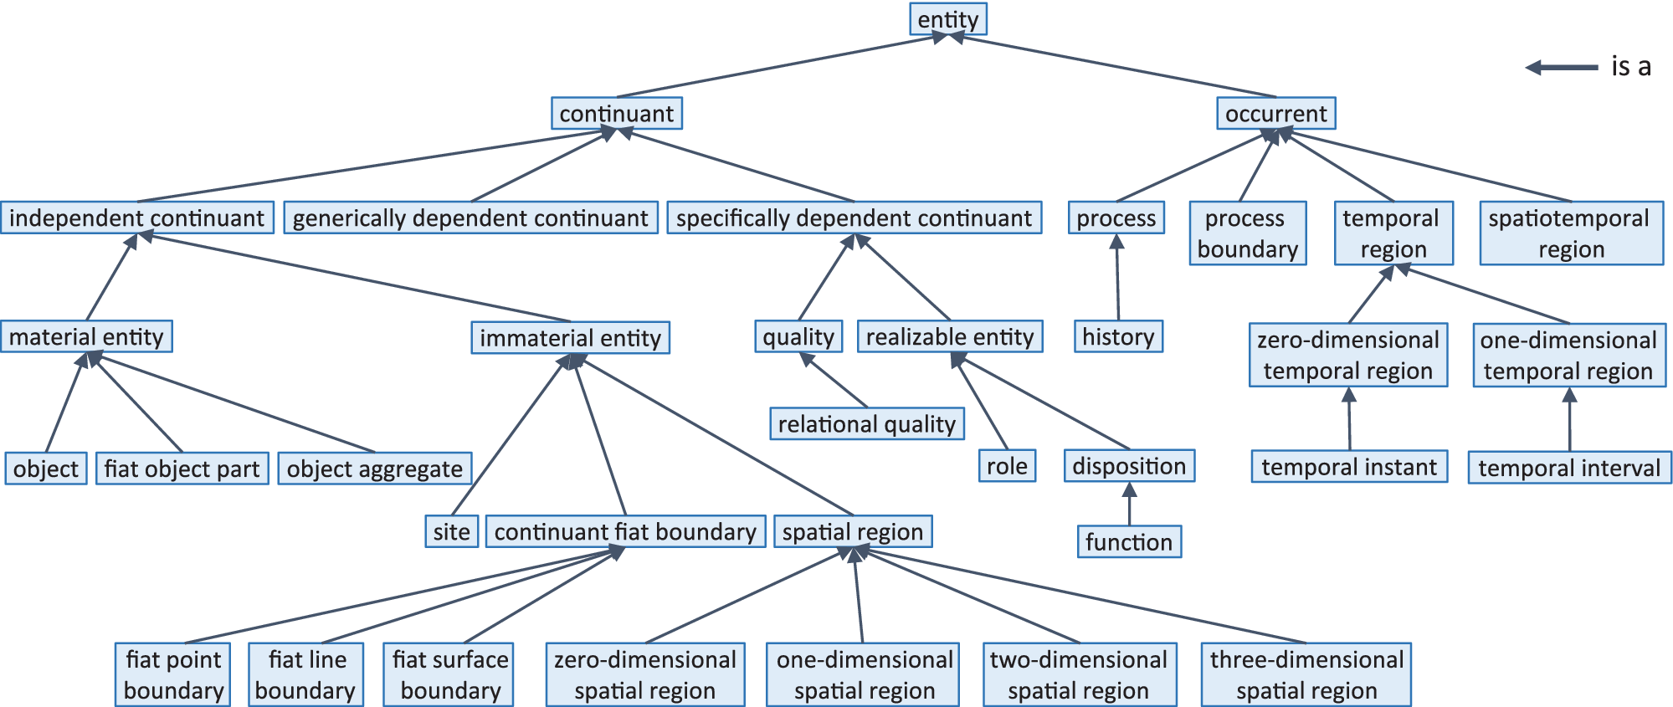
BFO’s taxonomy of categories
ISO/IEC 21838‑2:2021(E) Information technology — Top-level ontologies (TLO) — Part 2: Basic Formal Ontology (BFO)

Slide 12
‘Categories’ BFO2020
Entity: item that is perceivable or conceivable. [1]
Universal: entity that has indefinitely many instances. [2]
Extension: collection of instances of a universal. [2]
Collection: group of particulars. [2]
the particulars in a collection are called its members.
to be understood as allowing change of members over time.
Particular: individual entity. [1]
Defined class: collection whose members are defined by specifying a restriction on one or more universals, that is not the extension of any universal. [2]
Instance: particular that instantiates some universal. [2]
[1] ISO/IEC 21838-1:2021(E) Information technology — Top-Level Ontologies (TLO) — Part 1: Requirements
[2] ISO/IEC 21838‑2:2021(E) Information technology — Top-level ontologies (TLO) — Part 2: Basic Formal Ontology (BFO)

Slide 13
BFO’s category assumptions (1)
Space and time are entities. Places occupy spaces.
All entities are ‘actual’
‘possibilia’ can be expressed through …
Realizable entities and plans (ICEs)
All instances of a universal form an extension of which each such instance is a member.
BFO is neutral as to whether there may be distinct universals that have identical extensions.
Compare: : In OWL, every Class is associated with a Class Extension, which is the set of Instances of the Class. Furthermore "A class has an intensional meaning (the underlying concept) which is related but not equal to its class extension. Thus, two classes may have the same class extension, but still be different classes."
ISO/IEC 21838‑2:2021(E) Information technology — Top-level ontologies (TLO) — Part 2: Basic Formal Ontology (BFO)

Slide 14
BFO’s category assumptions (2)
BFO does not recognize higher-level universals (universals instantiated by universals). For example, there is no universal named "universal".
BFO takes identity of continuants as something primitive. Occurrents, in contrast, cannot change. Thus, they cannot gain and lose parts.
Parts, wholes, unity and boundaries in BFO:
distinct parthood relations for continuants and occurrents.
distinction between objects and object aggregates, viewing the latter as exact sums of the former; however, it includes no axioms governing the summation of parts in general.
BFO deals for objects with three sorts of unity thus far, and includes fiat object parts.
ISO/IEC 21838‑2:2021(E) Information technology — Top-level ontologies (TLO) — Part 2: Basic Formal Ontology (BFO)

Slide 15
BFO’s category assumptions (3)
Quantities are subtypes of the corresponding qualities.
There are no attributes of processes, nor states. They are represented through Defined Classes (in BFO sense):
defined class: collection whose members are defined by specifying a restriction on one or more universals, that is not the extension of any universal;
extension: collection of instances of a universal;
collection: group of particulars.
BFO identifies material entities with the material of which they are made at any given time (constitution = identity).
Causality in BFO: causal unity of objects, and of processes triggering dispositions; an exhaustive account of causal relations is possible only by combining BFO with domain ontologies.
ISO/IEC 21838‑2:2021(E) Information technology — Top-level ontologies (TLO) — Part 2: Basic Formal Ontology (BFO)

Slide 16
Snomed CT’s basic assumptions

Slide 17
Content of SNOMED CT
Stefan Schulz.
ICBO / FOIS 2021 Keynote. SNOMED CT x BFO: can the gap between legacy terminology and foundational ontology be bridged?

Slide 18
How to bridge between SNOMED CT and BFO?
Stefan Schulz.
ICBO / FOIS 2021 Keynote. SNOMED CT x BFO: can the gap between legacy terminology and foundational ontology be bridged?

Slide 19
Stefan Schulz.
ICBO / FOIS 2021 Keynote. SNOMED CT x BFO: can the gap between legacy terminology and foundational ontology be bridged?

Slide 20
Description Logic(s)
A DL is a fragment of FOL.
DLs come in many varieties, most of which are decidable.
A logic is decidable if there is an effective method for determining whether arbitrary formulas of the logic are logically valid formulas.
A FOL is not decidable if its signature (i.e. the list and description of non-logical symbols) includes equality and at least one other predicate with two or more arguments.
Flavors: https://en.wikipedia.org/wiki/Description_logic .

Slide 21
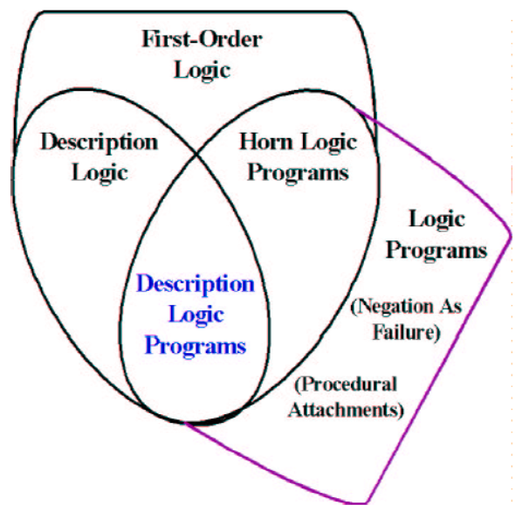
Relations between some logics
DL
Benjamin Grosof , Ian Horrocks, Raphael Volz, Stefan Decker.
Description Logic Programs: Combining Logic Programs with Description Logic. 2004 Research Papers in Economics.. http://www.cs.man.ac.uk/~horrocks/Publications/download/2003/p117-grosof.pdf

Slide 22
‘Negation’
Logical negation:
not(X) is true if it can be proven that X is false.
not(X) is false if it can be proven that X is true.
Negation by failure (Prolog):
not(X) is true if it is not possible to prove that X is true.
not(X) is false if it can be proven that X is true.
Safe use of ‘not(X)’ in Prolog:
X is fully instantiated when not(X) is processed, or;
X has uninstantiated variables, but they don't appear anywhere else in the clause.

Slide 23
Description Logic(s)
Three essential components of a DL system:
Abox: Father(john). concept assertion
fatherOf(john, barry). role assertion
john ≠ barry
…
Tbox: Father Parent concept inclusion
Person ≡ Human concept equivalence
…
Rbox: fatherOf parentOf role inclusion
disjoint(parentOf, childOf) disjointness of roles
…
Assertions need to be interpreted as being about sets.

Slide 24
DL constructors
Male Parent intersection / conjunction
Male Female union / disjunction
¬ Male complement / negation
…
Can be used in Tbox axioms, e.g.
Father ≡ Male Parent
T Male Female everything is included in the set of males and females
Male Female ⊥ the intersection of the set of males and the set of females is empty
…
Markus Krötzsch, Frantisek Simancik, Ian Horrocks. A Description Logic Primer. https://arxiv.org/pdf/1201.4089.pdf

Slide 25
Role restrictions
Universal restriction:
∀parentOf.Female
The set of individuals all of whose children are female including those that have no children at all.
Existential restriction:
∃parentOf.T
The set of individuals that are parents of at least one individual.
Combinations:
∃parentOf.T ∀parentOf.Female
The set of all individuals with at least one child, all children being female.
∃sonOf.T male
The set of individuals that are the son of at least one individual is a subset of the set of males.
Markus Krötzsch, Frantisek Simancik, Ian Horrocks. A Description Logic Primer. https://arxiv.org/pdf/1201.4089.pdf

Slide 26
Snomed’s DL is EL (1)
The description logic EL allow the following concepts:
C, D → A | (atomic concept)
T | (universal concept)
⊥ | (bottom concept)
{a} | (singular enumeration)
C D | (intersection / conjunction)
∃R.C | (existential restriction)
With the following axioms:
C D and C ≡ D for concept descriptions C and D.
P Q and P ≡ Q for roles P, Q.
C(a) and R(a, b) for concept C, role R and individuals a, b

Slide 27
Snomed’s DL is EL (2)
It lacks:
negation, (only disjointness of classes: C D ⊥),
disjunction,
universal quantification,
cardinalities,
inverse roles,
some role characteristics

Slide 28
The following slides are from
https://confluence.ihtsdotools.org/download/attachments/87043117/SnomedCtExpo_DL_Enhancements_2019.pdf?version=1&modificationDate=1572491411000&api=v2

Slide 31
Existential restriction

Slide 37
Stefan Schulz.
ICBO / FOIS 2021 Keynote. SNOMED CT x BFO: can the gap between legacy terminology and foundational ontology be bridged?

Slide 38
Fracture of radius

Slide 39
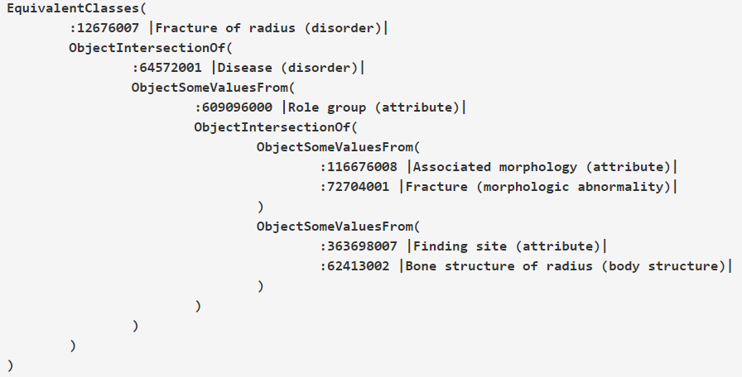
Fracture of radius

Slide 40
Stefan Schulz.
ICBO / FOIS 2021 Keynote. SNOMED CT x BFO: can the gap between legacy terminology and foundational ontology be bridged?

Slide 41
Unintended model ?
Stefan Schulz.
ICBO / FOIS 2021 Keynote. SNOMED CT x BFO: can the gap between legacy terminology and foundational ontology be bridged?

Slide 43
Assignment A2
Assignment to be done strictly individually.
Implement in Prolog the named simple expression constraints except ‘self’, ‘any’ and ‘member of’, thus eight in total, of SNOMED CT’s Expression Constraint Language (ECL) listed on https://confluence.ihtsdotools.org/pages/viewpage.action?pageId=110341487.
Apply this to the BFO2020 continuant hierarchy.
Response format: a fully working Prolog program with argumentation, ideally proofs, that it gives only intended answers to constraint queries re the BFO continuant hierarchy.
Assessment criteria: see syllabus.
Due date: Sept 27, 2021, noon

