Slide 1
BMI708 – Spring 2021 Advanced Topics in Biomedical Ontology (class number 24641) Class 3 – Sept 15, 2021 Gentle introduction to Logic, Prolog and BFO’s axiomatization
Werner CEUSTERS^{1,2}
¹ Department of Biomedical Informatics, University at Buffalo, USA
² Department of Psychiatry, University at Buffalo, USA

Slide 2
Motivation
Overall learning objective:
be able to understand BFO’s axiomatization
so that you can axiomatize other ontologies you use or design,
so that you can apply logic reasoning to data expressed in terms of these ontologies.
BFO’s axiomatization is in Common Logic (CL) using CLIF syntax (CL Interchange Format).
CL is based on First Order Logic (FOL), and extension of the simpler Propositional Logic.
Prolog is a language which automates logic reasoning with Horn clauses on the basis of back-tracking.
Horn clauses form a subset of FOL formulas.
The procedural features of Prolog allows to build reasoners that extend the limitations of Horn clauses.

Slide 3
What is ‘a logic’
A formal or informal language together with a deductive system and/or a model-theoretic semantics.
The language has components that correspond to a part of a natural language like English or Greek.
The deductive system is to capture, codify, or simply record arguments that are valid for the given language.
The semantics is to capture, codify, or record the meanings, or truth-conditions for at least part of the language.
Shapiro, Stewart and Teresa Kouri Kissel, "Classical Logic",
The Stanford Encyclopedia of Philosophy (Spring 2021 Edition), Edward N. Zalta (ed.).
https://plato.stanford.edu/archives/spr2021/entries/logic-classical/

Slide 4
Propositional Logic (PL) essentials

Slide 5
Language and semantics of PL
A well-formed formula is either atomic or composed following allowed composition rules.
Atomic formulae stand for propositions that must either be true or false:
A: ‘John eats too much’.
B: ‘John has a normal BMI’.
C: ‘John is careful’.
Formula connectors:
Negation (not): ¬ ~
Conjunction (and): ∧ & ∙
Disjunction (or): ∨
Material implication (if...then): → ⇒ ⊃
Biconditional (if and only if): ↔ ⬄ ≡ =

Slide 6
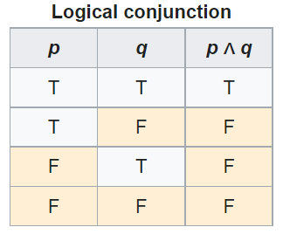
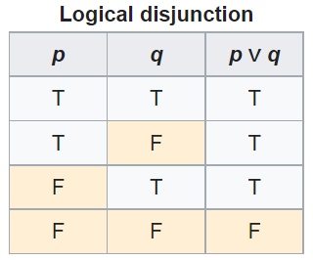
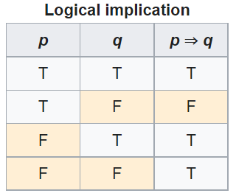
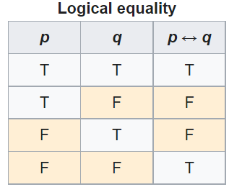
PL’s Deductive system: truth tables

Slide 7
Some PL laws
Truth tables can be used to prove laws, e.g.:
a Λ (b V c) = (a Λ b) V (a Λ c)
¬ (a Λ b) = ¬ a V ¬b
(a Λ (a → b)) → b
(a→ b) Λ ¬b) → ¬a
((a V b) Λ ¬a) → b
((a → b) Λ (b → c)) → (a → c)
…
More examples:
https://math.stackexchange.com/questions/1449866/catalogue-of-propositional-logic-laws
http://mathonline.wikidot.com/the-laws-of-propositional-logic#toc0
Both truth tables and laws can be used to solve puzzles.

Slide 8
Exercise
Given:
If John eats too much, then he does not have a normal BMI.
If John is not careful, then he eats too much.
John has a normal BMI.
Question
Is John careful?

Slide 9
Translate sentences into PL
Propositions
John eats too much |  |  | a
John has a normal BMI |  |  | b
John is careful |  |  | c
Given
If John eats too much, then he does not have a normal BMI |  |  | a → ¬b
If John is not careful, then he eats too much. |  |  | ¬c → a
John has a normal BMI |  |  | b
Determine the truth value of: |  | (a → ¬b) ∧ (¬c → a) ∧ b

Slide 10
Method 1: Determine with tables

Slide 11
Method 2: Determine using laws
Propositions
John eats too much |  | a
John has a normal BMI |  | b
John is careful |  | c
Given
If John eats too much, then he does not have a normal BMI |  | a → ¬b | g1
If John is not careful, then he eats too much. |  | ¬c → a | g2
John has a normal BMI |  | b | g3
Rule application: | (x→ y) Λ ¬y) → ¬x | ¬a | g3/g1 | g4
 | (x→ y) Λ ¬y) → ¬x | c | g2/g4

Slide 12
Another exercise
Solve this puzzle:
Given:
Everybody who eats too much, does not have a normal BMI.
Everybody who is not careful, eats too much.
Everybody has a normal BMI.
Question
Is everybody careful?
Same as before: yes.

Slide 13
What about this ome?
Solve this puzzle:
Given:
Everybody who eats too much, does not have a normal BMI.
Everybody who is not careful, eats too much.
John has a normal BMI.
Question
Is John careful?
Can not be done with propositional logic!
There is no way to create propositions (within the syntax and semantics of propositional logic) so that ‘everybody’ nor ‘John’ can be represented or related.

Slide 14
First Order Logics (FOL) (Predicate Logic)

Slide 15
First-order logic
Propositional logic with predicates, variables and quantifiers.
Predicate: a proposition that some property holds for some entity, or a relation between entities.
Prop.L. : A = ‘everybody eats too much’
FOL: A = ‘eats too much’ A(x)
Quantifiers:
‘all’ ∀ ∀x.A(x) everything eats too much
‘some’ ∃ ∃x.A(x) something eats too much
‘everybody eats too much’
∀x.person(x) → A(x)

Slide 16
First-Order Logic (FOL) - Syntax
User defines these primitives:
Constant symbols (i.e., the "individuals" in the world) E.g., bfo, 3
Function symbols (mapping individuals to individuals) E.g., author-of(bfo) = barry_smith
Predicate symbols (mapping from individuals to truth values)
E.g., greater(5,3) = true, smart(barry_smith) = true

Slide 17
First-Order Logic (FOL) - Syntax…
FOL supplies these primitives:
Variable symbols. E.g., x,y
Connectives.
Same as in PL:
not (~),
and (^),
or (v),
implies (→),
if and only if (<=>)
Quantifiers: Universal (∀) and Existential (∃)

Slide 18
Truth values of quantifiers
Statement | True when | False when
∀x.A(x) | A(x) is true for every x. | There is an x for which A(x) is false
∃x.A(x) | There is an x for which A(x) is true. | A(x) is false for every x.
Open or Closed World
Reality
Represented Reality

Slide 19
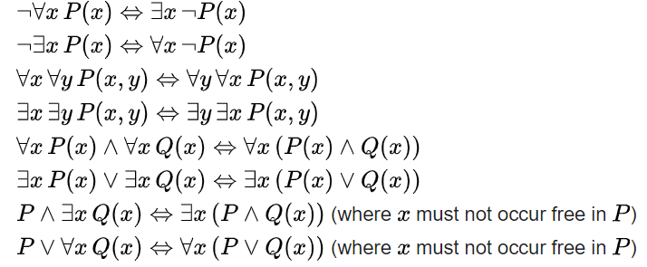
Some equivalences
A free variable is a variable not bound by a quantifier:
∀x.P(x) → Q(x) in contradistinction to ∀x.(P(x) → Q(x))

Slide 20
Flexibility in predicate formation
Some people eat too much:
∃x (person(x) Λ eats_too_much(x))
∃x (person(x) Λ eats(x, ‘too much’))
∃x ∃y (person(x) Λ eats(x, y) Λ quantity(y, ‘too much’))
However:
Are not equivalent,
Are based on a different ontology.
As a realist ontologist, make your choice on the basis of the method described in
https://genomebiology.biomedcentral.com/articles/10.1186/gb-2005-6-5-r46

Slide 21
Be careful with quantifiers
Order is important!
∀x ∃y symptomOf(x, y)
For all x, there exist some y such that x is a symptom of y
Every symptom originates from some disease;
Does not exclude that there is only one disease, and that all symptoms come from that one disease.
∃y ∀x symptomOf(x, y)
There exist some y, such that for all x, x is a symptom of y
There is a disease which is the cause of all symptoms that exist.

Slide 22
Be aware of ambiguities in language
‘Every patient has some provider’
Can mean:
∀x ∃y patientOf(x, y)
For all x, there exist some y such that x is a patient of y
Every patient has some provider.
∃y ∀x patientOf(x, y)
There exist some y, such that for all x, x is a patient of y
There is some provider that provides for all patients.

Slide 23
Common Logic (CL)
CL is a family of first-order logics which share a common abstract syntax and model theory, and an XML framework for encoding and transmitting them, or their content, on an open network.
CL syntax is very relaxed in the expressions it allows, in some ways going beyond classical FO logic.
ISO standard: https://standards.iso.org/ittf/PubliclyAvailableStandards/c066249_ISO_IEC_24707_2018.zip
https://www.w3.org/2004/12/rules-ws/slides/pathayes.pdf

Slide 24
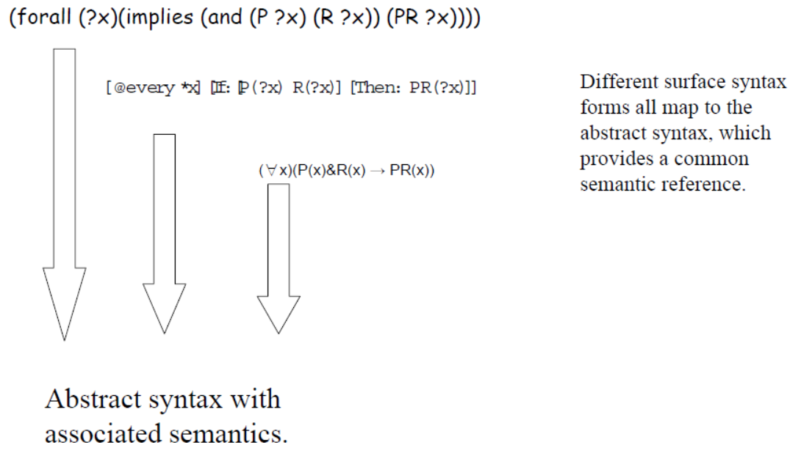
CL dialects
https://www.w3.org/2004/12/rules-ws/slides/pathayes.pdf

Slide 25
Common Logic Interchange Format (CLIF)
John is going to Boston by bus
(exists (x y)
(and (Go x) (Person John) (City Boston)
(Bus y) (Agnt x John) (Dest x Boston) (Inst x y)))
We’ll work in detail with CLIF when studying the axiomatization of BFO.
https://standards.iso.org/ittf/PubliclyAvailableStandards/c066249_ISO_IEC_24707_2018.zip

Slide 26
Prolog Basics

Slide 27
Remember the Propositional Logic laws
Logical equality (aka biconditional) laws:
a Λ (b V c) = (a Λ b) V (a Λ c)
¬ (a Λ b) = ¬a V ¬b
a → b = ¬a V b
...
Implication laws:
(a Λ (a → b)) → b
(a→ b) Λ ¬b) → ¬a
((a V b) Λ ¬a) → b
((a → b) Λ (b → c)) → (a → c)
…
…
Every proposition can be expressed in different logical ways

Slide 28
One such way: Conjunctive Normal Form (CNF)
A literal is either:
an atomic formula (called a positive literal) or
a negated atomic formula (called a negated literal)
e.g. P, ¬ Q
A clause is:
a literal, or
a disjunction of two or more literals, or
the empty clause,
e.g. P, P ∨ ¬Q ∨ R, □ (or :‐ or { })
A formula is in Conjunctive Normal Form (CNF) if it is the conjunction of some number of clauses.

Slide 29
Which one is in CNF ?
a Λ (b V c) = (a Λ b) V (a Λ c)

Slide 30
Which one is in CNF ?
a Λ (b V c) = (a Λ b) V (a Λ c)
Conjunction of two clauses, i.e. a literal and a disjunction.
Every PL formula can be converted to CNF and there exists an algorithm for doing so that runs in polynomial time!
→ a machine can do it.
Practical use in ‘Logic Programming’.

Slide 31
Example: P ⬄ (Q ∧ R)
‘You will have an A grade in BMI708’ (P) if and only if ‘you are smart’ (Q) and ‘you work hard’ (R)
Remove equivalence:
( P → (Q ∧ R) ) ∧ ( (Q ∧ R) → P )
Remove implication
( ¬P V (Q ∧ R) ) ∧ (¬(Q ∧ R) V P )
Move negation inwards:
( ¬P V (Q ∧ R) ) ∧ (¬Q V ¬R V P )
Distribute OR over AND:
( ¬P V Q ) ∧ (¬P V R) ) ∧ (¬Q V ¬R V P )

Slide 32
Transforming clauses in LPCs
LPC = ‘Logic Programming Clause’
Start with CNF:
( ¬P V Q ) ∧ (¬P V R) ) ∧ (¬Q V ¬R V P )
Rewrite in set notation of CNF:
{( ¬P V Q ) , (¬P V R) ) , (¬Q V ¬R V P ) }
Rewrite in set notation for clauses:
{ { ¬P , Q } , {¬P , R} ) , {¬Q , ¬R , P } }
Rewrite as LPC: (‘ :- ’ means ‘if’)
Q :- P. R :- P. P :- Q, R.

Slide 33
Horn clauses
A Horn clause is a sentence of the form:
(P1 Λ P2 Λ ... Λ Pn) → Q (syntax 1), or
Q :- P1, P2, …, Pn (Prolog syntax)
where the Pi's and Q are positive literals (includes True)
A formula F in CNF is a Horn formula if every disjunction in F contains at most one positive literal.
{ { ¬P , Q } , {¬P , R} ) , {¬Q , ¬R , P } }
Horn formula form a proper subset of FOL sentences.
All FOL formulas can be converted to ‘clausal normal form’ (CNF), i.e. a conjunction of clauses.
Most, but not all, FOL sentences can thus be rewritten as Horn clauses.

Slide 34
Converting FOL to CNF (1)
Simplify: (remove implication and equivalence)
P → Q becomes ¬P V Q
Move negations in:
¬ ∀x.P(x) becomes ∃x. ¬ P(x)
¬ ∃x.P(x) becomes ∀x. ¬ P(x)
¬(P ∧ Q) becomes ¬P V ¬Q
¬(P V Q) becomes ¬P ∧ ¬Q
¬¬P becomes P
Skolemize: (remove existential quantifiers)
∃x.P(x) becomes P(a) = skolem constant
∀x ∃y.P(x,y) becomes ∀x.P(x, f(x)) = skolem function
e.g. if P = patientOf, then f(x) is the provider of x.

Slide 35
Converting FOL to CNF (2)
Remove universal quantifiers:
rename all variables so that each quantifier has its own unique variable name
(∀y R(f(x), y) ∧ ∀y S(f(x), y)) becomes
(∀y R(f(x), y) ∧ ∀z S(f(x), z))
Move quantifiers to the left end and make the scope of each the entire sentence
∀y ∀z (R(f(x), y) ∧ S(f(x), z))
Drop the quantifiers:
R(f(x), y) ∧ S(f(x), z)
Proceed further as with Propositional Logic.

Slide 36
Horn clauses in Prolog
Prolog: a programming language for reasoning over Horn clauses.
Examples:
Conditional clauses aka rules:
fatherOf(X,Y) :- parentOf(X,Y),male(X).
father(X) :- fatherOf(X,_).
grandfatherOf(X,Y) :- fatherOf(X,Z), parentOf(Z,Y).
Facts:
male(john). Or: male(“John”).
parentOf(john,_).
parentOf(bert, john).

Slide 37
Prolog syntax
Data
Formulae and clauses
Queries

Slide 38
Prolog syntax: data
Atomic values (literals):
Numbers: 1, -3, …
Symbolic literals: alphanumeric strings starting with a lower-case letter or any string in single quotes.
Logical variables:
alphanumeric starting with an upper-case letter, or the anonymous variable ‘_’
Terms:
variables and literals are (atomic) terms,
Terms of the form ‘f(t1, t2, … ,tn)’,
two terms joined by an arithmetic operation is a term, e.g., X+1, 2*[1,2,3]
a finite list of terms, e.g. [2, cat, X1].

Slide 39
Prolog syntax – formulae and clauses
atomic formulae p(t1, t2, … , tn) where ti is a term, and p a symbolic literal called the predicate name;
(Horn) clauses written as ‘A :- B1, B2, … , Bn.’ where A and Bi are atomic formulas;
A is called the head of the clause
B1, B2, … , Bn is called the body.
A clause without a body is a fact, otherwise a conditional clause or rule.

Slide 40
Prolog syntax – programs and queries
a Prolog program is a finite sequence of Horn clauses.
Comments:
beginning with '%' and extending to the end of the line,
beginning with '/*' and extending (over end of lines) to '*/’.
Queries:
Are of the form: ‘?- B1, B2, … , Bn.’, n≥1, where Bi (1≤i≤n) is an atomic formula and each Bi is called a goal.

Slide 41
Programs and queries
Example Prolog program: father.pl
fatherOf(X,Y) :- parentOf(X,Y),male(X).
father(X) :- fatherOf(X,_).
grandfatherOf(X,Y) :- fatherOf(X,Z), parentOf(Z,Y).
parentOf(john,_).
parentOf(bert, john).
male(bert).
Example queries:
?-father(_). ‘Does there exist a father?’
?-father(X). ‘Who is a father?’
?-parentOf(bert,X). ‘Of who is Bert a parent?’
?-grandfatherOf(X,_). ‘Who is a grandfather of somebody?’
?-grandfatherOf(_,_). ‘Is there somebody who has a grandfather?’
?-grandfatherOf(X,Y). ‘Who is grandfather of who?’
?-parentOf(X,john),male(X). ‘Who is a male parent of john?’

Slide 42
Quantification in Prolog
grandfatherOf(X,Y) :- fatherOf(X,Z), parentOf(Z,Y).
All variables in the head are universally quantified.
All variables in the body which are not in the head, are existentially quantified.
For all X and all Y, X is the grandfather of Y if there exists some Z of which X is a father and which is a parent of Y.
?- grandfatherOf(X,Y), male(Y).
All variables in a query are existentially quantified.
Does there exist a pair X,Y such that X is the grandfather of Y and Y is male?
Important: quantification is over what is known!!!
‘closed world assumption’.

Slide 43
Prolog’s built-in reasoning strategy (1)
Three internal data structures:
a search tree in which each node has …
a list of goals (predicates),
a set of variable bindings (instantiations).
Two types of procedures working on the search tree:
Unification: finds instantiations of variables so as to make equal terms (if such instantiation exists)
Back-tracking: revisiting past decisions after a failed goal is reached.

Slide 44
Prolog’s built-in reasoning strategy (2)
Start: the search tree has just a root, the goal list consists only of the query, and the set of variable bindings is empty.
The program is scanned top to bottom for a clause (fact or rule) whose head potentially matches the current goal
for each such clause, add a child node to the search tree,
descend to the leftmost child.
→ ‘depth first’ search.
The top goal is unified with the clause’s head, yielding more variable bindings.
The clause’s body predicates are added to the goal list, left to right.
Return to 1.
If 1. or 2. fail due to no matching clause or failed unification:
backtrack to parent node and try next child in search tree,
if root node fails, stop and return false.

Slide 45
Generally: order matters
Order of facts and rules in file;
for efficiency:
facts before rules,
easy predicates before harder ones (e.g. those with recursion).
Order of predicates in the body of rules.
Order only influences termination, not outcomes.
Compiler directives can be used to override or force order.

Slide 46
Weaknesses of ‘native Prolog with Horn clauses’ (‘native’ = ‘without using work-arounds’)
It is not possible to express:
disjunctive facts or rules with a disjunctive head.
E.g.: x is either a continuant or an occurrent if x is an entity.
negative facts or negative heads.
E.g.: x is not an occurrent if it is a continuant.
existential quantification for facts or conclusions.
E.g.: there is some value for a variable which makes a predicate true though we don’t know what that variable is.
predicates as variables.
Some logically correct and faithful combinations of rules may lead to non-termination because of the back-tracking.
continuant(X) :- not(occurrent(X)).
occurrent(X) :- not(continuant(X)).

Slide 47
Exercise
For the following program:
loves(vincent, mia).
loves(marsellus, mia).
jealous(A,B) :- loves(A,C), loves(B,C).
And the following query:
?-jealous(X,Y).
What is Prolog’s (first) answer?
Loves.pl

Slide 48
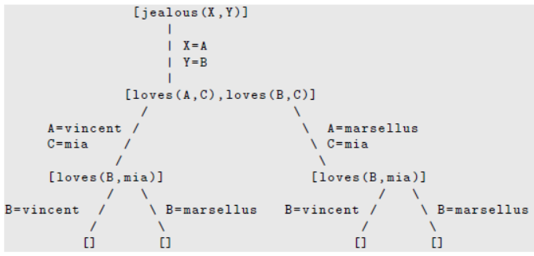
Search tree
3
1
4
2
Bos, Johan. “Drawing Prolog Search Trees: A Manual for Teachers and Students of Logic Programming.” ArXiv abs/2001.08133 (2020).
https://arxiv.org/pdf/2001.08133.pdf

Slide 49
Gentle introduction to BFO’s axiomatization
BFO’s basic assumptions

Slide 50
‘Particulars exist at some time’
(forall (p) (if (particular p) (exists (t) (exists-at p t))))
⇓ Standard FOL notation
∀p ( particular(p) → (∃t existsAt(p, t)))
The CL axiomatization contains also:
(cl:outdiscourse continuant-part-of temporal-part-of
exists-at particular universal instance-of)

Slide 51
‘Particulars exist at some time’
(forall (p) (if (particular p) (exists (t) (exists-at p t))))
⇓ Standard FOL notation
∀p ( particular(p) → (∃t existsAt(p, t)))
The CL axiomatization contains also:
(cl:outdiscourse continuant-part-of temporal-part-of
exists-at particular universal instance-of)
= ‘we don’t talk of these’, ‘they are not ‘individuals’ in our domain (of discourse)’
Do not confuse this with ‘individuals’ as synonym for ‘particular’ in ontological realism.
Only the p’s and t’s in the above are in the domain.

Slide 52
Individual universals are in the domain of discourse, but not ‘universal’ !!!
(cl:outdiscourse continuant-part-of temporal-part-of exists-at particular universal instance-of)
(cl:comment "1. There is always something that exists" (forall (t)
(if (instance-of t temporal-region t)
(exists (u i)
(and (not (= i t)) (universal u) (particular i) (instance-of i u t))))))

Slide 53
‘Particulars exist at some time’
(forall (p) (if (particular p) (exists (t) (exists-at p t))))
⇓ Standard FOL notation
∀p ( particular(p) → (∃t existsAt(p, t)))
⇓ Simplification: convert implication to disjunction
∀p (¬ particular(p) V (∃t existsAt(p, t)))
⇓ Negations are already inwards
⇓ Skolemize
∀p (¬ particular(p) V existsAt(p, time(p)))
⇓ Drop universal quantifier
(¬ particular(p) V existsAt(p, time(p)))
⇓ Prolog Horn clause notation
existsAt(p, time(p)) :- particular(p)

Slide 54
‘Particulars exist at some time’
(forall (p) (if (particular p) (exists (t) (exists-at p t))))
⇓ Standard FOL notation
∀p ( particular(p) → (∃t existsAt(p, t)))
⇓ Algorithmic conversion to Horn clause
existsAt(p, time(p)) :- particular(p)
Is there anything here that says that ‘t’ or ‘time(t)’ is a time?
No!

Slide 55
However!
(cl:comment "6. Particulars exist at some time"
(forall (p)
(if (particular p) (exists (t) (exists-at p t)))))
(cl:comment "9. Relata of exists-at are particulars."
(forall (i t)
(if (exists-at i t)
(and (particular i) (particular t)
(instance-of t temporal-region t)))))
→ The CLIF sentences do not reflect the comments faithfully, and vv. This doesn’t mean they are wrong.

