Slide 1
Advanced Topics in
Biomedical Ontology
PHI 637 SEM / BMI 708 SEM
Werner Ceusters and Barry Smith

Slide 2
Lecture 10
Barry Smith and Werner Ceusters
Ontological principles for combining healthcare data in big data repositories

Slide 3
Lecture 10 – part 2
Werner Ceusters
Ontological principles for
maximally explicit and self-explanatory data repositories

Slide 4
Using data from different sources
Data source A
Repeat the same question 6 times?
Data source D
Data source B
Data source E
Data source C
Data source F

Slide 5
Heterogeneity in distinct databases
Logical model differences:
  different internal names for semantically equivalent tables/columns,
  data stored in a single table vs. multiple tables,
  data stored in column-modeled vs. row-modeled form.
Semantic representation differences:
  differences in terminologies and coding systems,
  equivalent information stored at different levels of granularity.
  → Requires asking questions to retrieve the same type of content in as many ways as there are heterogeneous databases.
Marenco L, Wang R, Nadkarni P.
Automated Database Mediation Using Ontological Metadata Mappings.
J Am Med Inform Assoc. 2009 Sep-Oct;16(5):723-37.

Slide 6
Using data from different sources
Data source A
Data source D
Data source B
Data source E
?
Data source C
Data source F

Slide 7
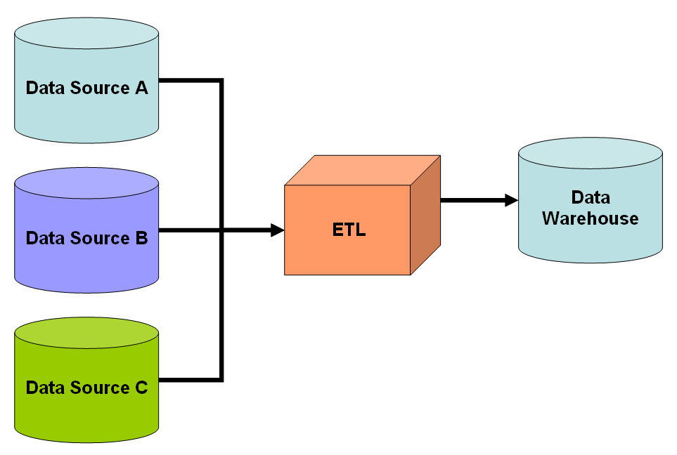
Data warehousing
Extract
Transfer
Load

Slide 8
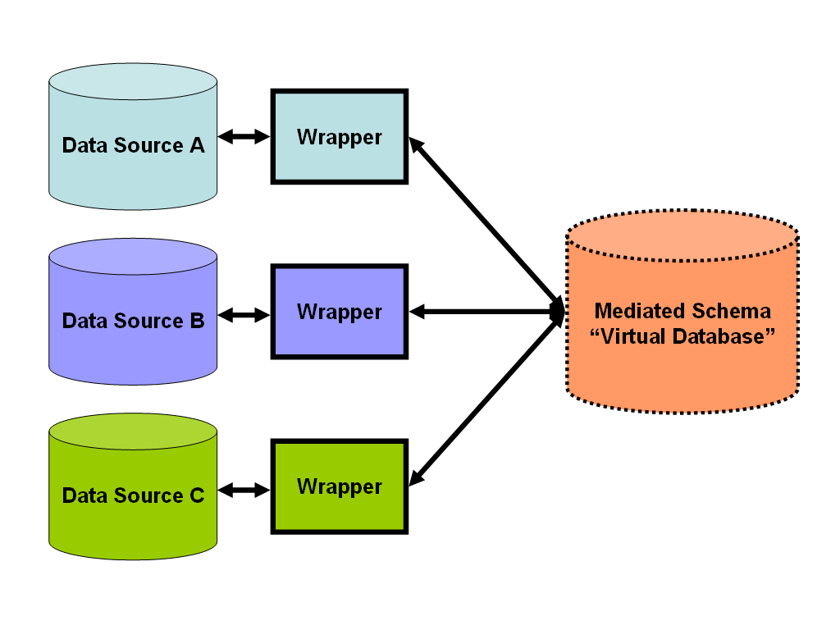
Data federation

Slide 9
Heterogeneity in distinct databases
Logical model differences:
  different internal names for semantically equivalent tables/columns,
  data stored in a single table vs. multiple tables,
  data stored in column-modeled vs. row-modeled form.
    → resolvable through database views and mappings of individual database schema elements to a global schema. → Field mapping.
Semantic representation differences:
  differences in terminologies and coding systems,
  equivalent information stored at different levels of granularity.
    → resolvable through ontology-based representation of what the data in the distinct databases are about. → Value mapping.
Marenco L, Wang R, Nadkarni P.
Automated Database Mediation Using Ontological Metadata Mappings.
J Am Med Inform Assoc. 2009 Sep-Oct;16(5):723-37.

Slide 10
IHI current data aggregation and use
Operational
systems
IHI Clinical
Integrated
Data Repository
Secondary
use
Cohort selection
EHR
Data Marts
EHR
EHR
EHR
Cost effectiveness
research
Common Data Models
Bio Bank
Decision support
Health
Insurers
Referent Tracking
Data Repository
Quality assurance
Health
Insurers
Health
Insurers

Slide 11
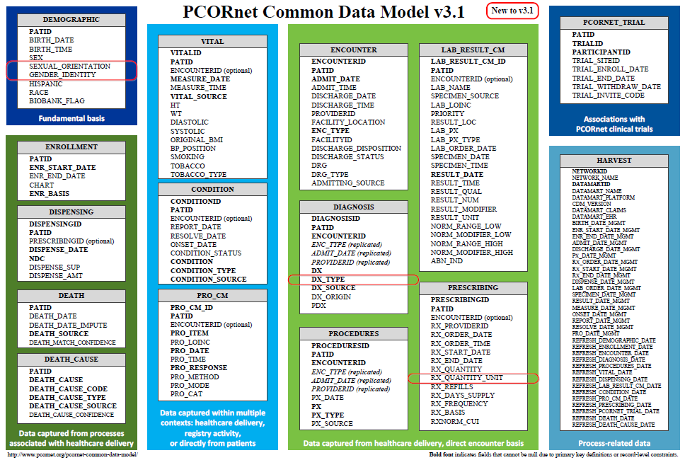
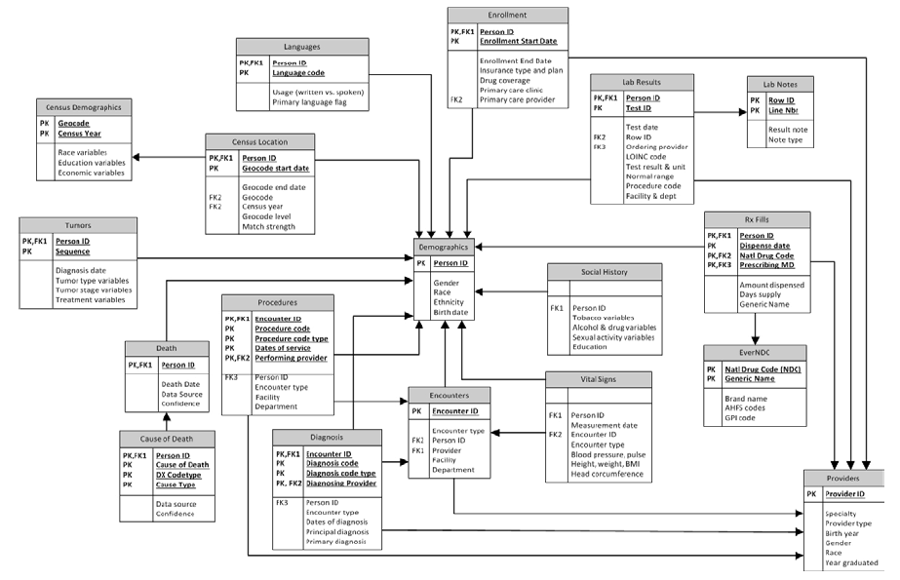
Common Data Models for Secondary Use
The Observational Medical Outcomes Partnership (OMOP)
Health Care Systems Research Network (HCSRN)
The National Patient-Centered Clinical Research Network (PCORNet)

Slide 12
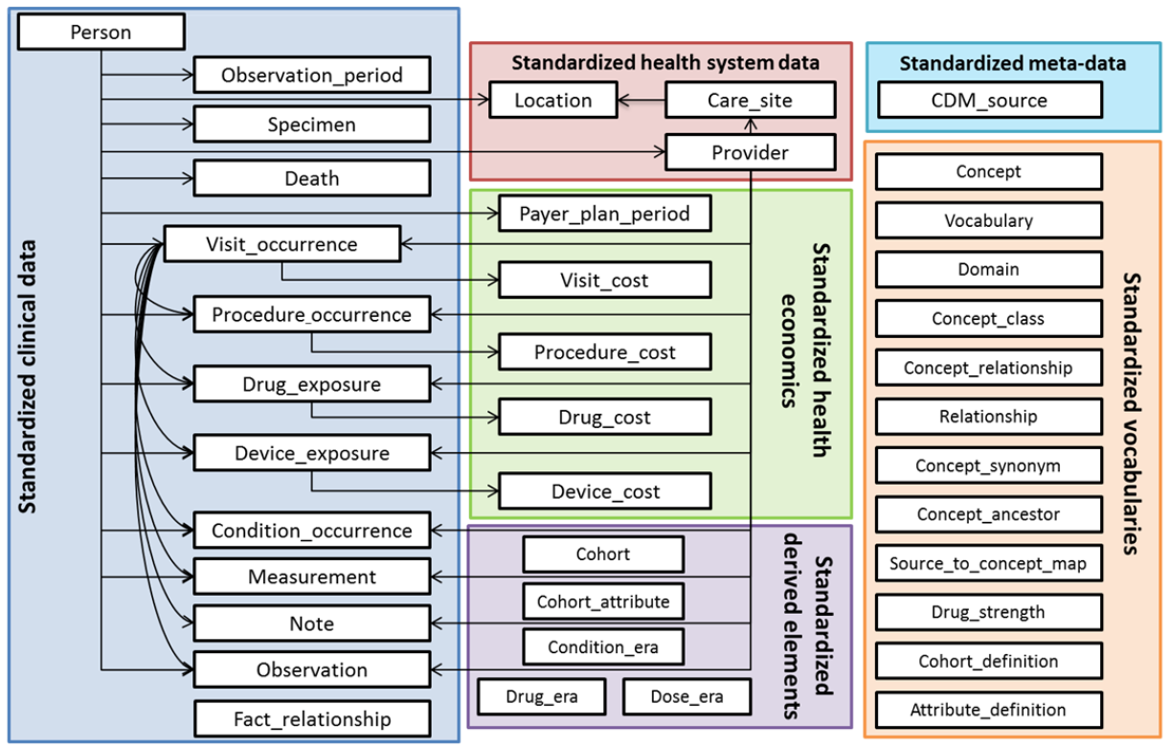
OMOP Common Data Model

Slide 13
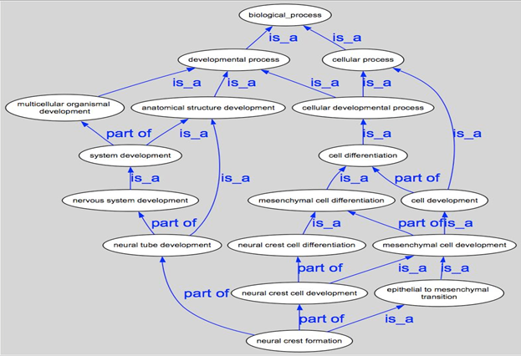
Better: (realism-based) ontology for mapping data collections

Slide 14
Requires analysis of databases and their documentation
Domain information model:
  Describes the domain (actors, places, activities) from where data are (to be) collected.
Data collection ‘cookbook’:
  Contains information on how to collect data.
Data dictionary:
  Contains information describing the contents, format, and structure of a database and the relationship between its elements, used to control access to and manipulation of the database.

Slide 15
Database documentation
Domain information model:
  Describes the domain (actors, places, activities) from where data are (to be) collected.
Data collection ‘cookbook’:
  Contains information on how to collect data.
Data dictionary:
  Contains information describing the contents, format, and structure of a database and the relationship between its elements, used to control access to and manipulation of the database.
Age
-10m <-> 140y
14y <-> 85y
Integer(3)

Slide 16
Supporting documentation: ‘codebook’
Field Name | Description | Type | Missing Value | Range |  | Coding Values
id | Subject id | numeric | none | [5033,6387]
age | Subject’s age | numeric | none | [14,85] |  | Age in years
sex | Subject’s gender | 0/1 | none |  |  | 0 – male, 1 - female
q3 | Have you had pain in the face, jaw, temple, in front of the ear or in the ear in the past month? | 0/1 | none |  |  | 0 – no, 1 - yes
The next 12 variables are from the Graded Chronic Pain Status in the RDC/TMD
an_8_gcps_1 | How would you rate your facial pain on a 0 to 10 scale at the present time, that is right now, where 0 is "no pain" and 10 is "pain as bad as could be"? | numeric | “.” | 0-10 | 0 – no pain to 10 - Pain as bad as could be
an_9_gcps_2 | In the past six months, how intense was your worst pain rated on a 0 to 10 scale where 0 is "no pain" and 10 is "pain as bad as could be"? | numeric | “.” | 0-10 | 0 – no pain to 10 - Pain as bad as could be

Slide 17
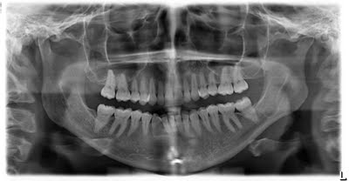
Panoramic X-ray of mouth

Slide 18
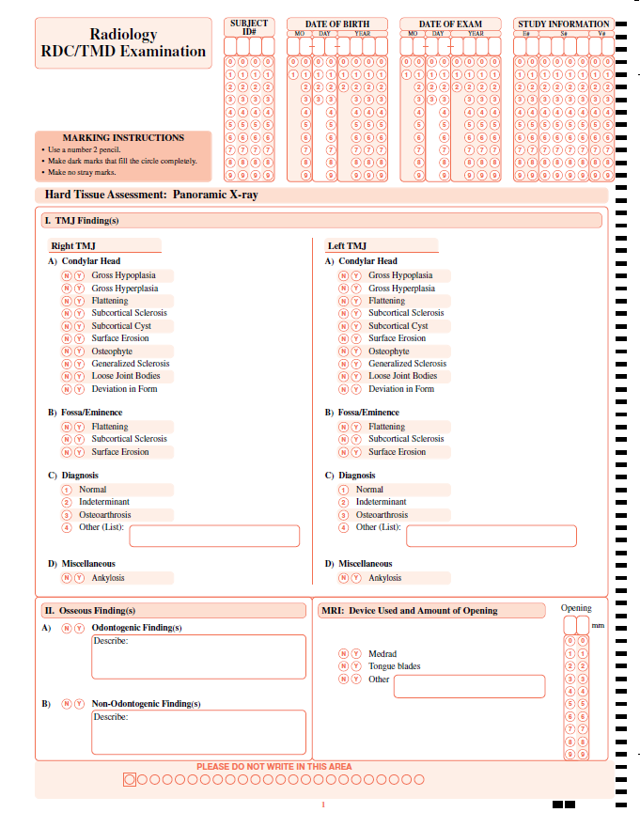
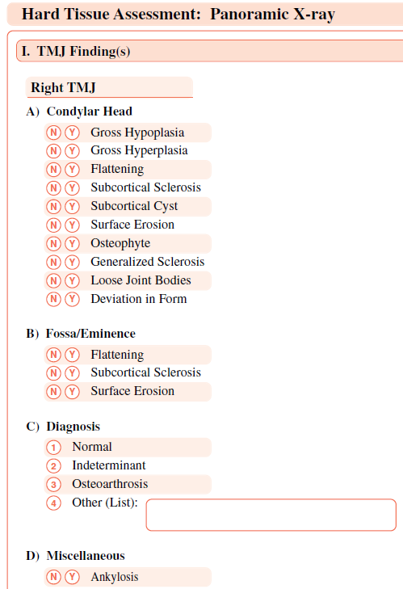
Radiology RDC/TMD Examination: data collection sheet

Slide 19
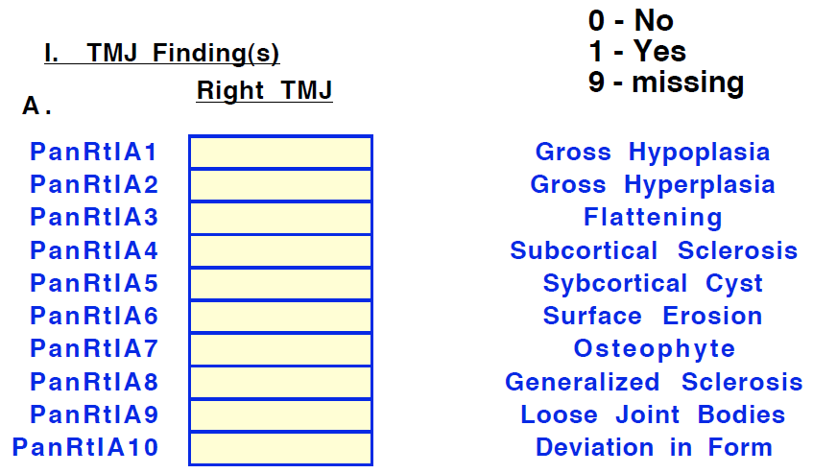
RDC/TMD: a collaborator’s data dictionary
Fieldnames in that collaborator’s data collection
Allowed values for the fields

Slide 20
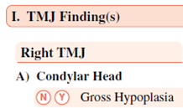
Anybody sees something disturbing ?

Slide 21
This data dictionary alone is not reliable!
That these variables are about the condylar head of the TMJ is ‘lost in translation’!

Slide 22
Dependencies in SAS files
/* No arthralgia or presence */
/* of coarse crepitus, then */
/* arthralgia diagnosis */
/* not present */
if aralgl1=0 or
( e50plt in (2,12) or e5cllt in (2,12 )
or e7lrt in (2,12) or e7llt in (2,12 )
or e7lprot in (2,12)
) then
aralgl=O;
← Absence of symptom
← Absence of diagnosis or diagnosis of absence of arthralgia?

Slide 23
Dependencies in SAS files
Missing values (unjustified absence)
if not(q3 in (O,l)) then q3=.;
if not(q14a in (0,1) then q14a=.;
if not (q14b in (0,1,8) then q14b=.;
if q14a eq 0 then q14b=8;
Not applicable values (justified absence)
if e50plt in (0,2,3 ) then e50pmslt=88;

Slide 24
Vision
Data repositories should be :
maximally explicit → each such repository should contain explicit reference to any and all the entities, including their interrelationships, that must exist for an assertion encoded in the repository to be a faithful representation of the corresponding part of reality.
maximally self-explanatory → the data in the repository should be presented in such a way that a researcher seeking to query/analyze the repository does not need to concern himself with any idiosyncrasies of and inconsistencies between datasets, or codes or formats, that were combined or used to build the repository.

Slide 25
IHI current data aggregation and use
Operational
systems
IHI Clinical
Integrated
Data Repository
Secondary
use
Cohort selection
EHR
Data Marts
EHR
EHR
EHR
Cost effectiveness
research
Common Data Models
Bio Bank
Decision support
Health
Insurers
Quality assurance
Health
Insurers
Health
Insurers

Slide 26
IHI intended data aggregation and use
Operational
systems
IHI Clinical
Integrated
Data Repository
Secondary
use
Cohort selection
EHR
Data Marts
EHR
EHR
EHR
Cost effectiveness
research
Common Data Models
Bio Bank
Decision support
Health
Insurers
Referent Tracking
Data Repository
Quality assurance
Health
Insurers
Health
Insurers

Slide 27
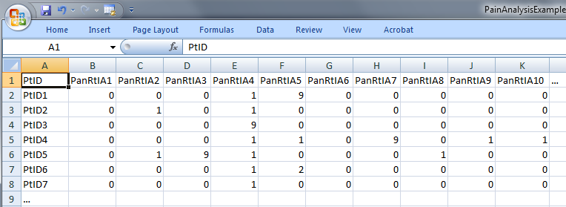
Step 1: ‘meaning’ of values in data collections
‘The patient with patient identifier ‘PtID4’ is stated to have had a panoramic X-ray of the mouth which is interpreted to show subcortical sclerosis of that patient’s condylar head of the right temporomandibular joint’
meaning
1

Slide 28
Step 2 (1): list the entities denoted and assign Instance Unique Identifiers (IUI)
1(The patient) with 2(patient identifier ‘PtID4’) 3(is stated) 4(to have had) a 5(panoramic X-ray) of 6(the mouth) which 7(is interpreted) to 8(show) 9(subcortical sclerosis of 10(that patient’s condylar head of the 11(right temporomandibular joint)))’
CLASS | INSTANCE IDENTIFIER
person | IUI-1
patient identifier | IUI-2
assertion | IUI-3
technically investigating | IUI-4
panoramic X-ray | IUI-5
mouth | IUI-6
interpreting | IUI-7
seeing | IUI-8
diagnosis | IUI-9
condylar head of right TMJ | IUI-10
right TMJ | IUI-11
notes: colors have no meaning here, just provide easy reference,
this first list can be different, any such differences being resolved in step 3

Slide 29
Step 2 (2): provide directly referential descriptions
CLASS | INSTANCE IDENTIFIER | DIRECTLY REFERENTIAL DESCRIPTIONS
person | IUI-1 | the person to whom IUI-2 is assigned
patient identifier | IUI-2 | the patient identifier of IUI-1
assertion | IUI-3 | 'the patient with patient identifier PtID4 has had a panoramic X-ray of the mouth which is interpreted to show subcortical sclerosis of that patient’s right temporomandibular joint'
technically investigating | IUI-4 | the technically investigating of IUI-6
panoramic X-ray | IUI-5 | the panoramic X-ray that resulted from IUI-4
mouth | IUI-6 | the mouth of IUI-1
interpreting | IUI-7 | the interpreting of the signs exhibited by IUI-5
seeing | IUI-8 | the seeing of IUI-5 which led to IUI-7
diagnosis | IUI-9 | the diagnosis expressed by means of IUI-3
condylar head of right TMJ | IUI-10 | the condylar head of the right TMJ of IUI-1
right TMJ | IUI-11 | the right TMJ of IUI-1

Slide 30
Step 3: identify further entities that ontologically must exist for each entity under scrutiny to exist.
assigner role | IUI-12 | the assigner role played by the entity while it performed IUI-21
assigning | IUI-21 | the assigning of IUI-2 to IUI-1 by the entity with role IUI-12
asserting | IUI-20 | the asserting of IUI-3 by the entity with asserter role IUI-13
asserter role | IUI-13 | the asserter role played by the entity while it performed IUI-20
investigator role | IUI-14 | the investigator role played by the entity while it performed IUI-4
panoramic X-ray machine | IUI-15 | the panoramic X-ray machine used for performing IUI-4
image bearer | IUI-16 | the image bearer in which IUI-5 is concretized and that participated in IUI-8
interpreter role | IUI-17 | the interpreter role played by the entity while it performed IUI-7
perceptor role | IUI-18 | the perceptor role played by the entity while it performed IUI-8
diagnostic criteria | IUI-19 | the diagnostic criteria used by the entity that performed IUI-7 to come to IUI-9
study subject role | IUI-22 | the study subject role which inheres in IUI-1

Slide 31
Step 3: some remarks
interpreter role, perceiver role, …
  reference to roles rather than the entity in which the roles inhere because it may be the same entity and one should not assign several IUIs to the same entity,
    It cannot always be avoided, but if it can be, it should be.
each description follows similar principles as Aristotelian definitions but is about particulars rather than universals.

Slide 32
Step 4: classify all entities in terms of – ideally but not necessary – realism-based ontologies
CLASS | HIGHER CLASS
person | BFO: Object
patient identifier | IAO: Information Content Entity
assertion | IAO: Information Content Entity
technically investigating | OBI: Assay
panoramic X-ray | IAO: Image
mouth | FMA: Mouth
interpreting | MFO: Assessing
seeing | BFO: Process
diagnosis | IAO: Information Content Entity
condylar head of right TMJ | FMA: Right condylar process of mandible
right TMJ | FMA: Right temporomandibular joint
assigner role | BFO: Role
assigning | BFO: Process
study subject role | OBI: Study subject role

Slide 33
Step 5: specify relationships between these entities
For instance:
  at least during the taking of the X-ray the study subject role inheres in the patient being investigated:
    IUI-23 inheres-in IUI-1 during t1
  the patient participates at that time in the investigation
    IUI-4 has-participant IUI-1 during t1
These relations need to follow the principles of the Relation Ontology.
Smith B, Ceusters W, Klagges B, Koehler J, Kumar A, Lomax J, Mungall C, Neuhaus F, Rector A, Rosse C. Relations in biomedical ontologies, Genome Biology 2005, 6:R46.

Slide 34
Step 6: outline all possible configurations of such entities for the sentence to be true
Such outlines are collections of relational expressions of the sort just described,
Variant configurations for the example:
  perceiver and interpreter are the same or distinct human beings,
  the X-ray machine is unreliable and produced artifacts which the interpreter thought to be signs motivating his diagnosis, while the patient has indeed the disorder specified by the diagnosis (the clinician was lucky)
  …

Slide 35
Then for each dataset
Build a formal template which describes:
  the results of steps 1-6 of the 1st order analysis,
  the relationships between:
    the 1st order entities and the corresponding data items in the data set,
    data items themselves.

Slide 36
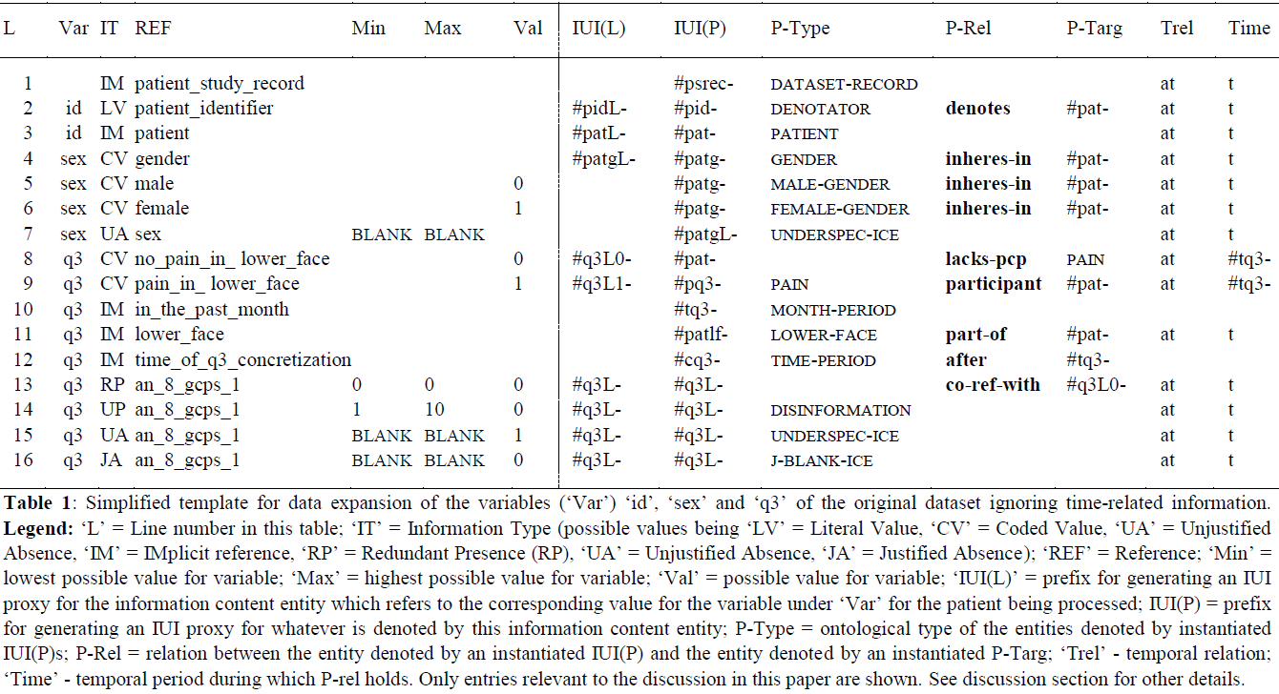
The template for one specific dataset

Slide 37
Then for each dataset
Build a formal template which describes:
  the results of steps 1-6 of the 1st order analysis,
  the relationships between:
    the 1st order entities and the corresponding data items in the data set,
    data items themselves.
Generate on the basis of the template for each subject (patient) in the dataset an RT-compatible representation of his 1st and 2nd order entities.

Slide 38
Then for each dataset
Build a formal template which describes:
  the results of steps 1-6 of the 1st order analysis,
  the relationships between:
    the 1st order entities and the corresponding data items in the data set,
    data items themselves.
Generate on the basis of the template for each subject (patient) in the dataset an RT-compatible representation of his 1st and 2nd order entities.
Requires elements from the Information Artifact Ontology

Slide 39
Proposed changes for IAO
  information content entity =def.
  an entity which is
  (1) generically dependent on
  (2) some material entity and which
  (3) is_about some portion of reality.
where
x is_about y means:
x refers to or is cognitively directed towards y.
Domain: representations;
Range: portions of reality.
Axiom: if x is_about y then y exists (veridicality).
Smith B, Ceusters W. Aboutness: Towards Foundations for the Information Artifact Ontology.
International Conference on Biomedical Ontologies, ICBO 2015, Lisbon, Portugal, July 27-30, 2015;47-51

Slide 40
Representations
Representation: an idea, image, record, or description which refers to (is of or about), or is intended to refer to, some entity or entities external to the representation.
Smith, B., Kusnierczyk, W., Schober, D., & Ceusters, W. (2006). Towards a reference terminology for ontology research and development in the biomedical domain Kr-med 2006, biomedical ontology in action. Baltimore MD, USA
Formal definitions:
  representation =def. a quality which is_about or is intended to be about a portion of reality (por).
  mental quality =def. a quality which specifically depends on an anatomical structure in the cognitive system of an organism.
  cognitive representation =def. a representation which is a mental quality.
Ceusters, W., & Smith, B. (2010). Foundations for a realist ontology of mental disease. Journal of Biomedical Semantics, 1(10), 1-23. doi: 10.1186/2041-1480-1-10

Slide 41
Representational unit
Informal definition:
  the smallest constituent sub-representations, including icons, names, simple word forms, or the sorts of alphanumeric identifiers we might find in patient records.
  Smith, B., Kusnierczyk, W., Schober, D., & Ceusters, W. (2006). Towards a reference terminology for ontology research and development in the biomedical domain Kr-med 2006, biomedical ontology in action. Baltimore MD, USA

Slide 42
Types of Representational Units
Referring representational unit (RRU): an RU which is both intended to be about something and does indeed succeed in this intent.
Ceusters, W., & Smith, B. (2010). Foundations for a realist ontology of mental disease.
Journal of Biomedical Semantics, 1(10), 1-23. doi:10.1186/2041-1480-1-10

Slide 43
Types of Representational Units
Referring representational unit (RRU): an RU which is both intended to be about something and does indeed succeed in this intent. ‘Paris’
Ceusters, W., & Smith, B. (2010). Foundations for a realist ontology of mental disease.
Journal of Biomedical Semantics, 1(10), 1-23. doi:10.1186/2041-1480-1-10

Slide 44
Types of Representational Units
Referring representational unit (RRU): an RU which is both intended to be about something and does indeed succeed in this intent. ‘Paris’
Non-referring representational unit (NRU): an RU which, for whatever reason, fails to be about anything.
Ceusters, W., & Smith, B. (2010). Foundations for a realist ontology of mental disease.
Journal of Biomedical Semantics, 1(10), 1-23. doi:10.1186/2041-1480-1-10

Slide 45
Types of Representational Units
Referring representational unit (RRU): an RU which is both intended to be about something and does indeed succeed in this intent. ‘Paris’
Non-referring representational unit (NRU): an RU which, for whatever reason, fails to be about anything. ‘Middle Earth’
Ceusters, W., & Smith, B. (2010). Foundations for a realist ontology of mental disease.
Journal of Biomedical Semantics, 1(10), 1-23. doi:10.1186/2041-1480-1-10

Slide 46
Types of Representational Units
Referring representational unit (RRU): an RU which is both intended to be about something and does indeed succeed in this intent. ‘Paris’
Non-referring representational unit (NRU): an RU which, for whatever reason, fails to be about anything. ‘Middle Earth’
Unrecognized non-referring representational unit (UNRU): an NRU which, although non-referring, is intended and believed to be about something;
Ceusters, W., & Smith, B. (2010). Foundations for a realist ontology of mental disease.
Journal of Biomedical Semantics, 1(10), 1-23. doi:10.1186/2041-1480-1-10

Slide 47
Types of Representational Units
Referring representational unit (RRU): an RU which is both intended to be about something and does indeed succeed in this intent. ‘Paris’
Non-referring representational unit (NRU): an RU which, for whatever reason, fails to be about anything. ‘Middle Earth’
Unrecognized non-referring representational unit (UNRU): an NRU which, although non-referring, is intended and believed to be about something; ‘Vulcan’ (as used by Le Verrier in 1860)
Ceusters, W., & Smith, B. (2010). Foundations for a realist ontology of mental disease.
Journal of Biomedical Semantics, 1(10), 1-23. doi:10.1186/2041-1480-1-10

Slide 48
Types of Representational Units
Referring representational unit (RRU): an RU which is both intended to be about something and does indeed succeed in this intent. ‘Paris’
Non-referring representational unit (NRU): an RU which, for whatever reason, fails to be about anything. ‘Middle Earth’
Unrecognized non-referring representational unit (UNRU): an NRU which, although non-referring, is intended and believed to be about something; ‘Vulcan’ (as used by Le Verrier in 1860)
Recognized non-referring representational unit (RNRU): an NRU, whether or not once intended and believed to be about something, is not believed to do so;
Ceusters, W., & Smith, B. (2010). Foundations for a realist ontology of mental disease.
Journal of Biomedical Semantics, 1(10), 1-23. doi:10.1186/2041-1480-1-10

Slide 49
Types of Representational Units
Referring representational unit (RRU): an RU which is both intended to be about something and does indeed succeed in this intent. ‘Paris’
Non-referring representational unit (NRU): an RU which, for whatever reason, fails to be about anything. ‘Middle Earth’
Unrecognized non-referring representational unit (UNRU): an NRU which, although non-referring, is intended and believed to be about something; ‘Vulcan’ (as used by Le Verrier in 1860)
Recognized non-referring representational unit (RNRU): an NRU, whether or not once intended and believed to be about something, is not believed to do so; ‘Vulcan’ (as used in Star Trek)
Ceusters, W., & Smith, B. (2010). Foundations for a realist ontology of mental disease.
Journal of Biomedical Semantics, 1(10), 1-23. doi:10.1186/2041-1480-1-10

Slide 50
Types of Representational Units
Referring representational unit (RRU): an RU which is both intended to be about something and does indeed succeed in this intent. ‘Paris’
Non-referring representational unit (NRU): an RU which, for whatever reason, fails to be about anything. ‘Middle Earth’
Unrecognized non-referring representational unit (UNRU): an NRU which, although non-referring, is intended and believed to be about something; ‘Vulcan’ (as used by Le Verrier in 1860)
Recognized non-referring representational unit (RNRU): an NRU, whether or not once intended and believed to be about something, is not believed to do so; ‘Vulcan’ (as used in Star Trek)
Representational unit component (RUC): a component of a representational artifact that is not intended by the artifact’s authors to refer in isolation;
Ceusters, W., & Smith, B. (2010). Foundations for a realist ontology of mental disease.
Journal of Biomedical Semantics, 1(10), 1-23. doi:10.1186/2041-1480-1-10

Slide 51
Types of Representational Units
Referring representational unit (RRU): an RU which is both intended to be about something and does indeed succeed in this intent. ‘Paris’
Non-referring representational unit (NRU): an RU which, for whatever reason, fails to be about anything. ‘Middle Earth’
Unrecognized non-referring representational unit (UNRU): an NRU which, although non-referring, is intended and believed to be about something; ‘Vulcan’ (as used by Le Verrier in 1860)
Recognized non-referring representational unit (RNRU): an NRU, whether or not once intended and believed to be about something, is not believed to do so; ‘Vulcan’ (as used in Star Trek)
Representational unit component (RUC): a component of a representational artifact that is not intended by the artifact’s authors to refer in isolation; ‘Le’ in ‘Le Verrier’
Ceusters, W., & Smith, B. (2010). Foundations for a realist ontology of mental disease.
Journal of Biomedical Semantics, 1(10), 1-23. doi:10.1186/2041-1480-1-10

Slide 52
Enlarging the range of aboutness to portions of reality ¹
Thus including:
universals, for instance in the ICE concretized by the string there are no instances of dinosaur which survive,
relations, for instance in the ICE concretized by the string the part-whole relation is transitive,
other ICEs, for instance when someone asserts that what someone else just stated is false, and
configurations, for instance in the ICE concretized by Barack Obama is the current President of the USA.
  ¹ Ceusters W. An Information Artifact Ontology Perspective on Data Collections and Associated Representational Artifacts. Medical Informatics Europe Conference (MIE 2012), Pisa, Italy, August 26-29, 2012,
  Stud Health Technol Inform 2012;180:68-72

Slide 53
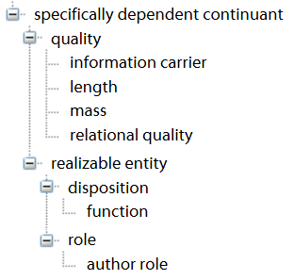
Qualities that concretize ICE are
Information Quality Entities
information quality entity (iqe) =def.
a quality that is the concretization of some information content entity (ice)
(Smith, B., Malyuta, T., Rudnicki, R., et al. (2013). Iao-intel: An ontology of information artifacts in the intelligence domain. Paper presented at the STIDS.)
Examples:
this DNA sequence is concretized in this specific ordering (pattern) of nucleotides in this molecule;
this sentence is concretized in this pattern of ink marks on this piece of paper (or also in this pattern of neuronal connections in this brain)
IQEs are called ‘information carriers’ in the IAO.
Smith B, Ceusters W. Aboutness: Towards Foundations for the Information Artifact Ontology.
International Conference on Biomedical Ontologies, ICBO 2015, Lisbon, Portugal, July 27-30, 2015;47-51

Slide 54
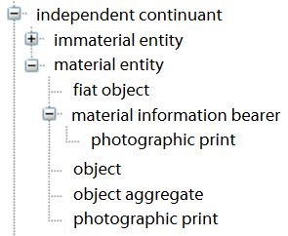
Information Artifact
artifact =def. a material entity created or modified or selected by some agent to realize a certain function or role
(Examples: a key, a lock, a screwdriver)
information artifact =def. an artifact whose function is to bear an information quality entity.
(Examples: a hard drive, a traffic sign, a printed form, a passport, a currency note, an RFID chip, a SIM card)

Slide 55


An attempt to make it clear (1)
Information
Artifact
instanceOf at t
instanceOf
at t

Slide 56
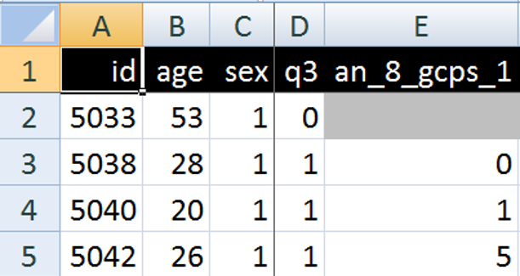
An attempt to make it clear (2)
Information
Artifact
instanceOf at t
instanceOf
at t
inheresIn
at t
instanceOf at t
IQE

Slide 57
An attempt to make it clear (3)
Information
Artifact
instanceOf at t
instanceOf
at t
ICE
instanceOf
at t
concretizationOf
at t
inheresIn
at t
instanceOf at t
IQE

Slide 58
An attempt to make it clear (4)
Information
Artifact
instanceOf at t
instanceOf
at t
ICE
instanceOf
at t
concretizationOf
at t
inheresIn
at t
instanceOf
at t
instanceOf at t
IQE
RU
IsA

Slide 59
An attempt to make it clear (5)
Information
Artifact
instanceOf at t
instanceOf
at t
ICE
POR
instanceOf
at t
≈
#n
concretizationOf
at t
isA bout
at t
inheresIn
at t
instanceOf
at t
instanceOf at t
IQE
RU
IsA

Slide 60
What makes to be about ?
#n
5042
#n
concretizationOf
at t
isA bout
at t
Is About at t ???

Slide 61
Proposed new relationships for IAO
x is_a_representation_of y =def.
x is a representa­tion
& x is_about y
x is_conformant_to y =def.
x is an information quality entity
& y is a cognitive representa­tion
& there is some GDC g such that x concretizes g and y concretizes g.
Example: x is a sentence on a piece of paper, y is the belief of the author of the sentence who wrote the sentence as an expression of her belief, and g is the ICE (the content) that belief and sentence share.
Smith B, Ceusters W. Aboutness: Towards Foundations for the Information Artifact Ontology.
International Conference on Biomedical Ontologies, ICBO 2015, Lisbon, Portugal, July 27-30, 2015;47-51

Slide 62
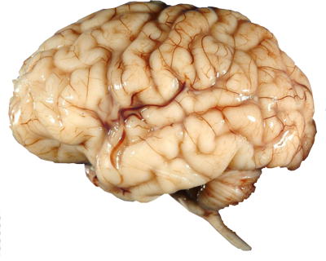

Existence of a conformant cognitive representation
Is About at t
instanceOf
at t
ICE
concretizationOf
at t
concretizationOf
at t
5042
#n
isA bout
at t
concretizationOf
at t
Is About at t
Conformant to at t

Slide 63
The template for one specific dataset
‘conditional part’
‘RT-compatible part’

Slide 64
RT compatible part of the template
IUI(L) | IUI(P) | P-Type | P-Rel | P-Targ | Trel | Time
 | #psrec- | dataset-record |  |  | at | t
#pidL- | #pid- | identifier | denotes | #pat- | at | t
#patL- | #pat- | patient |  |  | at | t
#patgL- | #patg- | gender | inheres-in | #pat- | at | t
 | #patg- | male-gender | inheres-in | #pat- | at | t
 | #patg- | female-gender | inheres-in | #pat- | at | t
 | #patgL- | underspec-ice |  |  | at | t

Slide 65
RT compatible part of the template
IUI(L) | IUI(P) | P-Type | P-Rel | P-Targ | Trel | Time
 | #psrec- | dataset-record |  |  | at | t
#pidL- | #pid- | identifier | denotes | #pat- | at | t
#patL- | #pat- | patient |  |  | at | t
#patgL- | #patg- | gender | inheres-in | #pat- | at | t
 | #patg- | male-gender | inheres-in | #pat- | at | t
 | #patg- | female-gender | inheres-in | #pat- | at | t
 | #patgL- | underspec-ice |  |  | at | t
Instantiated part of the template
IUI(L) | IUI(P) | P-Type | P-Rel | P-Targ | Trel | Time
 | #psrec-5033 | dataset-record |  |  | at | t
#pidL-5033 | #pid-5033 | identifier | denotes | #pat-5033 | at | t
#patL-5033 | #pat-5033 | patient |  |  | at | t
#patgL-5033 | #patg-5033 | gender | inheres-in | #pat-5033 | at | t
 | #patg-5033 | male-gender | inheres-in | #pat-5033 | at | t
 | #patg- | female-gender | inheres-in | #pat- | at | t
 | #patgL- | underspec-ice |  |  | at | t

Slide 66
What the instantiated template is about
instanceOf
at t
isAbout
at t
ICE
POR-T1
POR-T2
POR-T3
isAbout
at t
IUI(L) | IUI(P) | P-Type | P-Rel | P-Targ | Trel | Time
 | #psrec-5033 | dataset-record |  |  | at | t
#pidL-5033 | #pid-5033 | identifier | denotes | #pat-5033 | at | t
#patL-5033 | #pat-5033 | patient |  |  | at | t
#patgL-5033 | #patg-5033 | gender | inheres-in | #pat-5033 | at | t
 | #patg-5033 | male-gender | inheres-in | #pat-5033 | at | t

Slide 67
Codebook
id → patient identifier
age → age of the patient
sex → gender of the patient (0 = male, 1 = female)
q3 → answer to the question ‘Have you had pain in the face, jaw, temple, in front of the ear or in the ear in the past month?’ (0 = ‘no’, 1 = ‘yes’)
an_8_gcps_1 → answer to the question ‘How would you rate your facial pain on a 0 to 10 scale at the present time, that is right now, where 0 is “no pain” and 10 is “pain as bad as could be”?’.

Slide 68
Data versus what it is about
IUI(L) | IUI(P) | P-Type | P-Rel | P-Targ | Trel | Time
 | #psrec-5033 | dataset-record |  |  | at | t
#pidL-5033 | #pid-5033 | identifier | denotes | #pat-5033 | at | t
#patL-5033 | #pat-5033 | patient |  |  | at | t
#patgL-5033 | #patg-5033 | gender | inheres-in | #pat-5033 | at | t
 | #patg-5033 | male-gender | inheres-in | #pat-5033 | at | t
IUI denoting the Information Content Entity (ICE) concretized by the IQE inhering in this row.

Slide 69
Data versus what it is about
IUI(L) | IUI(P) | P-Type | P-Rel | P-Targ | Trel | Time
 | #psrec-5033 | dataset-record |  |  | at | t
#pidL-5033 | #pid-5033 | identifier | denotes | #pat-5033 | at | t
#patL-5033 | #pat-5033 | patient |  |  | at | t
#patgL-5033 | #patg-5033 | gender | inheres-in | #pat-5033 | at | t
 | #patg-5033 | male-gender | inheres-in | #pat-5033 | at | t
IUI denoting the Information Content Entity (ICE) concretized by the IQE inhering in this cell.

Slide 70
Data versus what it is about
IUI(L) | IUI(P) | P-Type | P-Rel | P-Targ | Trel | Time
 | #psrec-5033 | dataset-record |  |  | at | t
#pidL-5033 | #pid-5033 | identifier | denotes | #pat-5033 | at | t
#patL-5033 | #pat-5033 | patient |  |  | at | t
#patgL-5033 | #patg-5033 | gender | inheres-in | #pat-5033 | at | t
 | #patg-5033 | male-gender | inheres-in | #pat-5033 | at | t
IUI denoting the (real) person of which the content of this cell concretizes that person’s patient identifier.

Slide 71
Data versus what it is about
IUI(L) | IUI(P) | P-Type | P-Rel | P-Targ | Trel | Time
 | #psrec-5033 | dataset-record |  |  | at | t
#pidL-5033 | #pid-5033 | identifier | denotes | #pat-5033 | at | t
#patL-5033 | #pat-5033 | patient |  |  | at | t
#patgL-5033 | #patg-5033 | gender | inheres-in | #pat-5033 | at | t
 | #patg-5033 | male-gender | inheres-in | #pat-5033 | at | t
IUI denoting the gender of the (real) person.
The content of this cell concretizes what type of gender that person’s gender is an instance of.

Slide 72
Data versus what it is about
IUI(L) | IUI(P) | P-Type | P-Rel | P-Targ | Trel | Time
 | #psrec-5033 | dataset-record |  |  | at | t
#pidL-5033 | #pid-5033 | identifier | denotes | #pat-5033 | at | t
#patL-5033 | #pat-5033 | patient |  |  | at | t
#patgL-5033 | #patg-5033 | gender | inheres-in | #pat-5033 | at | t
 | #patg-5033 | male-gender | inheres-in | #pat-5033 | at | t
IUI of the ICE of which the content of this cell concretizes what type of gender #patg-5033 is an instance of.

Slide 73
Interpretation of instantiated template
IUI(L) | IUI(P) | P-Type | P-Rel | P-Targ | Trel | Time
 | #psrec-5033 | dataset-record |  |  | at | t
#pidL-5033 | #pid-5033 | identifier | denotes | #pat-5033 | at | t
#patL-5033 | #pat-5033 | patient |  |  | at | t
#patgL-5033 | #patg-5033 | gender | inheres-in | #pat-5033 | at | t
 | #patg-5033 | male-gender | inheres-in | #pat-5033 | at | t
#psrec-5033 instance-of Dataset-Record at t
(note: assignment of appropriate time-indexes not covered in these examples)

Slide 74
Interpretation of instantiated template
IUI(L) | IUI(P) | P-Type | P-Rel | P-Targ | Trel | Time
 | #psrec-5033 | dataset-record |  |  | at | t
#pidL-5033 | #pid-5033 | identifier | denotes | #pat-5033 | at | t
#patL-5033 | #pat-5033 | patient |  |  | at | t
#patgL-5033 | #patg-5033 | gender | inheres-in | #pat-5033 | at | t
 | #patg-5033 | male-gender | inheres-in | #pat-5033 | at | t
#patg-5033 instance-of Gender at t
AND
#patg-5033 inheres-in #pat-5033 at t
(note: assignment of appropriate time-indexes not covered in these examples)

Slide 75
Interpretation of instantiated template
IUI(L) | IUI(P) | P-Type | P-Rel | P-Targ | Trel | Time
 | #psrec-5033 | dataset-record |  |  | at | t
#pidL-5033 | #pid-5033 | identifier | denotes | #pat-5033 | at | t
#patL-5033 | #pat-5033 | patient |  |  | at | t
#patgL-5033 | #patg-5033 | gender | inheres-in | #pat-5033 | at | t
 | #patg-5033 | male-gender | inheres-in | #pat-5033 | at | t
 | #patg- | female-gender | inheres-in | #pat- | at | t
 | #patgL- | underspec-ice |  |  | at | t
Cannot both be true at the same time!
This template is never instantiated in total but only in part, which parts thereby being determined on the basis of
conditions specified in the conditional part of the
template (not shown here).
(note: assignment of appropriate time-indexes not covered in these examples)

Slide 76
Conditional part of template for 3 variables
L | Var | IT | REF | Min | Max | Val
1 |  | IM | patient_study_record
2 | id | LV | patient_identifier
3 | id | IM | patient
4 | sex | CV | gender
5 | sex | CV | male |  |  | 0
6 | sex | CV | female |  |  | 1
7 | sex | UA | sex | BLANK | BLANK
8 | q3 | CV | no_pain_in_ lower_face |  |  | 0
9 | q3 | CV | pain_in_ lower_face |  |  | 1
10 | q3 | IM | in_the_past_month
11 | q3 | IM | lower_face
12 | q3 | IM | time_of_q3_concretization
13 | q3 | RP | an_8_gcps_1 | 0 | 0 | 0
14 | q3 | UP | an_8_gcps_1 | 1 | 10 | 0
15 | q3 | UA | an_8_gcps_1 | BLANK | BLANK | 1
16 | q3 | JA | an_8_gcps_1 | BLANK | BLANK | 0

Slide 77
Names of variables
L | Var | IT | REF | Min | Max | Val
1 |  | IM | patient_study_record
2 | id | LV | patient_identifier
3 | id | IM | patient
4 | sex | CV | gender
5 | sex | CV | male |  |  | 0
6 | sex | CV | female |  |  | 1
7 | sex | UA | sex | BLANK | BLANK
8 | q3 | CV | no_pain_in_ lower_face |  |  | 0
9 | q3 | CV | pain_in_ lower_face |  |  | 1
10 | q3 | IM | in_the_past_month
11 | q3 | IM | lower_face
12 | q3 | IM | time_of_q3_concretization
13 | q3 | RP | an_8_gcps_1 | 0 | 0 | 0
14 | q3 | UP | an_8_gcps_1 | 1 | 10 | 0
15 | q3 | UA | an_8_gcps_1 | BLANK | BLANK | 1
16 | q3 | JA | an_8_gcps_1 | BLANK | BLANK | 0
Names of variables as they appear in the original dataset

Slide 78
Variable descriptions and dependencies
L | Var | IT | REF | Min | Max | Val
1 |  | IM | patient_study_record
2 | id | LV | patient_identifier
3 | id | IM | patient
4 | sex | CV | gender
5 | sex | CV | male |  |  | 0
6 | sex | CV | female |  |  | 1
7 | sex | UA | sex | BLANK | BLANK
8 | q3 | CV | no_pain_in_ lower_face |  |  | 0
9 | q3 | CV | pain_in_ lower_face |  |  | 1
10 | q3 | IM | in_the_past_month
11 | q3 | IM | lower_face
12 | q3 | IM | time_of_q3_concretization
13 | q3 | RP | an_8_gcps_1 | 0 | 0 | 0
14 | q3 | UP | an_8_gcps_1 | 1 | 10 | 0
15 | q3 | UA | an_8_gcps_1 | BLANK | BLANK | 1
16 | q3 | JA | an_8_gcps_1 | BLANK | BLANK | 0
Either a textual description for an entity (or configuration of entities) that must exist for the corresponding ‘var’ to make sense,
OR,
a variable name from the ‘Var’ column which stands in some relation to the ‘var’ in the REF-column

Slide 79
Variable names and value ranges
L | Var | IT | REF | Min | Max | Val
1 |  | IM | patient_study_record
2 | id | LV | patient_identifier
3 | id | IM | patient
4 | sex | CV | gender
5 | sex | CV | male |  |  | 0
6 | sex | CV | female |  |  | 1
7 | sex | UA | sex | BLANK | BLANK
8 | q3 | CV | no_pain_in_ lower_face |  |  | 0
9 | q3 | CV | pain_in_ lower_face |  |  | 1
10 | q3 | IM | in_the_past_month
11 | q3 | IM | lower_face
12 | q3 | IM | time_of_q3_concretization
13 | q3 | RP | an_8_gcps_1 | 0 | 0 | 0
14 | q3 | UP | an_8_gcps_1 | 1 | 10 | 0
15 | q3 | UA | an_8_gcps_1 | BLANK | BLANK | 1
16 | q3 | JA | an_8_gcps_1 | BLANK | BLANK | 0
Values and value ranges – for the ‘Var’-variable if ‘Val’ is empty OR for the ‘REF’-variable otherwise – as they may appear in the dataset.
Variable names as they appear in the original dataset

Slide 80
Information Types for variable/value combinations
L | Var | IT | REF | Min | Max | Val
1 |  | IM | patient_study_record
2 | id | LV | patient_identifier
3 | id | IM | patient
4 | sex | CV | gender
5 | sex | CV | male |  |  | 0
6 | sex | CV | female |  |  | 1
7 | sex | UA | sex | BLANK | BLANK
8 | q3 | CV | no_pain_in_ lower_face |  |  | 0
9 | q3 | CV | pain_in_ lower_face |  |  | 1
10 | q3 | IM | in_the_past_month
11 | q3 | IM | lower_face
12 | q3 | IM | time_of_q3_concretization
13 | q3 | RP | an_8_gcps_1 | 0 | 0 | 0
14 | q3 | UP | an_8_gcps_1 | 1 | 10 | 0
15 | q3 | UA | an_8_gcps_1 | BLANK | BLANK | 1
16 | q3 | JA | an_8_gcps_1 | BLANK | BLANK | 0
Indicator for the Information Type to which the ‘Var’ belongs as determined by the pattern instantiated through the contents of ‘REF’, ‘Min’, ‘Max’, and ‘Val’ on the same ‘L’(ine):
      LV: Literal value
      CV: Coded Value
      IM: Implicit
      JA: Justified Absence
      UA: Unjustified Absence
      UP: Unjustified Presence
      RP: Redundant Presence

Slide 81
Implicit information
L | Var | IT | REF | Min | Max | Val
1 |  | IM | patient_study_record
2 | id | LV | patient_identifier
3 | id | IM | patient
4 | sex | CV | gender
5 | sex | CV | male |  |  | 0
6 | sex | CV | female |  |  | 1
7 | sex | UA | sex | BLANK | BLANK
8 | q3 | CV | no_pain_in_ lower_face |  |  | 0
9 | q3 | CV | pain_in_ lower_face |  |  | 1
10 | q3 | IM | in_the_past_month
11 | q3 | IM | lower_face
12 | q3 | IM | time_of_q3_concretization
13 | q3 | RP | an_8_gcps_1 | 0 | 0 | 0
14 | q3 | UP | an_8_gcps_1 | 1 | 10 | 0
15 | q3 | UA | an_8_gcps_1 | BLANK | BLANK | 1
16 | q3 | JA | an_8_gcps_1 | BLANK | BLANK | 0

Slide 82
Condition-based IT determination (1)
L | Var | IT | REF | Min | Max | Val
8 | q3 | CV | no_pain_in_ lower_face |  |  | 0
9 | q3 | CV | pain_in_ lower_face |  |  | 1
11 | q3 | IM | lower_face
In case ‘REF’ does not contain a variable name from somewhere under ‘Var’:
If
the value for Var is as indicated by Val,
OR
there is no value for Var at all,
then
the presence or absence of the corresponding data item is of a sort indicated by IT.

Slide 83
Condition-based IT determination (2)
L | Var | IT | REF | Min | Max | Val
7 | sex | UA | sex | BLANK | BLANK
13 | q3 | RP | an_8_gcps_1 | 0 | 0 | 0
14 | q3 | UP | an_8_gcps_1 | 1 | 10 | 0
15 | q3 | UA | an_8_gcps_1 | BLANK | BLANK | 1
16 | q3 | JA | an_8_gcps_1 | BLANK | BLANK | 0
In case ‘REF’ does contain a variable name from somewhere under ‘Var’:
If the value of REF is either outside the range of Min/Max or ‘BLANK’
and
the value for Var is as indicated by Val, including no value at all,
then
the presence or absence of the corresponding data item is of a sort indicated by IT.

Slide 84
Condition-based IT determination (2)
L | Var | IT | REF | Min | Max | Val
7 | sex | UA | sex | BLANK | BLANK
13 | q3 | RP | an_8_gcps_1 | 0 | 0 | 0
14 | q3 | UP | an_8_gcps_1 | 1 | 10 | 0
15 | q3 | UA | an_8_gcps_1 | BLANK | BLANK | 1
16 | q3 | JA | an_8_gcps_1 | BLANK | BLANK | 0
Contains answer to the question: ‘’ How would you rate your facial pain on a 0 to 10 scale at the present time, that is right now, where 0 is "no pain" and 10 is "pain as bad as could be"?
Contains answer to the question: ‘Have you had pain in the face, jaw, temple, in front of the ear or in the ear in the past month?’

Slide 85
Condition-based IT determination (2)
L | Var | IT | REF | Min | Max | Val
7 | sex | UA | sex | BLANK | BLANK
13 | q3 | RP | an_8_gcps_1 | 0 | 0 | 0
14 | q3 | UP | an_8_gcps_1 | 1 | 10 | 0
15 | q3 | UA | an_8_gcps_1 | BLANK | BLANK | 1
16 | q3 | JA | an_8_gcps_1 | BLANK | BLANK | 0
Contains answer to the question: ‘’ How would you rate your facial pain on a 0 to 10 scale at the present time, that is right now, where 0 is "no pain" and 10 is "pain as bad as could be"?
Contains answer to the question: ‘Have you had pain in the face, jaw, temple, in front of the ear or in the ear in the past month?’
If the value for q3 is ‘0’ and the value for an_8_gcps_1 is ‘0’, then an_8_gcps_1 is redundantly present.

Slide 86
Condition-based IT determination (2)
L | Var | IT | REF | Min | Max | Val
7 | sex | UA | sex | BLANK | BLANK
13 | q3 | RP | an_8_gcps_1 | 0 | 0 | 0
14 | q3 | UP | an_8_gcps_1 | 1 | 10 | 0
15 | q3 | UA | an_8_gcps_1 | BLANK | BLANK | 1
16 | q3 | JA | an_8_gcps_1 | BLANK | BLANK | 0
Contains answer to the question: ‘’ How would you rate your facial pain on a 0 to 10 scale at the present time, that is right now, where 0 is "no pain" and 10 is "pain as bad as could be"?
Contains answer to the question: ‘Have you had pain in the face, jaw, temple, in front of the ear or in the ear in the past month?’
If the value for q3 is ‘0’ and the value for an_8_gcps_1 is between ‘1’ and ‘10’,
then an_8_gcps_1 is unjustifiably present.

Slide 87
Generating the appropriate RT assertions
‘conditional part’
‘RT-compatible part’

Slide 88
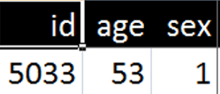
Generating the appropriate RT assertions
L | Var | IT | REF | Min | Max | Val
3 | id | IM | patient
4 | sex | CV | gender
5 | sex | CV | male |  |  | 0
6 | sex | CV | female |  |  | 1
7 | sex | UA | sex | BLANK | BLANK
L | IUI(L) | IUI(P) | P-Type | P-Rel | P-Tg | Tr | T
3 | #patL- | #pat- | patient |  |  | at | t
4 | #patgL- | #patg- | gender | inheres-in | #pat- | at | t
5 |  | #patg- | male-gender | inheres-in | #pat- | at | t
6 |  | #patg- | female-gender | inheres-in | #pat- | at | t
7 |  | #patgL- | underspec-ice |  |  | at | t

Slide 89
Unconditional generation
L | Var | IT | REF | Min | Max | Val
3 | id | IM | patient
4 | sex | CV | gender
5 | sex | CV | male |  |  | 0
6 | sex | CV | female |  |  | 1
7 | sex | UA | sex | BLANK | BLANK
L | IUI(L) | IUI(P) | P-Type | P-Rel | P-Tg | Tr | T
3 | #patL- | #pat- | patient |  |  | at | t
4 | #patgL- | #patg- | gender | inheres-in | #pat- | at | t
5 |  | #patg- | male-gender | inheres-in | #pat- | at | t
6 |  | #patg- | female-gender | inheres-in | #pat- | at | t
7 |  | #patgL- | underspec-ice |  |  | at | t
#pat-5033 instance-of Patient at t

Slide 90
Unconditional generation
L | Var | IT | REF | Min | Max | Val
3 | id | IM | patient
4 | sex | CV | gender
5 | sex | CV | male |  |  | 0
6 | sex | CV | female |  |  | 1
7 | sex | UA | sex | BLANK | BLANK
L | IUI(L) | IUI(P) | P-Type | P-Rel | P-Tg | Tr | T
3 | #patL- | #pat- | patient |  |  | at | t
4 | #patgL- | #patg- | gender | inheres-in | #pat- | at | t
5 |  | #patg- | male-gender | inheres-in | #pat- | at | t
6 |  | #patg- | female-gender | inheres-in | #pat- | at | t
7 |  | #patgL- | underspec-ice |  |  | at | t
#pat-5033 instance-of Patient at t
#patg-5033 instance-of Gender at t
#patg-5033 inheres-in #pat-5033 at t

Slide 91
No generation: condition not satisfied
L | Var | IT | REF | Min | Max | Val
3 | id | IM | patient
4 | sex | CV | gender
5 | sex | CV | male |  |  | 0
6 | sex | CV | female |  |  | 1
7 | sex | UA | sex | BLANK | BLANK
L | IUI(L) | IUI(P) | P-Type | P-Rel | P-Tg | Tr | T
3 | #patL- | #pat- | patient |  |  | at | t
4 | #patgL- | #patg- | gender | inheres-in | #pat- | at | t
5 |  | #patg- | male-gender | inheres-in | #pat- | at | t
6 |  | #patg- | female-gender | inheres-in | #pat- | at | t
7 |  | #patgL- | underspec-ice |  |  | at | t
#pat-5033 instance-of Patient at t
#patg-5033 instance-of Gender at t
#patg-5033 inheres-in #pat-5033 at t

Slide 92
Conditional generation
L | Var | IT | REF | Min | Max | Val
3 | id | IM | patient
4 | sex | CV | gender
5 | sex | CV | male |  |  | 0
6 | sex | CV | female |  |  | 1
7 | sex | UA | sex | BLANK | BLANK
L | IUI(L) | IUI(P) | P-Type | P-Rel | P-Tg | Tr | T
3 | #patL- | #pat- | patient |  |  | at | t
4 | #patgL- | #patg- | gender | inheres-in | #pat- | at | t
5 |  | #patg- | male-gender | inheres-in | #pat- | at | t
6 |  | #patg- | female-gender | inheres-in | #pat- | at | t
7 |  | #patgL- | underspec-ice |  |  | at | t
#pat-5033 instance-of Patient at t
#patg-5033 instance-of Female-Gender at t
#patg-5033 instance-of Gender at t
#patg-5033 inheres-in #pat-5033 at t

Slide 93
No generation: condition not satisfied
L | Var | IT | REF | Min | Max | Val
3 | id | IM | patient
4 | sex | CV | gender
5 | sex | CV | male |  |  | 0
6 | sex | CV | female |  |  | 1
7 | sex | UA | sex | BLANK | BLANK
L | IUI(L) | IUI(P) | P-Type | P-Rel | P-Tg | Tr | T
3 | #patL- | #pat- | patient |  |  | at | t
4 | #patgL- | #patg- | gender | inheres-in | #pat- | at | t
5 |  | #patg- | male-gender | inheres-in | #pat- | at | t
6 |  | #patg- | female-gender | inheres-in | #pat- | at | t
7 |  | #patgL- | underspec-ice |  |  | at | t
#pat-5033 instance-of Patient at t
#patg-5033 instance-of Female-Gender at t
#patg-5033 instance-of Gender at t
#patg-5033 inheres-in #pat-5033 at t

Slide 94
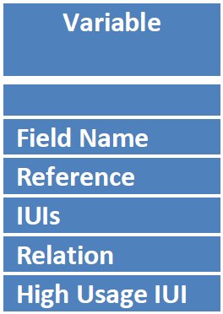
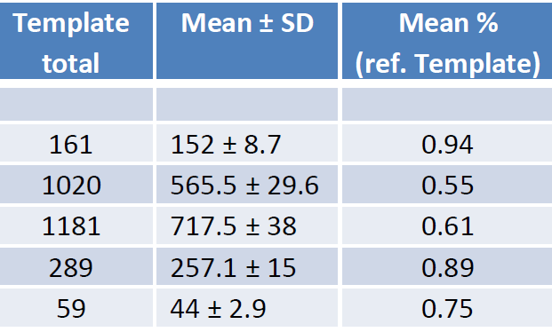
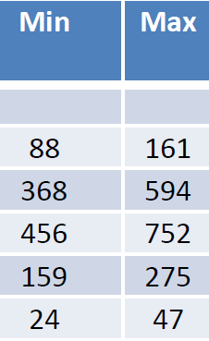
We are talking BIG data
For one dataset with 161 variables:
Between 456 and 752 IUIs generated per patient (average 717),
On average 257 relationships expressed between IUIs per patient.

Slide 95
Exercise: create a unified representation for two datasets that are faithful to reality
Pt-SSN | Age | Gender | Exam date
111-11-1111 | 35 | 0 | 01/23/2000
222-22-2222 | 24 | 1 | 04/23/2013
333-33-3333 | 76 | U | 12/12/2016
444-44-4444 | 46 | 0 | 01/21/2017
Pt-SSN | Gender | Birth date
111-11-1111 | M | 01/06/1965
555-55-5555 | M | 04/23/2013
333-33-3333 | F | 10/11/1940
444-44-4444 | F | 03/07/1971
Dataset chronologically collected since 01/01/2000.
Gender: 0=male, 1=female, U=not assessed.
Age in years.
Data assessed 10/07/2017.
Gender: M=male, F=female

