Slide 1
Advanced Topics in
Biomedical Ontology
PHI 637 SEM / BMI 708 SEM
Werner Ceusters and Barry Smith

Slide 2
Lecture 12
Werner Ceusters & Barry Smith
Ontology evaluation

Slide 3
Lecture 12 – part2
Werner Ceusters
Evolutionary ontology evaluation

Slide 4
Lecture overview
Recapitulation of Realism-based Ontology Change Management.
Evolutionary Quality Assessment (EQA):
  Theory,
  EQA applied to SNOMED CT and the Gene Ontology.
Using EQA to decide on when to upgrade to a new version of ontology.

Slide 5
1. Realism-based ontology change management

Slide 6
An “optimal” ontology (1)
Because ontologies, as conceived on realist terms,
  are artifacts created for some purpose (e.g. to serve as controlled vocabulary, or to provide domain knowledge to a software application),
  are at the same time intended to mirror reality,
  should allow reasoning which is efficient from a computational point of view,
we argue that an optimal ontology should constitute a representation of all and only those portions of reality that are relevant for its purpose.

Slide 7
An “optimal” ontology (2)
Each term in such an ontology would designate:
  (1) a single portion of reality (POR), which is
  (2) relevant to the purposes of the ontology and such that
  (3) the authors of the ontology intended to use this term to designate this POR, and
  (4) there would be no PORs objectively relevant to these purposes that are not referred to in the ontology.

Slide 8
But things may go wrong …
Root cause errors:
  assertion errors: ontology developers may be in error as to what is the case in their target domain;
  relevance errors: they may be in error as to what is objectively relevant to a given purpose;
  encoding errors: they may not successfully encode their underlying cognitive representations, so that particular representational units fail to point to the intended PORs.
Mismatches:
  Unjustified presence or absence of RUs,
  Redundancies: >1 RU → 1 POR,
  Ambiguities: 1 RU → >1 POR.

Slide 9
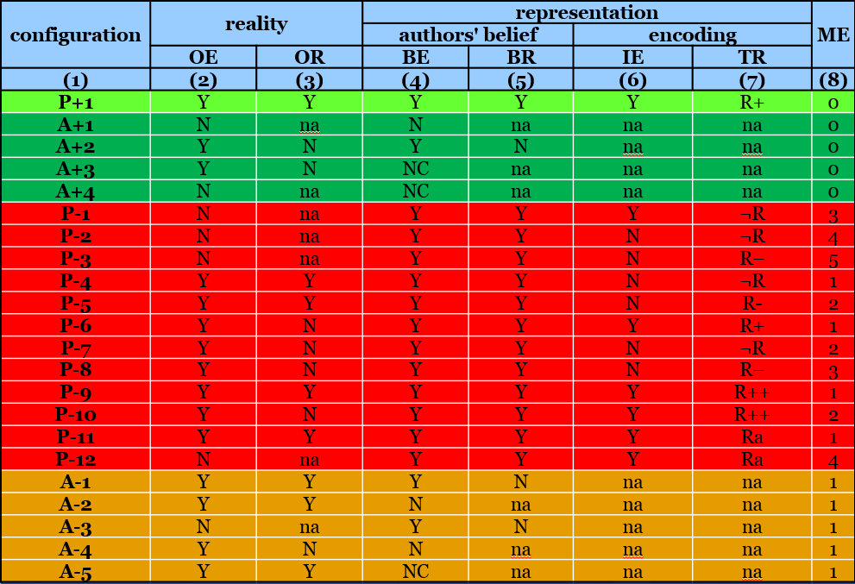
RU – reality correspondence types
1st version (2006):
Ceusters W, Smith B. A Realism-Based Approach to the Evolution of Biomedical Ontologies. Proceedings of AMIA 2006, Washington DC, 2006;:121-125.
1st revision (2009):
Ceusters W. Applying Evolutionary Terminology Auditing to the Gene Ontology. Journal of Biomedical Informatics 2009;42:518–529.
2nd revision (2014):
Seppãlã S, Smith B, Ceusters W. Applying the realism-based ontology versioning method for tracking changes in the Basic Formal Ontology. Formal Ontology in Information Systems. Proceedings of the Eight International Conference (FOIS 2014), Amsterdam: IOS Press, 2014;:227-240.

Slide 10
RU – reality correspondence types
configuration | reality |  | representation |  |  |  | ME
 |  |  | authors' belief |  | encoding
 | OE | OR | BE | BR | IE | TR
(1) | (2) | (3) | (4) | (5) | (6) | (7) | (8)
Reality:
  OE: Objective existence
  OE: Objective relevance
          Representation:
            BE: Author’s belief in existence
            BR: Author’s belief in relevance
              IE: Author’s intended encoding
              TR: Type of reference

Slide 11
configuration | reality |  | representation |  |  |  | ME
 |  |  | authors' belief |  | encoding
 | OE | OR | BE | BR | IE | TR
(1) | (2) | (3) | (4) | (5) | (6) | (7) | (8)
P+1
A+1
A+2
A+3
A+4
P-1
P-2
P-3
P-4
P-5
P-6
P-7
P-8
P-9
P-10
P-11
P-12
A-1
A-2
A-3
A-4
A-5
Configuration types
    P: present in the ontology
      P+: justifiably present
      P–: unjustifiably present
    A: absent from the ontology
      A+: justifiably absent
      A–: unjustifiably absent

Slide 12
configuration | reality |  | representation |  |  |  | ME
 |  |  | authors' belief |  | encoding
 | OE | OR | BE | BR | IE | TR
(1) | (2) | (3) | (4) | (5) | (6) | (7) | (8)
P+1
A+1
A+2
A+3
A+4
P-1
P-2
P-3
P-4
P-5
P-6
P-7
P-8
P-9
P-10
P-11
P-12
A-1
A-2
A-3
A-4
A-5
Configuration types
    1+4+12+5=22 possible configurations based on (mis)matches between reality, beliefs, and encodings

Slide 13
configuration | reality |  | representation |  |  |  | ME
 |  |  | authors' belief |  | encoding
 | OE | OR | BE | BR | IE | TR
(1) | (2) | (3) | (4) | (5) | (6) | (7) | (8)
P+1 | Y | Y | Y | Y | Y | R+ | 0
A+1 | N | na | N | na | na | na | 0
A+2 | Y | N | Y | N | na | na | 0
A+3 | Y | N | NC | na | na | na | 0
A+4 | N | na | NC | na | na | na | 0
P-1 | N | na | Y | Y | Y | ¬R | 3
P-2 | N | na | Y | Y | N | ¬R | 4
P-3 | N | na | Y | Y | N | R– | 5
P-4 | Y | Y | Y | Y | N | ¬R | 1
P-5 | Y | Y | Y | Y | N | R- | 2
P-6 | Y | N | Y | Y | Y | R+ | 1
P-7 | Y | N | Y | Y | N | ¬R | 2
P-8 | Y | N | Y | Y | N | R– | 3
P-9 | Y | Y | Y | Y | Y | R++ | 1
P-10 | Y | N | Y | Y | Y | R++ | 2
P-11 | Y | Y | Y | Y | Y | Ra | 1
P-12 | N | na | Y | Y | Y | Ra | 4
A-1 | Y | Y | Y | N | na | na | 1
A-2 | Y | Y | N | na | na | na | 1
A-3 | N | na | Y | N | na | na | 1
A-4 | Y | N | N | na | na | na | 1
A-5 | Y | Y | NC | na | na | na | 1
OE/BE value pairs
Y/Y: correct assertion of the existence of a POR;
Y/N: lack of awareness of a POR, reflecting an assertion error;
N/N: correct assertion that some putative POR does not exist;
N/Y: the false belief that some putative POR exists;
Y/NC: not considering that some POR exists;
N/NC: not considering that some putative POR does not exist.

Slide 14
configuration | reality |  | representation |  |  |  | ME
 |  |  | authors' belief |  | encoding
 | OE | OR | BE | BR | IE | TR
(1) | (2) | (3) | (4) | (5) | (6) | (7) | (8)
P+1 | Y | Y | Y | Y | Y | R+ | 0
A+1 | N | na | N | na | na | na | 0
A+2 | Y | N | Y | N | na | na | 0
A+3 | Y | N | NC | na | na | na | 0
A+4 | N | na | NC | na | na | na | 0
P-1 | N | na | Y | Y | Y | ¬R | 3
P-2 | N | na | Y | Y | N | ¬R | 4
P-3 | N | na | Y | Y | N | R– | 5
P-4 | Y | Y | Y | Y | N | ¬R | 1
P-5 | Y | Y | Y | Y | N | R- | 2
P-6 | Y | N | Y | Y | Y | R+ | 1
P-7 | Y | N | Y | Y | N | ¬R | 2
P-8 | Y | N | Y | Y | N | R– | 3
P-9 | Y | Y | Y | Y | Y | R++ | 1
P-10 | Y | N | Y | Y | Y | R++ | 2
P-11 | Y | Y | Y | Y | Y | Ra | 1
P-12 | N | na | Y | Y | Y | Ra | 4
A-1 | Y | Y | Y | N | na | na | 1
A-2 | Y | Y | N | na | na | na | 1
A-3 | N | na | Y | N | na | na | 1
A-4 | Y | N | N | na | na | na | 1
A-5 | Y | Y | NC | na | na | na | 1
2
4
1
3
‘na’ = not applicable
If there is no POR of a specific sort, relevance is not applicable.
If an author does not believe in some POR, believed relevance is not applicable.
If an author did not consider (‘nc’) existence of some POR, believed relevance is not applicable.
If believed relevance is either negative or not applicable, encoding is not applicable.

Slide 15
configuration | reality |  | representation |  |  |  | ME
 |  |  | authors' belief |  | encoding
 | OE | OR | BE | BR | IE | TR
(1) | (2) | (3) | (4) | (5) | (6) | (7) | (8)
P+1 | Y | Y | Y | Y | Y | R+ | 0
A+1 | N | na | N | na | na | na | 0
A+2 | Y | N | Y | N | na | na | 0
A+3 | Y | N | NC | na | na | na | 0
A+4 | N | na | NC | na | na | na | 0
P-1 | N | na | Y | Y | Y | ¬R | 3
P-2 | N | na | Y | Y | N | ¬R | 4
P-3 | N | na | Y | Y | N | R– | 5
P-4 | Y | Y | Y | Y | N | ¬R | 1
P-5 | Y | Y | Y | Y | N | R- | 2
P-6 | Y | N | Y | Y | Y | R+ | 1
P-7 | Y | N | Y | Y | N | ¬R | 2
P-8 | Y | N | Y | Y | N | R– | 3
P-9 | Y | Y | Y | Y | Y | R++ | 1
P-10 | Y | N | Y | Y | Y | R++ | 2
P-11 | Y | Y | Y | Y | Y | Ra | 1
P-12 | N | na | Y | Y | Y | Ra | 4
A-1 | Y | Y | Y | N | na | na | 1
A-2 | Y | Y | N | na | na | na | 1
A-3 | N | na | Y | N | na | na | 1
A-4 | Y | N | N | na | na | na | 1
A-5 | Y | Y | NC | na | na | na | 1
Modes of reference:
R+ | : faithful reference to correct referent
¬R | : no referent exist
R– | : reference to wrong referent
R++ | : redundant reference
Ra | : ambiguous reference

Slide 16
2. Evolutionary quality assessment
Theory

Slide 17
configuration | reality |  | representation |  |  |  | ME
 |  |  | authors' belief |  | encoding
 | OE | OR | BE | BR | IE | TR
(1) | (2) | (3) | (4) | (5) | (6) | (7) | (8)
P+1 | Y | Y | Y | Y | Y | R+ | 0
A+1 | N | na | N | na | na | na | 0
A+2 | Y | N | Y | N | na | na | 0
A+3 | Y | N | NC | na | na | na | 0
A+4 | N | na | NC | na | na | na | 0
P-1 | N | na | Y | Y | Y | ¬R | 3
P-2 | N | na | Y | Y | N | ¬R | 4
P-3 | N | na | Y | Y | N | R– | 5
P-4 | Y | Y | Y | Y | N | ¬R | 1
P-5 | Y | Y | Y | Y | N | R- | 2
P-6 | Y | N | Y | Y | Y | R+ | 1
P-7 | Y | N | Y | Y | N | ¬R | 2
P-8 | Y | N | Y | Y | N | R– | 3
P-9 | Y | Y | Y | Y | Y | R++ | 1
P-10 | Y | N | Y | Y | Y | R++ | 2
P-11 | Y | Y | Y | Y | Y | Ra | 1
P-12 | N | na | Y | Y | Y | Ra | 4
A-1 | Y | Y | Y | N | na | na | 1
A-2 | Y | Y | N | na | na | na | 1
A-3 | N | na | Y | N | na | na | 1
A-4 | Y | N | N | na | na | na | 1
A-5 | Y | Y | NC | na | na | na | 1
Magnitude of error

Slide 18
Error basis
configuration | reality |  | representation |  |  |  | ME
 |  |  | authors' belief |  | encoding
 | OE | OR | BE | BR | IE | TR
(1) | (2) | (3) | (4) | (5) | (6) | (7) | (8)
A+1 | N | na | N | na | na | na | 0
A+2 | Y | N | Y | N | na | na | 0
A+3 | Y | N | NC | na | na | na | 0
A+4 | N | na | NC | na | na | na | 0
P-1 | N | na | Y | Y | Y | ¬R | 3
P-2 | N | na | Y | Y | N | ¬R | 4
P-3 | N | na | Y | Y | N | R– | 5
P-4 | Y | Y | Y | Y | N | ¬R | 1
P-5 | Y | Y | Y | Y | N | R- | 2
P-6 | Y | N | Y | Y | Y | R+ | 1
P-7 | Y | N | Y | Y | N | ¬R | 2
P-8 | Y | N | Y | Y | N | R– | 3
P-9 | Y | Y | Y | Y | Y | R++ | 1
P-10 | Y | N | Y | Y | Y | R++ | 2
P-11 | Y | Y | Y | Y | Y | Ra | 1
P-12 | N | na | Y | Y | Y | Ra | 4

Slide 19
Error basis
configuration | reality |  | representation |  |  |  | ME
 |  |  | authors' belief |  | encoding
 | OE | OR | BE | BR | IE | TR
(1) | (2) | (3) | (4) | (5) | (6) | (7) | (8)
P+1 | Y | Y | Y | Y | Y | R+ | 0
A-1 | Y | Y | Y | N | na | na | 1
A-2 | Y | Y | N | na | na | na | 1
A-3 | N | na | Y | N | na | na | 1
A-4 | Y | N | N | na | na | na | 1
A-5 | Y | Y | NC | na | na | na | 1

Slide 20
Error basis
configuration | reality |  | representation |  |  |  | ME
 |  |  | authors' belief |  | encoding
 | OE | OR | BE | BR | IE | TR
(1) | (2) | (3) | (4) | (5) | (6) | (7) | (8)
A+1 | N | na | N | na | na | na | 0
 | 0 | 0 | 1 | 0 | 1 | 1
P-1 | N | na | Y | Y | Y | ¬R | 3

Slide 21
Error basis
configuration | reality |  | representation |  |  |  | ME
 |  |  | authors' belief |  | encoding
 | OE | OR | BE | BR | IE | TR
(1) | (2) | (3) | (4) | (5) | (6) | (7) | (8)
A+1 | N | na | N | na | na | na | 0
 | 0 | 0 | 1 | 1 | 1 | 1
P-12 | N | na | Y | Y | Y | Ra | 4

Slide 22
‘Simple snapshot’ changes
What happens from t1 → t2 ?
a change in reality will not immediately lead to a change in the ontology authors’ understanding thereof and,
if an encoding change is introduced, e.g. by making some syntactic correction to an existing term, then this does not result in a term which wrongly refers.

Slide 23
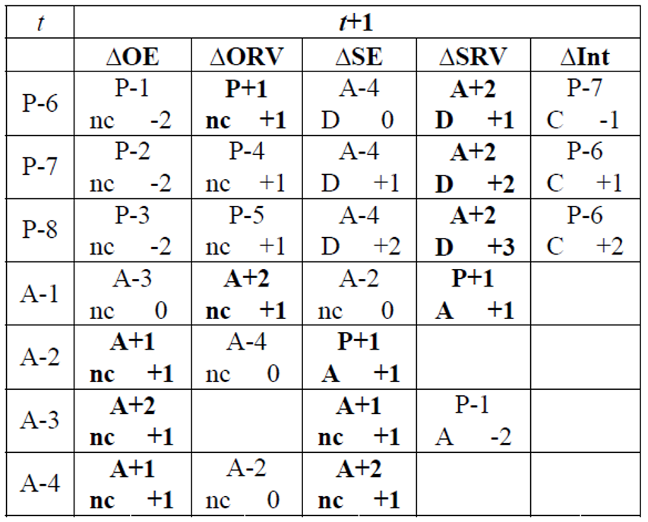
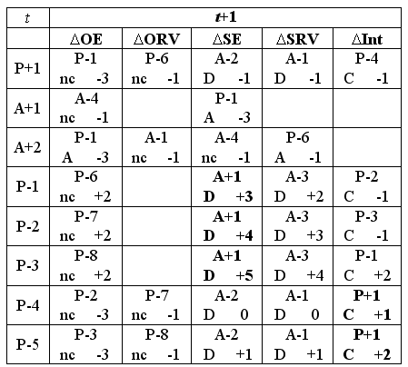
Effects of various sorts of ‘snapshot’ changes

Slide 24
Effects of various sorts of ‘snapshot’ changes
Change in error magnitude
No change in ontology
Addition
Deletion
Change in encoding
No snapshot transition
possible
…

Slide 25
Effects of various sorts of changes
When something faithfully represented at t ceases to be faithful at t+1, leaving the ontology unchanged causes a P+1 to become a P-1.
When something faithfully represented at t is not believed to be faithful anymore at t+1 while in fact it still is, removing the representational element causes a P+1 to become a A-2.
…

Slide 26
Updating is an active process
authors assume in good faith that:
  all included representational units are of the P+1 type, and,
  all they are aware of, but not included, of A+1 or A+2.
If they become aware of a mistake, they make a change under the assumption that their changes are also towards the P+1, A+1, or A+2 cases.
Thus at that time, they know:
  of what configuration type the previous entry must have been under the belief what the current configuration is, and,
  the reason for the change.

Slide 27
configuration | reality |  | representation |  |  |  | ME
 |  |  | authors' belief |  | encoding
 | OE | OR | BE | BR | IE | TR
(1) | (2) | (3) | (4) | (5) | (6) | (7) | (8)
P+1 | Y | Y | Y | Y | Y | R+ | 0
A+1 | N | na | N | na | na | na | 0
A+2 | Y | N | Y | N | na | na | 0
A+3 | Y | N | NC | na | na | na | 0
A+4 | N | na | NC | na | na | na | 0
P-1 | N | na | Y | Y | Y | ¬R | 3
P-2 | N | na | Y | Y | N | ¬R | 4
P-3 | N | na | Y | Y | N | R– | 5
P-4 | Y | Y | Y | Y | N | ¬R | 1
P-5 | Y | Y | Y | Y | N | R- | 2
P-6 | Y | N | Y | Y | Y | R+ | 1
P-7 | Y | N | Y | Y | N | ¬R | 2
P-8 | Y | N | Y | Y | N | R– | 3
P-9 | Y | Y | Y | Y | Y | R++ | 1
P-10 | Y | N | Y | Y | Y | R++ | 2
P-11 | Y | Y | Y | Y | Y | Ra | 1
P-12 | N | na | Y | Y | Y | Ra | 4
A-1 | Y | Y | Y | N | na | na | 1
A-2 | Y | Y | N | na | na | na | 1
A-3 | N | na | Y | N | na | na | 1
A-4 | Y | N | N | na | na | na | 1
A-5 | Y | Y | NC | na | na | na | 1
Evolution example:
The Higg’s boson was discovered and added to the ontology:
A-5 → P+1 → quality improvement of +1

Slide 28
This leads to a calculus …
NOT:
  to demonstrate how good an individual version of an ontology is,
But rather
  to measure how much it improved (hopefully) as compared to its predecessors.
Principle: recursive belief revision.
Ceusters W. Applying Evolutionary Terminology Auditing to SNOMED CT. In American Medical Informatics Association 2010 Annual Symposium (AMIA 2010) Proceedings, Washington DC, November 13-17, 2010:96-100.

Slide 29
However: unnoticed changes in reality do not lead to updates!
No change in ontology
…

Slide 30
Quality of a representation w.r.t. reality
n: number of representational elements in the ontology
m: number of unjustified absences
e_{i}: magnitude of the error, if any, for the i ^{th} representational element
Ceusters W. Applying Evolutionary Terminology Auditing to the Gene Ontology.
Journal of Biomedical Informatics 2009;42:518–529.

Slide 31
Quality of a representation w.r.t. reality
n: number of representational elements in the ontology
m: number of unjustified absences
e_{i}: magnitude of the error, if any, for the i ^{th} representational element
Quality of a Representational Unit: 5 – e_{i}
5 is the maximal magnitude of error, thus 0 ≤ ( 5 – e_{i} ) ≤ 5
Ceusters W. Applying Evolutionary Terminology Auditing to the Gene Ontology.
Journal of Biomedical Informatics 2009;42:518–529.

Slide 32
Quality of a representation w.r.t. reality
n: number of representational elements in the ontology
m: number of unjustified absences
e_{i}: magnitude of the error, if any, for the i ^{th} representational element
All unjustified absences have an error magnitude of 1
Ceusters W. Applying Evolutionary Terminology Auditing to the Gene Ontology.
Journal of Biomedical Informatics 2009;42:518–529.

Slide 33
Quality of a representation w.r.t. reality
n: number of representational elements in the ontology
m: number of unjustified absences
e_{i}: magnitude of the error, if any, for the i ^{th} representational element
The sum of the qualities of the RUs, each quality being:
5 for faithful RUs,
(5 – error magnitude) for deviant RUs.
Ceusters W. Applying Evolutionary Terminology Auditing to the Gene Ontology.
Journal of Biomedical Informatics 2009;42:518–529.

Slide 34
Quality of a representation w.r.t. reality
n: number of representational elements in the ontology
m: number of unjustified absences
e_{i}: magnitude of the error, if any, for the i ^{th} representational element
The quality of the ontology decreases through:
Error magnitude of unjustified presences,
Number of unjustified absences.
Ceusters W. Applying Evolutionary Terminology Auditing to the Gene Ontology.
Journal of Biomedical Informatics 2009;42:518–529.

Slide 35
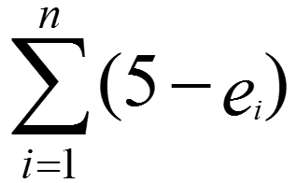
Quality of a representation w.r.t. reality
n: number of representational elements in the ontology
m: number of unjustified absences
e_{i}: magnitude of the error, if any, for the i ^{th} representational element
Ideal case:
e_{i} is 0 for all RUs, thus = 5n
Number of unjustified absences = 0, thus 4m = 0.
5n
5n
= 1
Ceusters W. Applying Evolutionary Terminology Auditing to the Gene Ontology.
Journal of Biomedical Informatics 2009;42:518–529.

Slide 36

Comparing quality of ontologies
 | Reality | Ontology 1 |  | Ontology 2 |  | Ontology 3
RU | Config. | Config. | Error | Config. | Error | Config. | Error
animal | P+1 | P+1 | 0 | P+1 | 0 | P+1 | 0
fish | P+1 | P+1 | 0 | P+1 | 0 | P+1 | 0
whale | P+1 | P+1 | 0 | P+1 | 0 | P+1 | 0
mammal | P+1 | P+1 | 0 | P+1 | 0 | P+1 | 0
fish are animals | P+1 | P+1 | 0 | P+1 | 0 | P+1 | 0
mammals are animals | P+1 | P+1 | 0 | P+1 | 0 | P+1 | 0
whales are fish | A+1 | P-1 | 3 | A+1 | 0 | A+1 | 0
whales are animals | P+1 | P+1 | 0 | P+1 | 0 | P+1 | 0
whales are mammals | P+1 | A-2 | 1 | A-2 | 1 | P+1 | 0
SCORE | 8*5/ ((8*5)+(0*4)) = 1.00 | ((7*5)+(1*2))/ ((8*5)+(1*4)) =0.84 |  | 7*5/ ((7*5)+(1*4)) =0.90 |  | 8*5/ ((8*5)+(0*4)) =1.00
n: number of RUs in the ontology
m: number of unjustified absences
e_{i}: magnitude of the error, if any,
for the i ^{th} RU

Slide 37

Comparing quality of ontologies
 | Reality | Ontology 1 |  | Ontology 2 |  | Ontology 3
RU | Config. | Config. | Error | Config. | Error | Config. | Error
animal | P+1 | P+1 | 0 | P+1 | 0 | P+1 | 0
fish | P+1 | P+1 | 0 | P+1 | 0 | P+1 | 0
whale | P+1 | P+1 | 0 | P+1 | 0 | P+1 | 0
mammal | P+1 | P+1 | 0 | P+1 | 0 | P+1 | 0
fish are animals | P+1 | P+1 | 0 | P+1 | 0 | P+1 | 0
mammals are animals | P+1 | P+1 | 0 | P+1 | 0 | P+1 | 0
whales are fish | A+1 | P-1 | 3 | A+1 | 0 | A+1 | 0
whales are animals | P+1 | P+1 | 0 | P+1 | 0 | P+1 | 0
whales are mammals | P+1 | A-2 | 1 | A-2 | 1 | P+1 | 0
SCORE | 8*5/ ((8*5)+(0*4)) = 1.00 | ((7*5)+(1*2))/ ((8*5)+(1*4)) =0.84 |  | 7*5/ ((7*5)+(1*4)) =0.90 |  | 8*5/ ((8*5)+(0*4)) =1.00
n: number of RUs in the ontology
m: number of unjustified absences
e_{i}: magnitude of the error, if any,
for the i ^{th} RU

Slide 38

Comparing quality of ontologies
 | Reality | Ontology 1 |  | Ontology 2 |  | Ontology 3
RU | Config. | Config. | Error | Config. | Error | Config. | Error
animal | P+1 | P+1 | 0 | P+1 | 0 | P+1 | 0
fish | P+1 | P+1 | 0 | P+1 | 0 | P+1 | 0
whale | P+1 | P+1 | 0 | P+1 | 0 | P+1 | 0
mammal | P+1 | P+1 | 0 | P+1 | 0 | P+1 | 0
fish are animals | P+1 | P+1 | 0 | P+1 | 0 | P+1 | 0
mammals are animals | P+1 | P+1 | 0 | P+1 | 0 | P+1 | 0
whales are fish | A+1 | P-1 | 3 | A+1 | 0 | A+1 | 0
whales are animals | P+1 | P+1 | 0 | P+1 | 0 | P+1 | 0
whales are mammals | P+1 | A-2 | 1 | A-2 | 1 | P+1 | 0
SCORE | 8*5/ ((8*5)+(0*4)) = 1.00 | ((7*5)+(1*2))/ ((8*5)+(1*4)) =0.84 |  | 7*5/ ((7*5)+(1*4)) =0.90 |  | 8*5/ ((8*5)+(0*4)) =1.00
n: number of RUs in the ontology m: number of unjustified absences e_{i}: magnitude of the error, if any, for the i ^{th} RU

Slide 39
Comparing quality of ontologies
 | Reality | Ontology 1 |  | Ontology 2 |  | Ontology 3
RU | Config. | Config. | Error | Config. | Error | Config. | Error
animal | P+1 | P+1 | 0 | P+1 | 0 | P+1 | 0
fish | P+1 | P+1 | 0 | P+1 | 0 | P+1 | 0
whale | P+1 | P+1 | 0 | P+1 | 0 | P+1 | 0
mammal | P+1 | P+1 | 0 | P+1 | 0 | P+1 | 0
fish are animals | P+1 | P+1 | 0 | P+1 | 0 | P+1 | 0
mammals are animals | P+1 | P+1 | 0 | P+1 | 0 | P+1 | 0
whales are fish | A+1 | P-1 | 3 | A+1 | 0 | A+1 | 0
whales are animals | P+1 | P+1 | 0 | P+1 | 0 | P+1 | 0
whales are mammals | P+1 | A-2 | 1 | A-2 | 1 | P+1 | 0
SCORE | 8*5/ ((8*5)+(0*4)) = 1.00 | ((7*5)+(1*2))/ ((8*5)+(1*4)) =0.84 |  | 7*5/ ((7*5)+(1*4)) =0.90 |  | 8*5/ ((8*5)+(0*4)) =1.00
n: number of RUs in the ontology m: number of unjustified absences e_{i}: magnitude of the error, if any, for the i ^{th} RU

Slide 40

Comparing consecutive versions: t1
 | Time t1 |  | Time t2 |  |  |  | Time t3
 | V1 |  | T1 |  | T2 |  | T1 |  | T2 |  | T3
 | C. | E. | C. | E. | C. | E. | C. | E. | C. | E. | C. | E.
animal | P+1 | 0 | P+1 | 0 | P+1 | 0 | P+1 | 0 | P+1 | 0 | P+1 | 0
fish | P+1 | 0 | P+1 | 0 | P+1 | 0 | P+1 | 0 | P+1 | 0 | P+1 | 0
whale | P+1 | 0 | P+1 | 0 | P+1 | 0 | P+1 | 0 | P+1 | 0 | P+1 | 0
mammal | P+1 | 0 | P+1 | 0 | P+1 | 0 | P+1 | 0 | P+1 | 0 | P+1 | 0
fish are animals | P+1 | 0 | P+1 | 0 | P+1 | 0 | P+1 | 0 | P+1 | 0 | P+1 | 0
mammals are animals | P+1 | 0 | P+1 | 0 | P+1 | 0 | P+1 | 0 | P+1 | 0 | P+1 | 0
whales are fish | P+1 | 0 | P-1 | 3 | A+1 | 0 | P-1 | 3 | A+1 | 0 | A+1 | 0
whales are animals | P+1 | 0 | P+1 | 0 | P+1 | 0 | P+1 | 0 | P+1 | 0 | P+1 | 0
whales are mammals | - | - | - | - | - | - | A-2 | 1 | A-2 | 1 | P+1 | 0
SCORE | 1.00 |  | 0.93 |  | 1.00 |  | 0.84 |  | 0.90 |  | 1.00
(8*5)
(8*5)
n: number of RUs in the ontology
m: number of unjustified absences
e_{i}: magnitude of the error, if any,
for the i ^{th} RU

Slide 41


Comparing consecutive versions: t2
 | Time t1 |  | Time t2 |  |  |  | Time t3
 | V1 |  | T1 |  | V2 |  | T1 |  | T2 |  | T3
 | C. | E. | C. | E. | C. | E. | C. | E. | C. | E. | C. | E.
animal | P+1 | 0 | P+1 | 0 | P+1 | 0 | P+1 | 0 | P+1 | 0 | P+1 | 0
fish | P+1 | 0 | P+1 | 0 | P+1 | 0 | P+1 | 0 | P+1 | 0 | P+1 | 0
whale | P+1 | 0 | P+1 | 0 | P+1 | 0 | P+1 | 0 | P+1 | 0 | P+1 | 0
mammal | P+1 | 0 | P+1 | 0 | P+1 | 0 | P+1 | 0 | P+1 | 0 | P+1 | 0
fish are animals | P+1 | 0 | P+1 | 0 | P+1 | 0 | P+1 | 0 | P+1 | 0 | P+1 | 0
mammals are animals | P+1 | 0 | P+1 | 0 | P+1 | 0 | P+1 | 0 | P+1 | 0 | P+1 | 0
whales are fish | P+1 | 0 | P-1 | 3 | A+1 | 0 | P-1 | 3 | A+1 | 0 | A+1 | 0
whales are animals | P+1 | 0 | P+1 | 0 | P+1 | 0 | P+1 | 0 | P+1 | 0 | P+1 | 0
whales are mammals | - | - | - | - | - | - | A-2 | 1 | A-2 | 1 | P+1 | 0
SCORE | 1.00 |  | 0.93 |  | 1.00 |  | 0.84 |  | 0.90 |  | 1.00
?
What must you believe at t2 about ontology version V1, in light of what you believe to be the case in reality at t2?
(7*5)
(7*5)
n: number of RUs in the ontology
m: number of unjustified absences
e_{i}: magnitude of the error, if any,
for the i ^{th} RU

Slide 42
Comparing consecutive versions: t2
 | Time t1 |  | Time t2 |  |  |  | Time t3
 | V1 |  | T1 |  | V2 |  | T1 |  | T2 |  | T3
 | C. | E. | C. | E. | C. | E. | C. | E. | C. | E. | C. | E.
animal | P+1 | 0 | P+1 | 0 | P+1 | 0 | P+1 | 0 | P+1 | 0 | P+1 | 0
fish | P+1 | 0 | P+1 | 0 | P+1 | 0 | P+1 | 0 | P+1 | 0 | P+1 | 0
whale | P+1 | 0 | P+1 | 0 | P+1 | 0 | P+1 | 0 | P+1 | 0 | P+1 | 0
mammal | P+1 | 0 | P+1 | 0 | P+1 | 0 | P+1 | 0 | P+1 | 0 | P+1 | 0
fish are animals | P+1 | 0 | P+1 | 0 | P+1 | 0 | P+1 | 0 | P+1 | 0 | P+1 | 0
mammals are animals | P+1 | 0 | P+1 | 0 | P+1 | 0 | P+1 | 0 | P+1 | 0 | P+1 | 0
whales are fish | P+1 | 0 | P-1 | 3 | A+1 | 0 | P-1 | 3 | A+1 | 0 | A+1 | 0
whales are animals | P+1 | 0 | P+1 | 0 | P+1 | 0 | P+1 | 0 | P+1 | 0 | P+1 | 0
whales are mammals | - | - | - | - | - | - | A-2 | 1 | A-2 | 1 | P+1 | 0
SCORE | 1.00 |  | 0.93 |  | 1.00 |  | 0.84 |  | 0.90 |  | 1.00
(7*5) + (1*2)
(8*5)
n: number of RUs in the ontology
m: number of unjustified absences
e_{i}: magnitude of the error, if any,
for the i ^{th} RU

Slide 43

Comparing consecutive versions: t3
 | Time t1 |  | Time t2 |  |  |  | Time t3
 | V1 |  | V1 |  | V2 |  | T1 |  | T2 |  | V3
 | C. | E. | C. | E. | C. | E. | C. | E. | C. | E. | C. | E.
animal | P+1 | 0 | P+1 | 0 | P+1 | 0 | P+1 | 0 | P+1 | 0 | P+1 | 0
fish | P+1 | 0 | P+1 | 0 | P+1 | 0 | P+1 | 0 | P+1 | 0 | P+1 | 0
whale | P+1 | 0 | P+1 | 0 | P+1 | 0 | P+1 | 0 | P+1 | 0 | P+1 | 0
mammal | P+1 | 0 | P+1 | 0 | P+1 | 0 | P+1 | 0 | P+1 | 0 | P+1 | 0
fish are animals | P+1 | 0 | P+1 | 0 | P+1 | 0 | P+1 | 0 | P+1 | 0 | P+1 | 0
mammals are animals | P+1 | 0 | P+1 | 0 | P+1 | 0 | P+1 | 0 | P+1 | 0 | P+1 | 0
whales are fish | P+1 | 0 | P-1 | 3 | A+1 | 0 | P-1 | 3 | A+1 | 0 | A+1 | 0
whales are animals | P+1 | 0 | P+1 | 0 | P+1 | 0 | P+1 | 0 | P+1 | 0 | P+1 | 0
whales are mammals | - | - | - | - | - | - | A-2 | 1 | A-2 | 1 | P+1 | 0
SCORE | 1.00 |  | 0.93 |  | 1.00 |  | 0.84 |  | 0.90 |  | 1.00
?
(8*5)
(8*5)
n: number of RUs in the ontology
m: number of unjustified absences
e_{i}: magnitude of the error, if any,
for the i ^{th} RU

Slide 44

Comparing consecutive versions: t3
 | Time t1 |  | Time t2 |  |  |  | Time t3
 | V1 |  | V1 |  | V2 |  | T1 |  | V2 |  | V3
 | C. | E. | C. | E. | C. | E. | C. | E. | C. | E. | C. | E.
animal | P+1 | 0 | P+1 | 0 | P+1 | 0 | P+1 | 0 | P+1 | 0 | P+1 | 0
fish | P+1 | 0 | P+1 | 0 | P+1 | 0 | P+1 | 0 | P+1 | 0 | P+1 | 0
whale | P+1 | 0 | P+1 | 0 | P+1 | 0 | P+1 | 0 | P+1 | 0 | P+1 | 0
mammal | P+1 | 0 | P+1 | 0 | P+1 | 0 | P+1 | 0 | P+1 | 0 | P+1 | 0
fish are animals | P+1 | 0 | P+1 | 0 | P+1 | 0 | P+1 | 0 | P+1 | 0 | P+1 | 0
mammals are animals | P+1 | 0 | P+1 | 0 | P+1 | 0 | P+1 | 0 | P+1 | 0 | P+1 | 0
whales are fish | P+1 | 0 | P-1 | 3 | A+1 | 0 | P-1 | 3 | A+1 | 0 | A+1 | 0
whales are animals | P+1 | 0 | P+1 | 0 | P+1 | 0 | P+1 | 0 | P+1 | 0 | P+1 | 0
whales are mammals | - | - | - | - | - | - | A-2 | 1 | A-2 | 1 | P+1 | 0
SCORE | 1.00 |  | 0.93 |  | 1.00 |  | 0.84 |  | 0.90 |  | 1.00
?
(7*5)
(7*5) + (1*4)
n: number of RUs in the ontology
m: number of unjustified absences
e_{i}: magnitude of the error, if any,
for the i ^{th} RU

Slide 45
Comparing consecutive versions: t3
 | Time t1 |  | Time t2 |  |  |  | Time t3
 | V1 |  | V1 |  | V2 |  | V1 |  | V2 |  | V3
 | C. | E. | C. | E. | C. | E. | C. | E. | C. | E. | C. | E.
animal | P+1 | 0 | P+1 | 0 | P+1 | 0 | P+1 | 0 | P+1 | 0 | P+1 | 0
fish | P+1 | 0 | P+1 | 0 | P+1 | 0 | P+1 | 0 | P+1 | 0 | P+1 | 0
whale | P+1 | 0 | P+1 | 0 | P+1 | 0 | P+1 | 0 | P+1 | 0 | P+1 | 0
mammal | P+1 | 0 | P+1 | 0 | P+1 | 0 | P+1 | 0 | P+1 | 0 | P+1 | 0
fish are animals | P+1 | 0 | P+1 | 0 | P+1 | 0 | P+1 | 0 | P+1 | 0 | P+1 | 0
mammals are animals | P+1 | 0 | P+1 | 0 | P+1 | 0 | P+1 | 0 | P+1 | 0 | P+1 | 0
whales are fish | P+1 | 0 | P-1 | 3 | A+1 | 0 | P-1 | 3 | A+1 | 0 | A+1 | 0
whales are animals | P+1 | 0 | P+1 | 0 | P+1 | 0 | P+1 | 0 | P+1 | 0 | P+1 | 0
whales are mammals | - | - | - | - | - | - | A-2 | 1 | A-2 | 1 | P+1 | 0
SCORE | 1.00 |  | 0.93 |  | 1.00 |  | 0.84 |  | 0.90 |  | 1.00
(7*5) + (1*2)
(8*5) + (1*4)
n: number of RUs in the ontology
m: number of unjustified absences
e_{i}: magnitude of the error, if any,
for the i ^{th} RU

Slide 46
Change management in
SNOMED CT

Slide 47
2. Evolutionary quality assessment
2. Application to SNOMED-CT and the Gene Ontology

Slide 48
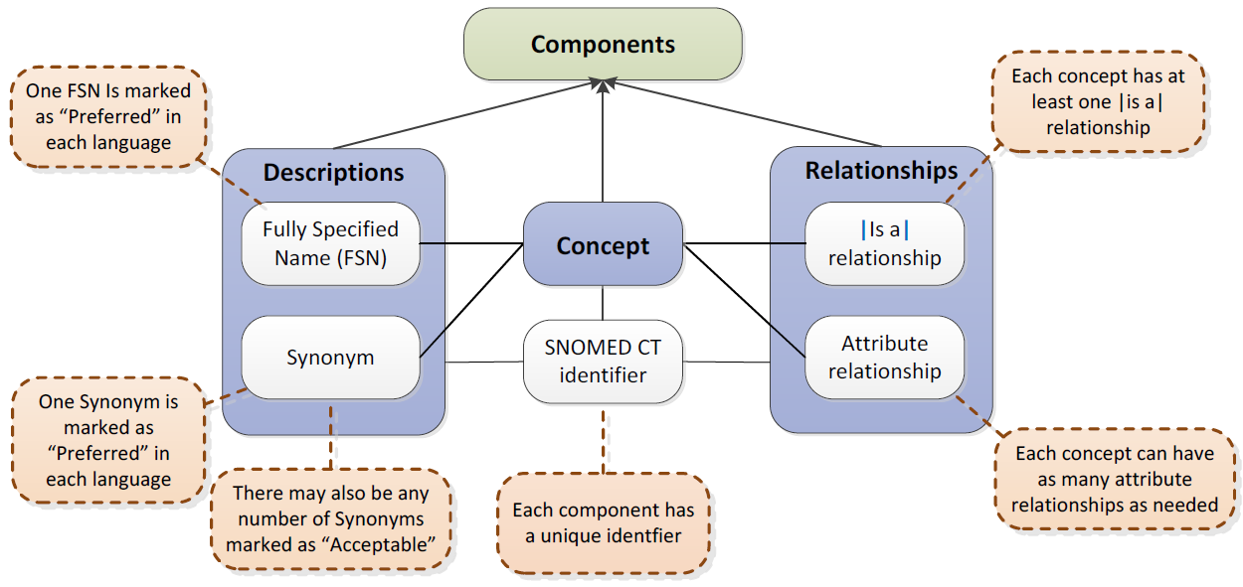
SNOMED CT structure
IHTSDO. SNOMED CT Starter Guide July 2014

Slide 49
SNOMED CT concepts’ status (July 2011)
ST
Concept Status
N
%
0
active in current use
292,073
74.677%
6
active with limited clinical value (classification concept or an administrative definition)
20,930
5.35%
1
inactive: ‘retired’ without a specified reason
7,525
1.92%
10
inactive because moved elsewhere
14,451
3.69%
2
inactive: withdrawn because duplication
37,752
9.65%
3
inactive because no longer recognized as a valid clinical concept (outdated)
1,439
0.37%
4
inactive because inherently ambiguous.
15,858
4.05%
5
inactive because found to contain a mistake
1,142
0.29%
TOTAL
391,170
100%

Slide 50
Some principles used for determining Ax/Px type from
SNOMED CT’s ‘reasons for change’
all new introductions are unjustifiably missing in earlier versions.
  is adequate for most types of concepts, except for pharmaceutical products and certain information artifacts such as newly constructed rating scales or named guidelines and protocols;
‘duplicate’ translates into P-9;
sample of 1000 changes to find common principles.
Ceusters W. Applying Evolutionary Terminology Auditing to SNOMED CT. In American Medical Informatics Association 2010 Annual Symposium (AMIA 2010) Proceedings, Washington DC, November 13-17, 2010:96-100.

Slide 51
Translating SNOMED-status into error types
Status | Existing concept made … | Error Type
0 | active: in current use | A-1
1 | inactive: ‘retired’ without a specified reason | P-1
2 | inactive: withdrawn because duplication | P-9
3 | inactive because no longer recognized as a valid clinical concept (outdated) | P-1
4 | inactive because inherently ambiguous. | P-4
5 | inactive because found to contain a mistake | P-1
6 | active with limited clinical value (classification concept or an administrative definition) | A-1
10 | inactive because moved elsewhere | P-6
11 | pending move | P-6
Ceusters W. Applying Evolutionary Terminology Auditing to SNOMED CT. In American Medical Informatics Association 2010 Annual Symposium (AMIA 2010) Proceedings, Washington DC, November 13-17, 2010:96-100.

Slide 52
Views on versions of SNOMED-CT
Ceusters W. Applying Evolutionary Terminology Auditing to SNOMED CT. In American Medical Informatics Association 2010 Annual Symposium (AMIA 2010) Proceedings, Washington DC, November 13-17, 2010:96-100.

Slide 53
Evolutionary view on the Jan 2002 release of SNOMED CT
concepts
descriptions
overall
relationships
Ceusters W. Applying Evolutionary Terminology Auditing to SNOMED CT. In American Medical Informatics Association 2010 Annual Symposium (AMIA 2010) Proceedings, Washington DC, November 13-17, 2010:96-100.

Slide 54
Quality change of SNOMED CT (200201-200907)
concepts
descriptions
overall
relationships
Ceusters W. Applying Evolutionary Terminology Auditing to SNOMED CT. In American Medical Informatics Association 2010 Annual Symposium (AMIA 2010) Proceedings, Washington DC, November 13-17, 2010:96-100.

Slide 55
Limitations (1)
We did not find any principle underlying the assignment of ‘inactive, reason not specified’ and ‘erroneous’.
All concepts with the status ‘outdated’ in our sample involved organisms.
The majority of concepts stated to be inactivated for reasons of ‘ambiguity’ do in our opinion not look ambiguous at all, as further witnessed by the fact that some of them have been replaced by a concept with an identical name.
Ceusters W. Applying Evolutionary Terminology Auditing to SNOMED CT. In American Medical Informatics Association 2010 Annual Symposium (AMIA 2010) Proceedings, Washington DC, November 13-17, 2010:96-100.

Slide 56
Limitations (2)
Lack of resources might prevent changes to be introduced although the authors know it has to be done at some point.
    thus a released version is perhaps not assumed to reflect state of the art.
the disappearance of a relationship in a newer version might not be a real disappearance since the relationship might still be inferred from the graph structure underlying SNOMED CT.
    Requires transitive closure computation for entire hierarchy
Ceusters W. Applying Evolutionary Terminology Auditing to SNOMED CT. In American Medical Informatics Association 2010 Annual Symposium (AMIA 2010) Proceedings, Washington DC, November 13-17, 2010:96-100.

Slide 57
Conclusions
These quality assessments are:
  upper bounds for concepts and descriptions,
  lower bounds for relationships.
Accurate calculations are only possible if SNOMED CT would provide reasons for change along the lines described.
The move towards a new information/distribution model (RF2) might be a good opportunity to start doing so.
    Note 2017: thus far, they didn’t!
Ceusters W. Applying Evolutionary Terminology Auditing to SNOMED CT. In American Medical Informatics Association 2010 Annual Symposium (AMIA 2010) Proceedings, Washington DC, November 13-17, 2010:96-100.

Slide 58
Error mapping from the Gene Ontology
P-2 (N = 25) | RU with wrong definition | RU with too specific definition for the name | 8
 |  | RU with wrong definition (explicitly stated as such) | 17
P-3 (N = 4) | RU denotes a non-intended entity | RU changed referent | 1
 |  | RU denotes a non-intended entity | 3
P-6 (N = 237) | Irrelevant RU | Defined class irrelevant | 23
 |  | entity is not synthesized by living organisms, and GO does not cover non-biological processes | 33
 |  | GO restructuring | 1
 |  | Referent outside the scope of GO | 2
 |  | RU contains info from more than one ontology | 45
 |  | RU does not denote a single biological process | 4
…

Slide 59
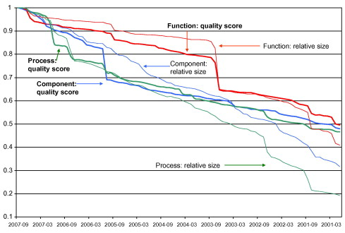
Comparison of the realism-based quality scores and the relative size of the three Gene Ontology vocabularies measured over time.

Slide 60
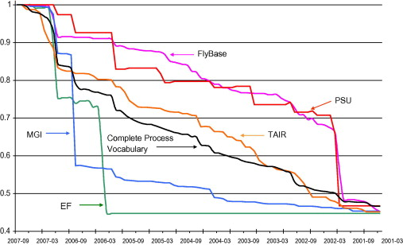
Quality score changes in the process vocabulary as a whole and in a few contributing sources

Slide 61
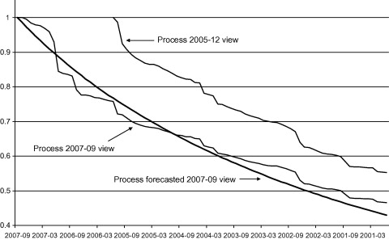
Forecasted quality scores for GO’s process vocabulary computed using the versions from January 2001 to December 2005 as reference.

Slide 62
3. Using Evolutionary Quality Assessment to decide on whether to upgrade to a new version

Slide 63
Updating does not come for free
‘While the efforts of each subsequent SNOMED CT version aim for continual improvement, changes made to its core structure and post-coordination guidelines make it more difficult to migrate proprietary data to this reference standard’
      Wade G, Rosenbloom T. The impact of SNOMED CT revisions on a mapped interface terminology: Terminology development and implementation issues. Journal of Biomedical Informatics. 2009;42(3):490–3.

Slide 64
Research questions
Observations:
    SNOMED CT undergoes considerable changes over time,
    applications use typically only a small subset of it,
    integrating new SNOMED CT versions is troublesome.
Questions:
    does within the scope of a specific application a new version of SNOMED CT contain more - and of better quality - knowledge than its predecessor or is it a mere reformulation of the same amount of knowledge?
    if the former, can this be computed in order to find out when it is worthwhile to upgrade to a new version?
Ceusters W. SNOMED CT Revisions and Coded Data Repositories: When to Upgrade? In American Medical Informatics Association 2011 Annual Symposium Proceedings, Washington DC, October 22-26, 2011:197-206

Slide 65
Methodology (1)
Study a subset of 883 SNOMED CT concepts used within a cancer clinic for encoding synoptic pathology reports and tumor registry data and for querying a biospecimen repository (source concepts - SC);
  motivation: real application use case.
Compute for each source concept the transitive closure set (target concepts - TC) of the Is a relation and all historical relations for each SNOMED CT version from January 2002 to July 2010, together with their concept status and path length to the source concept;
  motivation: information content is partially based on the graph structure,
  result: the 883 SCs were linked by means of 15,689 relationships to 1,415 TCs.

Slide 66
Transitive closure set for ‘C’
Distance
A
D
H
C isA B 1
C isA A 2
C r1 D 3
C isA E 1
C r2 G 2
C r2 H 3
C r2 F 1
isA
isA
B
E
r2
G
isA
isA
C
r2
F

Slide 67
Some (complete and partial) transitive closure sets for
Surgical margins involved by tumor (finding)
Rel-ID | Version |  |  |  |  |  |  |  |  |  |  |  |  |  |  |  |  |  | Rel-Type | Target Concept
 | 1 | 2 | 3 | 4 | 5 | 6 | 7 | 8 | 9 | 10 | 11 | 12 | 13 | 14 | 15 | 16 | 17 | 18
H-18608 | 6 | 6 | 7 | 4 | 4 | 4 | 4 | 4 | 4 | 4 | 4 | 4 | 4 | 4 | 4 | 4 | 4 | 4 | Is a | SNOMED CT Concept (SNOMED RT+CTV3)
H-23694 | 5 | 5 | 6 |  |  |  |  |  |  |  |  |  |  |  |  |  |  |  | Is a | Finding (finding)
H-18607 | 4 | 4 | 5 |  |  |  |  |  |  |  |  |  |  |  |  |  |  |  | Is a | Finding by method (finding)
H-12792 | 3 | 3 | 4 |  |  |  |  |  |  |  |  |  |  |  |  |  |  |  | Is a | Test finding (navigational concept)
H-12789 | 3 | 3 | 3 |  |  |  |  |  |  |  |  |  |  |  |  |  |  |  | Is a | Laboratory test finding (navigational concept)
H-07371 | 2 | 2 | 2 |  |  |  |  |  |  |  |  |  |  |  |  |  |  |  | Is a | Sample finding (finding)
H-07373 | 2 | 2 |  |  |  |  |  |  |  |  |  |  |  |  |  |  |  |  | Is a | Morphologic finding (finding)
220039029 | 1 | 1 |  |  |  |  |  |  |  |  |  |  |  |  |  |  |  |  | Is a | Clinical sample finding (finding)
H-07370 |  |  | 3 |  |  |  |  |  |  |  |  |  |  |  |  |  |  |  | Is a | Histopathology finding (finding)
H-07368 |  |  | 2 |  |  |  |  |  |  |  |  |  |  |  |  |  |  |  | Is a | General pathology (finding)
H-07369 |  |  | 2 |  |  |  |  |  |  |  |  |  |  |  |  |  |  |  | Is a | Laboratory finding present (navigational concept)
2030386023 |  |  | 1 |  |  |  |  |  |  |  |  |  |  |  |  |  |  |  | Is a | Pathology examination findings present (finding)
2030387025 |  |  | 1 |  |  |  |  |  |  |  |  |  |  |  |  |  |  |  | Is a | Surgical margin finding (finding)
…
Ceusters W. SNOMED CT Revisions and Coded Data Repositories: When to Upgrade? In American Medical Informatics Association 2011 Annual Symposium Proceedings, Washington DC, October 22-26, 2011:197-206

Slide 68
Computations over SNOMED CT’s
‘historical relationships’
C1→C2 | C2→C3 | C1→C3
Is a | Is a | Is a
Is a | IsA | IsA
IsA | Is a | IsA
IsA | IsA | IsA
SAME AS | Is a | IsA
SAME AS | IsA | IsA
Is a | SAME AS | IsA
IsA | SAME AS | IsA
Ceusters W. SNOMED CT Revisions and Coded Data Repositories: When to Upgrade? In American Medical Informatics Association 2011 Annual Symposium Proceedings, Washington DC, October 22-26, 2011:197-206

Slide 69
Transitive closure sets for Surgical margins involved by tumor (finding)
Rel-ID | Version |  |  |  |  |  |  |  |  |  |  |  |  |  |  |  |  |  | Rel-Type | Target Concept
 | 1 | 2 | 3 | 4 | 5 | 6 | 7 | 8 | 9 | 10 | 11 | 12 | 13 | 14 | 15 | 16 | 17 | 18
H-18608 | 6 | 6 | 7 | 4 | 4 | 4 | 4 | 4 | 4 | 4 | 4 | 4 | 4 | 4 | 4 | 4 | 4 | 4 | Is a | SNOMED CT Concept (SNOMED RT+CTV3)
H-23694 | 5 | 5 | 6 |  |  |  |  |  |  |  |  |  |  |  |  |  |  |  | Is a | Finding (finding)
H-18182 |  |  |  | 8 | 8 | 8 | 8 | 8 | 8 | 8 | 8 | 8 | 8 | 8 | 7 | 6 | 6 | 6 | IsA | SNOMED CT Concept (SNOMED RT+CTV3)
H-27662 |  |  |  | 7 |  |  |  |  |  |  |  |  |  |  |  |  |  |  | IsA | Finding (finding)
H-23376 |  |  |  | 6 | 6 | 6 | 6 | 6 | 6 | 6 | 6 | 6 | 6 | 6 |  |  |  |  | IsA | Finding by method (finding)
H-18183 |  |  |  | 5 | 5 | 5 | 5 | 5 | 5 | 5 | 5 | 5 | 5 | 5 | 5 |  |  |  | IsA | Test finding (navigational concept)
H-07379 |  |  |  | 4 | 4 | 4 | 4 | 4 | 4 | 4 | 4 | 4 | 4 | 4 | 4 | 3 | 3 | 3 | IsA | Histopathology finding (finding)
H-12412 |  |  |  | 4 | 4 | 4 | 4 | 4 | 4 | 4 | 4 | 4 | 4 | 4 | 4 |  |  |  | IsA | Laboratory test finding (navigational concept)
H-07380 |  |  |  | 4 | 4 | 4 | 4 | 4 | 4 | 4 | 4 | 4 | 4 | 4 | 4 |  |  |  | IsA | Sample finding (finding)
H-12418 |  |  |  | 4 | 4 | 4 | 4 | 4 | 4 | 4 | 4 | 4 | 4 | 4 | 4 |  |  |  | IsA | Morphologic finding (finding)
H-07378 |  |  |  | 3 | 3 | 3 | 3 | 3 | 3 | 3 | 3 | 3 | 3 | 3 | 3 | 3 | 3 | 3 | IsA | General pathology (finding)
H-12793 |  |  |  | 3 | 3 | 3 | 3 | 3 | 3 | 3 | 3 | 3 | 3 | 3 | 3 | 3 | 3 | 3 | Is a | Special concept (special concept)
H-07377 |  |  |  | 3 | 3 | 3 | 3 | 3 | 3 | 3 | 3 | 3 | 3 | 3 | 3 |  |  |  | IsA | Clinical sample finding (finding)
H-07381 |  |  |  | 3 | 3 | 3 | 3 | 3 | 3 | 3 | 3 | 3 | 3 | 3 | 3 |  |  |  | IsA | Laboratory finding present (navigational concept)
H-07374 |  |  |  | 2 | 2 | 2 | 2 | 2 | 2 | 2 | 2 | 2 | 2 | 2 | 2 | 2 | 2 | 2 | Is a | Inactive concept (inactive concept)
H-07382 |  |  |  | 2 | 2 | 2 | 2 | 2 | 2 | 2 | 2 | 2 | 2 | 2 | 2 | 2 | 2 | 2 | IsA | Pathology examination findings present (finding)
H-07384 |  |  |  | 2 | 2 | 2 | 2 | 2 | 2 | 2 | 2 | 2 | 2 | 2 | 2 | 2 | 2 | 2 | IsA | Surgical margin finding (finding)
2228147020 |  |  |  | 1 | 1 | 1 | 1 | 1 | 1 | 1 | 1 | 1 | 1 | 1 | 1 | 1 | 1 | 1 | Is a | Duplicate concept (inactive concept)
2295897028 |  |  |  | 1 | 1 | 1 | 1 | 1 | 1 | 1 | 1 | 1 | 1 | 1 | 1 | 1 | 1 | 1 | SAME AS | Surgical margin involved by tumor (finding)
H-18186 |  |  |  |  | 7 | 7 | 7 | 7 | 7 | 7 | 7 | 7 | 7 | 7 | 6 | 5 | 5 | 5 | IsA | Clinical finding (finding)
H-12417 |  |  |  |  |  |  |  |  |  |  |  |  |  |  |  | 4 | 4 | 4 | IsA | Evaluation finding (finding)
Ceusters W. SNOMED CT Revisions and Coded Data Repositories: When to Upgrade? In American Medical Informatics Association 2011 Annual Symposium Proceedings, Washington DC, October 22-26, 2011:197-206

Slide 70
Methodology (2)
compute for each Target Concept in each version of SNOMED CT the genericity:
    i.e. the number of times a TC appears in the paths from all SCs to the root.
4
3
1
2
2

Slide 71
Methodology (2)
compute for each TC in each version of SNOMED CT the genericity:
    i.e. the number of times a TC appears in the paths from all SCs to the root.
compute for each SC in each version its information content:
    i.e. the sum of the values obtained by dividing the genericity of each TC on a path from the SC to the top by the respective path lengths from SC to TC.
Ceusters W. SNOMED CT Revisions and Coded Data Repositories: When to Upgrade? In American Medical Informatics Association 2011 Annual Symposium Proceedings, Washington DC, October 22-26, 2011:197-206

Slide 72
IC for SC ‘pN1b: Metastasis in internal mammary lymph nodes with microscopic disease detected by sentinel lymph node dissection but not clinically apparent (breast) (finding)’.
Target Concepts | v1 | v2 | v3 | v4 | v5 | v6 | v7 | v8 | v9 | v10 | v11 | v12 | v13 | v14 | v15 | v16 | v17 | v18
SNOMED CT Concept (SNOMED RT+CTV3) | 0 | 58 | 56 | 103 | 139 | 104 | 104 | 104 | 93 | 93 | 93 | 93 | 93 | 93 | 93 | 93 | 93 | 93
Staging and scales (staging scale) | 0 | 9 | 0 | 0 | 0 | 0 | 0 | 0 | 0 | 0 | 0 | 0 | 0 | 0 | 0 | 0 | 0 | 0
Tumor staging (tumor staging) | 0 | 10 | 0 | 0 | 0 | 0 | 0 | 0 | 0 | 0 | 0 | 0 | 0 | 0 | 0 | 0 | 0 | 0
Cancer staging (tumor staging) | 0 | 5 | 0 | 0 | 0 | 0 | 0 | 0 | 0 | 0 | 0 | 0 | 0 | 0 | 0 | 0 | 0 | 0
Tumor-node-metastasis (TNM) tumor staging system (tumor staging) | 0 | 11 | 0 | 0 | 0 | 0 | 0 | 0 | 0 | 0 | 0 | 0 | 0 | 0 | 0 | 0 | 0 | 0
[cut]
Finding (finding) | 0 | 0 | 19 | 57 | 0 | 0 | 0 | 0 | 0 | 0 | 0 | 0 | 0 | 0 | 0 | 0 | 0 | 0
Clinical history and observation findings (finding) | 0 | 0 | 16 | 54 | 0 | 54 | 54 | 54 | 46 | 46 | 46 | 46 | 46 | 46 | 46 | 46 | 46 | 46
Clinical finding (finding) | 0 | 0 | 19 | 64 | 0 | 0 | 0 | 0 | 0 | 0 | 0 | 0 | 0 | 0 | 0 | 0 | 0 | 0
Tumor finding (finding) | 0 | 0 | 22 | 80 | 81 | 81 | 81 | 81 | 65 | 65 | 65 | 65 | 65 | 65 | 65 | 65 | 65 | 65
Node category finding (finding) | 0 | 0 | 5 | 10 | 11 | 11 | 11 | 11 | 11 | 11 | 11 | 11 | 11 | 11 | 11 | 11 | 11 | 11
Tumor stage finding (finding) | 0 | 0 | 18 | 0 | 0 | 0 | 0 | 0 | 56 | 56 | 56 | 56 | 56 | 56 | 56 | 56 | 56 | 56
Tumor-node-metastasis (TNM) tumor staging finding (finding) | 0 | 0 | 22 | 71 | 73 | 73 | 73 | 73 | 73 | 73 | 73 | 73 | 73 | 73 | 73 | 73 | 73 | 73
pN category finding (finding) | 0 | 0 | 6 | 14 | 15 | 15 | 15 | 15 | 15 | 15 | 15 | 15 | 15 | 15 | 15 | 15 | 15 | 15
N1 category (finding) | 0 | 0 | 3 | 7 | 8 | 8 | 8 | 0 | 0 | 0 | 0 | 0 | 0 | 0 | 0 | 0 | 0 | 0
Breast TNM finding (finding) | 0 | 0 | 10 | 10 | 12 | 12 | 12 | 12 | 12 | 12 | 12 | 12 | 12 | 12 | 12 | 12 | 12 | 12
Clinical finding (finding) | 0 | 0 | 0 | 0 | 88 | 63 | 63 | 63 | 55 | 55 | 55 | 55 | 55 | 55 | 55 | 55 | 55 | 55
Finding of lesion (finding) | 0 | 0 | 0 | 0 | 0 | 65 | 65 | 65 | 54 | 54 | 54 | 54 | 54 | 54 | 54 | 54 | 54 | 54
pN1b category (finding) | 0 | 0 | 0 | 0 | 0 | 0 | 0 | 0 | 0 | 0 | 0 | 0 | 0 | 0 | 0 | 0 | 4 | 4
Total Information content | 0 | 123 | 203 | 484 | 440 | 500 | 500 | 492 | 493 | 493 | 493 | 493 | 493 | 493 | 493 | 493 | 498 | 498
Ceusters W. SNOMED CT Revisions and Coded Data Repositories: When to Upgrade? In American Medical Informatics Association 2011 Annual Symposium Proceedings, Washington DC, October 22-26, 2011:197-206

Slide 73
Methodology (3)
compute for each TC in each version of SNOMED CT the genericity:
    i.e. the number of times a TC appears in the paths from all SCs to the root.
compute for each SC in each version its information content:
    i.e. the sum of the values obtained by dividing the genericity of each TC on a path from the SC to the top by the respective path lengths from SC to TC.
compute the relevant information content of a version as the sum of the information contents of all SCs in that version.

Slide 74
Hypothesis
the evolution of the information content of the versions over time can be used as an indicator to decide whether to upgrade to a new version.
IC evolution of 18 SNOMED CT versions relative to the 883 SCs
Ceusters W. SNOMED CT Revisions and Coded Data Repositories: When to Upgrade? In American Medical Informatics Association 2011 Annual Symposium Proceedings, Washington DC, October 22-26, 2011:197-206

Slide 75
Methodology (4)
intermediate inspection of the transitive closure sets reveals that the evolution thereof contains indicators for mistakes and corrections thereof:
Target Concepts | v1 | v2 | v3 | v4 | v5 | v6 | v7 | v8 | v9 | v10 | v11 | v12 | v13 | v14 | v15 | v16 | v17 | v18
SNOMED CT Concept (SNOMED RT+CTV3) | 0 | 58 | 56 | 103 | 139 | 104 | 104 | 104 | 93 | 93 | 93 | 93 | 93 | 93 | 93 | 93 | 93 | 93
[cut]
Finding (finding) | 0 | 0 | 19 | 57 | 0 | 0 | 0 | 0 | 0 | 0 | 0 | 0 | 0 | 0 | 0 | 0 | 0 | 0
Clinical history and observation findings (finding) | 0 | 0 | 16 | 54 | 0 | 54 | 54 | 54 | 46 | 46 | 46 | 46 | 46 | 46 | 46 | 46 | 46 | 46
Clinical finding (finding) | 0 | 0 | 19 | 64 | 0 | 0 | 0 | 0 | 0 | 0 | 0 | 0 | 0 | 0 | 0 | 0 | 0 | 0
Tumor finding (finding) | 0 | 0 | 22 | 80 | 81 | 81 | 81 | 81 | 65 | 65 | 65 | 65 | 65 | 65 | 65 | 65 | 65 | 65
Node category finding (finding) | 0 | 0 | 5 | 10 | 11 | 11 | 11 | 11 | 11 | 11 | 11 | 11 | 11 | 11 | 11 | 11 | 11 | 11
Tumor stage finding (finding) | 0 | 0 | 18 | 0 | 0 | 0 | 0 | 0 | 56 | 56 | 56 | 56 | 56 | 56 | 56 | 56 | 56 | 56
pN category finding (finding) | 0 | 0 | 6 | 14 | 15 | 15 | 15 | 15 | 15 | 15 | 15 | 15 | 15 | 15 | 15 | 15 | 15 | 15
N1 category (finding) | 0 | 0 | 3 | 7 | 8 | 8 | 8 | 0 | 0 | 0 | 0 | 0 | 0 | 0 | 0 | 0 | 0 | 0
Breast TNM finding (finding) | 0 | 0 | 10 | 10 | 12 | 12 | 12 | 12 | 12 | 12 | 12 | 12 | 12 | 12 | 12 | 12 | 12 | 12
Clinical finding (finding) | 0 | 0 | 0 | 0 | 88 | 63 | 63 | 63 | 55 | 55 | 55 | 55 | 55 | 55 | 55 | 55 | 55 | 55
Finding of lesion (finding) | 0 | 0 | 0 | 0 | 0 | 65 | 65 | 65 | 54 | 54 | 54 | 54 | 54 | 54 | 54 | 54 | 54 | 54
pN1b category (finding) | 0 | 0 | 0 | 0 | 0 | 0 | 0 | 0 | 0 | 0 | 0 | 0 | 0 | 0 | 0 | 0 | 4 | 4
Total Information content | 0 | 123 | 203 | 484 | 440 | 500 | 500 | 492 | 493 | 493 | 493 | 493 | 493 | 493 | 493 | 493 | 498 | 498

Slide 76
Appearances and disappearances of TCs
 | TimePattern
Relation | Contiguous |  |  |  | Non-contiguous
present in no. |  |  |  |  | Two blocks |  |  |  | Three blocks
of versions | B | BS | SBS | SB | BSB | BSBS | SBSBS | SBSB | BSBSB | SBSBSB | Totals | %
18 | 4316 |  |  |  |  |  |  |  |  |  | 4316 | 27.51%
17 |  | 4 |  | 333 | 37 |  |  |  |  |  | 374 | 2.38%
16 |  | 1 |  | 957 | 22 |  |  | 2 |  |  | 982 | 6.26%
15 |  | 9 | 4 | 2804 | 2 | 5 |  | 111 |  |  | 2935 | 18.71%
14 |  | 17 | 49 | 712 | 17 | 1 |  | 210 |  |  | 1006 | 6.41%
13 |  | 58 | 159 | 471 | 10 | 6 |  |  |  |  | 704 | 4.49%
12 |  | 13 | 362 | 344 |  | 2 |  | 3 |  |  | 724 | 4.61%
11 |  | 8 | 70 | 649 | 7 | 1 |  | 24 | 1 |  | 760 | 4.84%
10 |  | 21 | 22 | 38 | 10 |  |  | 5 |  |  | 96 | 0.61%
9 |  | 251 | 11 | 98 |  |  | 1 | 1 |  |  | 362 | 2.31%
8 |  | 3 | 25 | 112 | 8 |  |  | 4 |  |  | 152 | 0.97%
7 |  | 27 | 9 | 6 | 1 |  |  | 1 |  | 1 | 45 | 0.29%
Of the 45 relations that are present in 7 versions, 27 exhibits a ‘BS’ pattern, 9 a ‘SBS’ pattern, …
  ‘B’ stands for ‘block’ thus present, ‘S’ for ‘space’, thus absent
Example (the one ‘SBSBSB’ in the sample):
  000004003334400001 Ulcerative colitis Is a Inflammatory bowel disease
    numbers indicate path distance from SC to TC in each of the 18 versions studied (‘0’ = absence)

Slide 77
Appearances and disappearances of TCs
 | TimePattern
Relation | Contiguous |  |  |  | Non-contiguous
present in no. |  |  |  |  | Two blocks |  |  |  | Three blocks
of versions | B | BS | SBS | SB | BSB | BSBS | SBSBS | SBSB | BSBSB | SBSBSB | Totals | %
18 | 4316 |  |  |  |  |  |  |  |  |  | 4316 | 27.51%
17 |  | 4 |  | 333 | 37 |  |  |  |  |  | 374 | 2.38%
16 |  | 1 |  | 957 | 22 |  |  | 2 |  |  | 982 | 6.26%
15 |  | 9 | 4 | 2804 | 2 | 5 |  | 111 |  |  | 2935 | 18.71%
14 |  | 17 | 49 | 712 | 17 | 1 |  | 210 |  |  | 1006 | 6.41%
13 |  | 58 | 159 | 471 | 10 | 6 |  |  |  |  | 704 | 4.49%
12 |  | 13 | 362 | 344 |  | 2 |  | 3 |  |  | 724 | 4.61%
11 |  | 8 | 70 | 649 | 7 | 1 |  | 24 | 1 |  | 760 | 4.84%
10 |  | 21 | 22 | 38 | 10 |  |  | 5 |  |  | 96 | 0.61%
9 |  | 251 | 11 | 98 |  |  | 1 | 1 |  |  | 362 | 2.31%
8 |  | 3 | 25 | 112 | 8 |  |  | 4 |  |  | 152 | 0.97%
7 |  | 27 | 9 | 6 | 1 |  |  | 1 |  | 1 | 45 | 0.29%
6 |  | 13 | 35 | 13 |  |  |  |  |  |  | 61 | 0.39%
5 |  | 48 | 60 | 316 |  |  |  | 1 |  |  | 425 | 2.71%
4 |  | 8 | 160 | 75 | 1 | 2 |  | 1 |  |  | 247 | 1.57%
3 |  | 225 | 41 | 307 |  | 2 |  |  |  |  | 575 | 3.66%
2 |  | 280 | 386 | 184 |  |  |  |  |  |  | 850 | 5.42%
1 |  | 224 | 779 | 72 |  |  |  |  |  |  | 1075 | 6.85%
Totals | 4316 | 1210 | 2172 | 7491 | 115 | 19 | 1 | 363 | 1 | 1 | 15689 | 100.00%
 | 15189 |  |  |  | 500 |  |  |  |  |  | 15689 | 100.00%
Ceusters W. SNOMED CT Revisions and Coded Data Repositories: When to Upgrade? In American Medical Informatics Association 2011 Annual Symposium Proceedings, Washington DC, October 22-26, 2011:197-206

Slide 78
Intermediate Findings
in some versions target concepts for the source concept disappeared from the transitive closure set while reappearing in later versions.
when target concepts permanently disappeared from the transitive closure set, this could not always be explained by the retirement of the target concept within the corresponding version.
  Indicates a mistake or correction of a mistake
    → suspicious event.
Ceusters W. SNOMED CT Revisions and Coded Data Repositories: When to Upgrade? In American Medical Informatics Association 2011 Annual Symposium Proceedings, Washington DC, October 22-26, 2011:197-206

Slide 79
Methodology (5)
Intermediate inspection of the transitive closure sets reveals that the evolution thereof contains indicators for mistakes and corrections thereof.
Mark each SC / TC pair as being the seat (or not) of a suspicious event on the basis of the concept status of the TC:
  if a TC is retired and the SC/TC pair disappears, then no suspicious event
  if a pair appears or disappears otherwise, there is a suspicious event
If a change is marked in some version as being a suspicious event, it stays marked as such until in some later version – if at all – another change occurs that no longer meets the requirements for being suspicious.
Compute for each version tallies for all such events over all previous versions until another change was effected.

Slide 80
Evolution of suspicious events
N Binary %
Unmarked 15689
Stay unmarked 11182 71.27%
Become suspicious 4507 28.73%
Stay suspicious 1812 40.20%
Become unmarked 2695 59.80%
Stay unmarked 2296 85.19%
Become suspicious 399 14.81%
Stay suspicious 332 83.21%
Become unmarked 67 16.79%
Stay unmarked 66 98.51%
Become suspicious 1 1.49%
Stay suspicious 0 0.00%
Become unmarked 1 100.00%
Ceusters W. SNOMED CT Revisions and Coded Data Repositories: When to Upgrade? In American Medical Informatics Association 2011 Annual Symposium Proceedings, Washington DC, October 22-26, 2011:197-206

Slide 81
Hypothesis
the evolution of the information content of the versions over time can be used as an indicator to decide whether to upgrade to a new version.
the evolution of the suspicious event tallies over time, i.e. the suspicious event perseverance, yields a second indicator for migrating to a new version of SNOMED CT.
Ceusters W. SNOMED CT Revisions and Coded Data Repositories: When to Upgrade? In American Medical Informatics Association 2011 Annual Symposium Proceedings, Washington DC, October 22-26, 2011:197-206

Slide 82
Evolution of suspicious event perseverance
Evolution of suspicious event perseverance of all source concept/target concept.
Ceusters W. SNOMED CT Revisions and Coded Data Repositories: When to Upgrade? In American Medical Informatics Association 2011 Annual Symposium Proceedings, Washington DC, October 22-26, 2011:197-206

Slide 83
First selection of indicators for upgrade
Upgrade from V_{x} to V_{x+n} if:
  the information content of V_{x+n} is greater than of V_{x}
  or
  the suspicious event perseverance is lower in V_{x+n} than in V_{x}
Ceusters W. SNOMED CT Revisions and Coded Data Repositories: When to Upgrade? In American Medical Informatics Association 2011 Annual Symposium Proceedings, Washington DC, October 22-26, 2011:197-206

Slide 84
Results
Version |  | Information content | Suspicious event perseverance
v1 | January 2002 | 79,424.5499 | 
v2 | July 2002 | 88,838.2435 | 
v3 | January 2003 | 127,864.0057 | 
v4 | July 2003 | 368,261.2260 | 
v5 | January 2004 | 360,409.8979 | 
v6 | July 2004 | 388,775.7097 | 
v7 | January 2005 | 390,637.7034 | 
v8 | July 2005 | 401,196.6372 | 
v9 | January 2006 | 389,021.8138 | 
v10 | July 2006 | 387,226.2485 | 
v11 | January 2007 | 386,714.4974 | 
v12 | July 2007 | 386,816.9581 | 
v13 | January 2008 | 386,803.0803 | 
v14 | July 2008 | 386,075.3172 | 
v15 | January 2009 | 384,952.4653 | 
v16 | July 2009 | 384,960.7605 | 
v17 | January 2010 | 385,449.7811 | 
v18 | July 2010 | 385,052.7645 | 
Information content evolution
Suspicious event perseverance
Ceusters W. SNOMED CT Revisions and Coded Data Repositories: When to Upgrade? In American Medical Informatics Association 2011 Annual Symposium Proceedings, Washington DC, October 22-26, 2011:197-206

Slide 85
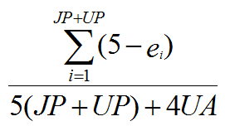
Evaluation
Use a more recent version of SNOMED CT as gold standard for earlier versions, expressing differences in terms of justified presence (JP), justified absence (JA), unjustified presence (UP) and unjustified absence (UA) yielding 17 combinations – change in reality, change in understanding, editorial mistake correction – to each of which corresponds an error value (e_{i}).
The overall quality of an earlier version with respect to a chosen later version is then computed by means of formula:
Ceusters W. Applying Evolutionary Terminology Auditing to SNOMED CT. American Medical Informatics Association 2010 Annual Symposium (AMIA 2010) Proceedings. Washington DC, 2010. p. 96-100.

Slide 86
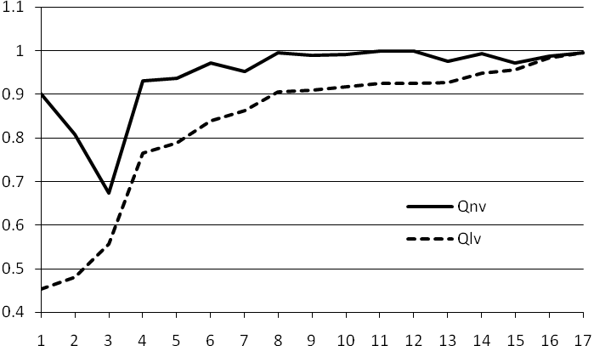
‘next’ and ‘last’ version quality improvement
The Qlv-view uses the most recent version as gold standard;
The Qnv-view uses as reference the version which follows immediately the version for which the quality is computed.
When the difference between two consecutive points on the Qnv curve shows a large increase, as is the case between v3 and v4, then this means that it is worth upgrading to the next version, thus v5.

Slide 87
Comparison with ‘next’ and ‘last’ version quality improvement
Version |  | Information content | Suspicious event perseverance | ‘Next version’ quality improvement | ‘Last version’ quality improvement
 |  |  |  |  | LQV | 5% | 10% | 15% | 20% | 25%
v1 | January 2002 | 79,424.5499 |  | 0.902158875 | 0.45334
v2 | July 2002 | 88,838.2435 |  | 0.807276754 | 0.47980 | Y
v3 | January 2003 | 127,864.0057 |  | 0.674182895 | 0.55653 | Y | Y | Y | Y
v4 | July 2003 | 368,261.2260 |  | 0.930927215 | 0.76591 | Y | Y | Y | Y | Y
v5 | January 2004 | 360,409.8979 |  | 0.936412939 | 0.78907
v6 | July 2004 | 388,775.7097 |  | 0.970773297 | 0.83995 | Y
v7 | January 2005 | 390,637.7034 |  | 0.952138559 | 0.86259 |  | Y
v8 | July 2005 | 401,196.6372 |  | 0.995326645 | 0.90446 | Y |  | Y
v9 | January 2006 | 389,021.8138 |  | 0.988407635 | 0.90854
v10 | July 2006 | 387,226.2485 |  | 0.992040473 | 0.91776
v11 | January 2007 | 386,714.4974 |  | 0.999406567 | 0.92518 |  |  |  | Y
v12 | July 2007 | 386,816.9581 |  | 0.998631853 | 0.92567
v13 | January 2008 | 386,803.0803 |  | 0.976249334 | 0.92638
v14 | July 2008 | 386,075.3172 |  | 0.992155217 | 0.94874
v15 | January 2009 | 384,952.4653 |  | 0.971849459 | 0.95583 | Y | Y
v16 | July 2009 | 384,960.7605 |  | 0.987649670 | 0.98262 |  |  |  |  | Y
v17 | January 2010 | 385,449.7811 |  | 0.994921958 | 0.99492
v18 | July 2010 | 385,052.7645 |  | - | -
Ceusters W. SNOMED CT Revisions and Coded Data Repositories: When to Upgrade? In American Medical Informatics Association 2011 Annual Symposium Proceedings, Washington DC, October 22-26, 2011:197-206

Slide 88
Conclusions (1)
the information content strategy approximates closely the 5% Qlv quality increase requirement, except:
  (1) unnecessary upgrades in January 2005 and July 2007, and
  (2) a failure to upgrade in January 2009 which is corrected in January 2010.
Combining this strategy with the suspicious event perseverance strategy would have led to an upgrade in July 2008 instead of January 2009.

Slide 89
Conclusions (2)
This is promising since:
  it is a completely automatic process;
  IC and SEP can be calculated with each new version, while Qnv gives a delay of one version and Qlv provides a post-hoc assessment;
  the method can be used for internal QA by SNOMED authors.
Limitations:
  for sure: transitive closure computations require serious computer resources;
  just one test case processed thus far.
Ceusters W. SNOMED CT Revisions and Coded Data Repositories: When to Upgrade? In American Medical Informatics Association 2011 Annual Symposium Proceedings, Washington DC, October 22-26, 2011:197-206

