Slide 1
BMI521 – Fall 2025
Logic Programming for Biomedical Informatics
Class 1 – Aug 29, 2025
Logic Essentials for Understanding Prolog
Werner CEUSTERS^{1,2}
¹ Department of Biomedical Informatics, University at Buffalo, USA
² Department of Psychiatry, University at Buffalo, USA

Slide 2
Class overview
Overview and Q/A of syllabus
Assignments
  Relation of A1 … A4 to A5 and A6
Intro to Logic relevant to Prolog.

Slide 3
What is ‘a logic’
A formal or informal language together with a deductive system and/or a model-theoretic semantics.
The language has components that correspond to a part of a natural language like English or Greek.
The deductive system is to capture, codify, or simply record arguments that are valid for the given language.
The semantics is to capture, codify, or record the meanings, or truth-conditions for at least part of the language.
Shapiro, Stewart and Teresa Kouri Kissel, "Classical Logic",
The Stanford Encyclopedia of Philosophy (Spring 2021 Edition), Edward N. Zalta (ed.).
https://plato.stanford.edu/archives/spr2021/entries/logic-classical/

Slide 4
Language and semantics of Propositional Logic
A well-formed formula is either atomic or composed following allowed composition rules.
Atomic formulae stand for propositions that must either be true or false:
  A: ‘John eats too much’.
  B: ‘John has a normal BMI’.
  C: ‘John is careful’.
Formula connectors:
  Negation (not): ¬ ~
  Conjunction (and): ∧ & ∙
  Disjunction (or): ∨
  Material implication (if...then): → ⇒ ⊃
  Biconditional (if and only if): ↔ ⬄ ≡ =

Slide 5
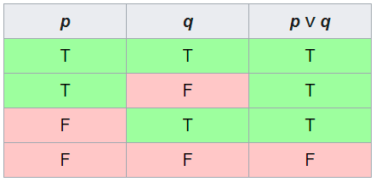
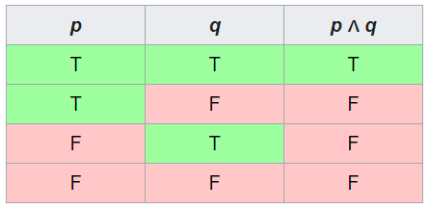
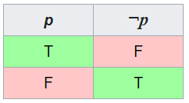
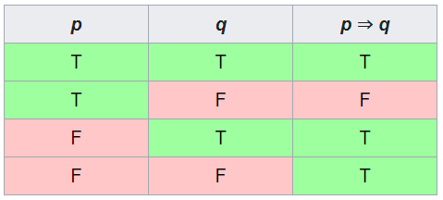
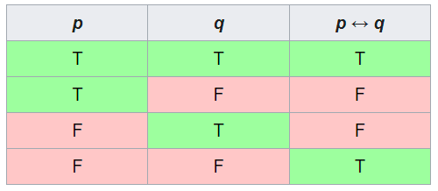
PL’s Deductive system: truth tables

Slide 6
Some Propositional Logic Laws
Truth tables can be used to prove laws, e.g.:
  a → b = ¬ a V b
  a Λ (b V c) = (a Λ b) V (a Λ c)
  ¬ (a Λ b) = ¬ a V ¬b
  (a Λ (a → b)) → b
  (a→ b) Λ ¬b) → ¬a
  ((a V b) Λ ¬a) → b
  ((a → b) Λ (b → c)) → (a → c)
  …
  More examples:
    https://math.stackexchange.com/questions/1449866/catalogue-of-propositional-logic-laws
    http://mathonline.wikidot.com/the-laws-of-propositional-logic#toc0

Slide 7
Conversion to Conjunctive Normal Form
Any well-formed formula with any combination of logical connectives can be transformed into CNF, i.e. a formula consisting of:
  A conjunction of clauses
  Each conjunction being a disjunction of literals
Examples:
  p → q ≡ ¬ p v q
  ( p → ¬ q ) ↔ r ≡ (( p → ¬ q ) → r) ∧ (r → ( p → ¬ q ))
  ≡ (¬ (¬ p v ¬ q ) v r) ∧ (¬ r v (¬ p v ¬ q ))
  ≡ (( p ∧ q ) v r) ∧ (¬ r v ¬ p v ¬ q ))
  ≡ (( p v r) ∧ ( p v q) ∧ (¬ r v ¬ p v ¬ q ))

Slide 8
From CNF to Kowalski rules
(( p v r ) ∧ (q v ¬ r v ¬ p))
Separate clauses and move negative literals left:
  p v r
  ¬ r v ¬ p v q
Transform disjunction of negative literals into conjunction:
  p v r
  ¬ ( r ∧ p ) v q
Transform where possible remaining disjunctions into implication:
  ¬ p → r
  ¬ r → p
  ( r ∧ p ) → q

Slide 9
Possible Kowalski rule forms
( p_{0…n} ∧ … ) → ( q_{0…m} v … )
(not n = m = 0)
If n = 0: TRUE
  m = 1 → ‘fact’ q₁
  m > 1 → ‘alternative’ q₁ v q₂ v …
If m = 0: FALSE
  n = 1 → ‘negative fact’ ¬ p₁
  n > 1 → ‘falsehood’ ¬ (p₁ ∧ p₂ ∧ …)
If n > 0
  m = 1 → Horn clause p₁ ∧ p₂ ∧ … → q₁

Slide 10
Equivalent perspective
‘if-then’-rules:
  ( a & b & … ) → p
  true → p
‘if-then-or’-rules:
  ( a & b & …) → ( p v q v … )
  true → ( p v q v … )
‘false-hood’-rules:
  ( a & b & … ) → false

Slide 11
Possible Kowalski rule forms
( p_{0…n} ∧ … ) → ( q_{0…m} ∧ … )
(not n = m = 0)
If n = 0
  m = 1 → ‘fact’
  m > 1 → ‘alternative’
If m = 0
  n = 1 → ‘negative fact’
  n > 1 → ‘falsehood’
If n > 0
  m = 1 → Horn clause
Allowed rule forms in ‘pure’ Prolog

Slide 12
Equivalent perspective
‘if-then’-rules:
  ( A & B & … ) → P ‘pure’ Prolog
  true → P
‘if-then-or’-rules:
  ( A & B & …) → ( P v Q v … )
  true → ( P v Q v … )
‘false-hood’-rules:
  ( A & B & … ) → false

Slide 13
Prolog clause schema
‘if-then’-rules:
  ( A & B & … ) → P
    written in Prolog as:
      p :- a, b, … . ‘p’ is the ‘head’
      ‘a, b, …’ is the ‘body’.
  true → P
    written in Prolog as:
      p.

Slide 14
Exercise
Can the following be written in ‘pure’ Prolog clauses ?
  ( r ∧ p ) → q
  p v r
Solution:
  q :- r, p.
  a) r :- \+p.
  b) p :- \+r.
The ‘head’ of a clause cannot be a negative literal.
Negative literals may appear in the ‘body’ of a clause.

Slide 15
First-Order Logic (FOL) - Syntax
User defines these primitives:
  Constant symbols (i.e., the "individuals" in the world) E.g., bfo, 3
  Function symbols (mapping individuals to individuals) E.g., author-of(bfo) = barry_smith
  Predicate symbols (mapping from individuals to truth values)
E.g., greater(5,3) = true, smart(barry_smith) = true

Slide 16
First-Order Logic (FOL) - Syntax…
FOL supplies these primitives:
  Variable symbols. E.g., x,y
  Connectives.
    Same as in PL:
      not (~),
      and (^),
      or (v),
      implies (→),
      if and only if (<=>)
  Quantifiers: Universal (∀) and Existential (∃)

Slide 17
Truth values of quantifiers
Statement | True when | False when
∀x.A(x) | A(x) is true for every x. | There is an x for which A(x) is false
∃x.A(x) | There is an x for which A(x) is true. | A(x) is false for every x.

Slide 18
Prolog supports predicates
In facts:
  s(a, b).
  r(c, d, e).
In clauses:
  q(X, a, T):-
  r(X, b, T),
  s(Y, X, T),
  r(Y, c, T).

Slide 19
Prolog supports predicates
In facts:
  s(a, b).
  r(c, d, e).
In clauses:
  q(X, a, T):-
  r(X, b, T),
  s(Y, X, T),
  r(Y, c, T).
  continuant_part_of(tumor_678, john).
  instance_of(tumor_678, tumor, ‘2025-08-29’).
  suffers_from(X, cancer, T):-
  instance_of(X, organism, T),
  continuant_part_of(Y, X, T),
  instance_of(Y, malignant_tumor, T).

Slide 20
Note !!!
Distinct facts:
  p(a, b). father_of(john, mike).
  p(b, a). father_of(mike, john).
  ALSO: equal(a, b) / equal(b, a)
  ALSO: p(a, b) / p(a, b, c)
For a given predicate:
  Arguments are ordered,
  number of arguments is fixed.

Slide 21
Allowed datatypes for predicate arguments
Atoms:
  a, p, werner, wernerCeusters, key12, malignant_tumor, ‘malignant tumor’, …
Variables:
  X, Value, _, …
Numbers:
  12, -2, 3.142592, …
Lists:
  [a, b, c], [a, 3, [X, werner]], …
Compound terms: look like predicates but are not!
  father_of(john), address(290, palmstreet, 14222, buffalo, ny), …
Strings:
  “werner ceusters”, …
Combinations of lists and compound terms with anything allowed in lists and compound terms

Slide 22
Quantification in Prolog
}
suffers_from(X, cancer, T):- ← ‘head’
instance_of(X, organism, T), ‘clause’
continuant_part_of(Y, X, T), ← ‘body’
instance_of(Y, malignant_tumor, T).
Variables introduced in the clause head are universally quantified
Variables introduced in the clause body are existentially quantified.
‘introduced’ means: appears for the first time.
}

Slide 23
Interpretation
}
suffers_from(X, cancer, T):- ← ‘head’
instance_of(X, organism, T), ‘clause’
continuant_part_of(Y, X, T), ← ‘body’
instance_of(Y, malignant_tumor, T).
Declarative (what is true):
  For all x and y, x suffers from cancer at y, if x is an instance of organism at t, y is a continuant part of x at t, and y is an instance of a malignant tumor at t.
Procedural (how to achieve a goal):
  To satisfy the goal suffers_from(X, cancer, T), first satisfy the goal instance_of(X, organism, T), then satisfy continuant_part_of(Y, X, T), and finally satisfy instance_of(Y, malignant_tumor, T).
}

Slide 24
Prolog’s deductive system: resolution
Resolution in general (on CNF):
  ¬p v ¬q v r v s
  ¬o v q v t
Resolution in Prolog:
  r :- q, p.
  q :- o.
  o.
  ? r.
¬p v r v s v ¬o v t

Slide 25
Prolog’s deductive system: resolution
Resolution in general (on CNF):
  ¬p v ¬q v r v s
  ¬o v q v t
Resolution in Prolog:
  r :- q, p.
  q :- o.
  o.
  ? r.
¬p v r v s v ¬o v t
r :- o, p.

Slide 26
Prolog’s deductive system: resolution
Resolution in general (on CNF):
  ¬p v ¬q v r v s
  ¬o v q v t
Resolution in Prolog:
  r :- q, p.
  q :- o.
  o.
  ? r.
¬p v r v s v ¬o v t
r :- o, p.
r :- p.

Slide 27
Prolog’s deductive system: resolution
Resolution in general (on CNF):
  ¬p v ¬q v r v s
  ¬o v q v t
Resolution in Prolog:
  r :- q, p.
  q :- o.
  o.
  ? r.
  ‘Closed world’ reasoning !
  What is not stated, is not the case!
¬p v r v s v ¬o v t
r :- o, p.
r :- p.
false.

Slide 28
Prolog’s deductive system: resolution + unification
suffers_from(X, cancer, T):-
instance_of(X, organism, T),
continuant_part_of(Y, X, T),
instance_of(Y, malignant_tumor, T).
instance_of(john, organism, t).
instance_of(johns_tumor, malignant_tumor, t).
continuant_part_of(johns_tumor, john, t).
BMI521-2025-p1.pl

Slide 29
Prolog’s deductive system: resolution + unification + back-tracking
suffers_from(X, cancer, T):-
instance_of(X, organism, T),
continuant_part_of(Y, X, T),
instance_of(Y, malignant_tumor, T).
instance_of(mary, organism, t).
instance_of(john, organism, t).
instance_of(johns_tumor, malignant_tumor, t).
continuant_part_of(johns_tumor, john, t).
BMI521-2025-p1.pl

