Slide 1
BMI508 – Fall 2024
Introduction to Biomedical Ontology
Class 6 – Oct 2, 2024
Relations in
Biomedical Ontologies
Werner CEUSTERS^{1,2}
¹ Department of Biomedical Informatics, University at Buffalo, USA
² Department of Psychiatry, University at Buffalo, USA

Slide 2
Essentials
Distinguishing what is denoted by ‘relation’ in technical sense (‘formal relations’) from what is denoted by ‘relation’ in non-formal language (‘material relations’);
Differences between type-level formal relations, particular-level formal relations and particular-type-level formal relations;
Arity and other properties of formal relations and differences thereof between particular-type formal relations and their corresponding type-level formal relations;
Elucidation versus definition of formal relations;
‘Basic’ formal relations versus ‘shortcut’ formal relations;
Axiomatic characterization of formal relations (Class C13).

Slide 3
Remember !
BFO2020-FOL’s axiomatization, compared to the definitions in previous versions, changed the arity of some relations.
  Previous principle: all relations in which at least one continuant is involved, should be time-indexed.
  Now: only the relations in the relationships table which have a temporalized version, are time-indexed.
For this class, I use the ‘old’ and ‘new’ style randomly.
For your assignments from now on:
  For any relation defined in BFO, you may either use the above principle, or use the BFO2020-FOL relation;
  For any relation you introduce and which is not in BFO2020, you MUST use the older principle.

Slide 4
Distinguishing what is denoted by ‘relation’ in technical sense from what is denoted by ‘relation’ in non-formal language

Slide 5
‘John is in a relation with Mary’

Slide 6
‘Relations’
(mainstream view)
Relations:
  ‘entities that glue together other entities’
  Formal relations:
    ‘hold between two or more entities directly, without any further intervening individual’.
  Material relations:
    ‘have material structure on their own’.
        = are entities
    Guizzardi & Wagner. What’s in a Relationship: An Ontological Analysis. In: Qing Li, Stefano Spaccapietra, Eric Yu, Antoni Olivé (Eds.), Conceptual Modeling - ER 2008. Lecture Notes in Computer Science, Vol. 5231, 83-97, 2008 https://doi.org/10.1007/978-3-540-87877-3_8↗

Slide 7
Material relation
‘John is in a relation with Mary’
isAbout at t
JM Romantic relationship
John
Mary

Slide 8
Material relation
‘John is in a relation with Mary’
isAbout at t
JM Romantic relationship
John
Mary
instanceOf at t
BFO:Object
BFO:Relational Quality

Slide 9
Material relation
‘John is in a relation with Mary’
isAbout at t
inheresIn at t
JM Romantic relationship
inheresIn at t
John
Mary
instanceOf at t
BFO:Object
BFO:Relational Quality

Slide 10
Material relation
‘John is in a relation with Mary’
isAbout at t
inheresIn at t
JM Romantic relationship
inheresIn at t
John
Mary
instanceOf at t
BFO:Object
BFO:Relational Quality

Slide 11
Material relation
‘John is in a relation with Mary’
isAbout at t
inheresIn at t
JM Romantic relationship
inheresIn at t
John
Mary
instanceOf at t
BFO:Object
BFO:Relational Quality

Slide 12
Material relations
‘have material structure on their own’
Are entities in their own right.
Relate other entities to each other by means of formal relations.
Examples: what might by some be denoted by:
  ‘patient’,
  ‘treatment’,
  ‘driver’.
Examples in BFO:
  relational qualities
      Have independent continuants as their bearers.
  relational processes: kissing, buying, …

Slide 13
Material relation
‘John is in a relation with Mary’
isAbout at t
inheresIn at t
JM Romantic relationship
inheresIn at t
John
Mary
instanceOf at t
BFO:Object
BFO:Relational Quality

Slide 14
Formal relations
‘John is in a relation with Mary’
isAbout at t
inheresIn at t
JM Romantic relationship
inheresIn at t
John
Mary
instanceOf at t
BFO:Object
BFO:Relational Quality

Slide 15
Formal relations
‘hold between two or more entities directly, without any further intervening individual’
Basic formal relations:
  existential dependence, inherence, subtype-of, part-of, subset-of, instantiation, …
Domain formal relations:
  ‘relations that exhibit similar characteristics, i.e., those relations of comparison such as is taller than, is older than, knows more Greek than’.
    Guizzardi & Wagner. What’s in a Relationship: An Ontological Analysis. In: Qing Li, Stefano Spaccapietra, Eric Yu, Antoni Olivé (Eds.), Conceptual Modeling - ER 2008. Lecture Notes in Computer Science, Vol. 5231, 83-97, 2008 https://doi.org/10.1007/978-3-540-87877-3_8↗

Slide 16

What is out there …
(… we want/need to deal with)?
portions of reality
formal
relations
configurations
relationships
participation
me participating in my life
types
particulars
universals
continuants
me
occurrents
representations
organism
defined
classes
my life

Slide 17
Relationships
‘John is in a relation with Mary’
isAbout at t
inheresIn at t
JM Romantic relationship
inheresIn at t
John
Mary
instanceOf at t
BFO:Object
BFO:Relational Quality

Slide 18
Configurations
‘John is in a relation with Mary’
isAbout at t
inheresIn at t
JM Romantic relationship
inheresIn at t
John
Mary
instanceOf at t
BFO:Object
BFO:Relational Quality

Slide 19
Configurations
‘John is in a relation with Mary’
isAbout at t
inheresIn at t
JM Romantic relationship
inheresIn at t
John
Mary
instanceOf at t
BFO:Object
BFO:Relational Quality

Slide 20
Configurations
‘John is in a relation with Mary’
isAbout at t
inheresIn at t
JM Romantic relationship
inheresIn at t
John
Mary
instanceOf at t
BFO:Object
BFO:Relational Quality

Slide 21
Configurations
‘John is in a relation with Mary’
isAbout at t
inheresIn at t
JM Romantic relationship
inheresIn at t
John
Mary
instanceOf at t
BFO:Object
BFO:Relational Quality

Slide 22
Relational PoRs ←→ relational expressions
‘Mary is patient of John’

Slide 23
Relational PoRs ←→ relational expressions
‘Mary is patient of John’
isAbout at t
Mary
John
patientOf at t
inheresIn at t
instanceOf
at t
Mary’s patient role
patient
role
instanceOf at t
Patient

Slide 24
Role (Externally-Grounded Realizable Entity)
role =def. a realizable entity
  which exists because the bearer is in some special physical, social, or institutional set of circumstances in which the bearer does not have to be, and
  is not such that, if it ceases to exist, then the physical make-up of the bearer is thereby changed.

Slide 25
Relational PoRs ←→ relational expressions
‘Mary is patient of John’
isAbout at t
Mary
John
patientOf at t
inheresIn at t
instanceOf
at t
Mary’s patient role
patient
role
instanceOf at t
²
p to p relations
particulars
universals
relational expression
p to u relations
Patient
³
²
¹
²

Slide 26
Relational PoRs ←→ relational expressions
‘Mary is friend of John’

Slide 27
Relational PoRs ←→ relational expressions
‘Mary is friend of John’
isAbout at t
Mary
John
friendOf at t
inheresIn at t
inheresIn at t
M&J’s friendship
instanceOf at t
friendship

Slide 28
Properties of formal relations

Slide 29
Arity of a relation
Binary:
  My youth partOf my life
1 2
Ternary:
  My hand partOf me now
1 2 3
Quaternary:
  My left middle finger between my left index finger
    1 2
  and my left ring finger now
  3 4
…

Slide 30
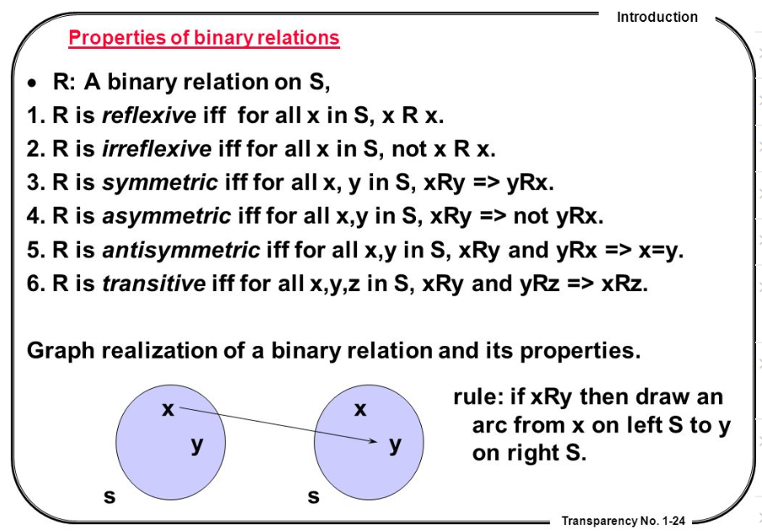
Properties of binary relations
http://en.ndncdc.org/page/symmetric-binary-relation-on-set/

Slide 31
Distinct levels at which formal relations exist

Slide 32
Relations in Ontological Realism
Instance-level relations
  Your heart (instance-level) continuant_part_of your body at t
  Your heart beating (instance-level) has_participant your heart at t
Instance-type relations
  John’s heart instantiates human heart at t.
  John’s heart beating instantiates human heart beating.
Type-level relations
  human heart continuant_part­_of human body
  human heart beating process has_occurrent_part beat profile

Slide 33
Features of relations on the level of instances may not hold on the level of universals
nucleus adjacent_to cytoplasm
  Not: cytoplasm adjacent_to nucleus
    Red blood cells don’t have a nucleus
seminal vesicle adjacent_to urinary bladder
  Not: urinary bladder adjacent_to seminal vesicle
    Women don’t have seminal vesicles
Adjacency as a relation between universals is not symmetric while it is symmetric at particular level.

Slide 34
the universal red
the universal eye
Instantiates at t
Instantiates at t
the particular case of redness (of a particular fly eye)
inheresIn at t
an instance of an eye (in a particular fly)

Slide 35
the universal
color
the universal
object
isa
isa
inheresIn ?
the universal red
the universal eye
Instantiates at t
Instantiates at t
the particular case of redness (of a particular fly eye)
inheresIn at t
an instance of an eye (in a particular fly)

Slide 36
Continuants versus Occurrents
Continuant
has_participant
Process
e.g. pathological
process
is_a
is_a
Independent
Continuant
e.g. organism
G or S
Dependent
Continuant
e.g. patient role
inheres_in
instance_of
universals
instance_of at t
.... ..... .......
particulars

Slide 37
Remember forever !!!
Formal relations expressed in the BFO are all type-type relations.
    IC isa Continuant
    SDC specifically depends on IC
domain
range

Slide 38
Explicit in BFO
portions of reality
formal
relations
configurations
relationships
types
particulars
universals
continuants
occurrents
representations
defined
classes

Slide 39
Explicit in BFO-based domain ontologies
portions of reality
formal
relations
configurations
relationships
types
particulars
universals
continuants
occurrents
representations
defined
classes

Slide 40
Remember !!!
Formal relations expressed in the BFO are all type-type relations.
    IC isa Continuant
    SDC specifically depends on IC
BFO’s type-type relations don’t express anything about types, but only what is the case for all particulars in the domain position of the relation.
BFO’s type-type relations are defined / elucidated on the basis of instance-level relations.

Slide 41
Elucidations and definitions of formal relations

Slide 42
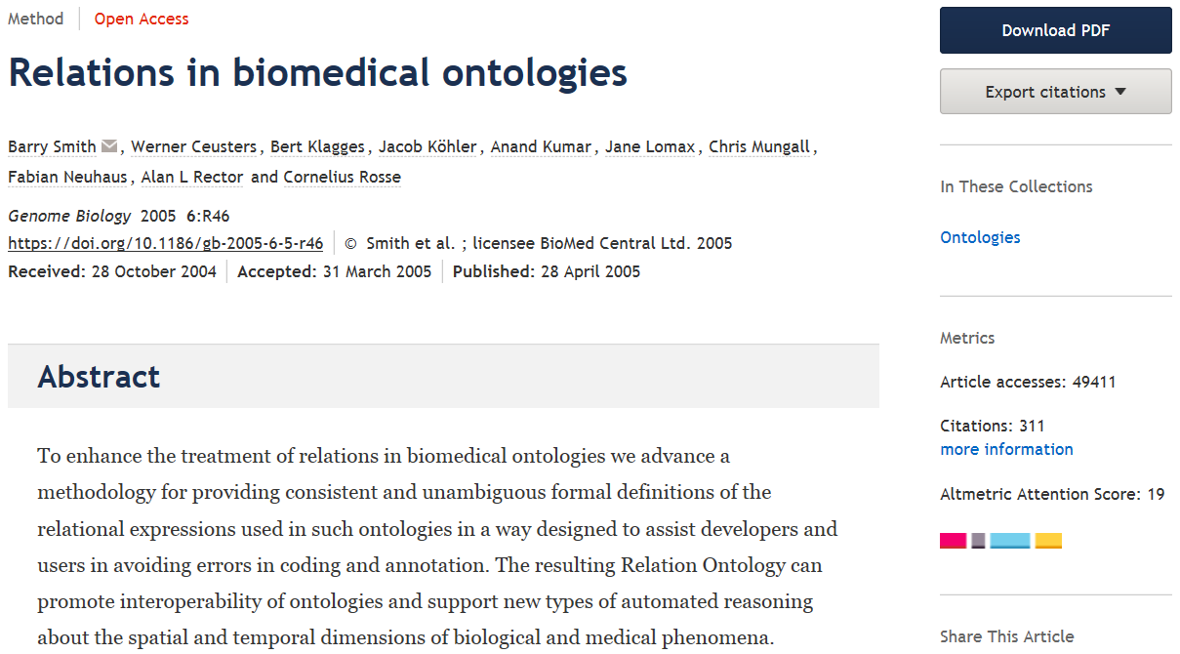

Slide 43
Elucidation of a formal relation
The instance_of relation holds between particulars and universals. It comes in two forms, for continuants (C, C1, …) and occurrents (P, P1, …) as follows:
  c instance_of C at t means: the particular continuant entity c instantiates the universal C at t
  BFO2.0:
    p instance_of P means: the particular occurrent entity p instantiates the universal P.
  BFO2020:
    p instance_of P at t

Slide 44
Elucidation of a formal relation
x is_about y means:
  x refers to or is cognitively directed towards y.
      Domain: representations;
      Range: portions of reality.
      Axiom: if x is_about y then y exists (veridicality).
x concretizes y at t means:
  x is a quality & y is a generically dependent continuant
  & for some material entity z,
    x specifically_depends_on z at t &
    y generically_depends_on z at t
  & if y migrates from bearer z to another bearer w then a copy of x will be created in w.
Smith B, Ceusters W. Aboutness: Towards Foundations for the Information Artifact Ontology. International Conference on Biomedical Ontologies, ICBO 2015, Lisbon, Portugal, July 27-30, 2015;47-51.

Slide 45
Definition of a formal relation
x is_a_representation_of y =def.
  x is a representa­tion & x is_about y (where y is a portion of reality). Note that not all representations are about something.
x is_conformant_to y =def.
  x is an information quality entity &
  y is a cognitive representa­tion &
  there is some GDC g such that x concretizes g and y concretizes g.
  Example: x is a sentence on a piece of paper, y is the belief of the author of the sentence who wrote the sentence as an expression of her belief, and g is the ICE (the content) that belief and sentence share.
Smith B, Ceusters W. Aboutness: Towards Foundations for the Information Artifact Ontology. International Conference on Biomedical Ontologies, ICBO 2015, Lisbon, Portugal, July 27-30, 2015;47-51.

Slide 46
Elucidation versus definition
x is_about y means:
  x refers to or is cognitively directed towards y. Domain: representations; Range: portions of reality. Axiom: if x is_about y then y exists (veridicality).
‘A means B’:
    If A is the case, you can conclude that B holds.
    If B is the case, you cannot conclude anything re A.
x is_a_representation_of y =def.
  x is a representa­tion & x is_about y (where y is a portion of reality). Note that not all representations are about something.
‘A =def. B’ :
    If A is the case, you can conclude that B holds.
    If B is the case, you can conclude that A holds.
    If one doesn’t hold, the other one doesn’t hold.

Slide 47
Key idea in defining ontological relations
Not enough to look just at universals or types
We need also to take account of instances and time.
This will yield an automatic bridge to the instance data in information systems, databases, repositories, …

Slide 48
Type-level relations presuppose the underlying instance-level relations
A part_of B =def(roughly). All instances of A are instance-level-parts-of some instance of B
  e.g. human heart part_of human
A has_participant B =def(roughly). All instances of A have some instance of B as instance-level participant
  e.g. cell binding has_participant cell

Slide 49
the all-some form
A continuant_part_of B =def.
  for all instances a and times t,
  If a is an instance of the universal A at t,
  then there is some instance b of the universal B
  such that
  a is an instance-level part_of b at t
Domain: Continuant
Range: Continuant

Slide 50
Definitions of the all-some form allow cascading inferences
If A R₁ B and B R₂ C, then we know that:
  every A stands in R₁ to some B,
  whichever B this is, it can be plugged into the R₂ relation, because R₂ is defined for every B.
Also allows for the definition of ‘shortcut’ relations:
  A R₃ C =def. A R₁ B and B R₂ C

Slide 51
How to define A is_a B
A is_a B =def.
  A and B are names of universals (natural kinds, types) in reality or of defined classes
  all instances of A are as a matter of science also instances of B
  for all times t, all instances of A at t are as a matter of science also instances of B at t

Slide 52
Formal BFO definition for is_a
The is_a relation is the subtype or subuniversal relation between universals or types.
  C is_a C1 =def.:
    C and C1 are continuant universals, and
    for all c, t, if c instance_of C at t then c instance_of C1 at t
  P is_a P1 =def.:
    P and P1 are occurrent universals, and
    for all p, if p instance_of P then p instance_of P1
Is_a is NOT used in BFO2020-FOL !

Slide 53
Compare with RDFS / OWL
AXIOM SCHEMA: class description rdfs:subClassOf class description
The rdfs:subClassOf construct is defined as part of RDF Schema [RDF Vocabulary]. Its meaning in OWL is exactly the same: if the class description C1 is defined as a subclass of class description C2, then the set of individuals in the class extension of C1 should be a subset of the set of individuals in the class extension of C2.
Differences with BFO:
  subClass is primitive, being a subset is a consequence
  You just have to declare it → how do you want the domain to be, not how the domain is!
  No time indexing.

Slide 54
part_of
organisms and other continuant entities may lose and gain parts over time
part_of must be time-indexed for continuants
A part_of B is defined as:
  Given any instance a and any time t,
  If a is an instance of the universal A at t,
  then there is some instance b of the universal B
  such that
  a is an instance-level part_of b at t

Slide 55
Part-of different for continuants and occurrents
process
living creature
Is_a
Is_a
leg
Is_a
human being
leg moving
walking
Instance-of
at t
Instance-of
Instance-of
at t
this leg moving
Instance-of
part-of
at t
part-of
my left leg
me
this walking

Slide 56
Part-of can be generalized, … with care !
C part_of C1 = [def]
for all c, t,
if c instanceOf C at t
then there is some c1 such that
c1 instanceOf C1 at t
and c part_of c1 at t.
living creature
leg
Is_a
human being
Instance-of
at t
Instance-of
at t
part-of
at t
my left leg
me

Slide 57
Part-of can be generalized, … with care !
C part_of C1 = [def]
for all c, t,
if c instanceOf C at t
then there is some c1 such that
c1 instanceOf C1 at t
and c part_of c1 at t.
living creature
?
leg
Is_a
human being
Part-of
Instance-of
at t
Instance-of
at t
part-of
at t
my left leg
me

Slide 58
Part-of can be generalized, … with care !
Horse legs are not parts of human beings
Amputated legs are not parts of human beings
‘Canonical leg is part of canonical human being’, but…, there are (very likely) no such particulars
…
living creature
?
leg
Is_a
human being
Part-of
Instance-of
at t
Instance-of
at t
part-of
at t
my left leg
me

Slide 59
Parthood as partial ordering
Partial ordering:
  a reflexive, transitive, antisymmetric relation
Axioms:
Everything is part of itself.
Any part of any part of a thing is itself part of that thing.
Two distinct things cannot be part of each other.

Slide 60
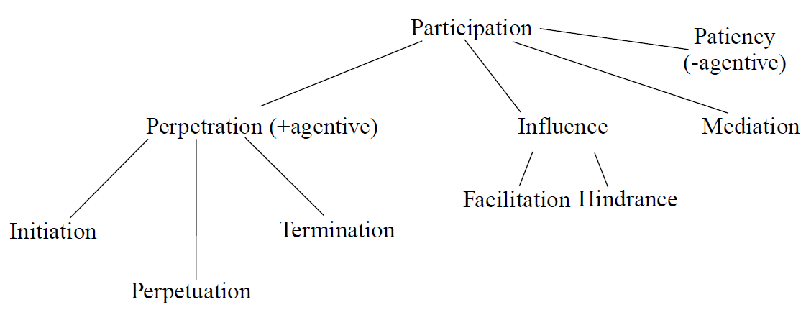
Participation
of independent continuant in process
Barry SMITH and Pierre GRENON.
The Cornucopia of Formal-Ontological Relations.
Dialectica Vol. 58, No 3 (2004), pp. 279-296

Slide 61
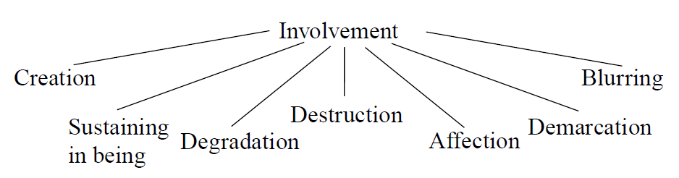
Involvement
of process in independent continuant
Barry SMITH and Pierre GRENON.
The Cornucopia of Formal-Ontological Relations.
Dialectica Vol. 58, No 3 (2004), pp. 279-296

Slide 62
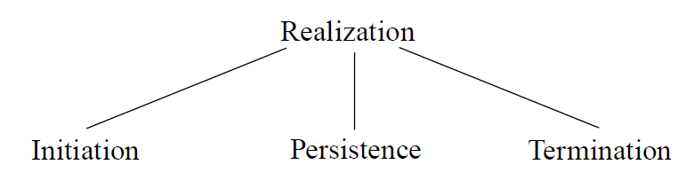
Realization
Of dependent continuant in process
Barry SMITH and Pierre GRENON.
The Cornucopia of Formal-Ontological Relations.
Dialectica Vol. 58, No 3 (2004), pp. 279-296

Slide 63
Various forms of realization per type of dependent continuant as recognized in language
– execution (of a plan)
– performance (of an act, of a symphony)
– expression (of a function, of a character, of an emotion)
– exercise (of a power, of a role)
– actualization (of a disposition)
– utterance (of a sentence)
– application (of a therapy, of a law)
– course (of a disease)
– increase (in temperature)
Barry SMITH and Pierre GRENON.
The Cornucopia of Formal-Ontological Relations.
Dialectica Vol. 58, No 3 (2004), pp. 279-296

Slide 64
derives_from
C
c at t
C₁
c₁ at t₁
time
C'
c' at t
instances
ovum
zygote derives_from
sperm

Slide 65
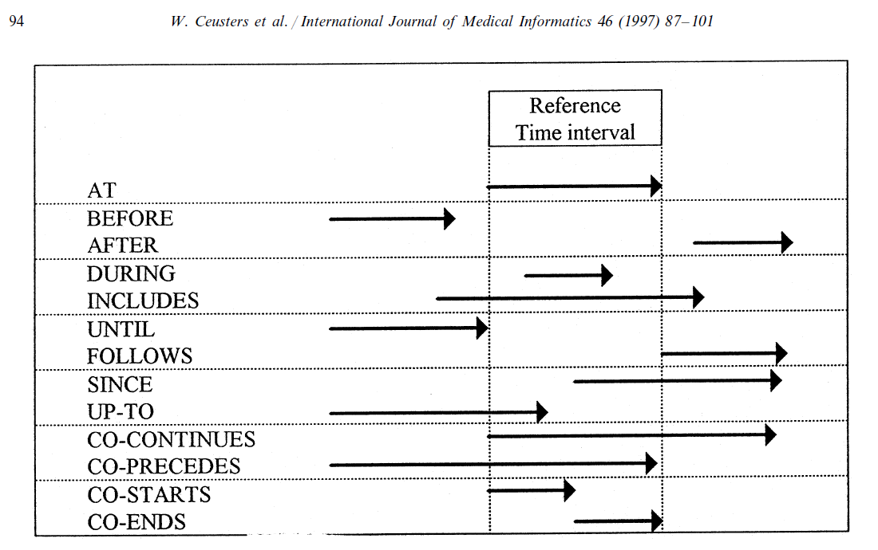
Extending ‘at’ with other time-specifiers

Slide 66
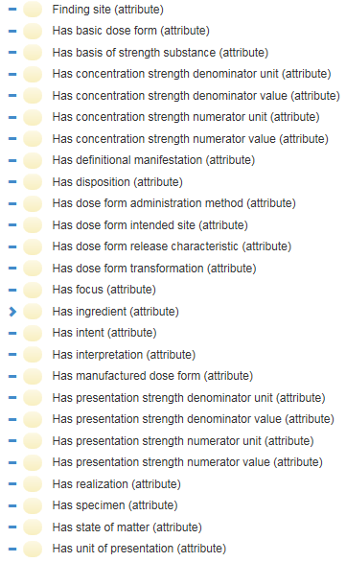
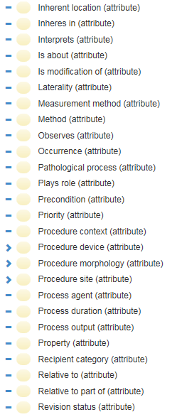
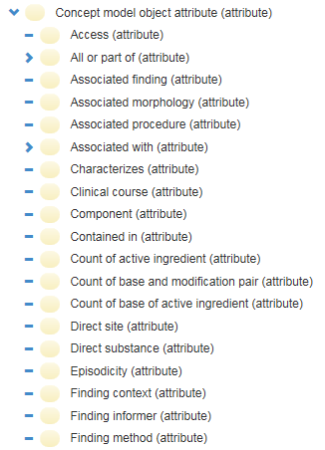
Relations in SNOMED CT
…

Slide 67
Avoid at all cost!!!
X hasY Y
Disease hasSymptom Symptom
Object hasTemperature Temperature
…

Slide 68
Assignment
A5: Apply a relational dependency analysis to the definitions (to be corrected from assignment A4) indicated by the instructor so as to create one large relational PoR as exemplified in slide 23. This may require further entities to be defined to tie the entities referenced in the definitions together by means of relations. All relations used must either have been taken from a realism-based source in which the relation is formally defined, OR you create a relation and define it appropriately.
Upload your work to the dedicated UB Box folder.
Name of the file: ‘BMI508-A5-[your UBITname].XXX’ where ‘XXX’ conforms to the format selected (Excel or Word).
Due date: Oct 7 – noon!

Slide 69
All BFO2020 relations
bearer of
concretizes at
continuant part of at
environs
first instant of
generically depends on at
has continuant part at
has first instant
has history
has last instant
has location at
has material basis at
has member part at
has occurrent part
has participant at
has proper continuant part at
has proper occurrent part
has proper temporal part
is concretized by at
last instant of
located in at
material basis of at
member part of at
occupies spatial region at
occupies spatiotemporal region
occupies temporal region
occurrent part of
occurs in
participates in at
preceded by
precedes
proper continuant part of at
proper occurrent part of
proper temporal part of
has realization
has temporal part
history of
inheres in
is carrier of at
realizes
spatially projects onto at
specifically-depended on by
specifically-depends on
temporal part of
temporally projects onto
Definitions: see BFO-2020-text.pdf in UB Box

Slide 70
Starting definitions for Abdul
Biomaterial: A substance that has been engineered to interact with biological systems for a medical purpose
Implanting: to insert a biomaterial into an organism
Biocompatible: Any material that is safely implanted and used in contact with biological tissues without causing immunological rejection

Slide 71
Starting definitions for Madhuvanti
Proliferating: The biological process of quickly dividing cells to reproduce or multiply them. Proliferating, as used in relation to cancer, describes the unrestricted of tumor cells, which helps in the spread and development of the tumor.
Tumor: An unusual mass of tissue that develops when cells proliferate and divide more than they should to or fail to die when they ought to. Malignant tumors have the ability to invade adjacent tissues and spread to other parts of the body (metastasis). Benign tumors are non-cancerous, while malignant tumors are cancerous.
Metastasis: The process that indicates an advanced stage of cancer and involves the migration of cancer cells from the primary tumor location to other bodily areas, usually through the lymphatic or circulatory systems.

Slide 72
Starting definitions for Saha
Brain (Object): The brain is the organ of the central nervous system responsible for controlling bodily functions, processing sensory information, and facilitating cognitive processes, such as thought and memory.
mental representation (information content entity): a mental representation is a cognitive entity formed in the mind that corresponds to an external object, event, or concept, allowing individuals to think, reason, and make decisions based on stored information.
cognitive process (mental process): a cognitive process is a mental activity that involves the acquisition, manipulation, and application of knowledge, enabling functions such as reasoning, memory, and decision-making.

Slide 73
For each one of you:
Think of a scenario with ‘concrete’ particulars each one of which instantiates a type that is mentioned in your definitions.
Eg: mutating: the mechanism by which an organism's genetic material, usually DNA, changes, either on its own or as a result of external factors. It is changes in the DNA sequence that can cause uncontrolled cell division, treatment resistance, and tumor development.
Scenario particulars:
  John
  The mutation occurring (?) in John at some time
  John’s DNA
  A particular sequence in John’s DNA
  The external factor that caused the mutation in John.
These particulars need to be related to each other where relevant/possible and this cross the three definitions!

Slide 74
Important !
Do not forget to provide full Aristotelian definitions for all new type-terms you introduce as part of this and forthcoming assignments!
Assessment:
  Definitions appropriately corrected in Aristotelian form and jointly complete: 20%
    (note: this means that all entities must be subsumed by the appropriate lowest level BFO universal)
  BFO relations correctly applied or new ones correctly defined (this requires to introduce a certain number of particulars): 40%
  Adequate motivations for decisions made in (1) and (2): 40%.

Slide 75
Demo

Slide 76
Reading pre-class!
Required reading pre-class:
  R7 Ceusters, W. and B. Smith, Tracking referents in electronic health records. Stud Health Technol Inform, 2005. 116: p. 71-6.[3]
  PDF downloadable from: http://ebooks.iospress.nl/publication/10278
More in detail:
  https://osf.io/preprints/osf/q8hts
Suggested additional reading (for sure for students with concentration in Biomedical Ontology):
  R8 Ceusters, W. and B. Smith, Strategies for referent tracking in electronic health records. J Biomed Inform, 2006. 39(3): p. 362-78.[4]
  https://www.sciencedirect.com/science/article/pii/S1532046405000754

