Slide 1
BMI508 – Fall 2024
Introduction to Biomedical Ontology
Class 4 – Sept 18, 2024
Basic Formal Ontology II: occurrents
Werner CEUSTERS^{1,2}
¹ Department of Biomedical Informatics, University at Buffalo, USA
² Department of Psychiatry, University at Buffalo, USA

Slide 2
Assignment
A3: Create a first version of your ontology consisting of at least 5 continuants and 5 occurrents satisfying the following requirements:
  (1) they belong to your selected research domain presented in A2,
  (2) they have not been discussed in class as part of A1, although they might have been mentioned,
  (3) they are not terms from BFO,
  (4) they are not all present in one single ontology published on the BioPortal or anywhere else,
  (5) no two entity types you selected may be directly subsumed by the same BFO universal.
For each term, indicate the most specific BFO-term by which it is subsumed.
Upload your work in an Excel file to UB Box as ‘BMI508-A3-[UBITNAME].xlsx’.
Due date: Sep 23 – noon.

Slide 3
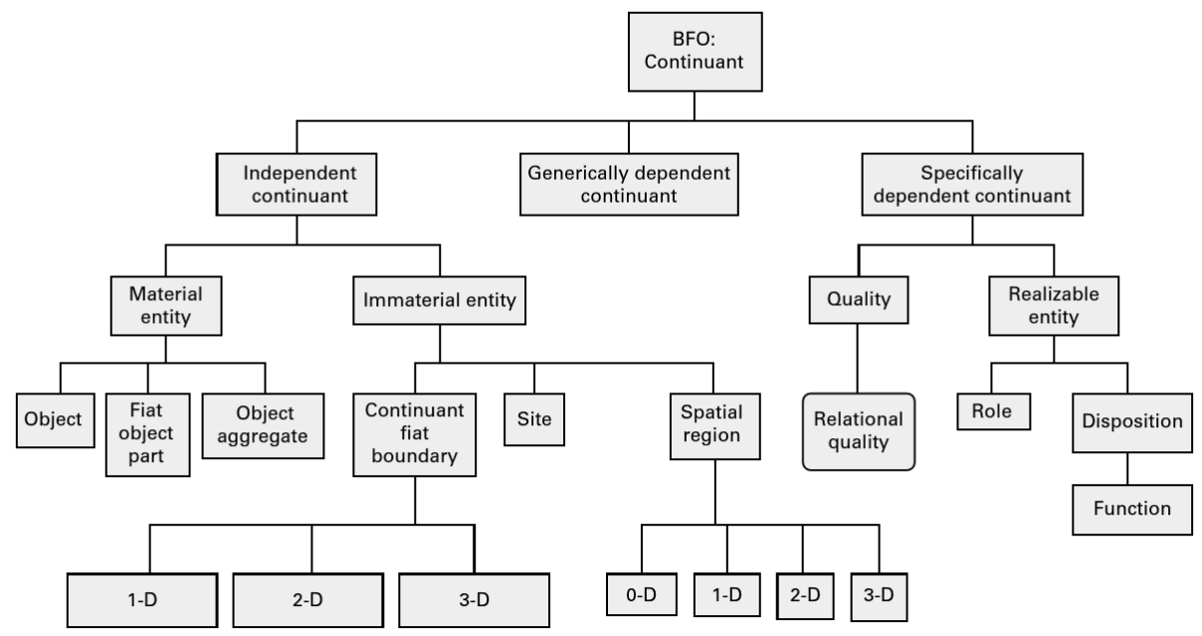
Allowed choices for continuant subsumers
allowed

Slide 4
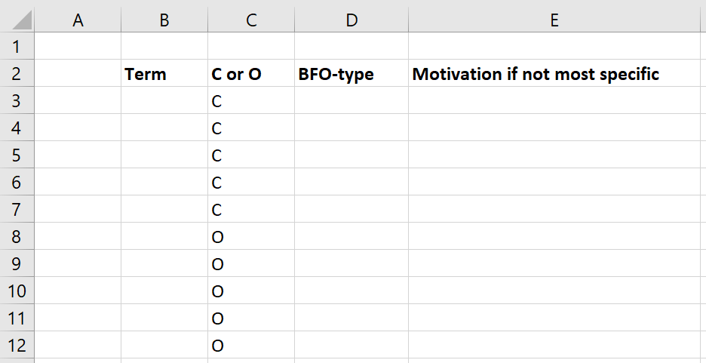
Format
Motivation

Slide 5
Assessment
1) The ten terms satisfy the five requirements: 40% (1% loss for each requirement not satisfied)
2) The ten terms are corrected classified in BFO at the appropriate level according to Fig 5.1 (p. 88) in R3 for the continuants, and the terms listed in R4: 40% (% loss for magnitude of the difference between selected level and correct level)
3) Motivation for your decisions: 20%. (2% for each term) A motivation which is plausible or for which reasonable arguments are provided may be positively scored, despite the wrong classification of the term.

Slide 6
Required reading pre-class
R9 Principles of best practice I and II. (pages 43-84) in:
Arp, R., B. Smith, and A.D. Spear, Building ontologies with basic formal ontology. 2015, The MIT Press,: Cambridge, Massachusetts. p. 1 online resource (245 p.)

Slide 7
Today’s class
Answers to Test T1.
Presentation of students’ ontology proposals.
Lecture on occurrents.

Slide 8
Major references
The BFO 2.0 Specifications (last update: June 26, 2015)
The ‘BFO-book’ (July 2015)
The ISO-standard (2020):
https://github.com/BFO-ontology/BFO/raw/master/docs/bfo2-reference/BFO2-Reference.docx
Arp, R., B. Smith, and A.D. Spear,
Building ontologies with basic formal ontology. 2015,
The MIT Press,: Cambridge, Massachusetts. p. 1 online resource (245 p).
  ISO/IEC PRF 21838-2:2020(E)
  https://standards.iso.org/iso-iec/21838/-2/ed-1/en/

Slide 9
BFO top
Entity
Continuant
Occurrent
Winston Churchill Churchill’s life
end of his life
the time during which Churchill lived
the spatiotemporal region in which he lived

Slide 10
Occurrent
Elucidation:
  an occurrent is an entity that:
  unfolds itself in time, or
  it is the start or end of such an entity, or
  it is a temporal or spatiotemporal region.
However:
  ‘19. Do not create terms for universals through logical combination.’
  Arp, Robert, et al. Building Ontologies with Basic Formal Ontology, MIT Press, 2015. ProQuest Ebook Central, http://ebookcentral.proquest.com/lib/buffalo/detail.action?docID=3433795.
  Contradiction?

Slide 11
Occurrent
Occurrent
Process
Temporal Region
unfolds itself in time
Process
Boundary
Spatiotemporal
Region
start or end of process
…

Slide 12
Process
Elucidation: p is a process =Def. p is an occurrent that has some temporal proper part and for some time t, p has some material entity as participant
Definition: p is a process = Def. p is an occurrent that has temporal proper parts and for some time t, p s-depends_on some material entity at t.
Examples:
  An act of selling, the life of an organism, a process of sleeping, a process of cell-division, a beating of the heart, …
  ISO/IEC PRF 21838-2:2020(E)
BFO 2.0 Specifications

Slide 13
Issues with the ‘Process’ definition?
Elucidation (?): p is a process =Def. p is an occurrent that has some temporal proper part and for some time t, p has some material entity as participant (?)
Definition: p is a process = Def. p is an occurrent that has temporal proper parts and for some time t, p s-depends_on some material entity at t.
Examples:
  An act of selling, the life of an organism, a process of sleeping, a process of cell-division, a beating of the heart, …
  ISO/IEC PRF 21838-2:2020(E)
BFO 2.0 Specifications

Slide 14
Seems to be suggested:
A process can only have material entities as participants.
A process can have temporal parts during which there is no participant.
But that is not the case!

Slide 15
Axioms are important (Class C13)
‘Participates in’ is time indexed and
  has domain: independent continuant but not spatial region or specifically dependent continuant or generically dependent continuant and
  range: process
  ∀a,b,t (participatesIn(a,b,t)→
    ((instanceOf(a,independentContinuant,t) ∧¬instanceOf(a,spatialRegion,t)) ∨ instanceOf(a,specificallyDependentContinuant,t) ∨ instanceOf(a,genericallyDependentContinuant,t))
    ∧ instanceOf(b,process,t) ∧ instanceOf(t,temporalRegion,t))
At every time a process exists it has a participant
  ∀p,t (instanceOf(p,process,t)→∃c participatesIn(c,p,t))
  ISO/IEC PRF 21838-2:2020(E)

Slide 16
Possible participants of process

Slide 17
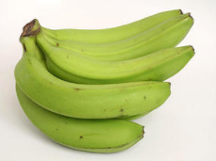
‘Change in color’
Object
Quality
isa
isa
Banana
isa
Color
isa
Green
instance
of at t₁
isa
instance of at t₁
Yellow
isa
Brown
Black

Slide 18
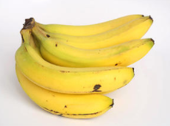
‘Change in color’
Object
Quality
isa
isa
Banana
isa
Color
isa
Green
instance
of at t₂
isa
instance of at t₂
Yellow
isa
Brown
Black

Slide 19
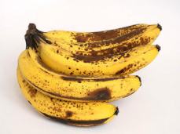
‘Change in color’
Object
Quality
isa
isa
Banana
isa
Color
isa
Green
instance
of at t₃
isa
Yellow
isa
Brown
instance of at t₃
Black

Slide 20
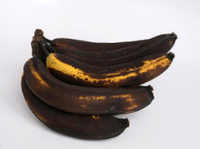
‘Change in color’
Object
Quality
isa
isa
Banana
isa
Color
isa
Green
instance
of at t₄
isa
Yellow
isa
Brown
Black
instance of at t₄

Slide 21
‘Change in color’
Elucidation: p is a process =Def. p is an occurrent that has some temporal proper part and for some time t, p has some material entity as participant.
At every time a specific dependent s participates in a process p there’s a part of that time, during which there’s an independent continuant that s s-depends on, and that participates in p at that time. (?)
  ISO/IEC PRF 21838-2:2020(E)

Slide 22
History
Elucidation:
  A history is a process that is the sum of the totality of processes taking place in the spatiotemporal region occupied by the material part of a material entity.
The relation between a material entity and its history is one-to-one.
Histories are very special kinds of processes:
  for any material entity a, there is exactly one process which is the history of a,
  for every history there is exactly one material entity which it is the history of.
  ISO/IEC PRF 21838-2:2020(E)
BFO 2.0 Specifications

Slide 23
Remember ‘exists at’
Elucidation: exists at is a relation between a particular and some temporal region at which the particular exists.
Domain: entity
Range: temporal region
Examples:
  First World War exists at 1914-1916,
  Mexico exists at January 1, 2000.
  ISO/IEC PRF 21838-2:2020(E)

Slide 24
Occurrent
Occurrent
exists at
Process
Temporal Region
Temporal Instant
(0-dimensional
temporal region)
1-dimensional
temporal region
Temporal interval
Temporal instants do not have temporal parts.
1-dimensional temporal regions have at least two temporal instants as temporal part.
A temporal interval is self-connected.

Slide 25
Temporal region
Given a temporal reference frame R, ‘time_{R}’ is defined as the maximal instance of the universal temporal region.
Elucidation: A temporal region is an occurrent entity that is part of time as defined relative to some reference frame.
A temporal region is an occurrent entity upon which a process can be projected. Temporal regions are introduced in BFO to provide a basis for consistent representation of temporal data.
BFO 2.0 Specifications

Slide 26
Process Boundary
Definition: p is a process boundary =Def.
  p is a temporal part of a process & p has no proper temporal parts.
Example: the boundary between the 2nd and 3rd year of your life.
BFO 2.0 Specifications

Slide 27
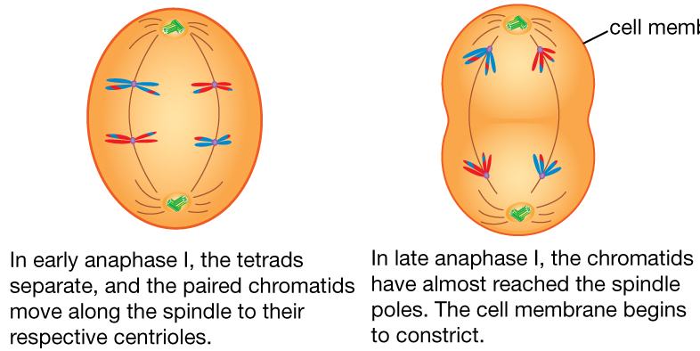
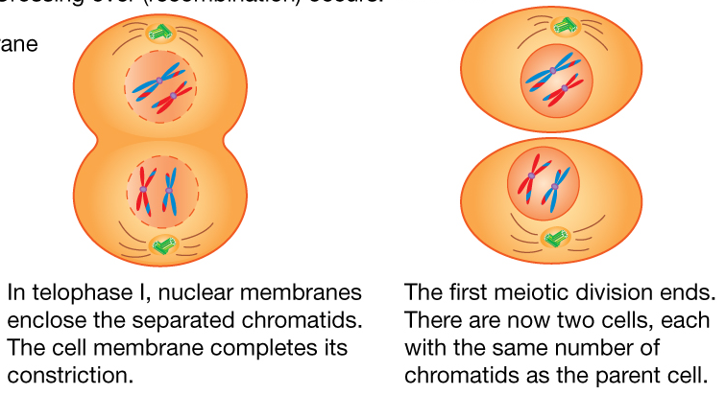
Meiosis
1
2
From Encyclopædia Britannica
2012
https://www.britannica.com/science/cell-biology/Meiosis
3
4

Slide 28
Process parts of ‘this class C4’ (1)
t
Temporal parts of a process ( ) are phases ‘sliced vertically’ through the entire ‘thickness’ of the process:
    Discussion of test T1 part of class C4
    Student proposal presentation part of class C4
    BFO:occurrents teaching part of class C4

Slide 29
Process parts of ‘this class C4’ (2)
t
Occurrent parts are ‘thin horizontally sliced’ parts:
    Ceusters’ history part during class C4; his teaching;
    his T1 explaining; his first sneezing during class; his
    listening to the students presentation, …
    student X’s participation in class C4.

Slide 30
Spatiotemporal region
A spatiotemporal region is an occurrent entity that is part of spacetime. ‘Spacetime’ here refers to the maximal instance of the universal spatiotemporal region.
Spatiotemporal regions are such that they can be occupied_by processes.
Examples:
    the spatiotemporal region occupied by a human life,
    the spatiotemporal region occupied by the development of a cancer tumor,
    the spatiotemporal region occupied by a process of cellular meiosis.
Each spatiotemporal region projects_onto some temporal region.
Each spatiotemporal region at any time t projects_onto some spatial region at t.
BFO 2.0 Specifications

