Slide 1
BMI508 – Fall 2024
Introduction to Biomedical Ontology
Class 13 – Nov 20, 2024
Axioms in Ontologies
Werner CEUSTERS^{1,2}
¹ Department of Biomedical Informatics, University at Buffalo, USA
² Department of Psychiatry, University at Buffalo, USA

Slide 2
Final exam

Slide 3
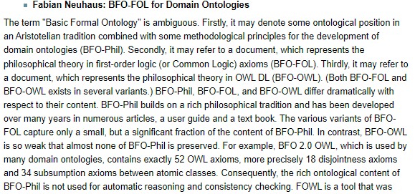
Never forget

Slide 4
Basic BFO building blocks
Renderings of BFO consist of a variable number of terms and relational expressions:
    terms: ‘continuant’, ‘occurrent’, ‘instance of at’, ‘isa’, …
    relational expressions: ‘a instance of A at t’, ‘A isa B’, …
Both terms and relational expressions can be primitive (syn: elucidated), or defined:
    defined: when described by a statement satisfying both (1) built out of logically more primitive terms and (2) expressing individually necessary and jointly sufficient conditions for an entity to fall under the designated type, or for a relation to hold.
    primitive: when they are so basic to our understanding of reality that there is no way of defining them in a noncircular fashion, or when only necessary conditions are specified.

Slide 5
Term examples
Primitive:
  Entity: (elucidation) anything that exists or has existed or will exist.
  Continuant: (elucidation) an entity that persists, endures, or continues to exist through time while maintaining its identity.
Defined:
  b is an independent continuant =Def. b is a continuant which is such that there is no c such that b s‐depends on c and no c such that b g‐depends on c.

Slide 6
Relational expression examples
Primitive:
  Elucidation: b continuant part of c at t means: b and c are continuants and b is a part of c at t
Defined:
  A is a B =Def.
    for all x, t, if x is an instance of A at t then x is an instance of B at t
  b has continuant part c at t =Def.
    b and c are continuants and b is a continuant part of c at t

Slide 7
Axioms
Expressions built out of already defined or elucidated terms or expressions stating that something else is also the case, either because:
  it is true, but not provable, or
  it is ‘enforced’, e.g. by further restricting the meaning of terms, or the logical consequences of relations.
  Theorems
Expressions built out of already defined or elucidated terms or expressions stating that something logically provably is the case.

Slide 8
Continuant axioms
If:
b is a continuant
and if:
for some c and some t, c continuant_part of b at t, then:
c is a continuant.
If:
b is a continuant
and if:
for some t, c has_continuant_part b at t,
Then:
c is a continuant.

Slide 9
Continuant-part axioms
Elucidation: b continuant_part_of c at t =Def. b is a part of c at t & t is a time & b and c are continuants .
Axioms:
  continuant_part_of is antisymmetric.
  continuant_part_of is transitive.
  continuant_part_of satisfies weak supplementation.
  continuant_part_of satisfies unique product.
Theorem:
  continuant_part_of is reflexive.

Slide 10
E.g. weak supplementation
If x continuant_part_of y at t
& not x = y,
then there is some z such that
( z continuant_part_of y at t
& there is no w
( w continuant_part_of z at t
& w continuant_part_of x at t)).
Y
x
Z

Slide 11
Some Axioms between different entity types
If x instance of Continuant at t
  then not (x instance of Occurrent at t).
At every time a specific dependent s participates in a process p there’s a part of that time, during which there’s an independent continuant that s s depends on, and that participates in p at that time.

Slide 12
Axioms are better expressed in a formal language
Logic

Slide 13
What is ‘a logic’
A formal or informal language together with a deductive system and/or a model-theoretic semantics.
The language has components that correspond to a part of a natural language like English or Greek.
The deductive system is to capture, codify, or simply record arguments that are valid for the given language.
The semantics is to capture, codify, or record the meanings, or truth-conditions for at least part of the language.
Shapiro, Stewart and Teresa Kouri Kissel, "Classical Logic",
The Stanford Encyclopedia of Philosophy (Spring 2021 Edition), Edward N. Zalta (ed.).
https://plato.stanford.edu/archives/spr2021/entries/logic-classical/

Slide 14
Propositional Logic (PL) essentials

Slide 15
Language and semantics of PL
A well-formed formula is either atomic or composed following allowed composition rules.
Atomic formulae stand for propositions that must either be true or false:
  A: ‘John eats too much’.
  B: ‘John has a normal BMI’.
  C: ‘John is careful’.
Formula connectors:
  Negation (not): ¬ ~
  Conjunction (and): ∧ & ∙
  Disjunction (or): ∨
  Material implication (if...then): → ⇒ ⊃
  Biconditional (if and only if): ↔ ⬄ ≡ =

Slide 16
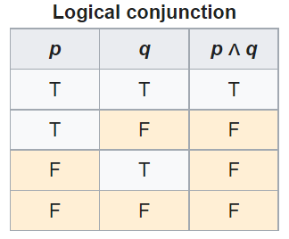
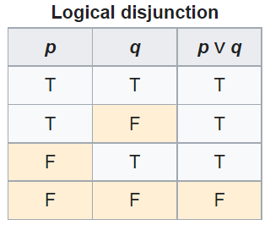
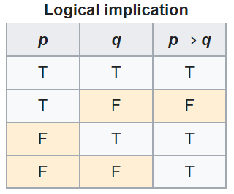
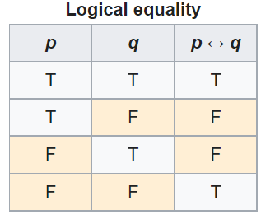
PL’s Deductive system: truth tables

Slide 17
Some PL laws
Truth tables can be used to prove laws, e.g.:
  a Λ (b V c) = (a Λ b) V (a Λ c)
  ¬ (a Λ b) = ¬ a V ¬b
  (a Λ (a → b)) → b
  (a→ b) Λ ¬b) → ¬a
  ((a V b) Λ ¬a) → b
  ((a → b) Λ (b → c)) → (a → c)
  …
  More examples:
    https://math.stackexchange.com/questions/1449866/catalogue-of-propositional-logic-laws
    http://mathonline.wikidot.com/the-laws-of-propositional-logic#toc0
Both truth tables and laws can be used to solve puzzles.

Slide 18
Exercise
Given:
  If John eats too much, then he does not have a normal BMI.
  If John is not careful, then he eats too much.
  John has a normal BMI.
Question
  Is John careful?

Slide 19
Translate sentences into PL
Propositions
John eats too much |  |  | a
John has a normal BMI |  |  | b
John is careful |  |  | c
Given
If John eats too much, then he does not have a normal BMI |  |  | a → ¬b
If John is not careful, then he eats too much. |  |  | ¬c → a
John has a normal BMI |  |  | b
Determine the truth value of: |  | (a → ¬b) ∧ (¬c → a) ∧ b

Slide 20
Method 1: Determine with tables

Slide 21
Method 2: Determine using laws
Propositions
John eats too much |  | a
John has a normal BMI |  | b
John is careful |  | c
Given
If John eats too much, then he does not have a normal BMI |  | a → ¬b | g1
If John is not careful, then he eats too much. |  | ¬c → a | g2
John has a normal BMI |  | b | g3
Rule application: | (x→ y) Λ ¬y) → ¬x | ¬a | g3/g1 | g4
 | (x→ y) Λ ¬y) → ¬x | c | g2/g4

Slide 22
Another exercise
Solve this puzzle:
  Given:
    Everybody who eats too much, does not have a normal BMI.
    Everybody who is not careful, eats too much.
    Everybody has a normal BMI.
  Question
    Is everybody careful?
Same as before: yes.

Slide 23
What about this ome?
Solve this puzzle:
  Given:
    Everybody who eats too much, does not have a normal BMI.
    Everybody who is not careful, eats too much.
    John has a normal BMI.
  Question
    Is John careful?
Can not be done with propositional logic!
  There is no way to create propositions (within the syntax and semantics of propositional logic) so that ‘everybody’ nor ‘John’ can be represented or related.

Slide 24
First Order Logics (FOL)
(Predicate Logic)

Slide 25
First-order logic
Propositional logic with predicates, variables and quantifiers.
Predicate: a proposition that some property holds for some entity, or a relation between entities.
  Prop.L. : A = ‘everybody eats too much’
  FOL: A = ‘eats too much’ A(x)
Quantifiers:
  ‘all’ ∀ ∀x.A(x) everything eats too much
  ‘some’ ∃ ∃x.A(x) something eats too much
‘everybody eats too much’
  ∀x.person(x) → A(x)

Slide 26
First-Order Logic (FOL) - Syntax
User defines these primitives:
  Constant symbols (i.e., the "individuals" in the world) E.g., bfo, 3
  Function symbols (mapping individuals to individuals) E.g., author-of(bfo) = barry_smith
  Predicate symbols (mapping from individuals to truth values)
E.g., greater(5,3) = true, smart(barry_smith) = true

Slide 27
First-Order Logic (FOL) - Syntax…
FOL supplies these primitives:
  Variable symbols. E.g., x,y
  Connectives.
    Same as in PL:
      not (~),
      and (^),
      or (v),
      implies (→),
      if and only if (<=>)
  Quantifiers: Universal (∀) and Existential (∃)

Slide 28
Truth values of quantifiers
Statement | True when | False when
∀x.A(x) | A(x) is true for every x. | There is an x for which A(x) is false
∃x.A(x) | There is an x for which A(x) is true. | A(x) is false for every x.
Open or Closed World
Reality
Represented Reality

Slide 29
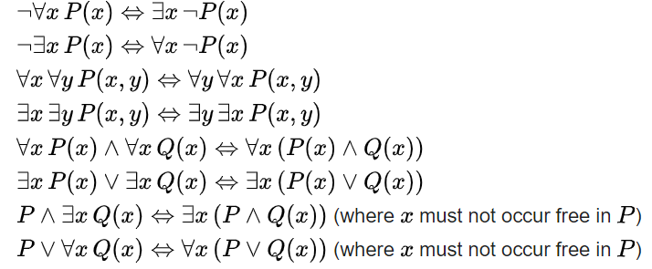
Some equivalences
A free variable is a variable not bound by a quantifier:
∀x.P(x) → Q(x) in contradistinction to ∀x.(P(x) → Q(x))

Slide 30
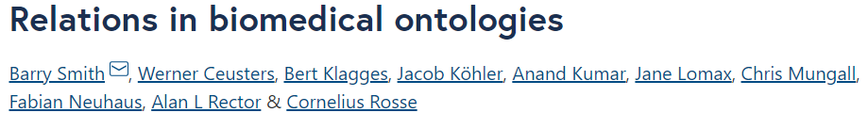
Flexibility in predicate formation
Some people eat too much:
  ∃x (person(x) Λ eats_too_much(x))
  ∃x (person(x) Λ eats(x, ‘too much’))
  ∃x ∃y (person(x) Λ eats(x, y) Λ quantity(y, ‘too much’))
However:
  Are not equivalent,
  Are based on a different ontology.
As a realist ontologist, make your choice on the basis of the method described in
https://genomebiology.biomedcentral.com/articles/10.1186/gb-2005-6-5-r46

Slide 31
Be careful with quantifiers
Order is important!
  ∀x ∃y symptomOf(x, y)
    For all x, there exist some y such that x is a symptom of y
      Every symptom originates from some disease;
      Does not exclude that there is only one disease, and that all symptoms come from that one disease.
  ∃y ∀x symptomOf(x, y)
    There exist some y, such that for all x, x is a symptom of y
      There is a disease which is the cause of all symptoms that exist.

Slide 32
Be aware of ambiguities in language
‘Every patient has some provider’
  Can mean:
    ∀x ∃y patientOf(x, y)
      For all x, there exist some y such that x is a patient of y
        Every patient has some provider.
    ∃y ∀x patientOf(x, y)
      There exist some y, such that for all x, x is a patient of y
        There is some provider that provides for all patients.

Slide 33
Common Logic (CL)
CL is a family of first-order logics which share a common abstract syntax and model theory, and an XML framework for encoding and transmitting them, or their content, on an open network.
CL syntax is very relaxed in the expressions it allows, in some ways going beyond classical FO logic.
ISO standard: https://standards.iso.org/ittf/PubliclyAvailableStandards/c066249_ISO_IEC_24707_2018.zip
https://www.w3.org/2004/12/rules-ws/slides/pathayes.pdf

Slide 34
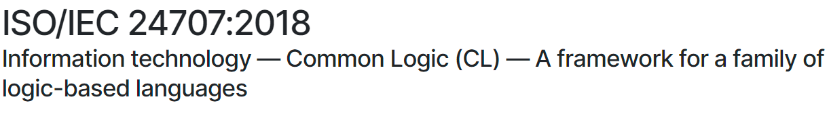
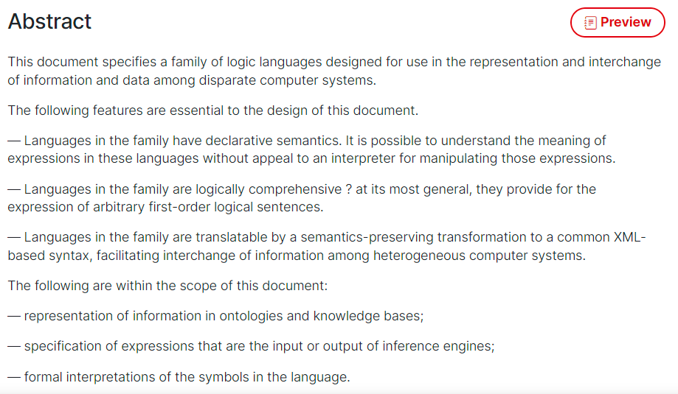
CLIF ISO Standard
https://www.iso.org/standard/66249.html

Slide 35
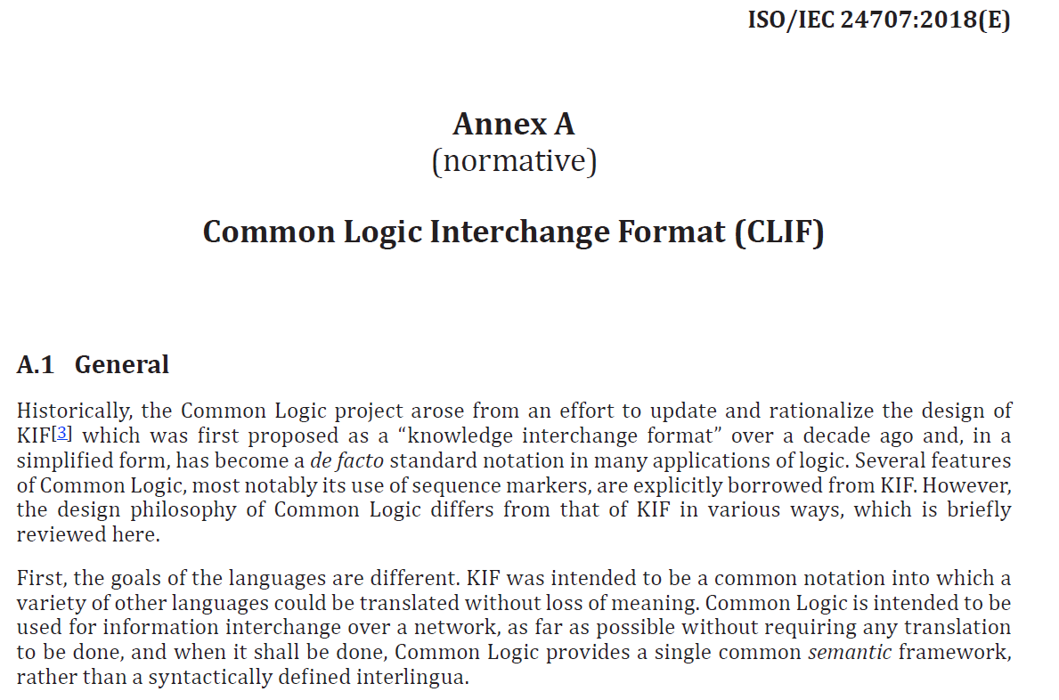
CLIF

Slide 36
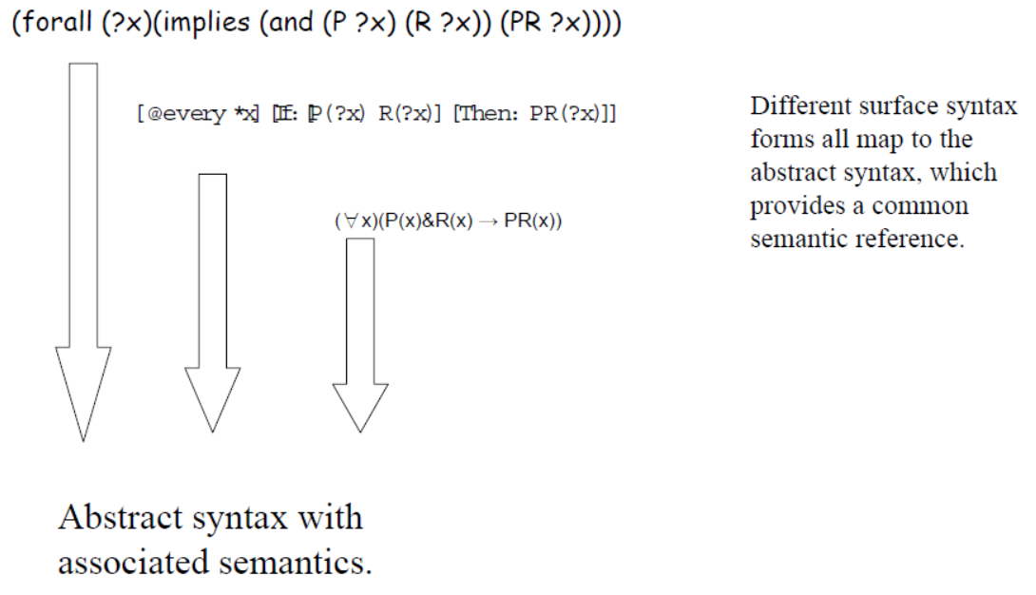
CL dialects
https://www.w3.org/2004/12/rules-ws/slides/pathayes.pdf

Slide 37
Gentle introduction to
BFO’s axiomatization
BFO’s basic assumptions

Slide 38
‘Particulars exist at some time’
(forall (p) (if (particular p) (exists (t) (exists-at p t))))
⇓ Standard FOL notation
∀p ( particular(p) → (∃t existsAt(p, t)))
The CL axiomatization contains also:
(cl:outdiscourse continuant-part-of temporal-part-of
exists-at particular universal instance-of)

Slide 39
‘Particulars exist at some time’
(forall (p) (if (particular p) (exists (t) (exists-at p t))))
⇓ Standard FOL notation
∀p ( particular(p) → (∃t existsAt(p, t)))
The CL axiomatization contains also:
(cl:outdiscourse continuant-part-of temporal-part-of
exists-at particular universal instance-of)
  = ‘we don’t talk of these’, ‘they are not ‘individuals’ in our domain (of discourse)’
  Do not confuse this with ‘individuals’ as synonym for ‘particular’ in ontological realism.
  Only the p’s and t’s in the above are in the domain.

Slide 40
Individual universals are in the domain of discourse, but not ‘universal’ !!!
(cl:outdiscourse continuant-part-of temporal-part-of exists-at particular universal instance-of)
(cl:comment "1. There is always something that exists" (forall (t)
(if (instance-of t temporal-region t)
(exists (u i)
(and (not (= i t)) (universal u) (particular i) (instance-of i u t))))))

Slide 41
‘Particulars exist at some time’
(forall (p) (if (particular p) (exists (t) (exists-at p t))))
⇓ Standard FOL notation
∀p ( particular(p) → (∃t existsAt(p, t)))
Is there anything here that says that ‘t’ or ‘time(t)’ is a time?
No!

Slide 42
However!
(cl:comment "6. Particulars exist at some time"
(forall (p)
(if (particular p) (exists (t) (exists-at p t)))))
(cl:comment "9. Relata of exists-at are particulars."
(forall (i t)
(if (exists-at i t)
(and (particular i) (particular t)
(instance-of t temporal-region t)))))
→ The CLIF sentences do not reflect the comments faithfully, and vv. This doesn’t mean they are wrong.

Slide 43
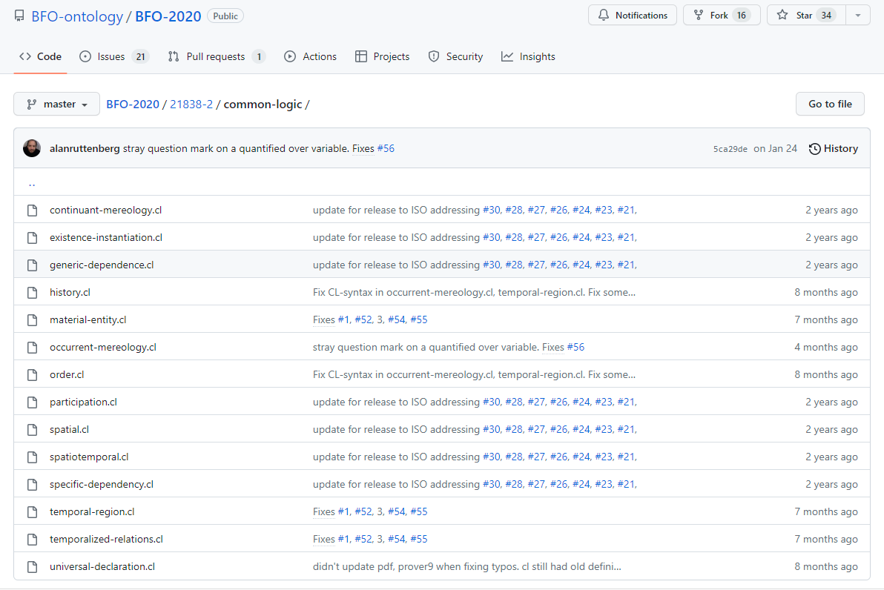
BFO2020-CLIF
https://github.com/BFO-ontology/BFO-2020/tree/master/21838-2/common-logic

Slide 44
BFO2020 axiomatization in CLIF
Uses only parts of the CLIF specifications.
Expressed in FOL with as important features:
  use of equality,
  (1-,) 2-, and 3-ary predicates,
  no functions,
  standard connectives
    OR, AND, IF, IFF, NOT
  universal and existential quantification
    FORALL, EXISTS
  ‘Realism-based’ choice of predicates.

Slide 45
‘Realism-based’ predicates
Criteria:
  Restricted to formal relations.
  Grounded in the distinction between types (universals and defined classes) and particulars.
  Use of temporal indexing.
Example: ‘all soccer balls are round’
  FOL with properties ‘fantologically conceived’:
    (forall (x) (if (soccer-ball x) (round x)))
  Realism-based:
    (forall (x t)
      (if (instance-of x soccer-ball t)
      (exists (y)
      (and (instance-of y round t)
      (inheres-in y x)))))
http://ontology.buffalo.edu/bfo/Against_Fantology.pdf

Slide 46

Deflated soccer balls are not round
No problem for fantologists:
  (forall (x) (if (deflated-soccer-ball x)
  (not-round x)))
For realism-based ontologists:
  One should not cram everything
  together in a predicate
  Explicit time-indexing draws attention to issues of generalization
  …
Trying to adhere to realism-based principles requires thinking beyond merely applying logic.
https://soccerlifestyle.com/how-to-deflate-a-soccer-ball/

Slide 47
Educational tools to train logical AND ontological thinking
For working with BFO2020-style CLIF:
  BFO2020-style CLIF template,
  BFO2020-style CLIF parser with:
    Various error-checking functions,
    Warnings,
    Tracking ontology-dependencies,
    Conversion to various formats.
      CLIF → CNF → CF → Kowalski rules
Kowalski-rule-based reasoner:
  Consistency checking for fact-based scenarios,
  Predicate derivation.

Slide 48
Why a possible improvement?
Making it easier to grasp what BFO really says about reality
  Way less, and more, than I thought!
Improving quality of ontology design by using FOL as a basis:
  Detecting inconsistencies
  Identifying unintended consequences
Improving quality of information systems, especially electronic healthcare records and repositories.
  Leveraging Referent Tracking.

Slide 49
BFO2020 axiomatization
Example (in CLIF):
(cl:comment "Definition of specifically dependent continuant. [akq-1]"
(forall (s)
(iff (exists (t)
(instance-of s specifically-dependent-continuant t))
(exists (c t)
(and (instance-of s continuant t)
(instance-of c independent-continuant t)
(not (instance-of c spatial-region t))
(specifically-depends-on s c))))))

Slide 50
‘BFO2020-style’ CLIF template
(cl:comment
" SOMETEXT
"
(cl:text
(cl:ttl "SOMETEXT"
(cl:outdiscourse PREDICATE-NAMES
)
(cl:comment "SOMETEXT"
( ...CLAUSE...)
)
)))

Slide 51
Parser: converts FOL → CNF → Kowalski-rules
% Definition of specifically dependent continuant. [akq-1]
r(469,1,[138],[],"akq-1",kow(if([[instance-of,B,specifically-dependent-continuant,A]]),then([instance-of,B,continuant,[e,138,[B]]]))).
r(470,1,[137,138],[],"akq-1",kow(if([[instance-of,B,specifically-dependent-continuant,A]]),then([instance-of,[e,137,[B]],independent-continuant,[e,138,[B]]]))).
r(471,2,[],[137,138],"akq-1",kow(if([[instance-of,B,specifically-dependent-continuant,A],[instance-of,[e,137,[B]],spatial-region,[e,138,[B]]]]),false)).
r(472,1,[137],[],"akq-1",kow(if([[instance-of,B,specifically-dependent-continuant,A]]),then([specifically-depends-on,B,[e,137,[B]]]))).
r(473,3,[139],[],"akq-1",kow(if([[instance-of,A,independent-continuant,B],[instance-of,C,continuant,B],[specifically-depends-on,C,A]]),then_or([[instance-of,A,spatial-region,B],[instance-of,C,specifically-dependent-continuant,[e,139,[C]]]]))).

Slide 52
5 forms of Kowalski rules
‘if-then’-rules:
  ( A & B & … ) → P
  true → P
‘if-then-or’-rules:
  ( A & B & …) → ( P v Q v … )
  true → ( P v Q v … )
‘false-hood’-rules:
  ( A & B & … ) → false

Slide 53
Current reasoning modes
Classic Propositional
  Modus ponendo ponens
  Modus ponendo tollens
  Modus tollendo tollens
  Modus tollendo ponens
Possible world approach to assumptions
Heuristics
  Limits on function embedding
  Tame incompleteness

Slide 54
‘BFO2020-style’ CLIF reasoner current reasoning modes (1)
ont = defined in ontology
mpp = modus ponendo ponens:
A ( ...& ... ) → B
A ( ...& ... )
---------------------
B
mpt = modus ponendo tollens:
(A & ...) & B → false
(A & ...)
--------------------------
not B

Slide 55
‘BFO2020-style’ CLIF reasoner current reasoning modes (2)
mtt = modus tollendo tollens:
A → B
not B
------
not A
A & B & C → D
not D
A
B
------
not C
mtp = modus tollendo ponens:
A → B v C
A
not B
------
C
alternative generation
A → B v C
A
------
B v C

Slide 56
‘BFO2020-style’ CLIF reasoner current reasoning modes (4)
Reductio ad absurdum:
rana = ra with negative assumption
B v C
assume not B
------
inconsistent → B
rapa = ra with positive assumption
B v C
assume B
------
inconsistent → not B
repl: replicate
fact with A
A = B
--------
fact with B

Slide 57
‘BFO2020-style’ CLIF reasoner current reasoning modes (3)
Computing undeniables from remaining alternatives ...
  mtpa: mtp on alternatives
(B v C v D) & not B & not D → C
  tapw: true in all possible worlds
    Process one by one all instantiated rule R of form: ‘true → A v B v …’
    Assume each consequent of R to be true in its own possible world and further inference using proven facts from the base world and the specific possible world
    Processing in a possible world stops when either
      inconsistency derived, → assumed alternative false in the base world
      If no further facts can be derived, evaluate all possible worlds (PW) for R
        if all PW inconsistent: then either the set of axioms is inconsistent or the input facts
        if all but one possible worlds leads to an inconsistency: then the orginal assumption for that one world is true in the base world as well as all derivations made
        if at least two PW not inconsistent: the derivations which are exactly similar in all PW are true in the base world. The original assumptions for these PW are then NOT proven.

Slide 58
Why possible worlds?
Some very odd conversions, eg [ild-1]
(cl:comment "participates-in is time indexed and has domain: independent-continuant but not spatial-region or specifically-dependent-continuant or generically-dependent-continuant and range: process [ild-1]"
(forall (a b t)
(if (participates-in a b t)
(and (or (and (instance-of a independent-continuant t)
(not (instance-of a spatial-region t)))
(instance-of a specifically-dependent-continuant t)
(instance-of a generically-dependent-continuant t))
(instance-of b process t)
(instance-of t temporal-region t)))))
‘or’ here reads as XOR but is not XOR!

Slide 59
ILD-1 generates 4 rules
If([participates-in,A,B,C]) →
then_or([ [instance-of,A,generically-dependent-continuant,C],
[instance-of,A,independent-continuant,C],
[instance-of,A,specifically-dependent-continuant,C] ]).
if([participates-in,A,B,C]),then([instance-of,B,process,C]).
if([participates-in,A,B,C]),then([instance-of,C,temporal-region,C]).
if([ [instance-of,A,spatial-region,C],
[participates-in,A,B,C]]) →
then_or( [ [instance-of,A,generically-dependent-continuant,C],
[instance-of,A,specifically-dependent-continuant,C] ]).

Slide 60
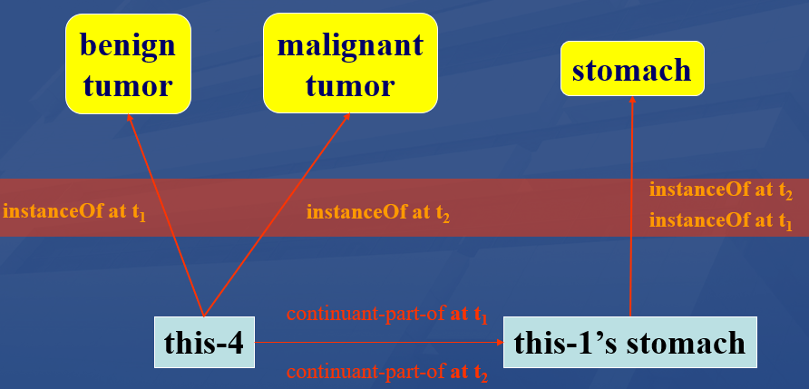
Reasoner input
Kowalski-rule base from axiomatized ontologies,
Assertions in referent tracking style:
  Example:
    t([true,instance-of, john, object, t]).
    t([true,proper-continuant-part-of, tumor-of-john, john, t1]).
    t([true,instance-of, tumor-of-john, benign-tumor, t1]).
    t([true,instance-of, tumor-of-john, cancer, t2]).

Slide 61
Reasoner at work …
BFO2020 Style CLIF reasoner, Version Oct22, 2022
Copyright: Werner Ceusters. All rights reserved.
PRE-PROCESSING
Checking start conditions ...OK!
Optimizing Kowalski input ...
Reading data input ...
Total facts: 4
REASONING
modus ponendo ponens ...
Total facts: 316
modus ponendo tollens ...
% 1,240,643 inferences, 0.188 CPU in 0.183 seconds (102% CPU, 6616763 Lips)
Listing remaining alternatives ...
modus tollendo ponens ...

Slide 62
… oh bugger
BFO2020 Style CLIF reasoner, Version Oct22, 2022
Copyright: Werner Ceusters. All rights reserved.
PRE-PROCESSING
Checking start conditions ...OK!
Optimizing Kowalski input ...
Reading data input ...
Total facts: 4
REASONING
modus ponendo ponens ...
Total facts: 316
modus ponendo tollens ...
% 1,240,643 inferences, 0.188 CPU in 0.183 seconds (102% CPU, 6616763 Lips)
Listing remaining alternatives ...
modus tollendo ponens ...
INCONSISTENCY FOUND: []
Rule: 128
Axiom: ilw-1
[]
Inconsistent facts: [[specifically-depends-on,tumor-of-john,[e,137,[tumor-of-john]]],[instance-of,tumor-of-john,independent-continuant,t1]]
Saving inconsistency proof to CLIFreasoner-inconsistency-proof.csv
Writing skolem constants to CLIFreasoner-skolems.txt
Press any character key to finish.

Slide 63
Inconsistency proof
FactID | T/F | predicate | Arg1 | Arg2 | Arg3 |  | Rule | Axiom | Mode | Triggers
400 | ERROR | inconsistency |  |  |  | ← | 128 | ilw-1 | inc | 92 | 192
192 | TRUE | specifically-depends-on | tumor-of-john | sk25 |  | ← | 472 | akq-1 | mpp | 176
176 | TRUE | instance-of | tumor-of-john | specifically-dependent-continuant | t2 | ← | 828 | qix-1 | mpp | 79
92 | TRUE | instance-of | tumor-of-john | independent-continuant | t1 | ← | 811 | faf-1 | mpp | 48
79 | TRUE | instance-of | tumor-of-john | realizable-entity | t2 | ← | 800 | fxd-1 | mpp | 60
60 | TRUE | instance-of | tumor-of-john | disposition | t2 | ← | 216 | ogms-dis-2 | mpp | 8
48 | TRUE | instance-of | tumor-of-john | material-entity | t1 | ← | 219 | ogms-diso-2 | mpp | 12
12 | TRUE | instance-of | tumor-of-john | disorder | t1 | ← | 218 | ogms-btu-2 | mpp | 3
8 | TRUE | instance-of | tumor-of-john | disease | t2 | ← | 217 | ogms-can-2 | mpp | 4
4 | TRUE | instance-of | tumor-of-john | cancer | t2 | ← | 0 | unmarked | input
3 | TRUE | instance-of | tumor-of-john | benign-tumor | t1 | ← | 0 | unmarked | input
(cl:comment "Any continuant that doesn't s-depend or g-depend on something is an independent continuant [ilw-1]"
(forall (c1)
(iff (exists (t) (instance-of c1 independent-continuant t))
(and (exists (t) (instance-of c1 continuant t))
(not (exists (c2 t) (or (specifically-depends-on c1 c2)
(generically-depends-on c1 c2 t))))))))

Slide 64
Relevant OGMS fragment
(cl:comment "diseases are dispositions [ogms-dis-2]"
(forall (t x)
(if (instance-of x disease t)
(instance-of x disposition t))))
(cl:comment "cancer is a disease [ogms-can-2]"
(forall (t x)
(if (instance-of x cancer t)
(instance-of x disease t))))
(cl:comment "benign tumors are disorders [ogms-btu-2]"
(forall (t x)
(if (instance-of x benign-tumor t)
(instance-of x disorder t))))
(cl:comment "disorders are material entities [ogms-diso-2]"
(forall (t x)
(if (instance-of x disorder t)
(instance-of x material-entity t))))
From BFO:
Dispositions, being SDCs, s-depend on something and therefor cannot be independent continuants, i.e. what material-entities are.

Slide 65
Assignment A10
Prepare a PowerPoint presentation of your ontology for presentation (A11) next week. It must contain:
  Purpose statement
  Explanation of major distinctions in types (below BFO and OGMS levels)
  One axiom pertaining to one most specific non-BFO, non-OGMS type in your ontology.
  History of all changes of that type made over versions and motivations therefor
  Where your ontology fits in the overall merged ontology developed in C12 (A9) for practical purposes.
  Unresolved issues
Due date: Dec 2 – noon. Uploaded as usual.

Slide 66
Note !!!
Paper for final exam is uploaded to UB Box
BMI508-2024-finalexampaper.pdf
Text in red font is not very relevant for the exam.
Task: read it. Questions can be asked and will be answered after your presentations during C14.

