Slide 1
BMI508 – Fall 2024
Introduction to Biomedical Ontology
Class 10 – Oct 30, 2024
Evaluation of Ontologies
Werner CEUSTERS^{1,2}
¹ Department of Biomedical Informatics, University at Buffalo, USA
² Department of Psychiatry, University at Buffalo, USA

Slide 2
1. Essentials of Ontology Evaluation

Slide 3
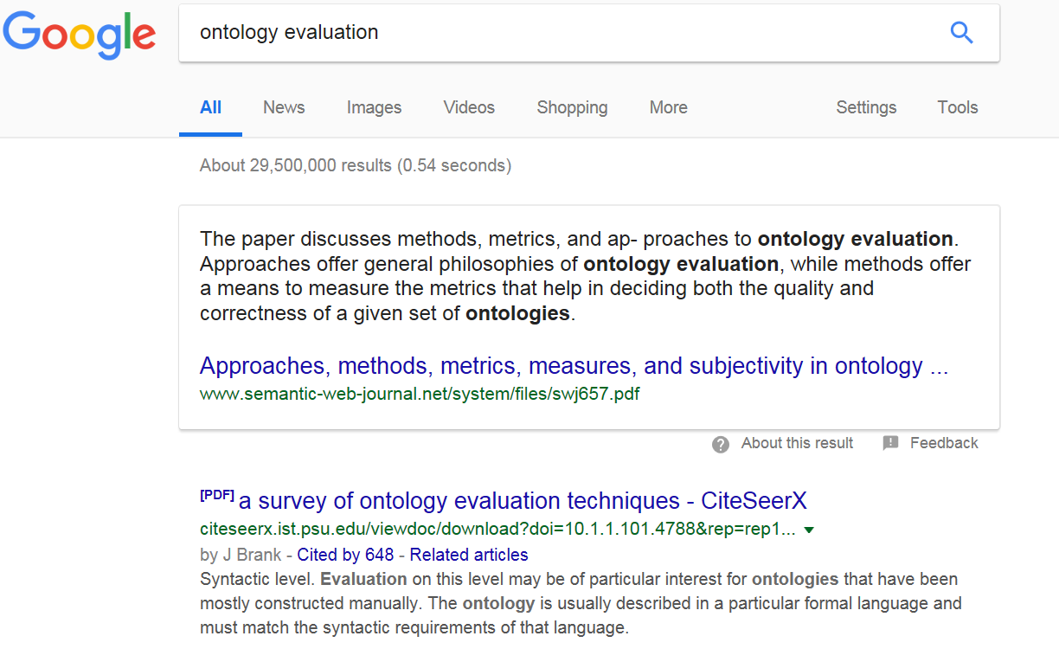
Accessed Nov 26, 2018

Slide 4
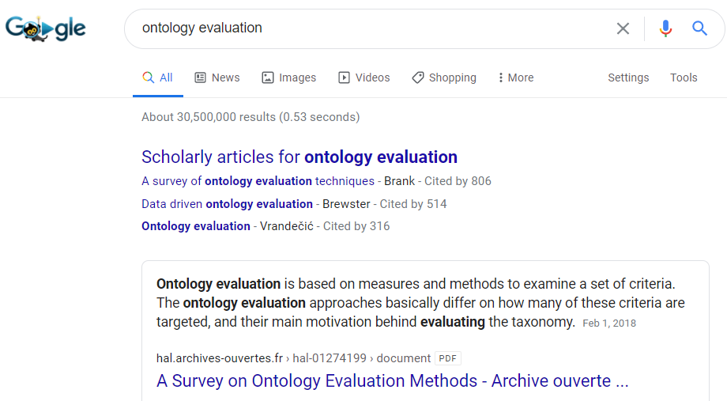
Accessed Oct 31, 2020

Slide 5
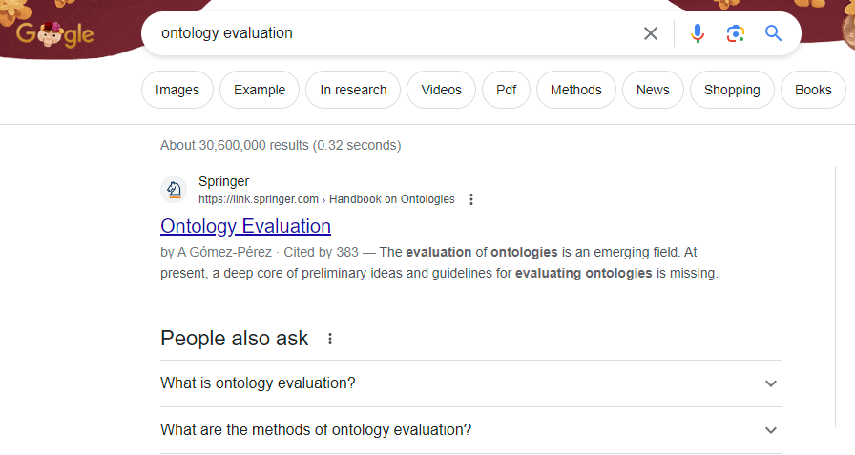
Accessed Oct 31, 2023

Slide 6
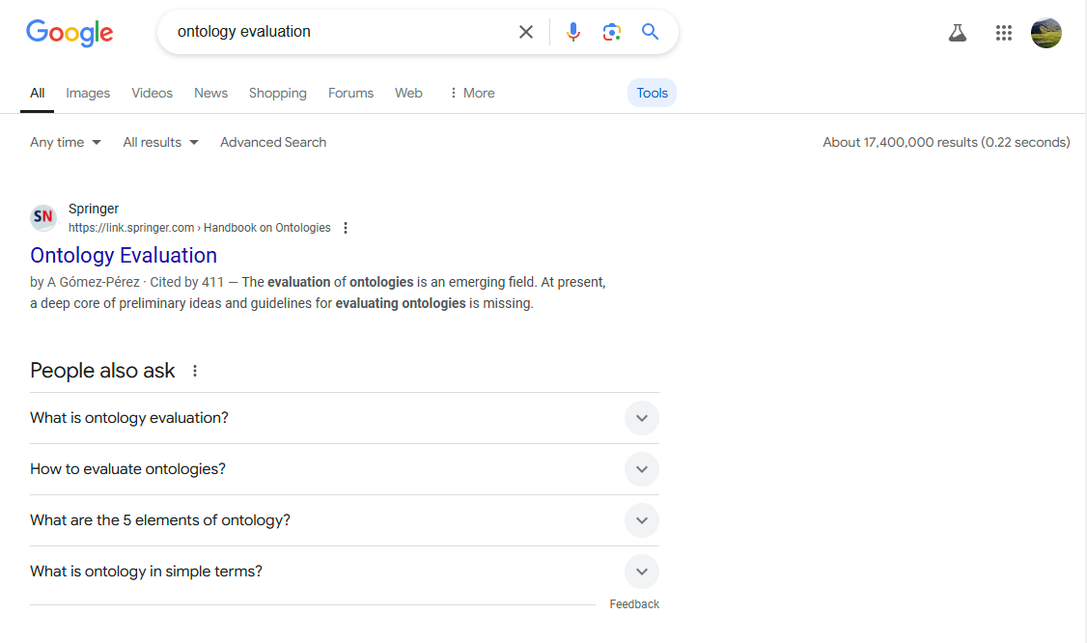
Accessed Oct 30, 2024

Slide 7
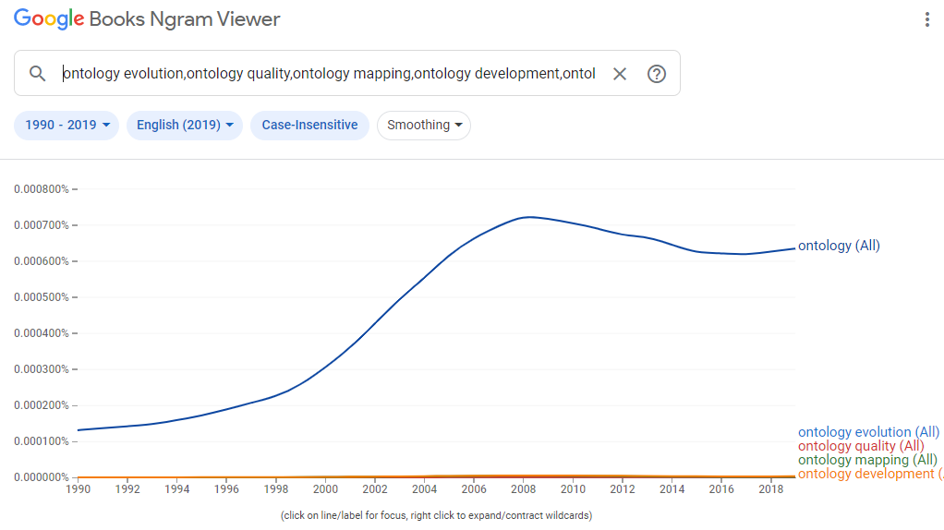

Slide 8
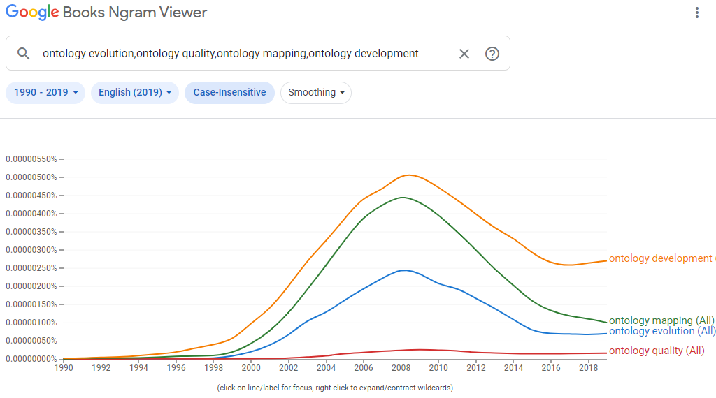

Slide 9
Some Ontology Quality Dimensions
Accuracy/validity | Redundancy
Cohesiveness | Naturalness
Complexity | Precision/completeness
Semantic consistency | Verifiability
Structural consistency | Volatility
Currency | Authority
Besiki Stvilia.
A model for ontology quality evaluation.
First Monday, Volume 12 Number 12 - 3 December 2007
http://firstmonday.org/ojs/index.php/fm/article/view/2043/1905

Slide 10
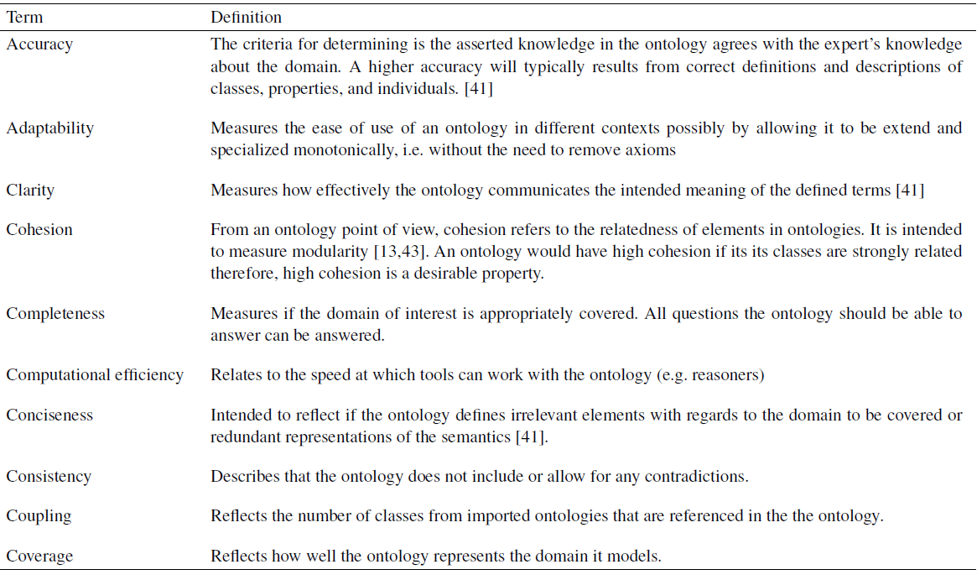
H. Hlomani, and Deborah Stacey / Approaches, methods, metrics, measures, and subjectivity in ontology evaluation: A survey. IOS Press 2014

Slide 11
What criteria to use ?
Adequacy of content:
  richness, complexity and granularity of the coverage of a particular domain;
Relevance to purpose:
  use cases, scenarios, requirements, applications, and data sources it was developed to address;
Formal properties
  consistency and completeness of the ontology and the representation language in which it is modeled;
  adherence to some specific upper ontology;
  kinds of reasoning methods that can be invoked on the ontology;
Underlying philosophical theory about reality.
Obrst L, Ceusters W, Mani I, Ray S, Smith B. The Evaluation of Ontologies: toward Improved Semantic Interoperability. In: Baker, Christopher J.O.; Cheung, Kei-Hoi (Eds.) Semantic Web: Revolutionizing Knowledge Discovery in the Life Sciences. Springer, Heidelberg, 2007;:139-58.

Slide 12
Three levels
Obrst L, Ceusters W, Mani I, Ray S, Smith B. The Evaluation of Ontologies: toward Improved Semantic Interoperability. In: Baker, Christopher J.O.; Cheung, Kei-Hoi (Eds.) Semantic Web: Revolutionizing Knowledge Discovery in the Life Sciences. Springer, Heidelberg, 2007;:139-58.

Slide 13
Some formal properties
Soundness:
  any expression that can be derived from the knowledge base (KB) of the ontology and its instances is logically implied by that KB,
Completeness:
  any expression that is logically implied by the KB can be derived,
Decidability:
  being both sound and complete;
Formal complexity:
  time of execution, space of memory needed to compute an answer;
  tractability: problems can be solved by computer algorithms that run in polynomial time;
Consistency:
  if contradictions can be proven from a given proposition, then the theory is inconsistent.

Slide 14
Measures in graph-based representations
Semantic distance (SD):
  measures how closely two nodes are topologically related in a graph;
semantic similarity (SS):
  captures to what extent two nodes might represent the same entity in reality.
How should SD and SS of the following two nodes relate to each other?
  ‘fractured arm’
  ‘arm fracture’

Slide 15
Relatedness of SS and SD
A node representing a “fractured arm” should have a very short semantic distance from one referring to an “arm fracture”;
Yet the semantic similarity would still be low: a fracture cannot be an arm.
It is now a measure of a high-quality ontology that it should be possible to compute the semantic distance of post-coordinated terms such as “patient-WITH-arm fracture” and “patient-WITH-fractured arm” as being minimal, and the semantic similarity as being maximal.
Obrst L, Ceusters W, Mani I, Ray S, Smith B. The Evaluation of Ontologies: toward Improved Semantic Interoperability. In: Baker, Christopher J.O.; Cheung, Kei-Hoi (Eds.) Semantic Web: Revolutionizing Knowledge Discovery in the Life Sciences. Springer, Heidelberg, 2007;:139-58.

Slide 16
Acceptable techniques for evaluation
evaluation with respect to the use of an ontology in an application,
evaluation with respect to domain data sources,
assessment by humans against a set of criteria,
natural language evaluation techniques,
use of a gold standard,
the use of reality itself as a benchmark.
Obrst L, Ceusters W, Mani I, Ray S, Smith B. The Evaluation of Ontologies: toward Improved Semantic Interoperability. In: Baker, Christopher J.O.; Cheung, Kei-Hoi (Eds.) Semantic Web: Revolutionizing Knowledge Discovery in the Life Sciences. Springer, Heidelberg, 2007;:139-58.

Slide 17
A Fragment of (is-a) Relation in WordNet
Joe Raad, Christophe Cruz. A Survey on Ontology Evaluation Methods. HAL Id: hal-01274199. https://hal.archives-ouvertes.fr/hal-01274199. Submitted on 1 Feb 2018

Slide 18
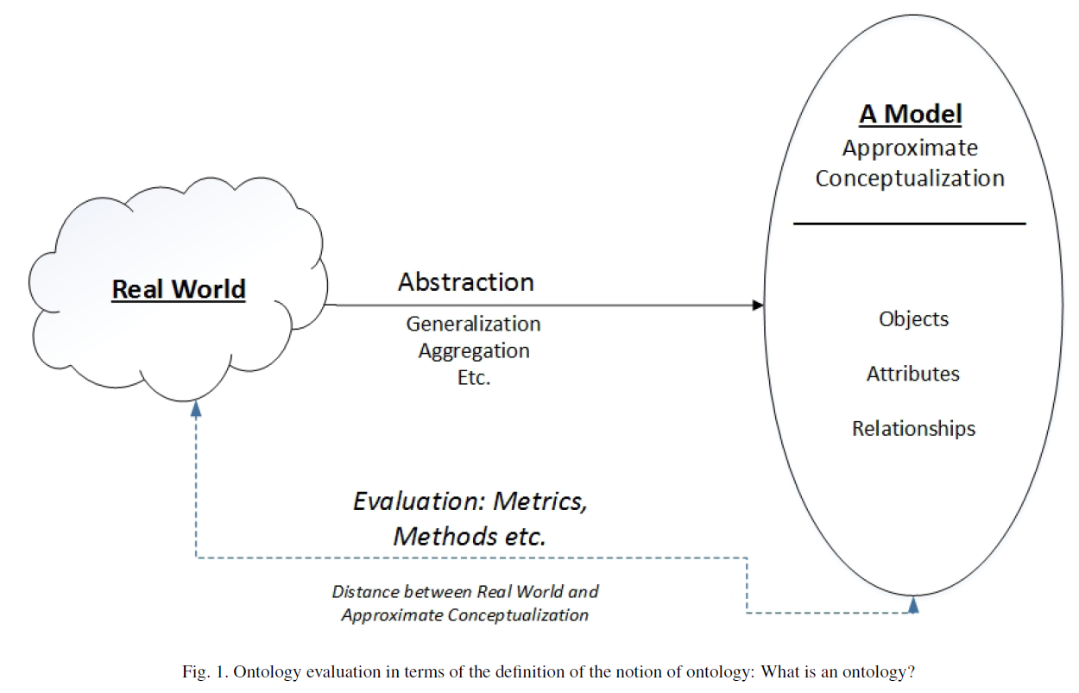
The ass-backward mainstream idea
H. Hlomani, and Deborah Stacey / Approaches, methods, metrics, measures, and subjectivity in ontology evaluation: A survey. IOS Press 2014

Slide 19
2. A close relation with Realism-based ontology change management

Slide 20
An “optimal” ontology (1)
Because ontologies, as conceived on realist terms,
  are artifacts created for some purpose (e.g. to serve as controlled vocabulary, or to provide domain knowledge to a software application),
  are at the same time intended to mirror reality,
  should allow reasoning which is efficient from a computational point of view,
we argue that an optimal ontology should constitute a representation of all and only those portions of reality that are relevant for its purpose.

Slide 21
An “optimal” ontology (2)
Each term in such an ontology would designate:
  (1) a single portion of reality (POR), which is
  (2) relevant to the purposes of the ontology and such that
  (3) the authors of the ontology intended to use this term to designate this POR,
  (4) there would be no PORs objectively relevant to these purposes that are not referred to in the ontology,
  (5) there would be no relevant PORs designated more than once.

Slide 22
But things may go wrong …
Root cause errors:
  assertion errors: ontology developers may be in error as to what is the case in their target domain;
  relevance errors: they may be in error as to what is objectively relevant to a given purpose;
  encoding errors: they may not successfully encode their underlying cognitive representations, so that particular representational units fail to point to the intended PORs.
Mismatches:
  Unjustified presence or absence of RUs,
  Redundancies: >1 RU → 1 POR,
  Ambiguities: 1 RU → >1 POR.

Slide 23
configuration | reality |  | representation |  |  |  | ME
 |  |  | authors' belief |  | encoding
 | OE | OR | BE | BR | IE | TR
(1) | (2) | (3) | (4) | (5) | (6) | (7) | (8)
P+1 | Y | Y | Y | Y | Y | R+ | 0
A+1 | N | na | N | na | na | na | 0
A+2 | Y | N | Y | N | na | na | 0
A+3 | Y | N | NC | na | na | na | 0
A+4 | N | na | NC | na | na | na | 0
P-1 | N | na | Y | Y | Y | ¬R | 3
P-2 | N | na | Y | Y | N | ¬R | 4
P-3 | N | na | Y | Y | N | R– | 5
P-4 | Y | Y | Y | Y | N | ¬R | 1
P-5 | Y | Y | Y | Y | N | R- | 2
P-6 | Y | N | Y | Y | Y | R+ | 1
P-7 | Y | N | Y | Y | N | ¬R | 2
P-8 | Y | N | Y | Y | N | R– | 3
P-9 | Y | Y | Y | Y | Y | R++ | 1
P-10 | Y | N | Y | Y | Y | R++ | 2
P-11 | Y | Y | Y | Y | Y | Ra | 1
P-12 | N | na | Y | Y | Y | Ra | 4
A-1 | Y | Y | Y | N | na | na | 1
A-2 | Y | Y | N | na | na | na | 1
A-3 | N | na | Y | N | na | na | 1
A-4 | Y | N | N | na | na | na | 1
A-5 | Y | Y | NC | na | na | na | 1

Slide 24
RU – reality correspondence types
configuration | reality |  | representation |  |  |  | ME
 |  |  | authors' belief |  | encoding
 | OE | OR | BE | BR | IE | TR
(1) | (2) | (3) | (4) | (5) | (6) | (7) | (8)
Reality:
  OE: Objective existence
  OE: Objective relevance
          Representation:
            BE: Author’s belief in existence
            BR: Author’s belief in relevance
              IE: Author’s intended encoding
              TR: Type of reference
Ceusters W, Smith B. A Realism-Based Approach to the Evolution of Biomedical Ontologies. Proceedings of AMIA 2006, Washington DC, 2006;:121-125.
Ceusters W. Applying Evolutionary Terminology Auditing to the Gene Ontology. Journal of Biomedical Informatics 2009;42:518–529.
Seppãlã S, Smith B, Ceusters W. Applying the realism-based ontology versioning method for tracking changes in the Basic Formal Ontology. Formal Ontology in Information Systems. Proceedings of the Eight International Conference (FOIS 2014), Amsterdam: IOS Press, 2014;:227-240.

Slide 25
configuration | reality |  | representation |  |  |  | ME
 |  |  | authors' belief |  | encoding
 | OE | OR | BE | BR | IE | TR
(1) | (2) | (3) | (4) | (5) | (6) | (7) | (8)
P+1
A+1
A+2
A+3
A+4
P-1
P-2
P-3
P-4
P-5
P-6
P-7
P-8
P-9
P-10
P-11
P-12
A-1
A-2
A-3
A-4
A-5
Configuration types
    P: present in the ontology
      P+: justifiably present
      P–: unjustifiably present
    A: absent from the ontology
      A+: justifiably absent
      A–: unjustifiably absent

Slide 26
configuration | reality |  | representation |  |  |  | ME
 |  |  | authors' belief |  | encoding
 | OE | OR | BE | BR | IE | TR
(1) | (2) | (3) | (4) | (5) | (6) | (7) | (8)
P+1
A+1
A+2
A+3
A+4
P-1
P-2
P-3
P-4
P-5
P-6
P-7
P-8
P-9
P-10
P-11
P-12
A-1
A-2
A-3
A-4
A-5
Configuration types
    1+4+12+5=22 possible configurations based on (mis)matches between reality, beliefs, and encodings

Slide 27
configuration | reality |  | representation |  |  |  | ME
 |  |  | authors' belief |  | encoding
 | OE | OR | BE | BR | IE | TR
(1) | (2) | (3) | (4) | (5) | (6) | (7) | (8)
P+1 | Y | Y | Y | Y | Y | R+ | 0
A+1 | N | na | N | na | na | na | 0
A+2 | Y | N | Y | N | na | na | 0
A+3 | Y | N | NC | na | na | na | 0
A+4 | N | na | NC | na | na | na | 0
P-1 | N | na | Y | Y | Y | ¬R | 3
P-2 | N | na | Y | Y | N | ¬R | 4
P-3 | N | na | Y | Y | N | R– | 5
P-4 | Y | Y | Y | Y | N | ¬R | 1
P-5 | Y | Y | Y | Y | N | R- | 2
P-6 | Y | N | Y | Y | Y | R+ | 1
P-7 | Y | N | Y | Y | N | ¬R | 2
P-8 | Y | N | Y | Y | N | R– | 3
P-9 | Y | Y | Y | Y | Y | R++ | 1
P-10 | Y | N | Y | Y | Y | R++ | 2
P-11 | Y | Y | Y | Y | Y | Ra | 1
P-12 | N | na | Y | Y | Y | Ra | 4
A-1 | Y | Y | Y | N | na | na | 1
A-2 | Y | Y | N | na | na | na | 1
A-3 | N | na | Y | N | na | na | 1
A-4 | Y | N | N | na | na | na | 1
A-5 | Y | Y | NC | na | na | na | 1
OE/BE value pairs
Y/Y: correct assertion of the existence of a POR;
Y/N: lack of awareness of a POR, reflecting an assertion error;
N/N: correct assertion that some putative POR does not exist;
N/Y: the false belief that some putative POR exists;
Y/NC: not considering that some POR exists;
N/NC: not considering that some putative POR does not exist.

Slide 28
configuration | reality |  | representation |  |  |  | ME
 |  |  | authors' belief |  | encoding
 | OE | OR | BE | BR | IE | TR
(1) | (2) | (3) | (4) | (5) | (6) | (7) | (8)
P+1 | Y | Y | Y | Y | Y | R+ | 0
A+1 | N | na | N | na | na | na | 0
A+2 | Y | N | Y | N | na | na | 0
A+3 | Y | N | NC | na | na | na | 0
A+4 | N | na | NC | na | na | na | 0
P-1 | N | na | Y | Y | Y | ¬R | 3
P-2 | N | na | Y | Y | N | ¬R | 4
P-3 | N | na | Y | Y | N | R– | 5
P-4 | Y | Y | Y | Y | N | ¬R | 1
P-5 | Y | Y | Y | Y | N | R- | 2
P-6 | Y | N | Y | Y | Y | R+ | 1
P-7 | Y | N | Y | Y | N | ¬R | 2
P-8 | Y | N | Y | Y | N | R– | 3
P-9 | Y | Y | Y | Y | Y | R++ | 1
P-10 | Y | N | Y | Y | Y | R++ | 2
P-11 | Y | Y | Y | Y | Y | Ra | 1
P-12 | N | na | Y | Y | Y | Ra | 4
A-1 | Y | Y | Y | N | na | na | 1
A-2 | Y | Y | N | na | na | na | 1
A-3 | N | na | Y | N | na | na | 1
A-4 | Y | N | N | na | na | na | 1
A-5 | Y | Y | NC | na | na | na | 1
2
4
1
3
‘na’ = not applicable
If there is no POR of a specific sort, relevance is not applicable.
If an author does not believe in some POR, believed relevance is not applicable.
If an author did not consider (‘nc’) existence of some POR, believed relevance is not applicable.
If believed relevance is either negative or not applicable, encoding is not applicable.

Slide 29
configuration | reality |  | representation |  |  |  | ME
 |  |  | authors' belief |  | encoding
 | OE | OR | BE | BR | IE | TR
(1) | (2) | (3) | (4) | (5) | (6) | (7) | (8)
P+1 | Y | Y | Y | Y | Y | R+ | 0
A+1 | N | na | N | na | na | na | 0
A+2 | Y | N | Y | N | na | na | 0
A+3 | Y | N | NC | na | na | na | 0
A+4 | N | na | NC | na | na | na | 0
P-1 | N | na | Y | Y | Y | ¬R | 3
P-2 | N | na | Y | Y | N | ¬R | 4
P-3 | N | na | Y | Y | N | R– | 5
P-4 | Y | Y | Y | Y | N | ¬R | 1
P-5 | Y | Y | Y | Y | N | R- | 2
P-6 | Y | N | Y | Y | Y | R+ | 1
P-7 | Y | N | Y | Y | N | ¬R | 2
P-8 | Y | N | Y | Y | N | R– | 3
P-9 | Y | Y | Y | Y | Y | R++ | 1
P-10 | Y | N | Y | Y | Y | R++ | 2
P-11 | Y | Y | Y | Y | Y | Ra | 1
P-12 | N | na | Y | Y | Y | Ra | 4
A-1 | Y | Y | Y | N | na | na | 1
A-2 | Y | Y | N | na | na | na | 1
A-3 | N | na | Y | N | na | na | 1
A-4 | Y | N | N | na | na | na | 1
A-5 | Y | Y | NC | na | na | na | 1
Modes of reference:
R+ | : faithful reference to correct referent
¬R | : no referent exist
R– | : reference to wrong referent
R++ | : redundant reference
Ra | : ambiguous reference

Slide 30
3. Evolutionary quality assessment

Slide 31
configuration | reality |  | representation |  |  |  | ME
 |  |  | authors' belief |  | encoding
 | OE | OR | BE | BR | IE | TR
(1) | (2) | (3) | (4) | (5) | (6) | (7) | (8)
P+1 | Y | Y | Y | Y | Y | R+ | 0
A+1 | N | na | N | na | na | na | 0
A+2 | Y | N | Y | N | na | na | 0
A+3 | Y | N | NC | na | na | na | 0
A+4 | N | na | NC | na | na | na | 0
P-1 | N | na | Y | Y | Y | ¬R | 3
P-2 | N | na | Y | Y | N | ¬R | 4
P-3 | N | na | Y | Y | N | R– | 5
P-4 | Y | Y | Y | Y | N | ¬R | 1
P-5 | Y | Y | Y | Y | N | R- | 2
P-6 | Y | N | Y | Y | Y | R+ | 1
P-7 | Y | N | Y | Y | N | ¬R | 2
P-8 | Y | N | Y | Y | N | R– | 3
P-9 | Y | Y | Y | Y | Y | R++ | 1
P-10 | Y | N | Y | Y | Y | R++ | 2
P-11 | Y | Y | Y | Y | Y | Ra | 1
P-12 | N | na | Y | Y | Y | Ra | 4
A-1 | Y | Y | Y | N | na | na | 1
A-2 | Y | Y | N | na | na | na | 1
A-3 | N | na | Y | N | na | na | 1
A-4 | Y | N | N | na | na | na | 1
A-5 | Y | Y | NC | na | na | na | 1
Magnitude of error

Slide 32
Error basis
configuration | reality |  | representation |  |  |  | ME
 |  |  | authors' belief |  | encoding
 | OE | OR | BE | BR | IE | TR
(1) | (2) | (3) | (4) | (5) | (6) | (7) | (8)
A+1 | N | na | N | na | na | na | 0
A+2 | Y | N | Y | N | na | na | 0
A+3 | Y | N | NC | na | na | na | 0
A+4 | N | na | NC | na | na | na | 0
P-1 | N | na | Y | Y | Y | ¬R | 3
P-2 | N | na | Y | Y | N | ¬R | 4
P-3 | N | na | Y | Y | N | R– | 5
P-4 | Y | Y | Y | Y | N | ¬R | 1
P-5 | Y | Y | Y | Y | N | R- | 2
P-6 | Y | N | Y | Y | Y | R+ | 1
P-7 | Y | N | Y | Y | N | ¬R | 2
P-8 | Y | N | Y | Y | N | R– | 3
P-9 | Y | Y | Y | Y | Y | R++ | 1
P-10 | Y | N | Y | Y | Y | R++ | 2
P-11 | Y | Y | Y | Y | Y | Ra | 1
P-12 | N | na | Y | Y | Y | Ra | 4
The error basis for P- configurations is in one of the A+ configurations

Slide 33
Error basis
configuration | reality |  | representation |  |  |  | ME
 |  |  | authors' belief |  | encoding
 | OE | OR | BE | BR | IE | TR
(1) | (2) | (3) | (4) | (5) | (6) | (7) | (8)
P+1 | Y | Y | Y | Y | Y | R+ | 0
A-1 | Y | Y | Y | N | na | na | 1
A-2 | Y | Y | N | na | na | na | 1
A-3 | N | na | Y | N | na | na | 1
A-4 | Y | N | N | na | na | na | 1
A-5 | Y | Y | NC | na | na | na | 1
The error basis for A- configurations is in the single P+1 configuration

Slide 34
Error basis
configuration | reality |  | representation |  |  |  | ME
 |  |  | authors' belief |  | encoding
 | OE | OR | BE | BR | IE | TR
(1) | (2) | (3) | (4) | (5) | (6) | (7) | (8)
A+1 | N | na | N | na | na | na | 0
 | 0 | 0 | 1 | 0 | 1 | 1
P-1 | N | na | Y | Y | Y | ¬R | 3

Slide 35
Error basis
configuration | reality |  | representation |  |  |  | ME
 |  |  | authors' belief |  | encoding
 | OE | OR | BE | BR | IE | TR
(1) | (2) | (3) | (4) | (5) | (6) | (7) | (8)
A+1 | N | na | N | na | na | na | 0
 | 0 | 0 | 1 | 1 | 1 | 1
P-12 | N | na | Y | Y | Y | Ra | 4

Slide 36
Two ‘simple snapshot’ change examples
What happens from t1 → t2 ?
a change in reality will not immediately lead to a change in the ontology authors’ understanding thereof and,
if an encoding change is introduced, e.g. by making some syntactic correction to an existing term, then this does not result in a term which wrongly refers.

Slide 37
configuration | reality |  | representation |  |  |  | ME
 |  |  | authors' belief |  | encoding
 | OE | OR | BE | BR | IE | TR
(1) | (2) | (3) | (4) | (5) | (6) | (7) | (8)
P+1 | Y | Y | Y | Y | Y | R+ | 0
A+1 | N | na | N | na | na | na | 0
A+2 | Y | N | Y | N | na | na | 0
A+3 | Y | N | NC | na | na | na | 0
A+4 | N | na | NC | na | na | na | 0
P-1 | N | na | Y | Y | Y | ¬R | 3
P-2 | N | na | Y | Y | N | ¬R | 4
P-3 | N | na | Y | Y | N | R– | 5
P-4 | Y | Y | Y | Y | N | ¬R | 1
P-5 | Y | Y | Y | Y | N | R- | 2
P-6 | Y | N | Y | Y | Y | R+ | 1
P-7 | Y | N | Y | Y | N | ¬R | 2
P-8 | Y | N | Y | Y | N | R– | 3
P-9 | Y | Y | Y | Y | Y | R++ | 1
P-10 | Y | N | Y | Y | Y | R++ | 2
P-11 | Y | Y | Y | Y | Y | Ra | 1
P-12 | N | na | Y | Y | Y | Ra | 4
A-1 | Y | Y | Y | N | na | na | 1
A-2 | Y | Y | N | na | na | na | 1
A-3 | N | na | Y | N | na | na | 1
A-4 | Y | N | N | na | na | na | 1
A-5 | Y | Y | NC | na | na | na | 1
When something faithfully represented at t ceases to be faithful at t+1, leaving the ontology unchanged causes a P+1 to become a P-1.

Slide 38
configuration | reality |  | representation |  |  |  | ME
 |  |  | authors' belief |  | encoding
 | OE | OR | BE | BR | IE | TR
(1) | (2) | (3) | (4) | (5) | (6) | (7) | (8)
P+1 | Y | Y | Y | Y | Y | R+ | 0
A+1 | N | na | N | na | na | na | 0
A+2 | Y | N | Y | N | na | na | 0
A+3 | Y | N | NC | na | na | na | 0
A+4 | N | na | NC | na | na | na | 0
P-1 | N | na | Y | Y | Y | ¬R | 3
P-2 | N | na | Y | Y | N | ¬R | 4
P-3 | N | na | Y | Y | N | R– | 5
P-4 | Y | Y | Y | Y | N | ¬R | 1
P-5 | Y | Y | Y | Y | N | R- | 2
P-6 | Y | N | Y | Y | Y | R+ | 1
P-7 | Y | N | Y | Y | N | ¬R | 2
P-8 | Y | N | Y | Y | N | R– | 3
P-9 | Y | Y | Y | Y | Y | R++ | 1
P-10 | Y | N | Y | Y | Y | R++ | 2
P-11 | Y | Y | Y | Y | Y | Ra | 1
P-12 | N | na | Y | Y | Y | Ra | 4
A-1 | Y | Y | Y | N | na | na | 1
A-2 | Y | Y | N | na | na | na | 1
A-3 | N | na | Y | N | na | na | 1
A-4 | Y | N | N | na | na | na | 1
A-5 | Y | Y | NC | na | na | na | 1
When something faithfully represented at t is not believed to be faithful anymore at t+1 while in fact it still is, removing the representational element causes a P+1 to become a A-2.

Slide 39
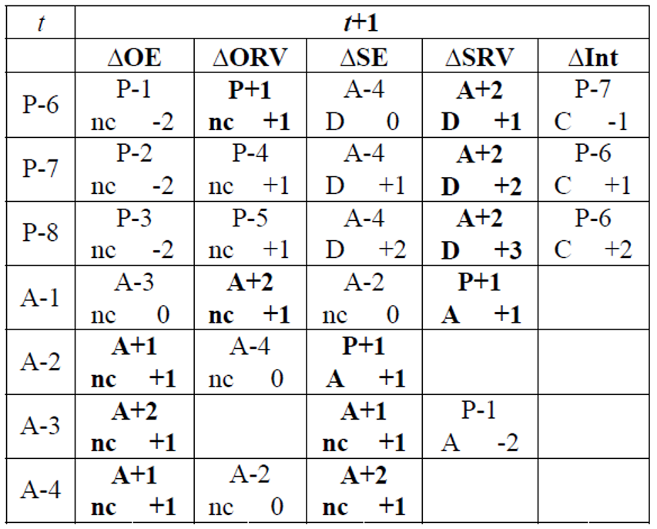
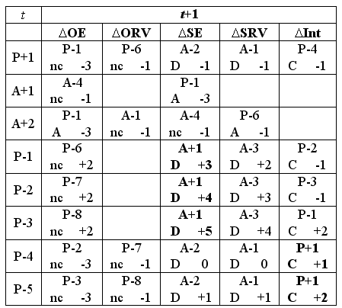
Effects of various sorts of ‘snapshot’ changes

Slide 40
Effects of various sorts of changes
When something faithfully represented at t ceases to be faithful at t+1, leaving the ontology unchanged causes a P+1 to become a P-1.
When something faithfully represented at t is not believed to be faithful anymore at t+1 while in fact it still is, removing the representational element causes a P+1 to become a A-2.
…

Slide 41
Effects of various sorts of ‘snapshot’ changes
Change in error magnitude
No change in ontology
Addition
Deletion
Change in encoding
No snapshot transition
possible
…

Slide 42
Updating is an active process
authors assume in good faith that:
  all included representational units are of the P+1 type, and,
  all they are aware of, but not included, of A+1 … A+4.
If they become aware of a mistake, they make a change under the assumption that their changes are also towards the P+1, A+1 … A+4 cases.
Thus at that time, they know:
  of what configuration type the previous entry must have been under the belief what the current configuration is, and,
  the reason for the change.

Slide 43
configuration | reality |  | representation |  |  |  | ME
 |  |  | authors' belief |  | encoding
 | OE | OR | BE | BR | IE | TR
(1) | (2) | (3) | (4) | (5) | (6) | (7) | (8)
P+1 | Y | Y | Y | Y | Y | R+ | 0
A+1 | N | na | N | na | na | na | 0
A+2 | Y | N | Y | N | na | na | 0
A+3 | Y | N | NC | na | na | na | 0
A+4 | N | na | NC | na | na | na | 0
P-1 | N | na | Y | Y | Y | ¬R | 3
P-2 | N | na | Y | Y | N | ¬R | 4
P-3 | N | na | Y | Y | N | R– | 5
P-4 | Y | Y | Y | Y | N | ¬R | 1
P-5 | Y | Y | Y | Y | N | R- | 2
P-6 | Y | N | Y | Y | Y | R+ | 1
P-7 | Y | N | Y | Y | N | ¬R | 2
P-8 | Y | N | Y | Y | N | R– | 3
P-9 | Y | Y | Y | Y | Y | R++ | 1
P-10 | Y | N | Y | Y | Y | R++ | 2
P-11 | Y | Y | Y | Y | Y | Ra | 1
P-12 | N | na | Y | Y | Y | Ra | 4
A-1 | Y | Y | Y | N | na | na | 1
A-2 | Y | Y | N | na | na | na | 1
A-3 | N | na | Y | N | na | na | 1
A-4 | Y | N | N | na | na | na | 1
A-5 | Y | Y | NC | na | na | na | 1
Evolution example:
The Higg’s boson was discovered and added to the ontology:
A-5 → P+1 → quality improvement of +1

Slide 44
This leads to a calculus …
NOT:
  to demonstrate how good an individual version of an ontology is,
But rather
  to measure how much it improved (hopefully) as compared to its predecessors.
Principle: recursive belief revision.
Ceusters W. Applying Evolutionary Terminology Auditing to SNOMED CT. In American Medical Informatics Association 2010 Annual Symposium (AMIA 2010) Proceedings, Washington DC, November 13-17, 2010:96-100.

Slide 45
However: unnoticed changes in reality do not lead to updates!
No change in ontology
…

Slide 46
Quality of a representation w.r.t. reality
n: number of representational elements in the ontology
m: number of unjustified absences
e_{i}: magnitude of the error, if any, for the i ^{th} representational element
Ceusters W. Applying Evolutionary Terminology Auditing to the Gene Ontology.
Journal of Biomedical Informatics 2009;42:518–529.

Slide 47
Quality of a representation w.r.t. reality
n: number of representational elements in the ontology
m: number of unjustified absences
e_{i}: magnitude of the error, if any, for the i ^{th} representational element
Quality of a Representational Unit: 5 – e_{i}
5 is the maximal magnitude of error, thus 0 ≤ ( 5 – e_{i} ) ≤ 5
Ceusters W. Applying Evolutionary Terminology Auditing to the Gene Ontology.
Journal of Biomedical Informatics 2009;42:518–529.

Slide 48
Quality of a representation w.r.t. reality
n: number of representational elements in the ontology
m: number of unjustified absences
e_{i}: magnitude of the error, if any, for the i ^{th} representational element
All unjustified absences have an error magnitude of 1
Ceusters W. Applying Evolutionary Terminology Auditing to the Gene Ontology.
Journal of Biomedical Informatics 2009;42:518–529.

Slide 49
Quality of a representation w.r.t. reality
n: number of representational elements in the ontology
m: number of unjustified absences
e_{i}: magnitude of the error, if any, for the i ^{th} representational element
The sum of the qualities of the RUs, each quality being:
5 for faithful RUs,
(5 – error magnitude) for deviant RUs.
Ceusters W. Applying Evolutionary Terminology Auditing to the Gene Ontology.
Journal of Biomedical Informatics 2009;42:518–529.

Slide 50
Quality of a representation w.r.t. reality
n: number of representational elements in the ontology
m: number of unjustified absences
e_{i}: magnitude of the error, if any, for the i ^{th} representational element
The quality of the ontology decreases through:
Error magnitude of unjustified presences,
Number of unjustified absences.
Ceusters W. Applying Evolutionary Terminology Auditing to the Gene Ontology.
Journal of Biomedical Informatics 2009;42:518–529.

Slide 51
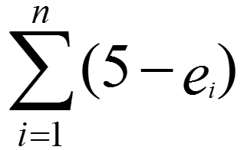
Quality of a representation w.r.t. reality
n: number of representational elements in the ontology
m: number of unjustified absences
e_{i}: magnitude of the error, if any, for the i ^{th} representational element
Ideal case:
e_{i} is 0 for all RUs, thus = 5n
Number of unjustified absences = 0, thus 4m = 0.
5n
5n
= 1
Ceusters W. Applying Evolutionary Terminology Auditing to the Gene Ontology.
Journal of Biomedical Informatics 2009;42:518–529.

Slide 52

Comparing quality of ontologies
 | Reality | Ontology 1 |  | Ontology 2 |  | Ontology 3
RU | Config. | Config. | Error | Config. | Error | Config. | Error
animal | P+1 | P+1 | 0 | P+1 | 0 | P+1 | 0
fish | P+1 | P+1 | 0 | P+1 | 0 | P+1 | 0
whale | P+1 | P+1 | 0 | P+1 | 0 | P+1 | 0
mammal | P+1 | P+1 | 0 | P+1 | 0 | P+1 | 0
fish are animals | P+1 | P+1 | 0 | P+1 | 0 | P+1 | 0
mammals are animals | P+1 | P+1 | 0 | P+1 | 0 | P+1 | 0
whales are fish | A+1 | P-1 | 3 | A+1 | 0 | A+1 | 0
whales are animals | P+1 | P+1 | 0 | P+1 | 0 | P+1 | 0
whales are mammals | P+1 | A-2 | 1 | A-2 | 1 | P+1 | 0
SCORE | 8*5/ ((8*5)+(0*4)) = 1.00 | ((7*5)+(1*2))/ ((8*5)+(1*4)) =0.84 |  | 7*5/ ((7*5)+(1*4)) =0.90 |  | 8*5/ ((8*5)+(0*4)) =1.00
n: number of RUs in the ontology
m: number of unjustified absences
e_{i}: magnitude of the error, if any,
for the i ^{th} RU

Slide 53

Comparing quality of ontologies
 | Reality | Ontology 1 |  | Ontology 2 |  | Ontology 3
RU | Config. | Config. | Error | Config. | Error | Config. | Error
animal | P+1 | P+1 | 0 | P+1 | 0 | P+1 | 0
fish | P+1 | P+1 | 0 | P+1 | 0 | P+1 | 0
whale | P+1 | P+1 | 0 | P+1 | 0 | P+1 | 0
mammal | P+1 | P+1 | 0 | P+1 | 0 | P+1 | 0
fish are animals | P+1 | P+1 | 0 | P+1 | 0 | P+1 | 0
mammals are animals | P+1 | P+1 | 0 | P+1 | 0 | P+1 | 0
whales are fish | A+1 | P-1 | 3 | A+1 | 0 | A+1 | 0
whales are animals | P+1 | P+1 | 0 | P+1 | 0 | P+1 | 0
whales are mammals | P+1 | A-2 | 1 | A-2 | 1 | P+1 | 0
SCORE | 8*5/ ((8*5)+(0*4)) = 1.00 | ((7*5)+(1*2))/ ((8*5)+(1*4)) =0.84 |  | 7*5/ ((7*5)+(1*4)) =0.90 |  | 8*5/ ((8*5)+(0*4)) =1.00
n: number of RUs in the ontology
m: number of unjustified absences
e_{i}: magnitude of the error, if any,
for the i ^{th} RU

Slide 54

Comparing quality of ontologies
 | Reality | Ontology 1 |  | Ontology 2 |  | Ontology 3
RU | Config. | Config. | Error | Config. | Error | Config. | Error
animal | P+1 | P+1 | 0 | P+1 | 0 | P+1 | 0
fish | P+1 | P+1 | 0 | P+1 | 0 | P+1 | 0
whale | P+1 | P+1 | 0 | P+1 | 0 | P+1 | 0
mammal | P+1 | P+1 | 0 | P+1 | 0 | P+1 | 0
fish are animals | P+1 | P+1 | 0 | P+1 | 0 | P+1 | 0
mammals are animals | P+1 | P+1 | 0 | P+1 | 0 | P+1 | 0
whales are fish | A+1 | P-1 | 3 | A+1 | 0 | A+1 | 0
whales are animals | P+1 | P+1 | 0 | P+1 | 0 | P+1 | 0
whales are mammals | P+1 | A-2 | 1 | A-2 | 1 | P+1 | 0
SCORE | 8*5/ ((8*5)+(0*4)) = 1.00 | ((7*5)+(1*2))/ ((8*5)+(1*4)) =0.84 |  | 7*5/ ((7*5)+(1*4)) =0.90 |  | 8*5/ ((8*5)+(0*4)) =1.00
n: number of RUs in the ontology m: number of unjustified absences e_{i}: magnitude of the error, if any, for the i ^{th} RU

Slide 55
Comparing quality of ontologies
 | Reality | Ontology 1 |  | Ontology 2 |  | Ontology 3
RU | Config. | Config. | Error | Config. | Error | Config. | Error
animal | P+1 | P+1 | 0 | P+1 | 0 | P+1 | 0
fish | P+1 | P+1 | 0 | P+1 | 0 | P+1 | 0
whale | P+1 | P+1 | 0 | P+1 | 0 | P+1 | 0
mammal | P+1 | P+1 | 0 | P+1 | 0 | P+1 | 0
fish are animals | P+1 | P+1 | 0 | P+1 | 0 | P+1 | 0
mammals are animals | P+1 | P+1 | 0 | P+1 | 0 | P+1 | 0
whales are fish | A+1 | P-1 | 3 | A+1 | 0 | A+1 | 0
whales are animals | P+1 | P+1 | 0 | P+1 | 0 | P+1 | 0
whales are mammals | P+1 | A-2 | 1 | A-2 | 1 | P+1 | 0
SCORE | 8*5/ ((8*5)+(0*4)) = 1.00 | ((7*5)+(1*2))/ ((8*5)+(1*4)) =0.84 |  | 7*5/ ((7*5)+(1*4)) =0.90 |  | 8*5/ ((8*5)+(0*4)) =1.00
n: number of RUs in the ontology m: number of unjustified absences e_{i}: magnitude of the error, if any, for the i ^{th} RU

Slide 56

Comparing consecutive versions: t1
 | Time t1 |  | Time t2 |  |  |  | Time t3
 | V1 |  | T1 |  | T2 |  | T1 |  | T2 |  | T3
 | C. | E. | C. | E. | C. | E. | C. | E. | C. | E. | C. | E.
animal | P+1 | 0 | P+1 | 0 | P+1 | 0 | P+1 | 0 | P+1 | 0 | P+1 | 0
fish | P+1 | 0 | P+1 | 0 | P+1 | 0 | P+1 | 0 | P+1 | 0 | P+1 | 0
whale | P+1 | 0 | P+1 | 0 | P+1 | 0 | P+1 | 0 | P+1 | 0 | P+1 | 0
mammal | P+1 | 0 | P+1 | 0 | P+1 | 0 | P+1 | 0 | P+1 | 0 | P+1 | 0
fish are animals | P+1 | 0 | P+1 | 0 | P+1 | 0 | P+1 | 0 | P+1 | 0 | P+1 | 0
mammals are animals | P+1 | 0 | P+1 | 0 | P+1 | 0 | P+1 | 0 | P+1 | 0 | P+1 | 0
whales are fish | P+1 | 0 | P-1 | 3 | A+1 | 0 | P-1 | 3 | A+1 | 0 | A+1 | 0
whales are animals | P+1 | 0 | P+1 | 0 | P+1 | 0 | P+1 | 0 | P+1 | 0 | P+1 | 0
whales are mammals | - | - | - | - | - | - | A-2 | 1 | A-2 | 1 | P+1 | 0
SCORE | 1.00 |  | 0.93 |  | 1.00 |  | 0.84 |  | 0.90 |  | 1.00
(8*5)
(8*5)
n: number of RUs in the ontology
m: number of unjustified absences
e_{i}: magnitude of the error, if any,
for the i ^{th} RU

Slide 57


Comparing consecutive versions: t2
 | Time t1 |  | Time t2 |  |  |  | Time t3
 | V1 |  | T1 |  | V2 |  | T1 |  | T2 |  | T3
 | C. | E. | C. | E. | C. | E. | C. | E. | C. | E. | C. | E.
animal | P+1 | 0 | P+1 | 0 | P+1 | 0 | P+1 | 0 | P+1 | 0 | P+1 | 0
fish | P+1 | 0 | P+1 | 0 | P+1 | 0 | P+1 | 0 | P+1 | 0 | P+1 | 0
whale | P+1 | 0 | P+1 | 0 | P+1 | 0 | P+1 | 0 | P+1 | 0 | P+1 | 0
mammal | P+1 | 0 | P+1 | 0 | P+1 | 0 | P+1 | 0 | P+1 | 0 | P+1 | 0
fish are animals | P+1 | 0 | P+1 | 0 | P+1 | 0 | P+1 | 0 | P+1 | 0 | P+1 | 0
mammals are animals | P+1 | 0 | P+1 | 0 | P+1 | 0 | P+1 | 0 | P+1 | 0 | P+1 | 0
whales are fish | P+1 | 0 | P-1 | 3 | A+1 | 0 | P-1 | 3 | A+1 | 0 | A+1 | 0
whales are animals | P+1 | 0 | P+1 | 0 | P+1 | 0 | P+1 | 0 | P+1 | 0 | P+1 | 0
whales are mammals | - | - | - | - | - | - | A-2 | 1 | A-2 | 1 | P+1 | 0
SCORE | 1.00 |  | 0.93 |  | 1.00 |  | 0.84 |  | 0.90 |  | 1.00
?
What must you believe at t2 about ontology version V1, in light of what you believe to be the case in reality at t2?
(7*5)
(7*5)
n: number of RUs in the ontology
m: number of unjustified absences
e_{i}: magnitude of the error, if any,
for the i ^{th} RU

Slide 58
Comparing consecutive versions: t2
 | Time t1 |  | Time t2 |  |  |  | Time t3
 | V1 |  | T1 |  | V2 |  | T1 |  | T2 |  | T3
 | C. | E. | C. | E. | C. | E. | C. | E. | C. | E. | C. | E.
animal | P+1 | 0 | P+1 | 0 | P+1 | 0 | P+1 | 0 | P+1 | 0 | P+1 | 0
fish | P+1 | 0 | P+1 | 0 | P+1 | 0 | P+1 | 0 | P+1 | 0 | P+1 | 0
whale | P+1 | 0 | P+1 | 0 | P+1 | 0 | P+1 | 0 | P+1 | 0 | P+1 | 0
mammal | P+1 | 0 | P+1 | 0 | P+1 | 0 | P+1 | 0 | P+1 | 0 | P+1 | 0
fish are animals | P+1 | 0 | P+1 | 0 | P+1 | 0 | P+1 | 0 | P+1 | 0 | P+1 | 0
mammals are animals | P+1 | 0 | P+1 | 0 | P+1 | 0 | P+1 | 0 | P+1 | 0 | P+1 | 0
whales are fish | P+1 | 0 | P-1 | 3 | A+1 | 0 | P-1 | 3 | A+1 | 0 | A+1 | 0
whales are animals | P+1 | 0 | P+1 | 0 | P+1 | 0 | P+1 | 0 | P+1 | 0 | P+1 | 0
whales are mammals | - | - | - | - | - | - | A-2 | 1 | A-2 | 1 | P+1 | 0
SCORE | 1.00 |  | 0.93 |  | 1.00 |  | 0.84 |  | 0.90 |  | 1.00
(7*5) + (1*2)
(8*5)
n: number of RUs in the ontology
m: number of unjustified absences
e_{i}: magnitude of the error, if any,
for the i ^{th} RU

Slide 59

Comparing consecutive versions: t3
 | Time t1 |  | Time t2 |  |  |  | Time t3
 | V1 |  | V1 |  | V2 |  | T1 |  | T2 |  | V3
 | C. | E. | C. | E. | C. | E. | C. | E. | C. | E. | C. | E.
animal | P+1 | 0 | P+1 | 0 | P+1 | 0 | P+1 | 0 | P+1 | 0 | P+1 | 0
fish | P+1 | 0 | P+1 | 0 | P+1 | 0 | P+1 | 0 | P+1 | 0 | P+1 | 0
whale | P+1 | 0 | P+1 | 0 | P+1 | 0 | P+1 | 0 | P+1 | 0 | P+1 | 0
mammal | P+1 | 0 | P+1 | 0 | P+1 | 0 | P+1 | 0 | P+1 | 0 | P+1 | 0
fish are animals | P+1 | 0 | P+1 | 0 | P+1 | 0 | P+1 | 0 | P+1 | 0 | P+1 | 0
mammals are animals | P+1 | 0 | P+1 | 0 | P+1 | 0 | P+1 | 0 | P+1 | 0 | P+1 | 0
whales are fish | P+1 | 0 | P-1 | 3 | A+1 | 0 | P-1 | 3 | A+1 | 0 | A+1 | 0
whales are animals | P+1 | 0 | P+1 | 0 | P+1 | 0 | P+1 | 0 | P+1 | 0 | P+1 | 0
whales are mammals | - | - | - | - | - | - | A-2 | 1 | A-2 | 1 | P+1 | 0
SCORE | 1.00 |  | 0.93 |  | 1.00 |  | 0.84 |  | 0.90 |  | 1.00
?
(8*5)
(8*5)
n: number of RUs in the ontology
m: number of unjustified absences
e_{i}: magnitude of the error, if any,
for the i ^{th} RU

Slide 60

Comparing consecutive versions: t3
 | Time t1 |  | Time t2 |  |  |  | Time t3
 | V1 |  | V1 |  | V2 |  | T1 |  | V2 |  | V3
 | C. | E. | C. | E. | C. | E. | C. | E. | C. | E. | C. | E.
animal | P+1 | 0 | P+1 | 0 | P+1 | 0 | P+1 | 0 | P+1 | 0 | P+1 | 0
fish | P+1 | 0 | P+1 | 0 | P+1 | 0 | P+1 | 0 | P+1 | 0 | P+1 | 0
whale | P+1 | 0 | P+1 | 0 | P+1 | 0 | P+1 | 0 | P+1 | 0 | P+1 | 0
mammal | P+1 | 0 | P+1 | 0 | P+1 | 0 | P+1 | 0 | P+1 | 0 | P+1 | 0
fish are animals | P+1 | 0 | P+1 | 0 | P+1 | 0 | P+1 | 0 | P+1 | 0 | P+1 | 0
mammals are animals | P+1 | 0 | P+1 | 0 | P+1 | 0 | P+1 | 0 | P+1 | 0 | P+1 | 0
whales are fish | P+1 | 0 | P-1 | 3 | A+1 | 0 | P-1 | 3 | A+1 | 0 | A+1 | 0
whales are animals | P+1 | 0 | P+1 | 0 | P+1 | 0 | P+1 | 0 | P+1 | 0 | P+1 | 0
whales are mammals | - | - | - | - | - | - | A-2 | 1 | A-2 | 1 | P+1 | 0
SCORE | 1.00 |  | 0.93 |  | 1.00 |  | 0.84 |  | 0.90 |  | 1.00
?
(7*5)
(7*5) + (1*4)
n: number of RUs in the ontology
m: number of unjustified absences
e_{i}: magnitude of the error, if any,
for the i ^{th} RU

Slide 61
Comparing consecutive versions: t3
 | Time t1 |  | Time t2 |  |  |  | Time t3
 | V1 |  | V1 |  | V2 |  | V1 |  | V2 |  | V3
 | C. | E. | C. | E. | C. | E. | C. | E. | C. | E. | C. | E.
animal | P+1 | 0 | P+1 | 0 | P+1 | 0 | P+1 | 0 | P+1 | 0 | P+1 | 0
fish | P+1 | 0 | P+1 | 0 | P+1 | 0 | P+1 | 0 | P+1 | 0 | P+1 | 0
whale | P+1 | 0 | P+1 | 0 | P+1 | 0 | P+1 | 0 | P+1 | 0 | P+1 | 0
mammal | P+1 | 0 | P+1 | 0 | P+1 | 0 | P+1 | 0 | P+1 | 0 | P+1 | 0
fish are animals | P+1 | 0 | P+1 | 0 | P+1 | 0 | P+1 | 0 | P+1 | 0 | P+1 | 0
mammals are animals | P+1 | 0 | P+1 | 0 | P+1 | 0 | P+1 | 0 | P+1 | 0 | P+1 | 0
whales are fish | P+1 | 0 | P-1 | 3 | A+1 | 0 | P-1 | 3 | A+1 | 0 | A+1 | 0
whales are animals | P+1 | 0 | P+1 | 0 | P+1 | 0 | P+1 | 0 | P+1 | 0 | P+1 | 0
whales are mammals | - | - | - | - | - | - | A-2 | 1 | A-2 | 1 | P+1 | 0
SCORE | 1.00 |  | 0.93 |  | 1.00 |  | 0.84 |  | 0.90 |  | 1.00
(7*5) + (1*2)
(8*5) + (1*4)
n: number of RUs in the ontology
m: number of unjustified absences
e_{i}: magnitude of the error, if any,
for the i ^{th} RU

Slide 62
Assignment
A8: Use the (to be) provided A8-assignment spreadsheet to perform an evaluation analysis following the method and format depicted in slides 52 to 55 (comparing your A5, A6, and A7 versions to reality) and 56 to 61 (comparing A^ to A5, and A7 to A5 and A6) respectively. Follow demo given in class.
Upload your work as usual.
Assessment: percentage of cells filled out correctly.
Due date: Nov 11 – noon (one week extra !).
Test T2: upload same way, due date: Nov 3 - noon.

Slide 63
Required reading
Ceusters, W., Towards a realism-based metric for quality assurance in ontology matching. Frontiers in Artificial Intelligence and Applications. Vol. 150. 2006. 321-332. [9]
http://ontology.buffalo.edu/bfo/Ontology_Matching.pdf

