Slide 1
BMI508 – Fall 2023 Introduction to Biomedical Ontology Class 8 – Oct 18, 2023 The Ontology for General Medical Science
Werner CEUSTERS^{1,2}
¹ Department of Biomedical Informatics, University at Buffalo, USA
² Department of Psychiatry, University at Buffalo, USA

Slide 2
The reference for OGMS:

Slide 3
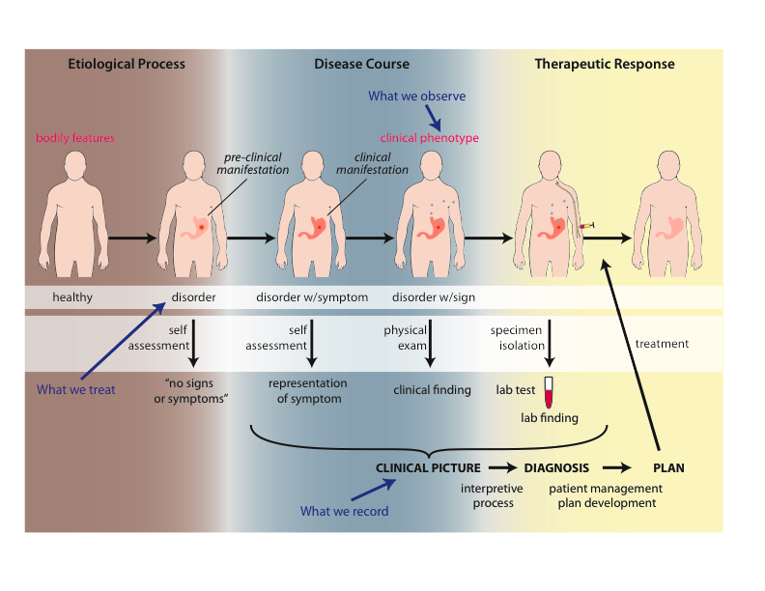
Big Picture

Slide 4
Motivation
Clarity about:
disease etiology and progression;
disease on the side of the patient and the diagnostic process on the side of the clinician or healthcare system;
phenotype and signs/symptoms;
how the entities relate to each other.
Better support for use of evidence in the context of patient care, clinical research and translational research;
Includes use of medical record information in support for clinical and translation research.
Extensibility.

Slide 5
Goals of OGMS (1)
What are the fundamental types of things for which we need ontological categories (what’s the domain)?
disease initiation, progression, pathogenesis, signs, symptoms, assessments, clinical and laboratory findings, disease diagnosis, treatment, treatment response and outcome;
normal phenotype, homeostatic (normal) profile.
Notes:
Answer the following questions.

Slide 6
Goals of OGMS (2)
What are the fundamental relationships:
between the process of observing, the results of the observation and what is being observed;
between signs/symptoms and disease (no absolutes?);
between clinical and pre-clinical pathological processes, their manifestations and their representations in the EHR.
Notes:
Answer the following questions.

Slide 7
Goals of OGMS (3)
How should ontologies be developed - intelligent design or natural selection (evolution)?
What is the relationship between
the ontologies,
the terminologies and
the information models?
Notes:
Answer the following questions.

Slide 8
Ontology / Terminology
Notes:
http://browser.ihtsdotools.org/?perspective=full&conceptId1=40733004&edition=en-edition&release=v20160731&server=http://browser.ihtsdotools.org/api/snomed&langRefset=900000000000509007

Slide 9
Ontology / Terminology
Notes:
http://browser.ihtsdotools.org/?perspective=full&conceptId1=40733004&edition=en-edition&release=v20160731&server=http://browser.ihtsdotools.org/api/snomed&langRefset=900000000000509007

Slide 10
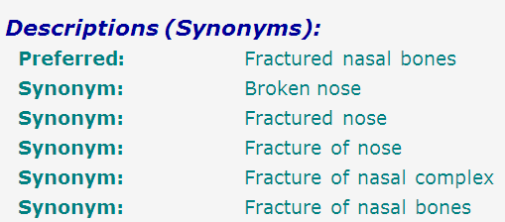
SNOMED-CT: abundance of false synonymy
bones
nose
fracture

Slide 11
EHR Information Models (simplified)
diagnosis
finding
finding
patient
patient
encounter
drug
drug
diagnosis

Slide 12
Approach of OGMS design
Propose terms and provide definitions for a representational framework drawing on best practices in ontology development as promulgated within the OBO Foundry for:
Etiological process
Disorder
Disease
Pathological process
Sign
Risk factor
Symptom
Laboratory finding
Diagnosis
Pre-disposition
Clinically abnormal
Biomarker
Notes:
Answer the following questions.

Slide 13
Approach
a disease is a disposition rooted in a physical disorder in the organism and realized in pathological processes.
produces
bears
realized_in
etiological process
disorder
disposition
pathological process
produces
diagnosis
interpretive process
signs & symptoms
abnormal bodily features
produces
participates_in
recognized_as
Notes:
font was too small, color inside green boxes was hardly readable

Slide 14
Cirrhosis - environmental exposure
Etiological process - phenobarbitol-induced hepatic cell death
produces
Disorder - necrotic liver
bears
Disposition (disease) - cirrhosis
realized_in
Pathological process - abnormal tissue repair with cell proliferation and fibrosis that exceed a certain threshold; hypoxia-induced cell death
produces
Abnormal bodily features
recognized_as
Symptoms - fatigue, anorexia
Signs - jaundice, splenomegaly
Symptoms & Signs
used_in
Interpretive process
produces
Hypothesis - rule out cirrhosis
suggests
Laboratory tests
produces
Test results – documentation of elevated liver enzymes in serum
used_in
Interpretive process
produces
Result - diagnosis that patient X has a disorder that bears the disease cirrhosis

Slide 15
Part 1
Foundational type-terms for pre-clinical entities on the side of the patient
produces
bears
realized_in
etiological process
disorder
disposition
pathological process
produces
diagnosis
interpretive process
signs & symptoms
abnormal bodily features
produces
participates_in
recognized_as
Notes:
font was too small, color inside green boxes was hardly readable

Slide 16
Foundational Terms (1)
Disorder =def. – A causally linked combination of physical components of the extended organism that is
(a) clinically abnormal and
(b) maximal, in the sense that it is not a part of some larger such combination.

Slide 17
Physical Disorder
– independent continuant
objects
fiat object parts
object aggregates
A causally linked combination of physical components of the extended organism.

Slide 18
Extended organism
Harth R. War and peace in the human gut: probing the microbiome
https://biodesign.asu.edu/sites/default/files/news/AthenaHostcooperation7.png

Slide 19
Clinically abnormal
something is clinically abnormal if:
is not part of the life plan for an organism of the relevant type (unlike aging or pregnancy),
is causally linked to an elevated risk either of pain or other feelings of illness, or of death or dysfunction, and
is such that the elevated risk exceeds a certain threshold level.

Slide 20
Foundational Terms (2)
Disorder =def. – A causally linked combination of physical components of the extended organism that is
(a) clinically abnormal and
(b) maximal, in the sense that it is not a part of some larger such combination.
Pathological Process =def. – A bodily process that is a manifestation of a disorder and is clinically abnormal.

Slide 21
Foundational Terms (3)
Disorder =def. – A causally linked combination of physical components of the extended organism that is (a) clinically abnormal and (b) maximal, in the sense that it is not a part of some larger such combination.
Pathological Process =def. – A bodily process that is a manifestation of a disorder and is clinically abnormal.
Disease =def. – A disposition (i) to undergo pathological processes that (ii) exists in an organism because of one or more disorders in that organism.

Slide 22
Disposition
if it ceases to exist, then its bearer and/or its immediate surrounding environment is physically changed;
its realization occurs when its bearer is in some special physical circumstances;
its realization is what it is in virtue of the bearer’s physical make-up.

Slide 23
independent
continuant
Specifically
dependent
continuant
occurrent
disposition
process
integumentary
system
process of going bald
to go bald
John’s
integumentary
system
John’s
disposition:
to go bald
John’s going
bald

Slide 24
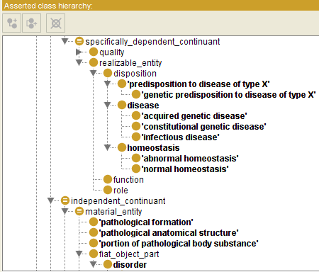

Slide 25
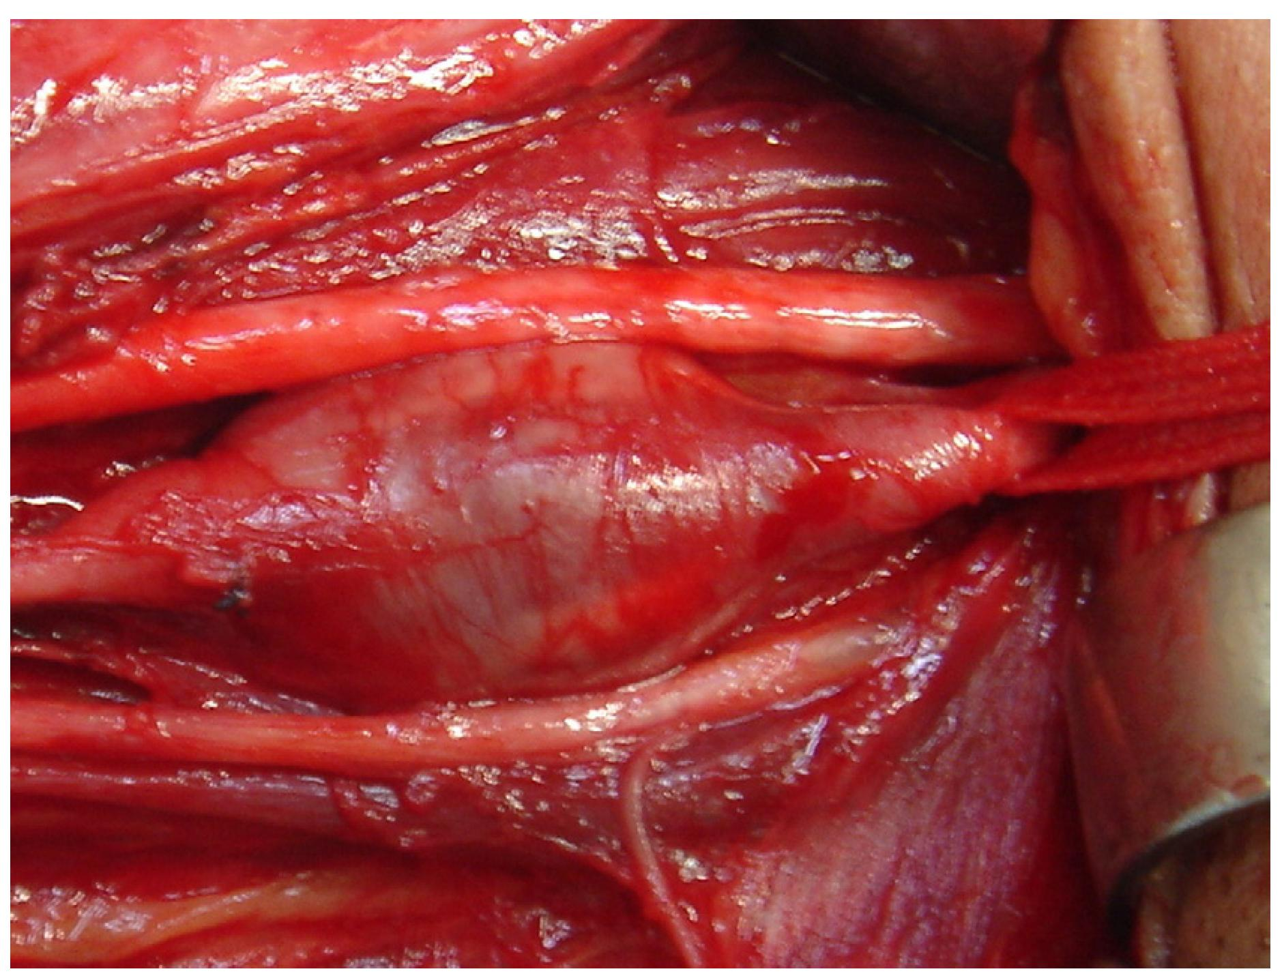
Arterial aneurysm
Jornal Vascular Brasileiro Print version ISSN 1677-5449 J. vasc. bras. vol.12 no.4 Porto Alegre Oct./Dec. 2013 Epub Dec 15, 2013
http://dx.doi.org/10.1590/jvb.2013.054
Subclavian and axillary arterial aneurysms: two case reports
Fernando Pinho Esteves¹ , André Ventura Ferreira¹ , Vanessa Prado dos Santos² , Gabriel Santos Novaes¹ , Álvaro Razuk Filho¹ , Roberto Augusto Caffaro¹

Slide 26
Arterial Aneurysm
Disposition – atherosclerosis
realized in
Pathological process – fatty material collects within the walls of arteries
produces
Disorder – artery with weakened wall
bears
Disposition – of artery to become distended
realized_in
Pathological process – process of distending
produces
Disorder – arterial aneurysm
bears
Disposition – of artery to rupture
realized in
Pathological process – (catastrophic event) of rupturing
produces
Disorder – ruptured artery, arterial system with dangerously low blood pressure
bears
Disposition – circulatory failure
realized in
Pathological process – exsanguination, failure of homeostasis
produces
Death

Slide 27
coronary heart disease
disease associated with early lesions and small fibrous plaques
disease associated with asymptomatic (‘silent’) infarction
disease associated with surface disruption of plaque
unstable angina
stable angina
instantiates at t₂
instantiates at t₃
instantiates at t₄
instantiates at t₅
instantiates at t₁
John’s coronary heart disease
time

Slide 28
independent
continuant
specifically
dependent
continuant
occurrent
disposition
process
heart
disease course
coronary heart disease
John’s heart
John’s coronary
heart disease
course of John’s
coronary heart disease

Slide 29
Disease course
The totality of all PROCESSes through which a given DISEASE instance is realized.

Slide 30
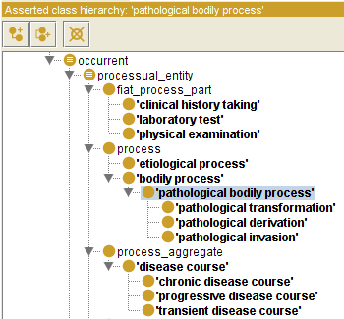

Slide 31
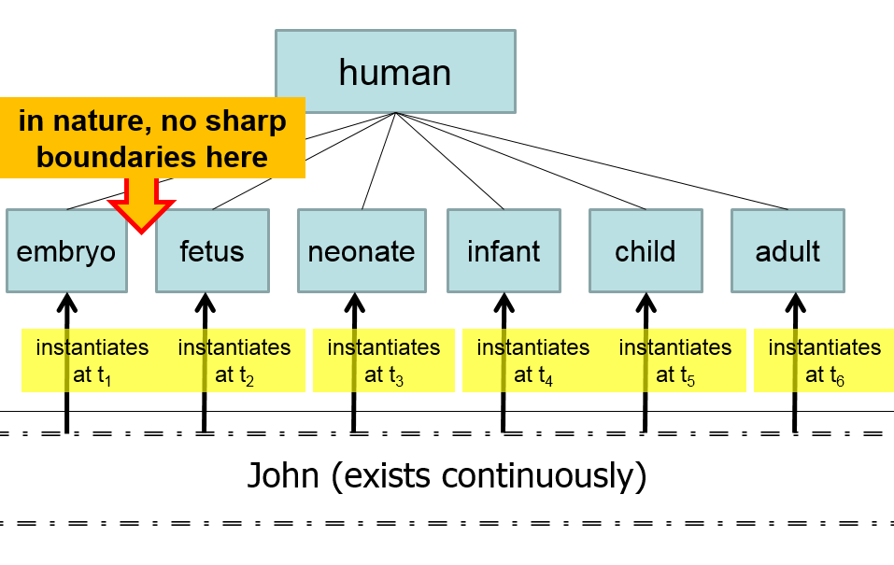
Compare with

Slide 33
Questions
How does one deal with the ever changing nature of the physical disorder?
How does one deal with the evolution of the disposition?
Is an infectious disorder still an infectious disorder even after the pathogenic organism has been sterilized?
Notes:
Answer the following questions.

Slide 34
Acute Influenza Infection Process
Immune response
Pathogen sterilization
State
Viral replication
& tissue destruction
Normal Homeostatic
Range
Etiological
Event
Time

Slide 35
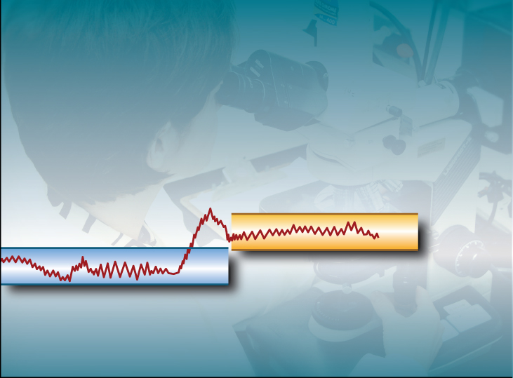
Normal Adaptation
State
Etiological
Event
Normal Homeostatic
Range
Normal Homeostatic
Range
Time

Slide 36
Acute Pathological Process
State
Etiological
Event
Normal Homeostatic
Range
Time

Slide 37
Chronic Pathological Process
State
Abnormal
Homeostatic
Range
Etiological
Event
Normal Homeostatic
Range
Time

Slide 38
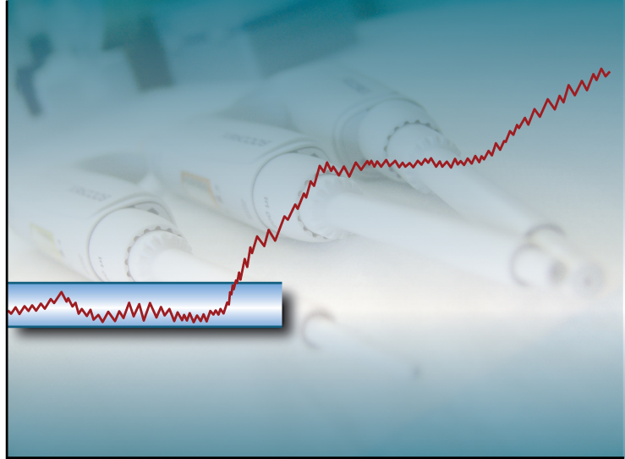
Progressive Pathological Process
State
Etiological
Event
Normal Homeostatic
Range
Time

Slide 39
Etiology
Etiological Process =def. – A process in an organism that leads to a subsequent disorder.
Examples:
toxic chemical exposure resulting in a mutation in the genomic DNA of a cell;
infection of a human with a pathogenic virus;
inheritance of two defective copies of a metabolic gene.
The etiological process creates the physical basis of that disposition to pathological processes which is the disease.

Slide 40
Dispositions and Predispositions
All diseases are dispositions; not all dispositions are diseases.
A predisposition is a disposition.
Predisposition to Disease of Type X =def. – A disposition in an organism that constitutes an increased risk of the organism’s subsequently developing the disease X.
Hereditary Non-polyposis Colorectal Cancer (HNPCC) is caused by a:
disorder (mutation) in a DNA mismatch repair gene that
disposes to the acquisition of additional mutations from defective DNA repair processes, and thus
predisposition to the development of colon cancer.

Slide 41
Hereditary Non-polyposis Colorectal Cancer HNPCC - genetic pre-disposition
Etiological process - inheritance of a mutant mismatch repair gene
produces
Disorder - chromosome 3 with abnormal hMLH1
bears
Disposition (disease) - Lynch syndrome
realized_in
Pathological process - abnormal repair of DNA mismatches
produces
Disorder - mutations in proto-oncogenes and tumor suppressor genes with microsatellite repeats (e.g. TGF-beta R2)
bears
Disposition (disease) - non-polyposis colon cancer

Slide 42
Hemorrhagic stroke
http://www.tomfit247.com/2013/05/stroke-what-is-it-what-causes-it-and.html

Slide 43
Hemorrhagic stroke
Disorder – cerebral arterial aneurysm
bears
Disposition – of weakened artery to rupture
realized in
Pathological process – rupturing of weakened blood vessel
produces
Disorder – Intraparenchymal cerebral hemorrhage
bears
Disposition (disease) – to increased intra-cranial pressure
realized in
Pathological process – increasing intra-cranial pressure, compression of brain structures
produces
Disorder – Cerebral ischemia, Cerebral neuronal death
bears
Disposition (disease) – stroke
realized in
Symptoms – weakness/paralysis, loss of sensation, etc

Slide 44
Definitions - Clinical Evaluation Terms (on the side of the patient!)
‘bodily feature’ - an abbreviation for physical component, a bodily quality, or a bodily process.
Sign =def. – A bodily feature of a patient that is observed in a physical examination and is deemed by the clinician to be of clinical significance. (Objectively observable features)
Symptom =def. – A bodily feature of a patient that is observed by the patient and is hypothesized by the patient to be a realization of a disease. (a restricted family of phenomena (including pain, nausea, anger, drowsiness), which are of their nature experienced in the first person)
Laboratory Test =def. – A measurement assay that has as input a patient-derived specimen, and as output a result representing a quality of the specimen.
Laboratory Finding =def. – A representation of a quality of a specimen that is the output of a laboratory test and that can support an inference to an assertion about some quality of the patient.

Slide 45
Part 2
Foundational type-terms for clinical entities on the side of the patient
produces
bears
realized_in
etiological process
disorder
disposition
pathological process
produces
diagnosis
interpretive process
signs & symptoms
abnormal bodily features
produces
participates_in
recognized_as
Notes:
font was too small, color inside green boxes was hardly readable

Slide 46
Definitions - manifestations
Manifestation of a Disease =def. – A bodily feature of a patient that is (a) a deviation from clinical normality that exists in virtue of the realization of a disease and (b) is observable.
Observability includes observable through elicitation of response or through the use of special instruments.
Preclinical Manifestation of a Disease =def. – A manifestation of a disease that exists prior to its becoming detectable in a clinical history taking or physical examination.
Clinical Manifestation of a Disease =def. – A manifestation of a disease that is detectable in a clinical history taking or physical examination.
Phenotype =def. – A (combination of) bodily feature(s) of an organism determined by the interaction of its genetic make-up and environment.
Clinical Phenotype =def. – A clinically abnormal phenotype.

Slide 47
Phenotype
On the side of the patient
Bodily features
Symptoms
Signs
Observed through physical examination
Observed through lab test

Slide 48
Phenotype
On the side of the patient
Bodily features
Symptoms
Signs
Observed through physical examination
Observed through lab test
Phenotype =def. – A (combination of) bodily
feature(s) of an organism determined by the
interaction of its genetic make-up and environment.
Clinical Phenotype =def. – A clinically abnormal
phenotype.

Slide 49
Part 3
Foundational type-terms for representations of entities on the side of the patient
produces
bears
realized_in
etiological process
disorder
disposition
pathological process
produces
diagnosis
interpretive process
signs & symptoms
abnormal bodily features
produces
participates_in
recognized_as
Notes:
font was too small, color inside green boxes was hardly readable

Slide 50
‘Findings’ / ‘observations’
On the side of the patient
Bodily features
Symptoms
Signs
Observed through physical examination
Observed through lab test
Representations
Findings
Anamnestic findings
Clinical findings
Laboratory findings

Slide 51
‘Findings’ / ‘observations’
On the side of the patient
Bodily features
Symptoms
Signs
Observed through physical examination
Observed through lab test
Clinical phenotype
Representations
Findings
Anamnestic findings
Clinical findings
Laboratory findings
Clinical picture

Slide 52
Clinical picture
Clinical Picture =def. – A representation of a clinical phenotype that is inferred from the combination of laboratory, image and clinical findings about a given patient.

Slide 53
‘Findings’ / ‘observations’
On the side of the patient
Bodily features
Symptoms
Signs
Observed through physical examination
Observed through lab test
Diseases
Representations
Findings
Anamnestic findings
Clinical findings
Laboratory findings
Diagnoses

Slide 54
Diagnosis
Clinical Picture =def. – A representation of a clinical phenotype that is inferred from the combination of laboratory, image and clinical findings about a given patient.
Diagnosis =def. – A conclusion of an interpretive process that has as input a clinical picture of a given patient and as output an assertion to the effect that the patient has a disease of such and such a type.

Slide 55
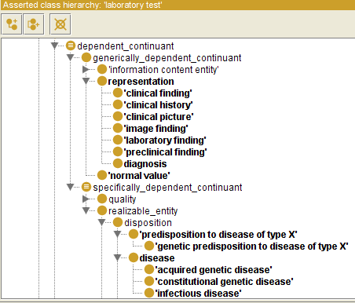

Slide 56
Generically Dependent Continuants
Generically
Dependent
Continuant
if one bearer ceases to exist, then the entity can survive, because there are other bearers
(copyability)
the pdf file on my laptop
the DNA (sequence) in this chromosome
Information
Content
Entity
Gene
Sequence

Slide 57
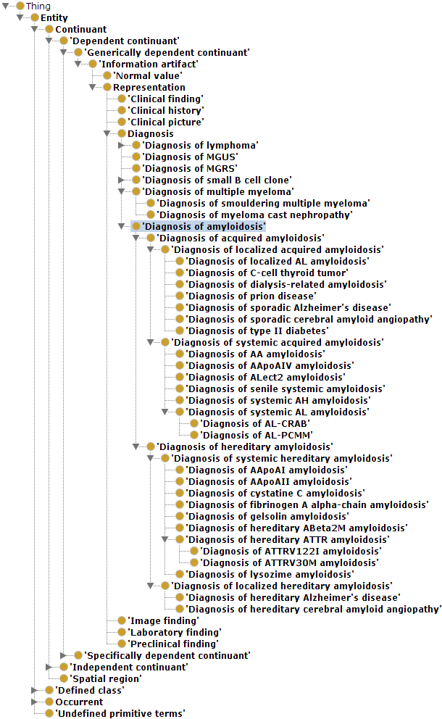
Although ontologically correct, it is totally ridiculous to implement this in this fashion, as ridiculous it would be to implement in this way an ontology for natural numbers.

Slide 59
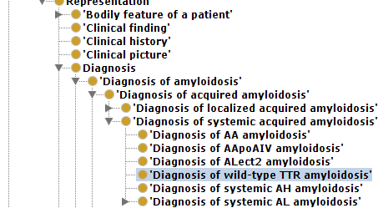
It is for sure incorrect when these correspond to GDC instances !!!

Slide 60
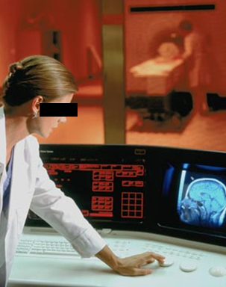
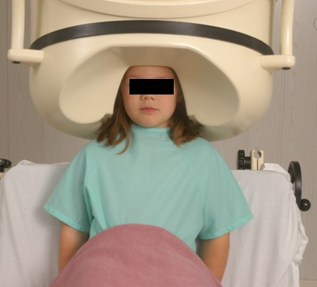
No conflation of diagnosis, disease, and disorder
The diagnosis is here
The disorder is there
The disease is there

Slide 61
No conflation of diagnosis, disease, and disorder
produces
bears
realized_in
etiological process
disorder
disease
pathological process
produces
diagnosis
interpretive process
signs & symptoms
abnormal bodily features
produces
participates_in
recognized_as
Notes:
font was too small, color inside green boxes was hardly readable

Slide 62
Application of OGMS in medical documentation

Slide 63
Key OGMS definitions
DISORDER
DISEASE
DISEASE COURSE
DIAGNOSIS
Scheuermann R, Ceusters W, Smith B. Toward an Ontological Treatment of Disease and Diagnosis. 2009 AMIA Summit on Translational Bioinformatics, San Francisco, California, March 15-17, 2009;: 116-120. Omnipress ISBN:0-9647743-7-2

Slide 64
Key OGMS definitions
DISORDER | A causally relatively isolated combination of physical components that is (a) clinically abnormal and (b) maximal, in the sense that it is not a part of some larger such combination.
DISEASE
DISEASE COURSE
DIAGNOSIS
Scheuermann R, Ceusters W, Smith B. Toward an Ontological Treatment of Disease and Diagnosis. 2009 AMIA Summit on Translational Bioinformatics, San Francisco, California, March 15-17, 2009;: 116-120. Omnipress ISBN:0-9647743-7-2

Slide 65
Key OGMS definitions
DISORDER | A causally relatively isolated combination of physical components that is (a) clinically abnormal and (b) maximal, in the sense that it is not a part of some larger such combination.
DISEASE | A DISPOSITION (i) to undergo PATHOLOGICAL PROCESSes that (ii) exists in an ORGANISM because of one or more DISORDERs in that ORGANISM.
DISEASE COURSE
DIAGNOSIS
Scheuermann R, Ceusters W, Smith B. Toward an Ontological Treatment of Disease and Diagnosis. 2009 AMIA Summit on Translational Bioinformatics, San Francisco, California, March 15-17, 2009;: 116-120. Omnipress ISBN:0-9647743-7-2

Slide 66
Key OGMS definitions
DISORDER | A causally relatively isolated combination of physical components that is (a) clinically abnormal and (b) maximal, in the sense that it is not a part of some larger such combination.
DISEASE | A DISPOSITION (i) to undergo PATHOLOGICAL PROCESSes that (ii) exists in an ORGANISM because of one or more DISORDERs in that ORGANISM.
DISEASE COURSE | The totality of all PROCESSes through which a given DISEASE instance is realized.
DIAGNOSIS
Scheuermann R, Ceusters W, Smith B. Toward an Ontological Treatment of Disease and Diagnosis. 2009 AMIA Summit on Translational Bioinformatics, San Francisco, California, March 15-17, 2009;: 116-120. Omnipress ISBN:0-9647743-7-2

Slide 67
Key OGMS definitions
DISORDER | A causally relatively isolated combination of physical components that is (a) clinically abnormal and (b) maximal, in the sense that it is not a part of some larger such combination.
DISEASE | A DISPOSITION (i) to undergo PATHOLOGICAL PROCESSes that (ii) exists in an ORGANISM because of one or more DISORDERs in that ORGANISM.
DISEASE COURSE | The totality of all PROCESSes through which a given DISEASE instance is realized.
DIAGNOSIS | A conclusion of an interpretive PROCESS that has as input a CLINICAL PICTURE of a given patient and as output an assertion (diagnostic statement) to the effect that the patient has a DISEASE of such and such a type.
Scheuermann R, Ceusters W, Smith B. Toward an Ontological Treatment of Disease and Diagnosis. 2009 AMIA Summit on Translational Bioinformatics, San Francisco, California, March 15-17, 2009;: 116-120. Omnipress ISBN:0-9647743-7-2

Slide 68
Disorder related configurations
No disorder instance → no disease instance,
→ no pathological processes;
A disorder instance can eliminate the range of circumstances under which another disorder instance can lead to pathological processes → no disease instance;
Disorders of the same type in distinct patients, or in the same patient at distinct times, may lead to diseases of distinct types;
Diseases of the same type may unfold themselves in disease courses of distinct types;
Diseases of distinct types may unfold themselves in disease courses of the same type;
…

Slide 69
A little exercise

Slide 70
What are diagnoses in EHRs about? (What are the options?)
DISORDER | A causally relatively isolated combination of physical components that is (a) clinically abnormal and (b) maximal, in the sense that it is not a part of some larger such combination.
DISEASE | A DISPOSITION (i) to undergo PATHOLOGICAL PROCESSes that (ii) exists in an ORGANISM because of one or more DISORDERs in that ORGANISM.
DISEASE COURSE | The totality of all PROCESSes through which a given DISEASE instance is realized.
DIAGNOSIS | A conclusion of an interpretive PROCESS that has as input a CLINICAL PICTURE of a given patient and as output an assertion (diagnostic statement) to the effect that the patient has a DISEASE of such and such a type.
Scheuermann R, Ceusters W, Smith B. Toward an Ontological Treatment of Disease and Diagnosis. 2009 AMIA Summit on Translational Bioinformatics, San Francisco, California, March 15-17, 2009;: 116-120. Omnipress ISBN:0-9647743-7-2

Slide 71
What are diagnoses in EHRs about? (What are the options?)
DISORDER | A causally relatively isolated combination of physical components that is (a) clinically abnormal and (b) maximal, in the sense that it is not a part of some larger such combination.
DISEASE | A DISPOSITION (i) to undergo PATHOLOGICAL PROCESSes that (ii) exists in an ORGANISM because of one or more DISORDERs in that ORGANISM.
DISEASE COURSE | The totality of all PROCESSes through which a given DISEASE instance is realized.
DIAGNOSIS | A conclusion of an interpretive PROCESS that has as input a CLINICAL PICTURE of a given patient and as output an assertion (diagnostic statement) to the effect that the patient has a DISEASE of such and such a type.
781.2 Abnormality of gait

Slide 72
What are diagnoses in EHRs about? (What are the options?)
DISORDER | A causally relatively isolated combination of physical components that is (a) clinically abnormal and (b) maximal, in the sense that it is not a part of some larger such combination.
DISEASE | A DISPOSITION (i) to undergo PATHOLOGICAL PROCESSes that (ii) exists in an ORGANISM because of one or more DISORDERs in that ORGANISM.
DISEASE COURSE | The totality of all PROCESSes through which a given DISEASE instance is realized.
DIAGNOSIS | A conclusion of an interpretive PROCESS that has as input a CLINICAL PICTURE of a given patient and as output an assertion (diagnostic statement) to the effect that the patient has a DISEASE of such and such a type.
781.2 Abnormality of gait

Slide 73
What are diagnoses in EHRs about? (What are the options?)
DISORDER | A causally relatively isolated combination of physical components that is (a) clinically abnormal and (b) maximal, in the sense that it is not a part of some larger such combination.
DISEASE | A DISPOSITION (i) to undergo PATHOLOGICAL PROCESSes that (ii) exists in an ORGANISM because of one or more DISORDERs in that ORGANISM.
DISEASE COURSE | The totality of all PROCESSes through which a given DISEASE instance is realized.
DIAGNOSIS | A conclusion of an interpretive PROCESS that has as input a CLINICAL PICTURE of a given patient and as output an assertion (diagnostic statement) to the effect that the patient has a DISEASE of such and such a type.
256.0 - Hyperestrogenism

Slide 74
What are diagnoses in EHRs about? (What are the options?)
DISORDER | A causally relatively isolated combination of physical components that is (a) clinically abnormal and (b) maximal, in the sense that it is not a part of some larger such combination.
DISEASE | A DISPOSITION (i) to undergo PATHOLOGICAL PROCESSes that (ii) exists in an ORGANISM because of one or more DISORDERs in that ORGANISM.
DISEASE COURSE | The totality of all PROCESSes through which a given DISEASE instance is realized.
DIAGNOSIS | A conclusion of an interpretive PROCESS that has as input a CLINICAL PICTURE of a given patient and as output an assertion (diagnostic statement) to the effect that the patient has a DISEASE of such and such a type.
256.0 - Hyperestrogenism

Slide 75
What are diagnoses in EHRs about? (What are the options?)
DISORDER | A causally relatively isolated combination of physical components that is (a) clinically abnormal and (b) maximal, in the sense that it is not a part of some larger such combination.
DISEASE | A DISPOSITION (i) to undergo PATHOLOGICAL PROCESSes that (ii) exists in an ORGANISM because of one or more DISORDERs in that ORGANISM.
DISEASE COURSE | The totality of all PROCESSes through which a given DISEASE instance is realized.
DIAGNOSIS | A conclusion of an interpretive PROCESS that has as input a CLINICAL PICTURE of a given patient and as output an assertion (diagnostic statement) to the effect that the patient has a DISEASE of such and such a type.
250.23 Diabetes with hyperosmolarity, type I, uncontrolled

Slide 76
What are diagnoses in EHRs about? (What are the options?)
DISORDER | A causally relatively isolated combination of physical components that is (a) clinically abnormal and (b) maximal, in the sense that it is not a part of some larger such combination.
DISEASE | A DISPOSITION (i) to undergo PATHOLOGICAL PROCESSes that (ii) exists in an ORGANISM because of one or more DISORDERs in that ORGANISM.
DISEASE COURSE | The totality of all PROCESSes through which a given DISEASE instance is realized.
DIAGNOSIS | A conclusion of an interpretive PROCESS that has as input a CLINICAL PICTURE of a given patient and as output an assertion (diagnostic statement) to the effect that the patient has a DISEASE of such and such a type.
250.23 Diabetes with hyperosmolarity, type I, uncontrolled

Slide 77
What are diagnoses in EHRs about? (What are the options?)
DISORDER | A causally relatively isolated combination of physical components that is (a) clinically abnormal and (b) maximal, in the sense that it is not a part of some larger such combination.
DISEASE | A DISPOSITION (i) to undergo PATHOLOGICAL PROCESSes that (ii) exists in an ORGANISM because of one or more DISORDERs in that ORGANISM.
DISEASE COURSE | The totality of all PROCESSes through which a given DISEASE instance is realized.
DIAGNOSIS | A conclusion of an interpretive PROCESS that has as input a CLINICAL PICTURE of a given patient and as output an assertion (diagnostic statement) to the effect that the patient has a DISEASE of such and such a type.
749.01 - Cleft palate, unilateral, complete

Slide 78
What are diagnoses in EHRs about? (What are the options?)
DISORDER | A causally relatively isolated combination of physical components that is (a) clinically abnormal and (b) maximal, in the sense that it is not a part of some larger such combination.
DISEASE | A DISPOSITION (i) to undergo PATHOLOGICAL PROCESSes that (ii) exists in an ORGANISM because of one or more DISORDERs in that ORGANISM.
DISEASE COURSE | The totality of all PROCESSes through which a given DISEASE instance is realized.
DIAGNOSIS | A conclusion of an interpretive PROCESS that has as input a CLINICAL PICTURE of a given patient and as output an assertion (diagnostic statement) to the effect that the patient has a DISEASE of such and such a type.
749.01 - Cleft palate, unilateral, complete

Slide 79
What are diagnoses in EHRs about? (What are the options?)
DISORDER | A causally relatively isolated combination of physical components that is (a) clinically abnormal and (b) maximal, in the sense that it is not a part of some larger such combination.
DISEASE | A DISPOSITION (i) to undergo PATHOLOGICAL PROCESSes that (ii) exists in an ORGANISM because of one or more DISORDERs in that ORGANISM.
DISEASE COURSE | The totality of all PROCESSes through which a given DISEASE instance is realized.
DIAGNOSIS | A conclusion of an interpretive PROCESS that has as input a CLINICAL PICTURE of a given patient and as output an assertion (diagnostic statement) to the effect that the patient has a DISEASE of such and such a type.
V65.5 - Person with feared complaint in whom no diagnosis was made

Slide 80
What are diagnoses in EHRs about? (What are the options?)
DISORDER | A causally relatively isolated combination of physical components that is (a) clinically abnormal and (b) maximal, in the sense that it is not a part of some larger such combination.
DISEASE | A DISPOSITION (i) to undergo PATHOLOGICAL PROCESSes that (ii) exists in an ORGANISM because of one or more DISORDERs in that ORGANISM.
DISEASE COURSE | The totality of all PROCESSes through which a given DISEASE instance is realized.
DIAGNOSIS | A conclusion of an interpretive PROCESS that has as input a CLINICAL PICTURE of a given patient and as output an assertion (diagnostic statement) to the effect that the patient has a DISEASE of such and such a type.
V65.5 - Person with feared complaint in whom no diagnosis was made

Slide 81
Application of OGMS to insights in other disease related ontologies

Slide 82
‘Disease’ in BioPortal junk
https://bioportal.bioontology.org/search?utf8=%E2%9C%93&query=disease&button=

Slide 83
Bad ‘disease ontologies’
Despite being listed in the OBO-Foundry: http://www.obofoundry.org/ontology/doid.html
Mondo Disease Ontology: junky collection of several other ‘ontologies’:
https://mondo.monarchinitiative.org/
https://www.ebi.ac.uk/ols/ontologies/mondo
The Semantic Science Ontology: junk as a foundation
https://bioportal.bioontology.org/ontologies/SIO?p=classes&conceptid=http%3A%2F%2Fsemanticscience.org%2Fresource%2FSIO_010299

Slide 84
Assignment A7
Add to your ontology 3 terms each one of which
(1) is a subtype of an OGMS entity and
(2) has thus far not been included in your ontology.
Perform a dependency and relational analysis to these terms to ensure that everything that can be related in your ontology, is so related. The result is version 5.
Upload your work as usual.
Due date: Oct 23 – noon.

Slide 85
Suggested pre-class reading
R12 Seppälä, S., B. Smith, and W. Ceusters, Applying the Realism-Based Ontology-Versioning Method for Tracking Changes in the Basic Formal Ontology, in Formal Ontology in Information Systems (FOIS 2014), P. Garbacz and O. Kutz, Editors. 2014, IOS Press. p. 227-240. [9]
http://ontology.buffalo.edu/smith/articles/fois2014.pdf

