Slide 1
BMI508 – Fall 2020
Introduction to Biomedical Ontology
Class 3 – Sept 13, 2023
Basic Formal Ontology I: continuants
Werner CEUSTERS^{1,2}
¹ Department of Biomedical Informatics, University at Buffalo, USA
² Department of Psychiatry, University at Buffalo, USA

Slide 2
Assignment
A2: prepare a PP presentation (max 5 min. in class presentation) in which you describe in what area and how you intend to develop a small realism-based ontology useful for your final MSc or PhD project/thesis.
Required content: precise description of domain, motivation, examples of terms to be represented, challenges you see, intended application with concrete indication of the sort of persons it will be applied to. Use previous classes, slides and readings as a guide.
Upload your PP file as ‘BMI508-A2-[your Ubitname].pptx’
Assessment: extent to which the material discussed in classes C1 to C3 is appropriately applied.
Due date: Sep 18 – noon.

Slide 3
Required reading pre-class
R4 Introduction to Basic Formal Ontology II: occurrents. (pages 121-130) in: Arp, R., B. Smith, and A.D. Spear, Building ontologies with basic formal ontology. 2015, The MIT Press,: Cambridge, Massachusetts. p. 1 online resource (245 p.) [1]
UB login: https://ebookcentral-proquest-com.gate.lib.buffalo.edu/lib/buffalo/detail.action?docID=3433795&pq-origsite=primo

Slide 4
Today’s class
Discussion on assignment A1: survey on problems / mistakes mentioned in Introduction (pages xix to xxiv) to: Arp, R., B. Smith, and A.D. Spear, Building ontologies with basic formal ontology. 2015, The MIT Press,: Cambridge, Massachusetts. p. 1 online resource (245 p.)
Lecture on continuants.
Test T1.

Slide 5
Major references
The BFO 2.0 Specifications (last update: June 26, 2015)
The ‘BFO-book’ (July 2015)
The ISO-standard (2020):
https://github.com/BFO-ontology/BFO/raw/master/docs/bfo2-reference/BFO2-Reference.docx
Arp, R., B. Smith, and A.D. Spear,
Building ontologies with basic formal ontology. 2015,
The MIT Press,: Cambridge, Massachusetts. p. 1 online resource (245 p).
  ISO/IEC PRF 21838-2:2020(E)
  https://standards.iso.org/iso-iec/21838/-2/ed-1/en/

Slide 6
BFO top
Entity
Elucidation:
An entity is anything that exists or has existed or will exist.

Slide 7
BFO top
Entity
Continuant
Occurrent
me my life
my intelligence my reasoning
my heart function the functioning of my heart
my instructor role my teaching
… …

Slide 8
Continuant
Elucidations:
  ‘An entity that at any time it exists, exists in total.’
Smith B, Ceusters W.
Ontological Realism as a Methodology for Coordinated Evolution of Scientific Ontologies.
Applied Ontology, 2010;5(3-4):139-188.
    Time-instant ?
  ‘An entity that persists, endures, or continues to exist through time while maintaining its identity.’
  ISO/IEC PRF 21838-2:2020(E)
  ‘[idem] … and has no temporal parts’
        Arp, R., B. Smith, and A.D. Spear,
        Building ontologies with basic formal ontology. 2015,
        The MIT Press,: Cambridge, Massachusetts. p. 1 online resource (245 p).

Slide 9
Time in BFO
Occurrent
Temporal Region
…
Temporal Instant
(0-dimensional
temporal region)
1-dimensional
temporal region
Temporal instants do not have temporal parts.
1-dimensional temporal regions have at least two temporal instants as temporal part.

Slide 10
Continuant
Elucidations:
  ‘An entity that at any time it exists, exists in total.’
Smith B, Ceusters W.
Ontological Realism as a Methodology for Coordinated Evolution of Scientific Ontologies.
Applied Ontology, 2010;5(3-4):139-188.
    Time-instant ?
  ‘An entity that persists, endures, or continues to exist through time while maintaining its identity.’
  ISO/IEC PRF 21838-2:2020(E)
  ‘[idem] … and has no temporal parts’
        Arp, R., B. Smith, and A.D. Spear,
        Building ontologies with basic formal ontology. 2015,
        The MIT Press,: Cambridge, Massachusetts. p. 1 online resource (245 p).

Slide 11
exists at
Elucidation: exists at is a relation between a particular and some temporal region at which the particular exists.
Domain: entity
Range: temporal region
Examples:
  First World War exists at 1914-1916,
  Mexico exists at January 1, 2000.
  ISO/IEC PRF 21838-2:2020(E)

Slide 12
Continuant
Elucidations:
  ‘An entity that at any time it exists, exists in total.’
Smith B, Ceusters W.
Ontological Realism as a Methodology for Coordinated Evolution of Scientific Ontologies.
Applied Ontology, 2010;5(3-4):139-188.
    Time-instant ?
  ‘An entity that persists, endures, or continues to exist through time while maintaining its identity.’
  ISO/IEC PRF 21838-2:2020(E)
  ‘[idem] … and has no temporal parts’
        Arp, R., B. Smith, and A.D. Spear,
        Building ontologies with basic formal ontology. 2015,
        The MIT Press,: Cambridge, Massachusetts. p. 1 online resource (245 p).

Slide 13
‘Identity’
Three broad meanings:
  As in ‘legal identity’, ‘self-identifying as’, …,
  As ‘being unique’,
  As ‘being exactly similar’.
It is in the second sense that ‘maintaining its identity’ is intended: → ‘numerically identical’.
Suggested further ‘expert’ reading:
    Noonan, Harold and Ben Curtis, "Identity", The Stanford Encyclopedia of Philosophy (Summer 2018 Edition), Edward N. Zalta (ed.). https://plato.stanford.edu/archives/sum2018/entries/identity/.

Slide 14
Identity criteria issues
Transformation:
  Sperm + egg → zygote → morula → blastula → gastrula → embryo → fetus → baby → child → adult → senior → corps → portion of ashes.
      How many numerically distinct entities?
Existence at ‘scattered temporal region’:
‘beam me up, Scotty’
Gradual repair with replacement and reconstruction:
  Ship of Theseus.
time
#1
#1
?
#1
#2
?

Slide 15
Continuant
Elucidations:
  ‘An entity that at any time it exists, exists in total.’
Smith B, Ceusters W.
Ontological Realism as a Methodology for Coordinated Evolution of Scientific Ontologies.
Applied Ontology, 2010;5(3-4):139-188.
    Time-instant ?
  ‘An entity that persists, endures, or continues to exist through time while maintaining its identity.’
  ISO/IEC PRF 21838-2:2020(E)
  ‘[idem] … and has no temporal parts’
        Arp, R., B. Smith, and A.D. Spear,
        Building ontologies with basic formal ontology. 2015,
        The MIT Press,: Cambridge, Massachusetts. p. 1 online resource (245 p).

Slide 16
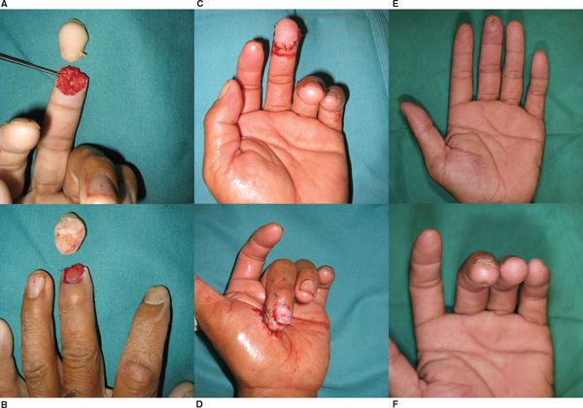
https://doctorlib.info/surgery/plastic/83.html

Slide 17
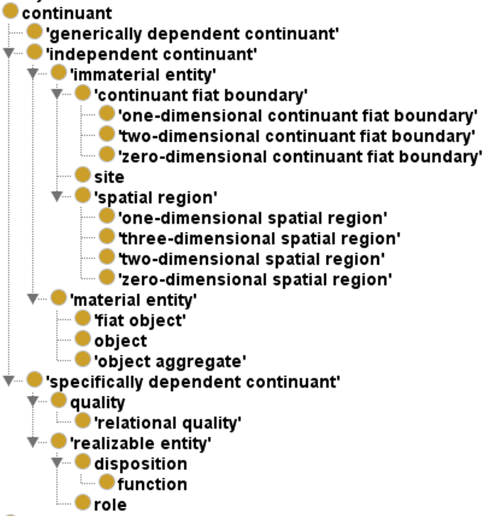
Basic
Formal Ontology
(2.0) hierarchy of continuants

Slide 18
Two major continuant types in BFO 1.0
Continuant
Independent
Continuant
Dependent
Continuant

Slide 19
Three major continuant types in BFO 2.0
Continuant
Independent
Continuant
Dependent
Continuant
IC
Specifically
dependent
continuant
Generically
dependent
continuant
SDC
GDC

Slide 20
Why the change?
Two dependency relations, both elucidated:
  S-dependence,
  G-dependence.
GDC is elucidated on the basis of g-dependence.
SDC is defined on the basis of s-dependence.
GDCs and SDCs ‘depend’ on ICs in different, incompatible, i.e. not generalizable ways.

Slide 21
Independent Continuant (IC)
Elucidation: an entity which does not ontologically depend on another entity.
Definition: b is an independent continuant =Def.
  b is a continuant which is such that there is no c such that b s-depends-on c and no c such that b g-depends-on c.
    ‘b s-depends-on c’ means: b and c do not share common parts & b is of a nature such that at all times t it cannot exist at t unless c exists at t & b is not a boundary of c.
    ‘b g-depends-on c at t’ means: there inheres in c an s-dependent continuant which concretizes b at t.
Examples: An atom, a molecule, an organism, a heart, a chair, the bottom right portion of a human torso, a leg; the interior of your mouth; a spatial region; an orchestra.
  ISO/IEC PRF 21838-2:2020(E)

Slide 22
Specifically Dependent Continuant (SDC)
Definition:
  b is a specifically dependent continuant =Def.
    b is a continuant
    & there is some independent continuant c
      which is not a spatial region
      & which is such that b s-depends on c.
Examples:
  with one bearer:
    The mass of this tomato, the pink colour of a medium rare piece of grilled filet mignon at its centre, the smell of this portion of mozzarella,
  with multiple bearers:
    love, authority
  ISO/IEC PRF 21838-2:2020(E)

Slide 23
Generically Dependent Continuant (GDC)
Elucidation: a generically dependent continuant is an entity that exists in virtue of the fact that there is at least one of what may be multiple copies; it is the content or the pattern that the multiple copies share.
Examples:
  The pdf file of which a copy is on laptop a, the pdf file that is a copy thereof on laptop b;
  the sequence of this protein molecule; the sequence that is a copy thereof in that protein molecule;
  the content of a sentence;
  an engineering blueprint.
  ISO/IEC PRF 21838-2:2020(E)

Slide 24
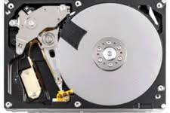
GDCs require SDCs
Generically
dependent
continuant
Instance of at
BMI508-2023
syllabus
concretizes at
Instance of at
BMI508-2023
syllabus copy 1
Specifically
dependent
continuant
concretizes at
Instance of at
BMI508-2023
syllabus copy 2
Independent
Continuant
Instance of at
inheres in (at)
inheres in (at)
g-depends-on at
Instance of at
g-depends-on at

Slide 25
Material and Immaterial Entity
Independent Continuant
Material Entity
Immaterial Entity
Elucidation: A material entity is an independent continuant that at all times at which it exists has some portion of matter as continuant part.
Definition: a is an immaterial entity =Def. a is an independent continuant which is such that there is no time t when it has a material entity as continuant part at t
  ISO/IEC PRF 21838-2:2020(E)

Slide 26

Material Entity
Material Entity
Fiat Object Part
Object
Object Aggregate

Slide 27


Material Entity
Material Entity
Object
Object
Object Aggregate

Slide 28
Material Entity
Material Entity
Object
Object
Object Aggregate
?

Slide 29
Object
An object is a Material Entity which is:
  spatially extended in three dimensions,
  causally unified,
  maximally self-connected.
Arp, R., B. Smith, and A.D. Spear,
Building ontologies with basic formal ontology. 2015,
The MIT Press,: Cambridge, Massachusetts. p. 1 online resource (245 p).

Slide 30
Object
Elucidation: an object is a material entity which manifests causal unity & is of a type instances of which are maximal relative to the sort of causal unity manifested [024-BFO]
Examples: an organism, a fish tank, a planet, a laptop, a valve, a block of marble, an ice cube.
  ISO/IEC PRF 21838-2:2020(E)

Slide 31
‘b is causally unified’ means:
b is a material entity which is such that its material parts are tied together in such a way that, in environments typical for entities of the type in question,
  if c, a continuant part of b that is in the interior of b at t, is larger than a certain threshold size (which will be determined differently from case to case, depending on factors such as porosity of external cover) and is moved in space to be at t′ at a location on the exterior of the spatial region that had been occupied by b at t, then either b’s other parts will be moved in coordinated fashion or b will be damaged in the interval between t and t′.
  causal changes in one part of b can have consequences for other parts of b without the mediation of any entity that lies on the exterior of b.
BFO 2.0 Specifications

Slide 32
Forms/Criteria of causal unity (CU)
CU₁ - Causal unity via physical covering:
  Skin of animals,
  Cell membrane of a cell.
CU₂ - Causal unity via internal physical forces:
  Atoms in molecules,
  Molecules in a protein aggregate,
  Rock.
CU₃ - Causal unity via engineered assembly of components:
  Car.
BFO 2.0 Specifications

Slide 33
b is maximal relative to some criterion of causal unity CU_{n}
means:
b is causally unified relative to CU_{n} at t
and, if :
for some t and c
  b continuant_part_of c at t
  & c is causally unified relative to the same CU_{n}
  then: b and c are identical.
BFO 2.0 Specifications

Slide 34
continuant part of at
Elucidation: ‘b continuant part of c at t’ means:
  b and c are continuants &
  b is a part of c at t.
      because the informal expression ‘part’ is used in both definiens and definiendum, this is not a definition.
Domain: continuant
Range: continuant
Examples:
  Mary’s arm continuant part of Mary in the time of her life prior to her operation;
  the Northern hemisphere of the planet Earth is a continuant part of the planet Earth at all times at which the planet Earth exists.
  ISO/IEC PRF 21838-2:2020(E)

Slide 35
Object aggregate
Elucidation: an object aggregate is a material entity consisting exactly of a plurality (≥1) of objects as member parts which together form a unit.
    ‘Exactly’ means that there are no parts of the object aggregate other than its member parts.
Examples:
  a symphony orchestra,
  the aggregate of bearings in a constant velocity axle joint,
  the nitrogen atoms in the atmosphere,
  a collection of cells in a blood biobank.
  ISO/IEC PRF 21838-2:2020(E)

Slide 36
member part of at
Definition: b member part of c at t =Def.
  b is an object
  & c is an object aggregate
  & there is at t a mutually exhaustive and pairwise disjoint partition of c into objects x₁, …, x_{n} (for some n ≥ 1) with b = x_{i} (for some 1 ≤ i ≤ n)
Domain: object
Range: object aggregate
Examples:
  Each tree in a forest is a member part of the forest;
  each Beatle in the collection called The Beatles is a member part of The Beatles;
  each human being is a member part of the population homo sapiens.
  ISO/IEC PRF 21838-2:2020(E)

Slide 37
Fiat Object Part
Elucidation: a fiat object part b is a material entity which is such that for all times t, if b exists at t then there is some object c such that b is a proper continuant part of c at t and b is demarcated from the remainder of c by one or more fiat surfaces.
Examples:
  The upper and lower lobes of the left lung,
  the dorsal and ventral surfaces of the body,
  the Western hemisphere of the Earth,
  the FMA:regional parts of an intact human body.
  ISO/IEC PRF 21838-2:2020(E)

Slide 38
proper continuant part of at
Definition:
  b proper continuant part of c at t =Def. b continuant part of c at t & not (c continuant part of b at t)
Domain: continuant
Range: continuant
  ISO/IEC PRF 21838-2:2020(E)

Slide 39
Fiat Surface
Elucidation: a fiat surface is a two-dimensional continuant fiat boundary that is self-connected.
Examples:
  the surface of the Earth,
  the plane separating the smoking from the non-smoking zone in a restaurant,
  the surface of the moon,
  the boundary between the upper and lower hemisphere of the moon,
  the surface of a tennis ball,
  the surface of a tabletop.
  ISO/IEC PRF 21838-2:2020(E)

Slide 40
Fiat Object Part ←→ Fiat Surface
Independent Continuant
Material Entity
Immaterial Entity
Fiat Object Part
Fiat Surface

Slide 41
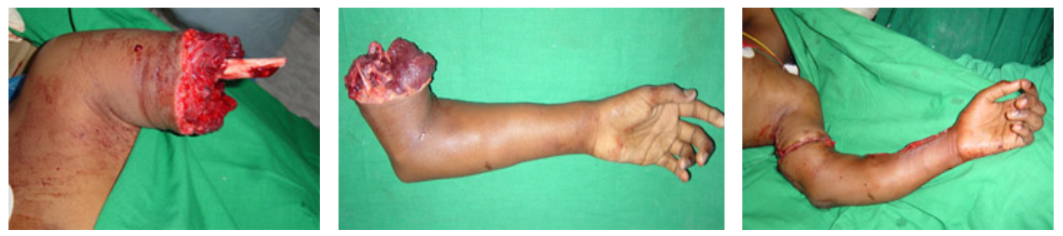
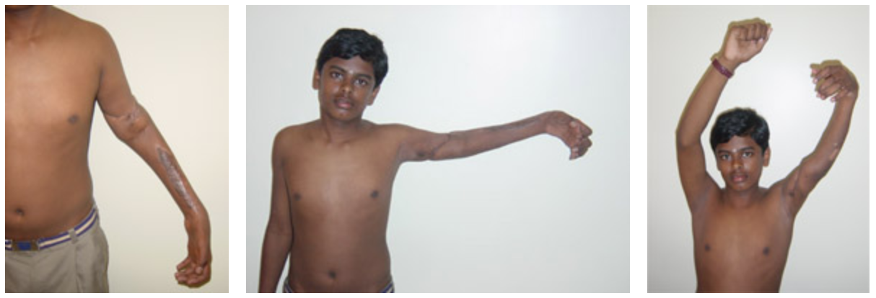
Traumatic amputation and replantation
http://www.gangahospital.com/plasticsurgery/microsurgeryandreplantation/MajorLimbReplantation.php

Slide 42
Borderline cases
Material Entity
Fiat Object Part
Object
Object Aggregate
Hurricane
Sand storm
Flame
Ocean wave
…

Slide 43
Immaterial Entity
Immaterial Entity
Continuant Fiat
Boundary
Site
Spatial Region
0-d SR
3-d SR
0-d CFD
2-d CFD
Fiat Point
Fiat Surface
1-d SR
2-d SR
1-d CFD
Fiat Line
Arp, R., B. Smith, and A.D. Spear,
Building ontologies with basic formal ontology. 2015,
The MIT Press,: Cambridge, Massachusetts. p. 1 online resource (245 p).
  ISO/IEC PRF 21838-2:2020(E)

Slide 44
Continuant Fiat Boundary
Elucidation:
b is a continuant fiat boundary means:
  b is an immaterial entity that is of zero, one or two dimensions,
  is such that there is no time t when b has a spatial region as continuant part at t,
  and whose location is determined in relation to some material entity.
  ISO/IEC PRF 21838-2:2020(E)

Slide 45
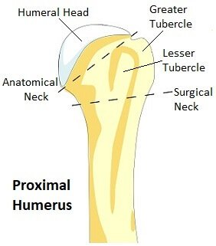
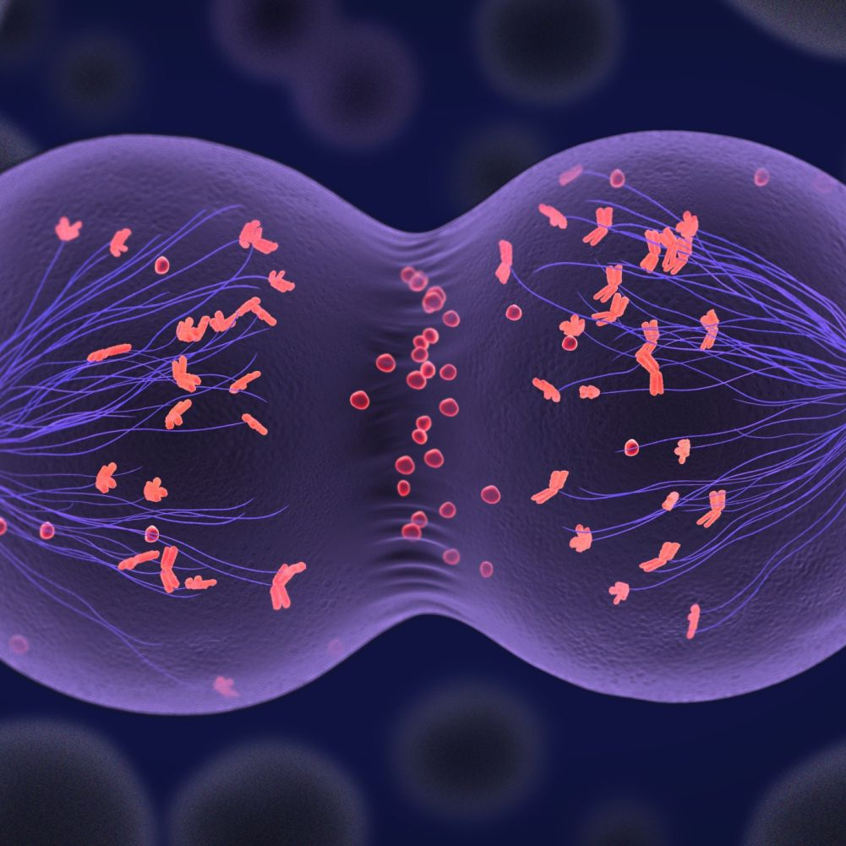
Continuant Fiat Boundary
https://www.thoughtco.com/meiosis-study-guide-373508
https://www.shoulder-pain-explained.com/proximal-humerus-fracture.html

Slide 46
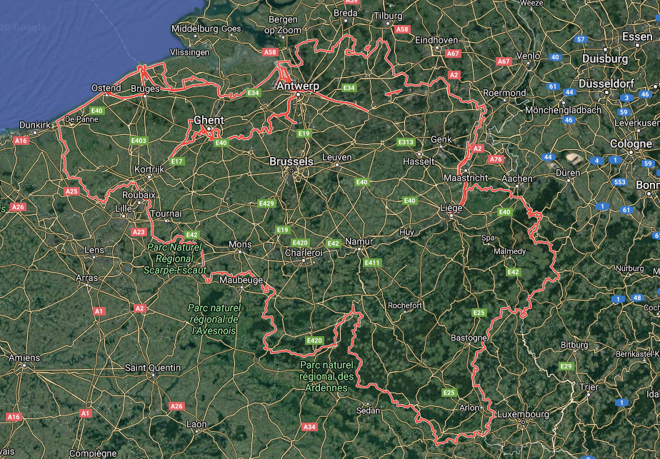

Slide 47
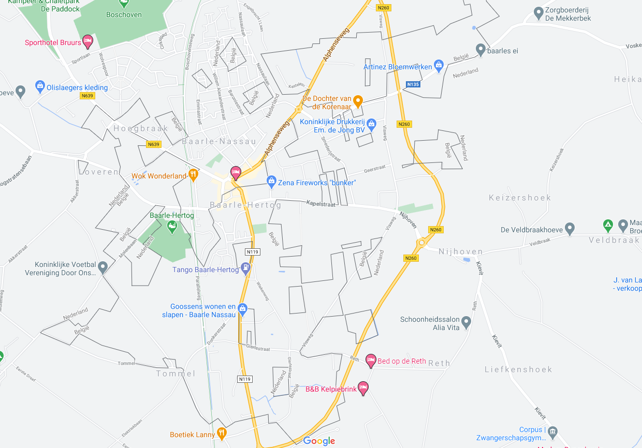
https://en.wikipedia.org/wiki/Baarle-Hertog

Slide 48
Spatial Region (1)

Slide 49

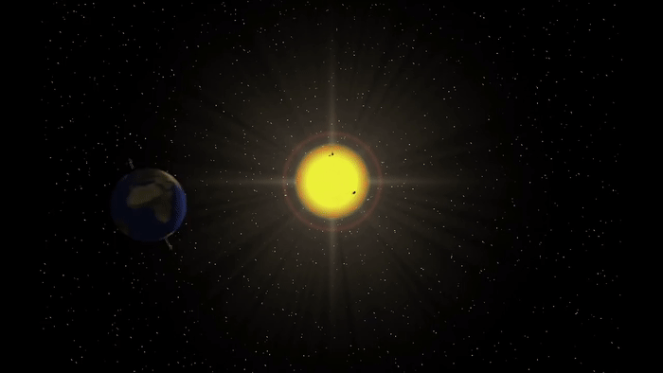
Spatial region (2)

Slide 50
Site
Elucidation: b is a site means: b is a 3-D immaterial entity whose boundaries either
  (1) (partially or wholly) coincide with the boundaries of one or more material entities or
  (2) have locations determined in relation to some material entity.
Examples: A hole in a portion of cheese, a rabbit hole, the Grand Canyon, the Piazza San Marco, the kangaroo-joey-containing hole of a kangaroo pouch, your left nostril (a fiat part – the opening – of your left nasal cavity), the lumen of your gut, the hold of a ship, the interior of the trunk of your car, a hole in an engineered floor joist.
  ISO/IEC PRF 21838-2:2020(E)

Slide 51
Specifically Dependent Continuant
Specifically Dependent Continuant
Quality
Realizable
Entity
Relational
Quality
Disposition
Role
Function
Arp, R., B. Smith, and A.D. Spear,
Building ontologies with basic formal ontology. 2015,
The MIT Press,: Cambridge, Massachusetts. p. 1 online resource (245 p).

Slide 52
Specifically Dependent Continuant
Specifically Dependent Continuant
Quality
Realizable
Entity
Elucidation: a quality is a specifically dependent continuant that, in contrast to roles and dispositions, does not require any further process in order to be realized.
Elucidation: b is a realizable entity means: b is a specifically dependent continuant that inheres in some independent continuant which is not a spatial region and is of a type some instances of which are realized in processes of a correlated type.
  ISO/IEC PRF 21838-2:2020(E)

Slide 53
Realizables and realizations
Continuant
Occurrent
Realizable entity
Process
Fragility of a glass
Skill of a craftsman
Role of a student
Function of a heart
Breaking
Constructing
Studying
Beating

Slide 54
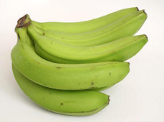
Quality
Object
Quality
isa
isa
Banana
isa
Color
isa
Green
instance
of at t₁
isa
instance of at t₁
Yellow
isa
Brown
Black

Slide 55
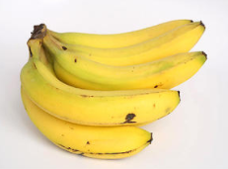
Quality
Object
Quality
isa
isa
Banana
isa
Color
isa
Green
instance
of at t₂
isa
instance of at t₂
Yellow
isa
Brown
Black

Slide 56
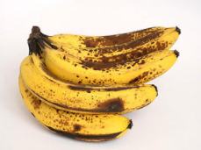
Quality
Object
Quality
isa
isa
Banana
isa
Color
isa
Green
instance
of at t₃
isa
Yellow
isa
Brown
instance of at t₃
Black

Slide 57
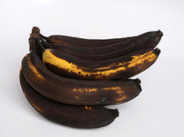
Quality
Object
Quality
isa
isa
Banana
isa
Color
isa
Green
instance
of at t₄
isa
Yellow
isa
Brown
Black
instance of at t₄

Slide 58
Relational Quality
Definition: b is a relational quality =Def. b is a quality and there exists c and d such that c and d are not identical, & b s-depends on c & b s-depends on d.
Quality
Relational
Quality
Instance of at t
isa
Instance
of at t
John’s love
for Mary
Instance
of at t
Mary’s love
for John
s-depends on
Mary
s-depends on
s-depends on
The love between
Mary and John
John
s-depends on

Slide 59
Realizable Entity
Realizable Entity
Disposition
Role
Elucidation: b is a disposition means:
b is a realizable entity
& this realization occurs
in virtue of the bearer’s physical make-up, and when and because this bearer is in some special physical circumstances,
& b is such that if it ceases to exist, then its bearer is physically changed.
Elucidation: b is a role means:
b is a realizable entity
& b exists because there is some single bearer that is in some special physical, social, or institutional set of circumstances in which this bearer does not have to be,
& b is not such that, if it ceases to exist, then the physical make-up of the bearer is thereby changed
  ISO/IEC PRF 21838-2:2020(E)

Slide 60
Function
Elucidation: A function is a disposition that exists in virtue of the bearer’s physical make-up and this physical make-up is something the bearer possesses because it came into being, either through evolution (in the case of natural biological entities) or through intentional design (in the case of artefacts), in order to realize processes of a certain sort.
Examples:
  The function of a hammer to drive in nails,
  the function of a heart pacemaker to regulate the beating of a heart through electricity.
  ISO/IEC PRF 21838-2:2020(E)

Slide 61
Function / role
Object #1 is designed to do y-type processes:
  → ‘to do y-type processes’ is #1’s function.
Object #1 is bought by somebody to do only z-type processes:
  → ‘to do y-type processes’ is still its function
  → ‘to do z-type processes’ is an acquired role.
Object #1 is then bought by somebody to do only w-type processes:
  → ‘to do y-type processes’ is still its function,
  → ‘to do w-type processes’ is an acquired role,
  → the role ‘to do z-type processes’ is lost.

Slide 62
!!!!
You do not need to know all these details by heart
but
You must be able to correctly apply them!

