Slide 1
BMI508 – Fall 2023
Introduction to Biomedical Ontology
Class 11 – Nov 8, 2023
Ontology merging and matching
Werner CEUSTERS^{1,2}
¹ Department of Biomedical Informatics, University at Buffalo, USA
² Department of Psychiatry, University at Buffalo, USA

Slide 2
The popular view on ‘ontology’
A formal specification of …
a shared and agreed upon conceptualization of
a domain.
Some portion of either (1) the world or a world.
Some ‘view’ of either (1) what the terms used in the language are supposed to mean, or (2) how the domain is ‘modelled’ for some purpose
Some language with formal syntax and ‘semantics’

Slide 3
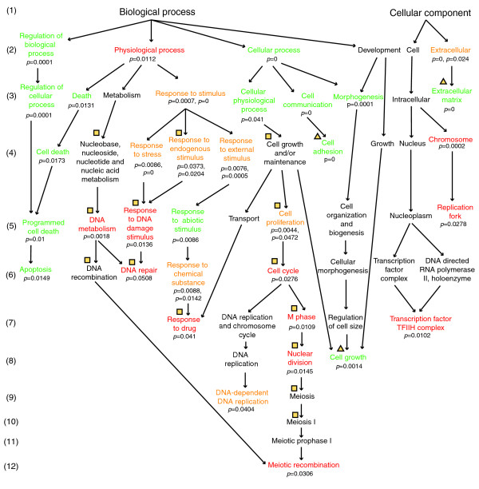
The most popular type of structure
A directed (acyclic) graph whose nodes are ‘concepts’ seen as referring to what are called ‘classes’, and the edges to relationships.

Slide 4
The problem with ‘conceptualization’ (1)
‘For example, consider an ontology describing traffic connections in Amsterdam, which includes such concepts as roads, cycle tracks, canals, bridges, and so on. If we adapt the ontology to describe not only the bicycle perspective but also a water-transport perspective, the conceptualization of a bridge changes from a remedy for crossing a canal to a time consuming obstacle.’
Natalya F. Noy and Michel Klein. Ontology evolution: Not the same as schema evolution. Knowledge and Information Systems, 5, 2003.

Slide 5
The problem with ‘conceptualization’ (1)
‘For example, consider an ontology describing traffic connections in Amsterdam, which includes such concepts as roads, cycle tracks, canals, bridges, and so on. If we adapt the ontology to describe not only the bicycle perspective but also a water-transport perspective, the conceptualization of a bridge changes from a remedy for crossing a canal to a time consuming obstacle.’
Bridges and roads in Amsterdam are not concepts!
Natalya F. Noy and Michel Klein. Ontology evolution: Not the same as schema evolution. Knowledge and Information Systems, 5, 2003.

Slide 6
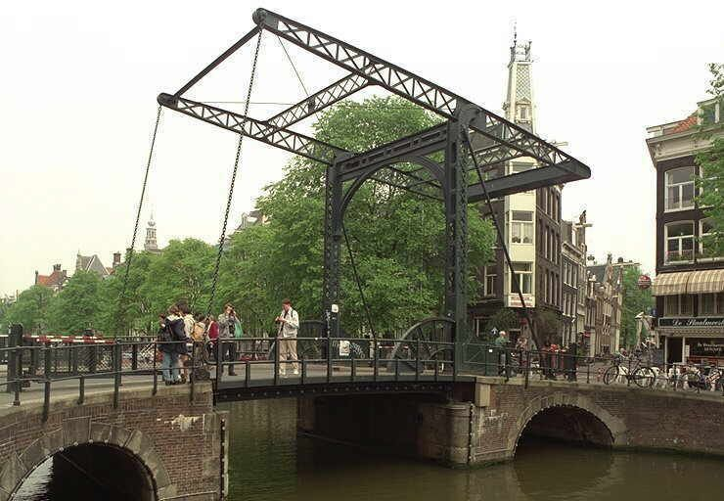
Amsterdam bridge

Slide 7
The problem with ‘conceptualization’ (2)
‘For example, consider an ontology describing traffic connections in Amsterdam, which includes such concepts as roads, cycle tracks, canals, bridges, and so on. If we adapt the ontology to describe not only the bicycle perspective but also a water-transport perspective, the conceptualization of a bridge changes from a remedy for crossing a canal to a time consuming obstacle.’
It is not the case that bridges in Amsterdam ‘ARE’ remedies or obstacles in the same sense as they ‘ARE’ bridges.
Natalya F. Noy and Michel Klein. Ontology evolution: Not the same as schema evolution. Knowledge and Information Systems, 5, 2003.

Slide 8
Therefore ...
Any such conceptualization is a distortion of the world,
Any specification that result from it is a distortion,
Rather than bridges, this way of dealing with conceptualizations presents an obstacle,
For sure an obstacle for what is in the area of ontology mapping, matching, merging, alignment, ...
  Note: we use ‘matching’ in what follows for any such initiative.

Slide 9
What is mapping, matching ... (1)
‘Given two ontologies A and B, mapping one ontology with another means that for each concept (node) in ontology A, we try to find a corresponding concept (node), which has the same or similar semantics, in ontology B and vice verse.’
M. Ehrig M and Y. Sure, Ontology mapping - an integrated approach. In Proceedings of the First European Semantic Web Symposium, ESWS 2004, volume 3053 of Lecture Notes in Computer Science, pages 76–91, Heraklion, Greece, May 2004. Springer Verlag.

Slide 10
What is mapping, matching ... (2)
‘the task of relating the vocabulary of two ontologies in such a way that the mathematical structure of ontological signatures and their intended interpretations, as specified by the ontological axioms, are respected.’
NB: ontological signature: ‘a hierarchy of concept symbols together with a set of relations symbols whose arguments are defined over the concepts of the concept hierarchy.’
Y. Kalfoglou and M. Schorlemmer, Ontology mapping: the state of the art. Knowl. Eng. Rev., 18(1):1--31, 2003.

Slide 11
What is mapping, matching ... (3)
‘a formal expression that states the semantic relation between two entities belonging to different ontologies’
‘Simple examples are:
  concept c1 in ontology O1 is equivalent to concept c2 in ontology O2;
  concept c1 in ontology O1 is similar to concept c2 in ontology O2;
  individual i1 in ontology O1 is the same as individual i2 in ontology O2’
P. Bouquet et al. KnowledgeWeb deliverable D2.2.1. Specification of a common framework for characterizing alignment.

Slide 12
Ontology Matching Methods
Shared vocabulary
Upper-level ontology
Instance-based matching
Van Harmelen F. Formal frameworks for interoperability. (tutorial slides)

Slide 13
Unfortunately, success is difficult to measure
‘there is no common understanding of what to align, how to provide the results and what is important’
‘human experts do not agree on how ontologies should be merged, and we do not yet have a good enough metric for comparing ontologies’
J. Euzénat et al. KnowledgeWeb Deliverable D2.2.3: State of the art on ontology alignment. V1.2, August 2004.
N.F. Noy and M.A. Musen, Evaluating Ontology-Mapping Tools: Requirements and Experience. Workshop on Evaluation of Ontology Tools at EKAW'02 (EON2002). 2002, p1-14.

Slide 14
A realism-based metric
Define a metric for quality assurance in ontology matching efforts,
based on what the expressions in ontologies are intended to refer to in reality.
That is, we hold that ontology matching is possible only if we view expressions in terms of that in reality to which they are believed to refer.
But: we do not propose a method for matching itself !
Ceusters W.
Towards A Realism-Based Metric for Quality Assurance in Ontology Matching.
In: Bennett B, Fellbaum C. (eds.) Formal Ontology in Information Systems, IOS Press, Amsterdam, 2006;:321-332. Proceedings of FOIS-2006, Baltimore, Maryland, November 9-11, 2006.

Slide 15
Requirement for an adequate metric
Must be able to deal with a variety of problems by which ontology matching endeavors thus far have been affected
  different ontology authors may have different though still veridical views on the same reality,
  ontology authors may make mistakes,
    when interpreting reality, or
    when formulating their interpretations in their chosen ontology language
  a matcher can not always be sure without input from the authors to what the expressions in an ontology actually refer (no God’s eye perspective),
  if two ontologies are developed at different times, reality itself may have changed in the intervening period.

Slide 16
One way to get there
have experts manually prepare for each given matching problem a gold standard to which matching efforts could be compared.
      M. Ehrig and J. Euzenat, Relaxed Precision and Recall for Ontology Matching, in: Proc. K-Cap 2005 workshop on Integrating ontology, Banff (CA), p. 25-32, 2005.
But
  Is very expensive
  Who are the experts ?
  Sometimes cannot be done for ‘political’ reasons:
    UMLS metathesaurus

Slide 17
A proposal
Measure what has been gained
i.e.: count the improvements that have been effected when the results of a given matching are compared to the ontologies as they had existed earlier, or whether the integration of two ontologies is an improvement over either of the input ontologies taking into account the purposes for which the ontologies have been built.

Slide 18
Background assumptions on matching (1)
Expressions from two or more ontologies can be considered for matching purposes only if they are built out of representational units which refer to instance-level portions of reality which overlap.
    ‘All mammals are vertebrates’
    ‘All fish are animals’
The referents of two expressions are said to overlap if either they or the referents of expressions from out of which they are composed are such that the portions of reality referred to by these expressions share parts.
    ‘All whales are animals’
    ‘All whales are vertebrates’

Slide 19
Background assumptions on matching (2)
Note that the ontologies in certain domains do not overlap because they contain expressions of the given sorts.
Rather, such expressions are (should be) included, and associated relations posited, because of the relationships that obtain in reality between the corresponding entities
  E.g. between spinal fractures and spines, between lung cancers and lungs.

Slide 20
Methodology based on a realist view of the world
The world exists ‘as it is’ prior to a cognitive agent’s perception thereof;
Cognitive agents build up ‘in their minds’ cognitive representations of the world;
To make these representations publicly accessible in some enduring fashion, they create representational artifacts that are fixed in some medium.
Smith B, Kusnierczyk W, Schober D, Ceusters W. Towards a Reference Terminology for Ontology Research and Development in the Biomedical Domain. Proceedings of KR-MED 2006, November 8, 2006, Baltimore MD, USA

Slide 21
But beware !
Are these representationals artifacts representations of these cognitive representations?
No! They are representations of that part of reality of which cognitive agents have built a cognitive representation
  They are like the images taken by means of a high quality camera;

Slide 22

They are not like the paintings of Dali
Non-canonical anatomy

Slide 23
Representational artifacts
Ideally built out of representational units and relationships that mirror the entities and their relationships in reality.
 | Non-Formalized | Formalized
Primarily about particulars | Progress notes, discharge letters, medical summaries, maps | Inventories, referent tracking database
Primarily about universals and defined classes | Medical textbooks, scientific theories | Ontologies, terminologies,

Slide 24
What influences the development of ontologies?
Level of reality:
  In healthcare: persons, diseases, pathological structures and formations,... do exist as particulars (p, d, ps, pf, ... ) and universals (P, D, PS, PF, ...), and are related in specific ways prior to our perception;
  Reality changes:
    d’s, p’s, ... come and go;
Level of science and case perception:
  Mirrors reality only partially
  Evolves over time towards better understanding

Slide 25
What influences the development of ontologies?
Level of concretizations
  Mirrors science and case perception only partially
    Editing mistakes
    In healthcare: leaving out diseases or pathological behaviours for non-biomedical reasons
      Smoking
    Adding non-pathological behaviour as a disease
      Homosexuality
    Leaving out wat is considered not relevant

Slide 26
Some characteristics of representational units
each unit is assumed by the creators of the representation to be veridical, i.e. to conform to some relevant POR as conceived on the best current scientific understanding
several units may correspond to the same POR by presenting different though still veridical views or perspectives;
what is to be represented by the units in a representation depends on the purposes which the representation is designed to serve.

Slide 27
Reality versus representations
t
U1
U2
Reality
p3
IUI-#3
O-#0
O-#2
Repr.
O-#1
= “refers to”
= what constitutes the meaning of representational units
…. Therefore: O-#0 is meaningless

Slide 28
configuration | reality |  | representation |  |  |  | ME
 |  |  | authors' belief |  | encoding
 | OE | OR | BE | BR | IE | TR
(1) | (2) | (3) | (4) | (5) | (6) | (7) | (8)
P+1 | Y | Y | Y | Y | Y | R+ | 0
A+1 | N | na | N | na | na | na | 0
A+2 | Y | N | Y | N | na | na | 0
A+3 | Y | N | NC | na | na | na | 0
A+4 | N | na | NC | na | na | na | 0
P-1 | N | na | Y | Y | Y | ¬R | 3
P-2 | N | na | Y | Y | N | ¬R | 4
P-3 | N | na | Y | Y | N | R– | 5
P-4 | Y | Y | Y | Y | N | ¬R | 1
P-5 | Y | Y | Y | Y | N | R- | 2
P-6 | Y | N | Y | Y | Y | R+ | 1
P-7 | Y | N | Y | Y | N | ¬R | 2
P-8 | Y | N | Y | Y | N | R– | 3
P-9 | Y | Y | Y | Y | Y | R++ | 1
P-10 | Y | N | Y | Y | Y | R++ | 2
P-11 | Y | Y | Y | Y | Y | Ra | 1
P-12 | N | na | Y | Y | Y | Ra | 4
A-1 | Y | Y | Y | N | na | na | 1
A-2 | Y | Y | N | na | na | na | 1
A-3 | N | na | Y | N | na | na | 1
A-4 | Y | N | N | na | na | na | 1
A-5 | Y | Y | NC | na | na | na | 1

Slide 29
Positions towards O¹ + O² → O^{m}
There is only one reality
  It can’t be that in O¹ something is referred to that wouldn’t be able to be referred to in O²
the relevance of a POR is to be assessed in light of the purposes for which the resultant mapped or merged ontology is being created, not in terms of the original purposes of the individual ontologies (although they can be assessed as being the same);
everything that exists or has existed can be referred to (where necessary by using appropriate temporal indices).

Slide 30
Reality exist before any observation
R
And also most structures in reality are there a priori

Slide 31
The author of O¹ acknowledges the existence of some Portion Of Reality (POR)
B¹
Some portions of reality
escape his attention.
R

Slide 32
He considers only some of them relevant for O¹, represents thus only part, here with IE = R+.
B¹
Both RU₁^{B1} and RU₁^{O1} are representational units referring to #1; they are concretizations of one and the same instance of GDC.
RU₁^{O1} is NOT a representation of RU₁^{B1};
RU₁^{O1} is created in correspondence with RU₁^{B1}.
RU₁^{B1}
RU₁^{O1}
O¹
#1
R

Slide 33
Similar concerning the author of O²
B¹
B²
O²
O¹
R

Slide 34
Creation of the mapping
B¹
B²
O^{m}
O²
O¹
R

Slide 35
Two (out of many other) possible configurations
#1 was not considered to be relevant for O², but is relevant for O^{m}.
The author of O¹ made an encoding mistake such that his ontology contains a reference to a non-intended referent, and this is copied into O^{m}.

Slide 36
Matching as QA procedure for the source Ontology
E.g. : if it is believed that for purpose pO^{m} of a merged ontology O^{m} a certain POR is relevant (because so suggested by its presence in O¹ ), and that for purpose pO² it is not, then one must also believe that if O² would be used for pO^{m} then there is an unjustified absence of an expression, namely one characterized as being of type A-1.
From the chart displayed earlier: a type A-1 situation scores 1 point less than the intended P+1.

Slide 37
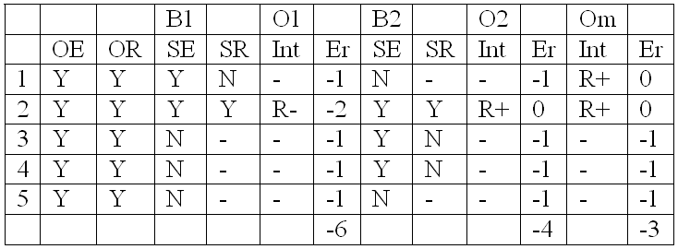
A toy example to clarify the principles
(here assuming all PORs relevant)

Slide 38
The original beliefs are usually not accessible
B¹
B²
O^{m}
O²
O¹
R

Slide 39
The original beliefs are usually not accessible
But if the ontologies are well documented and representations intelligible, then many such beliefs can be inferred, and mistakes found.
O^{m}
O²
O¹
R

Slide 40
For concept-based systems, there is also no reality
O^{m}
O²
O¹
R

Slide 41
But the combined belief that must hold if both ontologies are right, can be believed to mirror reality
O^{m}
O²
O¹

Slide 42
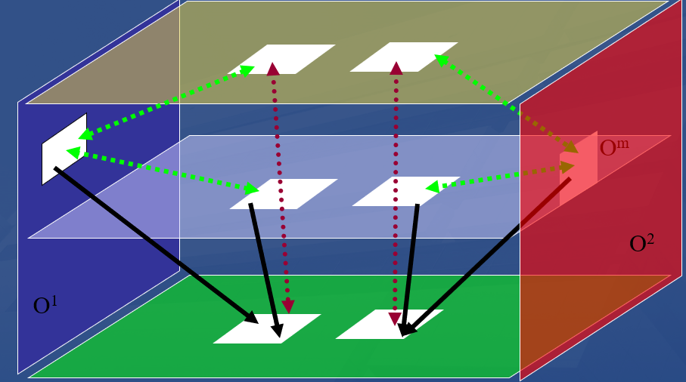
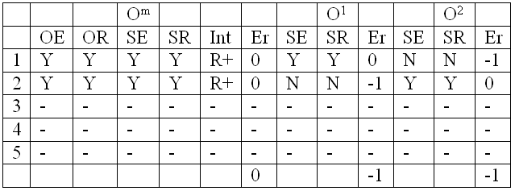
The principle of forced backward belief
A lot of information loss

Slide 43
To compensate for that loss
Apply a documentation method for successive versions of the same ontology specifying clearly the reasons for any change:
  Believed change in reality
  Change in belief about reality
  Change in relevance
  Correction of encoding error.
Ceusters W, Smith B. A Realism-Based Approach to the Evolution of Biomedical Ontologies. Forthcoming in Proceedings of AMIA 2006, Washington DC, November 11-15, 2006.

Slide 44
A decision support tool for dealing with inconsistencies ?
O¹:
  Holds that pinguins are birds, birds fly
O²:
  Holds that pinguins are birds, pinguins don’t fly
The problem for O^{m}:
  Which source ontology to believe?
  What might be the source of the inconsistency ?
    O¹ is right and pinguins do fly
    O¹ is wrong and either pinguins are not birds or not all birds fly
    Both are right but the representational units ‘pinguin’, ‘bird’ and ‘fly’ do not refer to the same entities in reality.

Slide 45
Conclusion
We have sketched the theoretical foundations of what can become a method to assess the quality of ontology mappings in quantitative terms taking into account the purposes of the source and merger ontologies.
The method is also able to detect inconsistencies in source ontologies
  perhaps it offers some help to know which of the two ontologies is in error
Although explained for realism-based ontologies, we believe it can be used for concept-based ontologies as well by assuming that the ‘concepts’ in seriously crafted ontologies indeed do refer to entities in reality.

