Slide 1
BMI508 – Fall 2020
Introduction to Biomedical Ontology
Class 6 – Oct 7, 2020
Relations in Biomedical Ontologies
Werner CEUSTERS^{1,2}
¹ Department of Biomedical Informatics, University at Buffalo, USA
² Department of Psychiatry, University at Buffalo, USA

Slide 2
Essentials
Distinguishing what is denoted by ‘relation’ in technical sense (‘formal relations’) from what is denoted by ‘relation’ in non-formal language (‘material relations’);
Differences between type-level formal relations, particular-level formal relations and particular-type-level formal relations;
Arity and other properties of formal relations and differences thereof between particular-type formal relations and their corresponding type-level formal relations;
Elucidation versus definition of formal relations;
‘Basic’ formal relations versus ‘shortcut’ formal relations;
Axiomatic characterization of formal relations (Class C13).

Slide 3
Distinguishing what is denoted by ‘relation’ in technical sense from what is denoted by ‘relation’ in non-formal language

Slide 4
‘John is in a relation with Mary’

Slide 5
‘Relations’
(mainstream view)
Relations:
  ‘entities that glue together other entities’
  Formal relations:
    ‘hold between two or more entities directly, without any further intervening individual’.
  Material relations:
    ‘have material structure on their own’.
        = are entities
    Guizzardi & Wagner. What’s in a Relationship: An Ontological Analysis. In: Qing Li, Stefano Spaccapietra, Eric Yu, Antoni Olivé (Eds.), Conceptual Modeling - ER 2008. Lecture Notes in Computer Science, Vol. 5231, 83-97, 2008 https://doi.org/10.1007/978-3-540-87877-3_8↗

Slide 6
Material relation
‘John is in a relation with Mary’
isAbout at t
JM Romantic relationship
John
Mary

Slide 7
Material relation
‘John is in a relation with Mary’
isAbout at t
JM Romantic relationship
John
Mary
instanceOf at t
BFO:Object
BFO:Relational Quality

Slide 8
Material relation
‘John is in a relation with Mary’
isAbout at t
inheresIn at t
JM Romantic relationship
inheresIn at t
John
Mary
instanceOf at t
BFO:Object
BFO:Relational Quality

Slide 9
Material relation
‘John is in a relation with Mary’
isAbout at t
inheresIn at t
JM Romantic relationship
inheresIn at t
John
Mary
instanceOf at t
BFO:Object
BFO:Relational Quality

Slide 10
Material relation
‘John is in a relation with Mary’
isAbout at t
inheresIn at t
JM Romantic relationship
inheresIn at t
John
Mary
instanceOf at t
BFO:Object
BFO:Relational Quality

Slide 11
Material relations
‘have material structure on their own’
Are entities in their own right.
Relate other entities to each other by means of formal relations.
Examples: what might by some be denoted by:
  ‘patient’,
  ‘treatment’,
  ‘driver’.
Examples in BFO:
  relational qualities
      Have independent continuants as their bearers.
  relational processes: kissing, buying, …

Slide 12
Material relation
‘John is in a relation with Mary’
isAbout at t
inheresIn at t
JM Romantic relationship
inheresIn at t
John
Mary
instanceOf at t
BFO:Object
BFO:Relational Quality

Slide 13
Formal relations
‘John is in a relation with Mary’
isAbout at t
inheresIn at t
JM Romantic relationship
inheresIn at t
John
Mary
instanceOf at t
BFO:Object
BFO:Relational Quality

Slide 14
Formal relations
‘hold between two or more entities directly, without any further intervening individual’
Basic formal relations:
  existential dependence, inherence, subtype-of, part-of, subset-of, instantiation, …
Domain formal relations:
  ‘relations that exhibit similar characteristics, i.e., those relations of comparison such as is taller than, is older than, knows more Greek than’.
    Guizzardi & Wagner. What’s in a Relationship: An Ontological Analysis. In: Qing Li, Stefano Spaccapietra, Eric Yu, Antoni Olivé (Eds.), Conceptual Modeling - ER 2008. Lecture Notes in Computer Science, Vol. 5231, 83-97, 2008 https://doi.org/10.1007/978-3-540-87877-3_8↗

Slide 15
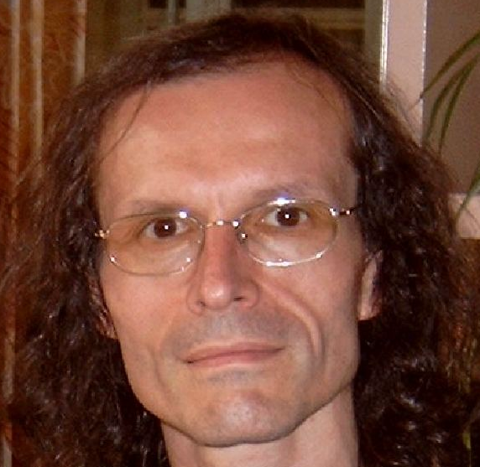
What is out there …
(… we want/need to deal with)?
portions of reality
formal
relations
configurations
relationships
participation
me participating in my life
types
particulars
universals
continuants
me
occurrents
representations
organism
defined
classes
my life

Slide 16
Relationships
‘John is in a relation with Mary’
isAbout at t
inheresIn at t
JM Romantic relationship
inheresIn at t
John
Mary
instanceOf at t
BFO:Object
BFO:Relational Quality

Slide 17
Configurations
‘John is in a relation with Mary’
isAbout at t
inheresIn at t
JM Romantic relationship
inheresIn at t
John
Mary
instanceOf at t
BFO:Object
BFO:Relational Quality

Slide 18
Configurations
‘John is in a relation with Mary’
isAbout at t
inheresIn at t
JM Romantic relationship
inheresIn at t
John
Mary
instanceOf at t
BFO:Object
BFO:Relational Quality

Slide 19
Configurations
‘John is in a relation with Mary’
isAbout at t
inheresIn at t
JM Romantic relationship
inheresIn at t
John
Mary
instanceOf at t
BFO:Object
BFO:Relational Quality

Slide 20
Configurations
‘John is in a relation with Mary’
isAbout at t
inheresIn at t
JM Romantic relationship
inheresIn at t
John
Mary
instanceOf at t
BFO:Object
BFO:Relational Quality

Slide 21
Relational PoRs ←→ relational expressions
‘Mary is patient of John’

Slide 22
Relational PoRs ←→ relational expressions
‘Mary is patient of John’
isAbout at t
Mary
John
patientOf at t
inheresIn at t
instanceOf
at t
Mary’s patient role
patient
role
instanceOf at t
Patient

Slide 23
Role (Externally-Grounded Realizable Entity)
role =def. a realizable entity
  which exists because the bearer is in some special physical, social, or institutional set of circumstances in which the bearer does not have to be, and
  is not such that, if it ceases to exist, then the physical make-up of the bearer is thereby changed.

Slide 24
Relational PoRs ←→ relational expressions
⁴
¹
²
³
‘Mary is patient of John’
isAbout at t
¹
Mary
John
patientOf at t
inheresIn at t
²
instanceOf
at t
Mary’s patient role
patient
role
instanceOf at t
Patient
³

Slide 25
Relational PoRs ←→ relational expressions
‘Mary is friend of John’

Slide 26
Relational PoRs ←→ relational expressions
‘Mary is friend of John’
isAbout at t
Mary
John
friendOf at t
inheresIn at t
inheresIn at t
M&J’s friendship
instanceOf at t
friendship

Slide 27
Properties of formal relations

Slide 28
Arity of a relation
Binary:
  My youth partOf my life
1 2
Ternary:
  My hand partOf me now
1 2 3
Quaternary:
  My left middle finger between my left index finger
    1 2
  and my left ring finger now
  3 4
…

Slide 29
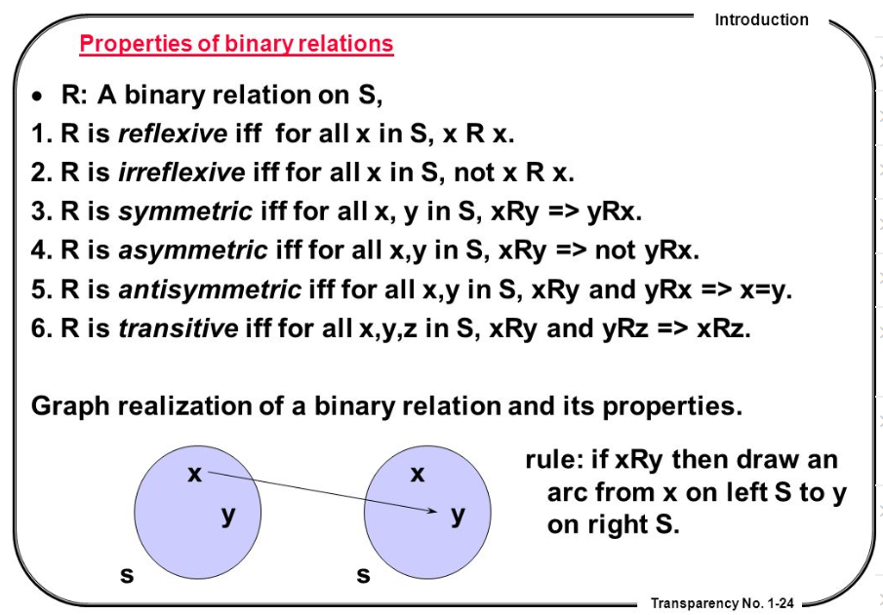
Properties of binary relations
http://en.ndncdc.org/page/symmetric-binary-relation-on-set/

Slide 30
Distinct levels at which formal relations exist

Slide 31
Relations in Ontological Realism
Instance-level relations
  Your heart (instance-level) continuant_part_of your body at t
  Your heart beating (instance-level) has_participant your heart at t
Instance-type relations
  John’s heart instantiates human heart at t.
  John’s heart beating instantiates human heart beating.
Type-level relations
  human heart continuant_part­_of human body
  human heart beating process has_occurrent_part beat profile

Slide 32
Features of relations on the level of instances may not hold on the level of universals
nucleus adjacent_to cytoplasm
  Not: cytoplasm adjacent_to nucleus
    Red blood cells don’t have a nucleus
seminal vesicle adjacent_to urinary bladder
  Not: urinary bladder adjacent_to seminal vesicle
    Women don’t have seminal vesicles
Adjacency as a relation between universals is not symmetric while it is symmetric at particular level.

Slide 33
the universal red
the universal eye
Instantiates at t
Instantiates at t
the particular case of redness (of a particular fly eye)
inheresIn at t
an instance of an eye (in a particular fly)

Slide 34
the universal
color
the universal
object
isa
isa
inheresIn ?
the universal red
the universal eye
Instantiates at t
Instantiates at t
the particular case of redness (of a particular fly eye)
inheresIn at t
an instance of an eye (in a particular fly)

Slide 35
Continuants versus Occurrents
Continuant
has_participant
Occurrent
e.g. pathological
process
is_a
is_a
Independent
Continuant
e.g. organism
G or S
Dependent
Continuant
e.g. patient role
inheres_in
instance_of
universals
instance_of at t
.... ..... .......
particulars

Slide 36
Remember forever !!!
Formal relations expressed in the BFO are all type-type relations.
    IC isa Continuant
    SDC specifically depends on IC
domain
range

Slide 37
Explicit in BFO
portions of reality
formal
relations
configurations
relationships
types
particulars
universals
continuants
occurrents
representations
defined
classes

Slide 38
Explicit in BFO-based domain ontologies
portions of reality
formal
relations
configurations
relationships
types
particulars
universals
continuants
occurrents
representations
defined
classes

Slide 39
Remember !!!
Formal relations expressed in the BFO are all type-type relations.
    IC isa Continuant
    SDC specifically depends on IC
BFO’s type-type relations don’t express anything about types, but only what is the case for all particulars in the domain position of the relation.
BFO’s type-type relations are defined / elucidated on the basis of instance-level relations.

Slide 40
Elucidations and definitions of formal relations

Slide 41


Slide 42
Elucidation of a formal relation
The instance_of relation holds between particulars and universals. It comes in two forms, for continuants (C, C1, …) and occurrents (P, P1, …) as follows:
  c instance_of C at t means: the particular continuant entity c instantiates the universal C at t
  p instance_of P means: the particular occurrent entity p instantiates the universal P.

Slide 43
Elucidation of a formal relation
x is_about y means:
  x refers to or is cognitively directed towards y.
      Domain: representations;
      Range: portions of reality.
      Axiom: if x is_about y then y exists (veridicality).
x concretizes y at t means:
  x is a quality & y is a generically dependent continuant
  & for some material entity z,
    x specifically_depends_on z at t &
    y generically_depends_on z at t
  & if y migrates from bearer z to another bearer w then a copy of x will be created in w.
Smith B, Ceusters W. Aboutness: Towards Foundations for the Information Artifact Ontology. International Conference on Biomedical Ontologies, ICBO 2015, Lisbon, Portugal, July 27-30, 2015;47-51.

Slide 44
Definition of a formal relation
x is_a_representation_of y =def.
  x is a representa­tion & x is_about y (where y is a portion of reality). Note that not all representations are about something.
x is_conformant_to y =def.
  x is an information quality entity &
  y is a cognitive representa­tion &
  there is some GDC g such that x concretizes g and y concretizes g.
  Example: x is a sentence on a piece of paper, y is the belief of the author of the sentence who wrote the sentence as an expression of her belief, and g is the ICE (the content) that belief and sentence share.
Smith B, Ceusters W. Aboutness: Towards Foundations for the Information Artifact Ontology. International Conference on Biomedical Ontologies, ICBO 2015, Lisbon, Portugal, July 27-30, 2015;47-51.

Slide 45
Elucidation versus definition
x is_about y means:
  x refers to or is cognitively directed towards y. Domain: representations; Range: portions of reality. Axiom: if x is_about y then y exists (veridicality).
‘A means B’:
    If A is the case, you can conclude that B holds.
    If B is the case, you cannot conclude anything re A.
x is_a_representation_of y =def.
  x is a representa­tion & x is_about y (where y is a portion of reality). Note that not all representations are about something.
‘A =def. B’ :
    If A is the case, you can conclude that B holds.
    If B is the case, you can conclude that A holds.
    If one doesn’t hold, the other one doesn’t hold.

Slide 46
Key idea in defining ontological relations
Not enough to look just at universals or types
We need also to take account of instances and time.
This will yield an automatic bridge to the instance data in information systems, databases, repositories, …

Slide 47
Type-level relations presuppose the underlying instance-level relations
A part_of B =def(roughly). All instances of A are instance-level-parts-of some instance of B
  e.g. human heart part_of human
A has_participant B =def(roughly). All instances of A have some instance of B as instance-level participant
  e.g. cell binding has_participant cell

Slide 48
the all-some form
A continuant_part_of B =def.
  for all instances a and times t,
  If a is an instance of the universal A at t,
  then there is some instance b of the universal B
  such that
  a is an instance-level part_of b at t
Domain: Continuant
Range: Continuant

Slide 49
Definitions of the all-some form allow cascading inferences
If A R₁ B and B R₂ C, then we know that:
  every A stands in R₁ to some B,
  whichever B this is, it can be plugged into the R₂ relation, because R₂ is defined for every B.
Also allows for the definition of ‘shortcut’ relations:
  A R₃ C =def. A R₁ B and B R₂ C

Slide 50
How to define A is_a B
A is_a B =def.
  A and B are names of universals (natural kinds, types) in reality or of defined classes
  all instances of A are as a matter of science also instances of B
  for all times t, all instances of A at t are as a matter of science also instances of B at t

Slide 51
Formal BFO definition for is_a
The is_a relation is the subtype or subuniversal relation between universals or types.
  C is_a C1 =def.:
    C and C1 are continuant universals, and
    for all c, t, if c instance_of C at t then c instance_of C1 at t
  P is_a P1 =def.:
    P and P1 are occurrent universals, and
    for all p, if p instance_of P then p instance_of P1

Slide 52
Compare with RDFS / OWL
AXIOM SCHEMA: class description rdfs:subClassOf class description
The rdfs:subClassOf construct is defined as part of RDF Schema [RDF Vocabulary]. Its meaning in OWL is exactly the same: if the class description C1 is defined as a subclass of class description C2, then the set of individuals in the class extension of C1 should be a subset of the set of individuals in the class extension of C2.
Differences with BFO:
  subClass is primitive, being a subset is a consequence
  You just have to declare it → how do you want the domain to be, not how the domain is!
  No time indexing.

Slide 53
part_of
organisms and other continuant entities may lose and gain parts over time
part_of must be time-indexed for continuants
A part_of B is defined as:
  Given any instance a and any time t,
  If a is an instance of the universal A at t,
  then there is some instance b of the universal B
  such that
  a is an instance-level part_of b at t

Slide 54
Part-of different for continuants and occurrents
process
living creature
Is_a
Is_a
leg
Is_a
human being
leg moving
walking
Instance-of
at t
Instance-of
Instance-of
at t
this leg moving
Instance-of
part-of
at t
part-of
my left leg
me
this walking

Slide 55
Part-of can be generalized, … with care !
C part_of C1 = [def]
for all c, t,
if c instanceOf C at t
then there is some c1 such that
c1 instanceOf C1 at t
and c part_of c1 at t.
living creature
leg
Is_a
human being
Instance-of
at t
Instance-of
at t
part-of
at t
my left leg
me

Slide 56
Part-of can be generalized, … with care !
C part_of C1 = [def]
for all c, t,
if c instanceOf C at t
then there is some c1 such that
c1 instanceOf C1 at t
and c part_of c1 at t.
living creature
?
leg
Is_a
human being
Part-of
Instance-of
at t
Instance-of
at t
part-of
at t
my left leg
me

Slide 57
Part-of can be generalized, … with care !
Horse legs are not parts of human beings
Amputated legs are not parts of human beings
‘Canonical leg is part of canonical human being’, but…, there are (very likely) no such particulars
…
living creature
?
leg
Is_a
human being
Part-of
Instance-of
at t
Instance-of
at t
part-of
at t
my left leg
me

Slide 58
Parthood as partial ordering
Partial ordering:
  a reflexive, transitive, antisymmetric relation
Axioms:
Everything is part of itself.
Any part of any part of a thing is itself part of that thing.
Two distinct things cannot be part of each other.

Slide 59
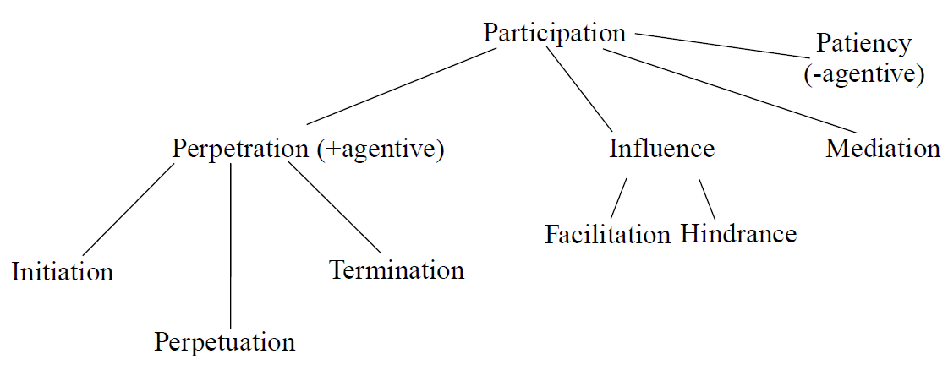
Participation
of independent continuant in process
Barry SMITH and Pierre GRENON.
The Cornucopia of Formal-Ontological Relations.
Dialectica Vol. 58, No 3 (2004), pp. 279-296

Slide 60
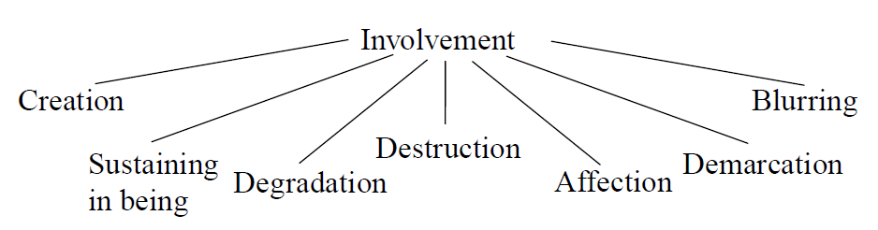
Involvement
of process in independent continuant
Barry SMITH and Pierre GRENON.
The Cornucopia of Formal-Ontological Relations.
Dialectica Vol. 58, No 3 (2004), pp. 279-296

Slide 61
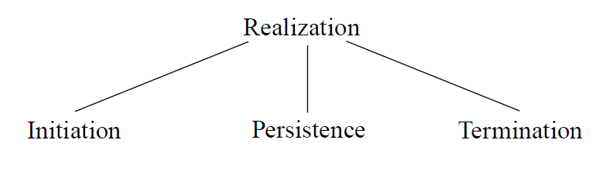
Realization
Of dependent continuant in process
Barry SMITH and Pierre GRENON.
The Cornucopia of Formal-Ontological Relations.
Dialectica Vol. 58, No 3 (2004), pp. 279-296

Slide 62
Various forms of realization per type of dependent continuant as recognized in language
– execution (of a plan)
– performance (of an act, of a symphony)
– expression (of a function, of a character, of an emotion)
– exercise (of a power, of a role)
– actualization (of a disposition)
– utterance (of a sentence)
– application (of a therapy, of a law)
– course (of a disease)
– increase (in temperature)
Barry SMITH and Pierre GRENON.
The Cornucopia of Formal-Ontological Relations.
Dialectica Vol. 58, No 3 (2004), pp. 279-296

Slide 63
derives_from
C
c at t
C₁
c₁ at t₁
time
C'
c' at t
instances
ovum
zygote derives_from
sperm

Slide 64
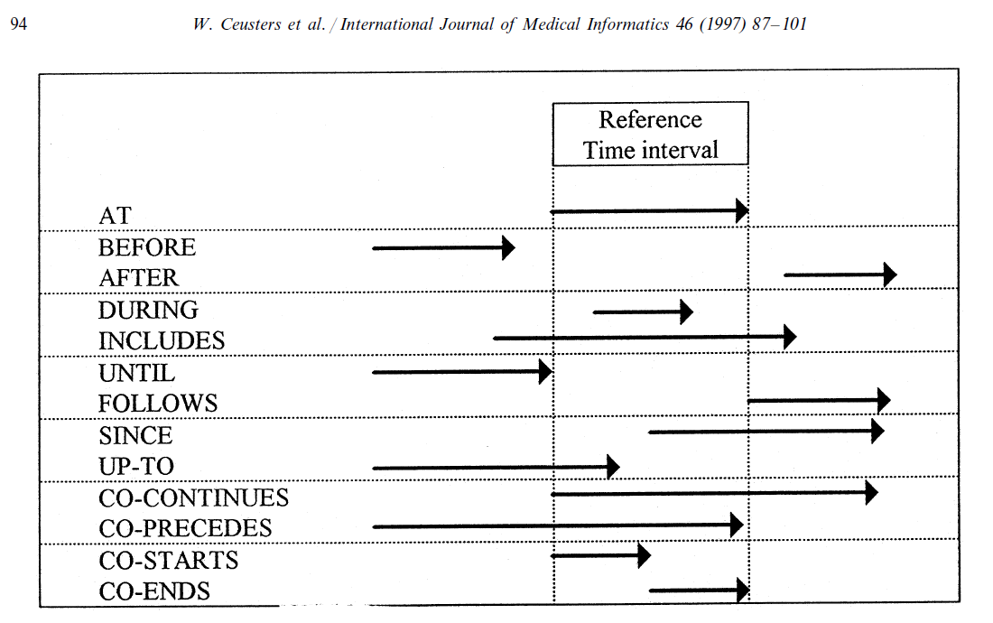
Extending ‘at’ with other time-specifiers

Slide 65
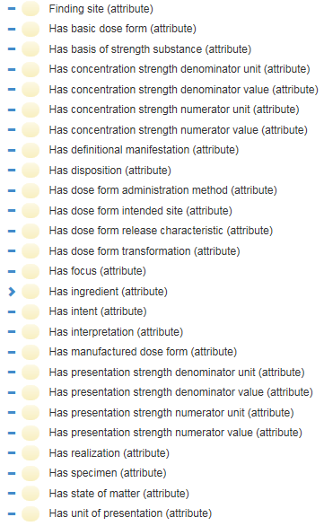
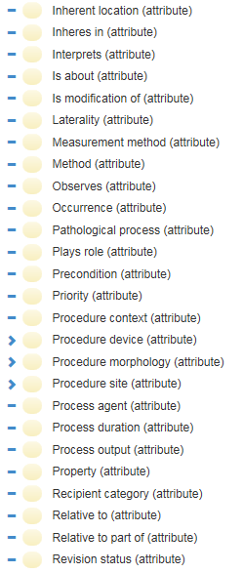
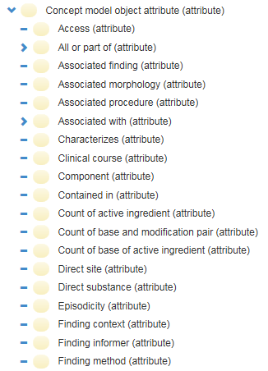
Relations in SNOMED CT
…

Slide 66
Avoid at all cost!!!
X hasY Y
Disease hasSymptom Symptom
Object hasTemperature Temperature
…

Slide 67
Performing a dependency analysis
Procedure explained:
Rudnicki R, Ceusters W, Manzoor S, Smith B. What Particulars are Referred to in EHR Data? A Case Study in Integrating Referent Tracking into an Electronic Health Record Application. In Teich JM, Suermondt J, Hripcsak C. (eds.), American Medical Informatics Association 2007 Annual Symposium Proceedings, Biomedical and Health Informatics: From Foundations to Applications to Policy, Chicago IL, 2007;:630-634.
http://www.referent-tracking.com/RTU/files/Ronfinal/1.0/Ronfinal.pdf

Slide 68
Dependence
on the instance level
a depends_on b =def. a is necessarily such that if b ceases to exist than a ceases to exist
on the type level
A depends_on B =def. for every instance a of A, there is some instance b of B such that a depends_on b.

Slide 69
Can it be more simple?
Only independent continuants do not depend on anything else.

Slide 70
realization depends_on realizable
Continuant
Occurrent
Independent
Continuant
bearer
Specifically
Dependent
Continuant
disposition
Process of
realization
.... ..... .......

Slide 71
Assignment
A4: Apply a relational dependency analysis to the terms thus far in your ontology.
Send your work in a Word doc to wceusters@gmail.com. Name of the file: ‘BMI508-A5-[your Ubitname].docx’
Due date: Oct 12 – noon.

Slide 72
Step 1: complete dependence analysis
All dependent entities in version 1 of your ontology must be related to the entities they depend on.
If such dependent entity depends only on independent continuants, you are done for now.
If this however necessitates the introduction of new dependent entities in your ontology, you need to analyze further until it is for all dependent entities specified upon which independent continuants they directly or indirectly depend.

Slide 73
Step 2: relation to ‘topic type’
For all types in your ontology thus far you must indicate how instances thereof relate directly or indirectly to an instance of the topic type you selected in A1.
If that requires further entities to be introduced, apply step (1) to them as well and continue doing so until for all types in your ontology steps (1) and (2) are done.
All relations used must either have been taken from a realism-based source in which the relation is formally defined, OR you create a relation and define it appropriately.

Slide 74
All BFO 2.0 relations
bearer of
concretizes at
continuant part of at
environs
first instant of
generically depends on at
has continuant part at
has first instant
has history
has last instant
has location at
has material basis at
has member part at
has occurrent part
has participant at
has proper continuant part at
has proper occurrent part
has proper temporal part
is concretized by at
last instant of
located in at
material basis of at
member part of at
occupies spatial region at
occupies spatiotemporal region
occupies temporal region
occurrent part of
occurs in
participates in at
preceded by
precedes
proper continuant part of at
proper occurrent part of
proper temporal part of
has realization
has temporal part
history of
inheres in
is carrier of at
realizes
spatially projects onto at
specifically-depended on by
specifically-depends on
temporal part of
temporally projects onto
Definitions: see BFO-2020-text.pdf

Slide 75
Do not forget to provide full Aristotelian definitions for all new type-terms you introduce as part of this and forthcoming assignments!

Slide 76
Reading pre-class!
Required reading pre-class:
  R7 Ceusters, W. and B. Smith, Tracking referents in electronic health records. Stud Health Technol Inform, 2005. 116: p. 71-6.[3]
  PDF downloadable from: http://ebooks.iospress.nl/publication/10278
Suggested additional reading (for sure for students with concentration in Biomedical Ontology):
  R8 Ceusters, W. and B. Smith, Strategies for referent tracking in electronic health records. J Biomed Inform, 2006. 39(3): p. 362-78.[4]
  https://www.sciencedirect.com/science/article/pii/S1532046405000754

