Slide 1
BMI508 – Fall 2020
Introduction to Biomedical Ontology
Class 5 – Sept 30, 2020
General principles for realism-based ontology development
Werner CEUSTERS^{1,2}
¹ Department of Biomedical Informatics, University at Buffalo, USA
² Department of Psychiatry, University at Buffalo, USA

Slide 2
Reading post-class
Change from syllabus: switch of classes C5 and C7
R9 Principles of best practice I and II. (pages 43-84) in: Arp, R., B. Smith, and A.D. Spear, Building ontologies with basic formal ontology. 2015, The MIT Press,: Cambridge, Massachusetts. p. 1 online resource (245 p.) [1]
UB login: https://ebookcentral-proquest-com.gate.lib.buffalo.edu/lib/buffalo/detail.action?docID=3433795&pq-origsite=primo

Slide 3
Required re-reading pre-class
R5: The ontology of relations. (pages 131-150) in: Arp, R., B. Smith, and A.D. Spear, Building ontologies with basic formal ontology. 2015, The MIT Press,: Cambridge, Massachusetts. p. 1 online resource (245 p.)
UB login: https://ebookcentral-proquest-com.gate.lib.buffalo.edu/lib/buffalo/detail.action?docID=3433795&pq-origsite=primo

Slide 4
Assignment
A6: Replace inadequate terms with adequate ones and provide an adequate textual and formal definition.
Make synonym list.
Do not delete inadequate terms!

Slide 5
Class overview
General re-introduction of ‘ontology’ versus ‘terminology’
Terminology selection and management
Definitions
Ontology design / putting it together

Slide 6
Ontology ←→ Terminology

Slide 7
Two important science- and research- related disciplines
Ontology
Terminology

Slide 8

Two important science- and research- related disciplines
Ontology
What entities exist?
How do entities relate to each other?
Terminology
What entities, if any at all, are denoted by words or terms?
‘Earth’ ‘Aarde’ ‘La Terre’
Reality first
Representation first

Slide 9
Canonical case: faithful representation
Reality
Representation
‘Earth’
‘Aarde’
‘La Terre’
…
denotes
means
represents

Slide 10
Delusions, fantasies, imaginations, …
Reality
Representation
‘unicorn’

Slide 11
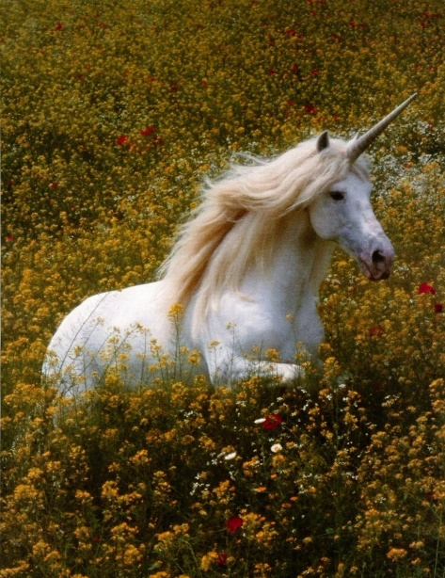
Delusions, fantasies, imaginations, …
Reality
Representation
‘unicorn’

Slide 12

Delusions, fantasies, imaginations, …
Terminology
Reality
Representation
‘unicorn’
Graphics

Slide 13
Delusions, fantasies, imaginations, …
Conceptualism
Terminology
Reality or
Imagination
Representation
‘unicorn’
Graphics
unicorn concept

Slide 14
Semiotic / semantic triangle
(Ogden & Richards, 1923:
The meaning of ‘meaning’)
concept
term
referent

Slide 15
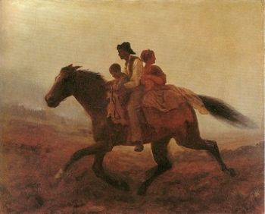
Prehistoric ‘psychiatry’: drapetomania
disease which causes slaves to suffer from an unexplainable propensity to run away
…
concept
term
referent
painting by Eastman Johnson. A Ride for Liberty: The Fugitive Slaves. 1860.
‘drapetomania’

Slide 16
What is the case ?
Reality
Representation
‘disorder’
‘disease’
‘illness’
‘sickness’

Slide 17
What is the case ?
Reality
Representation
‘disorder’
‘disease’
‘illness’
‘sickness’
U1
Synonymy

Slide 18
What is the case ?
Reality
Representation
U1
‘disorder’
‘disease’
‘illness’
‘sickness’
U2

Slide 19
What is the case ?
Reality
Representation
U1
‘disorder’
‘disease’
‘illness’
‘sickness’
U2
U3
U4

Slide 20
What is the case ?
Reality
Representation
U1
‘disorder’
‘disease’
‘illness’
‘sickness’
U2
U3
U4

Slide 21
How can we find out?

Slide 22
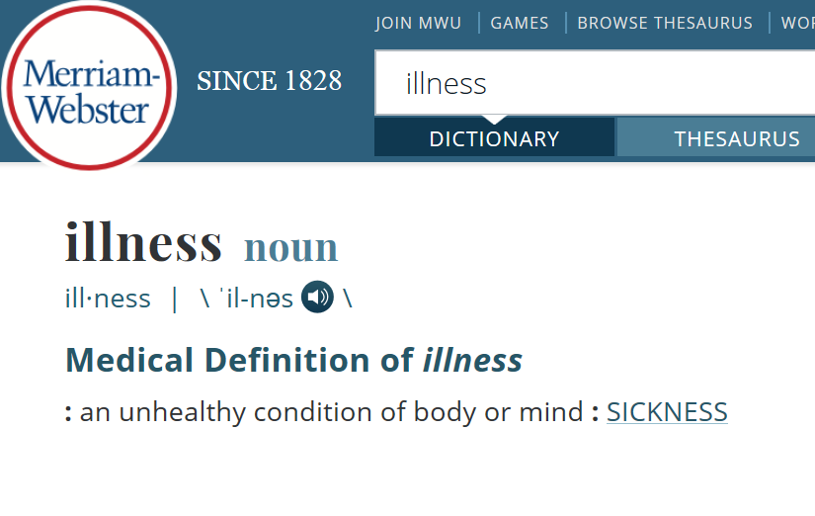

Slide 23
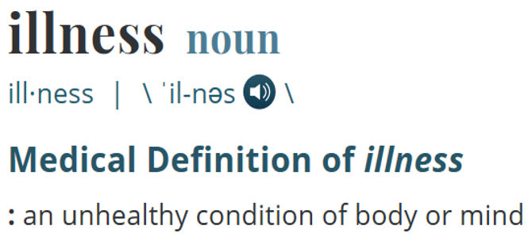
What is the case ?
Reality
Representation
‘illness’
ilness

Slide 24
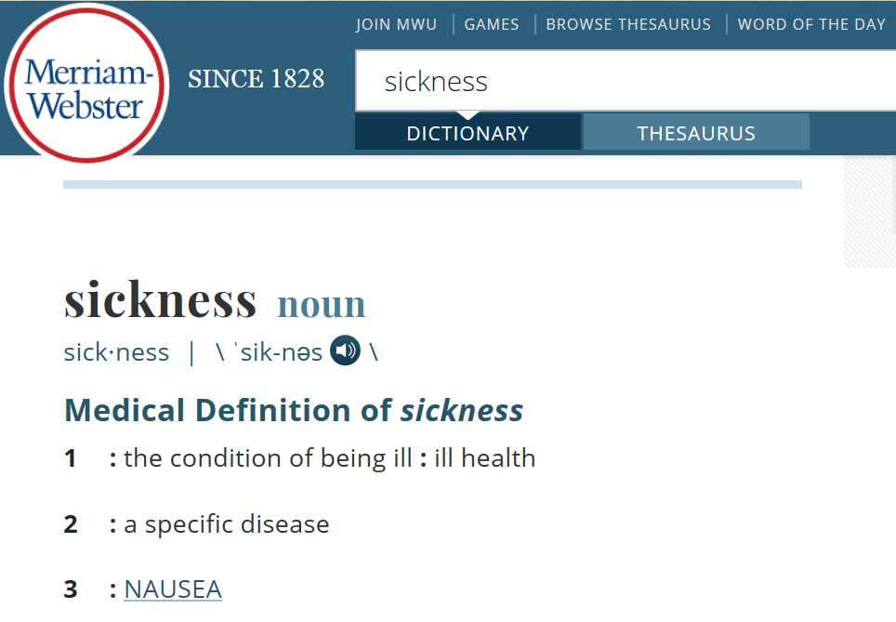

Slide 25
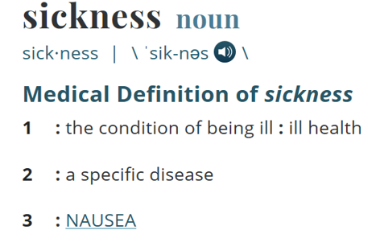
What is the case ?
Reality
Representation
‘illness’
Specific disease
=?
Homonymy
nausea
‘sickness’
illness
Synonyms?

Slide 26
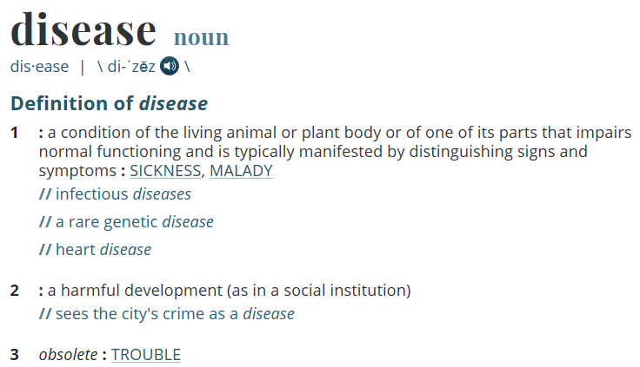

Slide 27
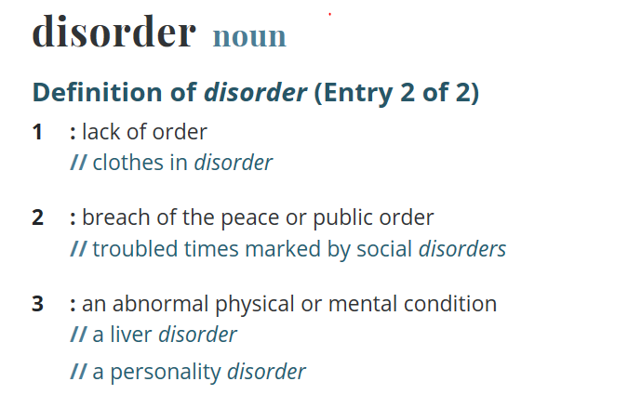

Slide 28
Better general strategy
Use terminology and metaphysics:
To make decisions on what type-terms to include in the ontology,
To define these type-terms precisely,
…

Slide 29
Metaphysical inquiry as a start
Define terms precisely so that what is intended by (ideally) all uses of the corresponding terms in the language under scrutiny falls under it;
Investigate how what is intended by these uses relate to each other.
Example: the ‘Bio-Psycho-Social Perspective’ on disease

Slide 30
The objective Bio-Psycho-Social perspective
‘T_{o}-Disease’:
  a health problem that consists of a physiological malfunction that results in an actual or potential reduction in physical capacities and/or a reduced life expectancy
‘T_{o}-Illness’:
  a subjectively interpreted undesirable state of health, consisting of subjective feeling states (e.g., pain, weakness), perceptions of the adequacy of their bodily functioning, and/or feelings of competence
‘T_{o}-Sickness’:
  a social entity in virtue of the poor health or the health problem(s) of an individual defined by others with reference to the social activity of that individual
Twaddle, A. (1994a). Disease, illness and sickness revisited.
In: A. Twaddle & L. Nordenfelt. (Eds.) Disease, Illness and Sickness: Three Central Concepts in the Theory of Health
(pp. 1–18). Link€oping: Studies on Health and Society, 18.

Slide 31
The subjective Bio-Psycho-Social perspective
T_{s}-Disease:
  when there are negative bodily occurrences as conceived of by the medical profession.
T_{s}-Illness:
  when there are negative bodily occurrences as conceived of by the person himself.
T_{s}-Sickness:
  when there are negative bodily occurrences as conceived of by the society and/or its institutions.
‘Occurrence’ here means ‘process’, ‘state’ or ‘event’.
Bjørn Hofmann. On the Triad Disease, Illness and Sickness.
Journal of Medicine and Philosophy 2002, Vol. 27, No. 6, pp. 651–673

Slide 32
Overlap in the subjective Bio-Psycho-Social perspective
T_{s}-Illness (patients)
6
3
4
1
5
7
2
T_{s}-Disease
(MDs)
T_{s}-Sickness
(society)
Bjørn Hofmann. On the Triad Disease, Illness and Sickness.
Journal of Medicine and Philosophy 2002, Vol. 27, No. 6, pp. 651–673

Slide 33
General strategy
Use terminology and metaphysics:
To make decisions on what type-terms to include in the ontology,
To define these type-terms precisely,
To create for each type-term a synonym-list indicating which terms in biomedical language tend to be used to refer to what is intended by your type-terms

Slide 34
The ontological approach
Reality
Representation
Entity1
‘term1’
‘term2’
Entity2
‘term3’
Entity3

Slide 35
‘Type-terms’ ←→ ‘language terms’
Type-terms
language-terms

Slide 36
Terminology selection and management

Slide 37
Definitions

