Slide 1
BMI508 – Fall 2020
Introduction to Biomedical Ontology
Class 1 – Sept 2, 2020
Course overview
Representational systems
Werner CEUSTERS^{1,2}
¹ Department of Biomedical Informatics, University at Buffalo, USA
² Department of Psychiatry, University at Buffalo, USA

Slide 2
Today’s class
Participant and instructor introduction;
Course introduction, housekeeping rules, expectations, course project work, final exam;
Traditional lecture on the basics of representational systems;
Guided exercise on on-line available resources;
Students will report on pre-class assignment (b) and explain their ideas, each presentation followed by discussion.

Slide 3
Assignment for next week
Required reading pre-class:
R2 What is an ontology? (pages 1-26) in: Arp, R., B. Smith, and A.D. Spear, Building ontologies with basic formal ontology. 2015, The MIT Press,: Cambridge, Massachusetts. online resource (245 p.)
UB login: https://ebookcentral-proquest-com.gate.lib.buffalo.edu/lib/buffalo/detail.action?docID=3433795&pq-origsite=primo

Slide 4

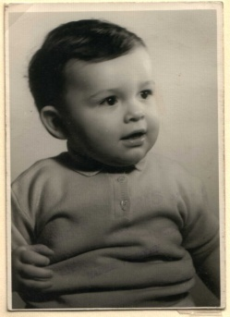
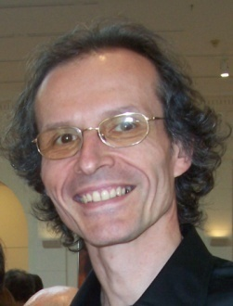



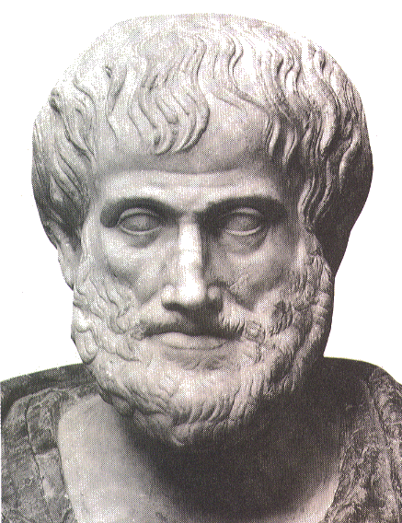






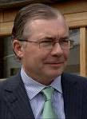

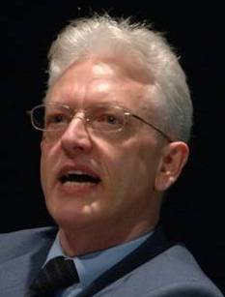


Short professional history
2014
2012
1977
1959 -
2006
1989
2004
1992
2002
1995
1998
1993
http://www.referent-tracking.com/RTU/ceusters_vita.html

Slide 5
Getting to know the students
First and lastname
Academic program
Professional expectations
Why did you take this course
Expectations

Slide 6
House keeping
The syllabus rules (but can be updated) !!!
Mic always off unless you want to speak / Video always on;
You may ask a question at any time but I decide whether and when to answer it;
Attend on time, submit assignments on-time;
Excuses are only accepted before a deadline;
You may email me at all times between classes with questions re the course, subject line must start with “BMI-508: ”
All assignments to be emailed: wceusters@gmail.com
Filenames’ format: “BMI508-A1-ceusters.docx”

Slide 7
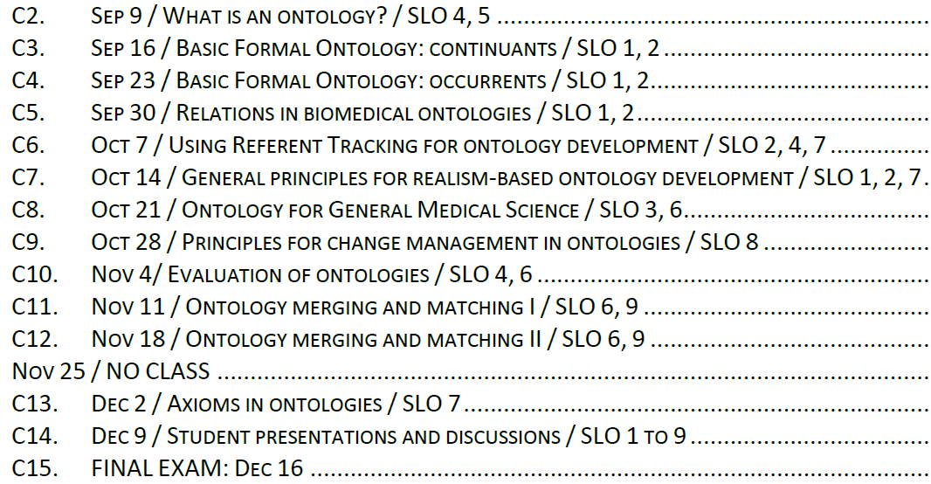
Course overview

Slide 8
Tasks and grading
Class | Date | Pre-class required readings | Assessments | Due dates | Final Score weight
C2 | 09-Sep | R2 | Post-class assignment A1 | 14-Sep - noon | 2%
C3 | 16-Sep | R3 | In-class open book test T1 Post-class assignment A2 | 21-Sep - noon | 4% 4%
C4 | 23-Sep | R4 | Post-class assignment A3 | 28-Sep - noon | 2%
C5 | 30-Sep | R5, (R6) | Post-class assignment A4 | 05-Oct - noon | 2%
C6 | 07-Oct | R7, (R8) | Post-class assignment A5 | 12-Oct - noon | 5%
C7 | 14-Oct | R9 | Post-class assignment A6 | 19-Oct - noon | 4%
C8 | 21-Oct | (R10), (R11) | Post-class assignment A7 | 26-Oct - noon | 6%
C9 | 28-Oct | (R12) | Post-class assignment A8 | 09-Nov - noon | 1%
C10 | 04-Nov | R13 | In-class open book test T2 |  | 7%
C11 | 11-Nov | R14
C12 | 18-Nov |  | Post-class assignment A9 | 30-Nov - noon | 3%
C13 | 02-Dec |  | Post-class assignment A10 | 07-Dec – noon | 17%
C14 | 09-Dec |  | In-class presentation A11 |  | 13%
EXAM | 16-Dec |  | In-class open-book exam |  | 30%
100%

Slide 9
Grading summary
Two in-class tests (T1, T2): 11%
Ten post-class assignments (A1 toA10): 46%
Final oral presentation (A11): 13%
Final exam: 30%
TOTAL: 100%

Slide 10
Core course output
A (micro-) realism-based ontology:
  in a domain of your choice,
  ideally related to your final degree requirement,
  for a demonstrable purpose, fulfilling some real need.
One standing offer: assisting a clinician with his TMD work.

Slide 11
Ontology design assignments
A2 – Sep 21: PP presentation (5 min.) about domain, purpose, challenges, some example terms.
A3 – Sep 28: V1 → 5 continuants / 5 occurrents
A4 – Oct 5: V2 → relationships added
A6 – Oct 19: V3 → all best practice requirements are met
A7 – Oct 26: V4 → linked to OGMS (or non-biomedical alternative)
A8 – Nov 9: formal version history V1 → V4
A9 – Nov 18: merging of all students’ ontologies
A10 – Dec 7: PP presentation ready
A11 – Dec 9: oral presentation (?) / discussion

Slide 12
Final Exam Dec 16
Max 90 minutes: group work on solving some ontology problems
output: one document D with problems identified and solved
Max 45 minutes: your personal reflections on D, indicating what you agree/disagree with, alternative better solution.
Max 45 minutes: questions on the basis of D.

Slide 13
The basics of representational systems / artifacts

Slide 14

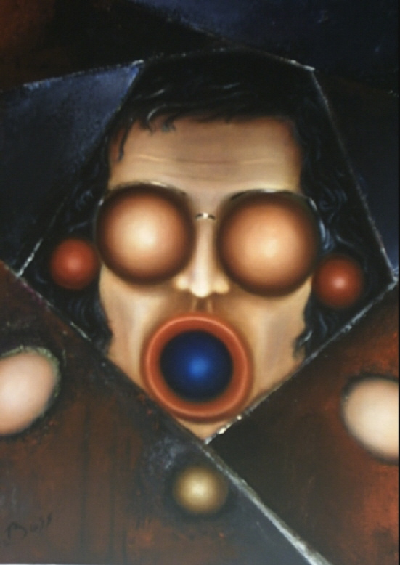
‘Representational artifact’
Roughly and broadly: something created to depict/represent/be about something else.
Examples:
‘Werner Ceusters’
‘The Division Chief Biomedical Ontology of the UB BMI’
‘Celtic Bompa’
Dboss 2004

Slide 15
Some rough definitions / elucidations (1)
REPRESENTATION: an entity, for example an idea, image, record, or description which refers to (is of or about), or is intended to refer to, some entity or entities external to the representation.
COMPOSITE REPRESENTATION: a representation built out of constituent sub-representations as their parts, in the way in which paragraphs are built out of sentences and sentences out of words.
REPRESENTATIONAL UNIT: The smallest constituent sub-representations such as icons, names, simple word forms, or the sorts of alphanumeric identifiers we might find in patient records.
Smith B, Kusnierczyk W, Schober D, Ceusters W. Towards a Reference Terminology for Ontology Research and Development in the Biomedical Domain. Proceedings of KR-MED 2006, Biomedical Ontology in Action, November 8, 2006, Baltimore MD, USA (draft)

Slide 16
Some rough definitions / elucidations (2)
COGNITIVE REPRESENTATION: a representation whose representational units are ideas, thoughts, or beliefs in the mind of some cognitive subject – for example a clinician engaged in applying theoretical (and practical) knowledge to the task of establishing a diagnosis.
REPRESENTATIONAL ARTIFACT: a representation that is fixed in some medium in such a way that it can serve to make the cognitive representations existing in the minds of separate subjects publicly accessible in some enduring fashion. Examples are: a text, a diagram, a map legend, a list, a clinical record, or a controlled vocabulary.
Smith B, Kusnierczyk W, Schober D, Ceusters W. Towards a Reference Terminology for Ontology Research and Development in the Biomedical Domain. Proceedings of KR-MED 2006, Biomedical Ontology in Action, November 8, 2006, Baltimore MD, USA (draft)

Slide 17
How many … ?
Representations
Composite representations
Representational units

Slide 18
And in the frame below ?
Water
Aqua
Eau
H₂O

Slide 19
What do they mean?
Do they all represent the same entity?
Water
Aqua
Eau
H₂O

Slide 20
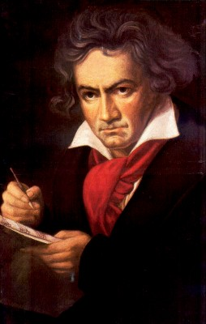
The semantic triangle
Ludwig van Beethoven
that great German composer that became deaf
…
concept
term
referent
‘Beethoven’
Ogden, C. K. and I.A. Richards. 1989[1923]. The Meaning of Meaning.
San Diego: Harcourt Brace Jovanovich. (Original published London: Kegan Paul.)

Slide 21
Semantic triangle useful in explaining …
synonymy
homonymy

Slide 22
Active ISO definitions for ‘concept’
a unit of thought (1985-2011, 8) - with close variants:
  a unitary mental representation of a real or abstract thing; an atomic unit of thought (2011, 1)
  an internal conception of some thing; general notion or idea of some thing (2003, 1)
  a general notion or idea of something (2003, 1)
  a unit of thought constituted by a unique set of necessary characteristics (2005-2010, 2)
  a unit of thought constituted through abstraction on the basis of properties common to a set of objects (2002-2005, 2)
a unit of knowledge created by a unique combination of characteristics (2000-2011, 13)
a unit of knowledge pertaining to an action, condition, idea, object, situation or to sets of relationships thereof, which can be designated and defined by words or symbols, or which can be detected by the senses (2009, 1)
an abstract entity for determining category membership (1997, 1)
ISO Online Browsing Platform (beta). http://www.iso.org/obp/ui/#search. Accessed Feb 29, 2012.

Slide 23
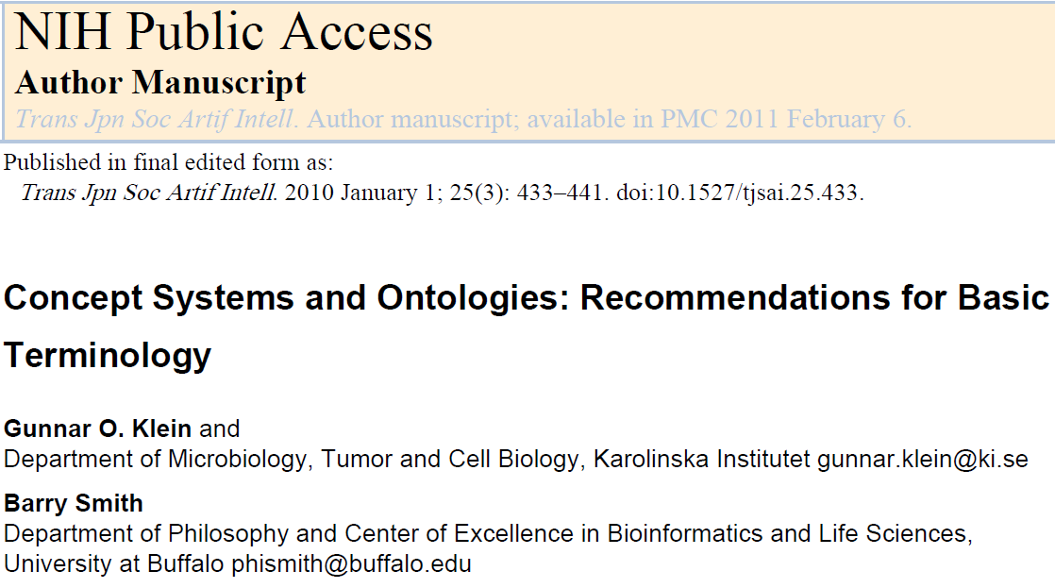
A house keeping proposal

Slide 24
‘Concept’
Definition: meaning of a term as agreed upon by a group of responsible persons.
  there can be agreed meanings for terms like “unicorn” which do not correspond to any unit of knowledge;
  ‘concepts’ as common understandings of the meaning of a term distinguishes concepts from ideas in the minds of individual cognitive subjects;
  the term refers to this meaning itself and not to any specification of this meaning in some natural or artificial language or in some formal model.
Concept systems and ontologies: Recommendations for basic terminology
Gunnar O. Klein & Barry Smith
Transactions of the Japanese Society for Artificial Intelligence 25 (3):433-441 (2010)

Slide 25
Concept system
Definition: collection of representations of concepts structured by means of representations of relations
  a concept system is a collection of elements (called concept system nodes) which are related together via interconnections representing relations such as narrower_than and broader_than between the corresponding meanings.
Concept systems and ontologies: Recommendations for basic terminology
Gunnar O. Klein & Barry Smith
Transactions of the Japanese Society for Artificial Intelligence 25 (3):433-441 (2010)

Slide 26
MeSH Tree Structures – 2007
Body Regions [A01]
  Extremities [A01.378]
    Lower Extremity [A01.378.610]
      Buttocks [A01.378.610.100]
      Foot [A01.378.610.250]
        Ankle [A01.378.610.250.149]
        Forefoot, Human [A01.378.610.250.300] +
        Heel [A01.378.610.250.510]
      Hip [A01.378.610.400]
      Knee [A01.378.610.450]
      Leg [A01.378.610.500]
      Thigh [A01.378.610.750]

Slide 27
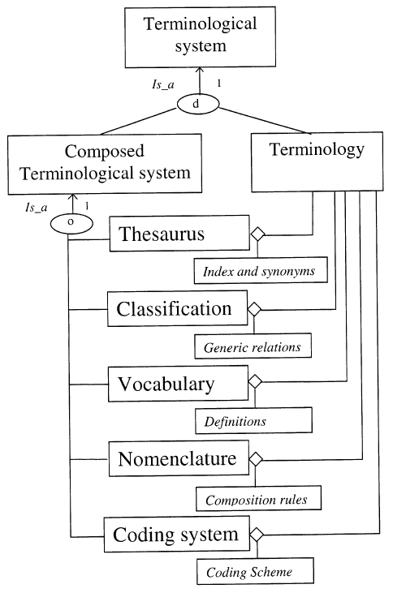
The world of ‘terminological systems’
Use of ‘terminological systems’
  A terminological system relates concepts, of a particular domain, among themselves and provides their terms and possibly their definitions and codes.
Based on CEN/ISO standards
N. F. de Keizer, A. Abu-Hanna, J. H. M. Zwetsloot-Schonk. Understanding Terminological Systems I: Terminology and Typology. Methods of Information in Medicine 2000;39:16-21.

Slide 28
Terminological systems
1st Generation
non-formal
children “narrower than” parents
  mixture of kinds-of / parts
made for people
information is spread over structure and text (rubrics)
mono-hierarchical
fixed
3rd Generation
formal
children strictly “kind of” parents
  clean separation
to be used by machines
all information is in the structure
dynamic reclassification
generative

Slide 29
Clean separation of knowledge
Conceptual knowledge: the knowledge of sensible medical concepts
Knowledge of clinical definitions and criteria: how to determine if a concept applies to a particular patient
Surface linguistic knowledge: how to express the concepts in any given language
Knowledge of classification and coding systems: how an expression has been classified by such a system
Pragmatic knowledge: what doctors usually say or think, what they consider important, how to integrate in EHCR
Rector AL, Nowlan WA and Kay S. Conceptual Knowledge: the core of medical information systems. In:
Medinfo 92. Lun KC et al. (eds). North Holland: Elsevier Science Publishers BV, 1992: 1420 - 1426.

Slide 30
Cimino’s desiderata for concept systems
Domain completeness: coverage of all possible terms that lie within a vocabulary’s domain
Non-vagueness: the term should represent the concept behind it as close as possible
Non-ambiguity: the same term cannot refer to more than one concept
Non-redundancy: each concept must be represented by one unique identifier
Synonymy: multiple ways for expressing a word (or concept) must be allowed
Multiple classification: concepts must be allowed to be classified in multiple hierarchies
Consistency of view: concepts must have the same relationships in all views
Explicit relationships: all relationships (e.g. class, synonymy,…) must be explicitly labelled.
Cimino J. Desiderata for controlled medical vocabularies in the twenty-first century. Methods Inf Med. 1998 Nov;37(4-5):394-403.
https://www.ncbi.nlm.nih.gov/pmc/articles/PMC3415631/

Slide 31
Concept definition
Definition: specification of a concept (i.e. of the agreed meaning of a term) by means of a descriptive statement or a formal expression which serves to differentiate it from other concepts
  There may be more than one definition which captures the same agreed meaning.
Concept systems and ontologies: Recommendations for basic terminology
Gunnar O. Klein & Barry Smith
Transactions of the Japanese Society for Artificial Intelligence 25 (3):433-441 (2010)

Slide 32
Concept system node
Definition: information element within the structure of a concept system that is a pointer linking one or several synonymous terms with a given concept definition and linked to other such information elements in the representation of relations between the corresponding concepts
Concept systems and ontologies: Recommendations for basic terminology
Gunnar O. Klein & Barry Smith
Transactions of the Japanese Society for Artificial Intelligence 25 (3):433-441 (2010)

Slide 33
Ontology
Definition: a representational artifact, comprising a taxonomy as proper part, whose representational units are intended to designate some combination of types, classes, and certain relations between them
Concept systems and ontologies: Recommendations for basic terminology
Gunnar O. Klein & Barry Smith
Transactions of the Japanese Society for Artificial Intelligence 25 (3):433-441 (2010)

Slide 34
Realism-based ontology
Definition: an ontology built out of terms which are intended to refer exclusively to types and which correspond to that part of the content of a scientific theory that is captured by its constituent general terms and their interrelations.
Concept systems and ontologies: Recommendations for basic terminology
Gunnar O. Klein & Barry Smith
Transactions of the Japanese Society for Artificial Intelligence 25 (3):433-441 (2010)

Slide 35
Guided exercise on some important biomedical terminological systems
SNOMED CT https://browser.ihtsdotools.org/?
Medical Subject Headings https://meshb.nlm.nih.gov/search
WHO Classification systems https://www.who.int/classifications/en/
BioPortal ‘ontologies’ https://bioportal.bioontology.org/

Slide 36
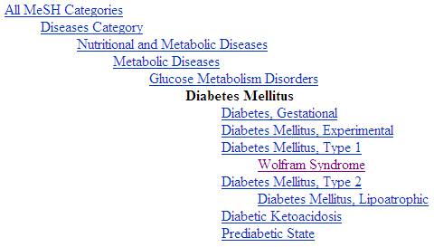
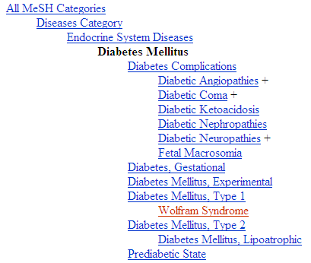
Diabetes Mellitus in MeSH 2008
MeSH: not always fine for drilling down to find more specific disorders
?
Different set of more specific terms when different path from the top is taken.

Slide 37
MeSH: perhaps fine for drilling down to find more specific disorders
All MeSH Categories
Diseases Category
Nervous System Diseases
Female Urogenital Diseases
and Pregnancy Complications
Eye Diseases
Male Urogenital
Diseases
Cranial Nerve
Diseases
Female Urogenital Diseases
Optic Nerve
Diseases
Neurodegenerative
Diseases
Optic Nerve
Diseases
Eye Diseases,
Hereditary
Heredodegenerative
Disorders,
Nervous System
Urologic Diseases
Optic Atrophy
Kidney Diseases
Optic Atrophies,
Hereditary
Diabetes Insipidus
Wolfram Syndrome

Slide 38
Student presentations

