Slide 1
BMI508 – Fall 2018
Biomedical Ontology
Evaluation of Ontologies
Werner CEUSTERS^{1,2}
¹ Department of Biomedical Informatics, University at Buffalo, USA
² Department of Psychiatry, University at Buffalo, USA

Slide 2
1. Essentials of Ontology Evaluation

Slide 3
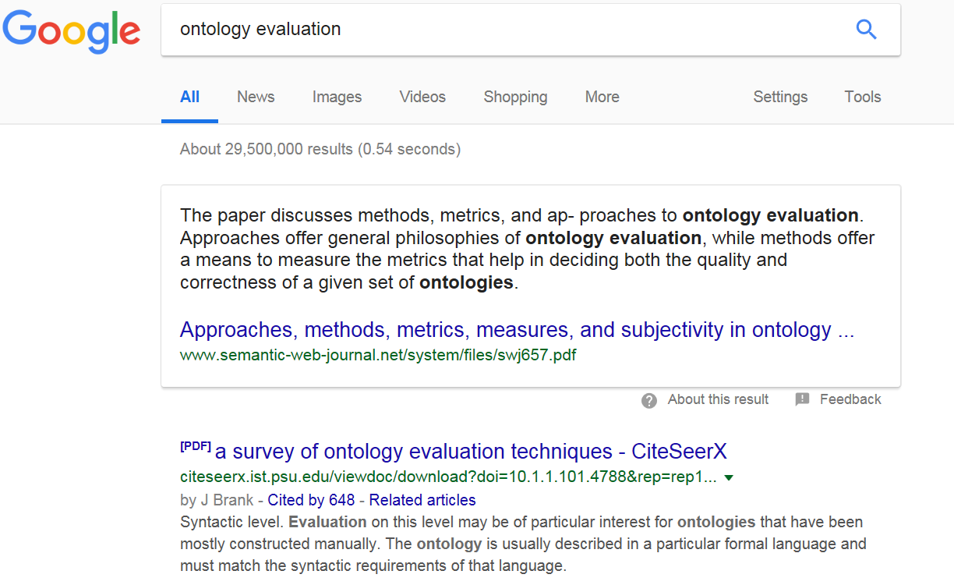
Accessed Nov 26, 2018

Slide 4
Some Ontology Quality Dimensions
Accuracy/validity | Redundancy
Cohesiveness | Naturalness
Complexity | Precision/completeness
Semantic consistency | Verifiability
Structural consistency | Volatility
Currency | Authority
Besiki Stvilia.
A model for ontology quality evaluation.
First Monday, Volume 12 Number 12 - 3 December 2007
http://firstmonday.org/ojs/index.php/fm/article/view/2043/1905

Slide 5
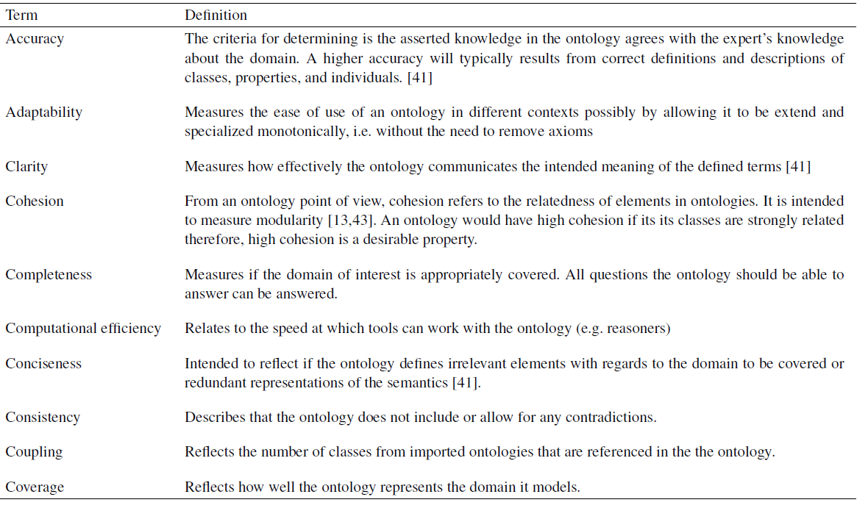
H. Hlomani, and Deborah Stacey / Approaches, methods, metrics, measures, and subjectivity in ontology evaluation: A survey. IOS Press 2014

Slide 6
What criteria to use ?
Adequacy of content:
  richness, complexity and granularity of the coverage of a particular domain;
Relevance to purpose:
  use cases, scenarios, requirements, applications, and data sources it was developed to address;
Formal properties
  consistency and completeness of the ontology and the representation language in which it is modeled;
  adherence to some specific upper ontology;
  kinds of reasoning methods that can be invoked on the ontology;
Underlying philosophical theory about reality.
Obrst L, Ceusters W, Mani I, Ray S, Smith B. The Evaluation of Ontologies: toward Improved Semantic Interoperability. In: Baker, Christopher J.O.; Cheung, Kei-Hoi (Eds.) Semantic Web: Revolutionizing Knowledge Discovery in the Life Sciences. Springer, Heidelberg, 2007;:139-58.

Slide 7
Three levels
Obrst L, Ceusters W, Mani I, Ray S, Smith B. The Evaluation of Ontologies: toward Improved Semantic Interoperability. In: Baker, Christopher J.O.; Cheung, Kei-Hoi (Eds.) Semantic Web: Revolutionizing Knowledge Discovery in the Life Sciences. Springer, Heidelberg, 2007;:139-58.

Slide 8
Some formal properties
Soundness:
  any expression that can be derived from the knowledge base (KB) of the ontology and its instances is logically implied by that KB,
Completeness:
  any expression that is logically implied by the KB can be derived,
Decidability:
  being both sound and complete;
Formal complexity:
  time of execution, space of memory needed to compute an answer;
  tractability: problems can be solved by computer algorithms that run in polynomial time;
Consistency:
  if contradictions can be proven from a given proposition, then the theory is inconsistent).

Slide 9
Measures in graph-based representations
Semantic distance (SD):
  measures how closely two nodes are topologically related in a graph;
semantic similarity (SS):
  captures to what extent two nodes might represent the same entity in reality.
How should SD and SS of the following two nodes relate to each other?
  ‘fractured arm’
  ‘arm fracture’

Slide 10
Relatedness of SS and SD
A node representing a “fractured arm” should have a very short semantic distance from one referring to an “arm fracture”;
Yet the semantic similarity would still be low: a fracture cannot be an arm.
It is now a measure of a high-quality ontology that it should be possible to compute the semantic distance of post-coordinated terms such as “patient-WITH-arm fracture” and “patient-WITH-fractured arm” as being minimal, and the semantic similarity as being maximal.
Obrst L, Ceusters W, Mani I, Ray S, Smith B. The Evaluation of Ontologies: toward Improved Semantic Interoperability. In: Baker, Christopher J.O.; Cheung, Kei-Hoi (Eds.) Semantic Web: Revolutionizing Knowledge Discovery in the Life Sciences. Springer, Heidelberg, 2007;:139-58.

Slide 11
Acceptable techniques for evaluation
evaluation with respect to the use of an ontology in an application,
evaluation with respect to domain data sources,
assessment by humans against a set of criteria,
natural language evaluation techniques,
use of a gold standard,
the use of reality itself as a benchmark.
Obrst L, Ceusters W, Mani I, Ray S, Smith B. The Evaluation of Ontologies: toward Improved Semantic Interoperability. In: Baker, Christopher J.O.; Cheung, Kei-Hoi (Eds.) Semantic Web: Revolutionizing Knowledge Discovery in the Life Sciences. Springer, Heidelberg, 2007;:139-58.

Slide 12
A Fragment of (is-a) Relation in WordNet
Joe Raad, Christophe Cruz. A Survey on Ontology Evaluation Methods. HAL Id: hal-01274199. https://hal.archives-ouvertes.fr/hal-01274199. Submitted on 1 Feb 2018

Slide 13
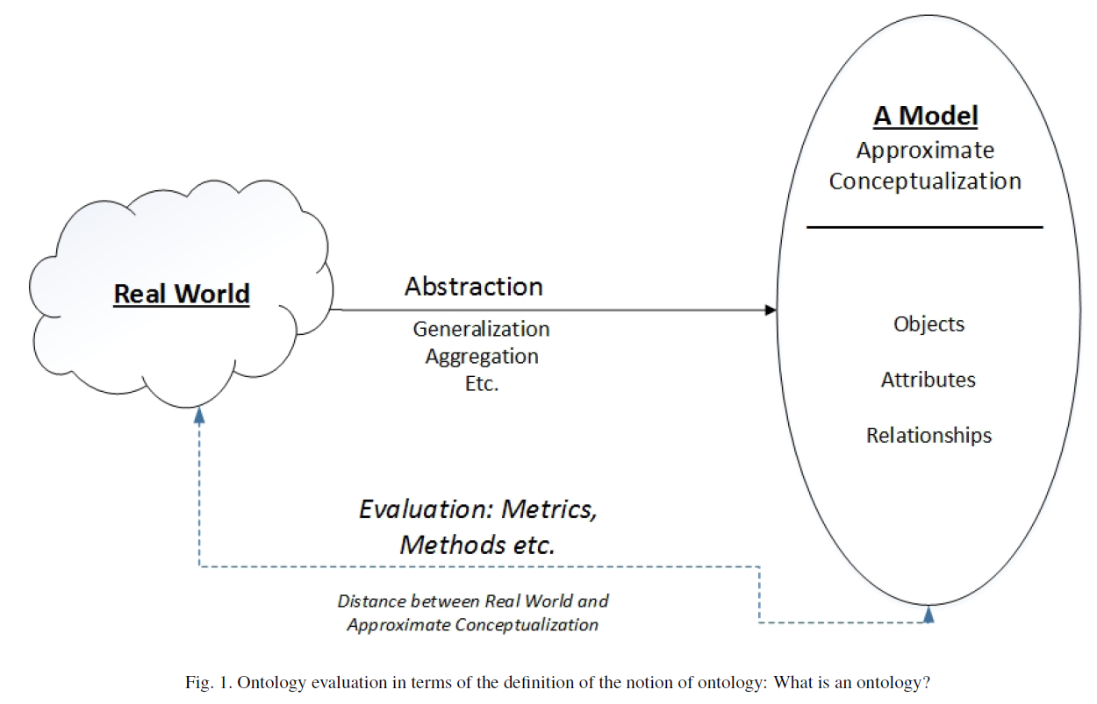
The ass-backward mainstream idea
H. Hlomani, and Deborah Stacey / Approaches, methods, metrics, measures, and subjectivity in ontology evaluation: A survey. IOS Press 2014

Slide 14
2. A close relation with Realism-based ontology change management

Slide 15
An “optimal” ontology (1)
Because ontologies, as conceived on realist terms,
  are artifacts created for some purpose (e.g. to serve as controlled vocabulary, or to provide domain knowledge to a software application),
  are at the same time intended to mirror reality,
  should allow reasoning which is efficient from a computational point of view,
we argue that an optimal ontology should constitute a representation of all and only those portions of reality that are relevant for its purpose.

Slide 16
An “optimal” ontology (2)
Each term in such an ontology would designate:
  (1) a single portion of reality (POR), which is
  (2) relevant to the purposes of the ontology and such that
  (3) the authors of the ontology intended to use this term to designate this POR, and
  (4) there would be no PORs objectively relevant to these purposes that are not referred to in the ontology.

Slide 17
But things may go wrong …
Root cause errors:
  assertion errors: ontology developers may be in error as to what is the case in their target domain;
  relevance errors: they may be in error as to what is objectively relevant to a given purpose;
  encoding errors: they may not successfully encode their underlying cognitive representations, so that particular representational units fail to point to the intended PORs.
Mismatches:
  Unjustified presence or absence of RUs,
  Redundancies: >1 RU → 1 POR,
  Ambiguities: 1 RU → >1 POR.

Slide 18
configuration | reality |  | representation |  |  |  | ME
 |  |  | authors' belief |  | encoding
 | OE | OR | BE | BR | IE | TR
(1) | (2) | (3) | (4) | (5) | (6) | (7) | (8)
P+1 | Y | Y | Y | Y | Y | R+ | 0
A+1 | N | na | N | na | na | na | 0
A+2 | Y | N | Y | N | na | na | 0
A+3 | Y | N | NC | na | na | na | 0
A+4 | N | na | NC | na | na | na | 0
P-1 | N | na | Y | Y | Y | ¬R | 3
P-2 | N | na | Y | Y | N | ¬R | 4
P-3 | N | na | Y | Y | N | R– | 5
P-4 | Y | Y | Y | Y | N | ¬R | 1
P-5 | Y | Y | Y | Y | N | R- | 2
P-6 | Y | N | Y | Y | Y | R+ | 1
P-7 | Y | N | Y | Y | N | ¬R | 2
P-8 | Y | N | Y | Y | N | R– | 3
P-9 | Y | Y | Y | Y | Y | R++ | 1
P-10 | Y | N | Y | Y | Y | R++ | 2
P-11 | Y | Y | Y | Y | Y | Ra | 1
P-12 | N | na | Y | Y | Y | Ra | 4
A-1 | Y | Y | Y | N | na | na | 1
A-2 | Y | Y | N | na | na | na | 1
A-3 | N | na | Y | N | na | na | 1
A-4 | Y | N | N | na | na | na | 1
A-5 | Y | Y | NC | na | na | na | 1

Slide 19
RU – reality correspondence types
configuration | reality |  | representation |  |  |  | ME
 |  |  | authors' belief |  | encoding
 | OE | OR | BE | BR | IE | TR
(1) | (2) | (3) | (4) | (5) | (6) | (7) | (8)
Reality:
  OE: Objective existence
  OE: Objective relevance
          Representation:
            BE: Author’s belief in existence
            BR: Author’s belief in relevance
              IE: Author’s intended encoding
              TR: Type of reference
Ceusters W, Smith B. A Realism-Based Approach to the Evolution of Biomedical Ontologies. Proceedings of AMIA 2006, Washington DC, 2006;:121-125.
Ceusters W. Applying Evolutionary Terminology Auditing to the Gene Ontology. Journal of Biomedical Informatics 2009;42:518–529.
Seppãlã S, Smith B, Ceusters W. Applying the realism-based ontology versioning method for tracking changes in the Basic Formal Ontology. Formal Ontology in Information Systems. Proceedings of the Eight International Conference (FOIS 2014), Amsterdam: IOS Press, 2014;:227-240.

Slide 20
configuration | reality |  | representation |  |  |  | ME
 |  |  | authors' belief |  | encoding
 | OE | OR | BE | BR | IE | TR
(1) | (2) | (3) | (4) | (5) | (6) | (7) | (8)
P+1
A+1
A+2
A+3
A+4
P-1
P-2
P-3
P-4
P-5
P-6
P-7
P-8
P-9
P-10
P-11
P-12
A-1
A-2
A-3
A-4
A-5
Configuration types
    P: present in the ontology
      P+: justifiably present
      P–: unjustifiably present
    A: absent from the ontology
      A+: justifiably absent
      A–: unjustifiably absent

Slide 21
configuration | reality |  | representation |  |  |  | ME
 |  |  | authors' belief |  | encoding
 | OE | OR | BE | BR | IE | TR
(1) | (2) | (3) | (4) | (5) | (6) | (7) | (8)
P+1
A+1
A+2
A+3
A+4
P-1
P-2
P-3
P-4
P-5
P-6
P-7
P-8
P-9
P-10
P-11
P-12
A-1
A-2
A-3
A-4
A-5
Configuration types
    1+4+12+5=22 possible configurations based on (mis)matches between reality, beliefs, and encodings

Slide 22
configuration | reality |  | representation |  |  |  | ME
 |  |  | authors' belief |  | encoding
 | OE | OR | BE | BR | IE | TR
(1) | (2) | (3) | (4) | (5) | (6) | (7) | (8)
P+1 | Y | Y | Y | Y | Y | R+ | 0
A+1 | N | na | N | na | na | na | 0
A+2 | Y | N | Y | N | na | na | 0
A+3 | Y | N | NC | na | na | na | 0
A+4 | N | na | NC | na | na | na | 0
P-1 | N | na | Y | Y | Y | ¬R | 3
P-2 | N | na | Y | Y | N | ¬R | 4
P-3 | N | na | Y | Y | N | R– | 5
P-4 | Y | Y | Y | Y | N | ¬R | 1
P-5 | Y | Y | Y | Y | N | R- | 2
P-6 | Y | N | Y | Y | Y | R+ | 1
P-7 | Y | N | Y | Y | N | ¬R | 2
P-8 | Y | N | Y | Y | N | R– | 3
P-9 | Y | Y | Y | Y | Y | R++ | 1
P-10 | Y | N | Y | Y | Y | R++ | 2
P-11 | Y | Y | Y | Y | Y | Ra | 1
P-12 | N | na | Y | Y | Y | Ra | 4
A-1 | Y | Y | Y | N | na | na | 1
A-2 | Y | Y | N | na | na | na | 1
A-3 | N | na | Y | N | na | na | 1
A-4 | Y | N | N | na | na | na | 1
A-5 | Y | Y | NC | na | na | na | 1
OE/BE value pairs
Y/Y: correct assertion of the existence of a POR;
Y/N: lack of awareness of a POR, reflecting an assertion error;
N/N: correct assertion that some putative POR does not exist;
N/Y: the false belief that some putative POR exists;
Y/NC: not considering that some POR exists;
N/NC: not considering that some putative POR does not exist.

Slide 23
configuration | reality |  | representation |  |  |  | ME
 |  |  | authors' belief |  | encoding
 | OE | OR | BE | BR | IE | TR
(1) | (2) | (3) | (4) | (5) | (6) | (7) | (8)
P+1 | Y | Y | Y | Y | Y | R+ | 0
A+1 | N | na | N | na | na | na | 0
A+2 | Y | N | Y | N | na | na | 0
A+3 | Y | N | NC | na | na | na | 0
A+4 | N | na | NC | na | na | na | 0
P-1 | N | na | Y | Y | Y | ¬R | 3
P-2 | N | na | Y | Y | N | ¬R | 4
P-3 | N | na | Y | Y | N | R– | 5
P-4 | Y | Y | Y | Y | N | ¬R | 1
P-5 | Y | Y | Y | Y | N | R- | 2
P-6 | Y | N | Y | Y | Y | R+ | 1
P-7 | Y | N | Y | Y | N | ¬R | 2
P-8 | Y | N | Y | Y | N | R– | 3
P-9 | Y | Y | Y | Y | Y | R++ | 1
P-10 | Y | N | Y | Y | Y | R++ | 2
P-11 | Y | Y | Y | Y | Y | Ra | 1
P-12 | N | na | Y | Y | Y | Ra | 4
A-1 | Y | Y | Y | N | na | na | 1
A-2 | Y | Y | N | na | na | na | 1
A-3 | N | na | Y | N | na | na | 1
A-4 | Y | N | N | na | na | na | 1
A-5 | Y | Y | NC | na | na | na | 1
2
4
1
3
‘na’ = not applicable
If there is no POR of a specific sort, relevance is not applicable.
If an author does not believe in some POR, believed relevance is not applicable.
If an author did not consider (‘nc’) existence of some POR, believed relevance is not applicable.
If believed relevance is either negative or not applicable, encoding is not applicable.

Slide 24
configuration | reality |  | representation |  |  |  | ME
 |  |  | authors' belief |  | encoding
 | OE | OR | BE | BR | IE | TR
(1) | (2) | (3) | (4) | (5) | (6) | (7) | (8)
P+1 | Y | Y | Y | Y | Y | R+ | 0
A+1 | N | na | N | na | na | na | 0
A+2 | Y | N | Y | N | na | na | 0
A+3 | Y | N | NC | na | na | na | 0
A+4 | N | na | NC | na | na | na | 0
P-1 | N | na | Y | Y | Y | ¬R | 3
P-2 | N | na | Y | Y | N | ¬R | 4
P-3 | N | na | Y | Y | N | R– | 5
P-4 | Y | Y | Y | Y | N | ¬R | 1
P-5 | Y | Y | Y | Y | N | R- | 2
P-6 | Y | N | Y | Y | Y | R+ | 1
P-7 | Y | N | Y | Y | N | ¬R | 2
P-8 | Y | N | Y | Y | N | R– | 3
P-9 | Y | Y | Y | Y | Y | R++ | 1
P-10 | Y | N | Y | Y | Y | R++ | 2
P-11 | Y | Y | Y | Y | Y | Ra | 1
P-12 | N | na | Y | Y | Y | Ra | 4
A-1 | Y | Y | Y | N | na | na | 1
A-2 | Y | Y | N | na | na | na | 1
A-3 | N | na | Y | N | na | na | 1
A-4 | Y | N | N | na | na | na | 1
A-5 | Y | Y | NC | na | na | na | 1
Modes of reference:
R+ | : faithful reference to correct referent
¬R | : no referent exist
R– | : reference to wrong referent
R++ | : redundant reference
Ra | : ambiguous reference

Slide 25
3. Evolutionary quality assessment

Slide 26
configuration | reality |  | representation |  |  |  | ME
 |  |  | authors' belief |  | encoding
 | OE | OR | BE | BR | IE | TR
(1) | (2) | (3) | (4) | (5) | (6) | (7) | (8)
P+1 | Y | Y | Y | Y | Y | R+ | 0
A+1 | N | na | N | na | na | na | 0
A+2 | Y | N | Y | N | na | na | 0
A+3 | Y | N | NC | na | na | na | 0
A+4 | N | na | NC | na | na | na | 0
P-1 | N | na | Y | Y | Y | ¬R | 3
P-2 | N | na | Y | Y | N | ¬R | 4
P-3 | N | na | Y | Y | N | R– | 5
P-4 | Y | Y | Y | Y | N | ¬R | 1
P-5 | Y | Y | Y | Y | N | R- | 2
P-6 | Y | N | Y | Y | Y | R+ | 1
P-7 | Y | N | Y | Y | N | ¬R | 2
P-8 | Y | N | Y | Y | N | R– | 3
P-9 | Y | Y | Y | Y | Y | R++ | 1
P-10 | Y | N | Y | Y | Y | R++ | 2
P-11 | Y | Y | Y | Y | Y | Ra | 1
P-12 | N | na | Y | Y | Y | Ra | 4
A-1 | Y | Y | Y | N | na | na | 1
A-2 | Y | Y | N | na | na | na | 1
A-3 | N | na | Y | N | na | na | 1
A-4 | Y | N | N | na | na | na | 1
A-5 | Y | Y | NC | na | na | na | 1
Magnitude of error

Slide 27
Error basis
configuration | reality |  | representation |  |  |  | ME
 |  |  | authors' belief |  | encoding
 | OE | OR | BE | BR | IE | TR
(1) | (2) | (3) | (4) | (5) | (6) | (7) | (8)
A+1 | N | na | N | na | na | na | 0
A+2 | Y | N | Y | N | na | na | 0
A+3 | Y | N | NC | na | na | na | 0
A+4 | N | na | NC | na | na | na | 0
P-1 | N | na | Y | Y | Y | ¬R | 3
P-2 | N | na | Y | Y | N | ¬R | 4
P-3 | N | na | Y | Y | N | R– | 5
P-4 | Y | Y | Y | Y | N | ¬R | 1
P-5 | Y | Y | Y | Y | N | R- | 2
P-6 | Y | N | Y | Y | Y | R+ | 1
P-7 | Y | N | Y | Y | N | ¬R | 2
P-8 | Y | N | Y | Y | N | R– | 3
P-9 | Y | Y | Y | Y | Y | R++ | 1
P-10 | Y | N | Y | Y | Y | R++ | 2
P-11 | Y | Y | Y | Y | Y | Ra | 1
P-12 | N | na | Y | Y | Y | Ra | 4

Slide 28
Error basis
configuration | reality |  | representation |  |  |  | ME
 |  |  | authors' belief |  | encoding
 | OE | OR | BE | BR | IE | TR
(1) | (2) | (3) | (4) | (5) | (6) | (7) | (8)
P+1 | Y | Y | Y | Y | Y | R+ | 0
A-1 | Y | Y | Y | N | na | na | 1
A-2 | Y | Y | N | na | na | na | 1
A-3 | N | na | Y | N | na | na | 1
A-4 | Y | N | N | na | na | na | 1
A-5 | Y | Y | NC | na | na | na | 1

Slide 29
Error basis
configuration | reality |  | representation |  |  |  | ME
 |  |  | authors' belief |  | encoding
 | OE | OR | BE | BR | IE | TR
(1) | (2) | (3) | (4) | (5) | (6) | (7) | (8)
A+1 | N | na | N | na | na | na | 0
 | 0 | 0 | 1 | 0 | 1 | 1
P-1 | N | na | Y | Y | Y | ¬R | 3

Slide 30
Error basis
configuration | reality |  | representation |  |  |  | ME
 |  |  | authors' belief |  | encoding
 | OE | OR | BE | BR | IE | TR
(1) | (2) | (3) | (4) | (5) | (6) | (7) | (8)
A+1 | N | na | N | na | na | na | 0
 | 0 | 0 | 1 | 1 | 1 | 1
P-12 | N | na | Y | Y | Y | Ra | 4

Slide 31
‘Simple snapshot’ changes
What happens from t1 → t2 ?
a change in reality will not immediately lead to a change in the ontology authors’ understanding thereof and,
if an encoding change is introduced, e.g. by making some syntactic correction to an existing term, then this does not result in a term which wrongly refers.

Slide 32
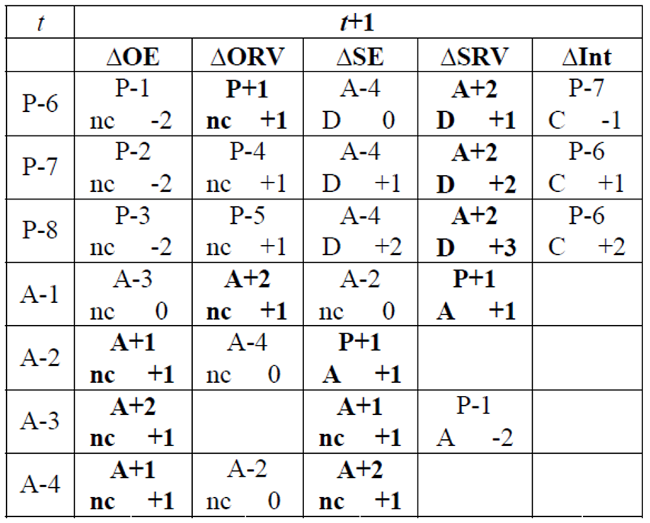
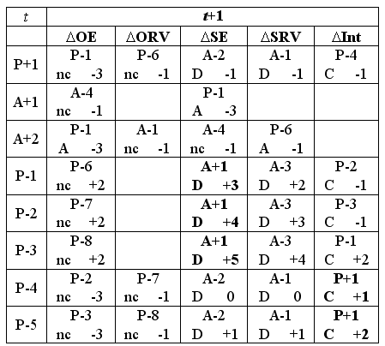
Effects of various sorts of ‘snapshot’ changes

Slide 33
Effects of various sorts of ‘snapshot’ changes
Change in error magnitude
No change in ontology
Addition
Deletion
Change in encoding
No snapshot transition
possible
…

Slide 34
Effects of various sorts of changes
When something faithfully represented at t ceases to be faithful at t+1, leaving the ontology unchanged causes a P+1 to become a P-1.
When something faithfully represented at t is not believed to be faithful anymore at t+1 while in fact it still is, removing the representational element causes a P+1 to become a A-2.
…

Slide 35
Updating is an active process
authors assume in good faith that:
  all included representational units are of the P+1 type, and,
  all they are aware of, but not included, of A+1 or A+2.
If they become aware of a mistake, they make a change under the assumption that their changes are also towards the P+1, A+1, or A+2 cases.
Thus at that time, they know:
  of what configuration type the previous entry must have been under the belief what the current configuration is, and,
  the reason for the change.

Slide 36
configuration | reality |  | representation |  |  |  | ME
 |  |  | authors' belief |  | encoding
 | OE | OR | BE | BR | IE | TR
(1) | (2) | (3) | (4) | (5) | (6) | (7) | (8)
P+1 | Y | Y | Y | Y | Y | R+ | 0
A+1 | N | na | N | na | na | na | 0
A+2 | Y | N | Y | N | na | na | 0
A+3 | Y | N | NC | na | na | na | 0
A+4 | N | na | NC | na | na | na | 0
P-1 | N | na | Y | Y | Y | ¬R | 3
P-2 | N | na | Y | Y | N | ¬R | 4
P-3 | N | na | Y | Y | N | R– | 5
P-4 | Y | Y | Y | Y | N | ¬R | 1
P-5 | Y | Y | Y | Y | N | R- | 2
P-6 | Y | N | Y | Y | Y | R+ | 1
P-7 | Y | N | Y | Y | N | ¬R | 2
P-8 | Y | N | Y | Y | N | R– | 3
P-9 | Y | Y | Y | Y | Y | R++ | 1
P-10 | Y | N | Y | Y | Y | R++ | 2
P-11 | Y | Y | Y | Y | Y | Ra | 1
P-12 | N | na | Y | Y | Y | Ra | 4
A-1 | Y | Y | Y | N | na | na | 1
A-2 | Y | Y | N | na | na | na | 1
A-3 | N | na | Y | N | na | na | 1
A-4 | Y | N | N | na | na | na | 1
A-5 | Y | Y | NC | na | na | na | 1
Evolution example:
The Higg’s boson was discovered and added to the ontology:
A-5 → P+1 → quality improvement of +1

Slide 37
This leads to a calculus …
NOT:
  to demonstrate how good an individual version of an ontology is,
But rather
  to measure how much it improved (hopefully) as compared to its predecessors.
Principle: recursive belief revision.
Ceusters W. Applying Evolutionary Terminology Auditing to SNOMED CT. In American Medical Informatics Association 2010 Annual Symposium (AMIA 2010) Proceedings, Washington DC, November 13-17, 2010:96-100.

Slide 38
However: unnoticed changes in reality do not lead to updates!
No change in ontology
…

Slide 39
Quality of a representation w.r.t. reality
n: number of representational elements in the ontology
m: number of unjustified absences
e_{i}: magnitude of the error, if any, for the i ^{th} representational element
Ceusters W. Applying Evolutionary Terminology Auditing to the Gene Ontology.
Journal of Biomedical Informatics 2009;42:518–529.

Slide 40
Quality of a representation w.r.t. reality
n: number of representational elements in the ontology
m: number of unjustified absences
e_{i}: magnitude of the error, if any, for the i ^{th} representational element
Quality of a Representational Unit: 5 – e_{i}
5 is the maximal magnitude of error, thus 0 ≤ ( 5 – e_{i} ) ≤ 5
Ceusters W. Applying Evolutionary Terminology Auditing to the Gene Ontology.
Journal of Biomedical Informatics 2009;42:518–529.

Slide 41
Quality of a representation w.r.t. reality
n: number of representational elements in the ontology
m: number of unjustified absences
e_{i}: magnitude of the error, if any, for the i ^{th} representational element
All unjustified absences have an error magnitude of 1
Ceusters W. Applying Evolutionary Terminology Auditing to the Gene Ontology.
Journal of Biomedical Informatics 2009;42:518–529.

Slide 42
Quality of a representation w.r.t. reality
n: number of representational elements in the ontology
m: number of unjustified absences
e_{i}: magnitude of the error, if any, for the i ^{th} representational element
The sum of the qualities of the RUs, each quality being:
5 for faithful RUs,
(5 – error magnitude) for deviant RUs.
Ceusters W. Applying Evolutionary Terminology Auditing to the Gene Ontology.
Journal of Biomedical Informatics 2009;42:518–529.

Slide 43
Quality of a representation w.r.t. reality
n: number of representational elements in the ontology
m: number of unjustified absences
e_{i}: magnitude of the error, if any, for the i ^{th} representational element
The quality of the ontology decreases through:
Error magnitude of unjustified presences,
Number of unjustified absences.
Ceusters W. Applying Evolutionary Terminology Auditing to the Gene Ontology.
Journal of Biomedical Informatics 2009;42:518–529.

Slide 44
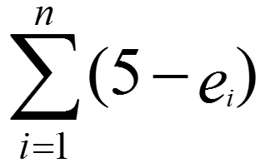
Quality of a representation w.r.t. reality
n: number of representational elements in the ontology
m: number of unjustified absences
e_{i}: magnitude of the error, if any, for the i ^{th} representational element
Ideal case:
e_{i} is 0 for all RUs, thus = 5n
Number of unjustified absences = 0, thus 4m = 0.
5n
5n
= 1
Ceusters W. Applying Evolutionary Terminology Auditing to the Gene Ontology.
Journal of Biomedical Informatics 2009;42:518–529.

Slide 45

Comparing quality of ontologies
 | Reality | Ontology 1 |  | Ontology 2 |  | Ontology 3
RU | Config. | Config. | Error | Config. | Error | Config. | Error
animal | P+1 | P+1 | 0 | P+1 | 0 | P+1 | 0
fish | P+1 | P+1 | 0 | P+1 | 0 | P+1 | 0
whale | P+1 | P+1 | 0 | P+1 | 0 | P+1 | 0
mammal | P+1 | P+1 | 0 | P+1 | 0 | P+1 | 0
fish are animals | P+1 | P+1 | 0 | P+1 | 0 | P+1 | 0
mammals are animals | P+1 | P+1 | 0 | P+1 | 0 | P+1 | 0
whales are fish | A+1 | P-1 | 3 | A+1 | 0 | A+1 | 0
whales are animals | P+1 | P+1 | 0 | P+1 | 0 | P+1 | 0
whales are mammals | P+1 | A-2 | 1 | A-2 | 1 | P+1 | 0
SCORE | 8*5/ ((8*5)+(0*4)) = 1.00 | ((7*5)+(1*2))/ ((8*5)+(1*4)) =0.84 |  | 7*5/ ((7*5)+(1*4)) =0.90 |  | 8*5/ ((8*5)+(0*4)) =1.00
n: number of RUs in the ontology
m: number of unjustified absences
e_{i}: magnitude of the error, if any,
for the i ^{th} RU

Slide 46

Comparing quality of ontologies
 | Reality | Ontology 1 |  | Ontology 2 |  | Ontology 3
RU | Config. | Config. | Error | Config. | Error | Config. | Error
animal | P+1 | P+1 | 0 | P+1 | 0 | P+1 | 0
fish | P+1 | P+1 | 0 | P+1 | 0 | P+1 | 0
whale | P+1 | P+1 | 0 | P+1 | 0 | P+1 | 0
mammal | P+1 | P+1 | 0 | P+1 | 0 | P+1 | 0
fish are animals | P+1 | P+1 | 0 | P+1 | 0 | P+1 | 0
mammals are animals | P+1 | P+1 | 0 | P+1 | 0 | P+1 | 0
whales are fish | A+1 | P-1 | 3 | A+1 | 0 | A+1 | 0
whales are animals | P+1 | P+1 | 0 | P+1 | 0 | P+1 | 0
whales are mammals | P+1 | A-2 | 1 | A-2 | 1 | P+1 | 0
SCORE | 8*5/ ((8*5)+(0*4)) = 1.00 | ((7*5)+(1*2))/ ((8*5)+(1*4)) =0.84 |  | 7*5/ ((7*5)+(1*4)) =0.90 |  | 8*5/ ((8*5)+(0*4)) =1.00
n: number of RUs in the ontology
m: number of unjustified absences
e_{i}: magnitude of the error, if any,
for the i ^{th} RU

Slide 47

Comparing quality of ontologies
 | Reality | Ontology 1 |  | Ontology 2 |  | Ontology 3
RU | Config. | Config. | Error | Config. | Error | Config. | Error
animal | P+1 | P+1 | 0 | P+1 | 0 | P+1 | 0
fish | P+1 | P+1 | 0 | P+1 | 0 | P+1 | 0
whale | P+1 | P+1 | 0 | P+1 | 0 | P+1 | 0
mammal | P+1 | P+1 | 0 | P+1 | 0 | P+1 | 0
fish are animals | P+1 | P+1 | 0 | P+1 | 0 | P+1 | 0
mammals are animals | P+1 | P+1 | 0 | P+1 | 0 | P+1 | 0
whales are fish | A+1 | P-1 | 3 | A+1 | 0 | A+1 | 0
whales are animals | P+1 | P+1 | 0 | P+1 | 0 | P+1 | 0
whales are mammals | P+1 | A-2 | 1 | A-2 | 1 | P+1 | 0
SCORE | 8*5/ ((8*5)+(0*4)) = 1.00 | ((7*5)+(1*2))/ ((8*5)+(1*4)) =0.84 |  | 7*5/ ((7*5)+(1*4)) =0.90 |  | 8*5/ ((8*5)+(0*4)) =1.00
n: number of RUs in the ontology m: number of unjustified absences e_{i}: magnitude of the error, if any, for the i ^{th} RU

Slide 48
Comparing quality of ontologies
 | Reality | Ontology 1 |  | Ontology 2 |  | Ontology 3
RU | Config. | Config. | Error | Config. | Error | Config. | Error
animal | P+1 | P+1 | 0 | P+1 | 0 | P+1 | 0
fish | P+1 | P+1 | 0 | P+1 | 0 | P+1 | 0
whale | P+1 | P+1 | 0 | P+1 | 0 | P+1 | 0
mammal | P+1 | P+1 | 0 | P+1 | 0 | P+1 | 0
fish are animals | P+1 | P+1 | 0 | P+1 | 0 | P+1 | 0
mammals are animals | P+1 | P+1 | 0 | P+1 | 0 | P+1 | 0
whales are fish | A+1 | P-1 | 3 | A+1 | 0 | A+1 | 0
whales are animals | P+1 | P+1 | 0 | P+1 | 0 | P+1 | 0
whales are mammals | P+1 | A-2 | 1 | A-2 | 1 | P+1 | 0
SCORE | 8*5/ ((8*5)+(0*4)) = 1.00 | ((7*5)+(1*2))/ ((8*5)+(1*4)) =0.84 |  | 7*5/ ((7*5)+(1*4)) =0.90 |  | 8*5/ ((8*5)+(0*4)) =1.00
n: number of RUs in the ontology m: number of unjustified absences e_{i}: magnitude of the error, if any, for the i ^{th} RU

Slide 49

Comparing consecutive versions: t1
 | Time t1 |  | Time t2 |  |  |  | Time t3
 | V1 |  | T1 |  | T2 |  | T1 |  | T2 |  | T3
 | C. | E. | C. | E. | C. | E. | C. | E. | C. | E. | C. | E.
animal | P+1 | 0 | P+1 | 0 | P+1 | 0 | P+1 | 0 | P+1 | 0 | P+1 | 0
fish | P+1 | 0 | P+1 | 0 | P+1 | 0 | P+1 | 0 | P+1 | 0 | P+1 | 0
whale | P+1 | 0 | P+1 | 0 | P+1 | 0 | P+1 | 0 | P+1 | 0 | P+1 | 0
mammal | P+1 | 0 | P+1 | 0 | P+1 | 0 | P+1 | 0 | P+1 | 0 | P+1 | 0
fish are animals | P+1 | 0 | P+1 | 0 | P+1 | 0 | P+1 | 0 | P+1 | 0 | P+1 | 0
mammals are animals | P+1 | 0 | P+1 | 0 | P+1 | 0 | P+1 | 0 | P+1 | 0 | P+1 | 0
whales are fish | P+1 | 0 | P-1 | 3 | A+1 | 0 | P-1 | 3 | A+1 | 0 | A+1 | 0
whales are animals | P+1 | 0 | P+1 | 0 | P+1 | 0 | P+1 | 0 | P+1 | 0 | P+1 | 0
whales are mammals | - | - | - | - | - | - | A-2 | 1 | A-2 | 1 | P+1 | 0
SCORE | 1.00 |  | 0.93 |  | 1.00 |  | 0.84 |  | 0.90 |  | 1.00
(8*5)
(8*5)
n: number of RUs in the ontology
m: number of unjustified absences
e_{i}: magnitude of the error, if any,
for the i ^{th} RU

Slide 50


Comparing consecutive versions: t2
 | Time t1 |  | Time t2 |  |  |  | Time t3
 | V1 |  | T1 |  | V2 |  | T1 |  | T2 |  | T3
 | C. | E. | C. | E. | C. | E. | C. | E. | C. | E. | C. | E.
animal | P+1 | 0 | P+1 | 0 | P+1 | 0 | P+1 | 0 | P+1 | 0 | P+1 | 0
fish | P+1 | 0 | P+1 | 0 | P+1 | 0 | P+1 | 0 | P+1 | 0 | P+1 | 0
whale | P+1 | 0 | P+1 | 0 | P+1 | 0 | P+1 | 0 | P+1 | 0 | P+1 | 0
mammal | P+1 | 0 | P+1 | 0 | P+1 | 0 | P+1 | 0 | P+1 | 0 | P+1 | 0
fish are animals | P+1 | 0 | P+1 | 0 | P+1 | 0 | P+1 | 0 | P+1 | 0 | P+1 | 0
mammals are animals | P+1 | 0 | P+1 | 0 | P+1 | 0 | P+1 | 0 | P+1 | 0 | P+1 | 0
whales are fish | P+1 | 0 | P-1 | 3 | A+1 | 0 | P-1 | 3 | A+1 | 0 | A+1 | 0
whales are animals | P+1 | 0 | P+1 | 0 | P+1 | 0 | P+1 | 0 | P+1 | 0 | P+1 | 0
whales are mammals | - | - | - | - | - | - | A-2 | 1 | A-2 | 1 | P+1 | 0
SCORE | 1.00 |  | 0.93 |  | 1.00 |  | 0.84 |  | 0.90 |  | 1.00
?
What must you believe at t2 about ontology version V1, in light of what you believe to be the case in reality at t2?
(7*5)
(7*5)
n: number of RUs in the ontology
m: number of unjustified absences
e_{i}: magnitude of the error, if any,
for the i ^{th} RU

Slide 51
Comparing consecutive versions: t2
 | Time t1 |  | Time t2 |  |  |  | Time t3
 | V1 |  | T1 |  | V2 |  | T1 |  | T2 |  | T3
 | C. | E. | C. | E. | C. | E. | C. | E. | C. | E. | C. | E.
animal | P+1 | 0 | P+1 | 0 | P+1 | 0 | P+1 | 0 | P+1 | 0 | P+1 | 0
fish | P+1 | 0 | P+1 | 0 | P+1 | 0 | P+1 | 0 | P+1 | 0 | P+1 | 0
whale | P+1 | 0 | P+1 | 0 | P+1 | 0 | P+1 | 0 | P+1 | 0 | P+1 | 0
mammal | P+1 | 0 | P+1 | 0 | P+1 | 0 | P+1 | 0 | P+1 | 0 | P+1 | 0
fish are animals | P+1 | 0 | P+1 | 0 | P+1 | 0 | P+1 | 0 | P+1 | 0 | P+1 | 0
mammals are animals | P+1 | 0 | P+1 | 0 | P+1 | 0 | P+1 | 0 | P+1 | 0 | P+1 | 0
whales are fish | P+1 | 0 | P-1 | 3 | A+1 | 0 | P-1 | 3 | A+1 | 0 | A+1 | 0
whales are animals | P+1 | 0 | P+1 | 0 | P+1 | 0 | P+1 | 0 | P+1 | 0 | P+1 | 0
whales are mammals | - | - | - | - | - | - | A-2 | 1 | A-2 | 1 | P+1 | 0
SCORE | 1.00 |  | 0.93 |  | 1.00 |  | 0.84 |  | 0.90 |  | 1.00
(7*5) + (1*2)
(8*5)
n: number of RUs in the ontology
m: number of unjustified absences
e_{i}: magnitude of the error, if any,
for the i ^{th} RU

Slide 52

Comparing consecutive versions: t3
 | Time t1 |  | Time t2 |  |  |  | Time t3
 | V1 |  | V1 |  | V2 |  | T1 |  | T2 |  | V3
 | C. | E. | C. | E. | C. | E. | C. | E. | C. | E. | C. | E.
animal | P+1 | 0 | P+1 | 0 | P+1 | 0 | P+1 | 0 | P+1 | 0 | P+1 | 0
fish | P+1 | 0 | P+1 | 0 | P+1 | 0 | P+1 | 0 | P+1 | 0 | P+1 | 0
whale | P+1 | 0 | P+1 | 0 | P+1 | 0 | P+1 | 0 | P+1 | 0 | P+1 | 0
mammal | P+1 | 0 | P+1 | 0 | P+1 | 0 | P+1 | 0 | P+1 | 0 | P+1 | 0
fish are animals | P+1 | 0 | P+1 | 0 | P+1 | 0 | P+1 | 0 | P+1 | 0 | P+1 | 0
mammals are animals | P+1 | 0 | P+1 | 0 | P+1 | 0 | P+1 | 0 | P+1 | 0 | P+1 | 0
whales are fish | P+1 | 0 | P-1 | 3 | A+1 | 0 | P-1 | 3 | A+1 | 0 | A+1 | 0
whales are animals | P+1 | 0 | P+1 | 0 | P+1 | 0 | P+1 | 0 | P+1 | 0 | P+1 | 0
whales are mammals | - | - | - | - | - | - | A-2 | 1 | A-2 | 1 | P+1 | 0
SCORE | 1.00 |  | 0.93 |  | 1.00 |  | 0.84 |  | 0.90 |  | 1.00
?
(8*5)
(8*5)
n: number of RUs in the ontology
m: number of unjustified absences
e_{i}: magnitude of the error, if any,
for the i ^{th} RU

Slide 53

Comparing consecutive versions: t3
 | Time t1 |  | Time t2 |  |  |  | Time t3
 | V1 |  | V1 |  | V2 |  | T1 |  | V2 |  | V3
 | C. | E. | C. | E. | C. | E. | C. | E. | C. | E. | C. | E.
animal | P+1 | 0 | P+1 | 0 | P+1 | 0 | P+1 | 0 | P+1 | 0 | P+1 | 0
fish | P+1 | 0 | P+1 | 0 | P+1 | 0 | P+1 | 0 | P+1 | 0 | P+1 | 0
whale | P+1 | 0 | P+1 | 0 | P+1 | 0 | P+1 | 0 | P+1 | 0 | P+1 | 0
mammal | P+1 | 0 | P+1 | 0 | P+1 | 0 | P+1 | 0 | P+1 | 0 | P+1 | 0
fish are animals | P+1 | 0 | P+1 | 0 | P+1 | 0 | P+1 | 0 | P+1 | 0 | P+1 | 0
mammals are animals | P+1 | 0 | P+1 | 0 | P+1 | 0 | P+1 | 0 | P+1 | 0 | P+1 | 0
whales are fish | P+1 | 0 | P-1 | 3 | A+1 | 0 | P-1 | 3 | A+1 | 0 | A+1 | 0
whales are animals | P+1 | 0 | P+1 | 0 | P+1 | 0 | P+1 | 0 | P+1 | 0 | P+1 | 0
whales are mammals | - | - | - | - | - | - | A-2 | 1 | A-2 | 1 | P+1 | 0
SCORE | 1.00 |  | 0.93 |  | 1.00 |  | 0.84 |  | 0.90 |  | 1.00
?
(7*5)
(7*5) + (1*4)
n: number of RUs in the ontology
m: number of unjustified absences
e_{i}: magnitude of the error, if any,
for the i ^{th} RU

Slide 54
Comparing consecutive versions: t3
 | Time t1 |  | Time t2 |  |  |  | Time t3
 | V1 |  | V1 |  | V2 |  | V1 |  | V2 |  | V3
 | C. | E. | C. | E. | C. | E. | C. | E. | C. | E. | C. | E.
animal | P+1 | 0 | P+1 | 0 | P+1 | 0 | P+1 | 0 | P+1 | 0 | P+1 | 0
fish | P+1 | 0 | P+1 | 0 | P+1 | 0 | P+1 | 0 | P+1 | 0 | P+1 | 0
whale | P+1 | 0 | P+1 | 0 | P+1 | 0 | P+1 | 0 | P+1 | 0 | P+1 | 0
mammal | P+1 | 0 | P+1 | 0 | P+1 | 0 | P+1 | 0 | P+1 | 0 | P+1 | 0
fish are animals | P+1 | 0 | P+1 | 0 | P+1 | 0 | P+1 | 0 | P+1 | 0 | P+1 | 0
mammals are animals | P+1 | 0 | P+1 | 0 | P+1 | 0 | P+1 | 0 | P+1 | 0 | P+1 | 0
whales are fish | P+1 | 0 | P-1 | 3 | A+1 | 0 | P-1 | 3 | A+1 | 0 | A+1 | 0
whales are animals | P+1 | 0 | P+1 | 0 | P+1 | 0 | P+1 | 0 | P+1 | 0 | P+1 | 0
whales are mammals | - | - | - | - | - | - | A-2 | 1 | A-2 | 1 | P+1 | 0
SCORE | 1.00 |  | 0.93 |  | 1.00 |  | 0.84 |  | 0.90 |  | 1.00
(7*5) + (1*2)
(8*5) + (1*4)
n: number of RUs in the ontology
m: number of unjustified absences
e_{i}: magnitude of the error, if any,
for the i ^{th} RU

Slide 55
4. Case study in SNOMED CT
Expanding Evolutionary Terminology Auditing with Historic Formal and Linguistic Intensions: a Case Study in SNOMED CT
Werner Ceusters and Sarah Mullin
(forthcoming)

Slide 56
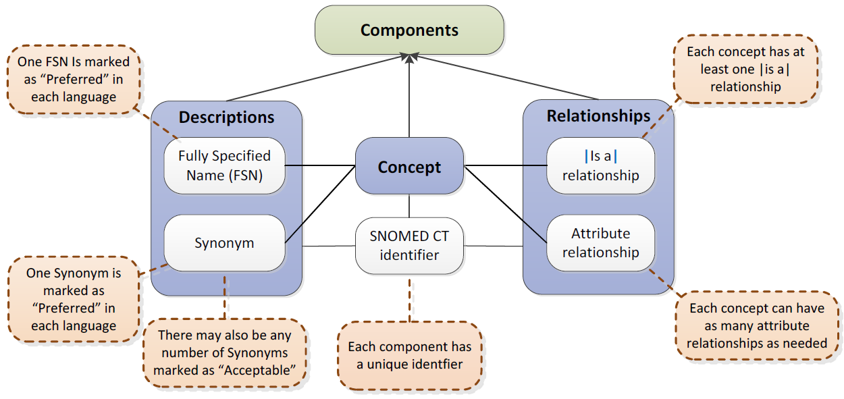
SNOMED CT structure
IHTSDO. SNOMED CT Starter Guide July 2014

Slide 57
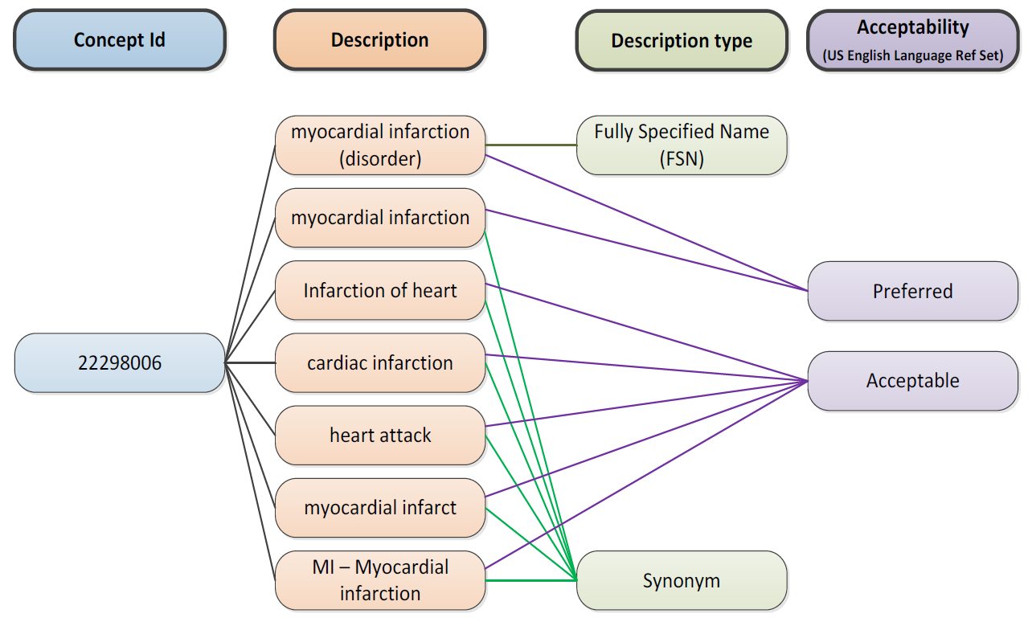
SNOMED CT Descriptions
IHTSDO. SNOMED CT Starter Guide July 2014

Slide 58
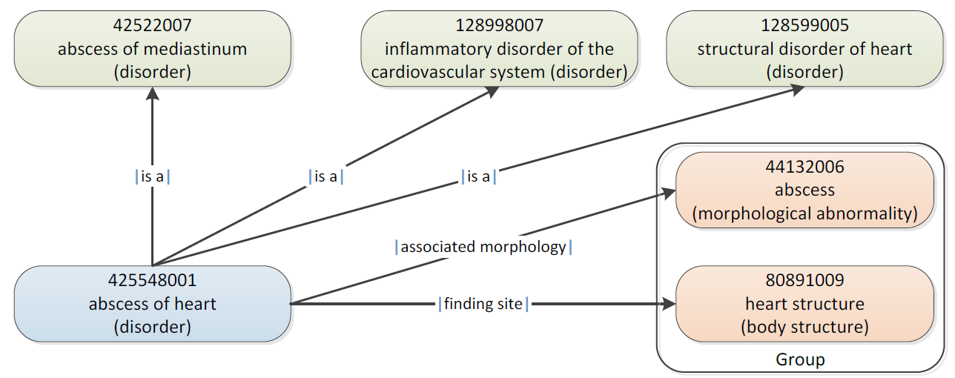
SNOMED CT Defining relationships
IHTSDO. SNOMED CT Starter Guide July 2014

Slide 59
Changes in SNOMED CT (RF2) concepts and relationships
conceptID | Effective Time | Active | ModuleID | Definitional Status
301381004 | 20020131 | 1 | 900000000000207008 | 900000000000074008
301381004 | 20080131 | 0 | 900000000000207008 | 900000000000074008
FSN = ‘Discomforting present pain (finding)’

Slide 60
Changes in SNOMED CT (RF2) concepts and relationships
conceptID | Effective Time | Active | ModuleID | Definitional Status
301381004 | 20020131 | 1 | 900000000000207008 | 900000000000074008
301381004 | 20080131 | 0 | 900000000000207008 | 900000000000074008
FSN = ‘Discomforting present pain (finding)’
RelID | Effective Time | Active | Attribute | Target
126300024 | 20020131 | 1 | Is a | Pain (finding)
126300024 | 20040131 | 0 | Is a | Pain (finding)
126301023 | 20020131 | 1 | Is a | Finding of present pain intensity (finding)
126301023 | 20080131 | 0 | Is a | Finding of present pain intensity (finding)
657858027 | 20020131 | 1 | Finding site | Structure of nervous system (body structure)
657858027 | 20060131 | 0 | Finding site | Structure of nervous system (body structure)
2260209021 | 20030731 | 1 | Interprets | Nervous system function (observable entity)
2260209021 | 20050131 | 0 | Interprets | Nervous system function (observable entity)
2458913020 | 20040131 | 1 | Is a | Discomfort (finding)
2458913020 | 20080131 | 0 | Is a | Discomfort (finding)
2858465020 | 20060131 | 1 | Finding site | Anatomical structure (body structure)
2858465020 | 20080131 | 0 | Finding site | Anatomical structure (body structure)

Slide 61
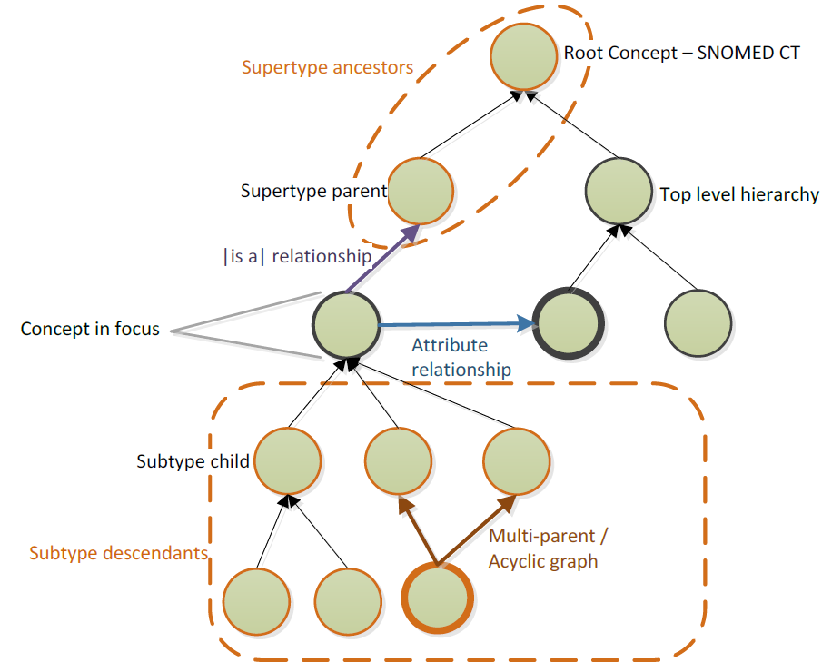
SNOMED CT Relationships

Slide 62
‘Meaning’ of a concept
For ontologies that do not explicitly adhere to a view based on Ontological Realism:
the meaning of a concept can be thought of as a combination of what is conveyed by means of three aspects:
  its linguistic intension as conveyed through its label(s),
  its formal intension, i.e. the properties implied by it as exhibited, for instance by means of the formal relations it holds with other concepts and
  its extension, i.e. the collection of data elements in, for instance, electronic medical record systems annotated with the concept.
S. Wang, S. Schlobach, and M. Klein, Concept drift and how to identify it, Journal of Web Semantics 9 (2011), 247-265.

Slide 63
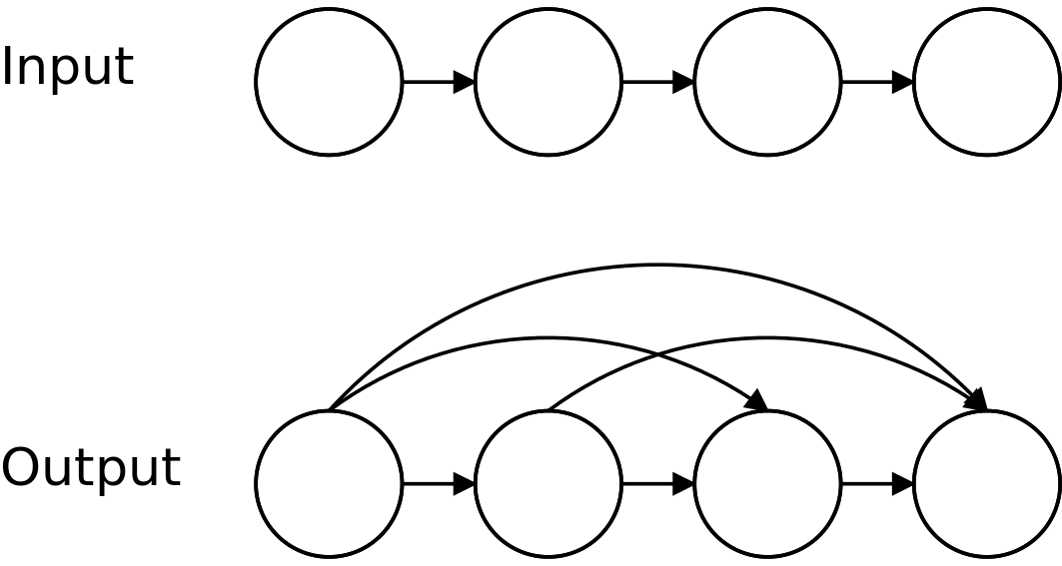
Transitive closure of a graph
By Anish Bramhandkar - Own work, CC BY-SA 4.0, https://commons.wikimedia.org/w/index.php?curid=8808985

Slide 64
Transitive closure over versions
10001005 |  |  | Bacterial sepsis Isa ….
 | 91302008 | Sepsis (disorder)
 | 87628006 | Bacterial infectious disease (disorder)
 | 64572001 | Disease (disorder)
 | 40733004 | Infectious disease (disorder)
 | 105592009 | Septicemia (disorder)
 | 404684003 | Clinical finding (finding)
 | 431950004 | Bloodstream finding (finding)
 | 431193003 | Infection of bloodstream (disorder)
 | 301811001 | Bacterial infection by site (disorder)
 | 301810000 | Infection by site (disorder)
 | 123946008 | Disorder by body site (disorder)
 | 118234003 | Finding by site (finding)
 | 434156008 | Infectious agent in bloodstream (finding)
 | 238149007 | Systemic inflammatory response syndrome (disorder)
 | 128139000 | Inflammatory disorder (disorder)

Slide 65
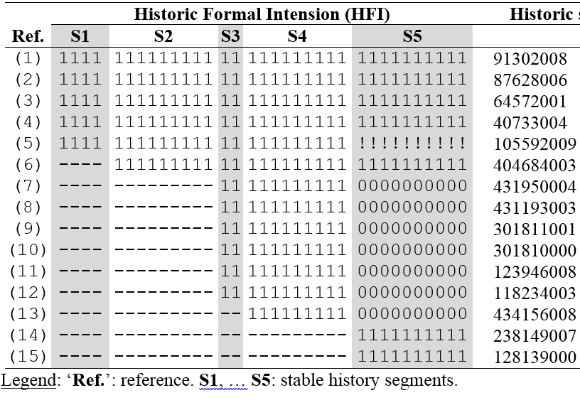
Transitive closure of ‘Bacterial Sepsis’ over 34 versions

Slide 66
15 Historic Signatures for TC relations
Inactive, target inactive
Active
Inactive, target active
Not yet present

Slide 67
Formal Intension of 10001005 in V14 & V15

Slide 68
Historic Formal Intension of 10001005

Slide 69
Rigid formal properties set of 10001005’s TC

Slide 70
5 Stable history segments of 10001005

Slide 71
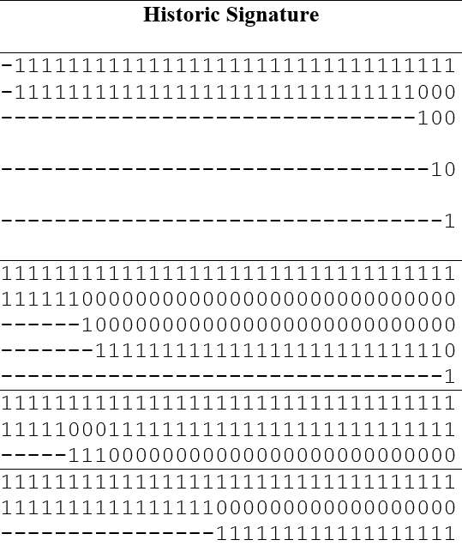
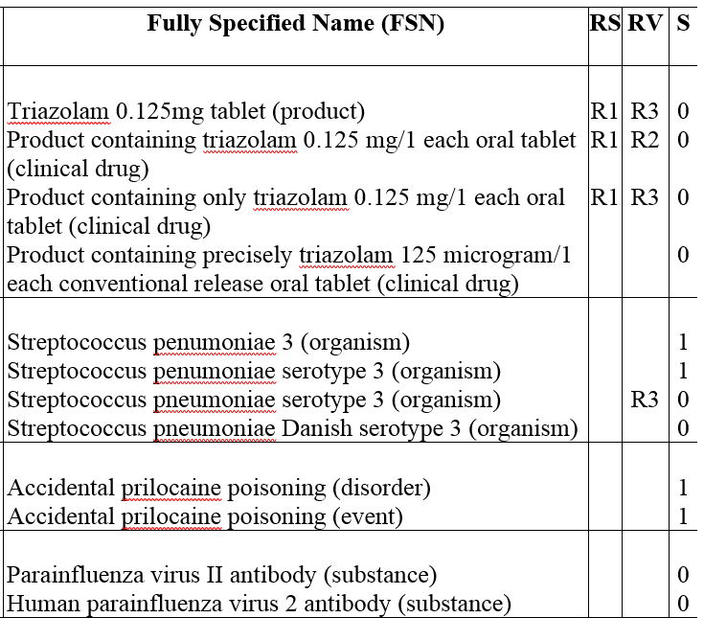
Historic signatures for FSNs
Change reason by SNOMED CT
Output of string matching

Slide 72
Simple string Transformation Algorithm
Search string | Replacement | Rule
"human leukocyte antigen" | → " " | R1
"antigen" | → " " | R2
"hla" | → " " | R3
"-" | → "" | R4
" " | → "" | R5
String transformation sequence |  | Rule
'hla-dr8 antigen'
'hla-dr8 ' |  | R2
'-dr8 '' |  | R3
'dr8 ' |  | R4
'dr8' |  | R5
'human leukocyte antigen hla-dr8 antigen'
' hla-dr8 antigen' |  | R1
' hla-dr8 ' |  | R2
' -dr8 ' |  | R3
' dr8 ' |  | R4
'dr8' |  | R5
'human leukocyte antigen dr8'
' dr8' |  | R1
'dr8' |  | R5

Slide 73
Suspicious annullment

Slide 74
Suspicious annullment
10001005 |  |  | Bacterial sepsis Isa ….
 | 91302008 | Sepsis (disorder)
 | 87628006 | Bacterial infectious disease (disorder)
 | 64572001 | Disease (disorder)
 | 40733004 | Infectious disease (disorder)
 | 105592009 | Septicemia (disorder)
 | 404684003 | Clinical finding (finding)
 | 431950004 | Bloodstream finding (finding)
 | 431193003 | Infection of bloodstream (disorder)
 | 301811001 | Bacterial infection by site (disorder)
 | 301810000 | Infection by site (disorder)
 | 123946008 | Disorder by body site (disorder)
 | 118234003 | Finding by site (finding)
 | 434156008 | Infectious agent in bloodstream (finding)
 | 238149007 | Systemic inflammatory response syndrome (disorder)
 | 128139000 | Inflammatory disorder (disorder)

Slide 75
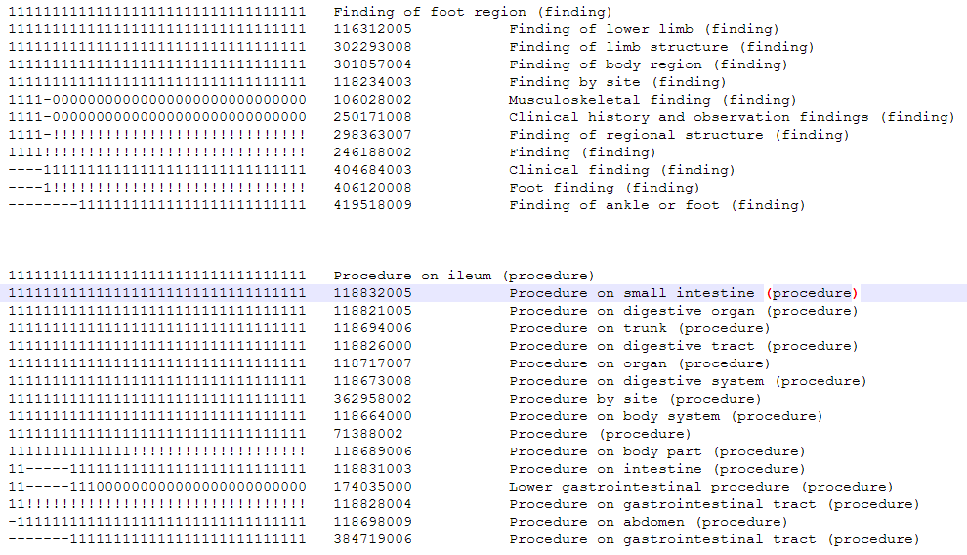
Suspiciously gapped concepts

Slide 76
Historic formal intension related measures
Descriptive Statistic | HFI | SHSC | ACTIVE | LIFETIME | RFP | RFP% | Susp. Ann. | Susp. gapped
Mean | 22.708 | 6.249 | 0.845 | 25.836 | 9.975 | 49.935 | 1.384 | 0.381
Standard Error | 0.028 | 0.006 | 0.001 | 0.018 | 0.016 | 0.048 | 0.009 | 0.027
Median | 17 | 5 | 1 | 34 | 7 | 43 | 0 | 0
Mode | 7 | 2 | 1 | 34 | 4 | 100 | 0 | 0
Standard Deviation | 17.784 | 3.861 | 0.362 | 11.417 | 10.026 | 30.703 | 5.627 | 17.164
Kurtosis | 2.247 | 0.577 | 1.615 | -0.609 | 6.597 | -1.091 | 311.509 | 63,995.461
Skewness | 1.428 | 0.952 | -1.901 | -0.999 | 2.256 | 0.371 | 13.736 | 202.515
Minimum (Min) | 1 | 1 | 0 | 1 | 0 | 0 | 0 | 0
Maximum (Max) | 152 | 25 | 1 | 34 | 125 | 100 | 326 | 6,643
Confidence Level(95.0%) | 0.055 | 0.012 | 0.001 | 0.035 | 0.031 | 0.095 | 0.017 | 0.053
N concepts with Max | 1 | 15 | 340,639 | 224,447 | 1 | 61,001 | 1 | 1
N concepts with Min | 204 | 7,961 | 62,721 | 9,689 | 9,241 | 9,241 | 300,868 | 395,777
N Active concepts with Max | 1 | 15 | 340,639 | 224,447 | 1 | 51,936 | 1 | 1
N Active concepts with Min | 180 | 7,961 | 0 | 6,505 | 8,274 | 8,274 | 238,147 | 333,066

Slide 77
Missing?
88425004: Congenital anomaly of nervous system (disorder)
 | 299735001: Neurological lesion (finding)
 | 102957003: Neurological finding (finding)
87290003: Congenital anomaly of head (disorder)
 | 204223000: Ear, face and neck congenital anomalies (disorder)
83502000: Operation on tendon sheath (procedure)
 | 118667007: Procedure on skeletal muscular system (procedure)
11381005: Acne (disorder)
 | 95320005: Disorder of skin (disorder)
 | 80659006: Disorder of skin and/or subcutaneous tissue (disorder)
 | 106076001: Skin finding (finding)
 | 301857004: Finding of body region (finding)
 | 19660004: Disorder of soft tissue (disorder)

Slide 78
Missing?
19838004: In-vitro immunologic test (procedure)
 | 103693007: Diagnostic procedure (procedure)
 | 362961001: Procedure by intent (procedure)
 | 127789004: Laboratory procedure categorized by method (procedure)
230179001: Chronic viral encephalitis (disorder)
 | 102957003: Neurological finding (finding)
116316008: Finding of foot region (finding)
 | 250171008: Clinical history and observation findings (finding)
118835007: Procedure on ileum (procedure)
 | 174035000: Lower gastrointestinal procedure (procedure)
10002003: Resection of stomach fundus (procedure)
 | 38829003: Partial excision (procedure)
116175006: Proximal subtotal gastrectomy (procedure)
 | 38829003: Partial excision (procedure)
287812001: Repair of stomach and/or duodenum (procedure)
 | 118821005: Procedure on digestive organ (procedure)
 | 118717007: Procedure on organ (procedure)

Slide 79
Changes in linguistic intension
SCTID: 374142001
1 | Product containing miglitol 25 mg/1 each oral tablet (clinical drug)
2 | Product containing only miglitol 25 mg/1 each oral tablet (clinical drug)
3 | Product containing precisely miglitol 25 milligram/1 each conventional release oral tablet (clinical drug)
SCTID: 100191000119105
1 | Acquired asymmetry of prostate (finding)
2 | Asymmetry of prostate (finding)
SCTID: 102549009
1 | Night cramps (finding)
2 | Cramp in lower leg associated with rest (finding)
SCTID: 106109006
1 | Number of previous abortions (finding)
2 | Number of previous induced termination of pregnancy (finding)
SCTID: 302828001
1 | Syringoma (disorder)
2 | Syringoma of skin (disorder)

