Slide 1
BMI508 – Fall 2018
Biomedical Ontology
Using Referent Tracking for ontology development and use
Werner CEUSTERS^{1,2}
¹ Department of Biomedical Informatics, University at Buffalo, USA
² Department of Psychiatry, University at Buffalo, USA

Slide 2
What is Referent Tracking ?

Slide 3
Reality
L1.
Reality

Slide 4
Generic versus specific entities
L1.
Reality
Generic: types
Specific: particulars

Slide 5
Generic versus specific entities
L1.
Reality
Generic: types
Specific: particulars
L3. Accessible representation
L2. Beliefs (cognitive representation)
L1⁻¹.
L1 which is not about anything

Slide 6
Generic versus specific entities
L1.
Reality
Generic: types
Specific: particulars
L3. Accessible representation
INFORMATION CONTENT ENTITY
‘WC has migraine’
L2. Beliefs (cognitive representation)
DIAGNOSIS
my doctor’s
diagnosis
L1⁻¹.
L1 which is not about anything
LAPTOP
HUMAN BEING
my doctor’s computer
my doctor
DISEASE
me
my migraine
MIGRAINE
HEADACHE
my headache
Ontology
Referent Tracking

Slide 7
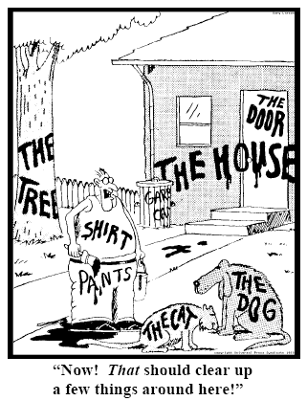
Essence of Referent Tracking
explicit reference to the individual entities
relevant to the accurate description of some
portion of reality, ...
Ceusters W, Smith B. Strategies for Referent Tracking in Electronic Health Records. J Biomed Inform. 2006 Jun;39(3):362-78.

Slide 8
Essence of Referent Tracking
explicit reference to the individual entities
relevant to the accurate description of some
portion of reality, ...
Ceusters W, Smith B. Strategies for Referent Tracking in Electronic Health Records. J Biomed Inform. 2006 Jun;39(3):362-78.

Slide 9
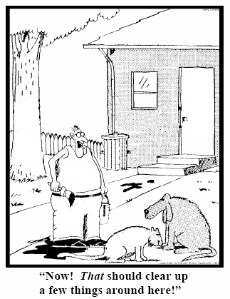
RT method: IUI assignment
  Introduce an Instance Unique Identifier (IUI) for each relevant particular (individual) entity
78
235
5678
321
322
666
427
Ceusters W, Smith B. Strategies for Referent Tracking in Electronic Health Records. J Biomed Inform. 2006 Jun;39(3):362-78.

Slide 10
Portions of reality
entities (= particulars, = instances),
  e.g.: me, my life;
relations,
  e.g.: the 3-place parthood relation between me, my nose, and the temporal region at which it holds,
types,
  universals, e.g. Nose,
  defined classes, e.g. Crooked Nose,
configurations,
  e.g. my nose now being part of me.
Why is RT only for particulars?

Slide 11
Identifiers and pseudo-identifiers
Representation | Reality
ID-a
ID-b | Entity-1
ID-c | Entity-2
ID-d | Entity-3
ID-e | Entity-4
ID-f | Entity-5

Slide 12
Identifiers and pseudo-identifiers
Representation | Reality
ID-a
ID-b | Entity-1
ID-c | Entity-2
ID-d | Entity-3
ID-e | Entity-4
ID-f | Entity-5
Pseudo-identifiers:
  ID-a: denotes nothing
  ID-b: denotes ambiguously
Singularly unique identifier: ID-c
Non-singularly unique identifiers: ID-f, ID-d, ID-e

Slide 13
IUI
There is for any particular only one identifier within all systems in which the entity is represented
Globally and Singularly Unique Identifier for a Particular
there is for any particular only one identifier within a given representation system

Slide 14
Importance:
L1.
Reality
Generic
Specific
L3. Accessible representation
INFORMATION CONTENT ENTITY
‘WC has migraine’
L2. Beliefs (cognitive representation)
DIAGNOSIS
my doctor’s
diagnosis
L1⁻¹.
L1 which is not about anything
LAPTOP
HUMAN BEING
my doctor’s computer
my doctor
DISEASE
me
my migraine
MIGRAINE
HEADACHE
my headache
Ontology
Referent Tracking
Underrepresented majority in information systems!

Slide 15
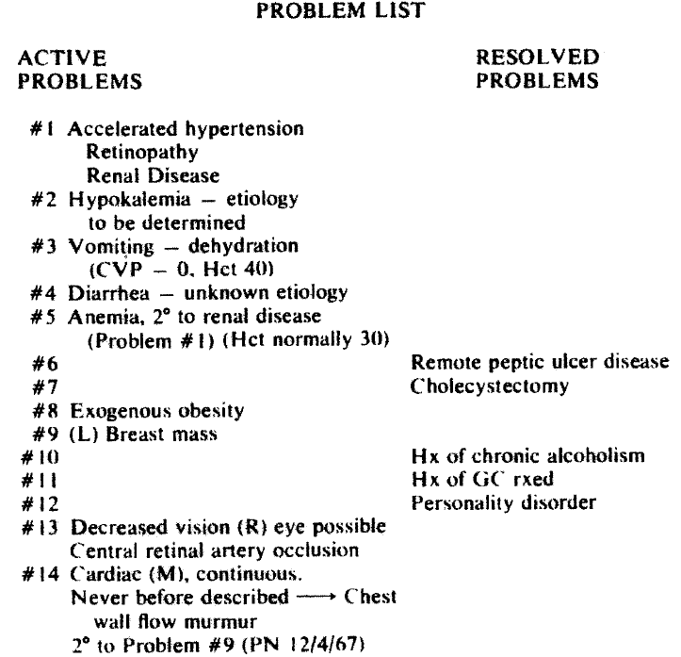
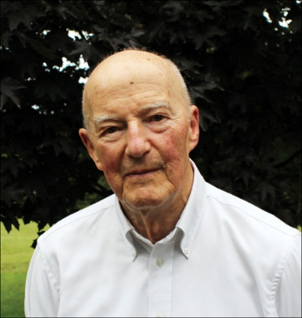
L. Weed.
Medical records that guide and teach.
New England Journal of Medicine 278 (1968), 593-600.

Slide 16
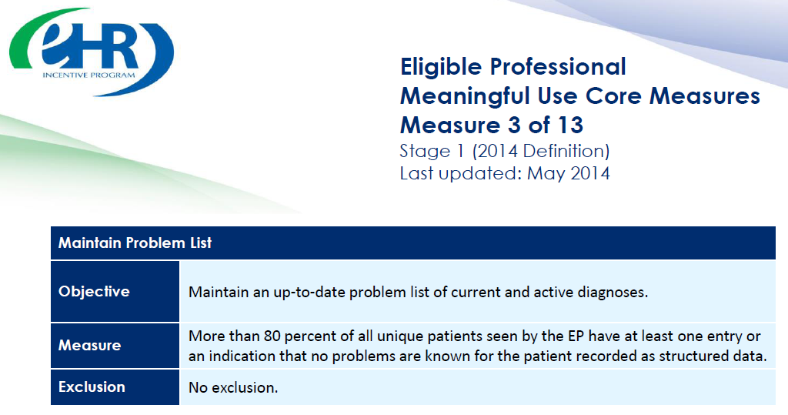

https://www.cms.gov/Regulations-and-Guidance/Legislation/EHRIncentivePrograms/downloads/3_Maintain_Problem_ListEP.pdf

Slide 17
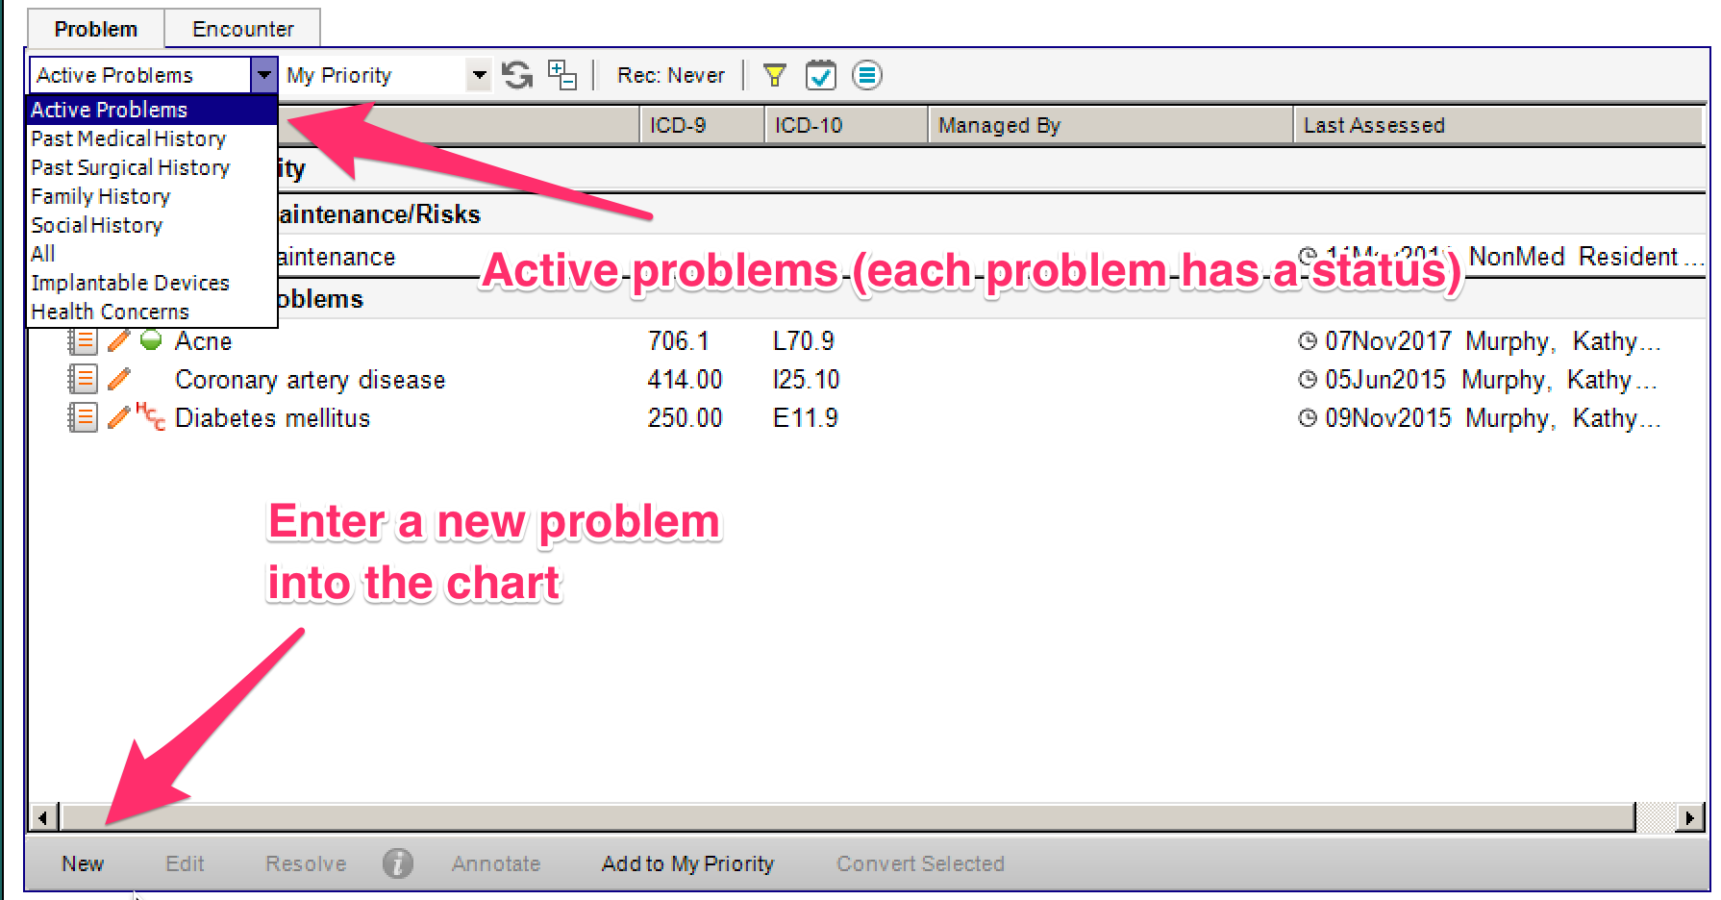

Slide 18
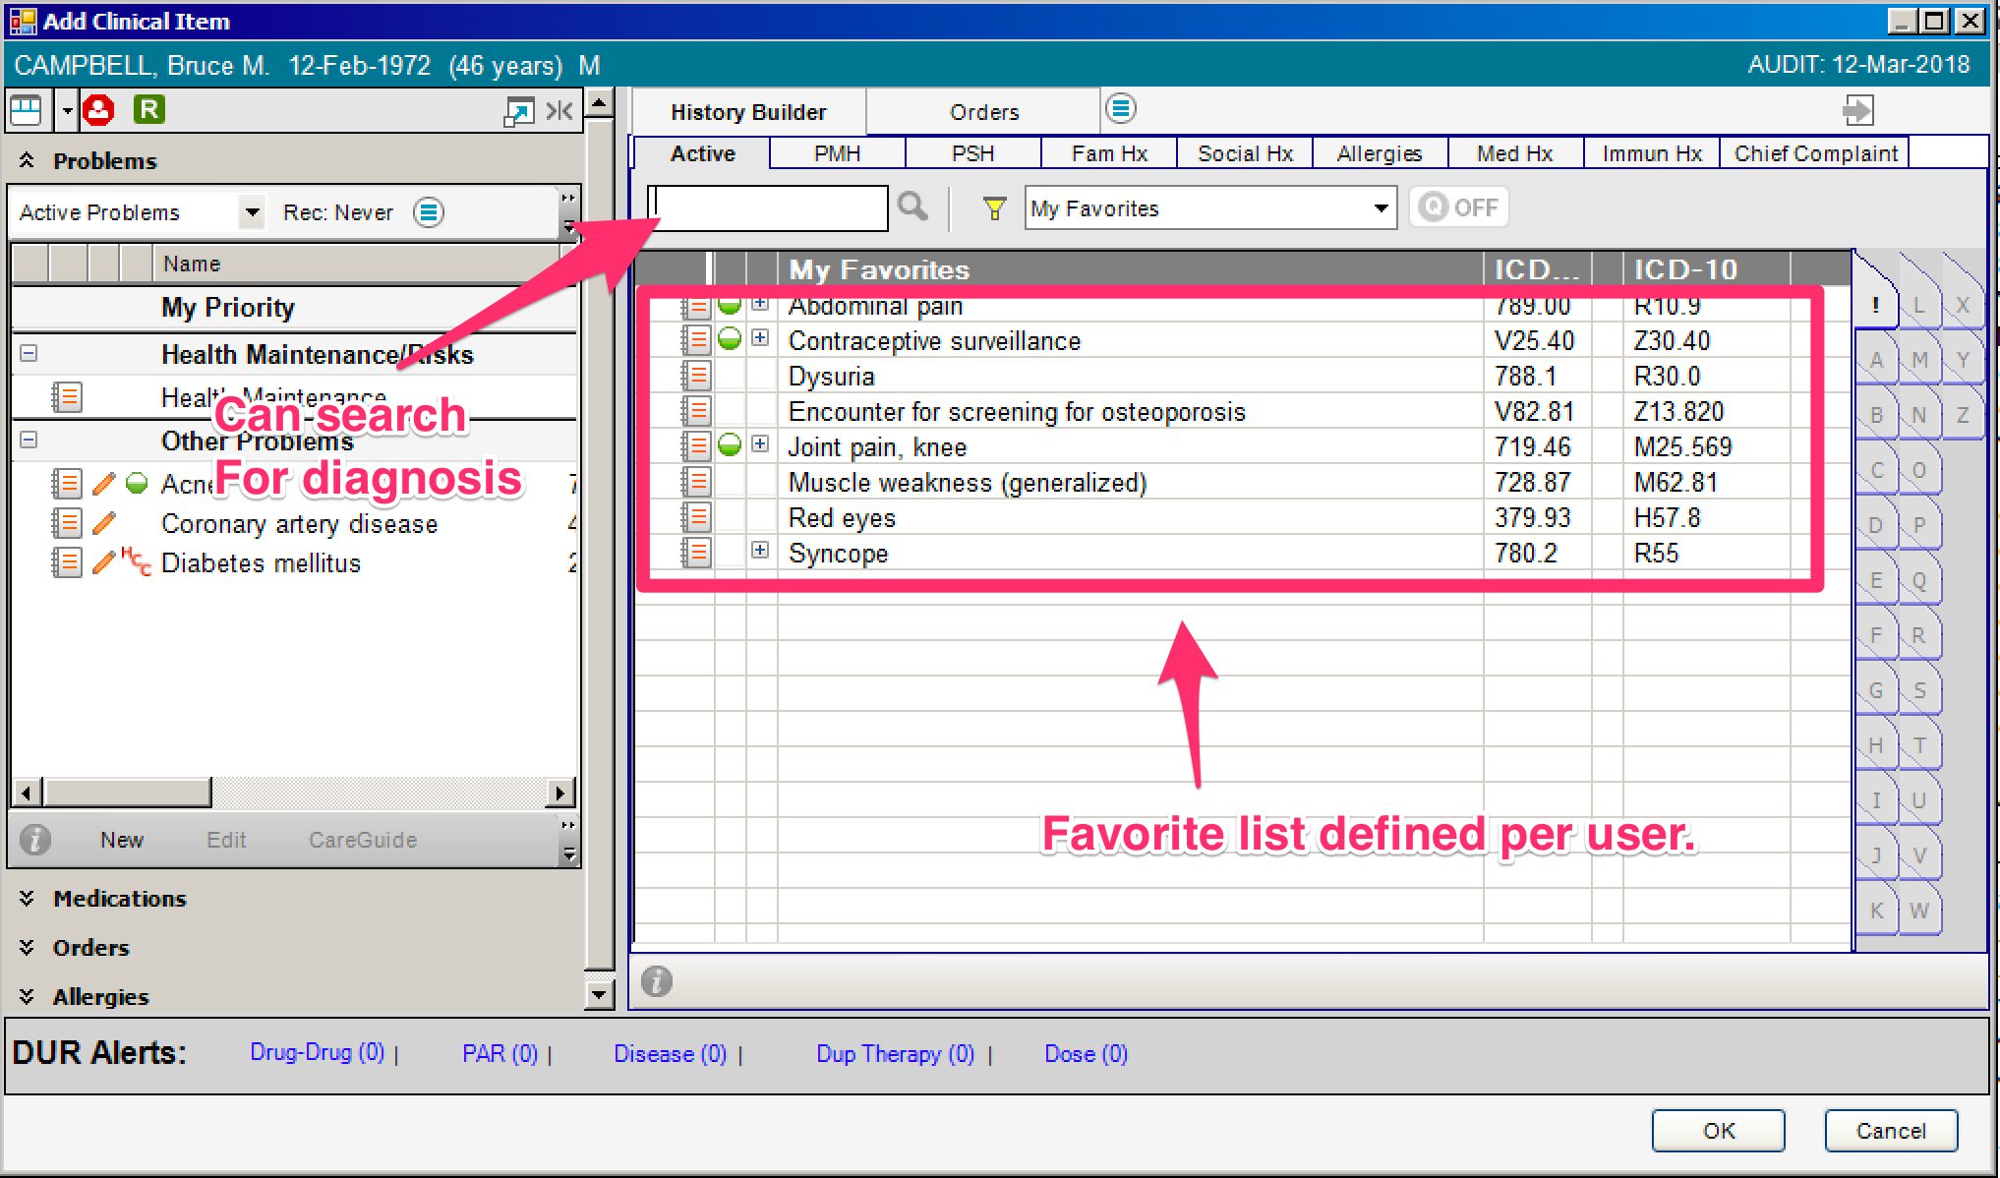

Slide 19
Problem list in an EHR
PtID
Date
ObsCode
Narrative
5572
04/07/1990
26442006
closed fracture of shaft of femur
5572
04/07/1990
81134009
Fracture, closed, spiral
5572
12/07/1990
26442006
closed fracture of shaft of femur
5572
12/07/1990
9001224
Accident in public building (supermarket)
5572
04/07/1990
79001
Essential hypertension
0939
24/12/1991
255174002
benign polyp of biliary tract
2309
21/03/1992
26442006
closed fracture of shaft of femur
2309
21/03/1992
9001224
Accident in public building (supermarket)
47804
03/04/1993
58298795
Other lesion on other specified region
5572
17/05/1993
79001
Essential hypertension
298
22/08/1993
2909872
Closed fracture of radial head
298
22/08/1993
9001224
Accident in public building (supermarket)
5572
01/04/1997
26442006
closed fracture of shaft of femur
5572
01/04/1997
79001
Essential hypertension
0939
20/12/1998
255087006
malignant polyp of biliary tract

Slide 20
Problem list in an EHR
PtID
Date
ObsCode
Narrative
5572
04/07/1990
26442006
closed fracture of shaft of femur
5572
04/07/1990
81134009
Fracture, closed, spiral
5572
12/07/1990
26442006
closed fracture of shaft of femur
5572
12/07/1990
9001224
Accident in public building (supermarket)
5572
04/07/1990
79001
Essential hypertension
0939
24/12/1991
255174002
benign polyp of biliary tract
2309
21/03/1992
26442006
closed fracture of shaft of femur
Same patient, same date,
2 different fracture codes: same (numerically identical) fracture ?
2309
21/03/1992
9001224
Accident in public building (supermarket)
47804
03/04/1993
58298795
Other lesion on other specified region
5572
17/05/1993
79001
Essential hypertension
298
22/08/1993
2909872
Closed fracture of radial head
298
22/08/1993
9001224
Accident in public building (supermarket)
5572
01/04/1997
26442006
closed fracture of shaft of femur
5572
01/04/1997
79001
Essential hypertension
0939
20/12/1998
255087006
malignant polyp of biliary tract

Slide 21
Problem list in an EHR
PtID
Date
ObsCode
Narrative
5572
04/07/1990
26442006
closed fracture of shaft of femur
5572
04/07/1990
81134009
Fracture, closed, spiral
5572
12/07/1990
26442006
closed fracture of shaft of femur
5572
12/07/1990
9001224
Accident in public building (supermarket)
5572
04/07/1990
79001
Essential hypertension
Same patient, different dates, same fracture codes: same (numerically identical) fracture ?
0939
24/12/1991
255174002
benign polyp of biliary tract
2309
21/03/1992
26442006
closed fracture of shaft of femur
2309
21/03/1992
9001224
Accident in public building (supermarket)
47804
03/04/1993
58298795
Other lesion on other specified region
5572
17/05/1993
79001
Essential hypertension
298
22/08/1993
2909872
Closed fracture of radial head
298
22/08/1993
9001224
Accident in public building (supermarket)
5572
01/04/1997
26442006
closed fracture of shaft of femur
5572
01/04/1997
79001
Essential hypertension
0939
20/12/1998
255087006
malignant polyp of biliary tract

Slide 22
Problem list in an EHR
PtID
Date
ObsCode
Narrative
5572
04/07/1990
26442006
closed fracture of shaft of femur
5572
04/07/1990
81134009
Fracture, closed, spiral
5572
12/07/1990
26442006
closed fracture of shaft of femur
5572
12/07/1990
9001224
Accident in public building (supermarket)
5572
04/07/1990
79001
Essential hypertension
0939
24/12/1991
255174002
benign polyp of biliary tract
2309
21/03/1992
26442006
closed fracture of shaft of femur
2309
21/03/1992
9001224
Accident in public building (supermarket)
47804
03/04/1993
Different patients, same fracture codes:
Same (numerically identical) fracture ?
58298795
Other lesion on other specified region
5572
17/05/1993
79001
Essential hypertension
298
22/08/1993
2909872
Closed fracture of radial head
298
22/08/1993
9001224
Accident in public building (supermarket)
5572
01/04/1997
26442006
closed fracture of shaft of femur
5572
01/04/1997
79001
Essential hypertension
0939
20/12/1998
255087006
malignant polyp of biliary tract

Slide 23
Problem list in an EHR
PtID
Date
ObsCode
Narrative
5572
04/07/1990
26442006
closed fracture of shaft of femur
5572
04/07/1990
81134009
Fracture, closed, spiral
5572
12/07/1990
26442006
closed fracture of shaft of femur
5572
12/07/1990
9001224
Accident in public building (supermarket)
5572
04/07/1990
79001
Essential hypertension
0939
24/12/1991
255174002
benign polyp of biliary tract
2309
21/03/1992
26442006
closed fracture of shaft of femur
2309
21/03/1992
9001224
Accident in public building (supermarket)
47804
Same patient, different dates,
Different codes. Same (numerically
identical) polyp ?
03/04/1993
58298795
Other lesion on other specified region
5572
17/05/1993
79001
Essential hypertension
298
22/08/1993
2909872
Closed fracture of radial head
298
22/08/1993
9001224
Accident in public building (supermarket)
5572
01/04/1997
26442006
closed fracture of shaft of femur
5572
01/04/1997
79001
Essential hypertension
0939
20/12/1998
255087006
malignant polyp of biliary tract

Slide 24
Problem list in an EHR
PtID
Date
ObsCode
Narrative
Same patient, same hypertension code:
Same (numerically identical) hypertension ?
5572
04/07/1990
26442006
closed fracture of shaft of femur
5572
04/07/1990
81134009
Fracture, closed, spiral
5572
12/07/1990
26442006
closed fracture of shaft of femur
5572
12/07/1990
9001224
Accident in public building (supermarket)
5572
04/07/1990
79001
Essential hypertension
0939
24/12/1991
255174002
benign polyp of biliary tract
2309
21/03/1992
26442006
closed fracture of shaft of femur
2309
21/03/1992
9001224
Accident in public building (supermarket)
47804
03/04/1993
58298795
Other lesion on other specified region
5572
17/05/1993
79001
Essential hypertension
298
22/08/1993
2909872
Closed fracture of radial head
298
22/08/1993
9001224
Accident in public building (supermarket)
5572
01/04/1997
26442006
closed fracture of shaft of femur
5572
01/04/1997
79001
Essential hypertension
0939
20/12/1998
255087006
malignant polyp of biliary tract

Slide 25
Problem list in an EHR
Different patients. Same supermarket? Maybe the same (irrelevant ?) freezer section ?
Or different supermarkets, but always in the freezer sections ?
PtID
Date
ObsCode
Narrative
5572
04/07/1990
26442006
closed fracture of shaft of femur
5572
04/07/1990
81134009
Fracture, closed, spiral
5572
12/07/1990
26442006
closed fracture of shaft of femur
5572
12/07/1990
9001224
Accident in public building (supermarket)
5572
04/07/1990
79001
Essential hypertension
0939
24/12/1991
255174002
benign polyp of biliary tract
2309
21/03/1992
26442006
closed fracture of shaft of femur
2309
21/03/1992
9001224
Accident in public building (supermarket)
47804
03/04/1993
58298795
Other lesion on other specified region
5572
17/05/1993
79001
Essential hypertension
298
22/08/1993
2909872
Closed fracture of radial head
298
22/08/1993
9001224
Accident in public building (supermarket)
5572
01/04/1997
26442006
closed fracture of shaft of femur
5572
01/04/1997
79001
Essential hypertension
0939
20/12/1998
255087006
malignant polyp of biliary tract

Slide 26
Problems with ‘problem’ coding
Statements refer only very implicitly to the concrete entities about which they give information.
Idiosyncracies of concept-based terminologies
  tell us only that some instance of the class the codes refer to, is refered to in the statement, but not what instance precisely.
  Are usually confused about classes and individuals.
    “Country” and “Belgium”.
Mixing up the act of observation and the thing observed.
Mixing up statements and the entities these statements refer to.

Slide 27
Consequences
Very difficult to:
  Count the number of (numerically) different diseases
    Bad statistics on incidence, prevalence, ...
    Bad basis for health cost containment
  Relate (numerically same or different) causal factors to disorders:
      Dangerous public places (specific work floors, swimming pools),
      dogs with rabies,
      HIV contaminated blood from donors,
      food from unhygienic source, ...
    Hampers prevention
  ...

Slide 28
Better – though not perfect – way
PtID
Date
IUI
ObsCode
ObsCode
Narrative
5572
04/07/1990
#1
26442006
26442006
closed fracture of shaft of femur
5572
04/07/1990
#1
81134009
81134009
Fracture, closed, spiral
5572
12/07/1990
#1
26442006
26442006
closed fracture of shaft of femur
5572
12/07/1990
#2
9001224
9001224
Accident in public building #11 (supermarket)
5572
04/07/1990
#3
79001
79001
Essential hypertension
0939
24/12/1991
#4
255174002
255174002
benign polyp of biliary tract
2309
21/03/1992
#5
26442006
26442006
closed fracture of shaft of femur
2309
21/03/1992
#6
9001224
9001224
Accident in public building #11 (supermarket)
47804
03/04/1993
#7
58298795
58298795
Other lesion on other specified region
5572
17/05/1993
#3
79001
79001
Essential hypertension
298
22/08/1993
#8
2909872
2909872
Closed fracture of radial head
298
22/08/1993
#9
9001224
9001224
Accident in public building #12 (supermarket)
5572
01/04/1997
#10
26442006
26442006
closed fracture of shaft of femur
5572
01/04/1997
#3
79001
79001
Essential hypertension
0939
20/12/1998
#4
255087006
255087006
malignant polyp of biliary tract

Slide 29
Problem list in an EHR
PtID
Date
IUI
ObsCode
Narrative
5572
04/07/1990
#1
26442006
closed fracture of shaft of femur
5572
04/07/1990
#1
81134009
Fracture, closed, spiral
5572
12/07/1990
#1
26442006
closed fracture of shaft of femur
5572
12/07/1990
#2
9001224
Accident in public building #11 (supermarket)
instanceOf
hasParticipant
#2
Accident in supermarket
creates
t2
at
at
Closed spiral fracture
t1
#1
instanceOf
Closed femur shaft fracture
at
partOf
at
t3
#5572

Slide 30
Requirements for accurate annotations
R1: A faithful representation of reality
R2 … of everything that is digitally registered,
        what is generic → scientific theories
        what is specific → what individual entities exist and how they relate ontologically rather than statistically
R3: … throughout reality’s entire history,
R4 … which is computable in order to …
        … allow queries over the world’s past and present,
        … make predictions,
        … fill in gaps,
        … identify mistakes,
        … understand ‘the why’ about realities
        ...

Slide 31
Referent Tracking System Components
Referent Tracking Software
    Manipulation of statements about facts and beliefs
Referent Tracking Datastore:
    IUI repository
    A collection of globally unique singular identifiers denoting particulars
    Referent Tracking Database
    A collection of facts and beliefs about the particulars denoted in the IUI repository
Manzoor S, Ceusters W, Rudnicki R. Implementation of a Referent Tracking System. International Journal of Healthcare Information Systems and Informatics 2007;2(4):41-58.

Slide 32
Examples of Referent Tracking assertions
  #1 participantOf #2 at t1
  #2 instanceOf DiagnosticProcess
  #1 participantOf #3 at t2
  #3 instanceOf Life
  #1 participantOf #4 at t3
  #4 instanceOf SurgicalProcedure
  #4 precededBy #2
  #4 partOf #3
  t3 partOf t2

Slide 33
Key mechanism: IUI assignment
= an act carried out by the first ‘cognitive agent’ feeling the need to acknowledge the existence of a particular it has information about by labelling it with a universally unique singular identifier.
‘cognitive agent’:
  A person;
  An organisation;
  A device or software agent, e.g.
    Bank note printer,
    Image analysis software.

Slide 34
‘#n’: (globally) singularly unique identifiers
  #1 participantOf #2 at t1
  #2 instanceOf DiagnosticProcess
  #1 participantOf #3 at t2
  #3 instanceOf Life
  #1 participantOf #4 at t3
  #4 instanceOf SurgicalProcedure
  #4 precededBy #2
  #4 part of #3
  t3 partOf t2

Slide 35
‘tn’: (globally) unique identifiers
  #1 participantOf #2 at t1
  #2 instanceOf DiagnosticProcess
  #1 participantOf #3 at t2
  #3 instanceOf Life
  #1 participantOf #4 at t3
  #4 instanceOf SurgicalProcedure
  #4 precededBy #2
  #4 part of #3
  t3 partOf t2

Slide 36
Identifier assignment
You can only assign an identifier to something existing.
However, besides the existence of the entity, what or how it is precisely does not need to be known.

Slide 37
Identifier assignment
You can only assign an identifier to something existing.
However, besides the existence of the entity, what or how it is precisely does not need to be known.
  #1 participantOf #3 at t2
  #3 instanceOf Life

Slide 38
Identifier assignment
You can only assign an identifier to something existing.
However, besides the existence of the entity, what or how it is precisely does not need to be known.
  #1 participantOf #3 at t2
  #3 instanceOf Life
  t2 can be used as ID for the temporal region during which #1 participates in his life even if nothing is known (yet) about the length of t2.

Slide 39
Do t1 and t2 denote distinct temporal regions?
  #1 participantOf #2 at t1
  #2 instanceOf Life
  #3 participantOf #4 at t2
  #4 instanceOf Life
  #5 instanceOf MonoZygoticTwinBrotherHood
  #5 inheresIn #1 at t1
  #5 inheresIn #3 at t2

Slide 40
Do t1 and t2 denote distinct temporal regions?
  #1 participantOf #2 at t1
  #2 instanceOf Life
  #3 participantOf #4 at t2
  #4 instanceOf Life
  #5 instanceOf MonoZygoticTwinBrotherHood
  #5 inheresIn #1 at t1
  #5 inheresIn #3 at t2
  We will be able to tell when at least one of the twins dies:
    If only one: no.
    If both at the same time: yes.

Slide 41
Capacities for reasoners
  #1 participantOf #2 at t1
  #2 instanceOf DiagnosticProcess
  #1 participantOf #3 at t2
  #3 instanceOf Life
  #1 participantOf #4 at t3
  #4 instanceOf SurgicalProcedure
  #4 precededBy #2
  #4 partOf #3
  t3 partOf t2

Slide 42
Careful though !
  #1 participantOf #2 at t1
  #2 instanceOf DiagnosticProcess
  #1 participantOf #3 at t2
  #3 instanceOf Life
  #1 participantOf #4 at t3
  #4 instanceOf SurgicalProcedure
  #4 precededBy #2
  #4 partOf #3
  t3 partOf t2
  How does t1 relates to #2 ?

Slide 43
Careful though !
  #1 participantOf #2 at t1
  #2 instanceOf DiagnosticProcess
  #1 participantOf #3 at t2
  #3 instanceOf Life
  #1 participantOf #4 at t3
  #4 instanceOf SurgicalProcedure
  #4 precededBy #2
  #4 partOf #3
  t3 partOf t2
  How does t2 relates to #3 ?

Slide 44
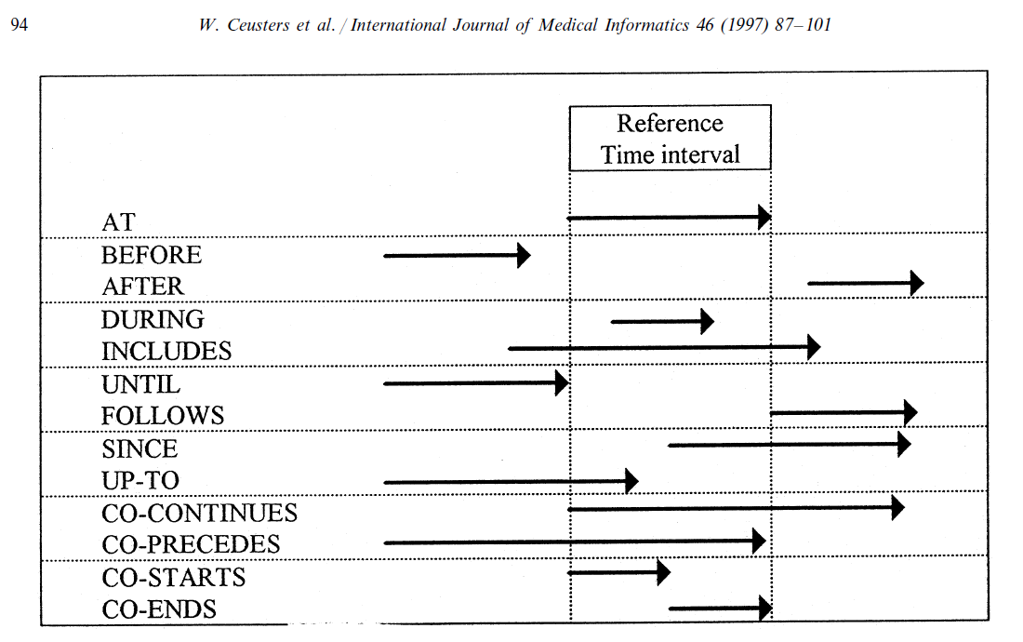
Representation of relation with time intervals

Slide 45
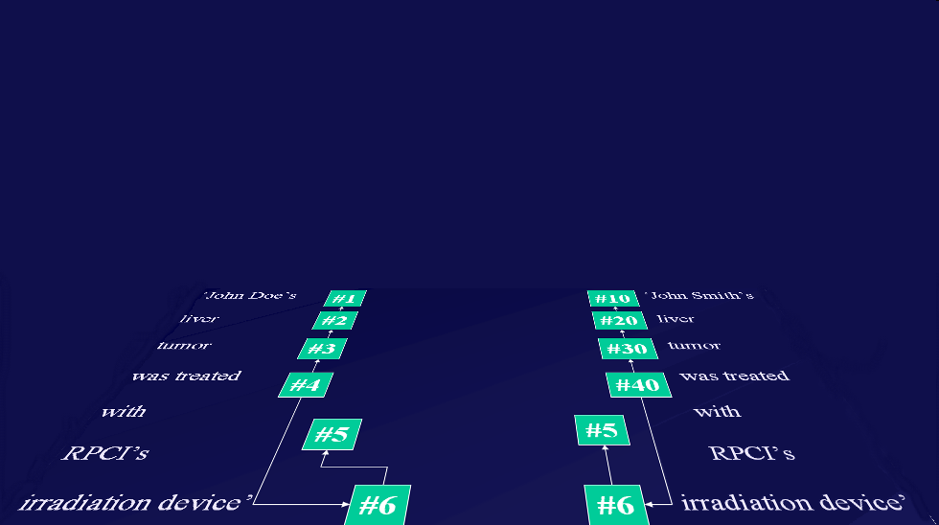
Ontology and Referent Tracking: division of labor
instance-of at t
caused
by
#105

Slide 46
Referent Tracking for ontology building
Case study for an ontology of adverse events
Ceusters W, Capolupo M, De Moor G, Devlies J, Smith B.
An Evolutionary Approach to Realism-Based Adverse Event Representations.
Methods of Information in Medicine, 2011;50(1):62-73

Slide 47
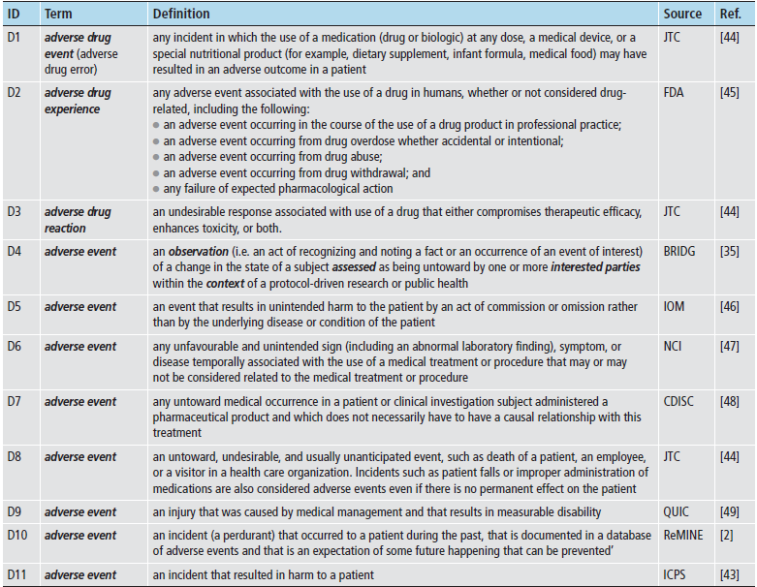

Slide 49
Representing particular adverse event cases
Is the generic representation of the portion of reality adequate enough for the description of particular cases?
Example: a patient
  born at time t₀
  undergoing anti-inflammatory treatment and physiotherapy since t₂
  for an arthrosis present since t₁
  develops a stomach ulcer at t₃.
49
Notes:
49

Slide 50
Anti-inflammatory treatment with ulcer development
IUI | Description of particular | Properties
#1 | the patient who is treated | #1 member_of C1 since t₂
#2 | #1’s treatment | #2 instance_of C3 #2 has_participant #1 since t₂ #2 has_agent #3 since t₂
#3 | the physician responsible for #2 | #3 member_of C4 since t₂
#4 | #1’s arthrosis | #4 member_of C5 since t₁
#5 | #1’s anti-inflammatory treatment | #5 part_of #2 #5 member_of C2 since t₃
#6 | #1’s physiotherapy | #6 part_of #2
#7 | #1’s stomach | #7 member_of C6 since t₂
#8 | #7’s structure integrity | #8 instance_of C8 since t₀ #8 inheres_in #7 since t₀
#9 | #1’s stomach ulcer | #9 part_of #7 since t₃
#10 | coming into existence of #9 | #10 has_participant #9 at t₃
#11 | change brought about by #9 | #11 has_agent #9 since t₃ #11 has_participant #8 since t₃ #11 instance_of C10 (harm) at t₃
#12 | noticing the presence of #9 | #12 has_participant #9 at t_{3+x} #12 has_agent #3 at t_{3+x}
#13 | cognitive representation in #3 about #9 | #13 is_about #9 since t_{3+x}
50
Notes:
50

Slide 51
Time line and dependencies (1)
t₀
t₁
t₂
t₃
#1
the patient (#1) who is treated
#7
#1’s stomach
#8
#7’s structure integrity
C8
structure integrity
At t₀, the patient is born, and since that time, his stomach is part of him and a structure integrity (C8) inheres in it:
  #1 instance-of person since t₀
  #7 part-of #1 since t₀
  #8 instance_of C8 since t₀
  #8 inheres_in #7 since t₀
51
Notes:
51

Slide 52
Time line and dependencies (2)
t₀
t₁
t₂
t₃
#1
the patient who is treated
#7
#1’s stomach
#8
#7’s structure integrity
C8
structure integrity
#4
#1’s arthrosis
C5
underlying disease
At t₁, the patient acquires arthrosis:
  #4 member_of C5 since t₁
  #4 inheres_in #1 since t₁
52
Notes:
52

Slide 53
Time line and dependencies (3)
t₀
t₁
t₂
t₃
#1
the patient who is treated
C1
subject of care
#7
#1’s stomach
C6
involved structure
#8
#7’s structure integrity
C8
structure integrity
#4
#1’s arthrosis
C5
underlying disease
#2
#1’s treatment
C3
act of care
#6
#1’s physiotherapy
#5
#1’s anti-inflammatory treatment
At t₂, the patient consults #3 who starts treatment. It is then that the patient becomes a member of the class subject of care (C1) and his stomach a member of the class involved structure (C6)
#3
the physician responsible for #2
C4
care giver
53
Notes:
53

Slide 54
Time line and dependencies …
t₀
t₁
t₂
t₃
#1
the patient who is treated
C1
subject of care
#7
#1’s stomach
C6
involved structure
#8
#7’s structure integrity
C8
structure integrity
#4
#1’s arthrosis
C5
underlying disease
#2
#1’s treatment
C3
act of care
#6
#1’s physiotherapy
#5
#1’s anti-inflammatory treatment
C2
act under scrutiny
#9
#1’s stomach ulcer
#11
change brought about by #9
C10
harm
#12
noticing #9
#13
cognitive representation in #3 about #9
#3
the physician responsible for #2
C4
care giver
54
Notes:
54

