Slide 1
Biomedical Ontology PHI 548 / BMI 508
Werner Ceusters and Barry Smith

Slide 2
Lecture 11 SNOMED CT
Werner Ceusters

Slide 3
Lecture 11 Part 1
Introduction to SNOMED CT
Werner Ceusters

Slide 4
SNOP: Systematized Nomenclature of Pathology
Pathologia et Microbiologia 1967;30:826–827

Slide 5
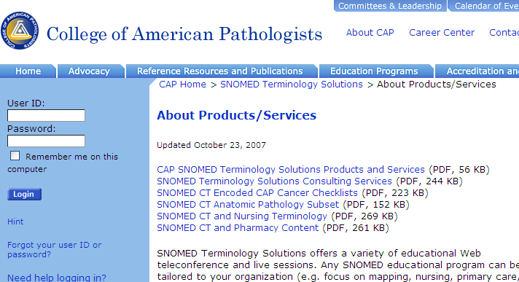
SNOMED’s origin: SNOP from CAP (1965)

Slide 6
Since mid 2007

Slide 7
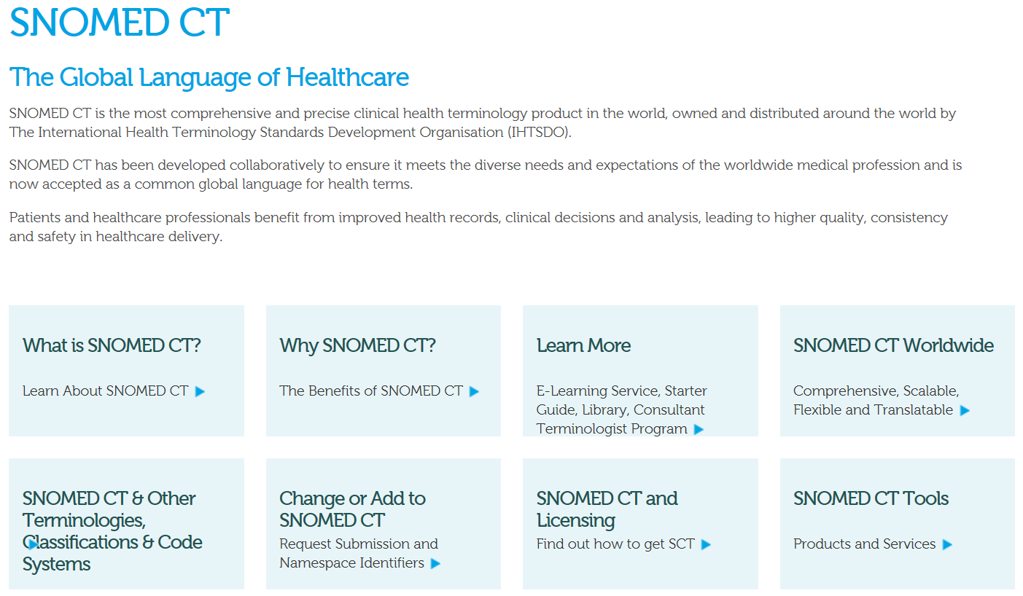
SNOMED CT 2016
http://www.ihtsdo.org/snomed-ct

Slide 8
Intended uses of SNOMED CT

Slide 9
SNOMED CT as a ‘knowledge base’
Pharmaceutical/
biologic product
Substance
Drug or medicament
Allergen class
Autonomic drug
Drug allergen
Hormone
Sympathomimetic agent
(product)
Sympathomimetic agent (substance)
Epinephrine preparation
Adrenal medullary
hormone
Respiratory sympathomimetic agent
Parenteral form epinephrine
Epinephrine
Injection (product)
Adrenaline 1:10,000
100micrograms/1mL
prefilled syringe
Has active ingredient
Has dose form
isa

Slide 10
SNOMED CT for documentation
Patient (person)
Injection (procedure)
Adrenaline 1:10,000
100micrograms/1mL
prefilled syringe
Described_by_
means_of
Described_by_means_of
Described_by_means_of
John Doe (#6189)
John Doe’s medication
#72566
Drug administration act #125611

Slide 11
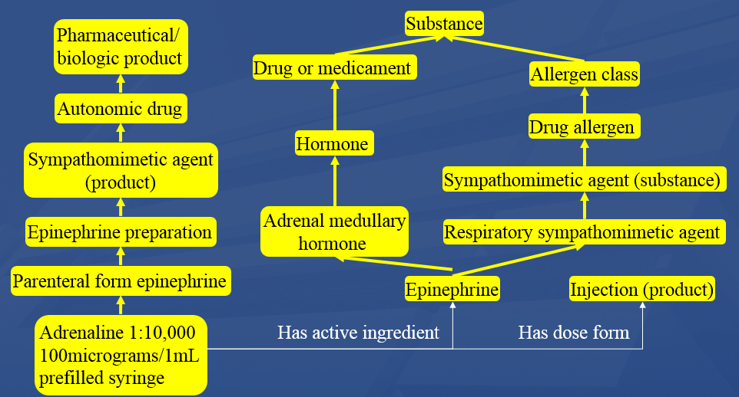
SNOMED CT for documentation
Adrenaline 1:10,000
100micrograms/1mL
prefilled syringe
Described_by_means_of
John Doe (#6189)
John Doe’s medication
#72566
Drug administration act #125611

Slide 12
SNOMED CT’s architecture

Slide 13
SNOMED CT structure
IHTSDO. SNOMED CT Starter Guide July 2014

Slide 14
SNOMED CT Descriptions
IHTSDO. SNOMED CT Starter Guide July 2014

Slide 15
SNOMED CT Relationships

Slide 16
SNOMED CT Defining relationships
IHTSDO. SNOMED CT Starter Guide July 2014

Slide 17
SNOMED CT’s DL
IHTSDO. SNOMED CT Starter Guide July 2014

Slide 18
Changes in SNOMED CT

Slide 19
History of SNOMED CT
USA / Canada United Kingdom
SNOP (1965) Read Codes (1980)
SNOMED (1975)
SNOMED II (1979)
SNOMED III / International (1993)
SNOMED RT (2000) Clinical Terms V3
SNOMED CT (2002)
1998
http://www.ihtsdo.org/snomed-ct/what-is-snomed-ct/history-of-snomed-ct

Slide 20
Snomed International (1995) Number of records (V3.1)
T Topography 12,385
M Morphology 4,991
F Function 16,352
L Living Organisms 24,265
C Drugs & Biological Products 14,075
A Physical Agents, Forces and Activities 1,355
D Disease/ Diagnosis 28,623
P Procedures 27,033
S Social Context 433
J Occupations 1,886
G General Modifiers 1,176
TOTAL RECORDS 132,641

Slide 21
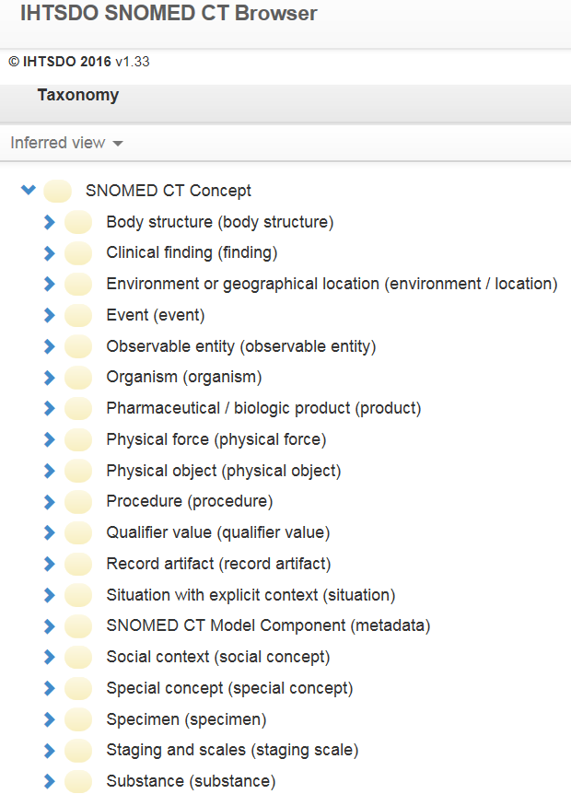
SNOMED CT’s top categories
denote (roughly):
Entities on the side of the patient
Ceusters W & Bona J. Analyzing SNOMED CT’s Historical Data: Pitfalls and Possibilities. AMIA 2016, Chicago.

Slide 22
SNOMED CT’s top categories
denote (roughly):
Entities on the side of the patient
Entities to describe entities on the side of the patient
Ceusters W & Bona J. Analyzing SNOMED CT’s Historical Data: Pitfalls and Possibilities. AMIA 2016, Chicago.

Slide 23
SNOMED CT’s top categories
denote (roughly):
Entities on the side of the patient
Entities to describe entities on the side of the patient
Entities on the side of SNOMED CT as descriptive tool
Ceusters W & Bona J. Analyzing SNOMED CT’s Historical Data: Pitfalls and Possibilities. AMIA 2016, Chicago.

Slide 24
SNOMED CT’s top categories
denote (roughly):
Entities on the side of the patient
Entities to describe entities on the side of the patient
Entities on the side of SNOMED CT as descriptive tool
A hodge podge of A and B
Ceusters W & Bona J. Analyzing SNOMED CT’s Historical Data: Pitfalls and Possibilities. AMIA 2016, Chicago.

Slide 25
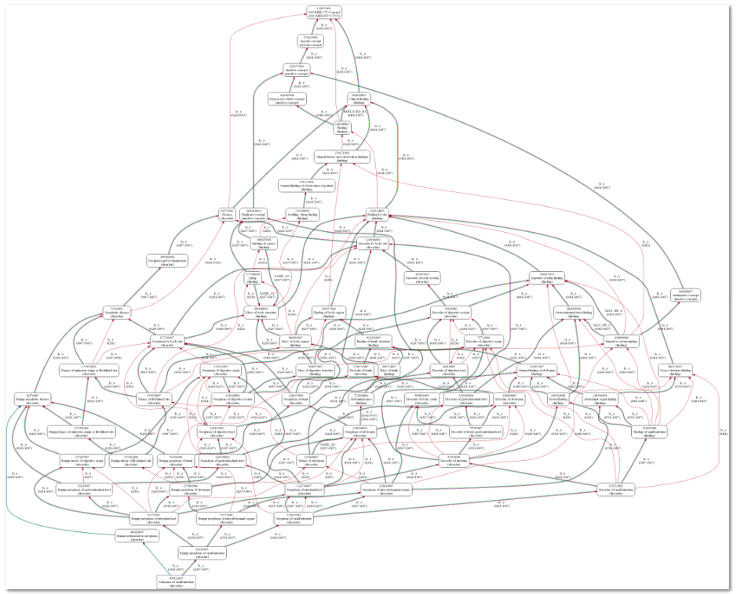
Indirect changes to Adenoma of small intestine
Ceusters W. Applying Evolutionary Terminology Auditing to SNOMED CT. In American Medical Informatics Association 2010 Annual Symposium (AMIA 2010) Proceedings, Washington DC, November 13-17, 2010:96-100.

Slide 26
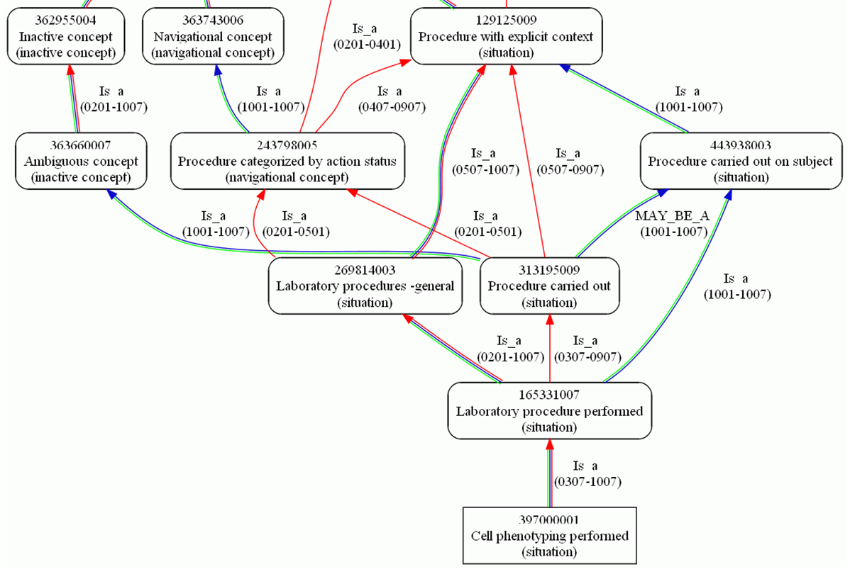
Indirect changes to Cell phenotyping performed
Ceusters W. Applying Evolutionary Terminology Auditing to SNOMED CT. In American Medical Informatics Association 2010 Annual Symposium (AMIA 2010) Proceedings, Washington DC, November 13-17, 2010:96-100.

Slide 27
Number of times individual components changed directly (2007)
Mods
Concepts
Descriptions
N
N
%
N
%
1
230,738
61.74%
869,736
83.40%
2
120,913
32.35%
158,488
15.20%
3
19,972
5.34%
12,871
1.23%
4
2,030
0.54%
1,728
0.17%
5
74
0.02%
43
0.00%
6
3
0.00%
3
0.00%
7
0
0.00%
2
0.00%
8
1
0.00%
0
0.00%
Total
373,731
100%
1,042,871
100%
Ceusters W. Applying Evolutionary Terminology Auditing to SNOMED CT. In American Medical Informatics Association 2010 Annual Symposium (AMIA 2010) Proceedings, Washington DC, November 13-17, 2010:96-100.

Slide 28
SNOMED CT concepts’ status (July 2010)
ST
Concept Status
N
%
0
active in current use
292,073
74.677%
6
active with limited clinical value (classification concept or an administrative definition)
20,930
5.35%
1
inactive: ‘retired’ without a specified reason
7,525
1.92%
10
inactive because moved elsewhere
14,451
3.69%
2
inactive: withdrawn because duplication
37,752
9.65%
3
inactive because no longer recognized as a valid clinical concept (outdated)
1,439
0.37%
4
inactive because inherently ambiguous.
15,858
4.05%
5
inactive because found to contain a mistake
1,142
0.29%
TOTAL
391,170
100%

Slide 29
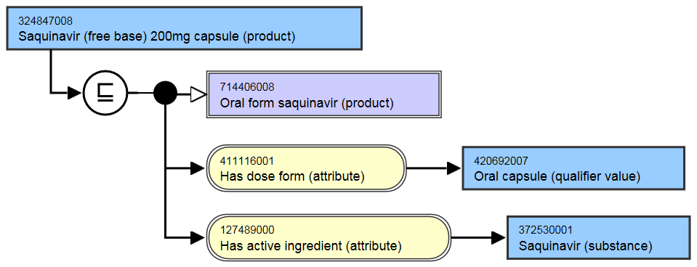
Several concepts exhibit multiple (in)activations: e.g. the history of Saquinovir
ConceptID | Version | Active
324847008 | 20020131 | 1
324847008 | 20030131 | 0
324847008 | 20040131 | 1
324847008 | 20040731 | 0
324847008 | 20050131 | 1
324847008 | 20050731 | 0
324847008 | 20070131 | 1

Slide 30
Several concepts exhibit multiple (in)activations: e.g. the history of Saquinovir
ConceptID | Version | Active
324847008 | 20020131 | 1
324847008 | 20030131 | 0
324847008 | 20040131 | 1
324847008 | 20040731 | 0
324847008 | 20050131 | 1
324847008 | 20050731 | 0
324847008 | 20070131 | 1
They changed their mind 7 times!

Slide 31
SNOMED CT concept (in)activations
 | From Concept file |  | From 2016 'snapshot' file
Version | Activated In | Deactivated in | Active since | Inactive since
20020131 | 278183 | 47833 | 185564 | 47673
20020731 | 7485 | 1747 | 9950 | 1725
20030131 | 7806 | 5834 | 7151 | 5569
20030731 | 8124 | 1905 | 7684 | 1888
20040131 | 4573 | 2008 | 3899 | 1990
20040731 | 4599 | 1580 | 7462 | 1471
20050131 | 2817 | 897 | 6699 | 891
20050731 | 1722 | 438 | 4148 | 433
20060131 | 2422 | 718 | 6687 | 710
20060731 | 2125 | 1035 | 2295 | 1029
20070131 | 3036 | 1363 | 4717 | 1351
20070731 | 2325 | 907 | 4153 | 902
20080131 | 2073 | 1071 | 3403 | 1070
20080731 | 5126 | 889 | 11747 | 884
20090131 | 3745 | 9221 | 4214 | 9221
20090731 | 1337 | 3657 | 4773 | 3655
20100131 | 1744 | 18293 | 3702 | 18292
20100731 | 1157 | 289 | 2288 | 288
20110131 | 1906 | 211 | 3363 | 210
20110731 | 1969 | 189 | 2162 | 187
20120131 | 319 | 108 | 340 | 108
20120731 | 794 | 281 | 1124 | 279
20130131 | 1673 | 114 | 1841 | 112
20130731 | 1124 | 304 | 1307 | 304
20140131 | 2229 | 2466 | 2593 | 2466
20140731 | 12610 | 349 | 12580 | 348
20150131 | 3287 | 1131 | 3671 | 1131
20150731 | 4458 | 399 | 5309 | 399
20160131 | 3115 | 726 | 4620 | 726
SUMS | 373883 | 105963 | 319446 | 105312
Changes in concepts are enormous and not straightforward.
Research based on the January 2016 version of SNOMED CT
Ceusters W & Bona J. Analyzing SNOMED CT’s Historical Data: Pitfalls and Possibilities. AMIA 2016, Chicago.

Slide 32
SNOMED CT concept (in)activations
 | From Concept file |  | From 2016 'snapshot' file
Version | Activated In | Deactivated in | Active since | Inactive since
20020131 | 278183 | 47833 | 185564 | 47673
20020731 | 7485 | 1747 | 9950 | 1725
20030131 | 7806 | 5834 | 7151 | 5569
20030731 | 8124 | 1905 | 7684 | 1888
20040131 | 4573 | 2008 | 3899 | 1990
20040731 | 4599 | 1580 | 7462 | 1471
20050131 | 2817 | 897 | 6699 | 891
20050731 | 1722 | 438 | 4148 | 433
20060131 | 2422 | 718 | 6687 | 710
20060731 | 2125 | 1035 | 2295 | 1029
20070131 | 3036 | 1363 | 4717 | 1351
20070731 | 2325 | 907 | 4153 | 902
20080131 | 2073 | 1071 | 3403 | 1070
20080731 | 5126 | 889 | 11747 | 884
20090131 | 3745 | 9221 | 4214 | 9221
20090731 | 1337 | 3657 | 4773 | 3655
20100131 | 1744 | 18293 | 3702 | 18292
20100731 | 1157 | 289 | 2288 | 288
20110131 | 1906 | 211 | 3363 | 210
20110731 | 1969 | 189 | 2162 | 187
20120131 | 319 | 108 | 340 | 108
20120731 | 794 | 281 | 1124 | 279
20130131 | 1673 | 114 | 1841 | 112
20130731 | 1124 | 304 | 1307 | 304
20140131 | 2229 | 2466 | 2593 | 2466
20140731 | 12610 | 349 | 12580 | 348
20150131 | 3287 | 1131 | 3671 | 1131
20150731 | 4458 | 399 | 5309 | 399
20160131 | 3115 | 726 | 4620 | 726
SUMS | 373883 | 105963 | 319446 | 105312
Whereas in 2002 14.7% of total concepts were inactive, it was already 24.8% in January 2016.
Ceusters W & Bona J. Analyzing SNOMED CT’s Historical Data: Pitfalls and Possibilities. AMIA 2016, Chicago.

Slide 33
SNOMED CT concept (in)activations
 | From Concept file |  | From 2016 'snapshot' file
Version | Activated In | Deactivated in | Active since | Inactive since
20020131 | 278183 | 47833 | 185564 | 47673
20020731 | 7485 | 1747 | 9950 | 1725
20030131 | 7806 | 5834 | 7151 | 5569
20030731 | 8124 | 1905 | 7684 | 1888
20040131 | 4573 | 2008 | 3899 | 1990
20040731 | 4599 | 1580 | 7462 | 1471
20050131 | 2817 | 897 | 6699 | 891
20050731 | 1722 | 438 | 4148 | 433
20060131 | 2422 | 718 | 6687 | 710
20060731 | 2125 | 1035 | 2295 | 1029
20070131 | 3036 | 1363 | 4717 | 1351
20070731 | 2325 | 907 | 4153 | 902
20080131 | 2073 | 1071 | 3403 | 1070
20080731 | 5126 | 889 | 11747 | 884
20090131 | 3745 | 9221 | 4214 | 9221
20090731 | 1337 | 3657 | 4773 | 3655
20100131 | 1744 | 18293 | 3702 | 18292
20100731 | 1157 | 289 | 2288 | 288
20110131 | 1906 | 211 | 3363 | 210
20110731 | 1969 | 189 | 2162 | 187
20120131 | 319 | 108 | 340 | 108
20120731 | 794 | 281 | 1124 | 279
20130131 | 1673 | 114 | 1841 | 112
20130731 | 1124 | 304 | 1307 | 304
20140131 | 2229 | 2466 | 2593 | 2466
20140731 | 12610 | 349 | 12580 | 348
20150131 | 3287 | 1131 | 3671 | 1131
20150731 | 4458 | 399 | 5309 | 399
20160131 | 3115 | 726 | 4620 | 726
SUMS | 373883 | 105963 | 319446 | 105312
All versions exhibit activations and inactivations, but only few versions come with more inactivations than activations.
Ceusters W & Bona J. Analyzing SNOMED CT’s Historical Data: Pitfalls and Possibilities. AMIA 2016, Chicago.

Slide 34
SNOMED CT concept (in)activations
 | From Concept file |  | From 2016 'snapshot' file
Version | Activated In | Deactivated in | Active since | Inactive since
20020131 | 278183 | 47833 | 185564 | 47673
20020731 | 7485 | 1747 | 9950 | 1725
20030131 | 7806 | 5834 | 7151 | 5569
20030731 | 8124 | 1905 | 7684 | 1888
20040131 | 4573 | 2008 | 3899 | 1990
20040731 | 4599 | 1580 | 7462 | 1471
20050131 | 2817 | 897 | 6699 | 891
20050731 | 1722 | 438 | 4148 | 433
20060131 | 2422 | 718 | 6687 | 710
20060731 | 2125 | 1035 | 2295 | 1029
20070131 | 3036 | 1363 | 4717 | 1351
20070731 | 2325 | 907 | 4153 | 902
20080131 | 2073 | 1071 | 3403 | 1070
20080731 | 5126 | 889 | 11747 | 884
20090131 | 3745 | 9221 | 4214 | 9221
20090731 | 1337 | 3657 | 4773 | 3655
20100131 | 1744 | 18293 | 3702 | 18292
20100731 | 1157 | 289 | 2288 | 288
20110131 | 1906 | 211 | 3363 | 210
20110731 | 1969 | 189 | 2162 | 187
20120131 | 319 | 108 | 340 | 108
20120731 | 794 | 281 | 1124 | 279
20130131 | 1673 | 114 | 1841 | 112
20130731 | 1124 | 304 | 1307 | 304
20140131 | 2229 | 2466 | 2593 | 2466
20140731 | 12610 | 349 | 12580 | 348
20150131 | 3287 | 1131 | 3671 | 1131
20150731 | 4458 | 399 | 5309 | 399
20160131 | 3115 | 726 | 4620 | 726
SUMS | 373883 | 105963 | 319446 | 105312
Of the 278,183 active concepts in 2002, only 66.7% was (still) active in January 2016.
Ceusters W & Bona J. Analyzing SNOMED CT’s Historical Data: Pitfalls and Possibilities. AMIA 2016, Chicago.

Slide 35
SNOMED CT concept (in)activations
 | From Concept file |  | From 2016 'snapshot' file
Version | Activated In | Deactivated in | Active since | Inactive since
20020131 | 278183 | 47833 | 185564 | 47673
20020731 | 7485 | 1747 | 9950 | 1725
20030131 | 7806 | 5834 | 7151 | 5569
20030731 | 8124 | 1905 | 7684 | 1888
20040131 | 4573 | 2008 | 3899 | 1990
20040731 | 4599 | 1580 | 7462 | 1471
20050131 | 2817 | 897 | 6699 | 891
20050731 | 1722 | 438 | 4148 | 433
20060131 | 2422 | 718 | 6687 | 710
20060731 | 2125 | 1035 | 2295 | 1029
20070131 | 3036 | 1363 | 4717 | 1351
20070731 | 2325 | 907 | 4153 | 902
20080131 | 2073 | 1071 | 3403 | 1070
20080731 | 5126 | 889 | 11747 | 884
20090131 | 3745 | 9221 | 4214 | 9221
20090731 | 1337 | 3657 | 4773 | 3655
20100131 | 1744 | 18293 | 3702 | 18292
20100731 | 1157 | 289 | 2288 | 288
20110131 | 1906 | 211 | 3363 | 210
20110731 | 1969 | 189 | 2162 | 187
20120131 | 319 | 108 | 340 | 108
20120731 | 794 | 281 | 1124 | 279
20130131 | 1673 | 114 | 1841 | 112
20130731 | 1124 | 304 | 1307 | 304
20140131 | 2229 | 2466 | 2593 | 2466
20140731 | 12610 | 349 | 12580 | 348
20150131 | 3287 | 1131 | 3671 | 1131
20150731 | 4458 | 399 | 5309 | 399
20160131 | 3115 | 726 | 4620 | 726
SUMS | 373883 | 105963 | 319446 | 105312
Of the 47,833 inactive concepts in 2002, 160 became re-activated between 2002 and 2016.
Ceusters W & Bona J. Analyzing SNOMED CT’s Historical Data: Pitfalls and Possibilities. AMIA 2016, Chicago.

Slide 36
SNOMED CT concept (in)activations
 | From Concept file |  | From 2016 'snapshot' file
Version | Activated In | Deactivated in | Active since | Inactive since
20020131 | 278183 | 47833 | 185564 | 47673
20020731 | 7485 | 1747 | 9950 | 1725
20030131 | 7806 | 5834 | 7151 | 5569
20030731 | 8124 | 1905 | 7684 | 1888
20040131 | 4573 | 2008 | 3899 | 1990
20040731 | 4599 | 1580 | 7462 | 1471
20050131 | 2817 | 897 | 6699 | 891
20050731 | 1722 | 438 | 4148 | 433
20060131 | 2422 | 718 | 6687 | 710
20060731 | 2125 | 1035 | 2295 | 1029
20070131 | 3036 | 1363 | 4717 | 1351
20070731 | 2325 | 907 | 4153 | 902
20080131 | 2073 | 1071 | 3403 | 1070
20080731 | 5126 | 889 | 11747 | 884
20090131 | 3745 | 9221 | 4214 | 9221
20090731 | 1337 | 3657 | 4773 | 3655
20100131 | 1744 | 18293 | 3702 | 18292
20100731 | 1157 | 289 | 2288 | 288
20110131 | 1906 | 211 | 3363 | 210
20110731 | 1969 | 189 | 2162 | 187
20120131 | 319 | 108 | 340 | 108
20120731 | 794 | 281 | 1124 | 279
20130131 | 1673 | 114 | 1841 | 112
20130731 | 1124 | 304 | 1307 | 304
20140131 | 2229 | 2466 | 2593 | 2466
20140731 | 12610 | 349 | 12580 | 348
20150131 | 3287 | 1131 | 3671 | 1131
20150731 | 4458 | 399 | 5309 | 399
20160131 | 3115 | 726 | 4620 | 726
SUMS | 373883 | 105963 | 319446 | 105312
Of all inactivated concepts, 651 became reactivated.

Slide 37
SNOMED CT concept (in)activations
 | From Concept file |  | From 2016 'snapshot' file
Version | Activated In | Deactivated in | Active since | Inactive since
20020131 | 278183 | 47833 | 185564 | 47673
20020731 | 7485 | 1747 | 9950 | 1725
20030131 | 7806 | 5834 | 7151 | 5569
20030731 | 8124 | 1905 | 7684 | 1888
20040131 | 4573 | 2008 | 3899 | 1990
20040731 | 4599 | 1580 | 7462 | 1471
20050131 | 2817 | 897 | 6699 | 891
20050731 | 1722 | 438 | 4148 | 433
20060131 | 2422 | 718 | 6687 | 710
20060731 | 2125 | 1035 | 2295 | 1029
20070131 | 3036 | 1363 | 4717 | 1351
20070731 | 2325 | 907 | 4153 | 902
20080131 | 2073 | 1071 | 3403 | 1070
20080731 | 5126 | 889 | 11747 | 884
20090131 | 3745 | 9221 | 4214 | 9221
20090731 | 1337 | 3657 | 4773 | 3655
20100131 | 1744 | 18293 | 3702 | 18292
20100731 | 1157 | 289 | 2288 | 288
20110131 | 1906 | 211 | 3363 | 210
20110731 | 1969 | 189 | 2162 | 187
20120131 | 319 | 108 | 340 | 108
20120731 | 794 | 281 | 1124 | 279
20130131 | 1673 | 114 | 1841 | 112
20130731 | 1124 | 304 | 1307 | 304
20140131 | 2229 | 2466 | 2593 | 2466
20140731 | 12610 | 349 | 12580 | 348
20150131 | 3287 | 1131 | 3671 | 1131
20150731 | 4458 | 399 | 5309 | 399
20160131 | 3115 | 726 | 4620 | 726
SUMS | 373883 | 105963 | 319446 | 105312
A total of 153,830 activations and deactivations effectuated since the first version, resulted in:
an increase of 41,263 active concepts (→ a growth of merely 14.8%), with
an efficiency of only 26.9%.
Ceusters W & Bona J. Analyzing SNOMED CT’s Historical Data: Pitfalls and Possibilities. AMIA 2016, Chicago.

Slide 38
Transition from nomenclature to ‘formal terminology’

Slide 39
Snomed International (1995): knowledge in the codes.
T
-
3
5
3
2
2
posterior
anatomic leaflet
mitral
cardiac valve
cardiovascular
Why was this not a good idea ?

Slide 40
Snomed International : multiple ways to express the same thing
D5-46210 Acute appendicitis, NOS
D5-46100 Appendicitis, NOS
G-A231 Acute
M-41000 Acute inflammation, NOS
G-C006 In
T-59200 Appendix, NOS
G-A231 Acute
M-40000 Inflammation, NOS
G-C006 In
T-59200 Appendix, NOS

Slide 41
Transition to a formal language
SNOMED III: juxtaposition of codes
D5-30150 Postoperative esophagitis
T-56000 Esophagus
M-40000 Inflammation
F-06030 Post-operative state
(T-56000)(M-40000)(F-06030)
Parent term in the SNOMED III hierarchy:
D5-30100 Esophagitis, NOS
SNOMED RT syntax: introduction of relationships
D5-30150 = D5-30100 &
(assoc-topography T-56000) &
(assoc-morphology M-40000) &
(assoc-etiology F-06030)
Proc AMIA Annu Fall Symp. 1997:640-4. SNOMED RT: a reference terminology for health care. Spackman KA(1), Campbell KE, Côté RA

Slide 42
SNOMED about diseases and concepts (until 2010)
‘Disorders are concepts in which there is an explicit or implicit pathological process causing a state of disease which tends to exist for a significant length of time under ordinary circumstances.’
And also: “Concepts are unique units of thought”.
Thus: Disorders are unique units of thoughts in which there is a pathological process …???
And thus: to eradicate all diseases in the world at once we simply should stop thinking ?

Slide 43
SNOMED now (since version 201007)
Concept: An ambiguous term. Depending on the context, it may refer to:
A clinical idea to which a unique ConceptId has been assigned.
The ConceptId itself, which is the key of the Concepts Table (in this case it is less ambiguous to use the term ‘concept code’).
The real-world referent(s) of the ConceptId, that is, the class of entities in reality which the ConceptId represents.

Slide 44
Find the problem
SNOMED-RT (2000)
SNOMED-CT (2003)
DL don’t guarantee you to get parthood right !

Slide 45
Find the problem

Slide 46
Find the problem
new-1
new-2

Slide 47
Inconsistent response to queries
Concept search: heart structure AND tumor
Term search: heart tumor

Slide 48
Find the problem
What is the problem ? Missing: ISA neoplasm of heart

Slide 49
Find the problem
terms

Slide 50
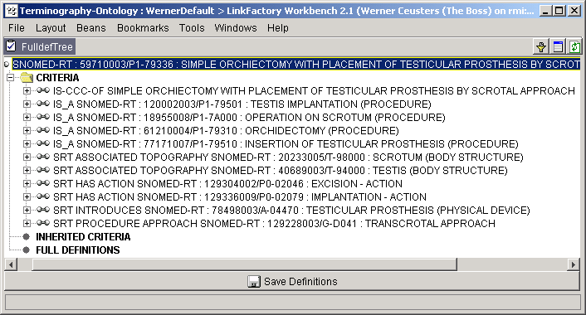
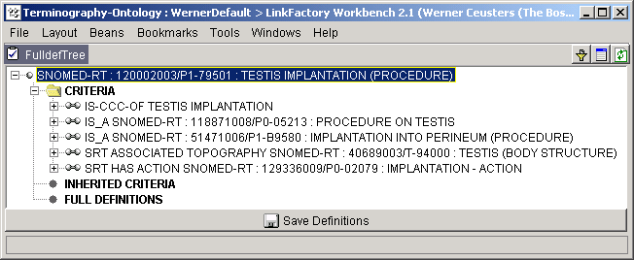
Find the problem
Can there be something that is an excision and an implantation ?
No ! Although suggested, that is not what is expressed.
Does “testis implantation” mean that a testis is implanted ?

Slide 51
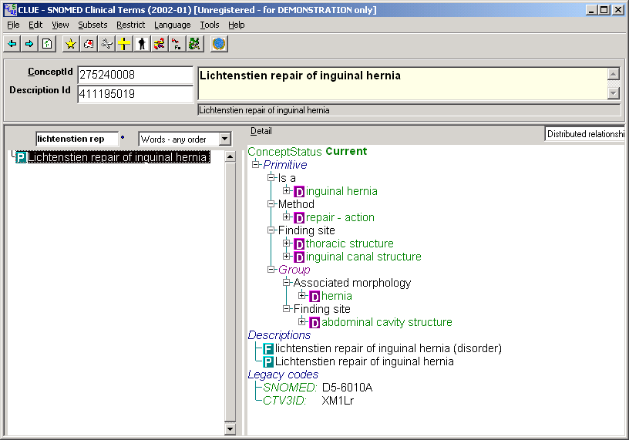
Find the problem

Slide 52
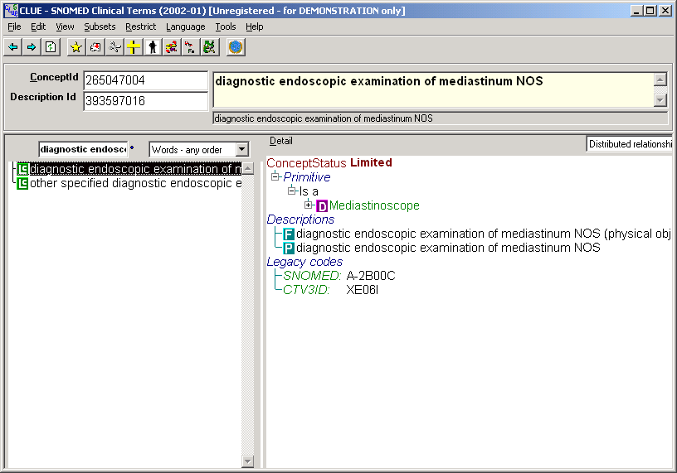
Find the problem

Slide 53
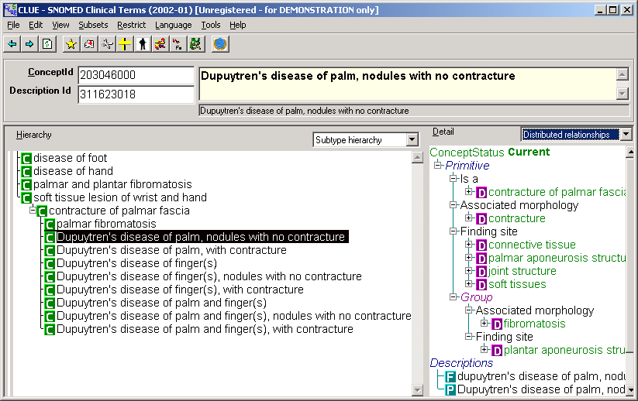
Find the problem

Slide 54
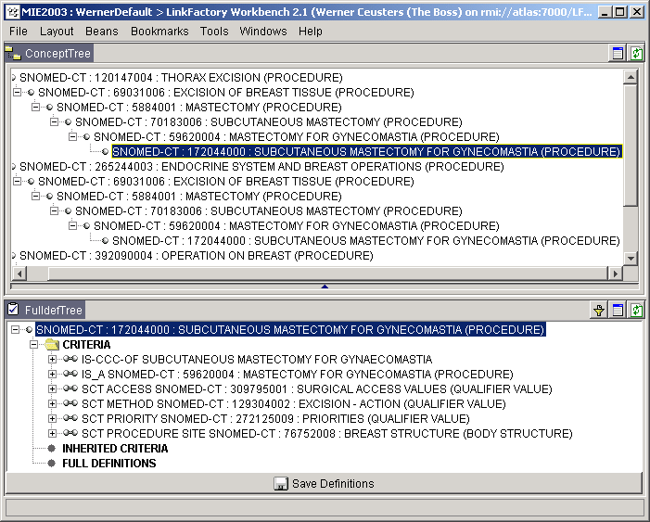
Find the problem

Slide 55
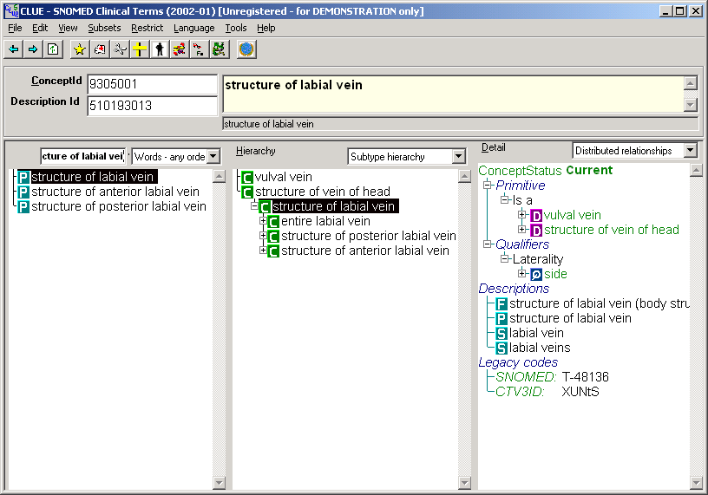
Uncorrected lexical mapping

Slide 56
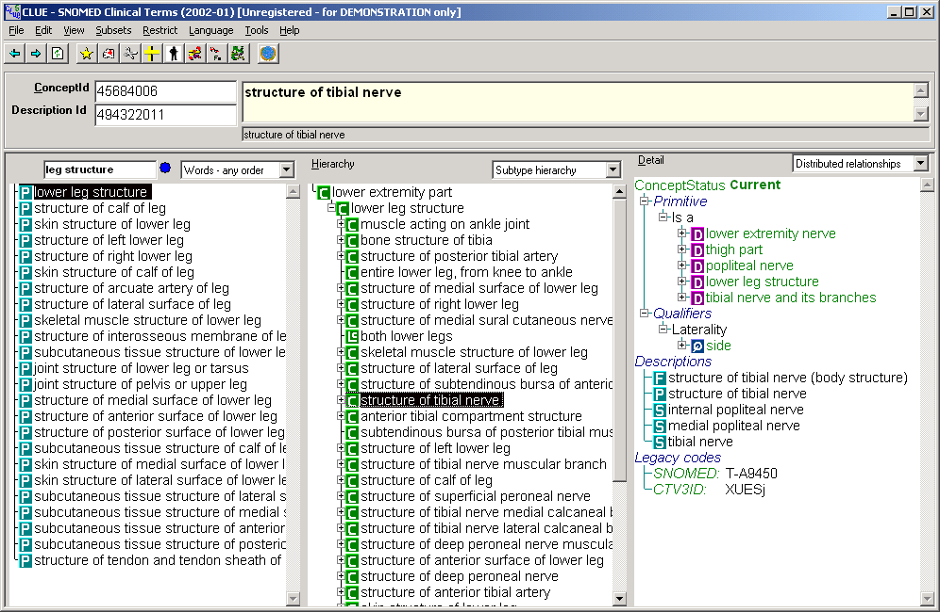
Find the problem

Slide 57
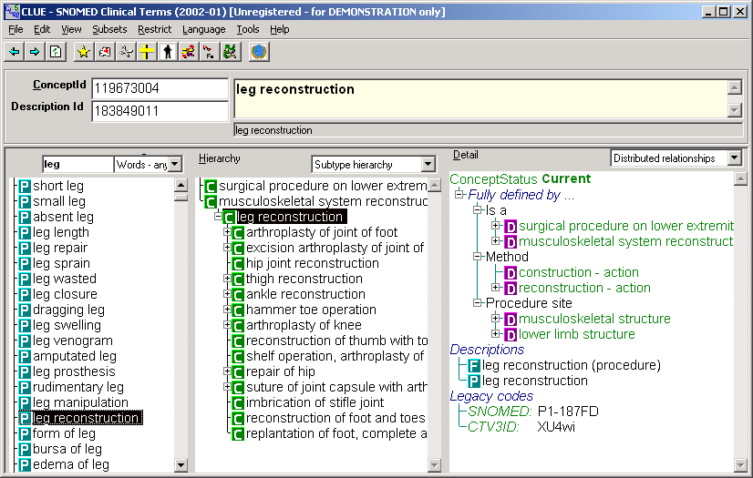
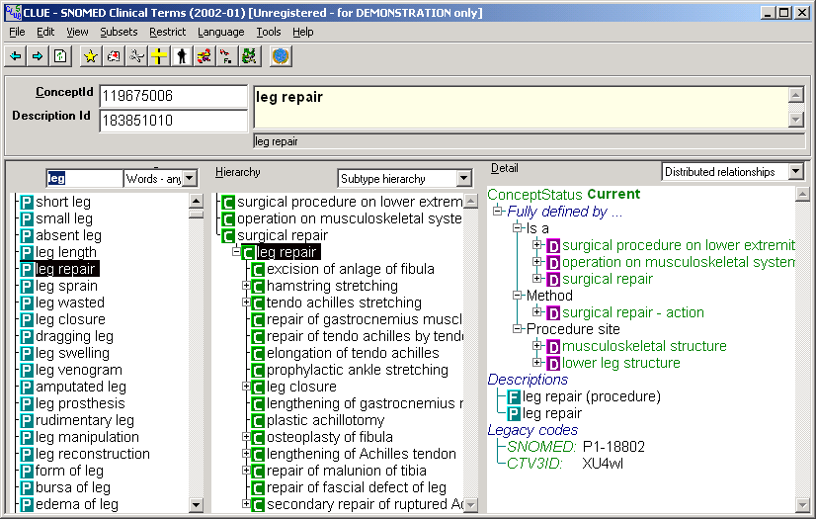
Find the problem

Slide 58
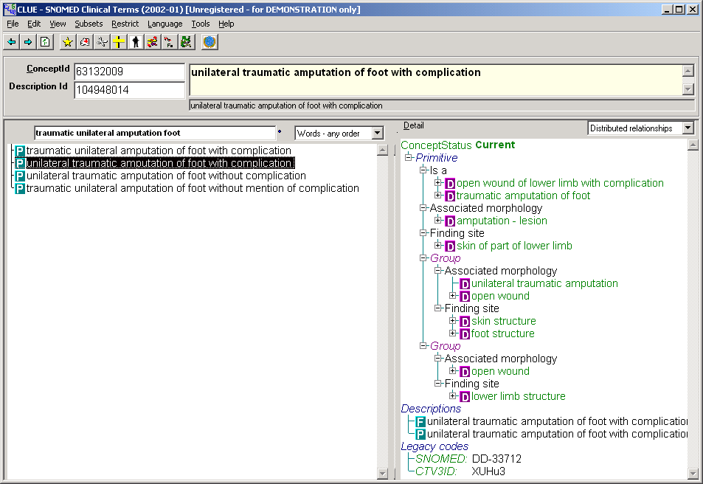
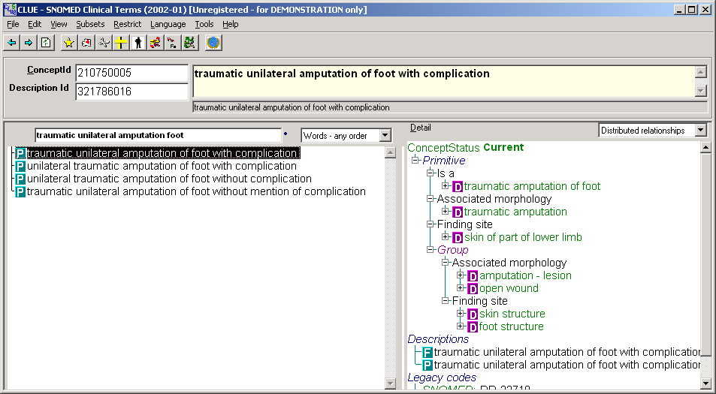
Find the problem

Slide 59
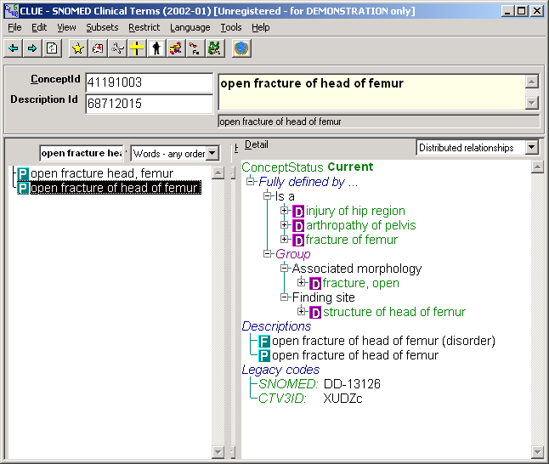
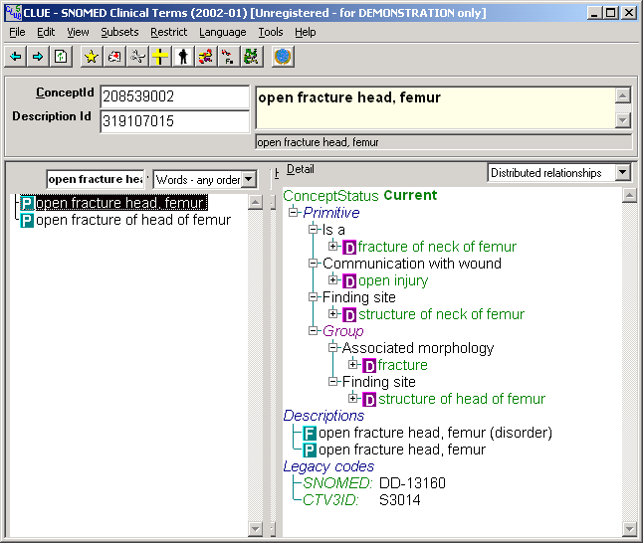
Find the problem

Slide 60
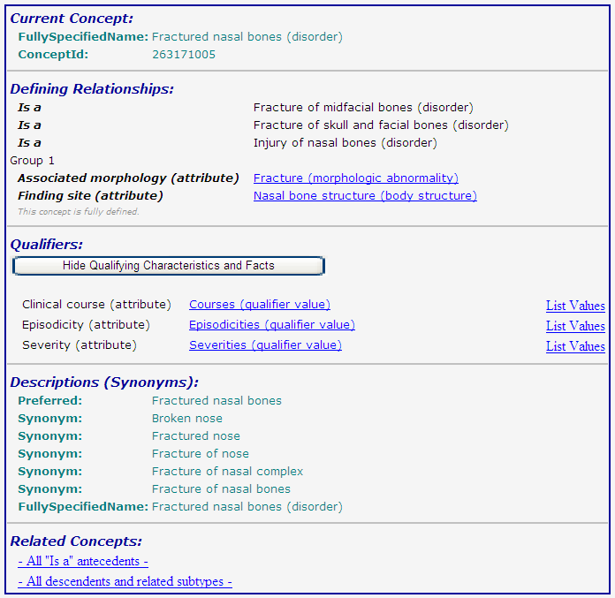

Slide 61
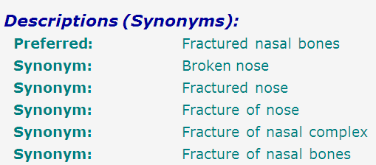
SNOMED-CT: abundance of false synonymy
bones
nose
fracture

Slide 62
Coding / Classification confusion
A patient with a fractured nasal bone
=
A patient with a broken nose
=
A patient with a fracture of the nose

Slide 63
Coding / Classification confusion
A patient with a fractured nasal bone
A patient with a fractured nasal bone
=
=
A patient with a broken nose
A patient with a broken nose
=
=
A patient with a fracture of the nose
A patient with a fracture of the nose

Slide 64
Snomed CT (July 2007): “fractured nasal bones”

Slide 65
Snomed CT (July 2007): “fractured nasal bones”
Problems of multiple inheritance:
(1) “… ISA fracture of skull and facial bones”
Which facial bones are not part of the skull ?
If there would be non-skull facial bones, how many fractures are then required ?
(2) “… ISA fracture of mid-facial bones”
Which mid-facials bones or not facial bones ?
If all, then (1) is redundant
(3) “… ISA injury of nasal bones”
Are not all fractures “injuries’ and if not, why would then all nasal fractures be injuries ?

Slide 66
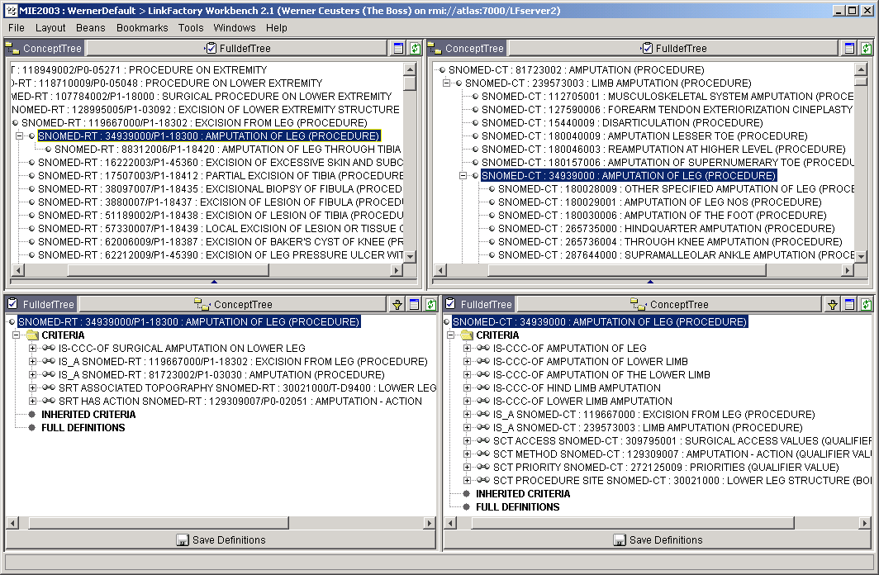
Find the problem

