Slide 1
Biomedical Ontology
PHI 548 / BMI 508
Werner Ceusters and Barry Smith

Slide 2
Lecture 10
Terminology and Ontology
Alan Ruttenberg and Werner Ceusters

Slide 3
Lecture 10
Part 2
Medical Terminologies
Werner Ceusters

Slide 4
Language is ambiguous
‘I know that you believe that you understood what you think I said, but I am not sure you realize that what you heard is not what I meant.’
  Robert McCloskey, State Department spokesman (attributed).
    http://www.quotationspage.com/quotes/Robert_McCloskey/

Slide 5
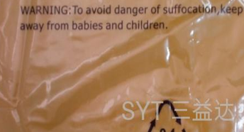
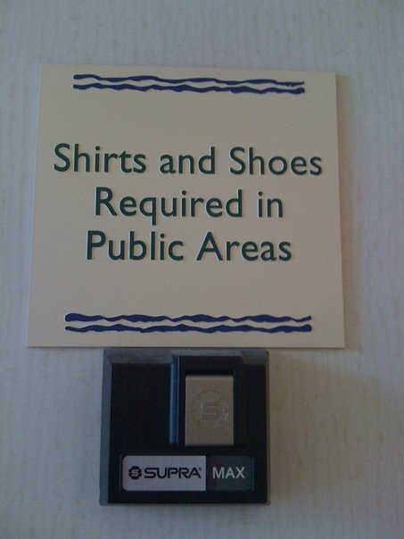

Language is ambiguous
Often we can figure it out …
warning on plastic bag
in Miami hotel lobby
in Miami bar

Slide 6
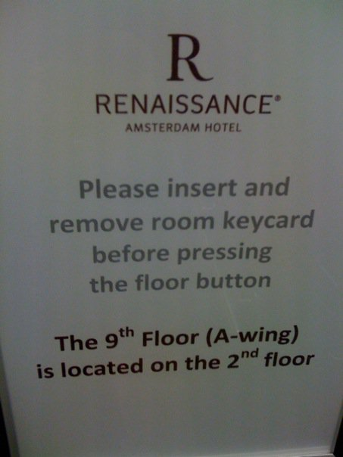
Language is ambiguous
Sometimes, we can not …
in Amsterdam hotel elevator

Slide 7
A double mystery
(It is argued that) On September 9th, 1935, Carl Austin Weiss shot Senator Huey Long in the Louisiana State Capitol with a .35 calibre pistol. Long died from this wound thirty hours later on September 10th. Weiss, on the other hand, received between thirty-two and sixty .44 and .45 calibre hollow point bullets from Long's agitated bodyguards and died immediately.
        Sorensen, R., 1985, "Self-Deception and Scattered Events", Mind, 94: 64-69.
Questions:
  Did Weiss kill Senator Long ?
  If so, when did he kill him ?

Slide 8
Relevance to Healthcare?
‘Nuances in the English language can be both challenging and amusing, however, when variants in language impact treatment, safety and billing, it is all challenge and no humor.
Although English contains a reasonable degree of conformity, divergence in phrasing and meaning can compound comprehension problems and impact patient safety. These language "woes" can be minimized through the use of sophisticated healthcare IT systems ...’
Schwend GT. The language of healthcare. Variance in the English language is harming patients and hospitals' bottom lines. Is healthcare IT the solution? Health Manag Technol. 2008 Feb;29(2):14, 16, 18

Slide 9
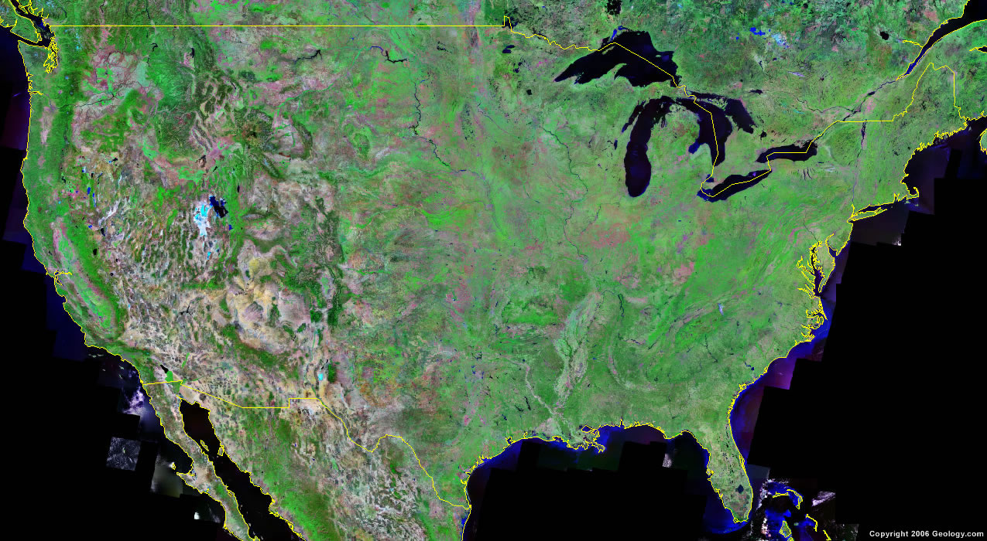

Indeed, these days, not just people communicate …

Slide 10
Understanding content (1)
We see:
“John Doe has a pyogenic granuloma of the left thumb”
The machine sees:
John Doe has a pyogenic granuloma of the left thumb

Slide 11
Understanding content (2)
The XML misunderstanding
We see:
<record>
  <patient>John Doe</patient>
  <diagnosis>pyogenic granuloma of the left thumb</diagnosis>
</record>
The machine sees:
<record>
  <subject> John Doe </subject>
  <diagnosis> pyogenic granuloma of the left thumb </diagnosis>
</record>

Slide 12
The clever (?) business man and his XML card
<business-card>
  <name> John Nitwit </name>
  <address>
  <street> 524 Moon base avenue </street>
  <city> Utopia </city>
  </address>
  <phone> … </phone>
  …
</business-card>
Is this the name of the business card or of the business card owner?

Slide 13
Intermediate conclusion
We need for sure methods and techniques that allow:
  people to express exactly what they mean,
  people to understand exactly what is communicated to them,
  machines to communicate information without any distortion.
If information overload is a problem, we also need methods and techniques that allow machines to understand exactly what is communicated to them.
Is terminology the right answer?

Slide 14
Terminology (is) for dummies

Slide 15
The word ‘Terminology’ has two meanings
The discipline of terminology management
  synonymous with terminology work (used in ISO 704)
The set of designations used in the special language of a subject field, such as the terminology of medicine
  Used in both the singular and plural
  Used with an article in the singular: a terminology

Slide 16
Terminology is VERY standardised
ISO 704: 2000 Terminology work – Principles and methods
ISO 860: 1996 Terminology work – Harmonization of concepts and terms
ISO 1087-1: 2000 Terminology work – Vocabulary – Part 1: Theory and application
ISO 15188: 2001 Project management guidelines for terminology standardization
ISO 1087-2:2000 Terminology work – Vocabulary – Part 2: Computer applications
ISO 12620: 1999 Computer applications in terminology – Data categories
ISO 16642: 2003 Computer applications in terminology – Terminological markup framework
ISO 2788: 1986 Documentation – Guidelines for the establishment and development of monolingual thesauri

Slide 17
ISO Standards in Terminology: building blocks
Objects
    perceived or conceived, concrete or abstract
    abstracted or conceptualized into concepts
Concepts
    depict or correspond to a set of objects based on a defined set of characteristics
    represented or expressed in language by designations or by definitions
    organized into concept systems
Designations
    represented as terms, names (appellations) or symbols
    designate or represent a concept
    attributed to a concept by consensus within a special language community

Slide 18
Fundamental Activities of Terminology Work
Identifying ‘concepts’ and ‘concept relations’;
  Analyzing and modeling concept systems on the basis of identified concepts and concept relations;
  Establishing representations of concept systems through concept diagrams;
  Crafting concept-oriented definitions;
  Attributing designations (predominantly terms) to each concept in one or more languages; and,
  Recording and presenting terminological data, principally in terminological entries stored in print and electronic media (terminography).

Slide 19
Why terminologies ?
As such ?
  Fixing/stabilizing the language within a domain and a linguistic community;
  Unambiguous communication.
In Healthcare Information Technology ?
  Semantic Indexing;
  Information exchange and linking between heterogeneous systems;
  Terminologies as basis for documentation through coding and classification

Slide 20
Origin: Peirce, Ogden & Richards, Wüster
Unit of Thinking (Concept)
(Unit of Thought, Unit of Knowledge)
Designation
(Symbol, Sign,
Term, Formula
etc.)
Referent
(Concrete Object,
Real Thing,
Conceived Object)

Slide 21
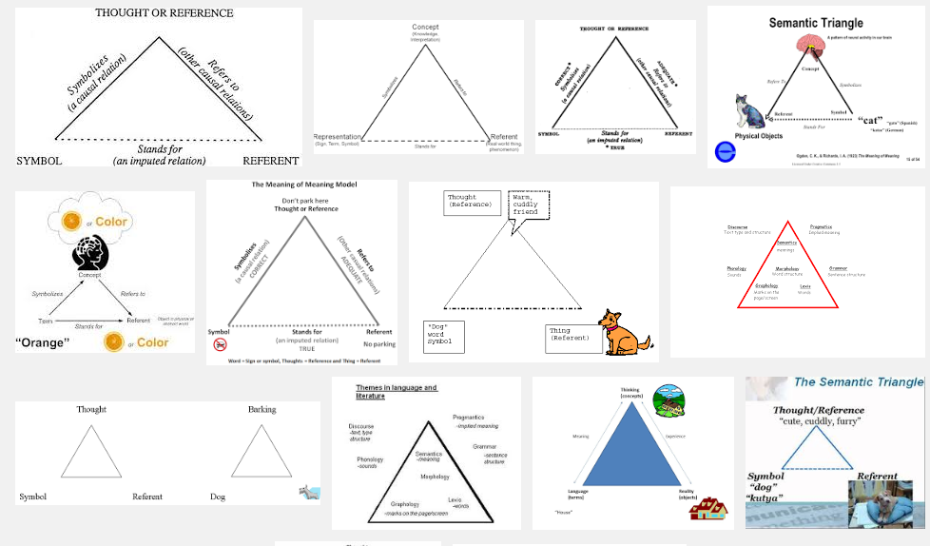
The semantic/semiotic triangle
The Meaning of Meaning: A Study of the Influence of Language upon Thought and of the Science of Symbolism (1923) C. K. Ogden and I. A. Richards

Slide 22
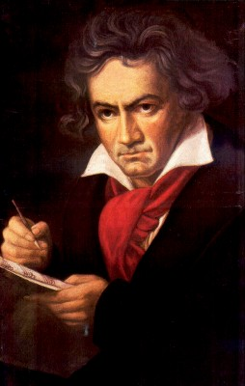
The semantic/semiotic triangle
Ludwig van Beethoven
that great German composer that became deaf
…
concept
term
referent
‘Beethoven’

Slide 23
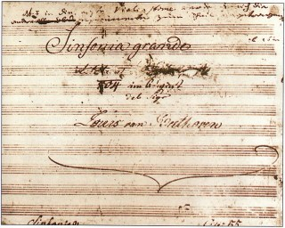
The semantic triangle works sometimes fine
Beethoven’s symphony dedicated to Bonaparte
the symphony played after the Munich Olympics massacre
…
concept
term
referent
‘Eroica’
‘Beethoven's Symphony No. 3’
‘Beethoven's Opus 55’

Slide 24
Sometimes the semantic triangle fails
the symphony Beethoven wrote after the tenth
…
concept
term
referent
‘Beethoven's Symphony No. 11’

Slide 25
Sometimes the semantic triangle fails
the symphony Beethoven wrote after the tenth
…
some hold this term has meaning
concept
term
referent
‘Beethoven's Symphony No. 11’

Slide 26
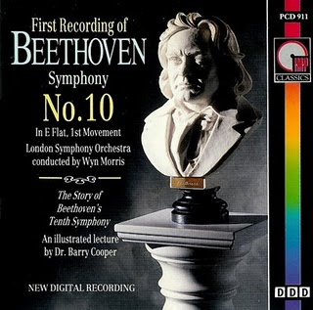
Sometimes the semantic triangle fails
the one assembled by Barry Cooper from fragmentary sketches
Beethoven’s hypothetical symphony
…
concept
term
referent
‘Beethoven's Symphony No. 10’

Slide 27
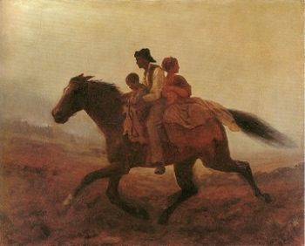
Prehistoric ‘psychiatry’: drapetomania
disease which causes slaves to suffer from an unexplainable propensity to run away
…
concept
term
referent
painting by Eastman Johnson. A Ride for Liberty: The Fugitive Slaves. 1860.
‘drapetomania’

Slide 28
Some etiologic, diagnostic and therapeutic reflections on ‘Drapetomenia’
It is unknown to our medical authorities, although its diagnostic symptom, the absconding from service, is well known to our planters and overseers...
The cause in the most of cases, that induces the negro to run away from service, is as much a disease of the mind as any other species of mental alienation, and much more curable, as a general rule.
If the white man attempts to oppose the Deity's will, by trying to make the negro anything else than "the submissive knee-bender," (which the Almighty declared he should be); or if he abuses the power which God has given him over his fellow-man, by being cruel to him, or by neglecting to protect him from the wanton abuses of his fellow-servants and all others, or by denying him the usual comforts and necessaries of life, the negro will run away;
but if he keeps him in the position that we learn from the Scriptures he was intended to occupy, that is, the position of submission; and if his master or overseer be kind and gracious in his hearing towards him, without condescension, and at the same time ministers to his physical wants, and protects him from abuses, the negro is spell-bound, and cannot run away.
Cartwright, Samuel A. (1851). "Diseases and Peculiarities of the Negro Race". De Bow's Review
Southern and Western States Volume XI, New Orleans, 1851. AMS Press, Inc. New York, 1967 .

Slide 29
Naïve terminology design and principles that are often violated

Slide 30
Border’s classification of medicine: what’s wrong ?
Medicine
  Mental health
  Internal medicine
    Endocrinology
      Oversized endocrinology
    Gastro-enterology
    ...
  Pediatrics
  ...
  Oversized medicine
Refer to the size of the books that do not fit on a normal Border’s Bookshop shelf

Slide 31
Similar mistake in ICHD
‘13.1.2.4 Painful trigeminal neuropathy attributed to MS plaque’
‘attributed to’ relates to somebody’s opinion about what is the case, not to what is the case.
  the mistake: a feature on the side of the clinician – his (not) knowing - is taken to be a feature on the side of the patient.
Similar mistakes:
  ‘Probable migraine’
  ‘facial pain of unknown origin’ (not in ICHD).

Slide 32
MeSH:
Medical Subject Headings

Slide 33
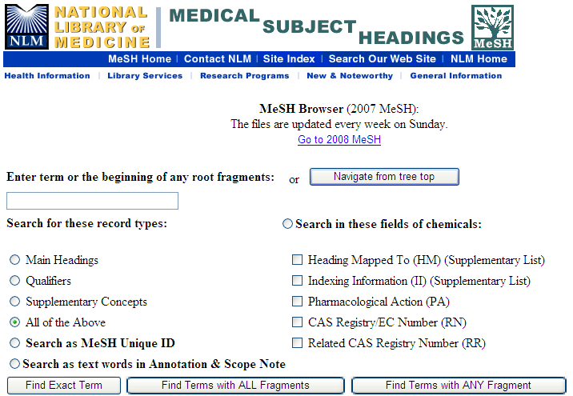
MeSH

Slide 34
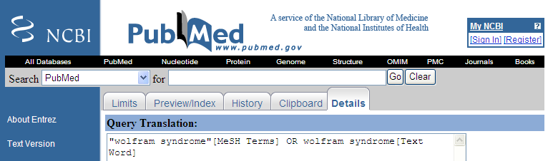
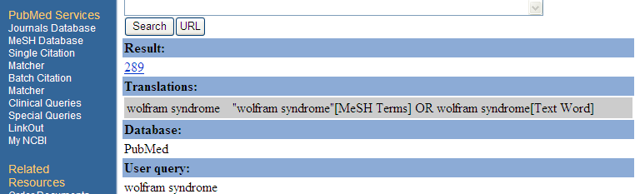
Use of MeSH in PUBMED
Wolfram syndrome

Slide 35
MeSH: Medical Subject Headings
Designed for bibliographic indexing, eg Index Medicus
Basis for MedLINE → Pubmed
focuses on biomedicine and other basic healthcare sciences
clinically very impoverished
Consistency amongst indexers:
  60% for headings
  30% for sub-headings

Slide 36
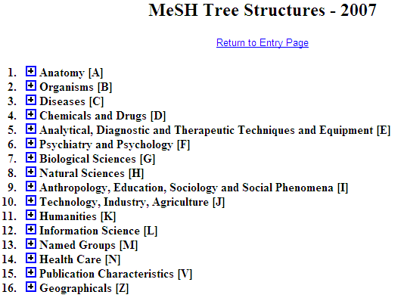
Is this a good idea ?
Cover subject matter of papers
Cover the form of papers

Slide 37
Principle
A representation should not mix object language and meta language
  object language describes the referents in the subject domain
  meta language describes the object language

Slide 38
Geographic Locations: a good hierarchy ?
Africa [Z01.058] +
Americas [Z01.107] +
Antarctic Regions [Z01.158]
Arctic Regions [Z01.208]
Asia [Z01.252] +
Atlantic Islands [Z01.295] +
Australia [Z01.338] +
Cities [Z01.433] +
Europe [Z01.542] +
Historical Geographic Locations [Z01.586] +
Indian Ocean Islands [Z01.600] +
Oceania [Z01.678] +
Oceans and Seas [Z01.756] +
Pacific Islands [Z01.782] +
mereological mess:
mixture of geographic entities with socio-political entities
mixture of space and time

Slide 39
Geographic Locations [Z01]
Africa [Z01.058] +
Americas [Z01.107] +
Antarctic Regions [Z01.158]
Arctic Regions [Z01.208]
Asia [Z01.252] +
Atlantic Islands [Z01.295] +
Australia [Z01.338] +
Cities [Z01.433] +
Europe [Z01.542] +
Historical Geographic Locations [Z01.586] +
Indian Ocean Islands [Z01.600] +
Oceania [Z01.678] +
Oceans and Seas [Z01.756] +
Pacific Islands [Z01.782] +
Ancient Lands [Z01.586.035] +
Austria-Hungary [Z01.586.117]
Commonwealth of Independent States [Z01.586.200] +
Czechoslovakia [Z01.586.250] +
European Union [Z01.586.300]
Germany [Z01.586.315] +
Korea [Z01.586.407]
Middle East [Z01.586.500] +
New Guinea [Z01.586.650]
Ottoman Empire [Z01.586.687]
Prussia [Z01.586.725]
Russia (Pre-1917) [Z01.586.800]
USSR [Z01.586.950] +
Yugoslavia [Z01.586.980] +

Slide 40
Geographic Locations [Z01]
Africa [Z01.058] +
Americas [Z01.107] +
Antarctic Regions [Z01.158]
Arctic Regions [Z01.208]
Asia [Z01.252] +
Atlantic Islands [Z01.295] +
Australia [Z01.338] +
Cities [Z01.433] +
Europe [Z01.542] +
Historical Geographic Locations [Z01.586] +
Indian Ocean Islands [Z01.600] +
Oceania [Z01.678] +
Oceans and Seas [Z01.756] +
Pacific Islands [Z01.782] +
Ancient Lands [Z01.586.035] +
Austria-Hungary [Z01.586.117]
Commonwealth of Independent States [Z01.586.200] +
Czechoslovakia [Z01.586.250] +
European Union [Z01.586.300]
Germany [Z01.586.315] +
Korea [Z01.586.407]
Middle East [Z01.586.500] +
New Guinea [Z01.586.650]
Ottoman Empire [Z01.586.687]
Prussia [Z01.586.725]
Russia (Pre-1917) [Z01.586.800]
USSR [Z01.586.950] +
Yugoslavia [Z01.586.980] +

Slide 41
Principle
A hierarchical structure should not represent distinct hierarchical relations unless they are formally characterized

Slide 42
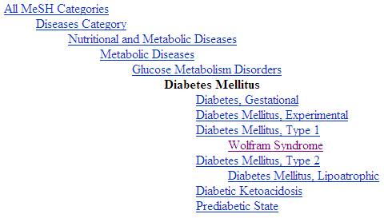
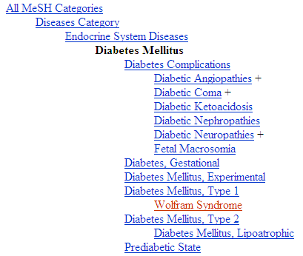
Diabetes Mellitus in MeSH 2008
?
Different set of more specific terms when different path from the top is taken.

Slide 43
MeSH: some paths from top to Wolfram Syndrome
All MeSH Categories
Diseases Category
Nervous System Diseases
Female Urogenital Diseases
and Pregnancy Complications
Eye Diseases
Male Urogenital
Diseases
Cranial Nerve
Diseases
Female Urogenital Diseases
Optic Nerve
Diseases
Neurodegenerative
Diseases
Optic Nerve
Diseases
Eye Diseases,
Hereditary
Heredodegenerative
Disorders,
Nervous System
Urologic Diseases
Optic Atrophy
Kidney Diseases
Optic Atrophies,
Hereditary
Diabetes Insipidus
Wolfram Syndrome

Slide 44

What would it mean if used in the context of a patient ?
All MeSH Categories
???
Diseases Category
Nervous System Diseases
Female Urogenital Diseases
and Pregnancy Complications
Eye Diseases
Male Urogenital
Diseases
Cranial Nerve
Diseases
Female Urogenital Diseases
…
Neurodegenerative
Diseases
Optic Nerve
Diseases
Optic Nerve
Diseases
Eye Diseases,
Hereditary
has
Heredodegenerative
Disorders,
Nervous System
Urologic Diseases
Optic Atrophy
Kidney Diseases
Optic Atrophies,
Hereditary
Diabetes Insipidus
has
Wolfram Syndrome

Slide 45
Principle
If a particular (individual) is related in a specific way to a ‘class’, it should also be related in the same way to all the ‘superclasses’ of that class
  Technically: “… to all the classes that subsume that class”

Slide 46
MeSH Tree Structures – 2007
Body Regions [A01]
  Extremities [A01.378]
    Lower Extremity [A01.378.610]
      Buttocks [A01.378.610.100]
      Foot [A01.378.610.250]
        Ankle [A01.378.610.250.149]
        Forefoot, Human [A01.378.610.250.300] +
        Heel [A01.378.610.250.510]
      Hip [A01.378.610.400]
      Knee [A01.378.610.450]
      Leg [A01.378.610.500]
      Thigh [A01.378.610.750]
What is bad practice ?

Slide 47
MeSH Tree Structures – 2007
Body Regions [A01]
  Abdomen [A01.047] +
  Back [A01.176] +
  Breast [A01.236] +
  Extremities [A01.378]
    Amputation Stumps [A01.378.100]
    Lower Extremity [A01.378.610] +
    Upper Extremity [A01.378.800] +
  Head [A01.456] +
  Neck [A01.598]
  Pelvis [A01.673] +
  Perineum [A01.719]
  Thorax [A01.911] +
  Viscera [A01.960]
What is wrong ?

Slide 48
‘Ontology’
In philosophy:
  Ontology (no plural) is the study of what entities exist and how they relate to each other;

Slide 49
‘Ontology’
In philosophy:
  Ontology (no plural) is the study of what entities exist and how they relate to each other;
  by some philosophers taken to be synonymous with ‘metaphysics’ while others draw distinctions in many distinct ways (the distinctions being irrelevant for this talk), but almost agreeing on the following classification:
    metaphysics → studies ‘how is the world?’
      general metaphysics → studies general principles and ‘laws’ about the world
        ontology → studies what type of entities exist in the world
      special metaphysics → focuses on specific principles and entities
  distinct from ‘epistemology’ which is the study of how we can come to know about what exists.
  distinct from ‘terminology’ which is the study of what terms mean and how to name things.

Slide 50
The Terminology / Ontology divide
Terminology:
  solves certain issues related to language use, i.e. with respect to how we talk about entities in reality (if any);
    Relations between terms / concepts
  does not provide an adequate means to represent independent of use what we talk about, i.e. how reality is structured;
    Women, Fire and Dangerous Things (Lakoff).
Ontology (of the right sort):
  Language and perception neutral view on reality.
    Relations between entities in first-order reality

Slide 51
Distinct questions. What type are they of?
Terminological:
  what does ‘pain’ mean ?
Metaphysical:
  what have all pains in common in virtue of which they are pains?
Ontological:
  what type of entity is pain?
Onto-terminological:
  what, if anything at all, does ‘pain’ denote?
Epistemological:
  how can we find out whether something is pain?

Slide 52
UMLS:
Unified Medical Language System

Slide 53
UMLS: Unified Medical Language System
Tool for information retrieval of 4 components:
  Metathesaurus contains information about biomedical concepts and how they are represented in diverse terminological systems.
  Semantic Network contains information about concept categories and the permissible relationships among them
  Information Sources Map contains both human-readable and machine-processable information about all kinds of biomedical terminological systems
  Specialist lexicon: english words with POS

Slide 54
Linking of concept-based resources
Declaring equivalence (synonymy) between concepts from distinct resources comes down to:
  stating that these concepts mean the same thing,
  however not what they mean.
There is no common underlying ontology:
  Trying to decipher what is meant by concept structures from separate resources is hampered by inconsistencies between these resources.
Use of an ontology language might reveal the inconsistencies, but not resolve them.

Slide 55
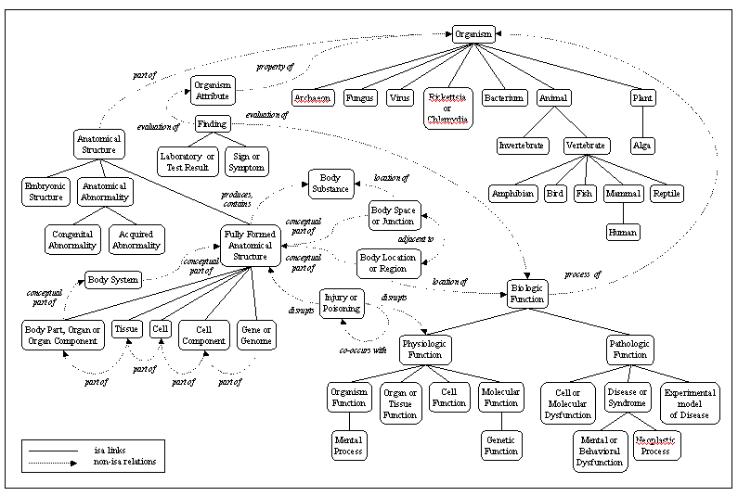
UMLS Semantic Network

Slide 56
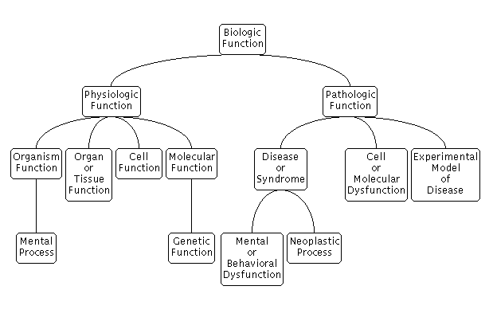
Semantic Network “Biologic Function” Hierarchy

Slide 57
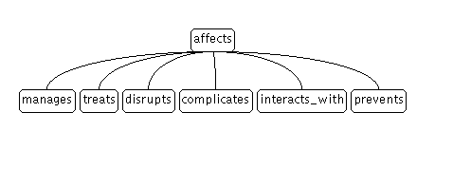
Semantic Network "affects" Hierarchy

Slide 58
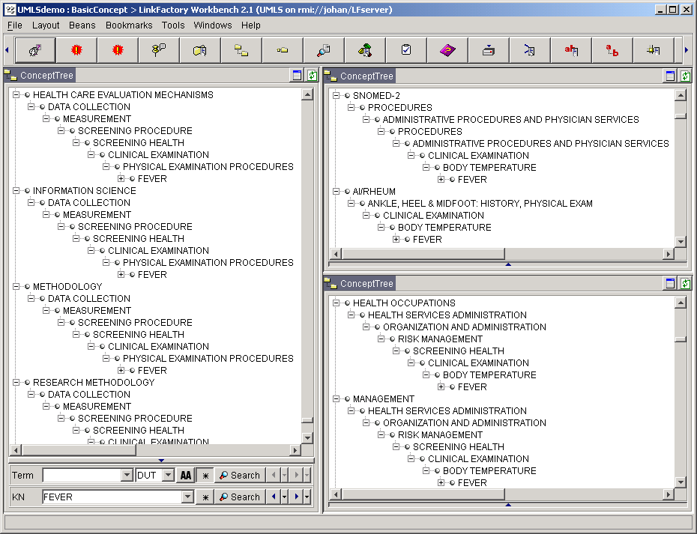
Metathesaurus: merging terminologies
cycles in
hierarchical
relationships

Slide 59
Conclusion

Slide 60
Summary of current deficiencies in traditional and formal terminologies (1)
Terms often require “reading in context”
Agrammatical constructions (paper-based indexing)
Semantic drift as one moves between hierarchies
Not (yet) useful for natural language understanding by software (but were not designed for that purpose)

Slide 61
Summary of current deficiencies in traditional and formal terminologies (2)
labels for terms do not correspond with formal meaning
underspecification (leading to erroneous classification in DL-based systems)
overspecification (leading to wrong assumptions with respect to instances)

Slide 62
Take-home message
Concept-based terminology (and standardisation thereof) is there as a mechanism to improve understanding of messages by humans.
It is NOT the right device
  to explain why reality is what it is, how it is organised, etc., (although it is needed to allow communication),
  to reason about reality,
  to make machines understand what is real,
  to integrate across different views, languages, conceptualisations, ...

Slide 63
Why not ?
Does not take care of universals and particulars appropriately
Concepts not necessarily correspond to something that exist(s)(ed)
  Sorcerer, unicorn, leprechaun, ...
Definitions set the conditions under which terms may be used, and may not be abused as conditions an entity must satisfy to be what it is
Language can make strings of words look as if it were terms
  “Middle lobe of left lung”
...

