Slide 1
Biomedical Ontology PHI 548 / BMI 508
Werner Ceusters and Barry Smith

Slide 2
Lecture 12 Internet of Things Concluding summary
Werner Ceusters and Barry Smith

Slide 3
Lecture 12 Part 1
Internet of Things
Werner Ceusters

Slide 4
Internet of Things
a dynamic global network infrastructure with self-configuring capabilities where physical and virtual "things" have identities, physical attributes, virtual personalities and use intelligent interfaces, and are seamlessly integrated into the information network.
"things" are … active participants in … processes where they are enabled to interact and communicate among themselves and with the environment by exchanging data and information "sensed" about the environment, while reacting autonomously to the "real/physical world" events and influencing it by running processes that trigger actions and create services with or without direct human intervention.
http://cordis.europa.eu/fp7/ict/enet/rfid-iot_en.html

Slide 5
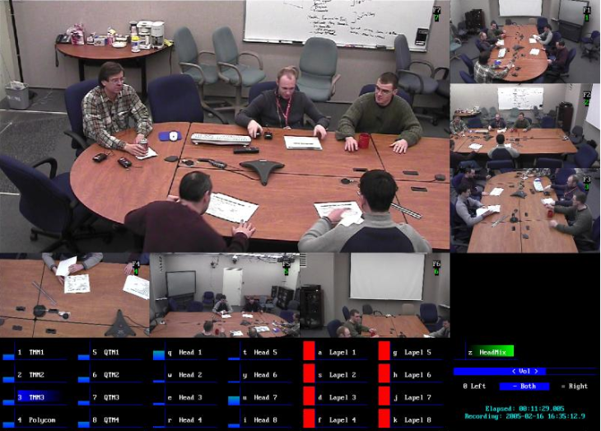
NIST: Smart Spaces Project
http://www.nist.gov/smartspace/index.html

Slide 8
IoT for Health

Slide 9
Internet of Things:
Similar perspective as Ontological Realism
a dynamic global network infrastructure with self-configuring capabilities where physical and virtual "things" have identities, physical attributes, virtual personalities and use intelligent interfaces, and are seamlessly integrated into the information network.
"things" are … active participants in … processes where they are enabled to interact and communicate among themselves and with the environment by exchanging data and information "sensed" about the environment, while reacting autonomously to the "real/physical world" events and influencing it by running processes that trigger actions and create services with or without direct human intervention.
http://cordis.europa.eu/fp7/ict/enet/rfid-iot_en.html

Slide 10
Internet of Things:
Similar perspective as Ontological Realism
a dynamic global network infrastructure with self-configuring capabilities where physical and virtual "things" have identities, physical attributes, virtual personalities and use intelligent interfaces, and are seamlessly integrated into the information network.
"things" are … active participants in … processes where they are enabled to interact and communicate among themselves and with the environment by exchanging data and information "sensed" about the environment, while reacting autonomously to the "real/physical world" events and influencing it by running processes that trigger actions and create services with or without direct human intervention.
http://cordis.europa.eu/fp7/ict/enet/rfid-iot_en.html

Slide 11
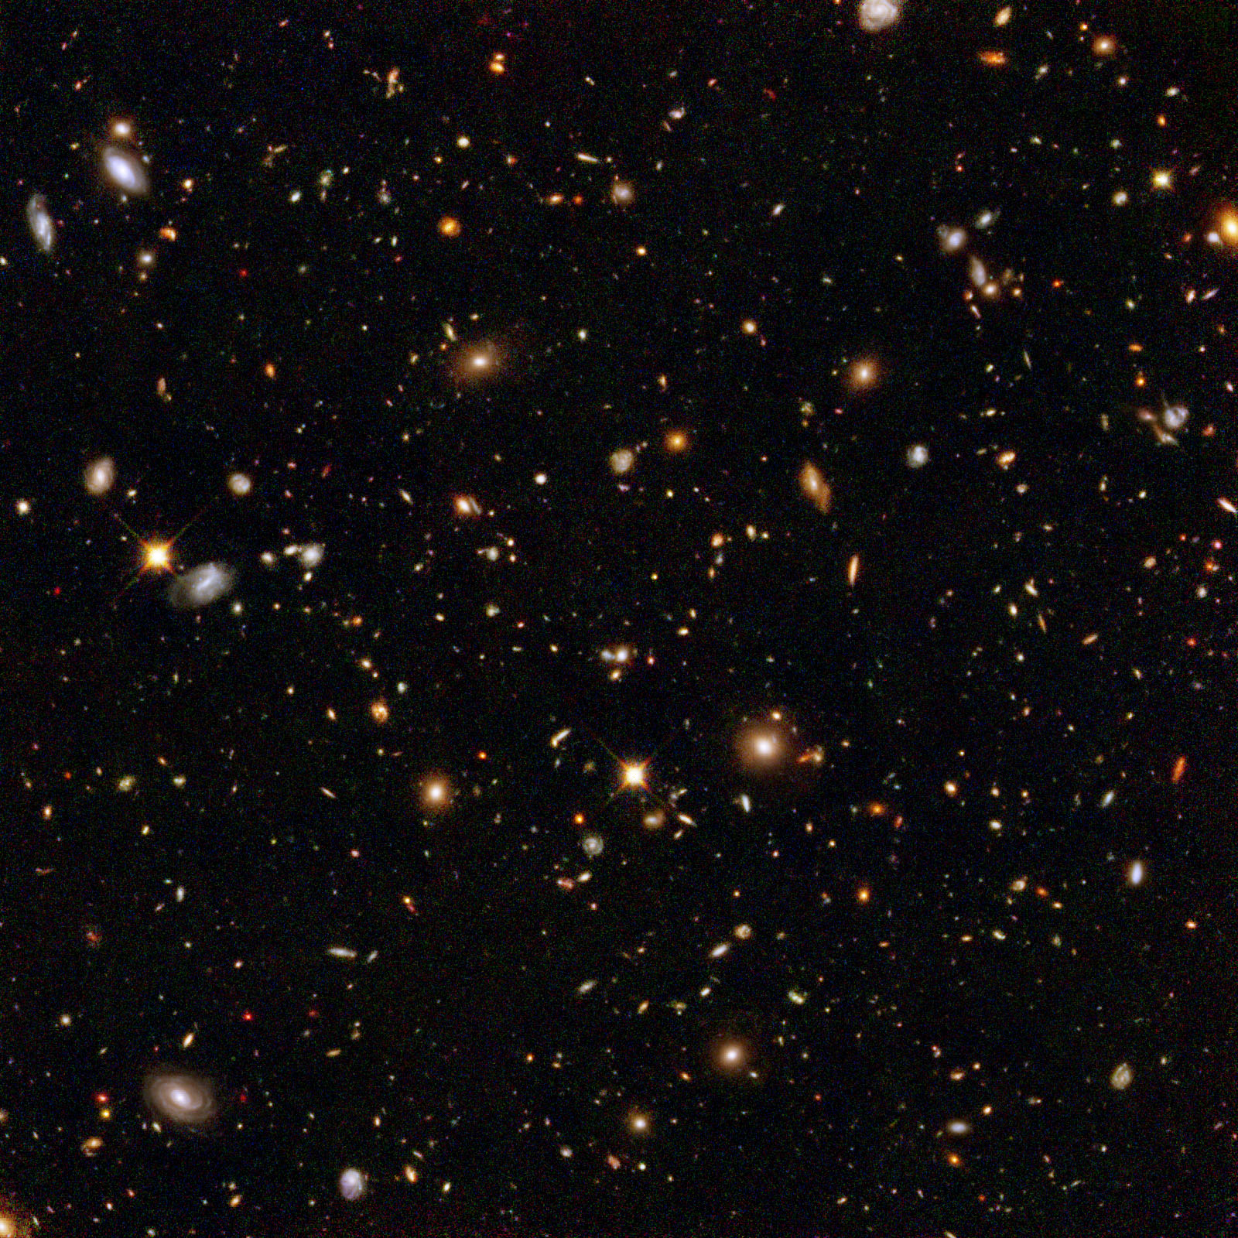
The basis of Ontological Realism
There is an external reality which is ‘objectively’ the way it is;
Smith B, Kusnierczyk W, Schober D, Ceusters W. Towards a Reference Terminology for Ontology Research and Development in the Biomedical Domain. Proceedings of KR-MED 2006, Biomedical Ontology in Action, November 8, 2006, Baltimore MD, USA

Slide 12
Internet of Things: Similar perspective as Ontological Realism
a dynamic global network infrastructure with self-configuring capabilities where physical and virtual "things" have identities, physical attributes, virtual personalities and use intelligent interfaces, and are seamlessly integrated into the information network.
"things" are … active participants in … processes where they are enabled to interact and communicate among themselves and with the environment by exchanging data and information "sensed" about the environment, while reacting autonomously to the "real/physical world" events and influencing it by running processes that trigger actions and create services with or without direct human intervention.
http://cordis.europa.eu/fp7/ict/enet/rfid-iot_en.html

Slide 13
The basis of Ontological Realism
There is an external reality which is ‘objectively’ the way it is;
That reality is accessible to us, and by extension: sensors;
Smith B, Kusnierczyk W, Schober D, Ceusters W. Towards a Reference Terminology for Ontology Research and Development in the Biomedical Domain. Proceedings of KR-MED 2006, Biomedical Ontology in Action, November 8, 2006, Baltimore MD, USA

Slide 14
Internet of Things: Similar perspective as Ontological Realism
a dynamic global network infrastructure with self-configuring capabilities where physical and virtual "things" have identities, physical attributes, virtual personalities and use intelligent interfaces, and are seamlessly integrated into the information network.
"things" are … active participants in … processes where they are enabled to interact and communicate among themselves and with the environment by exchanging data and information "sensed" about the environment, while reacting autonomously to the "real/physical world" events and influencing it by running processes that trigger actions and create services with or without direct human intervention.
http://cordis.europa.eu/fp7/ict/enet/rfid-iot_en.html

Slide 15
The basis of Ontological Realism
There is an external reality which is ‘objectively’ the way it is;
That reality is accessible to us, and by extension: sensors;
IoT agents build in their memories representations of reality;
Smith B, Kusnierczyk W, Schober D, Ceusters W. Towards a Reference Terminology for Ontology Research and Development in the Biomedical Domain. Proceedings of KR-MED 2006, Biomedical Ontology in Action, November 8, 2006, Baltimore MD, USA

Slide 16
Internet of Things: Similar perspective as Ontological Realism
a dynamic global network infrastructure with self-configuring capabilities where physical and virtual "things" have identities, physical attributes, virtual personalities and use intelligent interfaces, and are seamlessly integrated into the information network.
"things" are … active participants in … processes where they are enabled to interact and communicate among themselves and with the environment by exchanging data and information "sensed" about the environment, while reacting autonomously to the "real/physical world" events and influencing it by running processes that trigger actions and create services with or without direct human intervention.
http://cordis.europa.eu/fp7/ict/enet/rfid-iot_en.html

Slide 17
The basis of Ontological Realism
There is an external reality which is ‘objectively’ the way it is;
That reality is accessible to us, and by extension: sensors;
IoT agents build in their memories representations of reality;
They communicate with others about what they sensed to be there.
Smith B, Kusnierczyk W, Schober D, Ceusters W. Towards a Reference Terminology for Ontology Research and Development in the Biomedical Domain. Proceedings of KR-MED 2006, Biomedical Ontology in Action, November 8, 2006, Baltimore MD, USA

Slide 18
Internet of Things:
Similar perspective as Referent Tracking
a dynamic global network infrastructure with self-configuring capabilities where physical and virtual "things" have identities, physical attributes, virtual personalities and use intelligent interfaces, and are seamlessly integrated into the information network.
"things" are … active participants in … processes where they are enabled to interact and communicate among themselves and with the environment by exchanging data and information "sensed" about the environment, while reacting autonomously to the "real/physical world" events and influencing it by running processes that trigger actions and create services with or without direct human intervention.
http://cordis.europa.eu/fp7/ict/enet/rfid-iot_en.html

Slide 19
Internet of Things:
Similar perspective as Referent Tracking
a dynamic global network infrastructure with self-configuring capabilities where physical and virtual "things" have identities, physical attributes, virtual personalities and use intelligent interfaces, and are seamlessly integrated into the information network.
"things" are … active participants in … processes where they are enabled to interact and communicate among themselves and with the environment by exchanging data and information "sensed" about the environment, while reacting autonomously to the "real/physical world" events and influencing it by running processes that trigger actions and create services with or without direct human intervention.
http://cordis.europa.eu/fp7/ict/enet/rfid-iot_en.html

Slide 20
IoT for Health

Slide 21
Two sides of a coin
Multitude of sensors can monitor individual particulars from distinct perspectives, resulting in:
availability of distinct representations about the same particulars;
Multitude of distinct representations about the same particulars can be used as quality control for the sensor devices.
→ Use ontological realism and referent tracking for coherent and consistent representations
→ Use reasoners for quality control
Ceusters W, Bona J. Ontological Foundations for Tracking Data Quality through the Internet of Things. Special Topic Conference Transforming Healthcare with the Internet of Things (EFMI-STC2016), Paris, France, April 17-19, 2016;
Stud Health Technol Inform. 2016;221:74-8.

Slide 22
Essential Universals and Defined Classes
Type | Definition (D) or Elucidation (E)
Assay U | (E) planned process to produce information about a material entity by physically examining it or its proxies [OBI]
Bodily feature DC | (D) bodily component, bodily quality, or bodily process. [OGMS]
Caregiver DC | (D) Human Being in which there inheres a Caregiver Role [RemAEO]
Device U | (E) Object which manifests causal unity via engineered assembly of components & of a type instances of which are maximal relative to this criterion of causal unity. [BFO]
Interpretive process U | (D) cognitive process (in brains or through software implementations) which brings into being, sustains or destroys cognitive representations on the basis of an observation [OMH]
IoT for Health DC | (D) Object aggregate which is part of the IoT and is composed out of Devices and other Objects that generate or analyze Observations within a community of Subjects of Care. [RemAEO]
Sensor Device DC | (D) Device in which inheres the Functions to perform Assays and to generate Observations
Site U | (E) 3-dimensional Immaterial Entity that is bounded by a material entity or is a 3-dimensional immaterial part thereof. [BFO]
Subject of care DC | (D) Human Being undergoing Acts of Care [RemAEO]
Observation DC | (D) Representation resulting from an assay [IAO]
Representation DC | (D) Quality which is_about or is intended to be about a Portion of Reality [IAO]

Slide 23
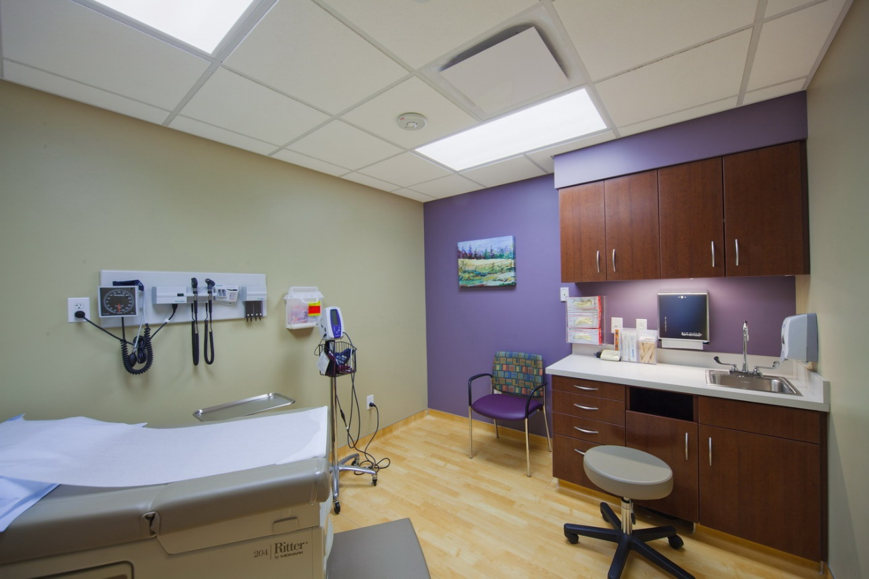
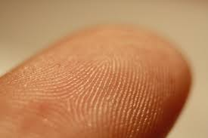
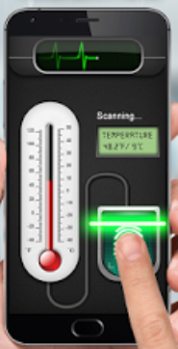
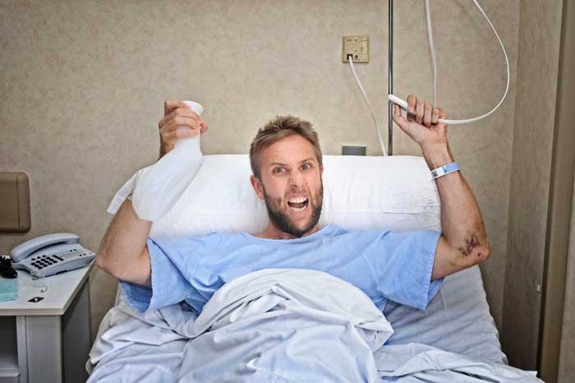
Example scenario: the players
site
Subject
of care
Bodily component
sensordevice
instanceOf at t_{x}
device
caregiver
#3
#11
#4
#9
#2
#1
#6

Slide 24
Example scenario: the temperature assay
assay
instanceOf
#7
#9
#6
#1

Slide 25
Further assertions
#100: #101: #102: #103: #104: #105: #106: #107: #108: #109: #110: #111: #112: #113: #114: #115: #116: #117: #118: | #1 instanceOf Human Being since t1 #1 instanceOf SubjectOfCare since t2 #2 instanceOf Device includes t2 #2 locatedOn #1 since t2 #4 instanceOf Sensor Device includes t #4 locatedIn #3 includes t #3 instanceOf Site includes t #4 partOf #5 includes t #5 instanceOf IoT For Health includes t #2 locatedIn #3 since t3 #4 authorOf #109 at t3 #6 instanceOf Caregiver includes t #7 instanceOf Assay #1 specifiedInputOf #7 during t4 #6 participantOf #7 during t4 #9 participantOf #7 during t4 #9 instanceOf Sensor Device includes t4 #9 locatedIn #3 at t6 #9 partOf #5 since t5

Slide 26
Domotics and RFID systems
Avoiding adverse events in a hospital because of insufficient day/night illumination:
Light sensors and motion detectors in rooms and corridors
and representations thereof in an Adverse Event Management System (AEMS)
What are ‘sufficient’ illumination levels for specific sites is expressed in defined classes,
Each change in a detector is registered in real time in the AEMS,
Action-logic implemented in a rule-base system, f.i. to generate alerts.
Ceusters W, Capolupo M, Devlies J. D4.3 – RAPS Application ontology (Version 1). Background materials and methodology used to develop Application Ontologies for Risks against Patient Safety, January 11, 2009, 53p.

Slide 27
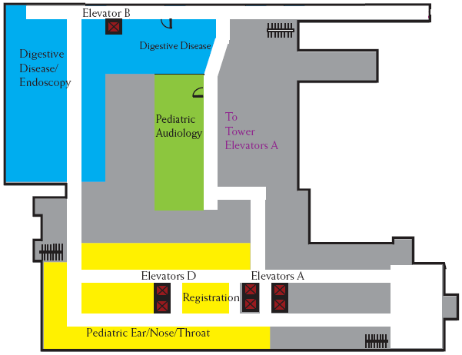
RT-based representation (1): IUI assignment
Reality level 1
#1: that corridor
#2: that lamp
#3: that motion detector
#4: that light detector
#5: that RFID reader
#6: that patient with
RFID #7
#8: that RFID reader
#9: this elevator
#10: 2nd floor of clinic B

Slide 28
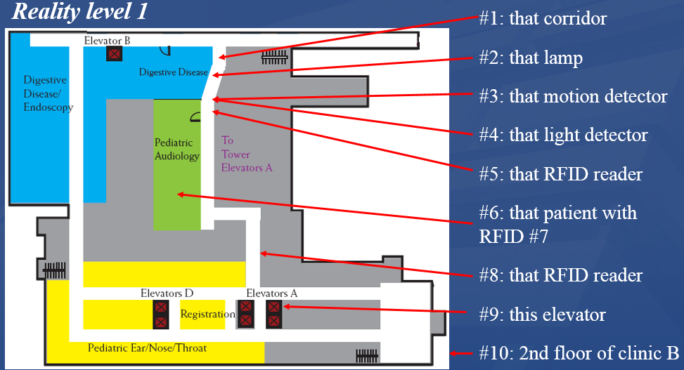
RT-based representation (2): relationships
(Semi-)stable relationships:
#1 instance-of ReM:Corridor since t1
#2 instance-of ReM:Lamp since t2
#2 contained-in #1 since t3
#6 member-of ReM:Patient since t4
#6 adjacent-to #7 since t4
#18 instance-of ReM:Illumination since t1
#18 inheres-in #1 since t1
…

Slide 29
RT-based representation (2): relationships
(Semi-)stable relationships:
#1 instance-of ReM:Corridor since t1
#2 instance-of ReM:Lamp since t2
#2 contained-in #1 since t3
#6 member-of ReM:Patient since t4
#6 adjacent-to #7 since t4
#18 instance-of ReM:Illumination since t1
#18 inheres-in #1 since t1
…
Semi-stable because of:
lamps may be replaced
persons are not patients all the time
…
→ keeping track of these changes provides a history for each tracked entity

Slide 30
RT-based representation (3): rule base
Setting illumination requirements for lamp #2:
#18 member-of ReM:Insufficient illumination during t_{y}
if
t_{x} part-of ReM:Daytime
#_{y1} instance-of ReM:Motion-detection
#_{y1} has-agent #3 at t_{y}
t_{y} part-of t_{x}
#_{y2} instance-of ReM:Illumination measurement
#_{y2} has-agent #4 at t_{y}
#_{y2} has-participant #18 at t_{y}
#_{y2} has-spec-out imr_{z} at t_{y}
imr_{z} less-than 30 lumen
else
t_{x} part-of ReM:Night time
…
endif

Slide 31
RT-based representation of events
Imagine #6 (with RFID #7) walking through #1
#2345 instance-of ReM:Motion-detection
#2345 has-agent #3 at t4
#2346 instance-of ReM:RFID-detection
#2346 has-agent #5 at t4
#2346 has-participant #7 at t4
…
Here, the happening of #2345 fires the rule explained on the previous slide.
If imr_{z} turns out to be too low, that might invoke another rule which sends an alert to the ward that lamp #2 might be broken.
#2346 might trigger yet another rule, namely an alert for imminent danger for AE with respect to patient #6
…

Slide 32
Discussion and conclusion
Related research:
A lot of reported research on privacy and security re IoT for Health, but not on data quality or anomaly detection
Use of ontology for IoT for Health is reported on, but again mainly for security
Ontology for biomedical informatics in general is very popular
Limitations for the applicability of our approach:
Required BFO compatible ontologies are available, but refinement is needed
High threshold for becoming proficient in OR and RT
Limitations of the (too) popular OWL
Need for higher order reasoners.

