Slide 1
Biomedical Ontology PHI 548 / BMI 508
Werner Ceusters and Barry Smith

Slide 2
Lecture 7 Ontology, Logic and Software
Werner Ceusters and Alan Ruttenberg

Slide 3
Lecture 7 Part 1
Diagnosis, misdiagnosis, lucky guess, hearsay, and more.
Werner Ceusters

Slide 4
To fresh up your memory
What kind of entities, in general language or in specific sublanguages, tend to be denoted by the word ‘diagnosis’?

Slide 5
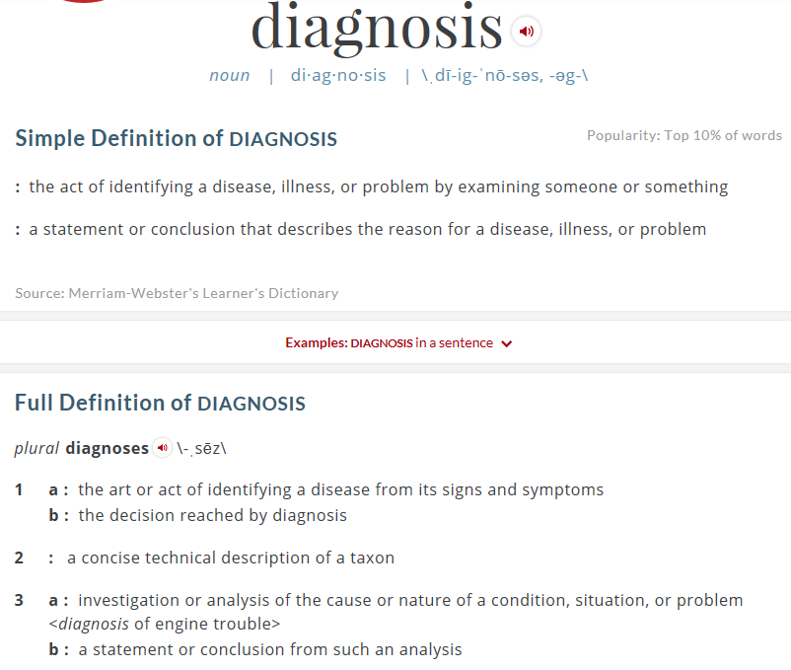
Dictionaries provide the various senses of a word or phrase.
http://www.merriam-webster.com/dictionary/diagnosis

Slide 6
Illustrates the historical appearance of the word in that sense in English.
http://www.merriam-webster.com/help/explanatory-notes/dict-definitions
http://www.merriam-webster.com/dictionary/diagnosis

Slide 7
Illustrates the historical appearance of and semantic relationship between (sub)senses
http://www.merriam-webster.com/help/explanatory-notes/dict-definitions
http://www.merriam-webster.com/dictionary/diagnosis

Slide 8
Occurrences of the word ‘diagnosis’
http://sentence.yourdictionary.com/diagnosis (accessed 2016-10-12)

Slide 9
Test: ‘diagnosis’ in which sense of slide 5?
2
3b
1a
1b
1a
1a
http://sentence.yourdictionary.com/diagnosis (accessed 2016-10-12)

Slide 10
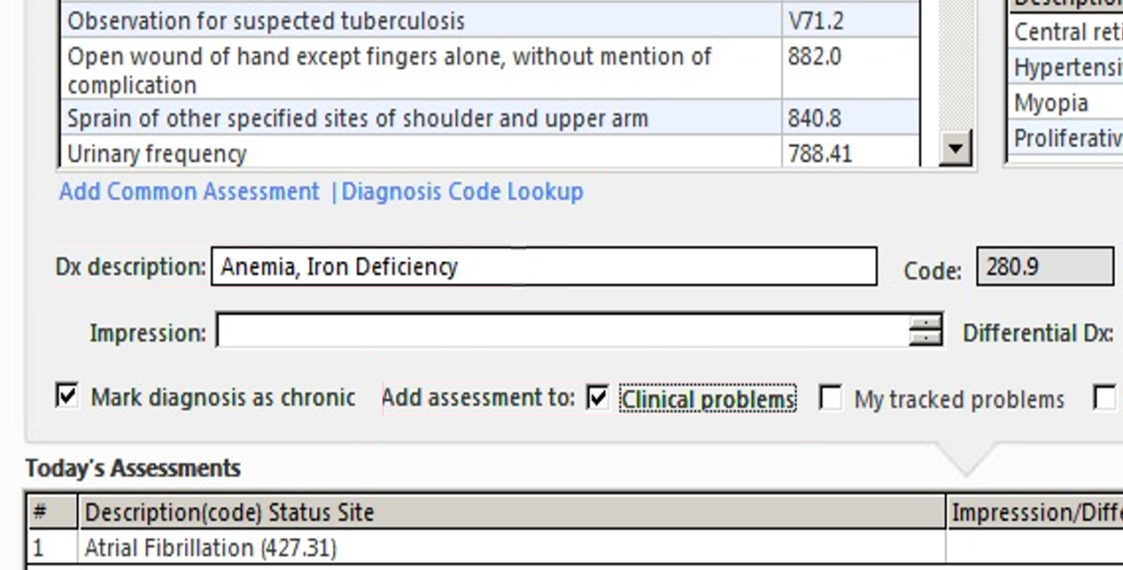
Some observations (1)
The word ‘diagnosis’ – whether in a medical context – is used for a variety of entities of distinct sorts, even wrongly:
What mistake?
http://incerio.com/planning-nextgen-version-5-8-upgrade-things-know-diagnosis-module/

Slide 11
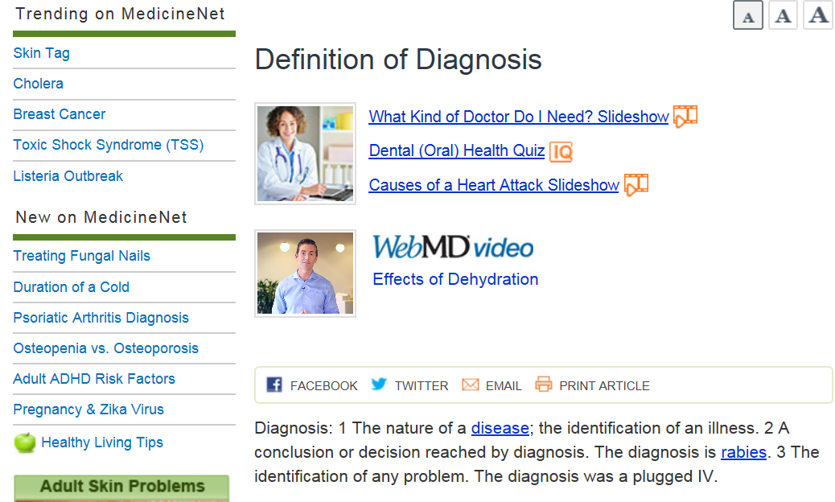
Some observations (2)
Dictionaries and terminologies sometimes contribute to the confusion rather than solve it;
What is confused?
http://www.medicinenet.com/script/main/art.asp?articlekey=2979

Slide 12
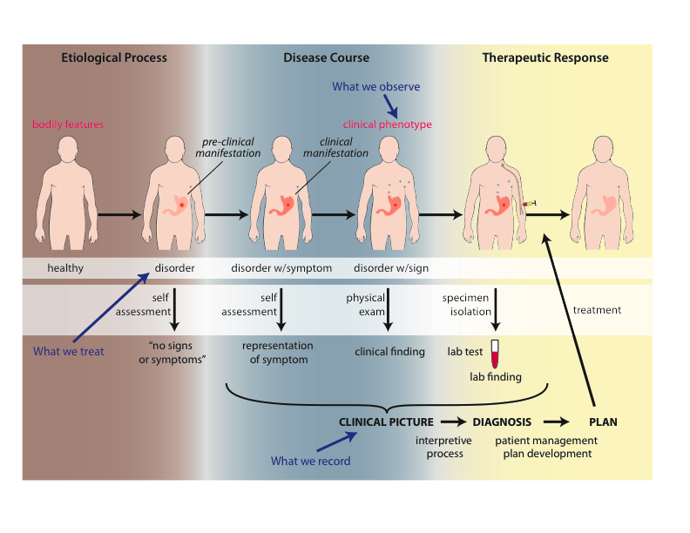
A proposed antidote: The Ontology for General Medical Science (OGMS)
Scheuermann R, Ceusters W, Smith B. Toward an Ontological Treatment of Disease and Diagnosis. 2009 AMIA Summit on Translational Bioinformatics, San Francisco, California, March 15-17, 2009;: 116-120.
http://www.referent-tracking.com/RTU/sendfile/?file=AMIA-0075-T2009.pdf
http://code.google.com/p/ogms/
Notes:
font was too small, color inside green boxes was hardly readable

Slide 13
Why would OGMS be an antidote?
Notes:
font was too small, color inside green boxes was hardly readable

Slide 14
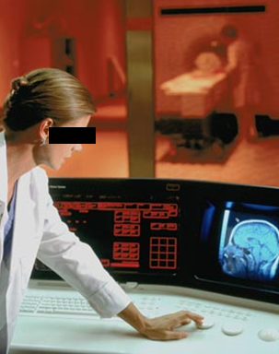
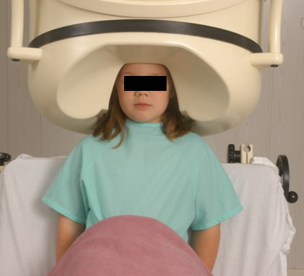
Why would OGMS be an antidote?
(1) No conflation of diagnosis, disease, and disorder
produces
bears
realized_in
etiological process
disorder
disease
pathological process
produces
diagnosis
interpretive process
signs & symptoms
abnormal bodily features
produces
participates_in
recognized_as
Scheuermann R, Ceusters W, Smith B. Toward an Ontological Treatment of Disease and Diagnosis. 2009 AMIA Summit on Translational Bioinformatics, San Francisco, California, March 15-17, 2009;: 116-120.
http://www.referent-tracking.com/RTU/sendfile/?file=AMIA-0075-T2009.pdf
http://code.google.com/p/ogms/
Notes:
font was too small, color inside green boxes was hardly readable

Slide 15
Why would OGMS be an antidote?
(2) Relatively precise definition denoting one single type of entity
Diagnosis =def. – A conclusion of an interpretive process that has as input a clinical picture of a given patient and as output an assertion to the effect that the patient has a disease of such and such a type.
Notes:
font was too small, color inside green boxes was hardly readable

Slide 16
Why would OGMS be an antidote?
(2) Relatively precise definition denoting one single type of entity
?
Diagnosis =def. – A conclusion of an interpretive process that has as input a clinical picture of a given patient and as output an assertion to the effect that the patient has a disease of such and such a type.
Notes:
font was too small, color inside green boxes was hardly readable

Slide 17
Why would OGMS be an antidote?
(2) Relatively precise definition denoting one single type of entity
Diagnosis =def. – A conclusion of an interpretive process that has as input a clinical picture of a given patient and as output an assertion to the effect that the patient has a disease of such and such a type.
Notes:
font was too small, color inside green boxes was hardly readable

Slide 18
Generic versus specific entities
Generic
Specific
L3. Representation
INFORMATION CONTENT ENTITY
‘WC has migraine’
L2. Beliefs (knowledge)
DIAGNOSIS
my doctor’s
diagnosis
L1.
First-order reality
LAPTOP
HUMAN BEING
my doctor’s computer
my doctor
DISEASE
me
my migraine
MIGRAINE
HEADACHE
my headache
Basic Formal Ontology
Referent Tracking

Slide 19
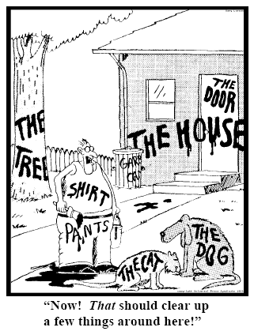
Representing specific entities
explicit reference to the individual entities relevant to the accurate description of some portion of reality, ...
Ceusters W, Smith B. Strategies for Referent Tracking in Electronic Health Records. J Biomed Inform. 2006 Jun;39(3):362-78.

Slide 20
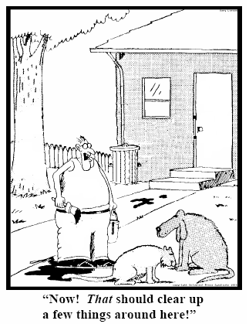
Method: IUI assignment
Introduce an Instance Unique Identifier (IUI) for each relevant particular (individual) entity
→ Referent Tracking
78
235
5678
321
322
666
427
Ceusters W, Smith B. Strategies for Referent Tracking in Electronic Health Records. J Biomed Inform. 2006 Jun;39(3):362-78.

Slide 21
Research question
To what extent are experts in RT able to develop independently from one another a collection of RT statements that describe the same portion of reality (POR) in a semantically-interoperable way?

Slide 22
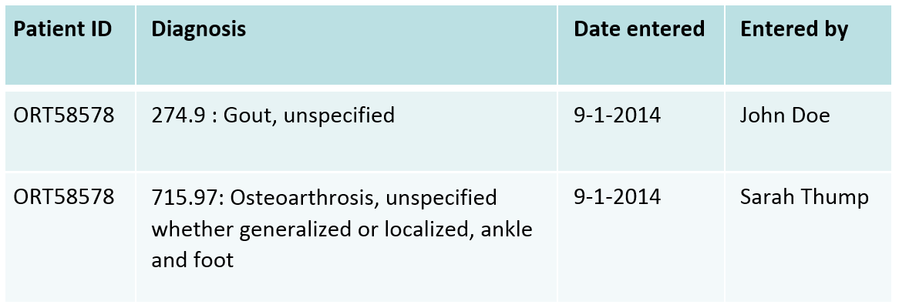
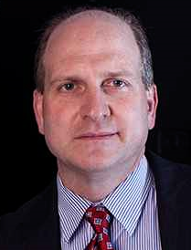
Intellectual experiment
Context:
An EHR with a problem list shows in a spreadsheet for a specific patient two diagnostic entries entered at the same date, but by distinct providers:
It is assumed that the patient with ID ORT58578 has only one disorder.
Task:
List the different kinds of Referent Tracking statements that would represent this situation.
Players:
Me and Bill Hogan, University of Florida.

Slide 23
Focus of the experiment
the choice of particulars deemed necessary and sufficient for an accurate description of the selected POR,
what these particulars are instances of,
how they relate to each other, and
the motivations of each participant in the experiment for the choices made.
Ceusters W, Hogan W.
An ontological analysis of diagnostic assertions in electronic healthcare records.
International Conference on Biomedical Ontologies, ICBO 2015, Lisbon, Portugal, July 27-30, 2015;7-11.

Slide 24
Relevance for this work
Differences in the choice of ontologies constitute a risk:
distinct ontologies may represent reality from distinct perspectives,
despite the RT statements being veridical, they might not be derivable from each other because the axioms required to do so might be missing as they might fall outside the purpose of the specific ontologies.
This would lead the representations by each of the authors not to be semantically interoperable unless additional ontology bridging axioms would be crafted.
Ceusters W, Hogan W.
An ontological analysis of diagnostic assertions in electronic healthcare records.
International Conference on Biomedical Ontologies, ICBO 2015, Lisbon, Portugal, July 27-30, 2015;7-11.

Slide 25
Methodology
No instructions on ontologies to use, or format of RTTs.
Results exchanged after each author finished work.
Analysis:
identification of the particulars that both authors referred to in their assertions.
re-assign IUIs to particulars referred to by both authors as if the collection of RTTs was merged into one single RT system, thereby still keeping track of which RTT was asserted by which author.
analyze and discuss differences in representations, however without paying attention to the temporal indexing required for RTTs describing a POR in which a continuant is involved.
Ceusters W, Hogan W.
An ontological analysis of diagnostic assertions in electronic healthcare records.
International Conference on Biomedical Ontologies, ICBO 2015, Lisbon, Portugal, July 27-30, 2015;7-11.

Slide 26
This spreadsheet
IUI | Lifespan | Particular Description | Relationships
#1 | t1 | the information content entity which is concretized in the spreadsheet you are looking at | #1 | instance-of | INFORMATION CONTENT ENTITY | at | t1
Assume this is on a blackboard

Slide 27
This spreadsheet
IUI | Lifespan | Particular Description | Relationships |  |  |  |  | Comments
#1 | t1 | the information content entity which is concretized in the spreadsheet you might be looking at is a concretization | #1 | instance-of | INFORMATION CONTENT ENTITY | at | t1 | An ICE is about something. Two concretizations of different ICE might look exactly the same, but be about distinct portions of reality.
#2 | t2 | the portion of chalk on the blackboard which make up what we call 'that spreadsheet' | #2 | instance-of | MATERIAL ENTITY | at | t2 | We present the case in which the spreadsheet is on a blackbord rather than a Powerpoint slide.
#3 |  | the pattern of chalk lines, spaces, characters, etc., in that portion of chalk | #3 | instance-of | QUALITY | at | t2 | This quality exists as long as the spreadsheet is on the blackboard.
 |  |  | #3 | inheres-in | #2 | at | t2 | It inheres in the bearer all the time the bearer exists.
 | t3 | the temporal region during which #1 is concretized in #3 | #3 | concretizes | #1 | at | t3 | but concretizes the spreadsheets' ICE when complete
 |  |  | t3 | part-of | t1 |  |  | that ICE might be concretized at other times elsewhere.

Slide 28
Who are the two data rows about?
#4 | t4 | the material entity (in BFO sense) whose ID is ‘ORT58578’ in the spreadsheet | #4 | instance-of | MATERIAL ENTITY | at | t4 | Instances of human beings don't exist all the time as human beings
 | t5 | the temporal region during which #4 is an instance of HUMAN BEING | #4 | instance-of | HUMAN BEING | at | t5
 |  |  | t5 | part-of | t4

Slide 29
What are the two data rows about?
(1) a diagnosis: d1 | #10 | t13 | the diagnosis which is concretized in the first two cells of the 2nd row of the concretization of #1 in front of your eyes | #10 | instance-of | DIAGNOSIS | at | t13
 | #11 | t14 | the quality through which #10 is concretized | #11 | concretizes | #10 | since | t15
 |  | t15 | the temporal region during which #10 is concretized in #11
(2) another diagnosis: d2 | #12 | t16 | the diagnosis concretized in the first two cells of the 3rd row of the concretization of #1 in front of your eyes | #12 | instance-of | DIAGNOSIS | at | t16
 | #13 | t17 | the quality through which #12 is concretized | #13 | concretizes | #12 | since | t18
 |  | t18 | the temporal region during which #12 is concretized in #13
(3) who 'entered' d1 and d2 | #14 | t19 | the person whose name is ‘John Doe’ in the spreadsheet | #14 | instance-of | HUMAN BEING | at | t19
 | #15 | t20 | the person whose name is ‘Sarah Thump’ in the spreadsheet | #15 | instance-of | HUMAN BEING | at | t20
(4) when d1 and d2 were entered |  | t21 | the temporal region expressed by both 3rd cells in row 2 and row 3

Slide 30
What must exist for the diagnoses d1 and d2 to exist?
produces
bears
realized_in
etiological process
disorder
disease
pathological process
produces
diagnosis
interpretive process
signs & symptoms
abnormal bodily features
produces
participates_in
recognized_as
Scheuermann R, Ceusters W, Smith B. Toward an Ontological Treatment of Disease and Diagnosis. 2009 AMIA Summit on Translational Bioinformatics, San Francisco, California, March 15-17, 2009;: 116-120.
http://www.referent-tracking.com/RTU/sendfile/?file=AMIA-0075-T2009.pdf
http://code.google.com/p/ogms/
Notes:
font was too small, color inside green boxes was hardly readable

Slide 31
What must exist for the diagnoses d1 and d2 to exist?
(1) what they are based on | #16 | t22 | the clinical picture about #4 available to #14 and #15 | #16 | instance-of | CLINICAL PICTURE | at | t22
 | #17 | t23 | part of the life of #4 which is described in #16 | #17 | instance-of | BODILY PROCESS
 |  |  |  | #17 | has-participant | #4 | at | t23
 |  |  |  | t23 | during | t4
(2) what created them | #18 | t24 | the interpretive process which resulted in #10 | #18 | creates | #10 | co-ends | t24
 |  |  |  | #18 | instance-of | BODILY PROCESS
 |  |  |  | #18 | has-agent | #14 | at | t24
 |  |  |  | #18 | has-input | #16 | co-starts | t24
 | #19 | t25 | the interpretive process which resulted in #12 | #19 | creates | #12 | co-ends | t25
 |  |  |  | #19 | instance-of | BODILY PROCESS
 |  |  |  | #19 | has-agent | #15 | at | t25
 |  |  |  | #19 | has-input | #16 | co-starts | t25

Slide 32
What should the diagnoses be about?
#20 | t26 | the disease in #4 | #20 | instance-of | DISEASE | at | t26
 |  |  | #20 | inheres-in | #4 | at | t8 | we assume there is only one disease present which is born by one disorder
 |  |  | t26 | part-of | t5 |  |  | diseases can start in entities before they transform into human beings

Slide 33
What is asserted in the diagnoses?
a DISEASE (type) reference | #21 | t27 | the ICE concretized in the 2nd cell of the 2nd row | #21 | instance-of | ICD-9-CM CODE AND LABEL | at | t27
 | #22 | t28 | the quality through which #21 is concretized | #22 | concretizes | #21 | since | t29
 |  | t29 | the temporal region during which #21 is concretized in #22
 |  |  |  | #22 | is-about | GOUT | since | t29
 | #23 | t30 | the ICE concretized in the 2nd cell of the 3rd row | #23 | instance-of | ICD-9-CM CODE AND LABEL | at | t30
 | #24 | t31 | the quality through which #23 is concretized | #24 | concretizes | #23 | since | t32
 |  | t32 | the temporal region during which #23 is concretized in #24
 |  |  |  | #24 | is-about | OSTEOARTHROSIS | since | t32
in reference to the patient |  |  |  | #11 | is-about | #4 | at | t15
 |  |  |  | t15 | after | t24
 |  |  |  | #13 | is-about | #4 | at | t18
 |  |  |  | t18 | after | t24
 |  |  |  | #11 | is-about | #20 | at | t15
 |  |  |  | #13 | is-about | #20 | at | t18

Slide 34
What is asserted about the diagnoses?
first, what must exist | #25 | t33 | the process of, as we say 'entering d1 in the EHR system' | #25 | instance-of | PROCESS
 |  |  |  | #25 | creates | #26 | co-ends | t33
 | #26 | t34 | the quality of some part of some hard disk which concretizes d1 | #26 | concretizes | #10 | co-ends | t33
 | #27 | t35 | the process of, as we say 'entering d2 in the EHR system' | #27 | instance-of | PROCESS
 |  |  |  | #27 | creates | #28 | co-ends | t35
 | #28 | t36 | the quality of some part of some hard disk which concretizes d2 | #28 | concretizes | #12 | co-ends | t35
who 'entered the diagnoses' |  |  |  | #14 | agent-of | #25 | at | t33
 |  |  |  | #15 | agent-of | #27 | at | t35
when, roughly, they were entered |  |  |  | t33 | part-of | t21
 |  |  |  | t35 | part-of | t21

Slide 35
Quantitative Results
 | X | Y | X+Y
# particulars referenced (TR excluded) | 21 | 28 | 39
# instantiations | 23 | 28 | 49/47/41
# instantiated classes | 12 | 11 | 20
# realism-based ontologies drawn from | 5 | 4 | 7
# classes without ontological home | 3 | 4 | 7
# particular-to-particular (PtoP) relations | 26 | 35 | 55
# RTTs judged not at all appropriate | 4 | 0 | 0
of which PtoP / P-inst | 4 / 0 | 0 / 0 | 0 / 0
# RTTs judged arguably appropriate | 22 | 20 | 16
of which PtoP / P-inst | 7 / 15 | 11 / 9 | 7 / 9
# RTTs judged for sure appropriate | 83 | 89 | 83
of which PtoP / P-inst | 48 / 35 | 48 / 41 | 48 / 35

Slide 36
Appropriateness
measured in terms of what an optimal collection of RTTs for the POR under scrutiny would be;
POR under scrutiny:
Assertional part: what is in the EHR
Non-assertional part: what is on the side of the patient
Optimal collection:
satisfies the following criteria:
(1) it consists of RTTs which describe the non-assertional part of the POR only to the extent to which there is enough evidence for what those RTTs themselves assert to be true (e.g. there is sufficient evidence that the patients are human beings, there is not sufficient evidence that the diagnoses are correct), and
(2) it consists of other RTTs which describe the assertional part in relation to the RTTs referenced under (1).

Slide 37
Very high inter-rater agreement
Obs |  | Y
 |  | 0 | 1 | 2
X | 0 | 0 | 4 | 0 | 4
 | 1 | 0 | 16 | 6 | 22
 | 2 | 0 | 0 | 83 | 83
 |  | 0 | 20 | 89 | 109
agreement |  | 0 | 16 | 83 | 99
by chance |  | 0 | 0.73 | 3.27 | 4
Cohen's kappa |  |  |  |  | 0.904762
http://www.real-statistics.com/reliability/cohens-kappa/

Slide 38
Main reasons for disagreement
Absence of uniform conventions on which ontologies and relations to use,
Problems in the ontological theories,
Issues with implementation of ontologies,
both authors resorted to OGMS for a large part of their RTTs,
Yet, differences in representation were observed because of the source material consulted:
X used the OGMS OWL artifact as basis, whereas Y used the definitions and descriptions in the paper that led to the development of OGMS (Scheuermann et al., 2009).
Lack of appropriate documentation.

Slide 39
Ontologies and orphan classes referenced
Ontologies X Y
Ontology of General Medical Science (OGMS) x x
Ontology of Medically Related Social Entities (OMRSE) x
the Foundational Model of Anatomy (FMA) x x
the Disease Ontology (DO) x
Ontology of Biomedical Investigations (OBI) x
Basic Formal Ontology (BFO) x
Information Artifact Ontology (IAO) x
Orphan classes
‘denotator’ x
‘EHR’ x
‘dataset record’ x
‘patient identifier’ x
‘ICD-9-CM code and label’ x

Slide 40
Material entity / human being
Ind | IUI | Description | Ontology Class |  | Y | X
T1 | P1 | the patient | OBI | Homo sapiens | 1 | 2
T2 | P2 | the doctor who made diagnosis #1 | OBI | Homo sapiens | 1 | 2
T3 | P3 | the doctor who made diagnosis #2 | OBI | Homo sapiens | 1 | 2
T15 | P13 | the patient's patient role | OMRSE | Patient role | 2 | 2
Ind | IUI | Description | Ontology Class |  | Y | X
T27 | P1 | the material entity whose ID is ‘1234’ in the spreadsheet | BFO | Material entity | 1 | 1
T2 | P2 | the person whose name is ‘J. Doe’ in the spreadsheet | FMA | Human being | 1 | 1
T3 | P3 | the person whose name is ‘S. Thump’ in the spreadsheet | FMA | Human being | 1 | 1
X represented P1 as a human with a patient role.
Y represented P1 as a material entity (P1 has been a material entity all the time through its existence, but not a human (e.g., it was a zygote at a time prior to being human)) without assigning a patient role.
This difference in representation is related to the temporal indexing that RT requires for continuants.
Given the two authors’ temporal indexing, both agree that each other’s views re material entity/human being (cave next slide) were correct.

Slide 41
Human being / Homo sapiens
Ind | IUI | Description | Ontology Class |  | Y | X
T1 | P1 | the patient | OBI | Homo sapiens | 1 | 2
T2 | P2 | the doctor who made diagnosis #1 | OBI | Homo sapiens | 1 | 2
T3 | P3 | the doctor who made diagnosis #2 | OBI | Homo sapiens | 1 | 2
T15 | P13 | the patient's patient role | OMRSE | Patient role | 2 | 2
Ind | IUI | Description | Ontology Class |  | Y | X
T27 | P1 | the material entity whose ID is ‘1234’ in the spreadsheet | BFO | Material entity | 1 | 1
T2 | P2 | the person whose name is ‘J. Doe’ in the spreadsheet | FMA | Human being | 1 | 1
T3 | P3 | the person whose name is ‘S. Thump’ in the spreadsheet | FMA | Human being | 1 | 1
Disagreement about how to interpret the representational units for the universal Human being from the selected ontologies:
Is ‘human being’ synonym for the FMA’s ‘human body’ class ?
Does OBI’s ‘Homo sapiens’ because of its linking to other ontologies in Ontobee confuse ‘Homo sapiens’ as an instance of ‘species’ with those instances of organism that belong to – but are not instances of – the species ‘Homo sapiens’?
‘Homo sapiens’ and similar classes in OBI all descend from a class called ‘organism’.
The ‘Homo sapiens’ class in OBI has synonyms ‘Human being’ and ‘human’.
The problem here is the lack of face value of terms selected as class names in the respective ontologies.

Slide 42
Disorders, diseases, diagnoses and DO
Agreement on the existence of a disorder, a disease, two diagnoses and two distinct processes that generated each.
Agreement that none of these entities should be confused or conflated: nothing at the same time can be an instance of two or more of the following: disease, disorder, diagnosis, and diagnostic process.
Disagreement on the appropriateness of DO.
Agreement that DO confuses not only disorders and disease, but also disease courses.
E.g.: ‘physical disorder’ is a subtype of ‘disease’, in direct contradiction to OGMS.
Goodwill argument: DO at least purports to strive for compliance with realist principles. If perfection were a requirement to use an ontology, we could make no progress. Nevertheless, the persistent, glaring flaws of DO from the perspective of OGMS give serious pause on using it accurately and precisely.

Slide 43
What part of the EHR constitutes a diagnosis?
Agreement that such part is built out of continuants that are concretizations of instances of ICE reflecting a diagnosis.
Disagreement on the extent of the part that denotes the diagnosis:
the mere concretization of the ICD-code and label?
the above, plus the concretization of the patient identifier?
Root cause of disagreement: distinct interpretations of the literature on
the nitty-gritty of how to deal with ICE and concretizations thereof,
how instances of ICE relate to other instances of ICE,
what exactly the relata are of relationships such as aboutness and denotation.
Examples:
Can ICE be parts of other ICE or does parthood only apply to the independent continuants in which inhere the qualities that concretize the corresponding ICE?
Is it the qualities concretizing the ICE that are about something or the ICE itself?
See Smith & Ceusters, ICBO 2015

Slide 44
Are diagnoses to be assumed correct? (1)
X interpreted both
(1) the RT tuple that instantiated the disease as gout (by Doe) and
(2) the RT tuple that instantiated it as osteoarthritis (by Thump)
as being faithful representations of what Thump and Doe believed at the time they formulated their diagnoses.
X did not believe himself to be recognizing both diagnoses as straightforwardly accurate and therefore resorted in his representation to a mechanism offered in RT to craft RTTs about RTTs that are later found to have been based on a misunderstanding of the reality at the time they were crafted.

Slide 45
Are diagnoses to be assumed correct? (2)
Y crafted a representation that does not commit to what specific disease type(s) the patient’s disease actually is an instance of.
This was achieved by representing the diagnoses to be simultaneously about the patient on the one hand (in contrast to X who represents the diagnoses to be about the disorder/ disease itself), and about the disease universals – gout and osteoarthrosis resp. – denoted by the respective ICD-codes and labels on the other hand.
This aboutness-relation between an instance of ICE and a universal can be represented in RT but of course cannot be represented in OWL without recourse to workarounds such as those discussed by Schulz et al (2014).

Slide 46
Conclusions (1)
The two authors agreed on the existence of key entities for the diagnoses to make sense.
They agreed in general about the types instantiated by the particulars in the scenario, and how the particulars are related to each other.
They chose different representational units and relations from different ontologies due to various issues such as
potential lack of orthogonality in the OBO Foundry and
in some cases disagreement on what types the classes in the ontologies represent.
These distinctions exist, not because the authors entertained distinct competing conceptualizations, but because they expressed matters differently.
Ceusters W, Hogan W.
An ontological analysis of diagnostic assertions in electronic healthcare records.
International Conference on Biomedical Ontologies, ICBO 2015, Lisbon, Portugal, July 27-30, 2015;7-11.

Slide 47
Conclusions (2)
Although this study is limited by the participation of only 2 subjects and the analysis of one report, it highlights the fact that the RT method and the clarity and precision it requires in representing reality is a powerful tool in identifying areas of needed improvement in existing, realism-based ontologies.
Disagreements primarily due to different interpretations of the literature on ICEs.
Note: Ceusters was using Smith B, Ceusters W. Aboutness: Towards Foundations for the Information Artifact Ontology. ICBO 2015, Lisbon, Portugal, July 27-30, 2015;47-51, written before the experiment, but published later.
Ceusters W, Hogan W.
An ontological analysis of diagnostic assertions in electronic healthcare records.
International Conference on Biomedical Ontologies, ICBO 2015, Lisbon, Portugal, July 27-30, 2015;7-11.

Slide 48
An extended analysis based on
Smith B, Ceusters W. Aboutness: Towards Foundations for the Information Artifact Ontology. ICBO 2015, Lisbon, Portugal, July 27-30, 2015;47-51

Slide 49
Basic types used
Term | Definition
INFORMATION CONTENT ENTITY | An ENTITY which is (1) GENERICALLY DEPENDENT on (2) some MATERIAL ENTITY and which is (3) concretized by a QUALITY (a) inhering in the MATERIAL ENTITY and (b) that is_about some PORTION OF REALITY
INFORMATION QUALITY ENTITY | A REPRESENTATION that is the concretization of some INFORMATION CONTENT ENTITY
REPRESENTATION | A QUALITY which is_about or is intended to be about a PORTION OF REALITY
MENTAL QUALITY | A QUALITY which specifically depends on an ANATOMICAL STRUCTURE in the cognitive system of an organism
COGNITIVE REPRESENTATION | A REPRESENTATION which is a MENTAL QUALITY
Relation | Explanation
x is_about y | x refers to or is cognitively directed towards y. Domain: representations; Range: portions of reality. Axiom: if x is_about y then y exists (veridicality).
x concretizes y | x is a QUALITY and y is a GENERICALLY DEPENDENT CONTINUANT (GDC) and for some MATERIAL ENTITY z, x specifically_depends_on z at t and y generically_depends_on z at t, and if y migrates from bearer z to another bearer w then a copy of x will be created in w.
x is_conformant_to y | =def. x is an INFORMATION QUALITY ENTITY and y is a COGNITIVE REPRESENTATION and there is some GDC g such that x concretizes g and y concretizes g.

Slide 50
Cognitive directedness
Information artifacts do not bear information in and of themselves, but only because cognitive subjects associate representations of certain sorts with the patterns which they manifest.
the doctrine of the ‘primacy of the intentional’
Chisholm, R. M. (1984). The primacy of the intentional. Synthese, 61(1), 89-109. doi: Doi 10.1007/Bf00485490
Information = grounded representation
the entry 72 beats per minute is about what it is about because of what the nurse himself directly observed when he measured the patient’s pulse.
Mis-information = ungrounded representation
Le Verrier wrote ‘about’ ‘Vulcan’. This intended reference depended on a certain – false - belief on Le Verrier’s part in the existence of an intra-Mercurial planet.
Mis-information is not a special kind of information!

Slide 51
Case study
Written on a piece of paper today
Obama is President of the United States
Smith B, Ceusters W. Aboutness: Towards Foundations for the Information Artifact Ontology. ICBO 2015, Lisbon, Portugal, July 27-30, 2015;47-51

Slide 52
Case study
Written on a piece of paper today
Obama is President of the United States
Smith B, Ceusters W. Aboutness: Towards Foundations for the Information Artifact Ontology. ICBO 2015, Lisbon, Portugal, July 27-30, 2015;47-51

Slide 53
Case study
Written on a piece of paper today
Obama is President of the United States
Smith B, Ceusters W. Aboutness: Towards Foundations for the Information Artifact Ontology. ICBO 2015, Lisbon, Portugal, July 27-30, 2015;47-51

Slide 54
Case study
Written on a piece of paper today
Obama is President of the United States
PORTION OF REALITY (CONFIGURATION)
Smith B, Ceusters W. Aboutness: Towards Foundations for the Information Artifact Ontology. ICBO 2015, Lisbon, Portugal, July 27-30, 2015;47-51

Slide 55
Case study
Written on a piece of paper today
Obama is President of Russia
Smith B, Ceusters W. Aboutness: Towards Foundations for the Information Artifact Ontology. ICBO 2015, Lisbon, Portugal, July 27-30, 2015;47-51

Slide 56
Case study
Written on a piece of paper today
Obama is President of Russia
Smith B, Ceusters W. Aboutness: Towards Foundations for the Information Artifact Ontology. ICBO 2015, Lisbon, Portugal, July 27-30, 2015;47-51

Slide 57
Case study
Written on a piece of paper today
Obama is President of Russia
Smith B, Ceusters W. Aboutness: Towards Foundations for the Information Artifact Ontology. ICBO 2015, Lisbon, Portugal, July 27-30, 2015;47-51

Slide 58
Remarks (1)
No requirement that the subject of a veridical representation knows what the portion of reality is that his representation is about.
A cat can see a mass cytometer
The case of believers in the Higgs boson before there was evidence for its existence
shows that there is no requirement that aboutness must imply that the subject knows that what he is representing exists
he must merely believe that it exists.

Slide 59
Remarks (2)
It is a requirement that the target of aboutness be a portion of reality (POR)
But no requirement that the relevant POR exists at the time when the associated cognitive representation exists.
Thus a patient can contemplate a past disorder, for instance by regretting his not having accepted the advice of some clinician.

Slide 60
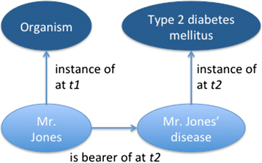
One configuration, six scenarios
correct diagnosis by physician (ideal case),
subsequent correct diagnosis by physician using first diagnosis,
incorrect diagnosis by physician,
coincidentally correct conclusion by layperson (lucky guess),
layperson’s justifiable conclusion,
correct diagnosis by computer-based expert system.
Hogan WR and Ceusters W.
Diagnosis, misdiagnosis, lucky guess, hearsay, and more: an ontological analysis.
Journal of Biomedical Semantics 2016;7(54).

Slide 61
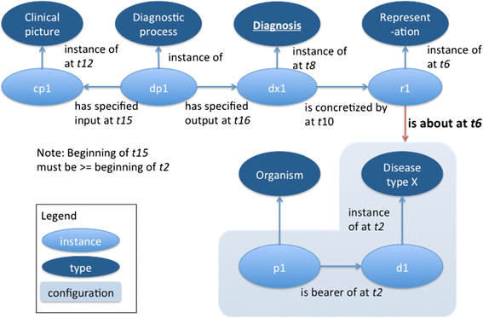
Scenario 1: correct diagnosis by physician
A correct diagnosis is an information content entity that is concretized by a representation that stands in an is_about relation to the configuration of an organism, its disease, the relation of inherence between the disease and the organism, a type that the disease instantiates, and the instantiation relation of the disease to that type, all within a given portion of spacetime.
Hogan WR and Ceusters W.
Diagnosis, misdiagnosis, lucky guess, hearsay, and more: an ontological analysis.
Journal of Biomedical Semantics 2016;7(54).

Slide 62
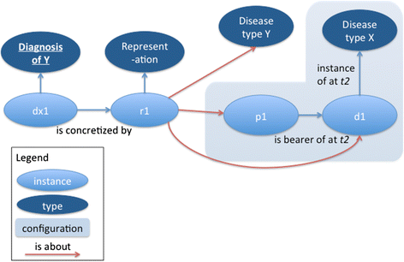
Scenario 3: misdiagnosis
Dr. Miller misdiagnoses Mr. Jones’ type 2 diabetes mellitus as type 1 diabetes mellitus. Because the misdiagnosis is still about Mr. Jones, his disease, the relationship between them, and the type ‘type 1 diabetes mellitus’ on the level of reference, it is an ICE. However, it fails to be about the configuration as a whole on the level of compound expression.
Hogan WR and Ceusters W.
Diagnosis, misdiagnosis, lucky guess, hearsay, and more: an ontological analysis.
Journal of Biomedical Semantics 2016;7(54).

Slide 63
Six possibilities for a diagnosis failing in aboutness on the level of compound expressions
Problem | Where it fails first | Description
Noninstantation, asserted type exists | Level of compound expression | Disease instantiates a different type than the stated type, but the stated type exists
Noninstantation, asserted type does not exist | Level of reference | Disease instantiates a different type than stated, while the stated type of disease does not exist
Disease nonexistence | Level of reference | The disease instance does not exist
Organism nonexistence | Level of reference | The organism instance does not exist. In this case, there could not be a clinical picture properly inferred and thus it is not a misdiagnosis although it could still be an ICE.
Disease non-inherence | Level of compound expression | The disease inheres in a different organism than the one stated. For example, the doctor mistakenly ascribes Mr. Johnson’s hypertension to his twin.
Configuration is not located in that part of spacetime where the diagnosis says it is located. | Level of compound expression | A diagnosis of type 2 diabetes mellitus 5 years ago is wrong because the patient didn’t have the disease at that time, even though the patient has type 2 diabetes today. Also, a diagnosis that the patient has an upper respiratory tract infection today when in reality the infection resolved two weeks ago.
Hogan WR and Ceusters W.
Diagnosis, misdiagnosis, lucky guess, hearsay, and more: an ontological analysis.
Journal of Biomedical Semantics 2016;7(54).

Slide 64
New proposals (1)
clinical history = def. – A series of statements representing health-relevant features of a patient.
clinical history = def. – A series of statements representing one or more health-relevant features of a patient, possibly complemented by representations of diseases and configurations.
Scheuermann R, Ceusters W, Smith B. Toward an Ontological Treatment of Disease and Diagnosis. 2009 AMIA Summit on Translational Bioinformatics, San Francisco, California, March 15-17, 2009;: 116-120. Omnipress ISBN:0-9647743-7-2
Hogan WR and Ceusters W.
Diagnosis, misdiagnosis, lucky guess, hearsay, and more: an ontological analysis.
Journal of Biomedical Semantics 2016;7(54).

Slide 65
New proposals (2)
clinical picture = def. – A representation of a CLINICAL PHENOTYPE that is inferred from the combination of laboratory, image and clinical findings about a given patient.
clinical picture = def. – A representation of a CLINICAL PHENOTYPE that is inferred from a combination of, for example, diagnoses and laboratory, image, and clinical findings about a given patient.
Scheuermann R, Ceusters W, Smith B. Toward an Ontological Treatment of Disease and Diagnosis. 2009 AMIA Summit on Translational Bioinformatics, San Francisco, California, March 15-17, 2009;: 116-120. Omnipress ISBN:0-9647743-7-2
Hogan WR and Ceusters W.
Diagnosis, misdiagnosis, lucky guess, hearsay, and more: an ontological analysis.
Journal of Biomedical Semantics 2016;7(54).

Slide 66
New proposals (3)
is-misrepresentation-of:
domain: representation,
range: portion of reality.
Def: x is-misrepresentation of y iif x is a representation and x is intended to be about y and it is not the case that x is about y.
Hogan WR and Ceusters W.
Diagnosis, misdiagnosis, lucky guess, hearsay, and more: an ontological analysis.
Journal of Biomedical Semantics 2016;7(54).

Slide 67
New proposals (4)
Diagnostic process = def. An interpretive PROCESS that has as input a CLINICAL PICTURE of a given patient and as output an assertion to the effect that the patient has a DISEASE of a certain type.
Diagnostic process = def. An interpretive PROCESS that has as input (1) a CLINICAL PICTURE of a given patient AND (2) an aggregate of REPRESENTATIONs of at least one type of disease and at least one type of phenotype whose instances are associated with instances of that disease, and as output an assertion to the effect that the patient has a DISEASE of a certain type.
Scheuermann R, Ceusters W, Smith B. Toward an Ontological Treatment of Disease and Diagnosis. 2009 AMIA Summit on Translational Bioinformatics, San Francisco, California, March 15-17, 2009;: 116-120. Omnipress ISBN:0-9647743-7-2
Hogan WR and Ceusters W.
Diagnosis, misdiagnosis, lucky guess, hearsay, and more: an ontological analysis.
Journal of Biomedical Semantics 2016;7(54).

