Slide 1
Biomedical Ontology
PHI 548 / BMI 508
Werner Ceusters and Barry Smith

Slide 2
Lecture 6
How to build an ontology
Werner Ceusters and Barry Smith

Slide 3
Lecture 6
Part 2
Some principles for ontology building

Slide 4
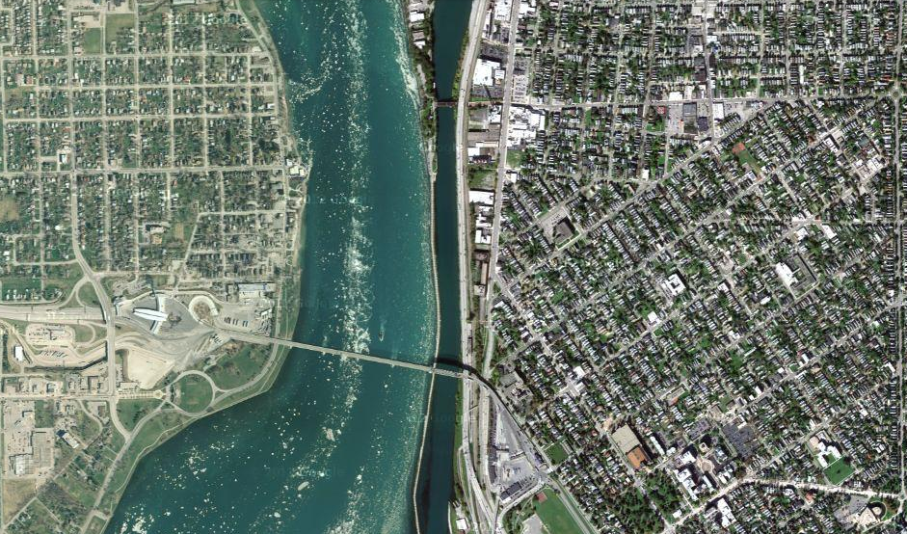
Reality (imagine)

Slide 5
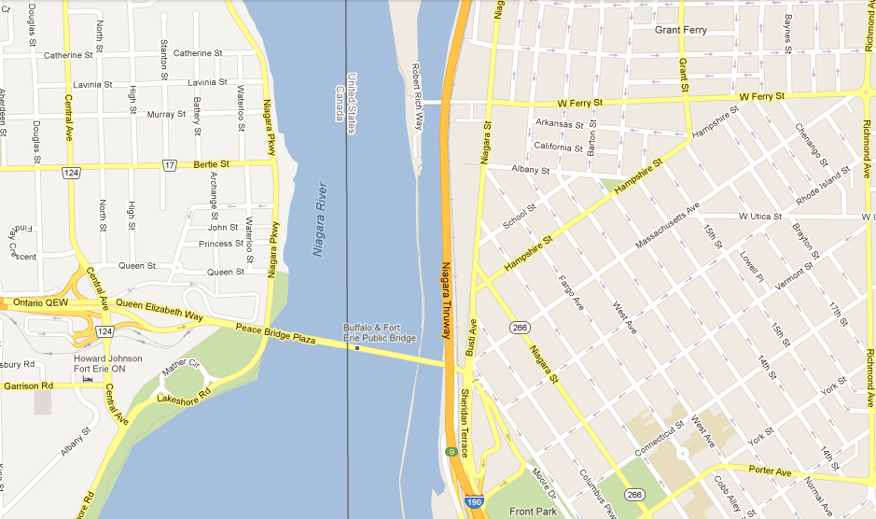
Representation

Slide 6
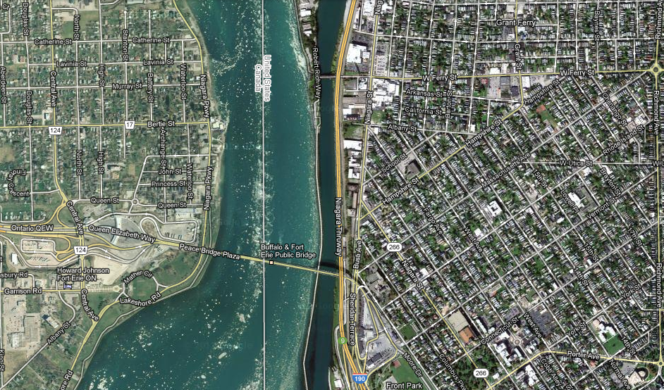
This is the goal of realism-based ontology design!

Slide 7
An ‘ontology’ in this sense is thus:
A representation of some pre-existing domain of reality (a portion of reality) which
  reflects the entities within its domain – and the relations between them – in such a way that there obtains a systematic correlation between reality and the representation itself,
  is intelligible to a domain expert,
  is formalized in a way that allows it to support automatic information processing.
Smith B, Kusnierczyk W, Schober D, Ceusters W. Towards a Reference Terminology for Ontology Research and Development in the Biomedical Domain. Proceedings of KR-MED 2006, Biomedical Ontology in Action, November 8, 2006, Baltimore MD, USA

Slide 8
Some characteristics of an optimal ontology
Each representational unit in such an ontology would designate:
  a single portion of reality (POR), which is
  relevant to the purposes of the ontology and such that
  the authors of the ontology intended to use this unit to designate this POR, and
  there would be no PORs objectively relevant to these purposes that are not referred to in the ontology.
Ceusters W, Smith B. A Realism-Based Approach to the Evolution of Biomedical Ontologies.
Proceedings of AMIA 2006, Washington DC, 2006;:121-125.

Slide 9
This is the goal of realism-based ontology design!
Getting there requires:
Principles
Understanding these principles
Applying these principles

Slide 10
FOCUS

Slide 11
Determine what type of ontology you want to design
Upper level ontologies:
  (should) describe the most generic structure of reality;
Domain ontologies:
  (should) describe the portion of reality that is dealt with in some domain
  Special case: reference ontologies
    (should) describe the domain exhaustively;
Application ontologies:
  To be used in a specific context and to support some specific application.

Slide 12
Example: clinical trial ontologies
As domain ontologies:
  Cover all entity types relevant in the clinical trial domain
As application ontologies:
  A subset of the above which is large enough to support all functions the application has to serve:
    CT protocol development
    Study management
    Data analysis
    …

Slide 13
Analyze the domain carefully
Naturalness:
  A good ontology should include in its basic category scheme only those categories which are instantiated by entities in reality (it should reflect nature at its joints);
  the categories in question should be reflected in scientific texts wherein the general natural language is extended by various technical vocabularies of medical and scientific disciplines;
No theoretical artifacts:
  a good ontology should not include in its basic category scheme artifacts of logical, mathematical or philosophical theories such as:
    transfinite cardinals,
    Continuants ‘at a time’,
    non-existent things (absent nipples, prevented abortions, …)
    functions across possible worlds,
    …

Slide 14
Be clear about your domain of interest
Bad example: ICHD. What is classified in ICHD?
  disorders? ‘The International Classification of Headache Disorders’
  headaches? ‘Many questions not needed in order to classify primary headaches…’
  patients? ‘The second edition will hopefully further promote unity in the way we classify, diagnose and treat headache patients throughout the world.’
  palsies?
  syndromes?
can be assumed from some heading names

Slide 15
ASSISTANCE

Slide 16
Limit the number of developers/contributors
Brooks' law (a claim about software project management):
“adding manpower to a late software project makes it later"
Frederick P. Brooks, Jr. The Mythical Man-Month. 1995 [1975]. Addison-Wesley.

Slide 17
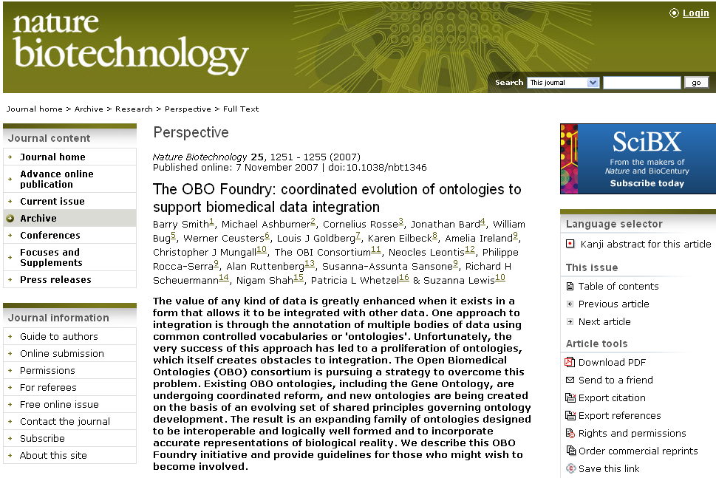
Be lazy in an intelligent way:
Re-use what has been crafted following good principles

Slide 18
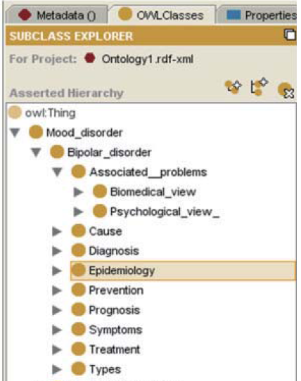
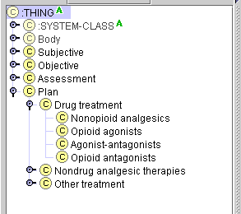
Be extremely critical when re-using.
Some people do not understand the representation language they are using!

Slide 19
NCIT’s “Lung” in OWL
<owl:Class rdf:ID="Lung">
<rdfs:label>Lung</rdfs:label>
<code>C12468</code>
<hasType>primitive</hasType>
<rdfs:subClassOf rdf:resource="#Organ"/>
<rdfs:subClassOf>
<owl:Restriction>
<owl:onProperty
rdf:resource="#rAnatomic_Structure_Has_Location"/>
<owl:someValuesFrom rdf:resource="#Thoracic_Cavity"/>
</owl:Restriction>
</rdfs:subClassOf>
...
</owl>
This is a claim that all lungs are in the Thoracic Cavity, thus denies the existence of lung removal.

Slide 20
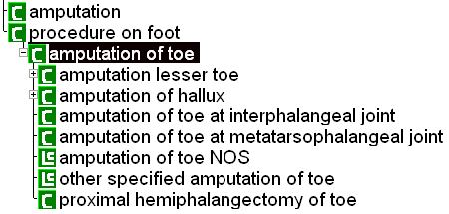

Do not have blind faith in computation
SNOMED-RT (2000)
SNOMED-CT (2003)

Slide 21
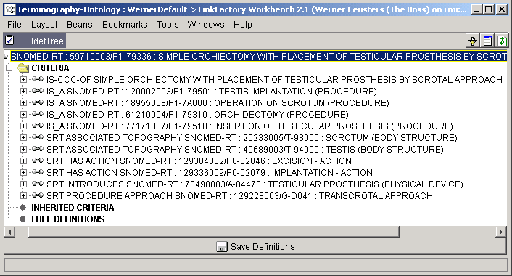
Do not have blind faith in computation

Slide 22
DEFINITIONS

Slide 23
Three purposes for definitions
to specify the conditions that must be satisfied in some community for a term to be an acceptable designator for an entity;
  → A terminological issue
to describe the ways in which entities of one type differ from entities of another type
  → Primarily about universals
to provide assistance in determining what type a specific entity belongs to.
  → Primarily to determine instantiation of particulars

Slide 24
Avoid circularity in definitions
Ingredient (BRIDG logical model p507)
Status: Proposed. Version 1.0. Phase 1.0.
Package: Adverse Event Keywords:
Detail: Created on 03/01/2006. Last modified on 03/01/2006.
GUID: {7D53B2A1-CEC4-49ae-8BD6-611E2CF4D862}
A substance that acts as an ingredient within a product. Note, that ingredients may also have ingredients.

Slide 25
Use Aristotelian definitions.
A
  B isa A which X
    C isa B which Y
    D isa C which Z
Make sure that X holds for C and that both X and Y hold for D.
Use this also in label formation to prevent, f.i.,
  ‘13.3 Nervus Intermedius (Facial Nerve) Neuralgia’ ‘13.3.2. Secondary Nervus Intermedius Neuropathy attributed to Herpes Zoster’

Slide 26
Clinical criteria do not replace Aristotelian definitions
‘13.1.1.1 Classical trigeminal neuralgia, purely paroxysmal’, has the criterion ‘at least three attacks of facial pain fulfilling criteria B-E’.
This does not mean: a patient with 2 such attacks does not exhibit this type of neuralgia;
It rather means: do not diagnose the patient (yet) as exhibiting this type of neuralgia.
If ‘chronic pain’ is defined as ‘pain lasting longer than three months’, at what point in time starts a patient to have that type of pain?

Slide 27
Make it clear whether assertions are about particulars or types
‘Persistent idiopathic facial pain (PIFP)’
  = ‘persistent facial pain with varying presentations …’
persistent
facial pain
presentation
type1
presentation
type2
presentation
type3
types
t₂
t₃
t₁
t₁
t₁
t₂
t₂
t₃
t₁
t₃
parti-
culars
t₁
t₂
t₂
t₁
t₃
t₂
t₃
t₃
my pain
her pain
his pain

Slide 28
Make it clear whether assertions are about particulars or types
‘Persistent idiopathic facial pain (PIFP)’
  = ‘persistent facial pain with varying presentations …’
  if the description is about types, then the three particular pains fall under PIFP.
  if the description is about (arbitrary) particulars, then only her pain falls under PIFP.

Slide 29
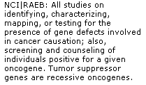

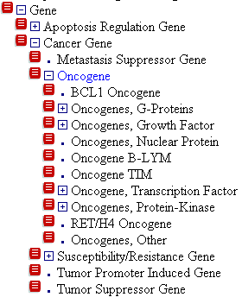
Let definitions reflect what is in the taxonomy

Slide 30
CONSISTENCY

Slide 31
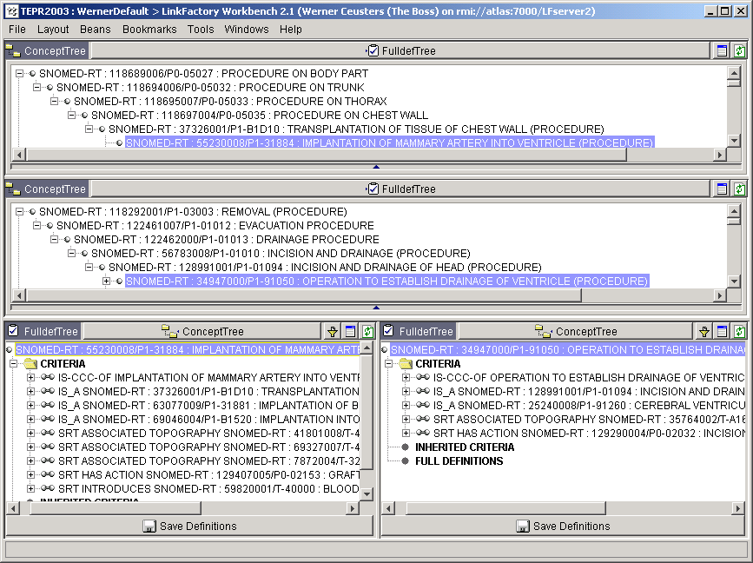
Use terminology consistently
cardiac ventricle
cerebral ventricle

Slide 32
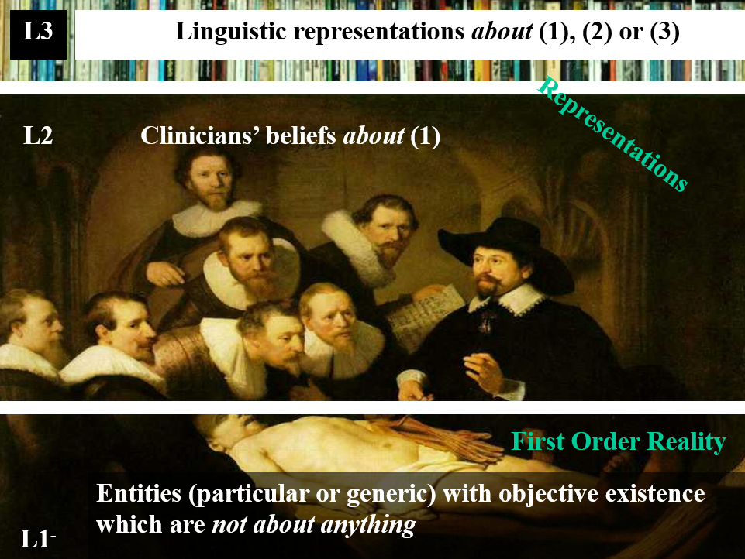
Keep the 3 levels of reality in mind

Slide 33
Separate knowledge from what it is about.
‘13.1.2.4 Painful trigeminal neuropathy attributed to MS plaque’
‘attributed to’ relates to somebody’s opinion about what is the case, not to what is the case.
  the mistake: a feature on the side of the clinician – his (not) knowing - is taken to be a feature on the side of the patient.
Similar mistakes:
  ‘Probable migraine’
  ‘facial pain of unknown origin’ (not in ICHD).

Slide 34
Don’t confuse the act of observing with what the observation is directed at
Old BRIDG definition of adverse event:
An observation of a change in the state of a subject that is assessed as being untoward by one or more interested parties within the context of protocol-driven research or public health.

Slide 35
Neither confuse descriptions with what they are about
Type: Class PerformedActivity
Status: Proposed. Version 1.0. Phase 1.0.
Package: CTOM Elements Keywords:
Detail: Created on 01/05/2005. Last modified on 12/14/2006.
GUID: {2289C0E8-855D-42e3-86FA-2ECBE59D8982}
The description of applying, dispensing or giving agents or medications to subjects.

Slide 36
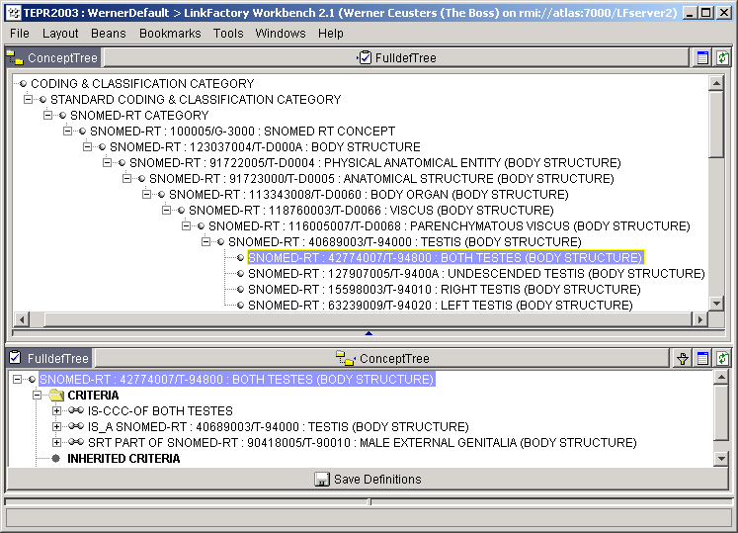
Be careful with mereological sums

Slide 37
Maintain a strict subsumption hierarchy
13.1. Trigeminal Neuralgia
  13.1.2 Painful Trigeminal Neuropathy
ICHD definitions:
  ‘neuralgia’ = pain in the distribution of nerve(s)
  ‘pain’ = a sensorial and emotional experience ...
  ‘neuropathy’ = a disturbance of function or pathological change in a nerve.
Several mismatches:
  (1) and (2): neuralgia is a sensorial and emotional experience in the distribution of nerve(s) ?
  (1) and (3): with much of goodwill, one could accept neuropathy to subsume neuralgia, but chapter 13 claims the opposite for the trigeminal case.
subsumes?

Slide 38
Class descriptions should be consistent with class labels
‘13.1.2.4 Painful Trigeminal neuropathy attributed to MS plaque’:
  described as ‘Trigeminal neuropathy induced by MS plaque’.
    attributed ←→ induced
    reference to pain missing in the description

Slide 39
Do not use names with a precise meaning in general language to designate entities which are of a more specific or totally different type in the context of a specific application
Animal (BRIDG logical model p526)
Type: Class InvestigatedParty
Status: Proposed. Version 1.0. Phase 1.0.
Package: InvestigatedSubject Keywords:
Detail: Created on 03/10/2006. Last modified on 03/10/2006.
GUID: {996CB91C-04EC-4b1d-9AFF-57B878D532D7}
A non-person living entity which is chosen to be the subject of an investigation, or which is the subject of an implicated act.

