Slide 1
Ontological Realism in Research: Principles and Application.
Lecture for BMI504:
Data Analysis, and Research Methods in Biomedical Informatics
April 6, 2016
University at Buffalo, Medical Campus
Werner CEUSTERS, MD
Ontology Research Group, Center of Excellence in Bioinformatics and Life Sciences,
UB Institute for Healthcare Informatics,
Departments of Biomedical Informatics and Psychiatry,
University at Buffalo, NY, USA

Slide 2
Lecture overview
Introduction to philosophical basis of research
  Special focus on Ontological Realism
Discussion of issues in biomedical informatics
  Statistical data analysis
  Maintaining a distinction between data and what data are about
  Information models
  Data management
  The notion of ‘biomarkers’
  ‘Mental disease’
  Extraterrestrial research

Slide 3
Philosophical basis

Slide 4
Four notions of ‘ontology’ as a study
(O1) the study of ontological commitment, i.e. what we or others are committed to,
(O2) the study of what there is,
(O3) the study of the most general features of what there is, and how the things there are relate to each other in the metaphysically most general ways,
(O4) the study of meta-ontology, i.e. saying what task it is that the discipline of ontology should aim to accomplish, if any, how the questions it aims to answer should be understood, and with what methodology they can be answered.
http://plato.stanford.edu/entries/logic-ontology/#DifConOnt

Slide 5


The basis of Ontological Realism (O.R.)
There is an external reality which is ‘objectively’ the way it is;
That reality is accessible to us;
We build in our brains cognitive representations of reality;
We communicate with others about what is there, and what we believe there is there.
Smith B, Kusnierczyk W, Schober D, Ceusters W. Towards a Reference Terminology for Ontology Research and Development in the Biomedical Domain. Proceedings of KR-MED 2006, Biomedical Ontology in Action, November 8, 2006, Baltimore MD, USA

Slide 6
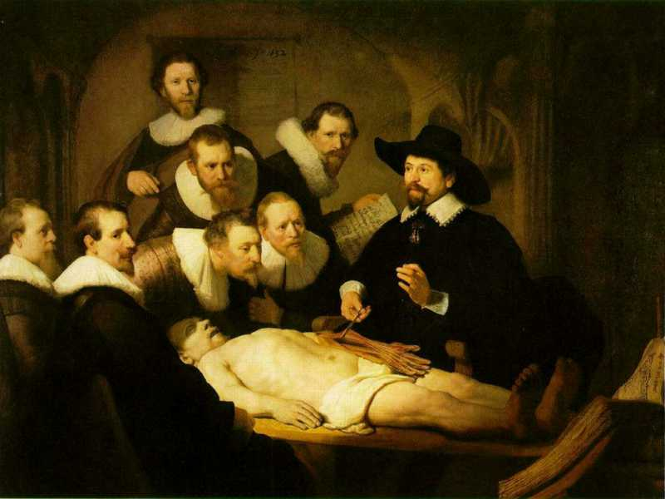
L3
Linguistic representations about (L1⁻), (L2) or (L3)
L2
Beliefs about (1)
Representations
First Order Reality
Entities (particular or generic) with objective existence which are not about anything
L1⁻

Slide 7
Definition of ‘research’
careful or diligent search
studious inquiry or examination; especially :
investigation or experimentation
aimed at
- the discovery and interpretation of facts,
- revision of accepted theories or laws in the light of new facts,
- or practical application of such new or revised theories or laws
the collecting of information about a particular subject
http://www.merriam-webster.com/dictionary/research

Slide 8
Definition of ‘research’
Keywords?
careful or diligent search
studious inquiry or examination; especially :
investigation or experimentation
aimed at
- the discovery and interpretation of facts,
- revision of accepted theories or laws in the light of new facts,
- or practical application of such new or revised theories or laws
the collecting of information about a particular subject
http://www.merriam-webster.com/dictionary/research

Slide 9
Definition of ‘research’
keywords
careful or diligent search
studious inquiry or examination; especially :
investigation or experimentation
aimed at
- the discovery and interpretation of facts,
- revision of accepted theories or laws in the light of new facts,
- or practical application of such new or revised theories or laws
the collecting of information about a particular subject
http://www.merriam-webster.com/dictionary/research

Slide 10
Keywords in research
Discovery:
  D1: there is something existing which is prior to our knowing about its existence.
  D2: There is something we come to know we didn’t know before

Slide 11
Keywords in research
Discovery:
  D1: there is something existing which is prior to our knowing about it.
  D2: There is something we come to know we didn’t know before
Facts:
  F1: I am currently teaching
  F2: ‘I am currently teaching’
  F3: 2 + 2 = 4

Slide 12
Keywords in research
Discovery:
  D1: there is something existing which is prior to our knowing about it.
  D2: There is something we come to know we didn’t know before
Facts:
  F1: I am currently teaching → D1 L1⁻
  F2: ‘I am currently teaching’ → D1 & D2 L3/L1⁻
  F3: 2 + 2 = 4 → D2 L3

Slide 13
Keywords in research
Discovery:
  D1: there is something existing which is prior to our knowing about it.
  D2: There is something we come to know we didn’t know before
Facts:
  F1: I am currently teaching → D1 L1⁻
  F2: ‘I am currently teaching’ → D1 & D2 L3/L1⁻
  F3: 2 + 2 = 4 → D2 L3
Interpretation:
  F1 is truth-maker for F2 when F2 is uttered when F1 is happening
  F1 is truth-maker for ‘I was teaching’ when uttered after F1 ceased to be the case.
  What is the truth-maker for F3?

Slide 14
Four notions of Logic
(L1) the study of artificial formal languages
→ e.g. properties of predicate logic studied in model theory
(L2) the study of formally valid inferences and logical consequence
→ e.g. IF A then B:
A, therefor: B
not B, therefor: not A
(L3) the study of logical truths
the most general truths, ones that are contained in any other body of truths that any other science aims to describe
(L4) the study of the general features, or form, of judgements (Kant)

Slide 15
Definition of ‘science’
3a : knowledge or a system of knowledge covering general truths or the operation of general laws especially as obtained and tested through scientific method
3b : such knowledge or such a system of knowledge concerned with the physical world and its phenomena: natural science
http://www.merriam-webster.com/dictionary/science

Slide 16
Definition of ‘science’
3a : knowledge or a system of knowledge covering general truths or the operation of general laws especially as obtained and tested through scientific method
3b : such knowledge or such a system of knowledge concerned with the physical world and its phenomena: natural science
http://www.merriam-webster.com/dictionary/science

Slide 17
The Scientific Method
principles and procedures for the systematic pursuit of knowledge involving the recognition and formulation of a problem, the collection of data through observation and experiment, and the formulation and testing of hypotheses

Slide 18
The Scientific Method
principles and procedures for the systematic pursuit of knowledge involving the recognition and formulation of a problem, the collection of data through observation and experiment, and the formulation and testing of hypotheses
http://www.merriam-webster.com/dictionary/scientific%20method

Slide 19
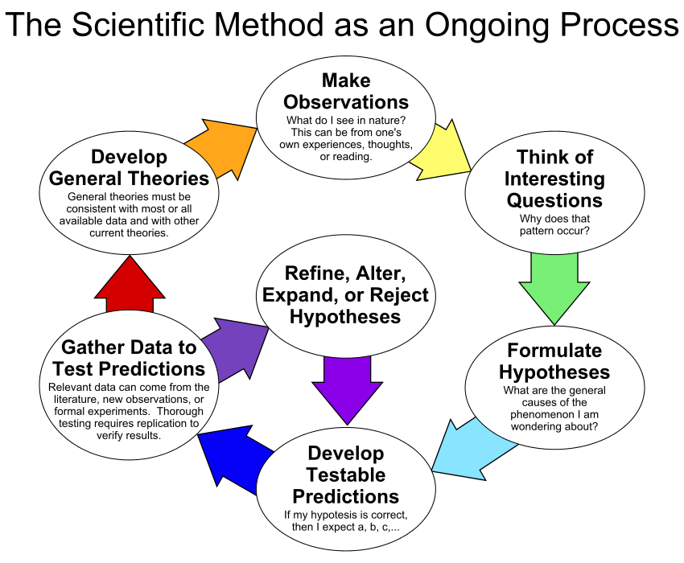
By ArchonMagnus - Own work, CC BY-SA 4.0, https://commons.wikimedia.org/w/index.php?curid=42164616

Slide 20
Quantitative research
In natural sciences and social sciences, quantitative research is the systematic empirical investigation of observable phenomena via statistical, mathematical or computational techniques.
https://en.wikipedia.org/wiki/Quantitative_research
Qualitative research
Qualitative Research is primarily exploratory research used to gain an understanding of underlying reasons, opinions, and motivations. It provides insights into the problem or helps to develop ideas or hypotheses for potential quantitative research.
http://www.snapsurveys.com/blog/what-is-the-difference-between-qualitative-research-and-quantitative-research/

Slide 21
Qualitative vs. quantitative research
Qualitative research emphasizes the importance of looking at variables in the natural setting in which they are found. Interaction between variables is important. Detailed data is gathered through open ended questions that provide direct quotations. The interviewer is an integral part of the investigation (Jacob, 1988). This differs from quantitative research which attempts to gather data by objective methods to provide information about relations, comparisons, and predictions and attempts to remove the investigator from the investigation (Smith, 1983).
http://www.okstate.edu/ag/agedcm4h/academic/aged5980a/5980/newpage21.htm

Slide 22
Characteristics of qualitative research
Purpose | Understanding - Seeks to understand people’s interpretations.
Reality | Dynamic - Reality changes with changes in people’s perceptions.
Viewpoint | Insider - Reality is what people perceive it to be.
Values | Value bound - Values will have an impact and should be understood and taken into account when conducting and reporting research.
Focus | Holistic - A total or complete picture is sought.
Orientation | Discovery - Theories and hypotheses are evolved from data as collected.
Data | Subjective - Data are perceptions of the people in the environment.
Instrumentation | Human - The human person is the primary collection instrument.
Conditions | Naturalistic - Investigations are conducted under natural conditions.
Results | Valid - The focus is on design and procedures to gain "real," "rich," and "deep" data.
http://www.okstate.edu/ag/agedcm4h/academic/aged5980a/5980/newpage21.htm

Slide 23
Realism
Generic Realism (on some subject matter):
a, b, and c and so on exist,
and the fact that they exist and have properties such as F-ness, G-ness, and H-ness is (apart from mundane empirical dependencies of the sort sometimes encountered in everyday life) independent of anyone's beliefs, linguistic practices, conceptual schemes, and so on.
http://plato.stanford.edu/entries/realism/

Slide 24
Scientific Realism
Three dimensions:
Metaphysically:
Semantically:
Epistemologically:
http://plato.stanford.edu/entries/scientific-realism/#WhaSciRea

Slide 25
Relevant disciplines and theories
Ontology
by some philosophers taken to be synonymous with ‘metaphysics’ while others draw distinctions in many distinct ways but almost agreeing on the following classification:
  metaphysics
    general metaphysics
      ontology
    special metaphysics
‘epistemology’:
‘terminology’ (as part of ‘semantics’):

Slide 26
Relevant disciplines and theories
Ontology (no plural) is the study of what entities exist and how they relate to each other;
by some philosophers taken to be synonymous with ‘metaphysics’ while others draw distinctions in many distinct ways but almost agreeing on the following classification:
  metaphysics → studies ‘how is the world?’
    general metaphysics → studies general principles and ‘laws’ about the world
      ontology → studies what type of entities exist in the world
    special metaphysics → focuses on specific principles and entities
‘epistemology’: the study of how we can come to know about what exists.
‘terminology’ (as part of ‘semantics’): the study of what terms mean and how to name things.

Slide 27
Distinct questions. What type are they of?
Terminological:
  what does ‘pain’ mean ?
Metaphysical:
  what have all pains in common in virtue of which they are pains?
Ontological:
  what type of entity is pain?
Onto-terminological:
  what, if anything at all, does ‘pain’ denote?
Epistemological:
  how can we find out whether something is pain?

Slide 28
Scientific Realism
Three dimensions:
Metaphysically: commits to the mind-independent existence of the world investigated by the sciences.
Semantically: commits to a literal interpretation of scientific claims about the world. Claims about scientific entities, processes, properties, and relations, whether they be observable or unobservable, should be construed literally as having truth values, whether true or false.
Epistemologically: commits to the idea that theoretical claims (interpreted literally as describing a mind-independent reality) constitute knowledge of the world.
http://plato.stanford.edu/entries/scientific-realism/#WhaSciRea

Slide 29
Scientific Realism
Our best scientific theories give true or approximately true descriptions of observable and unobservable aspects of a mind-independent world.
http://plato.stanford.edu/entries/scientific-realism/#WhaSciRea

Slide 30
Scientific Objectivity (1)
Objectivity as Faithfulness to Facts
Objectivity as Absence of Normative Commitments and the Value-Free Ideal
Objectivity as Freedom from Personal Biases
  Measurement and Quantification
  Inductive and Statistical Inference

Slide 31
Scientific Objectivity (2)
Science is objective in that, or to the extent that:
its products—theories, laws, experimental results and observations—constitute accurate representations of the external world. The products of science are not tainted by human desires, goals, capabilities or experience.
  product objectivity
the processes and methods that characterize it neither depend on contingent social and ethical values, nor on the individual bias of a scientist
  → process objectivity.
http://plato.stanford.edu/entries/scientific-objectivity

Slide 32
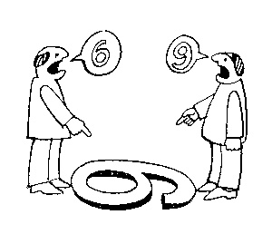
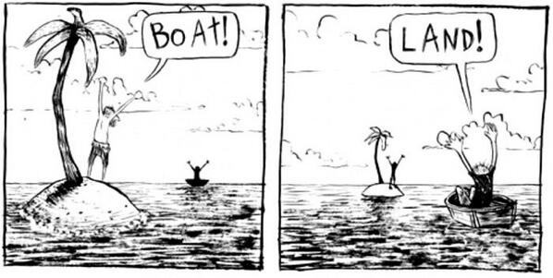
The view from nowhere
There are two kinds of qualities: ones that vary with the perspective one has or takes, and ones that remain constant through changes of perspective. The latter are the objective properties.
http://plato.stanford.edu/entries/scientific-objectivity

Slide 33
The view from nowhere
Nagel’s 3-step conception:
realize (or postulate) that our perceptions are caused by the actions of things on us, through their effects on our bodies.
realize (or postulate) that since the same properties that cause perceptions in us also have effects on other things and can exist without causing any perceptions at all, their true nature must be detachable from their perspectival appearance and need not resemble it.
form a conception of that “true nature” independently of any perspective.
http://plato.stanford.edu/entries/scientific-objectivity
Nagel, T., 1986, The View From Nowhere, New York, NY: Oxford University Press.

Slide 34
Impact of value(s) on science
the choice of a scientific research problem;
the gathering of evidence in relation to the problem;
the acceptance of a scientific hypothesis or theory as an adequate answer to the problem on the basis of the evidence;
the proliferation and application of scientific research results.
(Weber 1917 [1988]).
http://plato.stanford.edu/entries/scientific-objectivity

Slide 35
Value types
Scientific values:
  Accuracy, simplicity, …
Epistemic (or cognitive) values:
  predictive accuracy, scope, unification, explanatory power, coherence with other accepted theories, …
contextual (non-cognitive) values:
  moral, personal, social, political and cultural values such as pleasure, justice and equality, conservation of the natural environment, diversity, …
http://plato.stanford.edu/entries/scientific-objectivity

Slide 36
Three theses
Value-Free Ideal (VFI):
    Scientists should strive to minimize the influence of contextual values on scientific reasoning, e.g., in gathering evidence and assessing/accepting scientific theories.
    scientific objectivity is characterized by absence of contextual values and by exclusive commitment to epistemic values in scientific reasoning
Value-Neutrality Thesis (VNT):
    Scientists can—at least in principle—gather evidence and assess/accept theories without making contextual value judgments.
Value-Laden Thesis (VLT):
    Scientists cannot gather evidence and assess/accept theories without making contextual value judgments.
http://plato.stanford.edu/entries/scientific-objectivity

Slide 37
Inductive and Statistical Inference
No statistical theory of evidence manages to eliminate all sources of personal bias and idiosyncrasy.
    The Bayesian is honest about it: subjective assumptions are ineliminable from scientific reasoning. Bayesian inductive logic tells you how to change your own attitudes as soon as you encounter evidence.
    The likelihoodist has perhaps the “purest” model of objective statistical evidence, but also the one with the most restricted scope.
    The frequentist conception based on p-values still dominates statistical practice, but it suffers from several conceptual drawbacks, and in particular the misleading impression of objectivity.
http://plato.stanford.edu/entries/scientific-objectivity

Slide 38
Evidence-based medicine
Evidence-based medicine de-emphasizes intuition, unsystematic clinical experience, and pathophysiological rationale as sufficient grounds for clinical decision making and stresses the examination of evidence from clinical research.
‘Evidence’ = analyses of the results of randomized controlled trials (RCTs) which attempt to eliminate selection bias.
Judgment still required to assess the extent to which a patient is similar to the study subjects
http://plato.stanford.edu/entries/scientific-objectivity

Slide 39
Statistical data analysis

Slide 40

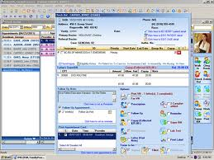
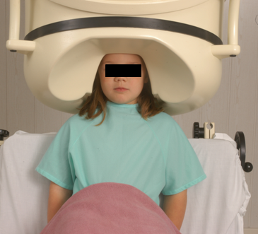

Clinical data registration and use
Register in EHR
observation &
measurement
research
Δ = outcome
application

Slide 41
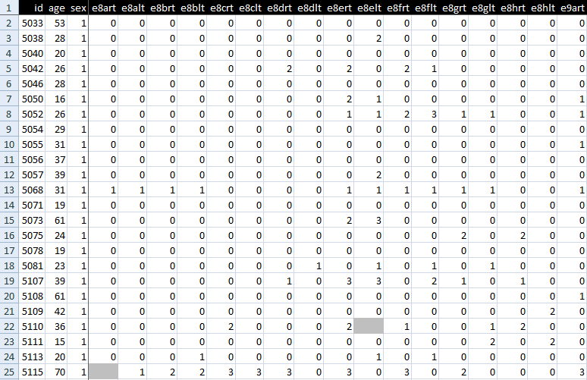
An EHR data collection

Slide 42
Standard approach in data analysis
Cases | Characteristics
 | ch1 | ch2 | ch3 | ch4 | ch5 | ch6 | ...
case1
case2
case3
case4
case5
case6
...
phenotypic
genotypic
treatment
outcome …

Slide 43
Standard approach in data analysis (1)
Cases | Characteristics
 | ch1 | ch2 | ch3 | ch4 | ch5 | ch6 | ...
case1
case2
case3
case4
case5
case6
...
finding correlations
phenotypic
genotypic
treatment
outcome …

Slide 44
Standard approach in data analysis (2)
Cases | Characteristics
 | ch1 | ch2 | ch3 | ch4 | ch5 | ch6 | ...
case1
case2
case3
case4
case5
case6
...
{
finding correlations
therefore
expectation
phenotypic
genotypic
treatment
outcome …

Slide 45
Standard approach in data analysis (3)
Cases | Characteristics
 | ch1 | ch2 | ch3 | ch4 | ch5 | ch6 | ...
case1
case2
case3
case4
case5
case6
...
generalization ?
{
finding correlations
therefore
expectation
phenotypic
genotypic
treatment
outcome …

Slide 46
Is it that easy?
A clinician runs a query over his electronic health record system to create two groups of patients:
those who have higher average blood pressures in winter than in summer, and
those with no seasonal difference in average blood pressure.
He then checks both groups for their drinking habits and finds that the group with higher winter blood pressures has a higher percentage of rum drinkers than the other group. Which of the following conclusions can he make?
high blood pressure causes people to drunk rum in winter;
rum causes people to have higher blood pressure, both in winter and summer;
cold weather makes people drink more rum, and also increases their blood pressure;
all of the above are valid conclusions;
none of the above are valid conclusions.

Slide 47
Correlation vs. Causality
A clinician runs a query over his electronic health record system to create two groups of patients:
those who have higher average blood pressures in winter than in summer, and
those with no seasonal difference in average blood pressure.
He then checks both groups for their drinking habits and finds that the group with higher winter blood pressures has a higher percentage of rum drinkers than the other group. Which of the following conclusions can he make?
high blood pressure causes people to drunk rum in winter;
rum causes people to have higher blood pressure, both in winter and summer;
cold weather makes people drink more rum, and also increases their blood pressure;
all of the above are valid conclusions;
none of the above are valid conclusions.

Slide 48
Question
There is a test for a disease for which:
the rate of false negatives (negative results in cases where the disease is present) is zero, and
the rate of false positives (positive results in cases where the disease is absent) is one in ten (that is, disease-free individuals test positive 10% of the time).
If one tests positive, what are the chances that one has the disease?

Slide 49
Question
There is a test for a disease for which:
the rate of false negatives (negative results in cases where the disease is present) is zero, and
the rate of false positives (positive results in cases where the disease is absent) is one in ten (that is, disease-free individuals test positive 10% of the time).
If one tests positive, what are the chances that one has the disease?
90% ?

Slide 50
Base rate fallacy
There is a test for a disease for which:
the rate of false negatives is zero, and
the rate of false positives is one in ten.
If one tests positive, what are the chances that one has the disease?
The actual probability depends on some further, crucial information: the base rate of the disease in the population (the proportion of people having it). The lower the incidence of the disease at large, the lower the probability that a positive result signals the presence of the disease.
http://plato.stanford.edu/entries/scientific-realism/#WhaSciRea

Slide 51
Pitfalls in statistics
Three broad categories:
  Sources of bias.
    These are conditions or circumstances which affect the external validity of statistical results.
  Errors in methodology,
    which can lead to inaccurate or invalid results.
  Interpretation errors,
    misapplication of statistical results to real world issues.

Slide 52
Example: confounding in epidemiology
Confounders are:
  not part of the real association between exposure and disease,
  predictors of disease,
  unequally distributed between exposure groups.
Example: grey hair
  take from the street the first 100 people you encounter with grey hair and the first 100 that don’t have grey hair;
  check them for heart disease;
  you will very likely find that there are significantly more people in the grey hair group that have heart disease than in the other group because
  both grey hair and heart disease are more prevalent in elderly;
  therefore (?): grey hair causes heart disease (or the other way round?)

Slide 53
Some strategies to reduce confounding
randomization (distribute - known and measurable - confounders between study groups)
restriction (restrict entry to study of individuals with confounding factors
  risks: introduce bias
matching, stratification, adjustment, …
  → check your course in medical statistics,
    if you didn’t take one: shame on you.

Slide 54
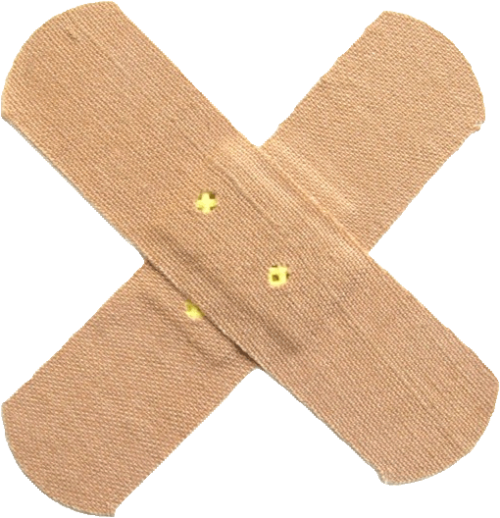
However !

Slide 55
Maintaining a distinction between data and what data are about

Slide 56
Correlation with reality
What type of relationship is there between data items and the part of reality they are obtained from?
What, if anything at all, do variable names in header rows correspond to?
Do correlations between data items mimic the relationships between the entities in reality the data items are obtained from?

Slide 57

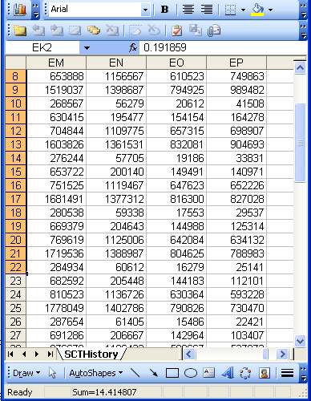
A non-trivial relation
Referents
References

Slide 58

For instance: source and impact of changes
Are differences in data about the same entities in reality at different points in time due to:
  changes in first-order reality ?
  changes in our understanding of reality ?
  inaccurate observations ?
  differences in perspectives ?
  registration mistakes ?
Ceusters W, Smith B. A Realism-Based Approach to the Evolution of Biomedical Ontologies. AMIA 2006 Proceedings, Washington DC, 2006;:121-125. http://www.referent-tracking.com/RTU/sendfile/?file=CeustersAMIA2006FINAL.pdf

Slide 59
What makes it non-trivial?
Referents
  are (meta-) physically the way they are,
  relate to each other in an objective way,
  follow laws of nature.
Window on reality
  restricted by:
  what is physically and technically observable,
  fit between what is measured and what we think is measured,
  fit between established knowledge and laws of nature.
References
  follow, ideally, the syntactic-semantic conventions of some representation language,
  are restricted by the expressivity of that language,
  to be interpreted correctly, reference collections need external documentation.

Slide 60
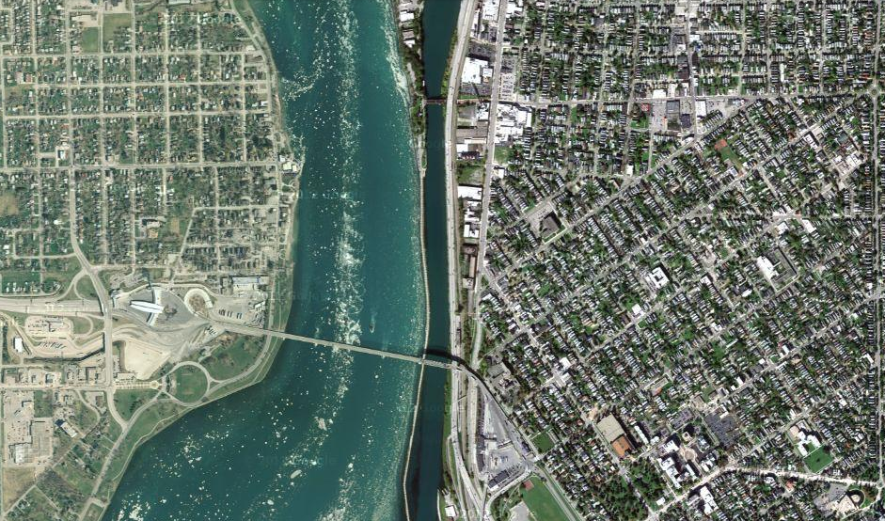
Satellite view

Slide 61
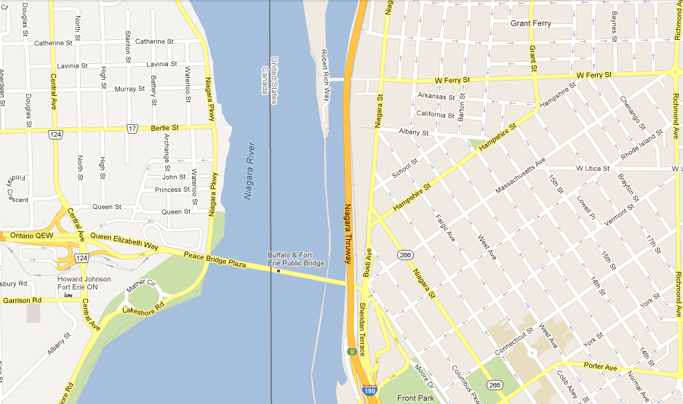
Map

Slide 62
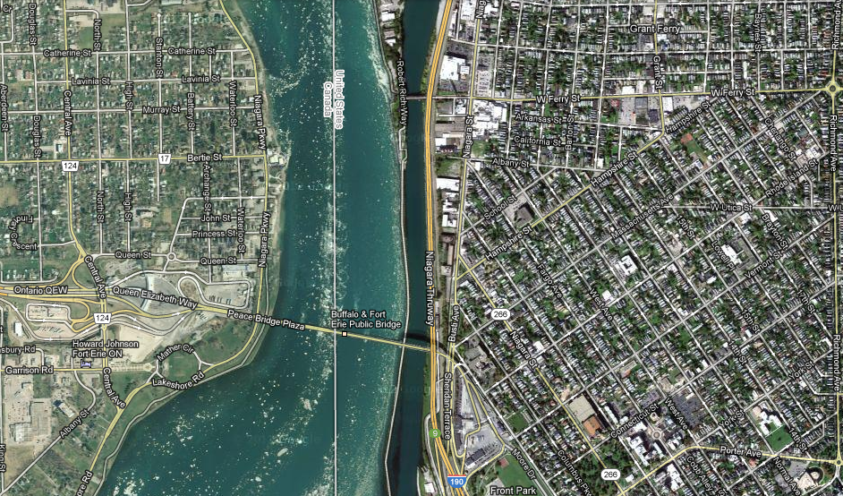
Map overlay

Slide 63
Main data ←→ reality views
Nominalism:
  there are no generic entities in reality: there is no ‘personhood’, there are only individual persons.
Conceptualism:
  generalizations are in our minds. ‘personhood’ is a concept construed in our mind that allows us to reason about persons without any particular person in mind.
Realism:
  generic entities do exist and are called ‘universals’. Each particular person is an instance of the universal we call ‘person’.

Slide 64
Main data ←→ reality views
Nominalism:
  there are no generic entities in reality: there is no ‘personhood’, there are only individual persons.
Conceptualism: ← mainstream approach
  generalizations are in our minds. ‘personhood’ is a concept construed in our mind that allows us to reason about persons without any particular person in mind.
Realism: ← our approach
  generic entities do exist and are called ‘universals’. Each particular person is an instance of the universal we call ‘person’.

Slide 65
Conceptualism versus Ontological Realism
First order reality
concept
universal
term
referent
representational
unit
particular
Conceptualism
Ontological Realism

Slide 66
What is out there …
(… we want/need to deal with)?
portions of reality
relations
configurations
?
participation
me participating in my life
universals
entities
?
particulars
continuants
occurrents
me
my life
organism

Slide 67
The essential pieces
dependent continuant
material
object
spacetime
region
spatial
region
temporal
region
history
t
t
instanceOf
t
participantOf at t
occupies
some temporal region
some quality
my life
my 4D STR
projectsOn
me
… at t
projectsOn at t
some spatial
region
located-in at t

Slide 68
Ambiguities: are assertions about particulars or types?
‘Persistent idiopathic facial pain (PIFP)’
  = ‘persistent facial pain with varying presentations …’
persistent
facial pain
presentation
type1
presentation
type2
presentation
type3
types
t₂
t₃
t₁
t₁
t₁
t₂
t₂
t₃
t₁
t₃
parti-
culars
t₁
t₂
t₂
t₁
t₃
t₂
t₃
t₃
my pain
her pain
his pain

Slide 69
Ambiguities: are assertions about particulars or types?
‘Persistent idiopathic facial pain (PIFP)’
  = ‘persistent facial pain with varying presentations …’
  if the description is about types, then the three particular pains fall under PIFP.
  if the description is about (arbitrary) particulars, then only her pain falls under PIFP.

Slide 70
Information models

Slide 71
Major problem with EHRs for data analysis
The information model behind current EHRs is optimized for individual patient care, reflecting ‘care models’, without being a faithful model of how medical reality is structured in its entirety.
data
organization
observation &
measurement
Δ = outcome
application

Slide 72
EHR Information Models (simplified)
diagnosis
finding
finding
patient
patient
encounter
drug
drug
diagnosis

Slide 73
EHR Information Models (simplified)
condition
problem
?
episode
?
finding
?
patient
encounter
drug
diagnosis

Slide 74
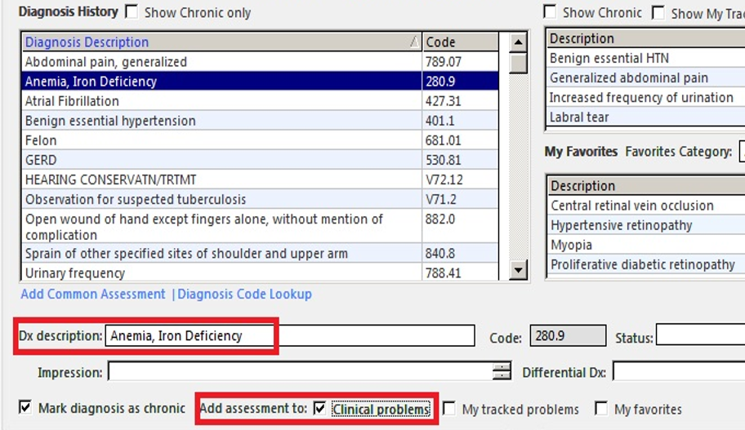
What are the referents ?
Are there really ‘chronic diagnoses’, or is it diseases that are chronic ?
http://incerio.com/planning-nextgen-version-5-8-upgrade-things-know-diagnosis-module/

Slide 75
What are the referents ?
Whose problems and favorites are intended here: the patient’s or the clinician’s?
http://incerio.com/planning-nextgen-version-5-8-upgrade-things-know-diagnosis-module/

Slide 76
Idiosyncrasies in relation to diagnoses
Diagnostic uncertainty
  Diagnosis may be recorded when there is only a suspicion of disease
  Some overlapping clinical conditions are difficult to distinguish reliably
  Patients may only partially fit diagnostic criteria
  Patients in whom diagnostic testing is done but is negative are still more likely to have disease
Diagnostic timing
  Repeated diagnosis codes over time may represent a new event or a follow-up to an earlier event
  First diagnosis in a database is not necessarily an incident case of disease
Hersh, WR, Weiner, MG, et al. (2013).
Caveats for the use of operational electronic health record data in comparative effectiveness research. Medical Care. 51(Suppl 3): S30-S37.

Slide 77
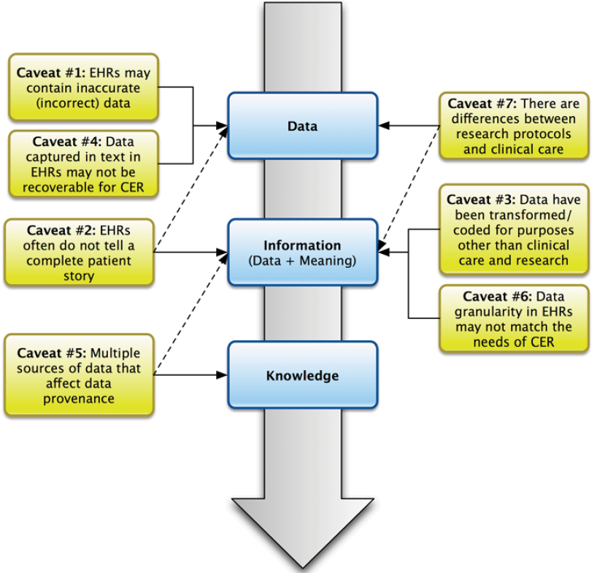
Caveats from a traditional informatics perspective
Hersh, WR, Weiner, MG, et al. (2013). Caveats for the use of operational electronic health record data in comparative effectiveness research. Medical Care. 51(Suppl 3): S30-S37.

Slide 78
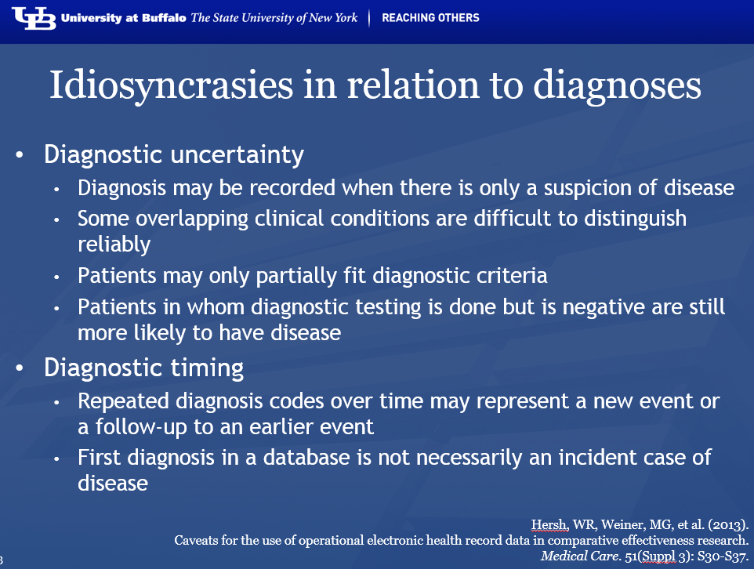
Remember
Most of them are due to failures in acknowledging the L1-L2-L3/generic-specific distinctions !!!

Slide 79
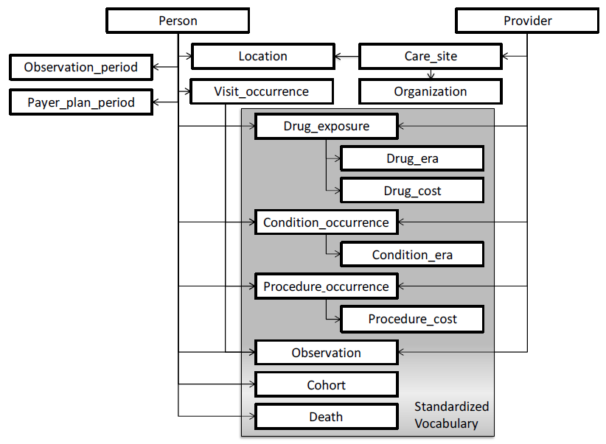
This is not just in EHRs, but also in ‘standards’ for information exchange and data aggregation, eg. OMOP
Condition Occurrence: a diagnosis or condition that has been recorded about a person at a certain time:
→ confuses two types: the diagnosis, and the condition about which a diagnosis is made.
Observational Medical Outcomes Partnership Common Data Model Specifications Version 4.0

Slide 80
This is not just in EHRs, but also in ‘standards’ for information exchange and data aggregation, eg. OMOP
Drug Exposure: Association between a Person and a Drug at a specific time
→ confuses two particulars: the drug and the exposure
Observational Medical Outcomes Partnership Common Data Model Specifications Version 4.0

Slide 81
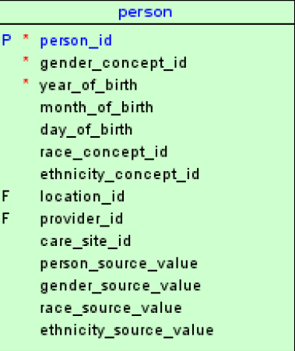
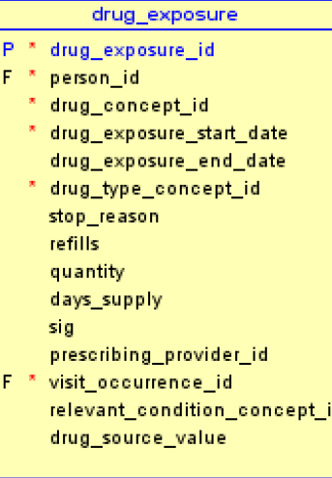
OMOP’s tables: an ontologist’s nightmare
Observational Medical Outcomes Partnership Common Data Model Specifications Version 4.0

Slide 82
Data management

Slide 83
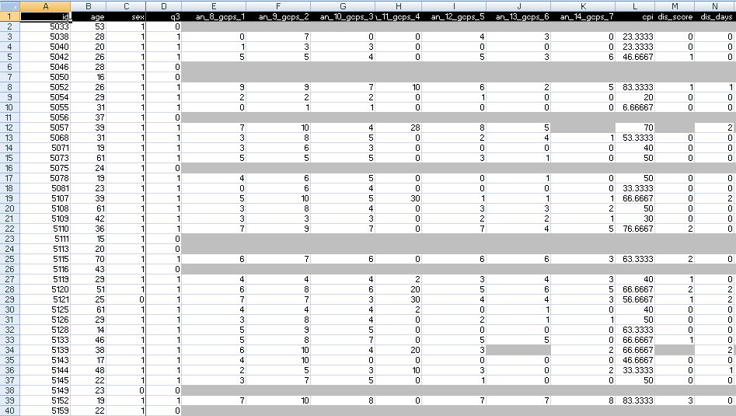
A colleague shares his research data set

Slide 84
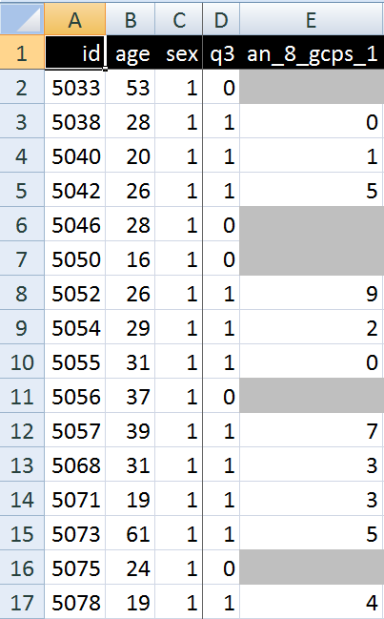
A closer look
What are you going to ask him right away?
What do these various values stand for and how do they relate to each other?
  Might this mean that patient #5057 had only once sex at the age of 39?

Slide 85

Documenting datasets
Sources | Data generation | Data organization
Data collection sheets
Instruction manuals
Interpretation criteria
Diagnostic criteria
Assessment instruments
Terminologies
Data validation procedures
Data dictionaries
Ontologies
If not used for data collection and organization, these sources can be used post hoc to document, and perhaps increase, the level of data clarity and faithfulness in and comparability of existing data collections.

Slide 86
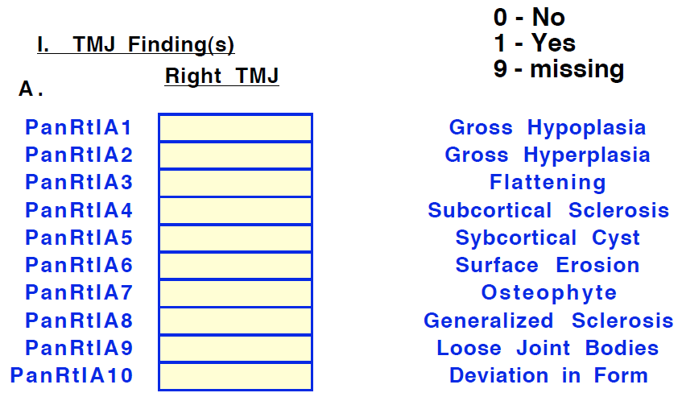
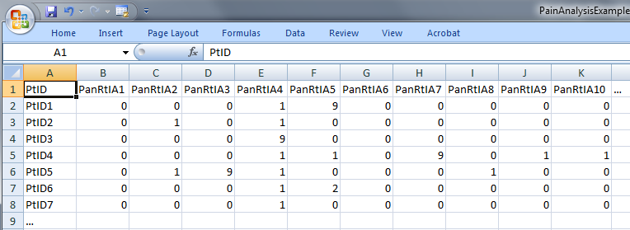
‘meaning’ of values in data collections
‘The patient with patient identifier ‘PtID4’ is stated to have had a panoramic X-ray of the mouth which is interpreted to show subcortical sclerosis of that patient’s condylar head of the right temporomandibular joint’
meaning
1

Slide 87
Preemptive study design
Goal: register data at a more fine-grained level
Method:
Start with a detailed description of the constructs to study as well as of hypothesized relationships amongst them
Translate constructs in (perhaps overlapping) sets of variables
Determine for each possible value V of each variable all possible configurations of entities (according to our best scientific understanding) for which the following can be true:
  V
  ‘it is stated that V’
Describe these possible configurations by means of sentences from a formal language that mimic the structure of reality.

Slide 88
For example
For value V for patient P stating that ‘P has had a panoramic X-ray of the mouth which is interpreted to show subcortical sclerosis of that patient’s condylar head of the right temporomandibular joint’ to be true,
  this statement must have been made,
for the statement to be true, there must have been that patient, an X-ray, etc, …
BUT! It is not necessarily true that that patient has indeed the sclerosis as diagnosed.

Slide 89
Coded variable expansion
Formulate for each variable a sentence explaining as accurately as possible what the variable stands for,
list the entities in reality that the terms in the sentence denote,
list recursively for all entities listed further entities that ontologically must exist for the entity under scrutiny to exist,
classify all entities in terms of realism-based ontologies (RBO),
specify all obtaining relationships between these entities,
outline all possible configurations of such entities for the sentence to be true,
translate this configurations in appropriate (coded) values.

Slide 90
Use of explicit references
CLASS | INSTANCE IDENTIFIER | DIRECTLY REFERENTIAL DESCRIPTIONS
person | IUI-1 | the person to whom IUI-2 is assigned
patient identifier | IUI-2 | the patient identifier of IUI-1
assertion | IUI-3 | 'the patient with patient identifier PtID4 has had a panoramic X-ray of the mouth which is interpreted to show subcortical sclerosis of that patient’s right temporomandibular joint'
technically investigating | IUI-4 | the technically investigating of IUI-6
panoramic X-ray | IUI-5 | the panoramic X-ray that resulted from IUI-4
mouth | IUI-6 | the mouth of IUI-1
interpreting | IUI-7 | the interpreting of the signs exhibited by IUI-5
seeing | IUI-8 | the seeing of IUI-5 which led to IUI-7
diagnosis | IUI-9 | the diagnosis expressed by means of IUI-3
condylar head of right TMJ | IUI-10 | the condylar head of the right TMJ of IUI-1
right TMJ | IUI-11 | the right TMJ of IUI-1

Slide 91
Classifying entities in terms of realism-based ontologies
CLASS | HIGHER CLASS
person | BFO: Object
patient identifier | IAO: Information Content Entity
assertion | IAO: Information Content Entity
technically investigating | OBI: Assay
panoramic X-ray | IAO: Image
mouth | FMA: Mouth
interpreting | MFO: Assessing
seeing | BFO: Process
diagnosis | IAO: Information Content Entity
condylar head of right TMJ | FMA: Right condylar process of mandible
right TMJ | FMA: Right temporomandibular joint
assigner role | BFO: Role
assigning | BFO: Process
study subject role | OBI: Study subject role
requires more ontological and philosophical skills than domain expertise or expertise with Protégé,
not just term matching

Slide 92
Specifying relationships between these entities
For instance:
  at least during the taking of the X-ray the study subject role inheres in the patient being investigated:
    IUI-23 inheres-in IUI-1 during t1
  the patient participates at that time in the investigation
    IUI-4 has-participant IUI-1 during t1
These relations need to follow the principles of the Relation Ontology / BFO 2.0.
Smith B, Ceusters W, Klagges B, Koehler J, Kumar A, Lomax J, Mungall C, Neuhaus F, Rector A, Rosse C. Relations in biomedical ontologies, Genome Biology 2005, 6:R46.

Slide 93
Outlining all possible configurations of such entities for the sentence to be true (a one semester course on its own)
Such outlines are collections of relational expressions of the sort just described,
Variant configurations for the example:
  perceptor and interpreter are the same or distinct human beings,
  the X-ray machine is unreliable and produced artifacts which the interpreter thought to be signs motivating his diagnosis, while the patient has indeed the disorder specified by the diagnosis (the clinician was lucky)
  …

Slide 94
Take home messages
Statements, even scientific jargon, as well as data collections can make sense and be about something, without each part thereof making sense or being about something.
  (a + b)² = a² + 2ab + b² is true whatever a and b are,
  c² = a² + b² is sometimes true, for instance if a, b, and c are the lengths of certain sides of a rectangular triangle.
For data collections to be interpretable and comparable, each part of it needs to be documented as to what it intends to denote.
Ontological Realism is a method to achieve this.

Slide 95
The notion of ‘biomarkers’

Slide 96

IOM’s definition for ‘biomarker’
Biomarkers are characteristics that are objectively [The committee defines “objectively” to mean “reliably and accurately.”] measured and evaluated as an indicator of normal biological processes, pathogenic processes, or pharmacologic responses to therapeutic intervention.
Cholesterol and blood sugar levels are biomarkers, as are blood pressure, enzyme levels, measurements of tumor size from magnetic resonance imaging (MRI) or computed tomography (CT), and the biochemical and genetic variations observed in age-related macular degeneration.
Evaluation of Biomarkers and Surrogate Endpoints in Chronic Disease, ed. C.M. Micheel and J.R. Ball. 2010, Washington, D.C.: The National Academies Press. 314. [p1]

Slide 97
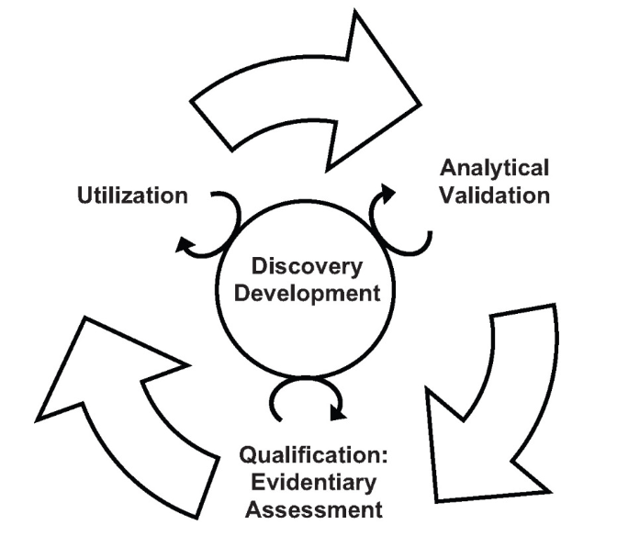
How to get there?
the need is expressed:
to develop a transparent process for creating well-defined consensus standards and guidelines for biomarker development, validation, qualification, and use to reduce the uncertainty in the process of development and adoption.
Evaluation of Biomarkers and Surrogate Endpoints in Chronic Disease, ed. C.M. Micheel and J.R. Ball. 2010, Washington, D.C.: The National Academies Press. 314.
[p7 and p18]

Slide 98
Utility of biomarkers
Disease risk stratification: assess the likelihood for disease to develop or recur
Prevention: identify and track risk factors
Screening: detect and treat early-stage disease in asymptomatic population
Diagnosis: definitively establish the presence of disease
Classification: classify patients by disease subset
Prognosis: predict the probable outcome of disease to determine the aggressiveness of treatment
Treatment stratification: predict response to particular therapies and choose the drug that is mostly likely to yield a favorable response in a given patient
Therapy-related risk management: identify patients with a high probability of adverse effects of a treatment
Therapy monitoring: determine whether a therapy is having the intended effect on a disease and whether adverse effects arise
Surveillance: early detection and treatment of advancing disease or complications
Evaluation of Biomarkers and Surrogate Endpoints in Chronic Disease, ed. C.M. Micheel and J.R. Ball. 2010, Washington, D.C.: The National Academies Press. 314. [p24]

Slide 99
Biomarker terminology is confusing
The committee observed a great deal of inconsistent and imprecise definition and use of terms relevant to biomarkers and biomarker evaluation.
Consistent, precise definition and use of terms is critical for biomarker evaluation because it is a topic important across many disciplines and has been for several decades.
The definition of the term “biomarker” itself is not controversial.
Evaluation of Biomarkers and Surrogate Endpoints in Chronic Disease, ed. C.M. Micheel and J.R. Ball. 2010, Washington, D.C.: The National Academies Press. 314. [p22]

Slide 100
Uncontroversial, yet cumbersome
in light of the principles of Ontological Realism and Basic Formal Ontology
Being
Believing
Communicating

Slide 101
Uncontroversial, yet cumbersome
in light of the principles of Ontological Realism and Basic Formal Ontology
Ontology
Classification /
conceptualization
Being
Believing
Communicating
Terminology

Slide 102
Uncontroversial, yet cumbersome
Biomarkers are characteristics that are objectively [The committee defines “objectively” to mean “reliably and accurately.”] measured and evaluated as an indicator of normal biological processes, pathogenic processes, or pharmacologic responses to therapeutic intervention.
Cholesterol and blood sugar levels are biomarkers, as are blood pressure, enzyme levels, measurements of tumor size from magnetic resonance imaging (MRI) or computed tomography (CT), and the biochemical and genetic variations observed in age-related macular degeneration.
Evaluation of Biomarkers and Surrogate Endpoints in Chronic Disease, ed. C.M. Micheel and J.R. Ball. 2010, Washington, D.C.: The National Academies Press. 314. [p1]

Slide 103
Uncontroversial, yet cumbersome
Ambiguous terminology:
  Measuring process or data resulting from measuring?
Biomarkers are characteristics that are objectively [The committee defines “objectively” to mean “reliably and accurately.”] measured and evaluated as an indicator of normal biological processes, pathogenic processes, or pharmacologic responses to therapeutic intervention.
Cholesterol and blood sugar levels are biomarkers, as are blood pressure, enzyme levels, measurements of tumor size from magnetic resonance imaging (MRI) or computed tomography (CT), and the biochemical and genetic variations observed in age-related macular degeneration.
Evaluation of Biomarkers and Surrogate Endpoints in Chronic Disease, ed. C.M. Micheel and J.R. Ball. 2010, Washington, D.C.: The National Academies Press. 314. [p1]

Slide 104
Uncontroversial, yet cumbersome
Ambiguous terminology:
  Measuring process or data resulting from measuring?
Supertype ‘characteristic’ is too vague, ‘anything goes’ is not an appropriate ontological category;
Biomarkers are characteristics that are objectively [The committee defines “objectively” to mean “reliably and accurately.”] measured and evaluated as an indicator of normal biological processes, pathogenic processes, or pharmacologic responses to therapeutic intervention.
Cholesterol and blood sugar levels are biomarkers, as are blood pressure, enzyme levels, measurements of tumor size from magnetic resonance imaging (MRI) or computed tomography (CT), and the biochemical and genetic variations observed in age-related macular degeneration.
Evaluation of Biomarkers and Surrogate Endpoints in Chronic Disease, ed. C.M. Micheel and J.R. Ball. 2010, Washington, D.C.: The National Academies Press. 314. [p1]

Slide 105
Uncontroversial, yet cumbersome
Ambiguous terminology:
  Measuring process or data resulting from measuring?
Supertype ‘characteristic’ is too vague, ‘anything goes’ is not an appropriate ontological category;
Both entities on the side of the patient, and representations thereof seem to qualify as biomarkers;
Biomarkers are characteristics that are objectively [The committee defines “objectively” to mean “reliably and accurately.”] measured and evaluated as an indicator of normal biological processes, pathogenic processes, or pharmacologic responses to therapeutic intervention.
Cholesterol and blood sugar levels are biomarkers, as are blood pressure, enzyme levels, measurements of tumor size from magnetic resonance imaging (MRI) or computed tomography (CT), and the biochemical and genetic variations observed in age-related macular degeneration.
Evaluation of Biomarkers and Surrogate Endpoints in Chronic Disease, ed. C.M. Micheel and J.R. Ball. 2010, Washington, D.C.: The National Academies Press. 314. [p1]

Slide 106
Uncontroversial, yet cumbersome
Ambiguous terminology:
  Measuring process or data resulting from measuring?
Supertype ‘characteristic’ is too vague, ‘anything goes’ is not an appropriate ontological category;
Both entities on the side of the patient, and representations thereof seem to qualify as biomarkers;
Whether an entity qualifies as a biomarker seems to be determined by what we intend to do with it rather than with what it is.
None of the above is satisfactory!
Biomarkers are characteristics that are objectively [The committee defines “objectively” to mean “reliably and accurately.”] measured and evaluated as an indicator of normal biological processes, pathogenic processes, or pharmacologic responses to therapeutic intervention.
Cholesterol and blood sugar levels are biomarkers, as are blood pressure, enzyme levels, measurements of tumor size from magnetic resonance imaging (MRI) or computed tomography (CT), and the biochemical and genetic variations observed in age-related macular degeneration.
Evaluation of Biomarkers and Surrogate Endpoints in Chronic Disease, ed. C.M. Micheel and J.R. Ball. 2010, Washington, D.C.: The National Academies Press. 314. [p1]

Slide 107
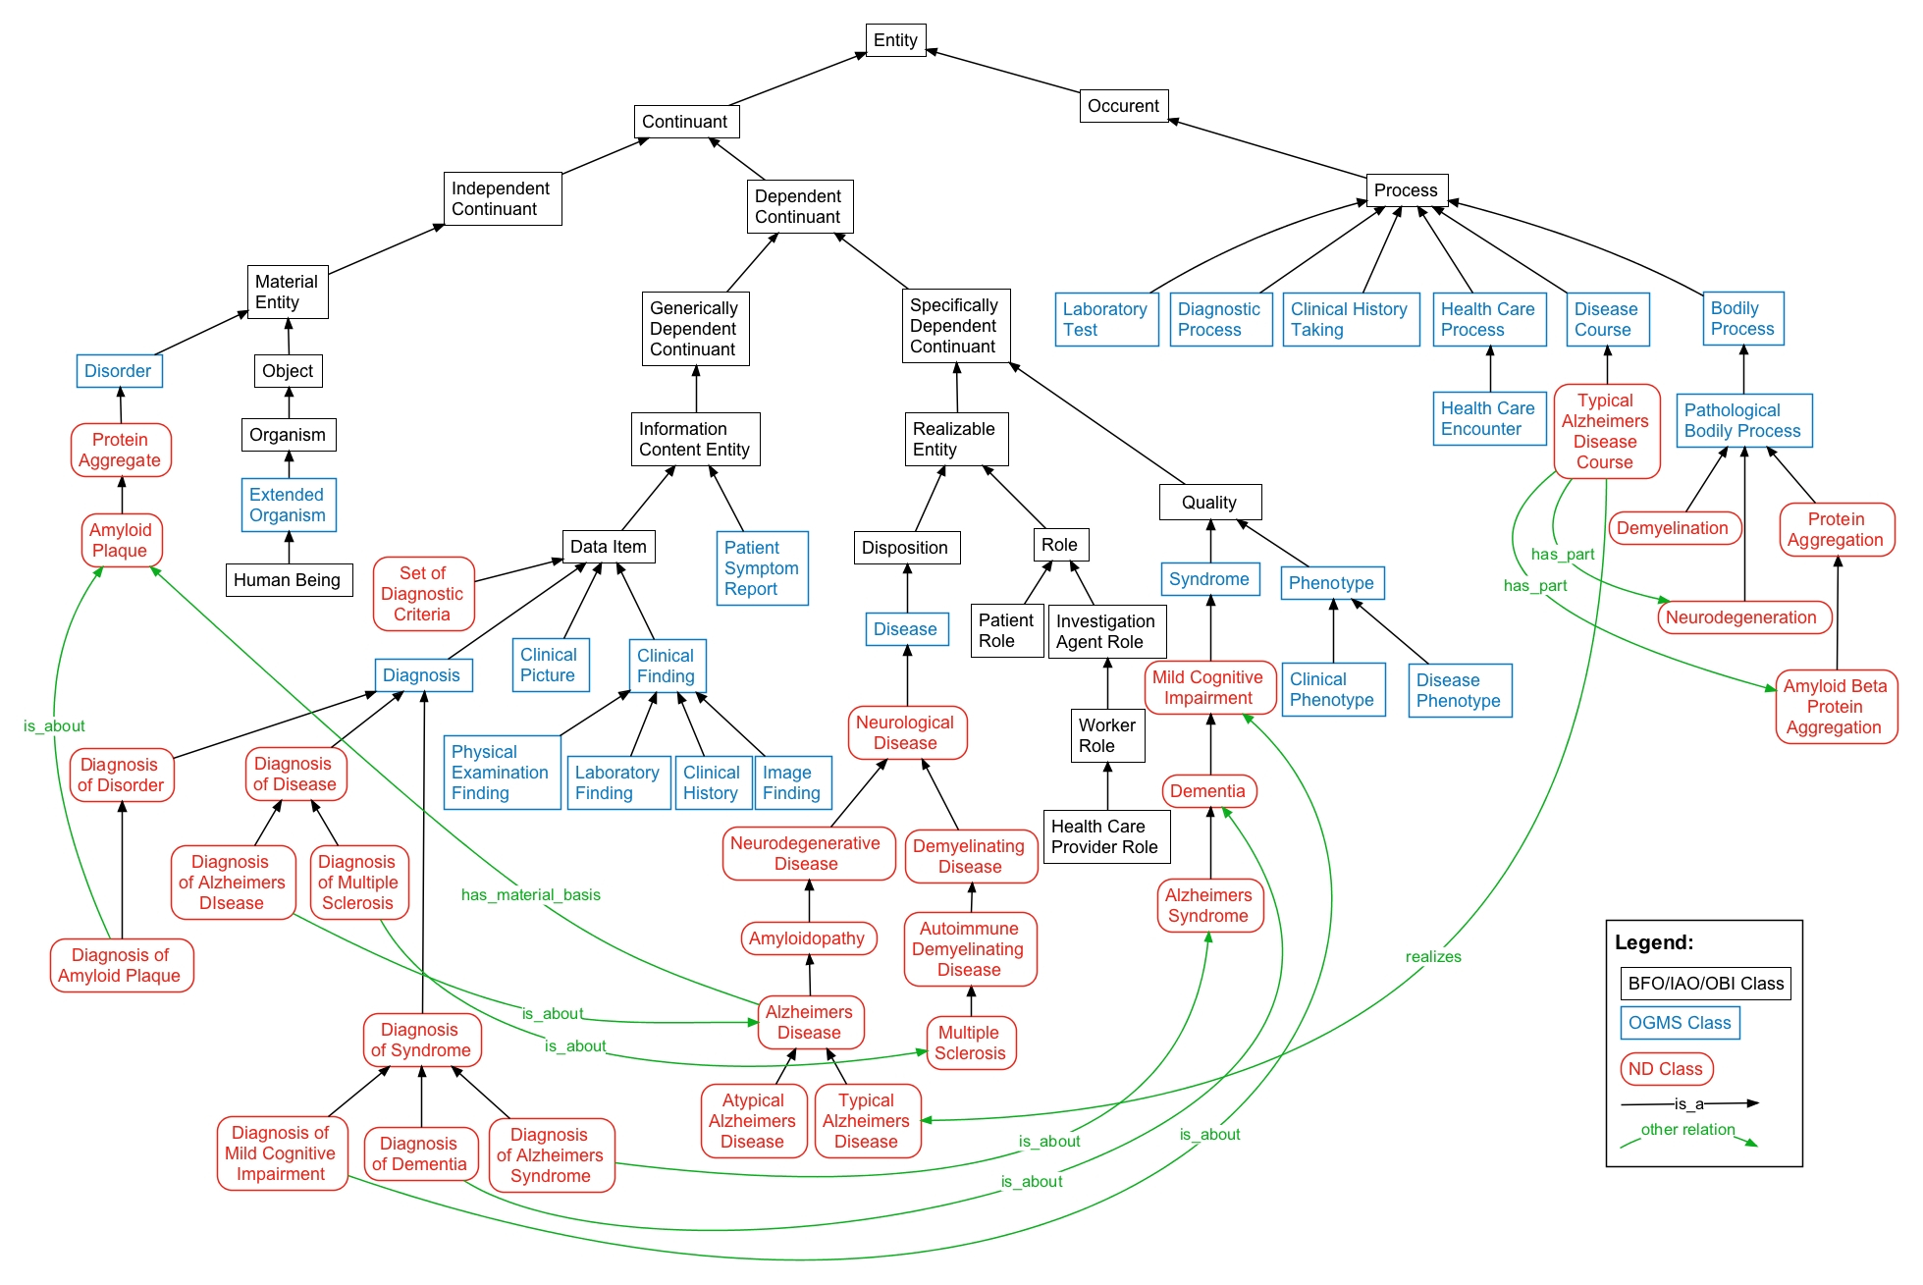
Basic Formal Ontology (BFO) and
Ontology of General Medical Science (OGMS)
Scheuermann R, Ceusters W, Smith B. Toward an Ontological Treatment of Disease and Diagnosis. 2009 AMIA Summit on Translational Bioinformatics, San Francisco, California, March 15-17, 2009;: 116-120.

Slide 108
Basic Formal Ontology (BFO) and
Ontology of General Medical Science (OGMS)
Scheuermann R, Ceusters W, Smith B. Toward an Ontological Treatment of Disease and Diagnosis. 2009 AMIA Summit on Translational Bioinformatics, San Francisco, California, March 15-17, 2009;: 116-120.

Slide 109
Assumptions about IOM’s intention
IOM intended biomarkers to be entities on the side of the patient, and not (for example) processes on the part of the clinician or data obtained through such processes;
in requiring that biomarkers be ‘objectively measured and evaluated’ the IOM had in mind not that an entity becomes a biomarker after and because it has been measured and evaluated, but rather that it was a biomarker already prior to observation because of certain properties it has intrinsically → observability
the logical disjunction expressed by the ‘or’ in the list of processes for which the IOM definition asserts biomarkers to be an indicator has to be interpreted as an exclusive or (XOR).

Slide 110
Entities on the side of the patient qualifying for biomarker
Independent
Continuant
Dependent
Continuant
Process
BFO
isa
isa
isa
Material
Entity
Quality
isa
isa
Bodily
Component
Bodily
Quality
Bodily
Process
OGMS
instanceOf at t
instanceOf at t
instanceOf at t
me
my xanthelasma
my cholesterol
level
my partly obstructed
blood flow

Slide 111
The problem of observability
Because:
  Observability is a disposition;
  Dispositions can only inhere in independent continuants, not in qualities and processes;
  Our ability to evaluate/assess these qualities and processes is brought about in part by the observability of the independent continuants upon which they depend;
what the IOM defined as ‘biomarker’ does not form a homogenous group of entities with similar characteristics;
Therefore: three different types of biomarkers need to be defined.

Slide 112
Material Biomarker
Independent
Continuant
Dependent
Continuant
Process
BFO
isa
isa
isa
Material
Entity
Quality
isa
isa
Bodily
Component
Bodily
Quality
Bodily
Process
OGMS
Material
Biomarker
=def.– bodily component capable of being assessed objectively to determine either (a) what kind of processes it results from, or (b) what kind of processes resulted in qualities that depend on it.

Slide 113
Quality Biomarker
Independent
Continuant
Dependent
Continuant
Process
BFO
isa
isa
isa
Material
Entity
Quality
isa
isa
Bodily
Component
Bodily
Quality
Bodily
Process
OGMS
=def.– BODILY QUALITY inhering in a BODILY COMPONENT c and in virtue of which c is an instance of MATERIAL BIOMARKER
Material
Biomarker
Quality
Biomarker

Slide 114
Process Biomarker
Independent
Continuant
Dependent
Continuant
Process
BFO
isa
isa
isa
Material
Entity
Quality
isa
isa
Bodily
Component
Bodily
Quality
Bodily
Process
OGMS
=def.– BODILY PROCESS p instances of which are capable of being assessed objectively to determine whether p is a realization of NORMAL or of ABNORMAL HOMEOSTASIS.
Material
Biomarker
Quality
Biomarker
Process
Biomarker

Slide 115
The final picture
isa
Bodily
Component
subClassOf
Biomarker
Material
Biomarker
Bodily
Quality
Bodily
Process
Disease
Biomarker
Diagnostic
Biomarker
Quality
Biomarker
Process
Biomarker
Material
Diagnostic
Biomarker
Quality
Diagnostic
Biomarker
Process
Diagnostic
Biomarker
Prognostic
Biomarker

Slide 116
‘Mental disease’

Slide 117

Does mental illness exist?
Their answer:
  ‘there are no biological abnormalities responsible for so-called mental illness, mental disease, or mental disorder, therefore mental illness has no biological existence.
  Perhaps more importantly, however, mental illness also has no non-biological existence,
  except in the sense that the term is used to indicate disapproval of some aspect of a person's mentality.’
  Lawrence Stevens, J.D, 1999
The
Antipsychiatry
Coalition

Slide 118
Their argument is based on the (narrow ?) definitions for disease.
Most attempts refer to bodily issues:
  STEDMAN (27th edition):
    An interruption, cessation, or disorder of body function, system, or organ. Syn: illness, morbus, sickness
    A morbid entity characterized usually by at least two of these criteria: recognized etiologic agent(s), identifiable group of signs and symptoms, or consistent anatomic alterations.
  DORLAND
    any deviation from or interruption of the normal structure or function of a part, organ, or system of the body as manifested by characteristic symptoms and signs; the etiology, pathology, and prognosis may be known or unknown.

Slide 119
Latest WHO definition
A disease is:
  an interconnected set of one or more dysfunctions in one or more body systems including:
    a pattern of signs, symptoms and findings (symptomatology - manifestations)
    a pattern or patterns of development over time (course and outcome)
    a common underlying causal mechanism (etiology)
  linking to underling genetic factors (genotypes, phenotypes and endophenotypes) and to interacting environmental factors
  and possibly: to a pattern or patterns of response to interventions (treatment response).

Slide 120
WHO constitution
The State Parties to this Constitution declare, in conformity with the Charter of the United Nations, that the following principles are basic to the happiness, harmonious relations and security of all peoples:
  Health is a state of complete physical, mental and social well-being and not merely the absence of disease or infirmity.
  …

Slide 121
What is a mental disorder ?
The social-constructivist position:
  mental disorder is a value-laden social construct with no counterpart in biomedical reality.
The objectivist position:
  mental disorders are natural entities that could be understood in biological terms.
The hybrid position:
  Mental disorder is harmful dysfunction.
    the social definition of "harm" is counterbalanced by a factual component of a malfunctioning internal mechanism causing objective dysfunction.
Jablensky A: Does psychiatry need an overarching concept of "mental disorder"? World Psychiatry 2007, 6:157-158.

Slide 122
A terminological and ontological problem (1)
  WHO: Lexicon of psychiatric and mental health terms. Second edn. Geneva: WHO; 1994.
  ‘mental disorder’: an imprecise term designating any disorder of the mind, acquired or congenital
  organic mental disorder: a range of mental disorders grouped together on the basis of their having in common a demonstrable etiology in cerebral disease, brain injury, or other insult, leading to cerebral dysfunction.
Does WHO rule out the existence of mental disorders which are not due to brain disorder?

Slide 123
The old debate on the “body-mind problem”…
Dualistic views in Philosophy of Mind:
  asserts the separate existence of mind and body
  comes in various flavours:
    Ontological dualism
      Substance dualism
      Property dualism
      Predicate dualism
    Interaction dualism
Monistic views in Philosophy of Mind:
    Behaviourism
    Identity theory
    Functionalism
    Non-reductive physicalism
…

Slide 124
… and its impact on Psychiatry
Mental health professionals continue to employ a mind-brain dichotomy when reasoning about clinical cases.
The more a behavioral problem is seen as originating in “psychological” processes, the more a patient tends to be viewed as responsible and blameworthy for his or her symptoms;
conversely, the more behaviors are attributed to neurobiological causes, the less likely patients are to be viewed as responsible and blameworthy.
Miresco MJ, Kirmayer LJ.
The Persistence of Mind-Brain Dualism in Psychiatric Reasoning About Clinical Scenarios.
Am J Psychiatry 2006; 163:913–918
But:
  Conducted in one institution
  Based on a questionnaire with voluntary submission
Thus risk for major bias

Slide 125
A terminological and ontological problem (2)
Szasz: ‘mental illness is a myth whose function it is to disguise and thus render more palatable the bitter pill of moral conflicts in human relations’
  Szasz TS: The Myth of Mental Illness. American Psychologist 1960, 15:113-118.

Slide 126
The “Myth of Mental Illness”
“I maintain
  that the mind is not the brain,
  that mental functions are not reducible to brain functions, and
  that mental diseases are not brain diseases,
  indeed, that mental diseases are not diseases at all.
When I assert the latter, I do not imply that distressing personal experiences and deviant behaviors do not exist. Anxiety, depression, and conflict do exist--in fact, are intrinsic to the human condition--but they are not diseases in the pathological sense.”
Thomas S. Szasz (MD), Mental Disorders Are Not Diseases.
USA Today (Magazine) January 2000

Slide 127
Our interpretation of Szasz (1)
the group of persons ‘known to manifest various peculiarities or disorders of thinking and behavior’ and about which it is therefore said that they have a mental illness, consists of two subgroups:
  (1) those for which there is an underlying brain disorder perhaps not yet discoverable by what the state of the art is able to offer; and
  (2) those who exhibit in their behavior a ‘deviance … from certain psychosocial, ethical, or legal norms’ as judged by themselves, by clinicians, or by others.

Slide 128
Our interpretation of Szasz (2)
  those for which there is an underlying brain disorder perhaps not yet discoverable by what the state of the art is able to offer
  would be better described as having a brain disorder,
those who exhibit in their behavior a ‘deviance … from certain psychosocial, ethical, or legal norms’ as judged by themselves, by clinicians, or by others
  while they might indeed have ‘problems of living’, and thus be suffering, are not suffering because of some disorder of a special, mental kind.

Slide 129
Our interpretation of Szasz (3)
Szasz hereby rejects as fallacious the view which regards social intercourse ‘as something inherently harmonious, its disturbance being due solely to the presence of “mental illness” in many people’.

Slide 130
A terminological and ontological problem (3)
Adoption of a generic, presumably universal, definition of "mental disorder" would be premature. It may cause more harm than good to psychiatry.
  Jablensky A: Does psychiatry need an overarching concept of "mental disorder"? World Psychiatry 2007, 6:157-158.

Slide 131
Jablensky’s arguments (1)
A terminological argument
  Neither disease nor health has ever been strictly and unambiguously defined in terms of finite sets of observable referential phenomena.
Arguments of utility:
  the medical person is least concerned with what healthy and sick mean in general ... we do not need the concept of ‘illness in general’ at all
    Jaspers K. General psychopathology. Birmingham: Birmingham University Press; 1963.
  doctors do not concern themselves with maximizing the evolutionary advantages of the human race as a whole, but with aiding individuals
    Toon PD. Defining "disease" - classification must be distinguished from evaluation. J Med Ethics. 1981;7:197–201.

Slide 132
Jablensky’s arguments (2)
Ontological argument:
  we now know that no such general and uniform concept exists.
    Jaspers K. General psychopathology ,Birmingham: Birmingham University Press; 1963..
Epistemological argument:
  the emergence of molecular genetic classifications of large groups of diseases, and the concomitant availability of genetic diagnostic tests, raise the possibility that the entire taxonomy of human disease may eventually be revised.

Slide 133
Missing the nail
A definition of ‘mental disorder’ should be such
  (a) that it ‘can be used as a criterion for assessing potential candidates for inclusion in the classification, and deletions from it’ and
  (b) that there should be ‘at least no ambiguity about the reason that individual candidate diagnoses are included or excluded’.
    Kupfer D, First M, Regier D (Eds.): A Research Agenda for DSM-V, American Psychiatric Association; 2002.
This doesn’t address at all what candidate mental disorders have in common, i.e. what differentiates them from other, non-mental disorders.

Slide 134
ICD-10 Mental disease guidelines
Two distinct ones:
  The ICD-10 Classification of Mental and Behavioural Disorders: Clinical descriptions and diagnostic guidelines. Geneva: World Health Organization; 1992.
  The ICD-10 Classification of Mental and Behavioural Disorders: Diagnostic criteria for research. Geneva: World Health Organization; 1993.
Yet, an individual entity, such as a mental disorder in a specific patient, does not change when looked at from distinct perspectives.

Slide 135
The ‘categorical – dimensional’ debate on the classification of mental disorders
Rough distinction:
  “Categorical”: ‘mental disorders’ can be classified as single, discrete and mutually exclusive types, of which a particular patient does or does not exhibit an instance.
  “Dimensional”: any particular ‘mental disorder’ in a patient is an instance of just one single type and differences between cases are a matter of ‘scale’.
‘Rough’, because
  the literature is huge and vague
  descriptions are (philosophically) very incoherent

Slide 136
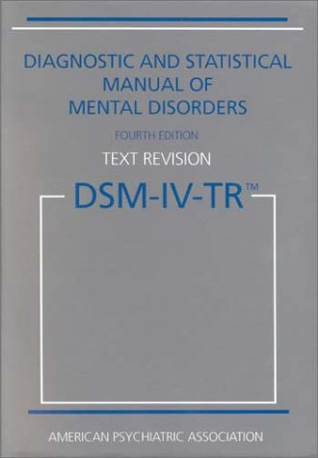
The categorical view
Recognizes various mental disorder types
Accepts that disorders are manifested through signs and symptoms, either ‘marker’ or ‘constitutional’
Provides diagnostic criteria to guide the clinician in making a diagnosis.

Slide 137
Evolution of the DSM (1)
Psychodynamic period: I and II, 1952-1980
  no sharp distinction between normal and abnormal.
  psychosis / neurosis scale
  all disorders viewed as reactions (leading to behavior) to environmental events,
  everyone is more or less abnormal,
  inclusion in the manual presumes abnormality.
DSM-II contained “homosexuality” as mental disorder which was removed in 1973 by vote.

Slide 138
Evolution of the DSM (2)
Adoption of biomedical model: III, IV 1980 -
  Clear distinction between normal/abnormal
  Introduction of diagnostic criteria
  Latest version is from 2000
DSM-V: foreseen for 2011

Slide 139
DSM under fire (1)
severely ill inpatients often meet criteria for more than one DSM-IV personality disorder
  → suggests a high rate of co-morbidity, however in absence of any medical or etiologic reason for such a situation
many outpatients do not meet the criteria for any of the specific categories identified in DSM-IV;
patients with the same categorical diagnosis often vary substantially with respect to which diagnostic criteria were used to make the diagnosis, so that two patients with the same diagnosis can manifest very different signs and symptoms;

Slide 140
DSM under fire (2)
frequent revision of the diagnostic thresholds separating what is normal from what is disordered
  → it is as if given disorders would appear and disappear in course of time;
a number of the diagnostic categories mentioned in DSM-IV lack any developing scientific base for an understanding of the corresponding disorder types

Slide 141
The Dimensional Approach (1)
Mental processes and behavior follow traits/phenomena which are to be seen as continuous variables along continua on which all members of the population can be located. These continua extend to both normal and pathological phenotypes.
These traits are on a par with properties such as temperature, weight, …
  → Homo sapiens is not further subdivided in subspecies according to weight, temperature, …

Slide 142
The Dimensional Approach (2)
“Diagnostic categories defined by their syndromes should be regarded as valid only if they have been shown to be discrete entities with natural boundaries that separate them from other disorders.”
“there is no empirical evidence for natural boundaries between major syndromes” … “the categorical approach is fundamentally flawed”
Kendell R, Jablensky A. Distinguishing between the validity and utility of psychiatric diagnoses. Am J Psychiatry 2003; 160:4–12.
Cloninger CR: A new conceptual paradigm from genetics and psychobiology for the science of mental health. Aust N Z J Psychiatry 33:174–186, 1999.

Slide 143

Is there empirical evidence for this boundary ?
And if not, do these mountains exist ?

Slide 144
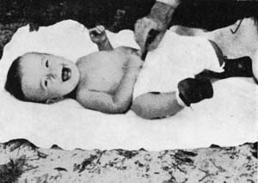
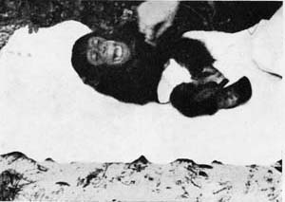
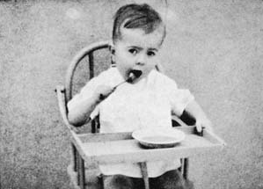
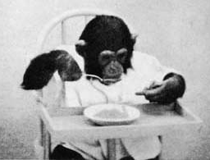
Then also these guys would be from the same species
W.N. Kellogg, L.A. Kellogg. The Ape and The Child; A Comparative Study of the Environmental Influence Upon Early Behavior. Hafner Publishing Company, New York and London, 1967.

Slide 145
Attempts to resolve the problem (1)
Mental disorders as ‘practical kinds’
  ‘stable patterns that can be identified with varying levels of reliability and validity’ and which are justified by their usefulness for specific purposes – such as giving an appropriate treatment
Zachar, P. 2000b. Psychiatric disorders are not natural kinds. Philosophy, Psychiatry and Psychology 7:167–94.

Slide 146
Basis: ‘epistemic value commitments’
‘values involved in making and advancing epistemologically-relevant claims, such as scientific ones’:
Coherence
Consistency
Comprehensiveness
Fecundity
Simplicity
Instrumental efficacy
Originality
Relevance
Precision
JZ. Sadler. Epistemic Value Commitments in the Debate over Categorical vs. Dimensional Personality Diagnosis. Philosophy, Psychiatry, & Psychology 3.3 (1996) 203-222

Slide 147
Extraterrestrial research

Slide 148


A hint:
Visual reality versus visual fiction
Notes:
http://www.dailymail.co.uk/news/article-2180269/Brute-strength-Taliban-fighter-caught-camera-brandishing-TWO-machine-guns-once.html
http://screencrush.com/rambo-tv-series/

Slide 149
A planet with tribal humanoids is discovered
O1: we observe a tribe T1 on one side of the planet. We observe that each time when a humanoid of that tribe slaps another one in the face, that other one slaps back.
Research proposals ….

Slide 150
A planet with tribal humanoids is discovered
O1: we observe a tribe T1 on one side of the planet. We observe that each time when a humanoid of that tribe slaps another one in the face, that other one slaps back until it gave the same number of slaps as it received.
Research proposals ….
O2: we observe the same behavior in different tribes that never were in contact with each other.
Research proposals ….

Slide 151
A planet with tribal humanoids is discovered
O1: we observe a tribe T1 on one side of the planet. We observe that each time when a humanoid of that tribe slaps another one in the face, that other one slaps back until it gave the same number of slaps as it received.
Research proposals ….
O2: we observe the same behavior in different tribes that never were in contact with each other.
Research proposals ….
O3: members of T1 go on exploration and make contact with members of T2, T3, …, T7, one tribe at a time. When someone from either meeting tribe slaps a member of the other tribe in the face, the same ritual happens.
Research proposals …

