Slide 1
Statistical data analysis and research methods
BMI504
Course 16249 – Spring 2025
Class 5 – February 20, 2025
Mixed methods: integration of quantitative and qualitative methods
Werner CEUSTERS

Slide 2
C5. Mixed methods: integration of quantitative and qualitative methods
Post-class assignment:
  Almoznino, G., et al., The Dental, Oral, Medical Epidemiological (DOME) Study: Protocol and Study Methods. Methods Inf Med, 2020. 59(4-05): p. 119-130.
https://www.thieme-connect.com/products/ejournals/html/10.1055/s-0040-1718582

Slide 3
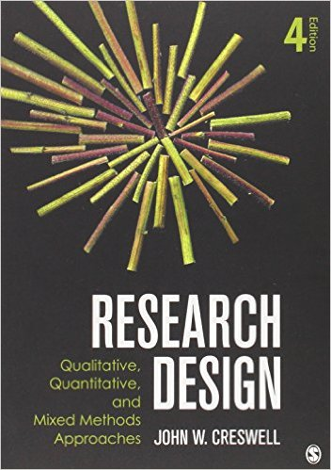

Basis of lecture C5

Slide 4
Also useful
LA Palinkas et. al.
Mixed Method Designs in Implementation Research.
Adm Policy Ment Health (2011) 38:44–53.
https://pubmed.ncbi.nlm.nih.gov/20967495/

Slide 5
Quality criteria for research proposals

Slide 6
Quality criteria for research proposals
A1/1.2-1.3.
Worthy topic | → | The topic of the research is • Relevant • Timely • Significant • Interesting
Rich rigor
Sincerity
Credibility
Resonance
Significant contribution
Ethical
Meaningful coherence
Sarah J. Tracy. Qualitative Quality: Eight “Big-Tent”
Criteria for Excellent Qualitative Research. Qualitative Inquiry 2010;16(10):837–851.

Slide 7
Quality criteria for research proposals
A3
Worthy topic |  | Does the study use sufficient, abundant, appropriate, and complex: • Theoretical constructs • Data and time in the field • Sample(s) • Context(s) • Data collection and analysis processes
Rich rigor | →
Sincerity
Credibility
Resonance
Significant contribution
Ethical
Meaningful coherence
Sarah J. Tracy. Qualitative Quality: Eight “Big-Tent”
Criteria for Excellent Qualitative Research. Qualitative Inquiry 2010;16(10):837–851.

Slide 8
Quality criteria for research proposals
A3
Worthy topic |  | Will there be enough data to support significant claims? Can the researcher spend enough time to gather interesting and significant data? Is the intended context or sample appropriate given the goals of the study? Will the researcher use appropriate procedures in terms of field note style, interviewing practices, and analysis procedures?
Rich rigor | →
Sincerity
Credibility
Resonance
Significant contribution
Ethical
Meaningful coherence
Sarah J. Tracy. Qualitative Quality: Eight “Big-Tent”
Criteria for Excellent Qualitative Research. Qualitative Inquiry 2010;16(10):837–851.

Slide 9
Quality criteria for research proposals
A4/4.5
Worthy topic |  | Is the proposals characterized by: self-reflexivity about subjective values, biases, and inclinations of the researcher(s); transparency about the methods and challenges?
Rich rigor
Sincerity | →
Credibility
Resonance
Significant contribution
Ethical
Meaningful coherence
Sarah J. Tracy. Qualitative Quality: Eight “Big-Tent”
Criteria for Excellent Qualitative Research. Qualitative Inquiry 2010;16(10):837–851.

Slide 10
Quality criteria for research proposals
Worthy topic |  | Is the research marked by: thick description, concrete detail, explication of tacit (nontextual) knowledge, and showing rather than telling; triangulation or crystallization; multivocality; member reflections.
Rich rigor
Sincerity
Credibility | →
Resonance
Significant contribution
Ethical
Meaningful coherence
Sarah J. Tracy. Qualitative Quality: Eight “Big-Tent”
Criteria for Excellent Qualitative Research. Qualitative Inquiry 2010;16(10):837–851.

Slide 11
Quality criteria for research proposals
Worthy topic |  | Does the research influence, affect, or move particular readers or a variety of audiences through: aesthetic, evocative representation, naturalistic generalizations, transferable findings.
Rich rigor
Sincerity
Credibility
Resonance | →
Significant contribution
Ethical
Meaningful coherence
Careful though! Avoid emotional rhetoric
and for sure fallacies of argumentation!
Sarah J. Tracy. Qualitative Quality: Eight “Big-Tent”
Criteria for Excellent Qualitative Research. Qualitative Inquiry 2010;16(10):837–851.

Slide 12
Use your brain at all times!!!
‘Statistics show that there are more than n million persons with a history of disease x in the United States alone. Early detection and diagnosis can help decrease these numbers in the coming years.’
???

Slide 13
Use your brain at all times!!!
  Research question:
In healthcare staff, how does gamified phishing training compared with traditional training affect phishing susceptibility and security reporting behavior within a 3-month period?
Reason:
Phishing attacks endanger healthcare data security and patient safety. Traditional training is ineffective , leading to high susceptibility.
???

Slide 14
Quality criteria for research proposals
Worthy topic
Rich rigor
Sincerity
Credibility
Resonance
Significant contribution | →
Ethical
Meaningful coherence
Sarah J. Tracy. Qualitative Quality: Eight “Big-Tent”
Criteria for Excellent Qualitative Research. Qualitative Inquiry 2010;16(10):837–851.

Slide 15
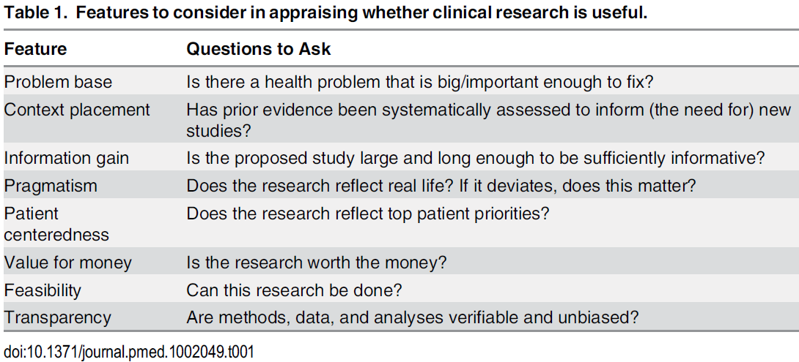
Usefulness features per Ioannidis
A2/2.3
Features Outline

Slide 16
Quality criteria for research proposals
Worthy topic |  | Does the research provide a significant contribution: Conceptually/theoretically Practically Morally Methodologically Heuristically
Rich rigor
Sincerity
Credibility
Resonance
Significant contribution | →
Ethical
Meaningful coherence
Sarah J. Tracy. Qualitative Quality: Eight “Big-Tent”
Criteria for Excellent Qualitative Research. Qualitative Inquiry 2010;16(10):837–851.

Slide 17
Quality criteria for research proposals
Worthy topic |  | Does the research consider: procedural ethics (such as human subjects); situational and culturally specific ethics; relational ethics; exiting ethics (leaving the scene and sharing the research).
Rich rigor
Sincerity
Credibility
Resonance
Significant contribution
Ethical | →
Meaningful coherence
Sarah J. Tracy. Qualitative Quality: Eight “Big-Tent”
Criteria for Excellent Qualitative Research. Qualitative Inquiry 2010;16(10):837–851.

Slide 18
Quality criteria for research proposals
Worthy topic |  | Does the proposal: contains all elements to achieve what it purports to be about? use methods and procedures that fit its stated goals? meaningfully interconnects literature, research questions/foci, findings, and interpretations with each other?
Rich rigor
Sincerity
Credibility
Resonance
Significant contribution
Ethical
Meaningful coherence | →
Sarah J. Tracy. Qualitative Quality: Eight “Big-Tent”
Criteria for Excellent Qualitative Research. Qualitative Inquiry 2010;16(10):837–851.

Slide 19
Three main types of research methods
Qualitative methods
Quantitative methods
Mixed methods

Slide 20
Qualitative research
Goals:
  exploring and understanding the meaning individuals or groups ascribe to a social or human problem;
  rendering the complexity of a situation.
Process of research:
  focus on emerging questions and procedures,
  data typically collected in the participant’s setting,
  data analysis inductively building from particulars to general themes,
  the researcher makes interpretations of the meaning of the data.
  flexible structure of research report.
Creswell JW. Research design : qualitative, quantitative, and mixed methods approaches— 4th ed. Sage Publications, 2014.

Slide 21
Quantitative research
Goals:
  testing objective theories deductively by examining the relationship among variables;
  being able to generalize and replicate the findings.
Process of research:
  measuring variables, typically on instruments, so that numbered data can be analyzed using statistical procedures;
  building in protections against bias;
  controlling for alternative explanations.
  the final written report has a set structure consisting of introduction, literature and theory, methods, results, and discussion.
Creswell JW. Research design : qualitative, quantitative, and mixed methods approaches— 4th ed. Sage Publications, 2014.

Slide 22
Mixed methods research
Goal:
  Obtain a deeper and more complete understanding of a research problem than either approach alone.
Process of research:
  collecting both quantitative and qualitative data,
  integrating the two forms of data, and
  using distinct designs that may involve different philosophical assumptions and theoretical frameworks.
Creswell JW. Research design : qualitative, quantitative, and mixed methods approaches— 4th ed. Sage Publications, 2014.

Slide 23
Some purposes of mixed methods
A3/3.1
Convergence:
Palinkas et. al. Mixed Method Designs in Implementation Research.
Adm Policy Ment Health (2011) 38:44–53

Slide 24
Some purposes of mixed methods
A3/3.1
Convergence: using both types to answer the same question, through comparison of results to see if they reach the same conclusion (triangulation) or by converting a data set from one type into another.
Complementarity:
Palinkas et. al. Mixed Method Designs in Implementation Research.
Adm Policy Ment Health (2011) 38:44–53

Slide 25
Some purposes of mixed methods
A3/3.1
Convergence: using both types to answer the same question, through comparison of results to see if they reach the same conclusion (triangulation) or by converting a data set from one type into another.
Complementarity: using each method to answer a related question or series of questions for purposes of evaluation or elaboration.
Expansion:
Palinkas et. al. Mixed Method Designs in Implementation Research.
Adm Policy Ment Health (2011) 38:44–53

Slide 26
Some purposes of mixed methods
A3/3.1
Convergence: using both types to answer the same question, through comparison of results to see if they reach the same conclusion (triangulation) or by converting a data set from one type into another.
Complementarity: using each method to answer a related question or series of questions for purposes of evaluation or elaboration.
Expansion: using one type to answer questions raised by the other type.
Development:
Palinkas et. al. Mixed Method Designs in Implementation Research.
Adm Policy Ment Health (2011) 38:44–53

Slide 27
Some purposes of mixed methods
A3/3.1
Convergence: using both types to answer the same question, through comparison of results to see if they reach the same conclusion (triangulation) or by converting a data set from one type into another.
Complementarity: using each method to answer a related question or series of questions for purposes of evaluation or elaboration.
Expansion: using one type to answer questions raised by the other type.
Development: using one type to answer questions that will enable use of the other method to answer other questions.
Sampling:
Palinkas et. al. Mixed Method Designs in Implementation Research.
Adm Policy Ment Health (2011) 38:44–53

Slide 28
Some purposes of mixed methods
Pick at least one purpose for your proposal and be specific!
Convergence: using both types to answer the same question, through comparison of results to see if they reach the same conclusion (triangulation) or by converting a data set from one type into another.
Complementarity: using each method to answer a related question or series of questions for purposes of evaluation or elaboration.
Expansion: using one type to answer questions raised by the other type.
Development: using one type to answer questions that will enable use of the other method to answer other questions.
Sampling: using one type to define or identify the participant sample for collection and analysis of data representing the other type.
Palinkas et. al. Mixed Method Designs in Implementation Research.
Adm Policy Ment Health (2011) 38:44–53

Slide 29
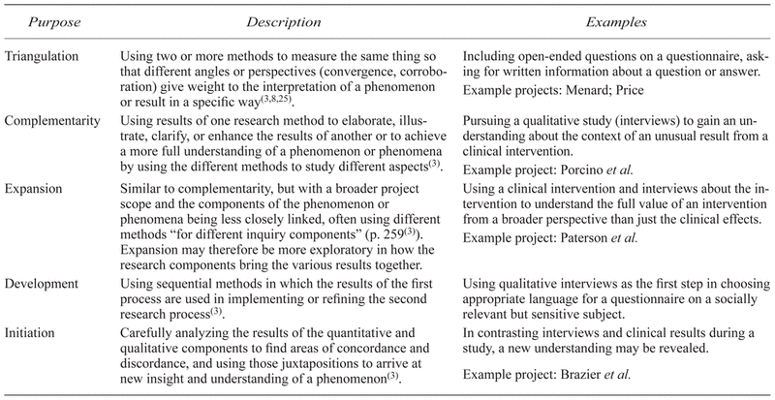
Some purposes of mixed methods
Greene JC, Caracelli VJ, Graham WF. Toward a conceptual framework for mixed-method evaluation designs. Educ Eval Policy Anal 1989; 11(3): 255–274.

Slide 30
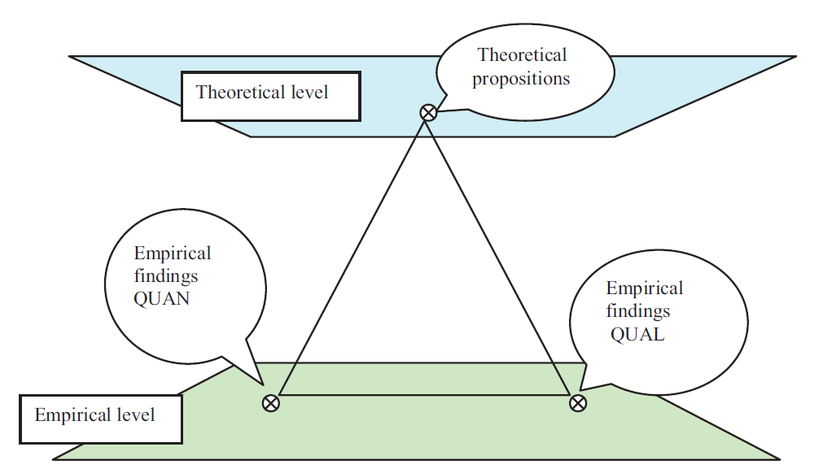
Triangulation
Erzberger, C., Kelle, U., 2003. Making inferences in mixed methods: The rules of integration.
In: Tashakkori, A., Teddlie, C. (Eds.), Handbook of Mixed Methods in Social & Behavioural Research.
Sage, Thousand Oaks, pp. 457–488.

Slide 31
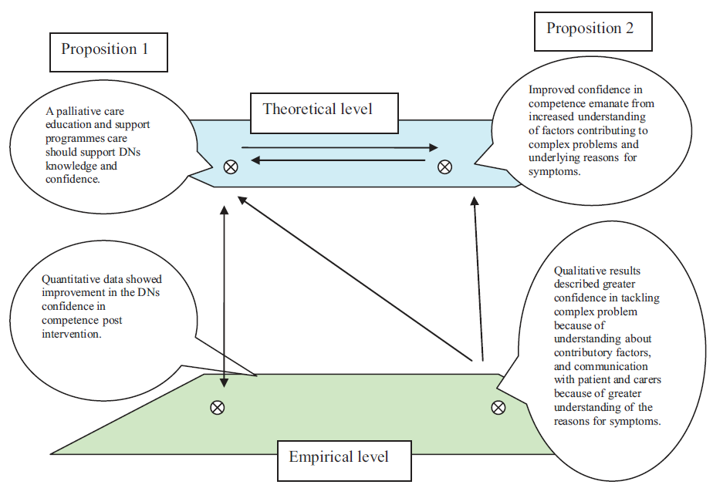
Triangulation with complementary results
(DNs = district nursing teams)
U. Ostlund et al. / International Journal of Nursing Studies 48 (2011) 369–383

Slide 32
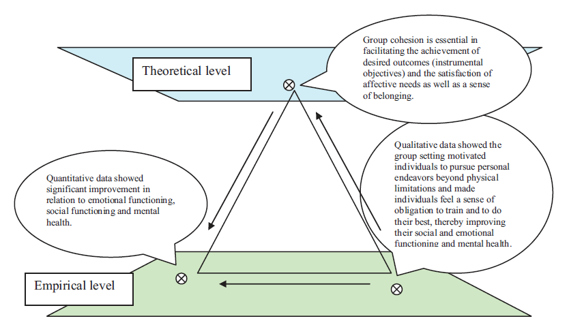
Triangulation with convergent results
U. Ostlund et al. / International Journal of Nursing Studies 48 (2011) 369–383

Slide 33
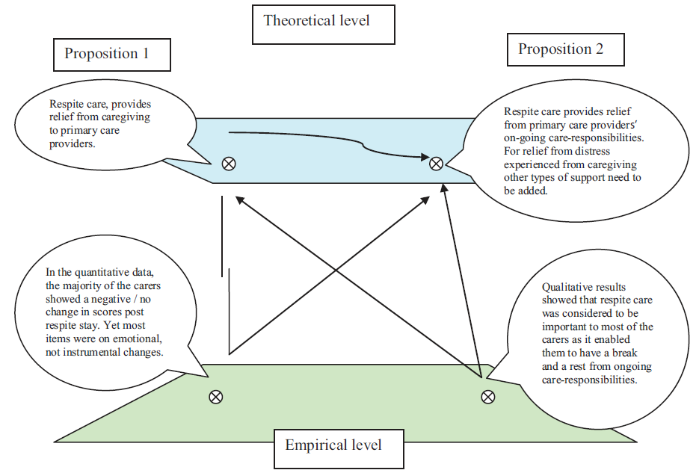
Triangulation with divergent results
???
U. Ostlund et al. / International Journal of Nursing Studies 48 (2011) 369–383
Notes:
Respite care = temporary institutional care of a sick, elderly, or disabled person, providing relief for their usual caregiver.

Slide 34
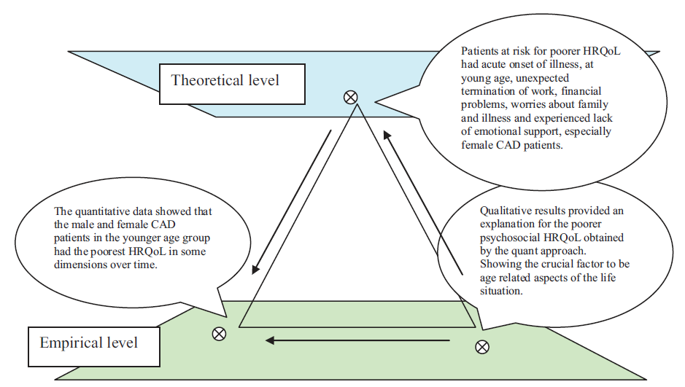
Triangulation to develop theory
A1/1.2 - A3/3.1
(CAD = coronary artery disease)
(HRQoL = health related quality of life)
U. Ostlund et al. / International Journal of Nursing Studies 48 (2011) 369–383

Slide 35
Some purposes of mixed methods
Greene JC, Caracelli VJ, Graham WF. Toward a conceptual framework for mixed-method evaluation designs. Educ Eval Policy Anal 1989; 11(3): 255–274.

Slide 36
Some purposes of mixed methods
Greene JC, Caracelli VJ, Graham WF. Toward a conceptual framework for mixed-method evaluation designs. Educ Eval Policy Anal 1989; 11(3): 255–274.

Slide 37
Some purposes of mixed methods
Greene JC, Caracelli VJ, Graham WF. Toward a conceptual framework for mixed-method evaluation designs. Educ Eval Policy Anal 1989; 11(3): 255–274.

Slide 38
Some purposes of mixed methods
Greene JC, Caracelli VJ, Graham WF. Toward a conceptual framework for mixed-method evaluation designs. Educ Eval Policy Anal 1989; 11(3): 255–274.

Slide 39
Mixed methods view on research problem
Comparing different perspectives drawn from quantitative and qualitative data.
Explaining quantitative results with a qualitative follow-up data collection and analysis.
Developing better measurement instruments by first collecting and analyzing qualitative data and then testing the instruments in a sample.
Understanding experimental results by incorporating the perspectives of individuals.
Developing a more complete understanding of changes needed for a marginalized group through the combination of qualitative and quantitative data.
Having a better understanding the need for and impact of an intervention program through collecting both quantitative and qualitative data over time.
Creswell JW. Research design : qualitative, quantitative, and mixed methods approaches— 4th ed. Sage Publications, 2014.

Slide 40
‘World views’
A4/4.5
‘I suggest that individuals preparing a research proposal or plan make explicit the larger philosophical ideas they espouse. This information will help explain why they chose qualitative, quantitative, or mixed methods approaches for their research’.
In writing about worldviews, a proposal might include a section that addresses the following:
  the philosophical worldview proposed in the study,
  a definition of basic ideas of that worldview,
  how the worldview shaped their approach to research.’
Creswell JW. Research design : qualitative, quantitative, and mixed methods approaches— 4th ed. Sage Publications, 2014, p5-6.

Slide 41
Main world views
Postpositivism | Constructivism Understanding Multiple participant meanings Social and historical construction Theory generation
Transformative Political Power and justice oriented Collaborative Change-oriented | Pragmatism
Creswell JW. Research design : qualitative, quantitative, and mixed methods approaches— 4th ed. Sage Publications, 2014, p6.

Slide 42
Main world views
Postpositivism Determination (Reductionism) Empirical observation and measurement Theory verification | Constructivism
Transformative Political Power and justice oriented Collaborative Change-oriented | Pragmatism
Creswell JW. Research design : qualitative, quantitative, and mixed methods approaches— 4th ed. Sage Publications, 2014, p6.

Slide 43
Main world views
Postpositivism Determination (Reductionism) Empirical observation and measurement Theory verification | Constructivism Understanding Multiple participant meanings Social and historical construction Theory generation
Transformative Political Power and justice oriented Collaborative Change-oriented | Pragmatism
Creswell JW. Research design : qualitative, quantitative, and mixed methods approaches— 4th ed. Sage Publications, 2014, p6.

Slide 44
Main world views
Postpositivism Determination (Reductionism) Empirical observation and measurement Theory verification | Constructivism Understanding Multiple participant meanings Social and historical construction Theory generation
Transformative Political Power and justice oriented Collaborative Change-oriented | Pragmatism
Creswell JW. Research design : qualitative, quantitative, and mixed methods approaches— 4th ed. Sage Publications, 2014, p6.

Slide 45
Main world views
Postpositivism Determination (Reductionism) Empirical observation and measurement Theory verification | Constructivism Understanding Multiple participant meanings Social and historical construction Theory generation
Transformative Political Power and justice oriented Collaborative Change-oriented | Pragmatism Consequences of actions Problem-centered Pluralistic Real-world practice oriented
Creswell JW. Research design : qualitative, quantitative, and mixed methods approaches— 4th ed. Sage Publications, 2014, p6.

Slide 46
Comparison of research processes
Quantitative Methods | Mixed Methods | Qualitative Methods
Pre-determined methods Instrument based questions Performance data, attitude data, observational data, and census data Statistical analysis Statistical interpretation | Both predetermined and emerging Both open- and closed-ended questions Multiple forms of data drawing on all possibilities Statistical and text analysis Across databases interpretation | Emerging methods Open-ended questions Interview data, observation data, document data, and audiovisual data Text and image analysis Themes, patterns interpretation
Creswell JW. Research design : qualitative, quantitative, and mixed methods approaches— 4th ed. Sage Publications, 2014, p17.

Slide 47
Data collection in mixed methods
The data for the qualitative data collection will be smaller than that for the quantitative data collection.
Reason:
  Purpose of qualitative data is
    to locate and obtain information from a small sample
    but to gather extensive information from this sample;
  For quantitative research, a large N is needed in order to conduct meaningful statistical tests.
Creswell JW. Research design : qualitative, quantitative, and mixed methods approaches— 4th ed. Sage Publications, 2014.

Slide 48
Mixed methods research
Is characterized by a research methodology or approach
focusing on research questions that call for real-life contextual understandings, multi-level perspectives, and cultural influences;
employing
  rigorous quantitative research assessing magnitude and frequency of constructs and
  rigorous qualitative research exploring the meaning and understanding of constructs;
utilizing multiple methods (e.g., intervention trials and in-depth interviews);
intentionally integrating or combining these methods to draw on the strengths of each; and
framing the investigation within philosophical and theoretical positions.
Creswell JW, Klassen AC, Plano Clark VL & Clegg Smith K.
Best Practices for Mixed Methods Research in the Health Sciences. Technical Report; 2011; 37p.

Slide 49
Research design types
A3/3.1
Quantitative | Qualitative | Mixed Methods
Experimental designs Nonexperimental designs, such as surveys | Narrative research Phenomenology Grounded theory Ethnographies Case study | Convergent Explanatory sequential Exploratory sequential Transformative, embedded, or multiphase
Be explicit in your proposal!
Add adequate level (see next slides)
Creswell JW. Research design : qualitative, quantitative, and mixed methods approaches— 4th ed. Sage Publications, 2014, p12.

Slide 50
Working with the data sets
A3/3.6
Merge
  Merge or converge the two datasets by actually bringing them together (e.g., convergence—triangulation to validate one dataset using another type of dataset)
Connect
  Have one dataset build upon another data set (e.g., complementarity—elaboration, transformation, expansion, initiation or sampling)
Embed
  Conduct one study within another so that one type of data provides a supportive role to the other dataset (e.g., complementarity—evaluation)
Palinkas et. al. Mixed Method Designs in Implementation Research.
Adm Policy Ment Health (2011) 38:44–53

Slide 51
Convergent parallel mixed methods (1)
Key assumption:
Both qualitative and quantitative data provide different types of information—often detailed views of participants qualitatively and scores on instruments quantitatively—and together they yield results that should be the same.
Creswell JW. Research design : qualitative, quantitative, and mixed methods approaches— 4th ed. Sage Publications, 2014.

Slide 52
Convergent parallel mixed methods (2)
Data collection:
Key idea: to collect both forms of data using the same or parallel variables, constructs, or concepts.
Qualitative data can be interviews, observations, documents, and records of instrument data, observational checklists, or numeric records, such as census data.
Creswell JW. Research design : qualitative, quantitative, and mixed methods approaches— 4th ed. Sage Publications, 2014, p6.

Slide 53
Convergent parallel mixed methods (3)
Data analysis:
Analyze databases separately and then bring together.
Options:
  side-by-side comparison:
    first report the quantitative statistical results and then discuss the qualitative findings (e.g., themes) that either confirm or disconfirm the statistical results, or,
    start with the qualitative findings and then compare them to the quantitative results.
  data transformation:
    take the qualitative themes or codes and count them (and possibly group them) to form quantitative measures.
  joint display of data:
    merge the two forms of data in a table or a graph.
Creswell JW. Research design : qualitative, quantitative, and mixed methods approaches— 4th ed. Sage Publications, 2014.

Slide 54
Convergent parallel mixed methods (4)
Drawbacks:
On interpretation:
  the comparison may not yield a clean convergent or divergent situation:
    state divergence as a limitation in the study,
    or
    return to the analyses and further explore the databases,
    collect additional information to resolve the differences, or
    discuss the results from one of the databases as possibly limited.
On validity:
  should be based on establishing both quantitative validity (e.g., construct) and qualitative validity (e.g., triangulation) for each database.
Creswell JW. Research design : qualitative, quantitative, and mixed methods approaches— 4th ed. Sage Publications, 2014.

Slide 55
Sequential designs
A3/3.1
Explanatory sequential mixed method
Exploratory sequential mixed methods
Creswell JW. Research design : qualitative, quantitative, and mixed methods approaches— 4th ed. Sage Publications, 2014.

Slide 56
Explanatory sequential design
A3/3.1
The quantitative results: inform
  the types of participants to be purposefully selected for the qualitative phase and
  the types of questions that will be asked of the participants.
Intent: to have the qualitative data help explain in more detail the initial quantitative results.
Sampling: rigorous in the first phase and purposeful in the second one (from within the first sample).
Do not merge the two databases because a direct comparison of the two databases is inadequate.
Creswell JW. Research design : qualitative, quantitative, and mixed methods approaches— 4th ed. Sage Publications, 2014.

Slide 57
Exploratory sequential design (1)
A3/3.1
Intent:
  to develop better measurements with specific samples of populations and to see if data from a few individuals (in qualitative phase) can be generalized to a large sample of a population (in quantitative phase);
  analyze the qualitative data to develop new variables, to identify the types of scales that might exist in current instruments or to form categories of information that will be explored further in a quantitative phase.
Three-phase procedure:
    exploratory phase
    instrument development,
    administering the instrument to a sample of a population.
Creswell JW. Research design : qualitative, quantitative, and mixed methods approaches— 4th ed. Sage Publications, 2014.

Slide 58
Exploratory sequential design (1)
Intent:
  to develop better measurements with specific samples of populations and to see if data from a few individuals (in qualitative phase) can be generalized to a large sample of a population (in quantitative phase);
  analyze the qualitative data to develop new variables, to identify the types of scales that might exist in current instruments or to form categories of information that will be explored further in a quantitative phase.
Three-phase procedure:
    exploratory phase
    instrument development,
    administering the instrument to a sample of a population.
ML and Prediction model proposals !!!
You need to have all three components, and 3. needs to be described in much detail!
Creswell JW. Research design : qualitative, quantitative, and mixed methods approaches— 4th ed. Sage Publications, 2014.

Slide 59
Exploratory sequential design (2)
Sampling:
draw both samples from the same population but make sure that the individuals for both samples are not the same.
Caveat: have individuals help develop an instrument and then to survey them in the quantitative phase would introduce confounding factors into the study.
Creswell JW. Research design : qualitative, quantitative, and mixed methods approaches— 4th ed. Sage Publications, 2014.

Slide 60
Concurrent design
A3/3.1

Slide 61
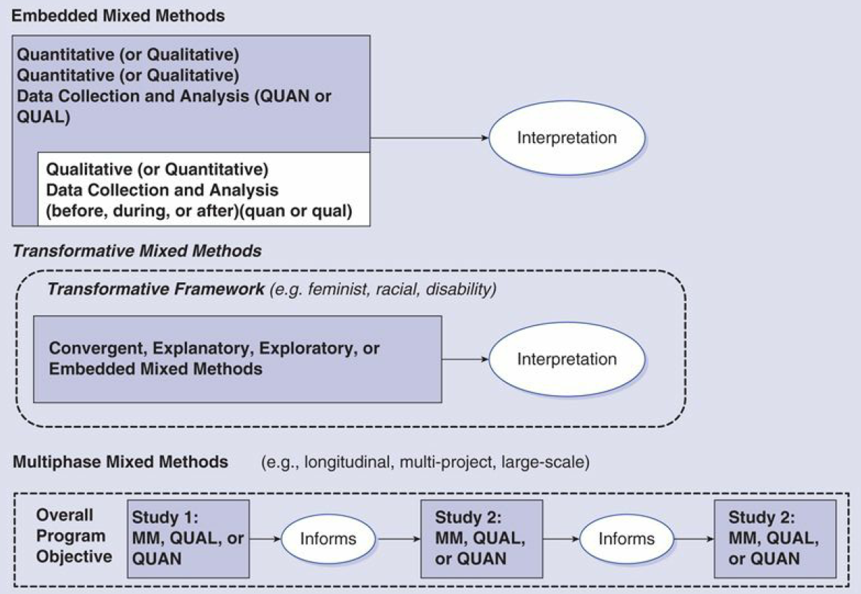
Advanced designs
Creswell JW. Research design : qualitative, quantitative, and mixed methods approaches— 4th ed. Sage Publications, 2014.

Slide 62
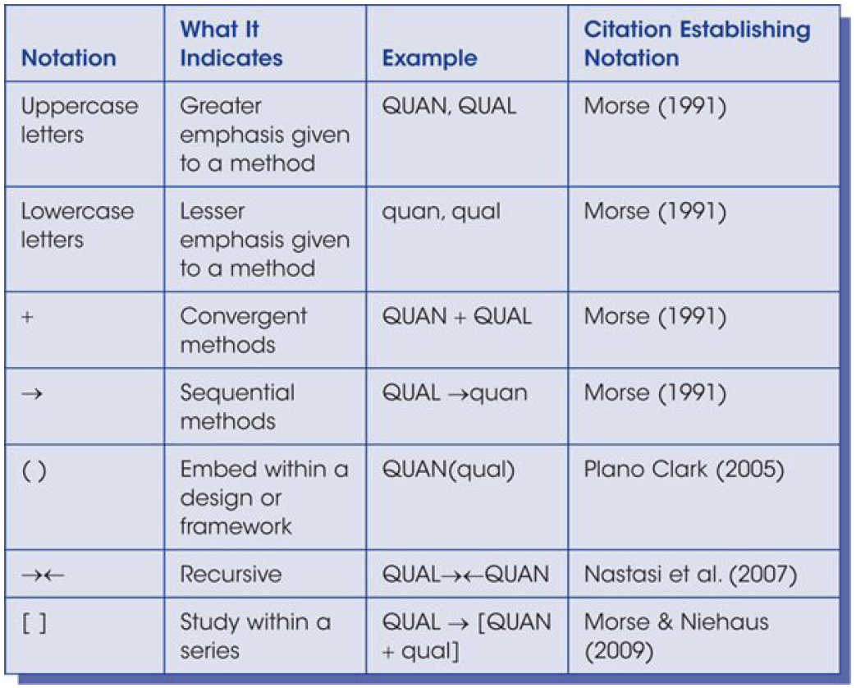
Shorthand notations for MM designs
Creswell JW. Research design : qualitative, quantitative, and mixed methods approaches— 4th ed. Sage Publications, 2014.

Slide 63
Criteria for choosing a specific MM design
Choice Based on:
  Outcomes expected;
  How the data will be used together (or integrated);
  Timing of the data collection;
  Emphasis placed on each database;
  Type of design most suited for a field;
  Single researcher or team.
Creswell JW. Research design : qualitative, quantitative, and mixed methods approaches— 4th ed. Sage Publications, 2014.

Slide 64
Criteria for choosing an MM design
A1 - A3/3.1
Reasons | Expected Outcomes | Design
Comparing different perspectives drawn from quantitative and qualitative data Explaining quantitative results with qualitative data Developing better measurement instruments Understanding experimental results by incorporating perspectives of individuals Developing an understanding of needed changes for a marginalized group Understanding the need for an impact of an intervention | Merging the two databases to show how the data converge or diverge An in-depth understanding of the quantitative results (often cultural relevance) A test of better measures for a sample of a population An understanding of participant views within the context of an experimental intervention A call for action program A formative and summative evaluation | Convergent parallel Explanatory sequential Exploratory sequential Embedded Transformative Multiphase
Creswell JW. Research design : qualitative, quantitative, and mixed methods approaches— 4th ed. Sage Publications, 2014.

Slide 65
Criteria for choosing an MM design
A1 - A3/3.1
Reasons | Expected Outcomes | Design
Comparing different perspectives drawn from quantitative and qualitative data Explaining quantitative results with qualitative data Developing better measurement instruments Understanding experimental results by incorporating perspectives of individuals Developing an understanding of needed changes for a marginalized group Understanding the need for an impact of an intervention | Merging the two databases to show how the data converge or diverge An in-depth understanding of the quantitative results (often cultural relevance) A test of better measures for a sample of a population An understanding of participant views within the context of an experimental intervention A call for action program A formative and summative evaluation | Convergent parallel Explanatory sequential Exploratory sequential Embedded Transformative Multiphase
Creswell JW. Research design : qualitative, quantitative, and mixed methods approaches— 4th ed. Sage Publications, 2014.

Slide 66
Criteria for choosing an MM design
A1 - A3/3.1
Reasons | Expected Outcomes | Design
Comparing different perspectives drawn from quantitative and qualitative data Explaining quantitative results with qualitative data Developing better measurement instruments Understanding experimental results by incorporating perspectives of individuals Developing an understanding of needed changes for a marginalized group Understanding the need for an impact of an intervention | Merging the two databases to show how the data converge or diverge An in-depth understanding of the quantitative results (often cultural relevance) A test of better measures for a sample of a population An understanding of participant views within the context of an experimental intervention A call for action program A formative and summative evaluation | Convergent parallel Explanatory sequential Exploratory sequential Embedded Transformative Multiphase
Creswell JW. Research design : qualitative, quantitative, and mixed methods approaches— 4th ed. Sage Publications, 2014.

Slide 67
Criteria for choosing an MM design
A1 - A3/3.1
Reasons | Expected Outcomes | Design
Comparing different perspectives drawn from quantitative and qualitative data Explaining quantitative results with qualitative data Developing better measurement instruments Understanding experimental results by incorporating perspectives of individuals Developing an understanding of needed changes for a marginalized group Understanding the need for an impact of an intervention | Merging the two databases to show how the data converge or diverge An in-depth understanding of the quantitative results (often cultural relevance) A test of better measures for a sample of a population An understanding of participant views within the context of an experimental intervention A call for action program A formative and summative evaluation | Convergent parallel Explanatory sequential Exploratory sequential Embedded Transformative Multiphase
Creswell JW. Research design : qualitative, quantitative, and mixed methods approaches— 4th ed. Sage Publications, 2014.

Slide 68
Criteria for choosing an MM design
A1 - A3/3.1
Reasons | Expected Outcomes | Design
Comparing different perspectives drawn from quantitative and qualitative data Explaining quantitative results with qualitative data Developing better measurement instruments Understanding experimental results by incorporating perspectives of individuals Developing an understanding of needed changes for a marginalized group Understanding the need for an impact of an intervention | Merging the two databases to show how the data converge or diverge An in-depth understanding of the quantitative results (often cultural relevance) A test of better measures for a sample of a population An understanding of participant views within the context of an experimental intervention A call for action program A formative and summative evaluation | Convergent parallel Explanatory sequential Exploratory sequential Embedded Transformative Multiphase
Creswell JW. Research design : qualitative, quantitative, and mixed methods approaches— 4th ed. Sage Publications, 2014.

Slide 69
Criteria for choosing an MM design
A1 - A3/3.1
Reasons | Expected Outcomes | Design
Comparing different perspectives drawn from quantitative and qualitative data Explaining quantitative results with qualitative data Developing better measurement instruments Understanding experimental results by incorporating perspectives of individuals Developing an understanding of needed changes for a marginalized group Understanding the need for an impact of an intervention | Merging the two databases to show how the data converge or diverge An in-depth understanding of the quantitative results (often cultural relevance) A test of better measures for a sample of a population An understanding of participant views within the context of an experimental intervention A call for action program A formative and summative evaluation | Convergent parallel Explanatory sequential Exploratory sequential Embedded Transformative Multiphase
Creswell JW. Research design : qualitative, quantitative, and mixed methods approaches— 4th ed. Sage Publications, 2014.

Slide 70
Criteria for choosing an MM design
A1 - A3/3.1
Reasons | Expected Outcomes | Design
Comparing different perspectives drawn from quantitative and qualitative data Explaining quantitative results with qualitative data Developing better measurement instruments Understanding experimental results by incorporating perspectives of individuals Developing an understanding of needed changes for a marginalized group Understanding the need for an impact of an intervention | Merging the two databases to show how the data converge or diverge An in-depth understanding of the quantitative results (often cultural relevance) A test of better measures for a sample of a population An understanding of participant views within the context of an experimental intervention A call for action program A formative and summative evaluation | Convergent parallel Explanatory sequential Exploratory sequential Embedded Transformative Multiphase
Creswell JW. Research design : qualitative, quantitative, and mixed methods approaches— 4th ed. Sage Publications, 2014.

Slide 71
Mixed method purpose statement
A3/3.1
contains
  the overall intent of the study,
  information about both the quantitative and qualitative strands of the study,
  a rationale of incorporating both strands to study the research problem.
Goal:
  provide major signposts for the reader to understand the quantitative and qualitative parts of a study.
Creswell JW. Research design : qualitative, quantitative, and mixed methods approaches— 4th ed. Sage Publications, 2014.

Slide 72
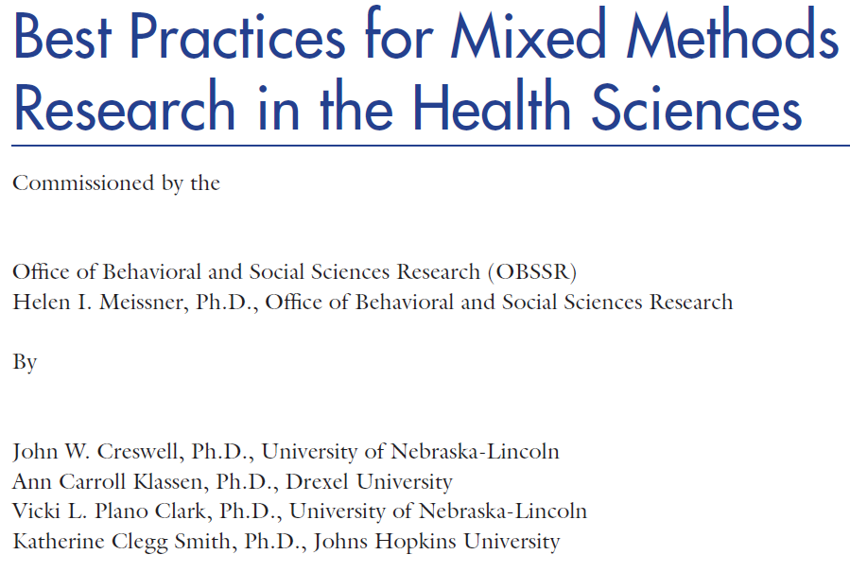
NIH proposals for MM research

Slide 73
Good Reporting of A Mixed Methods Study (GRAMMS)
Describe:
  the justification for using a mixed methods approach to the research question;
  the design in terms of the purpose, priority, and sequence of methods;
  each method in terms of sampling, data collection and analysis;
  where integration has occurred, how it has occurred, and who has participated in it;
  any limitation of one method associated with the presence of the other method; and
  any insights gained from mixing or integrating methods.
O’Cathain, A., Murphy, E., & Nicholl, J. (2008). The quality of mixed methods studies in health services research. Journal of Health Services Research Policy, 13(2), 92-98.

Slide 74
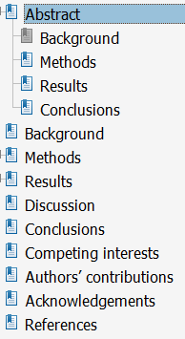
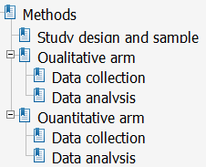
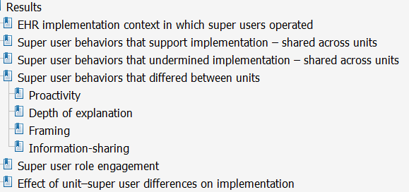
Journal article example
A mixed methods study of how clinician ‘super users’ influence others during the implementation of electronic health records
Yuan et al. BMC Medical Informatics and Decision Making (2015) 15:26

Slide 75
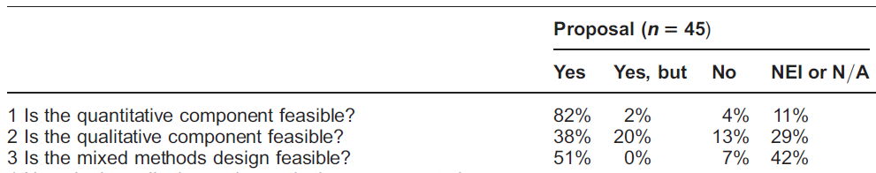
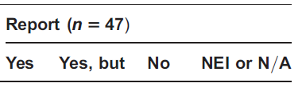
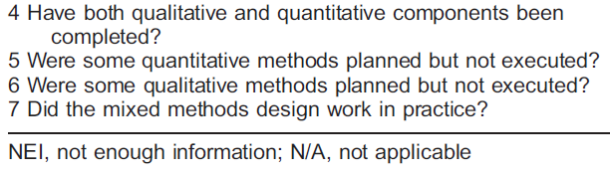
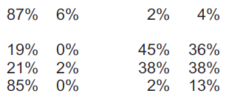
Success of MM studies in HSR
The quality of mixed methods studies in health services research
Alicia O’Cathain, Elizabeth Murphy1, Jon Nicholl
Journal of Health Services Research & Policy Vol 13 No 2, 2008: 92–98

Slide 76
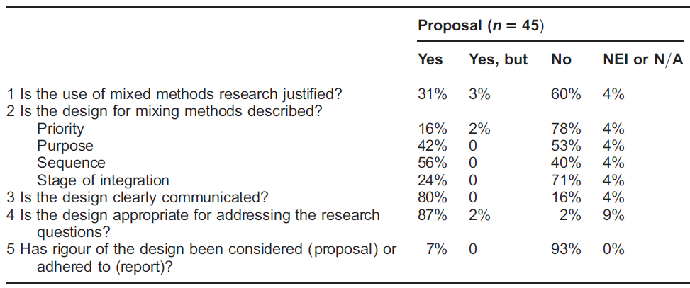
MM design quality of studies in HSR (1)
The quality of mixed methods studies in health services research
Alicia O’Cathain, Elizabeth Murphy1, Jon Nicholl
Journal of Health Services Research & Policy Vol 13 No 2, 2008: 92–98

Slide 77
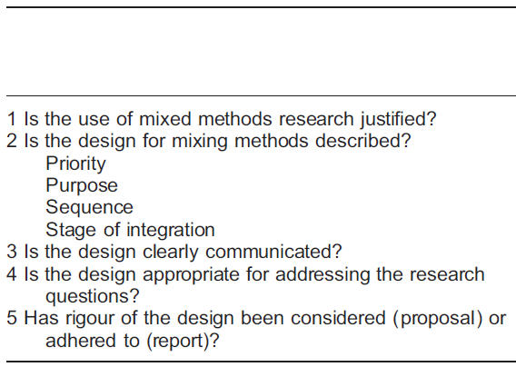
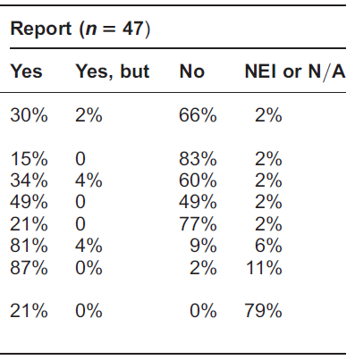
MM design quality of studies in HSR (2)
The quality of mixed methods studies in health services research
Alicia O’Cathain, Elizabeth Murphy1, Jon Nicholl
Journal of Health Services Research & Policy Vol 13 No 2, 2008: 92–98

Slide 78
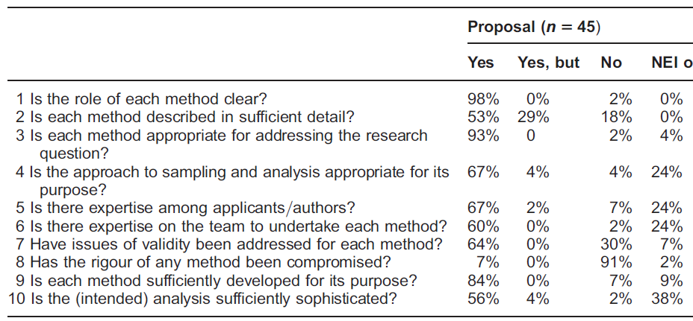
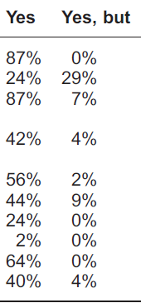
Quality assessment of components
QUAN QUAL
The quality of mixed methods studies in health services research
Alicia O’Cathain, Elizabeth Murphy1, Jon Nicholl
Journal of Health Services Research & Policy Vol 13 No 2, 2008: 92–98

Slide 79
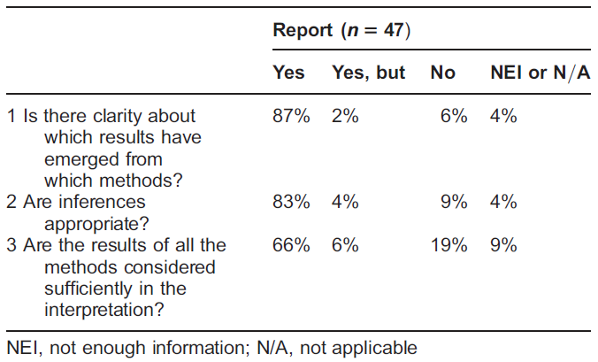
Assessment of inferences made
The quality of mixed methods studies in health services research
Alicia O’Cathain, Elizabeth Murphy1, Jon Nicholl
Journal of Health Services Research & Policy Vol 13 No 2, 2008: 92–98

