Slide 1
Statistical data analysis and research methods
BMI504
Course 17229 – Spring 2023
Class 9 – April 6, 2022
Elements of Epidemiology
Werner CEUSTERS

Slide 2
Extra credit opportunity

Slide 3
Recommendations for A6
Theoretical and Operational Linkages are BY FAR not adequately covered.

Slide 4
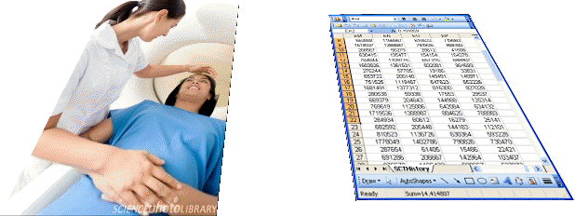
Data and Reality
Referents
Window on reality
References
  Population
  Phenomena
  Truthmakers for hypotheses
  Bias
  Sample data
  Statistical hypotheses
  Variable descriptions
  Theoretical linkage
  Operational linkage

Slide 5
Theoretical linkage
Should explain WHY you believe your alternate hypothesis is correct and the null to be rejected.
Should describe how various intermediate variables in your theory are related amongst each other, and to the dependent and independent variables so that the dependent variables corollate with the independent variables in the way claimed by your alternative hypothesis. Therefore, all these variables need to be described in your variable description section.

Slide 6
Operational linkage
should describe WHY you believe that the way you measure your variables will lead to observing the effect in the way that you predicted as described and motivated in the theoretical linkage.

Slide 7
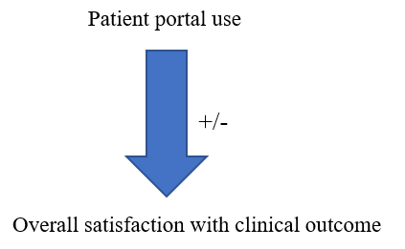
This is NOT an operational linkage!
This is only a graphical depiction of a hypothesis!

Slide 8
Recommendations for A6
Theoretical and Operational Linkages are BY FAR not adequately covered.
Stick to the format: variable descriptions as on C8 slides 35-37!.
Divide variables in three groups: (1) independent, (2) dependent, (3) bias and theory variables

Slide 9
Example for one variable
Variable: SPPC
Label: Satisfaction with Primary Physician Communication
Theoretical definition: extend to which the subject is satisfied with the communication with his primary physician.
Operational definition 1 (nominal level of measurement)
    Response to the question: Do you feel that most of the time your communication with your primary physician is satisfactory?
    (a) YES or (b) NO
Operational definition 2 (ordinal level of measurement)
    Response to the question: Do you feel that most of the time your communication with your primary physician is:
    (a) very satisfactory (d) somewhat unsatisfactory
    (b) somewhat satisfactory (e) very unsatisfactory
    (c) neither
Adapted from: James H. Watt and Sjef van den Berg. Research Methods For Communication Science. 2002 http://www.cios.org/readbook/rmcs/rmcs.htm

Slide 10
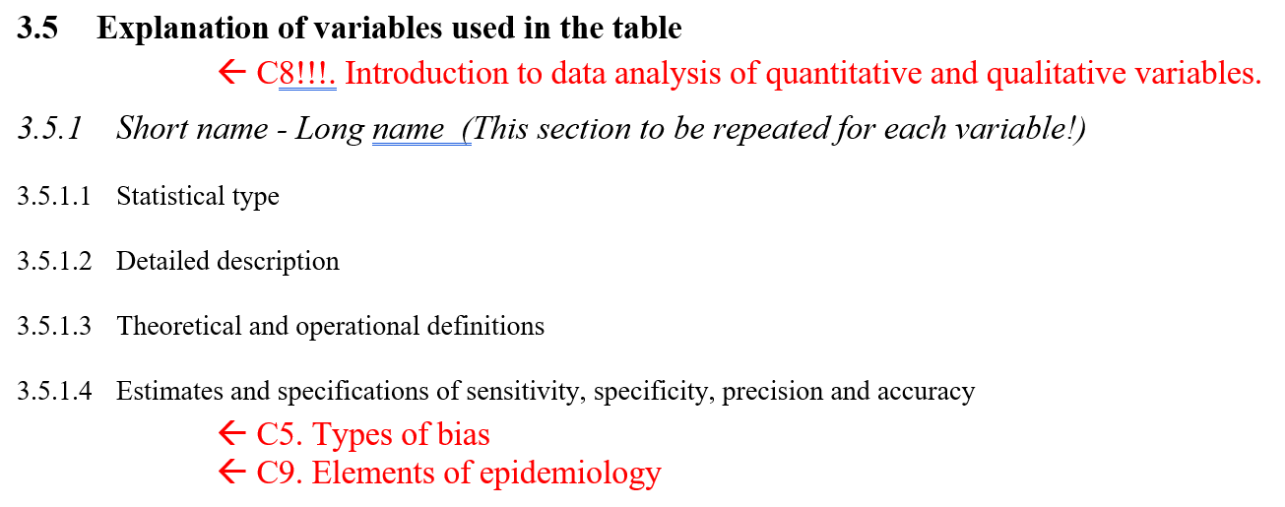
Confusion with proposal template

Slide 11
Recommendations for A6
Theoretical and Operational Linkages are BY FAR not adequately covered.
Stick to the format: variable descriptions as on C8 slides 35-37!.
Divide variables in three groups: (1) independent, (2) dependent, (3) bias and theory variables
Remove inconsistencies, redundancies, irrelevancies and overgeneralizations
If some aspect of the template is irrelevant for your study, say so, and don’t put irrelevant banter.
Do not omit what IS relevant and needed and specific!

Slide 12
Ground truth and proposals
Research Topic
ground truth (GT)
Proposal assertions
Hypothesis GT
Theory GT
Methodology GT
Outside Topic
ground truth (GT)

Slide 13
Above all !!!
Read your entire document through several times.
Apply critical thinking to everything you wrote.

Slide 14
Change in last two classes

Slide 15
C9. Elements of Epidemiology
Class structure:
  Lecture covering essential notions in population studies such as incidence, prevalence, mortality ratios, validity, reliability, sensitivity, and specificity, etc…
Post-class assignment:
  Produce A4 (see next slide)
  Upload to UB Learns.
  This version will be used by the instructor of C11 to make that class maximally relevant to the students’ research proposals.
  Make sure you put in your A4 specific questions you want the instructor to address re your proposal!!!!
  Due date: April 10 – noon.

Slide 16
Concrete A4 format: 5 min. sales pitch
Maximum ONE page: TO THE POINT!!!
  Introduction: very short, just to give the context
  Specific aim(s): what you want to achieve and why. Very short.
  Research question(s) in PICOT-format types, and for each:
    Hypotheses
      Theoretical linkage for the alternative hypotheses
    Statistical hypotheses
      Operational linkage for the alternative statistical hypotheses
Additional pages (no limitation)
  Data tables and structures
  Description of variables used (independent, dependent, bias)
    Label
    Levels of measurement
    Theoretical and Operational definitions.
Specific questions for the statistician to address.
(e.g. power study issues, bias control, statistic tests, ….)

Slide 17
2nd assignment: required reading
Required reading:
R11 McCluskey, A. and A.G. Lalkhen, Statistics II: Central tendency and spread of data. Continuing Education in Anaesthesia Critical Care & Pain, 2007. 7(4): p. 127-130.
  https://academic.oup.com/bjaed/article/7/4/127/466523 [11]
R12 Cohen, H.W., P values: use and misuse in medical literature. Am J Hypertens, 2011. 24(1): p. 18-23.. [12]
  https://academic.oup.com/ajh/article/24/1/18/165807
  !!! This paper will be the topic of a closed book in-class test during class C10 !!!

Slide 18
Epidemiology
‘about’
‘people’
‘study’
‘Epidemiology is:
the study of the distribution and determinants of health-related states and events in specified populations, and
the application of this study to prevention and control of health problems.’
Last JM, editor. Dictionary of epidemiology. 4th ed. New York: Oxford University Press; 2001. p. 61.

Slide 19
Basic Assumptions of Epidemiology
Diseases do not occur randomly.
The causes and nature of diseases and the spread of diseases depend on certain observable factors.
Modification of these causes can result in prevention and control of diseases.
Gordis, Leon. Epidemiology (5). Saint Louis, US: Saunders, 2013. ProQuest ebrary. Web. 2 March 2017

Slide 20
Basic Assumptions of Epidemiology determinist generalization
Diseases do not occur randomly.
  Whatever happens does not occur randomly.
The causes and nature of diseases and the spread of diseases depend on certain observable factors.
  Causes of changes depend on observable factors.
Modification of these causes can result in prevention and control of diseases.
  Modification of these causes can result in prevention of what we don’t want to happen or in happenings we do want.

Slide 21
Your job as student in this class
Find the parallels with the topics of your research proposals!

Slide 22
Key terms
Determinants: factors that influence health: biological, chemical, physical, social, cultural, genetic and behavior;
Distribution: of determinants over time, populations, and places;
Health-Related States and Events: diseases, causes of death, health-related behaviors (smoking, exercise), reaction to preventive programs, provision and utilization of health services;
Specified Populations: includes populations with identifiable characteristics such as occupation, race/ethnicity;
Prevention and Control: the aim of public health: to protect and restore health.
Gordis, Leon. Epidemiology (5). Saint Louis, US: Saunders, 2013. ProQuest ebrary. Web. 2 March 2017

Slide 23

Recommended movie

Slide 24
Earliest Example of Geographical Information System Methods by John Snow (1854 Cholera outbreak)
Location of
Historic
Broad Street
Pump
http://www.ph.ucla.edu/epi/snow/mapsbroadstreet.html

Slide 25
Observational Data leading to Prevention
http://www.ph.ucla.edu/epi/snow.html

Slide 26
Use of Epidemiology in Public Health
Describing:
  patterns and changes thereof of community health problems.
  patterns of disease in relation to persons, times, places, events, or other characteristic over time.
Providing insight in changes in risk factors, effect of treatments and/or healthcare-related technologies in the population.
Planning, promoting, and evaluating health services.
Steering public health policy.

Slide 27
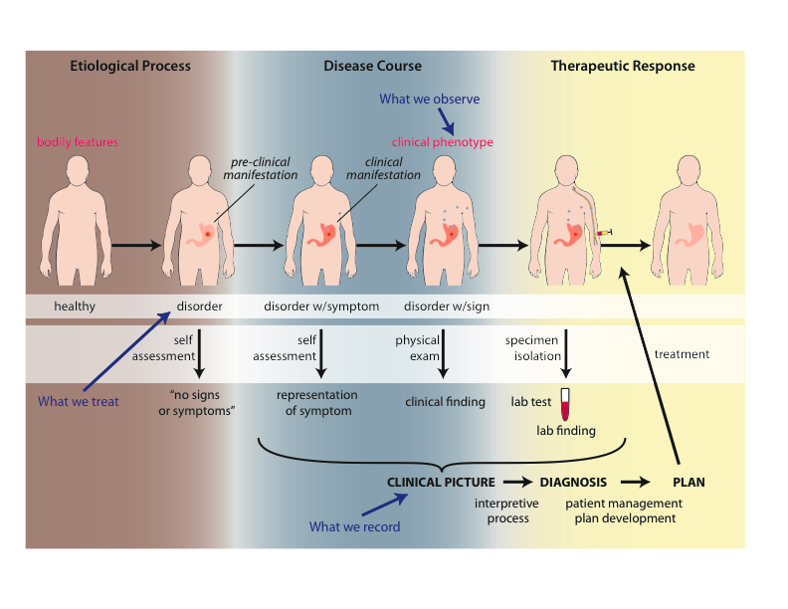
Evolution of a disease instance
Scheuermann R, Ceusters W, Smith B. Toward an Ontological Treatment of Disease and Diagnosis. 2009 AMIA Summit on Translational Bioinformatics, San Francisco, California, March 15-17, 2009;: 116-120. Omnipress ISBN:0-9647743-7-2

Slide 28
Ontological definition of ‘disease’
a disease is a disposition rooted in a physical disorder in the organism and realized in pathological processes.
produces
bears
realized_in
etiological process
disorder
disease
(disposition)
pathological process
produces
diagnosis
interpretive process
signs & symptoms
abnormal bodily features
produces
participates_in
recognized_as

Slide 29
Cirrhosis - environmental exposure
Etiological process - phenobarbitol-induced hepatic cell death
  produces
Disorder - necrotic liver
  bears
Disposition (disease) - cirrhosis
  realized_in
Pathological process - abnormal tissue repair with cell proliferation and fibrosis that exceed a certain threshold; hypoxia-induced cell death
  produces
Abnormal bodily features
  recognized_as
Symptoms - fatigue, anorexia
Signs - jaundice, splenomegaly
Symptoms & Signs
  used_in
Interpretive process
  produces
Hypothesis - rule out cirrhosis
  suggests
Laboratory tests
  produces
Test results – documentation of elevated liver enzymes in serum
  used_in
Interpretive process
  produces
Result - diagnosis that patient X has a disorder that bears the disease cirrhosis

Slide 30
Hereditary Non-polyposis Colorectal Cancer HNPCC - genetic pre-disposition
Etiological process - inheritance of a mutant mismatch repair gene
  produces
Disorder - chromosome 3 with abnormal hMLH1
  bears
Disposition (disease) - Lynch syndrome
  realized_in
Pathological process - abnormal repair of DNA mismatches
  produces
Disorder - mutations in proto-oncogenes and tumor suppressor genes with microsatellite repeats (e.g. TGF-beta R2)
  bears
Disposition (disease) - non-polyposis colon cancer

Slide 31
Hemorrhagic stroke
Disorder – cerebral arterial aneurysm
  bears
Disposition – of weakened artery to rupture
  realized in
Pathological process – rupturing of weakened blood vessel
  produces
Disorder – Intraparenchymal cerebral hemorrhage
  bears
Disposition (disease) – to increased intra-cranial pressure
  realized in
Pathological process – increasing intra-cranial pressure, compression of brain structures
  produces
Disorder – Cerebral ischemia, Cerebral neuronal death
  bears
Disposition (disease) – stroke
  realized in
Symptoms – weakness/paralysis, loss of sensation, etc

Slide 32
Ontological definition of ‘disease’
a disease is a disposition rooted in a physical disorder in the organism and realized in pathological processes.
Clinical Epidemiology
produces
bears
realized_in
etiological process
disorder
disease
(disposition)
pathological process
produces
diagnosis
interpretive process
signs & symptoms
abnormal bodily features
produces
participates_in
recognized_as

Slide 33
Disease Prevention
In the general population;
In high-risk groups;
Levels of preventive efforts:
  Primary -Prevent initial development of disease (e.g., risk factor reduction, immunization);
  Secondary -Early detection of existing disease to reduce morbidity and mortality (screening for cancer, high blood pressure, etc.);
  Tertiary -Reduce the impact of acute worsening of disease (e.g., coronary care unit for heart attacks; physical rehab after a stroke due to CVD).
Gordis, Leon. Epidemiology (5). Saint Louis, US: Saunders, 2013. ProQuest ebrary. Web. 2 March 2017

Slide 34
Ontological definition of ‘disease’
a disease is a disposition rooted in a physical disorder in the organism and realized in pathological processes.
Clinical Epidemiology
produces
bears
realized_in
3
etiological process
disorder
disease
(disposition)
pathological process
1
2
produces
diagnosis
interpretive process
signs & symptoms
abnormal bodily features
produces
participates_in
recognized_as

Slide 35
Epidemiologic Triad of Disease (ETD)
Susceptible Host
Environment
Agent : Infectious or non-infectious
Vector

Slide 36
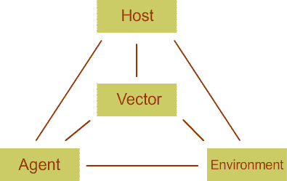
Other representation of ETD
https://newonlinecourses.science.psu.edu/stat507/node/25/

Slide 37
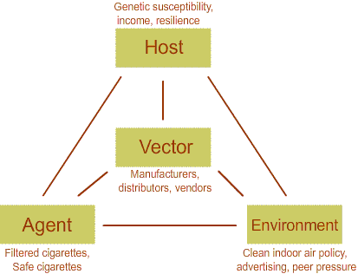
Depicting participants in disease creation
https://newonlinecourses.science.psu.edu/stat507/node/25/

Slide 38
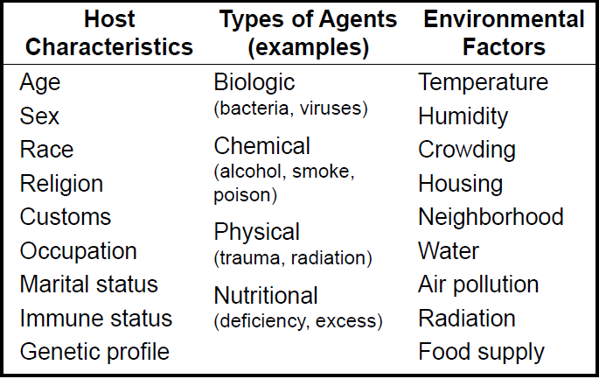
Sorts of disease determinants
Gordis, Leon. Epidemiology (5). Saint Louis, US: Saunders, 2013.

Slide 39
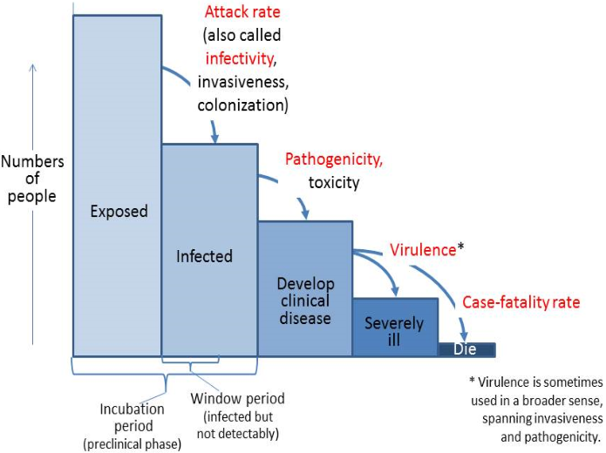
Stages of disease progression
https://www.med.uottawa.ca/sim/data/Pub_Infectious_e.htm#ID_hist

Slide 40
Disease Patterns
Endemic: Habitual presence of a disease in a geographic area or population.
Epidemic: Unusually frequent occurrence of a disease in a geographic area.
Pandemic: Worldwide epidemic.

Slide 41
Kenneth Rothman Definitions for “Induction” and “Latency”
Induction Period – The period of time from causal action until disease initiation (occurrence).
Latency Period – Interval between disease initiation and detection. Duration of interval influenced by methods of detection.

Slide 42
Ontological definition of ‘disease’
a disease is a disposition rooted in a physical disorder in the organism and realized in pathological processes.
produces
bears
realized_in
etiological process
disorder
disease
(disposition)
pathological process
Induction period
latency period
produces
diagnosis
interpretive process
signs & symptoms
abnormal bodily features
produces
participates_in
recognized_as

Slide 43
Kenneth Rothman Definitions for “Induction” and “Latency”
Induction Period – The period of time from causal action until disease initiation (occurrence).
Latency Period – Interval between disease initiation and detection. Duration of interval influenced by methods of detection.
Empirical Induction (or Latency) Period – An a priori hypothesis regarding the duration between exposure and disease occurrence or between exposure and disease detection.

Slide 44
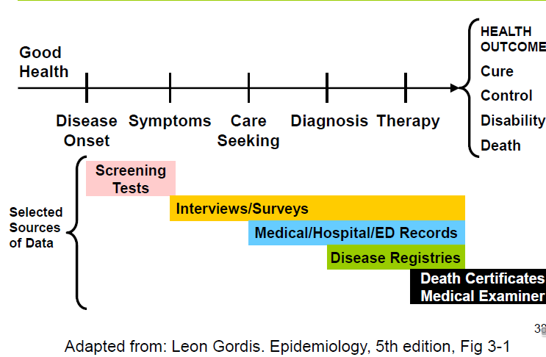
Methods of obtaining data about disease occurrences

Slide 45
Epidemiologic measures

Slide 46
Numerator / Denominator (1)
Numerator:
  Representation of cases exhibiting a certain characteristic;
    e.g.: count of persons with disease X
Denominator:
  Representation of the population in perspective of which the numerator is expressed;
    e.g.: count of citizens of Buffalo.
  Ideally: should be reflective of the population who could have been included in the numerator had they the characteristic of interest → population at risk.

Slide 47
Numerator / Denominator (2)
Example:
          a = people in NYS
          b = people with
          c = overweight
          people in
          Buffalo
          d = males
e
f
i
g
h
j
k

Slide 48
Numerator / Denominator (3)
Counts: a, b, c, d, …

Slide 49
Numerator / Denominator (3)
Counts: a, b, c, d, …
Ratios:
a) f/h ; i/k
b) j/b ; g/c

Slide 50
Numerator / Denominator (3)
Counts: a, b, c, d, …
Ratios:
a) f/h ; i/k
b) j/b ; g/c
→ difference?
Ratios:
a) numerator & denominator are unrelated
→ ‘ratio strictu sensu’
b) numerator counts are included in denominator counts
→ ‘proportion’

Slide 51
Measures of Disease occurrence
Form | Expressed | Description | Example
Count | a | Number of occurrences | Number of cases
Ratio | a:b | Division of two numbers not necessarily related | Number of males to females
Proportion | a/(a+b) | Division of two numbers that are related. Numerator is a part of denominator | Number of cases of opioid dependence per 100 thousand residents of Erie county
Rate | a/(a+b)/t or a/(a+b)*t | Ratio or proportion where time is included in the denominator | Number of new cases of lung cancer per 100,000 residents of Buffalo in one year
Adopted from Gordis, Leon. Epidemiology (5). Saint Louis, US: Saunders, 2013.

Slide 52
Incidence
The number of new cases or events occurring in a defined population during a specified time period.

Slide 53
Incidence
Incidence Rate
Incidence Density
Cumulative Incidence Rate
Special Incidence rates-
      Attack rate
      Secondary Attack rate

Slide 54
Incidence Rate
Special type of proportion that includes specification of time.
Represents the probability of having the disease in a defined population.
The basic measure of disease occurrence.

Slide 55
Calculation of Incidence rate
Number of new cases of disease occurring during a specified period of time
------------------------------------------------
Number of persons at risk for the disease during the same period
x K
Gordis, Leon. Epidemiology (5). Saint Louis, US: Saunders, 2013.

Slide 56
What is needed to calculate incidence rate
Case definition –What is considered disease?
Numerator = Number of Events
Denominator = Defined Population at Risk
Specified period
Constant (unit multiplier, “K”): e.g. per 100,000
Gordis, Leon. Epidemiology (5). Saint Louis, US: Saunders, 2013.

Slide 57
Characteristics of the denominator (1)
“For an incidence rate to be meaningful, any individual who is included in the denominator must have the potential to become part of the group included in the numerator”.
All cases in the numerator must come from the denominator.
Gordis, Leon. Epidemiology (5). Saint Louis, US: Saunders, 2013.

Slide 59
Characteristics of the denominator (2)
Potential = biological susceptibility and some probability of being exposed to causal factors.
At risk: Must be able to develop the disease, e.g., only women can contribute to uterine cancer incidence (thus, only women could be part of the denominator). You must always clearly specify the “source” population that is “at risk” to become part of the numerator.
Gordis, Leon. Epidemiology (5). Saint Louis, US: Saunders, 2013.

Slide 60
Risk
Incidence rate indicates a risk because it is a measure of transition from a non-diseased state to a diseased state.
Incidence rates are not affected by treatment but are affected by prevention.
The incidence rate measure is a key to studying disease etiology because causative factors will increase the incidence rate of disease.
Gordis, Leon. Epidemiology (5). Saint Louis, US: Saunders, 2013.

Slide 61
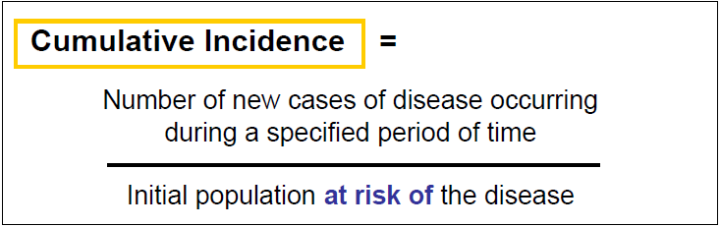
Cumulative Incidence
Cumulative incidence is a measure of disease frequency that addresses the question "How far has the disease spread during a specified period of time?" It is calculated using the following formula:
Gordis, Leon. Epidemiology (5). Saint Louis, US: Saunders, 2013.

Slide 62
Incidence Rate Cumulative
Incidence
Number of new cases of disease occurring during a specified period of time
--------------------------------------
Number of persons at risk for the disease during the same period
Number of new cases of disease occurring during a specified period of time
-----------------------------------
Initial population at risk for the disease
In a constant population, the number of persons at risk decreases with each new case!

Slide 63
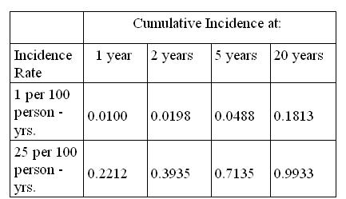
Incidence rate and cumulative incidence (1)
https://www.ctspedia.org/do/view/CTSpedia/RateCumulIncidence

Slide 64
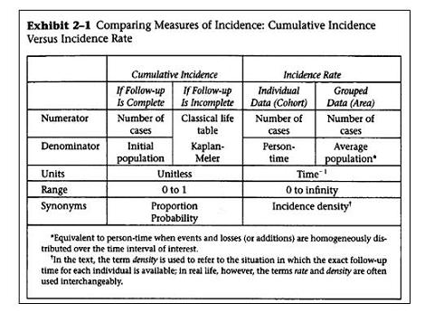
Incidence rate and cumulative incidence (2)
Szklo, M., & Nieto, F. (2007). Epidemiology: Beyond the Basics (2nd Edition ed.). Boston: Jones and Bartlett Publishers.

Slide 65
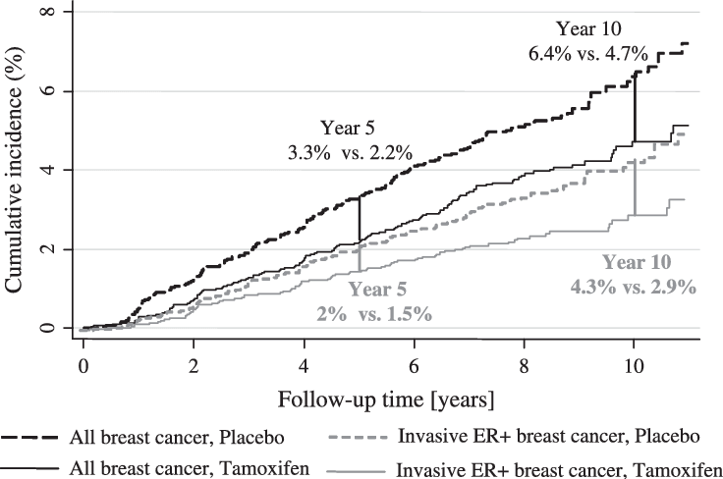
Cumulative incidence example
Cuzick J et. al. Long-Term Results of Tamoxifen Prophylaxis for Breast Cancer--96-Month Follow-up of the Randomized IBIS-I Trial
Journal of the National Cancer Institute 99(4):272-82

Slide 66
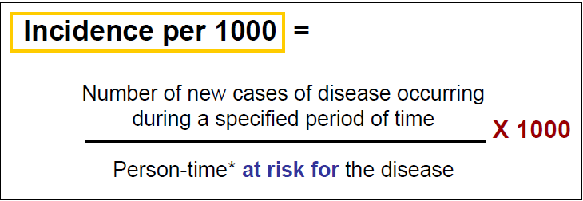
Incidence Density
Number of new cases of a disease during a specific period divided by the amount of person-time at risk (person x their time at risk)
Gordis, Leon. Epidemiology (5). Saint Louis, US: Saunders, 2013. ProQuest ebrary. Web. 2 March 2017

Slide 67
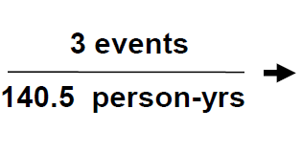
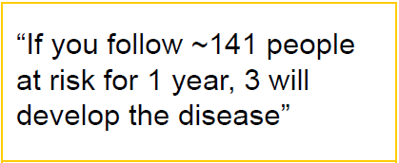
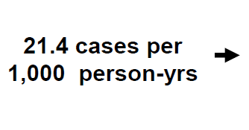
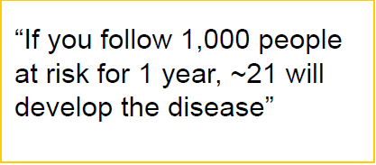
Incidence Density: Interpretation
Gordis, Leon. Epidemiology (5). Saint Louis, US: Saunders, 2013. ProQuest ebrary. Web. 2 March 2017

Slide 68
Identifying new cases
Define population;
Determine who has and who does not have the disease;
Follow the people who do not have the disease for a time period;
At the end of time period find out who had the disease in the population.

Slide 69
Prevalence
Prevalence is the total number of individuals in a population who have a disease or health condition at a specific period of time, usually expressed as a percentage of the population.
Gordis, Leon. Epidemiology (5). Saint Louis, US: Saunders, 2013. ProQuest ebrary. Web. 2 March 2017

Slide 70
Prevalence
Prevalence is the total number of individuals in a population who have a disease or health condition at a specific period of time, usually expressed as a percentage of the population.
Two types:
  Point Prevalence
  Period Prevalence
Gordis, Leon. Epidemiology (5). Saint Louis, US: Saunders, 2013. ProQuest ebrary. Web. 2 March 2017

Slide 71
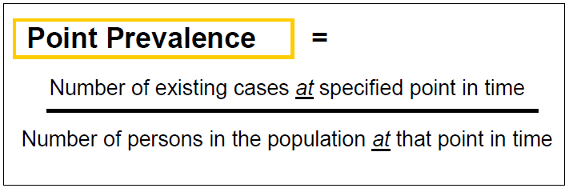
Point Prevalence
Proportion of the population with a particular disease at a particular point in time
Gordis, Leon. Epidemiology (5). Saint Louis, US: Saunders, 2013. ProQuest ebrary. Web. 2 March 2017

Slide 72
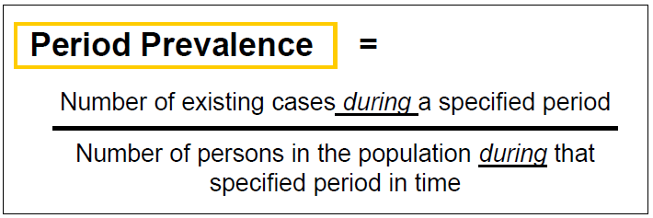
Period Prevalence
The proportion of the population with a particular disease during a specified period in time
Gordis, Leon. Epidemiology (5). Saint Louis, US: Saunders, 2013. ProQuest ebrary. Web. 2 March 2017

Slide 73
Why do we need point and period prevalence?
Point Prevalence:
  useful for conditions that need to be compared in different periods of time in different healthcare settings
Period Prevalence
  Useful for conditions that ‘come and go’…
    1-week -Hay fever or other allergy
    1-month -Depression symptoms
    1-year -Low-back pain
    5-year -Genital herpes recurrence

Slide 74
Are incidence and prevalence related?
incidence = # new cases,
prevalence = # existing cases,
➔ Prevalence rate = Incidence rate x average Duration of disease
(P = I x D)
Assumptions for this to be correct:
  Prevalence relatively constant
  Incidence and outflow (cure and death) relatively equal
  < 10% of population has the disease

Slide 75
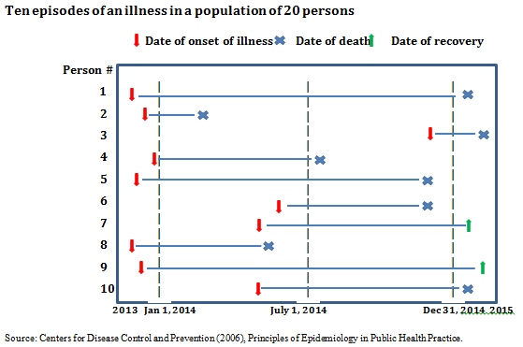
Incidence and prevalence

Slide 76
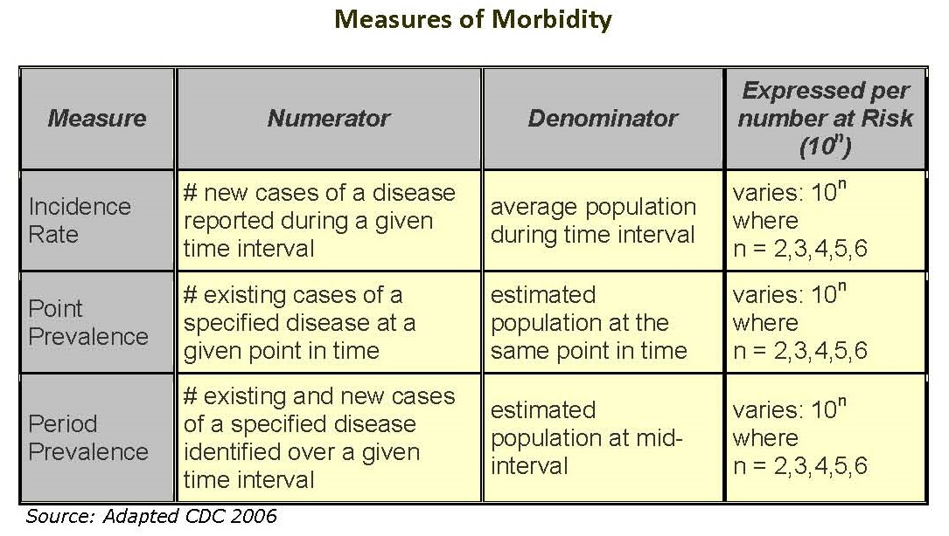
https://cursos.campusvirtualsp.org/mod/tab/view.php?id=25523

Slide 77
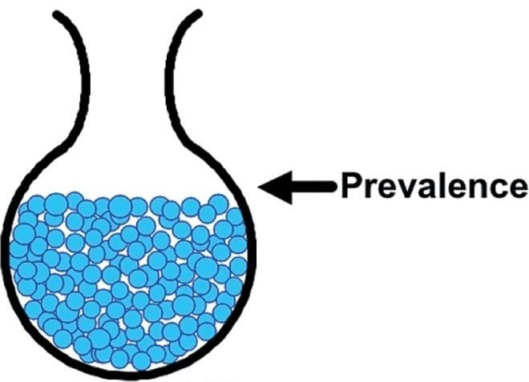
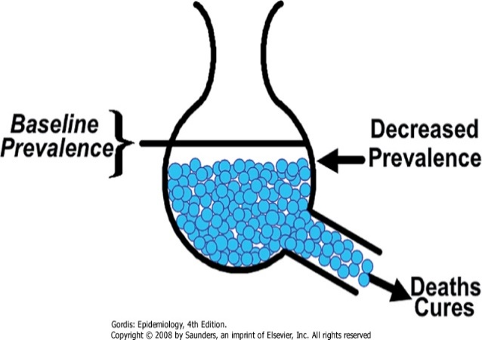
The effects of numerator and denominator
Adapted from Gordis, 5th edition, p. 49 (Fig. 3-12)

Slide 78
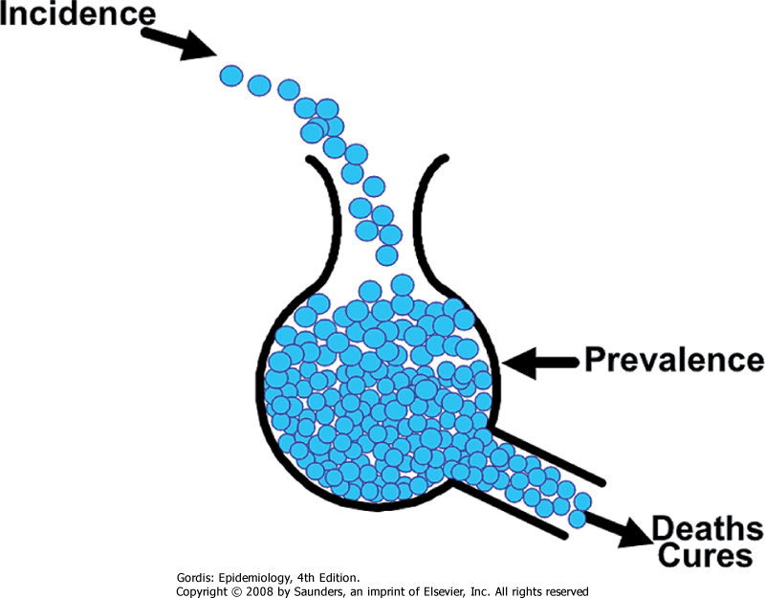
Prevalence is a dynamic situation reflecting incidence rate and disease duration, which is a function of deaths and cures
Adapted from Gordis, 5th edition, p. 45 (Figure 3-12)

Slide 79
Prevalence measures
A measure of disease burden in the population
Not useful for studying disease etiology (in contrast to incidence)
Useful for hypothesis generation
Essential in planning services
Periodic prevalence surveys are useful in evaluating disease prevention efforts
Gordis, Leon. Epidemiology (5). Saint Louis, US: Saunders, 2013. ProQuest ebrary. Web. 2 March 2017

Slide 80
Crude Rate
Number of all new events during a specified period
Number of persons (“population”) at risk for these events during the same period
CRUDE RATE
CRUDE RATE
=
NOTE: The new “event” can be the development of disease, death from a disease, etc.
Gordis, Leon. Epidemiology (5). Saint Louis, US: Saunders, 2013. ProQuest ebrary. Web. 2 March 2017

Slide 81
Drawbacks of crude rates
Crude rates do not take into consideration the subgroups in the population at risk that affects the differences in risk.
Crude rates may not be comparable across populations unless there is adjustment for population-specific subgroup composition.
Gordis, Leon. Epidemiology (5). Saint Louis, US: Saunders, 2013. ProQuest ebrary. Web. 2 March 2017

Slide 82
Mortality Rates
Significance of Mortality rates are:
  It can estimate the differences in risk from dying from a specific condition between different subgroups of the population.
  It is an indicator of disease severity.
  It can give an idea whether the treatment or intervention for a certain lethal condition has improved over time..
  It is a rough estimate of incidence when disease or condition has lethal outcomes

Slide 83
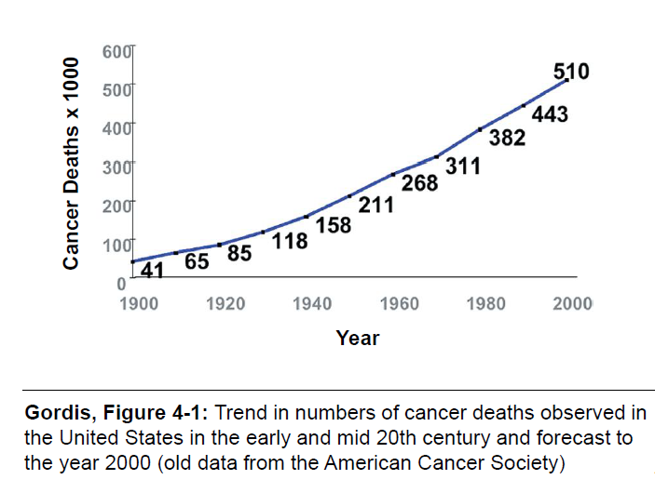
Mortality Trends over time

Slide 84
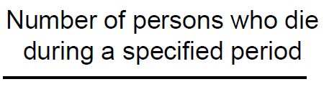
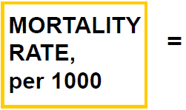
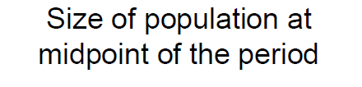
Mortality rate

Slide 85
Age adjusted Mortality Rate: Direct Method
Total Expected Death rates of different age groups
-----------------------------------------X1000
Age Adjusted Death Rate =
Total Standard Population

Slide 86
Direct Method: Pros
Used when the number of deaths in the study population is large enough to produce stable age specific death rates.
Assumes a constant age distribution across all study populations.
Rates from different study populations (e.g., counties in NYS) can all be directly compared to each other if adjusted using the same standard population.

Slide 87
Direct Method of Age Adjustment: Cons
Fictional rates are calculated
Suppresses details of how subgroups differ across the variable used for adjustment (age in this case)
From a public health perspective, these details may be more important than an overall adjusted rate.

Slide 88
Indirect Method of Mortality Rate
When the numbers of deaths in each age group in the study population are too small to calculate stable age-specific rates.
In developing countries or other areas where no information is available on age-specific deaths for the study population, only for a national or standard population.
Helpful for studies of mortality in occupationally exposed populations Mortality rates in the general population are often used as the reference.

Slide 89
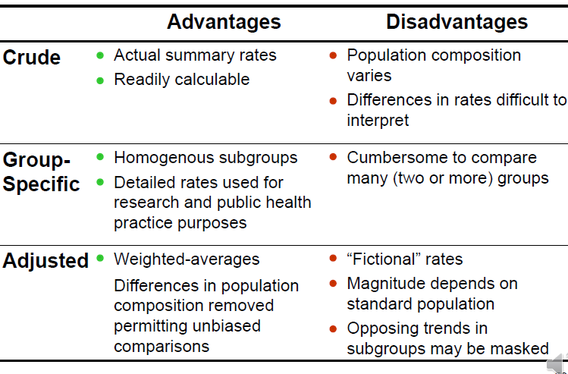
Pros and Cons

Slide 90
Risk
Gordis:
  “The probability of an event […] occurring”
Webster’s Dictionary:
  “The possibility of suffering harm or loss: DANGER”
The risk of acquiring a disease, and death from a disease (and any health-related event in between), is best approximated by a measure of its incidence rate.

Slide 91
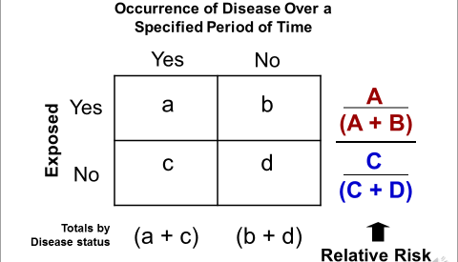
Relative Risk

Slide 92
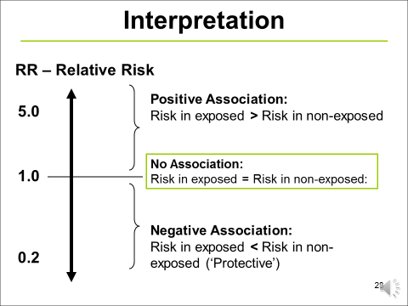
Interpretation

Slide 93
Odds of an ‘event’
= counts for being subjected to an event of type e / counts for not being subjected to an event of type e
  ‘event’: being exposed to COVID-19, being infected by COVID-19, positively testing for COVID-19, died from COVID-19, …
= probability for being subjected to e/ probability of not being subjected to e.
= P/(1-P)

Slide 94
Related events COVID-19
NYS citizens
Exposed
Not exposed
Not infected
Infected
Tested +
Tested -

Slide 95
Subgroups / cohorts
Exposed | Infected | Tested | Tested+ | Treated | Died
Y | Y | Y | Y | Y | Y
Y | Y | Y | Y | Y | N
Y | Y | Y | Y | N | Y
Y | Y | Y | Y | N | N
Y | Y | Y | N | Y | Y
Y | Y | Y | N | Y | N
Y | Y | Y | N | N | Y
Y | Y | Y | N | N | N
…
For unrelated events: 2^{n} groups
If related: less, e.g. one can’t test positive or negative when not tested at all.

Slide 96
Odds Ratio
  Probability of an event = p; (such as 0.4 or 40%)
  Probability of the non-event = (1 – p) (1 - 0.4 = .6 or 60%)
  Odds = p / (1 – p); (such as 0.4 / 1- 0.4)
  Odds = p / q, where q = (1 – p); (such as 0.4/0.6 = 0.667)
  The simple “Odds” is not used much in epidemiology, but the “Odds Ratio” (OR) is used extensively as a measure of excess risk (“association”) in different epidemiological study designs
Gordis, Leon. Epidemiology (5). Saint Louis, US: Saunders, 2013. ProQuest ebrary. Web. 2 March 2017

Slide 97
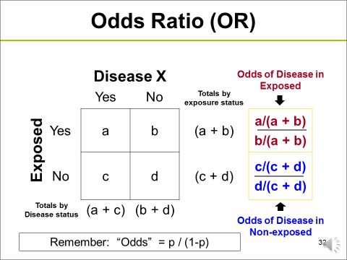
Odds Ratio
Remember Odds is p/(1-p)
Gordis, Leon. Epidemiology (5). Saint Louis, US: Saunders, 2013. ProQuest ebrary. Web. 2 March 2017

Slide 98
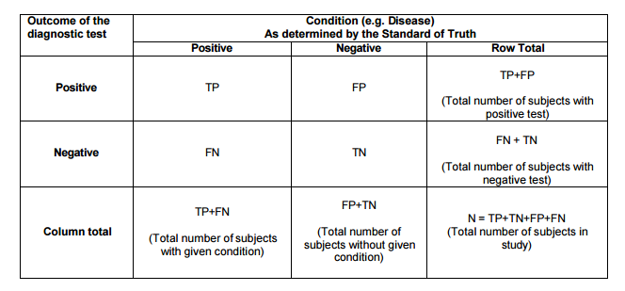
Sensitivity Specificity and Accuracy
http://www.lexjansen.com/nesug/nesug10/hl/hl07.pdf

Slide 99
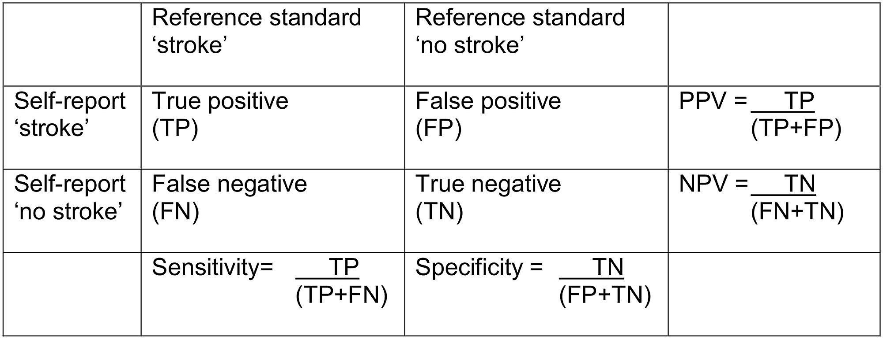
Stroke Reporting
https://s3-eu-west-1.amazonaws.com/ppreviews-plos-725668748/2257634/preview.jpg

Slide 100
Characteristics
Sensitivity is the probability that a test will indicate 'disease' among those with the disease:
Sensitivity: A/(A+C) × 100
Specificity is the fraction of those without disease who will have a negative test result:
Specificity: D/(D+B) × 100
Sensitivity and specificity are characteristics of the test. The population does not affect the results.

Slide 101
PPV and NPV
Positive and negative predictive values are influenced by the prevalence of disease in the population that is being tested.
Higher the positive predictive value of a test greater are the chances of high prevalence of disease.
PPV and NPV represent the chance that a person with a positive test truly has the disease.
Positive Predictive Value: A/(A+B) × 100
Negative Predictive Value: D/(D+C) × 100
A | B
C | D

