Slide 1
Statistical data analysis and research methods
BMI504
Course 19453 – Spring 2020
Class 12 – April 23, 2020
Mixed methods: integration of quantitative and qualitative methods
Werner CEUSTERS

Slide 2
C12. Mixed methods: integration of quantitative and qualitative methods
Pre-class reading:
LA Palinkas et. al.
Mixed Method Designs in Implementation Research.
Adm Policy Ment Health (2011) 38:44–53.
Post-class assignment:
  A8: update your proposal by adding an experimental design so that the overall approach is mixed method.
  Required readings:
    R13 Mårtensson, P., et al., Evaluating research: A multidisciplinary approach to assessing research practice and quality. Research Policy, 2016. 45(3): p. 593-603.
    R14 Sudheesh, K., D.R. Duggappa, and S.S. Nethra, How to write a research proposal? Indian journal of anaesthesia, 2016. 60(9): p. 631-634.

Slide 3
Next week: ‘in-class’ exercise
During the first part, the students will use R13, R14 and materials from all previous classes to develop together an evaluation template for research proposals.
During the second part, students will evaluate using the template the research proposals of their peers.

Slide 4
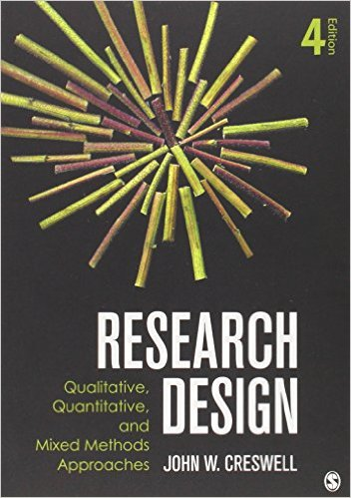
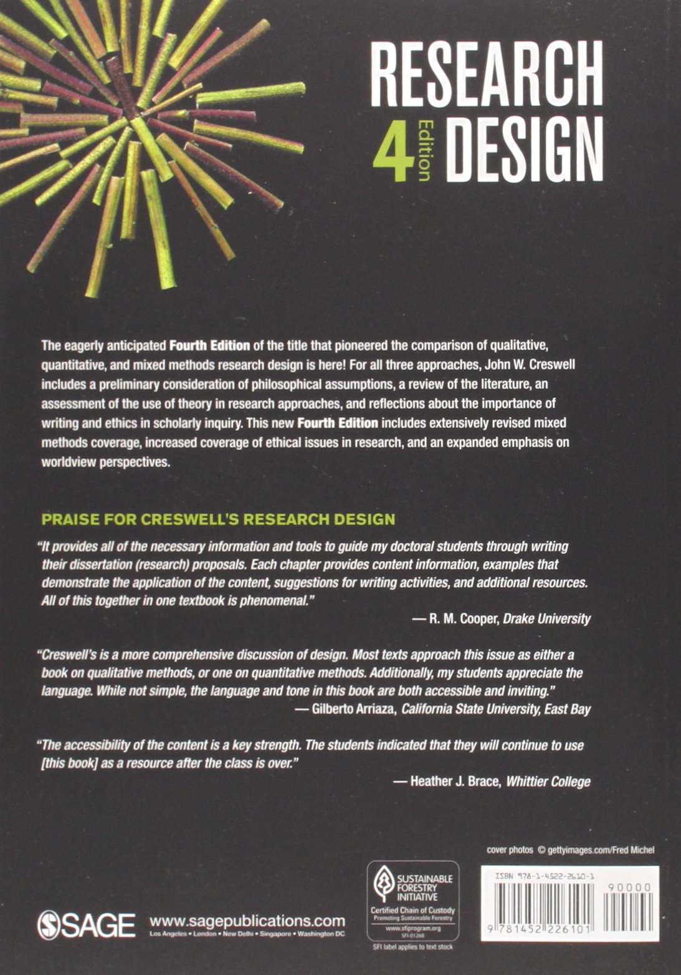
Basis of lecture C12

Slide 5
Quality criteria for research

Slide 6
Quality criteria for research
Worthy topic
Rich rigor
Sincerity
Credibility
Resonance
Significant contribution
Ethical
Meaningful coherence
Sarah J. Tracy. Qualitative Quality: Eight “Big-Tent”
Criteria for Excellent Qualitative Research. Qualitative Inquiry 2010;16(10):837–851.

Slide 7
Quality criteria for research
Worthy topic | →
Rich rigor
Sincerity
Credibility
Resonance
Significant contribution
Ethical
Meaningful coherence
Sarah J. Tracy. Qualitative Quality: Eight “Big-Tent”
Criteria for Excellent Qualitative Research. Qualitative Inquiry 2010;16(10):837–851.

Slide 8
Quality criteria for research
Worthy topic | → | The topic of the research is • Relevant • Timely • Significant • Interesting
Rich rigor
Sincerity
Credibility
Resonance
Significant contribution
Ethical
Meaningful coherence
Sarah J. Tracy. Qualitative Quality: Eight “Big-Tent”
Criteria for Excellent Qualitative Research. Qualitative Inquiry 2010;16(10):837–851.

Slide 9
Quality criteria for research
Worthy topic
Rich rigor | →
Sincerity
Credibility
Resonance
Significant contribution
Ethical
Meaningful coherence
Sarah J. Tracy. Qualitative Quality: Eight “Big-Tent”
Criteria for Excellent Qualitative Research. Qualitative Inquiry 2010;16(10):837–851.

Slide 10
Quality criteria for research
Worthy topic |  | The study uses sufficient, abundant, appropriate, and complex: • Theoretical constructs • Data and time in the field • Sample(s) • Context(s) • Data collection and analysis processes
Rich rigor | →
Sincerity
Credibility
Resonance
Significant contribution
Ethical
Meaningful coherence
Sarah J. Tracy. Qualitative Quality: Eight “Big-Tent”
Criteria for Excellent Qualitative Research. Qualitative Inquiry 2010;16(10):837–851.

Slide 11
Quality criteria for research
Worthy topic |  | Are there enough data to support significant claims? Did the researcher spend enough time to gather interesting and significant data? Is the context or sample appropriate given the goals of the study? Did the researcher use appropriate procedures in terms of field note style, interviewing practices, and analysis procedures?
Rich rigor | →
Sincerity
Credibility
Resonance
Significant contribution
Ethical
Meaningful coherence
Sarah J. Tracy. Qualitative Quality: Eight “Big-Tent”
Criteria for Excellent Qualitative Research. Qualitative Inquiry 2010;16(10):837–851.

Slide 12
Quality criteria for research
Worthy topic
Rich rigor
Sincerity | →
Credibility
Resonance
Significant contribution
Ethical
Meaningful coherence
Sarah J. Tracy. Qualitative Quality: Eight “Big-Tent”
Criteria for Excellent Qualitative Research. Qualitative Inquiry 2010;16(10):837–851.

Slide 13
Quality criteria for research
Worthy topic |  | The study is characterized by: Self-reflexivity about subjective values, biases, and inclinations of the researcher(s); Transparency about the methods and challenges.
Rich rigor
Sincerity | →
Credibility
Resonance
Significant contribution
Ethical
Meaningful coherence
Sarah J. Tracy. Qualitative Quality: Eight “Big-Tent”
Criteria for Excellent Qualitative Research. Qualitative Inquiry 2010;16(10):837–851.

Slide 14
Quality criteria for research
Worthy topic
Rich rigor
Sincerity
Credibility | →
Resonance
Significant contribution
Ethical
Meaningful coherence
Sarah J. Tracy. Qualitative Quality: Eight “Big-Tent”
Criteria for Excellent Qualitative Research. Qualitative Inquiry 2010;16(10):837–851.

Slide 15
Quality criteria for research
Worthy topic |  | The research is marked by: thick description, concrete detail, explication of tacit (nontextual) knowledge, and showing rather than telling; triangulation or crystallization; multivocality; member reflections.
Rich rigor
Sincerity
Credibility | →
Resonance
Significant contribution
Ethical
Meaningful coherence
Sarah J. Tracy. Qualitative Quality: Eight “Big-Tent”
Criteria for Excellent Qualitative Research. Qualitative Inquiry 2010;16(10):837–851.

Slide 16
Quality criteria for research
Worthy topic
Rich rigor
Sincerity
Credibility
Resonance | →
Significant contribution
Ethical
Meaningful coherence
Sarah J. Tracy. Qualitative Quality: Eight “Big-Tent”
Criteria for Excellent Qualitative Research. Qualitative Inquiry 2010;16(10):837–851.

Slide 17
Quality criteria for research
Worthy topic |  | The research influences, affects, or moves particular readers or a variety of audiences through: Aesthetic, evocative representation Naturalistic generalizations Transferable findings
Rich rigor
Sincerity
Credibility
Resonance | →
Significant contribution
Ethical
Meaningful coherence
Sarah J. Tracy. Qualitative Quality: Eight “Big-Tent”
Criteria for Excellent Qualitative Research. Qualitative Inquiry 2010;16(10):837–851.

Slide 18
Quality criteria for research
Worthy topic
Rich rigor
Sincerity
Credibility
Resonance
Significant contribution | →
Ethical
Meaningful coherence
Sarah J. Tracy. Qualitative Quality: Eight “Big-Tent”
Criteria for Excellent Qualitative Research. Qualitative Inquiry 2010;16(10):837–851.

Slide 19
Quality criteria for research
Worthy topic |  | The research provides a significant contribution: Conceptually/theoretically Practically Morally Methodologically Heuristically
Rich rigor
Sincerity
Credibility
Resonance
Significant contribution | →
Ethical
Meaningful coherence
Sarah J. Tracy. Qualitative Quality: Eight “Big-Tent”
Criteria for Excellent Qualitative Research. Qualitative Inquiry 2010;16(10):837–851.

Slide 20
Quality criteria for research
Worthy topic
Rich rigor
Sincerity
Credibility
Resonance
Significant contribution
Ethical | →
Meaningful coherence
Sarah J. Tracy. Qualitative Quality: Eight “Big-Tent”
Criteria for Excellent Qualitative Research. Qualitative Inquiry 2010;16(10):837–851.

Slide 21
Quality criteria for research
Worthy topic |  | The research considers: procedural ethics (such as human subjects); situational and culturally specific ethics; relational ethics; exiting ethics (leaving the scene and sharing the research).
Rich rigor
Sincerity
Credibility
Resonance
Significant contribution
Ethical | →
Meaningful coherence
Sarah J. Tracy. Qualitative Quality: Eight “Big-Tent”
Criteria for Excellent Qualitative Research. Qualitative Inquiry 2010;16(10):837–851.

Slide 22
Quality criteria for research
Worthy topic
Rich rigor
Sincerity
Credibility
Resonance
Significant contribution
Ethical
Meaningful coherence | →
Sarah J. Tracy. Qualitative Quality: Eight “Big-Tent”
Criteria for Excellent Qualitative Research. Qualitative Inquiry 2010;16(10):837–851.

Slide 23
Quality criteria for research
Worthy topic |  | The study: achieves what it purports to be about; uses methods and procedures that fit its stated goals; meaningfully interconnects literature, research questions/foci, findings, and interpretations with each other.
Rich rigor
Sincerity
Credibility
Resonance
Significant contribution
Ethical
Meaningful coherence | →
Sarah J. Tracy. Qualitative Quality: Eight “Big-Tent”
Criteria for Excellent Qualitative Research. Qualitative Inquiry 2010;16(10):837–851.

Slide 24
Three main types of research methods
Qualitative methods
Quantitative methods
Mixed methods

Slide 25
Qualitative research
Goals:
  exploring and understanding the meaning individuals or groups ascribe to a social or human problem;
  rendering the complexity of a situation.
Process of research:
  focus on emerging questions and procedures,
  data typically collected in the participant’s setting,
  data analysis inductively building from particulars to general themes,
  the researcher makes interpretations of the meaning of the data.
  flexible structure of research report.
Creswell JW. Research design : qualitative, quantitative, and mixed methods approaches— 4th ed. Sage Publications, 2014.

Slide 26
Quantitative research
Goals:
  testing objective theories deductively by examining the relationship among variables;
  being able to generalize and replicate the findings.
Process of research:
  measuring variables, typically on instruments, so that numbered data can be analyzed using statistical procedures;
  building in protections against bias;
  controlling for alternative explanations.
  the final written report has a set structure consisting of introduction, literature and theory, methods, results, and discussion.
Creswell JW. Research design : qualitative, quantitative, and mixed methods approaches— 4th ed. Sage Publications, 2014.

Slide 27
Mixed methods research
Goal:
  Obtain a deeper and more complete understanding of a research problem than either approach alone.
Process of research:
  collecting both quantitative and qualitative data,
  integrating the two forms of data, and
  using distinct designs that may involve different philosophical assumptions and theoretical frameworks.
Creswell JW. Research design : qualitative, quantitative, and mixed methods approaches— 4th ed. Sage Publications, 2014.

Slide 28
Some purposes of mixed methods
Convergence:
Palinkas et. al. Mixed Method Designs in Implementation Research.
Adm Policy Ment Health (2011) 38:44–53

Slide 29
Some purposes of mixed methods
Convergence: using both types to answer the same question, through comparison of results to see if they reach the same conclusion (triangulation) or by converting a data set from one type into another.
Complementarity:
Palinkas et. al. Mixed Method Designs in Implementation Research.
Adm Policy Ment Health (2011) 38:44–53

Slide 30
Some purposes of mixed methods
Convergence: using both types to answer the same question, through comparison of results to see if they reach the same conclusion (triangulation) or by converting a data set from one type into another.
Complementarity: using each method to answer a related question or series of questions for purposes of evaluation or elaboration.
Expansion:
Palinkas et. al. Mixed Method Designs in Implementation Research.
Adm Policy Ment Health (2011) 38:44–53

Slide 31
Some purposes of mixed methods
Convergence: using both types to answer the same question, through comparison of results to see if they reach the same conclusion (triangulation) or by converting a data set from one type into another.
Complementarity: using each method to answer a related question or series of questions for purposes of evaluation or elaboration.
Expansion: using one type to answer questions raised by the other type.
Development:
Palinkas et. al. Mixed Method Designs in Implementation Research.
Adm Policy Ment Health (2011) 38:44–53

Slide 32
Some purposes of mixed methods
Convergence: using both types to answer the same question, through comparison of results to see if they reach the same conclusion (triangulation) or by converting a data set from one type into another.
Complementarity: using each method to answer a related question or series of questions for purposes of evaluation or elaboration.
Expansion: using one type to answer questions raised by the other type.
Development: using one type to answer questions that will enable use of the other method to answer other questions.
Sampling:
Palinkas et. al. Mixed Method Designs in Implementation Research.
Adm Policy Ment Health (2011) 38:44–53

Slide 33
Some purposes of mixed methods
Convergence: using both types to answer the same question, through comparison of results to see if they reach the same conclusion (triangulation) or by converting a data set from one type into another.
Complementarity: using each method to answer a related question or series of questions for purposes of evaluation or elaboration.
Expansion: using one type to answer questions raised by the other type.
Development: using one type to answer questions that will enable use of the other method to answer other questions.
Sampling: using one type to define or identify the participant sample for collection and analysis of data representing the other type.
Palinkas et. al. Mixed Method Designs in Implementation Research.
Adm Policy Ment Health (2011) 38:44–53

Slide 34
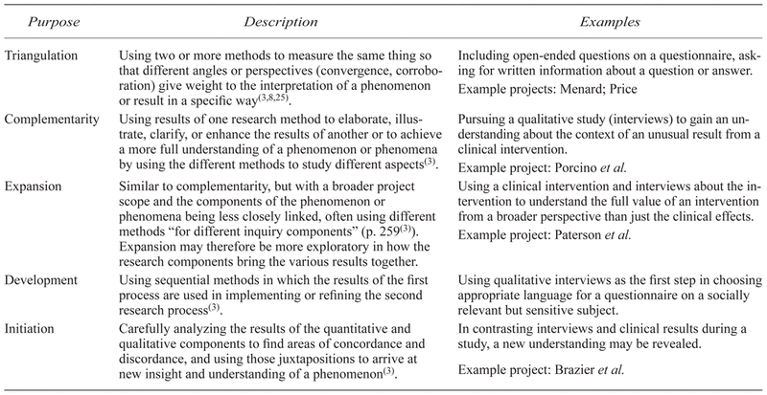
Some purposes of mixed methods
Greene JC, Caracelli VJ, Graham WF. Toward a conceptual framework for mixed-method evaluation designs. Educ Eval Policy Anal 1989; 11(3): 255–274.

Slide 35
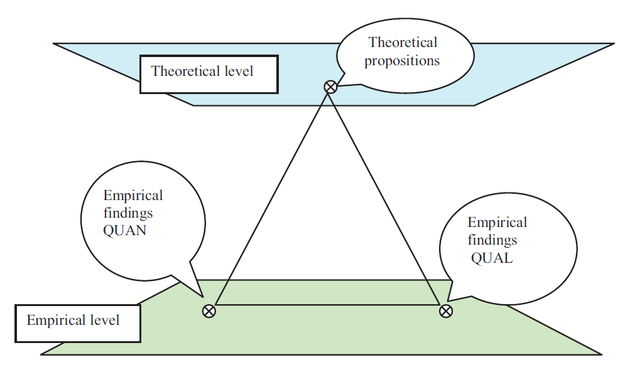
Triangulation
Erzberger, C., Kelle, U., 2003. Making inferences in mixed methods: The rules of integration.
In: Tashakkori, A., Teddlie, C. (Eds.), Handbook of Mixed Methods in Social & Behavioural Research.
Sage, Thousand Oaks, pp. 457–488.

Slide 36
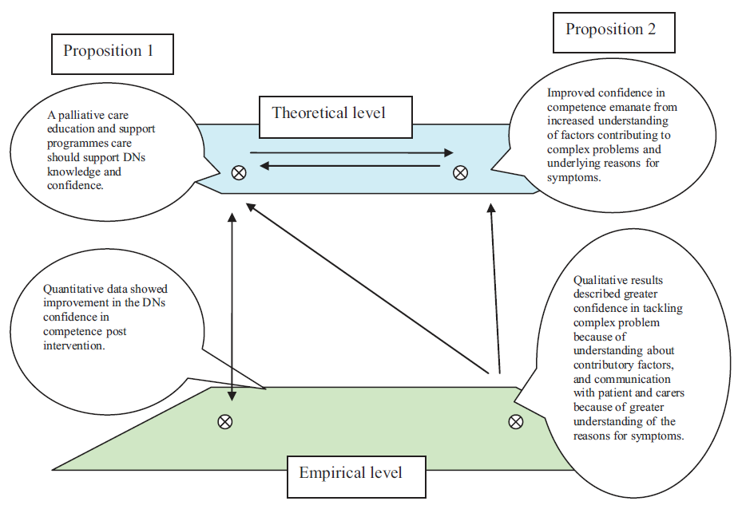
Triangulation with complementary results
U. Ostlund et al. / International Journal of Nursing Studies 48 (2011) 369–383

Slide 37
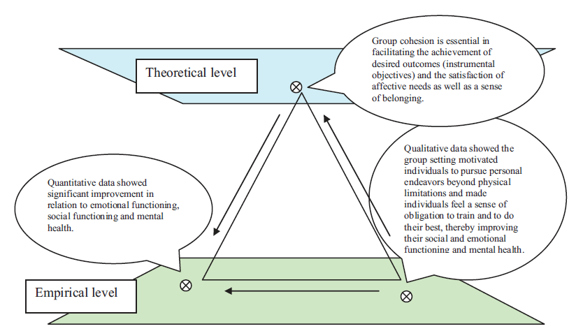
Triangulation with convergent results
U. Ostlund et al. / International Journal of Nursing Studies 48 (2011) 369–383

Slide 38
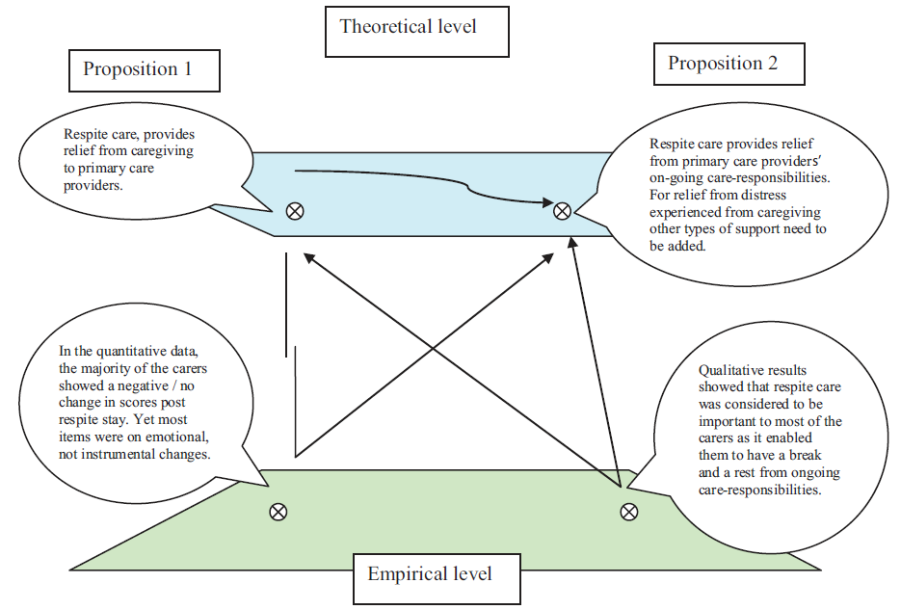
Triangulation with divergent results
???
U. Ostlund et al. / International Journal of Nursing Studies 48 (2011) 369–383

Slide 39
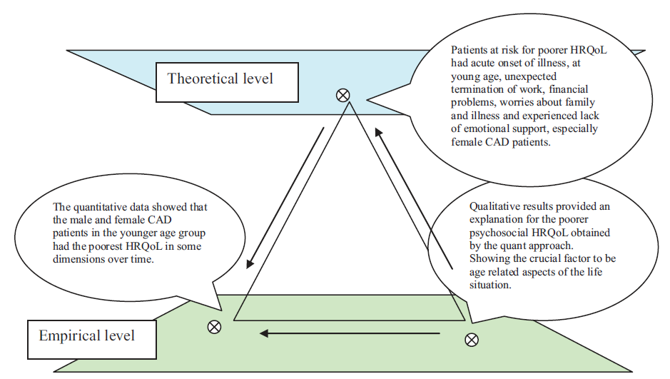
Triangulation to develop theory
U. Ostlund et al. / International Journal of Nursing Studies 48 (2011) 369–383

Slide 40
Some purposes of mixed methods
Greene JC, Caracelli VJ, Graham WF. Toward a conceptual framework for mixed-method evaluation designs. Educ Eval Policy Anal 1989; 11(3): 255–274.

Slide 41
Some purposes of mixed methods
Greene JC, Caracelli VJ, Graham WF. Toward a conceptual framework for mixed-method evaluation designs. Educ Eval Policy Anal 1989; 11(3): 255–274.

Slide 42
Some purposes of mixed methods
Greene JC, Caracelli VJ, Graham WF. Toward a conceptual framework for mixed-method evaluation designs. Educ Eval Policy Anal 1989; 11(3): 255–274.

Slide 43
Some purposes of mixed methods
Greene JC, Caracelli VJ, Graham WF. Toward a conceptual framework for mixed-method evaluation designs. Educ Eval Policy Anal 1989; 11(3): 255–274.

Slide 44
Some purposes of mixed methods
Greene JC, Caracelli VJ, Graham WF. Toward a conceptual framework for mixed-method evaluation designs. Educ Eval Policy Anal 1989; 11(3): 255–274.

Slide 45
Mixed methods view on research problem
Comparing different perspectives drawn from quantitative and qualitative data.
Explaining quantitative results with a qualitative follow-up data collection and analysis.
Developing better measurement instruments by first collecting and analyzing qualitative data and then testing the instruments in a sample.
Understanding experimental results by incorporating the perspectives of individuals.
Developing a more complete understanding of changes needed for a marginalized group through the combination of qualitative and quantitative data.
Having a better understanding the need for and impact of an intervention program through collecting both quantitative and qualitative data over time.
Creswell JW. Research design : qualitative, quantitative, and mixed methods approaches— 4th ed. Sage Publications, 2014.

Slide 46
‘World views’
‘I suggest that individuals preparing a research proposal or plan make explicit the larger philosophical ideas they espouse. This information will help explain why they chose qualitative, quantitative, or mixed methods approaches for their research’.
In writing about worldviews, a proposal might include a section that addresses the following:
  the philosophical worldview proposed in the study,
  a definition of basic ideas of that worldview,
  how the worldview shaped their approach to research.’
Creswell JW. Research design : qualitative, quantitative, and mixed methods approaches— 4th ed. Sage Publications, 2014, p5-6.

Slide 47
Main world views
Postpositivism | Constructivism Understanding Multiple participant meanings Social and historical construction Theory generation
Transformative Political Power and justice oriented Collaborative Change-oriented | Pragmatism
Creswell JW. Research design : qualitative, quantitative, and mixed methods approaches— 4th ed. Sage Publications, 2014, p6.

Slide 48
Main world views
Postpositivism Determination (Reductionism) Empirical observation and measurement Theory verification | Constructivism
Transformative Political Power and justice oriented Collaborative Change-oriented | Pragmatism
Creswell JW. Research design : qualitative, quantitative, and mixed methods approaches— 4th ed. Sage Publications, 2014, p6.

Slide 49
Main world views
Postpositivism Determination (Reductionism) Empirical observation and measurement Theory verification | Constructivism Understanding Multiple participant meanings Social and historical construction Theory generation
Transformative Political Power and justice oriented Collaborative Change-oriented | Pragmatism
Creswell JW. Research design : qualitative, quantitative, and mixed methods approaches— 4th ed. Sage Publications, 2014, p6.

Slide 50
Main world views
Postpositivism Determination (Reductionism) Empirical observation and measurement Theory verification | Constructivism Understanding Multiple participant meanings Social and historical construction Theory generation
Transformative Political Power and justice oriented Collaborative Change-oriented | Pragmatism
Creswell JW. Research design : qualitative, quantitative, and mixed methods approaches— 4th ed. Sage Publications, 2014, p6.

Slide 51
Main world views
Postpositivism Determination (Reductionism) Empirical observation and measurement Theory verification | Constructivism Understanding Multiple participant meanings Social and historical construction Theory generation
Transformative Political Power and justice oriented Collaborative Change-oriented | Pragmatism Consequences of actions Problem-centered Pluralistic Real-world practice oriented
Creswell JW. Research design : qualitative, quantitative, and mixed methods approaches— 4th ed. Sage Publications, 2014, p6.

Slide 52
Comparison of research processes
Quantitative Methods | Mixed Methods | Qualitative Methods
Pre-determined methods Instrument based questions Performance data, attitude data, observational data, and census data Statistical analysis Statistical interpretation | Both predetermined and emerging Both open- and closed-ended questions Multiple forms of data drawing on all possibilities Statistical and text analysis Across databases interpretation | Emerging methods Open-ended questions Interview data, observation data, document data, and audiovisual data Text and image analysis Themes, patterns interpretation
Creswell JW. Research design : qualitative, quantitative, and mixed methods approaches— 4th ed. Sage Publications, 2014, p17.

Slide 53
Data collection in mixed methods
The data for the qualitative data collection will be smaller than that for the quantitative data collection.
Reason:
  Purpose of qualitative data is
    to locate and obtain information from a small sample
    but to gather extensive information from this sample;
  For quantitative research, a large N is needed in order to conduct meaningful statistical tests.
Creswell JW. Research design : qualitative, quantitative, and mixed methods approaches— 4th ed. Sage Publications, 2014.

Slide 54
Mixed methods research
Is characterized by a research methodology or approach
focusing on research questions that call for real-life contextual understandings, multi-level perspectives, and cultural influences;
employing
  rigorous quantitative research assessing magnitude and frequency of constructs and
  rigorous qualitative research exploring the meaning and understanding of constructs;
utilizing multiple methods (e.g., intervention trials and in-depth interviews);
intentionally integrating or combining these methods to draw on the strengths of each; and
framing the investigation within philosophical and theoretical positions.
Creswell JW, Klassen AC, Plano Clark VL & Clegg Smith K.
Best Practices for Mixed Methods Research in the Health Sciences. Technical Report; 2011; 37p.

Slide 55
Research design types
Quantitative | Qualitative | Mixed Methods
Experimental designs Nonexperimental designs, such as surveys | Narrative research Phenomenology Grounded theory Ethnographies Case study | Convergent Explanatory sequential Exploratory sequential Transformative, embedded, or multiphase
Creswell JW. Research design : qualitative, quantitative, and mixed methods approaches— 4th ed. Sage Publications, 2014, p12.

Slide 56
Working with the data sets
Merge
  Merge or converge the two datasets by actually bringing them together (e.g., convergence—triangulation to validate one dataset using another type of dataset)
Connect
  Have one dataset build upon another data set (e.g., complementarity—elaboration, transformation, expansion, initiation or sampling)
Embed
  Conduct one study within another so that one type of data provides a supportive role to the other dataset (e.g., complementarity—evaluation)
Palinkas et. al. Mixed Method Designs in Implementation Research.
Adm Policy Ment Health (2011) 38:44–53

Slide 57
Convergent parallel mixed methods (1)
Key assumption:
Both qualitative and quantitative data provide different types of information—often detailed views of participants qualitatively and scores on instruments quantitatively—and together they yield results that should be the same.
Creswell JW. Research design : qualitative, quantitative, and mixed methods approaches— 4th ed. Sage Publications, 2014.

Slide 58
Convergent parallel mixed methods (2)
Data collection:
Key idea: to collect both forms of data using the same or parallel variables, constructs, or concepts.
Qualitative data can be interviews, observations, documents, and records of instrument data, observational checklists, or numeric records, such as census data.
Creswell JW. Research design : qualitative, quantitative, and mixed methods approaches— 4th ed. Sage Publications, 2014, p6.

Slide 59
Convergent parallel mixed methods (3)
Data analysis:
Analyze databases separately and then bring together.
Options:
  side-by-side comparison:
    first report the quantitative statistical results and then discuss the qualitative findings (e.g., themes) that either confirm or disconfirm the statistical results, or,
    start with the qualitative findings and then compare them to the quantitative results.
  data transformation:
    take the qualitative themes or codes and count them (and possibly group them) to form quantitative measures.
  joint display of data:
    merge the two forms of data in a table or a graph.
Creswell JW. Research design : qualitative, quantitative, and mixed methods approaches— 4th ed. Sage Publications, 2014.

Slide 60
Convergent parallel mixed methods (4)
Drawbacks:
On interpretation:
  the comparison may not yield a clean convergent or divergent situation:
    state divergence as a limitation in the study,
    or
    return to the analyses and further explore the databases,
    collect additional information to resolve the differences, or
    discuss the results from one of the databases as possibly limited.
On validity:
  should be based on establishing both quantitative validity (e.g., construct) and qualitative validity (e.g., triangulation) for each database.
Creswell JW. Research design : qualitative, quantitative, and mixed methods approaches— 4th ed. Sage Publications, 2014.

Slide 61
Sequential designs
Explanatory sequential mixed methods
Exploratory sequential mixed methods
Creswell JW. Research design : qualitative, quantitative, and mixed methods approaches— 4th ed. Sage Publications, 2014.

Slide 62
Explanatory sequential design
The quantitative results: inform
  the types of participants to be purposefully selected for the qualitative phase and
  the types of questions that will be asked of the participants.
Intent: to have the qualitative data help explain in more detail the initial quantitative results.
Sampling: rigorous in the first phase and purposeful in the second one (from within the first sample).
Do not merge the two databases because a direct comparison of the two databases is inadequate.
Creswell JW. Research design : qualitative, quantitative, and mixed methods approaches— 4th ed. Sage Publications, 2014.

Slide 63
Exploratory sequential design (1)
Intent:
  to develop better measurements with specific samples of populations and to see if data from a few individuals (in qualitative phase) can be generalized to a large sample of a population (in quantitative phase);
  analyze the qualitative data to develop new variables, to identify the types of scales that might exist in current instruments or to form categories of information that will be explored further in a quantitative phase.
Three-phase procedure:
    exploratory phase
    instrument development,
    administering the instrument to a sample of a population.
Creswell JW. Research design : qualitative, quantitative, and mixed methods approaches— 4th ed. Sage Publications, 2014.

Slide 64
Exploratory sequential design (2)
Sampling:
draw both samples from the same population but make sure that the individuals for both samples are not the same.
have individuals help develop an instrument and then to survey them in the quantitative phase would introduce confounding factors into the study.
Creswell JW. Research design : qualitative, quantitative, and mixed methods approaches— 4th ed. Sage Publications, 2014.

Slide 65
Concurrent design

Slide 66
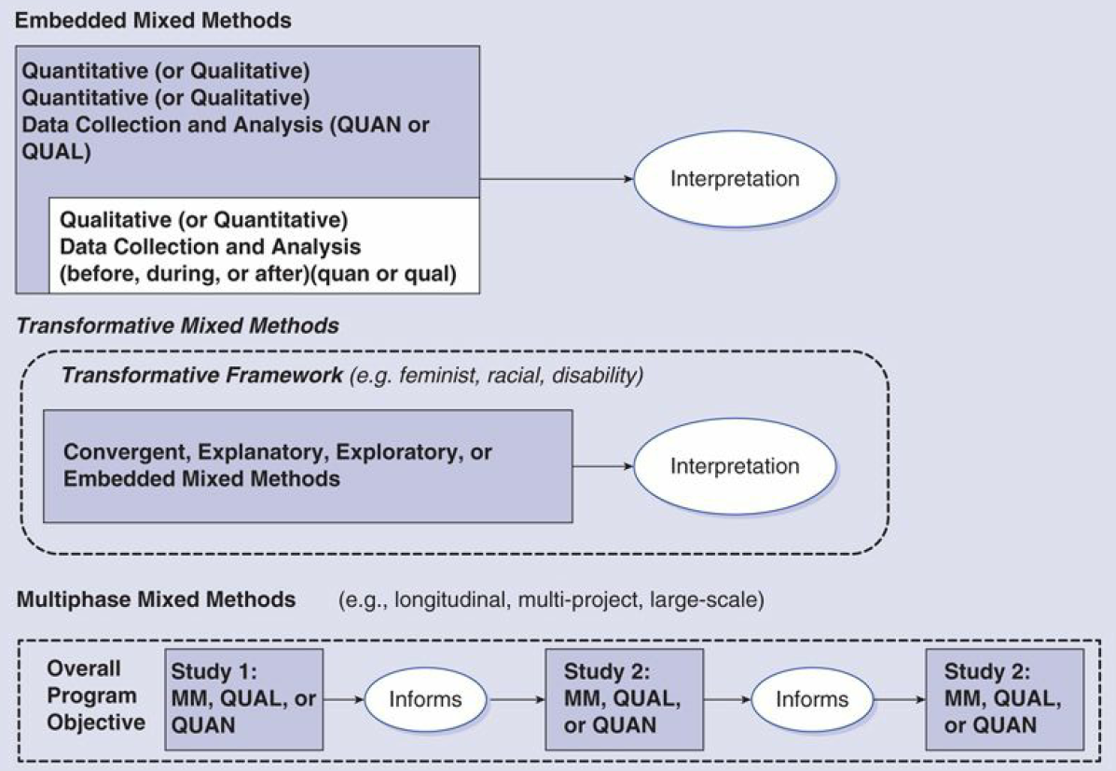
Advanced designs
Creswell JW. Research design : qualitative, quantitative, and mixed methods approaches— 4th ed. Sage Publications, 2014.

Slide 67
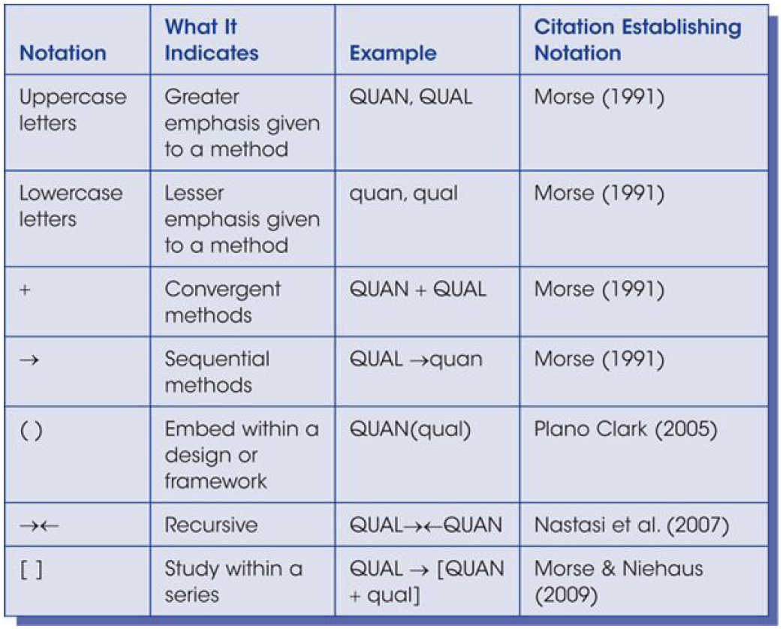
Shorthand notations for MM designs
Creswell JW. Research design : qualitative, quantitative, and mixed methods approaches— 4th ed. Sage Publications, 2014.

Slide 68
Criteria for choosing a specific MM design
Choice Based on:
  Outcomes expected;
  How the data will be used together (or integrated);
  Timing of the data collection;
  Emphasis placed on each database;
  Type of design most suited for a field;
  Single researcher or team.
Creswell JW. Research design : qualitative, quantitative, and mixed methods approaches— 4th ed. Sage Publications, 2014.

Slide 69
Criteria for choosing an MM design
Reasons | Expected Outcomes | Design
Comparing different perspectives drawn from quantitative and qualitative data Explaining quantitative results with qualitative data Developing better measurement instruments Understanding experimental results by incorporating perspectives of individuals Developing an understanding of needed changes for a marginalized group Understanding the need for an impact of an intervention | Merging the two databases to show how the data converge or diverge An in-depth understanding of the quantitative results (often cultural relevance) A test of better measures for a sample of a population An understanding of participant views within the context of an experimental intervention A call for action program A formative and summative evaluation | Convergent parallel Explanatory sequential Exploratory sequential Embedded Transformative Multiphase
Creswell JW. Research design : qualitative, quantitative, and mixed methods approaches— 4th ed. Sage Publications, 2014.

Slide 70
Criteria for choosing an MM design
Reasons | Expected Outcomes | Design
Comparing different perspectives drawn from quantitative and qualitative data Explaining quantitative results with qualitative data Developing better measurement instruments Understanding experimental results by incorporating perspectives of individuals Developing an understanding of needed changes for a marginalized group Understanding the need for an impact of an intervention | Merging the two databases to show how the data converge or diverge An in-depth understanding of the quantitative results (often cultural relevance) A test of better measures for a sample of a population An understanding of participant views within the context of an experimental intervention A call for action program A formative and summative evaluation | Convergent parallel Explanatory sequential Exploratory sequential Embedded Transformative Multiphase
Creswell JW. Research design : qualitative, quantitative, and mixed methods approaches— 4th ed. Sage Publications, 2014.

Slide 71
Criteria for choosing an MM design
Reasons | Expected Outcomes | Design
Comparing different perspectives drawn from quantitative and qualitative data Explaining quantitative results with qualitative data Developing better measurement instruments Understanding experimental results by incorporating perspectives of individuals Developing an understanding of needed changes for a marginalized group Understanding the need for an impact of an intervention | Merging the two databases to show how the data converge or diverge An in-depth understanding of the quantitative results (often cultural relevance) A test of better measures for a sample of a population An understanding of participant views within the context of an experimental intervention A call for action program A formative and summative evaluation | Convergent parallel Explanatory sequential Exploratory sequential Embedded Transformative Multiphase
Creswell JW. Research design : qualitative, quantitative, and mixed methods approaches— 4th ed. Sage Publications, 2014.

Slide 72
Criteria for choosing an MM design
Reasons | Expected Outcomes | Design
Comparing different perspectives drawn from quantitative and qualitative data Explaining quantitative results with qualitative data Developing better measurement instruments Understanding experimental results by incorporating perspectives of individuals Developing an understanding of needed changes for a marginalized group Understanding the need for an impact of an intervention | Merging the two databases to show how the data converge or diverge An in-depth understanding of the quantitative results (often cultural relevance) A test of better measures for a sample of a population An understanding of participant views within the context of an experimental intervention A call for action program A formative and summative evaluation | Convergent parallel Explanatory sequential Exploratory sequential Embedded Transformative Multiphase
Creswell JW. Research design : qualitative, quantitative, and mixed methods approaches— 4th ed. Sage Publications, 2014.

Slide 73
Criteria for choosing an MM design
Reasons | Expected Outcomes | Design
Comparing different perspectives drawn from quantitative and qualitative data Explaining quantitative results with qualitative data Developing better measurement instruments Understanding experimental results by incorporating perspectives of individuals Developing an understanding of needed changes for a marginalized group Understanding the need for an impact of an intervention | Merging the two databases to show how the data converge or diverge An in-depth understanding of the quantitative results (often cultural relevance) A test of better measures for a sample of a population An understanding of participant views within the context of an experimental intervention A call for action program A formative and summative evaluation | Convergent parallel Explanatory sequential Exploratory sequential Embedded Transformative Multiphase
Creswell JW. Research design : qualitative, quantitative, and mixed methods approaches— 4th ed. Sage Publications, 2014.

Slide 74
Criteria for choosing an MM design
Reasons | Expected Outcomes | Design
Comparing different perspectives drawn from quantitative and qualitative data Explaining quantitative results with qualitative data Developing better measurement instruments Understanding experimental results by incorporating perspectives of individuals Developing an understanding of needed changes for a marginalized group Understanding the need for an impact of an intervention | Merging the two databases to show how the data converge or diverge An in-depth understanding of the quantitative results (often cultural relevance) A test of better measures for a sample of a population An understanding of participant views within the context of an experimental intervention A call for action program A formative and summative evaluation | Convergent parallel Explanatory sequential Exploratory sequential Embedded Transformative Multiphase
Creswell JW. Research design : qualitative, quantitative, and mixed methods approaches— 4th ed. Sage Publications, 2014.

Slide 75
Criteria for choosing an MM design
Reasons | Expected Outcomes | Design
Comparing different perspectives drawn from quantitative and qualitative data Explaining quantitative results with qualitative data Developing better measurement instruments Understanding experimental results by incorporating perspectives of individuals Developing an understanding of needed changes for a marginalized group Understanding the need for an impact of an intervention | Merging the two databases to show how the data converge or diverge An in-depth understanding of the quantitative results (often cultural relevance) A test of better measures for a sample of a population An understanding of participant views within the context of an experimental intervention A call for action program A formative and summative evaluation | Convergent parallel Explanatory sequential Exploratory sequential Embedded Transformative Multiphase
Creswell JW. Research design : qualitative, quantitative, and mixed methods approaches— 4th ed. Sage Publications, 2014.

Slide 76
Components of mixed methods research proposal
Introduction
  research problem (existing research, deficiencies in the literature, relevance of study for audiences);
  purpose or study aim of the project and reasons or rationale for a mixed methods study;
  research questions and hypotheses (quantitative questions or hypotheses, qualitative and mixed methods questions);
  philosophical foundations for using mixed methods.
Literature review
  (optional review quantitative, qualitative, and mixed methods studies).
Creswell JW. Research design : qualitative, quantitative, and mixed methods approaches— 4th ed. Sage Publications, 2014.

Slide 77
Mixed method purpose statement
contains
  the overall intent of the study,
  information about both the quantitative and qualitative strands of the study,
  a rationale of incorporating both strands to study the research problem.
Goal:
  provide major signposts for the reader to understand the quantitative and qualitative parts of a study.
Creswell JW. Research design : qualitative, quantitative, and mixed methods approaches— 4th ed. Sage Publications, 2014.

Slide 78
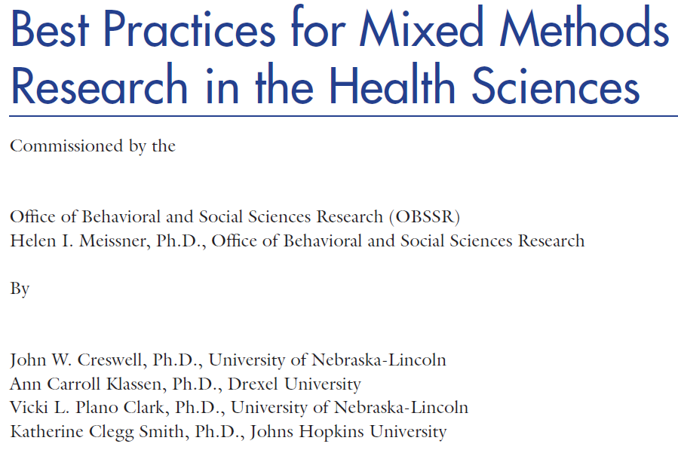
NIH proposals for MM research

Slide 79
Components of mixed methods research proposal
Research methods:
  A definition of mixed methods research;
  The type of design used and its definition;
  Challenges in using this design and how they will be addressed;
  Examples of use of the type of design;
  Reference and inclusion of a diagram of procedures;
  Quantitative data collection and analysis;
  Qualitative data collection and analysis;
  Mixed methods data analysis procedures;
  Validity approaches in both quantitative and qualitative research.
Creswell JW. Research design : qualitative, quantitative, and mixed methods approaches— 4th ed. Sage Publications, 2014.

Slide 80
Components of mixed methods research proposal
Researcher’s resources and skills to conduct mixed methods research
Potential ethical issues
References
Appendixes: Instruments, protocols, diagrams, timeline, budget, summary of major content for each chapter
Except if the granting agency has a different format !!!
Creswell JW. Research design : qualitative, quantitative, and mixed methods approaches— 4th ed. Sage Publications, 2014.

Slide 81
Good Reporting of A Mixed Methods Study (GRAMMS)
Describe:
  the justification for using a mixed methods approach to the research question;
  the design in terms of the purpose, priority, and sequence of methods;
  each method in terms of sampling, data collection and analysis;
  where integration has occurred, how it has occurred, and who has participated in it;
  any limitation of one method associated with the presence of the other method; and
  any insights gained from mixing or integrating methods.
O’Cathain, A., Murphy, E., & Nicholl, J. (2008). The quality of mixed methods studies in health services research. Journal of Health Services Research Policy, 13(2), 92-98.

Slide 82
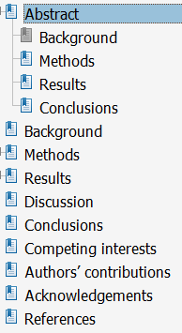
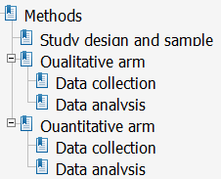
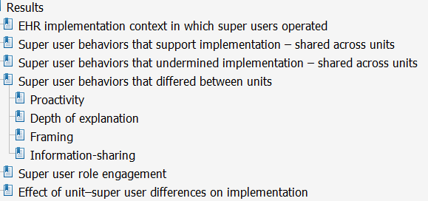
Journal article example
A mixed methods study of how clinician ‘super users’ influence others during the implementation of electronic health records
Yuan et al. BMC Medical Informatics and Decision Making (2015) 15:26

Slide 83
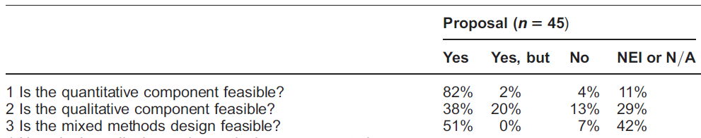
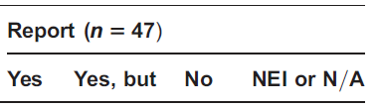
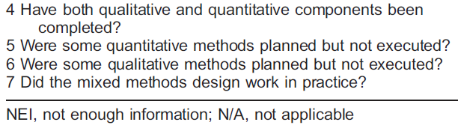
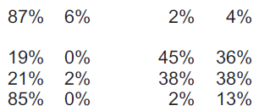
Success of MM studies in HSR
The quality of mixed methods studies in health services research
Alicia O’Cathain, Elizabeth Murphy1, Jon Nicholl
Journal of Health Services Research & Policy Vol 13 No 2, 2008: 92–98

Slide 84
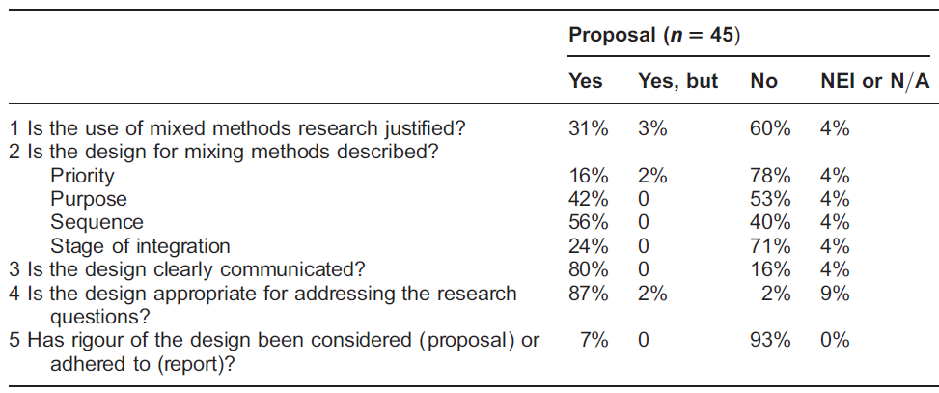
MM design quality of studies in HSR (1)
The quality of mixed methods studies in health services research
Alicia O’Cathain, Elizabeth Murphy1, Jon Nicholl
Journal of Health Services Research & Policy Vol 13 No 2, 2008: 92–98

Slide 85
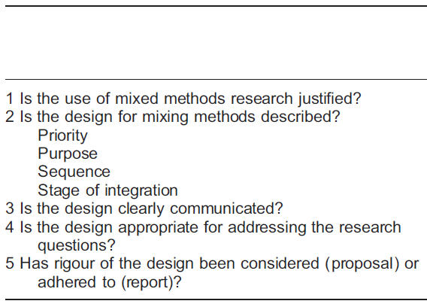
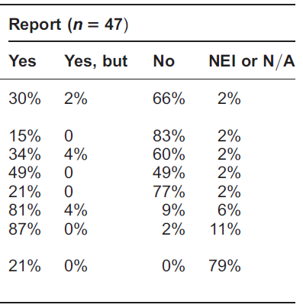
MM design quality of studies in HSR (2)
The quality of mixed methods studies in health services research
Alicia O’Cathain, Elizabeth Murphy1, Jon Nicholl
Journal of Health Services Research & Policy Vol 13 No 2, 2008: 92–98

Slide 86
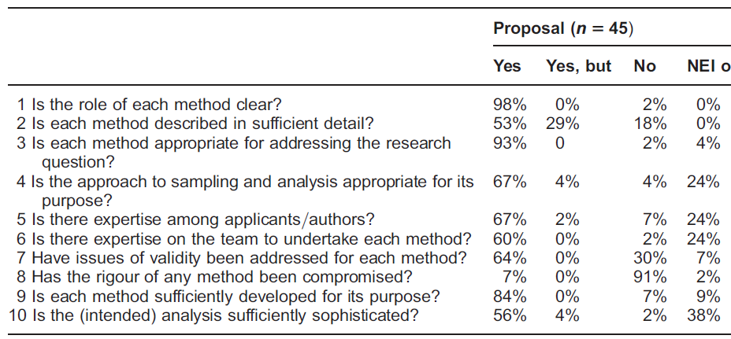
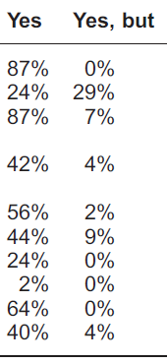
Quality assessment of components
QUAN QUAL
The quality of mixed methods studies in health services research
Alicia O’Cathain, Elizabeth Murphy1, Jon Nicholl
Journal of Health Services Research & Policy Vol 13 No 2, 2008: 92–98

Slide 87
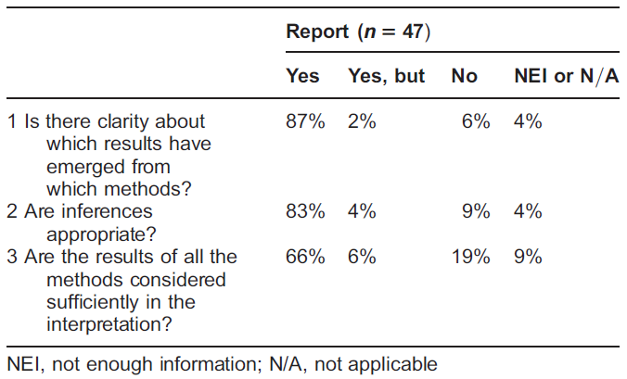
Assessment of inferences made
The quality of mixed methods studies in health services research
Alicia O’Cathain, Elizabeth Murphy1, Jon Nicholl
Journal of Health Services Research & Policy Vol 13 No 2, 2008: 92–98

