Slide 1
Statistical data analysis and research methods
BMI504
Course 19453 – Spring 2020
Class 11 – April 16, 2020
Clinical Trial Design
Werner CEUSTERS

Slide 2
Background
Evidence Based Medicine

Slide 3
Evidence-based medicine (EBM) steps
ASK Convert the need for information into a focused clinical question.
ACQUIRE Track down the best evidence with which to answer that question.
APPRAISE Critically appraise the evidence for its validity, impact, and applicability.
APPLY Integrate the evidence with your clinical expertise and your patient's characteristics and values.
ASSESS Assess the results of your intervention.
http://libguides.gwumc.edu/ebm/ebmintro

Slide 4
Two Cardinal Rules of EBM
Not all evidence is created equal:
  A hierarchy of evidence guides clinical decision-making.
Evidence alone is never enough:
  Competent physicians balance risks and benefits of management strategies in the context of patient values and preferences.
http://libguides.gwumc.edu/ebm/ebmintro

Slide 5
Level of evidence
Level of Evidence | Qualifying Studies
I | High-quality, multicenter or single-center, randomized controlled trial with adequate power; or systematic review of these studies
II | Lesser quality, randomized controlled trial; prospective cohort study; or systematic review of these studies
III | Retrospective comparative study; case-control study; or systematic review of these studies
IV | Case-series
V | Expert opinion; case report or clinical example; or evidence based on physiology, bench research, or “first principles”
Chung KC, Swanson JA, Schmitz D, et al. Introducing evidence-based medicine to plastic and reconstructive surgery. Plast. Reconstr. Surg. 2009;123:1385–1389.

Slide 6
Clinical research
Is medical research that involves human subjects.
Types of clinical research include:
  Epidemiological:
    improves the understanding of a disease by studying patterns, causes, and effects of health and disease in specific groups.
  Behavioral:
    improves the understanding of human behavior and how it relates to health and disease.
  Health services:
    looks at how people access health care providers and health care services, how much care costs, and what happens to patients as a result of this care.
  Clinical trials:
    evaluate the effects of an intervention on health outcomes.
https://www.nih.gov/health-information/nih-clinical-research-trials-you/basics

Slide 7
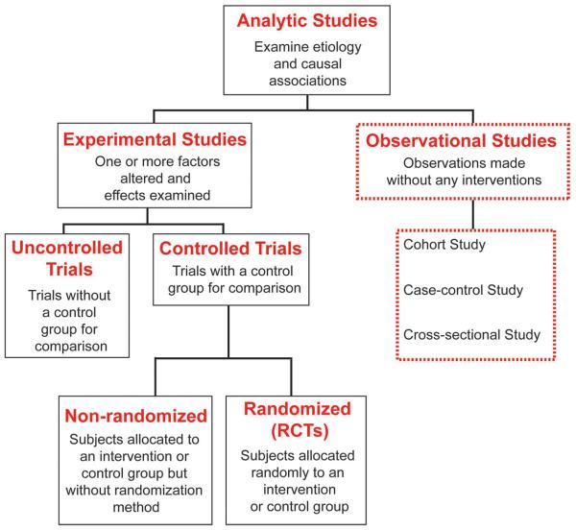
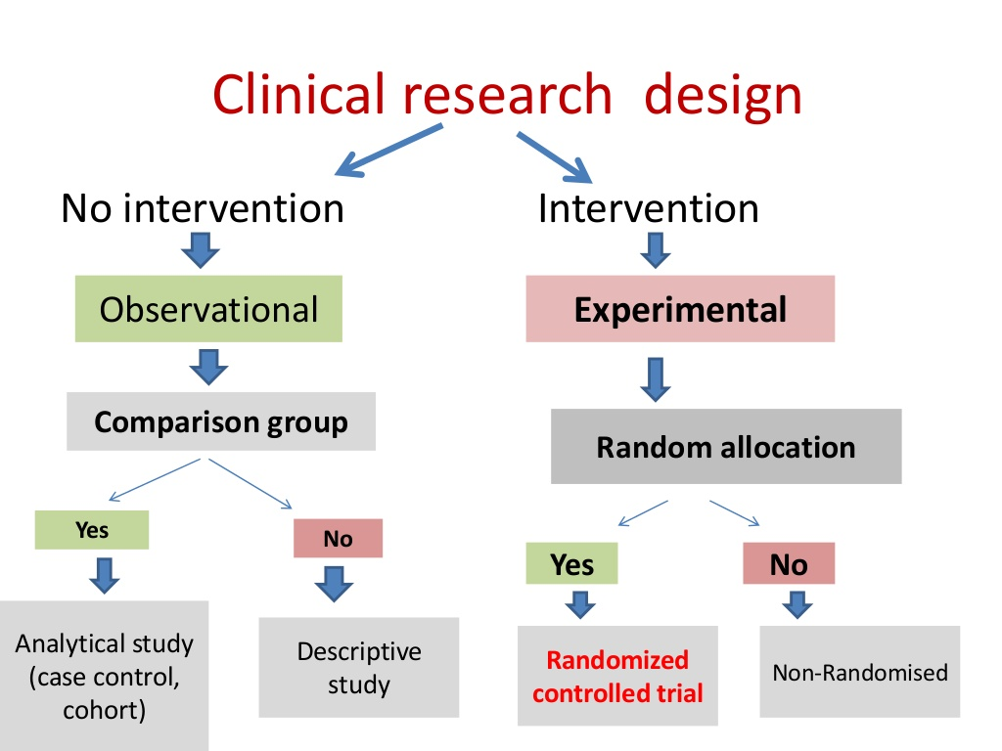
EBM terminology is not standardized !
Song JW, Chung KC. Observational studies: Cohort and case-control studies. Plast Reconstr Surg 2010;126:2234-42
https://www.slideshare.net/ritubudania/clinical-trial-design-28898802

Slide 8
Methodological principles and strategies
Summary and recapitulation
For details:
See Class 4 – Parameters for Research Designs

Slide 9
(Relatively) Common Strategies
Research question formulation
Standardization
Randomization and stratification
Blinding
Use of placebos/shams
Control group selection
Population selection
Endpoint selection
Protocol adherence
Sample size determination
Evans SR. Fundamentals of clinical trial design. Journal of experimental stroke & translational medicine. 2010;3(1):19-27.

Slide 10
S1: PICO(TT) Question Formulation
P | Patient Population of patients Problem | What is the best way to briefly describe this patient population or situation? E.g. pregnant women over 40 with preeclampsia, adolescent boys 13-15, etc.
I | Intervention (therapy or test) | What is the intervention? E.g. a drug, a questionnaire, a test, a procedure, etc.
C | Comparison | Is there an alternative intervention to compare to? E.g. placebo, current standard of care, another therapy, etc.
O | Outcome | Include specific patient-oriented outcomes E.g. morbidity, quality of life, etc.
T | Time for completion | Used to identify the time/duration for your data collection or for assessing your outcome. I.e. how long before you are to see that the intervention is having a positive impact OR the time in which the intervention will be delivered
T | Type of study | What is the ideal study design to answer this question? What type of study design do you realistically anticipate finding? E.g. randomized-controlled trial, systematic reviews, etc.

Slide 11
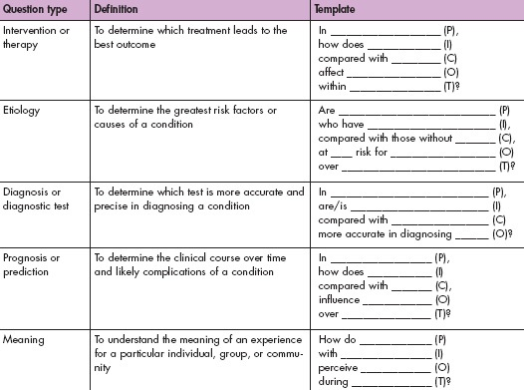
https://www.aaacn.org/sites/default/files/documents/misc-docs/1e_PICOT_Questions_template.pdf

Slide 12
S2. Standardization
Goal: minimize variation.
Strategies:
  construct consistent and uniform endpoint definitions which are as much as possible objectively measurable;
  use central labs/evaluators to eliminate between-lab/ between-evaluator variation;
  Use very precise evaluation manuals;
  Training of evaluators.
Evans SR. Fundamentals of clinical trial design. Journal of experimental stroke & translational medicine. 2010;3(1):19-27.

Slide 13
S3. Randomization
Goal: minimizing treatment selection bias;
    assignment to treated group not based on prognostic factors;
    prevents confounding of the treatment effects with other prognostic variables.
Strategies:
  Simple: flip a coin for each subject.
  Constrained: subjects pick token (T or nT) from a bag.
  Adaptive, several schemas, e.g.:
    pick token from bag to determine group, put it back, add one token from opposite category, or,
    pick from bag, give selected treatment, if treatment successful add two tokens of same treatment to bag, otherwise, one of each.
  Stratified: create treatment groups that are balanced with respect to confounding (prognostic) variables.

Slide 14
S4. Blinding
Of who:
  single: study subjects;
  double: subjects plus investigators;
  triple: subjects, investigators, evaluators, sponsors.
Not often possible:
  Ethical (no fake surgery)
  Different side effects of two compared treatments
  Different routes of administration
    Can be canceled out by ‘double dummy’ approach
Requires evaluation of the success of the blinding.
Evans SR. Fundamentals of clinical trial design. Journal of experimental stroke & translational medicine. 2010;3(1):19-27.

Slide 15
S5. Use of placebos
Sometimes costly
Sometimes impossible
  surgery
  device testing
May have treatment effects, most often with patient-reported outcomes.
Evans SR. Fundamentals of clinical trial design. Journal of experimental stroke & translational medicine. 2010;3(1):19-27.

Slide 16
S6. Control group selection
Goal: discriminate the effects caused by the study intervention from effects due to other factors.
      natural history of the disease, patient or clinician expectations, the effects of other interventions, …
Types:
  historical controls: data from previous studies
    Randomization not possible → more bias risk
  placebo/sham controls
  active controls: comparison to intervention with known outcomes
    ‘non-inferiority’ studies.
Evans SR. Fundamentals of clinical trial design. Journal of experimental stroke & translational medicine. 2010;3(1):19-27.

Slide 17
S7. Population selection
Determined by the study objective
Homogenous and small versus diverse and large
Response variation and effect isolation versus impact of intervention on society
Entry criteria considerations:
  Participant safety
  Reduction of variation
  Prevention of bias
    Eliminate confounding comorbidities
Evans SR. Fundamentals of clinical trial design. Journal of experimental stroke & translational medicine. 2010;3(1):19-27.

Slide 18
S8. Endpoint selection
Desiderata for endpoints:
  clinically relevant,
  interpretable,
  sensitive to the effects of intervention,
  practical and affordable to measure in an unbiased manner,
    Objective endpoints better than subjective endpoints .
Characterized as one of the variable types (nominal, …)
Evans SR. Fundamentals of clinical trial design. Journal of experimental stroke & translational medicine. 2010;3(1):19-27.

Slide 19
S10. Steps in sample size determination
Formulate null and alternative hypotheses.
    ‘minimum clinically relevant difference’.
Select type I and type II errors.
Obtain estimates of quantities that may be needed (e.g., estimates of variation or a control group response rate), through:
    searching the literature for prior data
    running pilot studies.
Select the minimum sample size such that two conditions hold:
    if the null hypothesis is true then the probability of incorrectly rejecting is no more than the selected Type I error rate, and
    if the alternative hypothesis is true then the probability of incorrectly failing to reject is no more than the selected Type II error.
Evans SR. Fundamentals of clinical trial design. Journal of experimental stroke & translational medicine. 2010;3(1):19-27.

Slide 20
S10. Alternative sample size method
Identify a primary quantity to be estimated (e.g. between-group difference in the mean response);
Estimate it with acceptable precision;
Compute the sample size so that there is a high probability that this quantity is estimated with acceptable precision as measured by, e.g. the width of the confidence interval for the between-group difference in means.
Evans SR. Fundamentals of clinical trial design. Journal of experimental stroke & translational medicine. 2010;3(1):19-27.

Slide 21
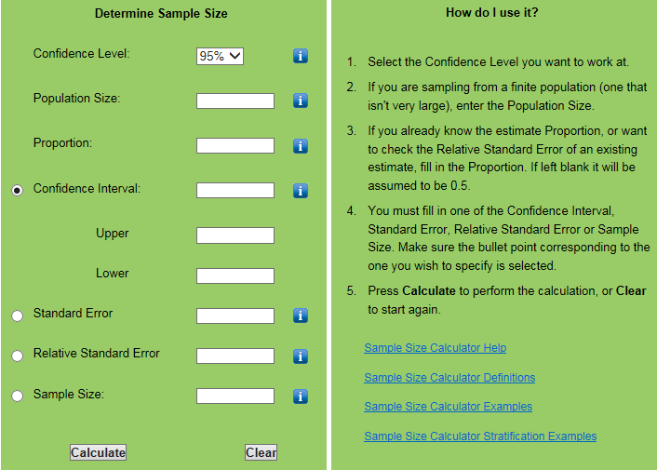
Notes:
http://www.nss.gov.au/nss/home.nsf/pages/Sample+size+calculator

Slide 22
Baseline determination
Consider all important baseline variables to be measured and how they are to be measured before treatment starts:
  Demographic characteristics (age, sex, height, weight, etc),
  Known factors that predict the outcome (potential confounders),
  Factors that predict or alter the risk of adverse reactions,
  Stratification factors,
  Pre-specified subgroups.
Burgess DC, Gebski VJ, Keech AC. Baseline data in clinical trials.
Med J Aust. 2003 Jul 21;179(2):105-7.

Slide 23
Table of Baseline Data
Table describing the characteristics of the intervention and control groups before the trial begins
Variables
  Demographics (age, gender, race, ethnicity, etc.)
  Lab Values
  Diagnoses
  Severity of illness scores (any risk factors for the primary outcome)
  Abnormal cut offs for values
  Combined values as needed for composite measures
  Comparison of the intervention and control groups

Slide 24

Am I clear?
If you did not do so thus far, all steps need to be accounted for in your research proposal!

Slide 25
Study designs

Slide 26
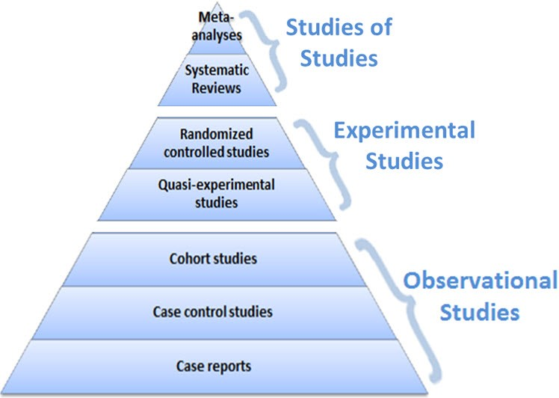
Levels of evidence
A proposal requirement!
https://guides.library.vcu.edu/humphrey/journal-club

Slide 27
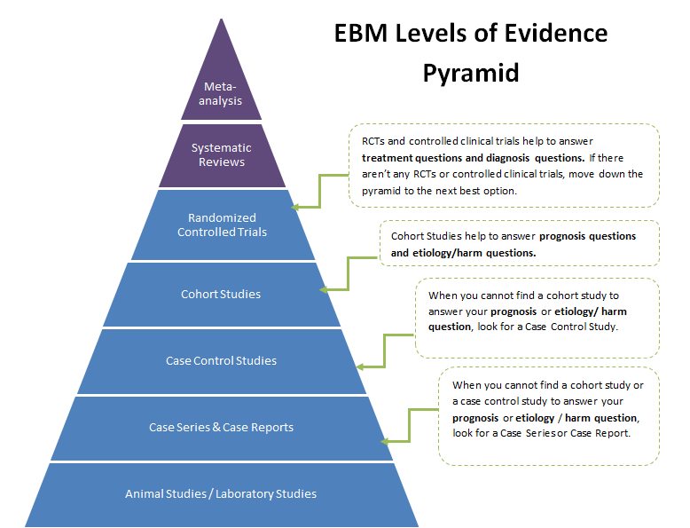
http://guides.dml.georgetown.edu/ebm/ebmclinicalquestions

Slide 28
Studies of studies
Meta-analysis:
  A study using statistical techniques to summarize the results of several studies in a single weighted estimate, in which more weight is given to results of studies with more events and sometimes to studies of higher quality.
Systematic review:
  a review in which specified and appropriate methods have been used to identify, appraise, and summarize studies addressing a defined question.
  It can, but need not, involve meta-analysis.

Slide 29
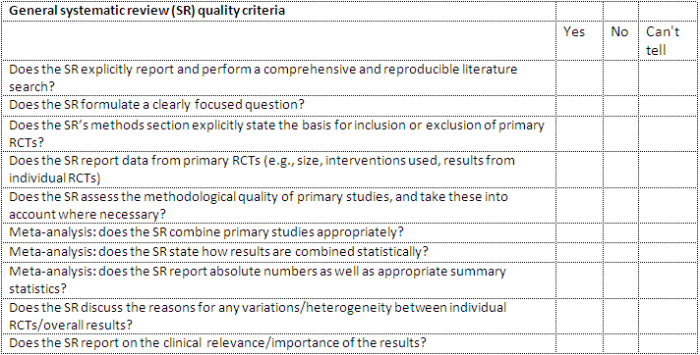
Appraising systematic reviews
http://clinicalevidence.bmj.com/x/set/static/ebm/toolbox/665052.html

Slide 30
Study designs
Clinical Trials
(strictu sensu)

Slide 31
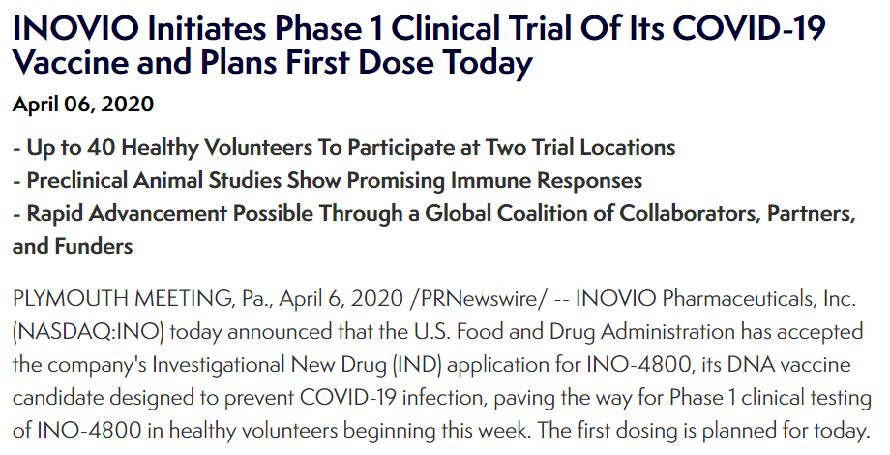
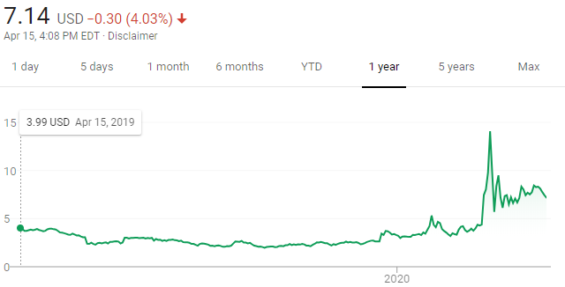
Clinical trials: from discovery to application
Phase I | The first studies conducted in humans using an experimental intervention. These trials often have small sample sizes (e.g., <20), may enroll healthy human participants, and are used to investigate pharmacokinetics, pharmacodynamics, and toxicity.
Evans SR. Fundamentals of clinical trial design. Journal of experimental stroke & translational medicine. 2010;3(1):19-27.

Slide 32
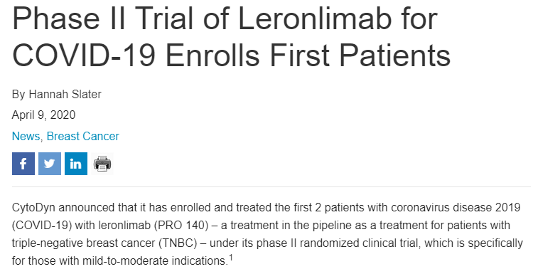
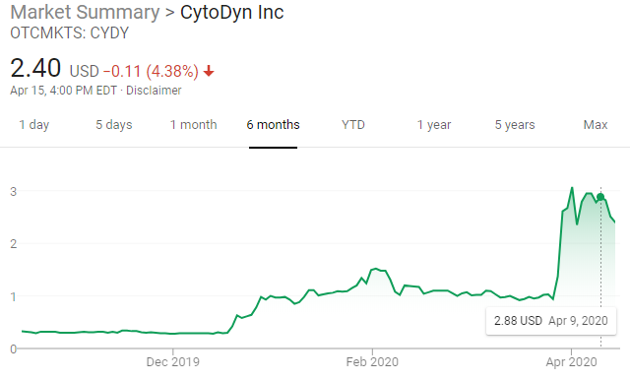
Clinical trials: from discovery to application
Phase I | The first studies conducted in humans using an experimental intervention. These trials often have small sample sizes (e.g., <20), may enroll healthy human participants, and are used to investigate pharmacokinetics, pharmacodynamics, and toxicity.
Phase II | Trials typically conducted to investigate a dose response relationship, identify an optimal dose, and to investigate safety issues.
Evans SR. Fundamentals of clinical trial design. Journal of experimental stroke & translational medicine. 2010;3(1):19-27.

Slide 33
Clinical trials: from discovery to application
Phase I | The first studies conducted in humans using an experimental intervention. These trials often have small sample sizes (e.g., <20), may enroll healthy human participants, and are used to investigate pharmacokinetics, pharmacodynamics, and toxicity.
Phase II | Trials typically conducted to investigate a dose response relationship, identify an optimal dose, and to investigate safety issues.
Phase III | Generally large trials (i.e., many study participants) designed to “confirm” efficacy of an intervention. They are sometimes called “confirmatory trials” or “registration trials” in the context of pharmaceutical development.
Evans SR. Fundamentals of clinical trial design. Journal of experimental stroke & translational medicine. 2010;3(1):19-27.

Slide 34
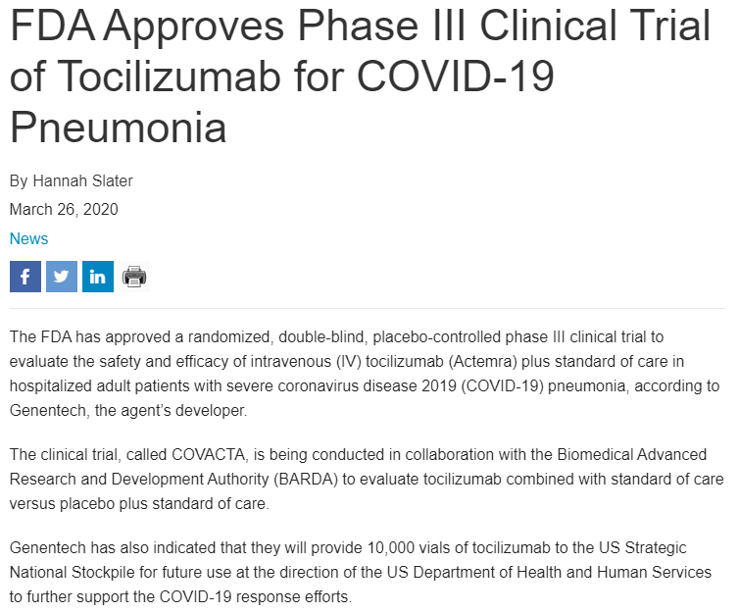
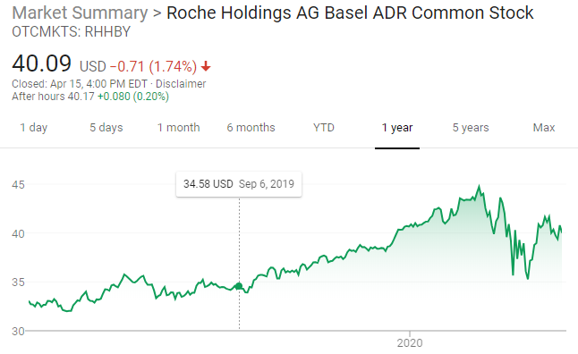

Slide 35
Clinical trials: from discovery to application
Phase I | The first studies conducted in humans using an experimental intervention. These trials often have small sample sizes (e.g., <20), may enroll healthy human participants, and are used to investigate pharmacokinetics, pharmacodynamics, and toxicity.
Phase II | Trials typically conducted to investigate a dose response relationship, identify an optimal dose, and to investigate safety issues.
Phase III | Generally large trials (i.e., many study participants) designed to “confirm” efficacy of an intervention. They are sometimes called “confirmatory trials” or “registration trials” in the context of pharmaceutical development.
Phase IV | Trials carried out after registration of an intervention. They are generally very large and are typically conducted by pharmaceutical companies for marketing purposes and to gain broader experience with the intervention.
Evans SR. Fundamentals of clinical trial design. Journal of experimental stroke & translational medicine. 2010;3(1):19-27.

Slide 36
NIH's Definition of a Clinical Trial
‘A research study in which one or more human subjects are pro-spectively assigned to one or more interventions (which may in-clude placebo or other control) to evaluate the effects of those interventions on health-related biomedical or behavioral outcomes’.
If the answer to all following questions is “yes,” then the clinical study is a clinical trial according to the NIH definition.
  Does the study involve human participants?
  Are the participants prospectively assigned to an intervention?
  Is the study designed to evaluate the effect of the intervention on the participants?
  Is the effect being evaluated a health-related biomedical or behavioral outcome?
https://grants.nih.gov/policy/clinical-trials/definition.htm

Slide 37
Is this a clinical trial?
The study involves the recruitment of research participants with disease X to receive either an investigational drug or a placebo. It is designed to evaluate the efficacy of the investigational drug to relieve disease symptoms.

Slide 38
The study involves the recruitment of research participants with disease X to receive either an investigational drug or a placebo. It is designed to evaluate the efficacy of the investigational drug to relieve disease symptoms.
Does the study involve human participants?
  Yes, the study involves human participants.
Are the participants prospectively assigned to an intervention?
  Yes, the participants are prospectively assigned to receive an intervention, the investigational drug or placebo.
Is the study designed to evaluate the effect of the intervention on the participants?
  Yes, the study is designed to evaluate the effect of the investigational drug on the participants’ symptoms.
Is the effect being evaluated a health-related biomedical or behavioral outcome?
  Yes, the effect being evaluated, relief of symptoms, is a health-related outcome.

Slide 39
A study involves the recruitment of children at two schools to evaluate their preferences for graphics and colors used in healthy food advertisements. Children will be presented by multiple health advertisement and their preferences for graphics and colors will be assessed.
Does the study involve human participants?
  Yes, children are human participants.
Are the participants prospectively assigned to an intervention?
  Yes, the participants are prospectively assigned to see different advertisements.
Is the study designed to evaluate the effect of the intervention on the participants?
  Yes, the study is designed to evaluate the advertisements.
Is the effect being evaluated a health-related biomedical or behavioral outcome?
  No, preferences are not health-related biomedical or behavioral outcomes.

Slide 40
Controlled Clinical Trial
Clinical trial in which participants are assigned to two or more different treatment groups by a method other than random allocation.

Slide 41
Randomized Controlled Trial
A clinical trial in which participants are randomly assigned to two or more groups: at least one (the experimental group) receiving an intervention that is being tested and another (the comparison or control group) receiving an alternative treatment or placebo.

Slide 42
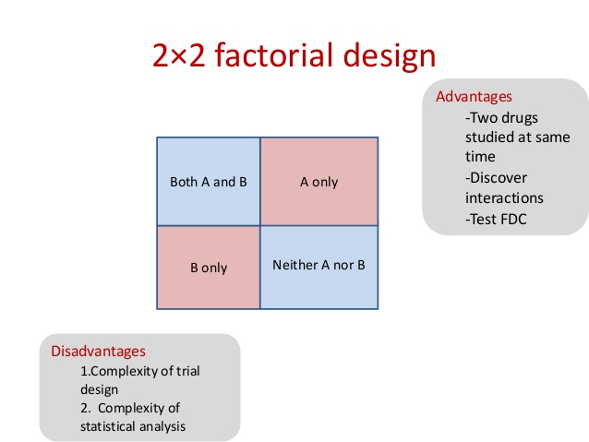
Factorial Designs
Perhaps two different dosings of the same drug can be tested for efficacy
  Clopidogrel standard vs double dose
  Clopidogrel plus ASA vs Clopidogrel alone vs ASA alone
  Clopidogrel with high dose ASA vs Clopidogrel with low dose ASA
    Should be no direct interaction of ASA and Clopidogrel other than the main outcomes (e.g. Metabolism)

Slide 43
N-of-1 studies
Select a patient for whom you want to know whether some treatment is the correct treatment for him.
You measure the baseline state (e.g. BP).
You give the treatment and then measure the outcome (e.g. BP).
Then you take him off the treatment and measure the outcome (e.g. BP).
Then you repeat steps 4 and 5 three times or more and analyze the differences.
An effective therapy should produce consistent effects.

Slide 44
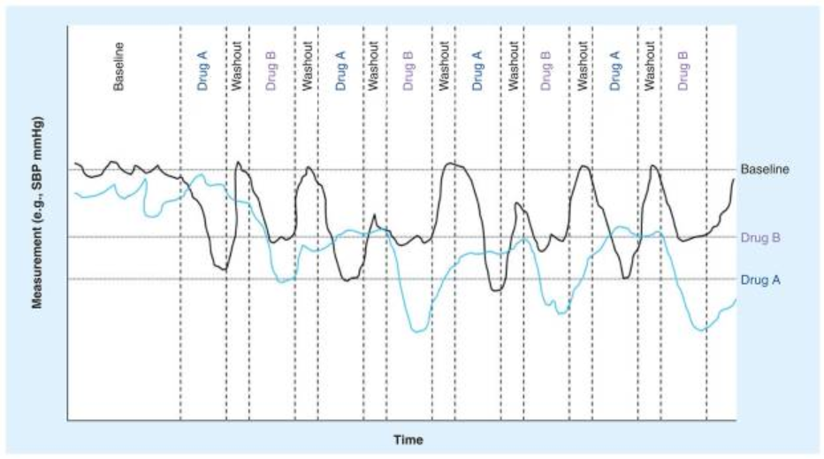
N-of-1 for treatment selection
https://www.ncbi.nlm.nih.gov/pmc/articles/PMC3118090/

Slide 45
Study designs
Cohort studies

Slide 46
Cohort Study
A non-experimental study design that follows one or more cohorts.
A cohort = a group of individuals, usually 100 or more in size, who share a common characteristic,
    e.g. smokers, workers in a lead smelter, people born in the same year, or all enrollees of a specific health insurance plan
Looks at how events differ among people within the group.
A study that examines a cohort, which differs in respect to exposure to some suspected risk factor (e.g. smoking), is useful for trying to ascertain whether exposure is likely to cause specified events (e.g. lung cancer).

Slide 47
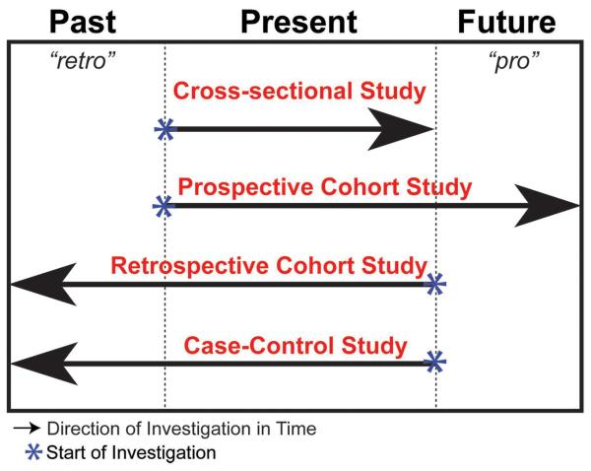
Cohort studies
Song JW, Chung KC. Observational studies: Cohort and case-control studies. Plast Reconstr Surg 2010;126:2234-42

Slide 48
Cohort studies: advantages
Advantages:
  Gather data regarding sequence of events; can assess causality
  Examine multiple outcomes for a given exposure
  Good for investigating rare exposures
  Can calculate rates of disease in exposed and unexposed individuals over time (e.g. incidence, relative risk)
Song JW, Chung KC. Observational studies: Cohort and case-control studies. Plast Reconstr Surg 2010;126:2234-42

Slide 49
Cohort studies: disadvantages
General:
  Large numbers of subjects are required to study rare exposures;
  Susceptible to selection bias.
Prospective Cohort Study:
  May be expensive to conduct;
  May require long durations for follow-up;
  Maintaining follow-up may be difficult;
  Susceptible to loss to follow-up or withdrawals.
Retrospective Cohort Study:
  Susceptible to recall bias or information bias;
  Less control over variables.
Song JW, Chung KC. Observational studies: Cohort and case-control studies. Plast Reconstr Surg 2010;126:2234-42

Slide 50
Selection of cohort study participants
Define the selected group of subjects by exposure status at the start of the investigation.
Have both the exposed and unexposed groups be selected from the same source population.
Song JW, Chung KC. Observational studies: Cohort and case-control studies. Plast Reconstr Surg 2010;126:2234-42

Slide 51
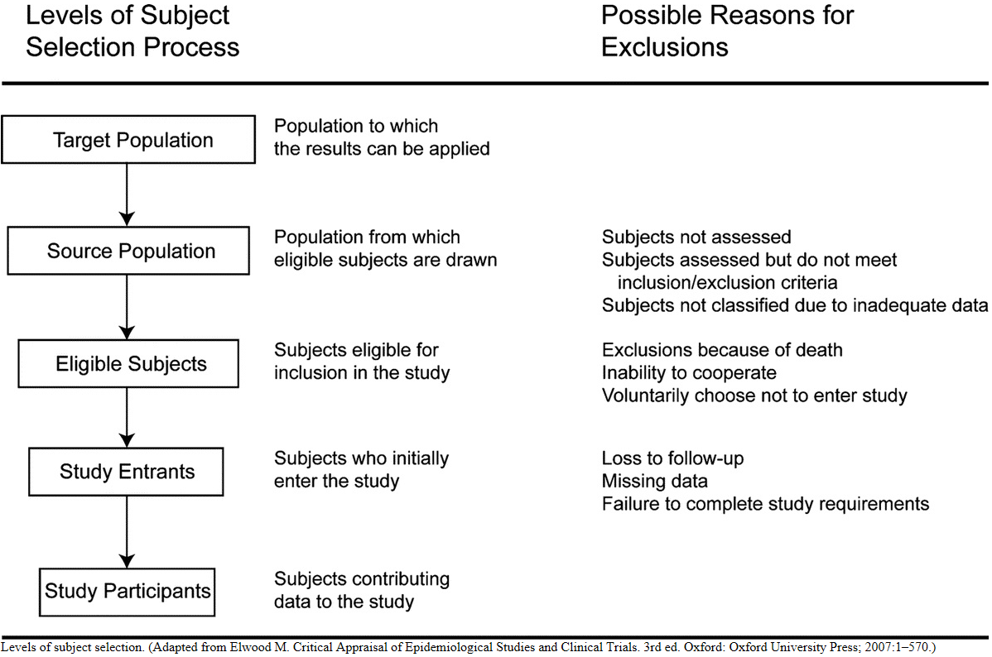
Selection of participants in cohort studies

Slide 52
Evaluation

Slide 53
Evaluation

Slide 54
What Odds Ratio (OR) and Risk Ratio (RR) tell you
That there IS a relationship between exposure and outcome when the OR or RR is clearly more than 1.0 or less than 1.0,
The DIRECTION of the effect:
  if AD greater than BC (OR > 1.0) then the exposure is more likely to lead to illness,
  if BC is greater than AD (OR< 1.0) the exposure is ‘protective’ against illness.
The SIZE or STRENGTH of the effect: the actual OR or RR value itself, read as the number of times one group is more likely to be ill than the other group.
https://www.quora.com/What-is-the-difference-between-the-risk-ratio-RR-and-the-odds-ratio-OR

Slide 55
Odds Ratio (OR) or Risk Ratio (RR) ?
It’s never wrong to use OR, but RR is preferred when you have the true incidence rate for both exposure groups.
  This is ONLY possible where you start with healthy exposed groups and follow them through time.
  You do NOT have this when you begin with some ill people (cases) and quickly assemble some non-ill people for comparison (as in a case control study).
OR is used for rare or uncommon diseases because you cannot realistically assemble ‘exposed’ and ‘non-exposed’ groups (as for RR).
Neither OR or RR are particularly reliable where the cell sizes are small.
https://www.quora.com/What-is-the-difference-between-the-risk-ratio-RR-and-the-odds-ratio-OR

Slide 56
Study designs
Cross-sectional studies

Slide 57
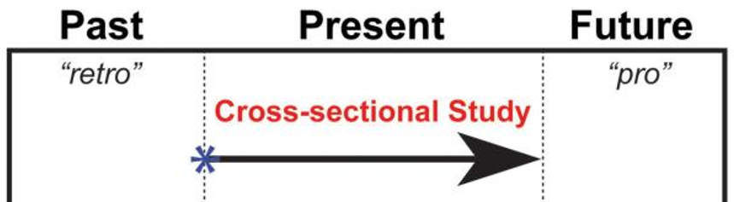
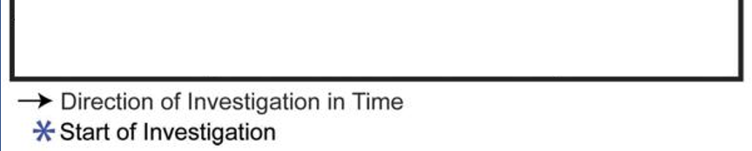
Cross-sectional study
An observational study in which subjects are sampled at one point in time, and then the associations between the concurrent risk factors and health outcomes are investigated.

Slide 58
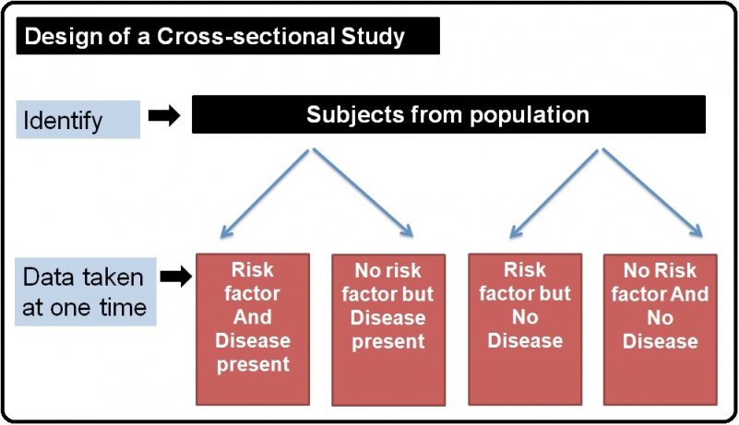
Cross-sectional design

Slide 59
Study designs
Case-control studies

Slide 60
Case control study
Examine two groups:
  One group of people who have experienced an event (= some outcome, usually an adverse event) and,
  Another group of people who have not experienced the same outcome.
Look at how exposure to suspect (usually noxious) agents differed between the two groups.
This type of study design is most useful for trying to ascertain the cause of rare events, such as rare cancers.
Aims to achieve the same goals (comparison of exposed and unexposed) as a cohort study but does so more efficiently, by the use of sampling.

Slide 61
Case control study
Synonyms:
  "retrospective studies“,
  "case-referent studies“.
Compares patients who have a disease or outcome of interest (cases) with patients who do not have the disease or outcome (controls),
Retrospective comparison of how frequently the exposure to a risk factor is present in each group to determine the relationship between the risk factor and the disease.
Are observational:
  no intervention is attempted,
  no attempt is made to alter the course of the disease.
The proportion of cases in the entire population-at-risk is unknown:
  → Designed to estimate odds.

Slide 62
ERIC Notebook. Case Control Studies (Second Edition No. 5)

Slide 63
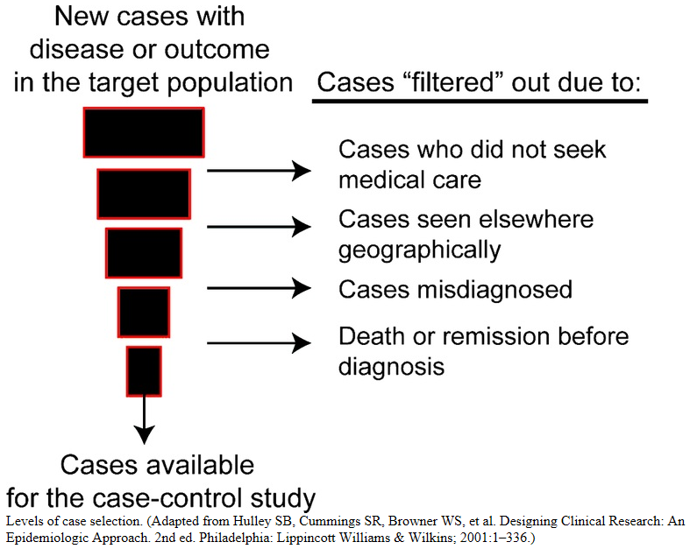
Case selection in case control studies
Song JW, Chung KC. Observational studies: Cohort and case-control studies. Plast Reconstr Surg 2010;126:2234-42

Slide 64
Case selection alternatives
Prevalent cases:
  persons who were existing cases of the health outcome or disease during the observation period.
    → prevalence odds ratio, which will be influenced by the incidence rate and survival or migration out of the prevalence pool of cases, and thus does not estimate the rate ratio.
Incident cases:
  persons who newly develop the health outcome or disease during the observation period.
    prevalence is influenced by both incidence and duration.
For cause of disease studies incident cases are preferred as they are more informative about factors that lead up to the development of disease rather than factors that affect duration.

Slide 65
Control selection in case-control studies
Most demanding aspects of a case-control study.
The distribution of exposure should be the same among cases and controls; in other words, both cases and controls should stem from the same source population.
The control group may also be an at-risk population, with the potential to develop the outcome.
Because the validity of the study depends on the comparability of these two groups, cases and controls should otherwise meet the same inclusion criteria in the study.
Song JW, Chung KC. Observational studies: Cohort and case-control studies. Plast Reconstr Surg 2010;126:2234-42

Slide 66
Matched case-control study
Matching attempts to ensure comparability between cases and controls.
Goal: reduce variability and systematic differences attributable to background variables and confounders:
    Background variables: variables that are not of interest to the investigator.
    Confounders: variables associated with the risk factor which may potentially be a cause of the outcome.
Each case is typically paired individually with a control subject with respect to the background variables and confounders → ‘individual matching’.
  Alternative: multiple controls (when cases are rare).
Song JW, Chung KC. Observational studies: Cohort and case-control studies. Plast Reconstr Surg 2010;126:2234-42

Slide 67
Case control study
Advantages
can obtain findings quickly
can often be undertaken with minimal funding
efficient for rare diseases
can study multiple exposures
generally requires few study subjects
Disadvantages
cannot generate incidence data
subject to bias
difficult if record keeping is either inadequate or unreliable
selection of controls can be difficult
cannot determine prevalence nor incidence of disease nor the risk factors as the subjects are generally collected by purposive sampling.

Slide 69
Interpretation of Odds Ratio
OR = 1 Odds of disease is the same for exposed and unexposed
OR > 1 Exposure increases odds of disease
OR < 1 Exposure reduces odds of disease

Slide 70
Bias in case control studies
Sampling bias:
  may occur if the cases and controls are taken from different subgroups of the population.
  the difference in the exposure may be due to some other inherent differences between the groups rather than the risk factor being studied.
Recall bias:
  May happen when subjects are asked to answer questions about exposure to risk factors in the past.
  It is likely that people who are diseased (cases) remember their exposure to the risk factor more accurately as compared to the controls. This may result in the OR value being higher than the actual value. It is important to note that case–control study designs cannot determine neither the prevalence or incidence of the disease nor the risk factors as the subjects are generally collected by purposive sampling.

Slide 71
Study designs
Case series

Slide 72
Case Series
Analysis of series of people with some characteristic.
There is no comparison group.
Settings (1):
  Initial reports of a new diagnosis or innovative treatment.
    e.g.: the recovery and complication rates after a treatment or procedure.
    Not to be used for treatment efficacy!
  Describing the natural history of a condition.
  Single physician or hospital reports of outcomes.
  Multi-institutional registry.
Carey TS, Boden SD. A critical guide to case series reports. Spine (Phila Pa 1976). 2003 Aug 1;28(15):1631-4. https://www.ncbi.nlm.nih.gov/pubmed/12897483

Slide 73
Case series settings (2)
Proof (or Disproof) of Concept for a New Hypothesis
Reporting of Sentinel Events
  Toxicities of Therapies
  Recognition of Epidemics
  Initial Identification of Previously Unrecognized Syndromes
Studying Outcomes of Rare Diseases or New Treatments (Limited Usefulness)
Kempen JH. Appropriate use and reporting of uncontrolled case series in the medical literature.
Am J Ophthalmol. 2011;151(1):7-10.e1.

Slide 74
Characteristics of good case series
Clearly defined question.
Well-described study population.
Well-described intervention.
Use of validated outcome measures.
Appropriate statistical analyses.
Well-described results.
Discussion/conclusions supported by data.
Funding source acknowledged.
Carey TS, Boden SD. A critical guide to case series reports. Spine (Phila Pa 1976). 2003 Aug 1;28(15):1631-4. https://www.ncbi.nlm.nih.gov/pubmed/12897483

Slide 75
Checklist for Reporting Case Series
Explicitly describe:
  The hypothesis/hypotheses under consideration
  Eligibility criteria for subjects in the report
  How treatments were administered or potential risk factors defined
Compare observed results to those in an appropriate external comparison group; discuss potential biases arising from such comparison
Perform appropriate statistics, ensuring that assumptions of the statistical methods are reasonable in this setting
Discuss the biological plausibility of the hypothesis in light of the report's observations
Explicitly discuss the report's limitations, and how these limitations could be overcome in future studies
Kempen JH. Appropriate use and reporting of uncontrolled case series in the medical literature.
Am J Ophthalmol. 2011;151(1):7-10.e1.

Slide 76
Study designs
Comparisons

Slide 77
Case Control Cohort
identify subjects by outcome status at the outset of the investigation
Once outcome status is identified and subjects are categorized as cases, controls (subjects without the outcome) are selected.
Both groups from the same source population.
define the selected group of subjects by exposure status at the start of the investigation.
Subjects who are not at risk for developing the outcome should be excluded from the study
Both groups from the same source population.
Song JW, Chung KC. Observational studies: Cohort and case-control studies. Plast Reconstr Surg 2010;126:2234-42

Slide 78
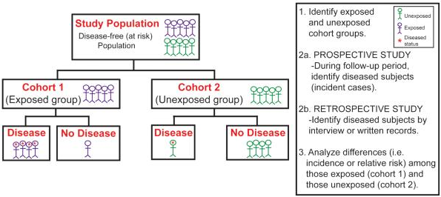
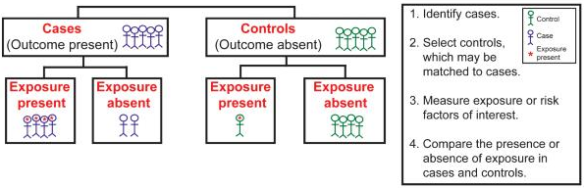
Cohort study
Case-control study
Song JW, Chung KC. Observational studies: Cohort and case-control studies. Plast Reconstr Surg 2010;126:2234-42

Slide 79
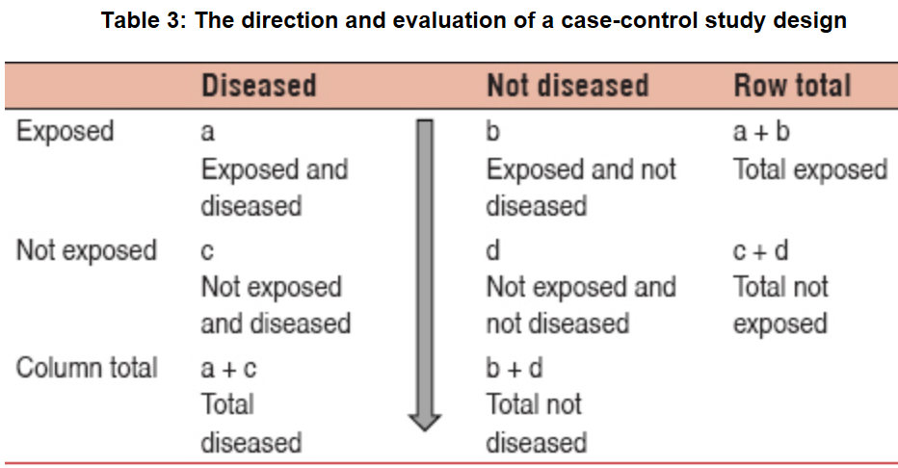

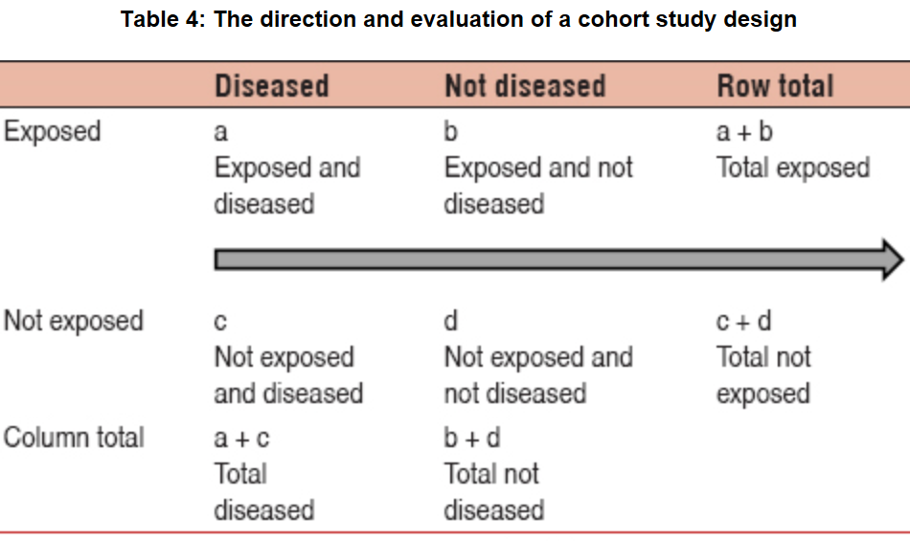


Case-control versus cohort
Notes:
Selecting the appropriate study design: Case–control and cohort study designs
A Omair - Journal of Health Specialties, 2016

Slide 80
Case-control / Cross-sectional / Cohort
Song JW, Chung KC. Observational studies: Cohort and case-control studies. Plast Reconstr Surg 2010;126:2234-42

Slide 81
Type of Question/ Type of Study
Therapy/ Treatment Selection of treatments of interventions that do more good than harm and that are worth the effort and cost. | Double-Blind Randomized Controlled Trial Systematic Review Meta Analysis of RCT
Diagnosis Selection and interpretation of diagnostic tests, in order to confirm or exclude a diagnosis, based on considering their precision, accuracy, acceptability, expense, safety, etc. | Controlled Trial Systematic Review Meta Analysis of Controlled Trial
Prognosis Estimation of a patient’s likely clinical course over time and anticipation of likely complications of disease. | Cohort Studies, Case Control, Case Series
Harm/ Etiology Identification of causes or risk factors for disease | Cohort Studies
Prevention | Randomized Controlled Trial, Cohort Studies
Quality Improvement | Randomized Controlled Trials
Adapted from: Sackett et al. Evidence-Based Medicine: How to Practice and Teach EBM, 2000

Slide 82
Study designs in function of objective
Objective Common design
Prevalence Cross sectional
Incidence Cohort
Cause in order of reliability:
cohort, case-control, cross sectional
Prognosis Cohort
Treatment effect Controlled trial
Mann, C.J. (2003) Observational research methods.
Research design II: Cohort, cross sectional, and case-control studies.
Emergency Medicine Journal 20 (1): 54–60.

Slide 83
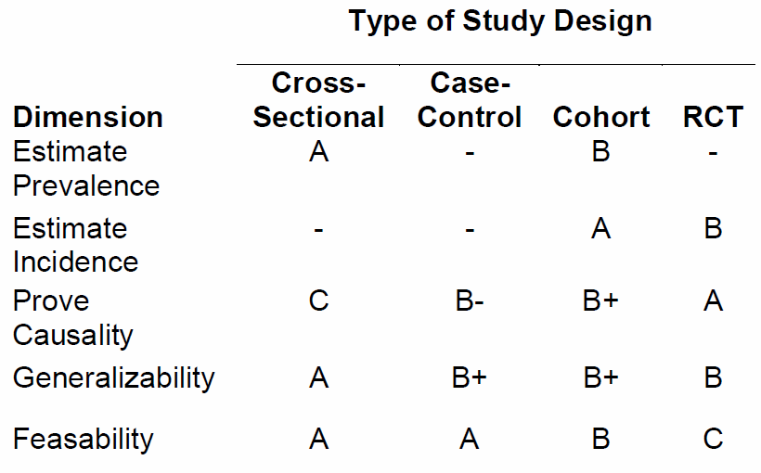
Study designs in function of objective
Edgar R Miller III. An Introduction to Clinical Trials: Design Issues.

Slide 84
Let’s try it

Slide 85
Q1. What is the study design? Explain.
To investigate the relationship between watching horror movies and angina pectoris, a group of patients admitted to hospital with angina pectoris were questioned about their watching habits.
A group of age and sex matched patients admitted to a fracture clinic were also questioned about their movie watching behavior using an identical protocol.
The two groups were compared.
Scoring: correct design 5p correct explanation 10p

Slide 86
Q2. What is the study design? Explain.
To investigate the relationship between meat processing and skin disease, all employees at a meat processing plant were questioned about their exposure to raw meat and bones, and the amount and length of exposure measured.
These subjects were monitored frequently for exposure and occurrence of disease, and after 8 years the researchers examined the death certificates for all deceased employees.
Scoring: correct design 5p correct explanation 10p

Slide 87
Q3. What is the study design? Explain.
A survey was conducted of all faculty of a particular department.
Among other questions, the questionnaire asked about the academic title of faculty and whether they were satisfied with their promotional prospects.
Scoring: correct design 5p correct explanation 10p

Slide 88
Q4. What is the study design? Explain.
To evaluate a new teaching method for biomedical informatics, students were randomly allocated to either the course with the new method or the conventional one.
At the end of the courses, the students were questioned about what they thought to have learned, and they were subjected to an exam by independent instructors.
Scoring: correct design 5p correct explanation 10p

Slide 89
Q5. What is the study design? Explain.
A new graduate student admission system has been set up at some university.
To evaluate it, the processing times of candidates were measured for 6 semesters and compared with the processing times at a nearby college.
Scoring: correct design 5p correct explanation 10p

Slide 90
Q6. When are case reports most useful?
a) When you encounter cases seen before and need more information
b) When new symptoms or outcomes are not yet identified
c) When developing clinical practice guidelines
d) When you have an extremely large study population
Pick one answer.
Scoring: correct 10p wrong -5p no answer 0p

Slide 91
Q7. Is this a case-control study? Explain.
A researcher forms for his study:
  a) a group of people with a known exposure and
  b) a comparison group (‘control group’) without the exposure.
He follows both groups through time to see what outcomes result.
Scoring: correct answer 5p correct explanation 10p

Slide 92
Q8. Which statements are correct?
An investigator wants to study whether clinicians using electronic medical record (EMR) systems are at risk factor for vision loss.
A cohort study is to be preferred over a case-control study. (correct answer 10p, wrong -5p, no 0p)
If one group is composed of EMR using clinicians suffering from vision loss, it is better to have the other group be composed of:
  Clinicians that do not use an EMR but suffer vision loss,
  Clinicians that use an EMR but do not have vision loss,
  EMR users with or without vision loss that are not clinicians.
(correct answer 10p, wrong -5p, no 0p)

Slide 93
Q9. Under what assumption would this be clinical trial per NIH?
In this study, subjects are recruited and randomized to receive one of two approved drugs. The goal is to compare the effects of the drugs on the concentration of a protein in the cerebrospinal fluid.
(correct answer 10p)

Slide 94
Q10. Which of the two is a clinical trial per NIH?
Human subjects with disease X are recruited to test an investigational in vitro diagnostic device (IVD). The study is designed to evaluate whether the device can measure the level of a protein in blood.
Human subjects with disease X are recruited to be evaluated with an investigational in vitro diagnostic device (IVD). The study aims to evaluate how knowledge of certain protein levels impacts clinical decisions for how to manage disease X.
correct answer 10p, wrong -5p, no 0p

Slide 95
Q11. Case-control study
Researchers conduct a case-control study of depression. The study included 200 cases and 200 controls. Of the cases, 80% reported they were graded by Ceusters. Among the controls, 50% reported they were graded by Ceusters.
Compute the exposure odds ratio
What does the exposure odds ratio tells us about being graded by Ceusters?
Scoring: Correct OR 20p , correct interpretation: 20p

Slide 96
Required reading for next week
R11. Lawrence A. Palinkas, Gregory A. Aarons, Sarah Horwitz, Patricia Chamberlain, Michael Hurlburt, John Landsverk
Mixed Method Designs in Implementation Research
Adm Policy Ment Health (2011) 38:44–53
https://www.ncbi.nlm.nih.gov/pmc/articles/PMC3025112/pdf/10488_2010_Article_314.pdf

