Slide 1
Statistical data analysis and research methods
BMI504
Course 20048 – Spring 2019
Class 8 – March 28, 2019
Descriptive and elementary statistics
Werner CEUSTERS

Slide 2
‘Statistics’
As mass noun:
    a branch of mathematics dealing with the collection, analysis, interpretation, and presentation of masses of numerical data.
As count noun:
    a collection of quantitative data.
The singular ‘statistic’:
    a single term or datum in a collection of statistics;
    a quantity (as the mean of a sample) that is computed from a sample; specifically an estimate;
    a random variable that takes on the possible values of a statistic.
        https://www.merriam-webster.com/dictionary/statistic

Slide 3
Descriptive vs. inferential statistics
Descriptive statistics:
  mathematical quantities that summarize and interpret some of the properties of a set of data (sample);
    More used as plural count noun
Inferential statistics:
  Research on a sample to infer the properties of the population from which the sample was drawn;
    More used as mass noun.

Slide 4
Methods to provide descriptive statistics
Organize Data
  Tables
  Graphs
Summarize Data
  Central Tendency
  Variation
    spread of the data about this central tendency.

Slide 5
A table with results of some measurements
72.8
71
76.5
83.9
78.4
83.9
76.5
80.9
91.2
85.9
92.5
85.9
83.9
84.6
84.6
88.1
86.6
95.2
86.6
95.2
95.2
83.6
88.2
90
92.5
86.5
90.7
93.2
73.8
76.8
81.9
78.1
74.3
84.3
81.9

Slide 6
Plots of the results of these measurements
← in order as presented
(down columns)
sorted by result
→

Slide 7
Magnified

Slide 8
Central notion: distribution
Most often: frequency distribution
a table or graph that displays the frequency of various outcomes in a sample.

Slide 9
Frequency distribution
71 | 1
72.8 | 1
73.8 | 1
74.3 | 1
76.5 | 2
76.8 | 1
78.1 | 1
78.4 | 1
80.9 | 1
81.9 | 2
83.6 | 1
83.9 | 3
84.3 | 1
84.6 | 2
85.9 | 2
86.5 | 1
86.6 | 2
88.1 | 1
88.2 | 1
90 | 1
90.7 | 1
91.2 | 1
92.5 | 2
93.2 | 1
95.2 | 3

Slide 10
Probability distribution tables
Distribution (frequency distribution): a table or graph that displays the frequency of various outcomes in a sample.
Probability distribution:
  a table that displays the probabilities of various outcomes in a sample.
  Is a "normalized frequency distribution table", where all occurrences of outcomes sum to 1.
Notes:
I wouldn’t necessarily say it is a table or a graph, which is why I added ‘tables’ to the title--- a probability distribution is a mathematical function that indicates the values a random variable may have
A random variable a function that associates a real number (the probability value) to an outcome of an experiment.

Slide 11
Probability distribution
 | Bin | Frequency | Prob distrib | Cumulative %
1 | 71 | 1 | 0.029 | 2.86%
2 | 72.8 | 1 | 0.029 | 5.71%
3 | 73.8 | 1 | 0.029 | 8.57%
4 | 74.3 | 1 | 0.029 | 11.43%
5 | 76.5 | 2 | 0.057 | 17.14%
6 | 76.8 | 1 | 0.029 | 20.00%
7 | 78.1 | 1 | 0.029 | 22.86%
8 | 78.4 | 1 | 0.029 | 25.71%
9 | 80.9 | 1 | 0.029 | 28.57%
10 | 81.9 | 2 | 0.057 | 34.29%
11 | 83.6 | 1 | 0.029 | 37.14%
12 | 83.9 | 3 | 0.086 | 45.71%
13 | 84.3 | 1 | 0.029 | 48.57%
14 | 84.6 | 2 | 0.057 | 54.29%
15 | 85.9 | 2 | 0.057 | 60.00%
16 | 86.5 | 1 | 0.029 | 62.86%
17 | 86.6 | 2 | 0.057 | 68.57%
18 | 88.1 | 1 | 0.029 | 71.43%
19 | 88.2 | 1 | 0.029 | 74.29%
20 | 90 | 1 | 0.029 | 77.14%
21 | 90.7 | 1 | 0.029 | 80.00%
22 | 91.2 | 1 | 0.029 | 82.86%
23 | 92.5 | 2 | 0.057 | 88.57%
24 | 93.2 | 1 | 0.029 | 91.43%
25 | 95.2 | 3 | 0.086 | 100.00%
 | More | 0 | 0.000 | 100.00%
 |  | 35 | 1

Slide 12
Probability distribution function
a mathematical function that indicates the values a random variable may have.
that random variable is the result of a function that associates a real number (the probability value) to an outcome of an experiment.
Cumulative probability distribution function (CDF): the probability that the random variable X takes on a value less than or equal to x.
Notes:
CHANGED

Slide 13
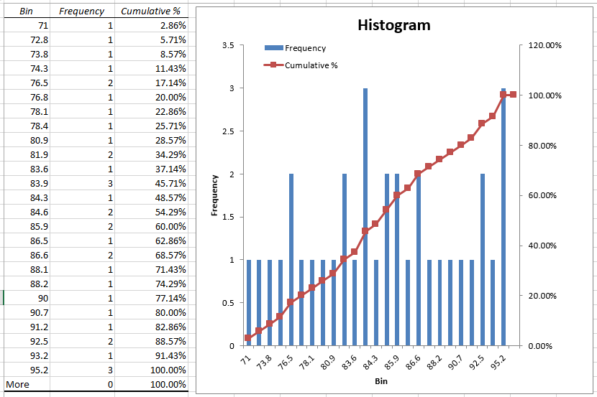
Histogram and frequency distribution

Slide 14
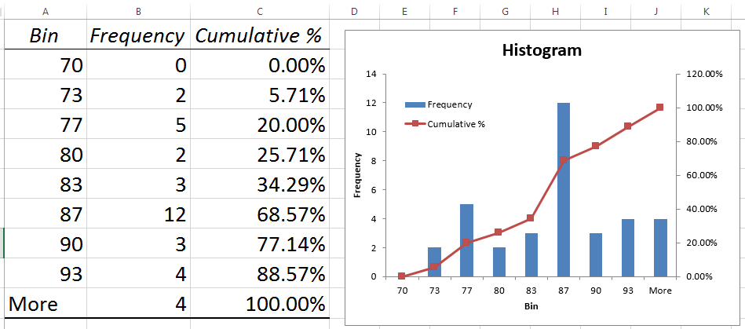
Histogram with fewer bins

Slide 15
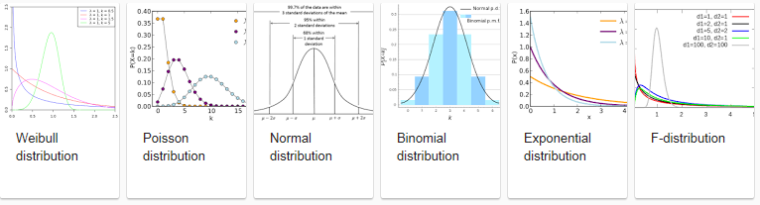
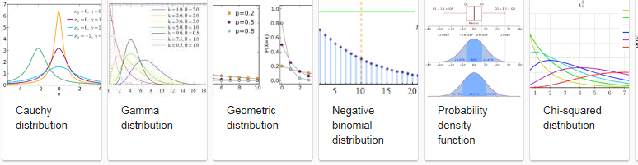
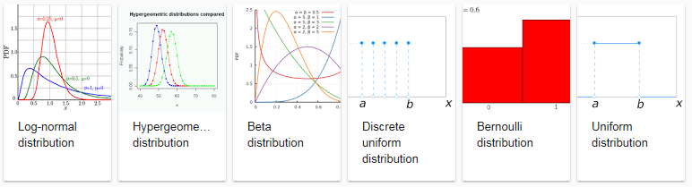
Distinct types of distribution functions

Slide 16
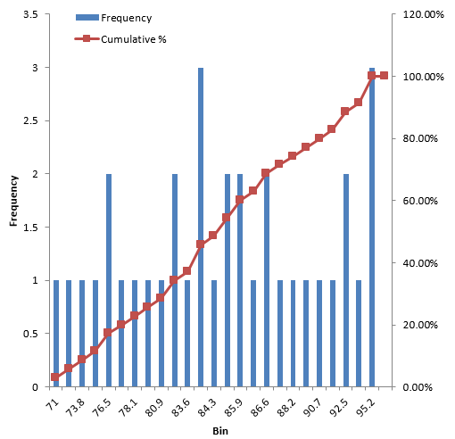
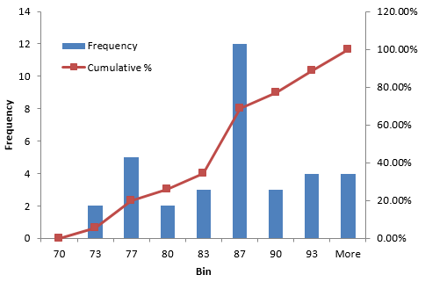
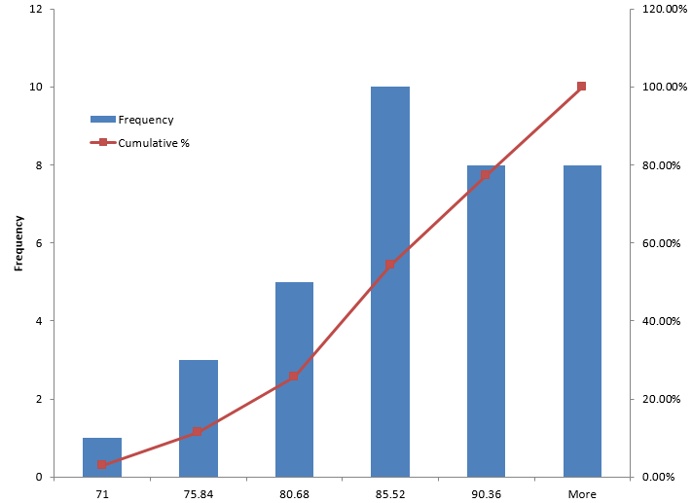
One can be creative (1)
Different ways of constructing the bins

Slide 17
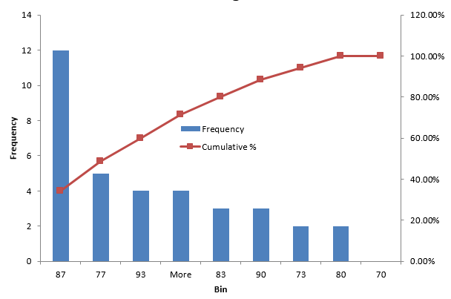
One can be creative (2)
Sorting the bins

Slide 18
Factors for sensible creativity
What is exactly measured, i.e. what are these values results of?
What type of variables are we dealing with?

Slide 19
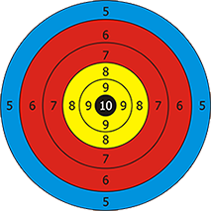
Shooting results
What kind of settings can you think of?

Slide 20
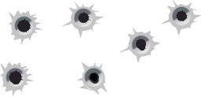
These two setups produced the same results
Same shooter different gun

Slide 21
These four setups also
Same shooter
different gun
Different shooter
same gun

Slide 22
Some descriptive statistics on the results
Mean | 84.43429
Standard Error | 1.135944
Median | 84.6
Mode | 83.9
Standard Deviation | 6.720335
Sample Variance | 45.16291
Kurtosis | -0.73002
Skewness | -0.19589
Range | 24.2
Minimum | 71
Maximum | 95.2
Sum | 2955.2
Count | 35
Largest(1) | 95.2
Smallest(1) | 71
Confidence Level(95.0%) | 2.308516
Depending on what distribution you are dealing with, and what the results are measurements of, these statistics can make sense ranging from not all to extremely well!

Slide 23
Range
= interval between highest and lowest values
Range = 24.2

Slide 24
Range
Does not change (much) depending on the ways of constructing bins

Slide 25
Percentiles / Quartiles
25th
50th
75th

Slide 26
Interquartile range
88.2-78.1=10.1
25th
50th
75th

Slide 27
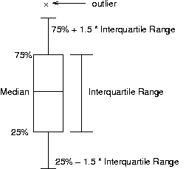
Box and whisker plot

Slide 28

The arithmetic mean
= arithmetic average of at least interval or ratio scores.
computed by adding all the scores (X1, X2, …) and dividing by the total number N of scores.

Slide 29
Inner mean
Also called ‘trimmed mean’.
Inner mean of N numbers is calculated by removing the x lowest values and the x highest value and calculating the arithmetic mean of the remaining N – 2x ‘inner’ values.
If x = N/2, inner mean = median.

Slide 30


Harmonic mean
Defined as the reciprocal of the arithmetic mean of the reciprocals
or
is f.i. used in population genetics, when calculating the effects of fluctuations in generation size on the effective breeding population.
    takes into account the fact that a very small generation is like a bottleneck and means that a very small number of individuals are contributing disproportionately to the gene pool, which can result in higher levels of inbreeding.

Slide 31
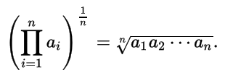
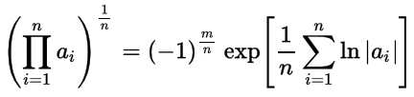
Geometric mean
is defined as the n^{th} root of the product of n numbers
Alternative calculation:
      where m = number of negative numbers in n
is the only correct mean when averaging normalized results, i.e. results that are presented as ratios to reference values.
often used when summarizing skewed data, especially if there is reason to believe that the data might be log-normally distributed.

Slide 32
Position of the arithmetic mean
Mean | 84.43429
17 | 84.3
18 | 84.6

Slide 33
Position of the arithmetic mean
Mean | 84.43429
17 | 84.3
18 | 84.6
Confidence Level(95.0%)
2.308516

Slide 34
Median
The central datum when all of the data are arranged (ranked) in numerical order.
Usable for at least ordinal data.
It is a literal measure of central tendency.
When there are an even number of data, the mean of the two central data points is taken as the median.

Slide 35
Mean and median
Mean | 84.43429
Median | 84.6
17 | 84.3
18 | 84.6

Slide 36
Mode
The most frequent value in a dataset
Often not a particularly good indicator of central tendency.
Despite its limitations, the mode is the only means of measuring central tendency in a dataset containing nominal values.

Slide 37
What is the mode here?
71 | 1
72.8 | 1
73.8 | 1
74.3 | 1
76.5 | 2
76.8 | 1
78.1 | 1
78.4 | 1
80.9 | 1
81.9 | 2
83.6 | 1
83.9 | 3
84.3 | 1
84.6 | 2
85.9 | 2
86.5 | 1
86.6 | 2
88.1 | 1
88.2 | 1
90 | 1
90.7 | 1
91.2 | 1
92.5 | 2
93.2 | 1
95.2 | 3

Slide 38
Bimodal data set
71 | 1
72.8 | 1
73.8 | 1
74.3 | 1
76.5 | 2
76.8 | 1
78.1 | 1
78.4 | 1
80.9 | 1
81.9 | 2
83.6 | 1
83.9 | 3
84.3 | 1
84.6 | 2
85.9 | 2
86.5 | 1
86.6 | 2
88.1 | 1
88.2 | 1
90 | 1
90.7 | 1
91.2 | 1
92.5 | 2
93.2 | 1
95.2 | 3

Slide 39
Mean, median and modes
Mean | 84.43429
Median | 84.6
17 | 84.3
18 | 84.6

Slide 40
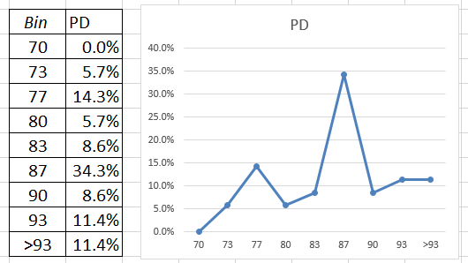
Mean, median and modes on distribution
Mean
Median
mode

Slide 41
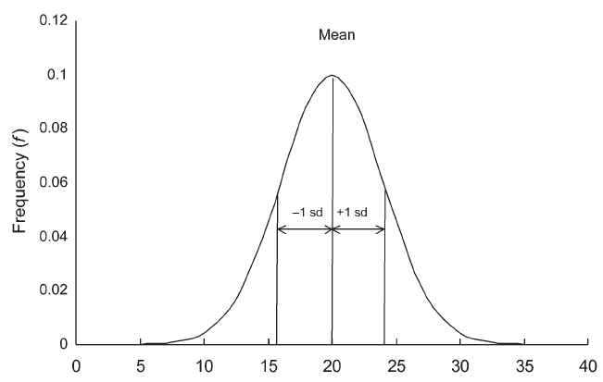
Mean, median and mode in the normal distribution
all three!

Slide 42
Skewness and kurtosis
Skewness:
  is a measure of lack of symmetry.
  a distribution, or data set, is symmetric if it looks the same to the left and right of the center point.

Slide 43
Skewness and kurtosis
Skewness:
  is a measure of lack of symmetry.
  a distribution, or data set, is symmetric if it looks the same to the left and right of the center point.

Slide 44
Skewness and kurtosis
Skewness:
  is a measure of lack of symmetry.
  a distribution, or data set, is symmetric if it looks the same to the left and right of the center point.
Kurtosis:
  is a measure of whether the data are heavy-tailed or light-tailed relative to a normal distribution;
  data sets with high kurtosis tend to have heavy tails, or outliers. Data sets with low kurtosis tend to have light tails, or lack of outliers.

Slide 45
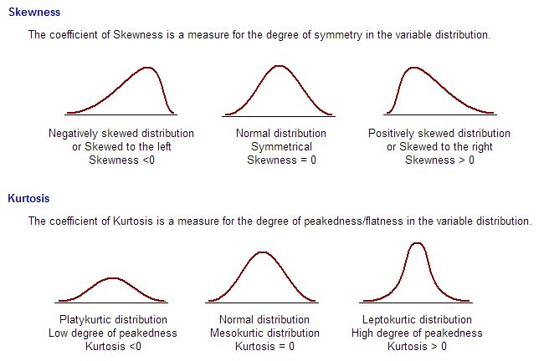
Skewness and kurtosis
http://www.janzengroup.net/stats/images/skewkurt.JPG

Slide 46
Skewness and kurtosis
Kurtosis | -0.73002
Skewness | -0.19589

Slide 47
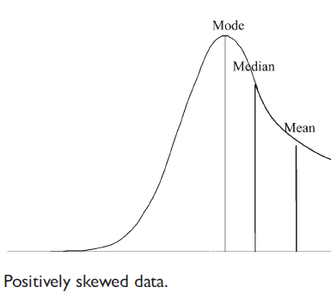
Skewness and kurtosis
Mean
Median
mode

Slide 48
Variance
A measure of the spread of the recorded values on a variable. A measure of dispersion.
The larger the variance, the further the individual cases are from the mean.
The smaller the variance, the closer the individual scores are to the mean.

Slide 49


Variance
The variance (σ²), is defined as the sum of the squared distances of each term in the distribution from the mean (μ), divided by the number of terms in the distribution (N).

Slide 50
Variance
Sample Variance 45.16291

Slide 51
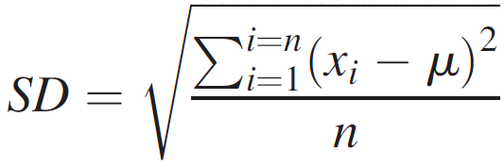
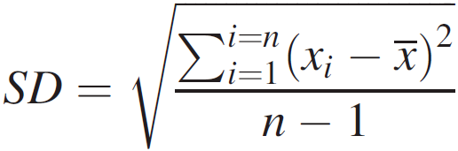
Standard deviation
Standard deviation for a population
Standard deviation for a sample:
Population
Mean
Size
Sample
Mean
Size

Slide 52
Standard deviation
Standard Deviation 6.720335
mean
sd
sd
sd
sd

Slide 53
IQV—Index of Qualitative Variation
For nominal variables
Statistic for determining the dispersion of cases across categories of a variable.
Ranges from 0 (no dispersion or variety) to 1 (maximum dispersion or variety)
1 refers to even numbers of cases in all categories, NOT that cases are distributed like population proportions
IQV is affected by the number of categories
www.sjsu.edu/people/james.lee/courses/102/s1/asDescriptive_Statistics2.ppt

Slide 54
IQV—Index of Qualitative Variation
To calculate:
K(100² – Σ cat.%²)
IQV = 100²(K – 1)
K=# of categories
Cat.% = percentage in each category
www.sjsu.edu/people/james.lee/courses/102/s1/asDescriptive_Statistics2.ppt

Slide 55
IQV—Index of Qualitative Variation
Problem: Is SJSU more diverse than UC Berkeley?
Solution: Calculate IQV for each campus to determine which is higher.
SJSU: UC Berkeley:
Percent Category Percent Category
00.6 Native American 00.6 Native American
06.1 Black 03.9 Black
39.3 Asian/PI 47.0 Asian/PI
19.5 Latino 13.0 Latino
34.5 White 35.5 White
What can we say before calculating? Which campus is more evenly distributed?
K (100² – Σ cat.%²)
IQV = 100²(K – 1)
www.sjsu.edu/people/james.lee/courses/102/s1/asDescriptive_Statistics2.ppt

Slide 56
IQV—Index of Qualitative Variation
Problem: Is SJSU more diverse than UC Berkeley? YES
Solution: Calculate IQV for each campus to determine which is higher.
SJSU: UC Berkeley:
Percent Category %² Percent Category %²
00.6 Native American 0.36 00.6 Native American 0.36
06.1 Black 37.21 03.9 Black 15.21
39.3 Asian/PI 1544.49 47.0 Asian/PI 2209.00
19.5 Latino 380.25 13.0 Latino 169.00
34.5 White 1190.25 35.5 White 1260.25
K = 5 Σ cat.%² = 3152.56 k = 5 Σ cat.%² = 3653.82
100² = 10000
K (100² – Σ cat.%²)
IQV = 100²(K – 1)
5(10000 – 3152.56) = 34237.2 5(10000 – 3653.82) = 31730.9
10000(5 – 1) = 40000 SJSU IQV = .856 10000(5 – 1) = 40000 UCB IQV =.793
www.sjsu.edu/people/james.lee/courses/102/s1/asDescriptive_Statistics2.ppt

Slide 57
Descriptive Statistics
Summarizing Data:
  Central Tendency (or Groups’ “Middle Values”)
    Mean
    Median
    Mode
  Variation (or Summary of Differences Within Groups)
    Range
    Interquartile Range
    Variance
    Standard Deviation

Slide 58
What are the results measurements of?
Group | Student | T1 | T2 | T3 | T4 | T5
 | S1 | 72.8 | 80.9 | 84.6 | 83.6 | 73.8
G1 | S2 | 71 | 91.2 | 88.1 | 88.2 | 76.8
 | S3 | 76.5 | 85.9 | 86.6 | 90 | 81.9
 | S4 | 83.9 | 92.5 | 95.2 | 92.5 | 78.1
G2 | S5 | 78.4 | 85.9 | 86.6 | 86.5 | 74.3
 | S6 | 83.9 | 83.9 | 95.2 | 90.7 | 84.3
 | S7 | 76.5 | 84.6 | 95.2 | 93.2 | 81.9
7 students divided in two groups passed 5 tests.
Which group is doing better?

Slide 59

The arithmetic mean
$\overline{X}$_{G1} = 82.1
$\overline{X}$_{G2} = 86.2
7 students divided in two groups passed 5 tests.
Is group 2 really doing better?

Slide 60
Various ways for presenting the same data
Result | Test | Student | Group
72.8 | T1 | S1 | G1
71 | T1 | S2 | G1
76.5 | T1 | S3 | G1
83.9 | T1 | S4 | G2
78.4 | T1 | S5 | G2
83.9 | T1 | S6 | G2
76.5 | T1 | S7 | G2
80.9 | T2 | S1 | G1
91.2 | T2 | S2 | G1
85.9 | T2 | S3 | G1
92.5 | T2 | S4 | G2
85.9 | T2 | S5 | G2
83.9 | T2 | S6 | G2
84.6 | T2 | S7 | G2
84.6 | T3 | S1 | G1
88.1 | T3 | S2 | G1
86.6 | T3 | S3 | G1
95.2 | T3 | S4 | G2
86.6 | T3 | S5 | G2
95.2 | T3 | S6 | G2
95.2 | T3 | S7 | G2
83.6 | T4 | S1 | G1
88.2 | T4 | S2 | G1
90 | T4 | S3 | G1
92.5 | T4 | S4 | G2
86.5 | T4 | S5 | G2
90.7 | T4 | S6 | G2
93.2 | T4 | S7 | G2
73.8 | T5 | S1 | G1
76.8 | T5 | S2 | G1
81.9 | T5 | S3 | G1
78.1 | T5 | S4 | G2
74.3 | T5 | S5 | G2
84.3 | T5 | S6 | G2
81.9 | T5 | S7 | G2
Student | Group | T1 | T2 | T3 | T4 | T5
S1 |  | 72.8 | 80.9 | 84.6 | 83.6 | 73.8
S2 | G1 | 71 | 91.2 | 88.1 | 88.2 | 76.8
S3 |  | 76.5 | 85.9 | 86.6 | 90 | 81.9
S4 |  | 83.9 | 92.5 | 95.2 | 92.5 | 78.1
S5 | G2 | 78.4 | 85.9 | 86.6 | 86.5 | 74.3
S6 |  | 83.9 | 83.9 | 95.2 | 90.7 | 84.3
S7 |  | 76.5 | 84.6 | 95.2 | 93.2 | 81.9

Slide 61
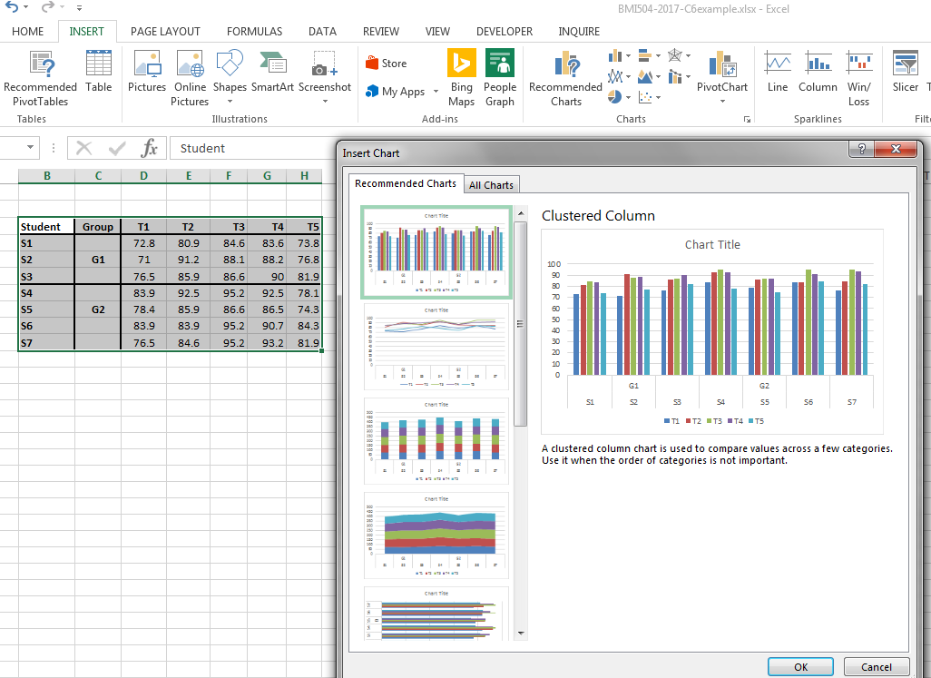
Table format influences charting

Slide 62
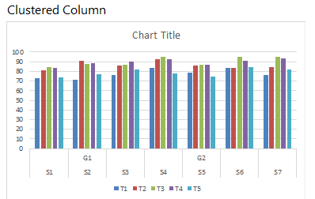
Groups are here not recognized

Slide 63
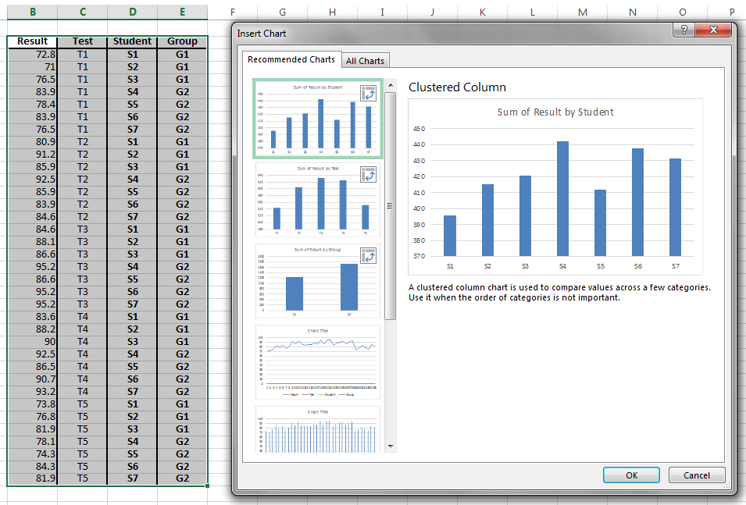
Groups are here recognized

Slide 64
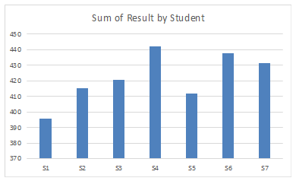
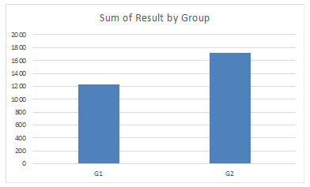
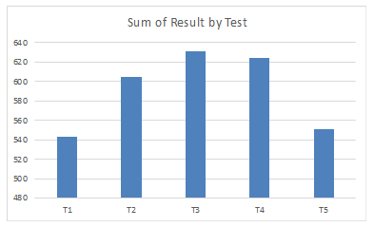
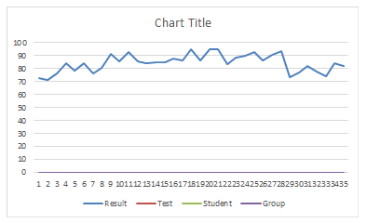
(Relatively) meaningful options

Slide 65
Only ‘results’
← ‘sorted’ by test
sorted by result →

Slide 66
Only ‘results’
← ‘sorted’ by test
sorted by test
with horizontal axis →
adapted to test number

Slide 67
Only ‘results’
← ‘sorted’ first by test
and then by result
sorted by test only→

Slide 68
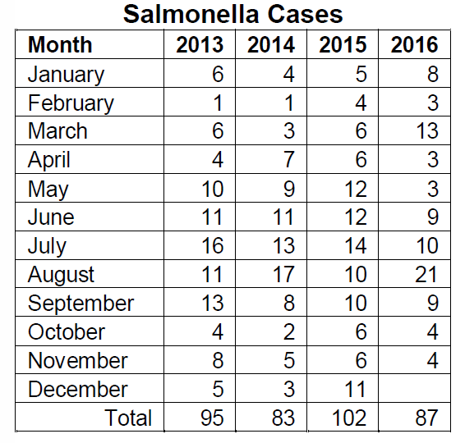
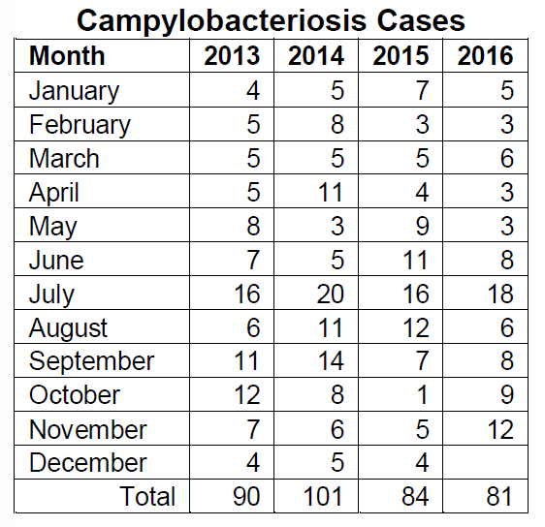
Erie.gov.health excerpt
http://www2.erie.gov/health/sites/www2.erie.gov.health/files/uploads/pdfs/reportablediseases.pdf

