Slide 1
Statistical data analysis and research methods BMI504 Course 20048 – Spring 2019
Class 4 – Feb 21, 2019
Preparation for Research Project Proposals
Werner CEUSTERS, MD

Slide 2
Pre-lecture required reading
R4. Reinhold Haux et.al.
Research Strategies for Biomedical and Health Informatics: Some Thought-provoking and Critical Proposals to Encourage Scientific Debate on the Nature of Good Research in Medical Informatics.
Methods Inf Med. 2017; 56(Open): e1–e10. 2017 Jan 25.
https://www.ncbi.nlm.nih.gov/pmc/articles/PMC5388922/pdf/ME-56-Open-16010125.pdf
R5. Hilde Tobi & Jarl K. Kampen.
Research design: the methodology for interdisciplinary research framework.
Qual Quant (2018) 52:1209–1225
https://link.springer.com/content/pdf/10.1007%2Fs11135-017-0513-8.pdf

Slide 3
Requested preparation for class
Prepare for discussion during class C4 topics for a course research project you are interested in and which will form the basis for your research proposal.

Slide 4
Class structure
Short lecture:
Elements of team science
Components of a research proposal
Initial discussion about possible research projects.
Rough definition of global research project and individual contributions.

Slide 5
Elements of Team Science

Slide 6
‘Interdisciplinary research’
Definition: any study or group of studies undertaken by scholars from two or more distinct scientific disciplines.
Interdisciplinary research:
is based upon a conceptual model that links or integrates theoretical frameworks from those disciplines,
uses study design and methodology that is not limited to any one field, and
requires the use of perspectives and skills of the involved disciplines throughout multiple phases of the research process.
Kagan, J.: The Three Cultures: Natural Sciences, Social Sciences and the Humanities in the 21st Century.
Cambridge University Press, Cambridge (2009)

Slide 7
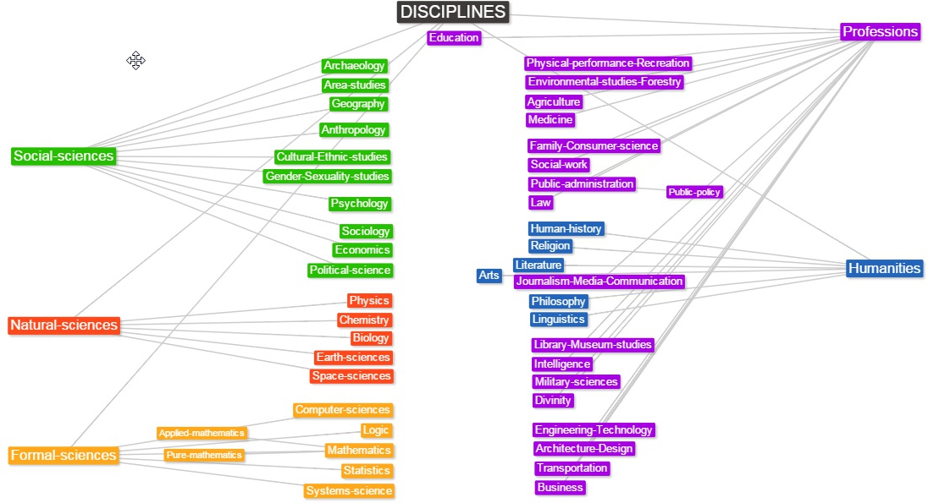
https://en.wikipedia.org/wiki/List_of_academic_fields#/media/File:Disciplines_mind_map.jpg

Slide 8
MeSH 2019
Disciplines and Occupations [H]
Anthropology, Education, Sociology, and Social Phenomena [I]
Technology, Industry, and Agriculture [J]
Humanities [K]
Information Science [L]

Slide 9
MeSH 2019
Disciplines and Occupations [H]
Natural Science Disciplines [H01]
Biological Science Disciplines [H01.158]
Chemistry [H01.181]
Earth Sciences [H01.277]
Materials Science [H01.413]
Mathematics [H01.548]
Microtechnology [H01.570]
Nanotechnology [H01.603]
Physics [H01.671]
Science [H01.770] 
Technology, Industry, and Agriculture [J]

Slide 10
MeSH 2019
Disciplines and Occupations [H]
Anthropology, Education, Sociology, and Social Phenomena [I]
Social Sciences [I01]
Anthropology [I01.076]
Criminology [I01.198]
Sociology [I01.880] 
… 
Technology, Industry, and Agriculture [J]
Humanities [K]
Information Science [L]

Slide 11
MeSH 2019
Disciplines and Occupations [H]
Anthropology, Education, Sociology, and Social Phenomena [I]
Technology, Industry, and Agriculture [J]
Technology, Industry, and Agriculture [J01]
Engineering [J01.293]
Military Science [J01.675]
Technology [J01.897]
Biomedical Technology [J01.897.115]
Biotechnology [J01.897.120]
Materials Science [J01.897.461]
Medical Laboratory Science [J01.897.480]
…

Slide 12
MeSH 2019
Disciplines and Occupations [H]
Anthropology, Education, Sociology, and Social Phenomena [I]
Technology, Industry, and Agriculture [J]
Humanities [K]
Humanities [K01]
Art [K01.093]
Occultism [K01.672]
Philosophy [K01.752]
Religion [K01.844]
Information Science [L]
Information Science [L01]
Classification [L01.100] 
Information Technology [L01.479]

Slide 13
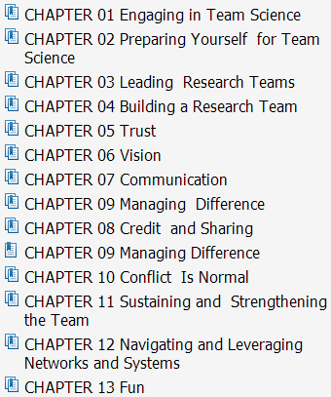
A good resource
https://www.cancer.gov/about-nci/organization/crs/research-initiatives/team-science-field-guide/collaboration-team-science-guide.pdf

Slide 14
Characteristics of an effective team
Self- and other-awareness
Effective building of a team, including setting shared expectations and defining roles and responsibilities
Making provisions for appropriate recognition and credit
Creating, sharing, and revisiting a shared vision
Enjoying the science and the work together
Effective leadership and management skills
Learning each others’ languages
Strategies developed for communicating openly
Trust is established among team members
Promoting disagreement while containing conflict
Bennett LM, H Gadlin H, Levine-Findley S. Team Science and Collaboration: A Field Guide. Bethesda: DHHS;

Slide 15
Critical success factors for team science
the paradigms or epistemologies in the current (mono-disciplinary) sciences,
the skills and competences of the scientists involved,
the institutional context of the research,
the organization of collaborations.
Fischer et.al. When natural met social: a review of collaboration between the natural and social sciences. Interdiscip. Sci. Rev. 36(4), 341–358 (2011)
the so-called ‘paradigm war’ between
neopositivism (a theory of knowledge asserting that only statements verifiable through empirical observation are meaningful),
constructivism (knowledge is contingent on convention, human perception and social experience and does not necessarily reflect any external realities)
Onwuegbuzie, A.J., Leech, N.L.: Taking the ‘‘Q’’ out of research: teaching research methodology courses without the divide between quantitative and qualitative paradigms. Qual. Quant. 39(3), 267–296 (2005)

Slide 16
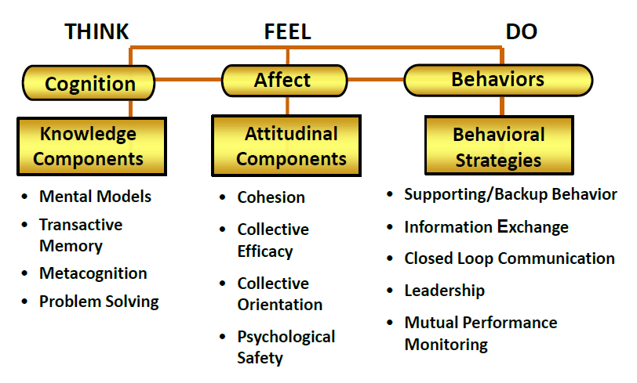
‘A process of teamwork to be mastered’
SM. Fiore. https://www.inscits.org/assets/SciTS_Conf_2010/presentations/2010-04-22-fiore.pdf

Slide 17
https://www.ncbi.nlm.nih.gov/pmc/articles/PMC3652225/

Slide 18
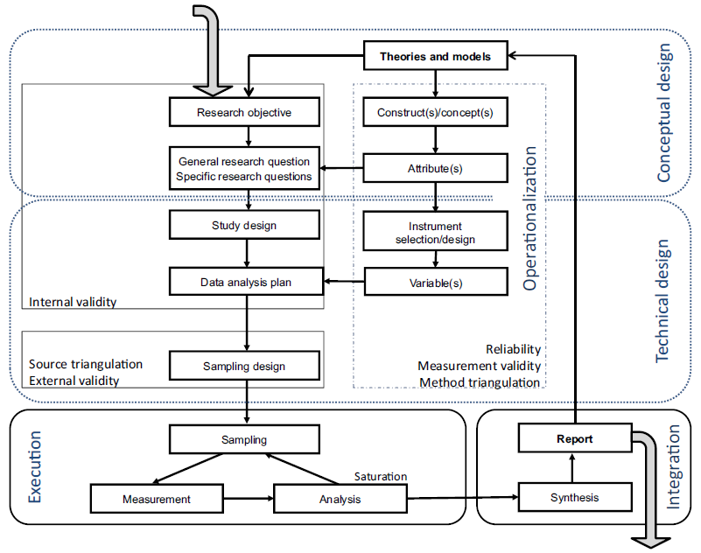
Team science methodology
Hilde Tobi & Jarl K. Kampen. Research design: the methodology for interdisciplinary research framework. Qual Quant (2018) 52:1209–1225

Slide 19
However
Team science is not a requirement for good science.
Good scientists have always:
been open for ideas from outside the domain,
‘fresh look’, thinking by analogy;
used skills and expertise from outside the domain (statistics, informatics, …).
On-line resources: 80% socio-politics / 20% science.
‘citizen scientists’;
‘community stakeholders’;
‘experience experts’.

Slide 20
Components of a Research Proposal

Slide 21
Rough outline of a research proposal
Typical headings/sections | Basic questions
Title
Keywords Aims | What is it all about?
Background
Literature review | What do we already know?
Research questions | What do we need to find out?
Methods | How will we get the necessary information?
Planning and resources | How long will it take and what will it cost?
Ethics | Is the research socially acceptable?
Outcomes | What will be the benefits?
https://www.mheducation.co.uk/openup/chapters/9780335244065.pdf

Slide 22
Another example (1)
Problem analysis
Problem analysis based on literature
Societal and scientific relevance
Objective and research questions (max 200 words)
Aim of the research
Research question
Theoretical foundations
What concepts, models or theoretical perspectives will be used
Previous studies, and, if applicable, a conceptual model

Slide 23
Another example (2)
Strategy
Study design
Recruitment of respondents and involvement of organizations
Data collection methods
Outcome measurements (independent and dependent variables, based on a conceptual model, see 3.)
Plan for data analysis
Validity and reliability

Slide 24
Another example (3)
Planning
Timeline of activities
Required skills
Personnel and time allocation
Ethical considerations
Confidentiality of research data
Research approval and consent issues
Literature references

Slide 25
Assignments !!!

Slide 26
Required reading
R6. John P. A. Ioannidis
Why Most Clinical Research Is Not Useful
PLoS Med 13(6): e1002049
http://journals.plos.org/plosmedicine/article?id=10.1371/journal.pmed.1002049

Slide 27
Assignment A2
After reading R6, and taking into account the content of all previous BMI504 lectures and papers:
students must write an outline (chapter headings and subheadings, 1 or 2 lines ‘concrete’ examples of future content) for their individual research project,
in the spirit of the scientific method,
thereby adapting the original ideas discussed in class in such a way that Ioannidis’ features for assessing whether clinical research is useful come out positive for what they propose.
Usefulness should be backed up by a short initial literature study.
Due date: Feb 26 – noon.

Slide 28
Assignment A2
After reading R6, and taking into account the content of all previous BMI504 lectures and papers:
students must write an outline (chapter headings and subheadings, 1 or 2 lines ‘concrete’ examples of future content) for their individual research project,
in the spirit of the scientific method,
thereby adapting the original ideas discussed in class in such a way that Ioannidis’ features for assessing whether clinical research is useful come out positive for what they propose.
Usefulness should be backed up by a short initial literature study.
Due date: Feb 26 – noon.

Slide 29
A hodge podge list of research designs
Action Research Design
Case Study Design
Causal Design
Cohort Design
Cross-Sectional Design
Descriptive Design
Experimental Design
Exploratory Design
Historical Design
Longitudinal Design
Meta-Analysis Design
Mixed-Method Design
Observational Design
Philosophical Design
Sequential Design
Systematic Review
http://libguides.usc.edu/c.php?g=235034&p=1559832

Slide 30
Research Design: what and what parts
The plans and procedures for research that span the steps from broad assumptions to detailed methods of data collection, analysis, and interpretation.
Decision to select a design must be informed by:
research problem, esp. its nature,
worldviews: the philosophical assumptions the researcher brings to the study;
methodology: procedures of inquiry (quantitative / qualitative / mixed)
research methods: how to conduct data collection, analysis, and interpretation.
Adapted from: Creswell, Research Design, Los Angeles, 2014

Slide 31
Design partially determines level of evidence
Evidence
level
https://guides.library.vcu.edu/humphrey/journal-club

Slide 32
Steps in scientific research
Specify the question you are asking.
Put the question in the form of a null hypothesis and alternative hypothesis.
Put the question in the form of a statistical null hypothesis and alternative hypothesis.
Determine which variables are relevant to the question.
Determine what kind of variable each one is.
Design an experiment that controls or randomizes the confounding variables.
Based on the number of variables, the kinds of variables, the expected fit to the parametric assumptions, and the hypothesis to be tested, choose the best statistical test to use.
If possible, do a power analysis to determine a good sample size for the experiment.
Do the experiment.
Examine the data to see if it meets the assumptions of the statistical test you chose. If it doesn't, choose a more appropriate test.
Apply the statistical test you chose, and interpret the results.
Communicate your results effectively, usually with a graph or table.
John H. McDonald. The Handbook of Biological Statistics ©. 2014. http://www.biostathandbook.com/

Slide 33
(Relatively) Common Strategies
Research question formulation
Standardization
Randomization and stratification
Blinding
Use of placebos/shams
Control group selection
Population selection
Endpoint selection
Protocol adherence
Sample size determination
Evans SR. Fundamentals of clinical trial design. Journal of experimental stroke & translational medicine. 2010;3(1):19-27.

Slide 34
Quantitative, qualitative and mixed methods
Quantitative methods | Qualitative methods | Mixed methods
Predetermined methods | Emerging methods | Both predetermined and emerging methods
Instrument based questions | Open-ended questions | Both open- and closed-ended questions
Observational data, performance data, attitude data, and census data | Interview data, observation data, document data, and audiovisual data | Multiple forms of data drawing on all possibilities
Statistical analysis | Text and image analysis | Statistical and text analysis
Statistical interpretation | Themes, patterns interpretation | Integration of multiple interpretations

Slide 35
Formulate research question with PICO(TT)
P | Patient Population of patients Problem | What is the best way to briefly describe this patient population or situation? E.g. pregnant women over 40 with preeclampsia, adolescent boys 13-15, etc.
I | Intervention (therapy or test) | What is the intervention? E.g. a drug, a questionnaire, a test, a procedure, etc.
C | Comparison | Is there an alternative intervention to compare to? E.g. placebo, current standard of care, another therapy, etc.
O | Outcome | Include specific patient-oriented outcomes E.g. morbidity, quality of life, etc.
T | Time for completion | Used to identify the time/duration for your data collection or for assessing your outcome. I.e. how long before you are to see that the intervention is having a positive impact OR the time in which the intervention will be delivered
T | Type of study | What is the ideal study design to answer this question? What type of study design do you realistically anticipate finding? E.g. randomized-controlled trial, systematic reviews, etc.

Slide 36
And more detail on other aspects will follow in future classes
All such aspects need to be accounted for in your proposal!
(When assessed as not applicable: provide arguments!)

