Slide 1
Statistical data analysis and research methods BMI504 Course 20048 – Spring 2019
Class 2 – Feb 7, 2019
Bias
Werner CEUSTERS, MD

Slide 2
Fifteen common mistakes encountered in clinical research. Failure to …
carefully examine the literature for similar, prior research
critically assess the prior literature
specify the inclusion and exclusion criteria for your subjects
determine and report the error of your measurement methods
specify the exact statistical assumptions made in the analysis
perform sample size analysis before the study begins
implement adequate bias control measures
write and stick to a detailed time line
vigorously recruit and retain subjects
have a detailed, written and vetted protocol
examine for normality of the data
report missing data, dropped subjects and use of an intention to treat analysis
perform and report power calculations
point out the weaknesses of your own study
understand and use correct scientific
Journal of Prosthodontic Research 55 (2011) 1–6

Slide 3
Class structure (C2)
Questions on required reading
Closed book test on required reading
Interactive lecture on bias
Guided exercise
Discussion

Slide 4
Assignment: Required Reading
R2. John P. A. Ioannidis
Why Most Published Research Findings Are False
PLOS Medicine 2005;2(8):e124
http://robotics.cs.tamu.edu/RSS2015NegativeResults/pmed.0020124.pdf
!!! This paper will be the topic of a closed book in-class test during class C3 !!!
R3. University of Southern California.
Organizing Your Social Sciences Research Paper: Types of Research Designs.
http://libguides.usc.edu/c.php?g=235034&p=1559832

Slide 5
Questions on required reading
R1: M Delgado-Rodríguez and J Llorca.
Bias.
J Epidemiol Community Health 2004;58:635-641
http://jech.bmj.com/content/58/8/635.full.pdf+html

Slide 6
Referral filter bias (1)
Q1: ‘the article says that difficult patients are referred to "tertiary care". I don't understand what they mean by categorizing patients into different care levels and consequently how that would produce bias.’
Some health systems work with levels of care:
1st: primary doctor / family doctor
2nd: specialized care / specialists, mostly but not necessarily in hospitals, clinics, …
3rd: highly specialized care
Access to level may be restricted by referral from lower level.

Slide 7
Referral filter bias (2)
What the article actually says:
‘Healthcare access bias may be due: […] to the healthcare organization if it is organised in increasing levels of complexity and [if] ‘‘difficult’’ cases are referred to tertiary care (referral filter bias)’
Potential source of the bias:
A patient is subjectively ‘difficult’ if it exceeds the competence/willingness to manage of the referrer, rather than objectively ‘difficult’.

Slide 8
Spectrum bias (1)
‘In the assessment of validity of a diagnostic test this bias is produced when researchers included only ‘‘clear’’ or ‘‘definite’’ cases, not representing the whole spectrum of disease presentation, and/or ‘‘clear’’ or healthy controls subjects, not representing the conditions in which a differential diagnosis should be carried out’
Q2: ‘if you could elaborate on how a case is not clear or definite? In my mind, you are either diagnosed with something or you aren't, therefore what is the opposite of an unclear case?’

Slide 9
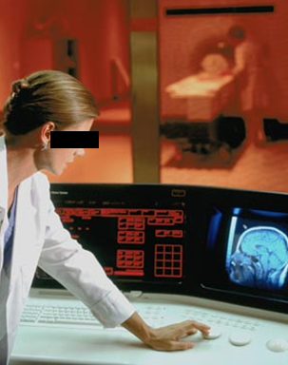
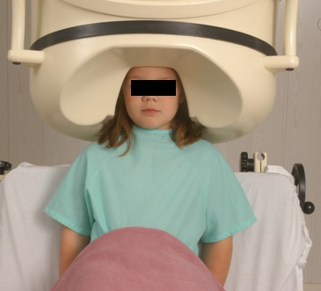
No conflation of diagnosis, disease, and disorder
The diagnosis is here
The disorder (malignant tumor)
is there
The disease (cancer) is there

Slide 10
Spectrum bias (2)
‘In the assessment of validity of a diagnostic test this bias is produced when researchers included only ‘‘clear’’ or ‘‘definite’’ cases, not representing the whole spectrum of disease presentation, and/or ‘‘clear’’ or healthy controls subjects, not representing the conditions in which a differential diagnosis should be carried out’
Q2: ‘if you could elaborate on how a case is not clear or definite? In my mind, you are either diagnosed with something or you aren't, therefore what is the opposite of an unclear case?’
Being ‘diagnosed with X’ does not mean you ‘have X’
→ misdiagnosis exists
Comparing diagnosis with actual disease in a population gives you a probability of true diagnosis.
A disease of type X can present itself differently in different patients
Presentation of type A → probability of disease X 90% = ‘relatively clear case’
Presentation of type B → probability of disease X 55% = ‘quite unclear case’
The goal is a diagnostic test: one that works only with clear cases misses a lot of the patients with unclear cases.

Slide 11
Friend control bias
Q3: the definition in unclear to me.
The paper did not give a definition, but:
Friend controls are non-randomly selected control subjects suggested by cases amongst their friends,
Studies on the characteristics of friends who accepted to function as control found them to be gregarious, outgoing, social, thus be different from the population in many respects → bias.

Slide 12
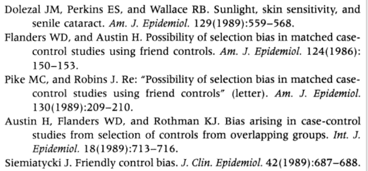
Friend control bias

Slide 13
Publication bias
Q4.: ‘general question- how do you avoid publication bias? clearly, only the "best" articles are published, so are "bad studies" just thrown out? are you supposed to allow more articles to be published to avoid this bias?’
Answer:
papers are subject to peer review.
not only good articles are published. In biomedical ontology, most are very bad, because most authors of those papers have no adequate education in ontology → peers suck!
Most important publication bias is bias on the selection of papers (once own, of friends, of reviewers, that support your case, …)
Others: see required reading.

Slide 14
Q5: Rumination / exposure submission bias ?
Rumination bias = recall basis occurring if the presence of some outcome or effect influences the perception of its causes.
Exposure submission bias = the presence of some outcome or effect influences the search for exposure to the putative cause.
Example:
Patient knows he has disease X
He performs searches online from which he ‘learns’ the variety of symptoms that it may come with and what causes there might be.
RB: he might confuse signs and symptoms he really has with signs and symptoms described.
ESB: he might ascribe an event in his past which is similar to one of the listed causes, as the real cause for his disease.

Slide 15
Q6. confounding by indication?
Confounding: an apparent effect is attributed to the exposure of interest, whereas in fact it ought to have been attributed to some other factor.
Confounding by indication: the indication is the confounding factor.
Example:
Cimetidine is indicated by gastric ulcer;
Gastric ulcer is a risk factor for gastric cancer;
More patients taking cimetidine showed to have gastric cancer than non-takers.
→? Cimetidine causes gastric cancer.

Slide 16
In-class test

Slide 17
In class-test
What is the title of the paper? (5p)
How does the paper define ‘bias’? (10p)
Which are the 3 highest level groups in their bias-classification? (15p)
Give the definition for one of the highest level bias types. (10p)
There are a few bias types for which the grouping in the 3 highest levels brakes down; name one. (10p)
Bonus points:
Define another highest level bias (5p)
Name another bias for which the classification breaks down (5p)

Slide 18
Lecture

Slide 19
Reality Representation
data
organization
model development
observation &
measurement
further R&D
(instrument and
study optimization)
add
verify
use
Δ = outcome
Generic
beliefs
application

Slide 20
Some Data Quality Dimensions
Dimension | # cited | Dimension | # cited | Dimension | # cited
Accuracy | 25 | Format | 4 | Comparability | 2
Reliability | 22 | Interpretability | 4 | Conciseness | 2
Timeliness | 19 | Content | 3 | Freedom from bias | 2
Relevance | 16 | Efficiency | 3 | Informativeness | 2
Completeness | 15 | Importance | 3 | Level of detail | 2
Currency | 9 | Sufficiency | 3 | Quantitativeness | 2
Consistency | 8 | Usableness | 3 | Scope | 2
Flexibility | 5 | Usefulness | 3 | Understandability | 2
Precision | 5 | Clarity | 2
Wang, R.Y., Storey, V.C., and Firth, C.P.
A framework for analysis of data quality research.
IEEE Trans. on Knowl. Data Eng. 7, 4 (1995), pp. 623–640.

Slide 21
Some Data Quality Dimensions
Dimension | # cited | Dimension | # cited | Dimension | # cited
Accuracy | 25 | Format | 4 | Comparability | 2
Reliability | 22 | Interpretability | 4 | Conciseness | 2
Timeliness | 19 | Content | 3 | Freedom from bias | 2
Relevance | 16 | Efficiency | 3 | Informativeness | 2
Completeness | 15 | Importance | 3 | Level of detail | 2
Currency | 9 | Sufficiency | 3 | Quantitativeness | 2
Consistency | 8 | Usableness | 3 | Scope | 2
Flexibility | 5 | Usefulness | 3 | Understandability | 2
Precision | 5 | Clarity | 2
Wang, R.Y., Storey, V.C., and Firth, C.P.
A framework for analysis of data quality research.
IEEE Trans. on Knowl. Data Eng. 7, 4 (1995), pp. 623–640.

Slide 22
Precision and accuracy of representations
Precision
The degree to which distinct representations (references) about the same portion of reality (the referent) are similar when derived under similar circumstances.
Accuracy
The degree to which a representation actually represents what it was intended to represent.
How close is a representation to the truth, the facts?

Slide 23
‘Classical’ picture

Slide 24
Accurate ?
x
x
x
x
x
x
x
x
x
x

Slide 25
Accurate ?
x
x
x
x
x
x
x
x
x
x
X = ? = ?

Slide 26
Accurate ?
x
x
x
x
x
x
x
x
x
x
X = data / information = information /
knowledge

Slide 27
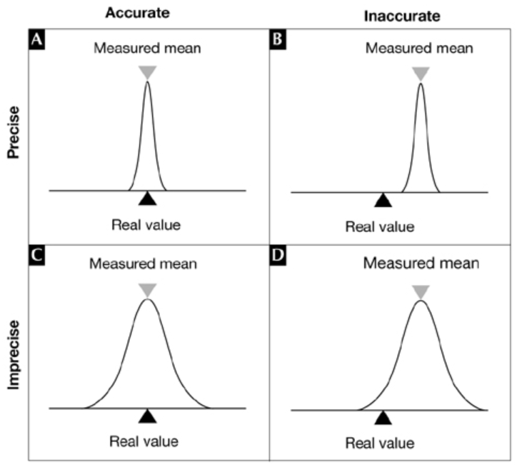
For measurements
http://embor.embopress.org/content/5/10/964.figures-only

Slide 28
Some Data Quality Dimensions
Dimension | # cited | Dimension | # cited | Dimension | # cited
Accuracy | 25 | Format | 4 | Comparability | 2
Reliability | 22 | Interpretability | 4 | Conciseness | 2
Timeliness | 19 | Content | 3 | Freedom from bias | 2
Relevance | 16 | Efficiency | 3 | Informativeness | 2
Completeness | 15 | Importance | 3 | Level of detail | 2
Currency | 9 | Sufficiency | 3 | Quantitativeness | 2
Consistency | 8 | Usableness | 3 | Scope | 2
Flexibility | 5 | Usefulness | 3 | Understandability | 2
Precision | 5 | Clarity | 2
Validity
Wang, R.Y., Storey, V.C., and Firth, C.P.
A framework for analysis of data quality research.
IEEE Trans. on Knowl. Data Eng. 7, 4 (1995), pp. 623–640.

Slide 29
Validity and reliability of representational methods/procedures
Validity
The extent to which a method or procedure allows or is able to derive representations of what is intended to be represented.
Reliability
The degree to which a method or procedure allows or is able to derive similar representations under similar circumstances.

Slide 30
Remember: scientific objectivity
Science is objective in that, or to the extent that:
its products—theories, laws, experimental results and observations—constitute accurate representations of the external world. The products of science are not tainted by human desires, goals, capabilities or experience.
product objectivity
the processes and methods that characterize it neither depend on contingent social and ethical values, nor on the individual bias of a scientist
→ process objectivity.
http://plato.stanford.edu/entries/scientific-objectivity

Slide 31
Validity
Internal validity
The method produces an accurate representation for the portion of reality under scrutiny.
External validity
The method produces for all similar portions of reality representations which with respect to these portions of reality are accurate to the same degree.
→ generalizability

Slide 32
Reliability Validity of method
Relations between reliability, validity, accuracy and precision.

Slide 33
Error
Error: the difference between the representation and the referent

Slide 34
Error types
Random error:
An error of a sort we can’t predict (even if we tried with all means possible)
Only caused by chance.
Systematic error:
An error due to any cause other than sampling variability.

Slide 35
Error types
Random error:
An error of a sort we can’t predict (even if we tried with all means possible)
Only caused by chance.
→ contributes to reduction in precision
Systematic error:
An error due to any cause other than sampling variability.
→ contributes to reduction in accuracy

Slide 36
Validity
Internal validity
The method produces an accurate representation for the portion of reality under scrutiny.
External validity
The method produces for all similar portions of reality representations which with respect to these portions of reality are accurate to the same degree.
→ generalizability
Similarity of portions of reality can only be guaranteed by absence of sampling error.

Slide 37
Bias
Most accurate, general determination:
Error introduced by lack of internal validity of a method which therefor produces inaccurate representations

Slide 38
Bias and Error
Difference between error and bias: true error is random while bias is systematic error.
Random sampling error can occur while selecting a population to survey due to uncontrollable issues.
A probability survey must include a margin of error and a confidence level. This tells us how much effect random sampling error could have on a study’s results.
Bias cannot be measured statistically and it can give a skewed artificial result.

Slide 39
Potential effects of biased methods
Need to be accounted for when distinctions in references are used as estimates for distinctions in referents assumed to exist because of some factor:
Positive bias:
The real distinction has a smaller magnitude than the estimated one.
Negative bias:
The real distinction is smaller than …
Bias ‘away from the null’:
The estimated distinction is further away from ‘no distinction’ than the real distinction is away from it.
Bias ‘towards the null’:
The estimated distinction is closer to ‘no distinction’ than …
VJ. Schoenbach J. Schildkraut, W. Rosamond, Sources of error, 2001. http://www.epidemiolog.net/

Slide 40
Previous slide more precise than …
‘Biases can be classified by the direction of the change they produce in a parameter (for example, the odds ratio (OR)). Toward the null bias or negative bias yields estimates closer to the null value (for example, lower and closer OR to 1), whereas away from the null bias produces the opposite, higher estimates than the true ones.’
In what way is this statement different from the previous one?
J Epidemiol Community Health 2004;58:635–641

Slide 41
Previous slide more precise than …
‘Biases can be classified by the direction of the change they produce in a parameter (for example, the odds ratio (OR)). Toward the null bias or negative bias yields estimates closer to the null value (for example, lower and closer OR to 1), whereas away from the null bias produces the opposite, higher estimates than the true ones.’
In what way is this statement different from the previous one?
Seems to equate ‘toward the null bias’ with ‘negative bias’
J Epidemiol Community Health 2004;58:635–641

Slide 42
Mainstream classification of bias types
Selection bias:
distortion that results from the method by which referents are selected into the study population,
Information bias (also called misclassification bias):
distortion that results from
inaccuracies in the representation of referent characteristics,
incorrect classification therefrom,
Confounding bias:
distortion in the interpretation of representations due to failure to take into account the effect of non-represented portions of reality other than the represented referent(s).
Adapted from: Kleinbaum DG, Kupper LL, Morgenstern H. Epidemiologic research. Belmont, CA: Lifetime Learning Publications, 1982.

Slide 43
Bias and research designs (1)
A good research design minimizes bias

Slide 44
For example: Randomization
Goal: minimizing treatment selection bias;
assignment to treated group not based on prognostic factors;
prevents confounding of the treatment effects with other prognostic variables.
Strategies:
Simple: flip a coin for each subject.
Constrained: subjects pick token (T or nT) from a bag.
Adaptive, several schemas, e.g.:
pick token from bag to determine group, put it back, add one token from opposite category, or,
pick from bag, give selected treatment, if treatment successful add two tokens of same treatment to bag, otherwise, one of each.
Stratified: create treatment groups that are balanced with respect to confounding (prognostic) variables.

Slide 45
Fight bias through management plans
Study management plan:
is a document that explains the procedures or extras steps to be taken to minimize the risk of bias.
The procedures or protections put into place to reduce the risk of bias are often called “controls.”
Management plans are typically tailored to the specific study and/or sponsor and the researcher’s financial interests.
J. Moore, C. McGoff, MA. Conflicts of Interest in Human Subjects. Research. https://about.citiprogram.org/en/homepage/.

Slide 46
Bias and research designs (2)
A good research design minimizes bias
Some studies are purposefully set up to take advantage of bias.

Slide 47
Champions of sneakily biased surveys: ACLU
They issue only questions about what they are opposed to. (https://www.watchdog.org/issues/accountability/survey-highlights-nonpartisan-aclu-s-liberal-biases/article_8489a54a-0798-58bf-a075-f413a54f6c96.html)
Phrase questions as if they are about facts:
‘3.) How concerned are you about proposals to ban Muslims from entering America based solely on their religious beliefs?’ (2016 ACLU Survey)
‘How concerned are you about Donald Trump abusing power and undermining the rule of law’ (Q6. 2017)

Slide 48
Bias and research designs (3)
A good research design minimizes bias
Some studies are purposefully set up to take advantage of bias.
Certain designs are more prone to certain biases.

Slide 49
Risks for bias in interviews
Bias A:
the effects of the researcher on the interviewees;
e.g. researcher poses a threat to the interviewees.
Bias B:
the effects of the interviewees on the researcher;
e.g. researcher ‘becomes native’, part of the interviewees.
AJ. Onwuegbuzie et.al. Innovative Data Collection Strategies in Qualitative Research. The Qualitative Report 2010;15(3):696-726.
http://www.nova.edu/ssss/QR/QR15-3/onwuegbuzie.pdf

Slide 50
Bias in questionnaires / interviews
Respondent bias occurs when a participant is unable or unwilling to provide accurate or honest answers to a survey.
Inability to provide correct answers because of unfamiliarity, respondent fatigue, faulty recall, question format, and question context.
Opt out choice in the question design - do not know, not sure etc,
Proper screening questions should be used to select the respondents who will be able to answer the question correctly. Use branching questions

Slide 51
Cohort studies: disadvantages re bias
General:
Susceptible to selection bias.
Prospective Cohort Study:
Susceptible to loss to follow-up or withdrawals.
Retrospective Cohort Study:
Susceptible to recall bias or information bias;
Less control over variables.
Song JW, Chung KC. Observational studies: Cohort and case-control studies. Plast Reconstr Surg 2010;126:2234-42

Slide 52
Bias in case control studies
Sampling bias:
may occur if the cases and controls are taken from different subgroups of the population.
the difference in the exposure may be due to some other inherent differences between the groups rather than the risk factor being studied.
Recall bias:
May happen when subjects are asked to answer questions about exposure to risk factors in the past.
It is likely that people who are diseased (cases) remember their exposure to the risk factor more accurately as compared to the controls. This may result in the OR value being higher than the actual value. It is important to note that case–control study designs cannot determine neither the prevalence or incidence of the disease nor the risk factors as the subjects are generally collected by purposive sampling.

Slide 53
Bias and research designs (3)
A good research design minimizes bias
Some studies are purposefully set up to take advantage of bias.
Certain designs are more prone to certain biases.
Conflicts of Interest may taint any design.

Slide 54
Bias through Conflicts of Interest (COI)
• Decisions about enrollment and inclusion/exclusion criteria.
• Decisions about the choice of personnel to conduct the study.
• Recruitment and consenting of research subjects.
• Vendor selection in the purchase of equipment and other supplies.
• Data collection, analysis, and interpretation.
• Sharing of research results.
• Choice of research design and statistical methods.

Slide 55
Controls for avoiding COI (1)
• Adding an independent monitor to the study team to make sure that the research procedures are transparent.
• Creating a safe environment for any research team member and/or student to report any perceived conflicts that may occur while the study is being conducted.
• Disclosing the potential COI to the subjects in the informed consent form.
• Reducing the researcher’s role in the research if they have a COI (less interaction with subjects, less data analysis).
…
J. Moore, C. McGoff, MA. Conflicts of Interest in Human Subjects. Research. https://about.citiprogram.org/en/homepage/.

Slide 56
Controls for avoiding COI (2)
• Using an independent third-party review of data.
• Ensuring a careful study design, which may include randomization and blinding.
• Disclosure of the COI, including in publications or presentations of the study results.
• Requiring an independent monitor to ensure that student progress is not affected by the conflicted mentor’s activities (for example, doing work for the mentor’s start-up company at the expense of doing work for a graduate or doctoral thesis).
J. Moore, C. McGoff, MA. Conflicts of Interest in Human Subjects. Research. https://about.citiprogram.org/en/homepage/.

Slide 57
Questions?

Slide 58
Guided exercise
You may use the paper

Slide 59
What type of bias ?
For disease surveillance and registries
health-care providers are more likely to report a case that results in severe illness and hospitalization than a mild case, even though a person with mild illness might be more likely to transmit infection to others because the person might not be confined at home or in the hospital.
health-care providers are more likely to report cases when the disease is receiving media attention.

Slide 60
What type of bias ?
For disease surveillance and registries
health-care providers are more likely to report a case that results in severe illness and hospitalization than a mild case, even though a person with mild illness might be more likely to transmit infection to others because the person might not be confined at home or in the hospital.
health-care providers are more likely to report cases when the disease is receiving media attention.
Reporting bias

Slide 61
Consequence of the bias ?
For disease surveillance and registries
health-care providers are more likely to report a case that results in severe illness and hospitalization than a mild case, even though a person with mild illness might be more likely to transmit infection to others because the person might not be confined at home or in the hospital.

Slide 62
Consequence of the bias ?
For disease surveillance and registries
health-care providers are more likely to report a case that results in severe illness and hospitalization than a mild case, even though a person with mild illness might be more likely to transmit infection to others because the person might not be confined at home or in the hospital.
inflated estimate of disease severity in such measures as the death-to-case ratio.

Slide 63
Consequence of the bias ?
For disease surveillance and registries
health-care providers are more likely to report cases when the disease is receiving media attention.

Slide 64
Consequence of the bias ?
For disease surveillance and registries
health-care providers are more likely to report cases when the disease is receiving media attention.
an underestimate of the baseline incidence of disease after media attention wanes

Slide 65
Which of these constitute bias ?
a systematic deviation of results or inferences from the truth or processes leading to such systematic deviation;
a systematic tendency in the collection, analysis, interpretation, publication, or review of data that can lead to conclusions that are systematically different from the truth.

Slide 66
Which of these constitute bias ?
a systematic deviation of results or inferences from the truth or processes leading to such systematic deviation;
a systematic tendency in the collection, analysis, interpretation, publication, or review of data that can lead to conclusions that are systematically different from the truth.
Both

Slide 67
What highest level type of bias?
systematic difference in the collection of data regarding the participants in a study (e.g., about exposures in a case-control study, or about health outcomes in a cohort study) that leads to an incorrect result (e.g., risk ratio or odds ratio) or inference.

Slide 68
What highest level type of bias?
systematic difference in the collection of data regarding the participants in a study (e.g., about exposures in a case-control study, or about health outcomes in a cohort study) that leads to an incorrect result (e.g., risk ratio or odds ratio) or inference.
Information bias

Slide 69
What is a correct for term for this?
difference in the enrollment of participants in a study that leads to an incorrect result (e.g., risk ratio or odds ratio) or inference.

Slide 70
What is a correct for term for this?
difference in the enrollment of participants in a study that leads to an incorrect result (e.g., risk ratio or odds ratio) or inference.
Error

Slide 71
What is a correct for term for this?
difference in the enrollment of participants in a study that leads to an incorrect result (e.g., risk ratio or odds ratio) or inference.
Error

Slide 72
What type(s) of error are involved here?
Purpose of study:
assessing whether blood pressure at time t1 is an indicator for developing some disease at a later time.

Slide 73
What type(s) of error are involved here?
Purpose of study:
assessing whether blood pressure at time t1 is an indicator for developing some disease at a later time.
Answer:
Blood pressure varies from moment to moment, so that every measurement of blood pressure reflects a degree of random variability → random error.
Therefor:
Subjects who were classified as "high" on their initial measurement will include some who were "high" just by chance.
Subjects classified as "low" will include some who were "low" just by chance. The resulting error in exposure measurement will muddy the contrast between the group outcomes compared to what would obtain if our "high" group contained only those who were truly "high" and low group contained only those who were truly "low".
Assuming that chance variability is independent of study outcomes, then the result is nondifferential misclassification bias, and the observed association will be weaker than the "true" association.
Thus, random error can produce systematic error, or bias.
VJ. Schoenbach J. Schildkraut, W. Rosamond, Sources of error, 2001. http://www.epidemiolog.net/

Slide 74
Discussion

