Slide 1
Statistical data analysis and research methods
BMI504
Course 21287 – Spring 2018
Class 7 – March 15, 2017
Clinical Epidemiology (I): Study Design
Werner CEUSTERS

Slide 2
C7. Clinical Epidemiology – Study Design
Pre-class readings:
By Stuart J. Pocock, Tim C. Clayton, Gregg W. Stone:
Making Sense of Statistics in Clinical Trial Reports,
    Journal Of The American College Of Cardiology 2015;66(22): 2536–2549
    http://www.sciencedirect.com/science/article/pii/S0735109715068941
Statistical Controversies in Reporting of Clinical Trials
    Journal Of The American College Of Cardiology 2015;66(23): 2648 – 2662
    http://www.sciencedirect.com/science/article/pii/S0735109715069624
Design of Major Randomized Trials
    Journal Of The American College Of Cardiology 2015;66(24): 2757–2766
    http://www.sciencedirect.com/science/article/pii/S0735109715071016
Challenging Issues in Clinical Trial Design,
    Journal Of The American College Of Cardiology 2015;66(25): 2886 – 2898
    http://www.sciencedirect.com/science/article/pii/S0735109715071995

Slide 3
C7. Clinical Epidemiology – Study Design
Class structure:
  Lecture
  Discussion on study designs for extra-terrestrial slapping/spitting
Post class assignment:
  open book test with exercises covering the topics in the 4 papers.
  Due date: March 28, 9AM.
Assessment:
  results of open book test (5% of positive final score)

Slide 4
Steps in data analysis
Specify the question you are asking.
Put the question in the form of a null hypothesis and alternative hypothesis.
Put the question in the form of a statistical null hypothesis and alternative hypothesis.
Determine which variables are relevant to the question.
Determine what kind of variable each one is.
Design an experiment that controls or randomizes the confounding variables.
Based on the number of variables, the kinds of variables, the expected fit to the parametric assumptions, and the hypothesis to be tested, choose the best statistical test to use.
If possible, do a power analysis to determine a good sample size for the experiment.
Do the experiment.
Examine the data to see if it meets the assumptions of the statistical test you chose. If it doesn't, choose a more appropriate test.
Apply the statistical test you chose, and interpret the results.
Communicate your results effectively, usually with a graph or table.
John H. McDonald. The Handbook of Biological Statistics ©. 2014. http://www.biostathandbook.com/

Slide 5
Background
Evidence Based Medicine

Slide 6
Evidence-based medicine (EBM) steps
ASK Convert the need for information into a focused clinical question.
ACQUIRE Track down the best evidence with which to answer that question.
APPRAISE Critically appraise the evidence for its validity, impact, and applicability.
APPLY Integrate the evidence with your clinical expertise and your patient's characteristics and values.
ASSESS Assess the results of your intervention.
http://libguides.gwumc.edu/ebm/ebmintro

Slide 7
Two Cardinal Rules of EBM
Not all evidence is created equal:
  A hierarchy of evidence guides clinical decision-making.
Evidence alone is never enough:
  Competent physicians balance risks and benefits of management strategies in the context of patient values and preferences.
http://libguides.gwumc.edu/ebm/ebmintro

Slide 8
Level of evidence
Level of Evidence | Qualifying Studies
I | High-quality, multicenter or single-center, randomized controlled trial with adequate power; or systematic review of these studies
II | Lesser quality, randomized controlled trial; prospective cohort study; or systematic review of these studies
III | Retrospective comparative study; case-control study; or systematic review of these studies
IV | Case-series
V | Expert opinion; case report or clinical example; or evidence based on physiology, bench research, or “first principles”
Chung KC, Swanson JA, Schmitz D, et al. Introducing evidence-based medicine to plastic and reconstructive surgery. Plast. Reconstr. Surg. 2009;123:1385–1389.

Slide 9
Clinical research
Is medical research that involves human subjects
Types of clinical research include:
  Epidemiological:
    improves the understanding of a disease by studying patterns, causes, and effects of health and disease in specific groups.
  Behavioral:
    improves the understanding of human behavior and how it relates to health and disease.
  Health services:
    looks at how people access health care providers and health care services, how much care costs, and what happens to patients as a result of this care.
  Clinical trials:
    evaluate the effects of an intervention on health outcomes.
https://www.nih.gov/health-information/nih-clinical-research-trials-you/basics

Slide 10
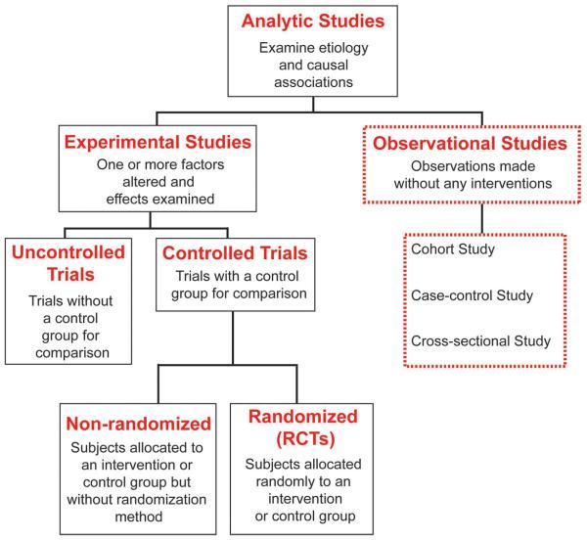
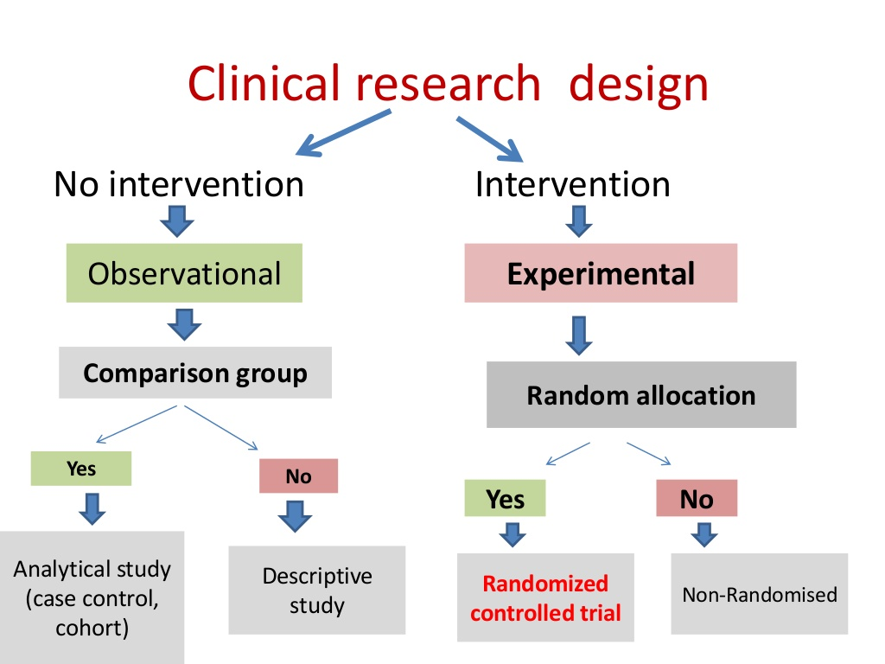
Terminology is not standardized !
Song JW, Chung KC. Observational studies: Cohort and case-control studies. Plast Reconstr Surg 2010;126:2234-42
https://www.slideshare.net/ritubudania/clinical-trial-design-28898802

Slide 11
Methodological principles and strategies

Slide 12
(Relatively) Common Strategies
Research question formulation
Standardization
Randomization and stratification
Blinding
Use of placebos/shams
Control group selection
Population selection
Endpoint selection
Protocol adherence
Sample size determination
Evans SR. Fundamentals of clinical trial design. Journal of experimental stroke & translational medicine. 2010;3(1):19-27.

Slide 13
S1. Question formulation
Precise formulation of the purpose of the study.
Strategies for framing the question.

Slide 14
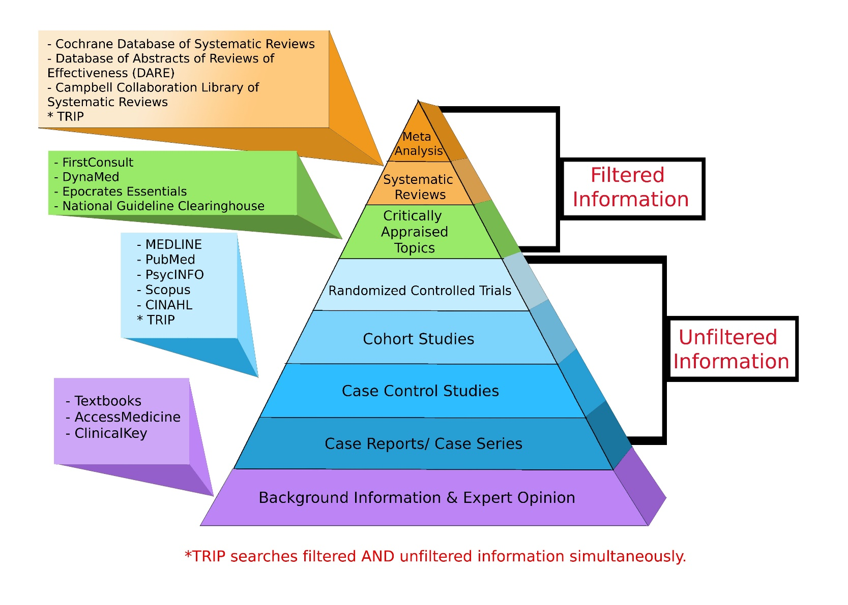
Where to search
http://libguides.gwumc.edu/ebm/studytypes

Slide 15
Framing the research question
Two general strategies:
hypothesis testing:
  researchers construct a null hypothesis (“no effect” or “no difference”) and an alternative hypothesis;
  evidence is sought to disprove the null and/or support the alternative hypothesis.
Estimation:
  Compute differences in some outcome for two different events with appropriate precision;
  Appropriate precision is measured by the width of a confidence interval of the difference between the outcomes in the two groups.
Evans SR. Fundamentals of clinical trial design. Journal of experimental stroke & translational medicine. 2010;3(1):19-27.

Slide 16
Specific strategy: PICO(TT) Framework
P | Patient Population of patients Problem | What is the best way to briefly describe this patient population or situation? E.g. pregnant women over 40 with preeclampsia, adolescent boys 13-15, etc.
I | Intervention (therapy or test) | What is the intervention? E.g. a drug, a questionnaire, a test, a procedure, etc.
C | Comparison | Is there an alternative intervention to compare to? E.g. placebo, current standard of care, another therapy, etc.
O | Outcome | Include specific patient-oriented outcomes E.g. morbidity, quality of life, etc.
T | Time for completion | Used to identify the time/duration for your data collection or for assessing your outcome. I.e. how long before you are to see that the intervention is having a positive impact OR the time in which the intervention will be delivered
T | Type of study | What is the ideal study design to answer this question? What type of study design do you realistically anticipate finding? E.g. randomized-controlled trial, systematic reviews, etc.

Slide 17
EBM question types
Intervention/Therapy
Etiology
Diagnosis
Prognosis/Prediction
Meaning
https://www.aaacn.org/sites/default/files/documents/misc-docs/1e_PICOT_Questions_template.pdf

Slide 18
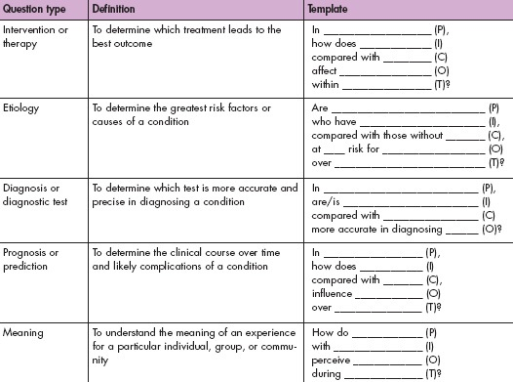
https://www.aaacn.org/sites/default/files/documents/misc-docs/1e_PICOT_Questions_template.pdf

Slide 19
S2. Standardization
Goal: minimize variation.
Strategies:
  construct consistent and uniform endpoint definitions which are as much as possible objectively measurable;
  use central labs/evaluators to eliminate between-lab/ between-evaluator variation;
  Use very precise evaluation manuals;
  Training of evaluators.
Evans SR. Fundamentals of clinical trial design. Journal of experimental stroke & translational medicine. 2010;3(1):19-27.

Slide 20
S3. Randomization
Goal: minimizing treatment selection bias;
    assignment to treated group not based on prognostic factors;
    prevents confounding of the treatment effects with other prognostic variables.
Strategies:
  Simple: flip a coin for each subject.
  Constrained: subjects pick token (T or nT) from a bag.
  Adaptive, several schemas, e.g.:
    pick token from bag to determine group, put it back, add one token from opposite category, or,
    pick from bag, give selected treatment, if treatment successful add two tokens of same treatment to bag, otherwise, one of each.
  Stratified: create treatment groups that are balanced with respect to confounding (prognostic) variables.

Slide 21
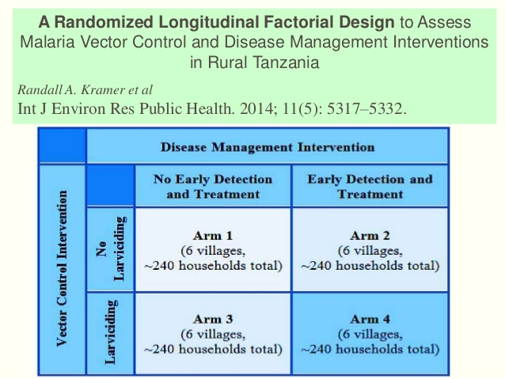

Slide 22
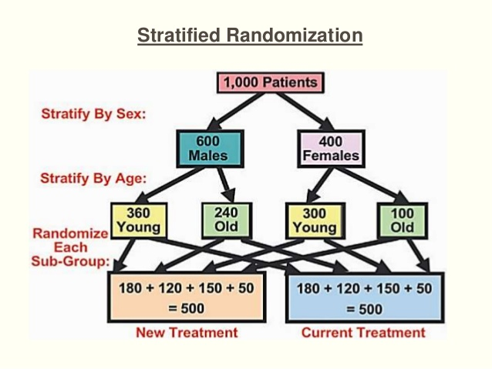

Slide 23
S4. Blinding
Of who:
  single: study subjects;
  double: subjects plus investigators;
  triple: subjects, investigators, evaluators, sponsors.
Not often possible:
  Ethical (no fake surgery)
  Different side effects of two compared treatments
  Different routes of administration
    Can be canceled out by ‘double dummy’ approach
Requires evaluation of the success of the blinding.
Evans SR. Fundamentals of clinical trial design. Journal of experimental stroke & translational medicine. 2010;3(1):19-27.

Slide 24
S5. Use of placebos
Sometimes costly
Sometimes impossible
  surgery
  device testing
May have treatment effects, most often with patient-reported outcomes.
Evans SR. Fundamentals of clinical trial design. Journal of experimental stroke & translational medicine. 2010;3(1):19-27.

Slide 25
S6. Control group selection
Goal: discriminate the effects caused by the study intervention from effects due to other factors.
      natural history of the disease, patient or clinician expectations, the effects of other interventions, …
Types:
  historical controls: data from previous studies
    Randomization not possible → more bias risk
  placebo/sham controls
  active controls: comparison to intervention with known outcomes
    ‘non-inferiority’ studies.
Evans SR. Fundamentals of clinical trial design. Journal of experimental stroke & translational medicine. 2010;3(1):19-27.

Slide 26
Control groups
The selection of a control group depends on:
  the research question,
  ethical constraints,
  the feasibility of blinding,
  the availability of quality data, and
  the ability to recruit participants.
Evans SR. Fundamentals of clinical trial design. Journal of experimental stroke & translational medicine. 2010;3(1):19-27.

Slide 27
Parallel and cross-over
Parallel A
B
Cross-over A A
B B

Slide 28
No control → Quasi-experimental design
A form of experimental research used extensively in the social sciences and psychology.
Mainly useful for measuring social variables.
The inherent weaknesses in the methodology do not undermine the validity of the data, as long as they are recognized and allowed for during the whole experimental process.
Quasi experiments resemble quantitative and qualitative experiments, but lack random allocation of groups or proper controls, so firm statistical analysis can be very difficult.
https://explorable.com/quasi-experimental-design

Slide 29
S7. Population selection
Determined by the study objective
Homogenous and small versus diverse and large
Response variation and effect isolation versus impact of intervention on society
Entry criteria considerations:
  Participant safety
  Reduction of variation
  Prevention of bias
    Eliminate confounding comorbidities
Evans SR. Fundamentals of clinical trial design. Journal of experimental stroke & translational medicine. 2010;3(1):19-27.

Slide 30
S8. Endpoint selection
Desiderata for endpoints:
  clinically relevant,
  interpretable,
  sensitive to the effects of intervention,
  practical and affordable to measure in an unbiased manner,
    Objective endpoints better than subjective endpoints .
Characterized as one of the variable types (nominal, …)
Evans SR. Fundamentals of clinical trial design. Journal of experimental stroke & translational medicine. 2010;3(1):19-27.

Slide 31
S8. Composite endpoints
An intervention can have effects on several important endpoints. Composite endpoints combine a number of endpoints into a single measure.
Possible advantages:
  more completed characterization of intervention effects higher power and resulting smaller sample sizes
  may reduce the bias due to competing risks and informative censoring.
  avoid the multiplicity issue of evaluating endpoints individually.
Possible disadvantages:
  significance of composite does not imply significance of components
  significance of components does not imply significance of the composite.
  interpretation can be challenging
  Intervention effects for different components can go in different directions.
Evans SR. Fundamentals of clinical trial design. Journal of experimental stroke & translational medicine. 2010;3(1):19-27.

Slide 32
S8. Surrogate endpoints
A surrogate endpoint is a measure that is predictive of the clinical event but takes a shorter time to observe.
The definitive endpoint often measures clinical benefit whereas the surrogate endpoint tracks the progress or extent of disease.
Surrogate endpoints could also be used when the clinical end-point is too expensive or difficult to measure, or not ethical to measure.
Criteria:
  the marker is predictive of the clinical event,
  the intervention effect on the clinical outcome manifests itself entirely through its effect on the marker.
significant correlation does not necessarily imply that a marker will be an acceptable surrogate.
Evans SR. Fundamentals of clinical trial design. Journal of experimental stroke & translational medicine. 2010;3(1):19-27.

Slide 33
Advantages of surrogate endpoints
Typically increase statistical power compared to clinical outcomes
Surrogate outcomes
  often continuous
  measured repeatedly
  less contamination by competing comorbidities if the study duration is short
Clinical outcomes
  often categorical
  surveillance till outcome occurs

Slide 34
Disadvantages of surrogate endpoints
Can involve complex, technical procedures
  procedures sometimes new
  procedures become obsolete
  many technical and analytic issues, often unapparent
Missing values are commonplace.
Potential for bias
  missing values occur in the sickest people,
  informative censoring, that is, loss of follow up data potentially related to treatment assignment.

Slide 35
S9. Protocol adherence
Goal: limit missing data
Strategies:
  Create simple trial;
  Use Intension to treat (ITT) model;
  Training of investigators;
  Explanation and motivation for patients.
Evans SR. Fundamentals of clinical trial design. Journal of experimental stroke & translational medicine. 2010;3(1):19-27.

Slide 36
S10. Steps in sample size determination
Formulate null and alternative hypotheses.
    ‘minimum clinically relevant difference’.
Select type I and type II errors.

Slide 37
Probabilities w.r.t. null hypothesis
Null Hypothesis | Claim that an investigator desires to disprove.
Power | The probability of rejecting a null hypothesis when it should be rejected.
Type I Error | The probability of rejecting the null hypothesis when it should not be rejected (i.e., a false positive).
Type II Error | The probability of failing to reject the null hypothesis when it should be rejected (i.e., a false negative). Type II error is the compliment of “power”.
Evans SR. Fundamentals of clinical trial design. Journal of experimental stroke & translational medicine. 2010;3(1):19-27.

Slide 38
Example: superiority trial
Superiority trial: trial designed to show that a new treatment is superior to another one, typically a placebo.
Power:
  The probability of identifying a treatment effect when indeed a true treatment effect exists.
Type I Error:
  The probability of (incorrectly) identifying a treatment effect when indeed a true treatment effect does not exist.
Type II Error:
  The probability of failing to identifying a treatment effect when indeed a true treatment effect exists.
Evans SR. Fundamentals of clinical trial design. Journal of experimental stroke & translational medicine. 2010;3(1):19-27.

Slide 39
Type I and type II errors
 | Reality
Observation | Treatment has no effect | Treatment has effect
Treatment is effective H₀ is rejected | Type I (or α) error (falsely reject H₀) α | Correct conclusion (reject H₀) 1-β (= study power)
Treatment has no effect H₀ is accepted | Correct conclusion (accept H₀) 1-α | Type II (or β) error (falsely accept H₀) β
Jerrold Lerman. Study design in clinical research: sample size estimation and power analysis

Slide 40
Sample size
Depends on four critical quantities:
  The type I and type II error rates (α and β)
  the population variance (σ²), and
  the effect size (ES),
    i.e. the amount by which we would expect two treatments to differ, or the difference that would be clinically worthwhile.
      ‘minimum clinically relevant difference’.

Slide 41
S10. Steps in sample size determination
Formulate null and alternative hypotheses.
    ‘minimum clinically relevant difference’.
Select type I and type II errors.

Slide 42
Select type I error
Typically set at 5%
Consider using a smaller Type I error (e.g., 1%)
  when a safe and effective intervention already exists, or
  when the new intervention appears to be “risky”.
Use a larger Type I error (e.g., 10%)
  when a safe and effective intervention does not exist and,
  when the new intervention appears to have low risk.
Evans SR. Fundamentals of clinical trial design. Journal of experimental stroke & translational medicine. 2010;3(1):19-27.

Slide 43
Select type II error
Typically Type II error is set at 10–20%.
Use of lower Type II error (e.g., 10%):
  When evaluating a new intervention for a serious disease that has no effective treatment.
Use of higher Type II error (e.g., 20%)
  when effective alternative interventions are available.
Evans SR. Fundamentals of clinical trial design. Journal of experimental stroke & translational medicine. 2010;3(1):19-27.

Slide 44
S10. Steps in sample size determination
Formulate null and alternative hypotheses.
    ‘minimum clinically relevant difference’.
Select type I and type II errors.
Obtain estimates of quantities that may be needed (e.g., estimates of variation or a control group response rate), through:
    searching the literature for prior data
    running pilot studies.
Select the minimum sample size such that two conditions hold:
    if the null hypothesis is true then the probability of incorrectly rejecting is no more than the selected Type I error rate, and
    if the alternative hypothesis is true then the probability of incorrectly failing to reject is no more than the selected Type II error.
Evans SR. Fundamentals of clinical trial design. Journal of experimental stroke & translational medicine. 2010;3(1):19-27.

Slide 45
S10. Alternative sample size method
Identify a primary quantity to be estimated (e.g. between-group difference in the mean response);
Estimate it with acceptable precision;
Compute the sample size so that there is a high probability that this quantity is estimated with acceptable precision as measured by, e.g. the width of the confidence interval for the between-group difference in means.
Evans SR. Fundamentals of clinical trial design. Journal of experimental stroke & translational medicine. 2010;3(1):19-27.

Slide 46
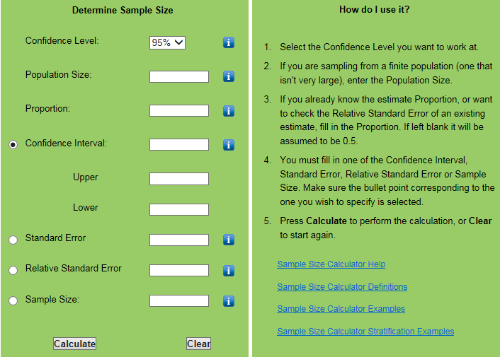
Notes:
http://www.nss.gov.au/nss/home.nsf/pages/Sample+size+calculator

Slide 47
Baseline determination
Consider all important baseline variables to be measured and how they are to be measured before treatment starts:
  Demographic characteristics (age, sex, height, weight, etc),
  Known factors that predict the outcome (potential confounders),
  Factors that predict or alter the risk of adverse reactions,
  Stratification factors,
  Pre-specified subgroups.
Burgess DC, Gebski VJ, Keech AC. Baseline data in clinical trials.
Med J Aust. 2003 Jul 21;179(2):105-7.

Slide 48
Table of Baseline Data
Table describing the characteristics of the intervention and control groups before the trial begins
Variables
  Demographics (age, gender, race, ethnicity, etc.)
  Lab Values
  Diagnoses
  Severity of illness scores (any risk factors for the primary outcome)
  Abnormal cut offs for values
  Combined values as needed for composite measures
  Comparison of the intervention and control groups

Slide 49
Study designs

Slide 50
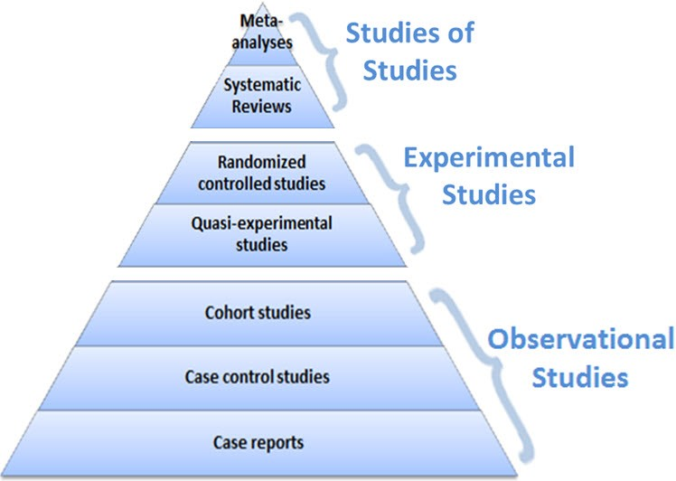
Levels of evidence
https://guides.library.vcu.edu/humphrey/journal-club

Slide 51
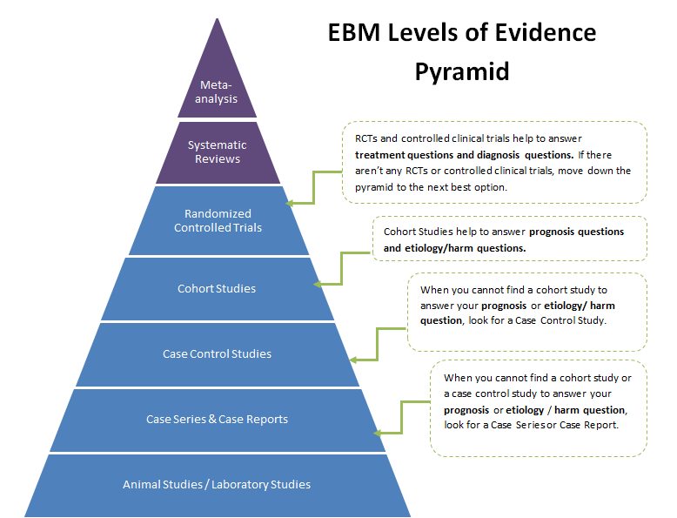
http://guides.dml.georgetown.edu/ebm/ebmclinicalquestions

Slide 52
Studies of studies
Meta-analysis:
  A study using statistical techniques to summarize the results of several studies in a single weighted estimate, in which more weight is given to results of studies with more events and sometimes to studies of higher quality.
Systematic review:
  a review in which specified and appropriate methods have been used to identify, appraise, and summarize studies addressing a defined question.
  It can, but need not, involve meta-analysis.

Slide 53
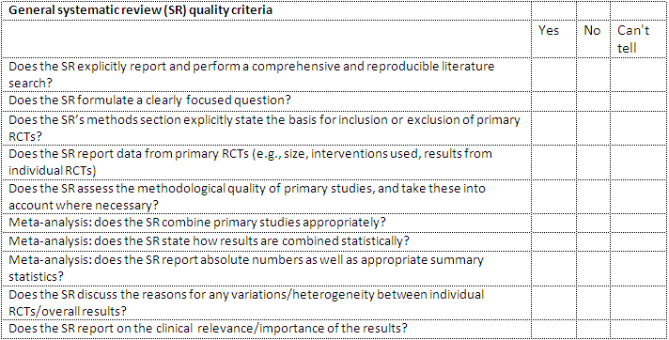
Appraising systematic reviews
http://clinicalevidence.bmj.com/x/set/static/ebm/toolbox/665052.html

Slide 54
Study designs
Clinical Trials
(strictu sensu)

Slide 55
Clinical trials: from discovery to application
Phase I | The first studies conducted in humans using an experimental intervention. These trials often have small sample sizes (e.g., <20), may enroll healthy human participants, and are used to investigate pharmacokinetics, pharmacodynamics, and toxicity.
Phase II | Trials typically conducted to investigate a dose response relationship, identify an optimal dose, and to investigate safety issues.
Phase III | Generally large trials (i.e., many study participants) designed to “confirm” efficacy of an intervention. They are sometimes called “confirmatory trials” or “registration trials” in the context of pharmaceutical development.
Phase IV | Trials carried out after registration of an intervention. They are generally very large and are typically conducted by pharmaceutical companies for marketing purposes and to gain broader experience with the intervention.
Evans SR. Fundamentals of clinical trial design. Journal of experimental stroke & translational medicine. 2010;3(1):19-27.

Slide 56
NIH's Definition of a Clinical Trial
‘A research study in which one or more human subjects are pro-spectively assigned to one or more interventions (which may in-clude placebo or other control) to evaluate the effects of those interventions on health-related biomedical or behavioral outcomes’.
If the answer to all following questions is “yes,” then the clinical study is a clinical trial according to the NIH definition.
  Does the study involve human participants?
  Are the participants prospectively assigned to an intervention?
  Is the study designed to evaluate the effect of the intervention on the participants?
  Is the effect being evaluated a health-related biomedical or behavioral outcome?
https://grants.nih.gov/policy/clinical-trials/definition.htm

Slide 57
Is this a clinical trial?
The study involves the recruitment of research participants with disease X to receive either an investigational drug or a placebo. It is designed to evaluate the efficacy of the investigational drug to relieve disease symptoms.

Slide 58
The study involves the recruitment of research participants with disease X to receive either an investigational drug or a placebo. It is designed to evaluate the efficacy of the investigational drug to relieve disease symptoms.
Does the study involve human participants?
  Yes, the study involves human participants.
Are the participants prospectively assigned to an intervention?
  Yes, the participants are prospectively assigned to receive an intervention, the investigational drug or placebo.
Is the study designed to evaluate the effect of the intervention on the participants?
  Yes, the study is designed to evaluate the effect of the investigational drug on the participants’ symptoms.
Is the effect being evaluated a health-related biomedical or behavioral outcome?
  Yes, the effect being evaluated, relief of symptoms, is a health-related outcome.

Slide 59
A study involves the recruitment of children at two schools to evaluate their preferences for graphics and colors used in healthy food advertisements. Children will be presented by multiple health advertisement and their preferences for graphics and colors will be assessed.
Does the study involve human participants?
  Yes, children are human participants.
Are the participants prospectively assigned to an intervention?
  Yes, the participants are prospectively assigned to see different advertisements.
Is the study designed to evaluate the effect of the intervention on the participants?
  Yes, the study is designed to evaluate the advertisements.
Is the effect being evaluated a health-related biomedical or behavioral outcome?
  No, preferences are not health-related biomedical or behavioral outcomes.

Slide 60
Controlled Clinical Trial
Clinical trial in which participants are assigned to two or more different treatment groups by a method other than random allocation.

Slide 61
Randomized Controlled Trial
A clinical trial in which participants are randomly assigned to two or more groups: at least one (the experimental group) receiving an intervention that is being tested and another (the comparison or control group) receiving an alternative treatment or placebo.

Slide 62
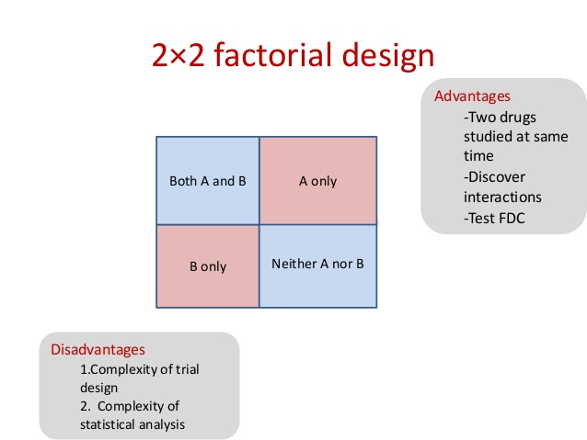
Factorial Designs
Perhaps two different dosings of the same drug can be tested for efficacy
  Clopidogrel standard vs double dose
  Clopidogrel plus ASA vs Clopidogrel alone vs ASA alone
  Clopidogrel with high dose ASA vs Clopidogrel with low dose ASA
    Should be no direct interaction of ASA and Clopidogrel other than the main outcomes (e.g. Metabolism)

Slide 63
N of 1 studies
The strongest evidence
A patient that you want to know if this is the correct treatment for them
You measure their baseline state (e.g. BP)
You give them the treatment and then measure the outcome (e.g. BP)
Then you take them off and measure the outcome (e.g. BP)
Then you repeat steps 4 and 5 three times or more and analyze the differences
An effective therapy should produce consistent effects

Slide 64
Study designs
Cohort studies

Slide 65
Cohort Study
A non-experimental study design that follows one or more cohorts.
A cohort = a group of individuals, usually 100 or more in size, who share a common characteristic,
    e.g. smokers, workers in a lead smelter, people born in the same year, or all enrollees of a specific health insurance plan
Looks at how events differ among people within the group.
A study that examines a cohort, which differs in respect to exposure to some suspected risk factor (e.g. smoking), is useful for trying to ascertain whether exposure is likely to cause specified events (e.g. lung cancer).

Slide 66
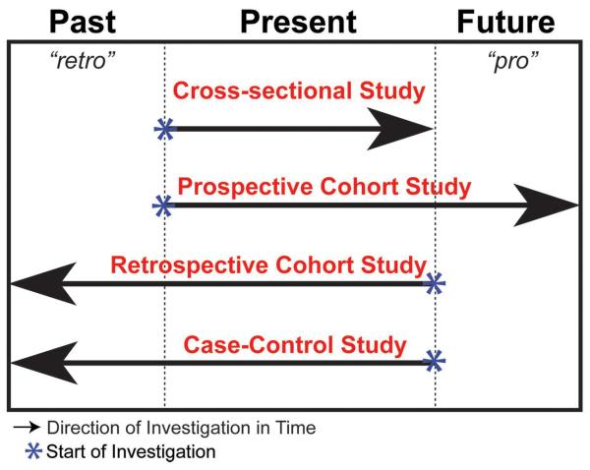
Cohort studies
Song JW, Chung KC. Observational studies: Cohort and case-control studies. Plast Reconstr Surg 2010;126:2234-42

Slide 67
Cohort studies: advantages
Advantages:
  Gather data regarding sequence of events; can assess causality
  Examine multiple outcomes for a given exposure
  Good for investigating rare exposures
  Can calculate rates of disease in exposed and unexposed individuals over time (e.g. incidence, relative risk)
Song JW, Chung KC. Observational studies: Cohort and case-control studies. Plast Reconstr Surg 2010;126:2234-42

Slide 68
Cohort studies: disadvantages
General:
  Large numbers of subjects are required to study rare exposures;
  Susceptible to selection bias.
Prospective Cohort Study:
  May be expensive to conduct;
  May require long durations for follow-up;
  Maintaining follow-up may be difficult;
  Susceptible to loss to follow-up or withdrawals.
Retrospective Cohort Study:
  Susceptible to recall bias or information bias;
  Less control over variables.
Song JW, Chung KC. Observational studies: Cohort and case-control studies. Plast Reconstr Surg 2010;126:2234-42

Slide 69
Selection of cohort study participants
Define the selected group of subjects by exposure status at the start of the investigation.
Have both the exposed and unexposed groups be selected from the same source population.
Song JW, Chung KC. Observational studies: Cohort and case-control studies. Plast Reconstr Surg 2010;126:2234-42

Slide 70
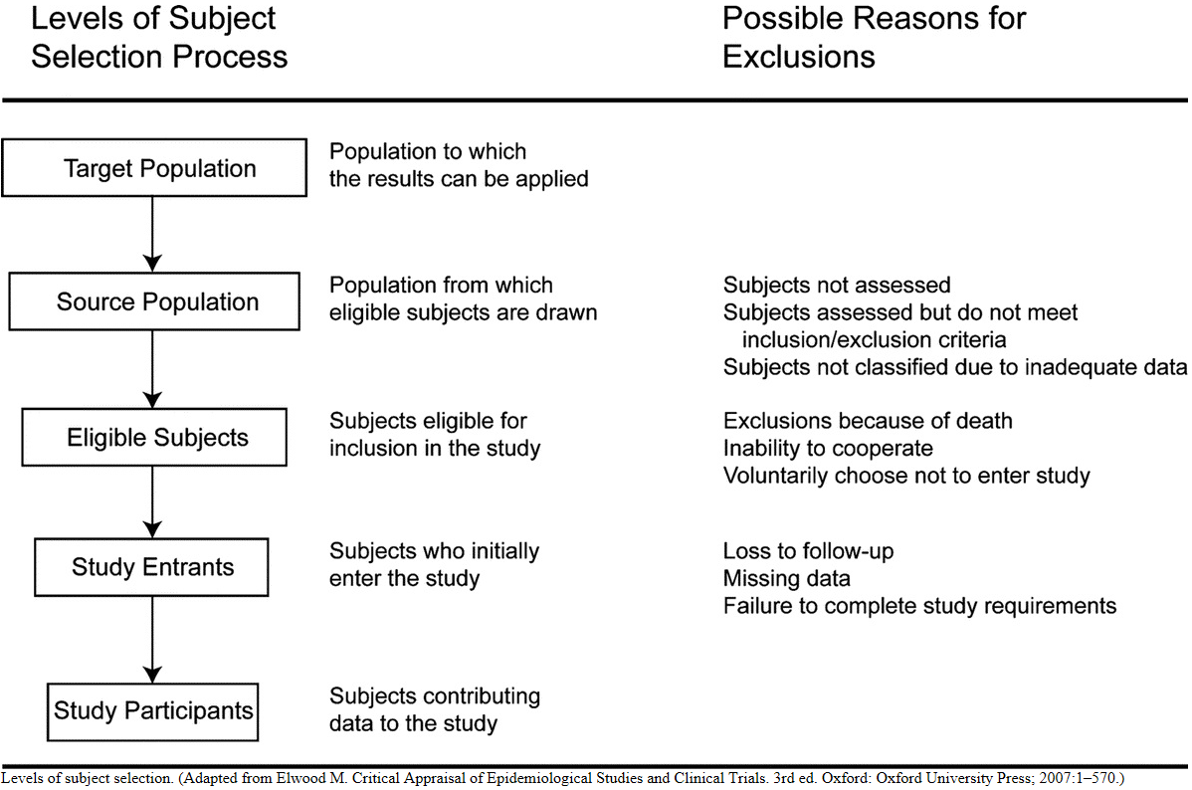
Selection of participants in cohort studies

Slide 71
Evaluation

Slide 72
Evaluation

Slide 73
What Odds Ratio (OR) and Risk Ratio (RR) tell you
That there IS a relationship between exposure and outcome when the OR or RR is clearly more than 1.0 or less than 1.0,
The DIRECTION of the effect:
  if AD greater than BC (OR > 1.0) then the exposure is more likely to lead to illness,
  if BC is greater than AD (OR< 1.0) the exposure is ‘protective’ against illness.
The SIZE or STRENGTH of the effect: the actual OR or RR value itself, read as the number of times one group is more likely to be ill than the other group.
https://www.quora.com/What-is-the-difference-between-the-risk-ratio-RR-and-the-odds-ratio-OR

Slide 74
Odds Ratio (OR) or Risk Ratio (RR) ?
It’s never wrong to use OR, but RR is preferred when you have the true incidence rate for both exposure groups.
  This is ONLY possible where you start with healthy exposed groups and follow them through time.
  You do NOT have this when you begin with some ill people (cases) and quickly assemble some non-ill people for comparison (as in a case control study).
OR is used for rare or uncommon diseases because you cannot realistically assemble ‘exposed’ and ‘non-exposed’ groups (as for RR)
Neither OR or RR are particularly reliable where the cell sizes are small.
https://www.quora.com/What-is-the-difference-between-the-risk-ratio-RR-and-the-odds-ratio-OR

Slide 75
Study designs
Cross-sectional studies

Slide 76
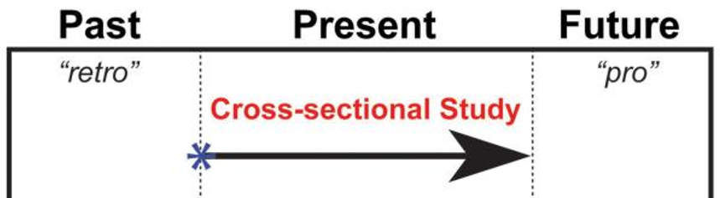
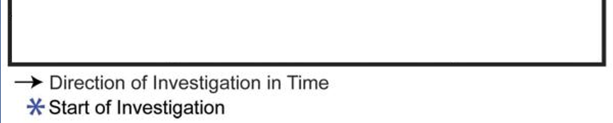
Cross-sectional study
An observational study in which subjects are sampled at one point in time, and then the associations between the concurrent risk factors and health outcomes are investigated.

Slide 77
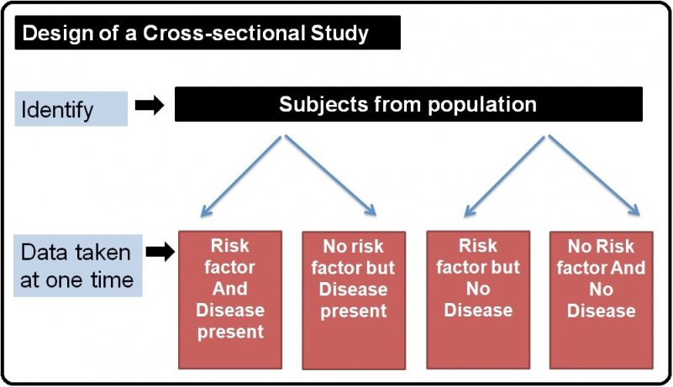
Cross-sectional design

Slide 78
Study designs
Case-control studies

Slide 79
Case control study
Examine two groups:
  One group of people who have experienced an event (= some outcome, usually an adverse event) and,
  Another group of people who have not experienced the same outcome.
Look at how exposure to suspect (usually noxious) agents differed between the two groups.
This type of study design is most useful for trying to ascertain the cause of rare events, such as rare cancers.
Aims to achieve the same goals (comparison of exposed and unexposed) as a cohort study but does so more efficiently, by the use of sampling.

Slide 80
Case control study
Synonyms:
  "retrospective studies“,
  "case-referent studies“.
Compares patients who have a disease or outcome of interest (cases) with patients who do not have the disease or outcome (controls),
Retrospective comparison of how frequently the exposure to a risk factor is present in each group to determine the relationship between the risk factor and the disease.
Are observational:
  no intervention is attempted,
  no attempt is made to alter the course of the disease.
The proportion of cases in the entire population-at-risk is unknown:
  → Designed to estimate odds.

Slide 81
ERIC Notebook. Case Control Studies (Second Edition No. 5)

Slide 82
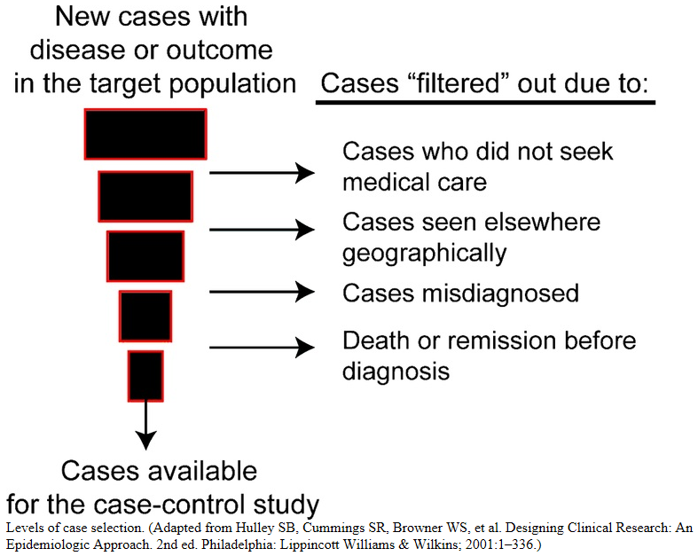
Case selection in case control studies
Song JW, Chung KC. Observational studies: Cohort and case-control studies. Plast Reconstr Surg 2010;126:2234-42

Slide 83
Case selection alternatives
Prevalent cases:
  persons who were existing cases of the health outcome or disease during the observation period.
    → prevalence odds ratio, which will be influenced by the incidence rate and survival or migration out of the prevalence pool of cases, and thus does not estimate the rate ratio.
Incident cases:
  persons who newly develop the health outcome or disease during the observation period.
    prevalence is influenced by both incidence and duration.
For cause of disease studies incident cases are preferred as they are more informative about factors that lead up to the development of disease rather than factors that affect duration.

Slide 84
Control selection in case-control studies
Most demanding aspects of a case-control study.
The distribution of exposure should be the same among cases and controls; in other words, both cases and controls should stem from the same source population.
The control group may also be an at-risk population, with the potential to develop the outcome.
Because the validity of the study depends on the comparability of these two groups, cases and controls should otherwise meet the same inclusion criteria in the study.
Song JW, Chung KC. Observational studies: Cohort and case-control studies. Plast Reconstr Surg 2010;126:2234-42

Slide 85
Matched case-control study
Matching attempts to ensure comparability between cases and controls.
Goal: reduce variability and systematic differences attributable to background variables and confounders:
    Background variables: variables that are not of interest to the investigator.
    Confounders: variables associated with the risk factor which may potentially be a cause of the outcome.
Each case is typically paired individually with a control subject with respect to the background variables and confounders → ‘individual matching’.
  Alternative: multiple controls (when cases are rare).
Song JW, Chung KC. Observational studies: Cohort and case-control studies. Plast Reconstr Surg 2010;126:2234-42

Slide 86
Case control study
Advantages
can obtain findings quickly
can often be undertaken with minimal funding
efficient for rare diseases
can study multiple exposures
generally requires few study subjects
Disadvantages
cannot generate incidence data
subject to bias
difficult if record keeping is either inadequate or unreliable
selection of controls can be difficult
cannot determine prevalence nor incidence of disease nor the risk factors as the subjects are generally collected by purposive sampling.

Slide 88
Interpretation of Odds Ratio
OR = 1 Odds of disease is the same for exposed and unexposed
OR > 1 Exposure increases odds of disease
OR < 1 Exposure reduces odds of disease

Slide 89
Bias in case control studies
Sampling bias:
  may occur if the cases and controls are taken from different subgroups of the population.
  the difference in the exposure may be due to some other inherent differences between the groups rather than the risk factor being studied.
Recall bias:
  May happen when subjects are asked to answer questions about exposure to risk factors in the past.
  It is likely that people who are diseased (cases) remember their exposure to the risk factor more accurately as compared to the controls. This may result in the OR value being higher than the actual value. It is important to note that case–control study designs cannot determine neither the prevalence or incidence of the disease nor the risk factors as the subjects are generally collected by purposive sampling

Slide 90
Study designs
Case series

Slide 91
Case Series
Analysis of series of people with some characteristic.
There is no comparison group.
Settings (1):
  Initial reports of a new diagnosis or innovative treatment.
    e.g.: the recovery and complication rates after a treatment or procedure.
    Not to be used for treatment efficacy!
  Describing the natural history of a condition.
  Single physician or hospital reports of outcomes.
  Multi-institutional registry.
Carey TS, Boden SD. A critical guide to case series reports. Spine (Phila Pa 1976). 2003 Aug 1;28(15):1631-4. https://www.ncbi.nlm.nih.gov/pubmed/12897483

Slide 92
Case series settings (2)
Proof (or Disproof) of Concept for a New Hypothesis
Reporting of Sentinel Events
  Toxicities of Therapies
  Recognition of Epidemics
  Initial Identification of Previously Unrecognized Syndromes
Studying Outcomes of Rare Diseases or New Treatments (Limited Usefulness)
Kempen JH. Appropriate use and reporting of uncontrolled case series in the medical literature.
Am J Ophthalmol. 2011;151(1):7-10.e1.

Slide 93
Characteristics of good case series
Clearly defined question.
Well-described study population.
Well-described intervention.
Use of validated outcome measures.
Appropriate statistical analyses.
Well-described results.
Discussion/conclusions supported by data.
Funding source acknowledged.
Carey TS, Boden SD. A critical guide to case series reports. Spine (Phila Pa 1976). 2003 Aug 1;28(15):1631-4. https://www.ncbi.nlm.nih.gov/pubmed/12897483

Slide 94
Checklist for Reporting Case Series
Explicitly describe:
  The hypothesis/hypotheses under consideration
  Eligibility criteria for subjects in the report
  How treatments were administered or potential risk factors defined
Compare observed results to those in an appropriate external comparison group; discuss potential biases arising from such comparison
Perform appropriate statistics, ensuring that assumptions of the statistical methods are reasonable in this setting
Discuss the biological plausibility of the hypothesis in light of the report's observations
Explicitly discuss the report's limitations, and how these limitations could be overcome in future studies
Kempen JH. Appropriate use and reporting of uncontrolled case series in the medical literature.
Am J Ophthalmol. 2011;151(1):7-10.e1.

Slide 95
Study designs
Comparisons

Slide 96
Case Control Cohort
identify subjects by outcome status at the outset of the investigation
Once outcome status is identified and subjects are categorized as cases, controls (subjects without the outcome) are selected.
Both groups from the same source population.
define the selected group of subjects by exposure status at the start of the investigation.
Subjects who are not at risk for developing the outcome should be excluded from the study
Both groups from the same source population.
Song JW, Chung KC. Observational studies: Cohort and case-control studies. Plast Reconstr Surg 2010;126:2234-42

Slide 97
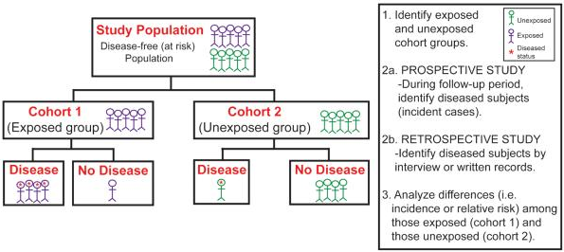
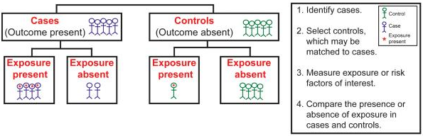
Cohort study
Case-control study
Song JW, Chung KC. Observational studies: Cohort and case-control studies. Plast Reconstr Surg 2010;126:2234-42

Slide 98
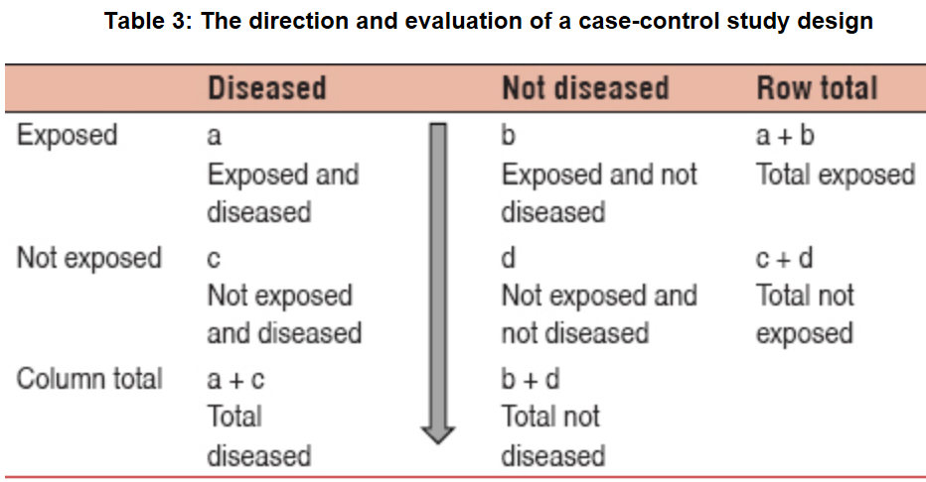

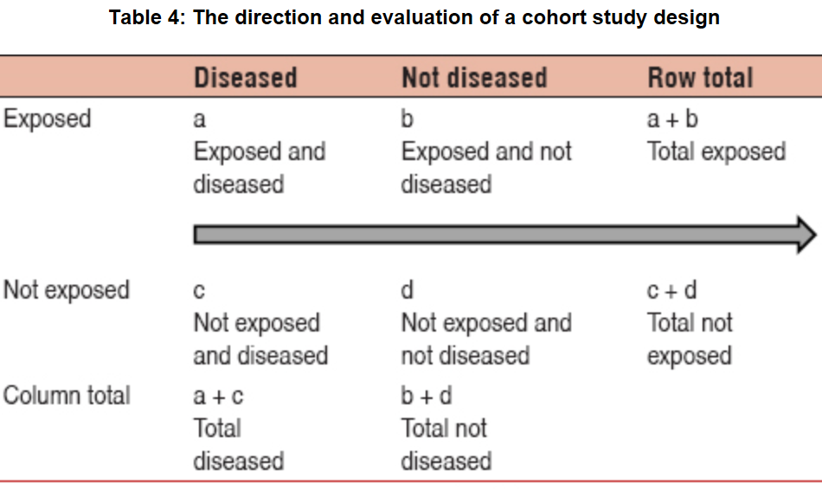


Case-control versus cohort
Notes:
Selecting the appropriate study design: Case–control and cohort study designs
A Omair - Journal of Health Specialties, 2016

Slide 99
Case-control / Cross-sectional / Cohort
Song JW, Chung KC. Observational studies: Cohort and case-control studies. Plast Reconstr Surg 2010;126:2234-42

Slide 100
Type of Question/ Type of Study
Therapy/ Treatment Selection of treatments of interventions that do more good than harm and that are worth the effort and cost. | Double-Blind Randomized Controlled Trial Systematic Review Meta Analysis of RCT
Diagnosis Selection and interpretation of diagnostic tests, in order to confirm or exclude a diagnosis, based on considering their precision, accuracy, acceptability, expense, safety, etc. | Controlled Trial Systematic Review Meta Analysis of Controlled Trial
Prognosis Estimation of a patient’s likely clinical course over time and anticipation of likely complications of disease. | Cohort Studies, Case Control, Case Series
Harm/ Etiology Identification of causes or risk factors for disease | Cohort Studies
Prevention | Randomized Controlled Trial, Cohort Studies
Quality Improvement | Randomized Controlled Trials
Adapted from: Sackett et al. Evidence-Based Medicine: How to Practice and Teach EBM, 2000

Slide 101
Study designs in function of objective
Objective Common design
Prevalence Cross sectional
Incidence Cohort
Cause in order of reliability:
cohort, case-control, cross sectional
Prognosis Cohort
Treatment effect Controlled trial
Mann, C.J. (2003) Observational research methods.
Research design II: Cohort, cross sectional, and case-control studies.
Emergency Medicine Journal 20 (1): 54–60.

Slide 102
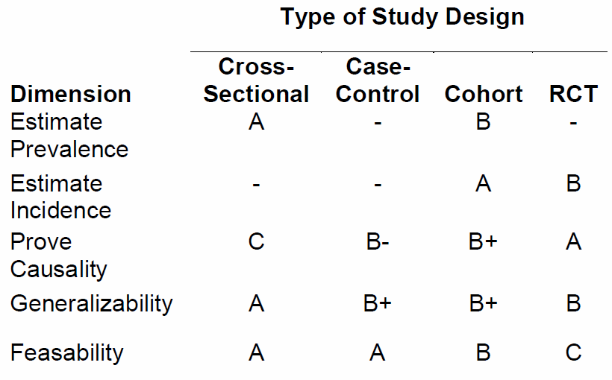
Study designs in function of objective
Edgar R Miller III. An Introduction to Clinical Trials: Design Issues.

Slide 103
Sections of a Research Protocol (1)
Background and Significance
Hypotheses
  Testable
Specific Aims
  Who, What, Where, When and How
Methods (Research Strategy)
  Description of the Intervention
  Population
  Power Calculation informed from prior studies
  Recruitment
  Design
  Handling of discontinued subjects or subjects who change their treatment
  Protocol Violations
  Analysis method(s) to be used
  Ethics

Slide 104
Sections of a Research Protocol (2)
Data Handling
  Security
  Confidentiality
  Data Retention
  Adverse Event Reporting
  Data Safety Monitoring
Results
  Primary Outcome
    Expected Significance
  Secondary Outcomes
    Expected Significance
Trial Calendar
Discussion
Data Sharing Plan
Benefits of this research to science of biomedicine

Slide 105
Assignment:
Open Book Test
Due: March 28, 9AM

Slide 106
Q1. What is the study design? Explain.
To investigate the relationship between watching horror movies and angina pectoris, a group of patients admitted to hospital with angina pectoris were questioned about their watching habits.
A group of age and sex matched patients admitted to a fracture clinic were also questioned about their movie watching behavior using an identical protocol.
The two groups were compared.
Scoring: correct design 5p correct explanation 10p

Slide 107
Q2. What is the study design? Explain.
To investigate the relationship between meat processing and skin disease, all employees at a meat processing plant were questioned about their exposure to raw meat and bones, and the amount and length of exposure measured.
These subjects were monitored frequently for exposure and occurrence of disease, and after 8 years the researchers examined the death certificates for all deceased employees.
Scoring: correct design 5p correct explanation 10p

Slide 108
Q3. What is the study design? Explain.
A survey was conducted of all faculty of a particular department.
Among other questions, the questionnaire asked about the academic title of faculty and whether they were satisfied with their promotional prospects.
Scoring: correct design 5p correct explanation 10p

Slide 109
Q4. What is the study design? Explain.
To evaluate a new teaching method for biomedical informatics, students were randomly allocated to either the course with the new method or the conventional one.
At the end of the courses, the students were questioned about what they thought to have learned, and they were subjected to an exam by independent instructors.
Scoring: correct design 5p correct explanation 10p

Slide 110
Q5. What is the study design? Explain.
A new graduate student admission system has been set up at some university.
To evaluate it, the processing times of candidates were measured for 6 semesters and compared with the processing times at a nearby college.
Scoring: correct design 5p correct explanation 10p

Slide 111
Q6. When are case reports most useful?
a) When you encounter cases seen before and need more information
b) When new symptoms or outcomes are not yet identified
c) When developing clinical practice guidelines
d) When you have an extremely large study population
Pick one answer.
Scoring: correct 10p wrong -5p no answer 0p

Slide 112
Q7. Is this a case-control study? Explain.
A researcher forms for his study:
  a) a group of people with a known exposure and
  b) a comparison group (‘control group’) without the exposure.
He follows both groups through time to see what outcomes result.
Scoring: correct answer 5p correct explanation 10p

Slide 113
Q8. Which statements are correct?
An investigator wants to study whether clinicians using electronic medical record (EMR) systems are at risk factor for vision loss.
A cohort study is to be preferred over a case-control study. (correct answer 10p, wrong -5p, no 0p)
If one group is composed of EMR using clinicians suffering from vision loss, it is better to have the other group be composed of:
  Clinicians that do not use an EMR but suffer vision loss,
  Clinicians that use an EMR but do not have vision loss,
  EMR users with or without vision loss that are not clinicians.
(correct answer 10p, wrong -5p, no 0p)

Slide 114
Q9. Under what assumption would this be clinical trial per NIH?
In this study, subjects are recruited and randomized to receive one of two approved drugs. The goal is to compare the effects of the drugs on the concentration of a protein in the cerebrospinal fluid.
(correct answer 10p)

Slide 115
Q10. Which of the two is a clinical trial per NIH?
Human subjects with disease X are recruited to test an investigational in vitro diagnostic device (IVD). The study is designed to evaluate whether the device can measure the level of a protein in blood.
Human subjects with disease X are recruited to be evaluated with an investigational in vitro diagnostic device (IVD). The study aims to evaluate how knowledge of certain protein levels impacts clinical decisions for how to manage disease X.
correct answer 10p, wrong -5p, no 0p

Slide 116
Q11. Case-control study
Researchers conduct a case-control study of depression. The study included 200 cases and 200 controls. Of the cases, 80% reported they were graded by Ceusters. Among the controls, 50% reported they were graded by Ceusters.
Compute the exposure odds ratio
What does the exposure odds ratio tells us about being graded by Ceusters?
Scoring: Correct OR 20p , correct interpretation: 20p

Slide 117
Scheduling change !
March 29: C9 - Mixed methods: Integration of quantitative and qualitative methods
April 5: C8 - Surveys and questionnaire construction for qualitative and quantitative research

Slide 118
Discussion
What studies are possible for our extra-terrestrial research?

