Slide 1
Statistical data analysis and research methods
BMI504
Course 21287 – Spring 2018
Class 1 – Feb 1, 2017
Fundamentals of Research - Introduction
Werner CEUSTERS

Slide 2
Class structure (C1)
Overview of the course with:
  assessment of student expectations,
  preferences in examples to be addressed within the context of resp. classes.
In-class test on pre-class reading.
Discussion of the pre-reading based on:
  answers from (2),
  worldviews relevant to research, research versus engineering, types of research as discussed in (1).

Slide 3
Housekeeping
Links to papers are provided in syllabus.
Slides of presentations will be made available after the class at:
  http://www.referent-tracking.com/RTU/ceusters_vita.html#teaching, section 4. Lectures

Slide 4

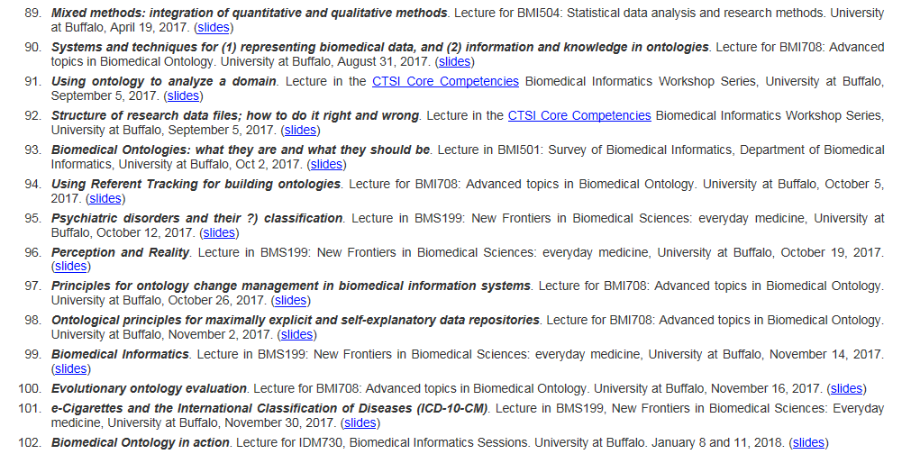
…
…
…

Slide 5
Housekeeping
Links to papers are provided in syllabus.
Slides of presentations will be made available after the class at:
  http://www.referent-tracking.com/RTU/ceusters_vita.html#teaching, section 4. Lectures
Be present and on time.
    Many classes have in-class tests which contribute to final score.

Slide 6
Class Scoring
Positives | 100%
Pre-readings | 12%
In-class participation | 28%
Assignments | 40%
Final exam | 20%
Penalties (late submissions) | 9%

Slide 7
Class | Date | Instructor | Assessment | Due dates | Score weight
C1 | 01-Feb | Ceusters (1) | in-class test on reading |  | 3%
C2 | 08-Feb | Ceusters (2) | in-class application test |  | 3%
 |  |  | late penalty | 3/15/18 9am | 1%
 |  |  | assignment result |  | 5%
C3 | 15-Feb | Ceusters (3) | participation in discussion |  | 2%
 |  |  | late penalty | 2/22/18 9am | 1%
 |  |  | assignment result |  | 3%
C4 | 22-Feb | Ceusters (4) | participation in discussion |  | 2%
 |  |  | test on pre-class readings |  | 4%
C5 | 01-Mar | Ceusters (5) | late penalty | 3/8/18 9am | 1%
 |  | Mullin (0.5) | assignment result |  | 4%
C6 | 08-Mar | Mullin (1) | late penalty | 3/14/18 9am | 1%
 |  |  | assignment result |  | 5%
C7 | 15-Mar | Ceusters (6) | late penalty | 3/28/18 9am | 1%
 |  |  | assignment result |  | 5%
C8 | 29-Mar | Sinha (1) | test on pre-class readings |  | 2%
 |  |  | late penalty | 4/4/18 9am | 1%
 |  |  | assignment result |  | 4%
C9 | 05-Apr | Ceusters (7) | late penalty | 4/11/18 9am | 1%
 |  |  | assignment result |  | 4%
C10 | 12-Apr | Ceusters (8) | role identification |  | 2%
 |  |  | reviewers comments |  | 3%
 |  |  | response to reviewers |  | 4%
C11 | 19-Apr | Ceusters (9) | in-class open-book test |  | 7%
C12 | 26-Apr | Mullin (2) | late penalty | 5/2/18 9am | 1%
 |  |  | assignment result |  | 5%
C13 | 3-May | Mullin (3) | late penalty | 5/9/18 9am | 1%
 |  |  | assignment result |  | 5%
C14 | 10-May | Sinha (2) | test on pre-class readings |  | 3%
 |  |  | post-class test |  | 5%
EXAM | 17-May | Ceusters (10) |  |  | 20%

Slide 8
Scores to expect
Grade | Quality Points | Percentage
A | 4.0 | 93.0% -100.00%
A- | 3.67 | 90.0% - 92.9%
B+ | 3.33 | 87.0% - 89.9%
B | 3.00 | 83.0% - 86.9%
B- | 2.67 | 80.0% - 82.9%
C+ | 2.33 | 77.0% - 79.9%
C | 2.00 | 73.0% - 76.9%
C- | 1.67 | 70.0% - 72.9%
D+ | 1.33 | 67.0% - 69.9%
D | 1.00 | 60.0% - 66.9%
F | 0 | 59.9 or below
Positives | 100%
Pre-readings | 12%
In-class participation | 28%
Assignments | 40%
Final exam | 20%
Penalties (late submissions) | 9%
Never on time: max. score = A-
No preparation for pre-class papers: max. score = B+
…

Slide 9
Scoring bonus: final score = class scores + max 30% of (100% - class scores)
Each student who wishes to participate (consent through email) receives for each class taught by Ceusters prior to May:
  The detailed results of his score for that class,
  The total results of each participating student for that class, all students (including self) being represented by unique pseudonymic identifiers,
  The result of a function applied to:
    (1) its own total score for that class (including penalty where applicable) and
    (2) the total scores of the other participating students for that class.

Slide 10
Form of communication for student 2
(5 participating students, after 5 classes)
Student | Task | Raw score | Output of function
 |  |  | S1 | S2 | S3 | S4 | S5
 | T1 | 70 | 71.5 | 64 | 70.5 | 81.5 | 71.5
 | T2 | 35 | 54.6 | 81.6 | 76.1 | 78.6 | 70.6
S1 | T3 | 100 | 89.1 | 83.1 | 61.6 | 85.1 | 78.6
 | T4 | 80 | 81.8 | 88.3 | 81.3 | 84.3 | 82.8
 | T5 | 61 | 70.6 | 82.6 | 79.1 | 84.1 | 78.6

Slide 11
Scoring bonus: final score = class scores + max 30% of (100% - class scores)
To obtain a bonus score, participating students must prior to May 7 send to me their assessment of which unique identifier was assigned to which student.
Scoring:
+10% for correct assessment of your own pseudonym;
+10% for finding the function,
+10%/(part. stud.) for each other student you assess correctly,
-10%/(part. stud.) for each student that assesses your pseudonym correctly.

Slide 12
Effect of bonus on original grades
course score | with max bonus | original grade | grade with bonus
42.9 | 60.03 | F | D
52.9 | 67.03 | F | D+
57.2 | 70.04 | F | C-
60 | 72 | D | C-
61.5 | 73.05 | D | C
67 | 76.9 | D+ | C
67.2 | 77.04 | D+ | C+
70 | 79 | C- | C+
71.5 | 80.05 | C- | B-
73 | 81.1 | C | B-
75.8 | 83.06 | C | B
77 | 83.9 | C+ | B
80 | 86 | B- | B
81.5 | 87.05 | B- | B+
83 | 88.1 | B | B+
85.8 | 90.06 | B | A-
87 | 90.9 | B+ | A-
90 | 93 | A- | A
93 | 95.1 | A | A

Slide 13
Mandatory!
Read the syllabus in detail.
Any mistake, lack of clarity or unfair principle you believe to perceive should be communicated to the course director prior to the 2nd class.

Slide 14
Course overview

Slide 15
C2. Philosophy of science and ontology

Slide 16
C2. Philosophy of science and ontology
‘Philosophy of science is about as useful to scientists as ornithology is to birds’.

Slide 17
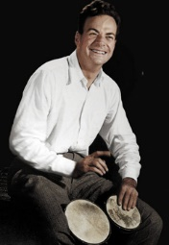

C2. Philosophy of science and ontology
‘Philosophy of science is about as useful to scientists as ornithology is to birds’.
    Attributed to Richard Feynman in Donald E. Simanek and John C. Holden, Science Askew: A Light-Hearted Look at the Scientific World (Philadelphia: Institute of Physics Publishing, 2002) , 215.
Feynman photo © Richard Hartt/Caltech archives

Slide 18
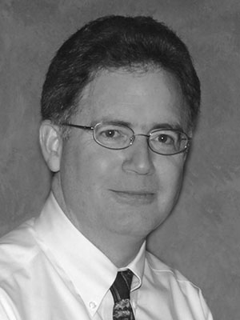
Philosophy of science: use(ful/less)?
‘Philosophy of science is about as useful to scientists as ornithology is to birds’.
    Attributed to Richard Feynman in Donald E. Simanek and John C. Holden, Science Askew: A Light-Hearted Look at the Scientific World (Philadelphia: Institute of Physics Publishing, 2002) , 215.
Feynman photo © Richard Hartt/Caltech archives
‘Science can't be free of philosophy any more than baseball can be free of physics’.
    Jeffrey L. Kasser, Ph.D. http://www.thegreatcourses.com/courses/philosophy-of-science.html#BVRRWidgetID

Slide 19
Definition of ‘science’
keywords
3a : knowledge or a system of knowledge covering general truths or the operation of general laws especially as obtained and tested through the scientific method.
3b : such knowledge or such a system of knowledge concerned with the physical world and its phenomena: natural science.
http://www.merriam-webster.com/dictionary/science

Slide 20
Definition of ‘science’
keywords
3a : knowledge or a system of knowledge covering general truths or the operation of general laws especially as obtained and tested through the scientific method.
3b : such knowledge or such a system of knowledge concerned with the physical world and its phenomena: natural science.
http://www.merriam-webster.com/dictionary/science

Slide 21
Definition of ‘research’
careful or diligent search.
studious inquiry or examination; especially :
investigation or experimentation
aimed at
- the discovery and interpretation of facts,
- revision of accepted theories or laws in the light of new facts,
- or practical application of such new or revised theories or laws.
the collecting of information about a particular subject.
http://www.merriam-webster.com/dictionary/research

Slide 22
Definition of ‘research’
Keywords?
careful or diligent search
studious inquiry or examination; especially :
investigation or experimentation
aimed at
- the discovery and interpretation of facts,
- revision of accepted theories or laws in the light of new facts,
- or practical application of such new or revised theories or laws
the collecting of information about a particular subject
http://www.merriam-webster.com/dictionary/research

Slide 23
Definition of ‘research’
keywords
careful or diligent search
studious inquiry or examination; especially :
investigation or experimentation
aimed at
- the discovery and interpretation of facts,
- revision of accepted theories or laws in the light of new facts,
- or practical application of such new or revised theories or laws
the collecting of information about a particular subject
http://www.merriam-webster.com/dictionary/research

Slide 24
Definition of ‘research’
keywords
careful or diligent search
studious inquiry or examination; especially :
investigation or experimentation
aimed at
- the discovery and interpretation of facts,
- revision of accepted theories or laws in the light of new facts,
- or practical application of such new or revised theories or laws
the collecting of information about a particular subject
http://www.merriam-webster.com/dictionary/research

Slide 25
C2. Philosophy of science and ontology
Pre class reading: none.
Class structure:
    interactive lecture covering an introduction to the philosophical basis of research with a special focus on Ontological Realism.
    application of the previous through a guided discussion on what counts as ‘mental disease’.

Slide 26
C2. Philosophy of science and ontology
Pre class reading: none.
Class structure:
    interactive lecture covering an introduction to the philosophical basis of research with a special focus on Ontological Realism.
    application of the previous through a guided discussion on what counts as ‘mental disease’.
    in-class application test:
      students will be presented with three evolving scenarios about behaviors in some populations. Each scenario will add some more observations about the populations.
      Students will be asked to suggest for each scenario hypotheses about the observed behaviors and specify a research method and analysis procedure for each hypothesis.
      For the 2nd and 3rd scenario, they will also need to indicate which hypotheses from the previous scenario(s), if any at all, can be ruled out on the basis of the new observations.

Slide 27
C2. Philosophy of science and ontology
Pre class reading: none.
Class structure:
    interactive lecture covering an introduction to the philosophical basis of research with a special focus on Ontological Realism.
    application of the previous through a guided discussion on what counts as ‘mental disease’.
    in-class application test.
Post-class assignment:
    Read SR Taquette et. al. ‘The perceptions of medical researchers on qualitative methodologies’ Cad. Saúde Pública, Rio de Janeiro, 31(4):722-732, 2015.
    Write a 2-page commentary on this paper discussing the extent to which the research conducted and the report thereof follow the scientific principles for qualitative research as covered in classes C1 to C5. Deadline: March 15, 9AM.

Slide 28
Why early announcement for late due date?
Raw first read after C2
→ interpretation based on ‘partly informed’ assumptions
→ new material offered in C3 and C4
→ better insight from new material
correction of erroneous assumptions and conclusions
→ more material for discussion in the essay
e.g.: ‘one might think that …, but, …’
Of further relevance: pre-readings of C10 on research reporting and paper writing.

Slide 29
Research viewpoints
Positivism
The natural and social world are governed by principles, which may take the form of law-like regularities.
Beuving and de Vries, Doing Qualitative Research, Amsterdam, 2015

Slide 30
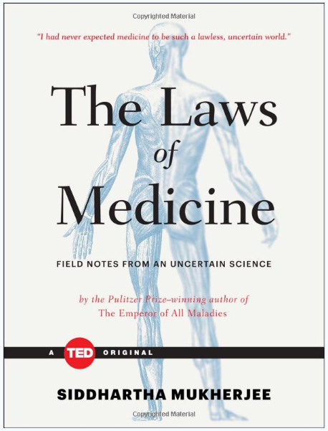
Laws of Medicine
I had never expected medicine to be such a lawless, uncertain world.

Slide 31
Research viewpoints
Positivism
The natural and social world are governed by principles, which may take the form of law-like regularities.
Interpretivism
Order of the social world follows from how humans understand their situation and act upon it.
Beuving and de Vries, Doing Qualitative Research, Amsterdam, 2015

Slide 32
Research worldviews
Positivism | Constructivism
Determination Reductionism Empirical observation and measurement Theory verification | Understanding Multiple participant meanings Social and historical construction Theory generation
Transformative | Pragmatism
Political agenda Change-oriented | Consequences of actions Problem-centered Real-world practice oriented
Creswell, Research Design, Los Angeles, 2014

Slide 33
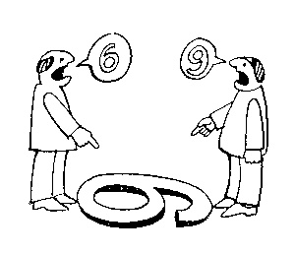
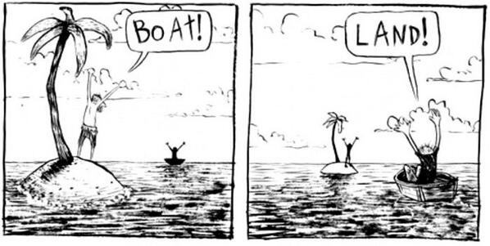
The view from nowhere
There are two kinds of qualities: ones that vary with the perspective one has or takes, and ones that remain constant through changes of perspective. The latter are the objective properties.
http://plato.stanford.edu/entries/scientific-objectivity

Slide 34
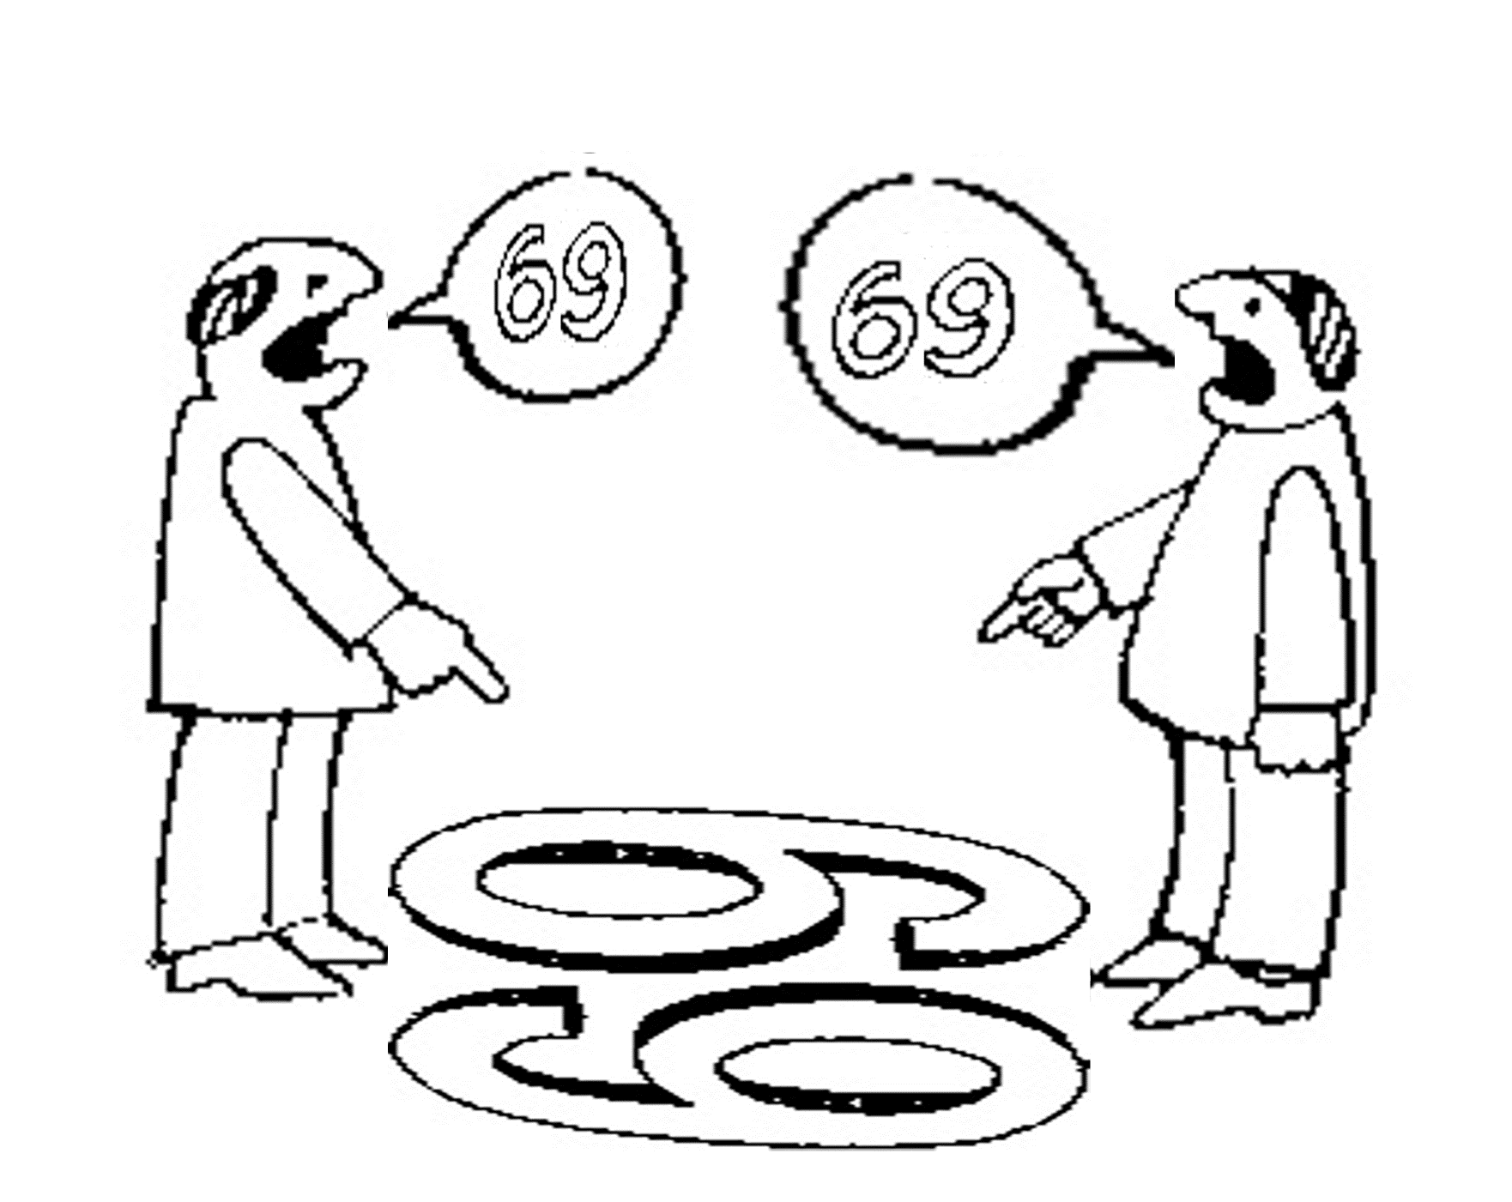
Is there scientific objectivity here?
sixty
nine
sixty
nine

Slide 35
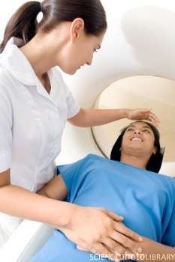
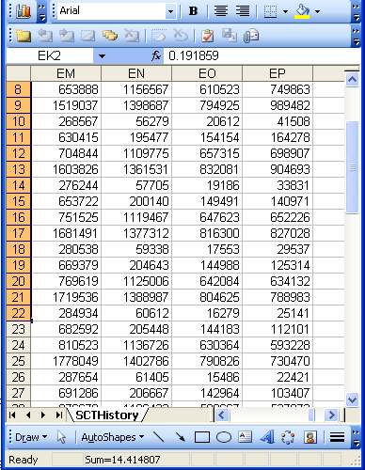
A non-trivial relation
Referents
References

Slide 36

What makes it non-trivial?
  are (meta-) physically the way they are,
  relate to each other in an objective way,
  follow laws of nature.
  what is physically and technically observable,
  fit between what is measured and what we think is measured,
  fit between established knowledge and laws of nature.
  follow, ideally, the syntactic-semantic conventions of some representation language,
  are restricted by the expressivity of that language,
  to be interpreted correctly, reference collections need external documentation.
Referents
Window on reality
  restricted by:
References

Slide 37
Quantitative research
Two distinct methods
In natural sciences and social sciences, quantitative research is the systematic empirical investigation of observable phenomena via statistical, mathematical or computational techniques.
https://en.wikipedia.org/wiki/Quantitative_research
Qualitative research
Qualitative Research is primarily exploratory research used to gain an understanding of underlying reasons, opinions, and motivations. It provides insights into the problem or helps to develop ideas or hypotheses for potential quantitative research.
http://www.snapsurveys.com/blog/what-is-the-difference-between-qualitative-research-and-quantitative-research/

Slide 38
C3. Qualitative research methods: theory and data collection methods
Pre-class reading: same as for C2 assignment.
Class structure:
  lecture on common qualitative data collection methods (Document Review, Observation, Interview (face-to-face), Focus Group Discussion, Ethnography,…),
  discussion of the pre-reading paper on the basis of what was taught in the lecture.
Post-class assignment: open book test with multiple choice questions and open-ended motivation based on literature. Deadline: Feb 22, 9AM.
Assessment:
  Participation in discussion,
  Evaluation of post-class assessment: Delivered in time / content.

Slide 39
C4. Introduction to data analysis of quantitative and qualitative variables
Pre-class readings:
    Savitri Abeyasekera. Quantitative analysis approaches to qualitative data: why, when and how?
    John PA Ioannidis. Why Most Published Research Findings Are False.
Class structure: interactive lecture.
Post-class assignment: none.
Assessment:
    pre-lecture test on readings,
    participation in interactive lecture.

Slide 40
Statistics on qualitative data
Main topics:
  types of research questions that can be answered on the basis of qualitative information,
  the types of data format that will lend themselves readily to appropriate data analysis procedures,
  how the data analysis can be benefited by recognizing the data structure and paying attention to relevant sources of variation.
Correct sampling is a major problem:
  Absolute requirement: an adequate representation of the communities being targeted for study.

Slide 41
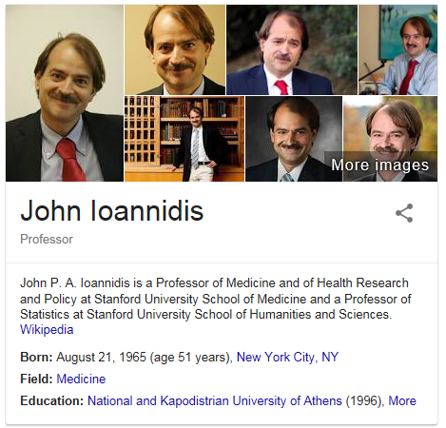
Why Most Published Research Findings Are False.
John P. A. Ioannidis.
Why Most Published Research Findings Are False.
PLOS Medicine 2005;2(8):e124
http://robotics.cs.tamu.edu/RSS2015NegativeResults/pmed.0020124.pdf

Slide 42
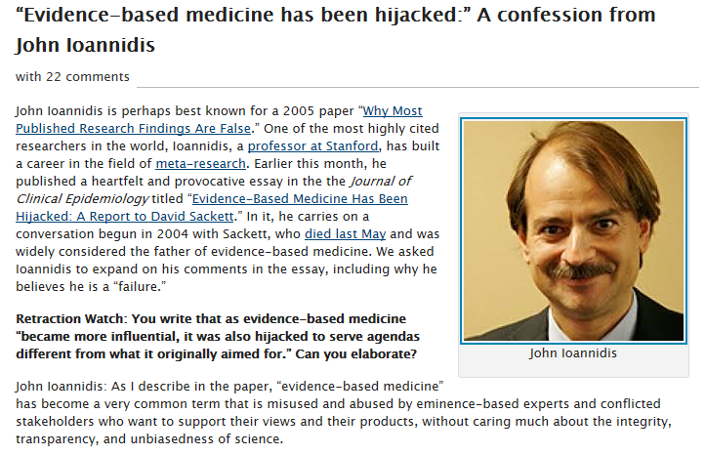
http://retractionwatch.com/2016/03/16/evidence-based-medicine-has-been-hijacked-a-confession-from-john-ioannidis/

Slide 43
Why Most Published Research Findings Are False.
Research findings are less likely to be true:
the smaller the studies conducted in a scientific field,
the smaller the effect sizes in a scientific field,
the greater the number and the lesser the selection of tested relationships in a scientific field,
the greater the flexibility in designs, definitions, outcomes, and analytical modes in a scientific field,
the greater the financial and other interests and prejudices in a scientific field,
the hotter a scientific field (with more scientific teams involved).
John P. A. Ioannidis. Why Most Published Research Findings Are False. PLOS Medicine 2005;2(8):e124
http://robotics.cs.tamu.edu/RSS2015NegativeResults/pmed.0020124.pdf

Slide 44
Fifteen common mistakes encountered in clinical research. Failure to …
carefully examine the literature for similar, prior research
critically assess the prior literature
specify the inclusion and exclusion criteria for your subjects
determine and report the error of your measurement methods
specify the exact statistical assumptions made in the analysis
perform sample size analysis before the study begins
implement adequate bias control measures
write and stick to a detailed time line
vigorously recruit and retain subjects
have a detailed, written and vetted protocol
examine for normality of the data
report missing data, dropped subjects and use of an intention to treat analysis
perform and report power calculations
point out the weaknesses of your own study
understand and use correct scientific
Journal of Prosthodontic Research 55 (2011) 1–6

Slide 45
C5. Descriptive and elementary statistics
Pre-class reading:
  Anthony McCluskey and Abdul Ghaaliq Lalkhen. Statistics II: Central tendency and spread of data. Continuing Education in Anaesthesia, Critical Care & Pain 2007;7(4):127-130.
Class structure:
  lecture covering the theories and applications of average value, median, mode, variance, standard deviation, inter-quartile range, skewness, kurtosis, histogram, box and whisker plot.

Slide 46
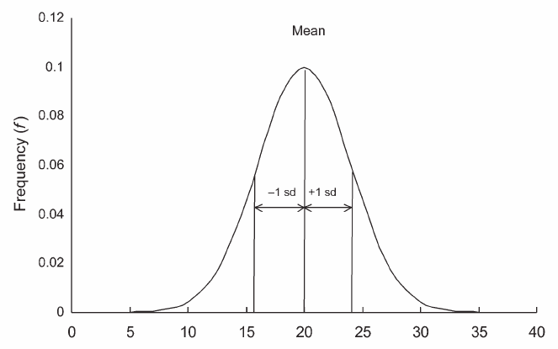
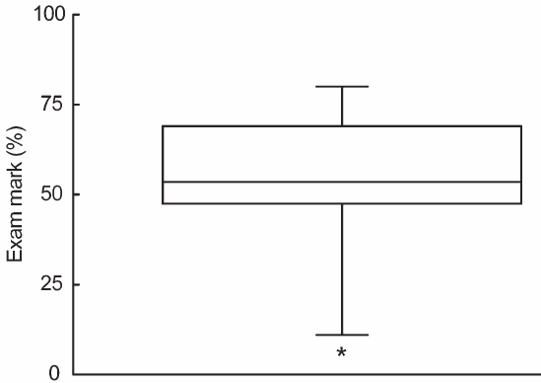
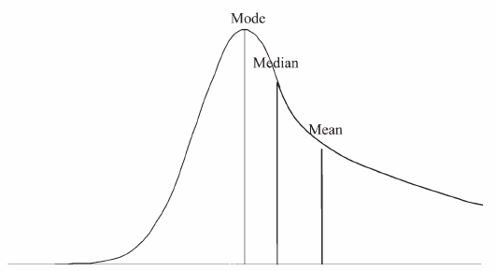
Central tendency and spread of data
Anthony McCluskey and Abdul Ghaaliq Lalkhen
Statistics II: Central tendency and spread of data
Continuing Education in Anaesthesia,
Critical Care & Pain 2007;7(4):127-130.

Slide 47
Examples of normal distribution in health
Systolic blood pressure of people?
Body temperature?
Body mass of adults?

Slide 48
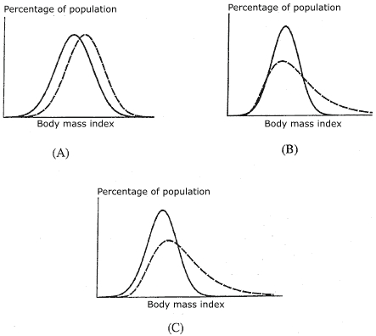
BMI changes in a population
Two theories.
Implications?
  If (A) is correct, actions must be taken to entire population, otherwise only to the right-end tail.
Alan D Penman, and William D Johnson.
The Changing Shape of the Body Mass Index Distribution Curve in the Population: Implications for Public Health Policy to Reduce the Prevalence of Adult Obesity.
Prev Chronic Dis. 2006 Jul; 3(3): A74.

Slide 49
C5. Descriptive and elementary statistics
Pre-class reading:
  Anthony McCluskey and Abdul Ghaaliq Lalkhen. Statistics II: Central tendency and spread of data. Continuing Education in Anaesthesia, Critical Care & Pain 2007;7(4):127-130.
Class structure:
  lecture covering the theories and applications of average value, median, mode, variance, standard deviation, inter-quartile range, skewness, kurtosis, histogram, box and whisker plot.
  a guided application of the use of R for elementary and descriptive statistics.

Slide 50
C5. Descriptive and elementary statistics
Pre-class reading:
  Anthony McCluskey and Abdul Ghaaliq Lalkhen. Statistics II: Central tendency and spread of data. Continuing Education in Anaesthesia, Critical Care & Pain 2007;7(4):127-130.
Class structure:
  lecture covering the theories and applications of average value, median, mode, variance, standard deviation, inter-quartile range, skewness, kurtosis, histogram, box and whisker plot.
  a guided application of the use of R for elementary and descriptive statistics.
Post class assignment:
    what hypotheses about the evolution of reportable communicable diseases in Erie county can you derive from the data available at erie.gov.health?
    Provide arguments using methods and techniques discussed in this class (pre-readings for advanced statistics classes?) and demonstrate using R or MS Excel.
    Due date: March 8, 9am.

Slide 51
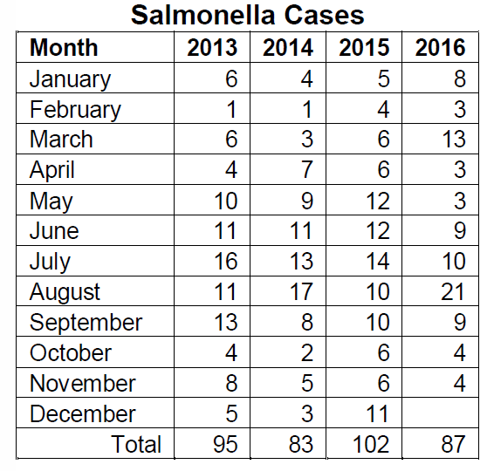
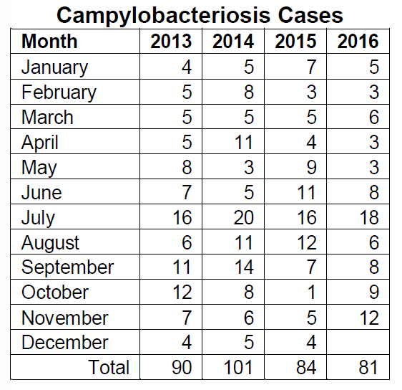
Erie.gov.health excerpt
http://www2.erie.gov/health/sites/www2.erie.gov.health/files/uploads/pdfs/reportablediseases.pdf

Slide 52
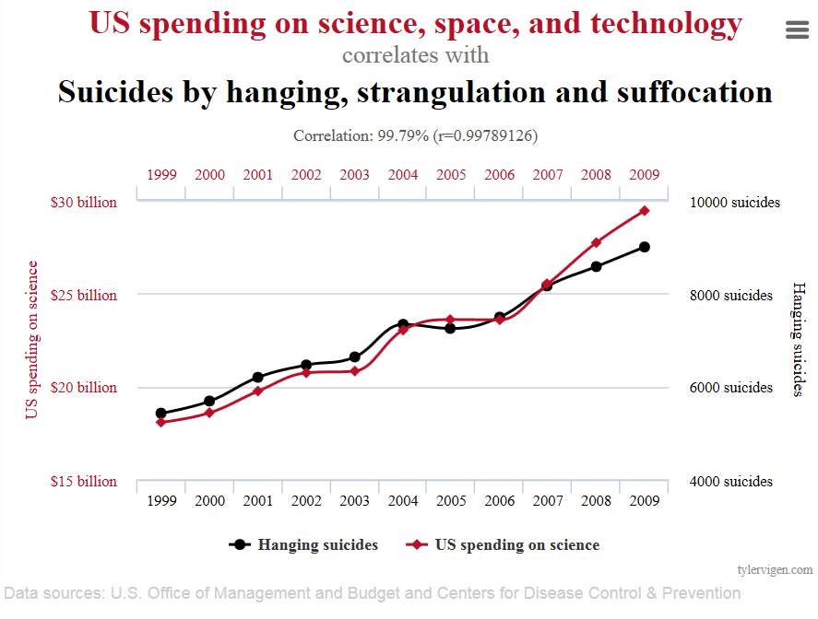
Correlation
http://www.tylervigen.com/spurious-correlations

Slide 53
Correlation
http://www.tylervigen.com/spurious-correlations

Slide 54
C6 - C12 - C13. Advanced Statistics
Pre-class readings:
  Several chapters from Streiner and Norman, Biostatistics: Bare Essentials.
Class-structure: lectures.
Post-lecture assignment:
  will address statistical problems using R and biological data and reflect what was taught in class and the reading. A rubric will be provided for each set of problems outlining what needs to be included in order to receive full credit. Due dates: 1 week after class.
Assessment:
  Evaluation of post-class assignment, delivered in time and content.
Instructor: Sarah Mullin.

Slide 55
Inductive and Statistical Inference
No statistical theory of evidence manages to eliminate all sources of personal bias and idiosyncrasy.
    The Bayesian is honest about it: subjective assumptions are ineliminable from scientific reasoning. Bayesian inductive logic tells you how to change your own attitudes as soon as you encounter evidence.
    The likelihoodist has perhaps the “purest” model of objective statistical evidence, but also the one with the most restricted scope.
    The frequentist conception based on p-values still dominates statistical practice, but it suffers from several conceptual drawbacks, and in particular the misleading impression of objectivity.
http://plato.stanford.edu/entries/scientific-objectivity

Slide 56
C7. Clinical epidemiology (I)
Pre-class readings: 4 papers from SJ Pocock, TC Clayton, GW Stone,
  Making Sense of Statistics in Clinical Trial Reports,
  Statistical Controversies in Reporting of Clinical Trials,
  Design of Major Randomized Trials,
  Challenging Issues in Clinical Trial Design.
Class structure:
  lecture on cohort study design, clinical study design, analysis of clinical trials, randomized controlled clinical trials, sample size and power, survival analysis, missing data, Cox proportional hazard model, hazard ratio, kaplan meier, 2x2 factorial designs, cross over designs.
Post-lecture quiz. Due date: 3/28, 9am.

Slide 57
C8. Surveys and questionnaire construction
Pre class reading: one or more out of (details in syllabus):
  Data Mining: Qualitative Analysis with Health Informatics Data.
  Optimizing Digital Health Informatics Interventions Through Unobtrusive Quantitative Process Evaluations.
  Patients' Perception of Hospital Care in the United States
Class structure:
  lecture with pptx presentation,
  hands on questionnaire writing session
Post class assignment:
  take home case study. Due date: April 4, 9am.
Instructor: Shyamashree Sinha.

Slide 58
C9. Mixed methods: integration of quantitative and qualitative methods
Pre-class reading:
LA Palinkas et. al.
Mixed Method Designs in Implementation Research.
Adm Policy Ment Health (2011) 38:44–53.
Class structure:
  The first part will be an interactive lecture covering the topic.
  The second part will consist of a guided exercise aimed at determining the best research designs to (dis)confirm hypotheses proposed for the scenarios discussed during the in-class application test of class C2.

Slide 59
C9. Mixed methods: integration of quantitative and qualitative methods
Post-class assignment:
  build further on the guided exercise to write a research proposal for an experimental design attempting to explain the behaviors observed as discussed during the in-class application test of class C2. Deadline: April 11, 9AM
Assessment:
  quality and soundness of the research proposal. (4% of positive final score)

Slide 60
Quantitative, qualitative and mixed methods
Quantitative methods | Qualitative methods | Mixed methods
Predetermined methods | Emerging methods | Both predetermined and emerging methods
Instrument based questions | Open-ended questions | Both open- and closed-ended questions
Observational data, performance data, attitude data, and census data | Interview data, observation data, document data, and audiovisual data | Multiple forms of data drawing on all possibilities
Statistical analysis | Text and image analysis | Statistical and text analysis
Statistical interpretation | Themes, patterns interpretation | Integration of multiple interpretations

Slide 61
Why mixed methods in intervention design?
Use QNM to measure intervention and/or implementation outcomes and QLM to understand the process;
Use QLM to explore a phenomenon and generate a conceptual model along with testable hypotheses, and use QNM to confirm the validity of the model by testing the hypotheses;
Incorporate the perspective of potential consumers of evidence-based practices;
To compensate for one set of methods by the use of another set of methods.

Slide 62
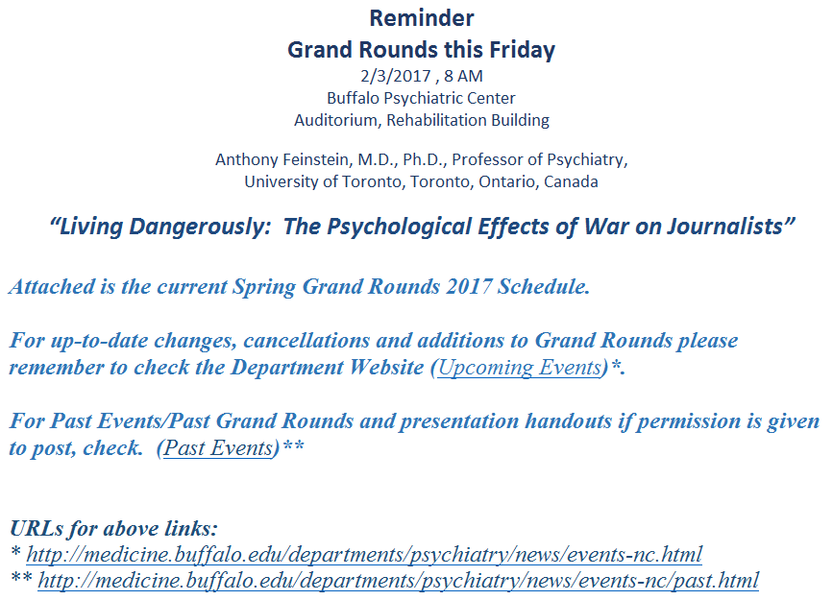
C10. Research reporting and report evaluation

Slide 63
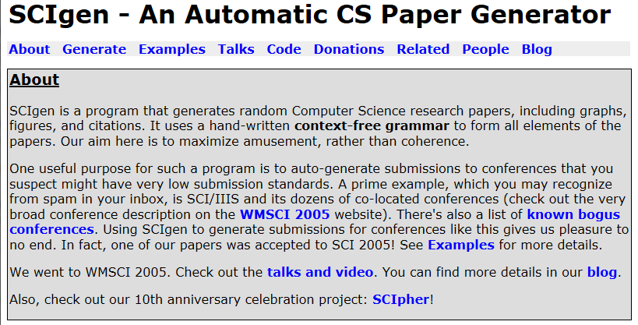
C10. Research reporting and report evaluation
https://pdos.csail.mit.edu/archive/scigen/

Slide 64
C10. Research reporting and report evaluation
Pre-class readings:
  11 steps to structuring a science paper editors will take seriously;
  8 reasons I rejected your article;
  8 reasons I accepted your article;
  A recently published article, suitable for a Journal Club in biomedical informatics, TBD
Class structure: role playing
  during the first half, the class will simulate a meeting of an editorial committee which will discuss the merits of the paper and write review comments with the possibility to indicate whether or not they individually agree with the individual comments. Different roles will be assigned to the students: neutral reviewers, biased reviewers in favor of the publication, biased against the publication.
  the second half will consist of all students writing together the ‘response to reviewers’, with the possibility to indicate whether or not they individually agree with the way the ‘group as author’ would accept or deny each of the individual requests for modifications.

Slide 65
C10. Evaluation
30%: They need to identify which students were assigned what kind of reviewer role. For each correct identification they make, they will be given 2 points. They will lose 1 point for each student by whom they are correctly identified as playing the role assigned to them.
30%: the degree to which their reviewers’ comments correspond with those of the instructor, with extra points for comments not made by the instructor, but assessed as adequate.
40%: the degree to which their agreement to modifications made correspond with how the instructor would respond.

Slide 66
C11. Research ethics; plagiarism; informed consent; IRB
Pre-class reading: none.
Class structure:
  interactive lecture followed by
  in-class open book test on the topics covered in the lecture.
Post-class assignment: none.
Assessment: scores on in-class open-book test (7% of positive final score).

Slide 67
C14. Clinical epidemiology (II)
Pre-class readings: one or more out of (details in syllabus):
  Bias;
  Epidemiology in the era of Big Data;
  Finding the Missing Link for Big Biomedical Data.
Class structure:
  lecture and discussion,
  Applied Epidemiology MCQ quiz.
Post-class assignment: none.
Assessment: results of pre-class reading tests (3%) and end-of-class MCQ (5%).
Instructor: Shyamashree Sinha.

Slide 68
Final Exam
The final exam will be held in the class room.
It will be composed of questions and exercises covering the complete content of the course.
Bring your laptop to the exam pre-loaded with any documentation you consider useful to consult during the text, whether or not used during the course.
Wifi services must be disabled and use of cell phones is not allowed.
Assessment: 20% of positive final score

Slide 69
Questions?

Slide 70
Pre-class reading
ESSAY
Why Most Clinical Research Is Not Useful
John P. A. Ioannidis1,2
1 Stanford Prevention Research Center, Department of Medicine and Department of Health Research and Policy, Stanford University School of Medicine, Palo Alto, California, United States of America,
2 Meta-Research Innovation Center at Stanford (METRICS), Stanford University, Palo Alto, California, United States of America
PLoS Med 13(6): e1002049
http://journals.plos.org/plosmedicine/article?id=10.1371/journal.pmed.1002049

Slide 71
Pre-class reading test
 | Max | Min | Student score
A | 5 | -5 | As
B | 1 | -1 | Bs
C | 5 | 0 | Cs
D | 1 | -1 | Ds
E | 5 | -5 | Es
F | 5 | -5 | Fs
G | 5 | -5 | Gs
H | 3 | 0 | Hs
 |  | TOTAL | MIN(100*SUM(As:Hs) / Sum(Amax:Gmax), 100)

Slide 72
A. Which features are proposed to be considered in appraising whether clinical research is useful?
Importance of problem
Expected information gain
Efficiency of research plan
Length of study
Value for money
Feasibility
Unbiased
Availability of prior evidence
Pragmatism
Patient centeredness
Size of study
Verifiability
Correctness / truth
Systems biology approach
Answer form: 1x, 2x, …, 14x where x = T(rue)/F(alse)/D(on’t know)
Scoring: 5*roundup((TP-FP+TN-FN)/(TP+TN))
Notes:
False:3,14

Slide 73
B. Which feature is met by the majority of clinical research studies?
Importance of problem
Expected information gain
Efficiency of research plan
Length of study
Value for money
Feasibility
Unbiased
Availability of prior evidence
Pragmatism
Patient centeredness
Size of study
Verifiability
Correctness / truth
Systems biology approach
Answer form: one number out of 1 … 14
Scoring: correct answer: 1 / no answer: 0 / wrong answer: -1
Notes:
6

Slide 74
C. What is ‘disease mongering’ ?
Answer form: one sentence definition
Scoring: good faith interpretation of completeness of answer
0 … 5
Notes:
the practice of widening the diagnostic boundaries of illnesses and aggressively promoting their public awareness in order to expand the markets for treatment.

Slide 75
D. Which type of studies is more prone to bias?
Studies that are clinically useful
(1) regardless of their eventual results
or
(2) only if a particular result is obtained ?
Answer form: one number (1 or 2)
Scoring: correct answer: 1 / no answer: 0 / wrong answer: -1
Notes:
2

Slide 76
E. Which of the following components of clinical research and use thereof are subject to bias?
(1) Design (2) Conduct (3) Analysis
(4) Reporting (5) Interpretation
Answer form: 1x, 2x, …, 5x where x = T(rue)/F(alse)/D(on’t know)
Scoring: 5*(TP-FP+TN-FN)/(TP+TN)
Notes:
All

Slide 77
F. Which of the following statements confirm what is asserted in the paper?
Most researchers who co-authored a biomedical paper have done so only once.
Clinical impact of published research papers is often used to judge academic performance.
Current research funding incentivizes small studies of short duration that can be quickly performed.
Routinely collected observational data is more representative of real life than clinical trials.
There is a strong correlation between the amount of research done and the burden of various diseases.
Answer form: 1x, 2x, …, 5x where
x = T(rue =confirms!)/F(alse)/D(on’t know)
Scoring: 5*roundup((TP-FP+TN-FN)/(TP+TN))
Notes:
1, 3

Slide 78
G. Which of the following statements contradict what is asserted in the paper?
Observational studies often add more confusion rather than filling the information deficits.
Many clinical trials are terminated because of futility.
An estimated 90% of the present cost of trials could be safely eliminated.
A trial population should be fully representative of the general population of all patients (for treatment) or the entire community (for prevention) to be generalizable.
Most new research is preceded or accompanied by systematic reviews.
Answer form: 1x, 2x, …, 5x where
x = T(rue =contradicts!)/F(alse)/D(on’t know)
Scoring: 5*roundup((TP-FP+TN-FN)/(TP+TN))
Notes:
4 and 5

Slide 79
H. Bonus question: for both citations to make sense, what might the authors mean by ‘knowing’?
‘Useful clinical research procures a clinically relevant information gain [9]: it adds to what we already know’
    Ioannidis JPA (2016) Why Most Clinical Research Is Not Useful. PLoS Med 13(6): e1002049. doi:10.1371/journal.pmed.1002049 (p2)
‘Whatever we are allowed to imagine in science must be consistent with everything else we know’
    The Feynman Lectures in Physics (1964), Vol. 2, Lecture 20, p.20-10. As quoted by James Gleick in Genius: The Life and Science of Richard Feynman (1992), 324.
Answer form: plausible explanation (one sentence) for their ‘knowing’
Scoring: good faith correct answer 3 … 0 no answer

Slide 80
Discussion

Slide 81
A. Which features are proposed to be considered in appraising whether clinical research is useful?
Importance of problem
Expected information gain
Efficiency of research plan
Length of study
Value for money
Feasibility
Unbiased
Availability of prior evidence
Pragmatism
Patient centeredness
Size of study
Verifiability
Correctness / truth
Systems biology approach
Answer form: 1x, 2x, …, 14x where x = T(rue)/F(alse)/D(on’t know)
Scoring: 5*roundup((TP-FP+TN-FN)/(TP+TN))
Notes:
False:3,14

Slide 82
A. Which features are proposed to be considered in appraising whether clinical research is useful?
Importance of problem
Expected information gain
Efficiency of research plan
Length of study
Value for money
Feasibility
Unbiased
Availability of prior evidence
Pragmatism
Patient centeredness
Size of study
Verifiability
Correctness / truth
Systems biology approach
Answer form: 1x, 2x, …, 14x where x = T(rue)/F(alse)/D(on’t know)
Scoring: 5*roundup((TP-FP+TN-FN)/(TP+TN))
Notes:
False:3,14

Slide 83
B. Which feature is met by the majority of clinical research studies?
Importance of problem
Expected information gain
Efficiency of research plan
Length of study
Value for money
Feasibility
Unbiased
Availability of prior evidence
Pragmatism
Patient centeredness
Size of study
Verifiability
Correctness / truth
Systems biology approach
Answer form: one number out of 1 … 14
Scoring: correct answer: 1 / no answer: 0 / wrong answer: -1
Notes:
6

Slide 84
B. Which feature is met by the majority of clinical research studies?
Importance of problem
Expected information gain
Efficiency of research plan
Length of study
Value for money
Feasibility
Unbiased
Availability of prior evidence
Pragmatism
Patient centeredness
Size of study
Verifiability
Correctness / truth
Systems biology approach
Answer form: one number out of 1 … 14
Scoring: correct answer: 1 / no answer: 0 / wrong answer: -1
Notes:
6

Slide 85
C. What is ‘disease mongering’ ?
Answer form: one sentence definition
Scoring: good faith interpretation of completeness of answer
0 … 5
Notes:
the practice of widening the diagnostic boundaries of illnesses and aggressively promoting their public awareness in order to expand the markets for treatment.

Slide 86
C. What is ‘disease mongering’ ?
the practice of
widening the diagnostic boundaries of illnesses
and
aggressively promoting their public awareness
in order to
expand the markets for treatment
https://en.wikipedia.org/wiki/Disease_mongering
Notes:
the practice of widening the diagnostic boundaries of illnesses and aggressively promoting their public awareness in order to expand the markets for treatment.

Slide 87
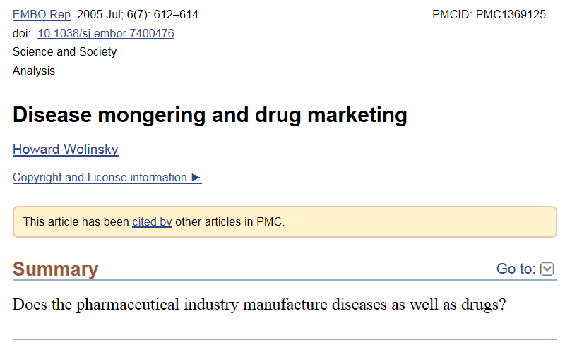

Slide 88
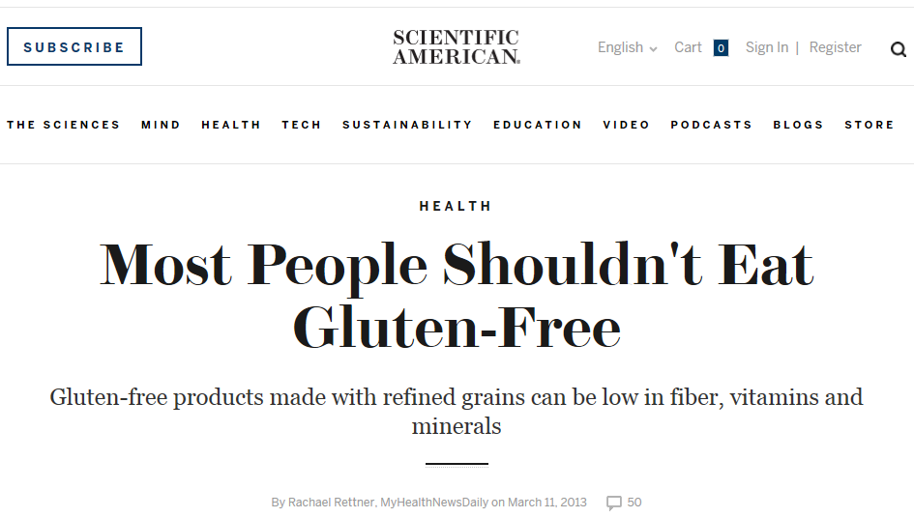
Unless you have celiac disease (<1% pop.)

Slide 89
D. Which type of studies is more prone to bias?
Studies that are clinically useful
(1) regardless of their eventual results or
(2) only if a particular result is obtained ?
Answer form: one number (1 or 2)
Scoring: correct answer: 1 / no answer: 0 / wrong answer: -1
Notes:
2

Slide 90
D. Which type of studies is more prone to bias?
Studies that are clinically useful
(1) regardless of their eventual results or
(2) only if a particular result is obtained ?
Answer form: one number (1 or 2)
Scoring: correct answer: 1 / no answer: 0 / wrong answer: -1
Notes:
2

Slide 91
E. Which of the following components of clinical research and use thereof are subject to bias?
(1) Design (2) Conduct (3) Analysis
(4) Reporting (5) Interpretation
Answer form: 1x, 2x, …, 5x where x = T(rue)/F(alse)/D(on’t know)
Scoring: 5*(TP-FP+TN-FN)/(TP+TN)
Notes:
All

Slide 92
E. Which of the following components of clinical research and use thereof are subject to bias?
(1) Design (2) Conduct (3) Analysis
(4) Reporting (5) Interpretation
Answer form: 1x, 2x, …, 5x where x = T(rue)/F(alse)/D(on’t know)
Scoring: 5*(TP-FP+TN-FN)/(TP+TN)
Notes:
All

Slide 93
F. Which of the following statements confirm what is asserted in the paper?
Most researchers who co-authored a biomedical paper have done so only once.
Clinical impact of published research papers is often used to judge academic performance.
Current research funding incentivizes small studies of short duration that can be quickly performed.
Routinely collected observational data is more representative of real life than clinical trials.
There is a strong correlation between the amount of research done and the burden of various diseases.
Answer form: 1x, 2x, …, 5x where
x = T(rue =confirms!)/F(alse)/D(on’t know)
Scoring: 5*roundup((TP-FP+TN-FN)/(TP+TN))
Notes:
1, 3

Slide 94
F. Which of the following statements confirm what is asserted in the paper?
Most researchers who co-authored a biomedical paper have done so only once.
Clinical impact of published research papers is often used to judge academic performance.
Current research funding incentivizes small studies of short duration that can be quickly performed.
Routinely collected observational data is more representative of real life than clinical trials.
There is a strong correlation between the amount of research done and the burden of various diseases.
Answer form: 1x, 2x, …, 5x where
x = T(rue =confirms!)/F(alse)/D(on’t know)
Scoring: 5*roundup((TP-FP+TN-FN)/(TP+TN))
Notes:
1, 3

Slide 95
G. Which of the following statements contradict what is asserted in the paper?
Observational studies often add more confusion rather than filling the information deficits.
Many clinical trials are terminated because of futility.
An estimated 90% of the present cost of trials could be safely eliminated.
A trial population should be fully representative of the general population of all patients (for treatment) or the entire community (for prevention) to be generalizable.
Most new research is preceded or accompanied by systematic reviews.
Answer form: 1x, 2x, …, 5x where
x = T(rue =contradicts!)/F(alse)/D(on’t know)
Scoring: 5*roundup((TP-FP+TN-FN)/(TP+TN))
Notes:
4 and 5

Slide 96
G. Which of the following statements contradict what is asserted in the paper?
Observational studies often add more confusion rather than filling the information deficits.
Many clinical trials are terminated because of futility.
An estimated 90% of the present cost of trials could be safely eliminated.
A trial population should be fully representative of the general population of all patients (for treatment) or the entire community (for prevention) to be generalizable.
Most new research is preceded or accompanied by systematic reviews.
Answer form: 1x, 2x, …, 5x where
x = T(rue =contradicts!)/F(alse)/D(on’t know)
Scoring: 5*roundup((TP-FP+TN-FN)/(TP+TN))
Notes:
4 and 5

Slide 97
H. Bonus question: for both citations to make sense, what might the authors mean by ‘knowing’?
‘Useful clinical research procures a clinically relevant information gain [9]: it adds to what we already know’
    Ioannidis JPA (2016) Why Most Clinical Research Is Not Useful. PLoS Med 13(6): e1002049. doi:10.1371/journal.pmed.1002049 (p2)
‘Whatever we are allowed to imagine in science must be consistent with everything else we know’
    The Feynman Lectures in Physics (1964), Vol. 2, Lecture 20, p.20-10. As quoted by James Gleick in Genius: The Life and Science of Richard Feynman (1992), 324.
Answer form: plausible definition (one sentence) for ‘knowing’
Scoring: good faith correct answer 3 … 0 no answer

Slide 98
Feynman: Take the world from another point of view (1/4)
https://www.youtube.com/watch?v=PsgBtOVzHKI

