Slide 1
Statistical data analysis and research methods BMI504 Course 22903 – Spring 2017
Class 2 – Feb 8, 2017
Philosophy of science and ontology
Werner CEUSTERS

Slide 2
C2. Philosophy of science and ontology
Pre class reading: none.
Class structure:
Part 1: interactive lecture covering an introduction to the philosophical basis of research with a special focus on Ontological Realism.
Part 2: application of the previous through a guided discussion on what counts as ‘mental disease’.
in-class application test.
Post-class assignment:
Write a 2-page essay on one or other position taken (or defended) by Kirsti Malterud in the paper, Theory and interpretation in qualitative studies from general practice: Why and how?, with which you disagree and build up an argumentation in light of what you learned in classes 1 and 2 and/or additional literature. Deadline: March 1, noon.

Slide 3
In-class application test
Students will be presented with three evolving scenarios about behaviors in some populations. Each scenario will add some more observations about the populations.
Students will be asked to suggest for each scenario hypotheses about the observed behaviors and specify a research method and analysis procedure for each hypothesis.
For the 2nd and 3rd scenario, they will also need to indicate which hypotheses from the previous scenario(s), if any at all, can be ruled out on the basis of the new observations.

Slide 4
A planet with tribal humanoids is discovered
O1: we are told about a tribe T1 on one side of a planet. We are told that when a humanoid of that tribe slaps another one in the face, (1) the other one often slaps back, (2) rarely the 2nd one spits the slapper in the face, and (3) nobody spits first. We want to find out why, jump in our spacecraft and start to observe the tribe. We are able to see all they do outside, but have no means to interact with them.
Interesting questions:
Hypotheses:
Testable predictions:
What data to gather?

Slide 5
Scoring
10%: Contribution of - and balance between - imagination and personal human zoo experiences in raising sufficiently distinct questions, hypotheses, proposed observables and testable predictions;
10%: The degree to which the predictions that would confirm the hypotheses are documented to be testable;
20%: The quality of the argument(s) used to assert the testability of the predictions;
20%: The extend to which observables proposed for testing predictions are described in terms of objective and interpretative features;
20%: The argumentation used to assess the plausibility of hypotheses forwarded in previous scenarios in light of new observations in later scenarios.
20%: The quality of the conclusion in terms of the most plausible hypothesis for the behavior of humanoids of the two distinct tribes and suggestions for future work.

Slide 6
Part 1 Philosophical basis

Slide 7
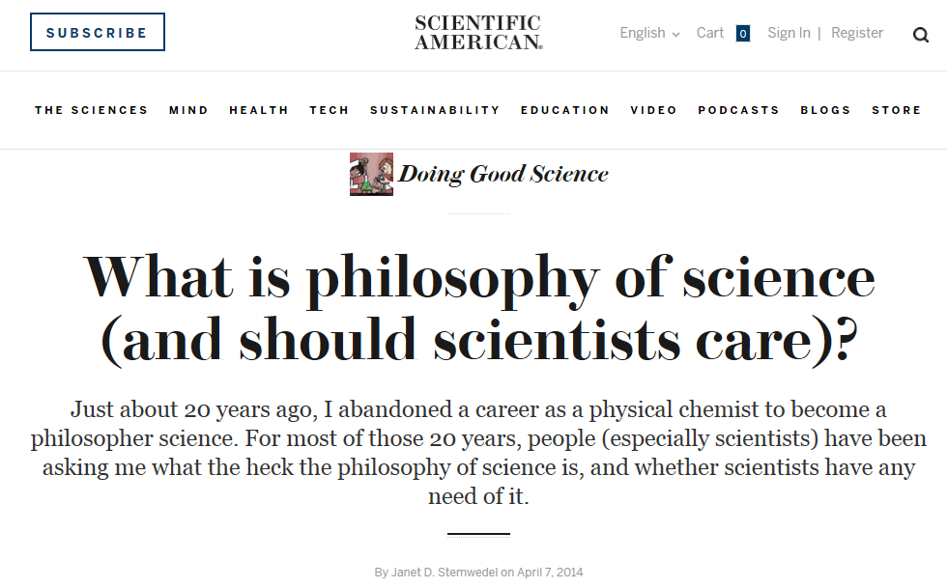
Roughly: https://blogs.scientificamerican.com/doing-good-science/what-is-philosophy-of-science-and-should-scientists-care/

Slide 8
Philosophy of Science (PhyS) ?
a rigorous academic study that deals specifically with what science is, how it works, and the logic through which we build scientific knowledge.
http://undsci.berkeley.edu/article/philosophy
a general philosophy of science seeks to describe and understand how science works within a wide range of sciences.
Malcolm Forster. An Introduction to Philosophy of Science, 2004.
philosophy of science should help us look at claims made within science, and claims made about science, and should help us make informed judgments about how and what we are to think about each case.
http://www.thegreatcourses.com/professors/jeffrey-l-kasser/

Slide 9
Philosophy of Science (PhyS) ?
a rigorous academic study that deals specifically with what science is, how it works, and the logic through which we build scientific knowledge.
http://undsci.berkeley.edu/article/philosophy
a general philosophy of science seeks to describe and understand how science works within a wide range of sciences.
Malcolm Forster. An Introduction to Philosophy of Science, 2004.
philosophy of science should help us look at claims made within science, and claims made about science, and should help us make informed judgments about how and what we are to think about each case.
http://www.thegreatcourses.com/professors/jeffrey-l-kasser/
Keywords?

Slide 10
Philosophy of Science (PhyS) ?
a rigorous academic study that deals specifically with what science is, how it works, and the logic through which we build scientific knowledge.
http://undsci.berkeley.edu/article/philosophy
a general philosophy of science seeks to describe and understand how science works within a wide range of sciences.
Malcolm Forster. An Introduction to Philosophy of Science, 2004.
philosophy of science should help us look at claims made within science, and claims made about science, and should help us make informed judgments about how and what we are to think about each case.
http://www.thegreatcourses.com/professors/jeffrey-l-kasser/
Keywords?

Slide 11
Philosophy of Science (PhyS) ?
a rigorous academic study that deals specifically with what science is, how it works, and the logic through which we build scientific knowledge.
http://undsci.berkeley.edu/article/philosophy
a general philosophy of science seeks to describe and understand how science works within a wide range of sciences.
Malcolm Forster. An Introduction to Philosophy of Science, 2004.
philosophy of science should help us look at claims made within science, and claims made about science, and should help us make informed judgments about how and what we are to think about each case.
http://www.thegreatcourses.com/professors/jeffrey-l-kasser/
Keywords?

Slide 12
Topics in PhyS
http://www.thegreatcourses.com/courses/philosophy-of-science.html#BVRRWidgetID
Science and Philosophy
Popper and the Problem of Demarcation
Further Thoughts on Demarcation
Einstein, Measurement, and Meaning
Classical Empiricism
Logical Positivism and Verifiability
Logical Positivism, Science, and Meaning
Holism
Discovery and Justification
Induction as Illegitimate
Some Solutions and a New Riddle
Instances and Consequences
Kuhn and the Challenge of History
Revolutions and Rationality
Assessment of Kuhn
For and Against Method
Sociology, Postmodernism, and Science Wars
(How) Does Science Explain?
Putting the Cause Back in "Because"
Probability, Pragmatics, and Unification
Laws and Regularities
Laws and Necessity
Reduction and Progress
Reduction and Physicalism
New Views of Meaning and Reference
Scientific Realism
Success, Experience, and Explanation
Realism and Naturalism
Values and Objectivity
Probability
Bayesianism
Problems with Bayesianism
Entropy and Explanation
Species and Reality
The Elimination of Persons?
Philosophy and Science
Notes:
I found the chapter selections very useful. I did not purchase the course and have no idea about its quality.

Slide 13
Roughly: https://blogs.scientificamerican.com/doing-good-science/what-is-philosophy-of-science-and-should-scientists-care/

Slide 14
Philosophy of science: use(ful/less)?
‘Philosophy of science is about as useful to scientists as ornithology is to birds’.
Attributed to Richard Feynman in Donald E. Simanek and John C. Holden, Science Askew: A Light-Hearted Look at the Scientific World (Philadelphia: Institute of Physics Publishing, 2002) , 215.
Feynman photo © Richard Hartt/Caltech archives

Slide 15
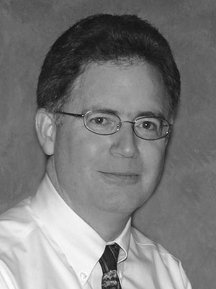
Philosophy of science: use(ful/less)?
‘Philosophy of science is about as useful to scientists as ornithology is to birds’.
Attributed to Richard Feynman in Donald E. Simanek and John C. Holden, Science Askew: A Light-Hearted Look at the Scientific World (Philadelphia: Institute of Physics Publishing, 2002) , 215.
Feynman photo © Richard Hartt/Caltech archives
‘Science can't be free of philosophy any more than baseball can be free of physics’.
Jeffrey L. Kasser, Ph.D. http://www.thegreatcourses.com/courses/philosophy-of-science.html#BVRRWidgetID

Slide 16
A scientist reviewer about:
I have advanced degrees in scientific fields and purchased this course with great interest….
The presenter appears to be reading from a manuscript and at a speed far too fast for the complexity of the material he is presenting.
The early lecture on the "Demarcation Problem" is a classic example of what I term philo-babble. Philo-babble is an attempt to carry on extended discussions, often reaching startling results, about a subject that is never defined. In this case, the presenter tries to talk about what is real science without ever defining what science is!
The presenter's prose becomes mostly unintelligible, at times resembling a "word-salad". You will frequently ask yourself " What on earth is he talking about ?"
The examples used are absurd and involve things such as dragon's and invented terms. The best he can do with actual real world science is Copernicus, Kepler, plus a little Newton and Einstein .
There is no real treatment of current problems crying for philosophical analysis, such as string theory and quantum mechanics.

Slide 17
A philosopher reviewer about:
Great for hard-core philosophy-enthusiasts:
This course is great for hard-core philosophy-enthusiasts, definitely not something to listen to with half an ear. It covers more material and in better depth than do many university introductory courses in the philosophy of science. (Much more than I do in MY philosophy of science course!) Be prepared to listen to some of the lectures more than once.

Slide 18
Another scientist reviewer:
Although much of my research has involved quantum mechanical analysis of atomic nuclei, I have for years been telling people that I was not sure that I really believed in atoms. They want to know how it could be that I am devoting my career to scientific work involving atoms if I have doubts about whether atoms exist! Frankly, I was never sure how to answer this question. I have found it truly thrilling when a detailed quantum mechanical analysis leads to a prediction that is confirmed by experiment, a prediction that I could never have guessed without first doing the analysis. It is impossible not to feel that there is something beautiful and powerful in the scientific theories that I am using, but does this definitely establish beyond any doubt that they are "true"? Particularly since atoms are so much smaller than any particles that we can see directly with our eyes, how could we definitively establish that atoms exist?
The great gift of this course is that it taught me how to think about questions of this sort.

Slide 19
Questions addressed in PhyS (1)
• What exactly is science? How to differentiate from pseudo-science?
www.hu.mtu.edu/~tlockha/h3700qst.doc

Slide 20
Definitions of ‘science’ (1)
3a : knowledge or a system of knowledge covering general truths or the operation of general laws especially as obtained and tested through scientific method
3b : such knowledge or such a system of knowledge concerned with the physical world and its phenomena: natural science
http://www.merriam-webster.com/dictionary/science

Slide 21
Definitions of ‘science’ (2)
Science is a systematic search for knowledge whose validity does not depend on the particular individual but is open for anyone to check or rediscover.
Hansson, Sven Ove, "Science and Pseudo-Science", The Stanford Encyclopedia of Philosophy (Spring 2015 Edition), Edward N. Zalta (ed.). https://plato.stanford.edu/archives/spr2015/entries/pseudo-science/.

Slide 22
Definitions of ‘science’ (3)
Science is the pursuit and application of knowledge and understanding of the natural and social world following a systematic methodology based on evidence.
http://sciencecouncil.org/about-us/our-definition-of-science/

Slide 23
What sort of question is asked for which these keywords are part of adequate answers?
Science and Philosophy
Popper and the Problem of Demarcation
Further Thoughts on Demarcation
Einstein, Measurement, and Meaning
Classical Empiricism
Logical Positivism and Verifiability
Logical Positivism, Science, and Meaning
Holism
Discovery and Justification
Induction as Illegitimate
Some Solutions and a New Riddle
Instances and Consequences
Kuhn and the Challenge of History
Revolutions and Rationality
Assessment of Kuhn
For and Against Method
Sociology, Postmodernism, and Science Wars
(How) Does Science Explain?
Putting the Cause Back in "Because"
Probability, Pragmatics, and Unification
Laws and Regularities
Laws and Necessity
Reduction and Progress
Reduction and Physicalism
New Views of Meaning and Reference
Scientific Realism
Success, Experience, and Explanation
Realism and Naturalism
Values and Objectivity
Probability
Bayesianism
Problems with Bayesianism
Entropy and Explanation
Species and Reality
The Elimination of Persons?
Philosophy and Science
Notes:
I found the chapter selections very useful. I did not purchase the course and have no idea about its quality.

Slide 24
Questions addressed in PhyS (2)
• What exactly is science? How to differentiate from pseudo-science?
www.hu.mtu.edu/~tlockha/h3700qst.doc

Slide 25
Some key principles in how to do science
Objective observation: measurement and data (possibly although not necessarily using mathematics as a tool),
Evidence,
Experiment and/or observation as benchmarks for testing hypotheses,
Induction: reasoning to establish general rules or conclusions drawn from facts or examples,
Repetition,
Critical analysis,
Verification and testing: critical exposure to scrutiny, peer review and assessment.
http://sciencecouncil.org/about-us/our-definition-of-science/

Slide 26
Identifying pseudoscience
Belief in authority: It is contended that some have a special ability to determine what is true or false. Others must accept their judgments.
Unrepeatable experiments: Reliance is put on experiments that cannot be repeated by others with the same outcome.
Handpicked examples: are used although they are not representative of the general category that the investigation refers to.
Unwillingness to test: A theory is not tested although it can be.
Disregard of refuting information: Observations or experiments that conflict with a theory are neglected.
Built-in subterfuge: The testing of a theory is so arranged that the theory can only be confirmed, never disconfirmed, by the outcome.
Explanations are abandoned without replacement. Tenable explanations are given up without being replaced, so that the new theory leaves much more unexplained than the previous one.
Hansson, Sven Ove, "Science and Pseudo-Science", The Stanford Encyclopedia of Philosophy (Spring 2015 Edition), Edward N. Zalta (ed.). https://plato.stanford.edu/archives/spr2015/entries/pseudo-science/.

Slide 27
A List Of Fallacious Arguments
http://www.don-lindsay-archive.org/skeptic/arguments.html
E.g.: False Compromise:
if one does not understand a debate, it must be "fair" to split the difference, and agree on a compromise between the opinions. (But one side is very possibly wrong, and in any case one could simply suspend judgment.) Journalists often invoke this fallacy in the name of "balanced" coverage.
"Some say the sun rises in the east, some say it rises in the west; the truth lies probably somewhere in between."
Television reporters like balanced coverage so much that they may give half of their report to a view held by a small minority of the people in question. There are many possible reasons for this, some of them good. However, viewers need to be aware of this tendency.

Slide 28
What sort of question is asked for which these keywords are part of adequate answers?
Science and Philosophy
Popper and the Problem of Demarcation
Further Thoughts on Demarcation
Einstein, Measurement, and Meaning
Classical Empiricism
Logical Positivism and Verifiability
Logical Positivism, Science, and Meaning
Holism
Discovery and Justification
Induction as Illegitimate
Some Solutions and a New Riddle
Instances and Consequences
Kuhn and the Challenge of History
Revolutions and Rationality
Assessment of Kuhn
For and Against Method
Sociology, Postmodernism, and Science Wars
(How) Does Science Explain?
Putting the Cause Back in "Because"
Probability, Pragmatics, and Unification
Laws and Regularities
Laws and Necessity
Reduction and Progress
Reduction and Physicalism
New Views of Meaning and Reference
Scientific Realism
Success, Experience, and Explanation
Realism and Naturalism
Values and Objectivity
Probability
Bayesianism
Problems with Bayesianism
Entropy and Explanation
Species and Reality
The Elimination of Persons?
Philosophy and Science
Notes:
I found the chapter selections very useful. I did not purchase the course and have no idea about its quality.

Slide 29
Questions addressed in PhyS (3)
• What exactly is science? How to differentiate from pseudo-science?
• Is there a single basic method of science? If there are several, what makes them all "scientific"?
•
www.hu.mtu.edu/~tlockha/h3700qst.doc

Slide 30
One or more?
Philosophy of Science (PhyS)
versus
Philosophies of Science (PhieS)

Slide 31
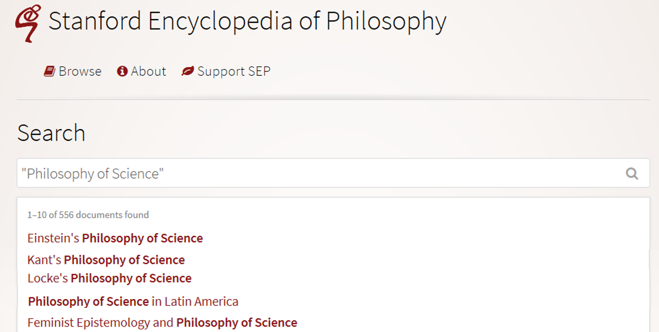
Many philosophies of science
https://plato.stanford.edu/search/search?query=%22Philosophy+of+Science%22

Slide 32
Questions addressed in PhyS (4)
• What exactly is science? How to differentiate from pseudo-science?
• Is there a single basic method of science? If there are several, what makes them all "scientific"?
• Is science the best way to know about the world?
• Is science compatible with religion, or do they conflict? If they conflict, which one should we believe?
• What is a scientific theory? How should scientists decide which among competing theories to accept?
• Why do scientists sometimes disagree with each other, even when they have the same data? Could fully rational scientists have such disagreements?
• What is scientific progress? Does it really exist? Is science getting us closer and closer to the Truth?
www.hu.mtu.edu/~tlockha/h3700qst.doc

Slide 33
Which questions addressed in PhyS should scientists deeply care about?
• What exactly is science? How to differentiate from pseudo-science?
• Is there a single basic method of science? If there are several, what makes them all "scientific"?
• Is science the best way to know about the world?
• Is science compatible with religion, or do they conflict? If they conflict, which one should we believe?
• What is a scientific theory? How should scientists decide which among competing theories to accept?
• Why do scientists sometimes disagree with each other, even when they have the same data? Could fully rational scientists have such disagreements?
• What is scientific progress? Does it really exist? Is science getting us closer and closer to the Truth?
www.hu.mtu.edu/~tlockha/h3700qst.doc

Slide 34
Which questions addressed in PhyS should scientists deeply care about?
• What exactly is science? How to differentiate from pseudo-science?
• Is there a single basic method of science? If there are several, what makes them all "scientific"? → What makes your approach scientific?
• Is science the best way to know about the world?
• Is science compatible with religion, or do they conflict? If they conflict, which one should we believe?
• What is a scientific theory? How should scientists decide which among competing theories to accept?
• Why do scientists sometimes disagree with each other, even when they have the same data? Could fully rational scientists have such disagreements?
• What is scientific progress? Does it really exist? Is science getting us closer and closer to the Truth?
www.hu.mtu.edu/~tlockha/h3700qst.doc

Slide 35
Some key notions from PhyS useful for (future) scientists

Slide 36
‘Ontology’
Helps scientists to determine and describe what sorts of entities their research is intended to be directed at.

Slide 37
Four notions of ‘ontology’ as a study
(O1) the study of ontological commitment, i.e. what we or others are committed to,
(O2) the study of what there is,
(O3) the study of the most general features of what there is, and how the things there are relate to each other in the metaphysically most general ways,
(O4) the study of meta-ontology, i.e. saying what task it is that the discipline of ontology should aim to accomplish, if any, how the questions it aims to answer should be understood, and with what methodology they can be answered.
http://plato.stanford.edu/entries/logic-ontology/#DifConOnt

Slide 38
Realism
Generic Realism (on some subject matter):
a, b, and c and so on exist,
and the fact that they exist and have properties such as F-ness, G-ness, and H-ness is (apart from mundane empirical dependencies of the sort sometimes encountered in everyday life) independent of anyone's beliefs, linguistic practices, conceptual schemes, and so on.
http://plato.stanford.edu/entries/realism/

Slide 39
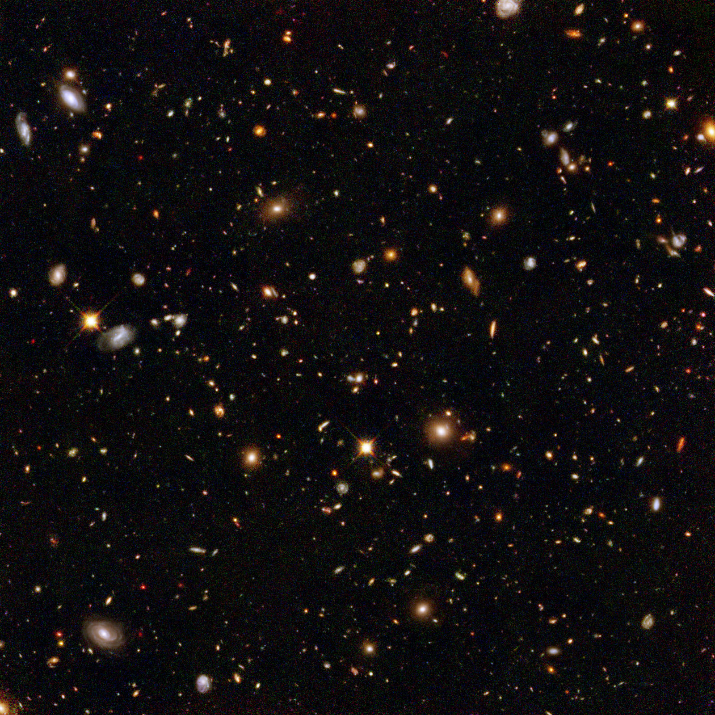
The basis of Ontological Realism (O.R.)
There is an external reality which is ‘objectively’ the way it is;
That reality is accessible to us;
We build in our brains cognitive representations of reality;
We communicate with others about what is there, and what we believe there is there.
Smith B, Kusnierczyk W, Schober D, Ceusters W. Towards a Reference Terminology for Ontology Research and Development in the Biomedical Domain. Proceedings of KR-MED 2006, Biomedical Ontology in Action, November 8, 2006, Baltimore MD, USA

Slide 40
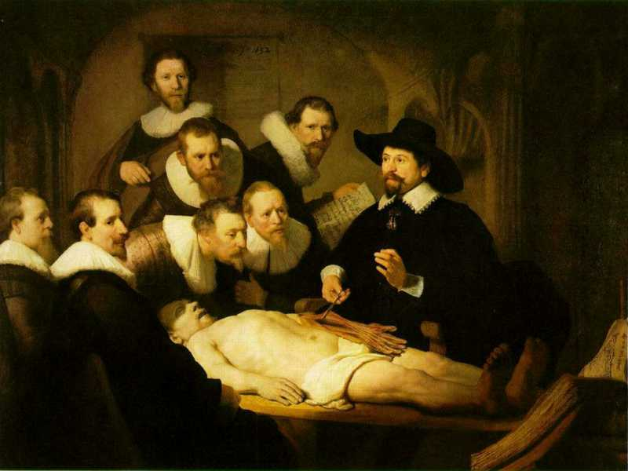

Slide 41
L3
Linguistic representations about (L1⁻), (L2) or (L3)
L2
Beliefs about (1)
Representations
First Order Reality
Entities (particular or generic) with objective existence which are not about anything
L1⁻

Slide 42
Scientific Realism
Three dimensions:
Metaphysically:
Semantically:
Epistemologically:
http://plato.stanford.edu/entries/scientific-realism/#WhaSciRea

Slide 43
Relevant disciplines and theories
Ontology
by some philosophers taken to be synonymous with ‘metaphysics’ while others draw distinctions in many distinct ways but almost agreeing on the following classification:
metaphysics
general metaphysics
ontology
special metaphysics
‘epistemology’:
‘terminology’ (as part of ‘semantics’):

Slide 44
Relevant disciplines and theories
Ontology (no plural) is the study of what entities exist and how they relate to each other;
by some philosophers taken to be synonymous with ‘metaphysics’ while others draw distinctions in many distinct ways but almost agreeing on the following classification:
metaphysics → studies ‘how is the world?’
general metaphysics → studies general principles and ‘laws’ about the world
ontology → studies what type of entities exist in the world
special metaphysics → focuses on specific principles and entities
‘epistemology’: the study of how we can come to know about what exists.
‘terminology’ (as part of ‘semantics’): the study of what terms mean and how to name things.

Slide 45
Distinct questions. What type are they of?
Terminological:
what does ‘pain’ mean ?
Metaphysical:
what have all pains in common in virtue of which they are pains?
Ontological:
what type of entity is pain?
Onto-terminological:
what, if anything at all, does ‘pain’ denote?
Epistemological:
how can we find out whether something is pain?

Slide 46
Scientific Realism
Three dimensions:
Metaphysically: commits to the mind-independent existence of the world investigated by the sciences.
Semantically: commits to a literal interpretation of scientific claims about the world. Claims about scientific entities, processes, properties, and relations, whether they be observable or unobservable, should be construed literally as having truth values, whether true or false.
Epistemologically: commits to the idea that theoretical claims (interpreted literally as describing a mind-independent reality) constitute knowledge of the world.
http://plato.stanford.edu/entries/scientific-realism/#WhaSciRea

Slide 47
Scientific Realism
Our best scientific theories give true or approximately true descriptions of observable and unobservable aspects of a mind-independent world.
http://plato.stanford.edu/entries/scientific-realism/#WhaSciRea

Slide 48
‘Research’
What researchers do when realizing their roles as scientists

Slide 49
Definition of ‘research’
careful or diligent search
studious inquiry or examination; especially :
investigation or experimentation
aimed at
- the discovery and interpretation of facts,
- revision of accepted theories or laws in the light of new facts,
- or practical application of such new or revised theories or laws
the collecting of information about a particular subject
http://www.merriam-webster.com/dictionary/research

Slide 50
Definition of ‘research’
Keywords?
careful or diligent search
studious inquiry or examination; especially :
investigation or experimentation
aimed at
- the discovery and interpretation of facts,
- revision of accepted theories or laws in the light of new facts,
- or practical application of such new or revised theories or laws
the collecting of information about a particular subject
http://www.merriam-webster.com/dictionary/research

Slide 51
Definition of ‘research’
keywords
careful or diligent search
studious inquiry or examination; especially :
investigation or experimentation
aimed at
- the discovery and interpretation of facts,
- revision of accepted theories or laws in the light of new facts,
- or practical application of such new or revised theories or laws
the collecting of information about a particular subject
http://www.merriam-webster.com/dictionary/research

Slide 52
Keywords in research
Discovery:
D1: there is something existing which is prior to our knowing about its existence.
D2: There is something we come to know we didn’t know before

Slide 53
Keywords in research
Discovery:
D1: there is something existing which is prior to our knowing about it.
D2: There is something we come to know we didn’t know before
Facts:
F1: I am currently teaching
F2: ‘I am currently teaching’
F3: 2 + 2 = 4

Slide 54
Keywords in research
Discovery:
D1: there is something existing which is prior to our knowing about it.
D2: There is something we come to know we didn’t know before
Facts:
F1: I am currently teaching
F2: ‘I am currently teaching’
F3: 2 + 2 = 4
How do F1, F2, resp. F3, relate to D1, D2?

Slide 55
Keywords in research
Discovery:
D1: there is something existing which is prior to our knowing about it.
D2: There is something we come to know we didn’t know before
Facts:
F1: I am currently teaching → D1
F2: ‘I am currently teaching’ → D1 & D2
F3: 2 + 2 = 4 → D2

Slide 56
Keywords in research
Discovery:
D1: there is something existing which is prior to our knowing about it.
D2: There is something we come to know we didn’t know before
Facts:
F1: I am currently teaching → D1
F2: ‘I am currently teaching’ → D1 & D2
F3: 2 + 2 = 4 → D2
How do F1, F2, resp. F3, relate to L1-, L2, L3?

Slide 57
Keywords in research
Discovery:
D1: there is something existing which is prior to our knowing about it.
D2: There is something we come to know we didn’t know before
Facts:
F1: I am currently teaching → D1 L1⁻
F2: ‘I am currently teaching’ → D1 & D2 L3 / L1⁻
F3: 2 + 2 = 4 → D2 L3 (/ L1⁻?)

Slide 58
Keywords in research
Discovery:
D1: there is something existing which is prior to our knowing about it.
D2: There is something we come to know we didn’t know before
Facts:
F1: I am currently teaching → D1 L1⁻
F2: ‘I am currently teaching’ → D1 & D2 L3 / L1⁻
F3: 2 + 2 = 4 → D2 L3 (/ L1⁻?)
Interpretation:
F1 is truth-maker for F2 when F2 is uttered when F1 is happening
F1 is truth-maker for ‘I was teaching’ when uttered after F1 ceased to be the case.
What is the truth-maker for F3?

Slide 59
‘Logic’
helps scientists to build arguments for the correctness of their conclusions

Slide 60
Four notions of Logic
(L1) The study of artificial formal languages;
→ e.g. properties of predicate logic studied in model theory.
(L2) The study of formally valid inferences and logical consequence;
→ e.g. IF A then B:
A, therefor: B
not B, therefor: not A
(L3) The study of logical truths;
the most general truths, ones that are contained in any other body of truths that any other science aims to describe.
(L4) The study of the general features, or form, of judgements (Kant).

Slide 61
Deduction and induction (1)
A deductive argument is an argument that is intended by the arguer to be (deductively) valid, that is, to provide a guarantee of the truth of the conclusion provided that the argument's premises (assumptions) are true.
http://www.iep.utm.edu/ded-ind/

Slide 62
Valid and sound (deductive) arguments
A deductive argument is said to be valid if and only if it takes a form that makes it impossible for the premises to be true and the conclusion nevertheless to be false. Otherwise, a deductive argument is said to be invalid.
A deductive argument is sound if and only if it is both valid, and all of its premises are actually true. Otherwise, a deductive argument is unsound.
http://www.iep.utm.edu/val-snd/

Slide 63
Valid argument?
A deductive argument is said to be valid if and only if it takes a form that makes it impossible for the premises to be true and the conclusion nevertheless to be false. Otherwise, a deductive argument is said to be invalid.
Patients always consult a doctor and follow the advice given.
Doctors’ advices are always such that when they are followed, patients get better.
Therefore, patients always get better.
http://www.iep.utm.edu/val-snd/

Slide 64
Sound argument?
A deductive argument is sound if and only if it is both valid, and all of its premises are actually true. Otherwise, a deductive argument is unsound.
If I get stuck in a traffic jam, I come home late.
If I come home late, I eat late.
If I eat late, I eat.
Yesterday, I got stuck in a traffic jam.
Therefore, I ate.
http://www.iep.utm.edu/val-snd/

Slide 65
Deduction and induction (2)
A deductive argument is an argument that is intended by the arguer to be (deductively) valid, that is, to provide a guarantee of the truth of the conclusion provided that the argument's premises (assumptions) are true.
An inductive argument is an argument that is intended by the arguer merely to establish or increase the probability of its conclusion. In an inductive argument, the premises are intended only to be so strong that, if they were true, then it would be unlikely that the conclusion is false.
http://www.iep.utm.edu/ded-ind/

Slide 66
‘The Scientific Method’
A name for a quite generally accepted scientific method

Slide 67
The Scientific Method
Keywords?
principles and procedures for the systematic pursuit of knowledge involving:
the recognition and formulation of a problem,
the collection of data through observation and experiment, and
the formulation and testing of hypotheses.
http://www.merriam-webster.com/dictionary/scientific%20method

Slide 68
The Scientific Method
Keywords?
principles and procedures for the systematic pursuit of knowledge involving:
the recognition and formulation of a problem,
the collection of data through observation and experiment, and
the formulation and testing of hypotheses.
http://www.merriam-webster.com/dictionary/scientific%20method

Slide 69
By ArchonMagnus - Own work, CC BY-SA 4.0, https://commons.wikimedia.org/w/index.php?curid=42164616

Slide 70
Quantitative research
In natural sciences and social sciences, quantitative research is the systematic empirical investigation of observable phenomena via statistical, mathematical or computational techniques.
https://en.wikipedia.org/wiki/Quantitative_research
Qualitative research
Qualitative Research is primarily exploratory research used to gain an understanding of underlying reasons, opinions, and motivations. It provides insights into the problem or helps to develop ideas or hypotheses for potential quantitative research.
http://www.snapsurveys.com/blog/what-is-the-difference-between-qualitative-research-and-quantitative-research/

Slide 71
Qualitative vs. quantitative research
Qualitative research emphasizes the importance of looking at variables in the natural setting in which they are found. Interaction between variables is important.
Detailed data is gathered through open ended questions that provide direct quotations. The interviewer is an integral part of the investigation (Jacob, 1988).
This differs from quantitative research which attempts to gather data by objective methods to provide information about relations, comparisons, and predictions and attempts to remove the investigator from the investigation (Smith, 1983).
http://www.okstate.edu/ag/agedcm4h/academic/aged5980a/5980/newpage21.htm

Slide 72
Characteristics of qualitative research
Purpose | Understanding - Seeks to understand people’s interpretations.
Reality | Dynamic - Reality changes with changes in people’s perceptions.
Viewpoint | Insider - Reality is what people perceive it to be.
Values | Value bound - Values will have an impact and should be understood and taken into account when conducting and reporting research.
Focus | Holistic - A total or complete picture is sought.
Orientation | Discovery - Theories and hypotheses are evolved from data as collected.
Data | Subjective - Data are perceptions of the people in the environment.
Instrumentation | Human - The human person is the primary collection instrument.
Conditions | Naturalistic - Investigations are conducted under natural conditions.
Results | Valid - The focus is on design and procedures to gain "real," "rich," and "deep" data.
http://www.okstate.edu/ag/agedcm4h/academic/aged5980a/5980/newpage21.htm

Slide 73
Scientific Objectivity (1)
Objectivity as Faithfulness to Facts
Objectivity as Absence of Normative Commitments and the Value-Free Ideal
Objectivity as Freedom from Personal Biases
Measurement and Quantification
Inductive and Statistical Inference

Slide 74
Scientific Objectivity (2)
Science is objective in that, or to the extent that:
its products—theories, laws, experimental results and observations—constitute accurate representations of the external world. The products of science are not tainted by human desires, goals, capabilities or experience.
product objectivity
the processes and methods that characterize it neither depend on contingent social and ethical values, nor on the individual bias of a scientist
→ process objectivity.
http://plato.stanford.edu/entries/scientific-objectivity

Slide 75
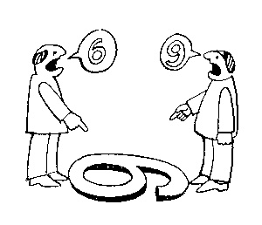
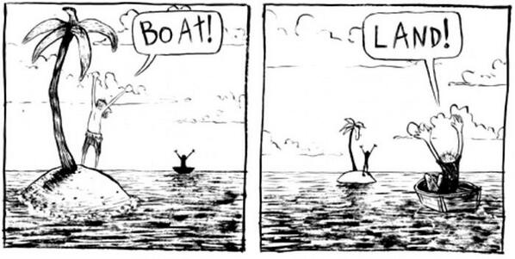
The view from nowhere
There are two kinds of qualities: ones that vary with the perspective one has or takes, and ones that remain constant through changes of perspective. The latter are the objective properties.
http://plato.stanford.edu/entries/scientific-objectivity

Slide 76
The view from nowhere
Nagel’s 3-step conception:
realize (or postulate) that our perceptions are caused by the actions of things on us, through their effects on our bodies.
realize (or postulate) that since the same properties that cause perceptions in us also have effects on other things and can exist without causing any perceptions at all, their true nature must be detachable from their perspectival appearance and need not resemble it.
form a conception of that “true nature” independently of any perspective.
http://plato.stanford.edu/entries/scientific-objectivity
Nagel, T., 1986, The View From Nowhere, New York, NY: Oxford University Press.

Slide 77
Impact of value(s) on science
the choice of a scientific research problem;
the gathering of evidence in relation to the problem;
the acceptance of a scientific hypothesis or theory as an adequate answer to the problem on the basis of the evidence;
the proliferation and application of scientific research results.
(Weber 1917 [1988]).
http://plato.stanford.edu/entries/scientific-objectivity

Slide 78
Value types
Scientific values:
Accuracy, simplicity, …
Epistemic (or cognitive) values:
predictive accuracy, scope, unification, explanatory power, coherence with other accepted theories, …
Contextual (non-cognitive) values:
moral, personal, social, political and cultural values such as pleasure, justice and equality, conservation of the natural environment, diversity, …
http://plato.stanford.edu/entries/scientific-objectivity

Slide 79
Three theses
Value-Free Ideal (VFI):
Scientists should strive to minimize the influence of contextual values on scientific reasoning, e.g., in gathering evidence and assessing/accepting scientific theories.
scientific objectivity is characterized by absence of contextual values and by exclusive commitment to epistemic values in scientific reasoning.
Value-Neutrality Thesis (VNT):
Scientists can—at least in principle—gather evidence and assess/accept theories without making contextual value judgments.
Value-Laden Thesis (VLT):
Scientists cannot gather evidence and assess/accept theories without making contextual value judgments.
http://plato.stanford.edu/entries/scientific-objectivity

Slide 80
Evidence-based medicine
Evidence-based medicine de-emphasizes intuition, unsystematic clinical experience, and pathophysiological rationale as sufficient grounds for clinical decision making and stresses the examination of evidence from clinical research.
‘Evidence’ = analyses of the results of randomized controlled trials (RCTs) which attempt to eliminate selection bias.
Judgment still required to assess the extent to which a patient is similar to the study subjects
http://plato.stanford.edu/entries/scientific-objectivity

Slide 81
Part 2. Application
‘Mental disease’

Slide 82
Does mental illness exist?
Their answer:
‘there are no biological abnormalities responsible for so-called mental illness, mental disease, or mental disorder, therefore mental illness has no biological existence.
Perhaps more importantly, however, mental illness also has no non-biological existence,
except in the sense that the term is used to indicate disapproval of some aspect of a person's mentality.’
Lawrence Stevens, J.D, 1999
The Antipsychiatry Coalition

Slide 83
Their argument is based on the (narrow ?) definitions for disease.
Most attempts refer to bodily issues:
STEDMAN (27th edition):
An interruption, cessation, or disorder of body function, system, or organ. Syn: illness, morbus, sickness
A morbid entity characterized usually by at least two of these criteria: recognized etiologic agent(s), identifiable group of signs and symptoms, or consistent anatomic alterations.
DORLAND
any deviation from or interruption of the normal structure or function of a part, organ, or system of the body as manifested by characteristic symptoms and signs; the etiology, pathology, and prognosis may be known or unknown.

Slide 84
Latest WHO definition
A disease is:
an interconnected set of one or more dysfunctions in one or more body systems including:
a pattern of signs, symptoms and findings (symptomatology - manifestations),
a pattern or patterns of development over time (course and outcome),
a common underlying causal mechanism (etiology).
linking to underling genetic factors (genotypes, phenotypes and endophenotypes) and to interacting environmental factors,
and possibly: to a pattern or patterns of response to interventions (treatment response).

Slide 85
WHO constitution
The State Parties to this Constitution declare, in conformity with the Charter of the United Nations, that the following principles are basic to the happiness, harmonious relations and security of all peoples:
Health is a state of complete physical, mental and social well-being and not merely the absence of disease or infirmity.
…

Slide 86
What is a mental disorder ?
The social-constructivist position:
mental disorder is a value-laden social construct with no counterpart in biomedical reality.
The objectivist position:
mental disorders are natural entities that could be understood in biological terms.
The hybrid position:
Mental disorder is harmful dysfunction.
the social definition of "harm" is counterbalanced by a factual component of a malfunctioning internal mechanism causing objective dysfunction.
Jablensky A: Does psychiatry need an overarching concept of "mental disorder"? World Psychiatry 2007, 6:157-158.

Slide 87
A terminological and ontological problem (1)
WHO: Lexicon of psychiatric and mental health terms. Second edn. Geneva: WHO; 1994.
‘mental disorder’: an imprecise term designating any disorder of the mind, acquired or congenital
organic mental disorder: a range of mental disorders grouped together on the basis of their having in common a demonstrable etiology in cerebral disease, brain injury, or other insult, leading to cerebral dysfunction.
Does WHO rule out the existence of mental disorders which are not due to brain disorder?

Slide 88
The old debate on the “body-mind problem”…
Dualistic views in Philosophy of Mind:
asserts the separate existence of mind and body
comes in various flavours:
Ontological dualism
Substance dualism
Property dualism
Predicate dualism
Interaction dualism
Monistic views in Philosophy of Mind:
Behaviourism
Identity theory
Functionalism
Non-reductive physicalism
…

Slide 89
… and its impact on Psychiatry
Mental health professionals continue to employ a mind-brain dichotomy when reasoning about clinical cases.
The more a behavioral problem is seen as originating in “psychological” processes, the more a patient tends to be viewed as responsible and blameworthy for his or her symptoms;
conversely, the more behaviors are attributed to neurobiological causes, the less likely patients are to be viewed as responsible and blameworthy.
Miresco MJ, Kirmayer LJ.
The Persistence of Mind-Brain Dualism in Psychiatric Reasoning About Clinical Scenarios.
Am J Psychiatry 2006; 163:913–918
But:
Conducted in one institution
Based on a questionnaire with voluntary submission
Thus risk for major bias

Slide 90
A terminological and ontological problem (2)
Szasz: ‘mental illness is a myth whose function it is to disguise and thus render more palatable the bitter pill of moral conflicts in human relations’
Szasz TS: The Myth of Mental Illness. American Psychologist 1960, 15:113-118.

Slide 91
The “Myth of Mental Illness”
“I maintain
that the mind is not the brain,
that mental functions are not reducible to brain functions, and
that mental diseases are not brain diseases,
indeed, that mental diseases are not diseases at all.
When I assert the latter, I do not imply that distressing personal experiences and deviant behaviors do not exist. Anxiety, depression, and conflict do exist--in fact, are intrinsic to the human condition--but they are not diseases in the pathological sense.”
Thomas S. Szasz (MD), Mental Disorders Are Not Diseases.
USA Today (Magazine) January 2000

Slide 92
Our interpretation of Szasz (1)
the group of persons ‘known to manifest various peculiarities or disorders of thinking and behavior’ and about which it is therefore said that they have a mental illness, consists of two subgroups:
(1) those for which there is an underlying brain disorder perhaps not yet discoverable by what the state of the art is able to offer; and
(2) those who exhibit in their behavior a ‘deviance … from certain psychosocial, ethical, or legal norms’ as judged by themselves, by clinicians, or by others.

Slide 93
Our interpretation of Szasz (2)
those for which there is an underlying brain disorder perhaps not yet discoverable by what the state of the art is able to offer
would be better described as having a brain disorder,
those who exhibit in their behavior a ‘deviance … from certain psychosocial, ethical, or legal norms’ as judged by themselves, by clinicians, or by others
while they might indeed have ‘problems of living’, and thus be suffering, are not suffering because of some disorder of a special, mental kind.

Slide 94
Our interpretation of Szasz (3)
Szasz hereby rejects as fallacious the view which regards social intercourse ‘as something inherently harmonious, its disturbance being due solely to the presence of “mental illness” in many people’.

Slide 95
A terminological and ontological problem (3)
Adoption of a generic, presumably universal, definition of "mental disorder" would be premature. It may cause more harm than good to psychiatry.
Jablensky A: Does psychiatry need an overarching concept of "mental disorder"? World Psychiatry 2007, 6:157-158.

Slide 96
Jablensky’s arguments (1)
A terminological argument
Neither disease nor health has ever been strictly and unambiguously defined in terms of finite sets of observable referential phenomena.
Arguments of utility:
the medical person is least concerned with what healthy and sick mean in general ... we do not need the concept of ‘illness in general’ at all
Jaspers K. General psychopathology. Birmingham: Birmingham University Press; 1963.
doctors do not concern themselves with maximizing the evolutionary advantages of the human race as a whole, but with aiding individuals
Toon PD. Defining "disease" - classification must be distinguished from evaluation. J Med Ethics. 1981;7:197–201.

Slide 97
Jablensky’s arguments (2)
Ontological argument:
we now know that no such general and uniform concept exists.
Jaspers K. General psychopathology ,Birmingham: Birmingham University Press; 1963..
Epistemological argument:
the emergence of molecular genetic classifications of large groups of diseases, and the concomitant availability of genetic diagnostic tests, raise the possibility that the entire taxonomy of human disease may eventually be revised.

Slide 98
Missing the nail
A definition of ‘mental disorder’ should be such
(a) that it ‘can be used as a criterion for assessing potential candidates for inclusion in the classification, and deletions from it’ and
(b) that there should be ‘at least no ambiguity about the reason that individual candidate diagnoses are included or excluded’.
Kupfer D, First M, Regier D (Eds.): A Research Agenda for DSM-V, American Psychiatric Association; 2002.
This doesn’t address at all what candidate mental disorders have in common, i.e. what differentiates them from other, non-mental disorders.

Slide 99
ICD-10 Mental disease guidelines
Two distinct ones:
The ICD-10 Classification of Mental and Behavioural Disorders: Clinical descriptions and diagnostic guidelines. Geneva: World Health Organization; 1992.
The ICD-10 Classification of Mental and Behavioural Disorders: Diagnostic criteria for research. Geneva: World Health Organization; 1993.
Yet, an individual entity, such as a mental disorder in a specific patient, does not change when looked at from distinct perspectives.

Slide 100
The ‘categorical – dimensional’ debate on the classification of mental disorders
Rough distinction:
“Categorical”: ‘mental disorders’ can be classified as single, discrete and mutually exclusive types, of which a particular patient does or does not exhibit an instance.
“Dimensional”: any particular ‘mental disorder’ in a patient is an instance of just one single type and differences between cases are a matter of ‘scale’.
‘Rough’, because
the literature is huge and vague
descriptions are (philosophically) very incoherent

Slide 101
The categorical view
Recognizes various mental disorder types
Accepts that disorders are manifested through signs and symptoms, either ‘marker’ or ‘constitutional’
Provides diagnostic criteria to guide the clinician in making a diagnosis.

Slide 102
Evolution of the DSM (1)
Psychodynamic period: I and II, 1952-1980
no sharp distinction between normal and abnormal.
psychosis / neurosis scale
all disorders viewed as reactions (leading to behavior) to environmental events,
everyone is more or less abnormal,
inclusion in the manual presumes abnormality.
DSM-II contained “homosexuality” as mental disorder which was removed in 1973 by vote.

Slide 103
Evolution of the DSM (2)
Adoption of biomedical model: III, IV 1980 -
Clear distinction between normal/abnormal
Introduction of diagnostic criteria
Latest version is from 2000
DSM-V: foreseen for 2011

Slide 104
DSM under fire (1)
severely ill inpatients often meet criteria for more than one DSM-IV personality disorder
→ suggests a high rate of co-morbidity, however in absence of any medical or etiologic reason for such a situation
many outpatients do not meet the criteria for any of the specific categories identified in DSM-IV;
patients with the same categorical diagnosis often vary substantially with respect to which diagnostic criteria were used to make the diagnosis, so that two patients with the same diagnosis can manifest very different signs and symptoms;

Slide 105
DSM under fire (2)
frequent revision of the diagnostic thresholds separating what is normal from what is disordered
→ it is as if given disorders would appear and disappear in course of time;
a number of the diagnostic categories mentioned in DSM-IV lack any developing scientific base for an understanding of the corresponding disorder types

Slide 106
The Dimensional Approach (1)
Mental processes and behavior follow traits/phenomena which are to be seen as continuous variables along continua on which all members of the population can be located. These continua extend to both normal and pathological phenotypes.
These traits are on a par with properties such as temperature, weight, …
→ Homo sapiens is not further subdivided in subspecies according to weight, temperature, …

Slide 107
The Dimensional Approach (2)
“Diagnostic categories defined by their syndromes should be regarded as valid only if they have been shown to be discrete entities with natural boundaries that separate them from other disorders.”
“there is no empirical evidence for natural boundaries between major syndromes” … “the categorical approach is fundamentally flawed”
Kendell R, Jablensky A. Distinguishing between the validity and utility of psychiatric diagnoses. Am J Psychiatry 2003; 160:4–12.
Cloninger CR: A new conceptual paradigm from genetics and psychobiology for the science of mental health. Aust N Z J Psychiatry 33:174–186, 1999.

Slide 108
Is there empirical evidence for this boundary ?
And if not, do these mountains exist ?

Slide 109
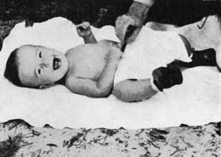
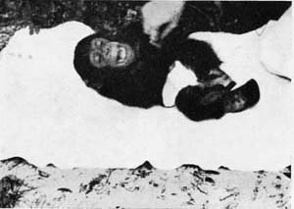
Then also these guys would be from the same species
W.N. Kellogg, L.A. Kellogg. The Ape and The Child; A Comparative Study of the Environmental Influence Upon Early Behavior. Hafner Publishing Company, New York and London, 1967.

Slide 110
Attempts to resolve the problem (1)
Mental disorders as ‘practical kinds’
‘stable patterns that can be identified with varying levels of reliability and validity’ and which are justified by their usefulness for specific purposes – such as giving an appropriate treatment
Zachar, P. 2000b. Psychiatric disorders are not natural kinds. Philosophy, Psychiatry and Psychology 7:167–94.

Slide 111
Basis: ‘epistemic value commitments’
‘values involved in making and advancing epistemologically-relevant claims, such as scientific ones’:
Coherence
Consistency
Comprehensiveness
Fecundity
Simplicity
Instrumental efficacy
Originality
Relevance
Precision
JZ. Sadler. Epistemic Value Commitments in the Debate over Categorical vs. Dimensional Personality Diagnosis. Philosophy, Psychiatry, & Psychology 3.3 (1996) 203-222

Slide 112
Most recent evolution

Slide 113
RDoC Matrix for the Cognitive domain

Slide 114
Cognitive Systems > Auditory Perception
Genes: BDNF
Molecules: Acetylcholine, GABA, Glutamate, NMDA, Serotonin
Cells: Cochlear hair cells, Cortical and limbic inhibitory interneurons, Ribbon synapses
Circuits:
Nodes in Circuits: A1, Anterior insula, Brainstem, Cochlea, Inferior colliculus, MGN, STG
Circuits: Corticofugal Dorsal/ventral streams
Physiology: Adaptation/ habituation, Auditory steady-state response (ASSR), fMRI, Intracortical EEG, Metabolic changes, Mismatch negativity (MMN), N1, Neural oscillations, P3a, P50, startle and PPI
Behavior: Perceptual identification, Perceptual learning, Perceptual priming, Spatial localization, Stimulus detection
Self-Report: Auditory hallucinations, Hyperacusis
Paradigms: Action-Perception loops, Auditory masking, auditory scene perception (e.g., streaming), Categorization, Cross-modal interactions, …

Slide 115
Cognitive Systems > Auditory Perception
Genes: BDNF
Molecules: Acetylcholine, GABA, Glutamate, NMDA, Serotonin
Cells: Cochlear hair cells, Cortical and limbic inhibitory interneurons, Ribbon synapses
Circuits:
Nodes in Circuits: A1, Anterior insula, Brainstem, Cochlea, Inferior colliculus, MGN, STG
Circuits: Corticofugal Dorsal/ventral streams
Physiology: Adaptation/ habituation, Auditory steady-state response (ASSR), fMRI, Intracortical EEG, Metabolic changes, Mismatch negativity (MMN), N1, Neural oscillations, P3a, P50, startle and PPI
Behavior: Perceptual identification, Perceptual learning, Perceptual priming, Spatial localization, Stimulus detection
Self-Report: Auditory hallucinations, Hyperacusis
Paradigms: Action-Perception loops, Auditory masking, auditory scene perception (e.g., streaming), Categorization, Cross-modal interactions, …

Slide 116
Brain Derived Neurotrophic Factor (BDNF)

Slide 117
Acetylcholine

Slide 118
Cross-modal interactions

Slide 119
Next week

Slide 120
C3. Qualitative research methods: theory and data collection methods
Pre-class reading:
Kirsti Malterud. Theory and interpretation in qualitative studies from general practice: Why and how?
Scandinavian Journal of Public Health, 2016; 44: 120–129
http://journals.sagepub.com/doi/pdf/10.1177/1403494815621181
Class structure:
lecture on common qualitative data collection methods (Document Review, Observation, Interview (face-to-face), Focus Group Discussion, Ethnography,…),
discussion of the C2-application test in light of a)
discussion of the pre-reading paper on the basis of what was taught in the lecture.
Post-class assignment: open book test with multiple choice questions and open-ended motivation based on literature. Deadline: Feb 22, noon.

Slide 121
Part 3. Application test
Extraterrestrial research

Slide 122
In-class application test
Students will be presented with three evolving scenarios about behaviors in some populations. Each scenario will add some more observations about the populations.
Students will be asked to suggest for each scenario hypotheses about the observed behaviors and specify a research method and analysis procedure for each hypothesis.
For the 2nd and 3rd scenario, they will also need to indicate which hypotheses from the previous scenario(s), if any at all, can be ruled out on the basis of the new observations.

Slide 123
Scoring
10%: Contribution of - and balance between - imagination and personal human zoo experiences in raising sufficiently distinct questions, hypotheses, proposed observables and testable predictions;
10%: The degree to which the predictions that would confirm the hypotheses are documented to be testable;
20%: The quality of the argument(s) used to assert the testability of the predictions;
20%: The extend to which observables proposed for testing predictions are described in terms of objective and interpretative features;
20%: The argumentation used to assess the plausibility of hypotheses forwarded in previous scenarios in light of new observations in later scenarios.
20%: The quality of the conclusion in terms of the most plausible hypothesis for the behavior of humanoids of the two distinct tribes and suggestions for future work.

Slide 124
By ArchonMagnus - Own work, CC BY-SA 4.0, https://commons.wikimedia.org/w/index.php?curid=42164616

Slide 125
A planet with tribal humanoids is discovered
O1: we are told about a tribe T1 on one side of a planet. We are told that when a humanoid of that tribe slaps another one in the face, (1) the other one often slaps back, (2) rarely the 2nd one spits the slapper in the face, and (3) nobody spits first. We want to find out why, jump in our spacecraft and start to observe the tribe. We are able to see all they do outside, but have no means to interact with them.
Interesting questions:
Hypotheses:
Testable predictions:
What data to gather?

Slide 126
By ArchonMagnus - Own work, CC BY-SA 4.0, https://commons.wikimedia.org/w/index.php?curid=42164616

Slide 127
A planet with tribal humanoids is discovered
O2: we observe on the other side of the planet exactly opposite behavior in a different tribe (T2) that never was in contact with T1. We have the same observational means, and still can’t interact.
Interesting questions:
Hypotheses:
Testable predictions:
What data to gather?

Slide 128
By ArchonMagnus - Own work, CC BY-SA 4.0, https://commons.wikimedia.org/w/index.php?curid=42164616

Slide 129
A planet with tribal humanoids is discovered
O3: we observe a large group of members of T1 going on exploration and make contact with members of T2. Initially when a T1 slaps a T2, the T2 slaps back and when a T2 spits a T1, the T1 spits back. After a while, we observe that most of the time when T1-T2 interactions happen, spitting is followed by slapping from the other party and the other way round. In such T1-T2 interactions, when it starts with spitting, it is most often, but not always, initiated by a T1, and with slapping a T2. T1-T1 and T2-T2 interactions stay as in O1 and O2.
Interesting questions:
Hypotheses:
Testable predictions:
What data to gather?

