Slide 1
Biomedical Ontology for Biomedical Informaticists.
Lecture in BMI501: Survey of Biomedical Informatics – Oct 12, 2023
Department of Biomedical Informatics, University at Buffalo
Werner CEUSTERS, MD
^{wceusters@gmail.com}
Ontology Research Group, Center of Excellence in Bioinformatics and Life Sciences,
Departments of Biomedical Informatics and Psychiatry,
University at Buffalo, NY, USA

Slide 2
Biomedical Ontology for Biomedical Informaticists.
Lecture in BMI501: Survey of Biomedical Informatics – Oct 12, 2023
Department of Biomedical Informatics, University at Buffalo
?
Werner CEUSTERS, MD
^{wceusters@gmail.com}
Ontology Research Group, Center of Excellence in Bioinformatics and Life Sciences,
Departments of Biomedical Informatics and Psychiatry,
University at Buffalo, NY, USA

Slide 3
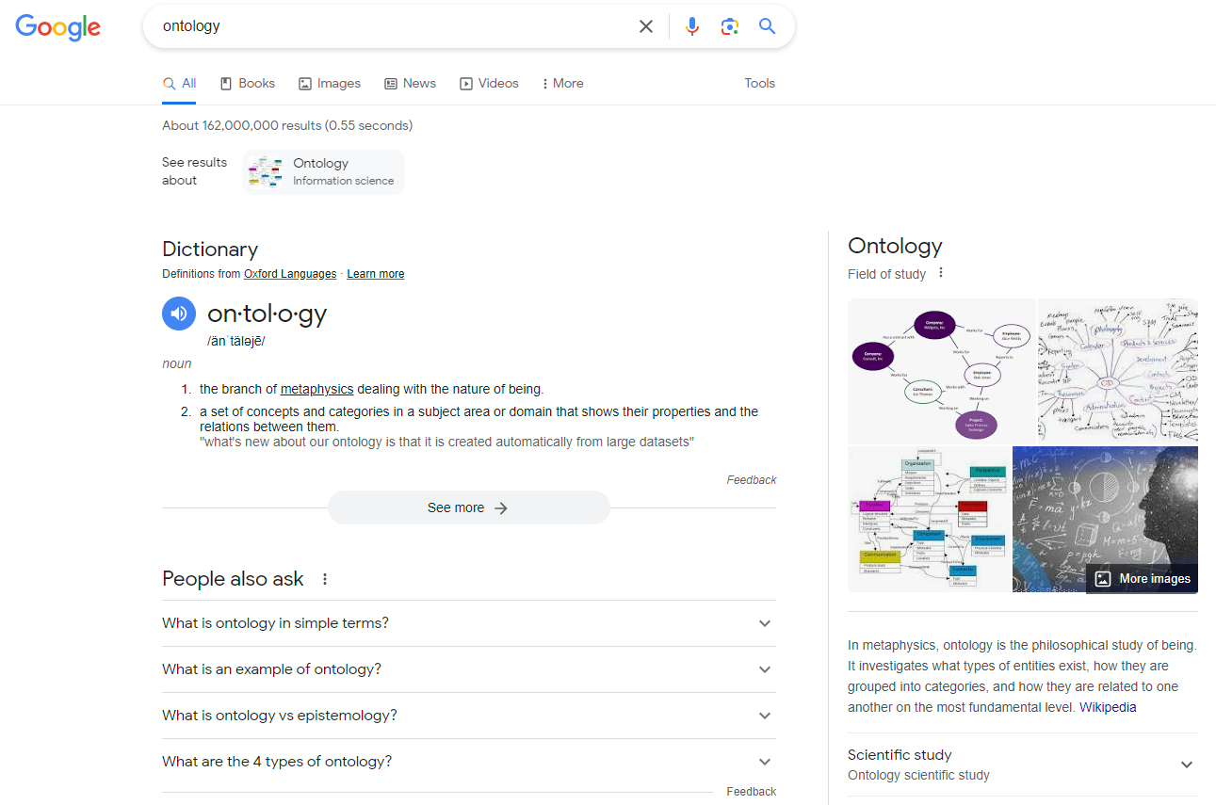
‘Ontology’? – Ask Google

Slide 4
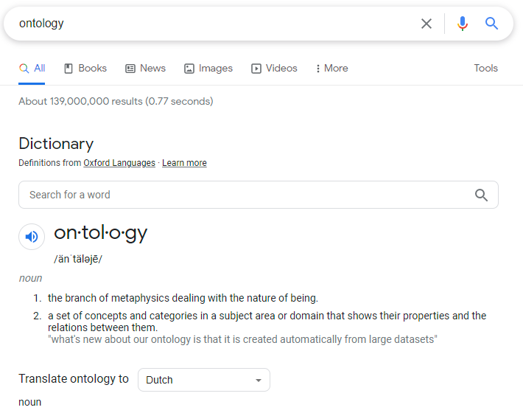
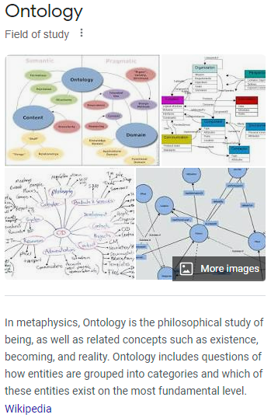

‘Ontology’? – Ask Google
All essential elements for correct understanding and use are here!

Slide 5
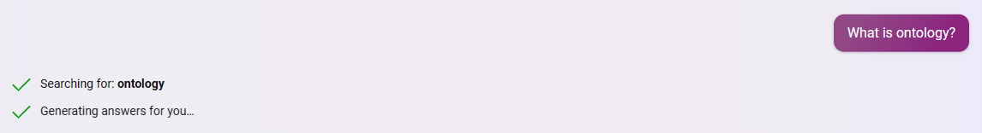

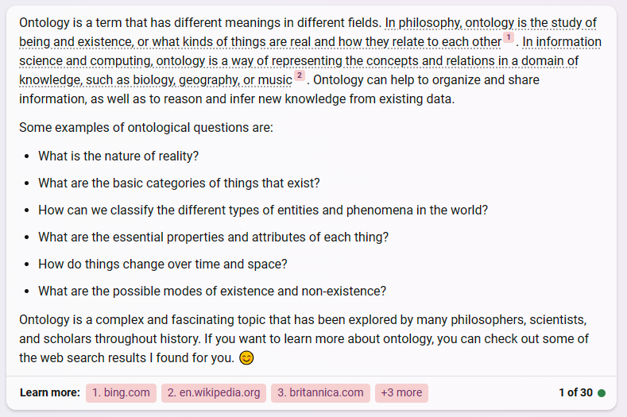

Slide 6
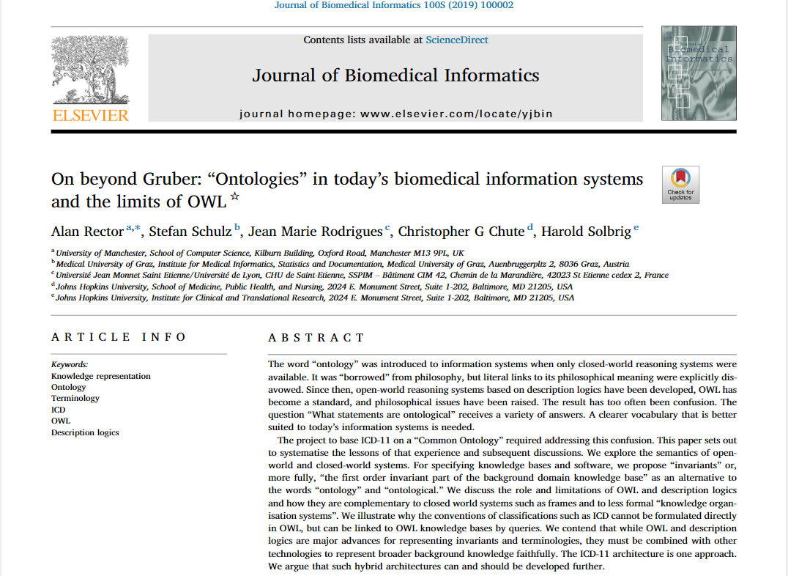
Most caveats are discussed here!
https://www.sciencedirect.com/science/article/pii/S2590177X19300010?via%3Dihub

Slide 7
Confusions and misunderstandings about and/or because of …
Ambiguous language;

Slide 8
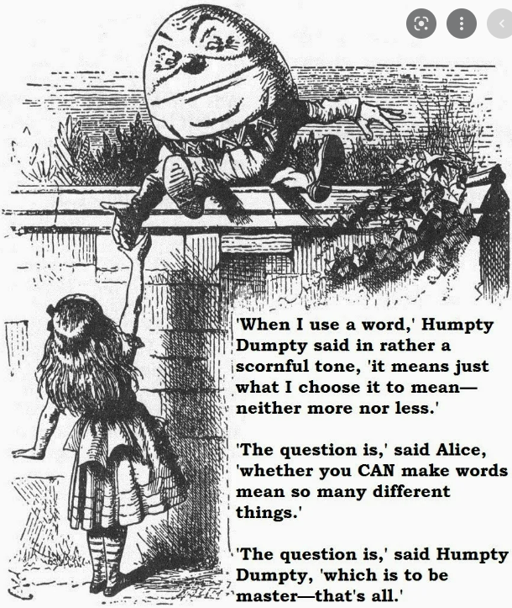
From Through the Looking Glass
by Lewis Carroll

Slide 9
Confusions and misunderstandings about and/or because of …
Ambiguous language;
Roles, required competencies, and abilities of humans and machines in their development, management and use;
Human variability in world-views, what constitutes reality, what counts as science, what is allowed to be represented and how matters should be represented;
Limitations of software and representation languages and the extent to which they are based on logic versus statistics;
Hypes, dogmas, peer-pressure, …

Slide 10
What have all ‘ontologies’ in common?
They are all
representations

Slide 11


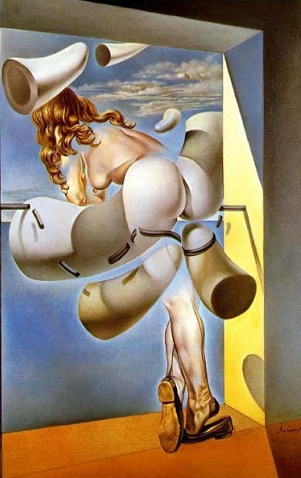
But …
‘woman in window’
‘woman in window’
‘woman in window’
Scientific Realism Empiricism Postmodernism
Image by tirachardz on Freepik
https://artanddesigninspiration.com/classic-salvador-dali-figure-at-the-window/

Slide 12
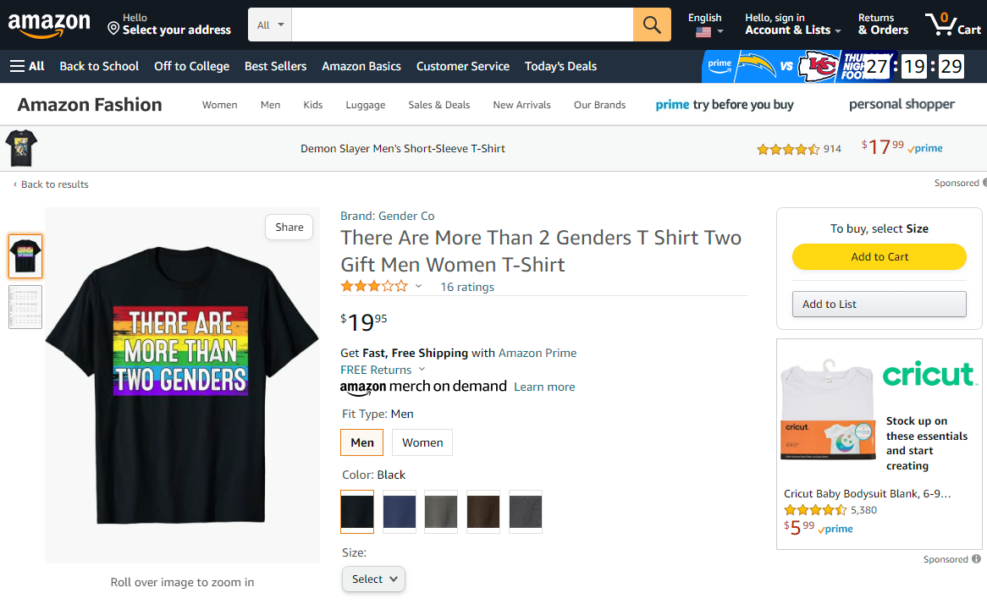

Slide 13
What have all ‘ontologies’ in common?
They all exhibit
one or other sort of networked structure

Slide 14
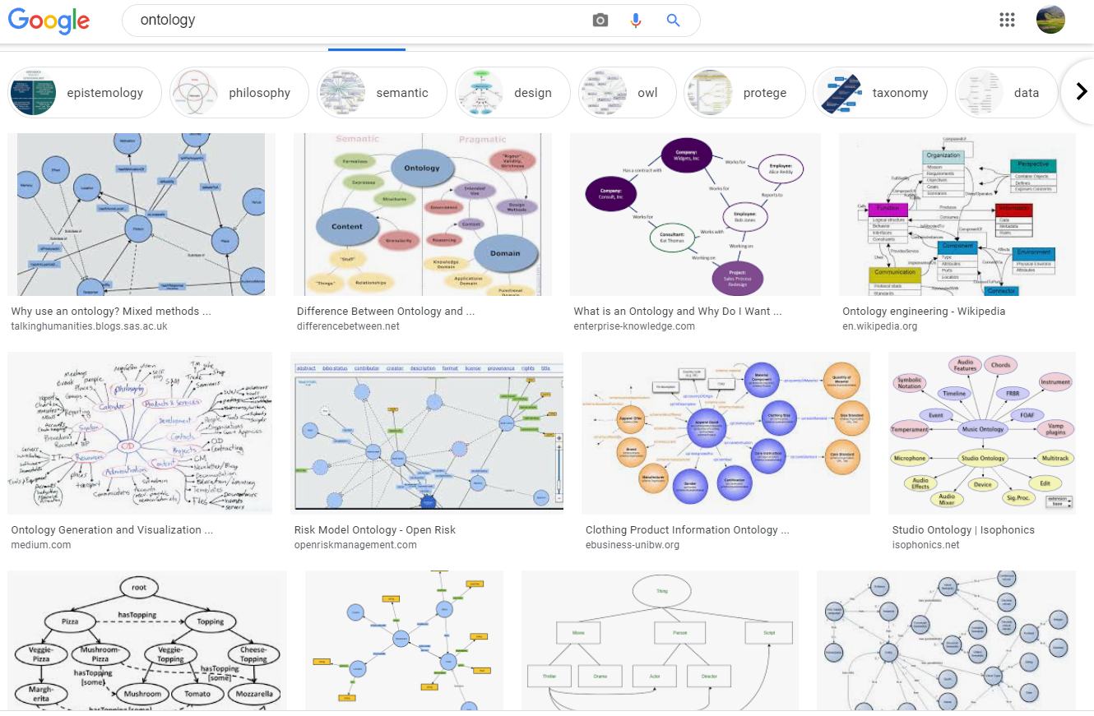
Google’s ‘image’ view on ‘ontology’

Slide 15

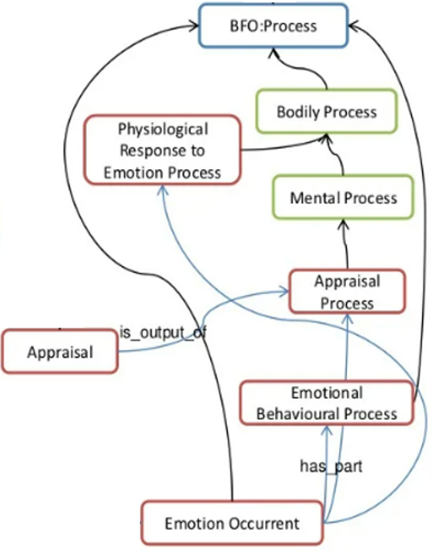
In what ‘ontologies’ tend to differ
What it is in reality that exists;
What it is that is/should be represented;
The degree to which the representation is faithful to reality according to the chosen worldview;

Slide 16
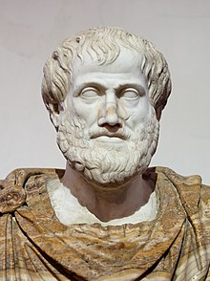
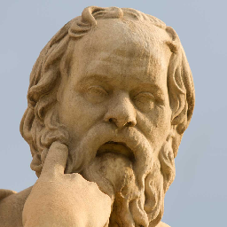
Aristoteles
Mediocrates
“To say of what is that it is, or of what is not that it is not, is true.”
“Meh, good enough”

Slide 17
In what tend ‘ontologies’ to differ
What it is in reality that exists;
What it is that is/should be represented;
The degree to which the representation is faithful to reality according to the chosen worldview;
Choice of representation language;
Extent to which they are developed using an environment that checks for consistency;
Whether all allowed (consistent) models are indeed desired models;
What the purpose/functionality is;

Slide 18
Stated goals and purposes of ontologies
Investigating a domain,
Representing a domain,
Enhancing collaboration,
Supporting data-related processing
  annotating, searching, indexing, merging, comparing, …,
Supporting ontology-related process
  comparing, merging, (re-)using, aligning, emulating, …,
Providing reasoning facilities for specific applications.
Towards modelling the intended purpose of ontologies: A case study in geography.
R Denaux, AG Cohn, V Dimitrova, G Hart
Proceedings of the Terra Cognita Workshop in conjunction with the 8th International Semantic Web Conference, CEUR-WS. Org. 2009. http://ceur-ws.org/Vol-518/terra09_submission_9.pdf

Slide 19
Most common: annotating biomedical data repositories
A huge matrix with data representing patient cases in one dimension and patient characteristics in the other dimension
genotypic
phenotypic

Slide 20
Goal of research data: analysis
Standard approach: use statistical correlation techniques to find associations between characteristics and (dis)similarities between cases
genotypic
phenotypic

Slide 21
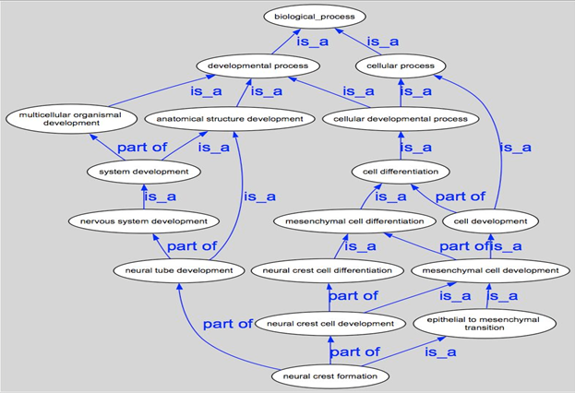
Using ontologies to cross-map distinct data repositories

Slide 22
The positive effects of appropriate mappings
more precise and comparable semantics of what data items in distinct data collections denote;
identification of ontological relations prior to statistical correlation:
  ch1 and ch4
  ch1 and ch5
  ch1 and ch2
  …

Slide 23
However …
Mainstream ontology design approaches fail in achieving their objectives:
  various sorts of mistakes in ontologies,
  inability to use ontologies adequately in information systems,
  failure to integrate data repositories even if these ontologies are appropriately designed.
Root causes:
  inadequacy of their conceptual semantic foundations,
  lack of knowledge about ontology as a philosophical discipline.
Proposed solution:
  Better education in and use of ontology (the philosophical discipline) to design ontologies (specific sorts of representational artifacts) and integrate them in information systems.

Slide 24
Related BMI courses
BMI 508: introduction to biomedical ontology
BMI 708: advanced topics in biomedical ontology
BMI 714: Referent Tracking
BMI 521: Logical Programming
Special topic labs: BMI 610 / BMI 698 / BMI 699

Slide 25
Major take home message for this class
Crucial distinctions made in Ontological Realism
reality ←→ representation
ontology ←→ ontologies
particulars ←→ types
continuants ←→ occurrents

Slide 26
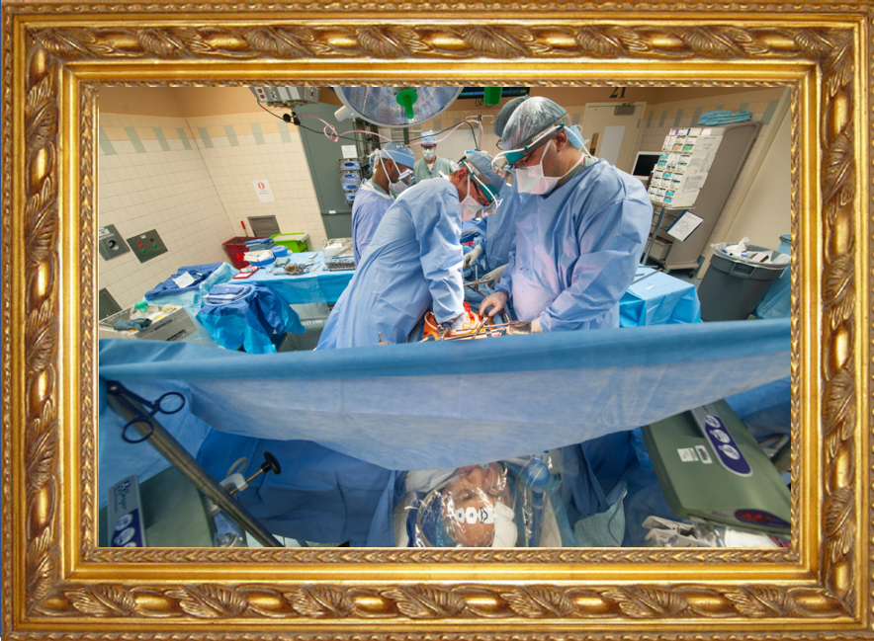
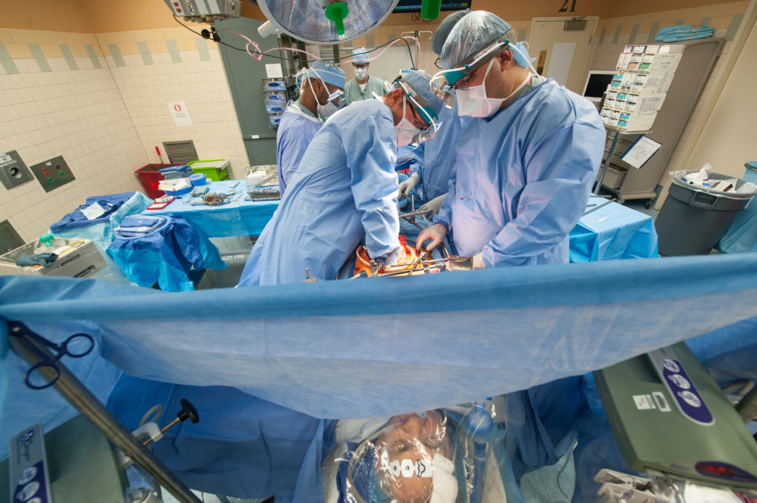
Reality ←→ Representation

Slide 27
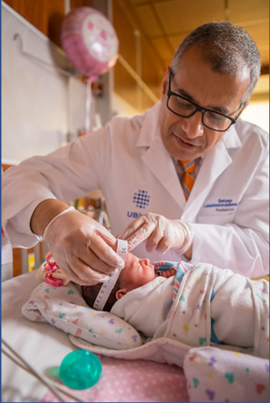
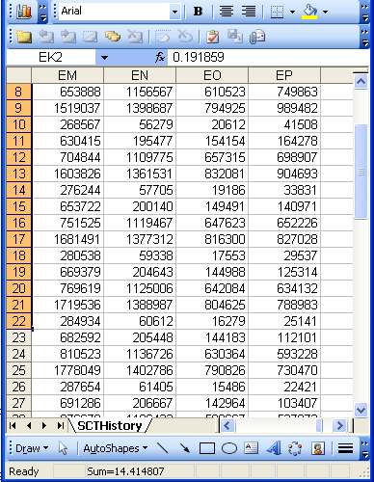
Reality ←→ Representation
(research) domain
(research) data
Beings & happenings
Descriptions

Slide 28
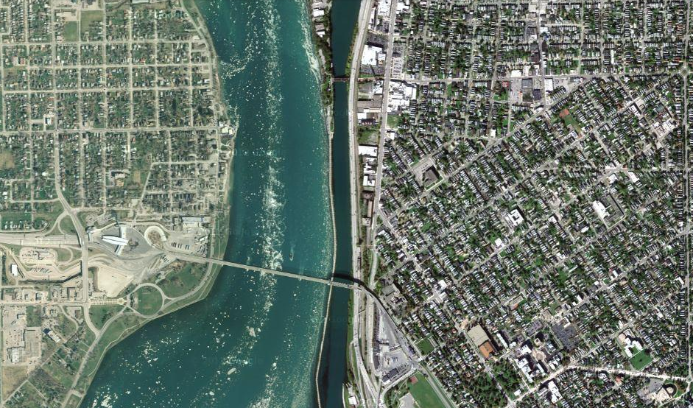
Satellite view

Slide 29
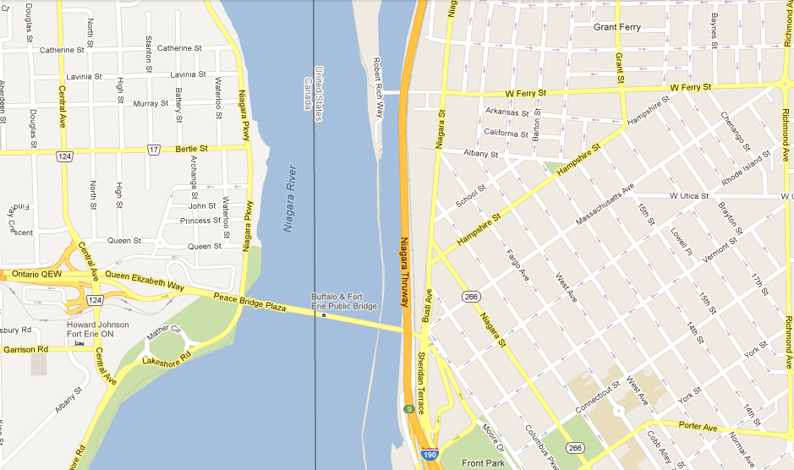
Map

Slide 30
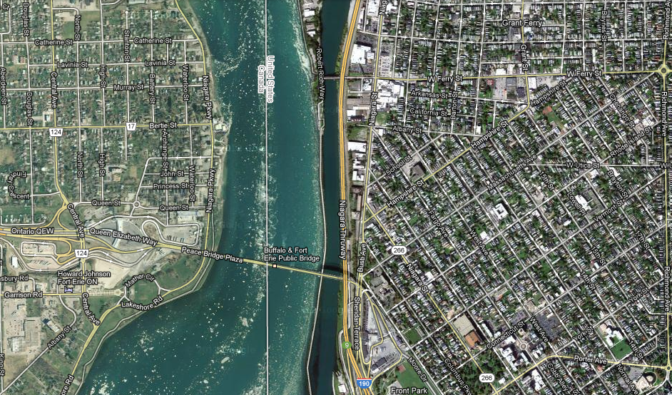
Map overlay

Slide 31
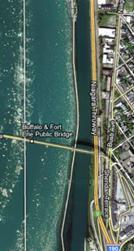
Map ←→ Reality
A message to map makers: “Highways are not painted red, rivers don’t have county lines running down the middle, and you can’t see contour lines on a mountain”
W. Kent. Data and Reality. North-Holland, Amsterdam, the Netherlands, 1978.

Slide 32
Main data ←→ reality views
Nominalism:
  there are no generic entities in reality: there is no personhood, there are only individual persons.
Conceptualism:
  generalizations are in our ‘minds’. Personhood is a concept construed in our ‘mind’ that allows us to reason about persons without any particular person in mind.
Realism:
  generic entities do exist and are called ‘universals’. Each particular person is an instance of the universal we call ‘person’.

Slide 33


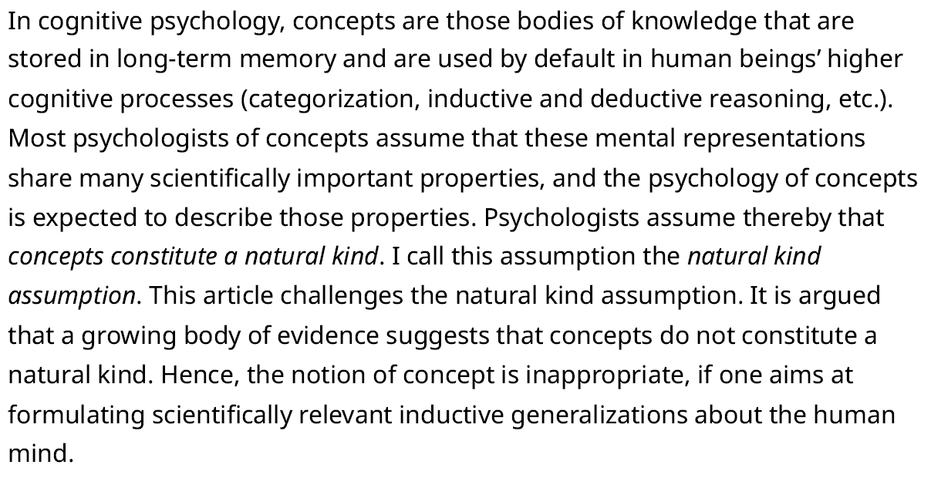

Slide 34
Main data ←→ reality views
Nominalism:
  there are no generic entities in reality: there is no personhood, there are only individual persons.
Conceptualism: ← mainstream approach
  generalizations are in our ‘minds’. Personhood is a concept construed in our ‘mind’ that allows us to reason about persons without any particular person in mind.
Realism: ← our approach
  generic entities do exist and are called ‘universals’. Each particular person is an instance of the universal we call ‘person’.

Slide 35

Canonical case: faithful representation
Reality
Representation
‘Earth’
‘Aarde’
‘La Terre’
…
denotes
means
represents

Slide 36
Delusions, fantasies, imaginations, …
Reality
Representation
‘unicorn’

Slide 37
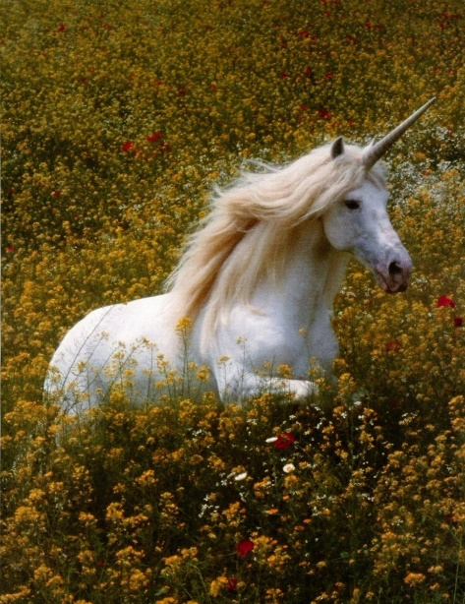
Delusions, fantasies, imaginations, …
Reality
Representation
‘unicorn’

Slide 38

Delusions, fantasies, imaginations, …
Terminology
Reality
Representation
‘unicorn’
Graphics

Slide 39
Delusions, fantasies, imaginations, …
Conceptualism
Terminology
Reality or
Imagination
Representation
‘unicorn’
Graphics
unicorn concept

Slide 40
Delusions, fantasies, imaginations, …
Conceptualism
Terminology
Reality or
Imagination
Representation
‘miasma’
‘something
in the water’
What is real and what is imagined?

Slide 41
‘Unicorns’ in modern medicine: ICD-10-CM
 | Row in version
CID | V2014 | V2017 | V2021
H8141 | Y Y N | Vertigo of central origin, right ear
H8142 | Y Y N | Vertigo of central origin, left ear
H8143 | Y Y N | Vertigo of central origin, bilateral
H8149 | Y Y N | Vertigo of central origin, unspecified ear
S060X7 | Y N N | Concussion with loss of consciousness of any duration with death due to brain injury prior to regaining consciousness
S060X7A | Y N N | Concussion with loss of consciousness of any duration with death due to brain injury prior to regaining consciousness, initial encounter
S060X7D | Y N N | Concussion with loss of consciousness of any duration with death due to brain injury prior to regaining consciousness, subsequent encounter
S060X7S | Y N N | Concussion with loss of consciousness of any duration with death due to brain injury prior to regaining consciousness, sequela
S63136A | Y Y N | Dislocation of proximal interphalangeal joint of unspecified thumb, initial encounter
S63136D | Y Y N | Dislocation of proximal interphalangeal joint of unspecified thumb, subsequent encounter
S63136S | Y Y N | Dislocation of proximal interphalangeal joint of unspecified thumb, sequela
S6314 | Y Y N | Subluxation and dislocation of distal interphalangeal joint of thumb
S63141 | Y Y N | Subluxation of distal interphalangeal joint of right thumb
S63141A | Y Y N | Subluxation of distal interphalangeal joint of right thumb, initial encounter
S63141D | Y Y N | Subluxation of distal interphalangeal joint of right thumb, subsequent encounter

Slide 42
Peter Hendler’s philosophical nonsense
Snomed Ct’s Clinical Engagement Lead for the US 2019-07-15 10:02
‘Past, current, and future medical science can never know "things in the real world". All of the historical "diseases" that no longer exist because of subsequent scientific studies prove that.’
‘A good example today is the "concept" of "Systemic Lupus Erythematosis". This term is quite useful and necessary today. But is is only a concept. It is NOT something in the real world.’
‘We might in the future discover that Sjogrens, and perhaps other diseases should in fact all be given a new concept name and grouped together.’
https://confluence.ihtsdotools.org/mag/discussions/bfo-and-snomed

Slide 43
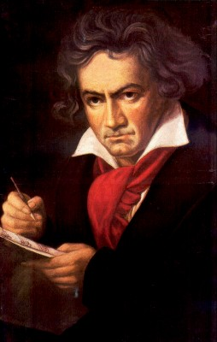
The semantic/semiotic triangle:
(the sandbox of the conceptualist)
Ludwig van Beethoven
that great German composer that became deaf
…
concept
term
referent
‘Beethoven’

Slide 44

The semantic/semiotic triangle:
The dog from the ‘Beethoven’ movie
…
concept
term
referent
‘Beethoven’
https://celebritydogwatcher.com/2019/02/most-famous-movie-dogs/

Slide 45
Sometimes the semantic triangle fails
the symphony Beethoven wrote after the tenth
…
concept
term
referent
‘Beethoven's Symphony No. 11’

Slide 46
Sometimes the semantic triangle fails
the symphony Beethoven wrote after the tenth
…
some hold this term has meaning
concept
term
referent
‘Beethoven's Symphony No. 11’

Slide 47
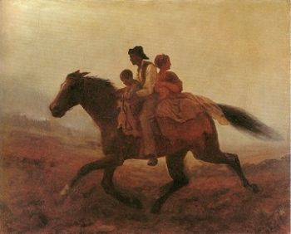
Prehistoric ‘psychiatry’: drapetomania
disease which causes slaves to suffer from an unexplainable propensity to run away
…
concept
term
referent
painting by Eastman Johnson. A Ride for Liberty: The Fugitive Slaves. 1860.
‘drapetomania’

Slide 48
A must read paper:
Cimino, J.J.,
Desiderata for controlled medical vocabularies in the twenty-first century.
Methods Inf Med, 1998. 37(4-5): p. 394-403.
Written in a (futile) attempt to do something about the stupidities in prevailing representations at that time.
(‘futile’ because not much has changed)

Slide 49
Cimino’s desiderata (1)
Content has adequate coverage for intended purposes.
Concept-orientation which guarantees:
  Non-vagueness: one term → at least one meaning
  Non-ambiguity: one term → only one meaning
  Non-redundancy: one meaning → only one term
concept = meaning
term
referent

Slide 50
Cimino’s desiderata (1)
Content has adequate coverage for intended purposes.
Concept-orientation which guarantees:
  Non-vagueness: one term → at least one meaning
  Non-ambiguity: one term → only one meaning
  Non-redundancy: one meaning → only one term
Concept-permanence: meaning should remain constant at all times (through versions),
Non-semantic concept identifier: meanings must be given an ID which by itself does not reflect anything about the meaning.
Taxonomic organization of concepts.

Slide 51
Taxonomic tree
A
…
B
All nodes represent groups (X, Y, …) the members of which have something (S_{x}, S_{y, …}) similar in some way.
All edges represent the same relation r which expresses some classificatory principle which is such that if X r Y holds, then the members of X have similarities S_{x} and S_{y}.
D
E
G
H
I

Slide 52
Taxonomic tree as sets
A
B
D
E
G
H
I

Slide 53
Directed Acyclic Graph (DAG)
A
…
B
All nodes represent groups (X, Y, …) the members of which have something (S_{x}, S_{y, …}) similar in some way.
All edges represent the same relation r which expresses some classificatory principle which is such that if X r Y holds, then the members of X have similarities S_{x} and S_{y}.
D
E
G
H
I

Slide 54
Directed Acyclic Graph (DAG)
A
B
D
E
G
H
I

Slide 55
Taxonomic tree with non-taxonomic relations
A
B
C
D
E
F
G
H
I
J
K
L

Slide 56
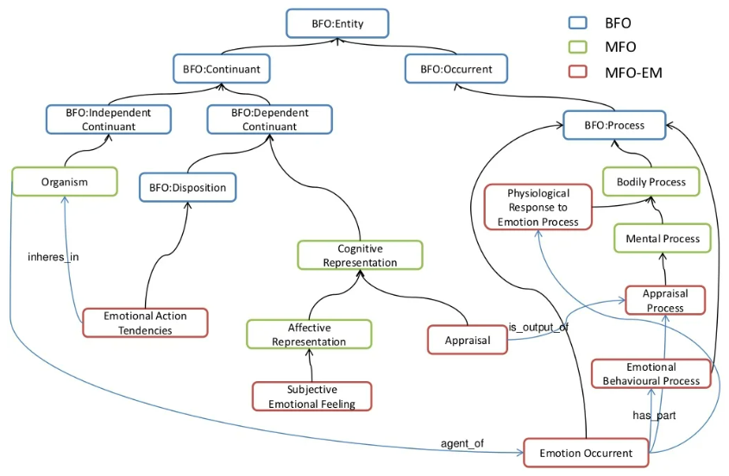
Hastings J, Ceusters W, Smith B, Mulligan K. The Emotion Ontology: enabling interdisciplinary research in the affective sciences. Lecture Notes in Artificial Intelligence 6967;119-123.

Slide 57
Cimino’s desiderata (2)
Meanings should have formal definitions in terms of already defined meaning.
‘Not elsewhere classified’ should not be part of a meaning or definition thereof.
Meanings need to be specified at multiple granularities
    → depending on purpose, taxonomy can be cut or extended at the bottom.
Offer multiple consistent views on the taxonomy.
Evolve gracefully ensuring that new versions don’t violate the posited desiderata.
Offer mechanisms to represent context.
    E.g. ‘covid-19’ versus ‘history of covid-19’ versus ‘covid-19 in household member’.

Slide 58
Still today, many terminological systems do not follow Cimino’s desiderata
Most notoriously: ICD !
An exercise …

Slide 59
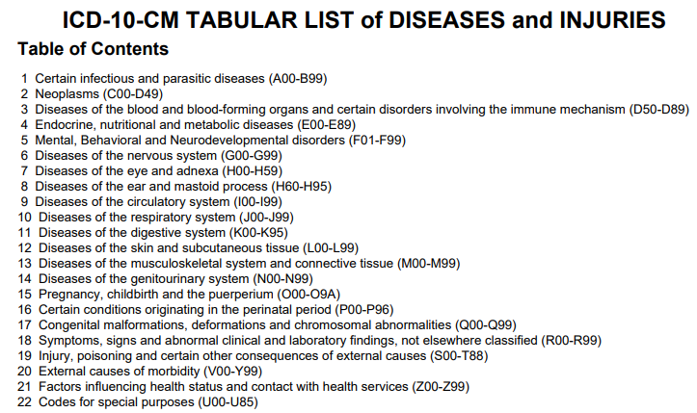
Mistake type 6: use of semantic concept identifiers

Slide 60
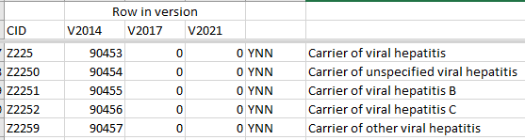
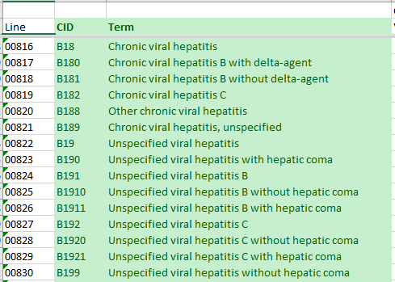
Mistake type 4: redundancy
‘carrier of viral hepatitis’: some have hepatitis.
‘chronic viral hepatitis’: all of them are carriers.

Slide 61
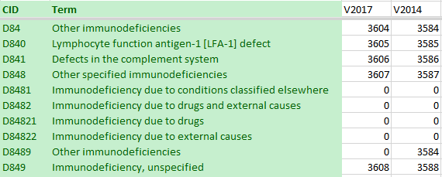
Mistake type 9: meanings not always at sufficient levels of granularity
The addition of subclasses of D848 in V2021 demonstrates that there was not enough granularity in 2014.

Slide 62
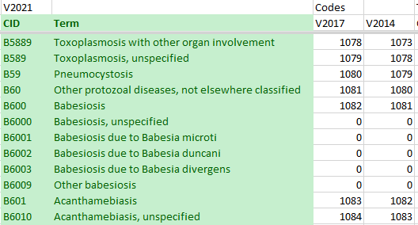
Mistake type 1: inadequate content

Slide 63

Mistake type 8: use of ‘not elsewhere classified’

Slide 64
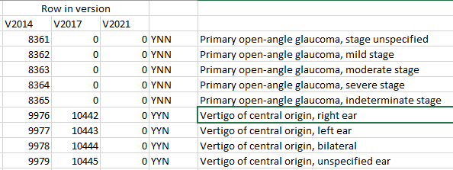
Mistake type 2: vagueness
(there must be at least one meaning)
‘Vertigo of central origin in an ear’ does not exist, thus this concept does not have a meaning in Cimino’s sense!

Slide 65
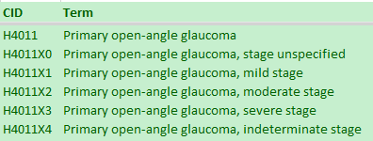
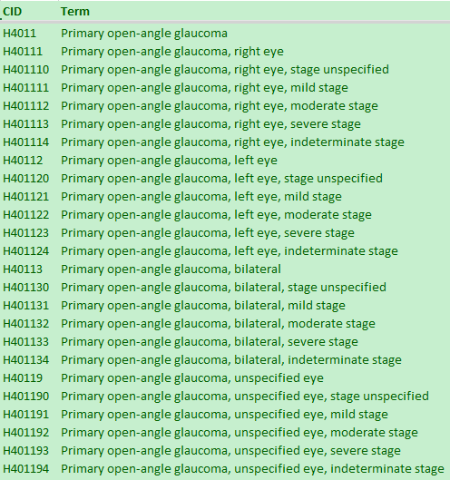
Mistake type 10: no graceful evolution
Same ‘meaning’ received in 2017 a different identifier than in 2014

Slide 66
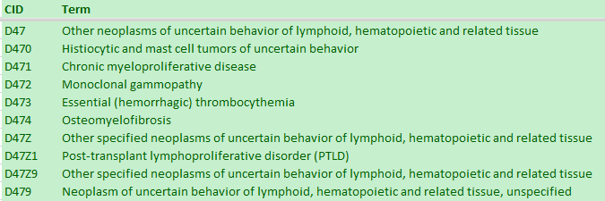
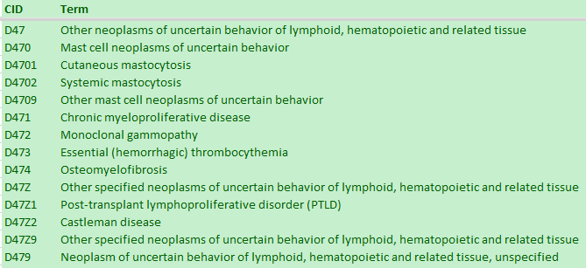
Mistake type 5: non-permanence
Insertion of an extra term in a subhierarchy changes the meaning of the ‘other’ collector concept.

Slide 67
Mistake type 7: no formal definitions
A00 Cholera
 | A00.0 Cholera due to Vibrio cholerae 01, biovar cholerae
 |  | A00.1 Cholera due to Vibrio cholerae 01, biovar eltor
 |  | A00.9 Cholera, unspecified
A01 Typhoid and paratyphoid fevers
 | A01.0 Typhoid fever
 |  | A01.00 Typhoid fever, unspecified
 |  | A01.01 Typhoid meningitis
 |  | A01.02 Typhoid fever with heart involvement
 |  | A01.03 Typhoid pneumonia
 |  | A01.04 Typhoid arthritis
 |  | A01.05 Typhoid osteomyelitis
 |  | A01.09 Typhoid fever with other complications
 | A01.1 Paratyphoid fever A
 | A01.2 Paratyphoid fever B
 | A01.3 Paratyphoid fever C
 | A01.4 Paratyphoid fever, unspecified
A02 Other salmonella infections
Limited inference possible.

Slide 68
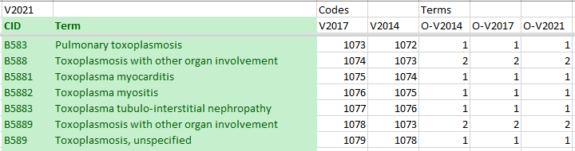
Mistake type 3: ambiguity
‘Toxoplasmosis with other organ involvement’ has two different meanings (there are two distinct CIDs).

Slide 69
Better interpretation of the semantic/semiotic triangle:
What we believe
through evidence about
such entities
cognitive
representation
What terms we (should) use for such entities
entities
term
referent
term
referent
data

Slide 70
Where do data come from?
knowledge
information
data
Representation
What is there on the side of the patient
Reality

Slide 71
Where do data come from?
knowledge
information
data
Questions not often enough asked:
What parts of our data correspond with something out there in reality ?
What parts of reality are not captured by our data, but should because they are relevant ?
Reality
What is there on the side of the patient

Slide 72
Where do data come from?
knowledge
information
data
Questions not often enough asked:
What parts of our data correspond with something out there in reality ?
What parts of reality are not captured by our data, but should because they are relevant ?
Ontology
Reality
What is there on the side of the patient

Slide 73
Where do data come from?
References
knowledge
information
data
Ontology
- representation
Reality
What is there on the side of the patient
Referents

Slide 74
Also representations are real!
References
knowledge
information
data
Ontology
- representation
Reality
What is there on the side of the patient
Referents

Slide 75
Generalization: data generation and use
data
organization
model development
observation &
measurement
further R&D
(instrument and
study optimization)
add
verify
use
Δ = outcome
Generic
beliefs
application

Slide 76
Reality as benchmark for data organization and representation
data
organization
model development
observation &
measurement
further R&D
(instrument and
study optimization)
add
verify
use
Δ = outcome
Generic
beliefs
application

Slide 77
What you should NEVER FORGET !!!
(major take home message)
Crucial distinctions made in Ontological Realism
reality ←→ representation
ontology ←→ ontologies
particulars ←→ types
continuants ←→ occurrents

Slide 78
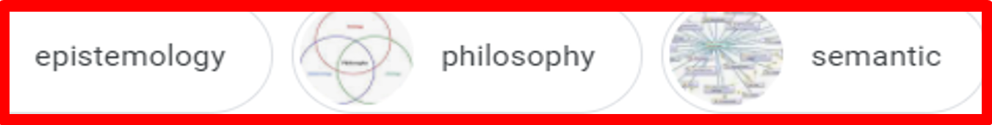
A biased view on ‘ontology’ images

Slide 79
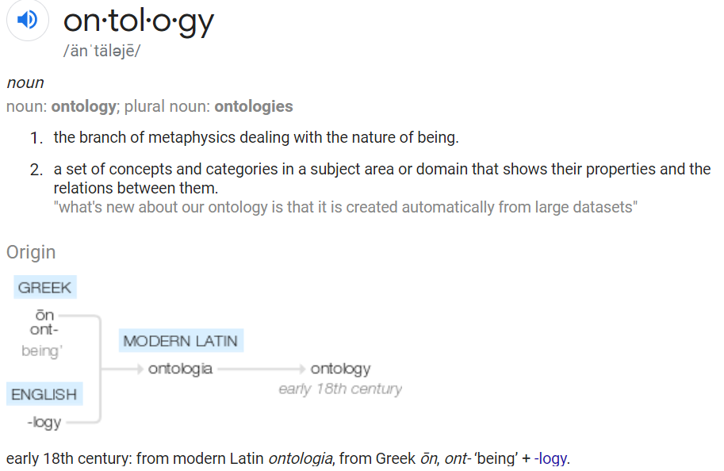
‘Ontology’
https://www.google.com/search?q=ontology
Click for
Word occurrence

Slide 80
‘Ontology’
In philosophy:
  Ontology (no plural) is the study of what entities exist and how they relate to each other;

Slide 81
‘Ontology’
In philosophy:
  Ontology (no plural) is the study of what entities exist and how they relate to each other;
  by some philosophers taken to be synonymous with ‘metaphysics’ while others draw distinctions in many distinct ways (the distinctions being irrelevant for this talk), but almost agreeing on the following classification:
    metaphysics → studies ‘how is the world?’
      general metaphysics → studies general principles and ‘laws’ about the world
        ontology → studies what type of entities exist in the world
      special metaphysics → focuses on specific principles and entities
  distinct from ‘epistemology’ which is the study of how we can come to know about what exists.
  distinct from ‘terminology’ which is the study of what terms mean and how to name things.

Slide 82
The Terminology / Ontology divide
Terminology:
  solves certain issues related to language use, i.e. with respect to how we talk about entities in reality (if any);
    Relations between terms / ‘concepts’
  does not provide an adequate means to represent independent of use what we talk about, i.e. how reality is structured;
    Women, Fire and Dangerous Things (Lakoff).
Ontology (of the right sort):
  Language and perception neutral view on reality.
    Relations between entities in first-order reality

Slide 83
Unfortunately, ‘ontology’ denotes ambiguously
In philosophy:
  Ontology (no plural) is the study of what entities exist and how they relate to each other;
In computer science and many biomedical informatics applications:
  An ontology (plural: ontologies) is a shared and agreed upon conceptualization of a domain;

Slide 84
New thoughts about this answer?

Slide 85
Computer science approach to ontology
Ontology
Authoring Tools
create
Domain
Ontologies
Reasoners
Semantic
Applications
use

Slide 86
Computer science approach to ontology
Ontology
Authoring Tools
the logic in reasoners:
guarantees consistent reasoning,
does not guarantee the faithfulness of the representation.
create
Domain
Ontologies
Reasoners
Semantic
Applications
use

Slide 87

But probably not more than 84 users can be trusted to use it appropriately!
https://protege.stanford.edu/

Slide 88
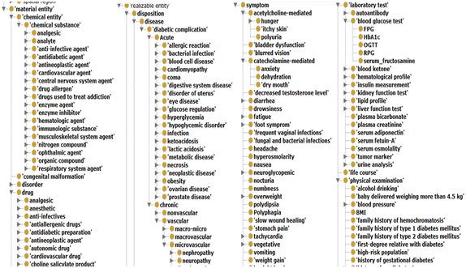
Abusing Protégé, BFO and OGMS
No reference provided due to vicarious embarrassment

Slide 89
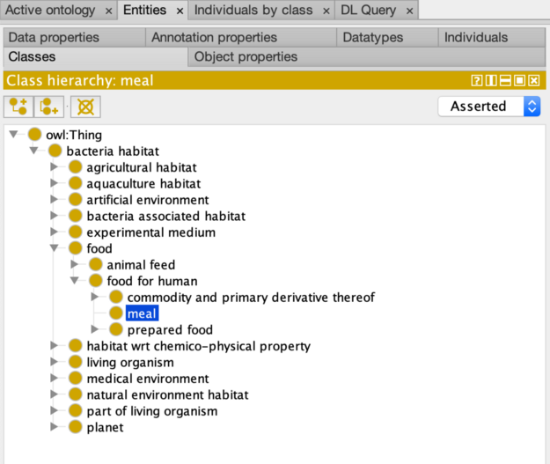
What about this?
Not given any serious thought!
https://medium.com/analytics-vidhya/prot%C3%A9g%C3%A9-d533f024087b

Slide 90
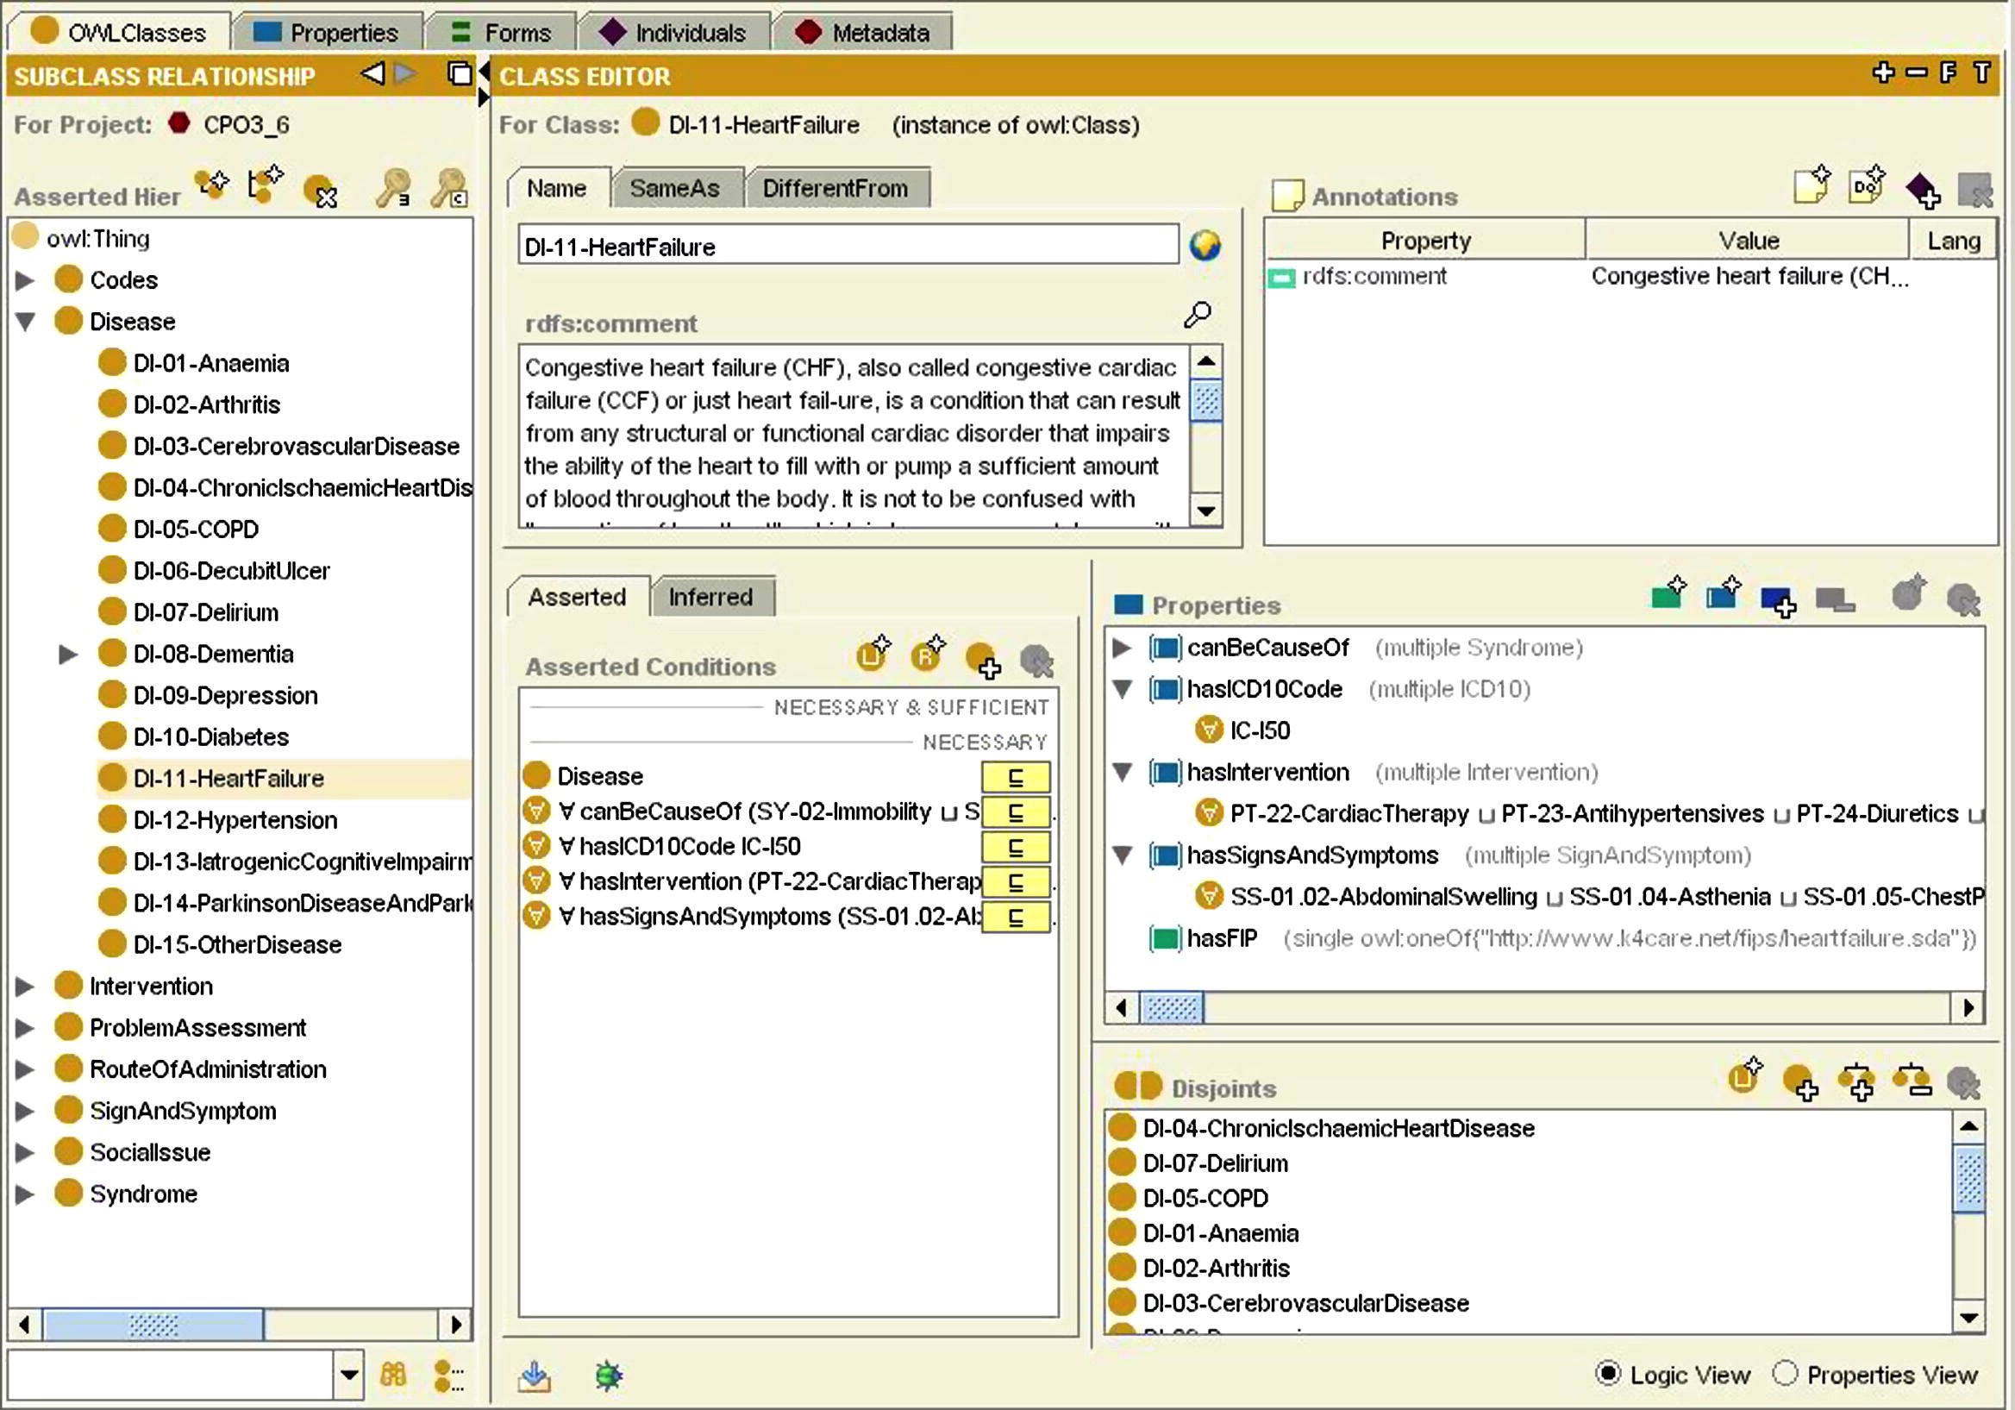
What about this?
Not given any serious thought!
https://www.sciencedirect.com/science/article/pii/S153204641100222X

Slide 91
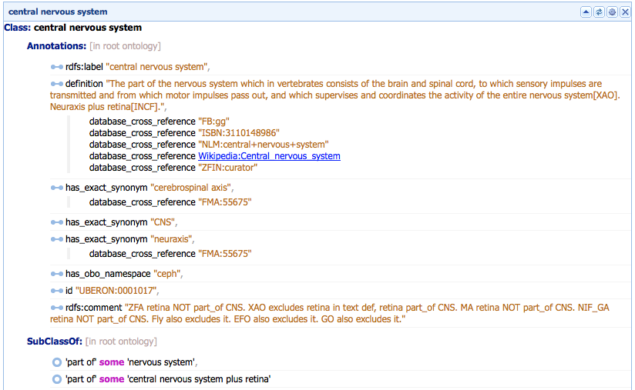
What about this?
Does not specify these parts have to be parts of that specific instance of which the CNS is a part!
https://protegewiki.stanford.edu/wiki/WebProtegeUsersGuide

Slide 92
Ontologies and ‘ontologies’
‘ontologies’
Direct
usefulness
for
people
Terminological
systems
Knowledge representation
systems
Realism-based
Ontologies
Direct usefulness for computers
Inspired by: Rector, A.. “Clinical terminology: why is it so hard?” Methods of information in medicine 38 4-5 (1999): 239-52 .

Slide 93
Early goals of Biomedical Ontology in
Healthcare Information Technology (HIT)
supporting the creation and use of adequate biomedical terminology.
supporting the creation of adequate coding and classification systems.
→ Terminological systems

Slide 94
Additional goals of Biomedical Ontology in
Healthcare Information Technology (HIT)
solving the semantic interoperability problem for heterogeneous biomedical information systems.
improving biomedical decision support applications.
Knowledge representation
systems

Slide 95
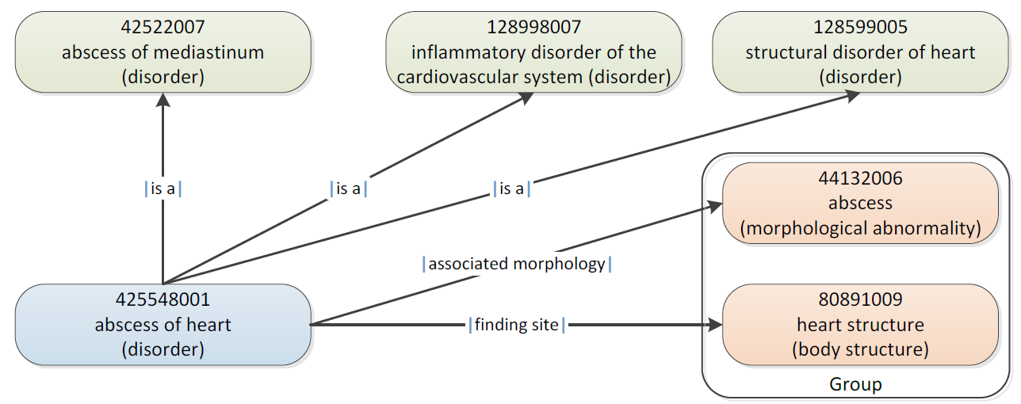
SNOMED CT Defining relationships
IHTSDO. SNOMED CT Starter Guide July 2014

Slide 96
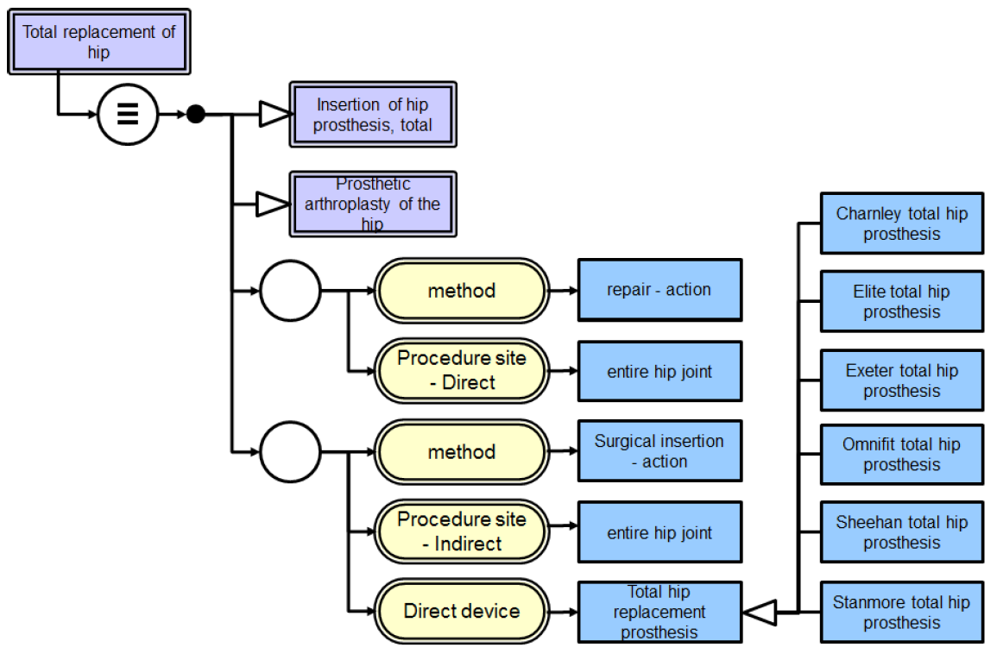
SNOMED CT’s Description Logic
IHTSDO. SNOMED CT Starter Guide July 2014

Slide 97
What is ‘a logic’
A formal or informal language together with a deductive system and/or a model-theoretic semantics.
The language has components that correspond to a part of a natural language like English or Greek.
The deductive system is to capture, codify, or simply record arguments that are valid for the given language.
The semantics is to capture, codify, or record the meanings, or truth-conditions for at least part of the language.
Shapiro, Stewart and Teresa Kouri Kissel, "Classical Logic",
The Stanford Encyclopedia of Philosophy (Spring 2021 Edition), Edward N. Zalta (ed.).
https://plato.stanford.edu/archives/spr2021/entries/logic-classical/

Slide 98
Example: Propositional Logic (PL)
A well-formed formula is either atomic or composed following allowed composition rules.
Atomic formulae stand for propositions that must either be true or false:
  A: ‘John eats too much’.
  B: ‘John has a normal BMI’.
  C: ‘John is careful’.
Formula connectors:
  Negation (not): ¬ ~
  Conjunction (and): ∧ & ∙
  Disjunction (or): ∨
  Material implication (if...then): → ⇒ ⊃
  Biconditional (if and only if): ↔ ⬄ ≡ =

Slide 99
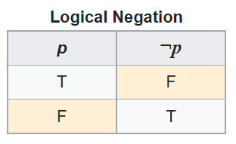
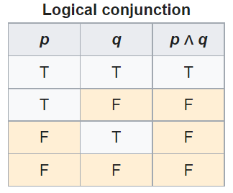
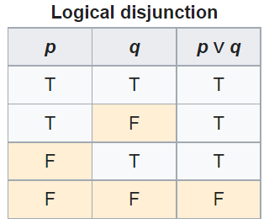
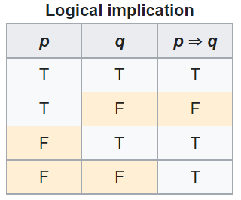

PL’s Deductive system: truth tables

Slide 100
Some PL laws
Truth tables can be used to prove laws, e.g.:
  a Λ (b V c) = (a Λ b) V (a Λ c)
  ¬ (a Λ b) = ¬ a V ¬b
  (a Λ (a → b)) → b
  (a→ b) Λ ¬b) → ¬a
  ((a V b) Λ ¬a) → b
  ((a → b) Λ (b → c)) → (a → c)
  …
  More examples:
    https://math.stackexchange.com/questions/1449866/catalogue-of-propositional-logic-laws
    http://mathonline.wikidot.com/the-laws-of-propositional-logic#toc0
Both truth tables and laws can be used to solve puzzles.

Slide 101
Exercise
Given:
  If John eats too much, then he does not have a normal BMI.
  If John is not careful, then he eats too much.
  John has a normal BMI.
Question
  Is John careful?

Slide 102
Translate sentences into PL
Propositions
John eats too much |  |  | a
John has a normal BMI |  |  | b
John is careful |  |  | c
Given
If John eats too much, then he does not have a normal BMI |  |  | a → ¬b
If John is not careful, then he eats too much. |  |  | ¬c → a
John has a normal BMI |  |  | b
Determine the truth value of: |  | (a → ¬b) ∧ (¬c → a) ∧ b

Slide 103
Apply PL’s laws
Propositions
John eats too much |  | a
John has a normal BMI |  | b
John is careful |  | c
Given
If John eats too much, then he does not have a normal BMI |  | a → ¬b | g1
If John is not careful, then he eats too much. |  | ¬c → a | g2
John has a normal BMI |  | b | g3
Rule application: | (x→ y) Λ ¬y) → ¬x | ¬a | g3/g1 | g4
 | (x→ y) Λ ¬y) → ¬x | c | g2/g4

Slide 104
Another exercise
Solve this puzzle with propositional logic:
  Given:
    Everybody who eats too much, does not have a normal BMI.
    Everybody who is not careful, eats too much.
    Everybody has a normal BMI.
  Question
    Is everybody careful?
Same as before: yes.
Note: the argument is valid (follows the logical rules correctly) but is not sound (not all premises are true)

Slide 105
What about this one?
Solve this puzzle with propositional logic :
  Given:
    Everybody who eats too much, does not have a normal BMI.
    Everybody who is not careful, eats too much.
    John has a normal BMI.
  Question
    Is John careful?
Can not be done with propositional logic!
  There is no way to create propositions (within the syntax and semantics of propositional logic) so that ‘everybody’ or ‘John’ can be represented or related.

Slide 106
First-order logic
Propositional logic with predicates, variables and quantifiers.
Predicate: a proposition that some property holds for some entity, or a relation between entities.
  Prop.L. : A = ‘everybody eats too much’
  FOL: A = ‘eats too much’ A(x)
Quantifiers:
  ‘all’ ∀ ∀x.A(x) everything eats too much
  ‘some’ ∃ ∃x.A(x) something eats too much
‘everybody eats too much’
  ∀x.person(x) → A(x)

Slide 107
Truth values of quantifiers
Statement | True when | False when
∀x.A(x) | A(x) is true for every x. | There is an x for which A(x) is false
∃x.A(x) | There is an x for which A(x) is true. | A(x) is false for every x.
Open or Closed World
Reality
Represented Reality

Slide 108
Flexibility in predicate formation
Some people eat too much:
  ∃x (person(x) Λ eats_too_much(x))
  ∃x (person(x) Λ eats(x, ‘too much’))
  ∃x ∃y (person(x) Λ eats(x, y) Λ quantity(y, ‘too much’))
However:
  Are not equivalent,
  Are based on a different ontology.
https://genomebiology.biomedcentral.com/articles/10.1186/gb-2005-6-5-r46

Slide 109
Be careful with quantifiers
Order is important!
  ∀x ∃y symptomOf(x, y)
    For all x, there exist some y such that x is a symptom of y
      Every symptom originates from some disease;
      Does not exclude that there is only one disease, and that all symptoms come from that one disease.
  ∃y ∀x symptomOf(x, y)
    There exist some y, such that for all x, x is a symptom of y
      There is a disease which is the cause of all symptoms that exist.

Slide 110
Be aware of ambiguities in language
‘Every patient has some provider’
  Can mean:
    ∀x ∃y patientOf(x, y)
      For all x, there exist some y such that x is a patient of y
        Every patient has some provider.
    ∃y ∀x patientOf(x, y)
      There exist some y, such that for all x, x is a patient of y
        There is some provider that provides for all patients.

Slide 111
Additional Goals of Realism-based Biomedical Ontology in HIT
supporting the identification of what sorts of biomedical entities exist, how they relate to each other and how they are best represented.

Slide 112
Philosophical approach to ontology
Ontological Realism: uses ontology as philosophical discipline to build ontologies as faithful representations of reality.

Slide 113

Realism-based Ontology (RBO)
Referents
  are (meta-) physically the way they are,
  relate to each other in an objective way,
  follow ‘laws of nature’.
Window on reality
  restricted by:
  what is physically and technically observable,
  fit between what is measured and what we think is measured,
  fit between established knowledge and ‘laws of nature’.
References
  follow, ideally, the syntactic-semantic conventions of some representation language,
  are restricted by the expressivity of that language,
  reference collections need to come, for correct interpretation, with documentation outside the representation.

Slide 114
What you should NEVER FORGET !!!
(major take home message)
Crucial distinctions made in Ontological Realism
reality ←→ representation
ontology ←→ ontologies
particulars ←→ types
continuants ←→ occurrents

Slide 115




Slide 116
Types versus particulars
Types
Particulars
counterparts in reality of (some of)
the general terms used in the formulation of scientific theories
concrete individual entities
(entities that exist in space and time and that exist only once)
Smith B, Ceusters W. Ontological Realism as a Methodology for Coordinated Evolution of Scientific Ontologies. Applied Ontology, 2010;5(3-4):139-188.

Slide 117
‘Types’
‘concepts’
‘kinds’
‘universals’
‘categories’
‘classes’
‘prototypes’
…
In realism-based ontology:
  Universals: human being
  Defined classes: human being in Buffalo

Slide 118
Types versus particulars
for every universal there is or has been at least one instance
some type
instanceOf …
entities on either site cannot ‘cross’ this boundary
every particular is an instance of at least one universal
some particular

Slide 119





Types versus particulars
Human being
instance of at t
particulars

Slide 120
Types versus particulars
Photograph
instance of at t
particulars

Slide 121
Instances are the objects of classification …
isa
Organism
isa
Vertebrate
isa
Mammal
Human being
instance of at t
particulars

Slide 122
Instances are the objects of classification …
isa
Organism
isa
Vertebrate
isa
Mammal
Human being
instance of at t
particulars

Slide 123
Conceptualism versus Ontological Realism
First order reality
concept
universal
term
referent
representational
unit
particular
Conceptualism
Ontological Realism

Slide 124
Ontological Realism offers three ways of relating, without assigning beliefs (concepts) a central status
drapetomania
slave
running away
mental disorder
propensity
How terms are related
How beliefs are / can
be related
How referents (in
reality) are related

Slide 125
drapetomania
slave
running away
mental disorder
propensity
How terms are
related
How beliefs are / can
be related
How referents
(in reality)
are related
Knowledge representation
systems
Terminological
systems
Realism-based
Ontologies

Slide 126
Adequate taxonomy design and classification
Taxonomy design:
Identify examples of particulars (‘individuals’, ‘things’, ‘entities’, …) you want to classify;
Identify the various characteristics that are possessed by (all or some of) these individual entities;
Identify groups (classes) on the basis of combinations of characteristics that co-occur;
Organize the groups hierarchically (‘parent-child’) so that characteristics that apply to a ‘parent’ (‘grandparent’,…) group apply to ALL groups beneath it;
Name the groups with terms that have face value.
Classification:
Assign individual entities to the groups that correspond with the combination of characteristics they exhibit.

Slide 127

Error:
confusing particulars with types
http://browser.ihtsdotools.org/
Oct 14, 2015

Slide 128
Do you see the ambiguity ?
‘Persistent idiopathic facial pain (PIFP)’
  = ‘persistent facial pain with varying presentations …’
persistent
facial pain
presentation
type1
presentation
type2
presentation
type3
types
t₂
t₃
t₁
t₁
t₁
t₂
t₂
t₃
t₁
t₃
parti-
culars
t₁
t₂
t₂
t₁
t₃
t₂
t₃
t₃
my pain
her pain
his pain

Slide 129
Make it clear whether assertions are about particulars or types
‘Persistent idiopathic facial pain (PIFP)’
  = ‘persistent facial pain with varying presentations …’
  if the description is about types, then the three particular pains fall under PIFP.
  if the description is about (arbitrary) particulars, then only her pain falls under PIFP.

Slide 130
Exercise: what parts of these sentences denote universals and which ones particulars?
A sore throat is a shared symptom of many illnesses.
The first symptom of COVID-19 is fever.
Difficulty swallowing, facial weakness or numbness, or double vision is a symptom of a tumor in the brain stem.
Fatigue is a disabling, multifaceted symptom that is highly prevalent and stubbornly persistent in fibromyalgia.
Actor Alan Alda went for a brain scan after experiencing this early sign (acting out dreams), eventually leading to his Parkinson's diagnosis.

Slide 131
What you should NEVER FORGET !!!
(major take home message)
Crucial distinctions made in Ontological Realism
reality ←→ representation
ontology ←→ ontologies
particulars ←→ types
continuants ←→ occurrents

Slide 132
Continuants ←→ Occurrents
 | Continuant | Occurrent
Entities that at any time they exist,
exist
in total
Entities that at any time they exist,
exist only
partially
Smith B, Ceusters W. Ontological Realism as a Methodology for Coordinated Evolution of Scientific Ontologies. Applied Ontology, 2010;5(3-4):139-188.

Slide 133
An ontological square
 | Continuant | Occurrent
Types | Tooth | Teeth grinding
Particulars | My left maxillary first molar | My teeth grinding

Slide 134
An ontological square (BFO2020)
 | Continuant | Occurrent
Types | Tooth | Teeth grinding
Particulars | My left maxillary first molar | My teeth grinding
Instance
of at t
Instance
of at t

Slide 135




Continuants preserve identity while changing
human
being
me
me
t
Instance-of
in 1960
child
Instance-of
since 1980
adult
living
creature
animal
caterpillar
butterfly

Slide 136
The importance of temporal indexing
benign
tumor
malignant
tumor
stomach
instanceOf at t₂
instanceOf at t₁
instanceOf at t₂
instanceOf at t₁
partOf at t₁
this-4
this-1’s stomach
partOf at t₂

Slide 137
The importance of temporal indexing
benign
tumor
malignant
tumor
stomach
instanceOf at t₂
instanceOf at t₁
instanceOf at t₂
instanceOf at t₁
this-4
partOf at t₁
this-1’s stomach
this-5
partOf at t₂

