Slide 1
Biomedical Ontology for Biomedical Informaticists.
Lecture in BMI501: Survey of Biomedical Informatics – Oct 28, 2020
Department of Biomedical Informatics, University at Buffalo
Werner CEUSTERS, MD
Ontology Research Group, Center of Excellence in Bioinformatics and Life Sciences,
UB Institute for Healthcare Informatics,
Departments of Biomedical Informatics and Psychiatry,
University at Buffalo, NY, USA

Slide 2
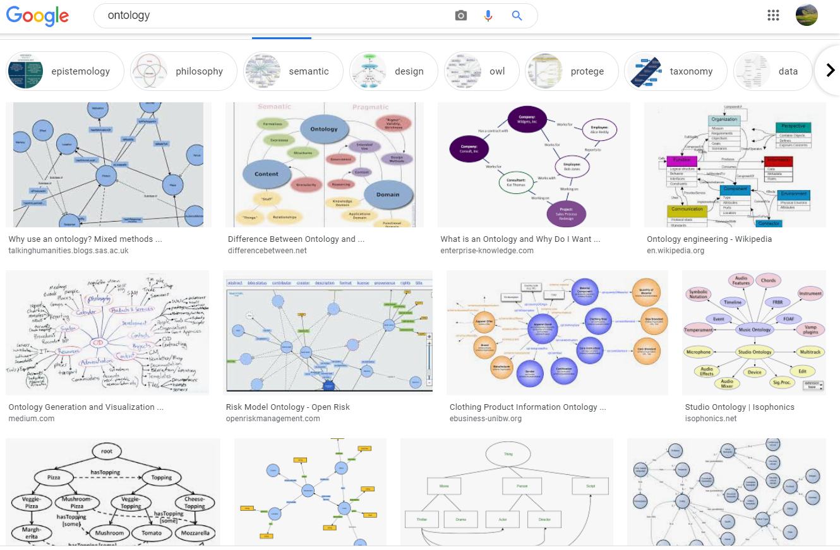
A view on ‘ontology’

Slide 3
Biomedical data repository
A huge matrix with data representing patient cases in one dimension and patient characteristics in the other dimension
genotypic
phenotypic

Slide 4
Goal of research data: analysis
Standard approach: use statistical correlation techniques to find associations between characteristics and (dis)similarities between cases
genotypic
phenotypic

Slide 5
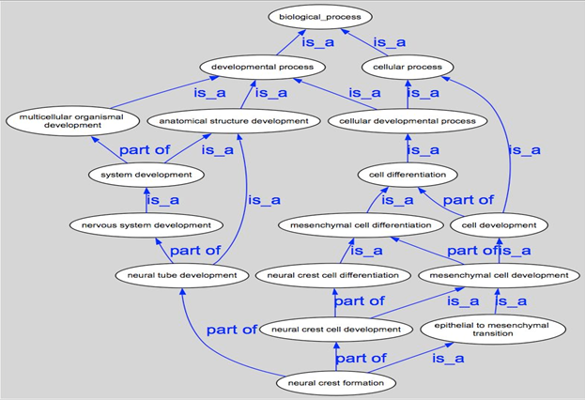
Using ontologies to cross-map distinct data repositories

Slide 6
The positive effects of appropriate mappings
more precise and comparable semantics of what data items in distinct data collections denote;
identification of ontological relations prior to statistical correlation:
  ch1 and ch4
  ch1 and ch5
  ch1 and ch2
  …

Slide 7
However …
Mainstream ontology design approaches fail in achieving their objectives:
  various sorts of mistakes in ontologies,
  inability to use ontologies adequately in information systems,
  failure to integrate data repositories even if these ontologies are appropriately designed.
Root causes:
  inadequacy of their conceptual semantic foundations,
  lack of knowledge about ontology as a philosophical discipline.
Proposed solution:
  Better use of ontology (the philosophical discipline) to design ontologies (specific sorts of representational artifacts) and integrate them in information systems.

Slide 8
What you should NEVER FORGET !!!
(major take home message)
Crucial distinctions made in Ontological Realism
ontology ←→ ontologies
reality ←→ representation
particulars ←→ types
continuants ←→ occurrents

Slide 9
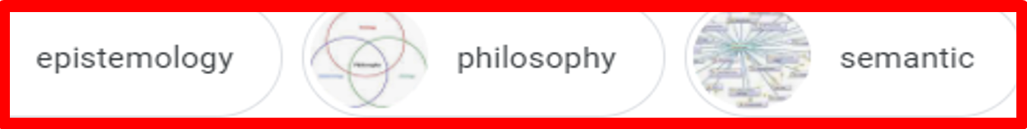
A biased view on ‘ontology’ images

Slide 10
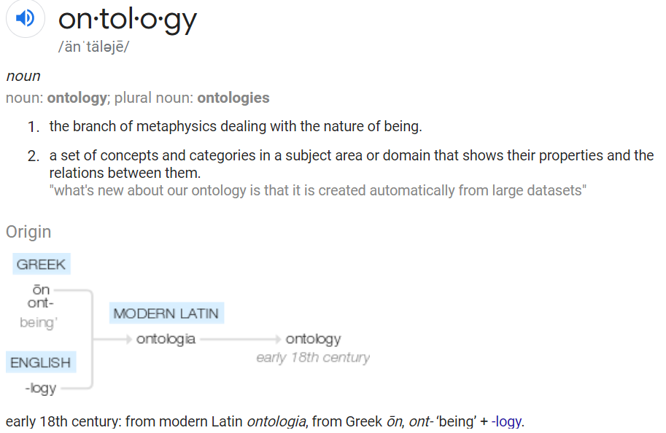
‘Ontology’
https://www.google.com/search?q=ontology
Occurrence

Slide 11
‘Ontology’
In philosophy:
  Ontology (no plural) is the study of what entities exist and how they relate to each other;

Slide 12
‘Ontology’
In philosophy:
  Ontology (no plural) is the study of what entities exist and how they relate to each other;
  by some philosophers taken to be synonymous with ‘metaphysics’ while others draw distinctions in many distinct ways (the distinctions being irrelevant for this talk), but almost agreeing on the following classification:
    metaphysics → studies ‘how is the world?’
      general metaphysics → studies general principles and ‘laws’ about the world
        ontology → studies what type of entities exist in the world
      special metaphysics → focuses on specific principles and entities
  distinct from ‘epistemology’ which is the study of how we can come to know about what exists.
  distinct from ‘terminology’ which is the study of what terms mean and how to name things.

Slide 13
The Terminology / Ontology divide
Terminology:
  solves certain issues related to language use, i.e. with respect to how we talk about entities in reality (if any);
    Relations between terms / ‘concepts’
  does not provide an adequate means to represent independent of use what we talk about, i.e. how reality is structured;
    Women, Fire and Dangerous Things (Lakoff).
Ontology (of the right sort):
  Language and perception neutral view on reality.
    Relations between entities in first-order reality

Slide 14
Unfortunately, ‘ontology’ denotes ambiguously
In philosophy:
  Ontology (no plural) is the study of what entities exist and how they relate to each other;
In computer science and many biomedical informatics applications:
  An ontology (plural: ontologies) is a shared and agreed upon conceptualization of a domain;

Slide 15
Computer science approach to ontology
Ontology
Authoring Tools
create
Domain
Ontologies
Reasoners
Semantic
Applications
use

Slide 16
Computer science approach to ontology
Ontology
Authoring Tools
the logic in reasoners:
guarantees consistent reasoning,
does not guarantee the faithfulness of the representation.
create
Domain
Ontologies
Reasoners
Semantic
Applications
use

Slide 17
Ontologies and ‘ontologies’
‘ontologies’
Direct
usefulness
for
people
Terminological
systems
Knowledge representation
systems
Realism-based
Ontologies
Direct usefulness for computers
Inspired by: Rector, A.. “Clinical terminology: why is it so hard?” Methods of information in medicine 38 4-5 (1999): 239-52 .

Slide 18
Early goals of Biomedical Ontology in
Healthcare Information Technology (HIT)
supporting the creation and use of adequate biomedical terminology.
supporting the creation of adequate coding and classification systems.
→ Terminological systems

Slide 19
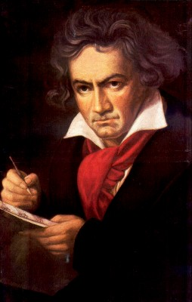
The semantic/semiotic triangle:
(the sandbox of the conceptualist)
Ludwig van Beethoven
that great German composer that became deaf
…
concept
term
referent
‘Beethoven’

Slide 20

The semantic/semiotic triangle:
The dog from the ‘Beethoven’ movie
…
concept
term
referent
‘Beethoven’
https://celebritydogwatcher.com/2019/02/most-famous-movie-dogs/

Slide 21
Sometimes the semantic triangle fails
the symphony Beethoven wrote after the tenth
…
concept
term
referent
‘Beethoven's Symphony No. 11’

Slide 22
Sometimes the semantic triangle fails
the symphony Beethoven wrote after the tenth
…
some hold this term has meaning
concept
term
referent
‘Beethoven's Symphony No. 11’

Slide 23
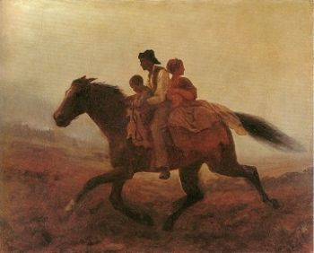
Prehistoric ‘psychiatry’: drapetomania
disease which causes slaves to suffer from an unexplainable propensity to run away
…
concept
term
referent
painting by Eastman Johnson. A Ride for Liberty: The Fugitive Slaves. 1860.
‘drapetomania’

Slide 24
Earlier required reading:
Cimino, J.J.,
Desiderata for controlled medical vocabularies in the twenty-first century.
Methods Inf Med, 1998. 37(4-5): p. 394-403.

Slide 25
Cimino’s desiderata (1)
Content has adequate coverage for intended purposes.
Concept-orientation which guarantees:
  Non-vagueness: one term → at least one meaning
  Non-ambiguity: one term → only one meaning
  Non-redundancy: one meaning → only one term
concept = meaning
term
referent

Slide 26
Cimino’s desiderata (1)
Content has adequate coverage for intended purposes.
Concept-orientation which guarantees:
  Non-vagueness: one term → at least one meaning
  Non-ambiguity: one term → only one meaning
  Non-redundancy: one meaning → only one term
Concept-permanence: meaning should remain constant at all times (through versions),
Non-semantic concept identifier: meanings must be given an ID which by itself does not reflect anything about the meaning.
Taxonomic organization of concepts.

Slide 27
Taxonomic tree
A
…
B
All nodes represent groups (X, Y, …) the members of which have something (S_{x}, S_{y}) similar in some way.
All edges represent the same relation r which expresses some classificatory principle which is such that if X r Y holds, then the members of X have similarities S_{x} and S_{y}.
D
E
G
H
I

Slide 28
Taxonomic tree as sets
A
B
D
E
G
H
I

Slide 29
Taxonomic tree with non-taxonomic relations
A
B
C
D
E
F
G
H
I
J
K
L

Slide 30
Cimino’s desiderata (2)
Meanings should have formal definitions in terms of already defined meaning.
‘Not elsewhere classified’ should not be part of a meaning or definition thereof.
Meanings need to be specified at multiple granularities
    → depending on purpose, taxonomy can be cut or extended at the bottom.
Offer multiple consistent views on the taxonomy.
Offer mechanisms to represent context.
    E.g. ‘covid-19’ versus ‘history of covid-19’ versus ‘covid-19 in household member’.
Evolve gracefully ensuring that new versions don’t violate the posited desiderata.

Slide 31
Still today, many terminological systems do not follow Cimino’s desiderata
Most notoriously: ICD !

Slide 32
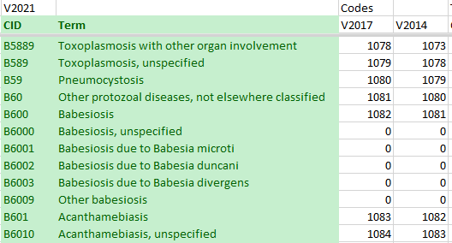
Mistake type 1: inadequate content

Slide 33
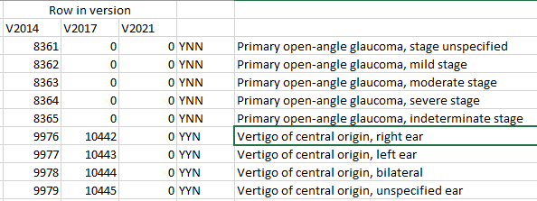
Mistake type 2: vagueness
(there must be at least one meaning)
‘Vertigo of central origin in an ear’ does not exist, thus this concept does not have a meaning in Cimino’s sense!

Slide 34
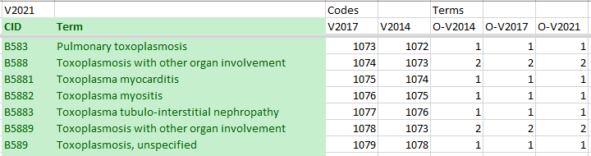
Mistake type 3: ambiguity
‘Toxoplasmosis with other organ involvement’ has two different meanings (there are two distinct CIDs).

Slide 35
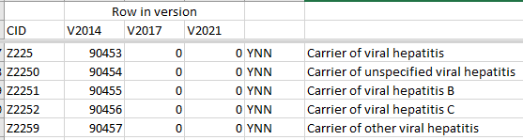
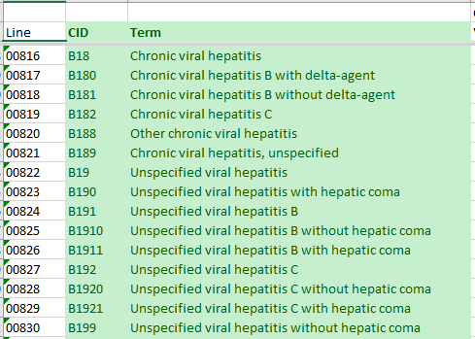
Mistake type 4: redundancy
‘carrier of viral hepatitis’: some have hepatitis.
‘chronic viral hepatitis’: all of them are carriers.

Slide 36
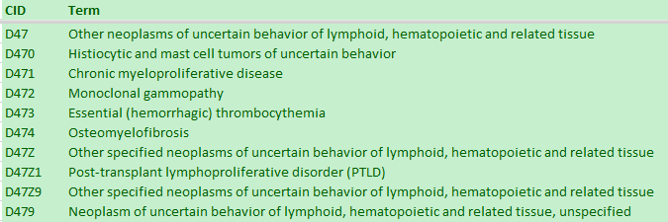
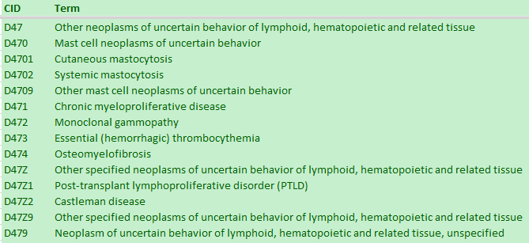
Mistake type 5: non-permanence
Insertion of an extra term in a subhierarchy changes the meaning of the ‘other’ collector concept.

Slide 37
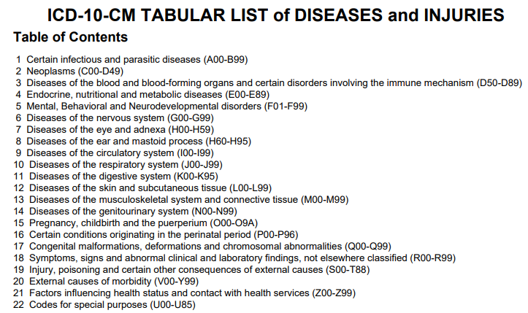
Mistake type 6: use of semantic concept identifiers

Slide 38
Mistake type 7: no formal definitions
A00 Cholera
 | A00.0 Cholera due to Vibrio cholerae 01, biovar cholerae
 |  | A00.1 Cholera due to Vibrio cholerae 01, biovar eltor
 |  | A00.9 Cholera, unspecified
A01 Typhoid and paratyphoid fevers
 | A01.0 Typhoid fever
 |  | A01.00 Typhoid fever, unspecified
 |  | A01.01 Typhoid meningitis
 |  | A01.02 Typhoid fever with heart involvement
 |  | A01.03 Typhoid pneumonia
 |  | A01.04 Typhoid arthritis
 |  | A01.05 Typhoid osteomyelitis
 |  | A01.09 Typhoid fever with other complications
 | A01.1 Paratyphoid fever A
 | A01.2 Paratyphoid fever B
 | A01.3 Paratyphoid fever C
 | A01.4 Paratyphoid fever, unspecified
A02 Other salmonella infections
Limited inference possible.

Slide 39

Mistake type 8: use of ‘not elsewhere classified’

Slide 40
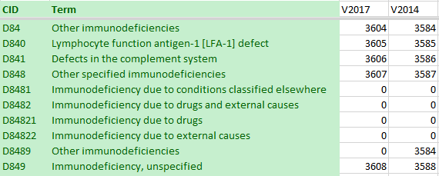
Mistake type 9: meanings not always at sufficient levels of granularity
The addition of subclasses of D848 in V2021 demonstrates that there was not enough granularity in 2014.

Slide 41
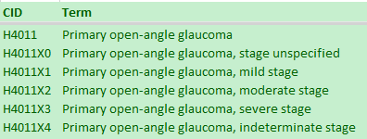
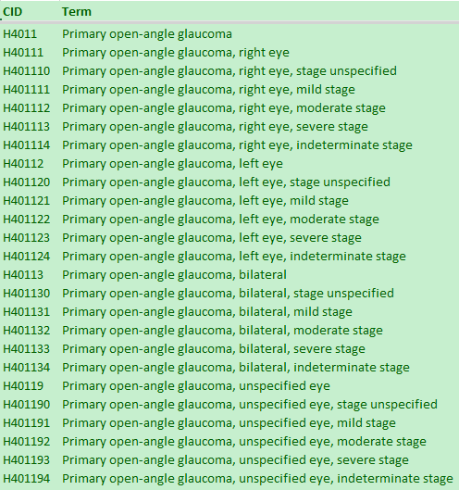
Mistake type 10: no graceful evolution
Same ‘meaning’ received in 2017 a different identifier than in 2014

Slide 42
Additional goals of Biomedical Ontology in
Healthcare Information Technology (HIT)
solving the semantic interoperability problem for heterogeneous biomedical information systems.
improving biomedical decision support applications.
Knowledge representation
systems

Slide 43
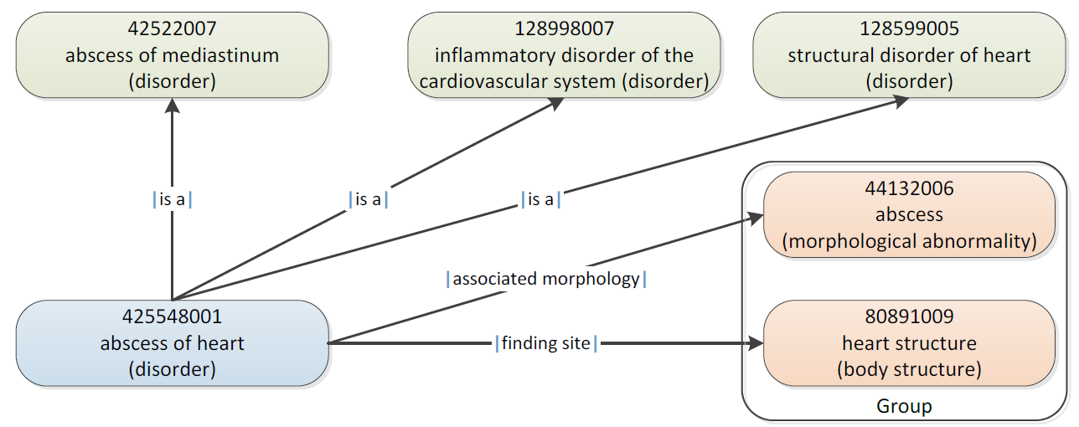
SNOMED CT Defining relationships
IHTSDO. SNOMED CT Starter Guide July 2014

Slide 44
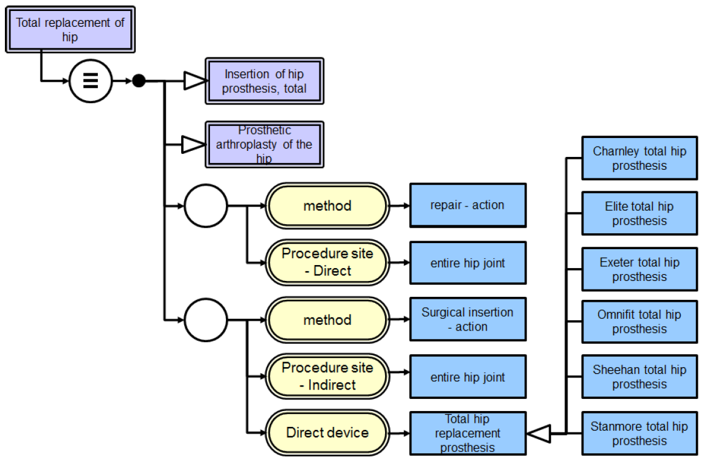
SNOMED CT’s Description Logic
IHTSDO. SNOMED CT Starter Guide July 2014

Slide 45
Additional Goals of Realism-based Biomedical Ontology in HIT
supporting the identification of what sorts of biomedical entities exist, how they relate to each other and how they are best represented.

Slide 46

Philosophical approach to ontology
Ontological Realism: uses ontology as philosophical discipline to build ontologies as faithful representations of reality.

Slide 47
What you should NEVER FORGET !!!
(major take home message)
Crucial distinctions made in Ontological Realism
ontology ←→ ontologies
reality ←→ representation
particulars ←→ types
continuants ←→ occurrents

Slide 48
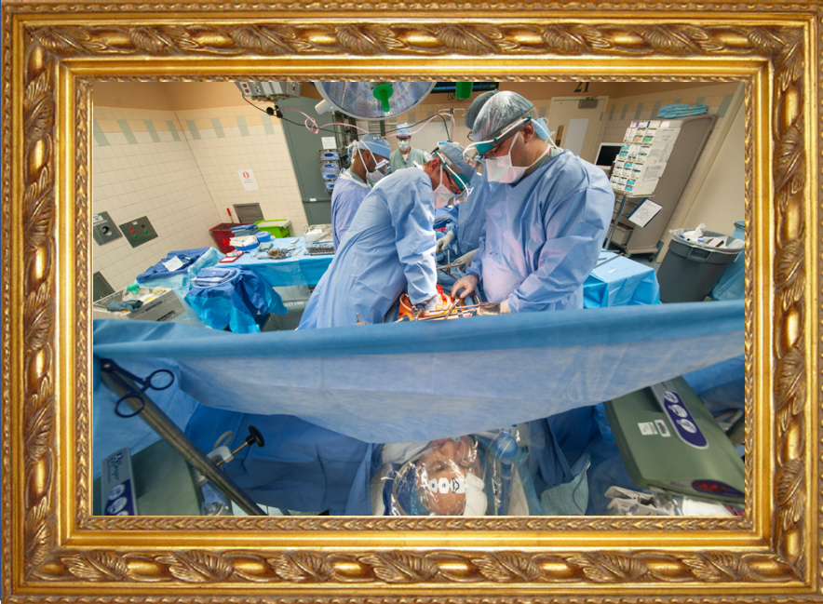
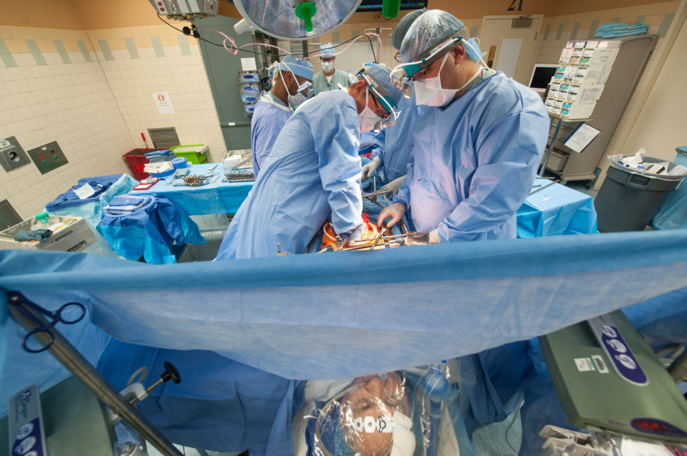
Reality ←→ Representation

Slide 49
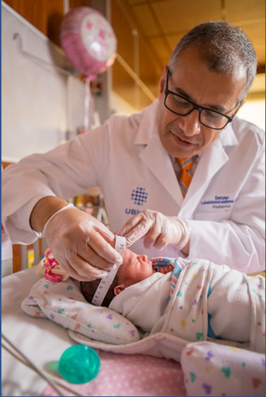
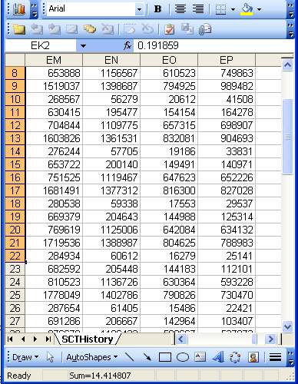
Reality ←→ Representation
(research) domain
(research) data
Beings & happenings
Descriptions

Slide 50
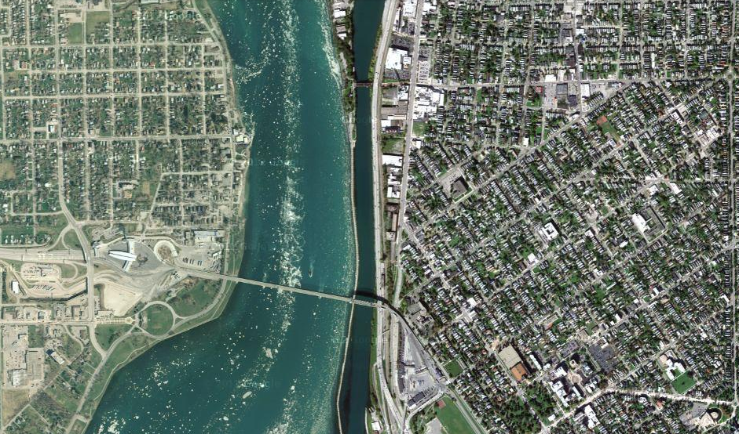
Satellite view

Slide 51
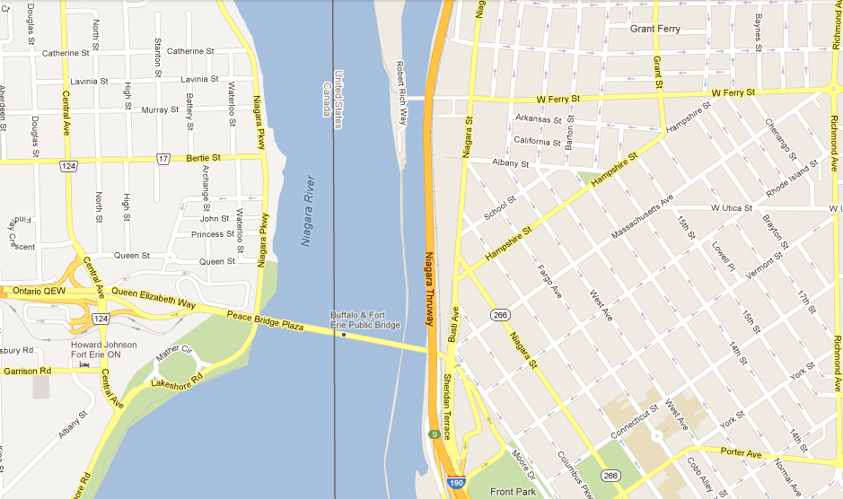
Map

Slide 52
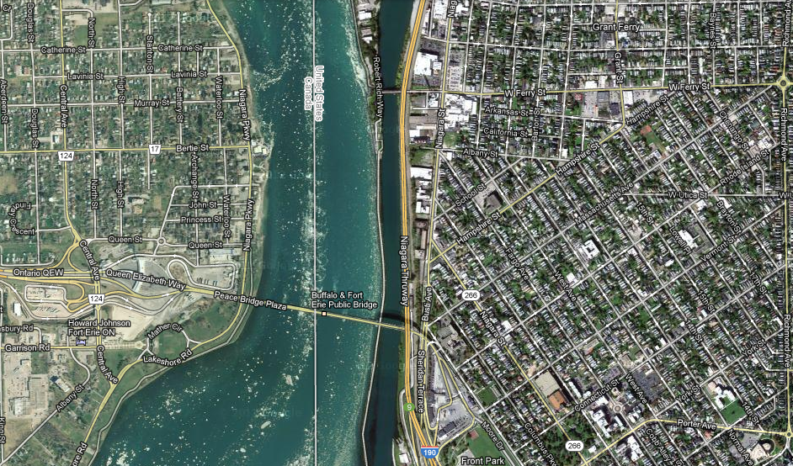
Map overlay

Slide 53
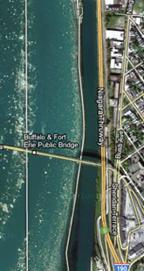
Map ←→ Reality
A message to map makers: “Highways are not painted red, rivers don’t have county lines running down the middle, and you can’t see contour lines on a mountain”
W. Kent. Data and Reality. North-Holland, Amsterdam, the Netherlands, 1978.

Slide 54
Main data ←→ reality views
Nominalism:
  there are no generic entities in reality: there is no personhood, there are only individual persons.
Conceptualism:
  generalizations are in our ‘minds’. Personhood is a concept construed in our ‘mind’ that allows us to reason about persons without any particular person in mind.
Realism:
  generic entities do exist and are called ‘universals’. Each particular person is an instance of the universal we call ‘person’.

Slide 55
Main data ←→ reality views
Nominalism:
  there are no generic entities in reality: there is no personhood, there are only individual persons.
Conceptualism: ← mainstream approach
  generalizations are in our ‘minds’. Personhood is a concept construed in our ‘mind’ that allows us to reason about persons without any particular person in mind.
Realism: ← our approach
  generic entities do exist and are called ‘universals’. Each particular person is an instance of the universal we call ‘person’.

Slide 56
Canonical case: faithful representation
Reality
Representation
‘Earth’
‘Aarde’
‘La Terre’
…
denotes
means
represents

Slide 57
Delusions, fantasies, imaginations, …
Reality
Representation
‘unicorn’

Slide 58
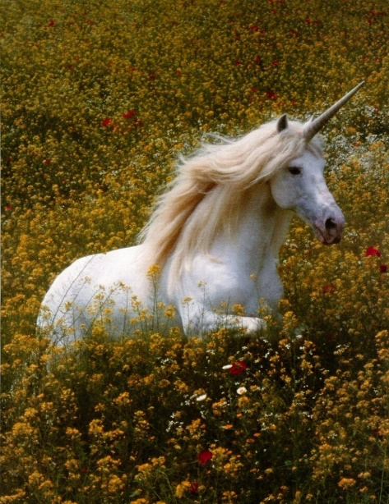
Delusions, fantasies, imaginations, …
Reality
Representation
‘unicorn’

Slide 59

Delusions, fantasies, imaginations, …
Terminology
Reality
Representation
‘unicorn’
Graphics

Slide 60
Delusions, fantasies, imaginations, …
Conceptualism
Terminology
Reality or
Imagination
Representation
‘unicorn’
Graphics
unicorn concept

Slide 61
‘Unicorns’ in modern medicine: ICD-10-CM
 | Row in version
CID | V2014 | V2017 | V2021
H8141 | Y Y N | Vertigo of central origin, right ear
H8142 | Y Y N | Vertigo of central origin, left ear
H8143 | Y Y N | Vertigo of central origin, bilateral
H8149 | Y Y N | Vertigo of central origin, unspecified ear
S060X7 | Y N N | Concussion with loss of consciousness of any duration with death due to brain injury prior to regaining consciousness
S060X7A | Y N N | Concussion with loss of consciousness of any duration with death due to brain injury prior to regaining consciousness, initial encounter
S060X7D | Y N N | Concussion with loss of consciousness of any duration with death due to brain injury prior to regaining consciousness, subsequent encounter
S060X7S | Y N N | Concussion with loss of consciousness of any duration with death due to brain injury prior to regaining consciousness, sequela
S63136A | Y Y N | Dislocation of proximal interphalangeal joint of unspecified thumb, initial encounter
S63136D | Y Y N | Dislocation of proximal interphalangeal joint of unspecified thumb, subsequent encounter
S63136S | Y Y N | Dislocation of proximal interphalangeal joint of unspecified thumb, sequela
S6314 | Y Y N | Subluxation and dislocation of distal interphalangeal joint of thumb
S63141 | Y Y N | Subluxation of distal interphalangeal joint of right thumb
S63141A | Y Y N | Subluxation of distal interphalangeal joint of right thumb, initial encounter
S63141D | Y Y N | Subluxation of distal interphalangeal joint of right thumb, subsequent encounter

Slide 62
Reinterpretation of the semantic/semiotic triangle:
What we think about such entities
cognitive
representation
What terms we use for such entities
entities
term
referent
term
referent

Slide 63
Where do data come from?
knowledge
information
data
Representation
What is there on the side of the patient
Reality

Slide 64
Where do data come from?
knowledge
information
data
Questions not often enough asked:
What parts of our data correspond with something out there in reality ?
What parts of reality are not captured by our data, but should because they are relevant ?
Reality
What is there on the side of the patient

Slide 65
Where do data come from?
knowledge
information
data
Questions not often enough asked:
What parts of our data correspond with something out there in reality ?
What parts of reality are not captured by our data, but should because they are relevant ?
Ontology
Reality
What is there on the side of the patient

Slide 66
Where do data come from?
References
knowledge
information
data
Ontology
- representation
Reality
What is there on the side of the patient
Referents

Slide 67
Also representations are real!
References
knowledge
information
data
Ontology
- representation
Reality
What is there on the side of the patient
Referents

Slide 68
Generalization: data generation and use
data
organization
model development
observation &
measurement
further R&D
(instrument and
study optimization)
add
verify
use
Δ = outcome
Generic
beliefs
application

Slide 69
Reality as benchmark for data organization and representation
data
organization
model development
observation &
measurement
further R&D
(instrument and
study optimization)
add
verify
use
Δ = outcome
Generic
beliefs
application

Slide 70
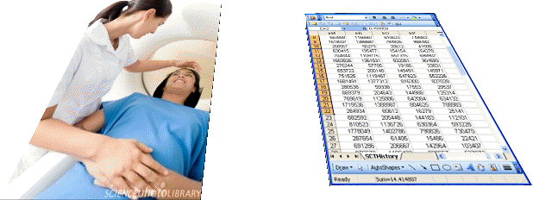
Realism-based Ontology (RBO)
Referents
  are (meta-) physically the way they are,
  relate to each other in an objective way,
  follow ‘laws of nature’.
Window on reality
  restricted by:
  what is physically and technically observable,
  fit between what is measured and what we think is measured,
  fit between established knowledge and ‘laws of nature’.
References
  follow, ideally, the syntactic-semantic conventions of some representation language,
  are restricted by the expressivity of that language,
  reference collections need to come, for correct interpretation, with documentation outside the representation.

Slide 71
What you should NEVER FORGET !!!
(major take home message)
Crucial distinctions made in Ontological Realism
ontology ←→ ontologies
reality ←→ representation
particulars ←→ types
continuants ←→ occurrents

Slide 72
Types versus particulars
Types
Particulars
counterparts in reality of (some of)
the general terms used in the formulation of scientific theories
concrete individual entities
(entities that exist in space and time and that exist only once)
Smith B, Ceusters W. Ontological Realism as a Methodology for Coordinated Evolution of Scientific Ontologies. Applied Ontology, 2010;5(3-4):139-188.

Slide 73
‘Types’
‘concepts’
‘kinds’
‘universals’
‘categories’
‘classes’
‘prototypes’
…
In realism-based ontology:
  Universals: human being
  Defined classes: human being in Buffalo

Slide 74
Types versus particulars
for every universal there is or has been at least one instance
some type
instanceOf …
entities on either site cannot ‘cross’ this boundary
every particular is an instance of at least one universal
some particular

Slide 75



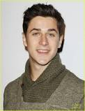
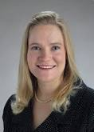
Types versus particulars
Human being
instance of at t
particulars

Slide 76
Types versus particulars
Photograph
instance of at t
particulars

Slide 77
Instances are the objects of classification …
isa
Organism
isa
Vertebrate
isa
Mammal
Human being
instance of at t
particulars

Slide 78
Instances are the objects of classification …
isa
Organism
isa
Vertebrate
isa
Mammal
Human being
instance of at t
particulars

Slide 79
Conceptualism versus Ontological Realism
First order reality
concept
universal
term
referent
representational
unit
particular
Conceptualism
Ontological Realism

Slide 80
Ontological Realism offers three ways of relating, without assigning beliefs (concepts) a central status
drapetomania
slave
running away
mental disorder
propensity
How terms are related
How beliefs are / can
be related
How referents (in
reality) are related

Slide 81
drapetomania
slave
running away
mental disorder
propensity
How terms are
related
How beliefs are / can
be related
How referents
(in reality)
are related
Knowledge representation
systems
Terminological
systems
Realism-based
Ontologies

Slide 82
Adequate taxonomy design and classification
Taxonomy design:
Identify examples of particulars (‘individuals’, ‘things’, ‘entities’, …) you want to classify;
Identify the various characteristics that are possessed by (all or some of) these individual entities;
Identify groups (classes) on the basis of combinations of characteristics that co-occur;
Organize the groups hierarchically (‘parent-child’) so that characteristics that apply to a ‘parent’ (‘grandparent’,…) group apply to ALL groups beneath it;
Name the groups with terms that have face value.
Classification:
Assign individual entities to the groups that correspond with the combination of characteristics they exhibit.

Slide 83
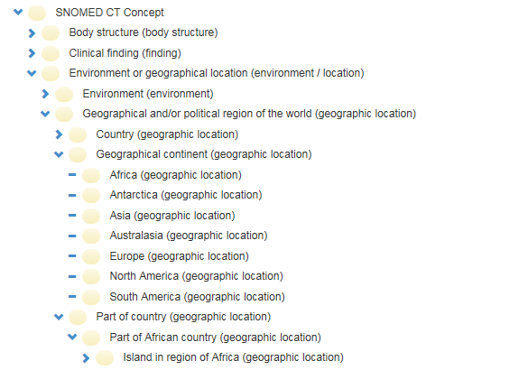
Error:
confusing particulars with types
http://browser.ihtsdotools.org/
Oct 14, 2015

Slide 84
Do you see the ambiguity ?
‘Persistent idiopathic facial pain (PIFP)’
  = ‘persistent facial pain with varying presentations …’
persistent
facial pain
presentation
type1
presentation
type2
presentation
type3
types
t₂
t₃
t₁
t₁
t₁
t₂
t₂
t₃
t₁
t₃
parti-
culars
t₁
t₂
t₂
t₁
t₃
t₂
t₃
t₃
my pain
her pain
his pain

Slide 85
Make it clear whether assertions are about particulars or types
‘Persistent idiopathic facial pain (PIFP)’
  = ‘persistent facial pain with varying presentations …’
  if the description is about types, then the three particular pains fall under PIFP.
  if the description is about (arbitrary) particulars, then only her pain falls under PIFP.

Slide 86
What you should NEVER FORGET !!!
(major take home message)
Crucial distinctions made in Ontological Realism
ontology ←→ ontologies
reality ←→ representation
particulars ←→ types
continuants ←→ occurrents

Slide 87
Continuants ←→ Occurrents
 | Continuant | Occurrent
Entities that at any time they exist,
exist
in total
Entities that at any time they exist,
exist only
partially
Smith B, Ceusters W. Ontological Realism as a Methodology for Coordinated Evolution of Scientific Ontologies. Applied Ontology, 2010;5(3-4):139-188.

Slide 88
An ontological square
 | Continuant | Occurrent
Types | Tooth | Teeth grinding
Particulars | My left maxillary first molar | My teeth grinding

Slide 89
An ontological square
 | Continuant | Occurrent
Types | Tooth | Teeth grinding
Particulars | My left maxillary first molar | My teeth grinding
Instance
of at t
Instance
of

Slide 90
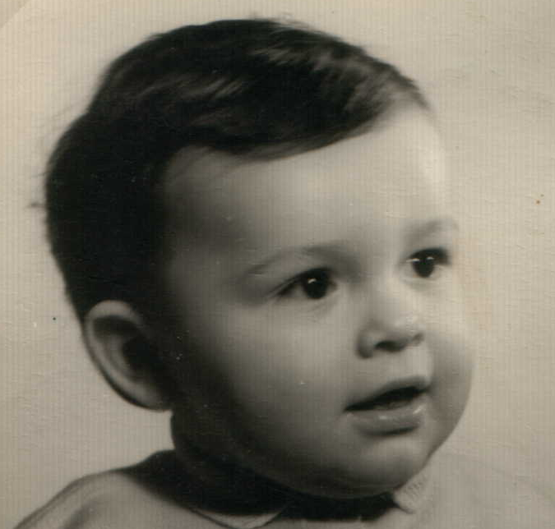

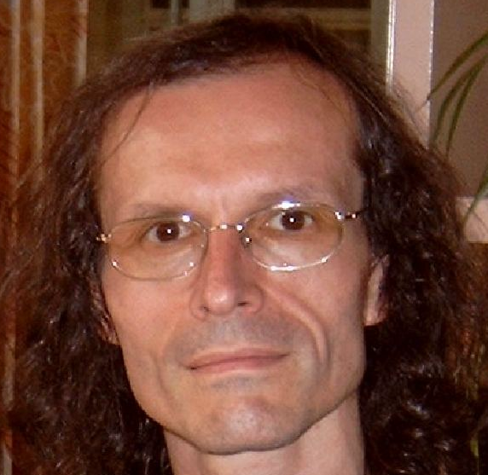
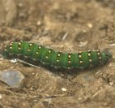
Continuants preserve identity while changing
human
being
me
me
t
Instance-of
in 1960
child
Instance-of
since 1980
adult
living
creature
animal
caterpillar
butterfly

Slide 91
The importance of temporal indexing
benign
tumor
malignant
tumor
stomach
instanceOf at t₂
instanceOf at t₁
instanceOf at t₂
instanceOf at t₁
partOf at t₁
this-4
this-1’s stomach
partOf at t₂

Slide 92
The importance of temporal indexing
benign
tumor
malignant
tumor
stomach
instanceOf at t₂
instanceOf at t₁
instanceOf at t₂
instanceOf at t₁
this-4
partOf at t₁
this-1’s stomach
this-5
partOf at t₂

