Slide 1
Biomedical ontologies: what they are and what they should be.
Lecture in BMI501: Survey of Biomedical Informatics – Oct 2, 2017
Department of Biomedical Informatics, University at Buffalo
Werner CEUSTERS, MD
Ontology Research Group, Center of Excellence in Bioinformatics and Life Sciences,
UB Institute for Healthcare Informatics,
Departments of Biomedical Informatics and Psychiatry,
University at Buffalo, NY, USA

Slide 2
Context of this lecture
Thesis: mainstream ontology design approaches fail in achieving their objectives:
  various sorts of mistakes in ontologies,
  inability to use ontologies adequately in information systems,
  failure to integrate data repositories even if these ontologies are appropriately designed.
Root causes:
  inadequacy of their conceptual semantic foundations,
  lack of knowledge about ontology as a philosophical discipline.
Proposed solution:
  Better use of ontology (the philosophical discipline) to design ontologies (specific sorts of representational artifacts) and integrate them in information systems.

Slide 3
Layout of this lecture
Test on lecture pre-readings;
Highlighting the activities in biomedical informatics that require good insight in ontology;
Contributions of philosophy to science and research relevant for biomedical informaticists;
What is ‘ontology’ and what are ‘ontologies’;
Principles of high quality ontology design and examples of violations thereof in heavily used systems;
Ontological Realism as an example of a discipline based on these principles;
Post-lecture test.

Slide 4
Take home messages
Do justice to the differences between general truths and individual facts:
    e.g. tumors are disorders versus this person has now a tumor.
Do justice to the differences between representations and what they are about:
    ‘tumors are disorders’ versus tumors being disorders,
    ‘this person has now a tumor’ versus this person having now a tumor.
Ontologies (should) contain only representations of general truths, information systems contain representations of individual facts.
Representations are not always faithful to reality.
Ontological Realism helps in creating faithful representations.

Slide 5
Test on pre-lecture readings

Slide 6
Pre-lecture test (1)
What is wrong in this statement:
Early versions of computational ontologies such as the Gene Ontology (GO), the Unified Medical Language System (UMLS) and the National Cancer Institute Thesaurus were criticized by some classical ontologists because of deficiencies in how they related to classical formalisms for representing reality in terms of categories and their instances [40–42].
  From: Maojo V, Crespo J, Garcia-Remesal M, de la Iglesia D, Pérez-Rey D, Kulikowski C. Biomedical Ontologies: Toward scientific debate. Methods Inf Med 2011; 50 (3): 203–216.

Slide 7
Pre-lecture test (2)
The BFO divides occurrents into two types: instantaneous and extended (over time). And, it defines continuants as falling into two categories: independent and dependent. Examples of independents are a cell, a bacterium, an organism (or a person), whereas examples of dependents are functions, qualities, etc [46, 51].
These philosophical specifications for ontological entities are, unfortunately, not necessarily consistent with scientific needs and practice. How can cells or viruses be entirely independent entities, even within a controlled laboratory environment?
      From: Maojo V, Crespo J, Garcia-Remesal M, de la Iglesia D, Pérez-Rey D, Kulikowski C. Biomedical Ontologies: Toward scientific debate. Methods Inf Med 2011; 50 (3): 203–216.
What does the 2nd paragraph tell about the authors of this statement?

Slide 8
Pre-lecture test (3)
What mistake is committed in the following statement?
For example, the distinction between continuants and occurrents does not account for the contrast between reversible and irreversible processes in biology, chemistry, computation, or quantum mechanics.
  From: Maojo V, Crespo J, Garcia-Remesal M, de la Iglesia D, Pérez-Rey D, Kulikowski C. Biomedical Ontologies: Toward scientific debate. Methods Inf Med 2011; 50 (3): 203–216.

Slide 9
Pre-lecture test (4)
True or false, and why?
A challenge for designers of biomedical ontologies is how to include the necessary representational power needed to represent biologically complex systems.
  From: Maojo V, Crespo J, Garcia-Remesal M, de la Iglesia D, Pérez-Rey D, Kulikowski C. Biomedical Ontologies: Toward scientific debate. Methods Inf Med 2011; 50 (3): 203–216.

Slide 10
What is biomedical informatics?

Slide 11
Biomedical Informatics
Definition:
Biomedical informatics (BMI) is
the interdisciplinary field
that studies and pursues the effective uses of biomedical data, information, and knowledge
for scientific inquiry, problem solving, and decision making,
driven by efforts to improve human health.
CA Kulikowski, EH Shortliffe, LM Currie, PL Elkin, LE Hunter, TR Johnson, IJ Kalet, LA Lenert, MA Musen, JG Ozbolt, JW Smith, PZ Tarczy-Hornoch, JWilliamson; AMIA Board white paper: definition of biomedical informatics and specification of core competencies for graduate education in the discipline, Journal of the American Medical Informatics Association, Volume 19, Issue 6, 1 November 2012, Pages 931–938, https://doi.org/10.1136/amiajnl-2012-001053

Slide 12
Biomedical Informatics
Definition:
Biomedical informatics (BMI) is
the interdisciplinary field
that studies and pursues the effective uses of biomedical data, information, and knowledge
for scientific inquiry, problem solving, and decision making,
driven by efforts to improve human health.
CA Kulikowski, EH Shortliffe, LM Currie, PL Elkin, LE Hunter, TR Johnson, IJ Kalet, LA Lenert, MA Musen, JG Ozbolt, JW Smith, PZ Tarczy-Hornoch, JWilliamson; AMIA Board white paper: definition of biomedical informatics and specification of core competencies for graduate education in the discipline, Journal of the American Medical Informatics Association, Volume 19, Issue 6, 1 November 2012, Pages 931–938, https://doi.org/10.1136/amiajnl-2012-001053

Slide 13
Current mainstream informatics thinking
knowledge
information
data

Slide 14
Current mainstream informatics thinking
?
knowledge
information
data

Slide 15
Current mainstream informatics thinking
wisdom
knowledge
information
data

Slide 16
Current mainstream informatics thinking
wisdom
knowledge
- representation
information
- representation
data
- representation

Slide 17
Where do data come from?
References
knowledge
- representation
information
- representation
data
- representation
Reality
What is there on the side of the patient
Referents

Slide 18
Where do data come from?
References
knowledge
- representation
information
- representation
data
- representation
Questions not often enough asked:
What part of our data corresponds with something out there in reality ?
What part of reality is not captured by our data, but should because it is relevant ?
Reality
What is there on the side of the patient
Referents

Slide 19
Where do data come from?
References
knowledge
- representation
information
- representation
data
- representation
Questions not often enough asked:
What part of our data corresponds with something out there in reality ?
What part of reality is not captured by our data, but should because it is relevant ?
Ontology
- representation
Reality
What is there on the side of the patient
Referents

Slide 20
Where do data come from?
However !!!
References
knowledge
- representation
information
- representation
data
- representation
Questions not often enough asked:
What part of our data corresponds with something out there in reality ?
What part of reality is not captured by our data, but should because it is relevant ?
Ontology
- representation
Reality
What is there on the side of the patient
Referents

Slide 21
Also representations are real!
References
knowledge
- representation
information
- representation
data
- representation
Questions not often enough asked:
What part of our data corresponds with something out there in reality ?
What part of reality is not captured by our data, but should because it is relevant ?
Ontology
- representation
Reality
What is there on the side of the patient
Referents

Slide 22
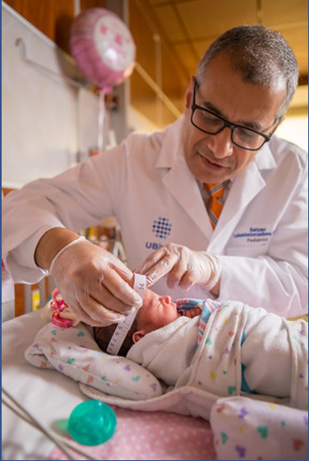
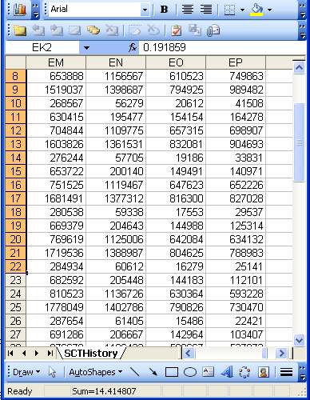
Beings, happenings and descriptions
(research) domain
(research) data
Beings & happenings
Descriptions

Slide 23
Biomedical Informatics
Definition:
Biomedical informatics (BMI) is
the interdisciplinary field
that studies and pursues the effective uses of biomedical data, information, and knowledge
for scientific inquiry, problem solving, and decision making,
driven by efforts to improve human health.
CA Kulikowski, EH Shortliffe, LM Currie, PL Elkin, LE Hunter, TR Johnson, IJ Kalet, LA Lenert, MA Musen, JG Ozbolt, JW Smith, PZ Tarczy-Hornoch, JWilliamson; AMIA Board white paper: definition of biomedical informatics and specification of core competencies for graduate education in the discipline, Journal of the American Medical Informatics Association, Volume 19, Issue 6, 1 November 2012, Pages 931–938, https://doi.org/10.1136/amiajnl-2012-001053

Slide 24
Definition of ‘science’
keywords
3a : knowledge or a system of knowledge covering general truths or the operation of general laws especially as obtained and tested through the scientific method.
3b : such knowledge or such a system of knowledge concerned with the physical world and its phenomena: natural science.
http://www.merriam-webster.com/dictionary/science

Slide 25
Definition of ‘science’
keywords
3a : knowledge or a system of knowledge covering general truths or the operation of general laws especially as obtained and tested through the scientific method.
3b : such knowledge or such a system of knowledge concerned with the physical world and its phenomena: natural science.
http://www.merriam-webster.com/dictionary/science

Slide 26
Definition of ‘research’
careful or diligent search.
studious inquiry or examination; especially :
investigation or experimentation
aimed at
- the discovery and interpretation of facts,
- revision of accepted theories or laws in the light of new facts,
- or practical application of such new or revised theories or laws.
the collecting of information about a particular subject.
http://www.merriam-webster.com/dictionary/research

Slide 27
Definition of ‘research’
Keywords?
careful or diligent search.
studious inquiry or examination; especially :
investigation or experimentation
aimed at
- the discovery and interpretation of facts,
- revision of accepted theories or laws in the light of new facts,
- or practical application of such new or revised theories or laws.
the collecting of information about a particular subject.
http://www.merriam-webster.com/dictionary/research

Slide 28
Definition of ‘research’
keywords
careful or diligent search.
studious inquiry or examination; especially :
investigation or experimentation
aimed at
- the discovery and interpretation of facts,
- revision of accepted theories or laws in the light of new facts,
- or practical application of such new or revised theories or laws.
the collecting of information about a particular subject.
http://www.merriam-webster.com/dictionary/research

Slide 29
Definition of ‘research’
keywords
careful or diligent search
studious inquiry or examination; especially :
investigation or experimentation
aimed at
- the discovery and interpretation of facts,
- revision of accepted theories or laws in the light of new facts,
- or practical application of such new or revised theories or laws
the collecting of information about a particular subject
http://www.merriam-webster.com/dictionary/research

Slide 30
Beings, happenings and descriptions
(research) domain
(research) data
Beings & happenings
Descriptions
https://ubphoto.smugmug.com/Years/2017/17011-Medicine-Satyanarayana-Lakshminrusimha-Newborn-MFS/i-Vj8g6p2

Slide 31
Beings, happenings and descriptions
(research) domain
(research) data
Beings & happenings
Descriptions
https://ubphoto.smugmug.com/Years/2017/17011-Medicine-Satyanarayana-Lakshminrusimha-Newborn-MFS/i-Vj8g6p2

Slide 32
Three relevant disciplines
(research) domain
(research) data
Beings & happenings
Descriptions
https://ubphoto.smugmug.com/Years/2017/17011-Medicine-Satyanarayana-Lakshminrusimha-Newborn-MFS/i-Vj8g6p2

Slide 33
Three relevant disciplines: (1)
Data science:
‘an interdisciplinary field about scientific methods, processes, and systems to extract knowledge or insights from data in various forms, either structured or unstructured, similar to data mining’.
(research) data
https://en.wikipedia.org/wiki/Data_science
Beings & happenings
Descriptions

Slide 34
Three relevant disciplines: (2)
Statistics:
‘a branch of mathematics dealing with the collection, analysis, interpretation, presentation, and organization of data’.
(research) data
https://en.wikipedia.org/wiki/Statistics
Beings & happenings
Descriptions

Slide 35
Three relevant disciplines: (3)
Several branches of philosophy:
Philosophy of science
Ontology
(research) data
Beings & happenings
Descriptions

Slide 36

Philosophy of science: use(ful/less)?
‘Philosophy of science is about as useful to scientists as ornithology is to birds’.
    Attributed to Richard Feynman in Donald E. Simanek and John C. Holden, Science Askew: A Light-Hearted Look at the Scientific World (Philadelphia: Institute of Physics Publishing, 2002) , 215.
Feynman photo © Richard Hartt/Caltech archives

Slide 37
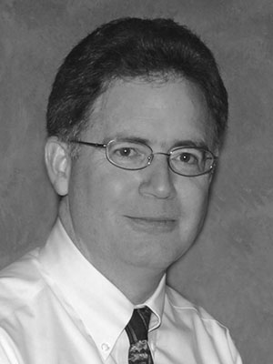
Philosophy of science: use(ful/less)?
‘Philosophy of science is about as useful to scientists as ornithology is to birds’.
    Attributed to Richard Feynman in Donald E. Simanek and John C. Holden, Science Askew: A Light-Hearted Look at the Scientific World (Philadelphia: Institute of Physics Publishing, 2002) , 215.
Feynman photo © Richard Hartt/Caltech archives
‘Science can't be free of philosophy any more than baseball can be free of physics’.
    Jeffrey L. Kasser, Ph.D. http://www.thegreatcourses.com/courses/philosophy-of-science.html#BVRRWidgetID

Slide 38
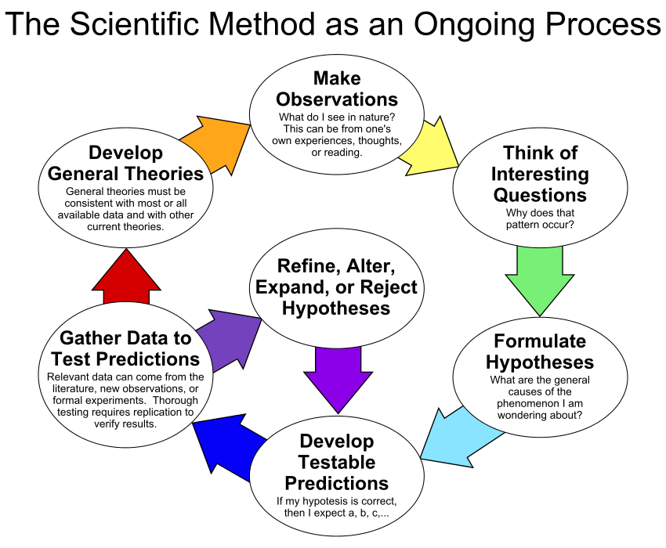
By ArchonMagnus - Own work, CC BY-SA 4.0, https://commons.wikimedia.org/w/index.php?curid=42164616

Slide 39
Scientific Objectivity (1)
Objectivity as Faithfulness to Facts
Objectivity as Absence of Normative Commitments and the Value-Free Ideal

Slide 40
Scientific Objectivity (1)
Objectivity as Faithfulness to Facts
Objectivity as Absence of Normative Commitments and the Value-Free Ideal
Objectivity as Freedom from Personal Biases
  Measurement and Quantification
  Inductive and Statistical Inference

Slide 41
Scientific Objectivity (2)
Science is objective in that, or to the extent that:
its products—theories, laws, experimental results and observations—constitute accurate representations of the external world. The products of science are not tainted by human desires, goals, capabilities or experience.
  product objectivity
the processes and methods that characterize it neither depend on contingent social and ethical values, nor on the individual bias of a scientist
  → process objectivity.
http://plato.stanford.edu/entries/scientific-objectivity

Slide 42
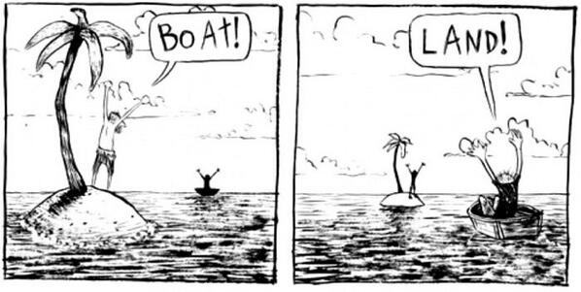
The view from nowhere
There are two kinds of qualities: ones that vary with the perspective one has or takes, and ones that remain constant through changes of perspective. The latter are the objective properties.
http://plato.stanford.edu/entries/scientific-objectivity

Slide 43
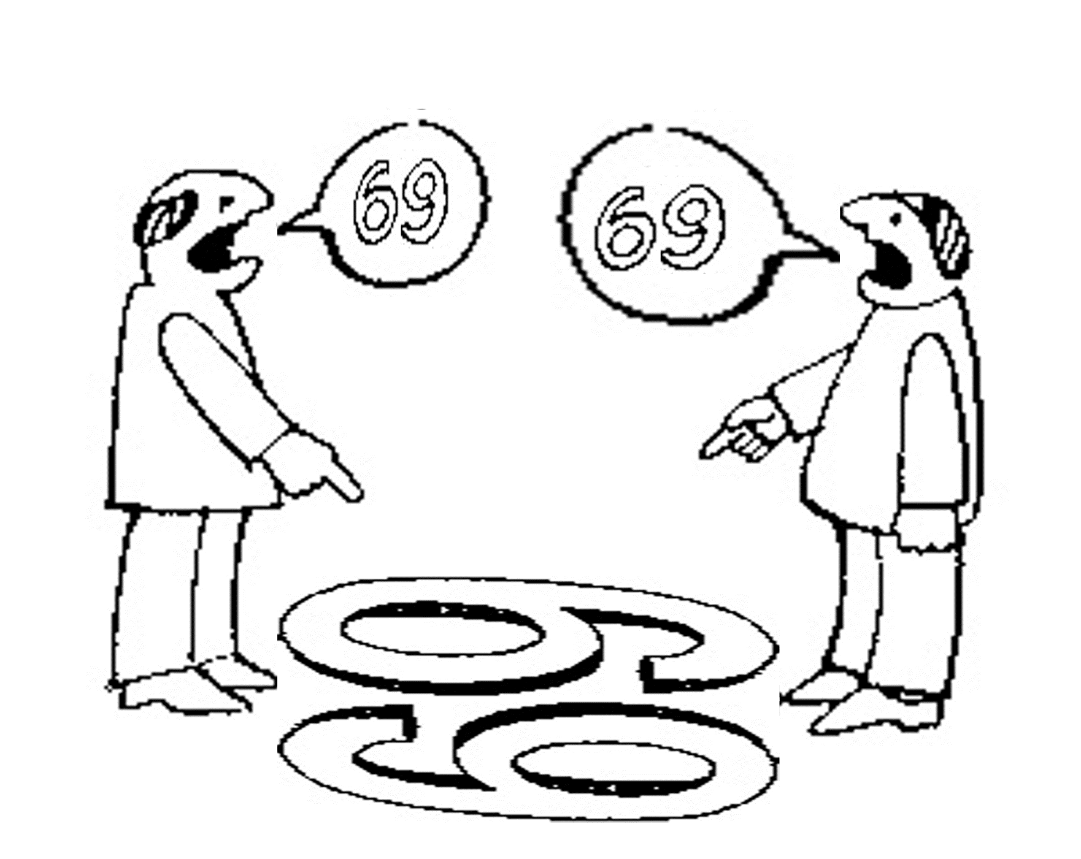
Which of the two quality types are taken as basis here?
six
nine

Slide 44
Which of the two quality types are taken as basis here?
nine
six

Slide 45
And here?
sixty
nine
sixty
nine

Slide 46
What is ontology?

Slide 47
‘Ontology’
In philosophy:
  Ontology (no plural) is the study of what entities exist and how they relate to each other;

Slide 48
‘Ontology’
In philosophy:
  Ontology (no plural) is the study of what entities exist and how they relate to each other;
  by some philosophers taken to be synonymous with ‘metaphysics’ while others draw distinctions in many distinct ways (the distinctions being irrelevant for this talk), but almost agreeing on the following classification:
    metaphysics → studies ‘how is the world?’
      general metaphysics → studies general principles and ‘laws’ about the world
        ontology → studies what type of entities exist in the world
      special metaphysics → focuses on specific principles and entities
  distinct from ‘epistemology’ which is the study of how we can come to know about what exists.
  distinct from ‘terminology’ which is the study of what terms mean and how to name things.

Slide 49
The Terminology / Ontology divide
Terminology:
  solves certain issues related to language use, i.e. with respect to how we talk about entities in reality (if any);
    Relations between terms / concepts
  does not provide an adequate means to represent independent of use what we talk about, i.e. how reality is structured;
    Women, Fire and Dangerous Things (Lakoff).
Ontology (of the right sort):
  Language and perception neutral view on reality.
    Relations between entities in first-order reality
This is the ‘terminology / ontology divide’

Slide 50
Distinct questions. What type are they of?
Terminological:
  what does ‘pain’ mean ?
Metaphysical:
  what have all pains in common in virtue of which they are pains?
Ontological:
  what type of entity is pain?
Onto-terminological:
  what, if anything at all, does ‘pain’ denote?
Epistemological:
  how can we find out whether something is pain?

Slide 51
Unfortunately, ‘ontology’ denotes ambiguously
In philosophy:
  Ontology (no plural) is the study of what entities exist and how they relate to each other;
In computer science and many biomedical informatics applications:
  An ontology (plural: ontologies) is a shared and agreed upon conceptualization of a domain;

Slide 52
Computer science approach to ontology
Ontology
Authoring Tools
create
Domain
Ontologies
Reasoners
Semantic
Applications
use

Slide 53
Computer science approach to ontology
Ontology
Authoring Tools
the logic in reasoners:
guarantees consistent reasoning,
does not guarantee the faithfulness of the representation.
create
Domain
Ontologies
Reasoners
Semantic
Applications
use

Slide 54
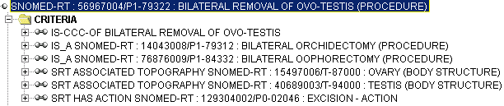
Consistent reasoning with nonsensical representations
Ceusters W, Smith B, Flanagan J. Ontology and Medical Terminology: why Descriptions Logics are not enough. Proceedings of the conference Towards an Electronic Patient Record (TEPR 2003),
San Antonio, 10-14 May 2003 (electronic publication 5pp)

Slide 55
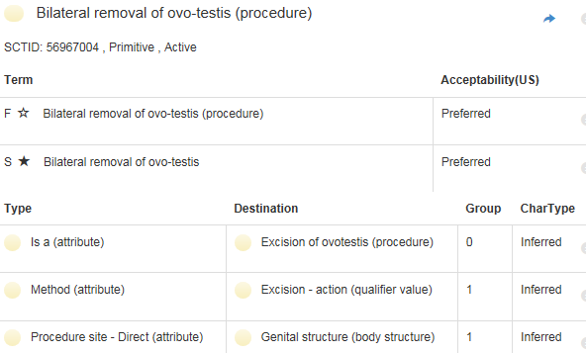
Correction
http://browser.ihtsdotools.org/
Oct 14, 2015

Slide 56

Philosophical approach to ontology
Ontological Realism: uses ontology as philosophical discipline to build ontologies as faithful representations of reality.

Slide 57
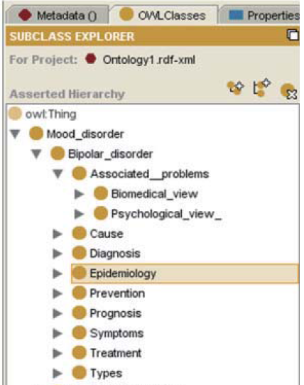
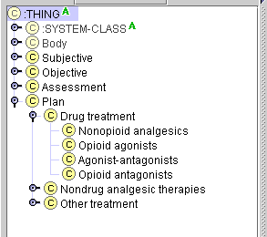
Two abundantly present fundamental mistakes (1)
The problems:
erroneous domain analysis
violations against representation language semantics

Slide 58
Another example: misunderstood semantics
<business-card>
  <name> John Nitwit </name>
  <address>
  <street> 524 Moon base avenue </street>
  <city> Utopia </city>
  </address>
  <phone> … </phone>
  …
</business-card>
Is this the name of the business card or of the business card owner?

Slide 59
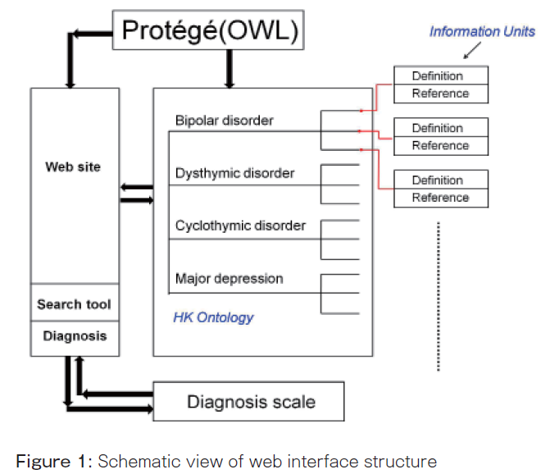
Two abundantly present fundamental mistakes (2)
You can’t exchange mental illnesses through websites or have Protégé interact with illnesses;
= confusing information with what information is about!

Slide 60
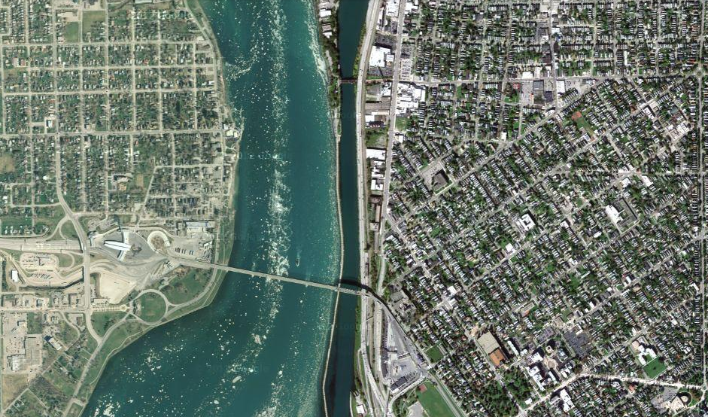
Satellite view

Slide 61
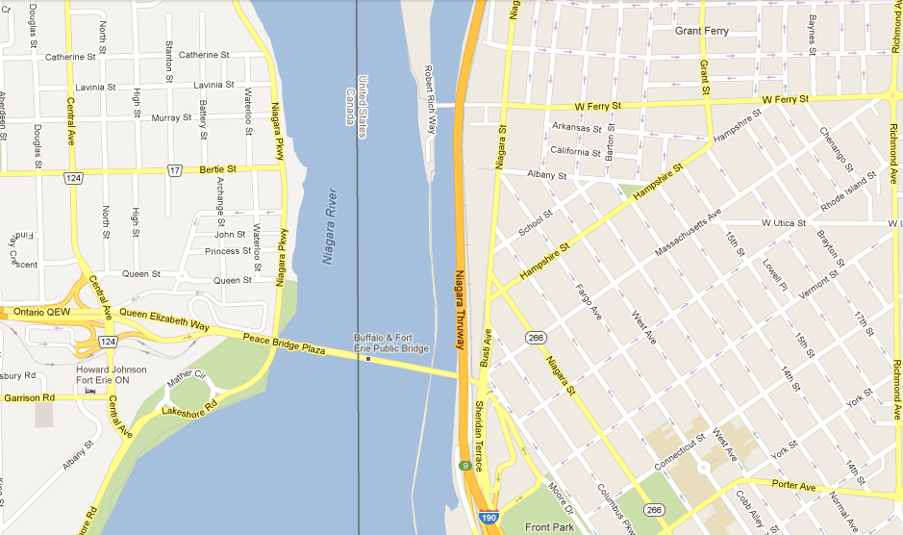
Map

Slide 62
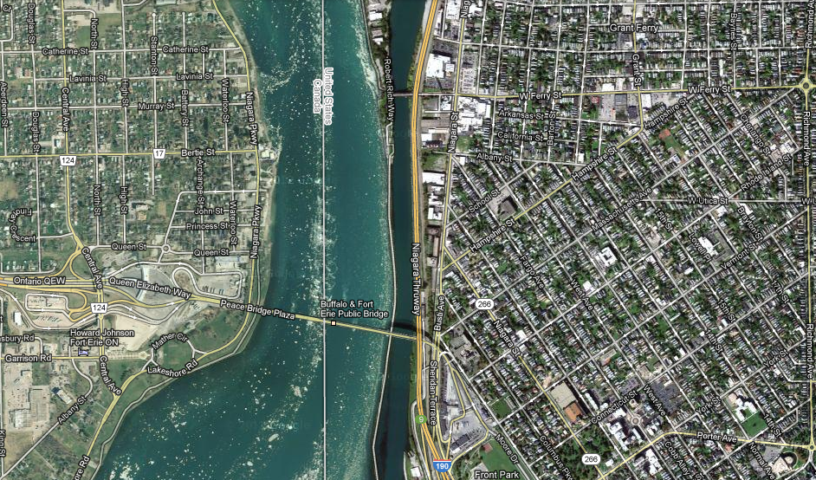
Map overlay

Slide 63
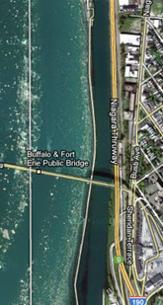
Map ←→ Reality
A message to map makers: “Highways are not painted red, rivers don’t have county lines running down the middle, and you can’t see contour lines on a mountain”
W. Kent. Data and Reality. North-Holland, Amsterdam, the Netherlands, 1978.

Slide 64
Main data ←→ reality views
Nominalism:
  there are no generic entities in reality: there is no personhood, there are only individual persons.
Conceptualism:
  generalizations are in our ‘minds’. Personhood is a concept construed in our ‘mind’ that allows us to reason about persons without any particular person in mind.
Realism:
  generic entities do exist and are called ‘universals’. Each particular person is an instance of the universal we call ‘person’.

Slide 65
Main data ←→ reality views
Nominalism:
  there are no generic entities in reality: there is no personhood, there are only individual persons.
Conceptualism: ← mainstream approach
  generalizations are in our ‘minds’. Personhood is a concept construed in our ‘mind’ that allows us to reason about persons without any particular person in mind.
Realism: ← our approach
  generic entities do exist and are called ‘universals’. Each particular person is an instance of the universal we call ‘person’.

Slide 66
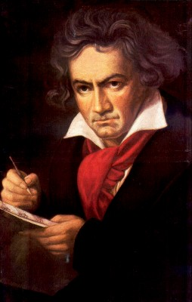
The semantic/semiotic triangle
Ludwig van Beethoven
that great German composer that became deaf
…
concept
term
referent
‘Beethoven’

Slide 67
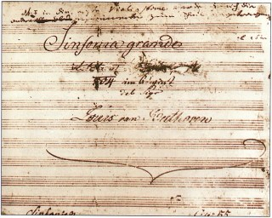
The semantic triangle works sometimes fine
Beethoven’s symphony dedicated to Bonaparte
the symphony played after the Munich Olympics massacre
…
concept
term
referent
‘Eroica’
‘Beethoven's Symphony No. 3’
‘Beethoven's Opus 55’

Slide 68
Sometimes the semantic triangle fails
the symphony Beethoven wrote after the tenth
…
concept
term
referent
‘Beethoven's Symphony No. 11’

Slide 69
Sometimes the semantic triangle fails
the symphony Beethoven wrote after the tenth
…
some hold this term has meaning
concept
term
referent
‘Beethoven's Symphony No. 11’

Slide 70
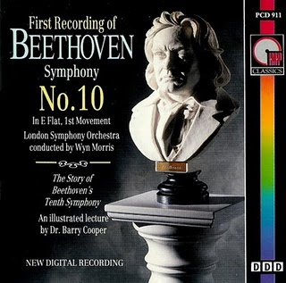
Sometimes the semantic triangle fails
the one assembled by Barry Cooper from fragmentary sketches
Beethoven’s hypothetical symphony
…
concept
term
referent
‘Beethoven's Symphony No. 10’

Slide 71
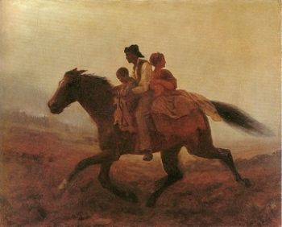
Prehistoric ‘psychiatry’: drapetomania
disease which causes slaves to suffer from an unexplainable propensity to run away
…
concept
term
referent
painting by Eastman Johnson. A Ride for Liberty: The Fugitive Slaves. 1860.
‘drapetomania’

Slide 72
The questions the triangle raises become trickier
Is …
  Beethoven’s 10th symphony a symphony ?
  Beethoven’s 10th symphony a hypothetical symphony ?
  a hypothetical symphony a symphony ?
In medicine, is …
  a prevented abortion an abortion ?
  an absent nipple a nipple ?

Slide 73
SNOMED about diseases and concepts (until 2010)
‘Disorders are concepts in which there is an explicit or implicit pathological process causing a state of disease which tends to exist for a significant length of time under ordinary circumstances.’
And also: “Concepts are unique units of thought”.
Thus: Disorders are unique units of thoughts in which there is a pathological process …???
And thus: to eradicate all diseases in the world at once we simply should stop thinking ?

Slide 74
Where it began: classification systems and taxonomies

Slide 75
Adequate taxonomy design and classification
Taxonomy design:
Identify examples of particulars (‘individuals’, ‘things’, ‘entities’, …) you want to classify;
Identify the various characteristics that are possessed by (all or some of) these individual entities;
Identify groups (classes) on the basis of combinations of characteristics that co-occur;
Organize the groups hierarchically (‘parent-child’) so that characteristics that apply to a ‘parent’ (‘grandparent’,…) group apply to ALL groups beneath it;
Name the groups with terms that have face value.
Classification:
Assign individual entities to the groups that correspond with the combination of characteristics they exhibit.

Slide 76
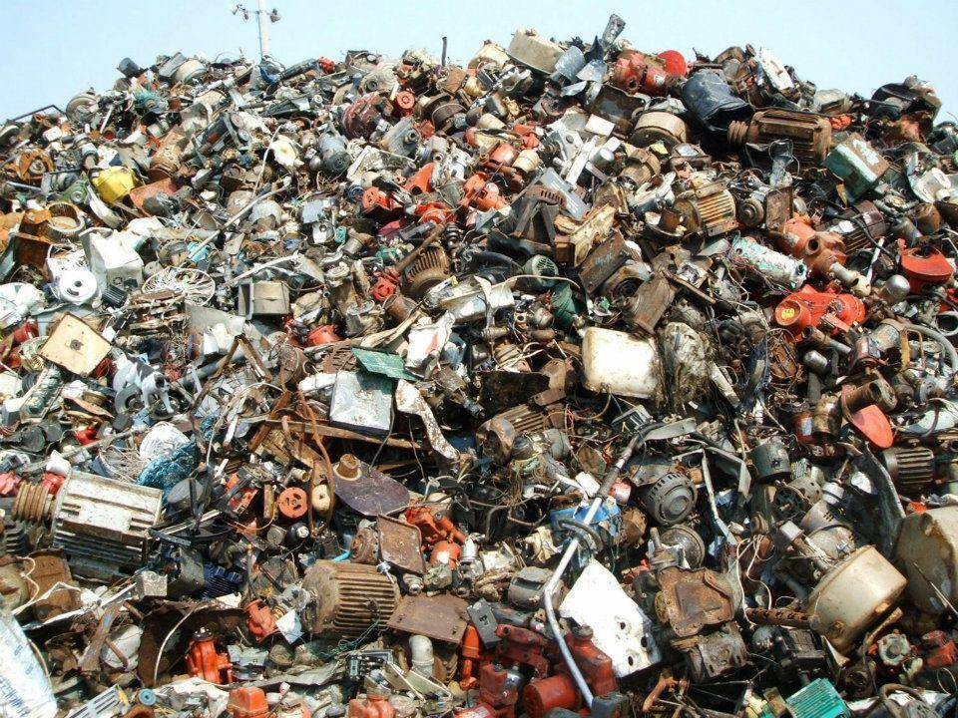
A large collection of individual entities
https://clipartfest.com/download/c2bd0a0071663cef17ac2126d73bf9350a9d15e2.html

Slide 77
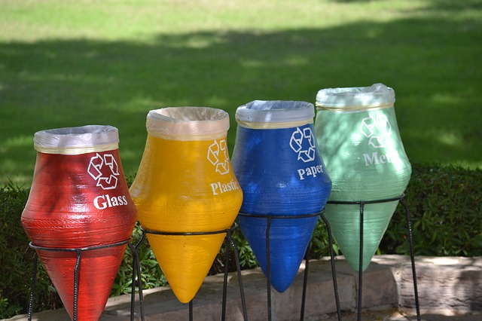
Groups based on material composition

Slide 78
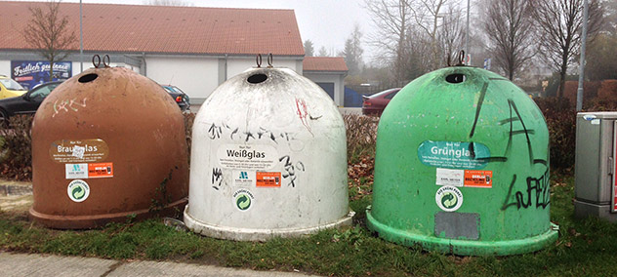
Groups for glass divided by color

Slide 79
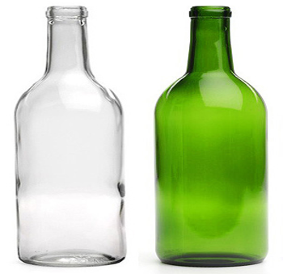

Slide 80
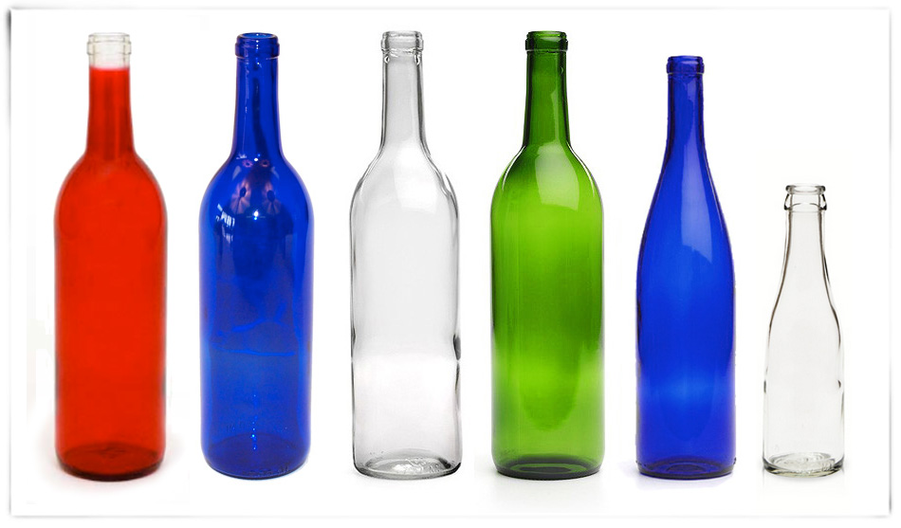

Slide 81
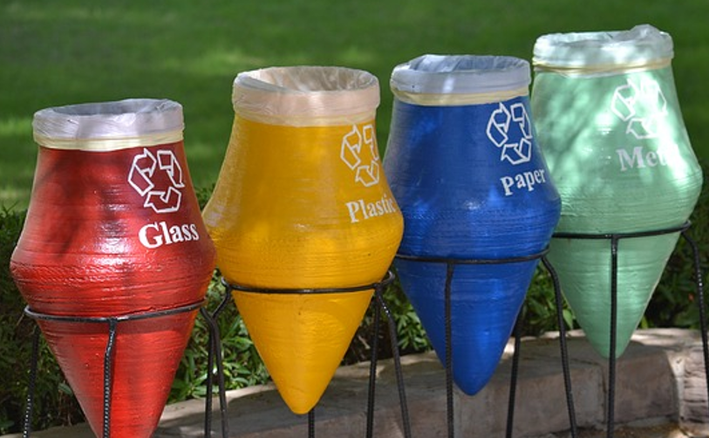


Slide 82


Slide 83
Naïve designs and principles that are often violated

Slide 84
Border’s classification of medicine: what’s wrong ?
Medicine
  Mental health
  Internal medicine
    Endocrinology
      Oversized endocrinology
    Gastro-enterology
    ...
  Pediatrics
  ...
  Oversized medicine
Refer to the size of the books that do not fit on a normal Border’s Bookshop shelf

Slide 85
Similar mistake in ICHD
‘13.1.2.4 Painful trigeminal neuropathy attributed to MS plaque’
‘attributed to’ relates to somebody’s opinion about what is the case, not to what is the case.
  the mistake: a feature on the side of the clinician – his (not) knowing - is taken to be a feature on the side of the patient.
Similar mistakes:
  ‘Probable migraine’
  ‘facial pain of unknown origin’ (not in ICHD).

Slide 86
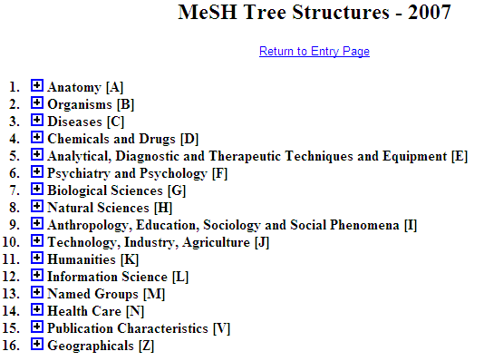
Is this a good idea ?
Cover subject matter of papers
Cover the form of papers

Slide 87
Principle
A representation should not mix object language and meta language
  object language describes the referents in the subject domain
  meta language describes the object language

Slide 88
Geographic Locations: a good hierarchy ?
Africa [Z01.058] +
Americas [Z01.107] +
Antarctic Regions [Z01.158]
Arctic Regions [Z01.208]
Asia [Z01.252] +
Atlantic Islands [Z01.295] +
Australia [Z01.338] +
Cities [Z01.433] +
Europe [Z01.542] +
Historical Geographic Locations [Z01.586] +
Indian Ocean Islands [Z01.600] +
Oceania [Z01.678] +
Oceans and Seas [Z01.756] +
Pacific Islands [Z01.782] +
mereological mess:
mixture of geographic entities with socio-political entities
mixture of space and time

Slide 89
Geographic Locations [Z01]
Africa [Z01.058] +
Americas [Z01.107] +
Antarctic Regions [Z01.158]
Arctic Regions [Z01.208]
Asia [Z01.252] +
Atlantic Islands [Z01.295] +
Australia [Z01.338] +
Cities [Z01.433] +
Europe [Z01.542] +
Historical Geographic Locations [Z01.586] +
Indian Ocean Islands [Z01.600] +
Oceania [Z01.678] +
Oceans and Seas [Z01.756] +
Pacific Islands [Z01.782] +
Ancient Lands [Z01.586.035] +
Austria-Hungary [Z01.586.117]
Commonwealth of Independent States [Z01.586.200] +
Czechoslovakia [Z01.586.250] +
European Union [Z01.586.300]
Germany [Z01.586.315] +
Korea [Z01.586.407]
Middle East [Z01.586.500] +
New Guinea [Z01.586.650]
Ottoman Empire [Z01.586.687]
Prussia [Z01.586.725]
Russia (Pre-1917) [Z01.586.800]
USSR [Z01.586.950] +
Yugoslavia [Z01.586.980] +

Slide 90
Geographic Locations [Z01]
Africa [Z01.058] +
Americas [Z01.107] +
Antarctic Regions [Z01.158]
Arctic Regions [Z01.208]
Asia [Z01.252] +
Atlantic Islands [Z01.295] +
Australia [Z01.338] +
Cities [Z01.433] +
Europe [Z01.542] +
Historical Geographic Locations [Z01.586] +
Indian Ocean Islands [Z01.600] +
Oceania [Z01.678] +
Oceans and Seas [Z01.756] +
Pacific Islands [Z01.782] +
Ancient Lands [Z01.586.035] +
Austria-Hungary [Z01.586.117]
Commonwealth of Independent States [Z01.586.200] +
Czechoslovakia [Z01.586.250] +
European Union [Z01.586.300]
Germany [Z01.586.315] +
Korea [Z01.586.407]
Middle East [Z01.586.500] +
New Guinea [Z01.586.650]
Ottoman Empire [Z01.586.687]
Prussia [Z01.586.725]
Russia (Pre-1917) [Z01.586.800]
USSR [Z01.586.950] +
Yugoslavia [Z01.586.980] +

Slide 91
Principle
A hierarchical structure should not represent distinct hierarchical relations unless they are formally characterized

Slide 92
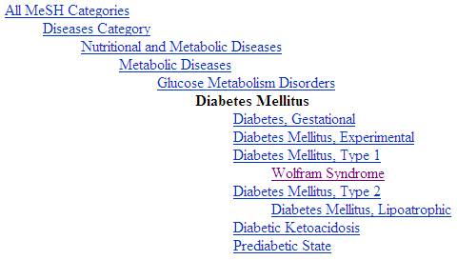
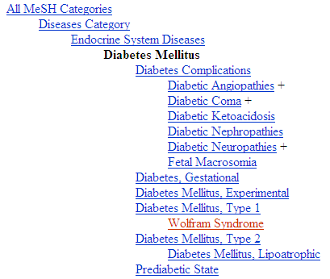
Diabetes Mellitus in MeSH 2008
?
Different set of more specific terms when different path from the top is taken.

Slide 93
MeSH: some paths from top to Wolfram Syndrome
All MeSH Categories
Diseases Category
Nervous System Diseases
Female Urogenital Diseases
and Pregnancy Complications
Eye Diseases
Male Urogenital
Diseases
Cranial Nerve
Diseases
Female Urogenital Diseases
Optic Nerve
Diseases
Neurodegenerative
Diseases
Optic Nerve
Diseases
Eye Diseases,
Hereditary
Heredodegenerative
Disorders,
Nervous System
Urologic Diseases
Optic Atrophy
Kidney Diseases
Optic Atrophies,
Hereditary
Diabetes Insipidus
Wolfram Syndrome

Slide 94

What would it mean if used in the context of a patient ?
All MeSH Categories
???
Diseases Category
Nervous System Diseases
Female Urogenital Diseases
and Pregnancy Complications
Eye Diseases
Male Urogenital
Diseases
Cranial Nerve
Diseases
Female Urogenital Diseases
…
Neurodegenerative
Diseases
Optic Nerve
Diseases
Optic Nerve
Diseases
Eye Diseases,
Hereditary
has
Heredodegenerative
Disorders,
Nervous System
Urologic Diseases
Optic Atrophy
Kidney Diseases
Optic Atrophies,
Hereditary
Diabetes Insipidus
has
Wolfram Syndrome

Slide 95
Principle
If a particular (individual) is related in a specific way to a ‘class’, it should also be related in the same way to all the ‘superclasses’ of that class
  Technically: “… to all the classes that subsume that class”

Slide 96
MeSH Tree Structures – 2007
Body Regions [A01]
  Extremities [A01.378]
    Lower Extremity [A01.378.610]
      Buttocks [A01.378.610.100]
      Foot [A01.378.610.250]
        Ankle [A01.378.610.250.149]
        Forefoot, Human [A01.378.610.250.300] +
        Heel [A01.378.610.250.510]
      Hip [A01.378.610.400]
      Knee [A01.378.610.450]
      Leg [A01.378.610.500]
      Thigh [A01.378.610.750]
What’s bad practice ?

Slide 97
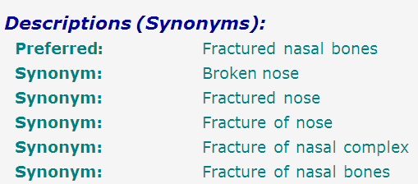
SNOMED-CT: what is wrong here?
bones
nose
fracture
false synonymy

Slide 98
Coding / Classification confusion
P + X
P + Y
P + Z
A patient with a fractured nasal bone
A patient with a fractured nasal bone
=
=
A patient with a broken nose
A patient with a broken nose
=
=
A patient with a fracture of the nose
A patient with a fracture of the nose

Slide 99
Avoid these problems by using Ontological Realism

Slide 100
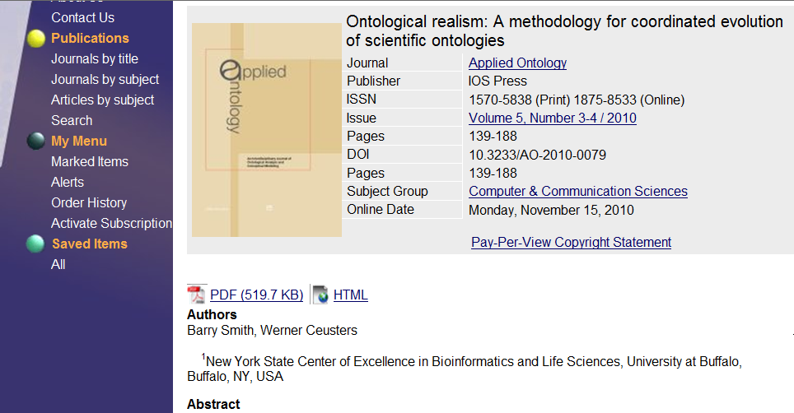
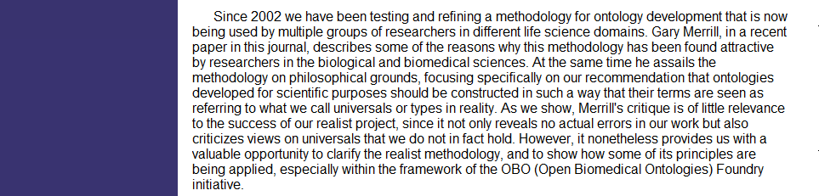

Slide 101
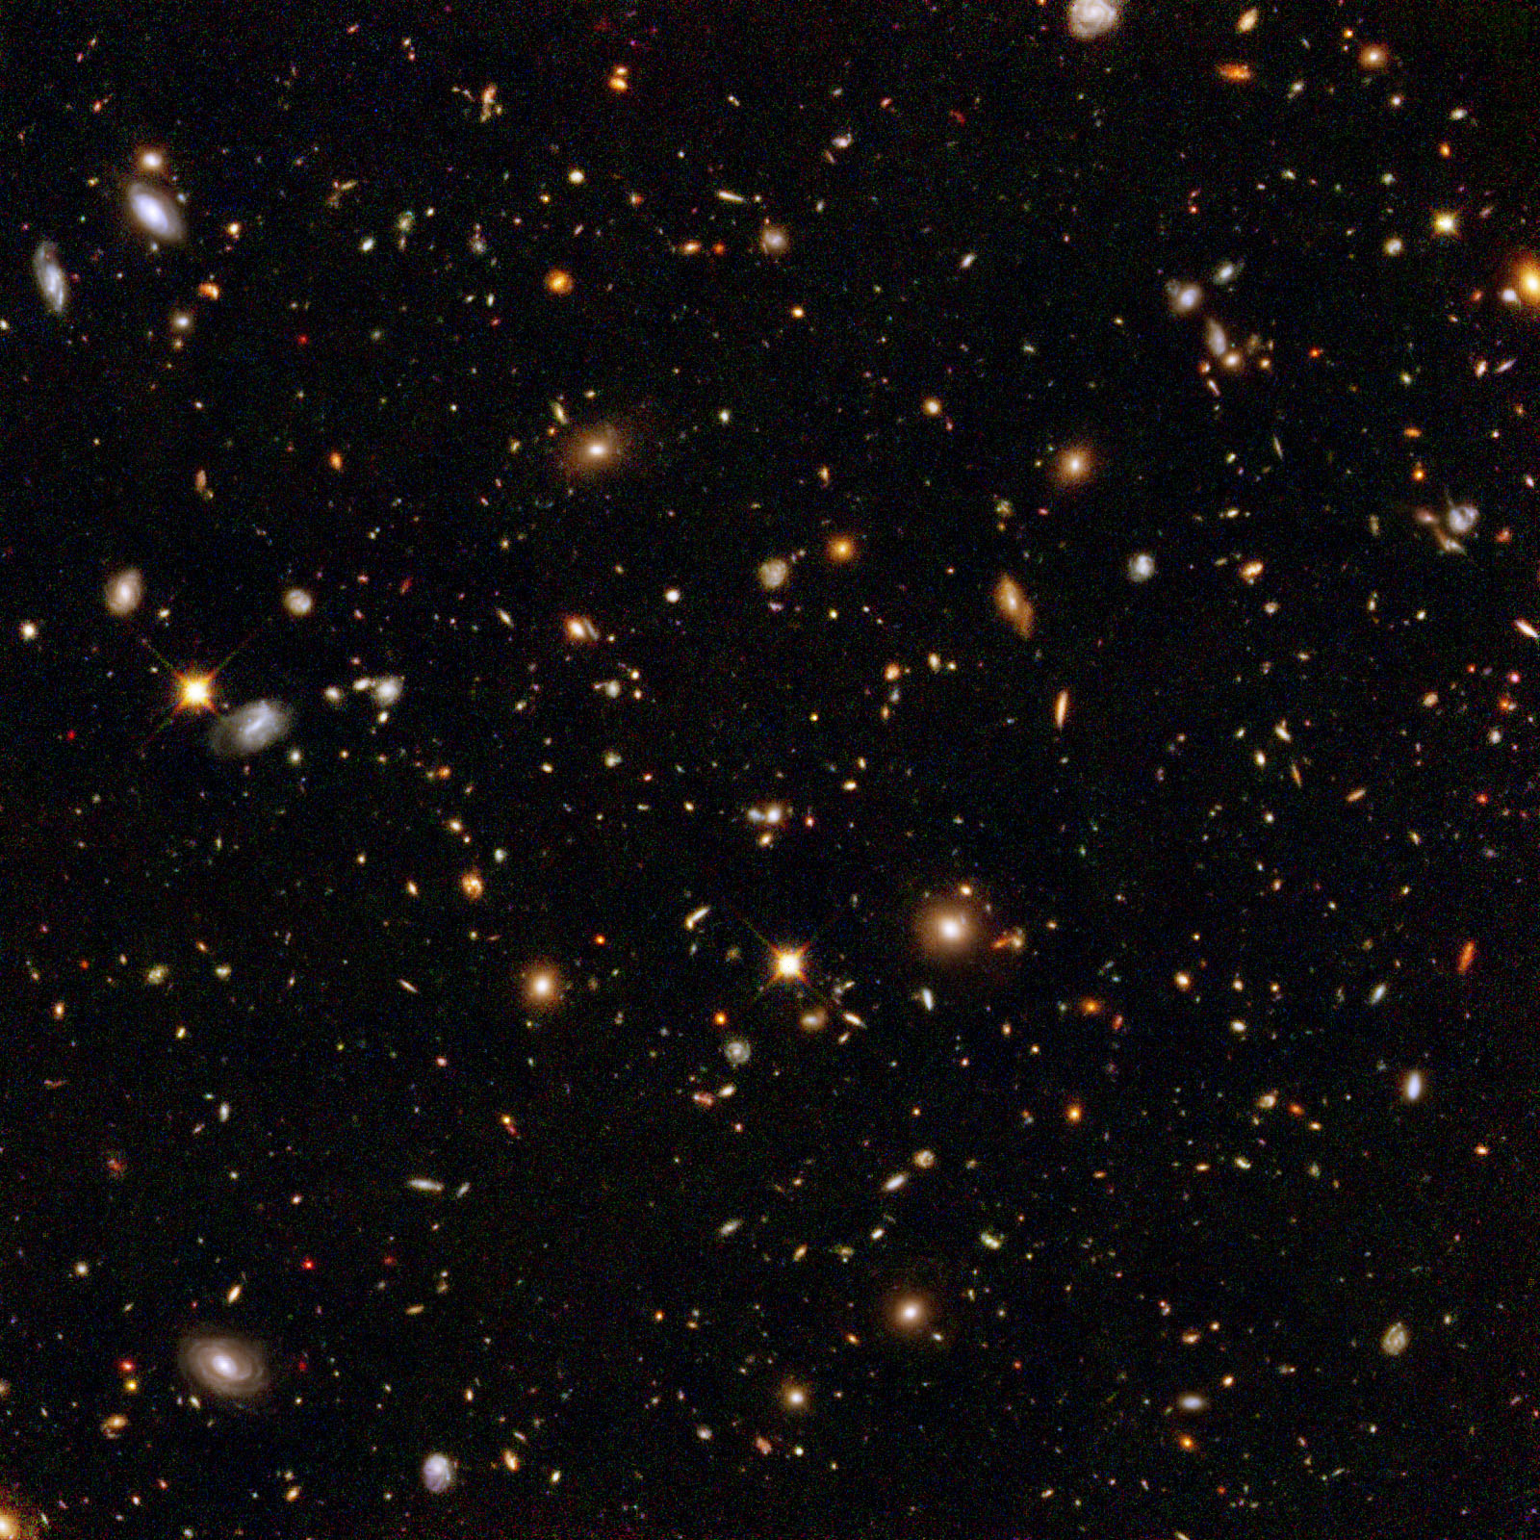
The basis of Ontological Realism
There is an external reality which is ‘objectively’ the way it is;
That reality is accessible to us;
We build in our brains cognitive representations of reality;
We communicate with others about what is there, and what we believe there is there.
Smith B, Kusnierczyk W, Schober D, Ceusters W. Towards a Reference Terminology for Ontology Research and Development in the Biomedical Domain. Proceedings of KR-MED 2006, Biomedical Ontology in Action, November 8, 2006, Baltimore MD, USA

Slide 102
Conceptualism versus Ontological Realism
First order reality
concept
universal
term
referent
representational
unit
particular
Conceptualism
Ontological Realism

Slide 103
Ontological Realism offers three ways of relating, without assigning beliefs (concepts) a central status
drapetomania
slave
running away
mental disorder
propensity
How beliefs are / can
be related
How terms are related
How referents (in
reality) are related

Slide 104
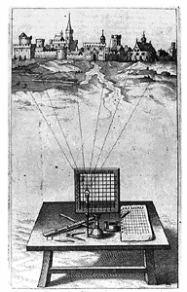
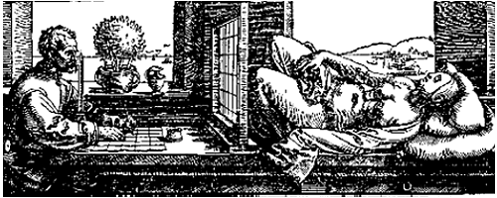
A useful parallel: Alberti’s grid
reality
Ontological
theory
representation

Slide 105
Ontological Realism makes three crucial distinctions
Between data and what data are about;
Between continuants and occurrents;
Between what is generic and what is specific.
Smith B, Ceusters W. Ontological Realism as a Methodology for Coordinated Evolution of Scientific Ontologies. Applied Ontology, 2010.

Slide 106
The oddities when not making these distinctions
  ReMINE’s notion of adverse event
  an ‘incident [that] occurred during the past and [is] documented in a database of adverse events’
      Stefano Arici, Paolo Bertele. ReMINE Deliverable D4.1 – RAPS Taxonomy: approach and definition. V1.0 (Final) August 8, 2008. (p21)
… which is a ‘perdurant’ - ibidem (p26)
… ‘that occurs to a patient’ - ibidem (p23)
  an expectation of some future happening that can be prevented - ibidem (p23)

Slide 107
Terminologists agree, ontologists think …
Can something which is an incident be at the same time an expectation ?
Can something which is an incident a time t, later become an adverse event simply because it [?] has been entered in a database ?
Can adverse events really occur in software ?
…

Slide 108
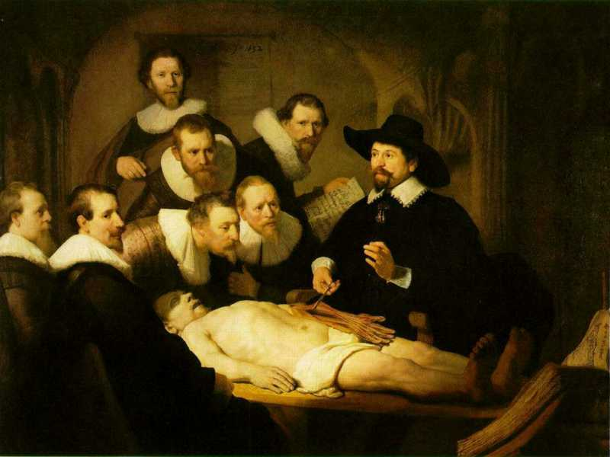
Data versus what data are about;

Slide 109
L3
Linguistic representations about (1), (2) or (3)
L2
Clinicians’ beliefs about (1)
Representations
First Order Reality
Entities (particular or generic) with objective existence which are not about anything
L1⁻

Slide 110
Mixing L1- and L3
‘13.1.2.4 Painful Trigeminal neuropathy attributed to MS plaque’:
  described as ‘Trigeminal neuropathy induced by MS plaque’.
    attributed ←→ induced
    reference to pain missing in the description

Slide 111
L1- / L3 and IASP definition of pain
IASP definition for ‘pain’:
  ‘an unpleasant sensory and emotional experience associated with actual or potential tissue damage, or described in terms of such damage’;
what asserts:
  a common phenomenology (‘unpleasant sensory and emotional experience’) to all instances of pain,
  the recognition of three distinct subtypes of pain involving, respectively:
    actual tissue damage,
    what is called ‘potential tissue damage’, and
    a description involving reference to tissue damage whether or not there is such damage.

Slide 112
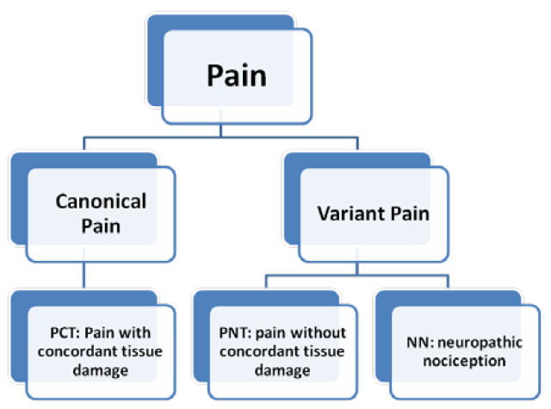
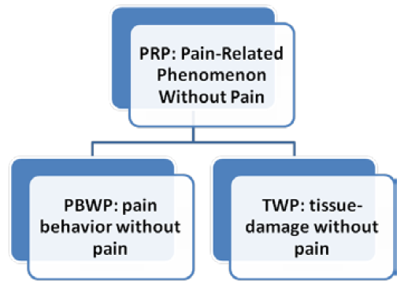
Five pain-related phenomena
Smith B, Ceusters W, Goldberg LJ, Ohrbach R. Towards an Ontology of Pain. In: Mitsu Okada (ed.), Proceedings of the Conference on Logic and Ontology, Tokyo: Keio University Press, February 2011:23-32.

Slide 113
Between ‘generic’ and ‘specific’
Generic
Generic
Specific
Specific
L3. Representation
pain classification
EHR
ICHD
my EHR
L2. Beliefs (knowledge)
DIAGNOSIS
my doctor’s
work plan
my doctor’s
diagnosis
INDICATION
L1.
First-order reality
PATHOLOGICAL
STRUCTURE
my doctor
my doctor’s computer
PERSON
me
DRUG
DISEASE
my migraine
PAIN
my headache
MIGRAINE
HEADACHE
Basic Formal Ontology
Referent Tracking

Slide 114
Particulars versus Universals
for every universal there is or has been at least one instance
some universal
instanceOf …
entities on either site cannot ‘cross’ this boundary
every particular is an instance of at least one universal
some particular

Slide 115
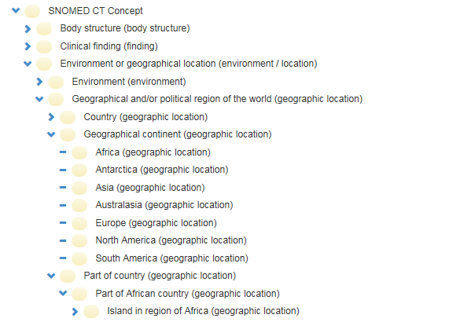
Error:
confusing particulars with types
http://browser.ihtsdotools.org/
Oct 14, 2015

Slide 116
Ontological Realism makes crucial distinctions
Between continuants and occurrents:
  obvious differences:
    a person versus his life
    a disease versus its course
    space versus time
  more subtle differences:
    observation (data-element) versus observing
    diagnosis versus making a diagnosis
    message versus transmitting a message

Slide 117
Continuants and Occurrents
organism
brain
disposition
process
Is_a
instance-of at t
Is_a
Is_a
instance-of at t
human being
to generate pain
pain
neurotransmission
instance-of
at t
instance-of
instance-of
my brain
my toothache
my caries
signaling
me
my left lower
wisdom tooth
my LLWT
caries
instance-of at t
instance-of at t₁
tooth
disorder
117

Slide 118
The importance of temporal indexing
benign
tumor
malignant
tumor
stomach
instanceOf at t₂
instanceOf at t₁
instanceOf at t₂
instanceOf at t₁
partOf at t₁
this-4
this-1’s stomach
partOf at t₂

Slide 119
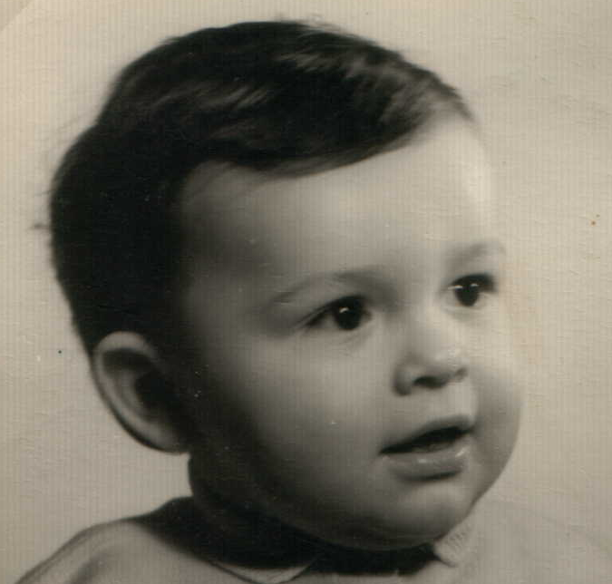


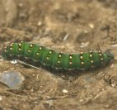
Continuants preserve identity while changing
human
being
me
me
t
Instance-of
in 1960
child
Instance-of
since 1980
adult
living
creature
animal
caterpillar
butterfly

Slide 120
Not easy to understand for conceptualists
‘the distinction between continuants and occurrents does not account for the contrast between reversible [processes] and irreversible processes in biology, chemistry, computation, or quantum mechanics’,
→ compare with: the distinction between males and females does not account for the contrast between nuns and housewives.
Maojo V, Crespo J, Garcia-Remesal M, de la Igleasia D, Perez-Rey D, Kulikowski C. Biomedical Ontologies: Towards Scientific Debate. Methods Inf Med. 2011 March 21;50(3)

Slide 121
Make it clear whether assertions are about particulars or types
‘Persistent idiopathic facial pain (PIFP)’
  = ‘persistent facial pain with varying presentations …’
persistent
facial pain
presentation
type1
presentation
type2
presentation
type3
types
t₂
t₃
t₁
t₁
t₁
t₂
t₂
t₃
t₁
t₃
parti-
culars
t₁
t₂
t₂
t₁
t₃
t₂
t₃
t₃
my pain
her pain
his pain

Slide 122
Make it clear whether assertions are about particulars or types
‘Persistent idiopathic facial pain (PIFP)’
  = ‘persistent facial pain with varying presentations …’
  if the description is about types, then the three particular pains fall under PIFP.
  if the description is about (arbitrary) particulars, then only her pain falls under PIFP.

Slide 123
Independent versus dependent
organism
brain
disposition
process
Is_a
instance-of at t
Is_a
Is_a
instance-of at t
human being
to generate pain
pain
neurotransmission
instance-of
at t
instance-of
instance-of
my brain
my toothache
my caries
signaling
me
Independent entities
Do not require any other entity to exist to enable their own existence
Dependent entities
Require the existence of another entity for their existence

Slide 124
Independent versus dependent
organism
brain
disposition
process
Is_a
instance-of at t
Is_a
Is_a
instance-of at t
human being
to generate pain
pain
neurotransmission
instance-of
at t
instance-of
Dependent
continuants
instance-of
my brain
my toothache
my caries
signaling
Occurrents (all dependent)
me
Independent continuants
Independent entities
Do not require any other entity to exist to enable their own existence
Dependent entities
Require the existence of another entity for their existence

Slide 125
Dependent continuants
Realized
  Quality: redness (of blood)
Realizable
  Function: to flex (of knee joint)
  Role: student
  Power: boss
  Disposition: brittleness (of a bone)

Slide 126
Dependent continuants
continuants
occurrents
Realizations
  flexing
  studying
  ordering
  breaking
Realized
  Quality: redness (of blood)
Realizable
  Function: to flex (of knee joint)
  Role: student
  Power: boss
  Disposition: brittleness (of a bone)

Slide 127
Not easy to understand for conceptualists
‘How can cells or viruses be entirely independent entities, even within a controlled laboratory environment?’
→ shows not understanding what ‘ontological dependence’ means
Maojo V, Crespo J, Garcia-Remesal M, de la Igleasia D, Perez-Rey D, Kulikowski C. Biomedical Ontologies: Towards Scientific Debate. Methods Inf Med. 2011 March 21;50(3)

Slide 128
Sorts of relations
Unconstrained
reasoning
UtoU: isa, partOf, …
U1
U2
PtoU: instanceOf, lacks,
denotes…
OWL-DL reasoning
PtoP: partOf, denotes, subclassOf,…
P1
P2

Slide 129
Part-of different for continuants and occurrents
organism
brain
disposition
process
Is_a
instance-of at t
Is_a
Is_a
instance-of at t
human being
to generate pain
pain
neurotransmission
instance-of
at t
instance-of
instance-of
part-of
my caries
signaling
part-of at t
my brain
my toothache
me
part-of at t
my left lower
wisdom tooth
instance-of at t
tooth

Slide 130
Part-of can be generalized, … with care !
C part_of C1 = [def]
for all c, t,
if Cct
then there is some c1 such that C1c1t and c part_of c1 at t.
living creature
tooth
Is_a
human being
Instance-of
at t
Instance-of
at t
part-of
at t
my left lower
wisdom tooth
me
Cct = c instance-of C at t

Slide 131
Part-of can be generalized, … with care !
C part_of C1 = [def]
for all c, t,
if Cct
then there is some c1 such that C1c1t and c part_of c1 at t.
living creature
?
tooth
Is_a
human being
Part-of
Instance-of
at t
Instance-of
at t
part-of
at t
my left lower
wisdom tooth
me
Cct = c instance-of C at t
131

Slide 132
Part-of can be generalized, … with care !
Horse teeth are not parts of human beings
Extracted teeth are not parts of human beings
‘Canonical tooth is part of canonical human being’, but…, there are (very likely) no such particulars
…
living creature
?
tooth
Is_a
human being
Part-of
Instance-of
at t
Instance-of
at t
part-of
at t
my left lower
wisdom tooth
me
132

Slide 133
Example: The dimensions/axes of the
Ontology of General Medical Science (OGMS)
produces
bears
realized_in
etiological process
disorder
disease
pathological process
produces
diagnosis
interpretive process
signs & symptoms
abnormal bodily features
produces
participates_in
recognized_as
Scheuermann R, Ceusters W, Smith B. Toward an Ontological Treatment of Disease and Diagnosis. 2009 AMIA Summit on Translational Bioinformatics, San Francisco, California, March 15-17, 2009;: 116-120.
http://www.referent-tracking.com/RTU/sendfile/?file=AMIA-0075-T2009.pdf
http://code.google.com/p/ogms/
Notes:
font was too small, color inside green boxes was hardly readable

Slide 134
Conclusion
Realism-based ontology has a lot to offer to make data collections comparable and unambiguously understandable.
It is hard !
How far one needs to go depends on the purposes.
  ideally: an analysis should be such that it can accommodate ALL purposes, i.e. the analysis should be independent of any purpose;
    distinction between reference ontologies and application ontologies.

Slide 135
Post-lecture test

Slide 136
Post-lecture test (1)
What is wrong in this statement:
Early versions of computational ontologies such as the Gene Ontology (GO), the Unified Medical Language System (UMLS) and the National Cancer Institute Thesaurus were criticized by some classical ontologists because of deficiencies in how they related to classical formalisms for representing reality in terms of categories and their instances [40–42].
  From: Maojo V, Crespo J, Garcia-Remesal M, de la Iglesia D, Pérez-Rey D, Kulikowski C. Biomedical Ontologies: Toward scientific debate. Methods Inf Med 2011; 50 (3): 203–216.

Slide 137
Post-lecture test (2)
The BFO divides occurrents into two types: instantaneous and extended (over time). And, it defines continuants as falling into two categories: independent and dependent. Examples of independents are a cell, a bacterium, an organism (or a person), whereas examples of dependents are functions, qualities, etc [46, 51].
These philosophical specifications for ontological entities are, unfortunately, not necessarily consistent with scientific needs and practice. How can cells or viruses be entirely independent entities, even within a controlled laboratory environment?
      From: Maojo V, Crespo J, Garcia-Remesal M, de la Iglesia D, Pérez-Rey D, Kulikowski C. Biomedical Ontologies: Toward scientific debate. Methods Inf Med 2011; 50 (3): 203–216.
What does the 2nd paragraph tell about the authors of this statement?

Slide 138
Post-lecture test (3)
What mistake is committed in the following statement?
For example, the distinction between continuants and occurrents does not account for the contrast between reversible and irreversible processes in biology, chemistry, computation, or quantum mechanics.
  From: Maojo V, Crespo J, Garcia-Remesal M, de la Iglesia D, Pérez-Rey D, Kulikowski C. Biomedical Ontologies: Toward scientific debate. Methods Inf Med 2011; 50 (3): 203–216.

Slide 139
Post-lecture test (4)
True or false, and why?
A challenge for designers of biomedical ontologies is how to include the necessary representational power needed to represent biologically complex systems.
  From: Maojo V, Crespo J, Garcia-Remesal M, de la Iglesia D, Pérez-Rey D, Kulikowski C. Biomedical Ontologies: Toward scientific debate. Methods Inf Med 2011; 50 (3): 203–216.

