Slide 1
Biomedical ontologies: current examples and a principled method for their enrichment and integration
Lecture in BMI501 (2159_24752): Survey of Biomedical Informatics – Oct 14, 2015
Department of Biomedical Informatics, University at Buffalo
Werner CEUSTERS, MD
Ontology Research Group, Center of Excellence in Bioinformatics and Life Sciences,
UB Institute for Healthcare Informatics,
Departments of Biomedical Informatics and Psychiatry,
University at Buffalo, NY, USA

Slide 2
Context of this lecture
Thesis: mainstream ontology design approaches fail in achieving their objectives:
  various sorts of mistakes in ontologies,
  inability to use ontologies adequately in information systems,
  failure to integrate data repositories even if these ontologies are appropriately designed.
Root causes:
  inadequacy of their conceptual semantic foundations,
  lack of knowledge about ontology as a philosophical discipline.
Proposed solution:
  Better use of ontology (the philosophical discipline) to design ontologies (specific sorts of representational artifacts).

Slide 3
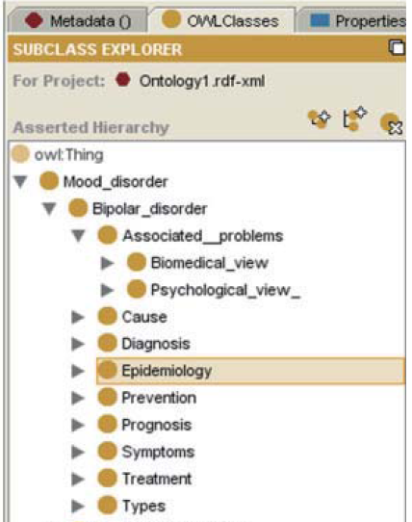
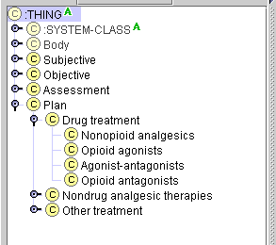
Two abundantly present fundamental mistakes (1)
The problems:
erroneous domain analysis
violations against representation language semantics

Slide 4
Another example: misunderstood semantics
<business-card>
  <name> John Nitwit </name>
  <address>
  <street> 524 Moon base avenue </street>
  <city> Utopia </city>
  </address>
  <phone> … </phone>
  …
</business-card>
Is this the name of the business card or of the business card owner?

Slide 5
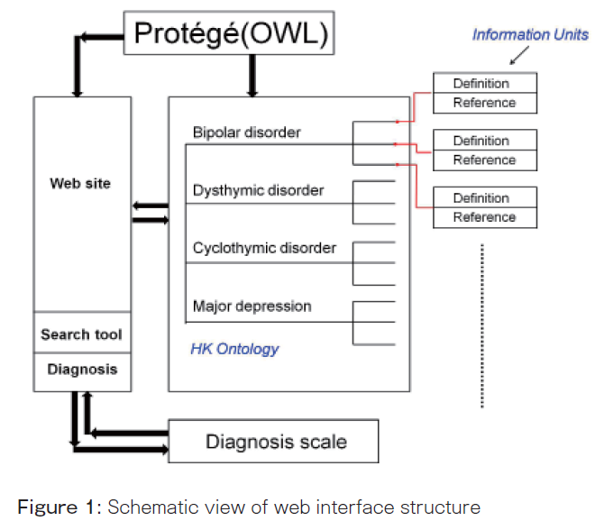
Two abundantly present fundamental mistakes (2)
You can’t exchange mental illnesses through websites or have Protégé interact with illnesses;
= confusing information with what information is about!

Slide 6
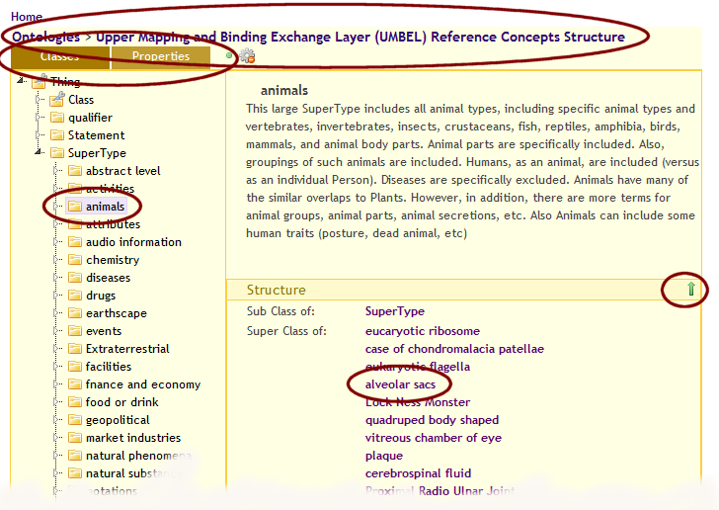
I hope this is a joke
http://www.mkbergman.com/ Last accessed: Jan 31, 2012
reproduction licensed through: http://creativecommons.org/licenses/by-nc-sa/2.5/

Slide 7
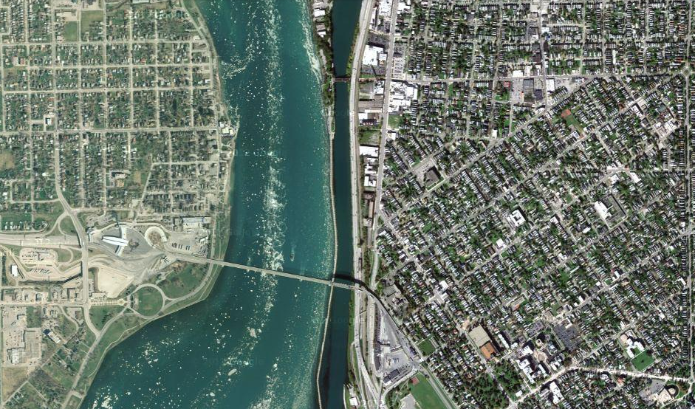
Satellite view

Slide 8
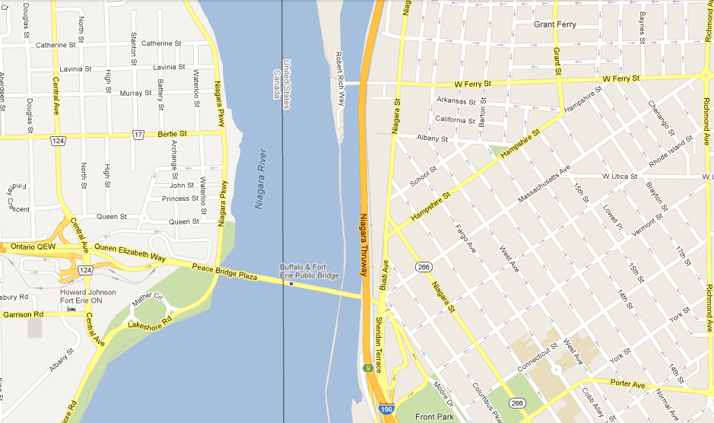
Map

Slide 9
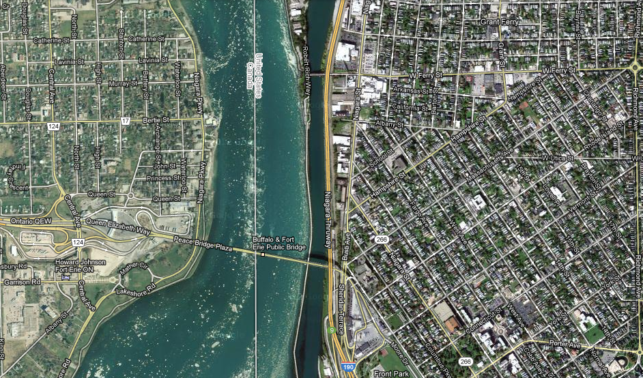
Map overlay

Slide 10
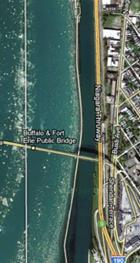
Map ←→ Reality
A message to map makers: “Highways are not painted red, rivers don’t have county lines running down the middle, and you can’t see contour lines on a mountain”
W. Kent. Data and Reality. North-Holland, Amsterdam, the Netherlands, 1978.

Slide 11
Main data ←→ reality views
Nominalism:
  there are no generic entities in reality: there is no personhood, there are only individual persons.
Conceptualism:
  generalizations are in our ‘minds’. Personhood is a concept construed in our ‘mind’ that allows us to reason about persons without any particular person in mind.
Realism:
  generic entities do exist and are called ‘universals’. Each particular person is an instance of the universal we call ‘person’.

Slide 12
Main data ←→ reality views
Nominalism:
  there are no generic entities in reality: there is no personhood, there are only individual persons.
Conceptualism: ← mainstream approach
  generalizations are in our ‘minds’. Personhood is a concept construed in our ‘mind’ that allows us to reason about persons without any particular person in mind.
Realism: ← our approach
  generic entities do exist and are called ‘universals’. Each particular person is an instance of the universal we call ‘person’.

Slide 13
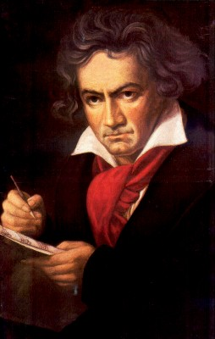
The semantic/semiotic triangle
Ludwig van Beethoven
that great German composer that became deaf
…
concept
term
referent
‘Beethoven’

Slide 14
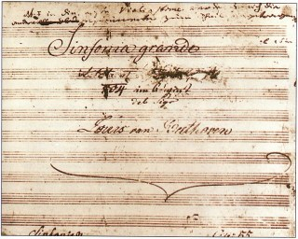
The semantic triangle works sometimes fine
Beethoven’s symphony dedicated to Bonaparte
the symphony played after the Munich Olympics massacre
…
concept
term
referent
‘Eroica’
‘Beethoven's Symphony No. 3’
‘Beethoven's Opus 55’

Slide 15
Sometimes the semantic triangle fails
the symphony Beethoven wrote after the tenth
…
concept
term
referent
‘Beethoven's Symphony No. 11’

Slide 16
Sometimes the semantic triangle fails
the symphony Beethoven wrote after the tenth
…
some hold this term has meaning
concept
term
referent
‘Beethoven's Symphony No. 11’

Slide 17
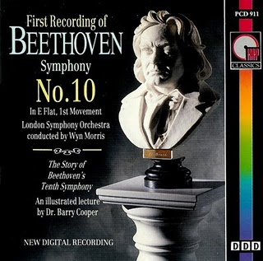
Sometimes the semantic triangle fails
the one assembled by Barry Cooper from fragmentary sketches
Beethoven’s hypothetical symphony
…
concept
term
referent
‘Beethoven's Symphony No. 10’

Slide 18
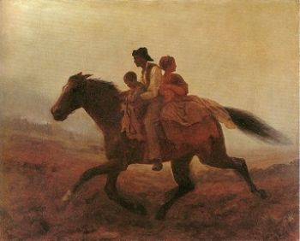
Prehistoric ‘psychiatry’: drapetomania
disease which causes slaves to suffer from an unexplainable propensity to run away
…
concept
term
referent
painting by Eastman Johnson. A Ride for Liberty: The Fugitive Slaves. 1860.
‘drapetomania’

Slide 19
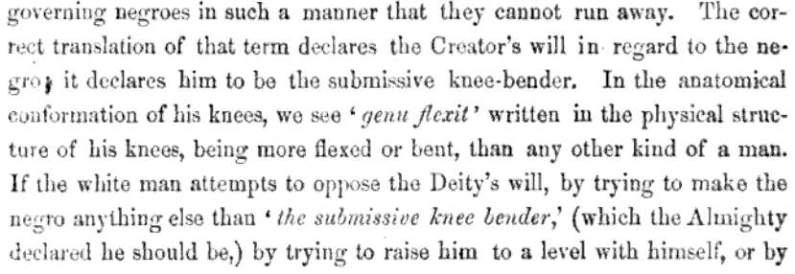
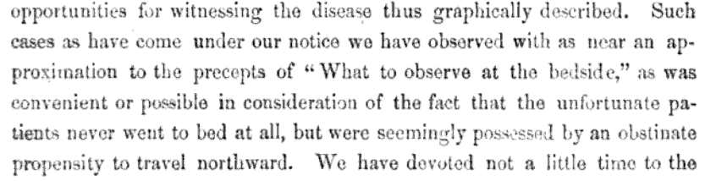
Some etiologic and diagnostic reflections
Buffalo Medical Journal, vol 10, p439, 1855

Slide 20
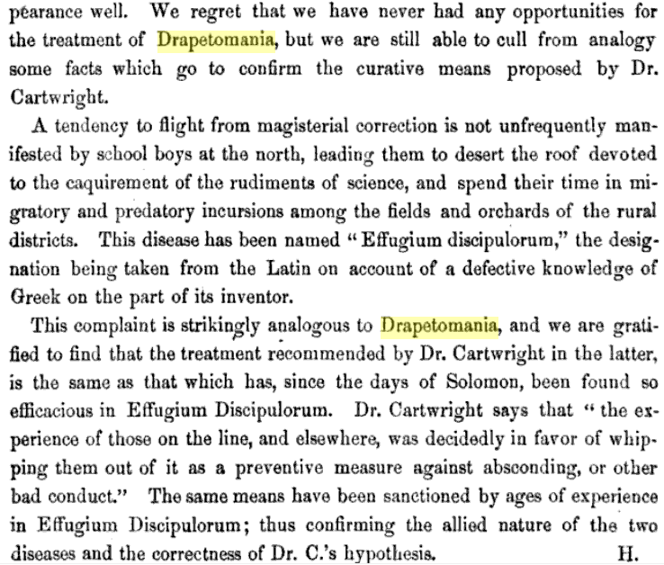
The North’s ‘Effugium Discipulorum’

Slide 21
The questions the triangle raises become trickier
Is …
  Beethoven’s 10th symphony a symphony ?
  Beethoven’s 10th symphony a hypothetical symphony ?
  a hypothetical symphony a symphony ?
In medicine, is …
  a prevented abortion an abortion ?
  an absent nipple a nipple ?

Slide 22
SNOMED about diseases and concepts (until 2010)
‘Disorders are concepts in which there is an explicit or implicit pathological process causing a state of disease which tends to exist for a significant length of time under ordinary circumstances.’
And also: “Concepts are unique units of thought”.
Thus: Disorders are unique units of thoughts in which there is a pathological process …???
And thus: to eradicate all diseases in the world at once we simply should stop thinking ?

Slide 23
Naïve ‘ontology’ design and principles that are often violated

Slide 24
Border’s classification of medicine: what’s wrong ?
Medicine
  Mental health
  Internal medicine
    Endocrinology
      Oversized endocrinology
    Gastro-enterology
    ...
  Pediatrics
  ...
  Oversized medicine
Refer to the size of the books that do not fit on a normal Border’s Bookshop shelf

Slide 25
Similar mistake in ICHD
‘13.1.2.4 Painful trigeminal neuropathy attributed to MS plaque’
‘attributed to’ relates to somebody’s opinion about what is the case, not to what is the case.
  the mistake: a feature on the side of the clinician – his (not) knowing - is taken to be a feature on the side of the patient.
Similar mistakes:
  ‘Probable migraine’
  ‘facial pain of unknown origin’ (not in ICHD).

Slide 26
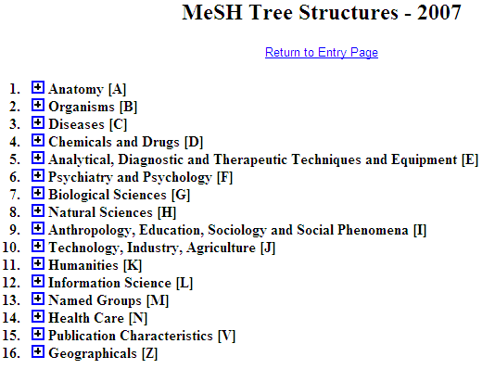
Is this a good idea ?
Cover subject matter of papers
Cover the form of papers

Slide 27
Principle
A representation should not mix object language and meta language
  object language describes the referents in the subject domain
  meta language describes the object language

Slide 28
Geographic Locations: a good hierarchy ?
Africa [Z01.058] +
Americas [Z01.107] +
Antarctic Regions [Z01.158]
Arctic Regions [Z01.208]
Asia [Z01.252] +
Atlantic Islands [Z01.295] +
Australia [Z01.338] +
Cities [Z01.433] +
Europe [Z01.542] +
Historical Geographic Locations [Z01.586] +
Indian Ocean Islands [Z01.600] +
Oceania [Z01.678] +
Oceans and Seas [Z01.756] +
Pacific Islands [Z01.782] +
mereological mess:
mixture of geographic entities with socio-political entities
mixture of space and time

Slide 29
Geographic Locations [Z01]
Africa [Z01.058] +
Americas [Z01.107] +
Antarctic Regions [Z01.158]
Arctic Regions [Z01.208]
Asia [Z01.252] +
Atlantic Islands [Z01.295] +
Australia [Z01.338] +
Cities [Z01.433] +
Europe [Z01.542] +
Historical Geographic Locations [Z01.586] +
Indian Ocean Islands [Z01.600] +
Oceania [Z01.678] +
Oceans and Seas [Z01.756] +
Pacific Islands [Z01.782] +
Ancient Lands [Z01.586.035] +
Austria-Hungary [Z01.586.117]
Commonwealth of Independent States [Z01.586.200] +
Czechoslovakia [Z01.586.250] +
European Union [Z01.586.300]
Germany [Z01.586.315] +
Korea [Z01.586.407]
Middle East [Z01.586.500] +
New Guinea [Z01.586.650]
Ottoman Empire [Z01.586.687]
Prussia [Z01.586.725]
Russia (Pre-1917) [Z01.586.800]
USSR [Z01.586.950] +
Yugoslavia [Z01.586.980] +

Slide 30
Geographic Locations [Z01]
Africa [Z01.058] +
Americas [Z01.107] +
Antarctic Regions [Z01.158]
Arctic Regions [Z01.208]
Asia [Z01.252] +
Atlantic Islands [Z01.295] +
Australia [Z01.338] +
Cities [Z01.433] +
Europe [Z01.542] +
Historical Geographic Locations [Z01.586] +
Indian Ocean Islands [Z01.600] +
Oceania [Z01.678] +
Oceans and Seas [Z01.756] +
Pacific Islands [Z01.782] +
Ancient Lands [Z01.586.035] +
Austria-Hungary [Z01.586.117]
Commonwealth of Independent States [Z01.586.200] +
Czechoslovakia [Z01.586.250] +
European Union [Z01.586.300]
Germany [Z01.586.315] +
Korea [Z01.586.407]
Middle East [Z01.586.500] +
New Guinea [Z01.586.650]
Ottoman Empire [Z01.586.687]
Prussia [Z01.586.725]
Russia (Pre-1917) [Z01.586.800]
USSR [Z01.586.950] +
Yugoslavia [Z01.586.980] +

Slide 31
Principle
A hierarchical structure should not represent distinct hierarchical relations unless they are formally characterized

Slide 32
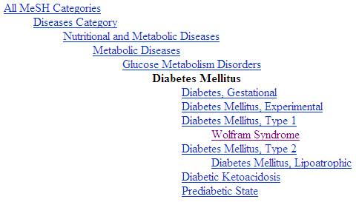
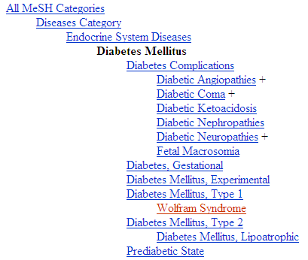
Diabetes Mellitus in MeSH 2008
?
Different set of more specific terms when different path from the top is taken.

Slide 33
MeSH: some paths from top to Wolfram Syndrome
All MeSH Categories
Diseases Category
Nervous System Diseases
Female Urogenital Diseases
and Pregnancy Complications
Eye Diseases
Male Urogenital
Diseases
Cranial Nerve
Diseases
Female Urogenital Diseases
Optic Nerve
Diseases
Neurodegenerative
Diseases
Optic Nerve
Diseases
Eye Diseases,
Hereditary
Heredodegenerative
Disorders,
Nervous System
Urologic Diseases
Optic Atrophy
Kidney Diseases
Optic Atrophies,
Hereditary
Diabetes Insipidus
Wolfram Syndrome

Slide 34
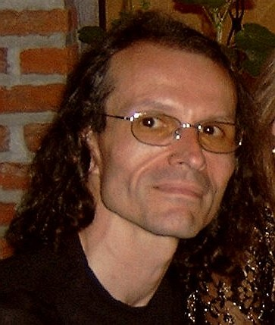
What would it mean if used in the context of a patient ?
All MeSH Categories
???
Diseases Category
Nervous System Diseases
Female Urogenital Diseases
and Pregnancy Complications
Eye Diseases
Male Urogenital
Diseases
Cranial Nerve
Diseases
Female Urogenital Diseases
…
Neurodegenerative
Diseases
Optic Nerve
Diseases
Optic Nerve
Diseases
Eye Diseases,
Hereditary
has
Heredodegenerative
Disorders,
Nervous System
Urologic Diseases
Optic Atrophy
Kidney Diseases
Optic Atrophies,
Hereditary
Diabetes Insipidus
has
Wolfram Syndrome

Slide 35
Principle
If a particular (individual) is related in a specific way to a ‘class’, it should also be related in the same way to all the ‘superclasses’ of that class
  Technically: “… to all the classes that subsume that class”

Slide 36
MeSH Tree Structures – 2007
Body Regions [A01]
  Extremities [A01.378]
    Lower Extremity [A01.378.610]
      Buttocks [A01.378.610.100]
      Foot [A01.378.610.250]
        Ankle [A01.378.610.250.149]
        Forefoot, Human [A01.378.610.250.300] +
        Heel [A01.378.610.250.510]
      Hip [A01.378.610.400]
      Knee [A01.378.610.450]
      Leg [A01.378.610.500]
      Thigh [A01.378.610.750]
What’s wrong ?

Slide 37
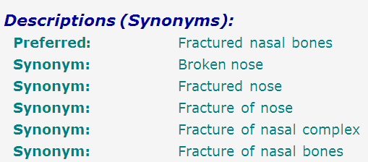
SNOMED-CT: what is wrong here?
bones
nose
fracture
false synonymy

Slide 38
Coding / Classification confusion
A patient with a fractured nasal bone
=
A patient with a broken nose
=
A patient with a fracture of the nose

Slide 39
Coding / Classification confusion
P + X
P + Y
P + Z
A patient with a fractured nasal bone
A patient with a fractured nasal bone
=
=
A patient with a broken nose
A patient with a broken nose
=
=
A patient with a fracture of the nose
A patient with a fracture of the nose

Slide 40
Avoid these problems by using Ontological Realism

Slide 41
‘Ontology’
In philosophy:
  Ontology (no plural) is the study of what entities exist and how they relate to each other;

Slide 42
‘Ontology’
In philosophy:
  Ontology (no plural) is the study of what entities exist and how they relate to each other;
  by some philosophers taken to be synonymous with ‘metaphysics’ while others draw distinctions in many distinct ways (the distinctions being irrelevant for this talk), but almost agreeing on the following classification:
    metaphysics → studies ‘how is the world?’
      general metaphysics → studies general principles and ‘laws’ about the world
        ontology → studies what type of entities exist in the world
      special metaphysics → focuses on specific principles and entities
  distinct from ‘epistemology’ which is the study of how we can come to know about what exists.
  distinct from ‘terminology’ which is the study of what terms mean and how to name things.

Slide 43
The Terminology / Ontology divide
Terminology:
  solves certain issues related to language use, i.e. with respect to how we talk about entities in reality (if any);
    Relations between terms / concepts
  does not provide an adequate means to represent independent of use what we talk about, i.e. how reality is structured;
    Women, Fire and Dangerous Things (Lakoff).
Ontology (of the right sort):
  Language and perception neutral view on reality.
    Relations between entities in first-order reality
This is the ‘terminology / ontology divide’

Slide 44
Distinct questions. What type are they of?
Terminological:
  what does ‘pain’ mean ?
Metaphysical:
  what have all pains in common in virtue of which they are pains?
Ontological:
  what type of entity is pain?
Onto-terminological:
  what, if anything at all, does ‘pain’ denote?
Epistemological:
  how can we find out whether something is pain?

Slide 45
Unfortunately, ‘ontology’ denotes ambiguously
In philosophy:
  Ontology (no plural) is the study of what entities exist and how they relate to each other;
In computer science and many biomedical informatics applications:
  An ontology (plural: ontologies) is a shared and agreed upon conceptualization of a domain;

Slide 46
Computer science approach to ontology
Ontology
Authoring Tools
create
Domain
Ontologies
Reasoners
Semantic
Applications
use

Slide 47
Computer science approach to ontology
Ontology
Authoring Tools
the logic in reasoners:
guarantees consistent reasoning,
does not guarantee the faithfulness of the representation.
create
Domain
Ontologies
Reasoners
Semantic
Applications
use

Slide 48
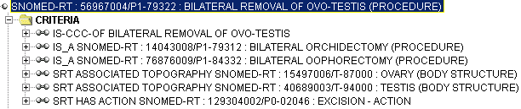
Consistent reasoning with nonsensical representations
Ceusters W, Smith B, Flanagan J. Ontology and Medical Terminology: why Descriptions Logics are not enough. Proceedings of the conference Towards an Electronic Patient Record (TEPR 2003),
San Antonio, 10-14 May 2003 (electronic publication 5pp)

Slide 49
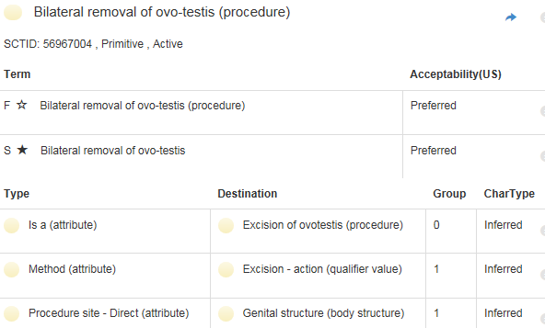
Correction
http://browser.ihtsdotools.org/
Oct 14, 2015

Slide 50

Philosophical approach to ontology
Ontological Realism: uses ontology as philosophical discipline to build ontologies as faithful representations of reality.

Slide 51
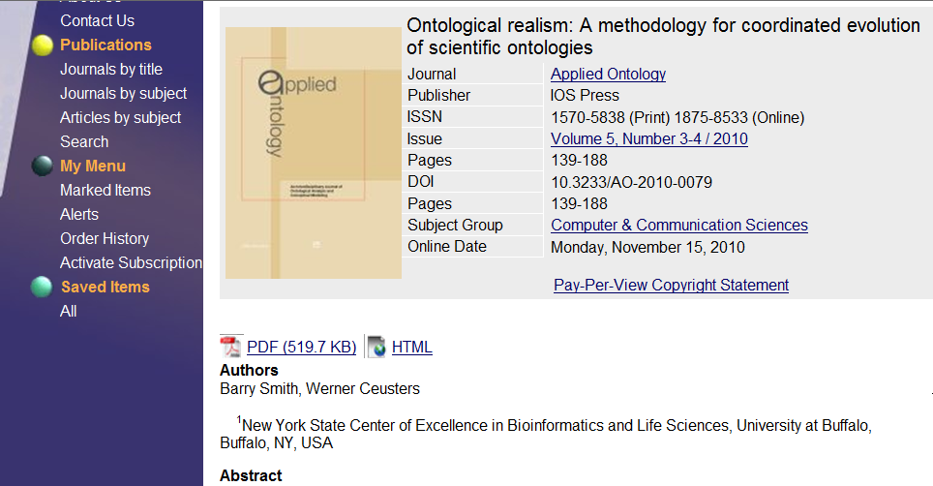


Slide 52

The basis of Ontological Realism
There is an external reality which is ‘objectively’ the way it is;
That reality is accessible to us;
We build in our brains cognitive representations of reality;
We communicate with others about what is there, and what we believe there is there.
Smith B, Kusnierczyk W, Schober D, Ceusters W. Towards a Reference Terminology for Ontology Research and Development in the Biomedical Domain. Proceedings of KR-MED 2006, Biomedical Ontology in Action, November 8, 2006, Baltimore MD, USA

Slide 53
Conceptualism versus Ontological Realism
First order reality
concept
universal
term
referent
representational
unit
particular
Conceptualism
Ontological Realism

Slide 54
Ontological Realism offers three ways of relating, without assigning beliefs (concepts) a central status
drapetomania
slave
running away
mental disorder
propensity
How beliefs are / can
be related
How terms are related
How referents (in
reality) are related

Slide 55
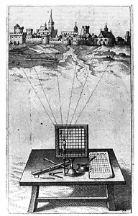
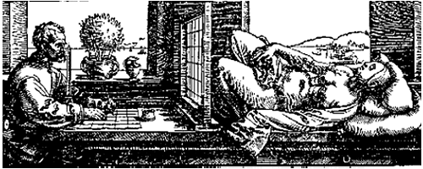
A useful parallel: Alberti’s grid
reality
Ontological
theory
representation

Slide 56
Ontological Realism makes three crucial distinctions
Between data and what data are about;
Between continuants and occurrents;
Between what is generic and what is specific.
Smith B, Ceusters W. Ontological Realism as a Methodology for Coordinated Evolution of Scientific Ontologies. Applied Ontology, 2010.

Slide 57
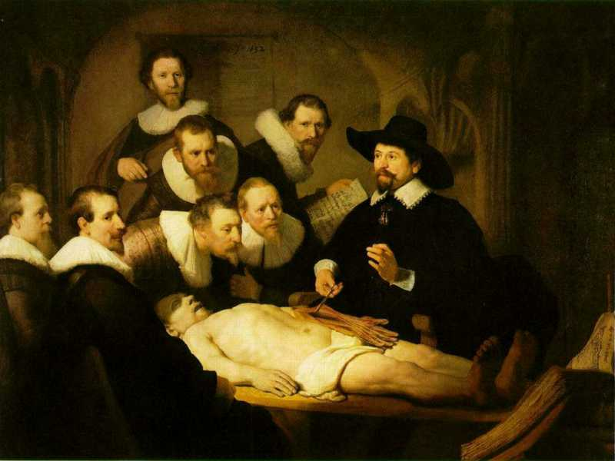

Slide 58
L3
Linguistic representations about (1), (2) or (3)
L2
Clinicians’ beliefs about (1)
Representations
First Order Reality
Entities (particular or generic) with objective existence which are not about anything
L1⁻

Slide 59
Mixing L1- and L3
‘13.1.2.4 Painful Trigeminal neuropathy attributed to MS plaque’:
  described as ‘Trigeminal neuropathy induced by MS plaque’.
    attributed ←→ induced
    reference to pain missing in the description

Slide 60
L1- / L3 and IASP definition of pain
IASP definition for ‘pain’:
  ‘an unpleasant sensory and emotional experience associated with actual or potential tissue damage, or described in terms of such damage’;
what asserts:
  a common phenomenology (‘unpleasant sensory and emotional experience’) to all instances of pain,
  the recognition of three distinct subtypes of pain involving, respectively:
    actual tissue damage,
    what is called ‘potential tissue damage’, and
    a description involving reference to tissue damage whether or not there is such damage.

Slide 61
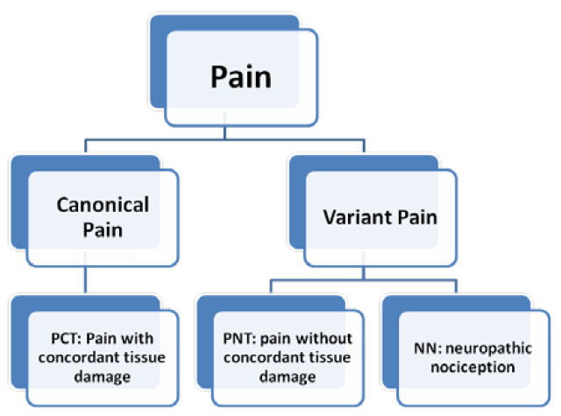
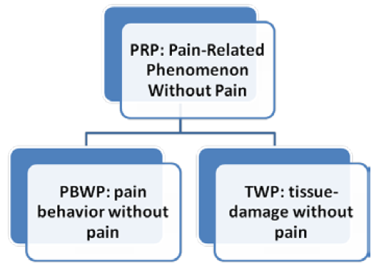
Five pain-related phenomena
Smith B, Ceusters W, Goldberg LJ, Ohrbach R. Towards an Ontology of Pain. In: Mitsu Okada (ed.), Proceedings of the Conference on Logic and Ontology, Tokyo: Keio University Press, February 2011:23-32.

Slide 62
ReMINE’s notion of adverse event
  an ‘incident [that] occurred during the past and [is] documented in a database of adverse events’
      Stefano Arici, Paolo Bertele. ReMINE Deliverable D4.1 – RAPS Taxonomy: approach and definition. V1.0 (Final) August 8, 2008. (p21)
… which is a ‘perdurant’ - ibidem (p26)
… ‘that occurs to a patient’ - ibidem (p23)
  an expectation of some future happening that can be prevented - ibidem (p23)

Slide 63
Terminologists agree, ontologists think …
Can something which is an incident be at the same time an expectation ?
Can something which is an incident a time t, later become an adverse event simply because it [?] has been entered in a database ?
Can adverse events really occur in software ?
…

Slide 64
Using the 3 levels and the particular/universal/class distinctions
Level 1:
  #1: an incident that happened in the past;
Level 2:
  #2: the interpretation by some cognitive agent that #1 is an adverse event;
  #3: the expectation by some cognitive agent that similar incidents might happen in the future;
Level 3:
  #4: an entry in the adverse event database concerning #1;
  #5: an entry in some other system about #3 for mitigation or prevention purposes.

Slide 65
Ontological Realism makes crucial distinctions
Between data and what data are about;
Between continuants and occurrents:
  obvious differences:
    a person versus his life
    a disease versus its course
    space versus time
  more subtle differences:
    observation (data-element) versus observing
    diagnosis versus making a diagnosis
    message versus transmitting a message

Slide 66
Between ‘generic’ and ‘specific’
Generic
Generic
Specific
Specific
L3. Representation
pain classification
EHR
ICHD
my EHR
L2. Beliefs (knowledge)
DIAGNOSIS
my doctor’s
work plan
my doctor’s
diagnosis
INDICATION
L1.
First-order reality
PATHOLOGICAL
STRUCTURE
my doctor
my doctor’s computer
PERSON
me
DRUG
DISEASE
my migraine
PAIN
my headache
MIGRAINE
HEADACHE
Basic Formal Ontology
Referent Tracking

Slide 67
Particulars versus Universals
for every universal there is or has been at least one instance
some universal
instanceOf …
entities on either site cannot ‘cross’ this boundary
every particular is an instance of at least one universal
some particular

Slide 68
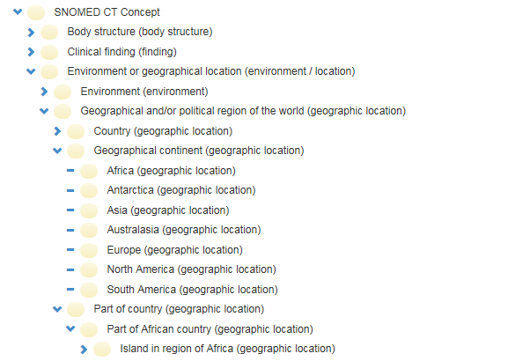
Error:
confusing particulars with types
http://browser.ihtsdotools.org/
Oct 14, 2015

Slide 69
Particulars and Universals
organism
brain
disposition
process
Is_a
instance-of at t
Is_a
Is_a
instance-of at t
human being
to generate pain
pain
neurotransmission
instance-of
at t
instance-of
instance-of
my brain
my toothache
my caries
signaling
me
my left lower
wisdom tooth
my LLWT
caries
instance-of at t
instance-of at t₁
tooth
disorder

Slide 70
The importance of temporal indexing
benign
tumor
malignant
tumor
stomach
instanceOf at t₂
instanceOf at t₁
instanceOf at t₂
instanceOf at t₁
partOf at t₁
this-4
this-1’s stomach
partOf at t₂

Slide 71
Continuants and Occurrents
organism
brain
disposition
process
Is_a
instance-of at t
Is_a
Is_a
instance-of at t
human being
to generate pain
pain
neurotransmission
instance-of
at t
instance-of
instance-of
my brain
my toothache
my caries
signaling
me
my left lower
wisdom tooth
my LLWT
caries
instance-of at t
instance-of at t₁
tooth
disorder
71

Slide 72
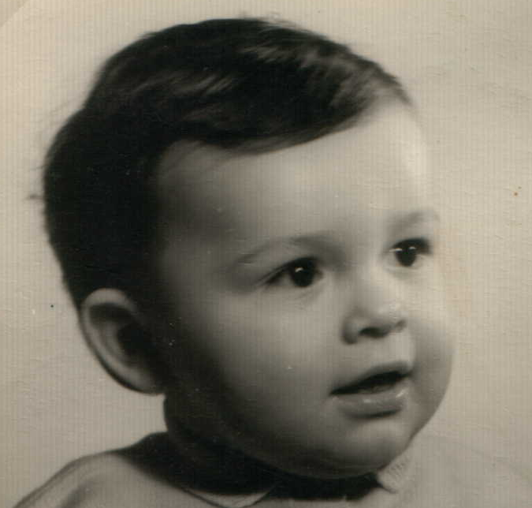



Continuants preserve identity while changing
human
being
me
me
t
Instance-of
in 1960
child
Instance-of
since 1980
adult
living
creature
animal
caterpillar
butterfly

Slide 73
Not easy to understand for conceptualists
‘the distinction between continuants and occurrents does not account for the contrast between reversible [processes] and irreversible processes in biology, chemistry, computation, or quantum mechanics’,
→ compare with: the distinction between males and females does not account for the contrast between nuns and housewives.
Maojo V, Crespo J, Garcia-Remesal M, de la Igleasia D, Perez-Rey D, Kulikowski C. Biomedical Ontologies: Towards Scientific Debate. Methods Inf Med. 2011 March 21;50(3)

Slide 74
Independent versus dependent
organism
brain
disposition
process
Is_a
instance-of at t
Is_a
Is_a
instance-of at t
human being
to generate pain
pain
neurotransmission
instance-of
at t
instance-of
instance-of
my brain
my toothache
my caries
signaling
me
Independent entities
Do not require any other entity to exist to enable their own existence
Dependent entities
Require the existence of another entity for their existence

Slide 75
Independent versus dependent
organism
brain
disposition
process
Is_a
instance-of at t
Is_a
Is_a
instance-of at t
human being
to generate pain
pain
neurotransmission
instance-of
at t
instance-of
Dependent
continuants
instance-of
my brain
my toothache
my caries
signaling
Occurrents (all dependent)
me
Independent continuants
Independent entities
Do not require any other entity to exist to enable their own existence
Dependent entities
Require the existence of another entity for their existence

Slide 76
Dependent continuants
Realized
  Quality: redness (of blood)
Realizable
  Function: to flex (of knee joint)
  Role: student
  Power: boss
  Disposition: brittleness (of a bone)

Slide 77
Dependent continuants
continuants
occurrents
Realizations
  flexing
  studying
  ordering
  breaking
Realized
  Quality: redness (of blood)
Realizable
  Function: to flex (of knee joint)
  Role: student
  Power: boss
  Disposition: brittleness (of a bone)

Slide 78
Not easy to understand for conceptualists
‘How can cells or viruses be entirely independent entities, even within a controlled laboratory environment?’
→ shows not understanding what ‘ontological dependence’ means
Maojo V, Crespo J, Garcia-Remesal M, de la Igleasia D, Perez-Rey D, Kulikowski C. Biomedical Ontologies: Towards Scientific Debate. Methods Inf Med. 2011 March 21;50(3)

Slide 79
Sorts of relations
Unconstrained
reasoning
UtoU: isa, partOf, …
U1
U2
PtoU: instanceOf, lacks,
denotes…
OWL-DL reasoning
PtoP: partOf, denotes, subclassOf,…
P1
P2

Slide 80
Part-of different for continuants and occurrents
organism
brain
disposition
process
Is_a
instance-of at t
Is_a
Is_a
instance-of at t
human being
to generate pain
pain
neurotransmission
instance-of
at t
instance-of
instance-of
part-of
my caries
signaling
part-of at t
my brain
my toothache
me
part-of at t
my left lower
wisdom tooth
instance-of at t
tooth

Slide 81
Part-of can be generalized, … with care !
C part_of C1 = [def]
for all c, t,
if Cct
then there is some c1 such that C1c1t and c part_of c1 at t.
living creature
tooth
Is_a
human being
Instance-of
at t
Instance-of
at t
part-of
at t
my left lower
wisdom tooth
me
Cct = c instance-of C at t

Slide 82
Part-of can be generalized, … with care !
C part_of C1 = [def]
for all c, t,
if Cct
then there is some c1 such that C1c1t and c part_of c1 at t.
living creature
?
tooth
Is_a
human being
Part-of
Instance-of
at t
Instance-of
at t
part-of
at t
my left lower
wisdom tooth
me
Cct = c instance-of C at t
82

Slide 83
Part-of can be generalized, … with care !
Horse teeth are not parts of human beings
Extracted teeth are not parts of human beings
‘Canonical tooth is part of canonical human being’, but…, there are (very likely) no such particulars
…
living creature
?
tooth
Is_a
human being
Part-of
Instance-of
at t
Instance-of
at t
part-of
at t
my left lower
wisdom tooth
me
83

Slide 84
The essential pieces
dependent continuant
material
object
spacetime
region
spatial
region
temporal
region
history
t
t
instanceOf
t
participantOf at t
occupies
some temporal region
some quality
my life
my 4D STR
projectsOn
me
… at t
projectsOn at t
some spatial
region
located-in at t

Slide 85
Existing (‘free for use’) realism-based ontologies
RELATION TO TIME GRANULARITY | CONTINUANT |  |  |  | OCCURRENT
 | INDEPENDENT |  | DEPENDENT
ORGAN AND ORGANISM | Organism (NCBI Taxonomy) | Anatomical Entity (FMA, CARO) | Organ Function (FMP, CPRO) | Phenotypic Quality (PaTO) | Biological Process (GO)
CELL AND CELLULAR COMPONENT | Cell (CL) | Cellular Component (FMA, GO) | Cellular Function (GO)
MOLECULE | Molecule (ChEBI, SO, RnaO, PrO) |  | Molecular Function (GO) |  | Molecular Process (GO)
85
Notes:
85

Slide 86
Ontologies based on ontological realism
Basic Formal Ontology
→ Generic top-level ontology
Relation Ontology (part of BFO 2.0)
→ Relations between particulars
Information artifact Ontology
→ Covers L3 (with extensions also bearers of L3)
Foundational Model of Anatomy
→ Human anatomy
Ontology of General Medical Science
→ Foundations for diseases, symptoms, investigations, …
Referent Tracking
  → To relate particulars to each other and to universals

Slide 87
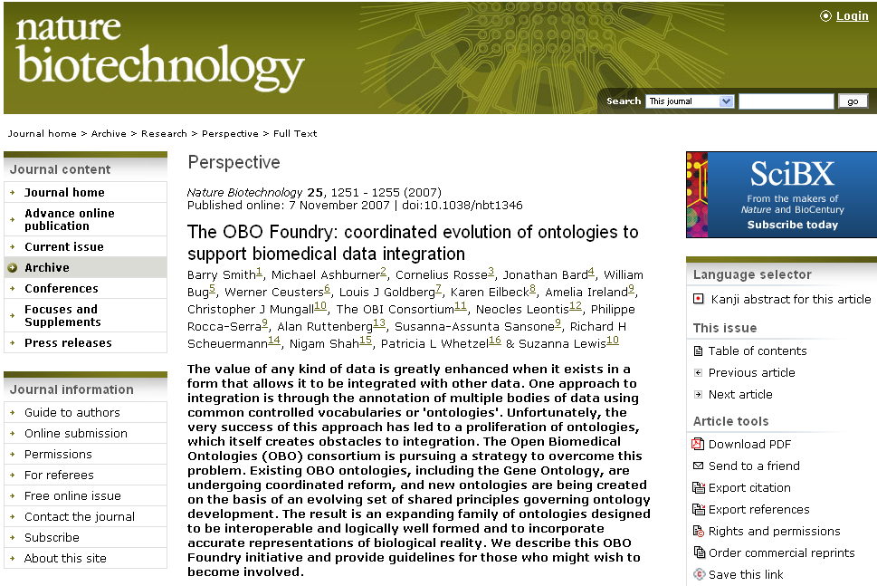

Slide 88

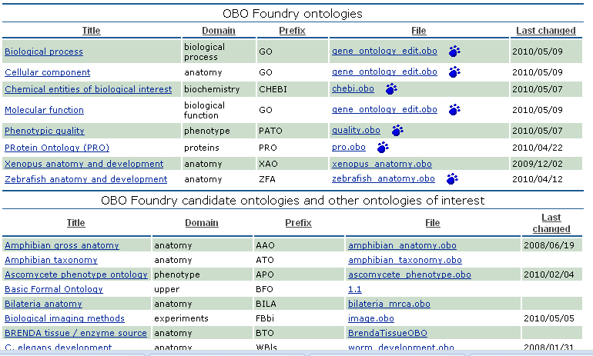
OBO Website

Slide 89
Example: The dimensions/axes of the
Ontology of General Medical Science (OGMS)
produces
bears
realized_in
etiological process
disorder
disease
pathological process
produces
diagnosis
interpretive process
signs & symptoms
abnormal bodily features
produces
participates_in
recognized_as
Scheuermann R, Ceusters W, Smith B. Toward an Ontological Treatment of Disease and Diagnosis. 2009 AMIA Summit on Translational Bioinformatics, San Francisco, California, March 15-17, 2009;: 116-120.
http://www.referent-tracking.com/RTU/sendfile/?file=AMIA-0075-T2009.pdf
http://code.google.com/p/ogms/
Notes:
font was too small, color inside green boxes was hardly readable

Slide 90
Ontology of Biomedical Investigations

Slide 91
Conclusion
Realism-based ontology has a lot to offer to make data collections comparable and unambiguously understandable.
It is hard !
How far one needs to go depends on the purposes.
  ideally: an analysis should be such that it can accommodate ALL purposes, i.e. the analysis should be independent of any purpose;
    distinction between reference ontologies and application ontologies.

