Slide 1
Clarity in Language II
International Classification of Diseases
Lecture in BMI199: What is Biomedical Informatics?
Oct 22, 2021 on-line, University at Buffalo
Werner CEUSTERS, MD
Departments of Biomedical Informatics and Psychiatry,
UB Institute for Healthcare Informatics,
Ontology Research Group, Center of Excellence in Bioinformatics and Life Sciences,
University at Buffalo, NY, USA

Slide 2
Required reading for this class:
Cimino, J.J.,
Desiderata for controlled medical vocabularies in the twenty-first century. Methods Inf Med, 1998. 37(4-5): p. 394-403.

Slide 3
Controlled Medical Vocabulary
‘An approved list of terms coded in a fashion that facilitates the use of the computer.’
‘Controlled vocabularies are essential if clinical applications are to function as intended.’
‘Widely used systems include the American College of Radiology (ACR) Code, Current Procedural Terminology (CPT), Diagnostic and Statistical Manual of Mental Disorders (DSM-IV) and the International Classification of Diseases.’
https://www.gartner.com/en/information-technology/glossary/cmv-controlled-medical-vocabulary

Slide 4
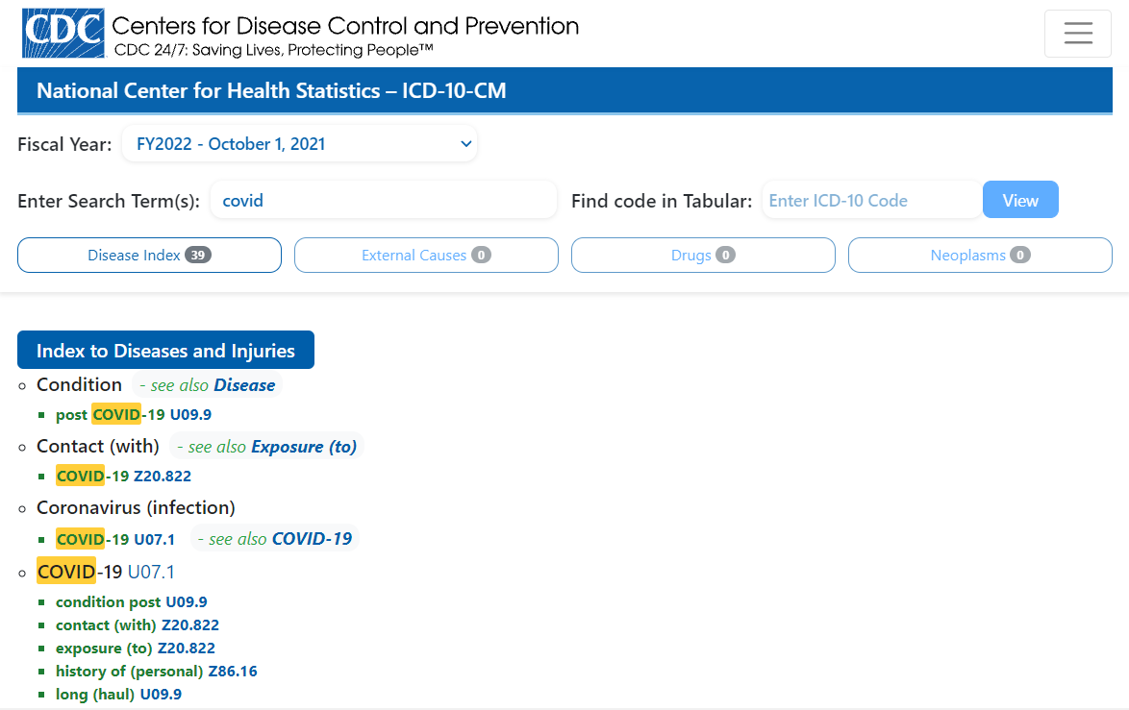
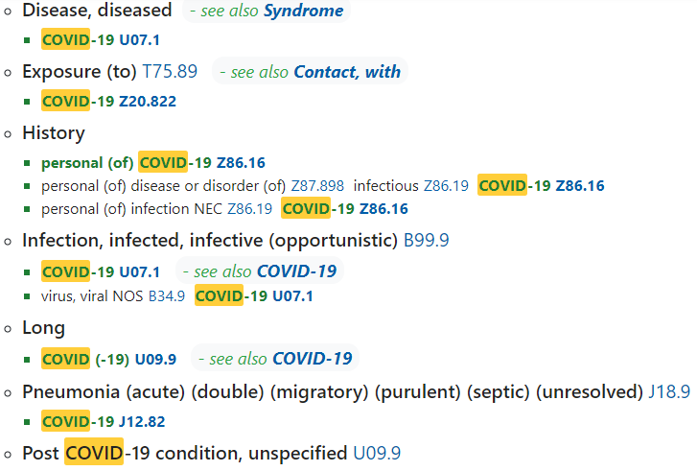
Today’s example: ICD-10-CM
https://icd10cmtool.cdc.gov/?fy=FY2022

Slide 5
Origin of ICD-10-CM
Basis: ICD-10, developed under ‘leadership’ of WHO;
    ‘ICD is the foundation for the identification of health trends and statistics globally, and the international standard for reporting diseases and health conditions. It is the diagnostic classification standard for all clinical and research purposes.’
        https://www.who.int/classifications/icd/en/
    https://www.who.int/classifications/icd/icdonlineversions/en/
WHO’s claim is seriously overstated, only approximately justifiable under a view of world-wide population health.
ICD-10 is too coarse-grained for adequate clinical use (for proper care and subsequent billing) or clinical research.
→ ICD-10-CM: ‘CM’ stands for ‘clinical modification’ and is developed by Centers for Medicare and Medicaid Services (CMS) and the National Center for Health Statistics (NCHS) from CDC.

Slide 6
Many critiques since inception
Missing terms
Irrelevant terms for certain purposes
Changes in meaning of terms
Unclear meanings
Redundancy
…
→ Cimino’s desiderata.

Slide 7
Cimino’s desiderata (1)
Content has adequate coverage for intended purposes.
Concept-orientation which guarantees:
  Non-vagueness: one term → at least one meaning
  Non-ambiguity: one term → only one meaning
  Non-redundancy: one meaning → only one term
concept = meaning
term
referent

Slide 8
Cimino’s desiderata (1)
Content has adequate coverage for intended purposes.
Concept-orientation which guarantees:
  Non-vagueness: one term → at least one meaning
  Non-ambiguity: one term → only one meaning
  Non-redundancy: one meaning → only one term
Concept-permanence: meaning should remain constant at all times (through versions),
Non-semantic concept identifier: meanings must be given an ID which by itself does not reflect anything about the meaning.
Taxonomic organization of concepts.

Slide 9
Cimino’s desiderata (2)
Meanings should have formal definitions in terms of already defined meaning.
‘Not elsewhere classified’ should not be part of a meaning or definition thereof.
Meanings need to be specified at multiple granularities
    → depending on purpose, taxonomy can be cut or extended at the bottom.
Offer multiple consistent views on the taxonomy.
Offer mechanisms to represent context.
    E.g. ‘covid-19’ versus ‘history of covid-19’ versus ‘covid-19 in household member’.
Evolve gracefully ensuring that new versions don’t violate the posited desiderata.

Slide 10
Mistakes against Cimino’s desiderata committed in ICD-10-CM
See file at UBLearns
ICD10CM-2014-2017-2021.xlsx
(requires a solid lap- or desktop computer)
Or
https://www.cdc.gov/nchs/icd/icd10cm.htm
(requires several downloads and is difficult to compare)

Slide 11
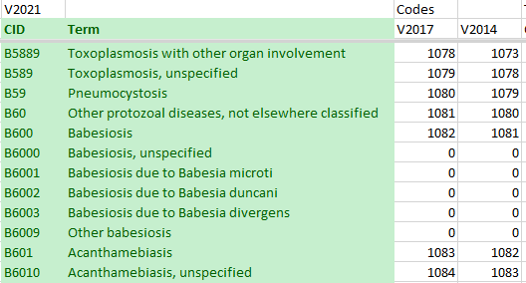
Mistake type 1: inadequate content

Slide 12
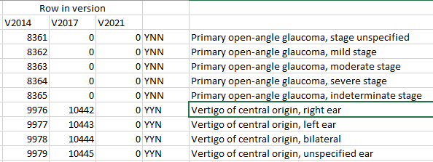
Mistake type 2: vagueness
  (non-vagueness: one term → at least one meaning)
‘Vertigo of central origin in an ear’ does not exist, thus this concept does not have a meaning in Cimino’s sense!

Slide 13
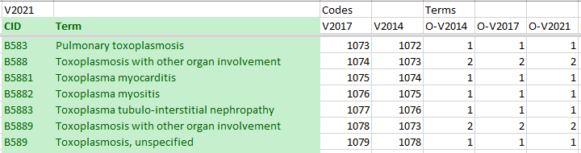
Mistake type 3: ambiguity
  (non-ambiguity: one term → only one meaning)
‘Toxoplasmosis with other organ involvement’ has two different meanings (there are two distinct CIDs).

Slide 14
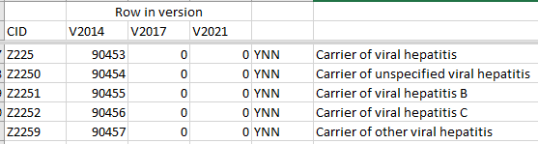
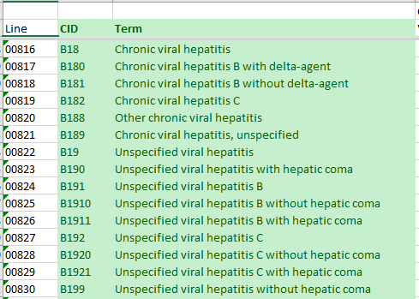
Mistake type 4: redundancy
  (non-redundancy: one meaning → only one term)
‘carrier of viral hepatitis’: some have hepatitis.
‘chronic viral hepatitis’: all of them are carriers.

Slide 15
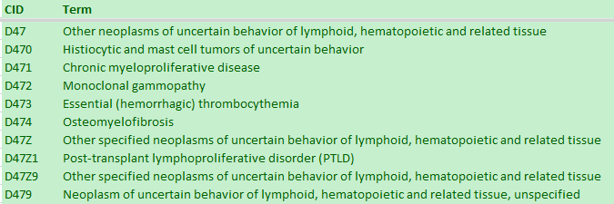
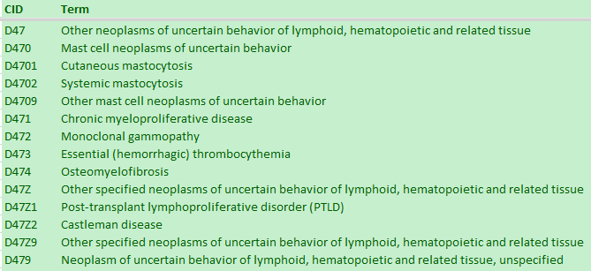
Mistake type 5: non-permanence
Insertion of an extra term in a subhierarchy changes the meaning of the ‘other’ collector concept.

Slide 16
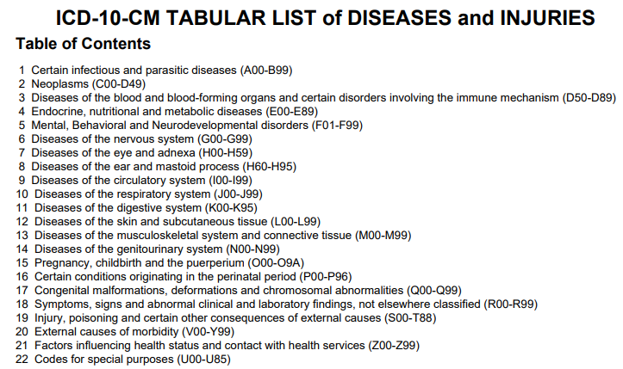
Mistake type 6: use of semantic concept identifiers

Slide 17
Good: no absence of taxonomy
However, the taxonomy itself reflects rather quackery.
A00 Cholera
 | A00.0 Cholera due to Vibrio cholerae 01, biovar cholerae
 |  | A00.1 Cholera due to Vibrio cholerae 01, biovar eltor
 |  | A00.9 Cholera, unspecified
A01 Typhoid and paratyphoid fevers
 | A01.0 Typhoid fever
 |  | A01.00 Typhoid fever, unspecified
 |  | A01.01 Typhoid meningitis
 |  | A01.02 Typhoid fever with heart involvement
 |  | A01.03 Typhoid pneumonia
 |  | A01.04 Typhoid arthritis
 |  | A01.05 Typhoid osteomyelitis
 |  | A01.09 Typhoid fever with other complications
 | A01.1 Paratyphoid fever A
 | A01.2 Paratyphoid fever B
 | A01.3 Paratyphoid fever C
 | A01.4 Paratyphoid fever, unspecified
A02 Other salmonella infections

Slide 18
Mistake type 7: no formal definitions
A00 Cholera
 | A00.0 Cholera due to Vibrio cholerae 01, biovar cholerae
 |  | A00.1 Cholera due to Vibrio cholerae 01, biovar eltor
 |  | A00.9 Cholera, unspecified
A01 Typhoid and paratyphoid fevers
 | A01.0 Typhoid fever
 |  | A01.00 Typhoid fever, unspecified
 |  | A01.01 Typhoid meningitis
 |  | A01.02 Typhoid fever with heart involvement
 |  | A01.03 Typhoid pneumonia
 |  | A01.04 Typhoid arthritis
 |  | A01.05 Typhoid osteomyelitis
 |  | A01.09 Typhoid fever with other complications
 | A01.1 Paratyphoid fever A
 | A01.2 Paratyphoid fever B
 | A01.3 Paratyphoid fever C
 | A01.4 Paratyphoid fever, unspecified
A02 Other salmonella infections
Limited inference possible.

Slide 19

Mistake type 8: use of ‘not elsewhere classified’

Slide 20
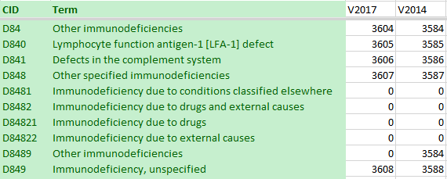
Mistake type 9: meanings not always at sufficient levels of granularity
The addition of subclasses of D848 in V2021 demonstrates that there was not enough granularity in 2014.

Slide 21
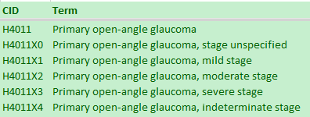
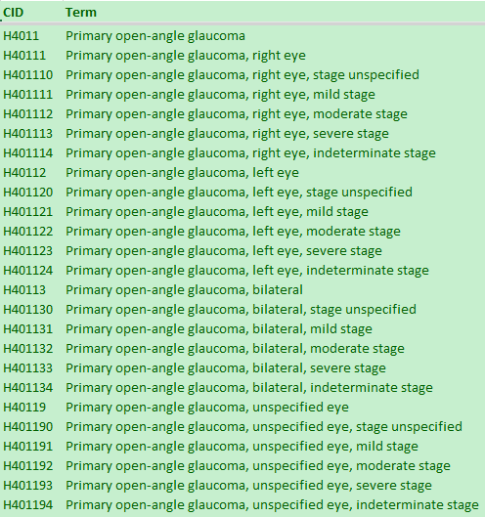
Mistake type 10: no graceful evolution
Same ‘meaning’ received in 2017 a different identifier than in 2014

Slide 22
Assignment A7
Learning objectives:
  Recognize mistakes in controlled vocabularies.
  Follow instructions precisely thereby identifying multiple constraints on what you are allowed to work with.
  Write motivations for a proposed solution adequately and succinctly.
  Develop a strategy to maximize all participants’ success given the constraints of a collaboration task.
  Implement the selected strategy in reporting results.
  Be able to import and export Excel files in “.xlsx” format

Slide 23
Task description
Each student needs to find 10 mistakes, one for each mistake type discussed in class C8, in the CMS/CDC ICD-10-CM versions of 2014, 2017 or 2021.
A ‘mistake’ is a problem of one of the 10 discussed mistake types inherent in a ICD-10-CM code/term combination irrespective of version.
The mistakes needs to be reported in a prepared Excel workbook following a precisely defined template with detailed instructions.
Two different students may not report the same mistake UNLESS there are less than 28 mistakes of that type in the ICD-10-CM.
The assignment score of a student is determined by the correctness of the reported mistakes, the time at which results are received by the instructor (students may compete for speed), the absence of the same mistakes reported by other students.

Slide 24
Evaluation and scoring
Score for each mistake identified in ICD – max 9p:
  +5p if it is indeed a mistake
  +2p if it is of the designated type
  +2p for correct motivation
  -3p if the mistake irrespective of type is reported also by another student
Score for comparative speed of result reporting – max 10p:
  (10 – 9*((S-1)/27)) points where ‘S’ is the order in which a result is received (within the same minute → same ‘time score’).
Penalties:
  - 10p for any instruction not followed
  0p score for unreadable result file or for sending link or for results received after the deadline of next week Wednesday Oct 27, 1pm.
Extra points (max 10):
  For each one of your correct 10 mistakes, identify - and PROVE so ! - whether or not it is still present in the 2022 version which you can find on the CDC website. Do that in the ‘mistake description’ field of the spreadsheet.

Slide 25
Explanation of detailed instructions in the Excel template

