Slide 1
Clarity in Language I
Snomed CT
Lecture in BMI199: What is Biomedical Informatics?
Oct 15, 2021 on-line, University at Buffalo
Werner CEUSTERS, MD
Departments of Biomedical Informatics and Psychiatry,
UB Institute for Healthcare Informatics,
Ontology Research Group, Center of Excellence in Bioinformatics and Life Sciences,
University at Buffalo, NY, USA

Slide 2
Semiotic / semantic triangle
(Ogden & Richards, 1923:
The meaning of ‘meaning’)
concept
term
referent

Slide 3
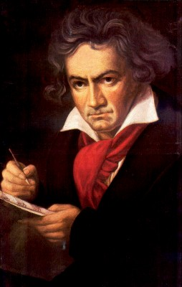
The semantic/semiotic triangle:
Ludwig van Beethoven
that great German composer that became deaf
…
concept
term
referent
‘Beethoven’

Slide 4
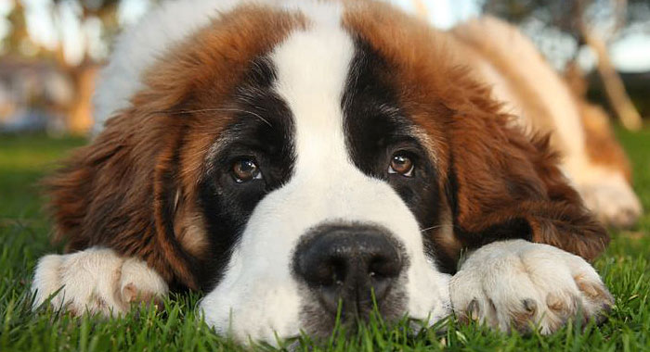
The semantic/semiotic triangle:
The dog from the ‘Beethoven’ movie
…
concept
term
referent
‘Beethoven’
https://celebritydogwatcher.com/2019/02/most-famous-movie-dogs/

Slide 5
The semantic/semiotic triangle:
What we think about such entities
concept
concept
What terms we use for such entities
entities
term
referent
term
referent

Slide 6
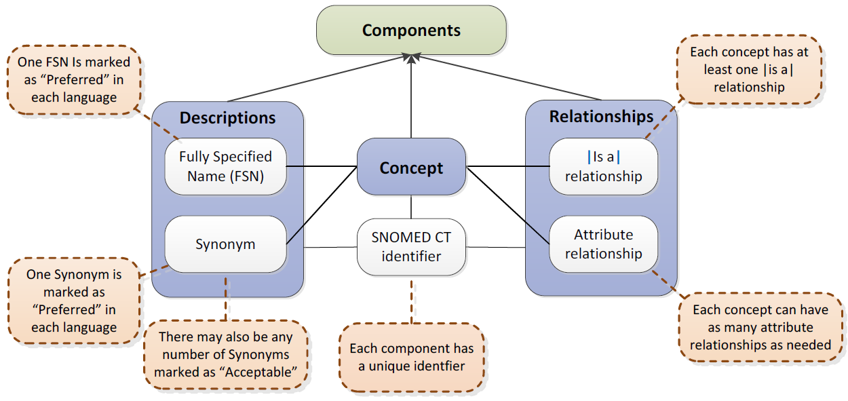

SNOMED CT structure
IHTSDO. SNOMED CT Starter Guide July 2014

Slide 7
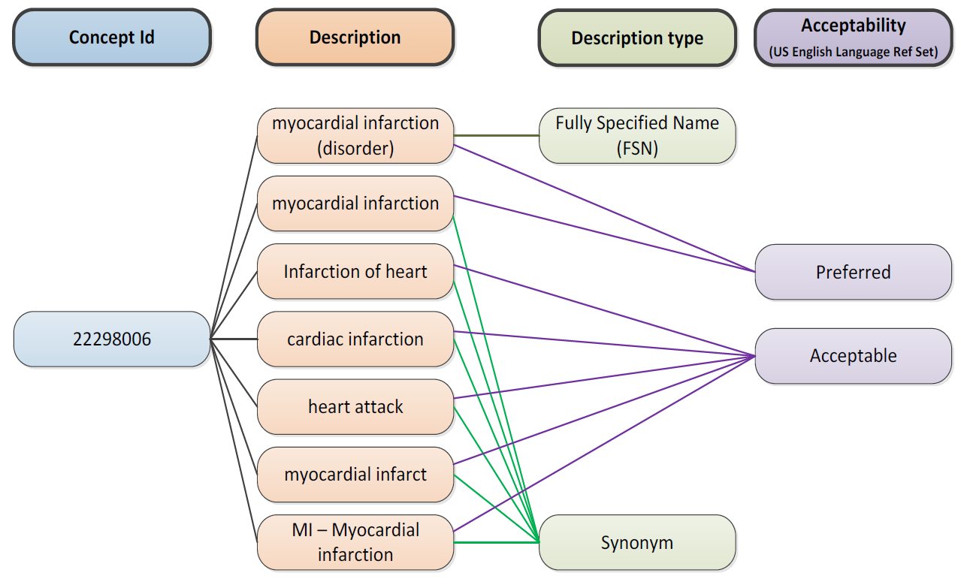
SNOMED CT Descriptions
IHTSDO. SNOMED CT Starter Guide July 2014

Slide 8
Graph theoretical structure
A
Edges
Nodes
B
C
D
E
F
G
H
I
J
K
L

Slide 9
Taxonomic tree
A
…
B
All nodes represent groups (X, Y, …) the members of which have something (S_{x}, S_{y}) similar in some way.
All edges represent the same relation r which expresses some classificatory principle which is such that if X r Y holds, then the members of X have similarities S_{x} and S_{y}.
D
E
G
H
I

Slide 10
Taxonomic tree as sets
A
B
D
E
G
H
I

Slide 11
Taxonomic tree with non-taxonomic relations
A
B
C
D
E
F
G
H
I
J
K
L

Slide 12
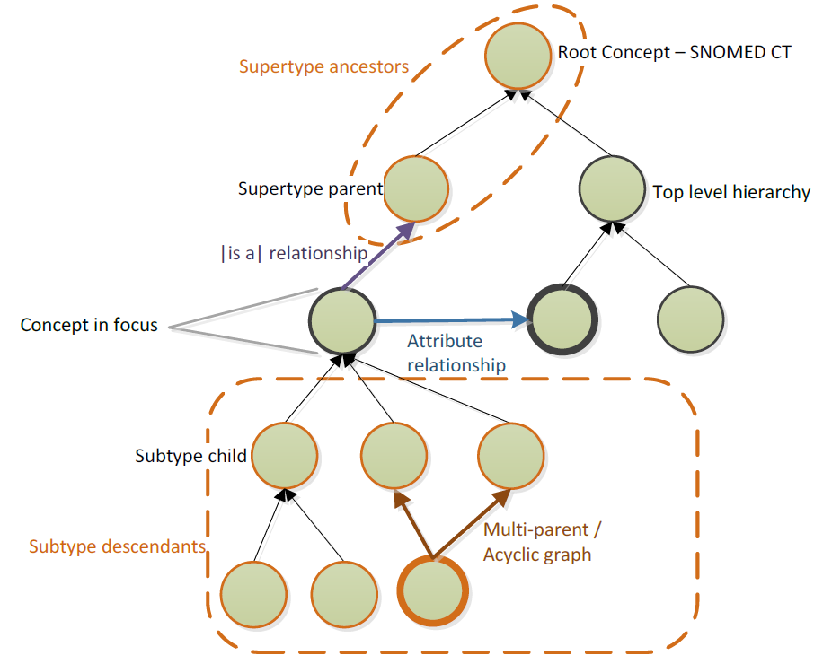
SNOMED CT Relationships

Slide 13
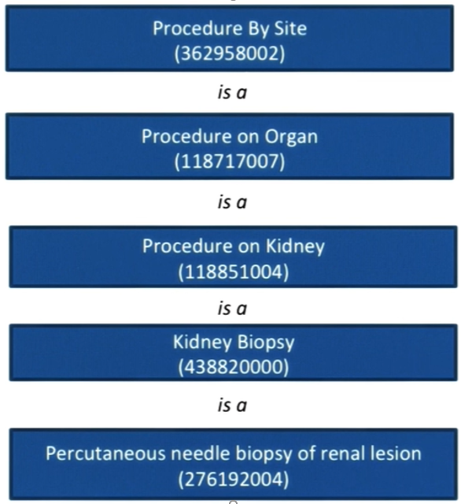
Use of taxonomy

Slide 14
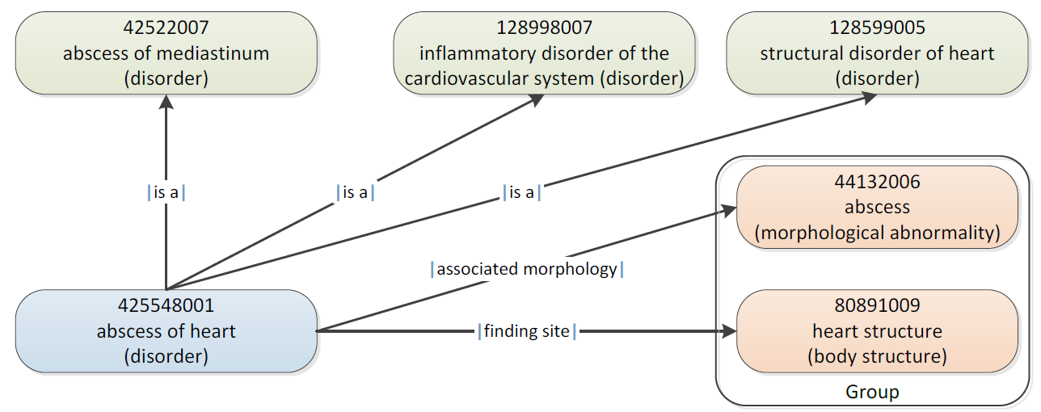
SNOMED CT Defining relationships
IHTSDO. SNOMED CT Starter Guide July 2014

Slide 15
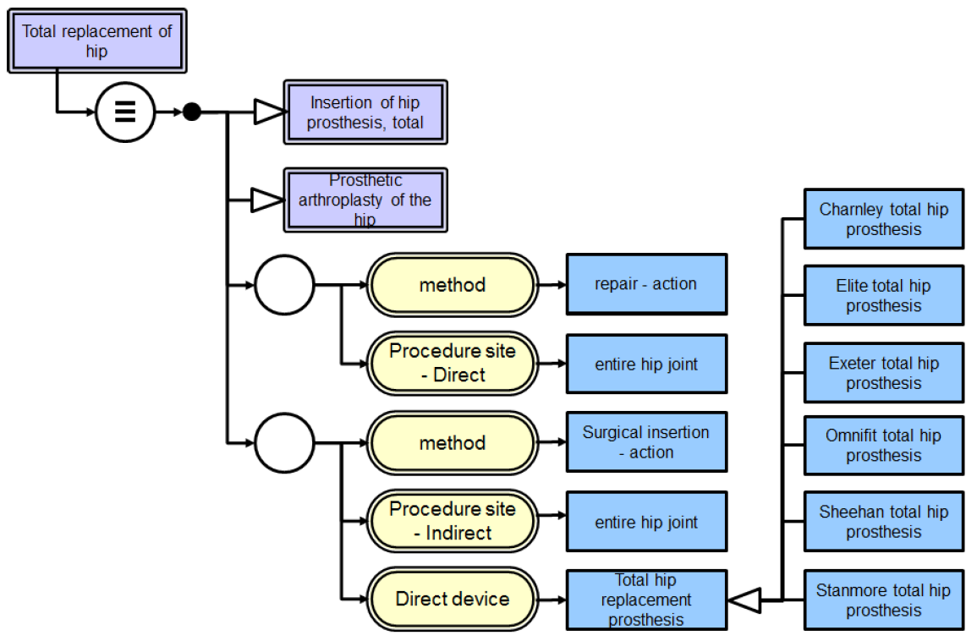
SNOMED CT’s Description Logic
IHTSDO. SNOMED CT Starter Guide July 2014

Slide 16
Reading for next week
Cimino, J.J.,
Desiderata for controlled medical vocabularies in the twenty-first century.
Methods Inf Med, 1998. 37(4-5): p. 394-403.
https://www.ncbi.nlm.nih.gov/pmc/articles/PMC3415631/

Slide 17
Assignment A6
A6. Students will organize themselves to form four groups of atmost 7 persons. Each group will collaborate on-line to perform a different and focused analysis on the presence of covid 19 terms in SNOMED CT (https://browser.ihtsdotools.org/?perspective=full&conceptId1=404684003&edition=MAIN/2021-07-31&release=&languages=en ) following instructions provided in C7.
ONE student of each group will send me the results, thereby clearly identifying the students who participated and who will present in class, in a document of type indicated per group to wceusters@gmail.com not later than Oct 20 – 1PM, cc-ing all students who collaborated in the group.

Slide 18
Purpose: acquire some useful skills
Drawing conclusions and argumentation thereof;
More do’s and don’ts in working with Excel/Word files;
Produce clean, good-looking and correct work;
Use instructions as examples, but possibly find other and perhaps better ways;
Understanding graphs as a knowledge representation;
Be able to work with the biggest and best formal medical terminology in the world: Snomed CT.
Keeping track of where you are in a task;
Divide work in a team so as to minimize effort, yet build in mechanisms for quality control.

Slide 19
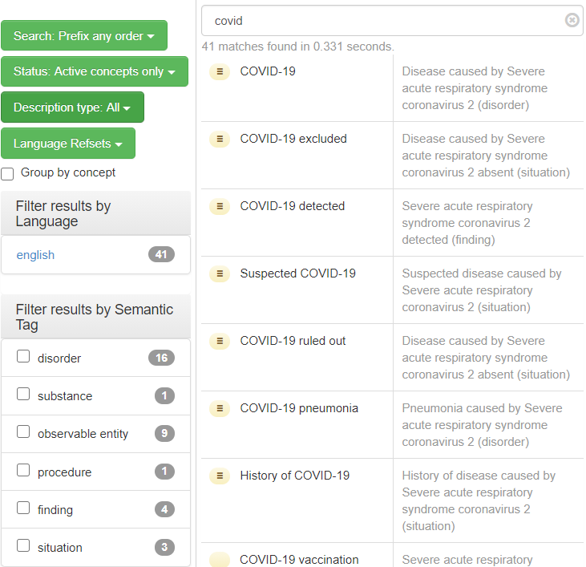
Start

Slide 20
Group 1
For the concept
  ‘Acute bronchitis caused by Severe acute respiratory syndrome coronavirus 2 (disorder)’
  https://browser.ihtsdotools.org/?perspective=full&conceptId1=138389411000119105&edition=MAIN/2021-07-31&release=&languages=en
Build up the complete taxonomy up to ‘Disease (disorder)’ under the ‘inferred’ perspective.
Ignore all parents ending with ‘(finding)’.
Use an Excel spreadsheet.
Suggestion: it is easy to make mistakes. Therefor, each one of you should do it, compare results, then correct.

Slide 21
Example for Group 1
https://browser.ihtsdotools.org/?perspective=full&conceptId1=22298006&edition=MAIN/2021-07-31&release=&languages=en

Slide 22
Group 2
Find amongst the 26 covid-related disorders ALL those disorders which at some higher point in their inferred taxonomy have a supertype which has itself multiple immediate parents of which at least one has the semantic tag ‘disorder’ and at least one other the semantic tag ‘finding’)
Give for each such covid-related disorder a supertype which exhibits these criteria (there might be more than one, but you stop for that disorder when you find a first one), and for that supertype the immediate parents that satisfy these criteria.
Format of Word document:
  [covid-related disorder 1]
    Supertype: [FSN of the supertype that satisfies the criteria]
      Supertype parent – disorder: [FSN of immediate parent with semantic tag ‘(disorder)’]
      Supertype parent – finding: [FSN of immediate parent with semantic tag ‘(finding)’]
  [covid-related disorder 2]
    …

Slide 23
For group 2
positive demonstration using ‘vegan anemia’,
  https://browser.ihtsdotools.org/?perspective=full&conceptId1=234360003&edition=MAIN/2021-07-31&release=&languages=en
negative one using ‘covid 19’
  https://browser.ihtsdotools.org/?perspective=full&conceptId1=840539006&edition=MAIN/2021-07-31&release=&languages=en

Slide 24
Group 3
For the concept
  ‘Acute bronchitis caused by Severe acute respiratory syndrome coronavirus 2 (disorder)’:
  https://browser.ihtsdotools.org/?perspective=full&conceptId1=138389411000119105&edition=MAIN/2021-07-31&release=&languages=en
Follow the complete inferred taxonomy up to ‘Disease (disorder)’ and ignoring (finding) concepts, but, in contrast to group 1, write down all associative relationships encountered on your way up, and count how many times you encountered each one.
Use an Excel document listing the encountered associations (see example file):
Finding site (attribute) | Heart structure (body structure) | 3
…

Slide 25
Example for Group 3
https://browser.ihtsdotools.org/?perspective=full&conceptId1=22298006&edition=MAIN/2021-07-31&release=&languages=en

Slide 26
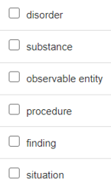
Group 4
Try to find a combination of covid-19 related concepts that, when combined in one graph using the taxonomy and associative relationships, includes all concepts that correspond to the semantic tags.
If there is no such combination, demonstrate
why it does not work with one or other tag
and try to make a combination without that
semantic tag.
Use a Word document as demonstrated.

