Slide 1
Wearable Devices and
The Internet of Things
Lecture in BMI199: What is Biomedical Informatics?
Nov 19, 2021 online, University at Buffalo
Werner CEUSTERS, MD
Departments of Biomedical Informatics and Psychiatry,
UB Institute for Healthcare Informatics,
Ontology Research Group, Center of Excellence in Bioinformatics and Life Sciences,
University at Buffalo, NY, USA

Slide 2
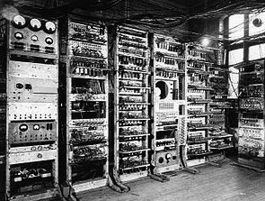
1949: The Manchester Mark I
First Digital Computer
https://www.britannica.com/technology/Manchester-Mark-I

Slide 3
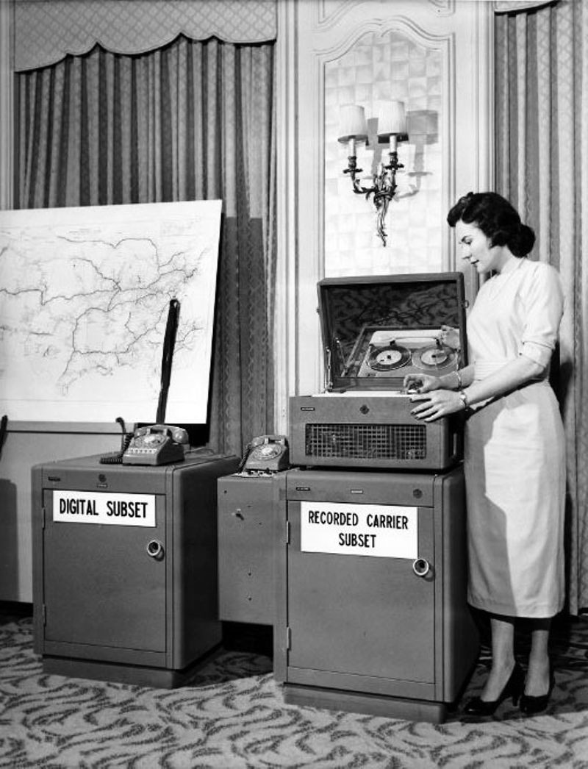
1958
First modem
(AT&T)
Asynchronous data links
https://www.computerhistory.org/timeline/networking-the-web/

Slide 4
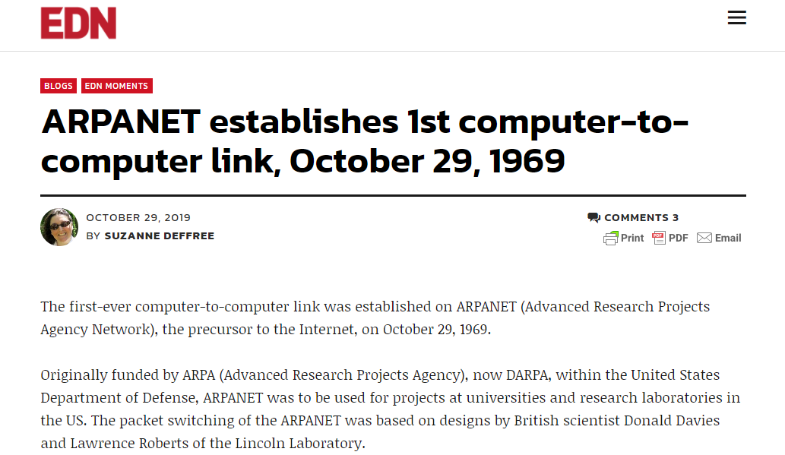
ARPANET
https://www.edn.com/arpanet-establishes-1st-computer-to-computer-link-october-29-1969/

Slide 5
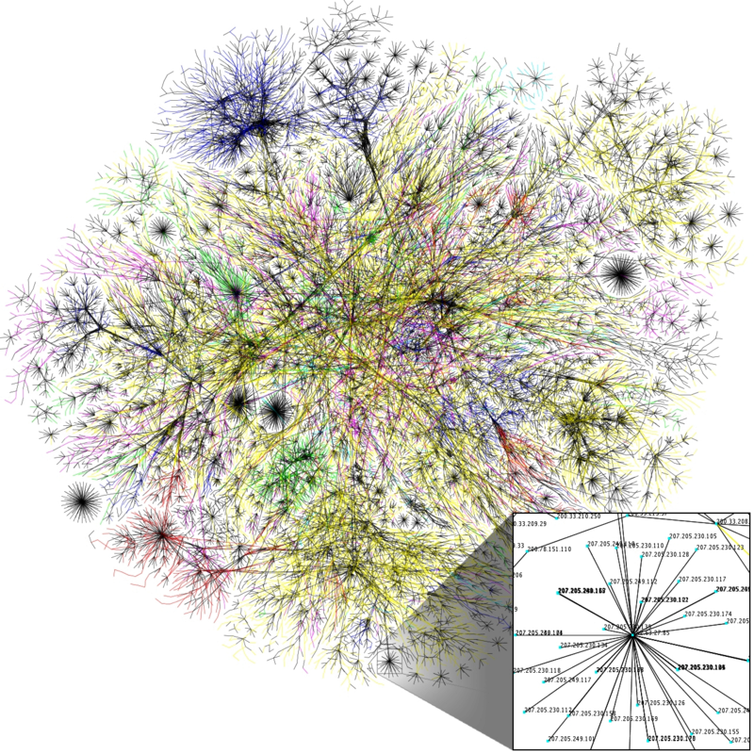
Emergence of other computer networks and merging into ‘The Internet’ (1980)
NPL network
Merit Network
CYCLADES
X.25 and public data networks
UUCP and Usenet
…
https://commons.wikimedia.org/wiki/File:Internet_map_1024_-_transparent,_inverted.png

Slide 6
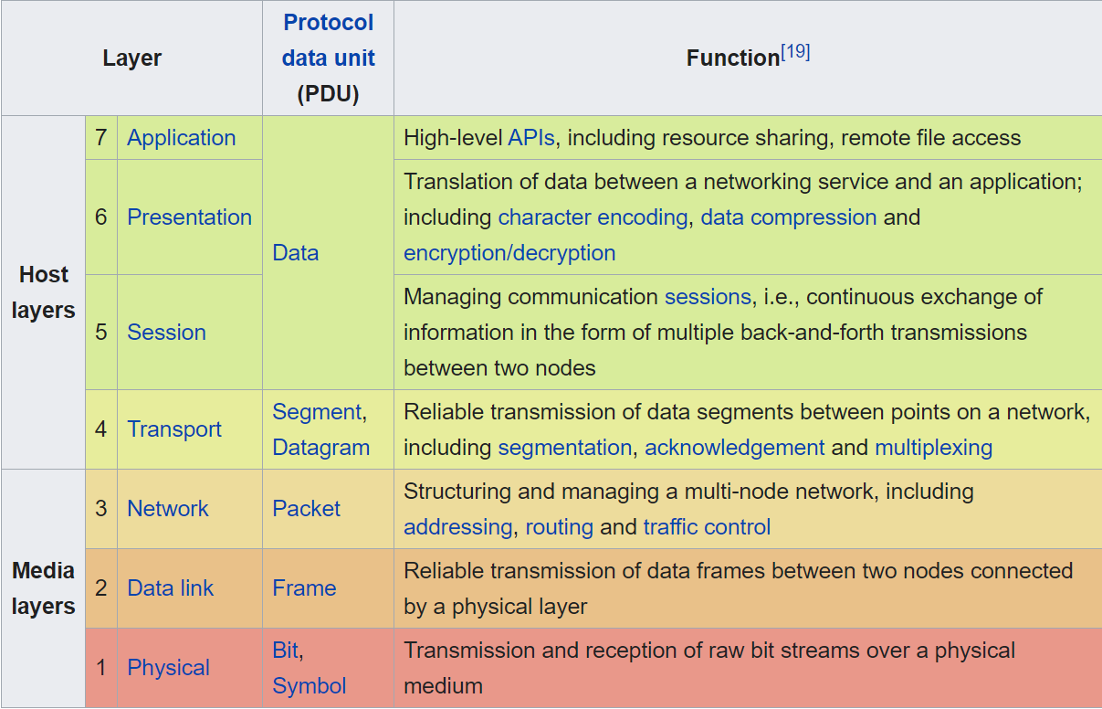
Open Systems Interconnection model
(OSI model – ISO 1980)

Slide 7
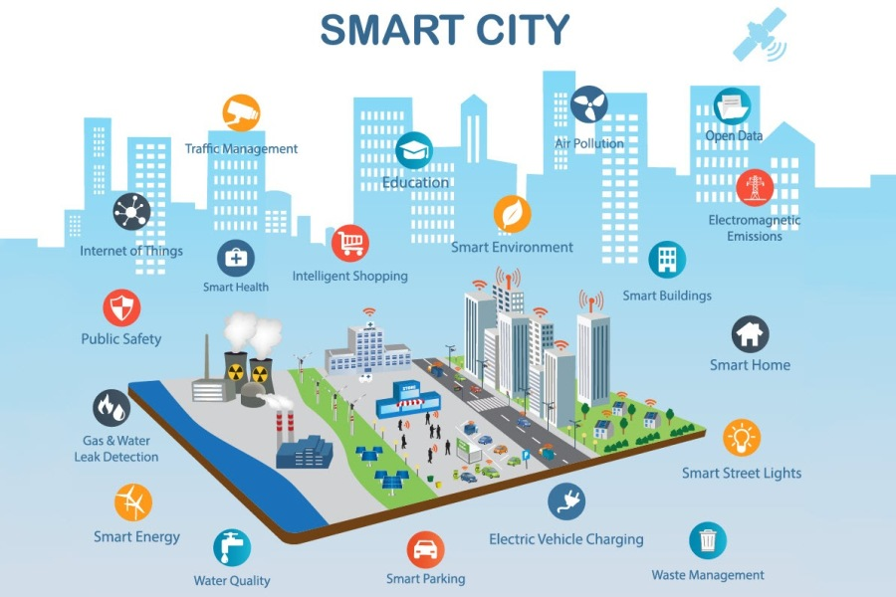
https://www.bebee.com/producer/@an-ela-bogdan/how-internet-of-things-is-changing-our-world-for-the-better
(photo by Charlotte Anderson, Axis Communication)

Slide 8
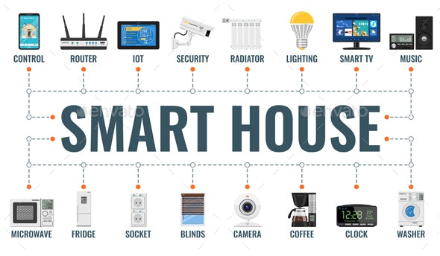
https://graphicriver.net/item/smart-house-and-internet-of-things/28972829

Slide 9
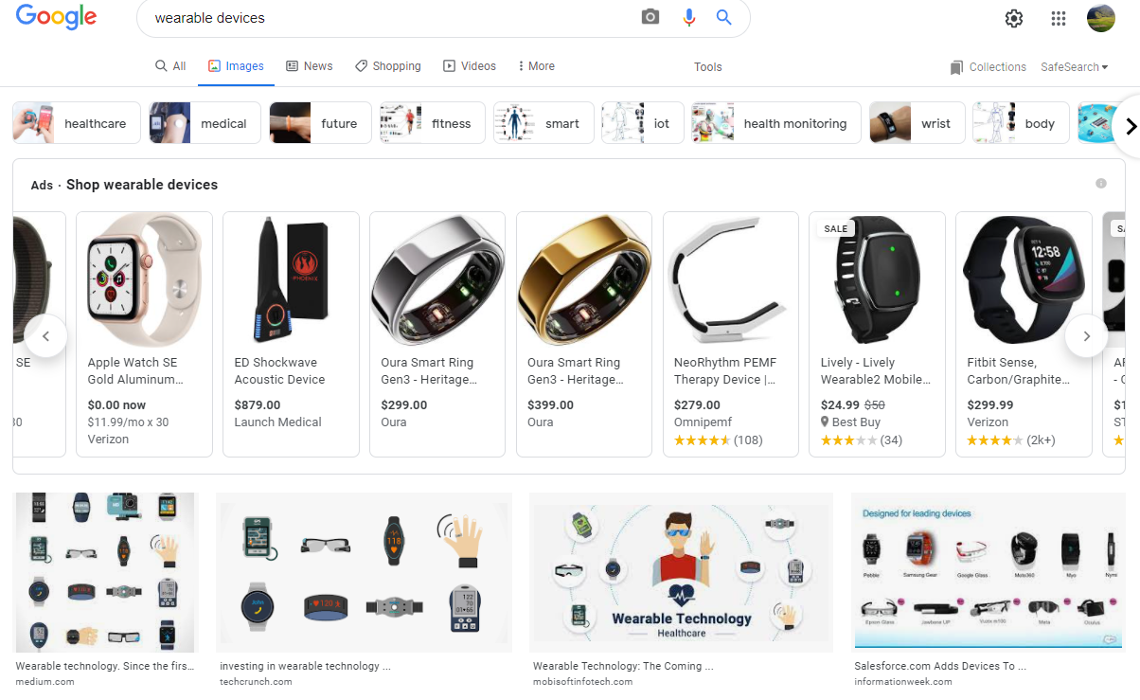
‘Wearable devices’ on Google (Nov 2021)

Slide 10
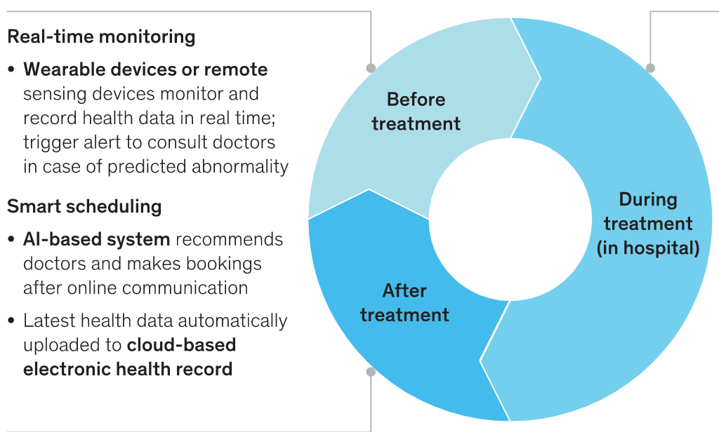
‘Smart’ Healthcare
Bo Chen, Axel Baur, Marek Stepniak, and Jin Wang
Finding the future of care provision: The role of smart hospitals. May 31, 2019McKinsey & Company
https://www.mckinsey.com/industries/healthcare-systems-and-services/our-insights/finding-the-future-of-care-provision-the-role-of-smart-hospitals

Slide 11
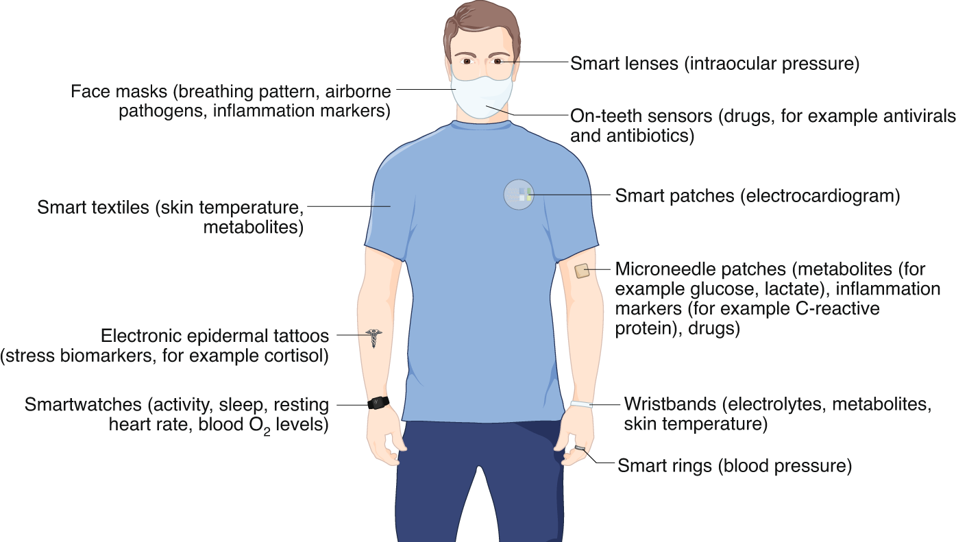
The future of wearable electronic devices
Ates, H.C., Yetisen, A.K., Güder, F. et al. Wearable devices for the detection of COVID-19. Nat Electron 4, 13–14 (2021). https://doi.org/10.1038/s41928-020-00533-1

Slide 12
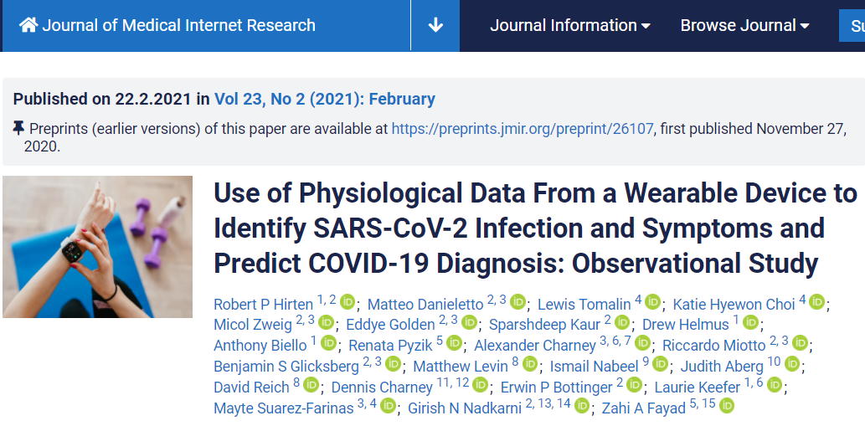

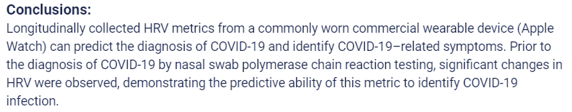
https://www.jmir.org/2021/2/e26107

Slide 13
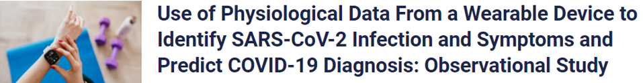
https://www.jmir.org/2021/2/e26107
Limitations
There are several limitations to our study. First, the number of participants who were diagnosed with COVID-19 in our cohort was small, limiting our ability to determine how predictive HRV can be of infection. However, these preliminary findings support the further evaluation of HRV as a metric to identify and predict COVID-19 and warrant further study. An additional limitation is the sporadic collection of HRV by the Apple Watch. Although our statistical modeling was able to account for this, a denser dataset would enable expanded evaluation of the relationship between this metric and infections/symptoms. The Apple Watch also only provides HRV in one time domain (SDNN), limiting assessment of the relationship between other HRV parameters with COVID-19 outcomes. Additionally, we did not capture the times of day during which participants were awake or sleeping. Therefore, fluctuations in sleep patterns may have impacted some HRV readings and could not be controlled in the analysis. Finally, an additional limitation is that we relied on self-reported data in this study, precluding independent verification of COVID-19 diagnosis.

Slide 14
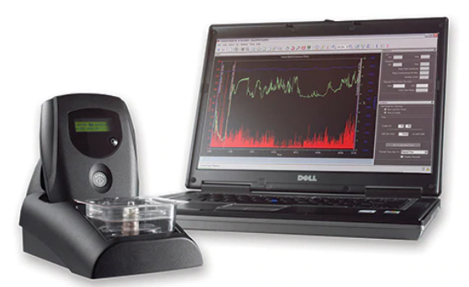
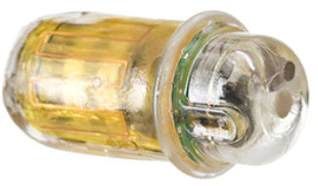
SmartPill™ motility capsule
Assists in localizing transit abnor-malities to a specific GI region by collecting data from the entire GI tract. As the SmartPill™ motility capsule travels through the patient's GI tract, it measures pressure, pH and temperature to provide you with valuable diagnostic infor-mation, including gastric emptying and total GI transit times in your patients.
MotiliGI™ software provides data analysis tools, offering physicians a variety of test reporting and exporting options to aid in the identification of motility disorders. The software calculates gastric emptying time, small bowel transit time, colonic transit time, combined small/ large bowel transit time, and whole gut transit time in graphical and statistical formats, and presents this data in a summary report.
www.medtronic.com

Slide 15
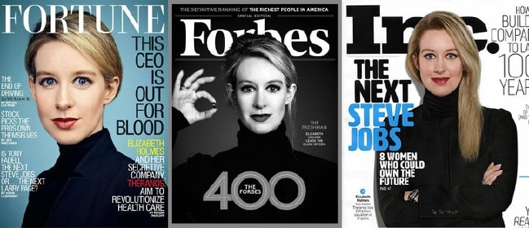
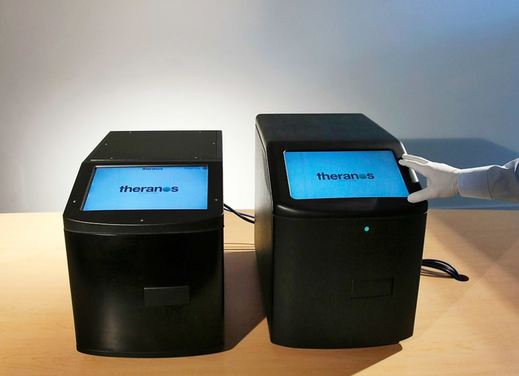
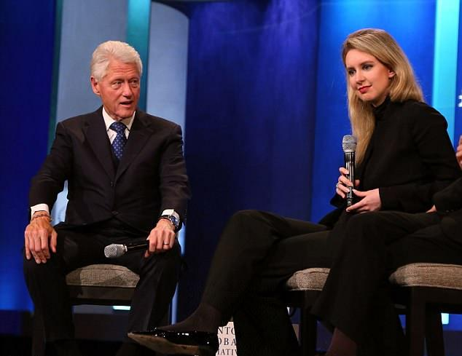
https://www.judiciaryreport.com/elizabeth_holmes_should_be_sent_to_prison_for_theranos_blood_testing_scam.htm

Slide 16
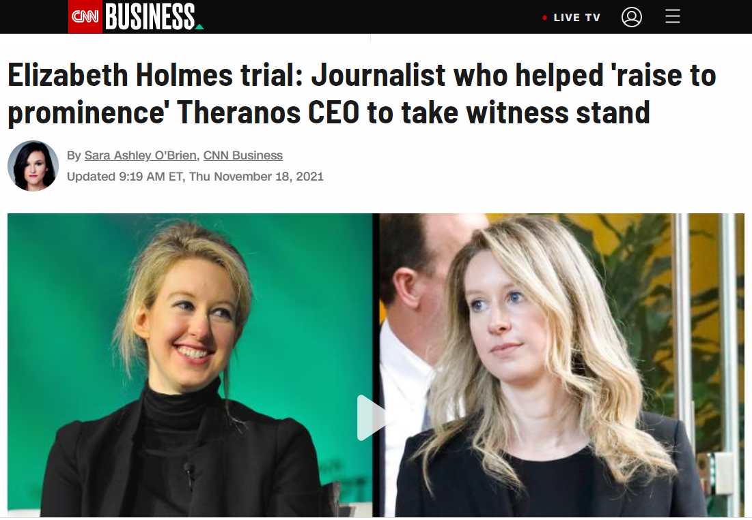
https://www.cnn.com/2021/11/18/tech/elizabeth-holmes-trial-roger-parloff/index.html
The government has alleged Holmes used the media, and Parloff's Fortune Magazine story titled "This CEO is Out for Blood" in particular, to perpetuate a scheme to defraud investors.
Parloff's anticipated testimony comes as the government has said it is close to resting its case against Holmes. She faces a dozen counts of federal fraud and conspiracy charges, and up to 20 years in prison over allegations that she knowingly misled doctors, patients and investors in order to take their money. Holmes has pleaded not guilty.
Holmes was for a time upheld in the media as a rare female founder who'd raised significant sums of capital and driven her startup to an eye-popping $9 billion valuation. Parloff's story was the first of many laudatory cover stories of Holmes and has been shown repeatedly in the San Jose courtroom. Prosecutors have tried to show jurors how the article, which contained false and misleading statements, was circulated to stakeholders and how it played a role in validating the company to outsiders.

Slide 17
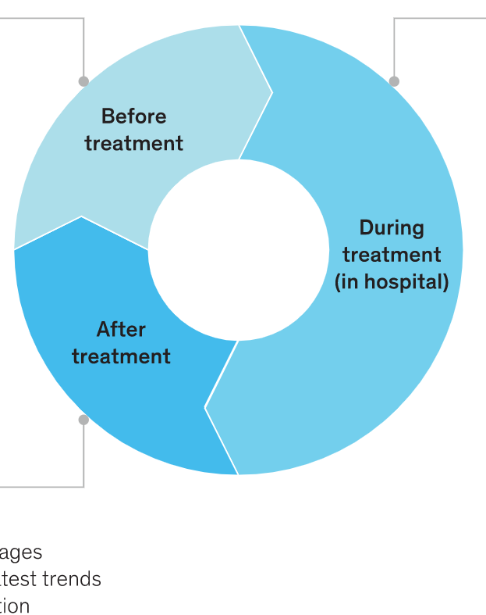

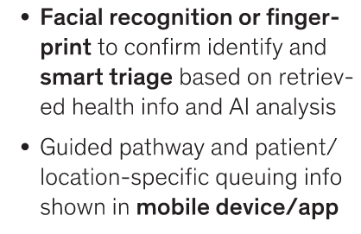
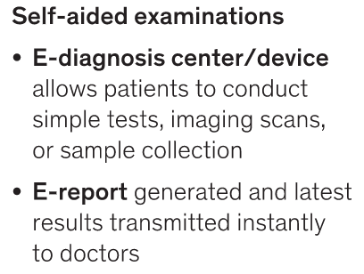
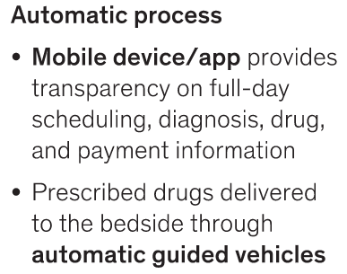
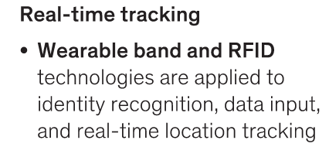
‘Smart’ Healthcare
Bo Chen, Axel Baur, Marek Stepniak, and Jin Wang
Finding the future of care provision: The role of smart hospitals. May 31, 2019McKinsey & Company

Slide 18
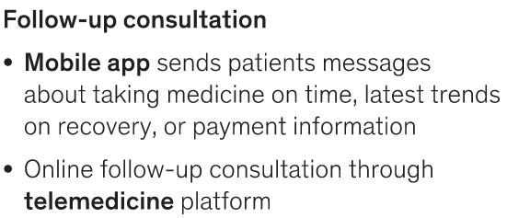


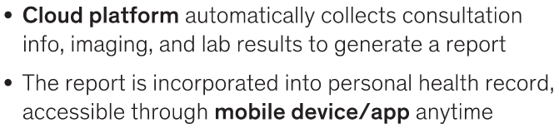
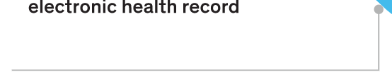
‘Smart’ Healthcare
Bo Chen, Axel Baur, Marek Stepniak, and Jin Wang
Finding the future of care provision: The role of smart hospitals. May 31, 2019McKinsey & Company
https://www.mckinsey.com/industries/healthcare-systems-and-services/our-insights/finding-the-future-of-care-provision-the-role-of-smart-hospitals

Slide 19
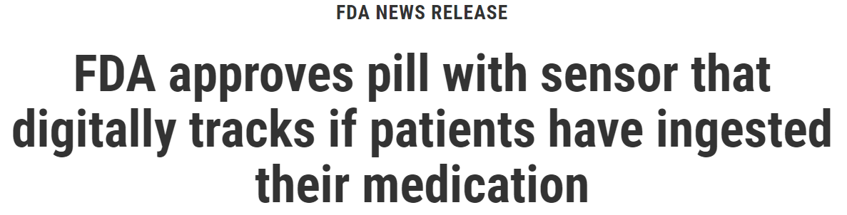
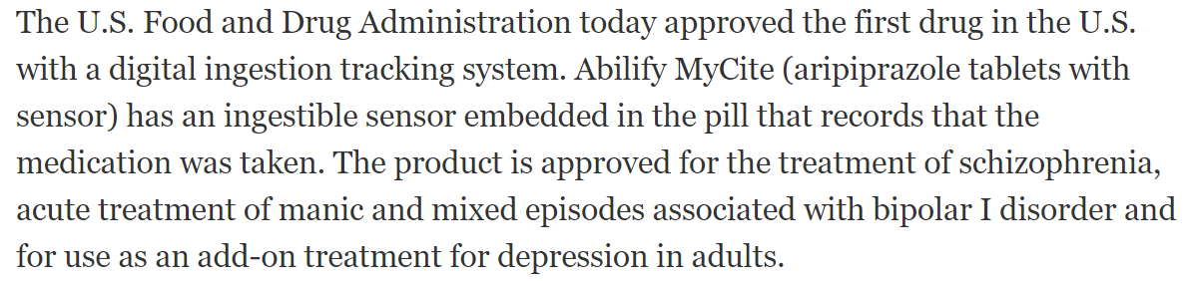
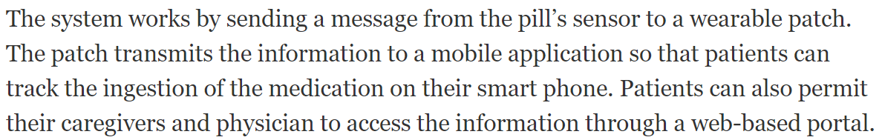
https://www.fda.gov/news-events/press-announcements/fda-approves-pill-sensor-digitally-tracks-if-patients-have-ingested-their-medication

Slide 20
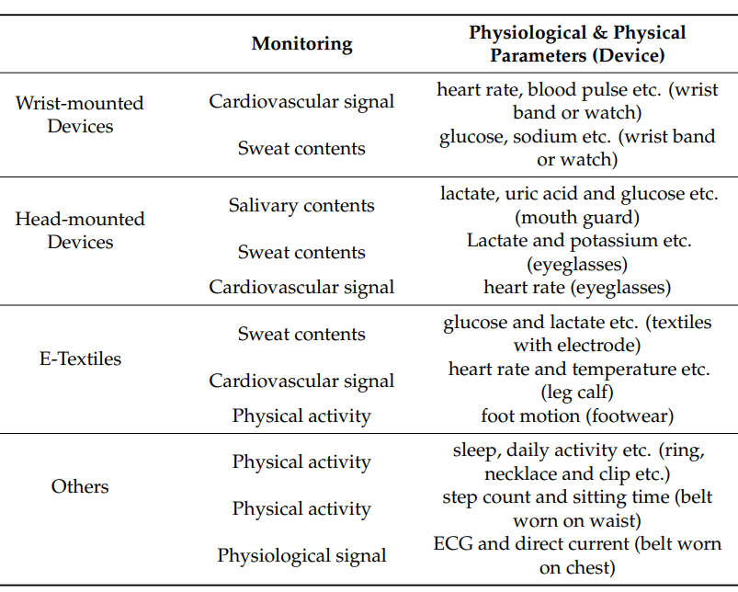
Guk K, Han G, Lim J, et al. Evolution of Wearable Devices with Real-Time Disease Monitoring for Personalized Healthcare. Nanomaterials (Basel). 2019;9(6):813. Published 2019 May 29. doi:10.3390/nano9060813

Slide 21
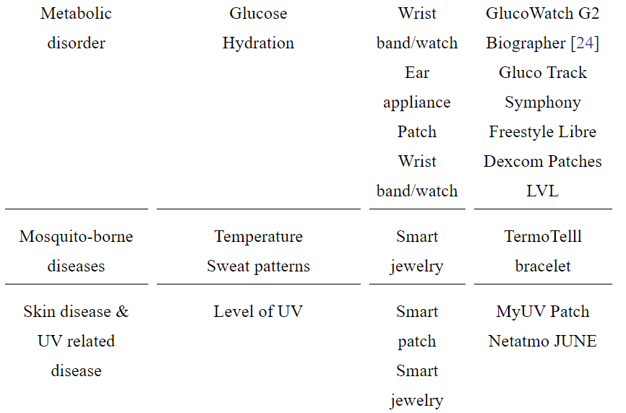
Commercially available WDs (1)
Guk K, Han G, Lim J, et al. Evolution of Wearable Devices with Real-Time Disease Monitoring for Personalized Healthcare. Nanomaterials (Basel). 2019;9(6):813. Published 2019 May 29. doi:10.3390/nano9060813

Slide 22
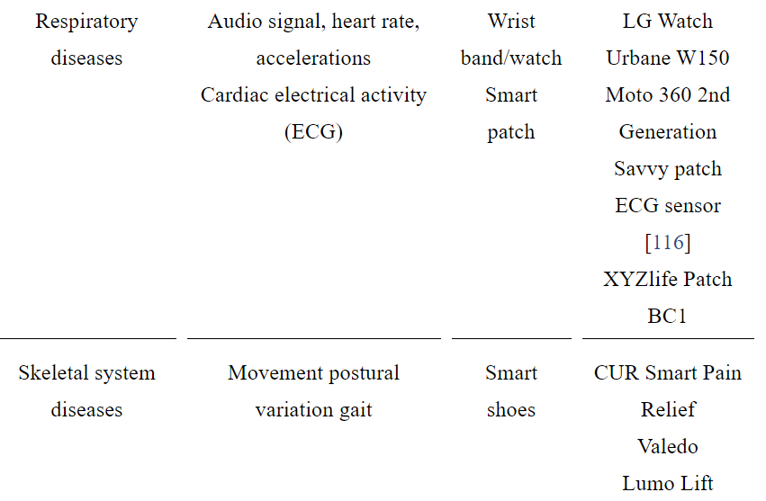
Commercially available WDs (2)
Guk K, Han G, Lim J, et al. Evolution of Wearable Devices with Real-Time Disease Monitoring for Personalized Healthcare. Nanomaterials (Basel). 2019;9(6):813. Published 2019 May 29. doi:10.3390/nano9060813

Slide 23
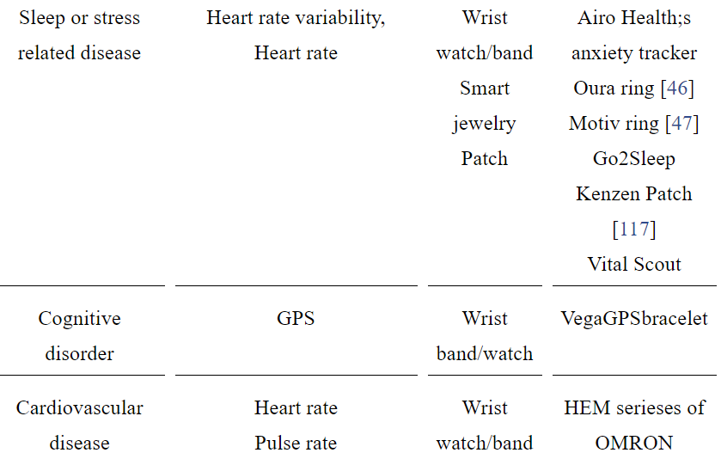
Commercially available WDs (3)
Guk K, Han G, Lim J, et al. Evolution of Wearable Devices with Real-Time Disease Monitoring for Personalized Healthcare. Nanomaterials (Basel). 2019;9(6):813. Published 2019 May 29. doi:10.3390/nano9060813

Slide 24
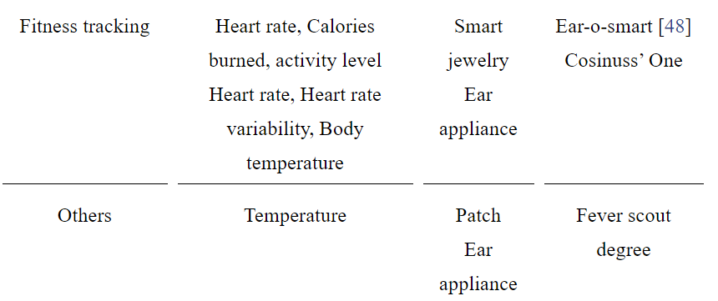
Commercially available WDs (4)
Guk K, Han G, Lim J, et al. Evolution of Wearable Devices with Real-Time Disease Monitoring for Personalized Healthcare. Nanomaterials (Basel). 2019;9(6):813. Published 2019 May 29. doi:10.3390/nano9060813
Guk K, Han G, Lim J, et al. Evolution of Wearable Devices with Real-Time Disease Monitoring for Personalized Healthcare. Nanomaterials (Basel). 2019;9(6):813. Published 2019 May 29. doi:10.3390/nano9060813

Slide 25
Wearable Health Care Devices Survey (1)
About 30% (1266/4551) of US adults use wearable health care devices.
Nearly half (47.33%) use the devices every day.
A majority (82.38% weighted) is willing to share the health data from wearables with their care providers.
  Most willing:
    Women (16.25%),
    White individuals (19.74%),
    Adults aged 18-50 years (19.52%),
    Some level of college education or college graduates (25.60%),
    annual household incomes greater than US $75,000 (17.66%).
Chandrasekaran, Ranganathan et al. “Patterns of Use and Key Predictors for the Use of Wearable Health Care Devices by US Adults: Insights from a National Survey.” Journal of medical Internet research vol. 22,10 e22443. 16 Oct. 2020, doi:10.2196/22443

Slide 26
Wearable Health Care Devices Survey (2)
The use of wearables declines with age.
US adults more likely to adopt and use wearables for tracking or monitoring their health:
  those who reported feeling healthier,
  were overweight,
  enjoyed exercise,
  reported higher levels of technology self-efficacy.
Chandrasekaran, Ranganathan et al. “Patterns of Use and Key Predictors for the Use of Wearable Health Care Devices by US Adults: Insights from a National Survey.” Journal of medical Internet research vol. 22,10 e22443. 16 Oct. 2020, doi:10.2196/22443

Slide 27
Key issues
Privacy
Security
Confidentiality

Slide 28
Key issues
Confidentiality:
  the obligation of professionals who have access to (health) data or communication to hold that information in confidence.
Privacy:
  the right of an individual to be let alone and to make decisions about how personal information is shared.
Security:
  the capabilities available to protect privacy and confidentiality of (health) information.

Slide 29
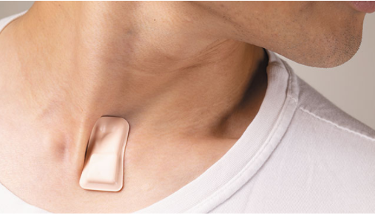
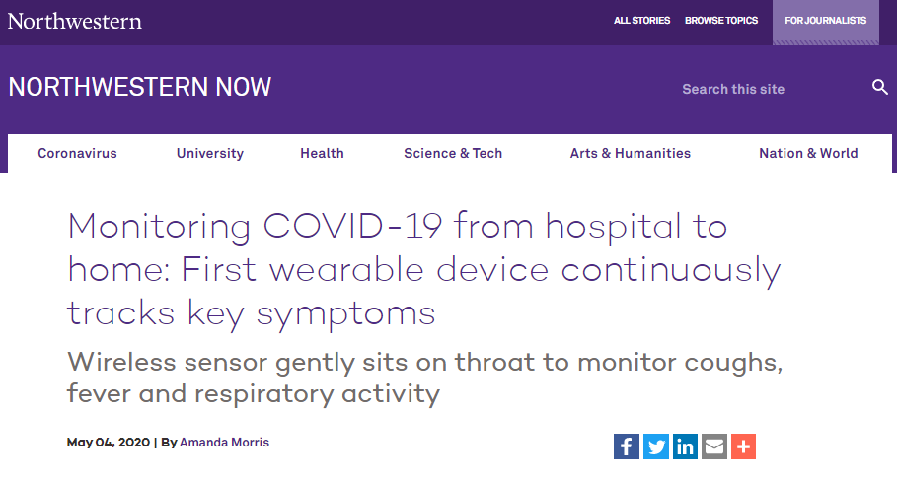
Assignment A10:
Read R10
https://news.northwestern.edu/stories/2020/04/monitoring-covid-19-from-hospital-to-home-first-wearable-device-continuously-tracks-key-symptoms/

Slide 30
Assignment A10
Task description:
  Several claims are made about what you could do with the device. The claims are highlighted in ‘R10 – Monitoring COVID.docx” on UBLearns.
  Pick one claim and, inspired by what you have learned from all previous lectures, find in the scientific literature arguments that support the claim and arguments against the claim.
  Come then to a conclusion which to a certain degree is in support or against the claim, and identify further areas of research that must be conducted to come to a definite conclusion. Motivate why.
  Upload your Word document (NOT a link) to UBLearns not later than December 1, 2021, 1pm.

Slide 31
Instructions
Each claim may be chosen by at most 2 students.
Use the template uploaded to UBLearns under the name ‘A10-XXX.docx’.
All sections in the template must be used.
DO NOT change the table structure.
Use Endnote for proper citation in the ‘Numbered’ style.
You MUST have citations for sections 2 and 3. If for one or other section you can’t find arguments from the literature, document your search procedure so that you can prove there are no arguments (and not just didn’t bother to find any). Then provide your own arguments.
Everything you write is in 10p Times Roman, single line spacing.
No space maximum or minimum, but negative credit for unjustified presence or absence of assertions.
Anything else outlined during class.
Change name of the document by replacing ‘XXX’ with your ubitname and make sure it stays Word-compatible.

Slide 32
Assessment
Positive points:
  selection of appropriate scientific papers,
  quality of argumentation,
  Logical coherence.
Negative points:
  Each instruction not followed: - 5p.
  Plagiarism: 0 for assignment.

Slide 33
No class next week: fall recess.
No recitation on Friday December 3th unless Shannon is available to cover whatever necessary.
There will be a lecture on Dec 3th at the regular time (although I might run a bit late).

